Slide 1
Algebra 1
Unit 9 More Quadratic Equations
Lesson 9.3 Completing the Square, Part 2

Slide 2

How to use these slides
On the activity slides check the speaker notes for teacher support and instructional information.
Each lesson includes 1 warm up, 2-3 learning activities, a cool down, practice and a lesson synthesis.
  Learning activities are followed by a self check question, and review section.
Some slides have been hidden from student view, more information can be found on the next slide (Reference Key).
You can edit and use these slides for personal and classroom use, but cannot sell them and must keep the attribution logos.
For more information, Check out the digital quick start guide!
OpenStax CC BY NC SA

Slide 3





Reference Key
Check the top right corner for an icon referencing these unique sections.
Icon | Title | View | Location and Description
n/a | Support for Students with Disability | Hidden | Learning Strategies slide, provides additional support to students for understanding the activity.
n/a | Support for English Language Learners | Hidden | Learning Strategies slide, provides additional support to students for understanding the activity.
n/a | Extending Your Thinking | Hidden | Extending Your Thinking slide, provides an extra challenge for students.
n/a | Self Check | Not Hidden | Self Check slide, checkpoint to assess student understanding after the learning activity.
n/a | Review | Hidden | Self Check - Review slide, designed to help review topics from the self check question.
On the next slides, check the speaker notes for teacher instructions and support.
Notes:
Check the Speaker Notes: On the next slides you can find discussion questions, lesson information, answers to the activities, and ways to adjust the activity for your students!

Slide 4

Learning Goals
By the end of this lesson you will be able to -
Solve by completing the square when given a quadratic equation in which the coefficient of the squared term is 1.
Notes:
Lesson Narrative
In this lesson, students learn that completing the square can be used to solve any quadratic equation, including equations that involve rational numbers that are not integers. Students notice that the process of completing the square is the same when the equations involve messier numbers as when they have simple integers, but the calculations may be more time consuming and prone to error. An error-analysis activity highlights some common errors related to completing the square.
What is important in this lesson is to recognize that putting a quadratic equation in the form of (𝑥 + 𝑝)² = 𝑞 allows them to solve it, but there are cases in which doing so may not always be the most efficient strategy.
Required Preparation
None
Required Materials
Scientific calculators
Texas Essential Knowledge and Skills
A1(G) display, explain, and justify mathematical ideas and arguments using precise mathematical language in written or oral communication.
A8(A) solve quadratic equations having real solutions by factoring, taking square roots, completing the square, and applying the quadratic formula.

Slide 5
Vocabulary
Previous
Completing the square
  A method used with quadratic expressions to transform it into a perfect square trinomial.
Perfect square
  The product of a whole number or expression that has been multiplied by itself.
Rational numbers
  A fraction or the opposite of a fraction.
New
None
Notes:
Lesson Vocabulary
To support student understanding of key vocabulary:
Introduce and review the vocabulary words students will see in this lesson.
Encourage students to notice how these words are used and to include them in their math discussions and explanations—both written and oral.
Use a word wall to reinforce vocabulary. Sample word wall cards are available here.
For newcomers or students with beginning English proficiency, use these Quizlet sets to support vocabulary learning:
Unit 9 Spanish Vocabulary – use first to build understanding
Unit 9 Vocabulary (English) – use after anchoring in Spanish
Support for English Language Learners
ELPS 2(C) learn new language structures, expressions, and basic and academic vocabulary heard during classroom instruction and interactions.
ELPS 2(E) use visual, contextual, and linguistic support to enhance and confirm understanding of increasingly complex and elaborate spoken language.
ELPS 2(F) listen to and derive meaning from a variety of media such as audiotape, video, DVD, and CD-ROM to build and reinforce concept and language attainment.
ELPS 3(D) speak using grade-level content area vocabulary in context to internalize new English words and build academic language proficiency.
ELPS 3(E) share information in cooperative learning interactions.

Slide 6
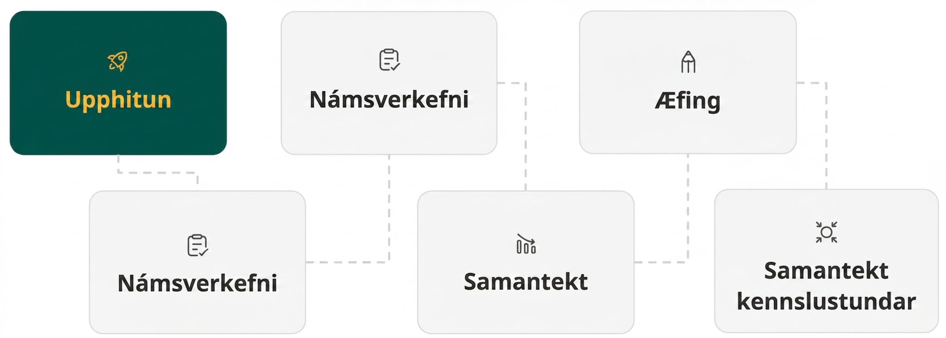
Lesson Journey
First Stop: Warm Up
Notes:
Alt text draft 1:
Image of six rectangles connected by dotted lines conveying the progression of the Lesson. Each rectangle has an icon with text.
The first rectangle is green with a yellow icon and text. The icon is a rocket and text reads Warm Up.
It is connected to the second rectangle, which is light gray with a dark gray icon and text. The icon is a clipboard with a checkmark and the text reads Learning Activity.
It is connected to the third rectangle, which is light gray with a dark gray icon and text. The icon is a clipboard with a checkmark and the text reads Learning Activity.
It is connected to the fourth rectangle, which is light gray with a dark gray icon and text. The icon is a three progressively smaller bar graph rectangles with an arrow on top, following the slope. The text reads Cool Down.
It is connected to the fifth rectangle, which is light gray with a dark gray icon and text. The icon is a pencil tip and the text reads Practice.
It is connected to the sixth rectangle, which is light gray with a dark gray icon and text. The icon is a four arrows pointing at a circle. The text reads Lesson Synthesis.

Slide 7

Warm Up
Math Talk! 👍
Solve each equation mentally. Signal when you have an answer.
x + x = ¼
(³/₂)² = x
⅗ + x = ⁹/₅
⅟₁₂ + x = ¼
Notes:
Warm Up (5 minutes)
The purpose of this Math Talk is to elicit strategies and understandings students have for operations on fractions and solving equations. These understandings help students develop fluency and will be helpful later in this lesson when students will need to use similar computations to solve quadratic equations.
Continue scrolling down for directions on how to launch the activity, answers, and synthesis questions.
Launch
Display one problem at a time. NOTE: The problems have been animated to display on a click to facilitate this procedure.
Give students quiet time to think individually for each problem.
Ask them to give a signal with a “thumbs up” when they have an answer and a strategy.
Keep all problems displayed throughout the talk.
Follow with a whole-class discussion.
Supports for students with disabilities and English language learners are available for this activity in the online Teacher Guide, if needed. Be sure you have logged in with your educator credentials to access the information.
Answers
x = ⅛
x = ⁹/₄
x = ⁶/₅
x = ⅙
Activity synthesis
Ask students to share their strategies for each problem. Record and display their responses for all to see. To involve more students in the conversation, consider asking:
Who can restate __________'s reasoning in a different way?
Did anyone have the same strategy but would explain it differently?
Did anyone solve the problem in a different way?
Does anyone want to add on to __________'s strategy?
Do you agree or disagree? Why?

Slide 8
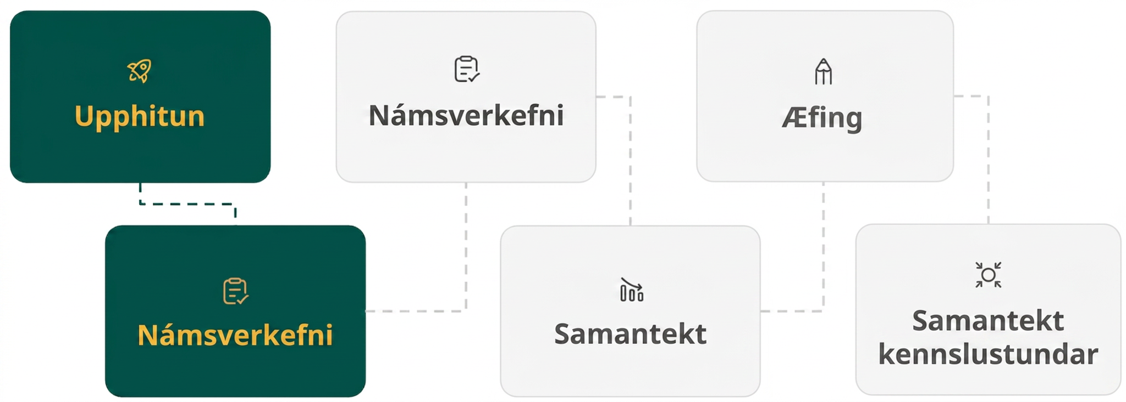
Lesson Journey
Second Stop: Learning Activity A

Slide 9

Learning Activity A | Learning Strategies
“Solving by Any Other Way …” 🌹
Teacher Instruction: Use these strategies to adjust the activity to support English language learners and students with disabilities.
You can copy and paste the callouts directly on top of the activity or give the instructions aloud.
Prepare to share your thinking with the class.
Listen and watch for words and phrases that connect ideas for you.
Identify how the words and phrases of the process can be expressed or used in different problems.
Collect and Display
Look through the problems and identify 2 problems you think you might label as “doable.” Select one to actually solve.
Identify 2 problems you think might be “difficult.” Select one to try to solve.
Select one other problem to solve.
Engagement
Notes:
Support for English Language Learners: MLR 2 Collect and Display: Conversing
During the whole-class discussion, listen for and collect language students use to generalize the process of solving by completing the square. Write students' words and phrases on a visual display, keeping track of each step from start to finish. If necessary, use a specific example to make connections to the generalized steps by highlighting, making annotations, or drawing arrows. For example, when describing the “coefficient of the linear term” or the “perfect square” in the generalized process, highlight the actual terms in the example. Remind students to borrow language from the display and use it as a resource to draw language from during small-group and whole-class discussions.
Design Principle(s): Maximize meta-awareness; Support sense-making
Provide support for students
Distribute graphic organizers to the students to assist them with participating in this routine.
Support for Students with Disabilities: Engagement: Provide Access by Recruiting Interest
Leverage choice around perceived challenge. Invite students to select at least three of the equations to solve. Encourage students to select the problems ahead, and persist with the problems they have chosen for the duration of the task (not re-selecting if a problem becomes challenging for them). Chunking this task into more manageable parts may also support students who benefit from additional processing time.
Supports accessibility for: Organization; Attention; Social-emotional skills

Slide 10
Learning Activity A | Part 1
“Solving by Any Other Way …” 🌹
Example: Solve 𝑥² + 8⁢𝑥 − 2 = 0
Step 1 - Write the equation in the form 𝑎⁢𝑥² + 𝑏⁢𝑥 = 𝑐.
𝑥² + 8⁢𝑥 = − 2
Step 2 - Complete the square by finding (^{b}/₂)².
(^{b}/₂)² = (⁸/₂)² = 16
Step 3 - Add the value to both sides of the equation.
𝑥² + 8⁢𝑥 + 16 = − 2 + 16
Step 4 - Factor the perfect square trinomial and simplify the constants.
(𝑥 + 4)² = 14
Step 5 - Take the square root of each side (don’t forget ±).
√(𝑥 + 4)² = √14 → 𝑥 + 4 = ± √14
Step 6 - Write two separate equations and solve each.
𝑥 + 4 = √14 or 𝑥 + 4 = – √14
𝑥 = – 4 + √14 or 𝑥 = – 4 – √14
Notes:
Support for All Learners
This activity offers additional support for students:
For English language learners and students with disabilities, be sure to review the Learning Strategies slide!
Activity (20 minutes)
In this activity, students encounter equations that contain rational numbers. They learn that, even though the numbers are not as straightforward as in equations they have previously seen, they can still solve the equations by completing the square.
The less-friendly numbers and the more elaborate equations make the computations more challenging, so students need to attend to precision and mind the steps for rearranging parts of the equations, as well as the signs of the numbers, especially negative numbers.
Make note of common errors or hurdles and address them during whole-class discussion.
Launch
Review the steps of the example with students.
Next, give students a moment to look at the list of equations in questions 1 – 3 and notice how they are like or unlike other equations they have seen and solved before.
Invite students to share some observations. They may notice, for instance:
(𝑥 − 3)(𝑥 + 1) = 5 does not have 0 on one side, so we cannot use the zero product property right away.
𝑥² + ½ 𝑥 = ³/₁₆ and 𝑥² + 3𝑥 + ⁸/₄ = 0 involve fractions.
𝑥² + 3𝑥 + ⁸/₄ = 0 has an odd number for the coefficient of the linear term.
(7 − 𝑥)(3 − 𝑥) + 3 = 0 has 0 on one side but the other side is a sum, not a product.
𝑥² + 1.6𝑥 + 0.63 = 0 has decimals.
Explain to students that each equation can be solved by completing the square and using the same reasoning as when we solved simpler-looking equations earlier.
Consider arranging students in groups of two.
If there is not enough time for students to answer all the questions, consider asking students to look at the list of equations and to choose one they think looks easier (or more familiar) and one that looks harder (or less familiar).
Activity image answer, and synthesis on the next slide.

Slide 11
Learning Activity A | Part 2
🌹 “… Would Still Smell as Sweet?”
For each problem: (a) Determine the correct value of (^{b}/₂)² that will complete the square. (b) Select the two roots that solve the quadratic equation.
(x – 3)(x + 1) = 5
        What is (^{b}/₂)²?
        Which TWO are roots? x = – 2, x = 1, x = 8, x = 4, or x = 9
x² + ½ x = ³/₁₆
        What is (^{b}/₂)²?
        Which TWO are roots? x = ½, x = ¼, x = – ¾, x = – ¼, or x = 1
x² + 3x + ⁸/₄ = 0
        What is (^{b}/₂)²?
        Which TWO are roots? x = –2, x = ⅟₁₆, x = 9, x = ¼, or x = –1
Notes:
Activity Answer
(a) 1; (b) 𝑥 = − 2, 𝑥 = 4
(a) ¹/₁₆; (b) 𝑥 = ¼, 𝑥 = – ¾
(a) ⁹/₄; (b) 𝑥 = − 2, 𝑥 = – 1
Additional questions are available in the online textbook if students need more practice.
Anticipated Misconceptions
Some students may have a difficult time getting started given the increased complexity of these problems. Encourage these students to use completing the square to solve a more familiar problem first, such as 𝑥² − 10𝑥 + 20 = 4, and then to use the structure of the process they followed as a guide to help them solve these more challenging problems.
Activity Synthesis
Select students to share their solutions and display their work for all to see. If students found solutions that differ from each other, as time permits, invite these students to describe their thinking to the class, and encourage them to try to identify any errors and determine which solutions are correct. Discuss any common challenges or errors.
Make sure students understand that the process of solving by completing the square is the same whether the numbers in the equations are integers or other rational numbers. Elicit from students a generalization of the process. For example:
Start with a quadratic expression in standard form on one side of the equal sign and a number (which could be 0) on the other side.
Take half of the coefficient of the linear term and square it. The result is the constant term that would make the quadratic expression a perfect square.
Perform the same operations to both sides of the equal sign so that the constant term that is on one side is a perfect square that makes the expression a perfect square.
Rewrite the expression (in standard form) as a squared factor.
Find both values of the factor that, when squared, give the number on the other side of the equal sign.
To scaffold instruction, provide a blank template with the steps for students to follow as they solve equations.

Slide 12
Learning Activity A
Self Check
After solving using completing the square, what are the zeros of the quadratic equation 𝑥² + 5𝑥 + ⁹/₄ = 0?
𝑥 = ¼, 𝑥 = – ¹⁹/₄
𝑥 = ²⁵/₄
𝑥 = – ½, 𝑥 = – ⁹/₂
𝑥 = ½
Let’s review!
Notes:
Answer Feedback - Individualized by Response
Incorrect. After adding the (^{𝑏}/₂)², make sure to take the square root of both sides.
Incorrect. This is the value of (^{𝑏}/₂)², not a zero.
That’s correct! Move the ⁹/₄ to the other side of the equation then complete the square and add ²⁵/₄ to each side. Take the square root of each side then factor. The equation becomes 𝑥 + ⁵/₂ = ±2. Solve for 𝑥 and these are the zeros.
Incorrect. The perfect square binomial created is (𝑥 + ⁵/₂)² but this does not give the zero.

Slide 13

Learning Activity A
Self Check - Review
SOLVING QUADRATICS BY COMPLETING THE SQUARE
Step 1 - Write the equation in the form 𝑎⁢𝑥² + 𝑏⁢𝑥 = 𝑐.
Step 2 - Complete the square by finding (^{b}/₂)².
Step 3 - Add the value to both sides of the equation.
Step 4 - Factor the perfect square trinomial and simplify the constants.
Step 5 - Take the square root of each side (don’t forget ±).
Step 6 - Write two separate equations and solve each.
Solve 𝑥² + 5⁢𝑥 − ⁷⁵/₄ = 0
Notes:
Remind students
Completing the square can be a useful method for solving quadratic equations in cases in which it is not easy to rewrite an expression in factored form.
Another way to phrase (^{b}/₂)² is “take ½ of the coefficient of the linear term and square it.”
Answers - Access the online textbook to see all of the steps and work.
𝑥 = ⁵/₂ or 𝑥 = − ¹⁵/₂

Slide 14
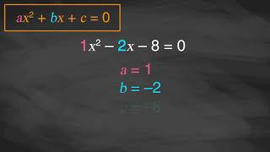
Learning Activity A | Video
Solve by Completing the Square
Notes:
This video discusses question 1 of activity 9.3.2.

Slide 15

Lesson Journey
Third Stop: Learning Activity B

Slide 16
Learning Activity B | Learning Strategies
“If This Be Error …” 🎭
Teacher Instruction: Use these strategies to adjust the activity to support English language learners and students with disabilities.
  You can copy and paste the callouts directly on top of the activity or give the instructions aloud.
Make sure each person in the group can explain the identified errors and proposed corrections.
Rehearse at least twice within your group with each other.
Discussion Supports
In 2 minutes, we will pause to check your progress.
Place a checkmark next to each step as you determine that all of its steps are correct. This will designate it has been “cleared.”
Be prepared to share your thinking with the class. (We will let you know ahead of time.)
Engagement
Notes:
Support for English Language Learners: MLR 8 Discussion Supports: Speaking, Representing
Give students additional time to make sure that everyone in their group can explain the errors they identified and proposed corrections. Invite groups to rehearse what they will say when they share with the whole class. Rehearsing provides students with additional opportunities to speak and clarify their thinking and will improve the quality of explanations shared during the whole-class discussion. Make sure to vary who is selected to represent the work of the group so that students get accustomed to preparing each other to fill that role.
Design Principle(s): Support sense-making; Cultivate conversation
Support for Students with Disabilities: Engagement: Develop Effort and Persistence
Chunk this task into manageable parts for students who benefit from support with organizational skills in problem solving. Check in with students after the first two to three minutes of work time. Invite one to two students to share how they identified the error in the first worked solution. Record their thinking on a display for all to see, and keep the work visible as students continue.
Supports accessibility for: Organization; Attention

Slide 17
Learning Activity B | Part 1
“If This Be Error …” 🎭
Solve your equation by completing the square. Next, examine the worked solution for the problem in order to find and describe the error.
Solve x² + 14x = – 24
Step 1 x² + 14x = – 24
Step 2 x² + 14x + 28 = 4
Step 3 (x + 7)² = 4
Step 4 x + 7 = 2
Step 5 x + 7 = – 2
Step 6 x = – 5; x = 9
Solve x² – 10x + 16 = 0
Step 1 x² – 10x + 16 = 0
Step 2 x² – 10x + 25 = 9
Step 3 (x – 5)² = 9
Step 4 x – 5 = 9
Step 5 x – 5 = – 9
Step 6 x = 14; x = – 4
Notes:
Support for All Learners
This activity offers additional support for students:
For English language learners and students with disabilities, be sure to review the Learning Strategies slide!
Activity (10 minutes)
In this activity, students analyze worked examples of equations solved by completing the square. The work allows them to further develop their understanding of the method when used with rational numbers and to notice common errors. Identifying errors in worked examples is an opportunity to attend to precision and to analyze and critique the reasoning of others.
Launch
Display the four equations in the task statement for all to see, have students access the online textbook, or provide a copy of the slides:
𝑥² + 14𝑥 = −24
𝑥² − 10𝑥 + 16 = 0
𝑥² + 2.4𝑥 = − 0.8
𝑥² − ⁶/₅ 𝑥 + ⅕ = 0
Arrange students in groups of three to four.
Assign one equation (or more, depending on time constraints) for each group to solve by completing the square.
Once group members agree on the solutions, ask them to look for errors in the worked solution for the same equation (as the one they solved).
Answers
x = –2 & x = – 12; Error: In Step 2, the number being added, 28, is not a perfect square. It should be 49.
x = 8 & x = 2; Errors: Step 4 should have 3 on the right side, not 9. Step 5 should have – 3 on the right side, not – 9.
Additional activity questions, answers, and synthesis on the next slide.

Slide 18
Learning Activity B | Part 2
… And Upon Me Proved” 🎭
Solve your equation by completing the square. Next, examine the worked solution for the problem in order to find and describe the error.
Solve x² + 2.4x = – 0.8
Step 1 x² + 2.4x = – 0.8
Step 2 x² + 2.4x + 1.44 = 0.64
Step 3 (x + 1.2)² = 0.64
Step 4 x + 1.2 = 0.8
Step 5 x = – 0.4
Solve x² – ⁶/₅ x + ⅕ = 0
Step 1 x² – ⁶/₅ x + ⅕ = 0
Step 2 x² – ⁶/₅ x + ⁹/₂₅ = ⁹/₂₅
Step 3 (x – ³/₅)² = ⁹/₂₅
Step 4 x – ³/₅ = ³/₅
Step 5 x – ³/₅ = – ³/₅
Step 6 x = ⁶/₅; x = 0
Notes:
Answers
x = – 0.4 & x = – 2; Error: In Step 4, only the positive square root is written and the negative square root is neglected.
x = 1 & x = ⅕; Errors: For example: In Step 2, different amounts are added to each side. On the left, ⁴/₂₅ is added. On the right, ⁹/₂₅ is added. Or: While ⁹/₂₅ is added on the right side, ⅕ was only subtracted from the left side. Other explanations may also be accurate.
Activity Synthesis
To involve more students in the discussion, after each student presents, consider asking students to classify each error by type (not limited to one type per error) and explain their classification. Here are some examples of types of errors:
Careless errors—for example, writing the wrong number or symbol, repeating the same step twice, leaving out a negative sign, or not following directions.
Computational errors—for example, adding or subtracting incorrectly or putting a decimal point in the wrong place.
Gaps in understanding—for example, misunderstanding of the problem or the rules of algebra, applying an ineffective strategy, or choosing the wrong operation or step.
Lack of precision or incomplete communication—for example, missing steps or explanations, incorrect notation, or forgetting labels or parentheses.

Slide 19

Learning Activity B
Self Check
Examine the work shown below. Which of the answer choices identifies the error that took place when the equation was solved by completing the square?
x² – 6x – 7 = 0
x² – 6x = 7
x² – 6x + 9 = 16
(x – 3)² = 16
x – 3 = 4
x = 7
The 7 should have been subtracted from each side.
When taking the square root, only the positive solution was included.
When completing the square, the wrong number was found for (^{b}/₂)².
This equation cannot be solved by completing the square.
Let’s review!
Notes:
Answer Feedback - Individualized by Response
Incorrect. The inverse operation was correctly used and 7 was added to both sides.
That’s correct! When taking √(𝑥 − 3)2 = √16 the positive and negative 4s must be considered so that 𝑥 − 3 = ±4.
Incorrect. (⁶/₂)² = 9 so the square was completed correctly.
Incorrect. This problem can be solved by completing the square since it is a quadratic equation with a real coefficient of 𝑥.

Slide 20
Learning Activity B
Self Check - Review
Identify the error in the worked solution:
Solve the quadratic equation by completing the square and finding its zeros.
Step 1 x² + 10x – 34 = 0
Step 2 x² + 10x = 34
Step 3 x² + 10x + 25= 34 – 25
Step 4 (x + 5)² = 9
Step 5 x + 5 = ± 3
Step 6 x = – 8; x = – 2
Notes:
Remind students
To find the error when solving quadratics, it is helpful to first solve the problem on your own.
Answer
In Step 3, 25 was added to the left side of the equation, but 25 was SUBTRACTED from the right side of the equation. Equations must remain balanced, and 25 should be added to each side of the equation.

Slide 21
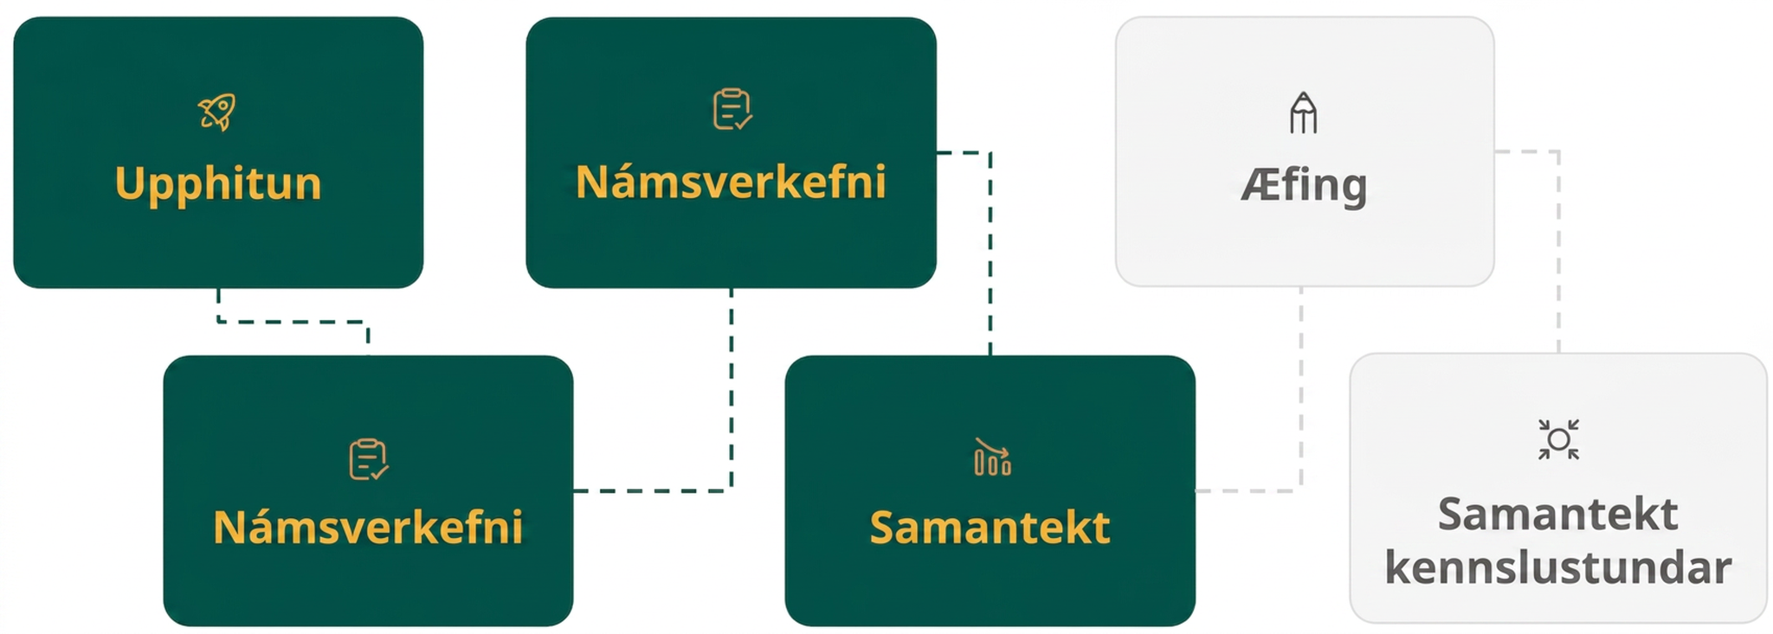
Lesson Journey
Fourth Step: Cool Down

Slide 22
Cool Down
Use completing the square to solve x² – x + ³/₁₆ = 0.
[The answers you should get are x = ¾ and x = ¼.]
Notes:
Cool Down (5 minutes)
Answers
Access the online textbook for all of the steps.
Response to Student Thinking - More Chances
Students will have more opportunities to understand the mathematical ideas in this cool down, so there is no need to slow down or add additional work to the next lessons. Instead, use the results of this cool down to provide guidance for what to look for and emphasize over the next several lessons to support students in advancing their current understanding.

Slide 23
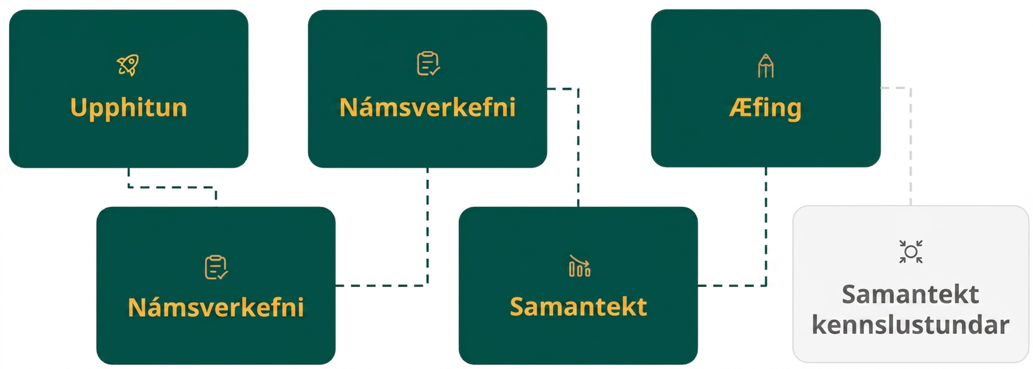
Lesson Journey
Fifth Stop: Practice

Slide 24

Practice
Put your hard work to action, practice what you’ve learned!
Notes:
Digital Practice: Access the practice pages at https://openstax.org/details/books/algebra-1

Slide 25
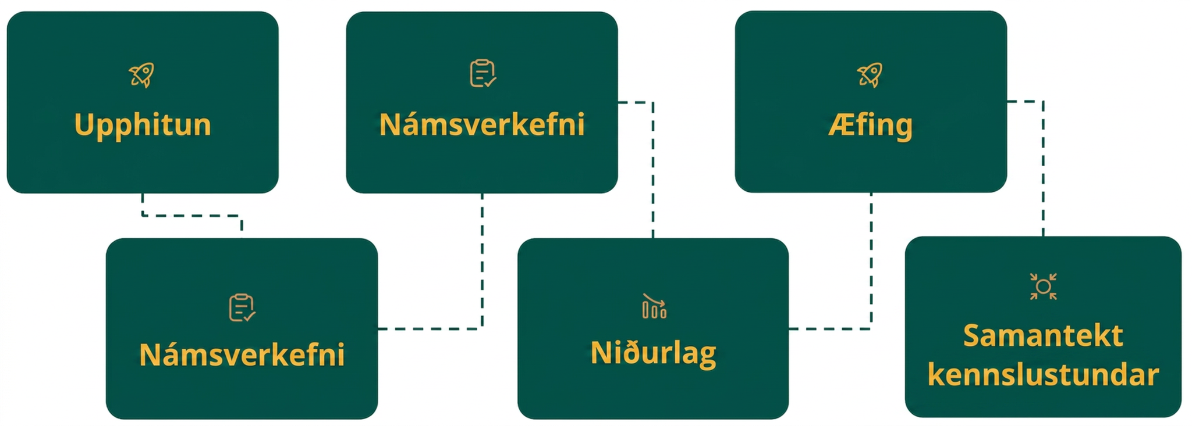
Lesson Journey
Sixth Stop: Lesson Synthesis

Slide 26
Lesson Synthesis
How was the process of completing the square in this lesson different than that in an earlier lesson?
How was the process of completing the square in this lesson like that in the previous lesson?
What are some errors you have seen or have made when the solving process involves multiple steps, especially when the numbers are tricky to work with?
When might we want to choose to solve quadratic equations by rewriting them in factored form instead of by completing the square? When might it be preferable to complete the square?
Notes:
Answers
The numbers in the equations are not as simple, so the calculations may be more involved and time consuming. In some cases, more steps were needed to complete the square, and the process may be more prone to error.
The steps are essentially the same: turn one side into a perfect-square expression, write it as a squared factor, and reason about the value of the factor.
Some common errors:
Only positive solutions are shown. Negative solutions are neglected.
Different amounts are added to the two sides of the equal sign.
The wrong amount is added so the quadratic expression is not a perfect square.
Incorrect calculations or missed steps.
When we could easily see the factors in a quadratic equation, then it makes sense to solve the equation by putting it in factored form. When it is not obvious what the factors are, or when the equation involves non-integers, then completing the square may be preferable.
Emphasize that completing the square is a handy technique that can be used to solve any quadratic equation, but depending on the numbers in the equation, it may or may not be an efficient method.

Slide 27
Self Assessment
How much do you agree with the following statements?
Learning Goals | I can | Almost | Not yet
Solve by completing the square when given a quadratic equation in which the coefficient of the squared term is 1. | ⃞ | ⃞ | ⃞

