Slide 1


Algebra 1
Unit 4 Functions
Lesson 4.1 Describing and Graphing Situations

Slide 2
How to use these slides
On the activity slides check the speaker notes for teacher support and instructional information.
Each lesson includes 1 warm up, 2-3 learning activities, a cool down, practice and a lesson synthesis.
  Learning activities are followed by a self check question, and review section.
Some slides have been hidden from student view, more information can be found on the next slide (Reference Key).
You can edit and use these slides for personal and classroom use, but cannot sell them and must keep the attribution logos.
For more information, Check out the digital quick start guide!

Slide 3






Reference Key
Check the top right corner for an icon referencing these unique sections.
 | Support for Students with Disability | Hidden | Learning Strategies slide, provides additional support to students for understanding the activity. Learning Strategies slide, provides additional support to students for understanding the activity.
 | Support for English Language Learners | Hidden
 | Extending Your Thinking | Hidden | Extending Your Thinking slide, provides an extra challenge for students.
 | Self Check | Not Hidden | Self Check slide, checkpoint to assess student understanding after the learning activity.
 | Review | Hidden | Self Check- Review slide, designed to help review topics from the self check question.
On the next slides, check the speaker notes for teacher instructions and support.
Notes:
Check the Speaker Notes: On the next slides you can find discussion questions, lesson information, answers to the activities, and ways to adjust the activity for your students!

Slide 4

Learning Goals
By the end of this lesson you will be able to -
Explain when a relationship between two quantities is a function.
Identify independent and dependent variables in a function, and use words and graphs to represent the function.
Explain what descriptions and graphs of functions tell us about situations.
Write a quadratic equation that represents a situation.
Notes:
Lesson Narrative
In this lesson, students review the definition of a function and explore real-world examples using descriptions, tables, and graphs. They learn that a function assigns exactly one output to each input and analyze representations to determine if a relationship is a function. Students interpret input-output pairs and connect verbal descriptions to tables and graphs in context.
Required Preparation
Make copies of coordinate grids and the 4.1.2 graphing activity printable.
Required Materials
Graphing technology
4.1.2 Activity Graphing Printable
Coordinate grids
Texas Essential Knowledge and Skills
A1(D) communicate mathematical ideas, reasoning, and their implications using multiple representations, including symbols, diagrams, graphs, and language as appropriate
A12(A) decide whether relations represented verbally, tabularly, graphically, and symbolically define a function;

Slide 5
Vocabulary
Previous
None
New
Relation
  A relation is any set of ordered pairs, (𝑥,𝑦).
Function
  A relation that takes inputs from one set and assigns them to outputs from another set, assigning exactly one output to each input.
Notes:
Lesson Vocabulary
To support student understanding of key vocabulary:
Introduce and review the vocabulary words students will see in this lesson.
Encourage students to notice how these words are used and to include them in their math discussions and explanations—both written and oral.
Use a word wall to reinforce vocabulary. Sample word wall cards are available here.
For newcomers or students with beginning English proficiency, use these Quizlet sets to support vocabulary learning:
Unit 4 Spanish Vocabulary, part 1 – use first to build understanding
Unit 4 Vocabulary (English), part 1 – use after anchoring in Spanish
Unit 4 Spanish Vocabulary, part 2 – use first to build understanding
Unit 4 Vocabulary (English), part 2 – use after anchoring in Spanish
Support for English Language Learners
ELPS 2(C) learn new language structures, expressions, and basic and academic vocabulary heard during classroom instruction and interactions
ELPS 2(F) listen to and derive meaning from a variety of media such as audiotape, video, DVD, and CD-ROM to build and reinforce concept and language attainment
ELPS 3(F) ask and give information ranging from using a very limited bank of high-frequency, high-need, concrete vocabulary, including key words and expressions needed for basic communication in academic and social contexts, to using abstract and content-based vocabulary during extended speaking assignments
ELPS 3(I) adapt spoken language appropriately for formal and informal purposes
ELPS 3(J) respond orally to information presented in a wide variety of print, electronic, audio, and visual media to build and reinforce concept and language attainment
ELPS 4(G) demonstrate comprehension of increasingly complex English by participating in shared reading, retelling, or summarizing material, responding to questions, and taking notes commensurate with content area and grade level needs

Slide 6





Lesson Journey
Warm Up
Learning Activity
Cool Down
Lesson Synthesis
Learning Activity
Learning Activity
Practice

Slide 7
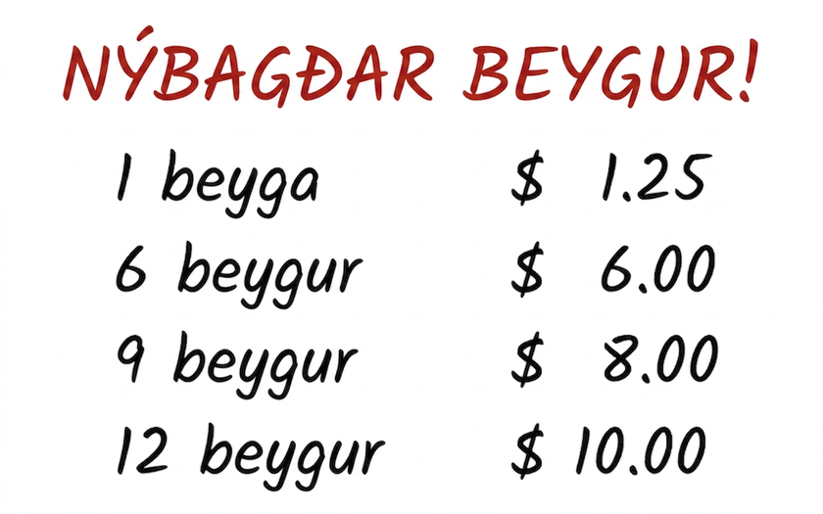
Warm Up - Buying Bagels 🥯
A customer buys 13 bagels, and the worker says, “That would be $16.25.” Jaime, Pedro, and Hannah all think it is a mistake.
Jaime says, “Shouldn’t the total be $13.25?”
Pedro says, “I think it should be $13.00.”
Hannah says, “No, I think it should be $11.25.”
How could the worker, Jaime, Pedro, and Hannah all be correct?
Notes:
Warm Up (5 minutes)
This opening activity uses a familiar context to help students recall what they learned about functions in middle school. Students explore two relationships: one where the number of bagels and their prices do not form a function, and another where each number of bagels has one best price, which does form a function. By comparing the two, students reason about possible prices, complete a table of values, and analyze graphs to deepen their understanding.
Launch
Scroll down to see the answers for the warm up on this slide. Optionally, have your students work through the extended version of this warmup, which has them create a table for each person: Desmos Activity: RAISE - Contrasting Two Relationships by Reasoning
Have students quietly think about how each person in the scenario might be correct, then optionally share with a partner to continue the activity together. Share the Desmos class code and guide students through the activity:
Screen 1, they create a table of best prices for bagels
Screens 2–4, they review the correct table, see that Hannah’s price is the best for 13 bagels, and explore how others arrived at their answers. Highlight unique or well-expressed student reasoning as you circulate.
Final screen, students reflect on how this pricing benefits the business and share their opinion as customers—pause for class discussion.
Unlike a graphing calculator, Desmos activities are interactive and allow teachers to monitor responses in real time and lead class discussions using the dashboard.
Activity Answers
Your answers may vary, but here is a sample.
The store worker thinks the price for 13 bagels should be $16.25 because she multiplied 13 times 1.25. She charged the customer for each bagel individually.
Jaime thinks the price for 13 bagels should be $13.25 because that is the cost of buying two sets of six bagels and then one more bagel.
Pedro thinks the price for 13 bagels should be $13.00 because he added the costs of buying 10 bagels and then 3 more bagels.
Hannah thinks the price for 13 bagels should be $11.25 because she noticed that a dozen bagels could be purchased for $10. She only needs one more bagel for $1.25 to have 13 bagels. That means her total cost is $11.25.

Slide 8

Lesson Journey
Warm Up
Learning Activity
Cool Down
Lesson Synthesis
Learning Activity
Learning Activity
Practice

Slide 9
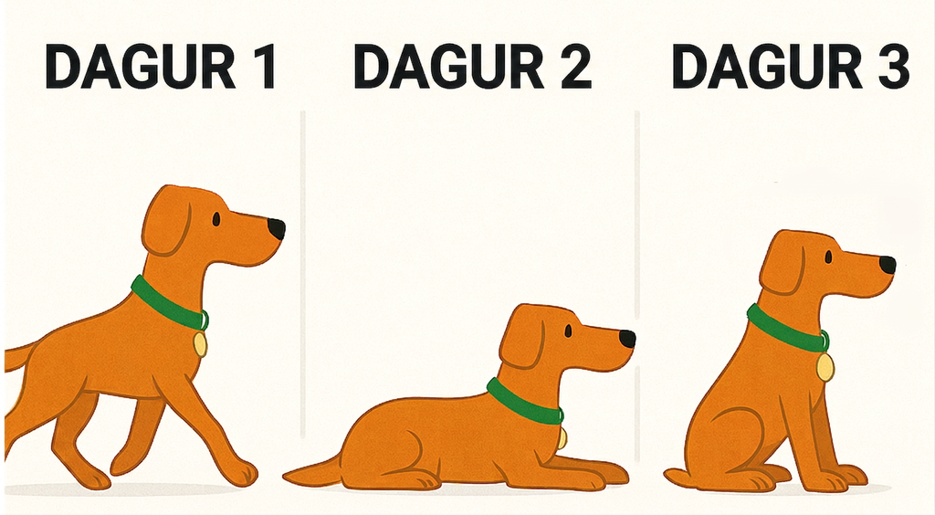
Learning Activity - Graphing Distance 🦮
Three days in a row, a dog owner tied his dog’s 5-foot-long leash to a post outside a store while he ran into the store to get a drink. Each time, the owner returned within minutes.
Each day, the dog started 1.5 ft from the post. After 60 seconds, it was 4 ft away. His movements each day are as follows:
Day 1: Walked around the whole time.
Day 2: Walked for 1 minute, then laid down.
Day 3: Tried to follow owner, got stopped by the leash, circled the post until the leash was fully wound, then stayed put.
Your teacher will assign you a day to analyze. Sketch a graph showing the dog’s distance from the post (in feet) over time (in seconds) after the owner left.
Notes:
Support for All Learners
This activity offers additional support and an extension for students:
For English language learners and students with disabilities, be sure to review the Learning Strategies slide!
For students looking for an extra challenge, be sure to review the Extending Your Thinking slide!
Activity (10 minutes)
In this activity, students explore functions by analyzing a dog’s distance from a post over time. They sketch graphs from movement descriptions and interpret each point as a time and distance. This helps them recall independent and dependent variables and understand why the relationship is a function—the dog can't be in two places at once. Teachers should note graphs that go above 5 feet or miss key points, as these offer chances to clarify the context and its limits.
Launch
Read the task statement and the descriptions about the dog owner and his three days of dog walking.
Provide students with a copy of the RAISE 4.1.2 Activity Handout.
Discuss features of a graph that could represent the dog’s movement on Day 3 and display a possible graph.
Click here for the slide with the example image, Launch Image 1.
Keep students in groups of 4. Ask 2 group members to graph the dog's movement on Day 1, and the other 2 members to graph the movement on Day 2.
One person who graphed day 1 should pair with someone who graphed day 2. Students should explain their graphs and help partners change the graphs where needed.
Digital graphing strategy - To graph day 3, have students access the GeoGebra link https://www.geogebra.org/classic/z8zah6ak to open a blank graph for the dog movement scenario. Provide students with the following prompting questions
If the dog was 1.5 feet from the post when the owner left him outside the store, how much time has passed?
What point does this represent? (t = 0; (0, 1.5) is the point that students will need to graph.)
If the dog is 4 feet away from the post after 60 seconds, what point does this represent? ((60, 4) is the point that students will need to graph.)
To graph the points (0, 1.5) and (60, 4), students can enter the points in the Input menu on the left side of the screen or they plot the points on the graph by using the Point tool. (Students click on the point tool to activate it, then click on the locations for the points on the graph.)
Click here for the slide with the example image, Launch Image 2.
Now, have the students use the Freehand Shape tool (accessed through the Move tool menu) to draw the graph that is described by the dog’s movement on Day 3.
Click here for the slide with the example image, Launch Image 3.
Students can reload the page to create their digital graphs for Days 1 and 2 or they can continue adding to their graph using the Freehand Shape tool and the left input menu. (Note that students can select/de-select the previous freehand shape or delete it.)
Activity image answer, and synthesis on the next slide.

Slide 10
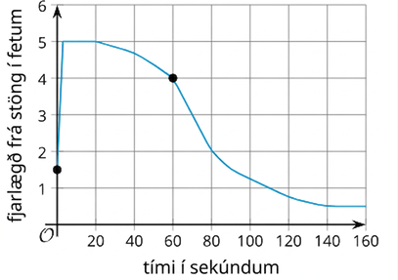

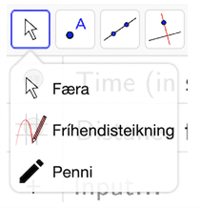
Learning Activity - Graphing Distance 🦮
Launch Image 2: GeoGebra Point tool
Launch Image 1: Potential Day 3 Graph
Launch Image 3: GeoGebra Freehand tool
Notes:
Launch Images

Slide 11
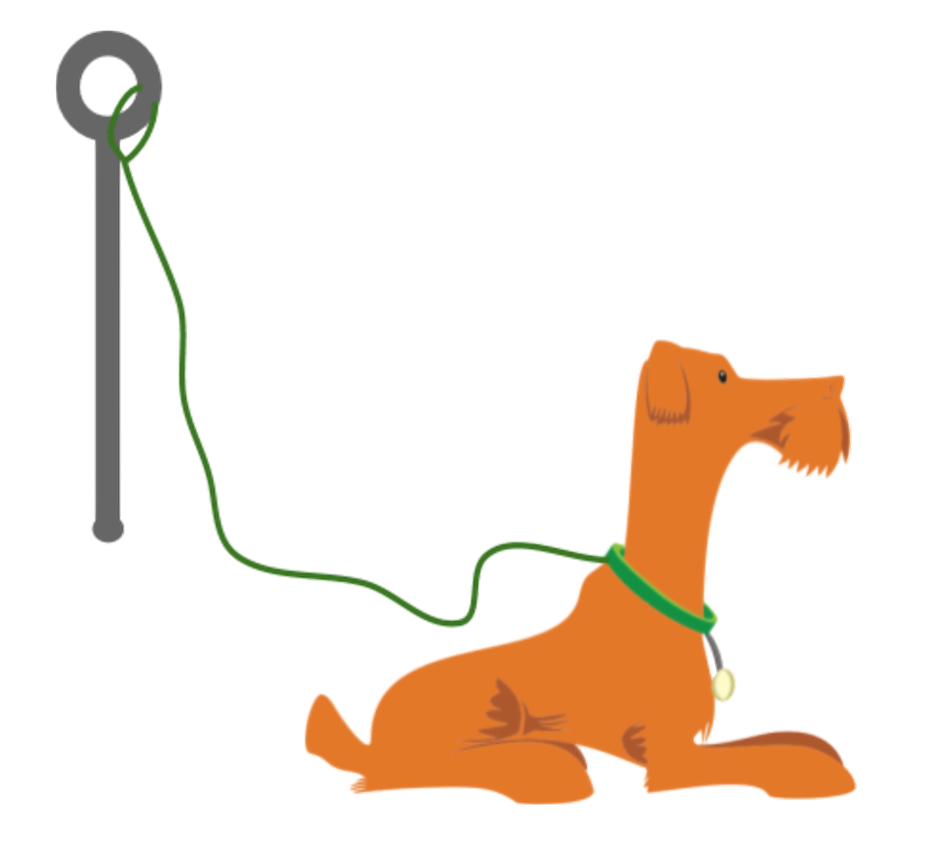
Learning Activity - Graphing Distance 🦮
Meet with two classmates, in your group, who were assigned different days than you. Work together to explain your graphs, make any needed changes, and sketch each other’s graphs before checking your work.
Are you ready for more?
Notes:
Activity Answer
Compare your work: Your answer may vary, but here is a sample for each day.
Day 1: Click here for the slide with the image Day 1.
Day 2: Click here for the slide with the image Day 2.
Day 3: Click here for the slide with the image Day 3.
Activity Synthesis
Select some students to share their graphs and a brief explanation of how the graphs match the descriptions.
One takeaway from this activity is that the relationship between the time since the owner left and the dog’s distance from the post is a function. Solicit as many explanations as possible as to why this is.
To emphasize that a function is a relationship in which one output is assigned to every input, explain that:
The dog can only be in one spot at a time and cannot have more than one distance away from the post at any time.
On each graph, we can see that only one value for distance corresponds to each value for time.
Ask students:
“In this situation, what is the input and what is the output?” (It makes sense for time in seconds to be the input and distance from the post to be the output.)
“Is it possible for the distance to be the input and the time to be the output? Why or why not?” (It is possible, but if the distance is the input, the relationship is no longer a function. This is because there could be multiple possible times at which the dog is a certain distance away from the post.)
Remind students that a quantity that is an input for a function is called an independent variable, and a quantity that is an output is called a dependent variable. In this case, time is independent and distance from the post is dependent.

Slide 12
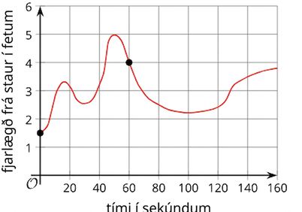
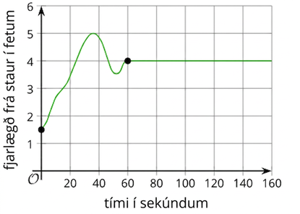
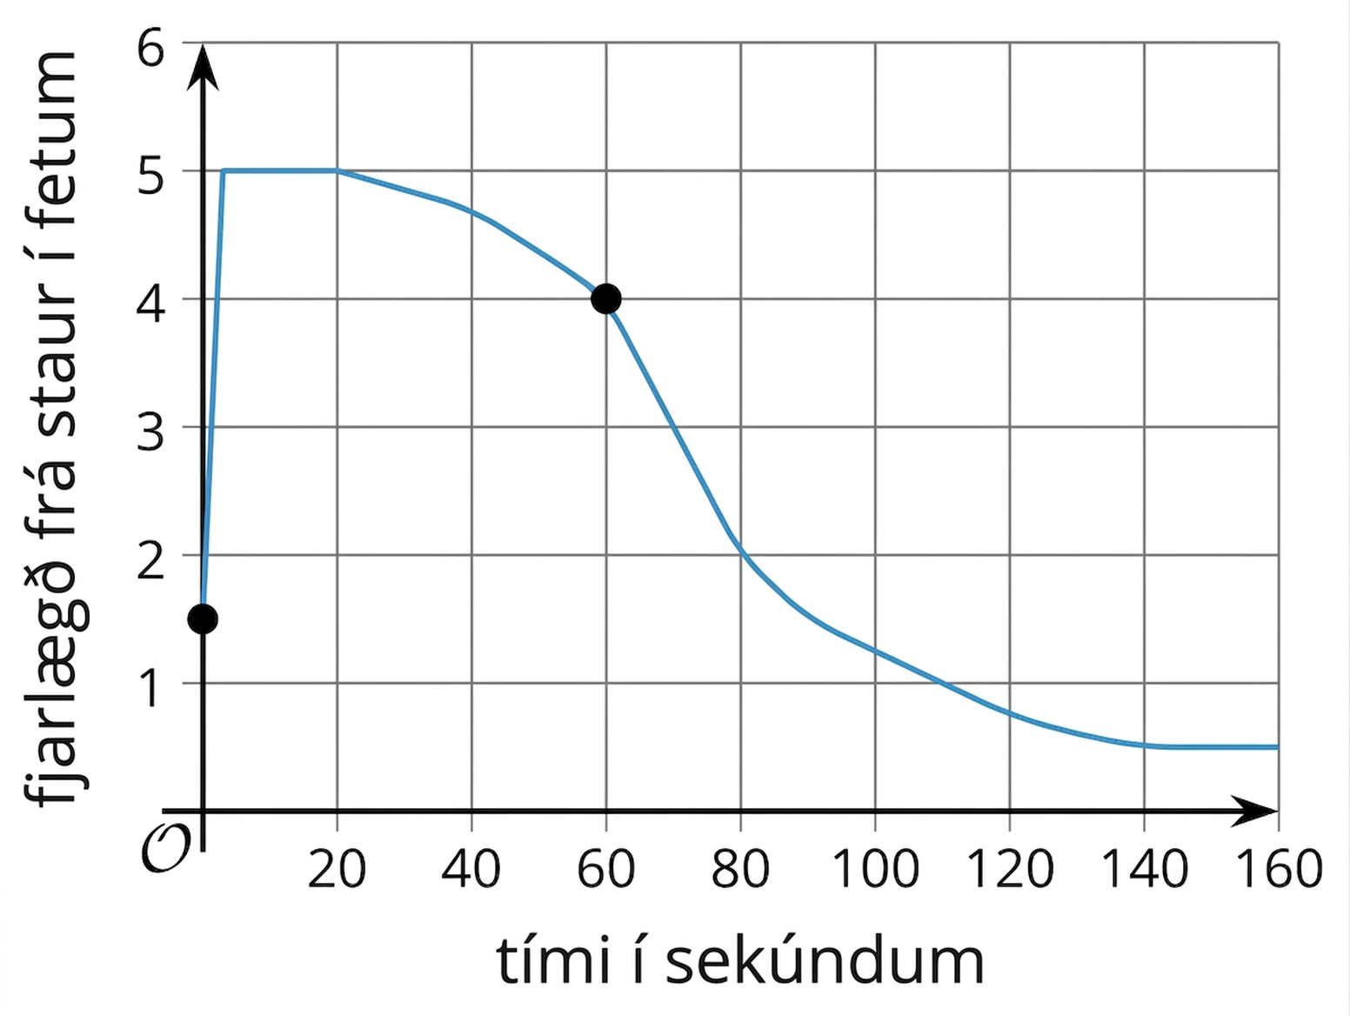
Learning Activity - Graphing Distance 🦮
Day 1
Day 2
Day 3
Notes:
Activity Images

Slide 13
Learning Strategies - Graphing Distance 🦮
Teacher Instruction: Use these strategies to adjust the activity to support English language learners and students with disabilities.
  You can copy and paste the callouts directly on top of the activity or give the instructions aloud.
First read: What is this situation about?
Second read: list what can be counted or measured.
Third read: listen for the question and brainstorm ways to solve.
Three Reads
Can you show where the dog can move when the leash is attached to the pole?"
What happens to the leash when the dog walks around the post?
Representation
Notes:
Support for English Language Learners: MLR 6 Three Reads: Reading, Listening, Conversing
Use this routine to support reading comprehension. Use the first read to orient students to the situation. After a shared reading, ask students, “What is this situation about?” (A dog’s movement while the owner ran into a store.) Use the second read to identify quantities and relationships. Ask students what can be counted or measured without focusing on the values. Listen for, and amplify, the important quantities that vary in relation to each other in this situation: distance from the post and time in seconds. After the third read, ask students to brainstorm possible strategies to answer the question. This helps students connect the language in the word problem and the reasoning needed to solve the problem while keeping the cognitive demand of the task.
Design Principle(s): Support sense-making
Learn more about this routine
View the instructional video and follow along with the materials to assist you with learning this routine.
Provide support for students
Distribute graphic organizers to the students to assist them with participating in this routine.
Support for Students with Disabilities: Representation: Internalize Comprehension
Represent the same information through different modalities by using physical objects to represent abstract concepts. Use a three-dimensional prop to represent the situation and the dog’s movement. This prop might use a dowel rod for the post and a piece of string or yarn for the leash. Viewing or manipulating the prop can help students better understand the context and quantities involved.
Supports accessibility for: Conceptual processing; Visual-spatial processing

Slide 14
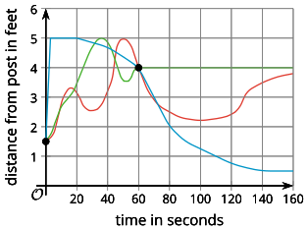
Extending Your Thinking
From the graph, is it possible to tell how many times the dog changed directions while walking around?
Be prepared to show your reasoning.
Notes:
Answer
For example: No. The graph only gives the distance from the post. The dog could change from moving clockwise around the post to moving counterclockwise around the post. These changes could not be seen on the graph.

Slide 15
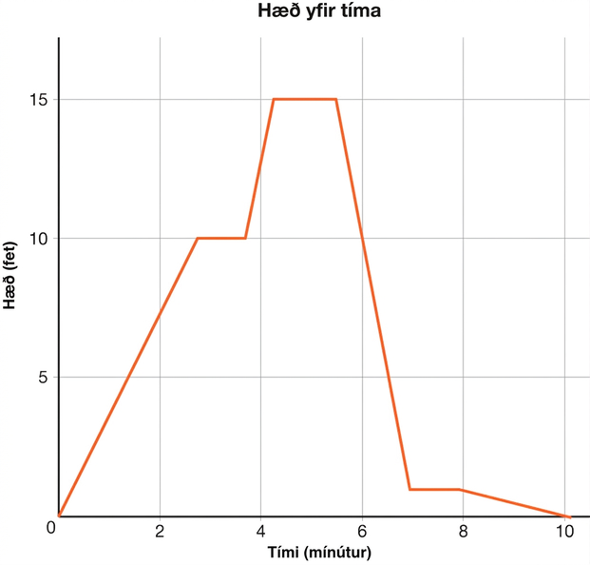
Self Check
The graph shows a person’s elevation for a period of 10 minutes. Which statement is true based on the graph?
The person sped up in the first 3 minutes.
The person slowed down for the second half of the hike.
During the first 3 minutes, the person was hiking up a hill.
The person never stopped climbing.
Let’s review!
Notes:
Answer Feedback - Individualized by Response
Incorrect. The graph is looking at time and elevation, not speed. The answer is that the person was hiking up a hill for the first 3 minutes.
Incorrect. The graph is looking at time and elevation, not speed. The answer is that the person was hiking up a hill for the first 3 minutes.
That’s correct! : As time passed during the first 3 minutes, the person’s elevation increased.
Incorrect. The elevation stayed the same from 3 to 4 minutes and about 5 to 6 minutes, so that is where they stopped climbing. The answer is that the person was hiking up a hill for the first 3 minutes.

Slide 16
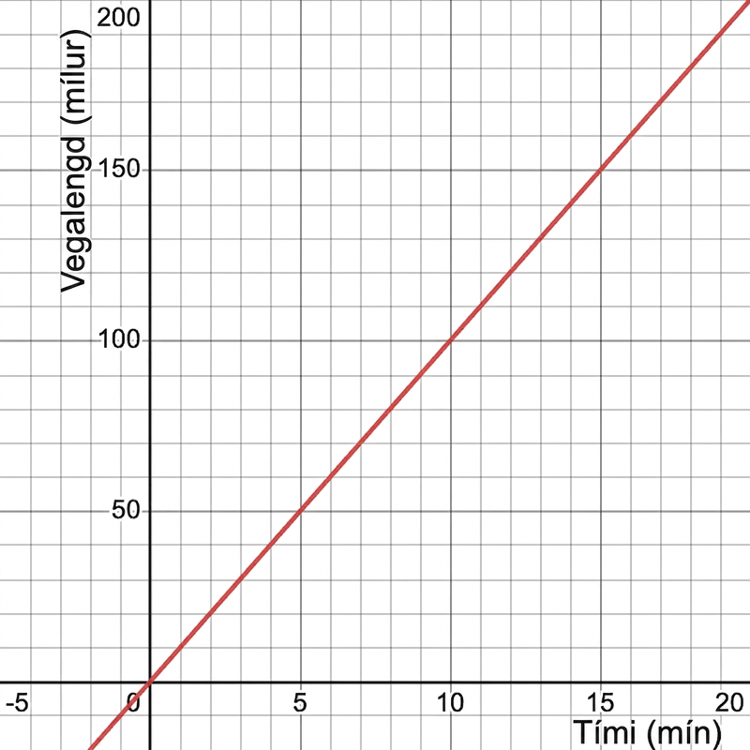
Self Check - Review
Representing Everyday Situations with Graphs
Drawing functions to represent everyday situations can be useful to provide a visual for what is happening in a situation.
What do you notice about Mia’s distance over time?
The graph shows the distance y, in miles, for the time of each of Mia’s runs in x minutes.
Notes:
Remind Students
Notice that at 0 minutes, Mia has run 0 miles.
At 30 minutes, Mia has run 3 miles.
At 180 minutes, Mia has run 18 miles.

Slide 17
Lesson Journey
Warm Up
Learning Activity
Cool Down
Lesson Synthesis
Learning Activity
Learning Activity
Practice

Slide 18

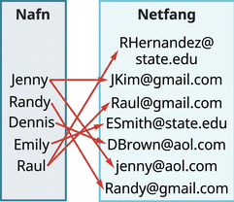
Learning Activity - Is the Relation a Function? ↗️
A relation is any set of ordered pairs, (x,y).
A function is a special type of relation that maps every input, x, to exactly one output, y.
Notes:
Activity (10 minutes)
This activity introduces the concept of relations as an ordered pair and leads students into determining if a relation is a function. Students should be able to determine if a relation is a function from a mapping or set of ordered pairs.
As students work, observe different strategies and plan to have contrasting approaches shared during discussion.
Launch
Arrange students into pairs so they can discuss if each relation is a function. As a class, discuss the inputs and outputs of each relation and if each is a function.
Activity questions, answers, and synthesis on the next slide.

Slide 19
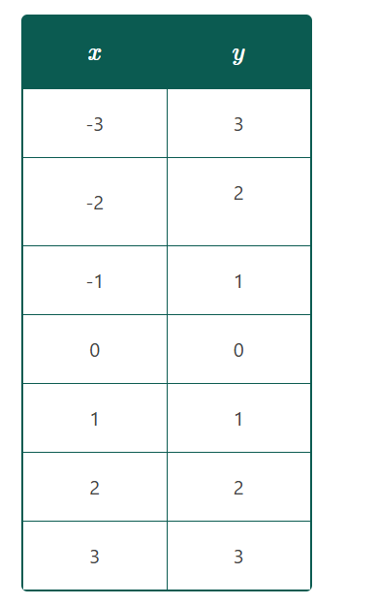
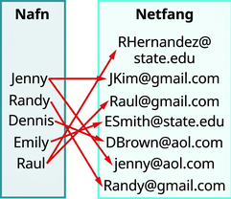
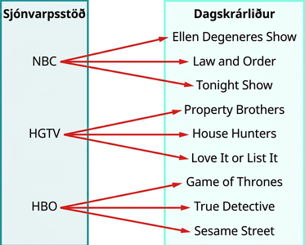
Learning Activity - Is the Relation a Function? ↗️
Tell if each relation is a function and explain.
{(−3, 27), (−2, 8), (−1, 1), (0, 0), (1, 1), (2, 8), (3, 27)}
{(9, −3), (4, −2), (1, −1), (0, 0), (1, 1), (4, 2), (9,3)
Notes:
Answers
Yes, this is a function because every input goes to exactly one output.
This relation is not a function. Raul and Jenny have 2 emails, so twice there are inputs that go to two outputs.
This is not a function because each input goes to multiple outputs.
Each input, x-value, is matched with only one output, y-value. So this relation is a function.
The input (x-value), 9, is matched with two outputs (y-values), both 3 and −3. So this relation is not a function.
Activity Synthesis
Lead the class into a discussion that a function is always a relation, but a relation is not always a function.
Give the students the following table and ask how they can determine if the relation is a function. Encourage students to write each point in the table as a coordinate pair and also as a mapping. Discuss which representation they prefer.
x: | 2 | 1 | 3 | 6 | 2 | -5 | 0 |
y: | 4 | 1 | 0 | 4 | -4 | 2 | 3 |
Since the x-value, or input, 2 is mapped onto both 4 and –4, this relation is not a function.

Slide 20
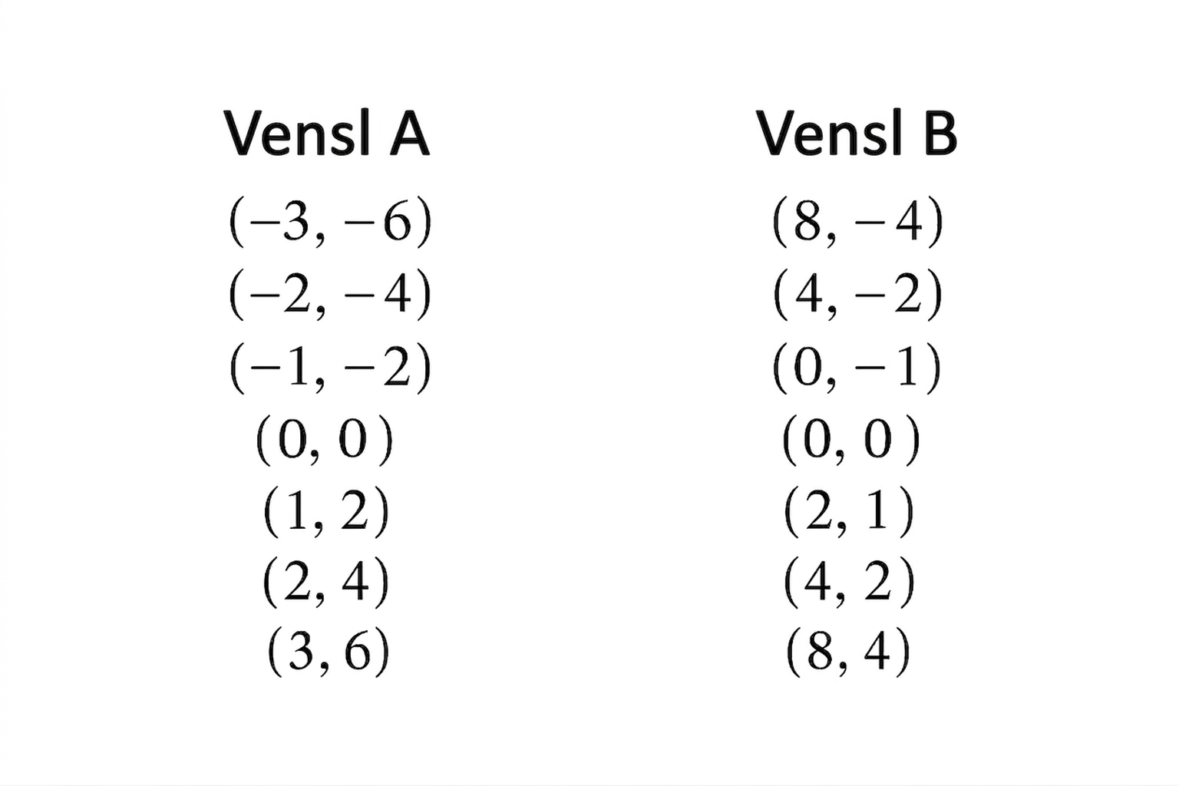
Self Check
Consider the two relations. Which statement is true about both relations?
Both relations are functions.
Relation A is a function, but relation B is not a function.
Relation B is a function, but relation A is not a function.
Neither relation is a function.
Let’s review!
Notes:
Answer Feedback - Individualized by Response
Incorrect. In relation B, the input, 4, is shared with 2 outputs. The answer is that relation A is a function, but relation B is not.
That’s correct! In relation A, every input goes to exactly one output, but in relation B, the input value 4 goes to both –2 and 2.
Incorrect. Relation B is not a function because the input value 4 goes to both 2 and –2. Relation A has every input value going to exactly one output value. The answer is that relation A is a function, but relation B is not.
Incorrect. Relation A is a function since every input value goes to exactly one output value. The answer is that relation A is a function, but relation B is not.

Slide 21
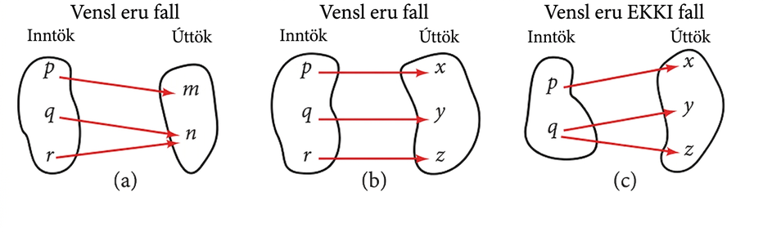
Self Check - Review
A relation is a set of ordered pairs (x,y), where the first numbers (x) are the dependant variables called inputs and the second (y) are the independent variables called outputs.
A function (f) is a relation that assigns a single output to each input. No x-values are repeated. The relation, {(1,2),(2,4),(3,6),(4,8),(5,10)}, is a function because each input, {1,2,3,4,5}, is paired with exactly one output, {2,4,6,8,10}.
A mapping uses arrows show the pairing of the inputs with the outputs.
How does mapping help determine if the relations to the right are functions?
Notes:
How does mapping help determine if the relations in the image are functions?
This relationship is a function because each input is associated with a single output. Note that inputs q and r both give output n.
This relationship is also a function. In this case, each input is associated with a single output.
This relationship is not a function because input q is associated with two different outputs.
Remind Students: How to determine if a relationship is a function.
Identify the input values.
Identify the output values.
If each input value leads to only one output value, classify the relationship as a function. If any input value leads to two or more outputs, do not classify the relationship as a function.

Slide 22
Lesson Journey
Warm Up
Learning Activity
Cool Down
Lesson Synthesis
Learning Activity
Learning Activity
Practice

Slide 23


Learning Activity - Types of Variables 🐶
In a function, there are two quantities called variables. The independent variable is the input, while the dependent variable is the output.
Here are two pairs of quantities. Each pair has a relationship that can be defined as a function.
Choose one pair of quantities and express their relationship as a function.
Time, in seconds, since the dog owner left and the total number of times the dog has barked.
Time, in seconds, since the owner left and the total distance, in feet, that the dog has walked while waiting.
Notes:
Support for All Learners
This activity offers additional support and an extension for students:
For English language learners and students with disabilities, be sure to review the Learning Strategies slide!
Activity (10 minutes)
This activity allows students to use mathematical language to describe functions and sketch graphs based on given descriptions, using a familiar context but different quantities. It engages students in modeling by having them identify independent and dependent variables, make sense of quantities, and consider reasonable values. Students may represent the number of barks as either a discrete or continuous graph, (Because the total number of barks cannot be fractional, creating a step graph would most accurately represent it as a function of time, but students are not expected to do so at this point.). Teachers can use these variations to prompt discussion and highlight different interpretations.
Launch
Arrange students in groups of 2. Tell students their task is to analyze two pairs of quantities from a familiar situation. Ask partners to each choose a different pair of quantities. Give students a few minutes of quiet work time, and then give time for partners to take turns sharing their functions and representations.
Tell students that the partner who is listening should listen for the following information:
How did their partner decide which quantity is independent (the input) and which is dependent (the output)?
How did they decide what makes ____ a function of ____?
How does the graph represent the relationship between ____ and ____?
On the graph, how was the scale for each axis determined?
Encourage students to notice any part of their own or their partner’s statement or graph that may not seem reasonable in the situation, and then think about what might be more reasonable. (For instance, it is not reasonable for a dog to bark 1,000 times in 2 minutes.)
Leave 1 – 2 minutes for a whole-class discussion.
Activity questions, answers, anticipated misconceptions, and synthesis on the next slide.

Slide 24
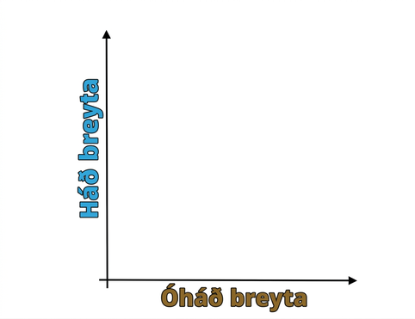
Learning Activity - Types of Variables 🐶
Answer the questions using the the pair you defined as a function.
In that function, which variable is independent? Which one is dependent?
Write a sentence of the form “____ is a function of ____.”
On a piece of graph paper, sketch a possible graph that represents your chosen scenario.
Notes:
Answers
Compare your answers:
The time, in seconds, since the owner left is independent. The total number of times the dog has barked is dependent.
The time, in seconds, since the owner left is independent. The total distance, in feet, the dog walked while waiting is dependent.
Compare your answers:
The total number of times the dog has barked is a function of the time, in seconds, since the owner left.
The total distance, in feet, is a function of the time, in seconds, since the owner left.
Compare your answer: Your answer may vary, but here is a sample for each of the scenarios.
Time, in seconds, since the dog owner left and the total number of times the dog has barked
Click here for the slide with image 3a.
Time, in seconds, since the owner left and the total distance, in feet, that the dog has walked while waiting
Click here for the slide with image 3b.
.
Anticipated Misconceptions
Because we often identify the input of a function first, some students may think that the independent variable always goes first in the statement “___ is a function of ____.”
Explain that we can think of the phrase “is a function of” to mean “depends on.” Suggest that they use “depends on” to describe the relationship between the quantities both ways and see which one makes more sense.
For example, “The dog’s distance from the post depends on the time since the owner left,” or “the time since the owner left depends on the dog’s distance from the post.” The former makes more sense, so we can say, “The dog’s distance from the post is a function of time since the owner left.”
Activity Synthesis
For each situation, select 1 – 2 students who drew different graphs to display them for all to see.
Ask the students to briefly explain how they decided which quantity should be the input and which should be the output, as well as what the graph should look like.

Slide 25
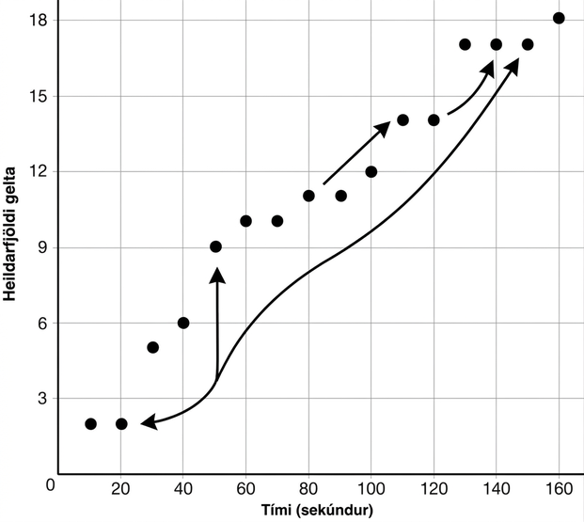
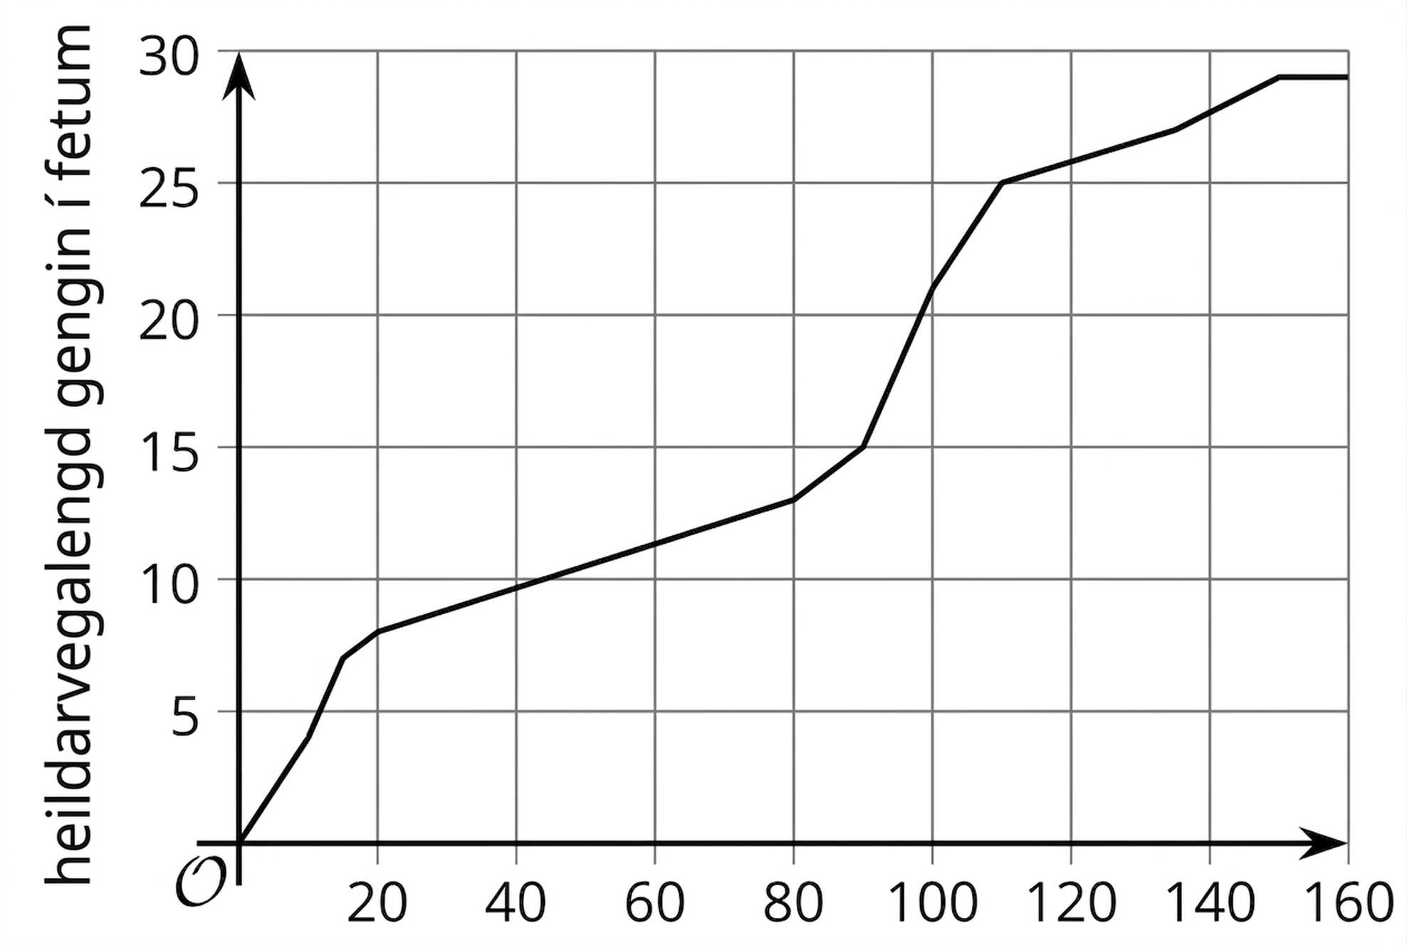
Learning Activity - Types of Variables 🐶
3a
3b
Notes:
Activity Images

Slide 26
Learning Strategies - Describing Functional Relationships
Teacher Instruction: Use these strategies to adjust the activity to support English language learners and students with disabilities.
You can copy and paste the callouts directly on top of the activity or give the instructions aloud.
“_____ is the input or output because . . .”
“I noticed _____, so . . .”
“To determine a scale on the graph, I . . . .
Discussion Supports
Use your graphic organizer to record your partner’s strategies.
Action and Expression:
Notes:
Support for English Language Learners: MLR 8 Discussion Supports: Speaking, Representing
Use this routine to support partner discussion as students analyze two pairs of quantities. Display the following sentence frames for all to see: “_____ is the input or output because . . .”; “I noticed _____, so . . .”; and “To determine a scale on the graph, I . . . .” Encourage students to challenge each other when they disagree. This will help students use mathematical language to describe relationships that are functions.
Design Principle(s): Support sense-making
NO links to supporting materials for teachers or students.
Support for Students with Disabilities: Action and Expression: Develop Expression and Communication
Invite students to engage in active listening during the partner activity by providing a two-column graphic organizer with the questions in one column and a blank space for recording their partner’s strategies in the other column.
Supports accessibility for: Language; Organization

Slide 27
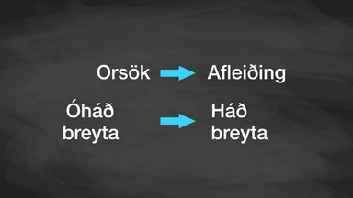
Video: Determining Independent and Dependent Variables

Slide 28

Self Check
The number of unread emails in Bryan’s account is 100. This number grows by 15 unread emails a day. Which of the following is true about this relationship?
Time, in days, is a function of the number of emails.
The number of emails is a function of time in days.
There is not a functional relationship between time
and the number of emails.
The number of unread emails is a function of the
number of new unread emails.
Let’s review!
Notes:
Answer Feedback - Individualized by Response
Incorrect. The input is time, and the output is the number of emails in the account. The answer is that the number of emails is a function of time in days.
That’s Correct! The input is time, and the output is the number of emails in the account.
Incorrect. There is exactly one output, number of emails, for each input, time in days. The answer is that the number of emails is a function of time in days.
Incorrect. The input is time, and the output is the number of emails in the account. The answer is that the number of emails is a function of time in days.

Slide 29
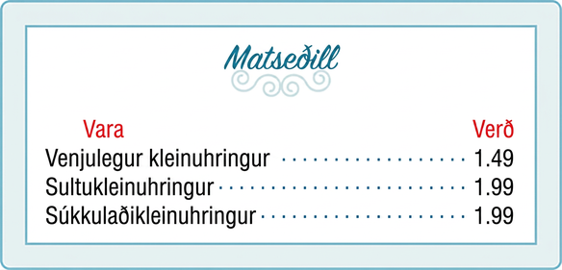
Self Check - Review
The coffee shop menu consists of items and their prices.
Is price a function of the item?
Is the item a function of the price?
How can mapping help determine if an item is a function of the price?
Notes:
Remind Students: How to determine if a relationship is a function.
Identify the input values.
Identify the output values.
If each input value leads to only one output value, classify the relationship as a function. If any input value leads to two or more outputs, do not classify the relationship as a function.
Discuss the Answers with the Students:
Let’s begin by considering the input values as the items on the menu. The output values are then the prices. Each item on the menu has only one price, so the price is a function of the item.
Two items on the menu have the same price. If we consider the prices to be the input values and the items to be the output, then the same input value could have more than one output associated with it.
The mapping helps to show that two items on the menu have the same price, therefore, an item is a not a function of price.

Slide 30

Lesson Journey
Warm Up
Learning Activity
Cool Down
Lesson Synthesis
Learning Activity
Learning Activity
Practice

Slide 31

Cool Down
A parent is using a garden hose to fill up a small inflatable pool for her young child. The pool has a capacity of 90 gallons. She turns the water off after 5 minutes, but she leaves the hose in the pool for another 3 minutes before putting it away.
In this situation, the relationship between the gallons of water in the pool and the time, in minutes, since the parent started filling the pool can be seen as a function.
In that function, which variable is independent?
In that function, which variable is dependent?
Write a sentence of the form “___ is a function of ___.”
Sketch a possible graph of the relationship on the coordinate plane. Be sure to label and indicate a scale on each axis.
Notes:
Cool Down (5 minutes)
Answers
The time is independent.
The amount of water is dependent.
The amount of water, in gallons, is a function of time, in minutes, since water started filling the pool.
Click here for the slide with image 3..
Response to Student Thinking - More Chances
Students will have more opportunities to understand the mathematical ideas in this cool down, so there is no need to slow down or add additional work to the next lessons. Instead, use the results of this cool down to provide guidance for what to look for and emphasize over the next several lessons to support students in advancing their current understanding.

Slide 32
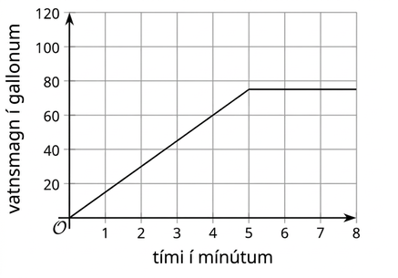
Cool Down
3
Notes:
Activity Images

Slide 33

Lesson Journey
Warm Up
Learning Activity
Cool Down
Lesson Synthesis
Learning Activity
Learning Activity
Practice

Slide 34

Practice
Put your hard work to action, practice what you’ve learned!
Notes:
Digital Practice: Access the practice pages at https://openstax.org/details/books/algebra-1

Slide 35

Lesson Journey
Warm Up
Learning Activity
Cool Down
Lesson Synthesis
Learning Activity
Learning Activity
Practice

Slide 36


Lesson Synthesis
In the situation that involved time as the output and number of barks as the input:
Is it possible that when the number of barks is 6, both 15 seconds and 16 seconds have passed?”
Can the time be a function of the number of barks? Why or why not?
In the situation that involved time as the output and the total distance the dog walked as the input:
Is it possible that when the dog has walked 27 feet, 50 seconds, 55 seconds, and 60 seconds have passed?”
Can the time be a function of the total distance walked? Why or why not?
Notes:
Prompt: Refer back to the situations in the last two activities. Discuss with students why, for each relationship to be a function, it makes sense for time to be the independent variable and the other quantity to be the dependent variable.
Answers:
Yes
No, because for any number of barks, more than one possible time could be the output.
Yes
No, because for any number of feet walked, many possible numbers of seconds could have passed.
If time permits, ask students to think of another example of a possible function in that situation (the number of times the dog was petted by a passerby as a function of time, for example), and to identify the input and output variables.

Slide 37
Self Assessment
How much do you agree with the following statements?
I can… | I can | Almost | Not yet
Explain when a relationship between two quantities is a function.
Identify independent and dependent variables in a function, and use words and graphs to represent the function.
Explain what descriptions and graphs of functions tell us about situations.

