Slide 1


Algebra 1
Unit 3 Two Variable Statistics
Lesson 3.2 Fitting Lines

Slide 2
How to use these slides
On the activity slides check the speaker notes for teacher support and instructional information.
Each lesson includes 1 warm up, 2-3 learning activities, a cool down, practice and a lesson synthesis.
  Learning activities are followed by a self check question, and review section.
Some slides have been hidden from student view, more information can be found on the next slide (Reference Key).
You can edit and use these slides for personal and classroom use, but cannot sell them and must keep the attribution logos.
For more information, Check out the digital quick start guide!

Slide 3






Reference Key
Check the top right corner for an icon referencing these unique sections.
 | Support for Students with Disability | Hidden | Learning Strategies slide, provides additional support to students for understanding the activity. Learning Strategies slide, provides additional support to students for understanding the activity.
 | Support for English Language Learners | Hidden
 | Extending Your Thinking | Hidden | Extending Your Thinking slide, provides an extra challenge for students.
 | Self Check | Not Hidden | Self Check slide, checkpoint to assess student understanding after the learning activity.
 | Review | Hidden | Self Check- Review slide, designed to help review topics from the self check question.
On the next slides, check the speaker notes for teacher instructions and support.
Notes:
Check the Speaker Notes: On the next slides you can find discussion questions, lesson information, answers to the activities, and ways to adjust the activity for your students!

Slide 4

Learning Goals
By the end of this lesson you will be able to -
Describe the rate of change and 𝑦-intercept for a linear model in everyday language.
Use technology to find the line of best fit.
Write linear models by hand from tables and graphs.
Notes:
Lesson Narrative
The purpose of this activity is for students to informally assess the fit of various lines to data, to use technology to find the line of best fit, and to interpret the slope and vertical intercept of the linear model. The work connects to previous work because students created scatter plots and created linear models for the data.
Required Preparation
Print and cut up slips for the card sort.
Prepare one copy of the blackline master for every group of 2 students.
The graphs will be used in activity 3.2.2. The tables will be used in activity 3.2.4.
To find best fit lines, students will need access to technology that will compute the least-squares regression lines for a set of data.
Acquire devices that can run Desmos (recommended) or other graphing technology. It is ideal if each student has their own device.
Required Materials
Graphing technology
Activity 3.2.2 & 3.2.4 card sort blackline masters
Coordinate grids
Texas Essential Knowledge and Skills
A1(A) apply mathematics to problems arising in everyday life, society, and the workplace.
A1(D) communicate mathematical ideas, reasoning, and their implications using multiple representations, including symbols, diagrams, graphs, and language as appropriate.
A1(G) display, explain, and justify mathematical ideas and arguments using precise mathematical language in written or oral communication.
A4(C) write, with and without technology, linear functions that provide a reasonable fit to data to estimate solutions and make predictions for real-world problems.

Slide 5
Vocabulary
Previous
Scatter plot
  Points on a graph demonstrating a relationship between two variables.
Slope
  The rate of change in 𝑦 over the change in 𝑥, or steepness of a line.
𝑦-intercept
  Point where the graph of a function crosses the 𝑦-axis.
New
Line of best fit
  Line on a graph that best approximates the equation of the points in a scatter plot.
Notes:
Lesson Vocabulary
To support student understanding of key vocabulary:
Introduce and review the vocabulary words students will see in this lesson.
Encourage students to notice how these words are used and to include them in their math discussions and explanations—both written and oral.
Use a word wall to reinforce vocabulary. Sample word wall cards are available here.
For newcomers or students with beginning English proficiency, use these Quizlet sets to support vocabulary learning:
Unit 3 Spanish Vocabulary – use first to build understanding
Unit 3 Vocabulary (English) – use after anchoring in Spanish
Support for English Language Learners
ELPS 2(F) listen to and derive meaning from a variety of media such as audiotape, video, DVD, and CD-ROM to build and reinforce concept and language attainment.
ELPS 3(B) expand and internalize initial English vocabulary by learning and using high-frequency English words necessary for identifying and describing people, places, and objects, by retelling simple stories and basic information represented or supported by pictures, and by learning and using routine language needed for classroom communication.
ELPS 3(F) ask and give information ranging from using a very limited bank of high-frequency, high-need, concrete vocabulary, including key words and expressions needed for basic communication in academic and social contexts, to using abstract and content-based vocabulary during extended speaking assignments.

Slide 6





Lesson Journey
Warm Up
Learning Activity
Cool Down
Lesson Synthesis
Learning Activity
Learning Activity
Practice

Slide 7

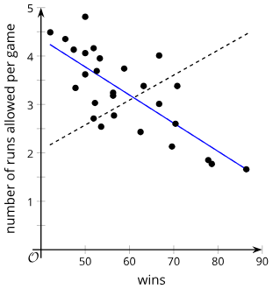
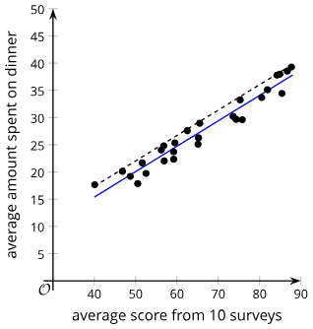
Warm Up - Which Line is Better? 🤔
Which of the lines is the better fit for the data in each scatter plot?
Be prepared to show your reasoning.
1. 2.
Notes:
Warm Up (5 minutes)
The mathematical purpose of this activity is for students to be able to visually assess the best line that fits data among a set of choices. The given lines address many common errors in student thinking about best fit lines, including: going through the most points, dividing the data in half, and connecting the points on both ends of the scatter plot.
Listen for students using the terms slope and 𝑦-intercept.
Launch
Provide students access to the images. Give students 2 minutes of quiet time to work on the questions.
Activity answers
The solid line is the better fit for the data since it goes through the middle of the data and follows the negative trend of the data.
The solid line is the better fit for the data since it goes through the middle of the data with approximately equal numbers of data points on either side of the line.
Additional activity questions, answers, and synthesis on the next slide.

Slide 8
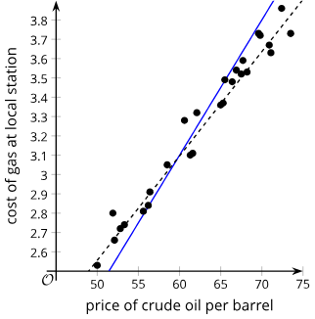
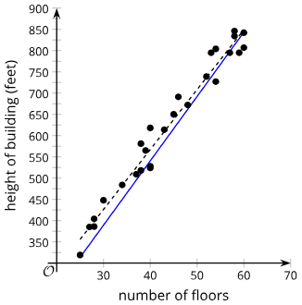
Warm Up - Which Line is Better? 🤔
Which of the lines is the better fit for the data in each scatter plot?
Be prepared to show your reasoning.
3. 4.
Notes:
Activity Answers
The dashed line is the better fit for the data since it goes through the middle of the data with a slope that follows the trend of the data. The solid line has a lot of points above the line to start and a lot of points below the line at the end.
The dashed line is the better fit for the data since it goes through the middle of the data, follows the trend of the data, and has a similar number of points on each side. The solid line fits the first and last point perfectly, but most of the data points are above the line.
Activity Synthesis
The purpose of this discussion is to understand bad fit, good fit, and best fit. In each scatter plot, the solid line represents the line of best fit—except for the last two graphs, for which the dashed line is the best fit.
Ask a student who uses the term slope while working the questions, “Can you explain the relationship between the two lines in the question about runs and wins using the concept of slope?”
The slope of the dashed line is positive, and the slope of the solid line is negative.
Ask a student who uses the term 𝑦-intercept, “Can you explain the significance of the 𝑦-intercept in the question about average survey scores and amount spent on dinner?”
The solid line will have a 𝑦-intercept less than the 𝑦-intercept for the dashed line. Because the two lines have approximately the same slope, they appear parallel in the scatter plot.
If time permits, discuss questions such as:
Is the dashed line in the question about runs and wins a bad fit, good fit, or best fit?
The line is a bad fit because it does not show the correct relationship between the variables. It shows that the value of 𝑦 increases as the value of 𝑥 increases, rather than the value of 𝑦 decreasing as the value of 𝑥 increases.
Is the dashed line in the question about oil and gas price a bad fit, good fit, or best fit?
It is the best fit because it is close to going through the middle of the data and follows the same trend as the data.
What factors helped you select the linear model that fits the data best?
The line should go through the middle of the data, follow the trend of the data, and have a similar number of points on each side of the line.

Slide 9

Lesson Journey
Warm Up
Learning Activity
Cool Down
Lesson Synthesis
Learning Activity
Learning Activity
Practice

Slide 10


Learning Strategies - Sorting Graphs ͏͏
Teacher Instruction: Use these strategies to adjust the activity to support English language learners and students with disabilities.
You can copy and paste the callouts directly on top of the activity or give the instructions aloud.
Take turns sorting the cards with your partner and explain your reasons
Use the following sentence stems:
“___ should be before ___ because … “
I noticed ___, so I … “
Discussion Supports
Fold a paper into thirds
Label columns “x,” “y,” and “linear model fits?”
Fill the first column with “increasing” for each card (graphs are read left to right)
Complete the second and third columns
Action and Expression
Notes:
Support for English Language Learners: MLR 8 Discussion Supports: Conversing
In pairs, ask students to take turns sorting the cards and explaining their reasoning to their partner. Display the following sentence frames for all to see: “ _____ should be before _____ because . . . ,” and “I noticed _____ , so I . . . .” Encourage students to challenge each other when they disagree. This will help students clarify their reasoning about linear models.
Design Principle(s): Support sense-making; Maximize meta-awareness
Support for Students with Disabilities: Action and Expression: Internalize Executive Functions
Provide students with a template for organizing their observations. Provide a template or invite students to fold a blank piece of paper in thirds and label with three headers of “𝑥,” “𝑦,” and “linear model fits?” to collect their answers. Explain that in the first column, they will always write “increasing” since they will be reading each graph from left to right. Then have them fill in the behavior of the 𝑦-values in the next column, and in the last column, their conclusions about whether a linear model fits well.
Supports accessibility for: Language; Organization

Slide 11
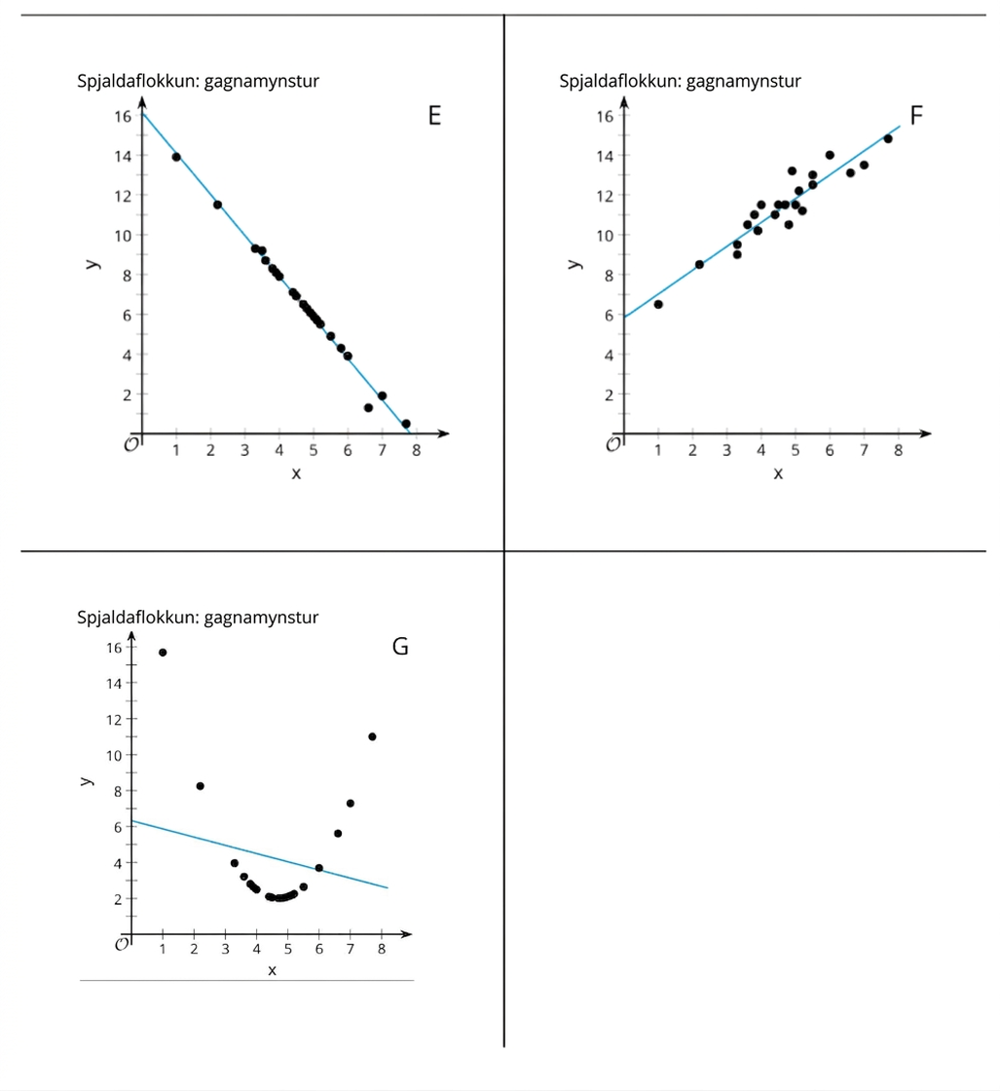
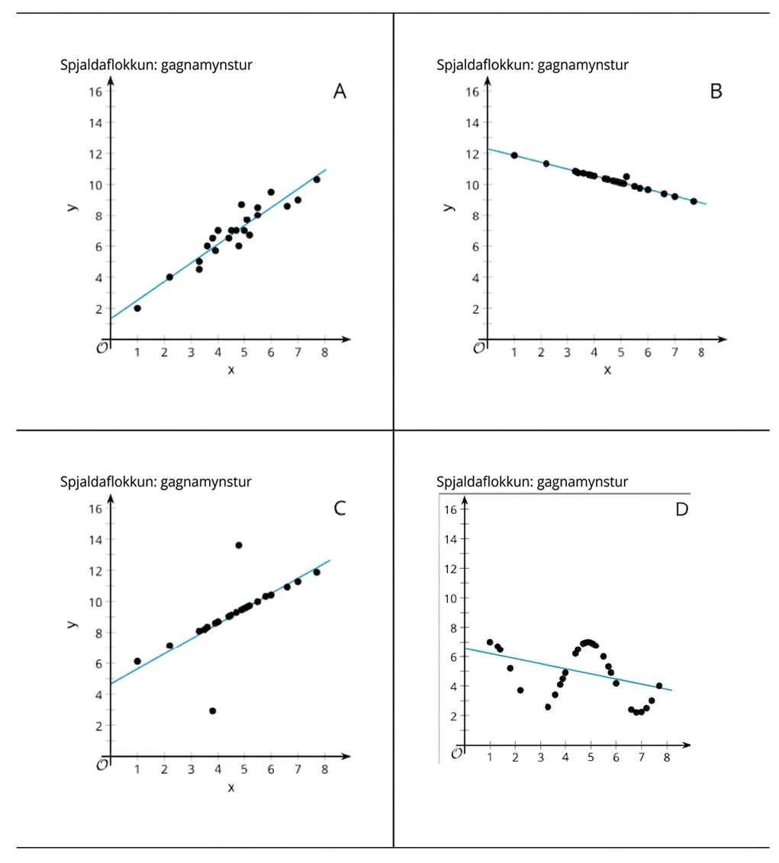
Learning Activity - Sorting Graphs
Arrange all the cards in three different ways. Ensure that you and your partner agree on each arrangement before moving on to the next one.
What is the order of the cards that displays the best to worst representations of a linear model?
What is the order of the cards that displays the least to greatest slope representations of a linear model that fits the data well?
What is the order of the cards that displays the least to greatest vertical intercept of a linear model that fits the data well?
Notes:
Support for All Learners
This activity offers additional support for students:
For English language learners and students with disabilities, be sure to review the Learning Strategies slide!
Activity (15 minutes)
The mathematical purpose of this activity is for students to:
Distinguish between linear and nonlinear relationships in bivariate, numerical data.
Informally assess the fit of a linear model.
Compare the slope and the vertical intercepts of different linear models.
Describe the relationship between two variables.
Give students the cards showing scatter plots and a linear model (pages 3 – 4 of the PDF). They sort the cards based on how well the lines fit the data as well as by slope and intercept in increasing order.
Launch
Arrange students in groups of 2. Give students a chance to familiarize themselves with what is on the cards. For example, you might ask them to sort the cards into categories of their choosing and explain their categories to their partner.
Answers
B, E, A, and F, C, D, and G. There may be some debate about the exact order. It is important that students recognize that B is the best fit, and that D and G should not be fit with linear models. They should be able to reason that linear models fit more poorly the farther the data are from the line.
E, B, A, and F, C, D and G do not have linear models that fit the data well.
A, C, F, B, E, D and G do not have linear models that fit the data well.
Activity questions continue on the next slide along with the activity synthesis.

Slide 12
Learning Activity - Sorting Graphs
The LINE OF BEST FIT follows the trend of the data.
It goes through the middle of the data
There are a similar number of points on each side of the line.
For each card, write a sentence that describes how 𝑦 changes as 𝑥 increases and whether the linear model is a good fit for the data.
Notes:
Activity Answer
Card A: As 𝑥 increases, 𝑦 also increases. The linear model fits the data fairly well.
Card B: As 𝑥 increases, 𝑦 decreases. The linear model fits the data very well.
Card C: As 𝑥 increases, 𝑦 increases. The linear model fits most of the data very well; however, there are two values that do not follow this trend.
Card D: As 𝑥 increases, 𝑦 goes up and down like a wave. The data do not follow the line very well at all.
Card E: As 𝑥 increases, 𝑦 decreases. Most of the data fit a linear model very well, but the one point at (7,15) does not fit with the rest of the data very well.
Card F: As 𝑥 increases, 𝑦 increases. The linear model fits the data fairly well.
Card G: As 𝑥 increases, 𝑦 decreases and then increases. The data do not follow the line very well at all.
Activity Synthesis
The purpose of this discussion is for students to discuss the goodness of fit for linear models. Here are some questions for discussion.
How are scatter plots of A and F the same? How are they different?
They have the same slope, and the linear models for each scatter plot are equally well fit. They are different because they have a different vertical intercept.
How do you know if a linear model is a good fit?
You need to look at the scatter plot and the line of best fit and make a decision about whether or not the data follow a linear trend.
Why is the goodness fit for the linear model in scatter plot B better than the fit for the linear model in scatter plot A?
The data in B fall on or very close to the linear model. The data in A are scattered around the line of best fit and have roughly the same number of values below that line of best fit as above the line of best fit.

Slide 13
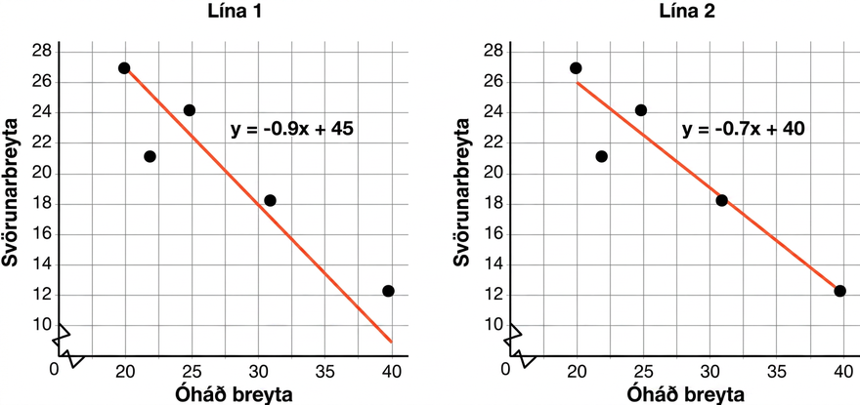
Self Check
Tell which line is the best fit for the data and give an explanation why it is the best fit.
Line 1 is the best fit because it touches the first point on the left of the scatter plot.
Line 2 is the best fit because it touches the last point on the right of the scatter plot.
Line 2 is the best fit because it goes through the middle of the data with about the same number of data points above and below the line.
Line 1 is the best fit because it has a steeper slope.
Let’s review!
Notes:
Answer Feedback - Individualized by Response
Incorrect. Where the line starts does not determine the line of best fit.
Incorrect. Where the line ends does not determine its fit.
That’s correct! Line 2 goes down the middle of the data and has almost the same number of points above and below the line.
Incorrect. The steepness of the slope does not determine the line of best fit.

Slide 14
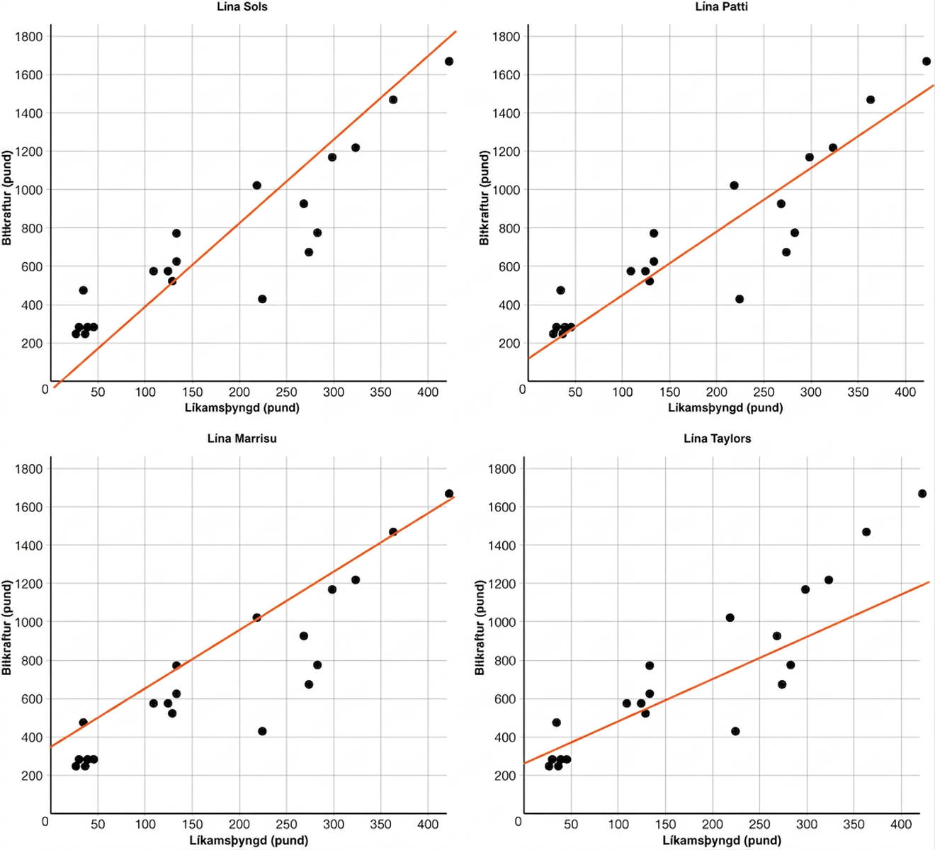
Self Check - Review
How to Draw a Best-Fit Line
for the Plotted Data
Make sure a linear model works for the data.
Place the line between the data points so that about the same number of points are above and below the line.
The scatter plots above are the same. Which line do you believe to be the best fit? Why?
Notes:
Answer
Patti’s line (upper right) looks like it fits the data well, so it would probably produce good predictions. The line goes through the middle of the points in the scatter plot, and the points are fairly close to the line.

Slide 15
Lesson Journey
Warm Up
Learning Activity
Cool Down
Lesson Synthesis
Learning Activity
Learning Activity
Practice

Slide 16


Learning Activity - Best Fit Lines
Number of months, t | 0 | 1 | 2 | 3
Number of songs, N | 200 | 215 | 230 | 245
Equation of a linear model
y = m𝑥 + b
The table above shows the number of songs Marcus will have in his collection as he adds new songs each month.
What is the initial amount of songs, or the 𝑦-intercept of this situation?
What is the slope, or rate of change?
Write the equation of the linear model that represents the situation in slope-intercept form.
How many songs will Marcus have in 8 months?
Notes:
Activity (10 minutes)
In the previous activity, students matched the line of best fit best modeled a scatter plot of data. Now, given data in a table or graph, students will find a linear model that represents the data without technology. They will use the data to review how to find the slope and 𝑦-intercept of an equation.
Launch
Arrange students in pairs and briefly review slope-intercept form and the meaning of the variables in the form.
Answers
200
15
N = 15t + 200
N = 15(8) + 200 = 320
Activity questions and answers continue on the next two slides.

Slide 17
Learning Activity - Best Fit Lines 🌳
A new plant food is introduced to a young tree to test its effect on the height of the tree. The table shows the height of the tree, H, in feet 𝑥 months since measurements began.
Number of months, x | 2 | 4 | 6 | 8
Height in feet, H | 13.5 | 14.5 | 15.5 | 16.5
What is the initial height of the tree, or the 𝑦-intercept, when measurements began?
What is the slope, or rate of change?
Write the equation of the linear model that represents the situation in slope-intercept form.
What will the height of the tree be in 14 months?
Notes:
If needed, provide students with the hint to work each row backwards to where 𝑥 = 0 for question 5.
Answers
12.5
½
H = ½ x + 12.5
H = ½(14) + 12.5 = 7 + 12.5 = 19.5

Slide 18
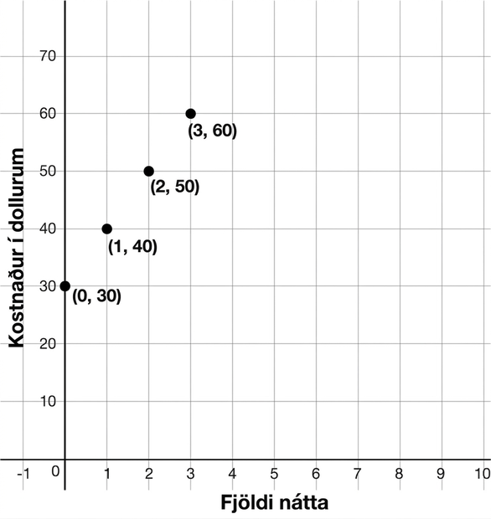
Learning Activity - Best Fit Lines ⛺
The graph models the cost in dollars, 𝐶, of renting a tent at a campground for n nights.
What is the 𝑦-intercept of the graph?
What is the slope, or rate of change?
Write the equation of the linear model that represents the situation in slope-intercept form.
How much does it cost to rent a tent for 5 nights?
Notes:
Answers
30
10
C = 10n + 30
C = 10(5) + 30 = 50 + 30 = 80

Slide 19
Self Check
The table below shows the revenue for the number of pizzas sold at a restaurant.
Which linear model could be used to predict the revenue if 4000 pizzas were sold?
𝑦 = 4000(10)
𝑦 = 80(4000)
𝑦 = 5(4000) + 10
𝑦 = ¹/₅(4000) + 10
Number of pizzas | 20 | 30 | 40 | 50
Revenue | 110 | 160 | 210 | 260
Let’s review!
Notes:
Answer Feedback - Individualized by Response
Incorrect. The change in y is 50 while the change in 𝑥 is 10 so the slope is 5. Working the table back to 0 will give a 𝑦-intercept of 10.
Incorrect. The change in y is 50 while the change in 𝑥 is 10 so the slope is 5. Working the table back to 0 will give a 𝑦-intercept of 10.
That’s correct! The change in y is 50 while the change in 𝑥 is 10 so the slope is 5. Working the table back to 0 will give a 𝑦-intercept of 10. Multiply this by 4000 to determine the revenue.
Incorrect. The change in y is 50 while the change in 𝑥 is 10 so the slope is 5.

Slide 20
Self Check - Review
WRITING LINEAR EQUATIONS FROM TABLES AND GRAPHS
Step 1 - Find the y-intercept.
Step 2 - Find the slope.
Step 3 - Write the equation in slope-intercept form,
y = mx + b.
Step 4 - Make a prediction using the equation.
The number of texts a teen sends, 𝑇, in days, 𝑑, is shown in the table below. Write an equation in slope-intercept form then predict the number of texts sent in 8 days.
Days, d | 1 | 2 | 3 | 4
Number of texts, T | 65 | 130 | 195 | 260
Step 1 - If we work backward, the y-intercept is 0.
Step 2 - The slope is 65 because the change in y is 65
and the change in 𝑥 is 1.
Step 3 - y = mx + b so y = 65x + 0.
Step 4 - y = 65x + 0 = 65(8) + 0 = 520.
Notes:
If another example is needed, use the following scenario and plot the given points on a coordinate plane.
The cost, C, for the number of days, 𝑑, a dog spends at doggie daycare is shown in a graph.
Points on the graph include: (1, 35), (2, 70), (3, 105), (4, 140)
Write an equation in slope-intercept form to represent the situation then predict the cost of a dog staying at doggie daycare after 7 days.
Step 1 - Find the 𝑦-intercept.
Since the value when 𝑑 = 0 is not present, work backwards to 𝑑 = 0. If 𝑑 = 0 was present, then 𝐶 = 0 since as each 𝑥-value increases by 1, the 𝑦-values increase by 35.
Step 2 - Find the slope of the situation.
The change in 𝑦 is 35 and the change in 𝑥 is 1, so the slope is 35.
Step 3 -Write the equation in slope-intercept form.
y = mx + b so y = 35x + 0.
Step 4 - Make a prediction.
y = 35x + 0 = y = 35(7) + 0 = 245.

Slide 21
Lesson Journey
Warm Up
Learning Activity
Cool Down
Lesson Synthesis
Learning Activity
Learning Activity
Practice

Slide 22
Learning Strategies - Calculate Best Fit Line
Walk around and find two other representations in the room.
Think about what’s the same and different about the representations.
Talk with your partner about what you noticed.
Compare and Connect
Teacher Instruction: Use these strategies to adjust the activity to support English language learners and students with disabilities.
  You can copy and paste the callouts directly on top of the activity or give the instructions aloud.
Enter the table into Desmos (use + table).
Describe the trend: “As x increases, y …”
Estimate the y-intercept.
Estimate the slope.
Calculate regression (use y₁ ~ mx₁ + b)
Engagement
Notes:
Support for English Language Learners: MLR 7 Compare and Connect: Representing, Conversing
As students share the connections they noticed between the scatter plot and the equation of the line of best fit, call students’ attention to the different ways the slope and vertical intercept are represented. Wherever possible, amplify student words and actions that describe the connections between a specific feature of one mathematical representation and a specific feature of another representation.
Design Principle(s): Maximize meta-awareness; Support sense-making
Learn more about this routine
View the instructional video and follow along with the materials to assist you with learning this routine.
Provide support for students
Distribute graphic organizers to the students to assist them with participating in this routine.
Support for Students with Disabilities: Engagement: Develop Effort and Persistence
Provide prompts, reminders, or checklists that focus on increasing the length of on-task orientation in the face of distractions. For example, provide two copies of the steps: graph the table, find the best fit line, find the slope, and find the 𝑦-intercept. Include phrases to activate knowledge from prior activities, such as, “As 𝑥 increases . . .”
Supports accessibility for: Organization; Conceptual processing; Attention

Slide 23
Learning Activity - Calculate Best Fit Line
The weight of ice cream sold at a small store in pounds (𝑥) and the average temperature outside in degrees Celsius (𝑦) are recorded in the table. Round all answers to the nearest hundredth.
Create a scatter plot and sketch a line that fits the data.
Use technology to compute the best fit line.
What is the value of the slope for the line of best fit?
What does this slope value mean in this situation?
What is the value of the 𝑦-intercept for the line of best fit?
What does this 𝑦-intercept value mean in this situation?
Use the best-fit line to predict the y-value when x is 10.
Is this a good estimate for the data? Be prepared to share your reasoning.
x | y
20 | 6
18 | 4.5
21 | 6.5
17 | 3.5
21.5 | 7.5
19.5 | 6.5
21 | 7
18 | 5
Notes:
Support for All Learners
This activity offers additional support and an extension for students:
For English language learners and students with disabilities, be sure to review the Learning Strategies slide!
For students looking for an extra challenge, be sure to review the Extending Your Thinking slide!
Activity (15 minutes)
The mathematical purpose of this activity is for students to use technology to compute a line of best fit for data given in a table and to understand the meaning of the slope and 𝑦-intercept. The discussion in the synthesis will prepare them for future activities when they use technology to find the line of best fit with technology and need to interpret the meaning of the slope and 𝑦-intercept for given scenarios.
Prompt students to access the directions for calculating regressions in the Using Desmos section of the Getting Started section of the book. Or, provide access to the PDF that contains instructions on how to use technology to find the equation of the best fit line.
Launch
Use the first 8 questions to familiarize students with the process of calculating linear regressions using Desmos. Then, after students complete the first 8 questions, return to the scatter plots from activity 3.2.2.
Provide data tables for the graphs for the cards from activity 3.2.2 that fit well with a linear model (Graphs A, B, C, E, and F).
Assign one table to each group. For students using the paper task, show them how to use technology to create a scatter plot of the data in a table.
After groups have had a chance to estimate the best fit lines, pause the class. Show students how to use technology to find the least-squares regression line for data and display the line with the scatter plot.
Answers
Graph of scatter plot and line of best fit can be viewed in the online textbook or accessing this Desmos graph.
Graph of scatter plot and line of best fit can be viewed in the online textbook or accessing this Desmos graph.
Slope = 0.78
This means that about 1 additional pound of ice cream is sold with every 0.78-degree increase in the outside temperature.
y-intercept = (0, – 9.44)
This means that no ice cream is sold when the temperature is about − 9.44 degrees Celsius.
About − 1.64 degrees Celsius.
This may be a good estimate for the data since the points seem close to the line, but something different might happen when the temperature gets below freezing, so it’s possible that when only 10 pounds of ice cream are sold, the relationship with the weather may be different.
Additional activity questions, answers, anticipated misconceptions, and synthesis on the next slide.

Slide 24
Learning Activity - Calculate Best Fit Line
You will be given a data table for one of the other scatter plots from a previous activity. Use technology and this table of data to create a scatter plot then determine the line of best fit.
Card A
Card B
Card C
Card E
Card F
Interpret the meaning of the value of the slope of the line of best fit for each card.
Are you ready for more?
Notes:
Answers
Lines of best fit
Card A: 𝑦 = 1.1979𝑥 + 1.3196
Card B: 𝑦 = − 0.4337𝑥 + 12.288
Card C: 𝑦 = 0.9749𝑥 + 4.6529
Card E: 𝑦 = − 2.063𝑥 + 16.144
Card F: 𝑦 = 1.1979𝑥 + 5.8196
Meanings of slope for each card
Card A: When 𝑥 is zero, 𝑦 is 1.3196. As 𝑥 increases by 1, 𝑦 increases, on average, by 1.1979.
Card B: When 𝑥 is zero, 𝑦 is 12.288. As 𝑥 increases by 1, 𝑦 decreases, on average, by 0.4337.
Card C: When 𝑥 is zero, 𝑦 is 4.6529. As 𝑥 increases by 1, 𝑦 increases, on average, by 0.9749.
Card E: When 𝑥 is zero, 𝑦 is 16.144. As 𝑥 increases by 1, 𝑦 decreases, on average, by 2.063.
Card F: When 𝑥 is zero, 𝑦 is 5.8196. As 𝑥 increases by 1, 𝑦 increases, on average, by 1.1979.
Anticipated Misconceptions
Students may struggle with interpreting slope and 𝑦-intercept. Remind students of how each relates to a situation.
To help students interpret slope, ask them: “What does the 𝑥 variable represent? What does the 𝑦 variable represent? How is slope connected to the 𝑥 and 𝑦 variables? What happens to 𝑥 as 𝑦 increases (or decreases)?”
To help students interpret the 𝑦-intercept, ask them: “What does the point (20,6) mean in the scatter plot? What are the coordinates of the 𝑦-intercept? What does each of the coordinates mean in the situation described? What is the 𝑦-value when 𝑥 is 0? Which variable has a value of 0? Which variable is represented with 𝑦?”
Activity Synthesis
The purpose of this discussion is for students to make connections between the scatter plot and the equation of the line of best fit. Display each scatter plot, the line of best fit, and the equation of the line of best fit (for cards A, B, C, E, and F). Here are some questions for discussion:
How does using technology help model the data in the scatter plot?
It allows different people to come up with the same equation for the line of best fit. If the line is just drawn by hand, there can be different linear equations that seem to fit the data well, but there is only one “best” fit line.
What does the 𝑦-intercept represent in each scatter plot? When is it reasonable to use this interpretation?
It represents the value of 𝑦 estimated by the linear model when 𝑥 = 0. When the intercept is near the range of the data, it can be reasonable to use this interpretation because otherwise, the linear trend may not continue. There are also some situations in which a value of 0 for 𝑥 does not make sense.
Why is the slope the same in scatter plot A and scatter plot F?
It is the same because the data in scatter plot F are the same data as in scatter plot A, except that the values for 𝑦 have all been increased by 4.5 units.
Remind students they should be careful when predicting values outside the range of the data—in particular, for the 𝑦-intercept. Even when the data are fit well by a linear model, the behavior of the variables farther away may not be linear. It is important to remember that all predictions using the best fit line are estimates and the reasonableness of the predictions should be considered.

Slide 25
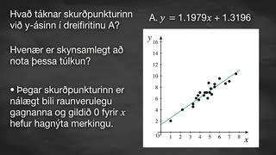
Video: Determining Lines of Best Fit

Slide 26
Extending Your Thinking 🚘
The table shows the distance, in miles,
Priya traveled during her last 10 trips
and the price of each trip, in dollars
when she used different ride services.
Priya creates a scatter plot of the data using the distance, 𝑥, and the price, 𝑦, using a linear model. Use technology to find the equation of a line of best fit.
Interpret the slope and the 𝑦-intercept of the equation of the best fit line in this situation.
Use the best fit line to estimate the cost of a 3.6-mile trip. Will this estimate be close to the actual value?
x | 3.1 | 4.2 | 5 | 3.5 | 2.5 | 1 | 0.8 | 1.6 | 4.3 | 3.3
y | 12.5 | 14.75 | 16 | 13.25 | 12 | 9 | 8.75 | 9.75 | 12 | 14
On her next trip, Priya tries a new ride service and travels 3.6 miles, but pays only $4.00 because she receives a discount. Include this trip in the table and calculate the equation of the line of best fit for the 11 trips. Did the slope of the equation of the line of best fit change? Why?
Priya uses the new ride service for her 12th trip. She travels 4.1 miles and is charged $24.75. How will the slope of the best fit line change when this trip is added to the data?
Notes:
Answers
𝑦 = 1.57𝑥 + 7.6
The slope means that the fare increases by $1.57 for each additional mile driven. The 𝑦-intercept means that the fee for getting in the car is approximately $7.60.
According to the line of best fit, the cost of a 3.6-mile trip is approximately $13.25, which is the same price as the 3.5-mile trip listed in the table.
The slope of the line decreased to $1.27 for each additional mile. It probably decreased because $4.00 is a far lower price per mile than any of her other trips because of the discount. This causes the slope, the increase in price for each additional mile, to decrease.
The slope of the line will probably increase because $24.75 is very expensive and will likely cause the cost for each additional mile to increase.

Slide 27
Self Check
Old Faithful is a geyser in Yellowstone National Park. The following table offers some rough estimates of the length of an eruption (in minutes) and the amount of water (in gallons) in that eruption.
Use technology to find an equation of the line of best fit. Round to the nearest hundredth.
𝑦 = 1151.19𝑥 + 1640.48
𝑦 = 800𝑥 + 2500
𝑦 = 1640.48𝑥 + 1151.19
𝑦 = − 1151.19𝑥 + 1640.48
Length (minutes) | 1.5 | 2 | 3 | 4.5
Amount of water (gallons) | 3,700 | 4,100 | 6,450 | 8,400
Let’s review!
Notes:
Answer Feedback - Individualized by Response
Incorrect. The slope of the line is the coefficient of 𝑥.
Incorrect. This was found using the first two points in the table. Use technology to enter the data from the table, and then find the linear regression line.
That’s correct! The slope of the line is the coefficient of 𝑥. The 𝑦-intercept would be below 3,700 with the linear trend.
Incorrect. The trend is increasing in the table, so the slope should be positive.

Slide 28
Self Check - Review 🐊
Scientists are interested in finding out how different species adapt to finding food sources. One group studied crocodilians to find out how their bite force was related to body mass and diet. The table displays the information they collected on body mass (in pounds) and bite force (in pounds).
Create a scatter plot that displays the data on body mass and bite force for the crocodilians in the study.
Using technology, find the line of best fit for the data.
What is the slope of the line of best fit and what does it represent? Does this value make sense?
What is the y-intercept of the line of best fit and what does it represent? Does this value make sense?
Notes:
NOTE: The data can be accessed in this Google sheet and displayed or a copy can be shared with students. Recall that students can copy and paste data from a spreadsheet into Desmos. A Desmos graph of this data can also be shared with students. The data can also be accessed in the Self Check for this lesson in the online textbook.
Answers
See graph in the online textbook or access this Desmos graph.
The line of best fit for the data is 𝑦 = 3.02𝑥 + 154.68.
The slope of the line of best fit is 3.02. This signifies that for every pound more the crocodile weighs, it has 3.02 more pounds of bite force. This value makes sense.
The 𝑦-intercept is 154.68, which doesn’t quite make sense for a crocodile that weighs 0 pounds but does give a minimum bite force to expect from a crocodile.

Slide 29

Lesson Journey
Warm Up
Learning Activity
Cool Down
Lesson Synthesis
Learning Activity
Learning Activity
Practice

Slide 30
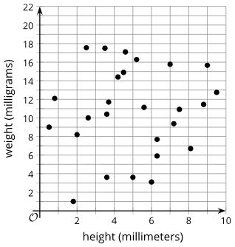
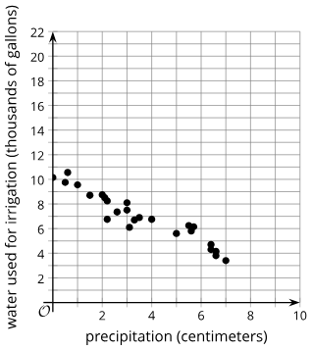
Cool Down
Which of these scatter plots shows data that would best be modeled with a linear function?
Be prepared to show your reasoning.
Graph A | Graph B
Notes:
Cool Down (5 minutes)
Answer
Graph B. Your answer may vary, but here is a sample. The points in scatter plot B seem to follow the shape of a line of best fit. The points in scatter plot in A are very spread out.
Question 2 of the Cool Down is displayed on the next slide.

Slide 31
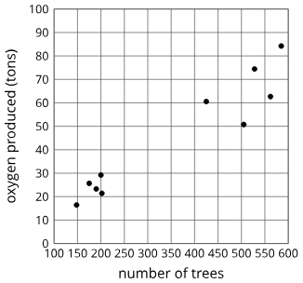
Cool Down
Number of trees in a forest | Tons of oxygen produced by the forest
148 | 16.43
175 | 25.64
190 | 23.28
200 | 29.2
202 | 21.41
425 | 60.56
505 | 50.75
528 | 74.45
562 | 62.66
585 | 84.24
Which of the following lines is most likely the line of best fit for the data provided in the table and graph?
𝑦 = − 0.51𝑥 + 225.12
𝑦 = 0.34𝑥 − 34.05
𝑦 = 0.13𝑥 − 0.19
𝑦 = 0.98𝑥 − 21.13
Notes:
Cool Down (5 minutes)
Answer
𝑦 = 0.13𝑥 − 0.19 (choice C)
Response to Student Thinking - Points to Emphasize
Unit 3 Project provides an additional opportunity to work with fitted lines.

Slide 32

Lesson Journey
Warm Up
Learning Activity
Cool Down
Lesson Synthesis
Learning Activity
Learning Activity
Practice

Slide 33

Practice
Put your hard work to action, practice what you’ve learned!
Notes:
Digital Practice: Access the practice pages at https://openstax.org/details/books/algebra-1

Slide 34

Lesson Journey
Warm Up
Learning Activity
Cool Down
Lesson Synthesis
Learning Activity
Learning Activity
Practice

Slide 35
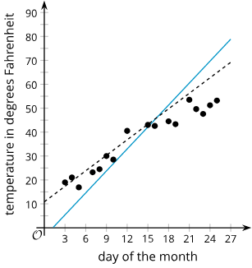
Lesson Synthesis
What is the best fit?
How do you know that you have a
line of best fit?
Examine the graph at right.
Which line fits the data better, the solid line
or the dashed line? Do you think it is the
line of best fit? Be prepared to
show your reasoning.
Notes:
Pose the provided questions for discussion with students.
Answers
The best linear model for the data
You can use technology to generate the line of best fit, but then you need to graph it on the scatter plot to verify that it fits the data well. It needs to follow the trend of the data, it should go roughly through the middle of the data, and it should have roughly the same number of data points on either side of it.
The dashed line fits the data better because its slope and vertical intercept more closely resemble the trend of the data than the slope and vertical intercept of the solid line. It is not the line of best fit because it does not go through the middle of the data. It should be a little lower on the graph.

Slide 36
Self Assessment
How much do you agree with the following statements?
I can… | I can | Almost | Not yet
Write linear models by hand from tables and graphs.
Describe the rate of change and 𝑦-intercept for a linear model in everyday language.
Use technology to find the line of best fit.
Notes:
Note: Lesson 3.3 on residuals is beyond the expectation of the TEKS and denoted as an optional lesson. Therefore, students may or may not understand the term, “residual,” based on coverage of that lesson. A lack of coverage for lesson 3.3 will not negatively impact student success for subsequent lessons.

