Slide 1
Algebra 1
Unit 8 Quadratic Equations
Lesson 8.5 How Many Solutions?

Slide 2

How to use these slides
On the activity slides check the speaker notes for teacher support and instructional information.
Each lesson includes 1 warm up, 2-3 learning activities, a cool down, practice and a lesson synthesis.
  Learning activities are followed by a self check question, and review section.
Some slides have been hidden from student view, more information can be found on the next slide (Reference Key).
You can edit and use these slides for personal and classroom use, but cannot sell them and must keep the attribution logos.
For more information, Check out the digital quick start guide!
OpenStax CC BY NC SA

Slide 3





Reference Key
Check the top right corner for an icon referencing these unique sections.
Icon | Title | View | Location and Description
n/a | Support for Students with Disability | Hidden | Learning Strategies slide, provides additional support to students for understanding the activity.
n/a | Support for English Language Learners | Hidden | Learning Strategies slide, provides additional support to students for understanding the activity.
n/a | Extending Your Thinking | Hidden | Extending Your Thinking slide, provides an extra challenge for students.
n/a | Self Check | Not Hidden | Self Check slide, checkpoint to assess student understanding after the learning activity.
n/a | Review | Hidden | Self Check - Review slide, designed to help review topics from the self check question.
On the next slides, check the speaker notes for teacher instructions and support.
Notes:
Check the Speaker Notes: On the next slides you can find discussion questions, lesson information, answers to the activities, and ways to adjust the activity for your students!

Slide 4

Learning Goals
By the end of this lesson you will be able to -
Explain why dividing by a variable to solve a quadratic equation is not a good strategy.
Explain why quadratic equations can have no solutions and explain why there are none.
Notes:
Lesson Narrative
The work in this lesson builds on the idea that both graphing and rewriting quadratic equations in the form of expression = 0 are useful strategies for solving equations. It also reinforces the ties between the zeros of a function and the horizontal intercepts of its graph, which students began exploring in an earlier unit.
Previously, to solve an equation such as −16𝑡² + 8𝑡 + 10 = 32 by graphing, students would graph 𝑦 = −16𝑡² + 8𝑡 + 10 and 𝑦 = 32 and inspect where the parabolic graph and the horizontal line intersect.
Here, students learn another way to use graphs to solve equations and to anticipate the number of solutions. Instead of graphing two separate equations—one quadratic and one linear—students learn that they can solve by rearranging the equation into the form expression = 0, graphing the equation 𝑦 = expression, and finding the horizontal intercepts. Why does this make sense?
The 𝑥-coordinate of those intercepts produces a 𝑦-coordinate of 0, so they are the solutions to the equation expression = 0.
The number of horizontal intercepts tells us the instances when the 𝑦-coordinate is 0, which tells us the number of solutions to the equation.
Later in the lesson, students think about why a quadratic equation that has an expression in factored form on one side of the equal sign but does not have 0 on the other side cannot be solved the same way as when the equation is expression = 0. They also notice that dividing each side of a quadratic equation by a variable is not reliable because it eliminates one of the solutions.
Required Preparation
Acquire devices that can run Desmos (recommended) or other graphing technology. It is ideal if each student has their own device.
Required Materials
Paper and pencil
Graphing technology
Texas Essential Knowledge and Skills
A1(C) select tools, including real objects, manipulatives, paper and pencil, and technology as appropriate, and techniques, including mental math, estimation, and number sense as appropriate, to solve problems
A1(D) communicate mathematical ideas, reasoning, and their implications using multiple representations, including symbols, diagrams, graphs, and language as appropriate
A8(A) solve quadratic equations having real solutions by factoring, taking square roots, completing the square, and applying the quadratic formula

Slide 5
Vocabulary
Previous
Quadratic Equation
  Polynomial equation of degree two.
Quadratic Function
  A function whose input is a quadratic expression, such as ax² + bx + c.
Factored form
  A quadratic equation in the form y = a(x – r₁)(x – r₂).
Zero product property
  If the product of factors is zero, then one or more of the factors equal zero.
Zero (of a function)
  A value of x where the function is 0.
Double Root
  A value that appears twice in the solution of an algebraic equation.
Notes:
Lesson Vocabulary
To support student understanding of key vocabulary:
Introduce and review the vocabulary words students will see in this lesson.
Encourage students to notice how these words are used and to include them in their math discussions and explanations—both written and oral.
Use a word wall to reinforce vocabulary. Sample word wall cards are available here.
For newcomers or students with beginning English proficiency, use these Quizlet sets to support vocabulary learning:
Unit 8 Spanish Vocabulary – use first to build understanding
Unit 8 Vocabulary (English) – use after anchoring in Spanish
Support for English Language Learners
ELPS 2(F) listen to and derive meaning from a variety of media such as audiotape, video, DVD, and CD-ROM to build and reinforce concept and language attainment
ELPS 3(B) expand and internalize initial English vocabulary by learning and using high-frequency English words necessary for identifying and describing people, places, and objects, by retelling simple stories
ELPS 3(E) share information in cooperative learning interactions
ELPS 3(F) ask and give information ranging from using a very limited bank of high-frequency, high-need, concrete vocabulary, including key words and expressions needed for basic communication in academic and social contexts, to using abstract and content-based vocabulary during extended

Slide 6

Lesson Journey
First Stop: Warm Up
Notes:
Alt text draft 1:
Image of six rectangles connected by dotted lines conveying the progression of the Lesson. Each rectangle has an icon with text.
The first rectangle is green with a yellow icon and text. The icon is a rocket and text reads Warm Up.
It is connected to the second rectangle, which is light gray with a dark gray icon and text. The icon is a clipboard with a checkmark and the text reads Learning Activity.
It is connected to the third rectangle, which is light gray with a dark gray icon and text. The icon is a clipboard with a checkmark and the text reads Learning Activity.
It is connected to the fourth rectangle, which is light gray with a dark gray icon and text. The icon is a three progressively smaller bar graph rectangles with an arrow on top, following the slope. The text reads Cool Down.
It is connected to the fifth rectangle, which is light gray with a dark gray icon and text. The icon is a pencil tip and the text reads Practice.
It is connected to the sixth rectangle, which is light gray with a dark gray icon and text. The icon is a four arrows pointing at a circle. The text reads Lesson Synthesis.

Slide 7

Warm Up
Is it true?🤷
Decide whether each statement is true or false.
3 is the only solution to 𝑥² − 9 = 0.
A solution to 𝑥² + 25 = 0 is –5.
𝑥(𝑥 − 7) = 0 has two solutions.
5 and –7 are the solutions to (𝑥 − 5)(𝑥 + 7) = 12.
Notes:
Warm Up (10 minutes)
This warm up reminds students of two facts: that to use the zero product property, the product of the factors must be 0, and that there is no number that can be squared to get a negative number. At this point, students don't yet know about complex numbers or that squaring a complex number produces a negative number. Consequently, for now we can just say that there is no number (with a silent "that you know about yet") that can be squared to get a negative number.
Launch
Display one problem at a time.
Give students quiet time to think individually for each problem and ask them to give a signal when they have an answer and an explanation.
Keep all problems displayed throughout the talk.
Follow with a whole-class discussion.
Answers
False. There are two solutions because there are two numbers that can be squared to get 9. Both 3 and –3 are possible solutions.
False. There is no solution to 𝑥²+25=0 because no real number can be squared to get –25.
True. There are two factors, 0 and 7, that could make the product of the expression 0.
False. The product of the two factors is not 0, so we cannot solve it using the zero product property (which gives 5 and –7 as solutions). If we evaluate the expression
(𝑥−5)(𝑥+7) at those two values, the result will be 0, not 12.
Anticipated Misconceptions
None
Activity Synthesis
Ask students to share their response and explanation for each problem. Record and display their responses for all to see. After each explanation, give the class a chance to agree or disagree. To involve more students in the conversation, consider asking:
"Who can restate _______'s reasoning in a different way?"
"Did anyone have the same strategy but would explain it differently?"
"Did anyone solve the problem in a different way?"
"Does anyone want to add on to _______'s strategy?"
"Do you agree or disagree? Why?"
Make sure students understand the rationale that makes each statement true or false, as shown in the student response.

Slide 8
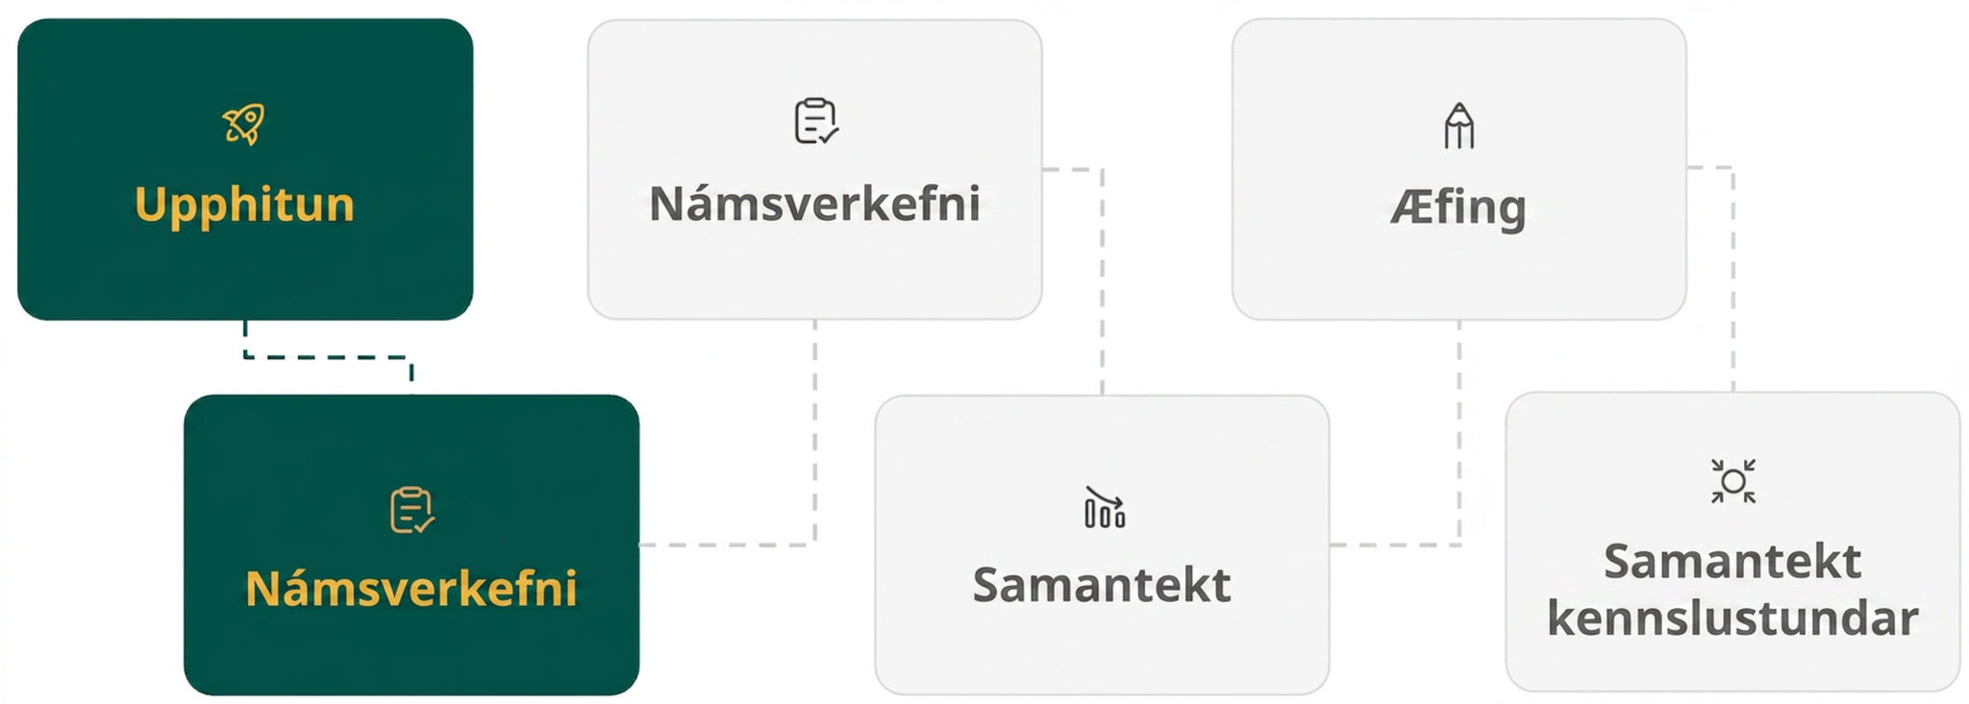
Lesson Journey
Second Stop: Learning Activity A

Slide 9

Learning Activity A | Learning Strategies
Just graph it! ✎📈
Teacher Instruction: Use these strategies to adjust the activity to support English language learners and students with disabilities.
You can copy and paste the callouts directly on top of the activity or give the instructions aloud.
Access the Desmos guide PDF for tips on solving problems with the Desmos graphing calculator.
Action and Expression
Notes:
Support for Students with Disabilities: Action and Expression: Provide Access for Physical Action
Support effective and efficient use of tools and assistive technologies. To use graphing technology, some students may benefit from a demonstration or access to step-by-step instructions.
Supports accessibility for: Organization; Memory; Attention

Slide 10
Learning Activity A | Part 1
Just graph it! ✎📈
Julio is solving three equations by graphing.
(𝑥 − 5)(𝑥 − 3) = 0
(𝑥 − 5)(𝑥 − 3) = −1
(𝑥 − 5)(𝑥 − 3) = −4
To solve the first equation, (𝑥 − 5)(𝑥 − 3) = 0, he graphed 𝑦 = (𝑥 − 5)(𝑥 − 3) and then looked for the 𝑥-intercepts of the graph.
Explain why the 𝑥-intercepts can be used to solve (𝑥 − 5)(𝑥 − 3) = 0.
Graph 𝑦 = (𝑥 − 5)(𝑥 − 3). What are the solutions?
Notes:
Support for All Learners
This activity offers additional support and an extension for students:
For students with disabilities, be sure to review the Learning Strategies slide!
For students looking for an extra challenge, be sure to review the Extending Your Thinking slide!
Activity (15 minutes)
In this activity, students encounter equations in which one side of the equal sign is not 0. To make one side equal 0 requires rearrangement. For example, to solve 𝑥(𝑥 + 6) = 8, the equation needs to be rearranged to 𝑥(𝑥 + 6) − 8 = 0. Yet because the expression on the left is no longer in factored form, the zero product property won't help after all, and another strategy is needed.
Launch
Arrange students in groups of two and provide access to graphing technology.
Give students a moment to think quietly about the first question.
Then ask them to briefly discuss their response with their partner before continuing with the rest of the activity.
Activity image answer, and synthesis on the next slide.

Slide 11
Learning Activity A | Part 2
Just graph it! ✎📈
To solve (𝑥 − 5)(𝑥 − 3) = −1, Julio rewrote it as (𝑥 − 5)(𝑥 − 3) + 1 = 0. He then graphed 𝑦 = (𝑥 − 5)(𝑥 − 3) + 1.
Graph 𝑦 = (𝑥 − 5)(𝑥 − 3) + 1. Use the graph to solve the equation.
Use Julio's strategy of graphing equations to solve (𝑥 − 5)(𝑥 − 3) = −4.
Why is it helpful to rearrange each equation to equal 0 on one side and then graph the expression on the non-zero side?
How many solutions does each of the three equations have?
Are you ready for more?
Notes:
Activity Answer
The solutions to (𝑥 − 5)(𝑥 − 3) = 0 are 𝑥-values that make the expression have a value of 0. At the 𝑥-intercepts, the 𝑦-value of the expression (𝑥 − 5)(𝑥 − 3) is 0, so the 𝑥-intercepts give the solutions.
The solutions are 𝑥 = 5 and 𝑥 = 3. DESMOS
DESMOS
There are no solutions for (𝑥 − 5)(𝑥 − 3) + 4 = 0. The graph has no 𝑥-intercept. DESMOS
When a quadratic expression is equal to 0 and we want to find the unknown values, we can think of it as finding the zeros of a quadratic function, or finding the 𝑥-intercepts of the graph of that function.
There are two solutions for the first equation, one solution for the second equation, and no solution for the last equation.
Anticipated Misconceptions
If students enter the equation (𝑥 − 5)(𝑥 − 3) = 0 into their graphing technology, they may see an error message, or they may see vertical lines. The lines will intersect the 𝑥 -axis at the solutions, but they are clearly not graphs of a quadratic function. Emphasize that we want to graph the function defined by 𝑦 = (𝑥 − 5)(𝑥 − 3) and use its 𝑥 -intercepts to find the solution to the related equation. All the points on the two vertical lines do represent solutions to the equation (because the points along each vertical line satisfy the equation regardless of the value chosen for 𝑦), but understanding this is beyond the expectations for students in this course.
Activity Synthesis
Invite students to share their responses, graphs, and explanations on how they used the graphs to solve the equations. Discuss questions such as:
"Are the original equation (𝑥−5)(𝑥−3)=−1 and the rewritten one (𝑥−5)(𝑥−3)+1=0 equivalent?" (Yes, the equations are equivalent. In that example, 1 is added to both sides of the original equation.)
"Why might it be helpful to rearrange the equation so that one side is an expression and the other side is 0?" (It allows us to find the zeros of the function defined by that expression. The zeros correspond to the 𝑥-intercepts of the graph.)
"What equation would you graph to solve this equation: (𝑥−4)(𝑥−6)=15?" ((𝑦=(𝑥−4)(𝑥−6)−15)
"What about (𝑥+3)2−1=5?" (𝑦=(𝑥+3)2−6)
Make sure students understand that some quadratic functions have two zeros, some have one zero, and some have no zeros, so their respective graphs will have two, one, or no horizontal intercepts, respectively.
Likewise, some quadratic equations have two solutions, some have one solution, and some have no real solutions. (Because students won't know about numbers that aren't real until a future course, for now it is sufficient to say "no solutions.")

Slide 12

Learning Activity A
Extending Your Thinking
Graph 𝑦 = (𝑥 − 3)(𝑥 − 5) and 𝑦 = −1 on the same coordinate plane.
How do the equations 𝑦 = (𝑥 − 3)(𝑥 − 5) and 𝑦 = −1 help solve the equation (𝑥 − 3)(𝑥 − 5) = −1?
Graph 𝑦 = (𝑥 − 3)(𝑥 − 5) and 𝑦 = 0 on the same coordinate plane.
How do the equations 𝑦 = (𝑥 − 3)(𝑥 − 5) and 𝑦 = 0 help solve the equation (𝑥 − 3)(𝑥 − 5) = 0? Desmos
Graph 𝑦 = (𝑥 − 3)(𝑥 − 5) and 𝑦 = 3 on the same coordinate plane.
How do the equations 𝑦 = (𝑥 − 3)(𝑥 − 5) and 𝑦 = 3 help solve the equation (𝑥 − 3)(𝑥 − 5) = 3? Desmos
Notes:
Go back to Lesson Activity
Answer
The solution to (𝑥−3)(𝑥−5)=−1 is the 𝑥-value of the intersection point of the two graphs of 𝑦=(𝑥−3)(𝑥−5) and 𝑦=−1. This solution is 4.
The solutions to (𝑥−3)(𝑥−5)=0 are the 𝑥-values of the intersection points of the two graphs of 𝑦=(𝑥−3)(𝑥−5) and 𝑦=0. These solutions are 3 and 5.
The solutions to (𝑥−3)(𝑥−5)=3 are the 𝑥-values of the intersection points of the two graphs of 𝑦=(𝑥−3)(𝑥−5) and 𝑦=3. These solutions are 2 and 6.
Additional questions and answers on the next slide.

Slide 13
Learning Activity A
Extending Your Thinking
Use the graphs you created in questions 1 – 3 to help you find a few other equations of the form (𝑥 − 3)(𝑥 − 5) = 𝑧 that have whole-number solutions.
Some of the values of 𝑧 that you might have found are –1, 0, 3, 8, 15, 24, etc. Find a pattern in the values of 𝑧 that give whole-number solutions.
Without solving, determine if (𝑥 − 5)(𝑥 − 3) = 120 and (𝑥 − 5)(𝑥 − 3) = 399 have whole-number solutions. Be prepared to show your reasoning.
Notes:
Go back to Lesson Activity
Answer
There are many different answers. For example: (𝑥 − 3)(𝑥 − 5) = 8, (𝑥 − 3)(𝑥 − 5) = 15, (𝑥 − 3)(𝑥 − 5) = 24
Starting at 𝑥=−1, add 1, then 3, then 5, and so on, to find the next 𝑥-value that yields whole-number solutions. Because the expressions 𝑥 − 3 and 𝑥 − 5 represent numbers whose difference is 2, the values of 𝑧 have the form −1⋅1, 0⋅2, 1⋅3, 2⋅4, and so on.
Both have whole-number solutions. The values of 𝑥 that produce whole-number solutions are all 1 less than a square number.

Slide 14
Learning Activity A
Self Check
Use graphing technology to determine the number of solutions for the equation (𝑥 + 3)(𝑥 − 6) = −22. Then find any solutions.
There is one solution. 𝑥 = 5.5
There are two solutions. 𝑥 = −6 or 𝑥 = 3
There are two solutions. 𝑥 = −3 or 𝑥 = 6
The equation has no solutions.
Let’s review!
Notes:
Answer Feedback - Individualized by Response
Incorrect. Look again at the graph of 𝑦 = (𝑥 + 3)(𝑥 − 6) + 22. There are no 𝑥-intercepts.
Incorrect. Look again at the graph of 𝑦 = (𝑥 + 3)(𝑥 − 6) + 22. There are no 𝑥-intercepts.
Incorrect. Look again at the graph of 𝑦 = (𝑥 + 3)(𝑥 − 6) + 22. There are no 𝑥-intercepts.
That’s correct! Check yourself: Look again at the graph of 𝑦 = (𝑥 + 3)(𝑥 − 6) + 22. There are no 𝑥-intercepts. This means there are no solutions.

Slide 15

Learning Activity A
Self Check - Review
Solve each equation by interpreting a graph.
(𝑥 − 4)(𝑥 − 7) = 0
(𝑥 − 4)(𝑥 − 7) = −2.25
(𝑥 − 4)(𝑥 − 7) = −5
Step 1 - Rearrange the equation to be in the form expression = 0.
Step 2 - Graph the equation y = expression.
Step 3 - Identify the 𝑥-intercepts from the graph.
Notes:
Remind Students
Remember, when a quadratic expression is equal to 0 and we want to find the unknown values, we can think of it as finding the zeros of a quadratic function, or finding the 𝑥-intercepts of the graph of that function.
Access the online textbook for the work that explains how to solve these examples.

Slide 16
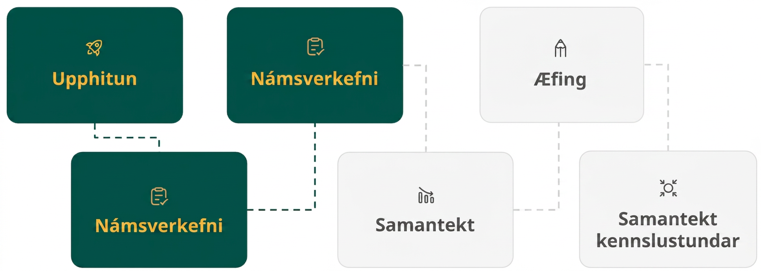
Lesson Journey
Third Stop: Learning Activity B

Slide 17
Learning Activity B | Learning Strategies
What’s the most effective strategy? ⏳
Teacher Instruction: Use these strategies to adjust the activity to support English language learners and students with disabilities.
  You can copy and paste the callouts directly on top of the activity or give the instructions aloud.
Select 4 questions from this activity and answer them completely.
Engagement
Notes:
Support for Students with Disabilities: Engagement: Provide Access by Recruiting Interest
Leverage choice around perceived challenge. Invite students to select four of the six equations to solve. Chunking this task into more manageable parts may also support students who benefit from additional processing time.
Supports accessibility for: Organization; Attention; Social-emotional skills

Slide 18
Learning Activity B | Part 1
What’s the most effective strategy? ⏳
Solve each equation. Be prepared to explain or show your reasoning.
𝑥² = 121
𝑥² − 31 = 5
(𝑥 − 4)(𝑥 − 4) = 0
(𝑥 + 3)(𝑥 − 1) = 5
(𝑥 + 1)² = −4
(𝑥 − 4)(𝑥 − 1) = 990
Notes:
Support for All Learners
This activity offers additional support for students:
For students with disabilities, be sure to review the Learning Strategies slide!
Activity (15 minutes)
This activity gives students an opportunity to practice solving quadratic equations and deciding on an effective strategy. Some equations can be easily solved by reasoning. Others would require solving by graphing because students have not yet learned the strategies to solve algebraically. Students who use graphing technology only when needed practice choosing tools strategically.
Launch
Give students continued access to technology.
Consider reminding students to try to use reasoning to solve the equations before using any of the other strategies from this lesson.
Answers
𝑥 = 11 and 𝑥 = −11
𝑥 = 6 and 𝑥 = −6
𝑥 = 4
𝑥 = -4 and 𝑥 = 2
No solution
𝑥 = 34 and 𝑥 = −29
Anticipated Misconceptions
None
Activity Synthesis
Select students to share their solutions and strategies. If not mentioned by students' explanations, highlight that:
The first three equations, as well as the equation (𝑥 + 1)² = −4, can be solved by reasoning, and graphing is not necessary.
The last three equations can be solved by graphing. There are two ways to do so, as shown in a previous activity.
One way is to graph each side of the equation separately: 𝑦 = expression on one side and 𝑦 = number on the other side.
Another way is to rearrange the equation such that it is in the form of expression = 0, graph 𝑦 = expression, and then find the 𝑥-intercepts.
The equation (𝑥 + 1)² = −4 states that some number squared is –4. Because no number can be squared to get a negative number, we can reason that there are no solutions. If this equation is solved by graphing 𝑦 = (𝑥 + 1)² + 4, the graph would show no 𝑥-intercepts. This also tells us that there are no solutions.

Slide 19
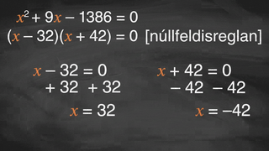
Learning Activity B | Video
Choosing an Effective Strategy to Solve Quadratic Equations
Notes:
This video discusses problems similar to questions 1-6 of activity 8.5.3. The examples in the video are different from those in the learning activity!

Slide 20

Learning Activity B
Self Check
Solve the equation using any method covered in the lesson.
(𝑥 − 6)(𝑥 + 5) = −30.25
No solutions
𝑥 = 0.5
𝑥 = 0.5 and 𝑥 = 1.5
𝑥 = 1.5
Let’s review!
Notes:
Answer Feedback - Individualized by Response
Incorrect. Graph the equation 𝑦=(𝑥−6)(𝑥+5)+30.25. There is one 𝑥-intercept at (0.5,0).
That's correct! Check yourself: This equation is best solved by graphing. Substitute 0.5 in for 𝑥 and check to see if the equation is true. (0.5−6)(0.5+5)=−30.25. Since the equation is true, 0.5 is correct.
Incorrect. Graph the equation 𝑦=(𝑥−6)(𝑥+5)+30.25. There is one 𝑥-intercept at (0.5,0).
Incorrect. Graph the equation 𝑦=(𝑥−6)(𝑥+5)+30.25. There is one 𝑥-intercept at (0.5,0).

Slide 21
Learning Activity B
Self Check - Review
Solve each equation using any method covered in the lesson.
(𝑥 + 1)² = 9
(𝑥 + 3)(2𝑥 + 7) = 0
(𝑥 + 2)(𝑥 − 1) = 4
Effective Strategies for Solving Quadratic Equations
Use the Square Root Property
Use the Zero Product Property
Interpret graphs
  Step 1 - Rearrange the equation to be in the form expression = 0.
  Step 2 - Graph the equation y = expression.
  Step 3 - Identify the 𝑥-intercepts from the graph.
Notes:
Remind Students
If possible, try to use reasoning before using any of the strategies covered in this lesson.
Access the online textbook for the work that explains how to solve these specific examples and for additional examples.

Slide 22
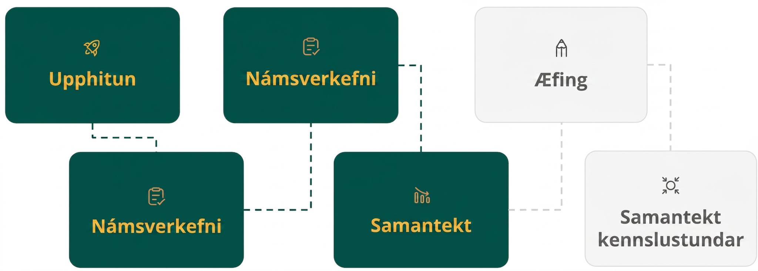
Lesson Journey
Fourth Step: Cool Down

Slide 23
Cool Down | Part 1
Cool Down
Consider (𝑥 − 5)(𝑥 + 1) = 7. Priya reasons that if this is true, then either 𝑥 − 5 = 7 or 𝑥 + 1 = 7. So, the solutions to the original equation are 12 and 6.
Do you agree? If not, where was the mistake in Priya's reasoning?
Consider 𝑥² − 10𝑥 = 0. Diego says that to solve we can just divide each side by 𝑥 to get 𝑥 − 10 = 0, so the solution is 10. Mai says, "I wrote the expression on the left in factored form, which gives 𝑥(𝑥 − 10)=0, and ended up with two solutions: 0 and 10."
Do you agree with either strategy? Be prepared to show your reasoning.
Notes:
Cool Down (10 minutes)
Keep students in groups of two and ask them to work quietly on the questions before discussing their responses with a partner.
Access the online Teacher’s Guide for information about a MLR available for this activity for emerging bilinguals.
Additional questions, answers, and Response to Student Thinking are on the next slide.

Slide 24
Cool Down | Part 2
Cool Down
Consider the equation 𝑥²=−16. Mona says that there are two solutions, 𝑥 = 4 or 𝑥 = −4.
Do you agree? If not, where was the mistake in Mona's reasoning?
Consider the equation (𝑥 − 3)(𝑥 − 3)=0. Dominic says that there are two solutions, 𝑥 = 3 or 𝑥 = −3.
Do you agree? If not, where was the mistake in Dominic's reasoning?
Notes:
Cool Down (10 minutes)
Answers
Disagree. Priya solved the equation using the reasoning we would use with the zero product property, but the zero product property only works if the product of two factors is 0. We can tell that 12 isn't a solution because (12−5)(12+1) is 91, not 7.
Agree with Mai's strategy. By substituting 0 for 𝑥 and then 10 for 𝑥, you can see that they are both solutions to the original equation. Diego's strategy of dividing by a variable eliminates one of the solutions, leaving only one solution.
Disagree. There are no numbers we can square to get a negative product. The equation has no solutions.
Disagree. Only 3 makes the equation true. The solution is 𝑥=3.
Response to Student Thinking - Points to Emphasize
For the first question, make sure students understand that the zero product property only works when the product of the factors is 0. While substituting 6 for 𝑥 in the expression does produce 7, substituting 12 does not give the same result.
For the second question, consider graphing the function 𝑦=𝑥2−10𝑥 so students can see that the graph intersects the 𝑥-axis at two points, which means that there are two 𝑥-values that give a zero output: 0 and 10. Rewriting 𝑥2−10𝑥 into the factored form, writing it to equal 0, and solving 𝑥(𝑥−10)=0 allow us to see that this is indeed the case.
Dividing each side by a variable (as Diego did) seems to enable us to isolate the remaining variable, but only one solution remains. Dividing each side of an equation by 𝑥 is not a valid move because when 𝑥 is 0, the expressions on each side become undefined.

Slide 25
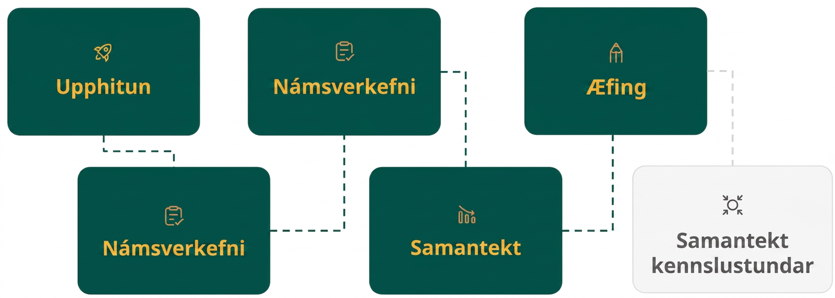
Lesson Journey
Fifth Stop: Practice

Slide 26

Practice
Put your hard work to action, practice what you’ve learned!
Notes:
Digital Practice: Access the practice pages at https://openstax.org/details/books/algebra-1

Slide 27
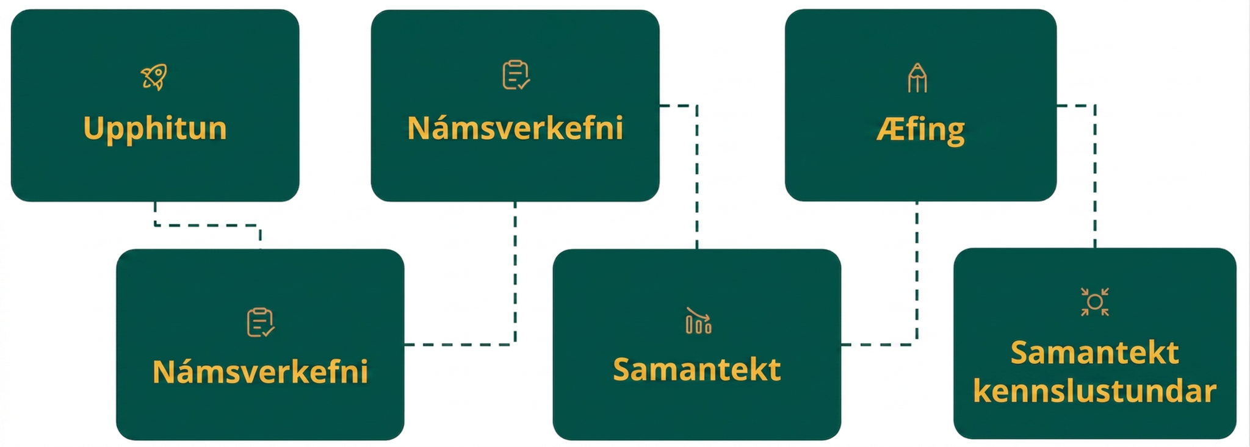
Lesson Journey
Sixth Stop: Lesson Synthesis

Slide 28
Lesson Synthesis
How would you solve the equation 𝑥(𝑥 − 250) = 0?
If you choose to solve by graphing, is it necessary to rearrange and rewrite the equation first? What equation would you graph, and how would you use the graph to solve the equation?
Can we use the zero product property to solve 𝑥(𝑥 − 250) = 100? Why or why not?
How would you solve 𝑥(𝑥 − 250) = 100?
How can the graph tell us how many solutions there are?
Notes:
Launch
Consider synthesizing the work in this lesson and connecting it to prior work by discussing these questions with students.
Answers to discussion questions
The simplest way would be to use the zero product property, which tells us that one of the factors must be 0, so 𝑥=0 and 𝑥=250.
No. We can just graph 𝑦=𝑥(𝑥−250) and look for the 𝑥-intercepts of the graph.
No, because the expression on the left does not equal 0.
We can rewrite the equation as 𝑥(𝑥−250)−100=0, graph 𝑦=𝑥(𝑥−250)−100, and see what the 𝑥-intercepts are.
The number of 𝑥-intercepts reveals the number of solutions.
Remind students that examining a graph is not a reliable way to get exact solutions to an equation. For example, the 𝑥-intercepts of the graph for 𝑦=𝑥(𝑥−250)−100 are (−0.399,0) and (250.399,0), and those 𝑥-coordinates are likely rounded results.
To solve equations exactly, we need to use algebraic means. In upcoming lessons, we'll learn more strategies for doing so.

Slide 29
Self Assessment
How much do you agree with the following statements?
Learning Goals | I can | Almost | Not yet
Explain why dividing by a variable to solve a quadratic equation is not a good strategy. | ⃞ | ⃞ | ⃞
Explain why quadratic equations can have no solutions and explain why there are none. | ⃞ | ⃞ | ⃞

