Slide 1


Algebra 1
Unit 5 Introduction to Exponential Functions
Lesson 5.10 Looking at Rates of Change

Slide 2
How to use these slides
On the activity slides check the speaker notes for teacher support and instructional information.
Each lesson includes 1 warm up, 2-3 learning activities, a cool down, practice and a lesson synthesis.
  Learning activities are followed by a self check question, and review section.
Some slides have been hidden from student view, more information can be found on the next slide (Reference Key).
You can edit and use these slides for personal and classroom use, but cannot sell them and must keep the attribution logos.
For more information, Check out the digital quick start guide!

Slide 3






Reference Key
Check the top right corner for an icon referencing these unique sections.
 | Support for Students with Disability | Hidden | Learning Strategies slide, provides additional support to students for understanding the activity. Learning Strategies slide, provides additional support to students for understanding the activity.
 | Support for English Language Learners | Hidden
 | Extending Your Thinking | Hidden | Extending Your Thinking slide, provides an extra challenge for students.
 | Self Check | Not Hidden | Self Check slide, checkpoint to assess student understanding after the learning activity.
 | Review | Hidden | Self Check- Review slide, designed to help review topics from the self check question.
On the next slides, check the speaker notes for teacher instructions and support.
Notes:
Check the Speaker Notes: On the next slides you can find discussion questions, lesson information, answers to the activities, and ways to adjust the activity for your students!

Slide 4

Learning Goals
By the end of this lesson you will be able to -
Calculate the average rate of change of a function over a specified period of time.
Recognize how the average rate of change of an exponential function differs from that of a linear function.
Notes:
Lesson Narrative
In this lesson, students revisit average rate of change and extend it to exponential functions. They calculate and compare average rates of change over different intervals to see that exponential growth and decay are not constant. Contexts such as coffee shop growth and solar cell costs help students reason abstractly and quantitatively.
Required Preparation
None
Required Materials
None
Texas Essential Knowledge and Skills
A1(A) apply mathematics to problems arising in everyday life, society, and the workplace
A1(D) communicate mathematical ideas, reasoning, and their implications using multiple representations, including symbols, diagrams, graphs, and language as appropriate
A1(G) display, explain, and justify mathematical ideas and arguments using precise mathematical language in written or oral communication
A3(B) calculate the rate of change of a linear function represented tabularly, graphically, or algebraically in context of mathematical and real-world problems
A9(C) write exponential functions in the form f(x)=ab^{x} (where b is a rational number) to describe problems arising from mathematical and real-world situations, including growth and decay
A9(E) write, using technology, exponential functions that provide a reasonable fit to data and make predictions for real-world problems

Slide 5
Vocabulary
Previous
Function
  A relation that takes inputs from one set and assigns them to outputs from another set, assigning exactly one output to each input.
Exponential growth
  a percent increase of the original amount over time.
Exponential decay
  a percent decrease of the original amount over time.
Average rate of change
  The change in the outputs divided by the change in the inputs. It is the slope of the line on the graph.
Slope
  The change in two dependent values of a linear function divided by the change in the corresponding two independent values. This can be thought of rise over run, the rate of change in 𝑦 over the change in 𝑥, or steepness of a line.
New
Exponential function
  A function that has a constant growth factor. Another way to say this is that it grows by equal factors over equal intervals.
Notes:
Lesson Vocabulary
To support student understanding of key vocabulary:
Introduce and review the vocabulary words students will see in this lesson.
Encourage students to notice how these words are used and to include them in their math discussions and explanations—both written and oral.
Use a word wall to reinforce vocabulary. Sample word wall cards are available here.
For newcomers or students with beginning English proficiency, use these Quizlet sets to support vocabulary learning:
Unit 5 Spanish Vocabulary – use first to build understanding
Unit 5 Vocabulary (English) – use after anchoring in Spanish
Support for English Language Learners
ELPS 2(F) listen to and derive meaning from a variety of media such as audiotape, video, DVD, and CD-ROM to build and reinforce concept and language attainment
ELPS 4(K) demonstrate English comprehension and expand reading skills by employing analytical skills such as evaluating written information and performing critical analyses commensurate with content area and grade-level needs
ELPS 5(B) write using newly acquired basic vocabulary and content-based grade-level vocabulary

Slide 6





Lesson Journey
Warm Up
Learning Activity
Practice
Learning Activity
Cool Down
Lesson Synthesis

Slide 7


Warm Up - Solar Energy☀️
t | p(t)
0 | 80
1 | 60
2 | 45
3 | 33.5
4 | 23.31
5 | 18.98
6 | 14.24
7 | 10.68
8 | 8.01
9 | 6.01
10 | 4.51
Let p be the function that gives the cost p(t), in dollars, of producing 1 watt of solar energy t years after 1977. The table shows the values of p from 1977 to 1987.
Which expression best represents the average rate of change in solar cost between 1977 and 1987?
p(10) - p(0)
p(10)
3.
4.
Notes:
Warm Up (5 minutes)
The purpose of this warm up is for students to recall how to calculate an average rate of change from two points.
Launch
Ask students to close books/devices and think of at least one notice and one wonder.
Display the table, give 1 minute quiet think time, then select 3–5 students to share.
Record and display responses; if not pointed out, ask: “Describe how the data are changing as t increases.” (p decreases at a slower rate.)
Ask students to reopen books/devices, complete the activity, and follow with whole-class discussion.
Activity Answers
Answer number 3. p(10) - p(0) / 10 - 0
Anticipated Misconceptions
Some students might confuse finding an average of the values in the table with finding an average rate of change. Help them see that average usually involves one unit, such as average number of cookies. Average rate of change involves comparing how one quantity changes when another quantity changes by 1, such as cost ($) per year.
Activity Synthesis
The goal of this discussion is for students to recall the meaning of average rate of change for a function and how it is calculated. Select students to describe what the value of each expression represents in this context.
For example, p(10) − p(0) is the difference in cost for a solar cell between 1977 and 1987, while p(10) / p(0) could be used to identify the percent change from 1977 to 1987.
An important takeaway for students is that the actual expression for the average rate of change, p(10) - p(0) / 10 - 0 ≈ −7.55 tells us that the price decreased by –$7.55 each year on average since the expression looks at the total difference in price between 1977 and 1987 divided by the total number of years that passed.

Slide 8

Lesson Journey
Warm Up
Learning Activity
Practice
Learning Activity
Cool Down
Lesson Synthesis

Slide 9
Learning Strategies - Coffee Shop Expansion☕
Teacher Instruction: Use these strategies to adjust the activity to support English language learners.
  You can copy and paste the callouts directly on top of the activity or give the instructions aloud.
In your own words, explain how the rate of change differs during each specified time period?
Referencing two points on the graph in your explanation.
How can you use the graph to determine which time period is represented best by the rate of change?
Discussion Supports
Notes:
Support for English Language Learners: MLR 8 Discussion Supports: Speaking, Representing
Use this routine to amplify mathematical uses of language to communicate how the rate of change differs during each specified time period. Encourage students to demonstrate mathematical thinking and problem solving by referencing two points on the graph in their explanation. Press for further detail by asking, “How can you use the graph to determine which time period is represented best by the rate of change?” This will help students understand how the rate of change differs in exponential functions through a whole-class discussion.
Design Principle(s): Support sense-making

Slide 10
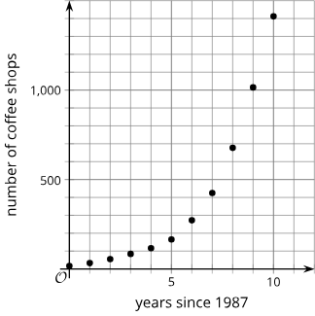
Learning Activity - Coffee Shop Expansion☕
Year | Number of Shops
1987 | 17
1988 | 33
1989 | 55
1990 | 84
1991 | 116
1992 | 165
1993 | 272
1994 | 425
1995 | 677
1996 | 1,015
1997 | 1,412
Notice, the shop growth was roughly exponential.
A Company’s total number of coffee shops, in their first 10 years. (1987–1997)
Find the average rate of change for each period of time. Show your reasoning.
  1987 to 1990
  1987 to 1993
  1987 to 1997
Notes:
Support for All Learners
This activity offers additional support for students:
For English language learners be sure to review the Learning Strategies slide!
Activity (20 minutes)
Earlier, students studied constant rates in linear functions.
Now, they explore average rates of change in exponential growth, noting how rates vary across intervals.
Next, they examine decay functions, revisiting familiar contexts.
Launch
Remind students that they previously studied constant rates of change in linear functions and explain that today’s focus is exponential growth, where rates vary.
Show the coffee shop growth table and scatter plot. Ask what they notice about how the number of shops changes over time.
Tell students they will calculate average rates of change over different intervals (3 years, 6 years, 10 years) and use these to describe how growth varied.
Ask students to keep in mind: How well do average rates of change describe exponential growth?
Activity answers, misconceptions, and synthesis on the next slide.

Slide 11

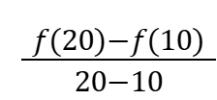
Learning Activity - Coffee Shop Expansion☕
Make some observations about the rates of change you calculated. What do these average rates tell us about how the company was growing during this time period?
Use the graph to support your answers to these questions. How well do the average rates of change describe the growth of the company in:
  the first 3 years?
  the first 6 years?
  the entire 10 years?
Let f be the function so that f(t) represents the number of stores t years since 1987. The value of f(20) is 15,011. Find and say what it tells us about the change in the number of stores.
Notes:
Activity Answer
Compare your work: Your answer may vary, but here is a sample for each day.
a. 22 ⅓ stores per year since (84−17) / (3−0) = 22 ⅓.
b. 42.5 stores per year since (272−17) / (6−0) = 42.5.
c. 139.5 stores per year since (1412−17) / (10−0) = 139.5.
For example: The average rate of change of the first 6 years is almost double that of the first 3 years. The average rate of change of the 10-year period is almost 7 times greater than that of the first 3 years and more than 3 times greater than the first 6 years. The company was growing at an increasing rate over the 10-year time period.
a. An average rate of change of 2213 is a fairly accurate prediction of growth over the first 3 years, but it is a poor prediction of growth much beyond 1992.
b. An average rate of change of 42.5 is an okay prediction of growth over the first 6 years, but it overestimates early on and greatly underestimates the growth in years after 1994.
c. An average rate of change of 139.5 does not accurately predict the actual growth of the company between 1987 and 1997.
For example: The average rate of growth from 1997 to 2007 is 1,359.9 stores per year. This is 60 times greater than the average rate of change over the first 3 years and almost 10 times greater than the average rate of change over the first 10 years of the time period. The number of stores continued to grow at an increasing rate from 1997 to 2007.
Anticipated Misconceptions
If students struggle with a rate of change that is not constant like the slope they saw in linear relationships, ask if they can draw a straight line connecting all the points on the graph in question 3. Spend time on the graph in the synthesis so the lines can help them see why the rate of change varies with an exponential function.
Activity Synthesis
For the third question, make sure students see that when they calculated the average rate of change for each of the three time periods, they were in effect finding the slope of the line that goes through two points that represent the starting year and the ending year. Display a graph like the one shown here to help illustrate this point:
Link to Desmos Graph: https://www.desmos.com/calculator/5ebwppmi5w
The line that connects the points for 1987 and 1990 fits the data for that period fairly well, so the slope of that line (the average rate of change between those two points) describes the growth in those three years fairly accurately. In contrast, the line that connects the points for 1987 and 1997 does not at all fit the data, so the slope of that line does not paint an accurate picture of how the company was growing that decade.
Here are some questions for discussion:
“Would the average rate of change between 1994 and 1997 accurately depict how the company was growing in the last three years in the data?” (Yes, because the average rate of change from 1994 to 1997 is 329 shops per year since (1412−425) / (10−7) = 329. The actual number of shops increased by 252, 338, and then 397 from 1994 to 1997, respectively.)
“Is there a single period of time where the average rate of change would accurately summarize how the company was growing from 1987 to 1997?” (No, since the number of shops is increasing at an increasing rate, an average of two values is not enough to summarize the growth of the company.)

Slide 12
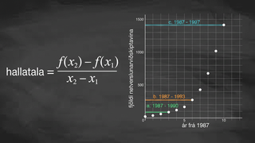
Video: Analyzing Average Rate of Change of an Exponential Function

Slide 13
Self Check
Suppose a population of cells starts at 500 and triples every day. The number of cells each day are calculated in the table on the right.
Find the average rate of change from day 0 to day 2.
1,000
4,500
2,000
-2,000
Number Of Days | Number Of Cells
0 | 500
1 | 1,500
2 | 4,500
3 | 13,500
Let’s review!
Notes:
Answer Feedback - Individualized by Response
Incorrect. This is the average rate of change from day 0 to day 1. The answer is 2,000.
Incorrect. This is the population at day 2, but it is not the rate of change from day 0 to day 2. The answer is 2,000.
That’s correct!: Find the difference between 4,500 and 500 and then divide by 2 days.
Incorrect. Make sure to align the corresponding values in the formula and watch the signs. The cell population is growing, not decaying. The answer is 2,000.

Slide 14
Self Check - Review
Let’s look at an exponential function we studied earlier. Let A(t) be the function that models the area A, in square yards, of algae covering a pond t weeks after beginning treatment to control the algae bloom.
The formula to calculate rate of change: (f(b) - f(a)) / (b - a).
What is the average rate of change of A from the start of treatment to week 2?
What is the average rate of change of A from week 2 to week 4.
t | A(t)
0 | 240
1 | 80
2 | 27
3 | 9
4 | 3
The table shows approximately how many square yards of algae remain during the first 5 weeks of treatment.
Notes:
Average Rate of Change from a Table
Answers
About –107 square yards per week. (f(2) - f(0)) / (2 - 0) = (27 - 240) / (2 - 0)
About –12 square yards per week. (f(4) - f(2)) / (4 - 2) = (3 - 27) / (4 -2)

Slide 15
Lesson Journey
Warm Up
Learning Activity
Practice
Learning Activity
Cool Down
Lesson Synthesis

Slide 16
Learning Strategies - More Solar Energy☀️
How can you display your calculations so another student can interpret them?
Use note or details to your graphs to help explain your thinking.
Fnd another person in the class who drew in similar lines on their graph or used the same points in calculations that you used.
Compare and Connect
Teacher Instruction: Use these strategies to adjust the activity to support English language learners and students with disabilities.
You can copy and paste the callouts directly on top of the activity or give the instructions aloud.
Use highlighters to color code each 5-year section a different color.
Representation
Notes:
Support for English Language Learners: MLR 7 Compare and Connect: Representing, Conversing
Ask students to prepare a visual display that shows their graph and mathematical thinking in response to Clare’s statement. Students should consider how to display their calculations so another student can interpret them. Some students may wish to add notes or details to their graphs or calculations to help communicate their thinking. When students find another person in the class who drew in similar lines on their graph or used the same points in calculations, provide 2 – 3 minutes of quiet time to think individually for students to read and interpret each other’s work. This will help students make connections between different representations of finding the average rate of change that produce similar results.
Design Principle(s): Cultivate conversation; Maximize meta-awareness
Learn more about this routine
View the instructional video and follow along with the materials to assist you with learning this routine.
Provide support for students
Distribute graphic organizers to the students to assist them with participating in this routine.
Support for Students with Disabilities: Representation: Internalize Comprehension
Demonstrate and encourage students to use color coding and annotations to highlight connections between representations in a problem. For example, students may use highlighters to color code each 5-year section a unique color.
Supports accessibility for: Visual-spatial processing

Slide 17
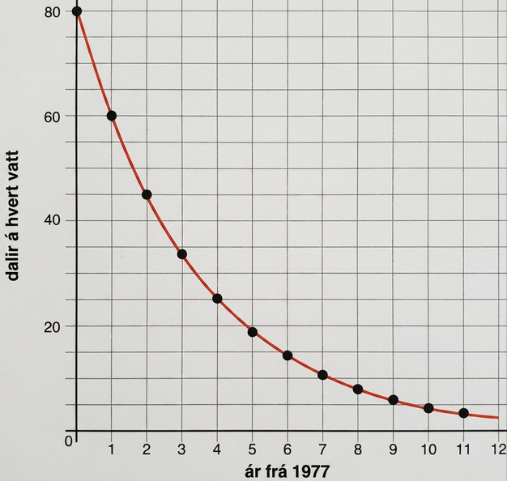
Learning Activity - More Solar Energy☀️
Here is a graph you saw in an earlier lesson. It represents the exponential function p, which models the cost p(t), in dollars, of producing 1 watt of solar energy from 1977 to 1988, where t is years since 1977.
Clare said, “In the first five years, between 1977 and 1982, the cost fell by about $12 per year. But in the second five years, between 1983 and 1988, the cost fell only by about $2 a year.” Show that Clare is correct.
Notes:
Support for All Learners
This activity offers additional support and an extension for students:
For English language learners and students with disabilities, be sure to review the Learning Strategies slide!
For students looking for an extra challenge, be sure to review the Extending Your Thinking slide!
Activity (10 minutes)
This activity reinforces students’ understanding about what makes a relationship between two variables a function, namely, that it gives a unique output for each input. It also prompts students to use function notation to express a functional relationship that does not involve numerical values for its input and output.
Launch
Keep students in pairs.
Have them take turns explaining each statement in the first question.
Partners should listen and discuss any disagreements until they agree.
Then, each student sketches their own graph based on their shared interpretation.
Answers
p(5) − p(0) / 5−0 ≈ −12.2; p(11) − p(6) / 11−6 ≈ −2.17
More activity questions, answers, and synthesis on the next slide.

Slide 18
Learning Activity - More Solar Energy☀️
If the trend continues, will the average decrease in price be more or less than $2 per year between 1987 and 1992? Be prepared to show your reasoning.
Are you ready for more?
Notes:
Answers
From the first 5 years to the next 5 years, the rate of decrease slowed down, so if the trend continues, the decrease in price from 1987 to 1992 should be less than $2 per year.
Activity Synthesis
Select previously identified students to share their graphs and why they drew in the lines along with their interpretation of the meaning in the context of the problem.
Invite other students who made slightly different calculations to share their reasoning, reminding students that, since everyone is making an estimate from the graph, answers are not likely to be identical, but they should be very close.
Conclude the discussion by selecting students to explain their reasoning about the last problem using their understanding of exponential functions.

Slide 19
Extending Your Thinking
Suppose the cost of producing 1 watt of solar energy had instead decreased by $12.20 each year between 1977 and 1982. Compute what the costs would be each year and plot them on a graph. Compare your graph to the graph from the beginning of the 5.10.3 activity (top of page).
How do these alternate costs compare to the actual costs shown?
This is the original graph from the beginning of the 5.10.3.activity.
Notes:
Answer
Link to Desmos graph: https://www.desmos.com/calculator/nspasobhtx
For example: The alternate costs with the constant decrease would be the same in 1977 and 1982 and higher for each year in between.

Slide 20
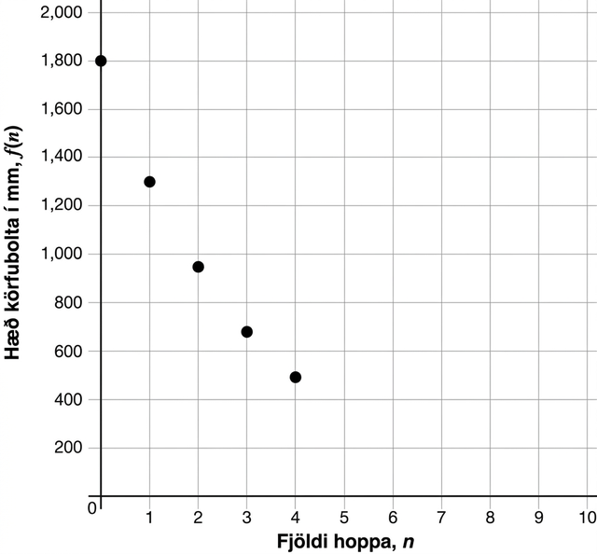
Self Check
The graph below shows the bounce height of a basketball at each bounce
What is the approximate average rate of change from the first bounce to the third bounce?
-600
600
-300
300
Let’s review!
Notes:
Answer Feedback - Individualized by Response
Incorrect. Remember to divide the change in y by 2. The answer is –300.
Incorrect. Watch the signs when finding rate of change. Notice the values are decreasing, so the rate of change should be negative. Remember to divide the change in y by 2. The answer is –300.
That’s correct! The difference in heights is 700−1300. Divide this by 2.
Incorrect. Watch the signs when calculating. Notice the values are decreasing. The average rate of change is negative. The answer is –300.

Slide 21
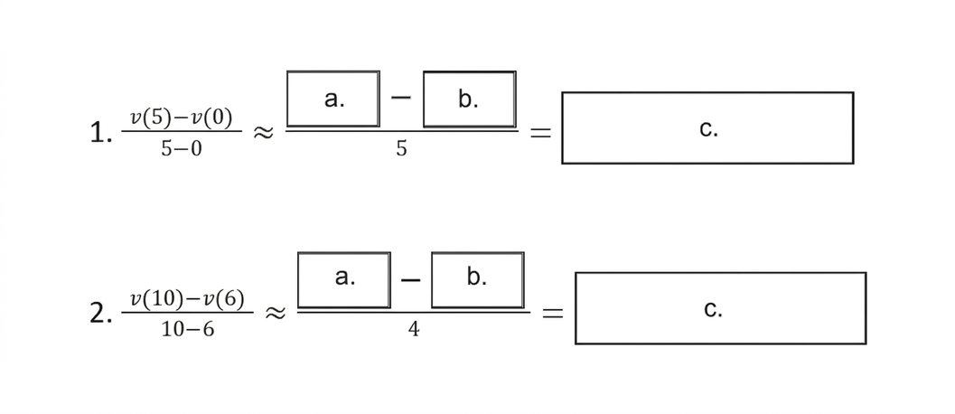
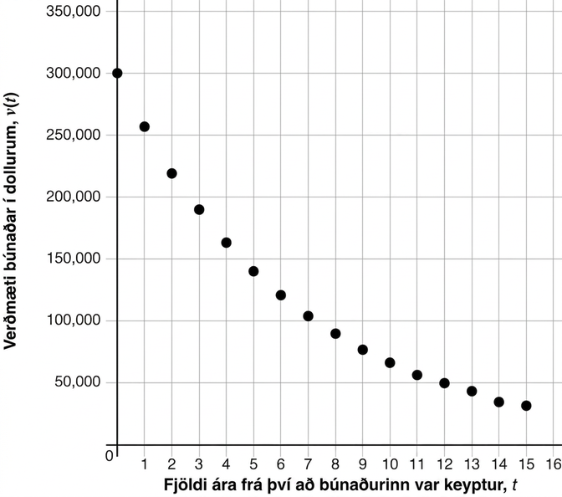
Self Check - Review
A construction company purchased some equipment costing $300,000. The equipment depreciates in value over time.
Approximately how much did the value drop from years 0 to 5 compared to years 6 to 10?
Notes:
Trends in Average Rates of Change
Discuss the Answers with the Students:
a. 140,000
b. 300,000
c. -32,000
a. 70,000
b. 120,000
c. -12,500
Following this trend, we would expect the average rate of change of the value of the equipment from years 11 – 15 to be below –12,500 dollars per year.

Slide 22

Lesson Journey
Warm Up
Learning Activity
Practice
Learning Activity
Cool Down
Lesson Synthesis

Slide 23
Cool Down
Here is the function f for Clare’s moldy bread that you saw earlier.
What is the average rate of change for the mold over the 6 days?
How well does the average rate of change describe how the mold changes for these 6 days?
How could the average rate of change be more accurate?
𝑑, time since mold spotting (days) | 𝑓(𝑑), area covered by mold (square millimeters)
0 | 1
1 | 2
2 | 4
3 | 8
4 | 16
5 | 32
6 | 64
Notes:
Cool Down (5 minutes)
Answers
10.5 square millimeters per day: ( f(6) - f(0) ) / (6 - 0) = 10.5
The average rate of change does not accurately describe how the mold changes over the 6-day period. The first day it only grows by 1 square millimeter, while on the fifth day it grows by 32 square millimeters.
The domain used to find the average rate of change could be smaller. The average rate of change of different intervals could be compared
Response to Student Thinking - More Chances
Students will have more opportunities to understand the mathematical ideas in this cool-down, so there is no need to slow down or add additional work to the next lessons. Instead, use the results of this cool-down to provide guidance for what to look for and emphasize over the next several lessons to support students in advancing their current understanding.

Slide 24

Lesson Journey
Warm Up
Learning Activity
Practice
Learning Activity
Cool Down
Lesson Synthesis

Slide 25

Practice
Put your hard work to action, practice what you’ve learned!
Notes:
Digital Practice: Access the practice pages at https://openstax.org/k12/algebra

Slide 26

Lesson Journey
Warm Up
Learning Activity
Practice
Learning Activity
Cool Down
Lesson Synthesis

Slide 27
Lesson Synthesis
The tables shows the value, in dollars, of a laptop originally purchased for $1,500 and losing 35 of its value every year after purchase.
Answer the following:
About how much was the average rate of change for the 5-year period?
Does the average rate of change accurately describe how the value of the laptop changes over the 5 years?
Are there some years where the average rate of change shows how the value of the laptop is changing?
years since purchase | value in dollars
0 | 1,500
1 | 600
2 | 240
3 | 96
4 | 38.4
5 | 15.36
Notes:
Answers
Almost $300 per year
No, it loses almost $1,000 in value the first year and very little from the third year to the fifth.
Yes; from year 1 to year 2, it is a reasonable estimate.

Slide 28
Self Assessment
How much do you agree with the following statements?
I can… | I can | Almost | Not yet
Calculate the average rate of change of a function over a specified period of time.
Recognize how the average rate of change of an exponential function differs from that of a linear function.

