Slide 1


Algebra 1
Unit 7 Introduction to Quadratic Functions
Lesson 7.6 Building Quadratic Functions to Describe Situations, Part 2
Notes:
How to Get Started
Review Slide 2: How to use these slides
Check out the digital quick start guide!
Review Slide 3: Reference Key of Icons

Slide 2
How to use these slides
On the activity slides check the speaker notes for teacher support and instructional information.
Each lesson includes 1 warm up, 2-3 learning activities, a cool down, practice and a lesson synthesis.
  Learning activities are followed by a self check question, and review section.
Some slides have been hidden from student view, more information can be found on the next slide (Reference Key).
You can edit and use these slides for personal and classroom use, but cannot sell them and must keep the attribution logos.
For more information, Check out the digital quick start guide!

Slide 3






Reference Key
Check the top right corner for an icon referencing these unique sections.
 | Support for Students with Disability | Hidden | Learning Strategies slide, provides additional support to students for understanding the activity. Learning Strategies slide, provides additional support to students for understanding the activity.
 | Support for English Language Learners | Hidden
 | Extending Your Thinking | Hidden | Extending Your Thinking slide, provides an extra challenge for students.
 | Self Check | Not Hidden | Self Check slide, checkpoint to assess student understanding after the learning activity.
 | Review | Hidden | Self Check- Review slide, designed to help review topics from the self check question.
On the next slides, check the speaker notes for teacher instructions and support.
Notes:
Check the Speaker Notes: On the next slides you can find discussion questions, lesson information, answers to the activities, and ways to adjust the activity for your students!

Slide 4

Learning Goals
By the end of this lesson you will be able to -
Create quadratic functions and graphs that represent a situation.
Relate the vertex of a graph and the zeros of a function to a situation.
Know that the domain of a function can depend on the situation it represents.
Notes:
Lesson Narrative
In this lesson, students extend their understanding of falling objects to model projectile motion with quadratic functions. They explore zeros, vertices, and appropriate domains. Starting with a linear model for upward motion, they adjust it for gravity, discovering that adding a squared term creates the curved path of a quadratic function.
Required Preparation
Acquire devices that can run Desmos (recommended) or other graphing technology. It is ideal if each student has their own device.
Required Materials
Graphing technology
Texas Essential Knowledge and Skills
A1(A) apply mathematics to problems arising in everyday life, society, and the workplace
A1(F) analyze mathematical relationships to connect and communicate mathematical ideas
A6(A) determine the domain and range of quadratic functions and represent the domain and range using inequalities
A7(A) graph quadratic functions on the coordinate plane and use the graph to identify key attributes, if possible, including x-intercept, y-intercept, zeros, maximum value, minimum values, vertex, and the equation of the axis of symmetry

Slide 5
Vocabulary
Term
  A number, a variable, or their product in an expression.
Zero (of a function)
  An input where f(x)=0; on the graph, it’s the point where the curve crosses the x-axis.
New
Parabola
  All points in a plane that are the same distance from a fixed point and a fixed line. The curved shape of the graph of a quadratic function.
Vertex (of a graph)
  On a parabola, it is the point where the graph changes from increasing to decreasing or vice versa. It is the highest or lowest point on the graph.
Initial Velocity
  The velocity of an object at the time interval 𝑡 = 0.
Previous
Constant
  In an expression like (5𝑥 + 2), it is the number 2 because it doesn't change when the 𝑥-value changes.
Equation
  A mathematical statement that demonstrates that two numbers, expressions, or other objects are equal.
Expression
  The sum of products of numbers and variables. The variables can be raised to different powers.
Functions
  A relation that takes inputs from one set and assigns them to outputs from another set, assigning exactly one output to each input.
Quadratic Function
  A function where the output is given by a quadratic expression in the input. 𝑓(𝑥) = 𝑎𝑥² + 𝑏𝑥 + 𝑐.
Notes:
Lesson Vocabulary
To support student understanding of key vocabulary:
Introduce and review the vocabulary words students will see in this lesson.
Encourage students to notice how these words are used and to include them in their math discussions and explanations—both written and oral.
Use a word wall to reinforce vocabulary. Sample word wall cards are available here.
For newcomers or students with beginning English proficiency, use these Quizlet sets to support vocabulary learning:
Unit 7 Spanish Vocabulary – use first to build understanding
Unit 7 Vocabulary (English) – use after anchoring in Spanish
Support for English Language Learners
ELPS 2(E) use visual, contextual, and linguistic support to enhance and confirm understanding of increasingly complex and elaborated spoken language
ELPS 2(F) listen to and derive meaning from a variety of media such as audio tape, video, DVD, and CD- ROM to build and reinforce concept and language attainment
ELPS 3(D) speak using grade-level content area vocabulary in context to internalize new English words and build academic language proficiency
ELPS 3(E) share information in cooperative learning interactions
ELPS 3(F) ask and give information ranging from using a very limited bank of high-frequency, high- need, concrete vocabulary, including key words and expressions needed for basic communication in academic and social contexts,to using abstract and content-based vocabulary during extended speaking assignments;
ELPS 4(F) use visual and contextual support and support from peers and teachers to read grade- appropriate content area text, enhance and confirm understanding, and develop vocabulary, grasp of language structures, and background knowledge needed to comprehend increasingly challenging language

Slide 6





Lesson Journey
Warm Up
Learning Activity
Practice
Learning Activity
Cool Down
Lesson Synthesis

Slide 7
Warm Up - Launch a Cannonball 🟣
A cannon is 10 feet off the ground. It launches a cannonball straight up with a velocity of 406 feet per second. Imagine that there is no gravity and that the cannonball continues to travel upward with the same velocity.
Fill in the table (questions a - f) of how far above the ground the cannonball is at each second.
Write an equation to model the distance in feet, d, of the ball t seconds after it was fired from the cannon, if there was no gravity.
Seconds | Distance Above Ground (Feet)
0 | 10
1 | a.___
2 | b.___
3 | c.___
4 | d.___
5 | e.___
t | f.___
Notes:
Warm Up (5 minutes)
In this warm-up, students imagine an object moving upward at a constant speed, modeled by a linear function. This prepares them to explore a more realistic quadratic model with gravity in the next activity. Using a spreadsheet helps students practice choosing tools strategically.
Launch
Ask a student to read the opening paragraph of the activity aloud.
To help students visualize the situation described, consider sketching a picture of a cannon pointing straight up, 10 feet above the ground.
Ask students to consider what a speed of 406 feet per second means in more concrete terms. How fast is that?
Students may be more familiar with miles per hour. Tell students that the speed of 406 feet per second is about 277 miles per hour.
Consider arranging students in groups of two so they can divide up the calculations needed to complete the table. Provide access to calculators, if requested..
Activity Answers
a. 416
b. 822
c. 1228
d. 1634
e. 2040
f. 10 + 406t
Activity Synthesis
Ask students how the values in the table are changing and what equation would describe the height of the cannonball if there were no gravity. Even without graphing, students should notice that the height of the cannonball over time is a linear function, given the repeated addition of 406 feet every time t increases by 1.
Tell students that, in the next activity, they will look at some actual heights of the cannonball.

Slide 8

Lesson Journey
Warm Up
Learning Activity
Practice
Learning Activity
Cool Down
Lesson Synthesis

Slide 9
Learning Strategies - Constant Rate or Not? 👍👎
Share your observations about the tables and graphs.
Restate your ideas using precise mathematical language.
Listen as classmates share their reasoning.
Repeat key phrases to help you practice using mathematical language and understand others’ ideas.
Discussion Supports
Teacher Instruction: Use these strategies to adjust the activity to support English language learners and students with disabilities.
  You can copy and paste the callouts directly on top of the activity or give the instructions aloud.
Use color-coding and notes to show connections between different representations.
Highlight the actual height value in one color.
Highlight the other data values in another color.
Compare the two colors to see how the values differ.
Representation
Notes:
Support for English Language Learners: MLR 8 Discussion Supports: Conversing, Representing
Use this routine to amplify mathematical uses of language to describe comparisons between the tables and graphs. After students share an observation, invite them to repeat their reasoning using mathematical language relevant to the lesson. Consider inviting the remaining students to repeat these phrases to provide additional opportunities for all students to produce language as they interpret the reasoning of others.
Design Principle(s): Support sense-making
Support for Students with Disabilities: Representation: Develop Language and Symbols
Use color-coding and annotations to highlight connections between representations in a problem. For example, ask students to highlight the actual height value and the hypothetical data values in the graph to show the contrast in values.
Supports accessibility for: Visual-spatial processing

Slide 10
Learning Activity - Constant Rate or Not? 👍👎
In activity 7.6.1, you completed a table that represents the height of a cannonball, in feet, as a function of time, in seconds, if there was no gravity.
The heights of the ball at different times.
Seconds | Distance Above Ground (Feet)
0 | 10
1 | 400
2 | 758
3 | 1084
4 | 1378
5 | 1640
Compare this table with your earlier one. What are two similarities or differences you notice?
Use the graphing tool or technology outside the course.
  Plot the two sets of data you have on the same coordinate plane.
  How are the two graphs alike? How are they different?
What is the starting position for both graphs?
Notes:
Support for All Learners
This activity offers additional support for students:
For English language learners and students with disabilities, be sure to review the Learning Strategies slide!
Activity (15 minutes)
Students compare constant-speed (linear) motion with motion affected by gravity, where adding a quadratic term “bends” the graph. They use differences between the no-gravity and gravity cases to see how height changes over time and reason about the quadratic relationship. Using spreadsheets or graphing tools supports strategic tool use.
Launch
Arrange students in groups of two.
Give students a minute of quiet time to think about the first question, and then time to share their observations with their partner.
Tell students that they will need to reference their work in the warm up.
Some students may choose to use a spreadsheet tool to extend the pattern, and subsequently to use graphing technology to plot the data. Make these tools accessible, in case requested.
Answers, additional questions, synthesis, and anticipated misconceptions on the next slide.

Slide 11
Learning Activity - Constant Rate or Not? 👍👎
The heights of the ball at different times.
What was the constant rate of change for the cannonball without gravity?
With a partner, write an equation to model the actual distance d, in feet, of the ball t seconds after it was fired from the cannon. Consider gravity and how the points changed on the graph.
Seconds | Distance Above Ground (Feet)
0 | 10
1 | 400
2 | 758
3 | 1084
4 | 1378
5 | 1640
The constant rate of change represents the initial velocity. The 16𝑡² term models gravity, which bends the graph as it pulls the cannonball downward.
Notes:
Answers
• The actual height values are all less than the hypothetical ones (except the first, before the cannonball has been fired).
• The difference between the distances after some number of seconds is not constant. For example, 1 second after firing, the
distances in the two tables are 416 and 400, a difference of 16 feet. Two seconds after firing, the difference between the two
values is 64 feet.
a. Link to Desmos graph: https://www.desmos.com/calculator/2i4y51dgaw
b. The dots (triangles) that form a straight line represent the hypothetical data that ignore gravity. The dots that form a curve represent the actual heights. They both start at the same place (0,10). The hypothetical data show the heights increasing at a constant rate, in a linear pattern, while the actual data show values growing more slowly each successive second.
10
406
Notice that gravity caused the heights to decrease, so, the effect of gravity is to subtract 16t². An equation for the actual height of the cannonball is d = 10 + 406t − 16t².
Anticipated Misconceptions
When comparing the tables, some students may make observations that lack the detail needed to write an equation for the actual height. Prompt them to rewrite the outputs for the actual height in terms of the hypothetical height (400 = 416 − 16, 758 = 822 − 64, 1084 =
1228 − 144, and so on). Show them values of 16t² from a previous lesson to help them see and extend the pattern to write the equation.
Activity Synthesis
Invite students to compare the two tables and graphs, noting that the second includes gravity’s effect. Highlight how each t-value’s output decreases by 16t² feet compared to the first table. Represent the situation with d = 10 + 406t − 16t². Discuss:
10: initial height (feet)
406t: upward velocity term
−16t²: effect of gravity
Explain that adding −16t² changes the graph from a line to a curve because the upward distance decreases over time until the cannonball falls.

Slide 12
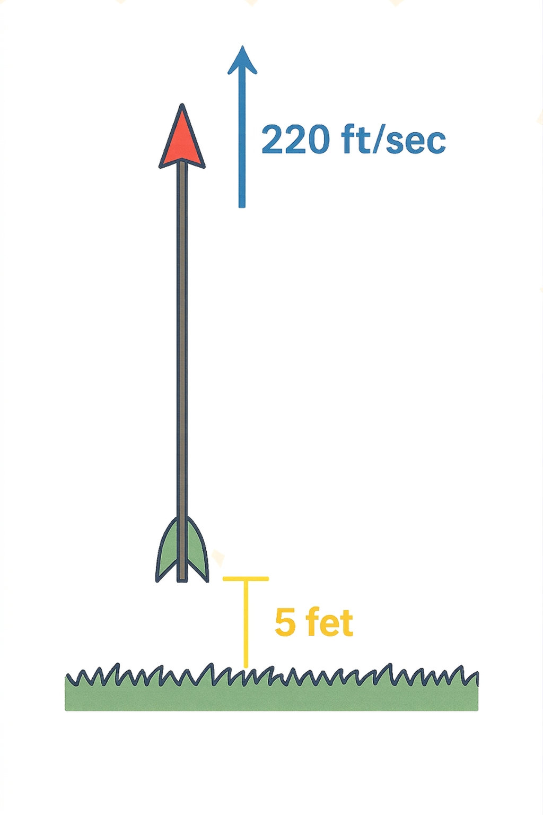
Self Check
An arrow is shot up into the air from 5 feet, at an initial velocity of 220 feet per second.
Which equation can represent the height, h(t), for any time, t?
h(t) = 5 + 220t
h(t) = 5 + 220t + 16t²
h(t) = 5 + 220t - 16t²
h(t) = 220 + 5t - 16t²
Let’s review!
Notes:
Answer Feedback - Individualized by Response
Incorrect. Be sure to subtract the effects of gravity.
Incorrect. Be sure to subtract the effects of gravity.
That’s correct! Subtract the effect of gravity from the starting point and constant rate.
Incorrect. The 220 is the initial velocity, not the starting height.

Slide 13
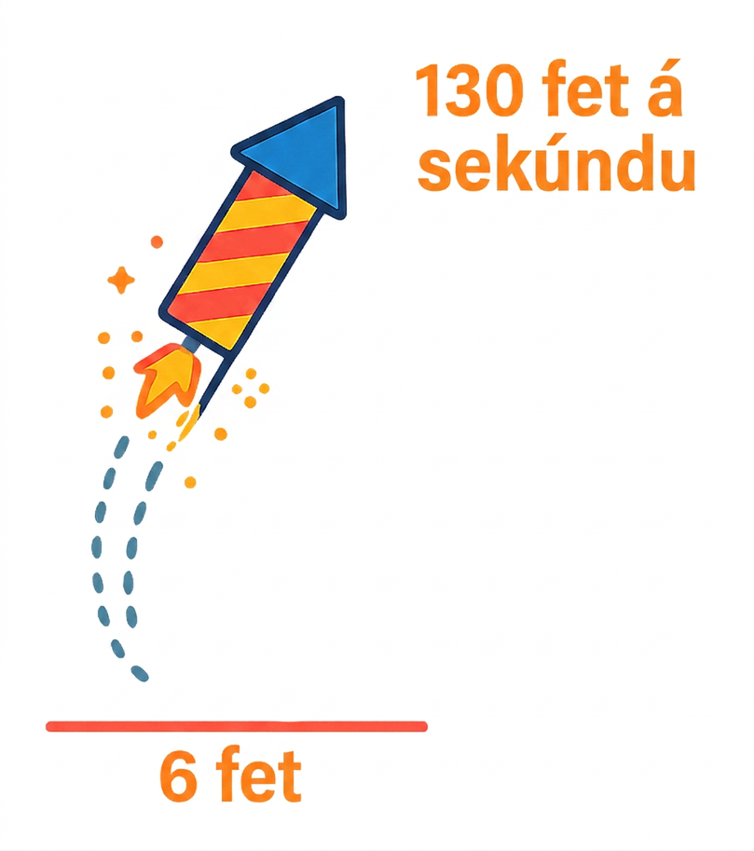
Self Check - Review
A firework is sent up in the air, at an initial velocity of 130 feet per second, from a height of 6 feet.
Identify the initial velocity, v₀.
Identify the starting height, h₀.
Write an equation of this form:
h(t) = h₀ + v₀t − 16t².
Notes:
The Effect of Gravity on Motion
Answers
130 ft per second
6
h(t) = 6 + 130t − 16t²

Slide 14
Lesson Journey
Warm Up
Learning Activity
Practice
Learning Activity
Cool Down
Lesson Synthesis

Slide 15
Learning Strategies - Projectile Motion 🚀
Help create a class display of key terms and visuals.
Suggest words, examples, or diagrams for:
  Vertex of the graph
  Zero of the function
  Parabola
Use the display to support your understanding during discussions and activities.
Representation
Teacher Instruction: Use these strategies to adjust the activity to support students with disabilities.
You can copy and paste the callouts directly on top of the activity or give the instructions aloud.
Notes:
Support for Students with Disabilities: Representation: Develop Language and Symbols
Create a display of important terms and vocabulary. Invite students to suggest language or diagrams to include that will support their understanding of: vertex of the graph, zero of the function, and parabola.
Supports accessibility for: Conceptual processing; Language

Slide 16
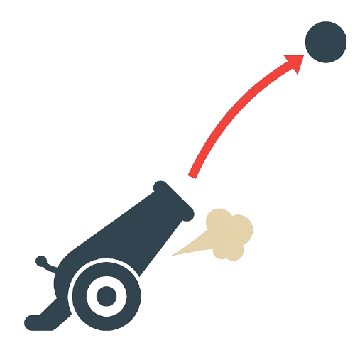
Learning Activity - Projectile Motion 🚀
The function defined by d = 50 + 312t − 16t² gives the height in feet of a cannonball t seconds after the ball leaves the cannon. What does each of the terms tell us about the cannonball?
        50
        312t
        16t²
Graph the function. Adjust the graphing window to the following boundaries: 0 < x < 25 and 0 < y <2000.
Notes:
Support for All Learners
This activity offers additional support and an extension for students:
For students with disabilities, be sure to review the Learning Strategies slide!
For students looking for an extra challenge, be sure to review the Extending Your Thinking slide!
Activity (15 minutes)
In this activity, students graph and interpret a quadratic model of projectile motion, identify a reasonable domain, and connect the vertex to the cannonball’s maximum height and the positive zero to when it hits the ground.
Launch
Ensure students have access to Desmos or another graphing tool.
If needed, model how to adjust graphing boundaries.
Observe how students estimate points on the graph; demonstrate tracing or finding coordinates if support is needed.
Ask: “Is this equation a good model for predicting the cannonball’s height after 10 seconds? After 1 minute?”
Answers
a. The cannonball is fired from 50 feet off of the ground.
b. The initial upward velocity is 312 feet per second.
c. The effect of gravity pulling the cannonball back to the ground.
Link to Desmos graph: https://www.desmos.com/calculator/u9muqglu26
More activity questions, answers, and activity synthesis on the next slide.

Slide 17

Learning Activity - Projectile Motion 🚀
Observe the graph and:
  Describe the shape of the graph. What does it tell us about the movement of the cannonball?
  Estimate the maximum height the ball reaches. When does this happen?
  Estimate when the ball hits the ground.
The zero of a function is where the function equals 0, or where it crosses the x-axis. In this case, there is only one zero where the cannonball hits the ground. The parabola does cross the x-axis in the negative x-values, but that does not make sense in this problem.
What domain is appropriate for this function?
Are you ready for more?
Notes:
Answers
a. The distance from the ground increases, reaches a peak, and then decreases, which makes sense in the situation. It also looks
like the distance from the ground decreases in the same way that it increased on the way up. The graph tells us the cannonball went up in the air, and then fell back down to the ground.
The shape of the quadratic function is called a parabola. It has a “U” shape.
b. The cannonball gets up to a little over 1500 feet, maybe to 1600 feet, at around 10 seconds.
c. The cannonball hits the ground a little bit before 20 seconds.
The equation is a good model for the height of the cannonball from the time it is launched, t = 0, until the time it lands, just before
t = 20. For times outside of these values, the function values do not mean anything in the context (for example, for t = 21 the function would place the cannonball underground).
Activity Synthesis
Invite students to share their observations and interpretations of the graph. Highlight the following points:
The graph representing a quadratic function is a parabola, which is a special kind of U shape. We will learn more about the geometry of this shape in a later course, but for now, notice that there is a point when the graph changes direction, from going up as x increases to going down (or changes from going down to going up). We call this point the vertex of the graph.
In the previous activity, we plotted a limited set of points, so we could not tell where the vertex of the graph was. In this graph, we are able to identify the vertex. In this situation, the vertex tells us the maximum height that the cannonball reaches and the number of seconds after launch that it took before it starts to fall.
In this graph, we can also see that the height of the cannonball is 0 when t is a little less than 20. That point, the horizontal intercept, relates to the zero of the function, or an input value that produces 0 for the output. In this situation, the zero tells us when the cannonball hits the ground.
Even though we can continue the graph beyond t = 20, in this situation any output values beyond that point would not have any meaning. After the cannonball hits the ground, the function is no longer appropriate for modeling the movement of the cannonball. Likewise, the function is not appropriate before t=0 or before the cannon is fired. In this situation, a domain between 0 and just below 20 seconds is appropriate.

Slide 18
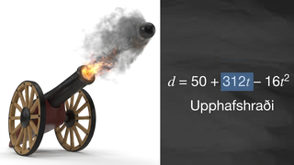
Video: Using Quadratic Functions to Describe Height

Slide 19

Extending Your Thinking
If the cannonball were fired at 800 feet per second, would it reach a mile in height?
Remember there are 5280 feet in a mile. Be prepared to show your reasoning.
Notes:
Answer
The equation here would be g(t) = 50 + 800t − 16t². Since g(10) = 6450 and there are 5280 feet in a mile, this cannonball would reach over a mile in height. This could also be seen by graphing the function.s
Go back to activity information.

Slide 20
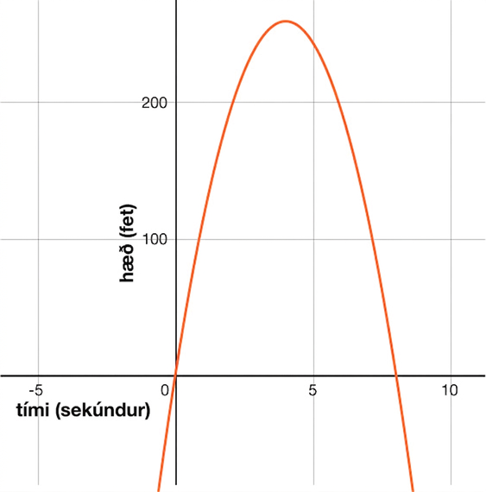
Self Check
A toy rocket is launched from a platform 4 feet above the ground at a velocity of 128 feet per second. Its height is graphed below. Approximately what is the rocket’s maximum height?
8
260
110
128
Let’s review!
Notes:
Answer Feedback - Individualized by Response
Incorrect. This is the time when the rocket hits the ground.
That’s correct! The peak, or vertex, of the graph is at approximately 260 feet.
Incorrect. This is the height at 1 second.
Incorrect. This is the velocity.

Slide 21
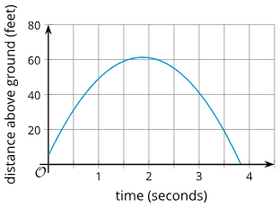
Self Check - Review
An object is thrown upward from a height of 5 feet with a velocity of 60 feet per second. Its height, h(t), in feet after t seconds is modeled by the function h(t) = 5 + 60t - 16t².
Identify the starting height.
Identify the maximum height by looking at the vertex or peak of the parabola.
Identify when the object reaches its maximum by matching the maximum with its matching time from the x-axis.
When does the object hit the ground?
Notes:
Reading Graphs of Quadratics
Answers
5 feet
Approximately 62 feet.
Approximately 1.75 seconds.
Look at where the object has a height of 0 feet, or the zero of the function. This happens at approximately 3.75 seconds. Notice there would be another zero on the graph of the function to the left of x = 0, but that does not make sense in the problem because the object was thrown from 5 feet.

Slide 22

Lesson Journey
Warm Up
Learning Activity
Practice
Learning Activity
Cool Down
Lesson Synthesis

Slide 23
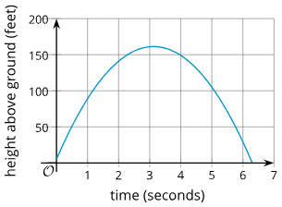
Cool Down
The height in feet, h, of a stomp rocket (propelled by a short blast of air) above the ground after t seconds is given by the equation h(t) = 5 + 100t - 16t². Here is a graph that represents h.
How does the 5 in the equation relate to the graph?
What does 100t in the equation mean in terms of the rocket?
What does the - 16t² mean in terms of the rocket?
About when does the rocket hit the ground?
Notes:
Cool Down (5 minutes)
Answers
The graph intersects the vertical axis at 5.
It indicates that the initial velocity of the rocket was 100 feet per second upward.
This indicates the effect of gravity pulling the rocket back toward Earth.
At about 6.3 seconds.
Response to Student Thinking - More Chances
Students will have more opportunities to understand the mathematical ideas in this cool down, so there is no need to slow down or add additional work to the next lessons. Instead, use the results of this cool down to provide guidance for what to look for and emphasize over the next several lessons to support students in advancing their current understanding.

Slide 24

Lesson Journey
Warm Up
Learning Activity
Practice
Learning Activity
Cool Down
Lesson Synthesis

Slide 25

Practice
Put your hard work to action, practice what you’ve learned!
Notes:
Digital Practice: Access the practice pages at https://openstax.org/k12/algebra

Slide 26

Lesson Journey
Warm Up
Learning Activity
Practice
Learning Activity
Cool Down
Lesson Synthesis

Slide 27
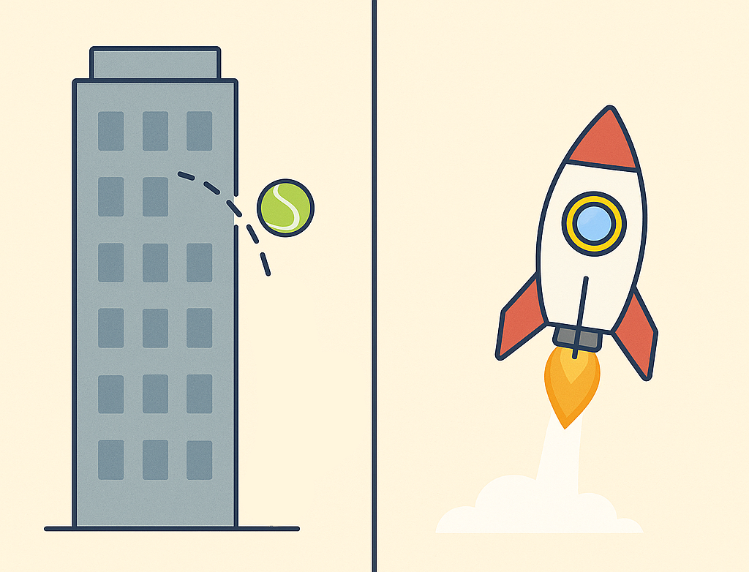
Lesson Synthesis
Here are three expressions that all represent distance, in feet, as a function of time, in seconds, for an object that is dropped or launched.
  16t²
  400 - 16t²
  50 + 400t - 16t²
What does each of them tell us?
If each expression defines a function, what does the zero of that function tell us?
Notes:
Possible Answers
a. The distance an object travels t seconds after being dropped.
b. The height of an object that is dropped from a height of 400 feet.
c. The height of an object that is shot up from 50 feet above the ground at a vertical speed of 100 feet per second, t seconds after being launched.
a. The zero is the time when the object has traveled a distance of 0 feet. This happens at t = 0, before the object is dropped.
b. The zero is the time when the height of the object is 0 feet, which is when it hits the ground.
c. The zero is the time when the height of the object is 0 feet, which is also when it hits the ground.
Explain to students that the models seen here are simplified models, and they ignore other factors, such as air resistance. The models that scientists use to study physical phenomena are likely to be more complex than what students have seen here.
If time permits, consider addressing a common misconception: that a graph of a quadratic function that represents distance-time relationship shows the physical trajectory of the object. Ask students to draw a sketch of what a bystander would see if they are facing the cannon as the ball is being launched. If needed, revisit the GeoGebra applet “Distance as a Quadratic Function of Elapsed Time” (from the previous lesson) to further emphasize this difference.
Clarify that the graph represents the height of the object as a function of time, not the path that the object travels. In the examples given here, the object just goes straight up and straight down.

Slide 28
Self Assessment
How much do you agree with the following statements?
I can… | I can | Almost | Not yet
Create quadratic functions and graphs that represent a situation.
Relate the vertex of a graph and the zeros of a function to a situation.
Explain how the situation that a function represents can influence its domain.

