Slide 1


Algebra 1
Unit 3 Two Variable Statistics
Lesson 3.1 Linear Models

Slide 2
How to use these slides
On the activity slides check the speaker notes for teacher support and instructional information.
Each lesson includes 1 warm up, 2-3 learning activities, a cool down, practice and a lesson synthesis.
  Learning activities are followed by a self check question, and review section.
Some slides have been hidden from student view, more information can be found on the next slide (Reference Key).
You can edit and use these slides for personal and classroom use, but cannot sell them and must keep the attribution logos.
For more information, Check out the digital quick start guide!

Slide 3






Reference Key
Check the top right corner for an icon referencing these unique sections.
 | Support for Students with Disability | Hidden | Learning Strategies slide, provides additional support to students for understanding the activity. Learning Strategies slide, provides additional support to students for understanding the activity.
 | Support for English Language Learners | Hidden
 | Extending Your Thinking | Hidden | Extending Your Thinking slide, provides an extra challenge for students.
 | Self Check | Not Hidden | Self Check slide, checkpoint to assess student understanding after the learning activity.
 | Review | Hidden | Self Check- Review slide, designed to help review topics from the self check question.
On the next slides, check the speaker notes for teacher instructions and support.
Notes:
Check the Speaker Notes: On the next slides you can find discussion questions, lesson information, answers to the activities, and ways to adjust the activity for your students!

Slide 4

Learning Goals
By the end of this lesson you will be able to -
Describe the rate of change and y-intercept for a linear model in everyday language.
Draw a linear model that fits the data well and use the linear model to estimate values.
Notes:
Lesson Narrative
The mathematical purpose of this lesson is to understand how a linear model is used to describe the relationship between two numerical variables and to use a line of best fit to make predictions. When students articulate things they notice and things they wonder about a scatter plot and the accompanying linear model, students have an opportunity to attend to precision in the language they use to describe what they see. Students reason abstractly by making sense of slope and intercept in context.
Required Preparation
None
Required Materials
Graphing technology
Texas Essential Knowledge and Skills
A1(A) apply mathematics to problems arising in everyday life, society, and the workplace
A1(C) select tools, including real objects, manipulatives, paper and pencil, and technology as appropriate, and techniques, including mental math, estimation, and number sense as appropriate, to solve problems.
A1(E) create and use representations to organize, record, and communicate mathematical ideas.
A4(C) write, with and without technology, linear functions that provide a reasonable fit to data to estimate solutions and make predictions for real-world problems.

Slide 5
Vocabulary
Previous
Scatter plot
  Points on a graph demonstrating a relationship between two variables.
Slope
  The rate of change in 𝑦 over the change in 𝑥, or steepness of a line.
Intercept
  Point where the graph of a function crosses the x-axis or the 𝑦-axis.
New
Extrapolate
  Estimating a value outside the domain and/or range of a data set.
Interpolate
  Estimating a value within the domain and/or range of a data set.
Notes:
Lesson Vocabulary
To support student understanding of key vocabulary:
Introduce and review the vocabulary words students will see in this lesson.
Encourage students to notice how these words are used and to include them in their math discussions and explanations—both written and oral.
Use a word wall to reinforce vocabulary. Sample word wall cards are available here.
For newcomers or students with beginning English proficiency, use these Quizlet sets to support vocabulary learning:
Unit 3 Spanish Vocabulary – use first to build understanding
Unit 3 Vocabulary (English) – use after anchoring in Spanish
Support for English Language Learners
ELPS 1(E) internalize new basic and academic language by using and reusing it in meaningful ways in speaking and writing activities that build concept and language attainment
ELPS 1(F) use accessible language and learn new and essential language in the process
ELPS 2(F) listen to and derive meaning from a variety of media such as audiotape, video, DVD, and CD-ROM to build and reinforce concept and language attainment
ELPS 3(B) expand and internalize initial English vocabulary by learning and using high-frequency English words necessary for identifying and describing people, places, and objects, by retelling simple stories and basic information represented or supported by pictures, and by learning and using routine language needed for classroom communication

Slide 6





Lesson Journey
Warm Up
Learning Activity
Cool Down
Lesson Synthesis
Learning Activity
Learning Activity
Practice

Slide 7

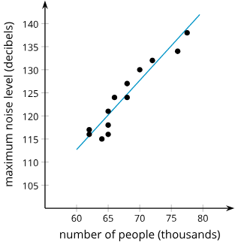
Warm Up - Notice & Wonder 🔊
What do you notice?
What do you wonder?
y = 1.5x + 22.7
Notes:
Warm Up (5 minutes)
The purpose of this warm up is to help students recall information about scatter plots. While students may notice and wonder many things about these images, the relationship between the number of people and the maximum noise level, the method for interpreting the line of best fit, and a general understanding of a scatter plot are the important discussion points.
Notice and highlight students who use correct terminology in their responses. In particular, the terms scatter plot, linear model, slope, and intercept are important to review during this warm up.
Launch
Tell students their job is to think of at least one thing they notice and at least one thing they wonder. Display the image for all to see. Give students 1 minute of quiet time to think individually and then 1 minute to discuss the things they notice with their partner, followed by a whole-class discussion.
Continue to scroll down through the notes for activity answers, misconceptions, and synthesis questions.
Activity Answers
Things students may notice:
More people generally means more noise.
At around 65,000 people, there are three different noise levels
The equation of the line is given.
Things students may wonder:
Where is the origin?
Why are all the points not on the line?
What can we do with this?
Anticipated Misconceptions
The vertical intercept appears to be approximately 105 decibels, but the origin is not shown on the graph.
Activity Synthesis
Ask students to share the things they noticed and wondered. Record and display their responses for all to see. If possible, record the relevant reasoning on or near the image. After all responses have been recorded without commentary or editing, ask students, “Is there anything on this list you are wondering about now?”
Encourage students to respectfully disagree, ask for clarification, or point out contradicting information. If students do not use these terms in their responses, ensure they recall the vocabulary from grade 8 math:
scatter plot
linear model
slope
intercept

Slide 8

Lesson Journey
Warm Up
Learning Activity
Cool Down
Lesson Synthesis
Learning Activity
Learning Activity
Practice

Slide 9

Learning Strategies - Weighing Oranges 🍊
Teacher Instruction: Use this strategy to adjust the activity to support students with disabilities.
You can copy and paste the callout directly on top of the activity or give the instructions aloud.
How predictable is an estimate of …
the weight of a box of pumpkins?
the weight of a bag of candy (Halloween, Easter, etc.)?
the weight of a dog?
Is the prediction more accurate when there are a few data or a lot?
Representation
Notes:
Support for Students with Disabilities: Representation: Internalize Comprehension
Begin the activity with concrete or familiar contexts to address the questions about estimation. Ask students to make predictions about similar scenarios that may become more variable as the sample size increases. For example, discussing the predictability of the weight of a box of fruit as a given sample size increases may be a relatable discussion that will encourage students to think about the difference between a grape and a grapefruit.
Supports accessibility for: Conceptual processing; Memory

Slide 10
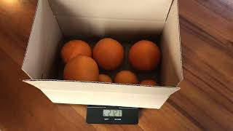
Learning Activity - Weighing Oranges 🍊
Number of oranges | Weight in kilograms
3
4
5
6
7
…
Record the weight for the number of oranges in the box from the video.
Create a scatter plot of the data.
Notes:
Support for All Learners
This activity offers additional support for students:
For students with disabilities, be sure to review the Learning Strategies slide!
Activity (15 minutes)
The mathematical purpose of this activity is for students to create a scatter plot from data given in context, to informally find a line they think does a good job of describing the relationship, to interpret the slope and vertical intercept of the linear model, and to use the linear model to make predictions.
Note that students may need a quick review of finding slope and 𝑦-intercepts from graphs and slope-intercept form as well as a review of finding slope using the slope formula.
Launch
Play the video of adding oranges to a box on a scale. You may need to pause the video for students to write down the weights.
Note: This activity works best when each student has access to devices that can run Desmos or other graphing technology because the level of precision is important. If students don’t have individual access, projecting the Desmos graph is helpful during the synthesis.
Additional activity questions, answers, and synthesis on the next slide.

Slide 11
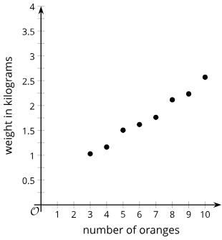
Learning Activity - Weighing Oranges 🍊
Approximate the equation of the line of best fit.
Estimate the slope of the line. What does the slope represent?
Estimate the weight of the box -
- containing 11 oranges.
Will this be close to the actual value?
- containing 50 oranges.
Will this be close to the actual value?
Estimate the vertical intercept of the line. What does the y-coordinate for the point represent?
Notes:
Activity Answers
(no. or oranges, weight in kg): (3, 1.027); (4, 1.162); (5, 1.502); (6, 1.617); (7, 1.761); (8, 2.115); (9, 2.233); (10, 2.569)
Scatter plot answer given on the slide.
Answers may vary. A line in given on the slide, but it may be moved/adjusted as needed. The regression line is y = 0.216x + 0.345.
Answers may vary, but based on our line: About 0.2. The value represents the approximate weight of each orange added to the box.
About 2.8 kg (2.6 + 0.2 = 2.8). The estimate should be close to the actual value since there is only 1 additional orange added, and while there is some variability, it is not great.
About 10.6 kilograms (2.6 + 40⋅0.2 = 10.6). This estimate will probably not be very close. With data only going to 10 oranges, the variability in orange weight with more oranges will make it harder to get an estimate that is close to the actual value.
About 0.3 kilogram. The 𝑦-coordinate estimates the weight of the box with no oranges in it.
Pose the following questions to students as follow up:
When you use a linear model to estimate a value in the data given in a scatter plot, that is called interpolation. When you use a linear model to estimate the value outside the data given in the scatter plot, that is called extrapolation. Which point(s) are best fit by your linear model? How did you decide?
Answer: When there were 6 oranges in the basket, it was closest to my line. I decided this because the line almost goes through that point.
Which point(s) fit the least well by your linear model? How did you decide? Compare your line with that of a partner. Discuss why you chose to put your lines where you did. How are your answers different? Which of you has a line that is the better fit? Why?
Answer: When there were 7 oranges in the basket, it was the worst estimate. I decided this since this point is the farthest from the line.
Anticipate Misconceptions
Students may struggle with estimating a slope when the scales on the 𝑥- and 𝑦-axes are different. Ask students to find the coordinates for a couple of points on or near the line and find the slope between those points.
Activity Synthesis: Ask students 2 or 3 of the following questions, as time permits.
How would the scatter plot and linear model change if the box itself were heavier?
The dots and line would shift up.
Can you think of reasons why the real weight of 50 oranges might be different from the answer we get by using an estimate from the linear model?
50 oranges may not fit in one box, so additional boxes may be needed, which will change the linear pattern in the data. Many of the additional oranges may be very small or very large and not fit the general trend seen with these 10 oranges. While the estimate from the line is interesting and may be better than a wild guess, it should not be considered a very good estimate.
How many oranges did we measure?
10
Since we measured 10 oranges, how does that affect your confidence in the estimate for 50 oranges?
It makes me very skeptical that the estimate will be accurate. Although the data may look like a line for this section, there may be very different things happening farther away.
How would the scatter plot and linear model change if grapefruits were used instead of oranges?
The weight would be increased for each point, and the slope of the line would be greater.

Slide 12
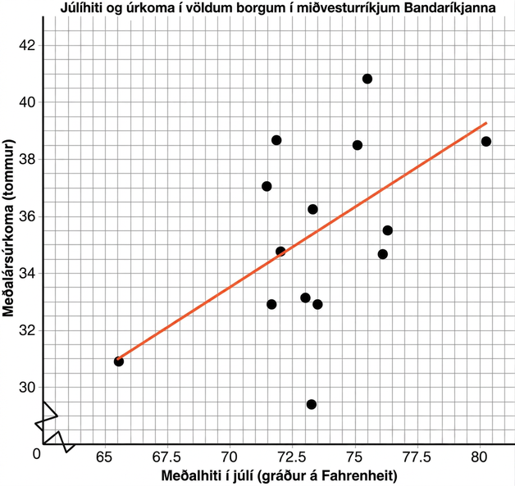
Self Check
The plot given is a scatter plot of mean temperature in July and mean inches of rain per year for a sample of midwestern cities. A line is drawn to fit the data.
Use the line provided to predict the mean number of inches of rain per year for a city that has a mean temperature of 70°F in July.
32 inches per year
33 inches per year
34 inches per year
31 inches per year
Let’s review!
Notes:
Answer Feedback
Incorrect
Correct! At 70 degrees on the 𝑥-axis, the value the line crosses is approximately 33 inches per year.
Incorrect
Incorrect

Slide 13
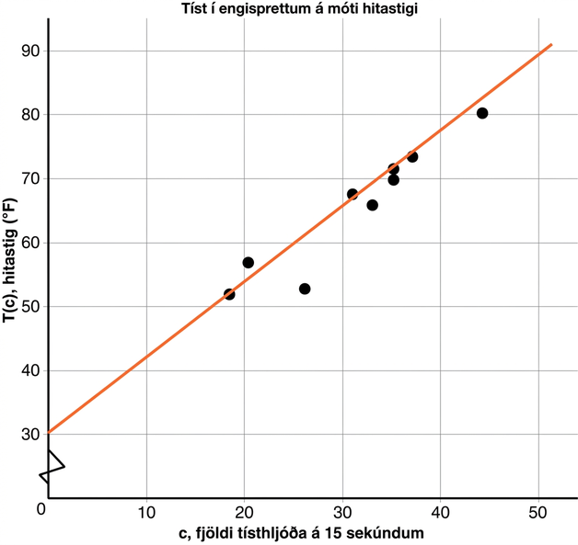
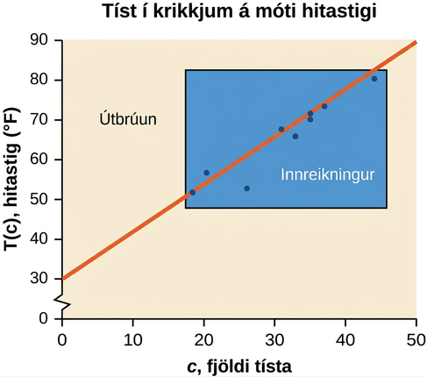
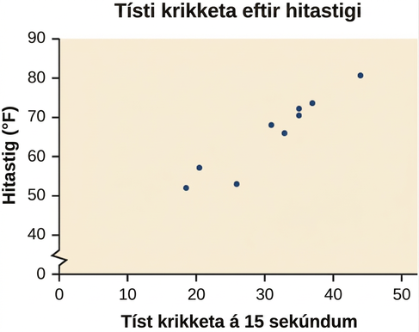
Self Check - Review
Plot the data: the number of cricket chirps in 15 seconds for different air temperatures in degrees Fahrenheit Trend appears roughly linear | Sketch a best fit line Use sample points to calculate the slope: (0, 30) & (50, 90) m = ⁶⁰/₅₀ = 1.2 Extend the line to find the y-intercept | Interpolation predicts a value inside the domain &/or range of data Extrapolation predicts a value outside the domain &/or range of data
Notes:
Image 1: Remind students the first step to creating a scatter plot is to graph any given data. We can see from the trend in the data that as the number of chirps in 15 seconds increases, the temperature increases. The trend appears to be roughly linear, though certainly not perfectly so.
Image 2: One way to approximate our linear function is to sketch the line that seems to best fit the data and then calculate the slope. This graph has a slope of 𝑚 = 1.2 and a 𝑦-intercept at 30.
The slope means that for every increase of 1 chirp per 15 seconds, the temperature increases 1.2 degrees.
The 𝑦-intercept stands for the temperature needed for crickets to start chirping.
Image 3: Review the definitions. Ask students to use the cricket data to answer the following questions:
Would predicting the temperature when crickets are chirping 30 times in 15 seconds be interpolation or extrapolation? Make the prediction, and discuss whether it is reasonable.
Answer: The number of chirps in the data provided varied from 18.5 to 44. A prediction at 30 chirps per 15 seconds is inside the domain of our data, so it would be interpolation. Using our model: 𝑇(30) = 30 + 1.2(30) = 66 𝑑𝑒𝑔𝑟𝑒𝑒𝑠. Based on the data we have, this value seems reasonable.
Would predicting the number of chirps crickets will make at 40 degrees be interpolation or extrapolation? Make the prediction, and discuss whether it is reasonable. Answer: The temperature values varied from 52 to 80.5. Predicting the number of chirps at 40 degrees is extrapolation because 40 is outside the range of our data. Using our model: 40 = 30 + 1.2𝑐
10 = 1.2𝑐
𝑐 ≈ 8.33

Slide 14
Lesson Journey
Warm Up
Learning Activity
Cool Down
Lesson Synthesis
Learning Activity
Learning Activity
Practice

Slide 15
Learning Strategies - Ingredient Costs 💰
Teacher Instruction: Use these strategies to adjust the activity to support English language learners and students with disabilities.
  You can copy and paste the callouts directly on top of the activity or give the instructions aloud.
“The slope means that as sales increase, the cost of ingredients increases.”
Identify inaccuracies in this statement.
Critique the reasoning.
Write a more correct explanation.
Clarify, Critique, Correct
Fold your paper in half to create a T-chart.
Label the left side, “graph.” Label the right side, “equation.”
Use the chart to organize your answers or capture answers from others.
Action and Expression
Notes:
Support for English Language Learners: MLR 3 Clarify, Critique, Correct: Reading, Writing, Speaking
Before students share their interpretations of the slope, present an ambiguous explanation. For example: “The slope means that as sales increase, the cost of ingredients increases.” Ask students to identify inaccuracies, critique the reasoning, and write a correct explanation. As students discuss with a partner, listen for students who identify and clarify the ambiguous language in the statement. Invite students to share their critiques and corrected explanations with the class. Listen for and amplify the language students use to describe what happens to the sale price when the cost of ingredients increases by $1. This helps students evaluate and improve on the written mathematical arguments of others as they clarify the meaning of slope in context.
Design Principle(s): Optimize output (for explanation); Maximize meta-awareness
Learn more about this routine
View the instructional video and follow along with the materials to assist you with learning this routine.
Provide support for students
Distribute graphic organizers to the students to assist them with participating in this routine.
Support for Students with Disabilities: Action and Expression: Internalize Executive Functions
Provide students with a two-column graphic organizer. Label one column “graph” and the other column “equation.” Ask students to transfer their answers into the corresponding column on their organizer. When the whole group shares, they can continue to use the organizer to capture the answer if anyone used the alternative method for each question.
Supports accessibility for: Language, Organization

Slide 16
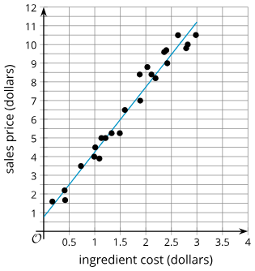
Learning Activity - Ingredient Costs 💰
Examine the graph. The line is represented by the equation below.
y = 3.48x + 0.76
What is the predicted sale price of an item with ingredients that cost $1.50?
What is the predicted ingredient cost of an item that has a sale price of $7?
Notes:
Support for All Learners
This activity offers additional support for students:
For English language learners and students with disabilities, be sure to review the Learning Strategies slide!
Activity (5 minutes)
In this activity, students are asked to interpret in context the slope and vertical intercept of a linear model given a scatter plot and the equation for a linear model that fits the data well. The linear model is also used to interpolate and extrapolate information about the data in context.
Monitor for students who:
Estimate values based on the graph.
Use the equation for the linear model to find the values.
Launch
Arrange students in groups of 2.
Answers
$5.98 from the equation (3.48 ⋅ 1.5 + 0.76 = 5.98), or approximately $6 from the scatter plot graph.
$1.79 from the equation (7 − 0.76) ÷ 3.48 = 1.79), or approximately $1.75 from the scatter plot graph.
Activity questions, answers, anticipated misconceptions, and synthesis on the next slide.

Slide 17
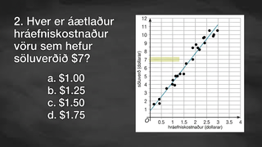
Video: Linear Models

Slide 18
Learning Activity - Ingredient Costs 💰
y = 3.48x + 0.76
What is the slope of the linear model?
What does the slope value mean?
What is the y-intercept of the linear model?
What does the y-intercept mean in this situation?
Does the y-intercept make sense in this situation?
Notes:
Answers
3.48
This means that for every extra dollar spent on ingredients, the sale price of the food item is expected to increase by about $3.48.
0.76
This means that a food item that is made with free ingredients would still be sold for approximately 76 cents.
Answers will vary, but here are some samples:
This doesn’t seem to make sense because something that is free to make should not cost anything for the customer.
This might make sense since it would still cost some money to either run the machines or pay the people to make the item.
Anticipated Misconceptions
Although the grid in the picture does not look like squares, all the lines in both the horizontal and vertical directions are 0.5 apart. Tell students who are confused to look at the values listed on the axes and identify the values attached to a few of the grid lines.
Activity Synthesis
The purpose of this discussion is for students to describe where to find the slope and vertical intercept from a scatter plot and interpret the values in terms of the context. Select previously identified students to share in the order listed in the narrative (#1 students who estimated values using the graph; #2 students who used the equation to find the values).
Ask students:
Are the values obtained from looking at the graph close to the values calculated using the equation?
Answer: Yes, the values are close.
Which method will you use to predict values based on the model?
Answer: Maybe a mixture of both methods. Using the equation produces a more precise value from the model, but it is also important to look at the graph to get a sense of how well the model fits the data where I am predicting.
Why do you think the 𝑦-intercept for the model is not (0,0)?
Answer: Companies may still charge money for items that cost nothing to produce. They need to pay for the salaries of their workers, research and development, as well as other things that require the company to make money more than just the cost of making the item. It may also be the case that it does not make sense to interpret the 𝑦-intercept since we have no evidence to believe that the same linear relationship will hold there.

Slide 19
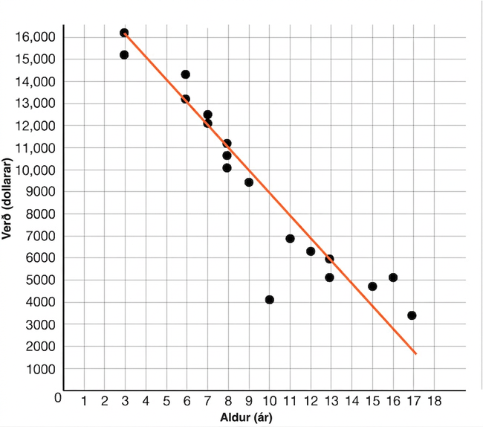
Self Check
The scatter plot below shows the age (in years) and the price (in dollars) of used compact cars advertised in the local newspaper.
Nora drew a line to fit the data. What is the slope of her line, and what does it mean in the problem?
– 1000, for every year older the car is, its price decreases 1000 dollars
1000, for every year older the car is, its price decreases 1000 dollars
1000, for every year older the car is, its price increases 1000 dollars
– ¹/₁₀₀₀, for every year older the car is, it decreases ¹/₁₀₀₀ of its value the year before
Let’s review!
Notes:
Answer Feedback
That’s correct! The slope is negative, and if the points (13, 6000) and (7, 12000) are used, the slope is (12000 − 6000) ÷ (7 − 13) = − ⁶⁰⁰⁰/₆= − 1000.
Incorrect. The slope of the line is negative, and the price decreases as the cars get older. The answer is the slope is −1000. For every year older the car is, its price decreases 1000 dollars.
Incorrect. The slope of the line is negative, and the price decreases as the cars get older. The answer is the slope is −1000. For every year older the car is, its price decreases 1000 dollars.
Incorrect. To find slope, use the change of the 𝑦-values over the change of the 𝑥-values, or rise over run. For every year older the car is, its price decreases 1000 dollars.

Slide 20
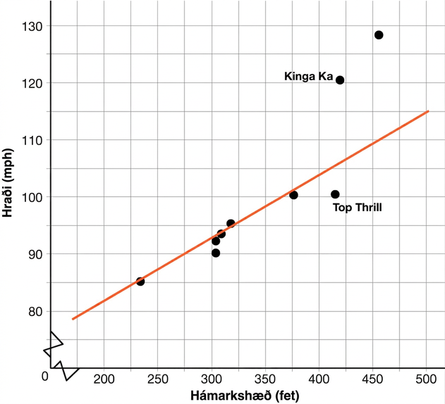
Self Check - Review
The scatter plot below shows the height and speed of some of the world’s fastest roller coasters. A line has been drawn to show a good fit for the data.
  The equation of the line drawn is
  𝑆 = 0.11ℎ + 60.
  What does this slope mean in the problem?
Notes:
Answer: For every foot taller the roller coaster is, the speed increases 0.11 miles per hour.
Consider asking students to make some predictions using the data as well (both the equation and the graph).

Slide 21
Lesson Journey
Warm Up
Learning Activity
Cool Down
Lesson Synthesis
Learning Activity
Learning Activity
Practice

Slide 22
Learning Strategies - Real World Data 📈
Teacher Instruction: Use these strategies to adjust the activity to support English language learners and students with disabilities.
  You can copy and paste the callouts directly on top of the activity or give the instructions aloud.
Use the following sentence stems:
“ ___ represents ___”
“Is there another way to say …?”
“It looks like ___ represents …”
Discussion Supports
Use the sentence stems:
“What does this part of ___ mean?”
“I predict ___ because … “
Annotate your graphs while using the sentence frames.
Action and Expression
Notes:
Support for English Language Learners: MLR 8 Discussion Supports: Conversing
In pairs, encourage students to take turns sharing their interpretation of the slope and vertical intercept for each scatter plot. Display the following sentence frames for all to see: “_____ represents _____,” “Is there another way to say . . .?” and “It looks like _____ represents . . .” Encourage students to challenge each other when they disagree. This will help students clarify their understanding of the meaning of the slope and the vertical intercept in context.
Design Principle(s): Support sense-making; Maximize meta-awareness
Support for Students with Disabilities: Action and Expression: Develop Expression and Communication
To help students get started, display sentence frames such as: “What does this part of _____ mean?” and “I predict _____ because . . .” Encourage students to annotate their graphs while using the sentence frames.
Supports accessibility for: Language; Organization

Slide 23
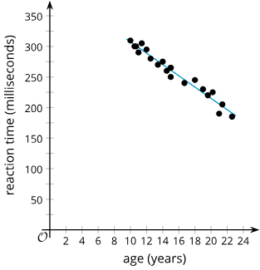
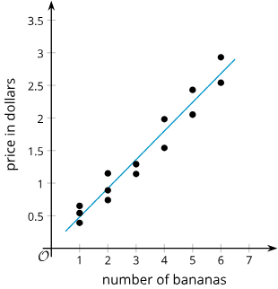
Learning Activity - Real World Data 📈
y = – 9.25x + 400
y = 0.44x + 0.04
Interpret the slope of the linear model in the situation shown. What does it mean? If the linear relationship continues, interpret the y-intercept of the linear model. | Interpret the slope of the linear model in the situation shown. What does it mean? If the linear relationship continues, interpret the y-intercept of the linear model.
Notes:
Support for All Learners
This activity offers additional support and an extension for students:
For English language learners and students with disabilities, be sure to review the Learning Strategies slide!
For students looking for an extra challenge, be sure to review the Extending Your Thinking slide!
Activity (10 minutes)
The mathematical purpose of this activity is for students to interpret the slope (rate of change) and the intercept (constant term) of a linear model in the context of the data. Students are given scatter plots for different pairs of variables and the equation of a line of best fit and then use them to describe the meaning of the vertical intercept and slope.
As students work, observe different strategies and plan to have contrasting approaches shared during discussion.
Launch
Arrange students in groups of 2. Ask students to compare their responses to their partner’s for the scatter plots and decide if both their responses are correct for each scatter plot, even if they are different. Follow with a whole-class discussion.
Answers
Scatter plot A: y = – 9.25x + 400
For every increase in age of one year, the linear model estimates that the reaction time decreases by about 9.25 milliseconds.
The reaction time estimated by the linear model for a newborn is 400 milliseconds.
Scatter plot B: y = 0.44x + 0.04
For every additional banana, the linear model estimates that the price increases by about $0.44.
The price estimated by the linear model for purchasing zero bananas is $0.04.
Additional activity questions, answers, and synthesis on the next slide.

Slide 24
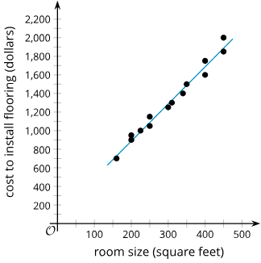
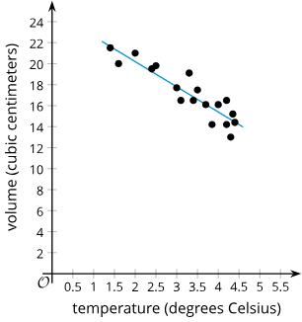
Learning Activity - Real World Data 📈
Are you ready for more?
y = 4x + 87
y = – 2.4x + 25.0
Interpret the slope of the linear model in the situation shown. What does it mean? If the linear relationship continues, interpret the y-intercept of the linear model. | Interpret the slope of the linear model in the situation shown. What does it mean? If the linear relationship continues, interpret the y-intercept of the linear model.
Notes:
Answers
Scatter plot C: y = 4x + 87
For each additional square foot, the linear model estimates that the cost to install flooring increases by about $4.
The fixed cost to install flooring is $87.
Scatter plot D: y = – 2.4x + 25.0
For every increase in temperature of 1 degree Celsius, the linear model estimates that the volume decreases by about 2.4 cubic centimeters.
25 cubic centimeters is the volume estimated by the linear model for a temperature of zero degrees Celsius.
Activity Synthesis: The purpose of this discussion is for students to describe the rate of change and the vertical intercept using the context in each graph. Use Think-Pair-Share to ask students:
Why is the intercept for the bananas not (0,0)?
A linear model is not exact even for the data it is based on. It is an approximation based on the data in the scatter plot. It is possible that it represents the weight of the bag that bananas were placed in. It is also possible that this value does not make sense since there is no evidence to believe the same linear relationship will hold near zero.
How do you interpret the slope for each equation?
The slope is the change in 𝑦 divided by the change in 𝑥, so look at the labels on the scatter plot and talk about for each increase of 1 on the 𝑥 variable, on average, there is a decrease (if the slope is negative) or increase (if the slope is positive) in the variable represented by the 𝑦-direction.
When might it make sense to interpret the 𝑦-intercept for a linear model?
When 𝑥-values around 0 are in the range of the data used to create the model. In other cases, care should be taken not to put too much faith in the answer since the linear trend may not continue to hold farther from the collected data.

Slide 25
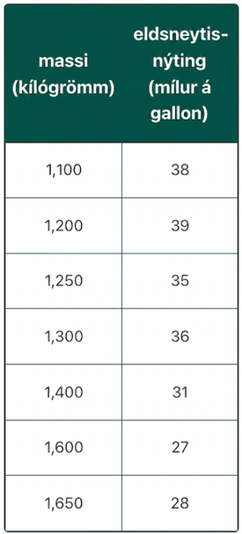
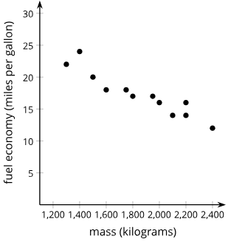
Extending Your Thinking
Clare, Diego, and Elena collect data on the mass and fuel economy
of cars at different dealerships.
y = – ⁹/₁₀₀₀ x + 34.3
Clare finds line of best fit for data about 12 cars Where x is the car’s mass (kg) and y is the fuel economy | Diego makes scatter plot for data about 10 cars | Elena makes a table for data on 11 hybrid cars
Notes:
Questions and Answers
Interpret the slope and 𝑦-intercept of Clare’s line of best fit in this situation.
Answer: The slope means that the fuel economy decreases 9 miles per gallon for every 1,000 kg increase in mass. The 𝑦-intercept represents the fuel economy of a car, in miles per gallon, that has a mass of 0 kg.
Diego looks at the data for new cars and used cars. He claims that the fuel economy of new cars decreases as the mass increases. He also claims that the fuel economy of used cars increases as the mass increases. Do you agree with Diego’s claims? Be prepared to show your reasoning.
Answer: Diego’s claim about new cars is correct. You can look at the graph and see that the fuel economy tends to decrease as the mass increases because the scatter plot appears to have a negative slope. Diego’s claim about used cars is not correct because the line of best fit has a negative slope, which means that the fuel economy decreases as the mass increases.
Elena looks at the data for hybrid cars and correctly claims that the fuel economy decreases as the mass increases. How could Elena compare the decrease in fuel economy as mass increases for hybrid cars to the decrease in fuel economy as mass increases for new cars? Be prepared to show your reasoning.
Answer: Elena needs to compare the slope of the data for hybrids to the slope of the data for new cars. She could do this by looking at the scatter plots and graphing an approximated line of best for each scatter plot. She could then see which line of best fit looks like it is decreasing faster or find and compare the slopes of each approximated line of best fit.

Slide 26
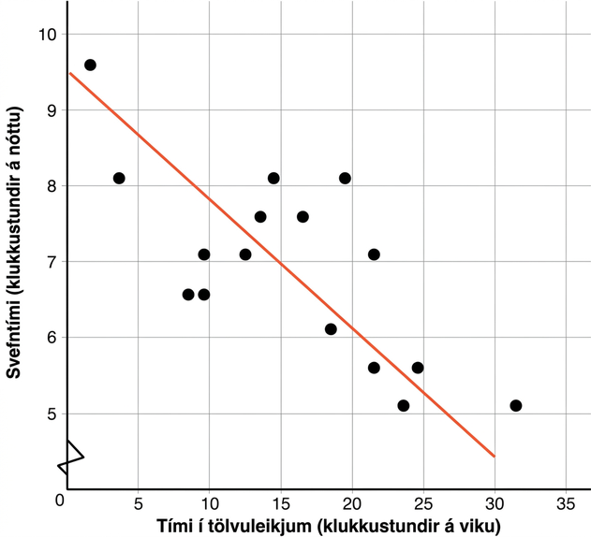
Self Check
The scatter plot shows the results of a survey of eighth-grade students who were asked to report the number of hours per week they spend playing video games and the typical number of hours they sleep each night.
Which of the following conclusions can you make looking at the data?
As video game time increases, sleep time increases.
As video game time decreases, sleep time decreases.
As video game time increases, sleep time decreases.
There is not a trend between time spent on video games and sleep time.
Let’s review!
Notes:
Answer Feedback
Incorrect. Notice the slope of the line is negative. As the line goes farther right, the line goes down.
Incorrect. As the line goes farther right, the line goes down.
That’s correct! As the number of hours spent on video games increases, the line goes down, so the number of hours spent sleeping decreases.
Incorrect. There is a linear model to the data points.

Slide 27
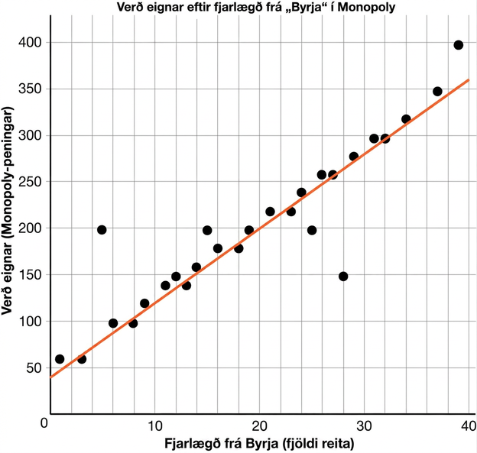
Self Check - Review
Equation of the linear model
𝑃 = 8𝑥 + 40
What claims can be made about the data or model?
As distance from “Go” increases ↑,
the price of the property increases ↑
Slope = 8; This means for every space from “Go,” property price increases $8
Calculate cost of property 39 spaces
from “Go”
  Using equation (linear model):
𝑦 = 8(39) + 40 = $352
Using graph data (actual price): $400
Notes:
Using Linear Models
The scatter plot shows the distance from “Go” to a property (in number of spaces moving from “Go” in a clockwise direction) and the price of the properties on the Monopoly game board. Have students examine the graph where 𝑃 represents the price (in Monopoly dollars) and 𝑥 represents the distance (in number of spaces).
What claims can be made about the data or model?
The model shows that as the distance from “Go” increases, the price of the property increases.
The slope of the equation of the linear model is 8. This means that for every space from “Go,” the price of the property increases $8.
Notice the model (equation) gives an estimate. The most expensive property is 39 spaces from “Go” and costs $400. The model would give the price to be 𝑦 = 8(39) + 40 or $352.
The model gives a difference of $48 between the estimated price using the model and the actual price.

Slide 28

Lesson Journey
Warm Up
Learning Activity
Cool Down
Lesson Synthesis
Learning Activity
Learning Activity
Practice

Slide 29
Cool Down
The scatter plot shows the maximum noise level (𝑦) when different numbers of people (x, in thousands) are in a stadium.
The slope is 1.5. What does this mean in terms of the maximum noise level and the number of people?
A sports announcer states there are 65,000 fans in the stadium. Estimate the maximum noise level.
Is this estimate reasonable?
What is the 𝑦-intercept of the linear model?
What does the value of the 𝑦-intercept mean in the context of the problem?
Is this value for the 𝑦-intercept reasonable?
Equation of the linear model
y = 1.5𝑥 + 22.7
Notes:
Cool Down (5 minutes)
Answers
For every additional thousand people in the stadium, the noise level increases by about 1.5 decibels.
120.2 decibels
Your answer may vary, but here is a sample: It is a reasonable value since the data seem to fit a linear model well, so it is probably near this value.
The 𝑦-intercept is (0, 22.7).
The point (0, 22.7) means a stadium with no people in it will have a maximum noise level of 22.7 decibels.
Your answer may vary, but here are some samples:
This is actually reasonable since a whisper is about 20 decibels.
This is not reasonable since it should be silent with no people in the stadium.
This is not reasonable because the point is so far from the data that it is unlikely that the linear model will be accurate.
Response to Student Thinking - Points to emphasize
This is a great opportunity to highlight that we have to look at axes and demonstrate the usefulness of using an equation for a fit line, rather than sketching on a graph. This will be revisited in the next lesson’s cool down.

Slide 30

Lesson Journey
Warm Up
Learning Activity
Cool Down
Lesson Synthesis
Learning Activity
Learning Activity
Practice

Slide 31

Practice
Put your hard work to action, practice what you’ve learned!
Notes:
Digital Practice: Access the practice pages at https://openstax.org/details/books/algebra-1

Slide 32

Lesson Journey
Warm Up
Learning Activity
Cool Down
Lesson Synthesis
Learning Activity
Learning Activity
Practice

Slide 33

Lesson Synthesis
How do you represent bivariate numerical data? How do you represent bivariate categorical data?
Why is creating a linear model useful?
What are some situations in which you have encountered a scatter plot or a line of best fit previously?
  What is the meaning of the slope and vertical intercept of the line of best fit in this context?
Notes:
Remind students: The goal of this discussion is for students to make connections between bivariate data, a linear model, and the context of the data.
Answers:
You could use a two-way table for categorical data and a scatter plot for numerical data.
A linear model allows us to make predictions for the data in a range near the given data. It also helps describe the relationship between the two variables quantitatively.
Answers will vary, but here is a sample: In science class, we graphed the relationship between the temperature and the time it took for a reaction to take place. The slope represents how much the reaction time changes, on average, for each unit increase in temperature. The vertical intercept represents the reaction time when the temperature is 0.

Slide 34
Self Assessment
How much do you agree with the following statements?
I can… | I can | Almost | Not yet
Describe the rate of change and y-intercept for a linear model in everyday language.
Draw a linear model that fits the data well and use the linear model to estimate values.

