Slide 1
Algebra 1
Unit 6 Working with Polynomials
Lesson 6.5 Factor Trinomials

Slide 2

How to use these slides
On the activity slides check the speaker notes for teacher support and instructional information.
Each lesson includes 1 warm up, 2-3 learning activities, a cool down, practice and a lesson synthesis.
  Learning activities are followed by a self check question, and review section.
Some slides have been hidden from student view, more information can be found on the next slide (Reference Key).
You can edit and use these slides for personal and classroom use, but cannot sell them and must keep the attribution logos.
For more information, Check out the digital quick start guide!
OpenStax CC BY NC SA

Slide 3





Reference Key
Check the top right corner for an icon referencing these unique sections.
Icon | Title | View | Location and Description
n/a | Support for Students with Disability | Hidden | Learning Strategies slide, provides additional support to students for understanding the activity.
n/a | Support for English Language Learners | Hidden | Learning Strategies slide, provides additional support to students for understanding the activity.
n/a | Extending Your Thinking | Hidden | Extending Your Thinking slide, provides an extra challenge for students.
n/a | Self Check | Not Hidden | Self Check slide, checkpoint to assess student understanding after the learning activity.
n/a | Review | Hidden | Self Check - Review slide, designed to help review topics from the self check question.
On the next slides, check the speaker notes for teacher instructions and support.
Notes:
Check the Speaker Notes: On the next slides you can find discussion questions, lesson information, answers to the activities, and ways to adjust the activity for your students!

Slide 4

Learning Goals
By the end of this lesson you will be able to -
Factor trinomials of the form
x² + bx + c.
Factor trinomials of the form
ax² + bx + c using trial and error.
Factor trinomials of the form ax² + bx + c using the “ac” method.
Factor trinomials using substitution.
Notes:
Lesson Narrative
This lesson introduces a method for factoring trinomials of the form 𝑥² + 𝑏𝑥 + 𝑐. By undoing FOIL, students can reverse the process used to multiply binomials and find the factored form of the trinomials.
This lesson also introduces multiple ways to factor trinomials of the form 𝑎𝑥² + 𝑏𝑥 + 𝑐.
Factor out the GCF and determine what simplifies the form of the trinomial.
If the form is still 𝑎𝑥² + 𝑏𝑥 + 𝑐, then students may choose from trial and error and the “𝑎𝑐” method.
If a polynomial does not seem to fit the known forms for factoring, it may be possible to substitute the variable 𝑢 for an expression, thus simplifying the trinomial into a more recognizable form before substituting the expression back into the polynomial.
Required Preparation
None
Required Materials
None
Texas Essential Knowledge and Skills
A1(C) select tools, including real objects, manipulatives, paper and pencil, and technology as appropriate, and techniques, including mental math, estimation, and number sense as appropriate, to solve problems.
A1(D) communicate mathematical ideas, reasoning, and their implications using multiple representations, including symbols, diagrams, graphs, and language as appropriate.
A1(F) analyze mathematical relationships to connect and communicate mathematical ideas.
A10(E) factor, if possible, trinomials with real factors in the form 𝑎𝑥² + 𝑏𝑥 + 𝑐, including perfect square trinomials of degree two.

Slide 5
Vocabulary
Previous
Binomial
  An algebraic expression with
  two terms.
Trinomial
  An algebraic expression with
  three terms.
Polynomial
  An algebraic expression containing one or more monomials combined with addition or subtraction.
New
Factoring
  Determining the numbers or expressions that multiply to a specific product.
Greatest common factor [GCF]
  The largest expression that is a factor of all given expressions.
Notes:
Lesson Vocabulary
To support student understanding of key vocabulary:
Introduce and review the vocabulary words students will see in this lesson.
Encourage students to notice how these words are used and to include them in their math discussions and explanations—both written and oral.
Use a word wall to reinforce vocabulary. Sample word wall cards are available here.
For newcomers or students with beginning English proficiency, use these Quizlet sets to support vocabulary learning:
Unit 6 Spanish Vocabulary – use first to build understanding
Unit 6 Vocabulary (English) – use after anchoring in Spanish
Support for English Language Learners
ELPS 2(F) listen to and derive meaning from a variety of media such as audiotape, video, DVD, and CD-ROM to build and reinforce concept and language attainment.
ELPS 3(E) share information in cooperative learning interactions.
ELPS 3(G) express opinions, ideas, and feelings ranging from communicating single words and short phrases to participating in extended discussions on a variety of social and grade-appropriate academic topics.

Slide 6
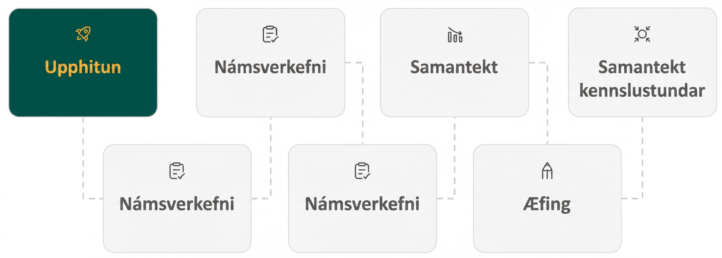
Lesson Journey
First Stop: Warm Up

Slide 7

Warm Up | Part 1
Reversing the Process
We want to factor q² + 10q + 24 by reversing the process of FOIL.
Find all the different combinations of factors of 24. Then, find the sum of each pair of factors.
Identify the pair of factors that fits the situation. What is the factored expression?
(q + ⬜)(q + ⬜)
Factors of 24 | Sum of factors
1, 24 | 1 + 24 = 25
_____ | _____
_____ | _____
_____ | _____
Notes:
Warm Up (5 minutes)
This warm up activity introduces the idea of reversing the FOIL process to factor a trinomial back into its factored form.
Launch
Introduce the first activity by identifying the trinomial 𝑞² + 10𝑞 + 24.
Allow 2 – 3 minutes for students to write down their answers, completing the table.
Once they have finished, review the solution to ensure their table is correct. Emphasize that we are looking for the factors that multiply to 24 and have a sum of 10.
Once students identify the correct factors, display the factored expression.
As a check, use FOIL to multiply the expression the students just found. This will demonstrate why they were searching for factors that multiplied to 24 and added to 10.
Answers
Factor Pairs Sum of Factors
1, 24 1 + 14 = 25
2, 12 2 + 12 = 14
3, 8 3 + 8 = 11
4, 6 4 + 6 = 10
4 and 6; so (q + 4)(q + 6)
Activity Synthesis
The FOIL process is a way of multiplying two binomials. By thinking about reversing this process, students can start to see how a trinomial might be rewritten into its factored form.

Slide 8
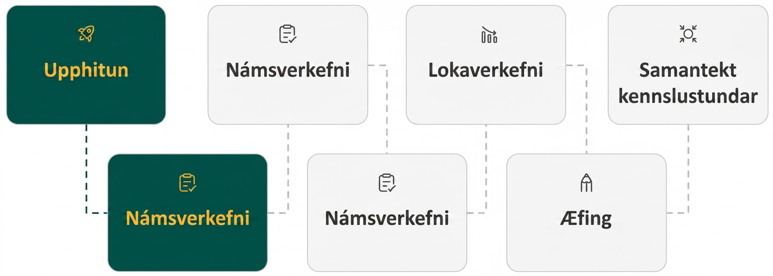
Lesson Journey
Second Stop: Learning Activity A

Slide 9
Learning Activity A | Part 1
Let the Factoring Begin! 🏇
Factors of 24 | Sum of factors
1, 24 | 1 + 24 = 25
_____ | _____
_____ | _____
_____ | _____
Let’s factor: t² + 14t + 24
What multiplies to be t²?
Think:
What are the factors of 24?
(record them in column 1 of the table)
Which of these factors add to 14?
(record the sum in column 2 of the table)
Use these factors as the last terms of the binomial.
Video
Notes:
Activity (15 minutes)
This activity introduces students to factoring a trinomial of the form 𝑥² + 𝑏𝑥 + 𝑐 by visualizing how to undo the FOIL process (or reversing the Distributive property). Students will try to think of two numbers that are factors of 𝑐 and have a sum of 𝑏. The factors that meet these requirements will be the last terms of the binomial factors of the trinomial.
Launch
Solve the first example as a class.
Pause on each part of the question for students to answer.
After students identify the correct factors, ask what should happen next.
(In the online textbook) When students are able to correctly say they should be placed as the last terms of the two binomial factors, click the Show/Hide button to reveal the factored form. A video has also been provided to explain the process.
Then allow students to solve the remaining problems individually.
As students finish, ask if there are any questions.
If you would like to use digital algebra tiles to model the process of factoring, extensive instructions are provided in the online Teacher Guide for this lesson activity. Remember you must be logged into your verified teacher account before you are able to access this resource (teacher and student accounts are free).
Activity questions, answers, anticipated misconceptions, and the activity synthesis are included on the next slide.

Slide 10
Learning Activity A | Part 2
Let the Factoring Begin! 🏇
Factor each trinomial. If the trinomial cannot be factored, write “prime.”
9m + m² + 18
a² – 11ab + 10b²
u² – 9uv – 12v²
5p – 6 + p²
m² – 64mn – 65n²
Notes:
Answers
(𝑚 + 3)(𝑚 + 6)
(𝑎 − 𝑏)(𝑎 − 10𝑏)
Prime
(𝑝 − 1)(𝑝 + 6)
(𝑚 + 𝑛)(𝑚 − 65𝑛)
Anticipated Misconceptions
Emphasize that students place the trinomial into terms with descending degrees. For example, the terms in questions 1 and 4 need to be commuted.
Also, students may struggle to determine what operations to place within the binomial factors. Emphasize to students the role of the signs in the trinomial:
The sign on the constant term, c, alerts them as to whether the the signs in the binomial factors will be the same (+) or different (-). [Students will encounter trinomials where c is negative in later lessons.]
In these trinomials of the form 𝑥² + 𝑏𝑥 + 𝑐, the sign on the linear term, b, alerts them as to whether both signs are positive or negative.
Activity Synthesis
Emphasize to students that for “undoing FOIL” to be possible as a way to factor a polynomial, it must be a trinomial of the form 𝑥² + 𝑏𝑥 + 𝑐. If the coefficient of the first term of degree 2 is not 1, then this is not an effective way to factor the polynomial.
When “undoing FOIL” to factor a trinomial, 𝑥2+𝑏𝑥+𝑐:
Think: What are the factors of 𝑐?
Which of these factors have a sum of 𝑏?
Use the factors that meet these requirements as the last terms of the binomial factors.
Multiply the binomials using FOIL to check your answer. The product should be the original trinomial.

Slide 11

Learning Activity A
Self Check
Factor y² – 16y + 63.
(y – 7)(y + 9)
(y + 7)(y – 9)
(y + 7)(y + 9)
(y – 7)(y – 9)
Let’s review!
Notes:
Answer Feedback - Individualized by Response
Incorrect. These factors do not produce the term −16𝑦 or the term +63.
Incorrect. These factors do not produce the term −16𝑦 or the term +63.
Incorrect. These factors do not produce the term −16𝑦.
That’s correct! Use FOIL (the Distributive Property) on the factors to verify that they are equivalent to 𝑦² −16𝑦 +63.

Slide 12

Learning Activity A
Self Check - Review
FACTORING x² + bx + c
Step 1 - Write the factors as two binomials with the first terms “x.”
Step 2 - Find two numbers m and n, that:
Multiply to be c: m ⏺ n = c
Sum to be b: m + n = b
Step 3 - Use m and n as the last terms in the factors.
Step 4 - Check by multiplying the factors.
Factor: y² – 11y + 28
Notes:
Additional examples are available in the online textbook and include polynomials where m and n have opposite signs (when the value of “c” is negative).

Slide 13
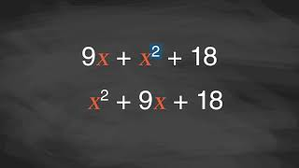
Learning Activity B | Video
Factoring Trinomials of the Form ax² + bx + c
Notes:
This video discusses question 1 of activity 6.5.2.

Slide 14
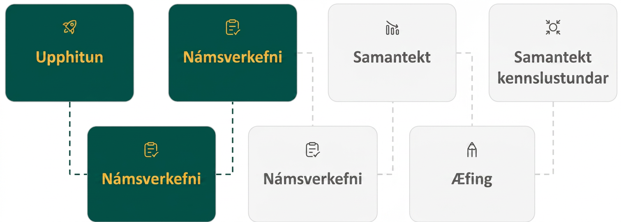
Lesson Journey
Third Stop: Learning Activity B

Slide 15
Learning Activity B | Learning Strategies
“BIG TIME” Factoring!
List the questions that could be asked to help determine which factors are needed.
Compare your questions with a partner and other classmates.
Co-craft Questions
Teacher Instruction: Use these strategies to adjust the activity to support English language learners and students with disabilities.
  You can copy and paste the callouts directly on top of the activity or give the instructions aloud.
Gather the algebra tiles you need for the polynomial.
Arrange the tiles into a rectangular shape.
HINT: Put the squared terms at the top left of the rectangle.
Action and Expression
Notes:
Support for English Language Learners: MLR 5 Co-Craft Questions: Speaking, Reading
Use this routine to help students talk through the trial and error process to factor trinomials. Ask students to write down possible mathematical questions that could be asked to help them determine which factors could solve the problem. Invite students to compare their questions before starting the trial and error process. Listen for and amplify any questions involving factoring trinomials. The process of creating mathematical questions, without the pressure of producing answers or solutions, prompts students to make sense of the given information and to activate the language of mathematical questions. This work helps to prepare students to process the actual questions.
Design Principle(s): Maximize meta-awareness; Support sense-making
Learn more about this routine
View the instructional video and follow along with the materials to assist you with learning this routine.
Provide support for students
Distribute graphic organizers to the students to assist them with participating in this routine.
Support for Students with Disabilities: Action and Expression: Flexibility and Choice
Provide students with algebra tiles to help factoring by trial and error. Algebra tiles help represent algebraic equations and provide students with a visualization of the process of factoring polynomials and trinomials. Watch the video in Factoring Trinomials with Leading Coefficients of 1 to see an example of how to use algebra tiles at the 2:00 mark.
Supports accessibility for: Conceptual processing; Visual-spatial processing

Slide 16
Learning Activity B | Part 1
“BIG TIME” Factoring!
FACTORING ax² + bx + c
Step 1 - Write the trinomial in descending order of degrees as needed.
Step 2 - Factor any GCF.
Step 3 - Find all the factor pairs of the first term.
Step 4 - Find all the factor pairs of the third term.
Step 5 - Test all the possible combinations of the factors until the correct product is found.
Step 6 - Check by multiplying the factors.
Work with a partner to factor each trinomial.
2a² + 5a + 3
8x² – 14x + 3
18x² – 3xy – 10y²
15n³ – 85n² + 100n
–10y⁴– 55y³ – 60y²
56q³ + 320q² – 96q
Notes:
Support for All Learners
This activity offers additional support for students:
For English language learners and students with disabilities, be sure to review the Learning Strategies slide!
Activity (20 minutes)
This activity introduces students to a new way to factor trinomials of the form 𝑎𝑥² + 𝑏𝑥 + 𝑐, where the leading coefficient is not 1. Students will use trial and error to find the binomial factors.
Continue scrolling down for directions on how to launch the activity, answers, and the activity synthesis.
Launch
Introduce the trial and error process used to factor a trinomial of the form 𝑎𝑥² + 𝑏𝑥 + 𝑐. Explain this is similar to the Undoing FOIL process, but that it is made more complicated when the leading coefficient is not 1.
Assign students partners to help them talk through the process of using trial and error to factor trinomials.
Read the helpful rules as a class. Discuss each one.
Allow each pair of students to work together to solve the remaining problems. Encourage them to share their reasoning as they use trial and error to factor the trinomials.
Activity - As you read through the steps, remind students to Remember these helpful rules when factoring trinomials:
Factor out the GCF first. (Step 2)
This is an important rule since it makes the remaining trinomial much simpler to factor. It may change the trinomial from the form 𝑎𝑥² + 𝑏𝑥 + 𝑐 to the form 𝑥² + 𝑏𝑥 + 𝑐. This would allow you to use the “undoing FOIL” process instead of trial and error.
When the middle term is negative and the last term is positive, the signs in the binomials must both be negative.
Only two negative numbers will result in a negative sum and a positive product.
If the leading coefficient is negative, so is the GCF.
Factoring out the negative sign from the leading coefficient will make the trinomial simpler to factor.
When the leading term is not 1 and there is no GCF, then the first two terms of the binomial factors will multiply to equal the leading term.
This means you can use trial and error to find the correct binomial factors.
Activity Synthesis
Invite students to provide suggestions for how to factor a trinomial of the form 𝑥² + 𝑏𝑥 + 𝑐. [Undo FOIL]
Invite students to provide suggestions for how to factor a trinomial of the form 𝑎𝑥² + 𝑏𝑥 + 𝑐. [First, check to see if a GCF can be factored out from the trinomial.
If yes, and a trinomial of the form 𝑥² + 𝑏𝑥 + 𝑐 remains, then “Undo FOIL.”
If yes or no, and a trinomial of the form 𝑎𝑥² + 𝑏𝑥 + 𝑐 remains, try trial and error.]
Ask a student to summarize in their own words the steps used when factoring a trinomial using trial and error. Display the steps shown at the start of the activity. Ask students if there is any point of confusion regarding these rules for factoring trinomials.

Slide 17

Learning Activity B
Self Check
Factor the trinomial completely: 6y³ + 18y² – 60y.
6y(y + 2)(y – 5)
(6y² – 12y)(y + 5)
6y(y – 2)(y + 5)
6y(y + 2)(y + 5)
Let’s review!
Notes:
Answer Feedback - Individualized by Response
Incorrect. The middle term is positive, so the greater number in the binomials should be added, not subtracted.
Incorrect. The answer is not completely factored. The first step is to factor out the GCF of 6y.
That’s correct! Multiply the factors together to determine if you have 6y³ + 18y² – 60y.
Incorrect. The last term of the trinomial is negative, so the binomials should have opposite signs. After removing the GCF of 6y, the trinomial is not correctly factored.

Slide 18
Learning Activity B
Self Check - Review
FACTORING ax² + bx + c
Step 1 - Write the trinomial in descending order of degrees as needed.
Step 2 - Factor any GCF.
Step 3 - Find all the factor pairs of the first term.
Step 4 - Find all the factor pairs of the third term.
Step 5 - Test all the possible combinations of the factors until the correct product is found.
Step 6 - Check by multiplying the factors.
Factor: 3x² + 5x + 2
Notes:
Additional examples are available in the online textbook including where a GCF needs to be factored and hints for narrowing down extensive searches.
Remind students –
When the middle term is negative and the last term is positive, the signs in the binomials must both be negative.
When we factor an expression, we always look for a greatest common factor first. If the expression does not have a greatest common factor, there cannot be one in its factors either. This may help us eliminate some of the possible factor combinations.

Slide 19
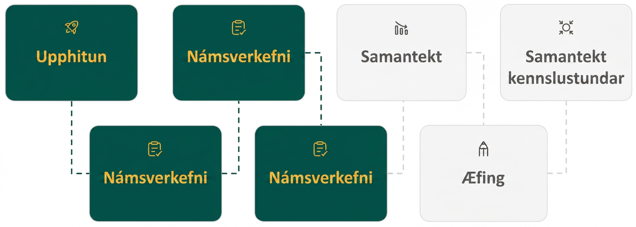
Lesson Journey
Fourth Stop: Learning Activity C

Slide 20
Learning Activity C | Part 1
“MAIN EVENT” Factoring!
Factor each trinomial using the “ac” method.
16x² – 32x + 12
6y² + y – 15
48z³ – 102z² – 45z
FACTORING USING THE “ac” METHOD
Step 1 - Factor any GCF.
Step 2 - Find the product “ac.”
Step 3 - Find two numbers m and n, that:
Multiply to be ac: m ● n = ac
Sum to be b: m + n = b
Step 4 - Split the middle term (the linear term) using m and n.
Step 5 - Factor by grouping.
Step 6 - Check by multiplying the factors.
Notes:
Activity (20 minutes)
Students have already learned one way to factor trinomials of the form 𝑎𝑥² + 𝑏𝑥 + 𝑐. In this activity, they will be introduced to the “𝑎𝑐” method, which works on any trinomial of the form 𝑎𝑥² + 𝑏𝑥 + 𝑐.
Students will also learn to recognize situations where they can substitute the variable 𝑢 for an expression, which leaves them a trinomial of the form 𝑎𝑥² + 𝑏𝑥 + 𝑐, which is much more recognizable to factor.
Launch
Open the activity by introducing the “𝑎𝑐” method to students. Explain that this method will allow them to factor any trinomial of the form 𝑎𝑥² + 𝑏𝑥 + 𝑐. Tell students that while this is a new way to factor trinomials, it is based on skills that they have already learned. Read through each step, stopping to address any confusion as needed.
Keep the steps visible to the class and work through the first problem. This will help solidify the process using the “𝑎𝑐” method.
If students are feeling less confident in the process, allow them to work in pairs as they complete questions 2 – 3. This will encourage them to talk out the process as they learn a new method to factor trinomials.
Steps 4 – 5 of the Launch will be included on the next slide with additional questions, answers, and the activity synthesis.
Answers
4(2𝑥 − 3)(2𝑥 − 1)
(3𝑦 + 5)(2𝑦 − 3)
3𝑧(8𝑧 + 3)(2𝑧 − 5)
Continuation of the activity questions, answers, and the activity synthesis are included on the next slide.

Slide 21
Learning Activity C | Part 2
“MAIN EVENT” Factoring!
When a trinomial does not seem to be in the form ax² + bx + c …
Try a substitution that allows the trinomial to be written in the ax² + bx + c form.
It is standard to use u for the substitution.
It might be a variable with an exponent, like x².
It might be a binomial, like (x – 3).
Factor each trinomial using the substitution method.
y⁴ – y² – 20
[HINT: Use u = y²]
(x – 5)² + 6(x – 5) + 8
x⁴ – 3x² – 28
Notes:
Launch, continued from previous slide
As a class, read the text on factoring by substitution that precedes question 4. To provide a hint for question 4, display the equation 𝑢 = 𝑦². By using this equation to substitute, students will find a trinomial of the form 𝑥² + 𝑏𝑥 + 𝑐 that they will recognize.
Allow time for students to complete questions 4 – 6. Pause for student questions about using substitution to factor before moving to the activity synthesis.
Continue scrolling down for answers and the activity synthesis.
Activity Answers
(𝑦² + 4)(𝑦² − 5)
(𝑥 − 3)(𝑥 − 1) [HINT: Let u = (𝑥 – 5) which yields ((𝑥 – 5) + 2)((𝑥 – 5) + 4) and simplifies to the answer given.]
(𝑥² − 7)(𝑥² + 4)
Activity Synthesis
In this activity, students learned two new ways to factor trinomials. By using the “𝑎𝑐” method, students can solve any trinomial of the form 𝑎𝑥² + 𝑏𝑥 + 𝑐. Ask the class as a whole to brainstorm the steps used in the “𝑎𝑐” method. If needed, repost the steps given on the previous slide (the steps are also given on the Additional Resources slide after the Self Check).
By using substitution, some trinomials that could not previously be factored using the methods we know will now seem to have the form 𝑎𝑥² + 𝑏𝑥 + 𝑐. Ask students to name sample values for which 𝑢 could be substituted in a polynomial: [𝑥², 𝑦², (𝑥 − 7)].

Slide 22
Learning Activity C
Self Check
Factor using the “ac” method: 6x² + 13x + 2.
(x + 2)(6x + 1)
(6x + 2)(x + 1)
(x – 2)(6x – 1)
(x – 2)(6x + 1)
Let’s review!
Notes:
Answer Feedback - Individualized by Response
That’s correct! Multiply using the FOIL method (Distributive Property) to check to make sure the answer is equivalent to the starting polynomial.
Incorrect. These factors do not multiply to the correct b term.
Incorrect. These factors do not multiply to the correct b term.
Incorrect. These factors do not multiply to neither the correct b nor c term.

Slide 23
Learning Activity C
Self Check - Review
Factor using the “ac” method: 6x² + 7x + 2
FACTORING USING THE “ac” METHOD
Step 1 - Factor any GCF.
Step 2 - Find the product “ac.”
Step 3 - Find two numbers m and n, that:
Multiply to be ac: m ● n = ac
Sum to be b: m + n = b
Step 4 - Split the middle term (the linear term) using m and n.
Step 5 - Factor by grouping.
Step 6 - Check by multiplying the factors.
Notes:
Additional examples are available in the online textbook including how to factor using substitution.

Slide 24
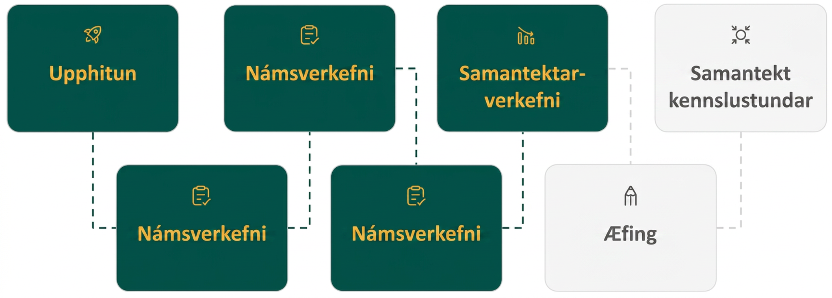
Lesson Journey
Fifth Step: Cool Down

Slide 25
Cool Down
Work with a partner.
For each trinomial, explain which method you use to factor.
When you have discussed your reasoning, factor the trinomial and compare your solutions.
x² – 14x – 32
6r² + 30r + 36
(x + 3)² – 9(x + 3) – 36
Notes:
Cool Down (5 minutes)
Answers
Trial and error; (x – 16)(x + 2)
The “ac” method; 6(r + 3)(r + 2)
Substitution; (x – 9)(x + 6)
Response to Student Thinking - Points to Emphasize
If students are still struggling to identify which method to use, encourage them to develop a set of questions they can pose to themselves like a checklist. For instance, “Is there a coefficient on the squared term?” or “Is there a GCF that can be factored out?” Remind them that the “ac” method works for any trinomial of the form ax² + bx + c.
Students will have opportunities to review and practice how to factor polynomial expressions again in Unit 8 when they use factoring to solve quadratic equations.

Slide 26
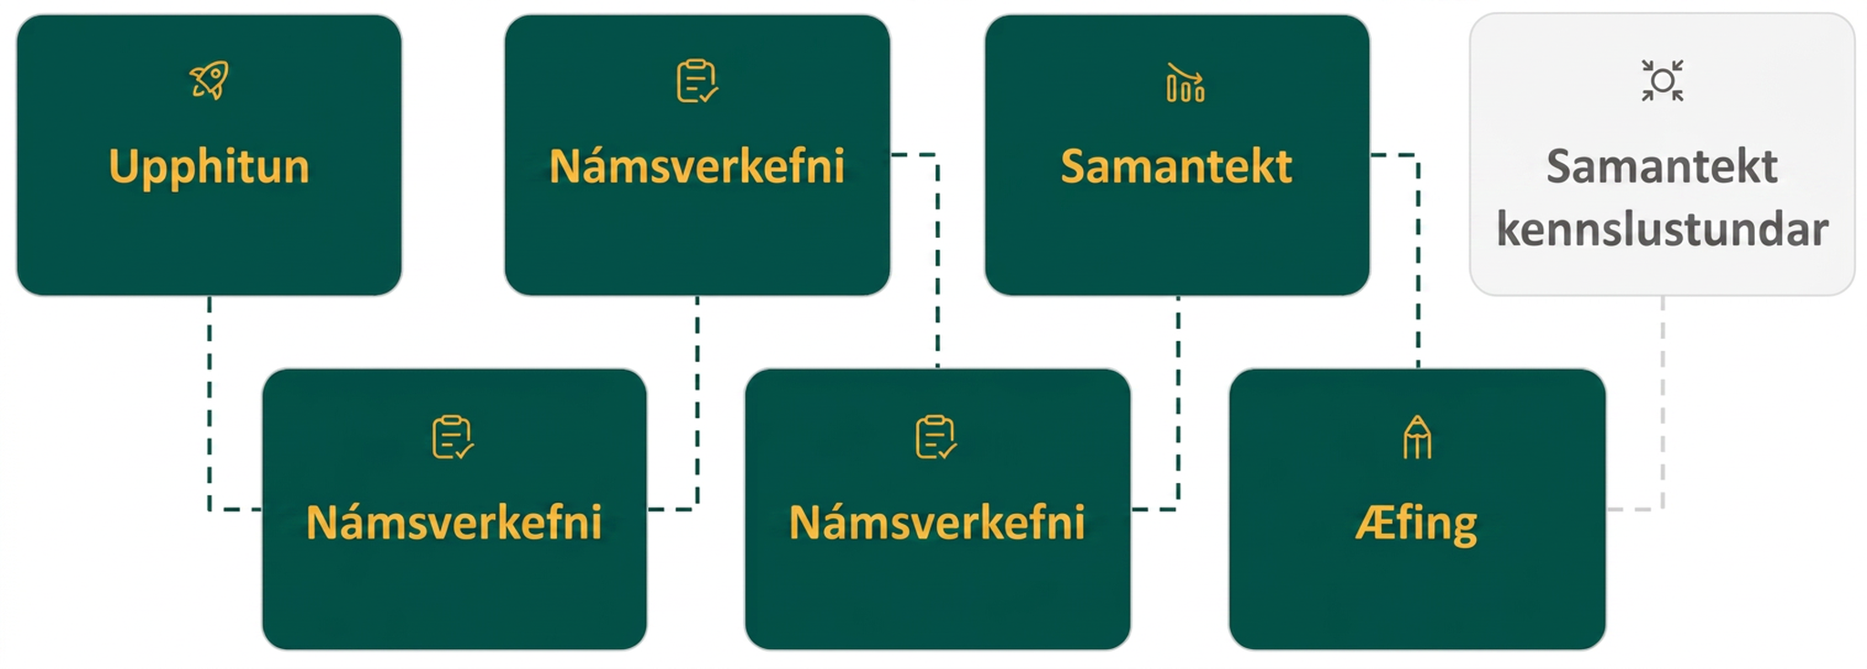
Lesson Journey
Sixth Stop: Practice

Slide 27

Practice
Put your hard work to action, practice what you’ve learned!
Notes:
Digital Practice: Access the practice pages at https://openstax.org/details/books/algebra-1

Slide 28
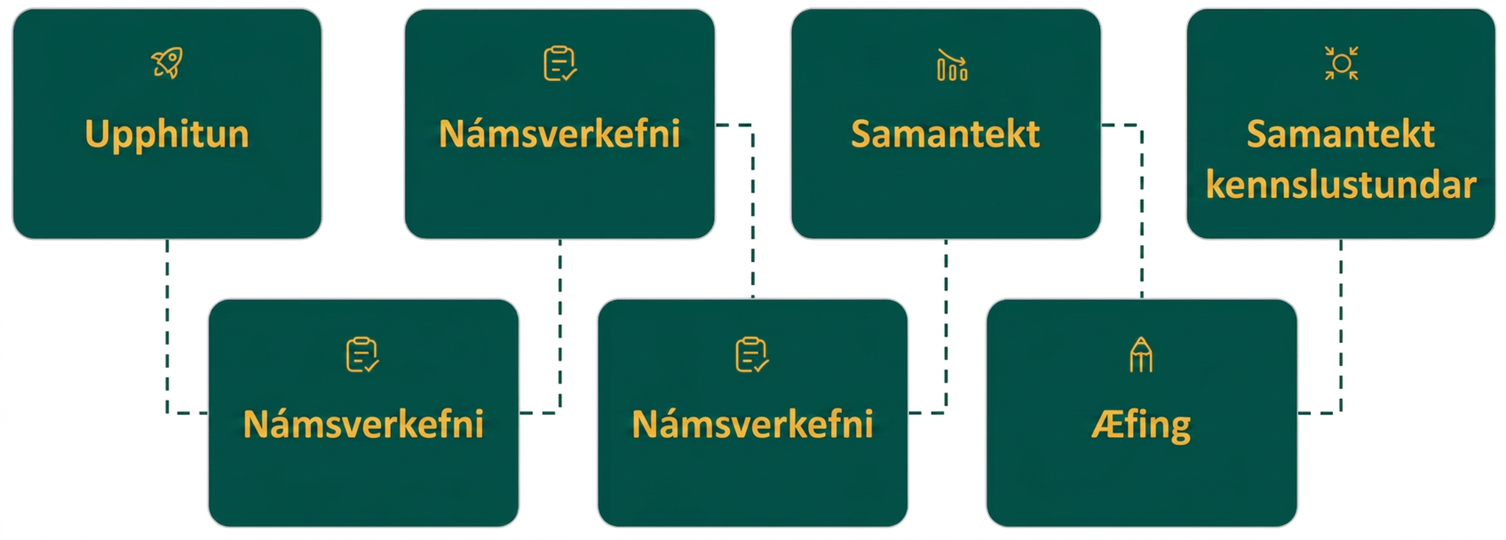
Lesson Journey
Seventh Stop: Lesson Synthesis

Slide 29
Lesson Synthesis
With a partner, list out the steps for each of the factoring methods given in the table.
Which method works on any trinomial of the form
ax² + bx + c?
To factor a trinomial of the form x² + bx + c, undo FOIL to find the binomial factors: | To factor a trinomial of the form ax² + bx + c, use the trial and error method:
For another way to factor a trinomial of the form ax² + bx + c, use the “ac” method: | To factor a trinomial not written in the form ax² + bx + c, use substitution:
Notes:
To help students’ understanding of key points from the lesson, discuss each of the following ways to factor trinomials:
To factor a trinomial of the form 𝑥² + 𝑏𝑥 + 𝑐, undo FOIL to find the binomial factors:
Write the factors as two binomials with the first terms 𝑥.
Find two numbers that multiply to 𝑐 and add to 𝑏.
Use these numbers as the last terms of the binomial factors.
Check by multiplying the factors together.
To factor a trinomial of the form 𝑎𝑥² + 𝑏𝑥 + 𝑐, use the trial and error method:
Factor any GCF.
Find all the factor pairs of the first term.
Find all the factor pairs of the third term.
Test all the possible combinations of the factors until the correct product is found.
Check by multiplying the factors together.
For another way to factor a trinomial of the form 𝑎𝑥² + 𝑏𝑥 + 𝑐, use the “𝑎𝑐” method:
This method works on any trinomial of the form 𝑎𝑥² + 𝑏𝑥 + 𝑐.
Factor any GCF.
Find the product 𝑎𝑐.
Find two numbers, 𝑚 and 𝑛, that multiply to 𝑎𝑐 and add to 𝑏.
Split the middle term using 𝑚 and 𝑛: 𝑎𝑥² + 𝑚𝑥 + 𝑛𝑥 + 𝑐.
Factor by grouping.
Check by multiplying the factors together.
To factor a polynomial that does not appear to be written in the form 𝑎𝑥² + 𝑏𝑥 + 𝑐, use substitution:
Factor any GCF.
Substitute 𝑢 for a common expression in the first terms.
Factor as if the trinomial is of the form 𝑎𝑥² + 𝑏𝑥 + 𝑐.
Replace 𝑢 with the original value.

Slide 30
Self Assessment
How much do you agree with the following statements?
Learning Goals | I can | Almost | Not yet
Factor trinomials of the form x² + bx + c. | ⃞ | ⃞ | ⃞
Factor trinomials of the form ax² + bx + c using trial and error. | ⃞ | ⃞ | ⃞
Factor trinomials of the form ax² + bx + c using the “ac” method. | ⃞ | ⃞ | ⃞
Factor trinomials using substitution. | ⃞ | ⃞ | ⃞

