Slide 1


Algebra 1
Unit 4 Functions
Lesson 4.18: The nth Term of a Sequence

Slide 2
How to use these slides
On the activity slides check the speaker notes for teacher support and instructional information.
Each lesson includes 1 warm up, 2-3 learning activities, a cool down, practice and a lesson synthesis.
  Learning activities are followed by a self check question, and review section.
Some slides have been hidden from student view, more information can be found on the next slide (Reference Key).
You can edit and use these slides for personal and classroom use, but cannot sell them and must keep the attribution logos.
For more information, Check out the digital quick start guide!

Slide 3






Reference Key
Check the top right corner for an icon referencing these unique sections.
 | Support for Students with Disability | Hidden | Learning Strategies slide, provides additional support to students for understanding the activity. Learning Strategies slide, provides additional support to students for understanding the activity.
 | Support for English Language Learners | Hidden
 | Extending Your Thinking | Hidden | Extending Your Thinking slide, provides an extra challenge for students.
 | Self Check | Not Hidden | Self Check slide, checkpoint to assess student understanding after the learning activity.
 | Review | Hidden | Self Check- Review slide, designed to help review topics from the self check question.
On the next slides, check the speaker notes for teacher instructions and support.
Notes:
Check the Speaker Notes: On the next slides you can find discussion questions, lesson information, answers to the activities, and ways to adjust the activity for your students!

Slide 4

Learning Goals
By the end of this lesson you will be able to -
Find terms of sequences directly.
Explain why different equations can represent the same sequence.
Notes:
Lesson Narrative
In this lesson, students review the definition of a function and explore real-world examples using descriptions, tables, and graphs. They learn that a function assigns exactly one output to each input and analyze representations to determine if a relationship is a function. Students interpret input-output pairs and connect verbal descriptions to tables and graphs in context.
Required Preparation
For the paper cutting activity, prepare 1 pair of scissors for every 2 students.
Required Materials
Sheets of 8 x 10 grid paper
Scissors
Graphing technology
Texas Essential Knowledge and Skills
A1(B) use a problem-solving model that incorporates analyzing given information, formulating a plan or strategy, determining a solution, justifying the solution, and evaluating the problem-solving process and the reasonableness of the solution
A1(F) analyze mathematical relationships to connect and communicate mathematical ideas
A12(D) write a formula for the nth term of arithmetic and geometric sequences, given the value of several of their terms

Slide 5
Vocabulary
Previous
Recursive Definition
  A function that provides a repeated or recurring process for finding terms in a sequence.
Arithmetic
  A sequence with a constant difference between consecutive terms.
Geometric
  A sequence where each term is found by multiplying the previous term by a constant ratio r, with r ≠ 0 and r ≠ 1.
New
nth term
  A formula that tells you the value of any term in a sequence based on its position, 𝑛.
Notes:
Lesson Vocabulary
To support student understanding of key vocabulary:
Introduce and review the vocabulary words students will see in this lesson.
Encourage students to notice how these words are used and to include them in their math discussions and explanations—both written and oral.
Use a word wall to reinforce vocabulary. Sample word wall cards are available here.
For newcomers or students with beginning English proficiency, use these Quizlet sets to support vocabulary learning:
Unit 4 Spanish Vocabulary, part 1 – use first to build understanding
Unit 4 Vocabulary (English), part 1 – use after anchoring in Spanish
Unit 4 Spanish Vocabulary, part 2 – use first to build understanding
Unit 4 Vocabulary (English), part 2 – use after anchoring in Spanish
Support for English Language Learners
ELPS 1(E) internalize new basic and academic language by using and reusing it in meaningful ways in speaking and writing activities that build concept and language attainment
ELPS 2(F) listen to and derive meaning from a variety of media such as audiotape, video, DVD, and CD-ROM to build and reinforce concept and language attainment
ELPS 3(D) speak using grade-level content area vocabulary in context to internalize new English words and build academic language proficiency
ELPS 3(F) ask and give information ranging from using a very limited bank of high-frequency, high-need, concrete vocabulary, including key words and expressions needed for basic communication in academic and social contexts, to using abstract and content-based vocabulary during extended speaking assignments
ELPS 3(G) express opinions, ideas, and feelings ranging from communicating single words and short phrases to participating in extended discussions on a variety of social and grade-appropriate academic topics

Slide 6





Lesson Journey
Warm Up
Learning Activity
Learning Activity
Practice
Learning Activity
Learning Activity
Cool Down
Lesson Synthesis

Slide 7

Warm Up - Which One Doesn’t Belong? 🤔
Which one doesn’t belong?
5 + 2 + 2 + 2 + 2 + 2 + 2
5 + 6 ⋅ 2
5⋅2⁶
5 ⋅ 2 ⋅ 2 ⋅ 2 ⋅ 2 ⋅ 2 ⋅ 2
Notes:
Warm Up (5 minutes)
This warm-up has students compare four expressions to encourage precise language and reveal their understanding of terminology. It reinforces that repeated addition is multiplication and repeated multiplication is exponents, preparing them to interpret sequence equations.
Launch
Arrange students in groups of 2 – 4. Display the expressions for all to see. Give students 1 minute of quiet time to think individually and then time to share their thinking with their small group. In their small groups, ask each student to share their reasoning why a particular item does not belong.
Answer
Doesn’t belong because:
It is the only expression with repeated addition.
It is the only expression that only has addition.
Doesn’t belong because:
It is the only expression with both addition and multiplication.
Doesn’t belong because:
It is the only expression with an exponent.
Doesn’t belong because:
It is the only expression with repeated multiplication.
It is the only expression that only has multiplication.
Activity Synthesis
Ask each group to share one reason why a particular item does not belong. Record and display the responses for all to see. After each response, ask the class if they agree or disagree. Since there is no single correct answer to the question of which one does not belong, attend to students’ explanations and ensure the reasons given are correct.
If it doesn’t come up during the discussion, highlight the fact that A and B are equivalent expressions, and C and D are equivalent expressions.

Slide 8

Lesson Journey
Warm Up
Learning Activity
Learning Activity
Practice
Learning Activity
Lesson Synthesis
Learning Activity
Learning Activity
Cool Down

Slide 9
Learning Strategies - Sierpinski Triangle🔺
Teacher Instruction: Use these strategies to adjust the activity to support English language learners and students with disabilities.
  You can copy and paste the callouts directly on top of the activity or give the instructions aloud.
“Whose equation do you think is correct?”
Stronger and Clearer Each Time
Notes:
Support for English Language Learners: MLR 1 Stronger and Clearer Each Time: Writing, Conversing
Use this routine to prepare students for the whole-class discussion by providing them with multiple opportunities to clarify their explanations through conversation. Before the whole-class discussion begins, give students time to meet with 1 – 2 other groups to share their response to the question, “Whose equation do you think is correct?” Invite listeners to ask questions and to press for details and mathematical language.
Design Principle(s): Optimize output (for explanation); Cultivate conversation
Provide support for students
Distribute graphic organizers to the students to assist them with participating in this routine.

Slide 10

Learning Activity - Sierpinski Triangle🔺
A Sierpinski triangle can be created by starting with an equilateral triangle, breaking the triangle into 4 congruent equilateral triangles, and then removing the middle triangle. Starting from a single black equilateral triangle:
Let S be the number of black triangles in Step n. Define S(n) recursively.
Andre and Lin are asked to write an equation for S that isn’t recursive. Andre writes S(n) = 3n for n ≥ 0, while Lin writes
S(n) = 3n − 1 for n ≥ 1. Whose equation do you think is correct?
Be prepared to show your reasoning.
Are you ready for more?
Notes:
Support for All Learners
This activity offers additional support and an extension for students:
For English language learners and students with disabilities, be sure to review the Learning Strategies slide!
For students looking for an extra challenge, be sure to review the Extending Your Thinking slide!
Activity (10 minutes)
This lesson extends TEKS A12(D) and serves as enrichment to deepen understanding of arithmetic and geometric sequences. The goal is for students to see that how an equation defines a function depends on how the domain is interpreted. Previously, starting at C(0) made sense because n was the number of cuts. In this activity, students compare two equations—one starting at Step 0, the other at Step 1—both representing the same visual pattern.
To help students see that both equations are valid, encourage precise language during partner work and discussion, emphasizing clarity in how n is defined. Some students may struggle with the idea that both equations are correct, so take time to address this misconception.
Monitor for students who clearly define n and use tables or other representations to show both equations produce the same sequence, and invite them to share during the discussion.
Making a spreadsheet available gives students an opportunity to choose appropriate tools strategically.
Launch
Arrange students in groups of 2.
Activity Answers
S(1) = 3, S(n) = 3⋅S(n − 1) for n ≥ 2.
They are both correct. For example: Lin is correct because if the image shows Steps 1 to 4, her equation gives the correct number of triangles for each step. Andre is correct since if we start with the black triangle, which is like Step 0, then Step 1 is the one with three triangles and Step 2 has 9 triangles, and those numbers match his equation.
Anticipated Misconceptions
Students may assume that at least one person has to be wrong because their equations aren’t equivalent. Encourage them to make a table for each equation that starts with the first value for n
according to the definition
Activity Synthesis
The goal of this discussion is to help students understand why both Andre's and Lin's equations represent the visual pattern, based on how they interpret n. Display the pattern, have students share reasoning for Andre or Lin, and record their ideas. If confusion remains about starting at 0, give more time to consider Andre's view (e.g., n as "breaking apart" phase) and have students explain.
Explain that choosing a domain depends on both the context and how the relationship is viewed. Multiple correct equations can represent a function, but students must clearly state their domain so others can interpret their equation correctly.

Slide 11
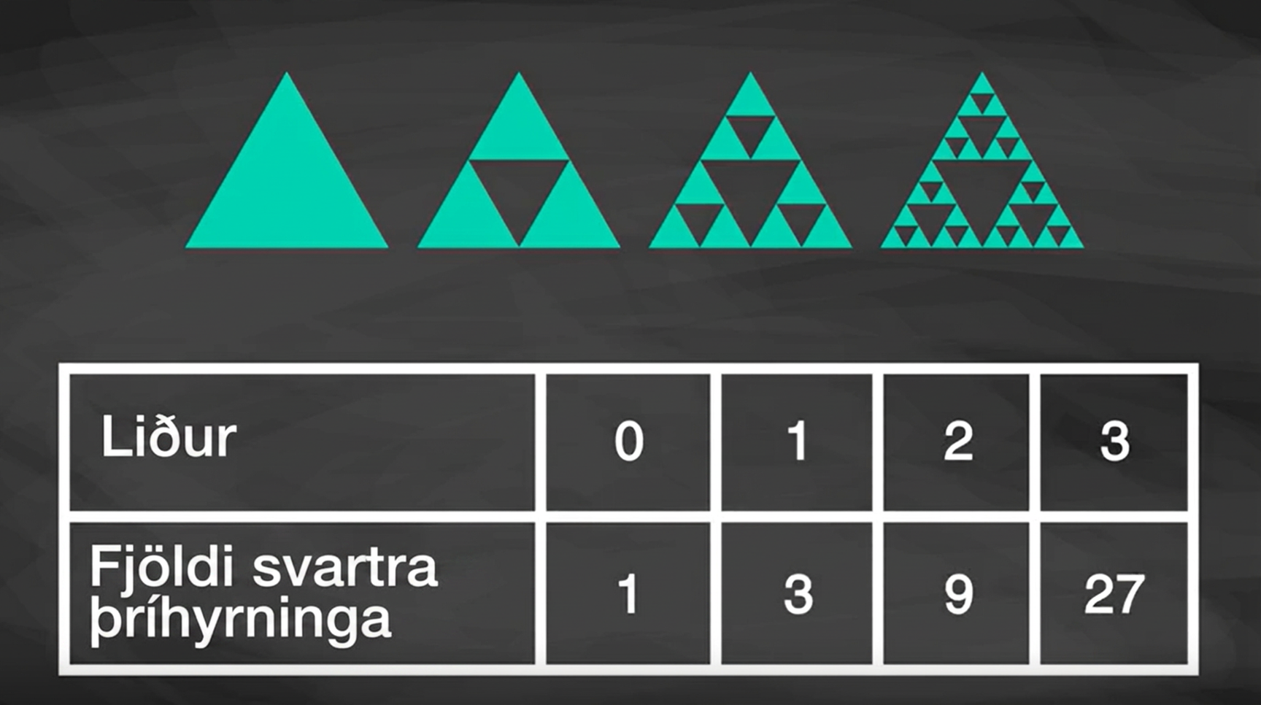
Video: Learning About Sierpinski’s Triangle

Slide 12

Extending Your Thinking
Here is a geometric sequence. Find the missing terms.
3, ____, 6, ____, 12, ____, 24
Notes:
Answer
3√2, 6√2, 12√2 or equivalent

Slide 13
Lesson Journey
Warm Up
Learning Activity
Learning Activity
Learning Activity
Practice
Learning Activity
Lesson Synthesis
Learning Activity
Learning Activity
Cool Down

Slide 14
Learning Strategies - Cutting Up Paper ✂️
Teacher Instruction: Use these strategies to adjust the activity to support English language learners and students with disabilities.
You can copy and paste the callouts directly on top of the activity or give the instructions aloud.
We are going to break the class into small group discussion groups and you will choose a representative from your group to report back to the whole class
Engagement
Notes:
Support for Students with Disabilities: Engagement: Develop Effort and Persistence
Break the class into small group discussion groups and then invite a representative from each group to report back to the whole class.
Supports accessibility for: Language; Social-emotional skills; Attention

Slide 15
Learning Activity - Cutting Up Paper ✂️
Clare starts with an 8x10 inch paper and repeatedly cuts it in half.
  Instead of writing a recursive definition, Clare writes C(n) = 80⋅(1/2)^{n}, where C is the area, in square inches, of the paper after n cuts. Explain where the terms in her expression came from.
  Approximately what is the area of the paper after 10 cuts?
Kiran starts with an 8x10 inch paper and repeatedly cuts away 1 inch from the width.
  Complete the table for the area of Kiran’s paper K(n), in square inches, after n cuts.
  Kiran says the area after 6 cuts, in square inches, is 80−8⋅6. Explain where the terms in her expression came from.
  Write a definition for K(n) that is not recursive.
n | K(n)
0 | 80
1
2 | 80 − 8 − 8 = 80 − 8(2) = 64
3
4
5
n | K(n)
0 | 80
1 | 72
2 | 64
3 | 56
4 | 48
5 | 40
Notes:
Support for All Learners
This activity offers additional support and an extension for students:
For English language learners and students with disabilities, be sure to review the Learning Strategies slide!
Activity (15 minutes)
In this activity, students revisit the 8x10 grid paper to explore non-recursive definitions of a geometric and an arithmetic sequence based on different cutting methods. They use repeated reasoning to find specific terms and then generalize to the nth term, introducing the idea that a function’s domain depends on how the relationship is viewed. Graphing technology can be provided for strategic tool use.
Depending on time, either ask students for observations about C(n) or explain it’s a geometric sequence with a growth factor of ½. Say, “This sequence starts at
n = 0, since we begin with a paper with 0 cuts. How can we write a recursive definition for C(n)?” (C(0) = 80, C(n) = C(n−1) ⋅ ½, n ≥ 1). Select students to share, emphasizing the starting term C(0) and n ≥ 1. Highlight that the domain depends on the situation, and starting at n = 1 isn't always appropriate. Using function notation, we specify starting at C(0) and adjust n ≥ 1 accordingly.
Clarify that multiplying 80 ⋅ ½ ⋅ ½ ⋯ n times is the same as 80 ⋅ (½ )^{n}. Discuss how (½ )² = ½ × ½ , etc.
Launch
Arrange students in pairs and give each group scissors and 2 sheets of grid paper if using.
Remind them of Clare’s paper cutting activity: starting with an 8x10 sheet, she cuts, stacks, and repeats. Define C(n) as the area of each piece after n cuts. Display the table for reference. Click Here to go to the slide that contains the table.
Activity Answers:
For example: Each cut halves the area, and there are n cuts. The original area is 80, so 80⋅12⋅12⋅⋅⋅⋅⋅12 with n multiplications of 12 is the same as saying 80⋅(12)^{n}.
Approximately 0.078 square inches (exactly ⁸⁰⁄₁₀₂₄ inches)
Filled in table appears on slide click.
For example: Each cut removes 8 square inches, so 6 cuts removes 48 square inches. The original area was 80 square inches, so the remaining area, in square inches, is 80 − 8⋅6.
K(n) = 80 − 8n for integers 0 ≤ n ≤ 9 or equivalent.
More activity questions, answers, anticipated misconceptions, and synthesis on the next slide.

Slide 16
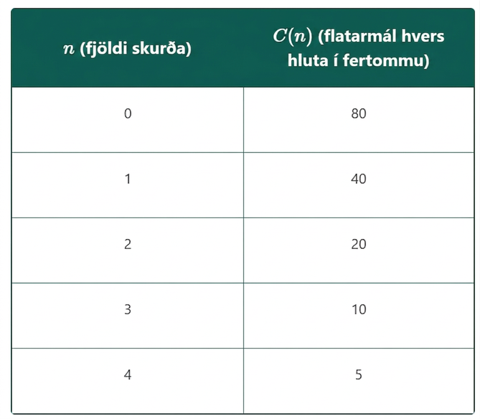
Learning Activity - Cutting Up Paper ✂️
Notes:
Table Used in the Launch
Ask students to recall the paper cutting activity from an earlier lesson. In it, Clare takes a sheet of paper that is 8 inches by 10 inches, cuts the paper in half, stacks the pieces, cuts the pieces in half, then stacks them, etc. We can let C(n) be the area, in square inches, of each piece based on the number of cuts n. Display the table for all to see.

Slide 17
Learning Activity - Cutting Up Paper ✂️
Arithmetic Sequence Formulas
Where a₁ is the first term, n is the term you want, and d is the common difference.
Recursive Formula Explicit General Formula
a_{n} = a_{n} ₋ ₁ + d a_{n} = a₁ + (n−1)d
Which is larger, K(6) or C(6)?
Is K arithmetic or geometric?
Is C arithmetic or geometric?
A recursive sequence defines each term using one or more previous terms. Given the nth term and the common difference or factor, you can find the (n+1)th term using a recursive formula.
Different definitions can produce the same sequence. For arithmetic and geometric sequences, explicit formulas provide a direct way to find any term.
These are called the nth term or the general term of the sequence.
Notes:
Answers
K(6) is larger.
K(n) is arithmetic.
C(n) is geometric.
Anticipated Misconceptions
Students struggling to visualize the paper cuts can draw and label each step or physically cut paper and calculate areas. If they don’t see why Kiran removes 8 square inches each time, have them record dimensions and areas for the first few steps, drawing if needed.
Activity Synthesis
Display the two definitions: C(n) = 80 ⋅ (½)^{n} and K(n) = 80 − 8n. Ask, “Which defines a geometric sequence and which an arithmetic sequence?” (C(n) halves each term—geometric. K(n) subtracts 8 each time—arithmetic.)
Explain that both are nth-term definitions, also called explicit formulas, which students will use when asked to write an equation for a sequence. Recursive definitions are different and will be explored later.
If time allows, ask students to compare K(10) and C(10). (K(10) = 0, C(10) > 0, though K(10) may not exist since a tenth cut isn’t possible.) Highlight the importance of considering domain based on context.

Slide 18
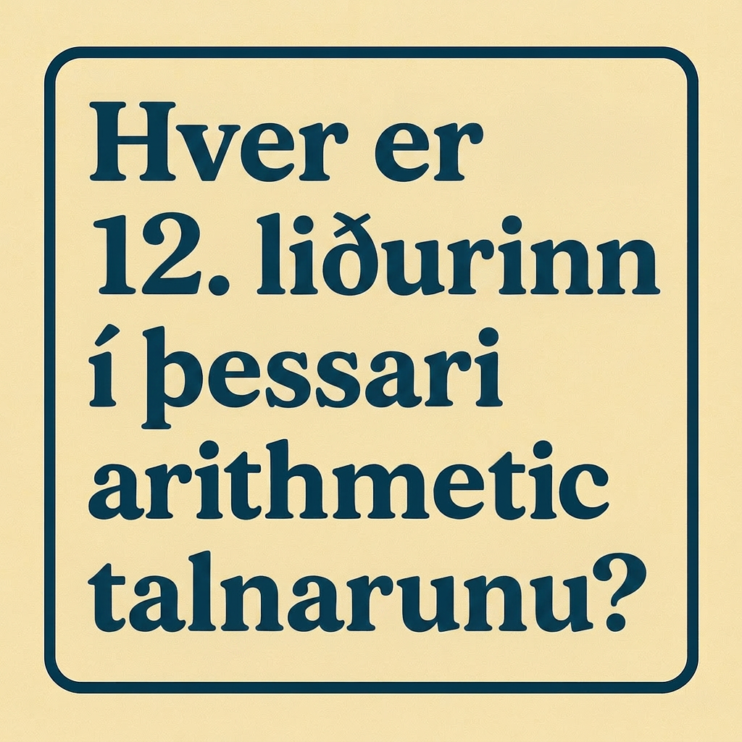
Self Check
What is the 12th term in an arithmetic sequence where the first term is 22 and the common difference is –2?
-2
-22
0
–45056
Let’s review!
Notes:
Answer Feedback - Individualized by Response
-2
Incorrect. Remember to multiply the difference by n − 1, not n. Substitute the values into the nth term formula for arithmetic sequences. The answer is 0.
-22
Incorrect. Make sure to add to the first term. The answer is 0.
0
That’s correct! Substitute into the formula, an = a₁ + (n − 1)d, so that a₁₂ = 22 + (12 − 1)(−2) = 22 + (−22) = 0.
–45056
Incorrect. Use the formula for arithmetic sequences, not geometric. The answer is 0.

Slide 19
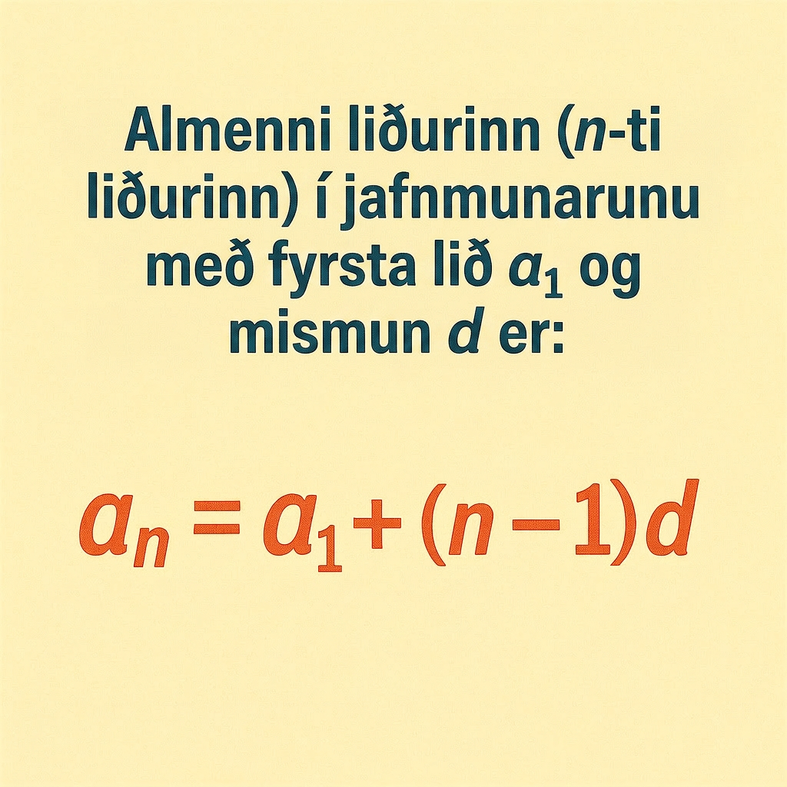
Self Check - Review
Write the explicit formula for the sequence given by the terms 18, 21, 24, 27, ...
Find the 15th term of a sequence where the first term is 3 and the common difference is 6.
Notes:
Write the explicit formula for the sequence given by the terms 18, 21, 24, 27, ...
Answer:
Step 1: Write the general formula an = a₁+ (n − 1)d.
Step 2: Substitute values for the first term, common difference/ratio, term number.
a₁ = 18, d = 3
a_{n} = 18 + (n − 1)3
So, the explicit formula for the sequence 18, 21, 24, 27… is a_{n} = 18 + (n − 1)3.
Now any term can more easily be determined - even the 1000th term!
Find the 15th term of a sequence where the first term is 3 and the common difference is 6.
Answer:
Step 1: Write the general formula an = a₁+ (n − 1)d.
Step 2: Substitute values for the first term, common difference/ratio, term number.
a₁ = 3, d = 6, n = 15
a₁₅ = 3 + (15 − 1)6
Step 3: Simplify the expression.
a₁₅ = 3 + (14)6
a₁₅ = 3 + 84
a₁₅ = 87
If the explicit formula for this question was needed, we would not have substituted n = 15 and the nth term formula would have been a_{n} = 3 + (n − 1)6. This formula is also equivalent to a_{n} = 3 + 6(n − 1).

Slide 20
Lesson Journey
Warm Up
Learning Activity
Learning Activity
Learning Activity
Practice
Learning Activity
Lesson Synthesis
Learning Activity
Learning Activity
Learning Activity
Cool Down

Slide 21
Learning Strategies- Estimating Wildcat Populations 🐯
Teacher Instruction: Use these strategies to adjust the activity to support English language learners and students with disabilities.
You can copy and paste the callouts directly on top of the activity or give the instructions aloud.
Create a visual display of your work.
Think about what to include on your display so others can understand how you figured out the year the population met certain conditions.
Compare and Connects
Notes:
Support for English Language Learners: MLR 7 Compare and Connect: Representing, Listening
Use this routine to prepare students for the whole-class discussion by inviting students to create a visual display of their work. Students should consider what to include on their display so that other students will be able to interpret how they determined the year the population met specific constraints. Students may wish to add notes or details to their displays to help communicate their reasoning. Begin the whole-class discussion by selecting and arranging 2-4 displays for all to see. Give students 1-2 minutes of quiet time to think individually to interpret the displays before inviting the authors to share their strategies.
Design Principle(s): Support sense-making, Maximize meta-awareness
Learn more about this routine
View the instructional video and follow along with the materials to assist you with learning this routine.
Provide support for students
Distribute graphic organizers to the students to assist them with participating in this routine.

Slide 22
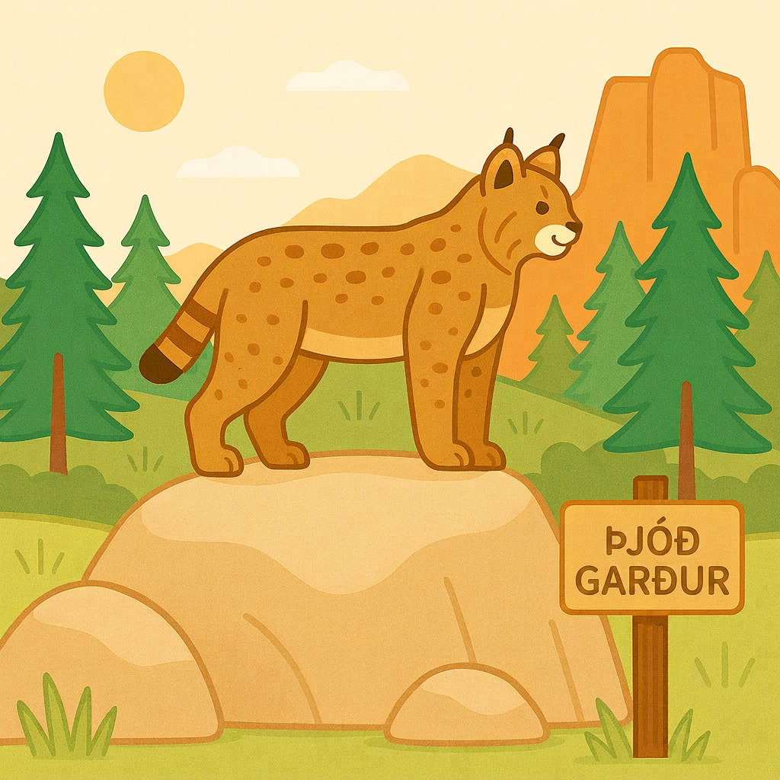
Learning Activity - Estimating Wildcat Populations 🐯
In 2015, the number of wildcats in a national park was 284. It was estimated that the wildcat population increased by 4% each year.
A researcher for the park writes W_{n} = 284(1.04)^{n}, where W is the projected wildcat population n years after 2015. Explain where the different factors in her expression came from.
Notes:
Support for All Learners
This activity offers additional support and an extension for students:
For English language learners and students with disabilities, be sure to review the Learning Strategies slide!
Activity (15 minutes)
This activity introduces the formula for finding the nth term of a geometric sequence and prepares students for exponential functions. As students predict when the population exceeds 500, circulate to observe their chosen strategies (table, graph, or equation) and select students using different methods to present. Monitor their use of terms like initial value, common ratio, recursive formula, and explicit formula, encouraging precise vocabulary.
Launch
Pair students and ask if they’ve seen wildcats in the wild or zoos. Discuss why estimating wildcat populations is challenging. Provide paper or graph paper for tables and graphs, and inform students they may be asked to present their method. Encourage detailed displays to explain their reasoning.
Activity Answers
Your answer may vary, but here are some samples.
The 284 is the starting population of the wildcats in 2015.
The 1.04 represents that the population grows 4% or 0.04 each year.
The 1.04 comes from 100% of the population + 4% growth = 104% or 1.04.
The n represents the number of years since 2015. So, in 2016, n = 1 and in 2017, n = 2
.
More activity questions and answers on the next slide.

Slide 23
Learning Activity - Estimating Wildcat Populations 🐯
With a partner, create a table estimating the wildcat population for the next 7 years.
Create a table of values to estimate the projected wildcat population over the next 7 years.
Year | n | Wildcat Population
2015 | 0 | W_{n} = 284(1.04)⁰ = 284
2016 | 1 | W_{n} = 284(1.04)¹ = 295
2017 | 2 | W_{n} = 284(1.04)² = ?
2018 | 3
2019 | 4
2020 | 5
2021 | 6
2022 | 7
Year | n | Wildcat Population
2015 | 0 | 284
2016 | 1 | 295
2017 | 2 | 307
2018 | 3 | 319
2019 | 4 | 332
2020 | 5 | 346
2021 | 6 | 359
2022 | 7 | 374
Notes:
Activity Answers
Filled in graph appears on slide click
More activity questions and answers on the next slide.

Slide 24
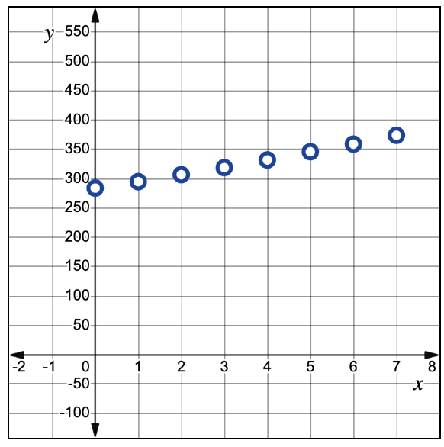
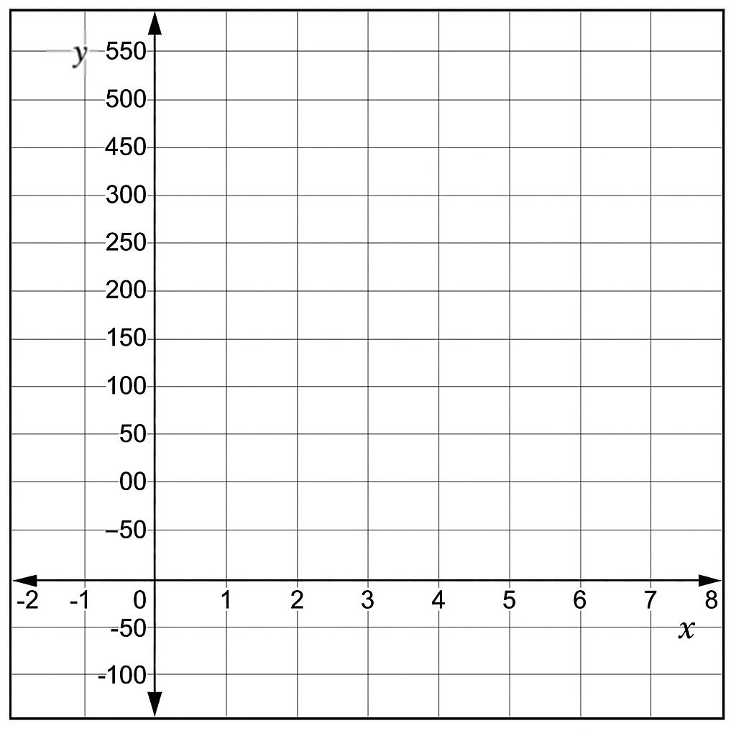
Learning Activity - Estimating Wildcat Populations 🐯
Answer the questions using the the pair you defined as a function.
On a piece of graph paper, graph the data that represents the population projections for this scenario.
Calculate and determine the year when the wildcat population will exceed 500 members.
Is the data that represents this scenario an arithmetic or geometric sequence? Explain your reasoning.
Notes:
Answers
Completed graph appears on slide click.
The wildcat population is expected to exceed 500 members in 2030 when they are projected to have 511 wildcats.
Your answer may vary, but here are some samples.
This data represents a geometric sequence because the equation has a common ratio of 1.04.
This data represents a geometric sequence because the ratio between consecutive terms in the table is 1.04.
This data represents a geometric sequence because the graph does not depict a line, it is curved a little and does not have a constant slope.
More activity questions, answers, anticipated misconceptions, and synthesis on the next slide.

Slide 25
Learning Activity - Estimating Wildcat Populations 🐯
Remember that a recursive formula defines terms using one or more of the previous terms. If you need to calculate the 100th or 500th term in a sequence, the recursive formula becomes difficult to use if you do not know the values of the terms near n = 100 or n = 500.
Different formulas can generate the same sequence, but some are written in an easier to use form called general or explicit rules. The, rule to find the nth term, formulas can be used to find any term in the sequence.
Geometric Sequence Formulas
Recursive Formula
a_{n} = a_{n} ₋ ₁ ⋅r
where a₁ is the first term, n is the term you want, and r is the common ratio.
Explicit General Formula
a_{n} = a₁ (r)^{n−1}
Where a₁ is the first term, n is the term you want, and r is the common ratio.
Notes:
Answers
Completed graph appears on slide click.
The wildcat population is expected to exceed 500 members in 2030 when they are projected to have 511 wildcats.
Your answer may vary, but here are some samples.
This data represents a geometric sequence because the equation has a common ratio of 1.04.
This data represents a geometric sequence because the ratio between consecutive terms in the table is 1.04.
This data represents a geometric sequence because the graph does not depict a line, it is curved a little and does not have a constant slope.
Anticipated Misconceptions:
Students may confuse explicit and recursive formulas. Post an anchor chart to help them reference definitions during discussions. Encourage them to explain why they chose a specific formula. Also, ensure students identify whether a sequence is arithmetic or geometric before presenting or completing tasks.
Activity Synthesis:
Students should understand the parts of an explicit formula for geometric sequences and when to use it. Wrap up by having students connect tables, graphs, and equations. Ask non-presenting students to annotate similarities across these representations.

Slide 26

Self Check
For the function J(n) = 180(⅓ )^{n − 1}, what is the value of the function when n = 5?
45
20
¹⁸⁰⁄₈₁
¹⁄₈₁
Let’s review!
Notes:
Answer Feedback - Individualized by Response
45
Incorrect. n = 5 must be substituted into the equation. This is ¹⁸⁰⁄₄. The answer is ¹⁸⁰⁄₈₁.
20
Incorrect. This is the value when n=3. The answer is ¹⁸⁰⁄₈₁.
¹⁸⁰⁄₈₁
That’s Correct! Substitute n = 5 into the function. (⅓ )⁴ = ¹⁄₈₁, so J(4) = ¹⁸⁰⁄₈₁.
¹⁄₈₁
Incorrect. Make sure to multiply (⅓ )⁴ by 180. The answer is ¹⁸⁰⁄₈₁.

Slide 27
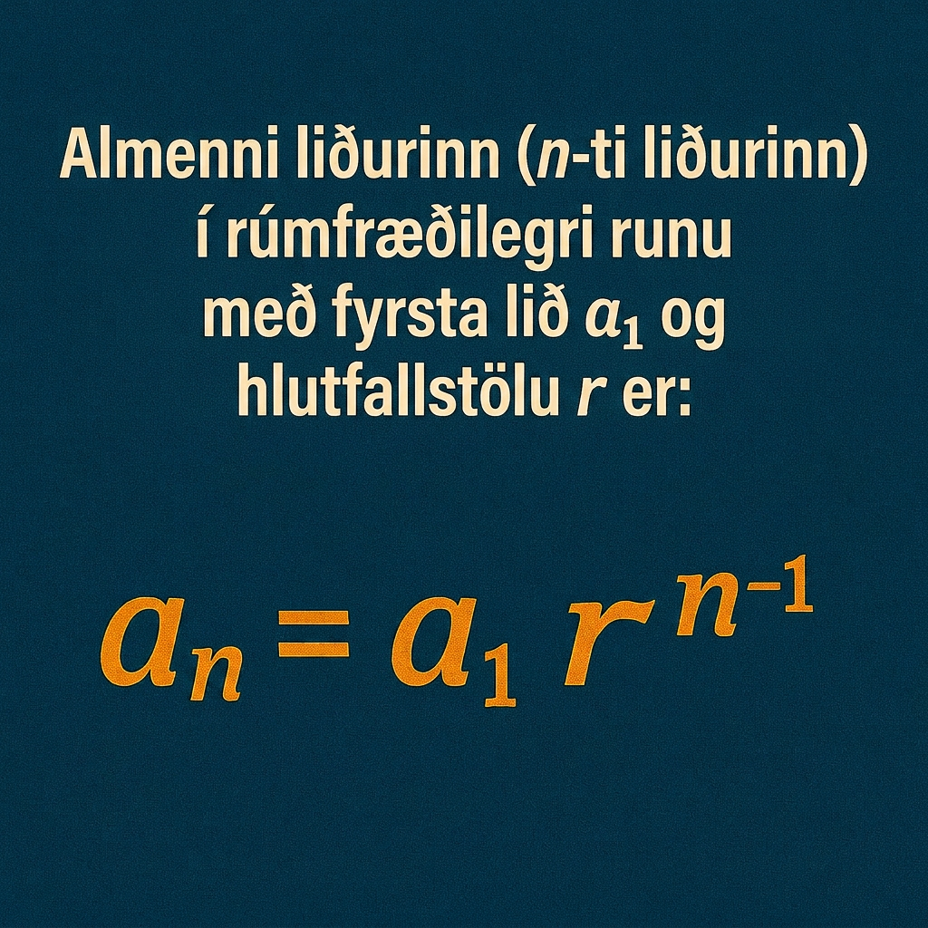
Self Check - Review
Write the explicit formula for the sequence given by the terms 3, 2, 43, 89 ...
Find the 14th term of a sequence where the first term is 64 and the common ratio, r = ½ .
Notes:
Write the explicit formula for the sequence given by the terms 3, 2, 43, 89 …
Answer
Step 1- Write the general formula.a_{n} = a₁(r^{n − 1}).
Step 2 - Substitute values for the first term, common difference/ratio, term number.
a₁ = 3, r = ⅔
a_{n} = 3(⅔ )^{n−1}
So, the explicit formula for the sequence 3, 2, 43, 89 ... is a_{n} = 3(⅔ )^{n−1}.
Just like it is with arithmetic sequences, the explicit formula makes finding any term easier to determine - especially term numbers that are very large!
Find the 14th term of a sequence where the first term is 64 and the common ratio, r = ½ .
Answer
Step 1- Write the general formula.a_{n} = a₁(r^{n − 1}).
Step 2 - Substitute values for the first term, common difference/ratio, term number.
a₁ = 64, r = ½, n = 14
a₁₄=64 (½)¹⁴⁻¹
Step 3 - Simplify the expression.
a₁₄= 64 (½)¹³
a₁₄= 64 (¹⁄₈₁₉₂)
a₁₄ = 1128
If the explicit formula for this question was needed, we would not have substituted n = 14 and the nth term formula would have been a_{n} = 64(½ )^{n − 1}.

Slide 28
Lesson Journey
Warm Up
Learning Activity
Learning Activity
Learning Activity
Learning Activity
Practice
Learning Activity
Lesson Synthesis
Learning Activity
Learning Activity
Learning Activity
Cool Down

Slide 29
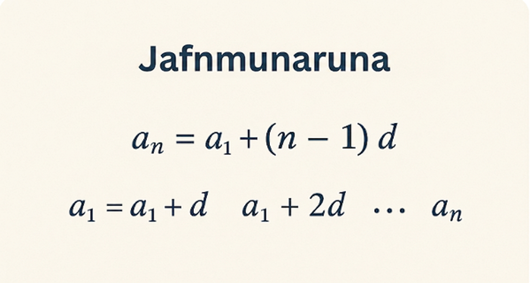
Learning Activity - Converting Between Formulas 🔄️
Converting from a Recursive Formula to an Explicit Formula for Arithmetic Sequences
An arithmetic sequence has the following recursive formula:
a₁= 3
a_{n}=a_{n−1}+2, n ≥ 2
Recall that this formula gives us the following two pieces of information:
The first term is 3.
To get any term from its previous term, add 2. In other words, the common difference is 2.
Let’s find an explicit formula for the sequence.
We can represent a sequence whose first term is A and common difference is B with the standard explicit form A + B(n − 1).
Therefore, an explicit formula of the sequence is a_{n} = 3 + 2(n − 1).
Write an explicit
(nth term) formula for an arithmetic sequence where b₁ = 2 and b_{n}=b_{n−1}+7, n ≥ 2.
Notes:
Activity Answers:
B_{n} = 2 + (n − 1)7
More activity questions on the next slide.

Slide 30
Learning Activity - Converting Between Formulas 🔄️
Converting from an Explicit Formula to a Recursive Formula for Arithmetic Sequences
Given the following nth term of an arithmetic sequence, use it to rewrite the recursive formula:
d_{n}= 5 + (n − 1) ⋅ 16
We can represent a sequence whose first term is A and common difference is B with the standard explicit form A + B(n − 1).
Find a recursive formula for the sequence using the following:
The first term of the sequence, which we know is 5.
The pattern rule to get any term from the term that comes before it. which we know is the common difference, “add 16.”
Therefore, a recursive formula for the sequence: d₁ = 5, d_{n} = d_{n−1}+ 16, n ≥ 2.
Write an explicit
(nth term) formula for an arithmetic sequence where
e_{n}=12 + (n−1)⋅2.
Notes:
Activity Answers:
e₁= 12, e_{n} = e_{n−1}+2, n ≥ 2
More activity questions on the next slide.

Slide 31
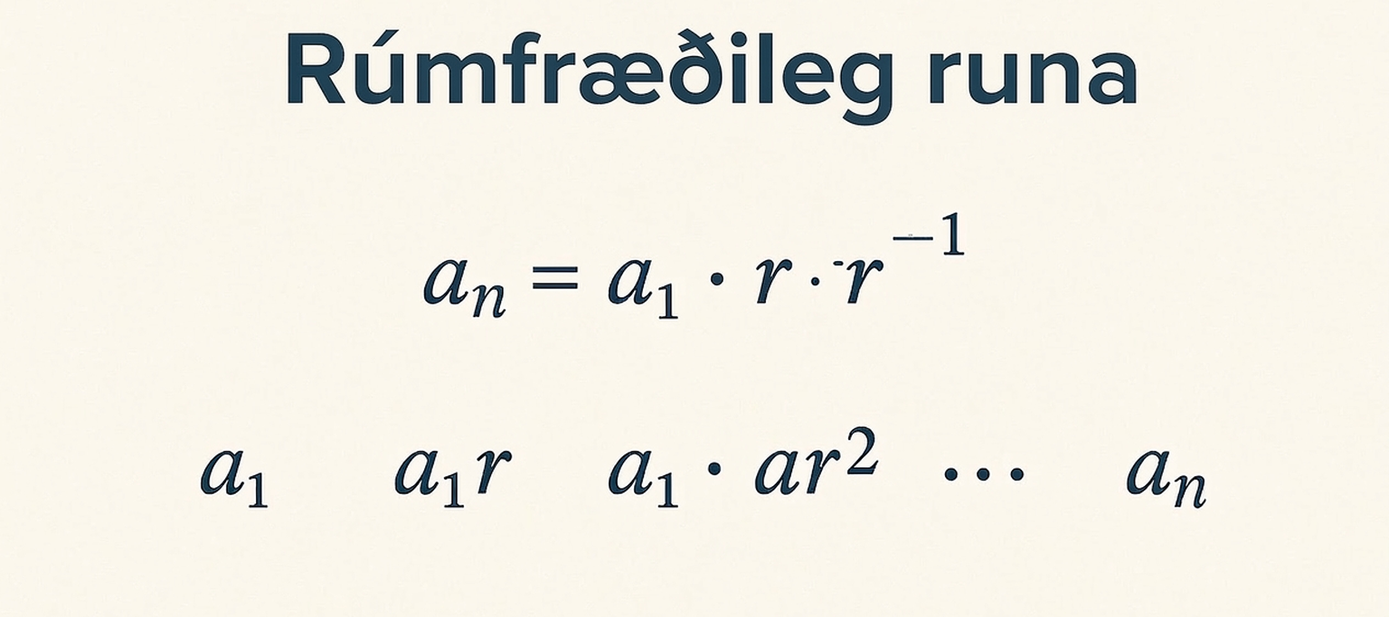
Learning Activity - Converting Between Formulas 🔄️
Converting from a Recursive Formula to an Explicit Formula for Geometric Sequences
An geometric sequence g(n) has the following recursive formula:
g₁= 9
g_{n} = g_{n − 1}⋅(8), n ≥ 2
Recall that this formula gives us the following two pieces of information:
The first term is 9.
8 is the common ratio.
Let’s find an explicit formula for the sequence.
An explicit formula is structured as:
g(x) = (1st term of sequence) ⋅ (common ratio)^{(x−1)}.
Substitute the values, and you get the explicit formula: g_{n} = 9⋅8^{(n−1)}
Write the nth term of the geometric sequence where
g₁= 5 and
g_{n} = g_{n−1}⋅4, n ≥ 2.
Notes:
Activity Answers:
g_{n} = 5⋅4^{(n−1)}
More activity questions on the next slide.

Slide 32
Learning Activity - Converting Between Formulas 🔄️
Converting from an Explicit Formula to a Recursive Formula for Geometric Sequences
Given the following nth term of a geometric sequence, use it to rewrite the recursive formula:
g_{n} where g_{n} = 6⋅3^{n−1}.
Working backward, when n = 1, g₁= 6.
The formula for geometric sequences recursively is g_{n} = g_{n−1}⋅r,, where r is the common ratio.
The common ratio of the given sequence is 3.
So, g₁ = 6, and g_{n} = g_{n−1}⋅ 3, n ≥ 2.
Write the geometric sequence represented by g_{n} = 14⋅2^{n−1}
using the recursive definition.
Notes:
Activity Answers:
g₁ = 14, g_{n} = g_{n−1}⋅2, n ≥ 2

Slide 33
Learning Activity - Converting Between Formulas 🔄️
Notes:
Table Used in the Launch
Ask students to recall the paper cutting activity from an earlier lesson. In it, Clare takes a sheet of paper that is 8 inches by 10 inches, cuts the paper in half, stacks the pieces, cuts the pieces in half, then stacks them, etc. We can let C(n) be the area, in square inches, of each piece based on the number of cuts n. Display the table for all to see.

Slide 34

Self Check
Write the nth term formula of the geometric sequence represented by
g₁ = −3 and g_{n} = g_{n} − 1⋅6, n ≥ 2.
g_{n} = 6n + −3
g_{n} = −3⋅6^{n}
g_{n} = −3⋅6^{n-1}
g_{n} = 6(n − 1) −3
Let’s review!
Notes:
Answer Feedback - Individualized by Response
g_{n} = 6n + −3
Incorrect. The common ratio should be raised to the power of n − 1, and the first term should be multiplied, not added. The answer is g_{n} = −3⋅6^{n-1}.
g_{n} = −3⋅6^{n}
Incorrect. The first term using this formula is –18. Use n − 1 for the exponent. The answer is g_{n} = −3⋅6^{n-1}.
g_{n} = −3⋅6^{n-1}
That’s Correct! he first term was –3 and the common ratio is 6.
g_{n} = 6(n − 1) −3
Incorrect. The first term should be multiplied by the common ratio. The answer is g_{n} = −3⋅6^{n-1}.

Slide 35
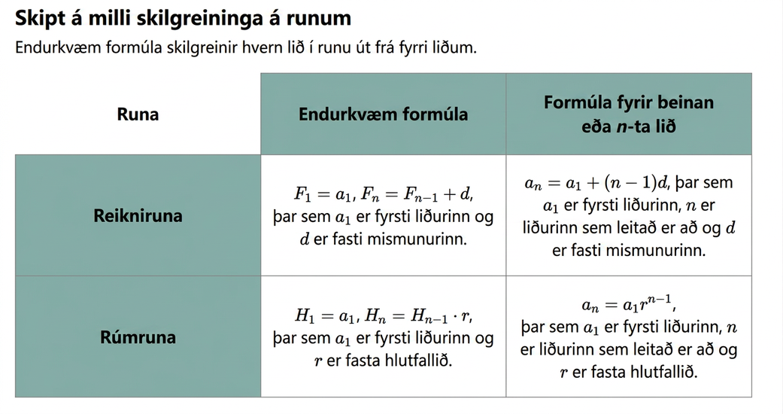
Self Check - Review
Notes:
An example for the explicit general formula for the arithmetic sequence in recursive form is on the next slide.

Slide 36
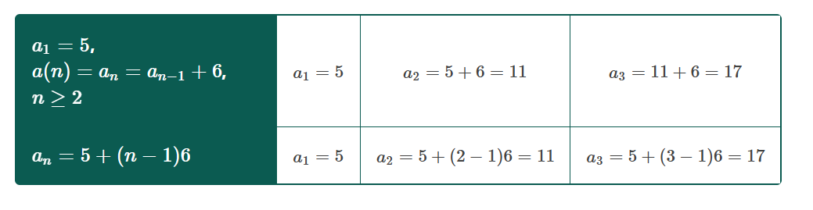
Self Check - Review
Example 1
Find the explicit general formula for the arithmetic sequence in recursive form: a₁ = 5, a_{n} = a_{n−1}+6, n ≥ 2.
Step 1 - Write the recursive formula. (given) a₁ = 5, a_{n} = a_{n−1}+6, n ≥ 2
Step 2 - Identify the first term. a₁ = 5
Step 3 - Identify the common difference/ratio. d = 6
Step 4 - Write the explicit formula for the nth term. a_{n} = a₁ + (n − 1)d
Step 5 - Substitute the first term and common difference/ratio into the formula. a_{n} = 5 + (n − 1)6
Check by finding the first 3 terms using each formula:
Both formulas produce the same first 3 terms:
5, 11, 17.
Notes:
An example for the explicit general formula for the geometric sequence in recursive form example is on next slide.

Slide 37
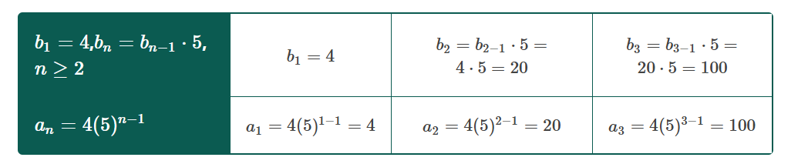
Self Check - Review
Example 2
Find the explicit general formula for the geometric sequence in recursive form: b₁ = 4, b_{n} = b_{n− 1}⋅5, n ≥ 2
Step 1 - Write the recursive formula. (given) b₁ = 4, b_{n} = b_{n− 1}⋅5, n ≥ 2
Step 2 - Identify the first term. a₁ = 4
Step 3 - Identify the common difference/ratio. r = 5
Step 4 - Write the explicit formula for the nth term. a_{n} = a₁r^{n-1}
Step 5 - Substitute the first term and common difference/ratio into the formula. a_{n} = 4(5)^{n − 1}
Check by finding the first 3 terms using each formula:
Both formulas produce the same first 3 terms:
4, 20, 100.
Notes:
An example for the recursive formula for the arithmetic sequence given in explicit general form is on the next slide.

Slide 38
Self Check - Review
Example 3
Find the recursive formula for the arithmetic sequence given in explicit general form. a_{n} = 21 + (n − 1)(−2)
Step 1 - Write the explicit formula. a_{n} = 21 + (n − 1)(−2)
Step 2 - Identify the first term. d = 21
Step 3 - Identify the common difference/ratio. d = -2
Step 4 - Write the explicit formula for the nth term. F₁ = a₁, F_{n} = F_{n−1}⋅ r, n ≥ 2
Step 5 - Substitute the first term and common difference/ratio into the formula. F₁ = 21, F_{n} = F_{n−1}-2, n ≥ 2
Check by finding the first 3 terms using each formula.
Both formulas produce the same first 3 terms: 21, 19, 17.
Notes:
An example for the recursive formula for the geometric sequence given in explicit general form is on the next slide.

Slide 39
Self Check - Review
Example 4
Find the recursive formula for the geometric sequence given in explicit general form. a_{n}=3⋅(¼ )^{n−1}
Step 1 - Write the explicit formula. a_{n}=3⋅(¼ )^{n−1}
Step 2 - Identify the first term. a₁ = 3
Step 3 - Identify the common difference/ratio. r = ¼
Step 4 - Write the explicit formula for the nth term. H₁ = a₁, H_{n} = H_{n−1}+ d, n ≥ 2
Step 5 - Substitute the first term and common difference/ratio into the formula. H₁ = 3, H_{n} = H_{n−1}⋅ ¼ , n ≥ 2
Check by finding the first 3 terms using each formula.
Both formulas produce the same first 3 terms: 3, ¾, ³⁄₁₆.

Slide 40

Lesson Journey
Warm Up
Learning Activity
Learning Activity
Learning Activity
Learning Activity
Practice
Learning Activity
Lesson Synthesis
Learning Activity
Learning Activity
Cool Down
Learning Activity
Cool Down

Slide 41
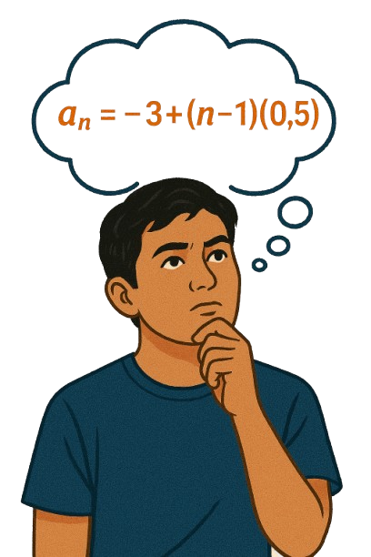
Cool Down
A sequence is defined by f₁ = −3, f_{n} = f_{n −1} + 0.5 for n ≥ 2.
Diego writes an equation for the n^{th} term of the sequence as a_{n} = −3 + (n − 1)(0.5). Is he correct?
Explain how you know.
How would you describe the representation
f₁ = −3, f_{n}= f_{n−1}+ 0.5 for n ≥ 2 for Diego’s sequence?
How would you describe the representation of Diego’s sequence, a_{n} = −3 + (n−1)(0.5)?
Notes:
Cool Down (5 minutes)
Answers
Yes. For example: Both definitions create a sequence that starts at –3 and increases by 0.5 each term.
It is the recursive definition of the sequence.
This is the n^{th} term of the sequence.
Response to Student Thinking - More Chances
Students will have more opportunities to understand the mathematical ideas in this cool down, so there is no need to slow down or add additional work to the next lessons. Instead, use the results of this cool down to provide guidance for what to look for and emphasize over the next several lessons to support students in advancing their current understanding.

Slide 42

Lesson Journey
Warm Up
Learning Activity
Learning Activity
Learning Activity
Learning Activity
Practice
Practice
Learning Activity
Lesson Synthesis
Learning Activity
Learning Activity
Cool Down
Learning Activity
Cool Down

Slide 43

Practice
Put your hard work to action, practice what you’ve learned!
Notes:
Digital Practice: Access the practice pages at https://openstax.org/k12/algebra

Slide 44

Lesson Journey
Warm Up
Learning Activity
Learning Activity
Learning Activity
Learning Activity
Practice
Practice
Learning Activity
Lesson Synthesis
Learning Activity
Learning Activity
Cool Down
Learning Activity
Cool Down
Lesson Synthesis

Slide 45
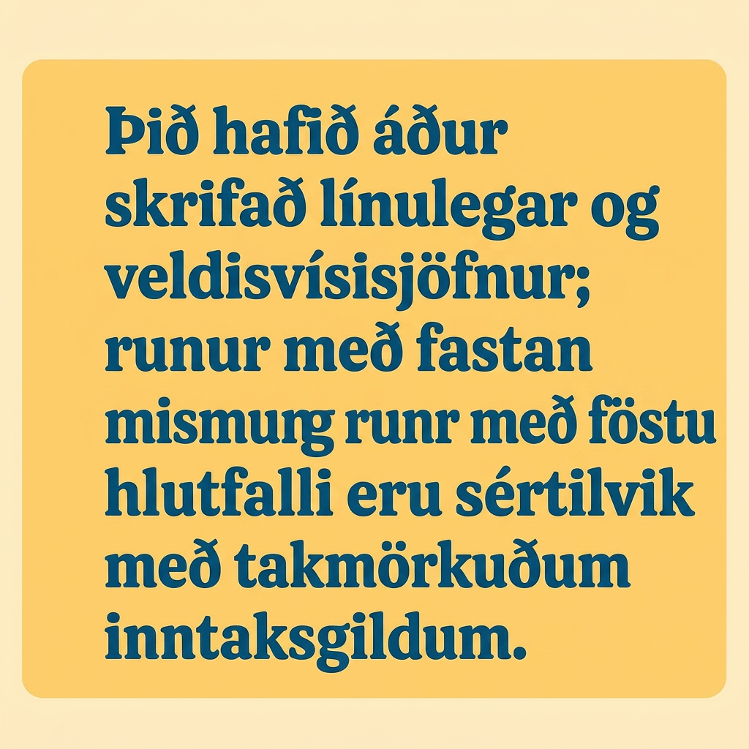
Lesson Synthesis
Pick one of the sequences and write an equation for the nth term.
C: 1, 2, 4, 8, 16, . . .
E: 20, 13, 6, –1, –8, . . .
Notes:
Prompt: Display these two sequences from an earlier lesson for all to see:
C: 1, 2, 4, 8, 16, . . .
E: 20, 13, 6, –1, –8, . . .
Invite students to pick one of the sequences and write an equation for the nth term. If students are unsure where to start, remind them of their work writing equations for linear and exponential functions done in previous courses. Arithmetic and geometric sequences are just special types of these functions with a restricted domain. After some work time, select students to share their equations, making sure they clearly state whether they assumed the sequence started with n = 0
or n = 1.
For example, an equation for E could be E(n) = 20 − 7(n) for n ≥ 0, or it could be E(n) = 20 − 7(n − 1) for n ≥ 1.
Closing the Lesson
After completing the Lesson Synthesis, wrap up the class by directing students to the Lesson Summary in their student textbook. In this section, students review the day’s learning targets, read summaries about the key takeaways from each activity, and then respond to a reflection question regarding their confidence with the material.
For more on the benefits of using this type of metacognitive reflection, see the Research in Practice section of the course.

Slide 46
Self Assessment
How much do you agree with the following statements?
I can… | I can | Almost | Not yet
Describe the nth term.
Find terms of sequences directly.
Explain why different equations can represent the same sequence.

