Slide 1
Algebra 1
Unit 5 Introduction to Exponential Functions
Lesson 5.2 Rational Exponents

Slide 2

How to use these slides
On the activity slides check the speaker notes for teacher support and instructional information.
Each lesson includes 1 warm up, 2-3 learning activities, a cool down, practice and a lesson synthesis.
  Learning activities are followed by a self check question, and review section.
Some slides have been hidden from student view, more information can be found on the next slide (Reference Key).
You can edit and use these slides for personal and classroom use, but cannot sell them and must keep the attribution logos.
For more information, Check out the digital quick start guide!
OpenStax CC BY NC SA

Slide 3





Reference Key
Check the top right corner for an icon referencing these unique sections.
Icon | Title | View | Location and Description
n/a | Support for Students with Disability | Hidden | Learning Strategies slide, provides additional support to students for understanding the activity.
n/a | Support for English Language Learners | Hidden | Learning Strategies slide, provides additional support to students for understanding the activity.
n/a | Extending Your Thinking | Hidden | Extending Your Thinking slide, provides an extra challenge for students.
n/a | Self Check | Not Hidden | Self Check slide, checkpoint to assess student understanding after the learning activity.
n/a | Review | Hidden | Self Check - Review slide, designed to help review topics from the self check question.
On the next slides, check the speaker notes for teacher instructions and support.
Notes:
Check the Speaker Notes: On the next slides you can find discussion questions, lesson information, answers to the activities, and ways to adjust the activity for your students!

Slide 4

Learning Goals
By the end of this lesson you will be able to -
Simplify radical expressions with even and odd indexes.
Rewrite expressions with rational exponents as roots.
Use properties for exponents with rational exponents.
Notes:
Lesson Narrative
This lesson explores the meaning of rational exponents. Students begin reviewing how to simplify numbers using radicals with given roots. They start with square roots and perfect squares and move to make conclusions about cubed roots.
In the following activities, students work to write radicals as terms with rational exponents and vice versa. They then work to apply the properties for exponents to terms that include rational exponents. In the cool-down, students also revisit negative exponents when exploring how properties work with rational exponents.
Required Preparation
None
Required Materials
None
Texas Essential Knowledge and Skills
A1(F) analyze mathematical relationships to connect and communicate mathematical ideas.
A11(B) simplify numeric and algebraic expressions using the laws of exponents, including integral and rational exponents.

Slide 5
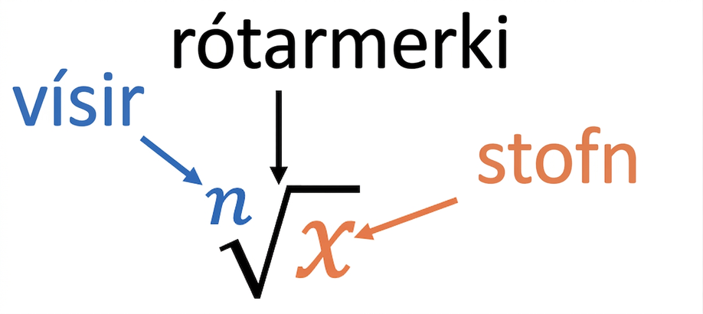
Vocabulary
New
Radical ⎷
  The symbol used to represent finding the root of a number or expression.
Root
  value represents a number (y), which when multiplied by itself a given number of times (y 𑇐 y 𑇐 y 𑇐 y 𑇐 ...), equals x, another number.
Index
  The number outside the root of a radical indicating the root. In a radical such as ⁿ√x, this value is represented by the n.
Radicand
  The term under a radical sign. In a radical such as ⁿ√x, this value is represented by the x.
Notes:
Lesson Vocabulary
To support student understanding of key vocabulary:
Introduce and review the vocabulary words students will see in this lesson.
Encourage students to notice how these words are used and to include them in their math discussions and explanations—both written and oral.
Use a word wall to reinforce vocabulary. Sample word wall cards are available here.
For newcomers or students with beginning English proficiency, use these Quizlet sets to support vocabulary learning:
Unit 5 Spanish Vocabulary – use first to build understanding
Unit 5 Vocabulary (English) – use after anchoring in Spanish
Support for English Language Learners
ELPS 1(F) use accessible language and learn new and essential language in the process.
ELPS 2(F) listen to and derive meaning from a variety of media such as audiotape, video, DVD, and CD-ROM to build and reinforce concept and language attainment.
ELPS 3(E) share information in cooperative learning interactions.

Slide 6
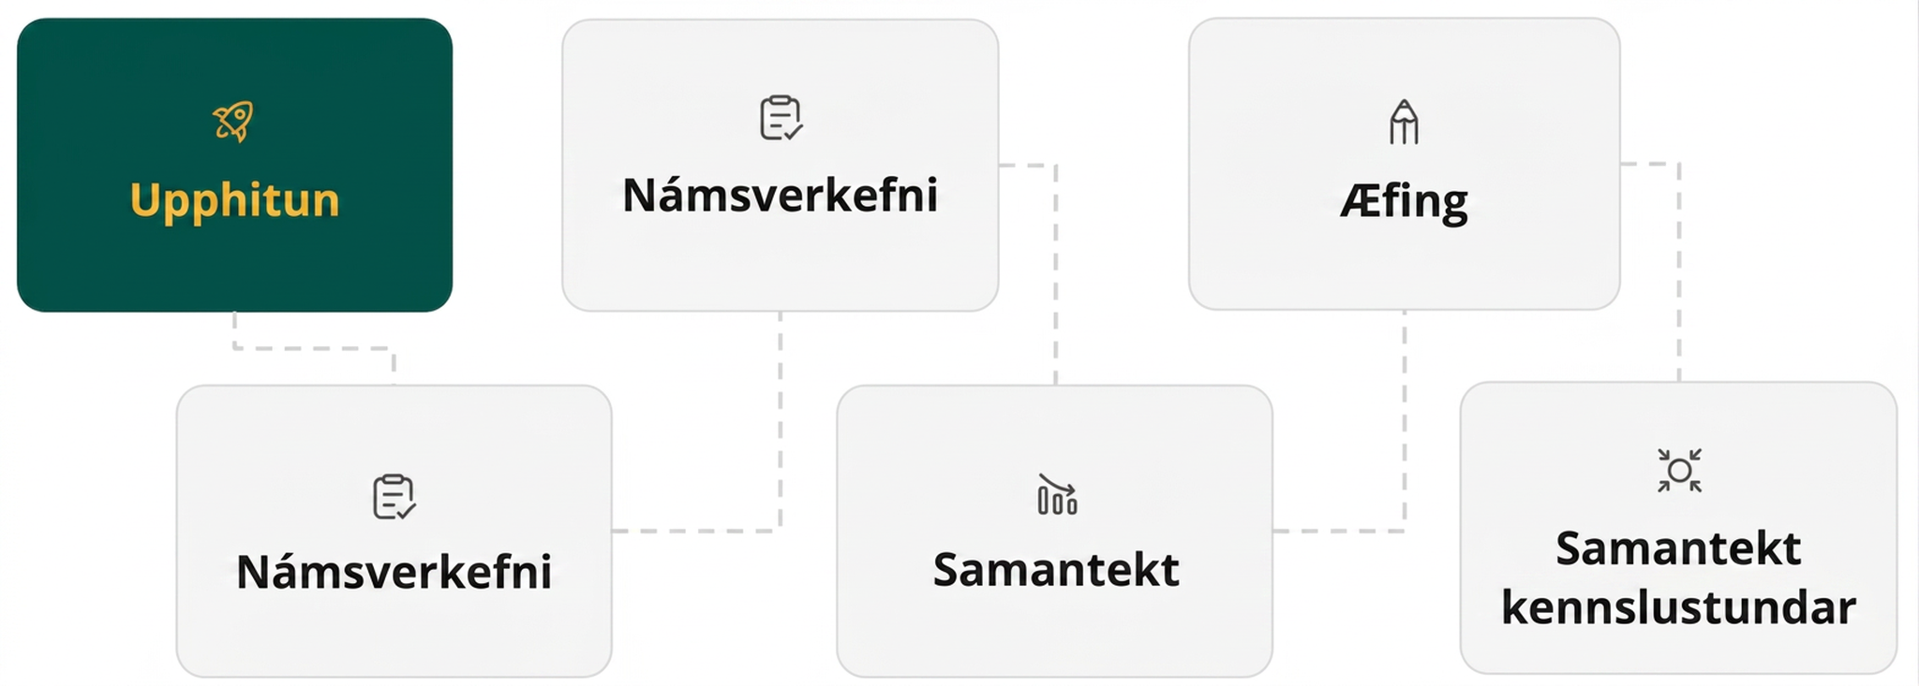
Lesson Journey
First Stop: Warm Up

Slide 7

Warm Up | Part 1
Am I Perfect … Or What? 😉
What is the value of 4 × 4?
What is the value of 4²?
Using what you know about roots, what is the value of √16?
Talk to a partner. How can you prove ²√(4²) = 4?
Talk to a partner. What do you think the answer to ⁵√(4⁵) would be?
Notes:
Warm Up (5 minutes)
This warm up reviews perfect squares and square roots and begins to elicit the idea of higher powers and the n^{th} root.
Launch
Arrange students in groups of 2.
Answers
16
16
4
Since 4² = 4 𑇐 4 = 16 and √16 = 4, then ²√(4²) = 4. Notice that the root and exponents are the same and simplify to leave the integer (base) only.
4
Activity Synthesis
If time allows, continue to give more examples where the exponent and index of the root are the same. Ask students to come up with a rule or pattern.

Slide 8
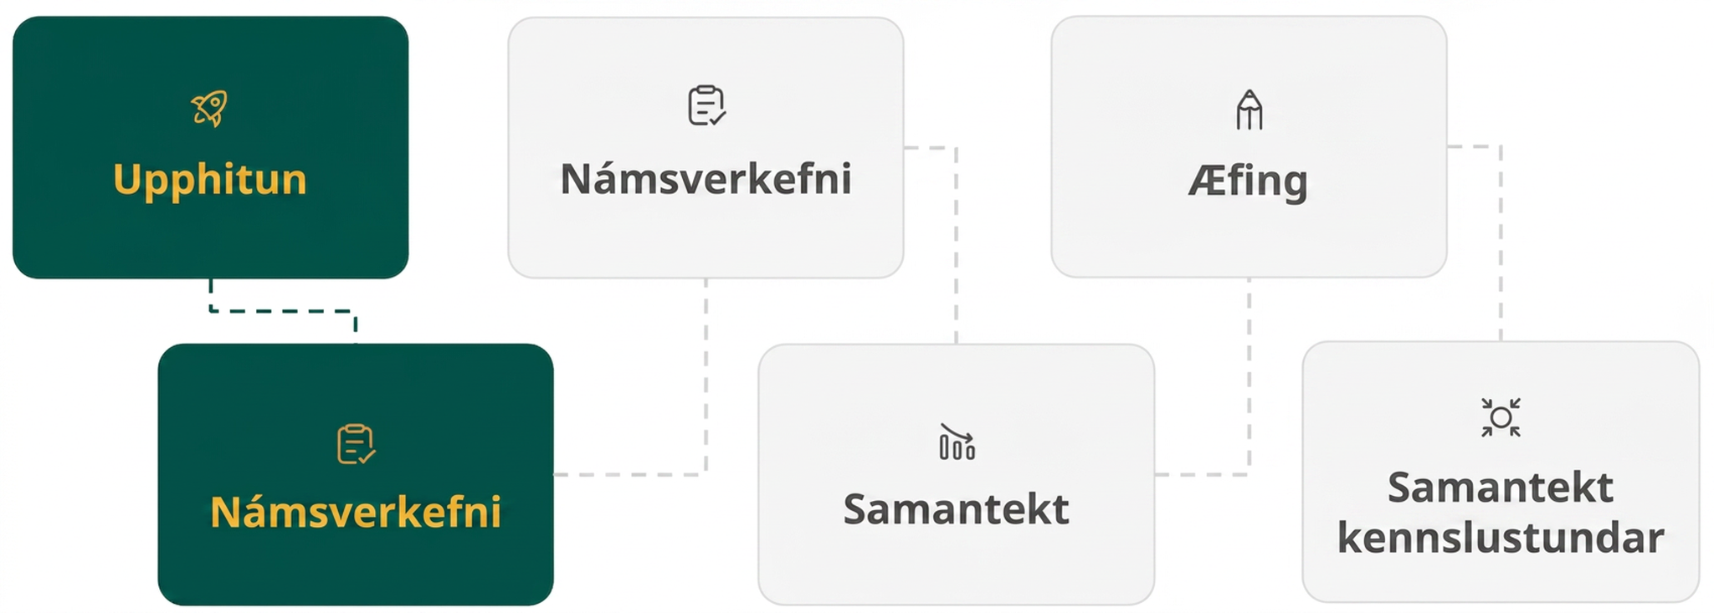
Lesson Journey
Second Stop: Learning Activity A

Slide 9
Learning Activity A | Part 1
Valley Girls 👧 + TMNT 🐢 = Radical Times 😂
With a partner, complete the table when n = –2.
Expression | Process | Simplified Result
n | (– 2) | – 2
n² | (– 2)² = (– 2)(– 2) | 4
n³ | ? | ?
n⁴ | ? | ?
n⁵ | ? | ?
What do you notice about the answers when the powers are even?
What do you notice about the answers when the powers are odd?
Notes:
Activity (20 minutes)
This activity prompts students to explore the parts of a radical as well as radicals with indexes above 2. Students may need a review of what an exponent does to a value, especially with negative numbers involved.
Launch
Arrange students into groups of 2.
Answers
At n³, result is – 8. At n⁴, result is 16. At n⁵, result is – 32.
The answers are positive when the power is even.
The answers are negative when the power is odd.
Additional activity questions, answers, anticipated misconceptions, and synthesis on the next slide.

Slide 10
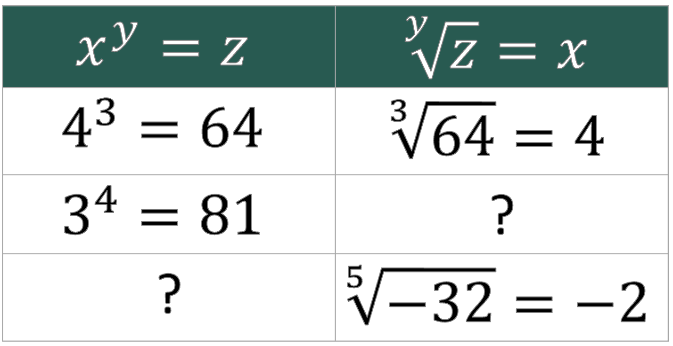
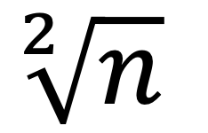
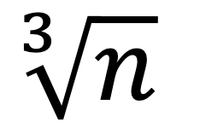
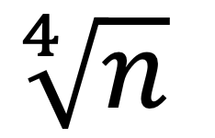
Learning Activity A | Part 2
Cell Phones 📱+ Beanie Babies 🐶 = Radical Times 😂
The √a, or the square root of a, is the same as ²√a. What about when we want to take roots that are higher than the square root? These are called RADICALS!
The n^{th} root, or radical, is written ^{n}√a.
The n is called the index of the radical.
The number inside the radical is called the radicand.
Square root ⇨
Cube root ⇨
Fourth root ⇨
Like in question 1, complete the table to find the roots.
Notes:
Activity Answers
⁴√81 = 3
(–2)⁵ = – 32
Time permitting, ask students:
Could we have an even root of a negative number? We know that the square root of a negative number is not a real number. The same is true for any even root. Even roots of negative numbers are not real numbers. Odd roots of negative numbers are real numbers.
Anticipated Misconceptions
Students may have trouble with multiplication of the negative signs and the rules associated with it. If needed, add another column to the table for students to allow them to expand each term to find the answer, and then take the root.
Activity Synthesis
Invite students to share how they arrived at their answers.

Slide 11

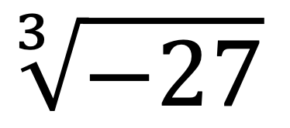
Learning Activity A
Self Check
Simplify the given term:
3
9
– 3
– 9
Let’s review!
Notes:
Answer Feedback - Individualized by Response
Incorrect. Think about what number is used as a factor 3 times to get –27. Watch the signs of the factor.
Incorrect. Think about what number is used as a factor 3 times to get –27.
That’s correct! (– 3) × (– 3) × (– 3) = – 27, so ³√(–27) = – 3.
Incorrect. This would be the result of dividing –27 by 3. Think about what number is used as a factor 3 times to get –27.

Slide 12
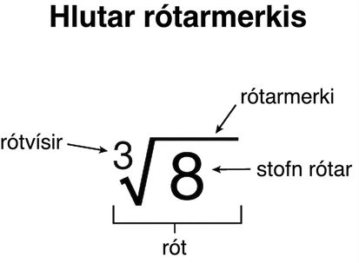

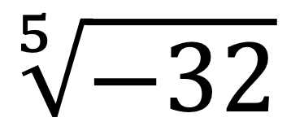
Learning Activity A
Self Check - Review
Example -
SIMPLIFYING RADICALS
STEP 1 - Identify the index.
STEP 2 - Identify the radicand (inside the radical)
STEP 3 - Determine the factors that can be used to get the radicand (the index tells you how many times it is needed).
STEP 4 - Simplify.
Notes:
Remind Students
Review the vocabulary associated with the parts of a radical.
When simplifying radicals, remind students to think about which number will be used as a factor the number of times indicated by the index to get the number under the radical.
When the index is odd, the root is allowed to be negative. When the index is even, the root cannot be negative.
Answer
– 2

Slide 13

Lesson Journey
Third Stop: Learning Activity B

Slide 14
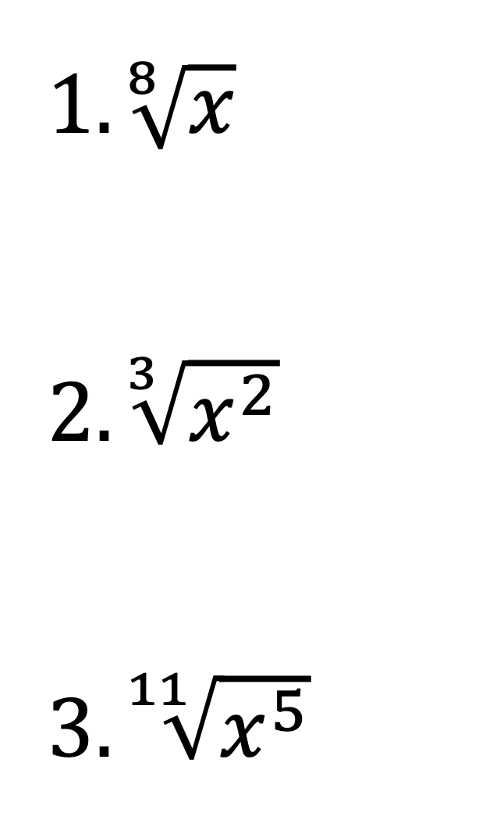
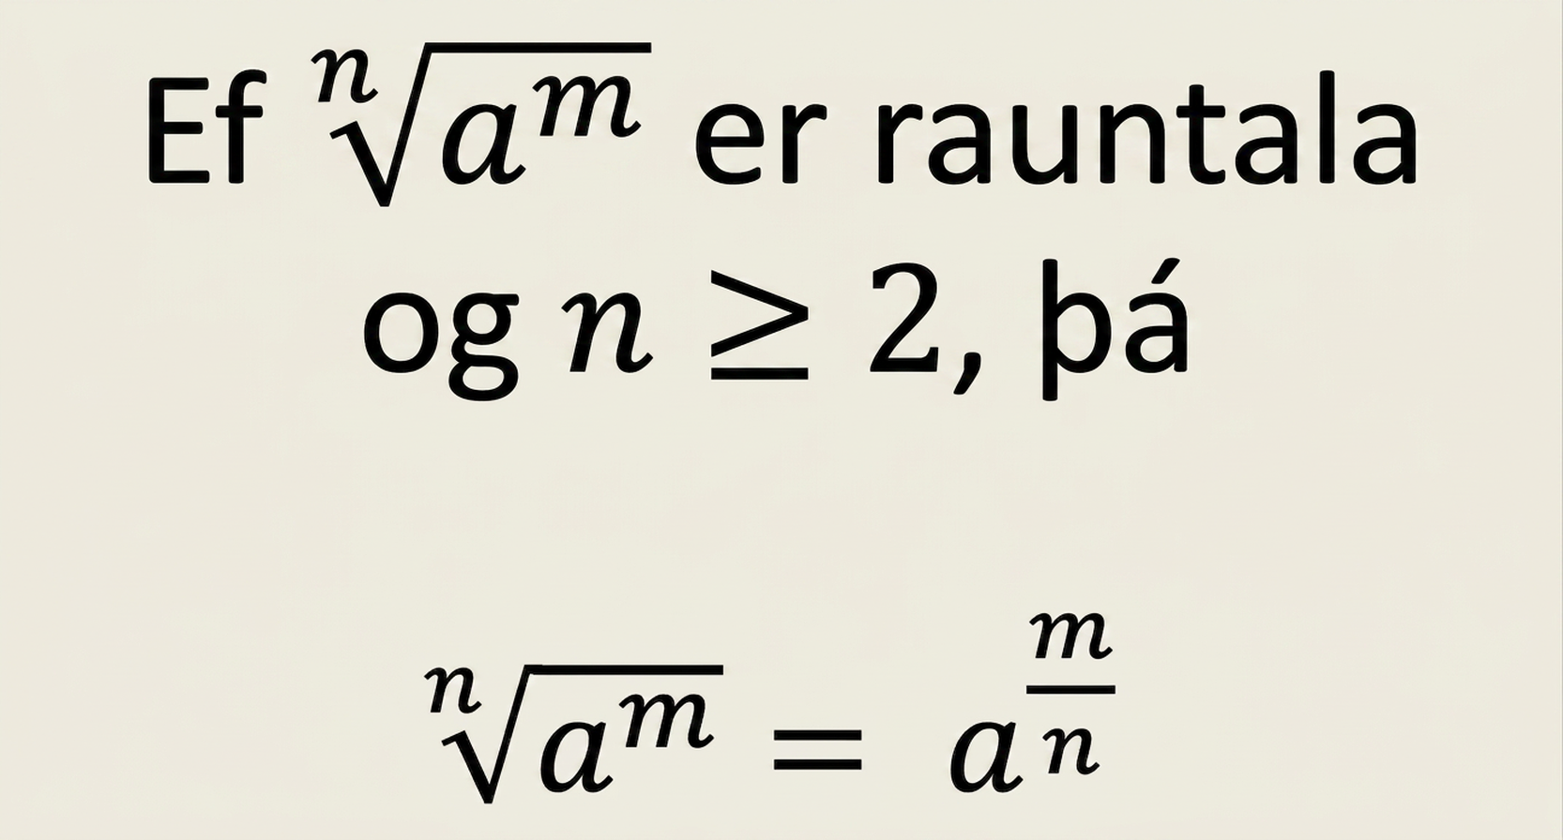
Learning Activity B | Part 1
Radical, Totally Radical! 😎
REWRITING RADICALS AS EXPONENTS
So, radicals can be rewritten as rational exponents.
Write each radical as a term with rational exponents.
Notes:
Activity (20 minutes)
This activity allows students to write radicals as terms with rational exponents and vice versa.
Launch
Arrange students into groups of 2.
Answers
𝑥^{1/8}
𝑥^{2/3}
𝑥^{5/11}
Additional activity questions, answers, anticipated misconceptions, and synthesis are on the next slide.

Slide 15
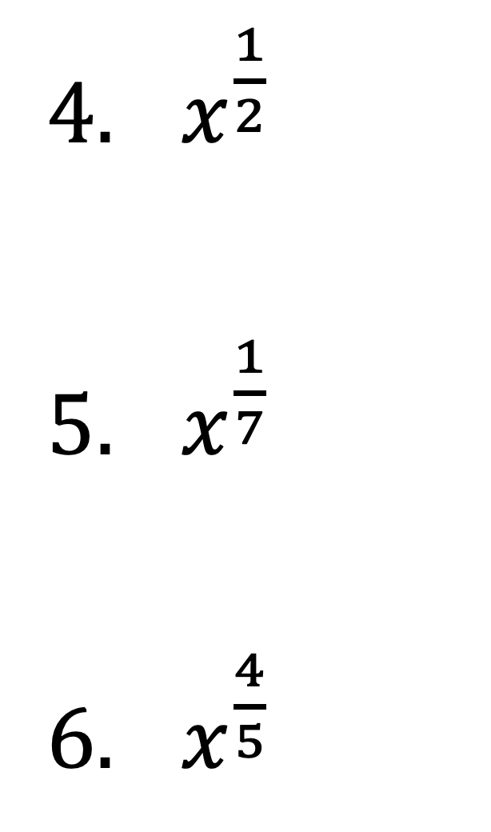
Learning Activity B | Part 2
Radical, Totally Radical! 😎
REWRITING RADICALS AS EXPONENTS
So, radicals can be rewritten as rational exponents.
Write each term with rational exponents as an equivalent radical.
Notes:
Answers
²√𝑥 or √𝑥
⁷√𝑥
⁵√𝑥⁴
Anticipated Misconceptions
When writing radicals as terms with rational exponents, it is important that the rational exponent has the original power on the top of the fraction and the index/root on the bottom. A graphic organizer can help students as a reference for this.
Activity Synthesis
Invite pairs to share their answers. Allow students to make their own examples and then trade with other partner groups if time allows.
First, have each pair write an example as a radical and switch with another pair. Then each pair writes the term with the rational exponent that matches their radical. Next, have each pair write a term with a rational exponent and then switch with another pair. Each pair writes the term as a radical.

Slide 16

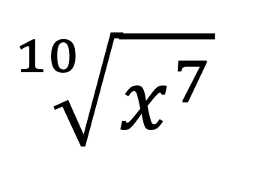
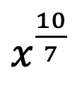
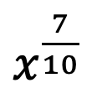
Learning Activity B
Self Check
Rewrite the following expression as a term with a rational exponent:
10x⁷
⁷/₁₀ x
Let’s review!
Notes:
Answer Feedback - Individualized by Response
Incorrect. The 10 is the root, not a coefficient.
Incorrect. The fraction should be the exponent.
Incorrect. The 7 is the exponent, and the 10 is the index.
That's correct! The exponent gets written over the root.

Slide 17
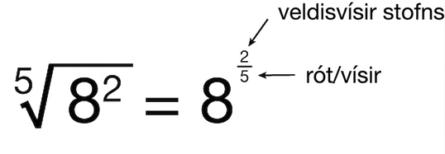
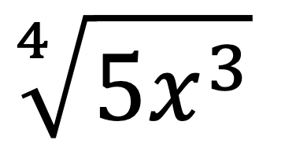
Learning Activity B
Self Check - Review
Example -
REWRITING RADICALS
STEP 1 - Identify the index.
STEP 2 - Identify the exponent (inside the radical)
STEP 3 - Write the power over the root.
Notes:
Remind Students
When writing radicals as a term with a rational exponent, the exponent becomes the numerator of the fraction in the exponent, the root or index.
In the example above the gray box, the 2 is the exponent and becomes the top of the fraction. The 5 is the index and becomes the bottom of the fraction.
Answer
5x^{¾}

Slide 18
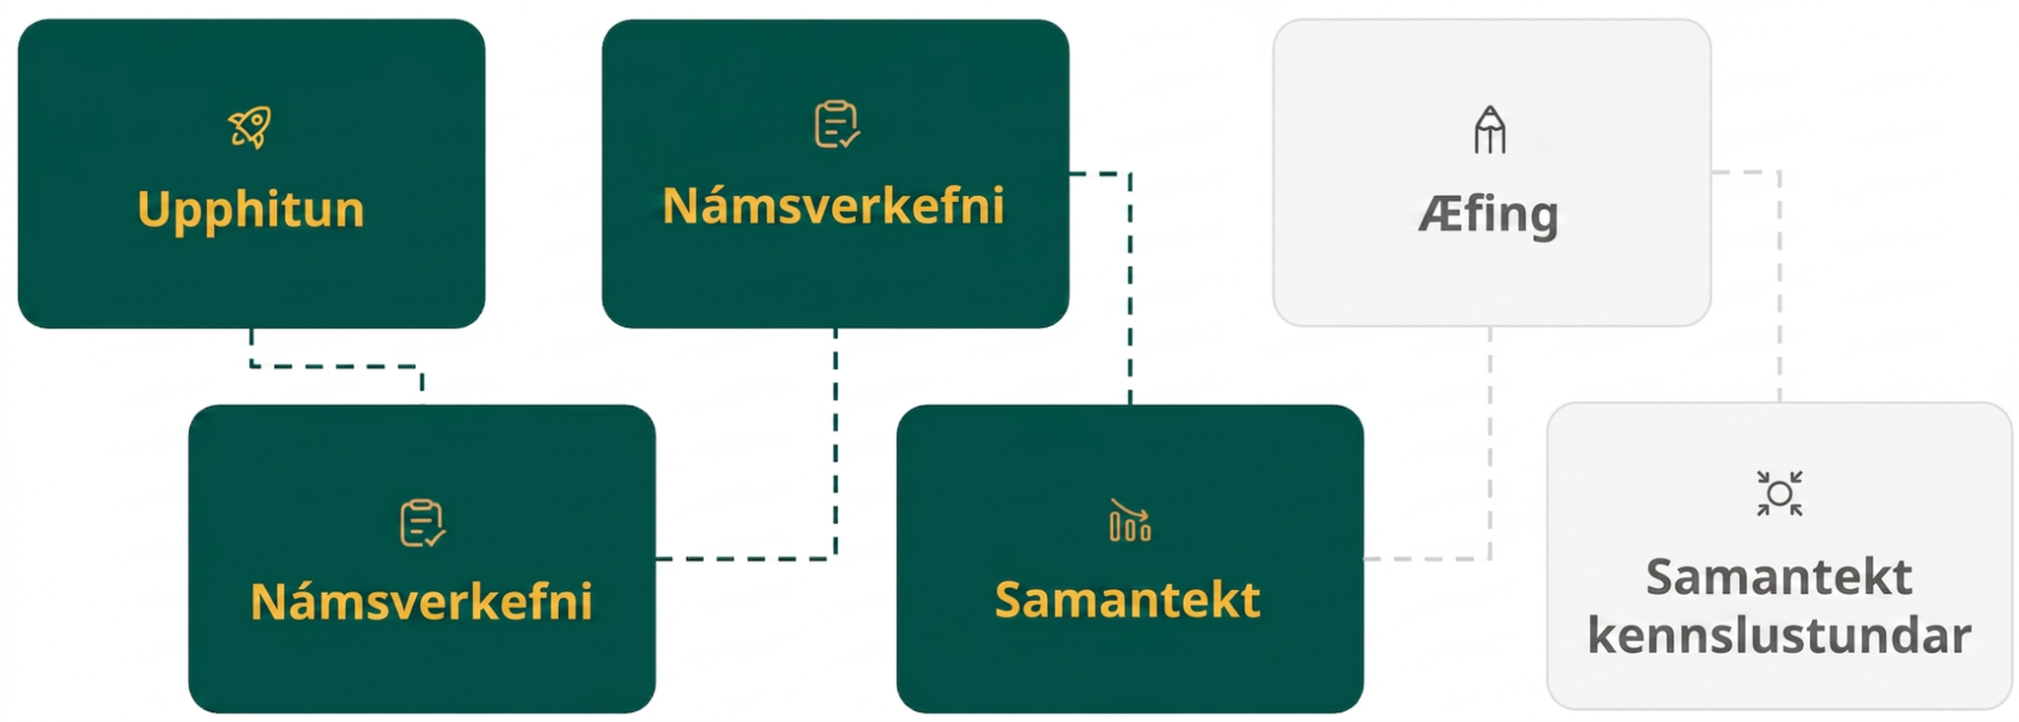
Lesson Journey
Fourth Step: Cool Down

Slide 19
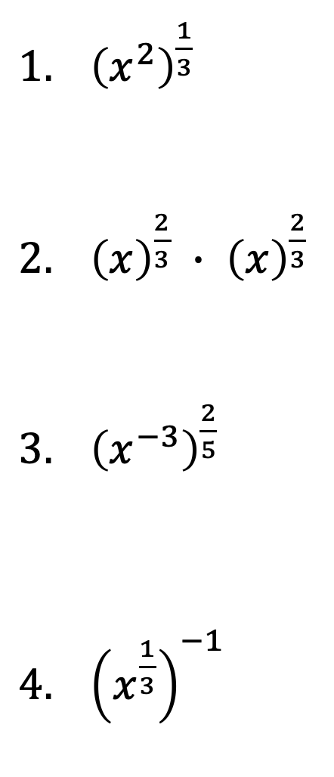
Cool Down
Simplify each expression.
Notes:
Cool Down (5 minutes)
Answers
𝑥^{2/3}
𝑥^{4/3}
𝑥^{−6/5} or 1/𝑥^{6/5}
𝑥^{−1/3} or 1/𝑥^{1/3}
Response to Student Thinking - Points to Emphasize
If students struggle to interpret rational exponents, refer back to the properties of exponents in the prior lesson. Help students understand the properties are the same, but now we are applying them to fractional values as well as integers. Students may also need additional support working with operations with fractions. Remember, too, there is a set of Automaticity Cards that you may wish to use with students to help develop their fluency with perfect squares or recognizing doubles & halves. More information about the Automaticity Cards and developing fluency is located in the Course Design section of the Appendix on the Unit Sequence and Resources page.

Slide 20
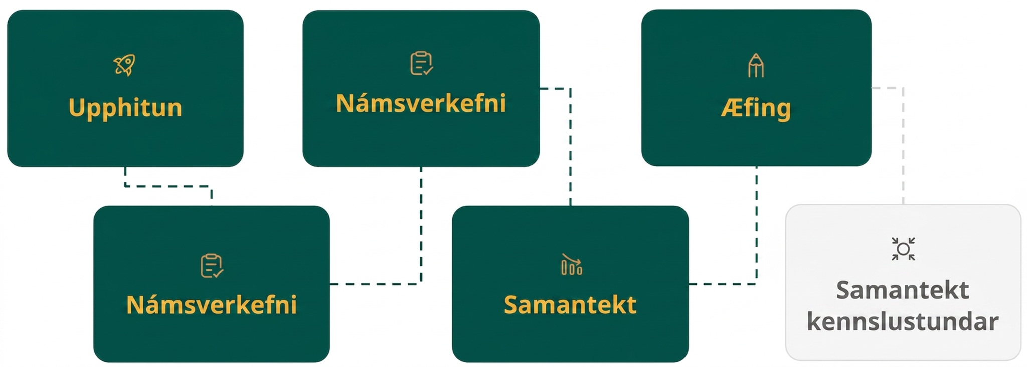
Lesson Journey
Fifth Stop: Practice

Slide 21

Practice
Put your hard work to action, practice what you’ve learned!
Notes:
Digital Practice: Access the practice pages at https://openstax.org/details/books/algebra-1

Slide 22
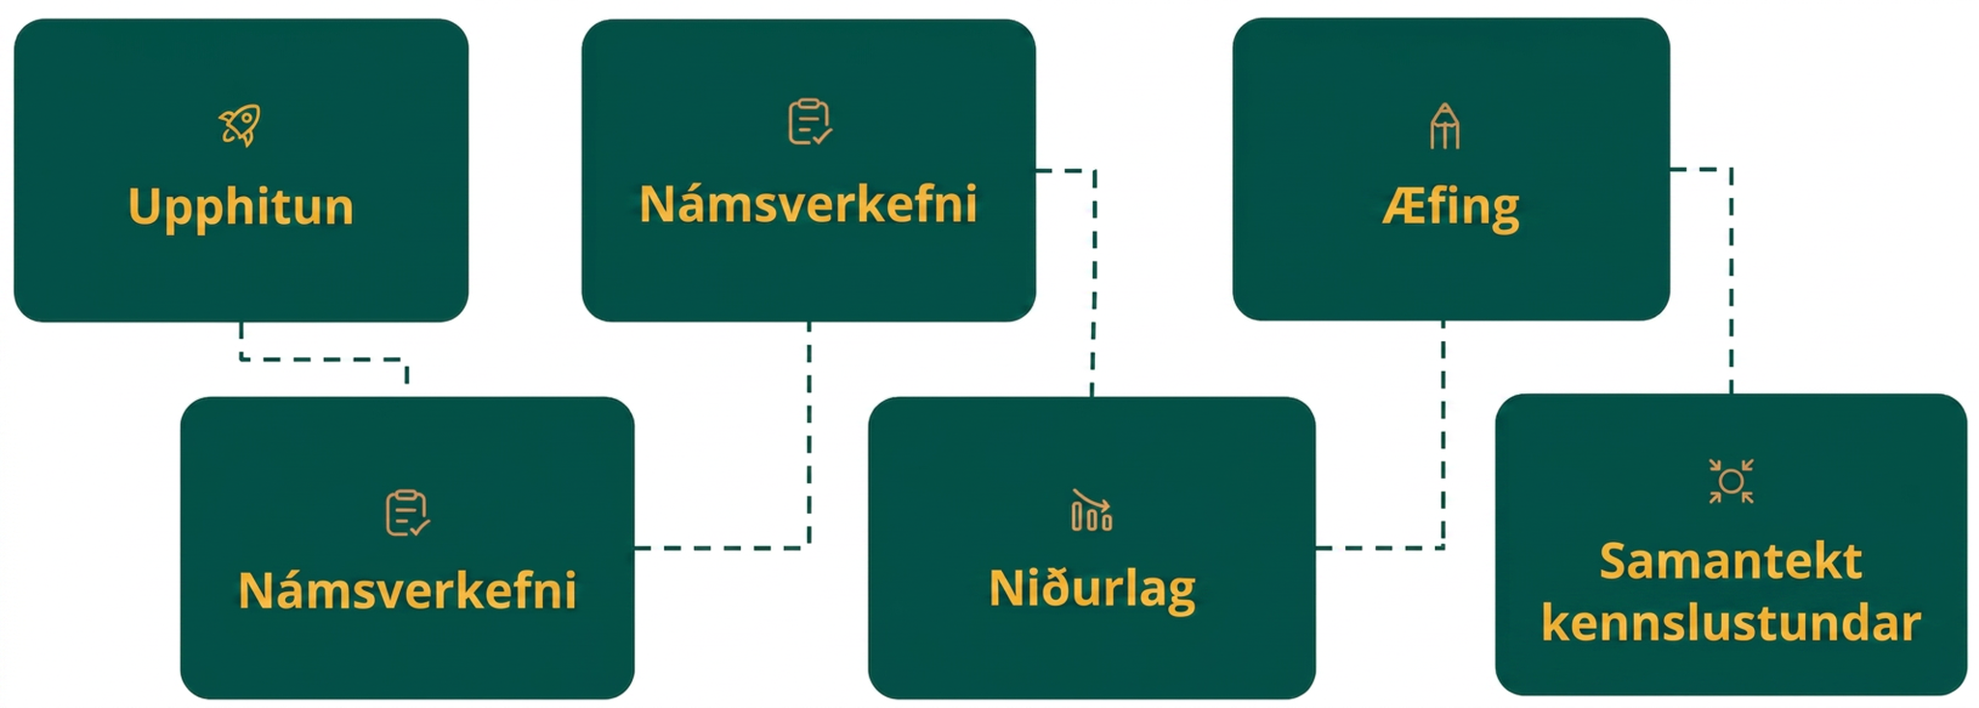
Lesson Journey
Sixth Stop: Lesson Synthesis

Slide 23
Lesson Synthesis
With a partner, create 2 problems that involve a radical expression with the following properties:
Set the index between at least 2, but no more than 5
Has a radicand with an exponent less than 8
Rewrite your radical as a term with rational exponents (this will be how you check someone else’s answer)
Be prepared to trade your problems with another set of partners to practice rewriting exponential expressions.
Next, we’ll write 2 terms with rational exponents and go the other way!
Notes:
Remind students
The exponent properties they reviewed in the prior lesson are still relevant and true. In the prior lesson they practiced the properties using exponents that were integers, but in this lesson, they used these properties with fractional powers! Nothing changes - the exponents just look a little different.
When writing radicals as terms with rational exponents, it is important that the rational exponent has the original power on the top of the fraction and the index/root on the bottom.
If needed, have students create a graphic organizer containing all of the exponent properties that they can use as a reference (see Lesson Synthesis slide from prior lesson). Be sure to have them add the information regarding how to write radicals as terms with rational exponents (see activities 2 and 3 from this lesson).
Parallel the synthesis from the previous lesson and have students participate in a Quiz-Quiz-Trade activity.
First, have each pair write an example as a radical and switch with another pair. Then each pair writes the term with the rational exponent that matches their radical.
Next, have each pair write a term with a rational exponent and then switch with another pair. Each pair writes the term as a radical.
Be sure you have checked each set of questions before beginning the trade part of the activity. Also, it may be helpful to model the type of problem you want students to create prior to having them write one. For example, for the first part, use ⁴√(x³y) with an answer of x^{¾}y^{¼}. For the second part, you could use the example of 3z^{⅔} with an answer of 3³√z².
Time permitting, continue the QQT activity and ask students to create problems that review all of the exponent properties. Add the stipulation that at least one variable must have a fractional exponent, etc.
Quiz-Quiz-Trade protocol
Student pairs take their problems and find another set of partners.
They give each other their problems and “Quiz” them … each partner group works out the questions questions given to them and checks their answers. They “Quiz” each other (Hence, Quiz-Quiz.)
If someone doesn’t understand how to work a problem, the partners must explain how to get the correct answer.
The partners then “Trade” questions. That means they should not have the original questions they started with - they should have another set of questions!
Repeat the process - have students find a new set of partners, etc.
Complete as many rounds as time permits.

Slide 24
Self Assessment
How much do you agree with the following statements?
Learning Goals | I can | Almost | Not yet
Simplify radical expressions with even and odd indexes. | ⃞ | ⃞ | ⃞
Rewrite expressions with rational exponents as roots. | ⃞ | ⃞ | ⃞
Use properties for exponents with rational exponents. | ⃞ | ⃞ | ⃞

