Slide 1


Algebra 1
Unit 7 Introduction to Quadratic Functions
Lesson 7.5 Building Quadratic Functions to Describe Situations, Part 1
Notes:
How to Get Started
Review Slide 2: How to use these slides
Check out the digital quick start guide!
Review Slide 3: Reference Key of Icons

Slide 2
How to use these slides
On the activity slides check the speaker notes for teacher support and instructional information.
Each lesson includes 1 warm up, 2-3 learning activities, a cool down, practice and a lesson synthesis.
  Learning activities are followed by a self check question, and review section.
Some slides have been hidden from student view, more information can be found on the next slide (Reference Key).
You can edit and use these slides for personal and classroom use, but cannot sell them and must keep the attribution logos.
For more information, Check out the digital quick start guide!

Slide 3






Reference Key
Check the top right corner for an icon referencing these unique sections.
 | Support for Students with Disability | Hidden | Learning Strategies slide, provides additional support to students for understanding the activity. Learning Strategies slide, provides additional support to students for understanding the activity.
 | Support for English Language Learners | Hidden
 | Extending Your Thinking | Hidden | Extending Your Thinking slide, provides an extra challenge for students.
 | Self Check | Not Hidden | Self Check slide, checkpoint to assess student understanding after the learning activity.
 | Review | Hidden | Self Check- Review slide, designed to help review topics from the self check question.
On the next slides, check the speaker notes for teacher instructions and support.
Notes:
Check the Speaker Notes: On the next slides you can find discussion questions, lesson information, answers to the activities, and ways to adjust the activity for your students!

Slide 4

Learning Goals
By the end of this lesson you will be able to -
Explain the meaning of the terms in a quadratic expression that represents the height of a falling object.
Use tables, graphs, and equations to represent the height of a falling object.
Notes:
Lesson Narrative
In this lesson, students explore how the motion of falling objects can be modeled with quadratic functions. They use tables, graphs, and equations to represent the relationship between distance and time, noticing regular patterns in the data. This work prepares them to model projectile motion and understand key features like zeros, vertex, and domain in later lessons.
Required Preparation
None
Required Materials
None
Texas Essential Knowledge and Skills
A1(A) apply mathematics to problems arising in everyday life, society, and the workplace
A7(A) graph quadratic functions on the coordinate plane and use the graph to identify key attributes, if possible, including x-intercept, y-intercept, zeros, maximum value, minimum values, vertex, and the equation of the axis of symmetry
A12(B) evaluate functions, expressed in function notation, given one or more elements in their domains

Slide 5
Vocabulary
Quadratic Expression
  An expression in 𝑥 that is equivalent to an expression of the form 𝑎𝑥² + 𝑏𝑥 + 𝑐 (where 𝑎, 𝑏, and 𝑐 are constants and 𝑎 ≠0).
Quadratic Function
  A function where the output is given by a quadratic expression in the input. 𝑓(𝑥) = 𝑎𝑥² + 𝑏𝑥 + 𝑐.
Term
  Part of an expression that can be a single number, a variable,or a number and a variable that are multiplied together.
Variable
  A quantity that can take on different values. Often represented by a letter such as 𝑥, 𝑦, 𝑎, 𝑏, 𝑚, etc.
New
None
Previous
Constant
  In an expression like (5𝑥 + 2), it is the number 2 because it doesn't change when the 𝑥-value changes.
Equation
  A mathematical statement that demonstrates that two numbers, expressions, or other objects are equal.
Expression
  The sum of products of numbers and variables. The variables can be raised to different powers.
Negative Numbers
  Numbers less than 0.
Opposite
  The number equidistant from zero on the number line as a given number, but on the opposite side of zero. Also called the additive inverse. For example, 2 and -2.
Notes:
Lesson Vocabulary
To support student understanding of key vocabulary:
Introduce and review the vocabulary words students will see in this lesson.
Encourage students to notice how these words are used and to include them in their math discussions and explanations—both written and oral.
Use a word wall to reinforce vocabulary. Sample word wall cards are available here.
For newcomers or students with beginning English proficiency, use these Quizlet sets to support vocabulary learning:
Unit 7 Spanish Vocabulary – use first to build understanding
Unit 7 Vocabulary (English) – use after anchoring in Spanish
Support for English Language Learners
ELPS 2(F) listen to and derive meaning from a variety of media such as audiotape, video, DVD, and CD-ROM to build and reinforce concept and language attainment
ELPS 3(B) expand and internalize initial English vocabulary by learning and using high-frequency English words necessary for identifying and describing people, places, and objects, by retelling simple stories and basic information represented or supported by pictures, and by learning and using routine language needed for classroom communication
ELPS 3(E) share information in cooperative learning interactions
ELPS 3(F) ask and give information ranging from using a very limited bank of high-frequency, high-need, concrete vocabulary, including key words and expressions needed for basic communication in academic and social contexts, to using abstract and content-based vocabulary during extended speaking assignments
ELPS 3(H) narrate, describe, and explain with increasing specificity and detail as more English is acquired

Slide 6





Lesson Journey
Warm Up
Learning Activity
Practice
Learning Activity
Cool Down
Lesson Synthesis

Slide 7
Warm Up - Compare Exponential Expressions🤔
Study the table. What do you notice? What do you wonder?
x | 0 | 1 | 2 | 3 | 4 | 5
y | 0 | 16 | 64 | 144 | 256 | 400
Notes:
Warm Up (5 minutes)
This warm-up helps students notice predictable patterns in a table, preparing them to analyze a falling object later. The goal is to focus on patterns, not finding a rule. Students may observe that all y-values are multiples of 16 and perfect squares, recognizing the pattern as nonlinear and possibly quadratic.
Launch
Have students write down their thoughts about what they notice and wonder in the table.
Have them turn and talk with a partner.
Ask pairs to share their thoughts with the class and add to a growing list.
If some of the sample answers are not present, then ask questions to facilitate their addition to the class list.
Activity Answers
Things you may notice:
The x-values increment by 1 as you move across the table.
The y-values increase.
All y-values are even and divisible by 4, 8, and 16.
The y-values are all perfect squares.
The successive differences between the y-values are growing.
Things you may wonder:
Is there a rule for these numbers?
Do the numbers represent the growth of a geometric pattern?
Do the numbers represent a quadratic relationship?
What is the next number in the table?
Activity Synthesis
Invite students to share their observations and questions. Record and display them for all to see.
After all responses are recorded, tell students that they will investigate these values more closely in upcoming activities.

Slide 8

Lesson Journey
Warm Up
Learning Activity
Practice
Learning Activity
Cool Down
Lesson Synthesis

Slide 9
Learning Strategies - Drop a Rock Off a Building 🪨
Look at the words in the problem and the building diagram.
Take 1–2 minutes to write your own math questions about the situation.
Share your question with the class when invited.
Listen for and notice questions about how time and distance are related for the falling object.
Co-Craft Questions
Teacher Instruction: Use these strategies to adjust the activity to support English language learners.
  You can copy and paste the callouts directly on top of the activity or give the instructions aloud.
Notes:
Support for English Language Learners: MLR 5 Co-Craft Questions: Speaking, Reading
Begin the launch by displaying only the context and the diagram of the building. Give students 1-2 minutes to write their own mathematical questions about the situation before inviting 3-4 students to share their questions with the whole class. Listen for and amplify any questions involving the relationship between elapsed time and the distance that a falling object travels.
Design Principle(s): Maximize meta-awareness; Cultivate conversation
Learn more about this routine
View the instructional video and follow along with the materials to assist you with learning this routine.
Provide support for students
Distribute graphic organizers to the students to assist them with participating in this routine.

Slide 10
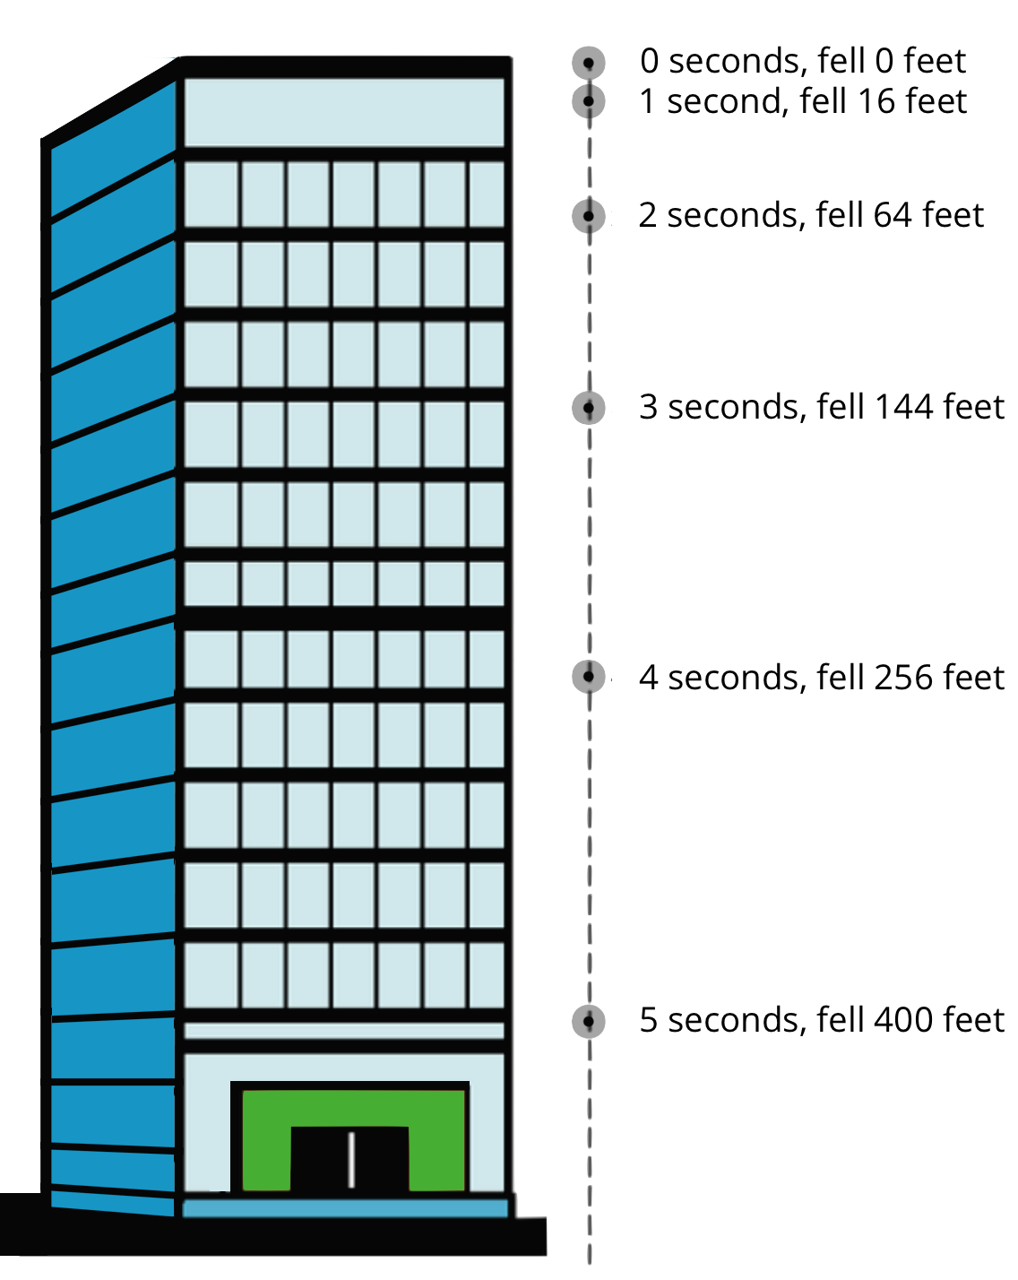
Learning Activity - Drop a Rock Off a Building 🪨
A rock is dropped from the top floor of a 500-foot-tall building. A camera captures the distance the rock traveled, in feet, after each second.
How many feet will the rock have fallen after 6 seconds? Explain.
Jada noticed that the distances fallen are all multiples of 16. She wrote down: 16 = 16 ⋅ 1 = 1²
64 = 16 ⋅ 4 = 2²
144 = 16 ⋅ 9 = 3²
256 = 16 ⋅ 16 = 4²
400 = 16 ⋅ 25 = 5²
  Use Jada’s observations to predict how far the object falls after 7 seconds, assuming the building is tall enough.
  Write an equation for the function, with d representing the distance dropped after t seconds.
Notes:
Support for All Learners
This activity offers additional support for students:
For English language learners, be sure to review the Learning Strategies slide!
Activity (15 minutes)
In this activity, students model the motion of a falling rock using time–distance data. They identify a regular pattern between time and distance and express it with a squared variable, developing a simple quadratic model that prepares them to analyze more complex motion later.
Launch
Display the image of the falling object for all to see. Students will recognize the numbers from the warm up. Invite students to make some other observations about the information. Ask questions such as:
“What do you think the numbers tell us?”
“Does the object fall the same distance every successive second? How do you know?”
Arrange students in groups of two.
Tell students to think quietly about the first question and share their thinking with a partner.
Afterward, consider pausing for a brief discussion before proceeding to the second question.
Some students may choose to use a spreadsheet tool to study the pattern, and subsequently to use graphing technology to plot the data. Others may wish to use a calculator to compute growth factors. Provide access to devices that can run a spreadsheet tool, graphing technology, or a scientific calculator.
Answers
The rock will have fallen 500 feet after 6 seconds. The distance fallen increased with each additional second. The rock fell 144 feet between 4 and 5 seconds, so between 5 - 6 seconds, it would fall more than 144 feet. After 5 seconds of falling, there is less than 144 feet to go before the rock hits the ground.
a. 784
b. d = 16 ⋅ t²
Anticipated Misconceptions
Some students may question why the distances are positive when the rock is falling. In earlier grades, negative numbers represented on a vertical number line may have been associated with an arrow pointing down. Emphasize that the values shown in the picture measure how far the rock fell and not the direction it is falling.
Activity Synthesis
Discuss the equation d = 16t². Emphasize that t² shows a quadratic relationship between time and distance. Ask students:
“How do you know this represents a function?” (Each time value gives one distance.)
“Will the rock travel 600 feet before 6 seconds?” (At 𝑡 = 6, 𝑑 = 16 × 6² = 576 feet.)
Explain that this is a simplified model, but quadratic functions are often used to represent motion affected by gravity.

Slide 11
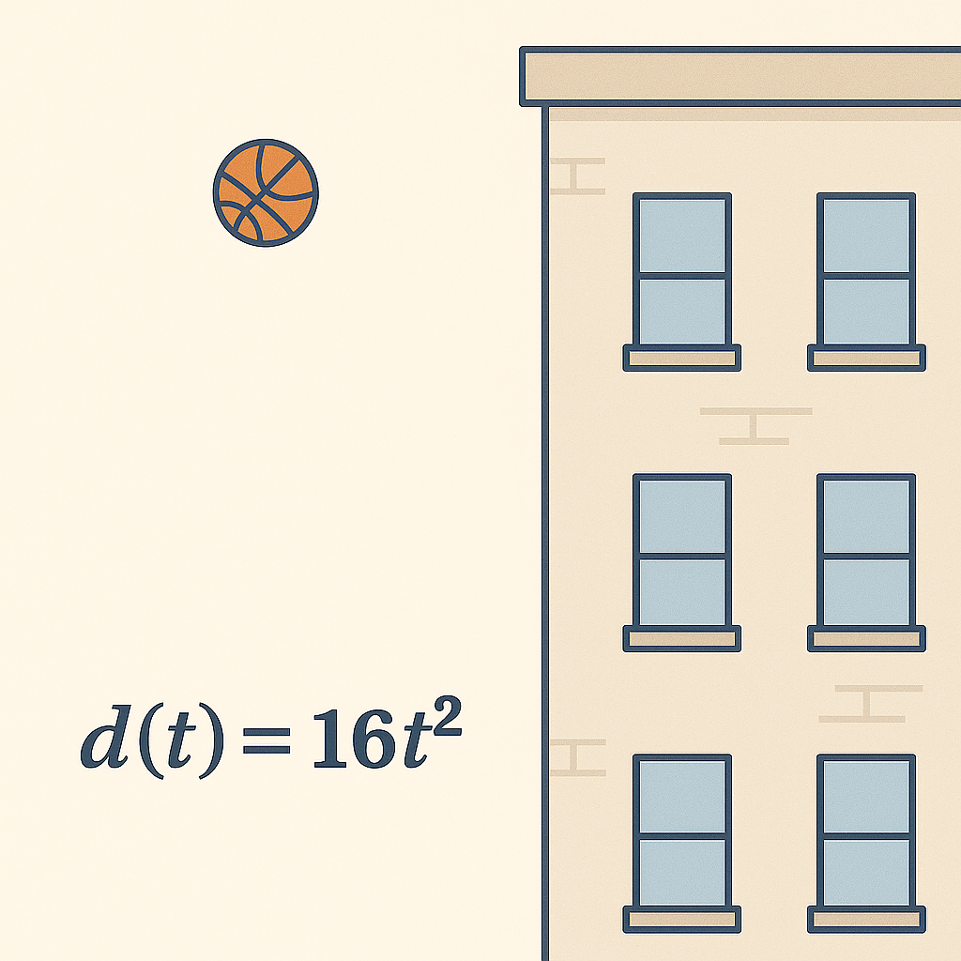
Self Check
An object is dropped from a building and falls so that the distance in feet it falls, d(t), is found by d(t) = 16t², after t seconds. How many feet has it fallen after 10 seconds?
160
320
1,600
2,560
Let’s review!
Notes:
Answer Feedback - Individualized by Response
Incorrect. Make sure to square the time.
Incorrect. Be sure to square the 10, not multiply by 2.
That’s correct! When t = 10, square the 10 to get 100, then multiply by 16.
Incorrect. Use order of operations and square 10 first. Then multiply by 16.

Slide 12
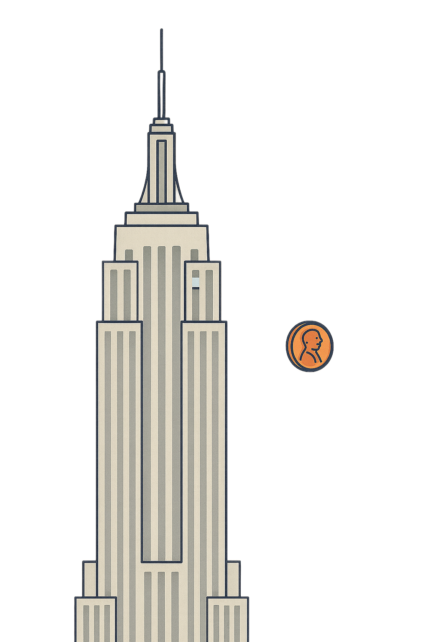
Self Check - Review
The Empire State Building is 1250 ft high (excluding the lightning rod). A visitor drops a penny from the top, and it falls straight down. How far has it fallen after 5 seconds?
Notes:
Finding Distance Fallen
Answers
Recall the previous activity formula h(t) = 16t². If we substitute t = 5, h(5)=16(5)² = 16 ⋅ 25 = 400 feet.

Slide 13
Lesson Journey
Warm Up
Learning Activity
Practice
Learning Activity
Cool Down
Lesson Synthesis

Slide 14
Learning Strategies - The Motion of Free-Falling Objects 🏀
Talk with your partner about what is the same and what is different between Elena’s and Diego’s tables.
Listen for words your classmates use to describe patterns and relationships.
Watch as key phrases are added to the class display.
Use the display to help explain your thinking during discussions.
Collect and Display
Teacher Instruction: Use these strategies to adjust the activity to support English language learners.
You can copy and paste the callouts directly on top of the activity or give the instructions aloud.
Notes:
Support for English Language Learners: MLR 2 Collect and Display: Conversing
As students discuss their expressions with a partner, listen for and collect the language students use to identify and describe what is the same and what is different between Elena and Diego’s tables. Write the students’ words and phrases on a visual display and update it with connections to the graphs introduced during the synthesis. Remind students to borrow language from the display as needed. This will help students read and use mathematical language during their paired and whole-group discussions.
Design Principle(s): Optimize output (for explanation); Maximize meta-awareness
Provide support for students
Distribute graphic organizers to the students to assist them with participating in this routine.

Slide 15
Learning Activity - The Motion of Free-Falling Objects 🏀
Galileo and other scholars found that a falling object’s distance in feet can be modeled by d = 16t², where t is time in seconds. An object is dropped from a height of 576 feet.
How many feet does it fall in 0.5 seconds?
To find out where the object is the first few seconds after it was dropped, Elena and Diego created columns in a table.
  How are the columns alike?
  How are the columns different?
Time (Seconds) | Elena Distance Fallen (Feet) | Diego Distance From Ground (Feet)
0 | 0 | 576
1 | 16 | 560
2 | 64 | 512
3
4
t
Notes:
Support for All Learners
This activity offers additional support for students:
For English language learners, be sure to review the Learning Strategies slide!
Activity (15 minutes)
In this activity, students extend their work with quadratic functions to model a falling object’s height over time. They evaluate d = 16t² for non-integer inputs and create a new function showing the object’s distance from the ground. Using a height of 576 feet helps students see that distance fallen and distance from the ground are measured from opposite directions.
Launch
Arrange students in groups of two.
Suggest that they check in with each other after trying each question.
To facilitate peer discussion, consider displaying sentence stems or questions that students could use, such as:
“Why do you think the object will have fallen that distance in 0.5 seconds?”
“How do you think the values in the first table are changing? What about in the second table?”
“How are the two tables alike? How are they different?”
Answers
4
a. They both have time in seconds and distance in feet as the two quantities being measured. They both show 0–4 seconds and t seconds for time. They describe the same object falling.
b. Elena’s table measures distance fallen, and Diego’s table measures distance from the ground. They record measurements from opposite ends. Elena’s table starts with 0 feet for 0 seconds, and Diego’s starts with 576 feet for 0 seconds.
More activity questions, answers, and activity synthesis on the next slide.

Slide 16
Learning Activity - The Motion of Free-Falling Objects 🏀
For each question, be prepared to explain your reasoning.
Complete Elena’s column. What is the distance the object has fallen?
Questions a - c.
Complete Diego,s column. What is the object’s distance from the ground? Questions d - f.
Time (Seconds) | Elena Distance Fallen (Feet) | Diego Distance From Ground (Feet)
0 | 0 | 576
1 | 16 | 560
2 | 64 | 512
3 | a.___ | d.___
4 | b.___ | e.___
t | c.___ | f.___
Notes:
Answers
a. 144
b. 256
c. 16t²
d. 432
e. 320
f. 576 − 16t²
Activity Synthesis
To help students make sense of the two functions, compare and contrast their representations (tables, equations, and graphs) and discuss the connections between them. Ask questions such as:
“How did you complete the missing values in the first table?” (Substituting 3 and 4 for t in 16t² gives the distances fallen after 3 and 4 seconds.)
“What about those in the second table?” (The distance from the ground is 576 minus the distance fallen, so we can use the values for t = 3
and t = 4 from the first table to calculate the values in the second table.)
“Why do the values in the first table increase and those in the second table decrease?” (The distance from the top of the building increases as the object falls farther and farther from it. The distance from the ground decreases as the object falls closer and closer to it.)
“The expression representing the distance fallen shows 16t², and the other shows 576−16t². Why is that?” (In the first function, the distance fallen, measured from where the object is dropped, will always be positive. In the second function, what’s measured is the height from the ground, so the distance fallen needs to be subtracted from the height of the building.)
“If we graph the two equations that represent distance fallen and distance from the ground over time, what would the graphs look like? Try sketching the graphs.”
Display graphs that represent the two functions and make sure students can interpret them. For example, they should see that the y-intercept of each graph corresponds to the starting value of each function before the object is dropped.
They should also notice that the difference in distance between successive seconds gets larger in both cases, hence the curving graphs. (If the differences were constant, the graphs would have been straight lines.)
Link to Elena’s graph in Desmos: https://www.desmos.com/calculator/hg9sdxdwyu
Link to Diego’s graph in Desmos: https://www.desmos.com/calculator/pdszftowdk
Display the graphs for all to see. Ask students how the graph of the height of the object is related to the path that the object takes as it falls.

Slide 17
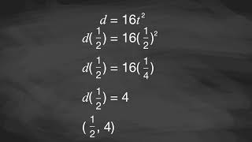
Video: Distance as a Quadratic Function of Elapsed Time

Slide 18
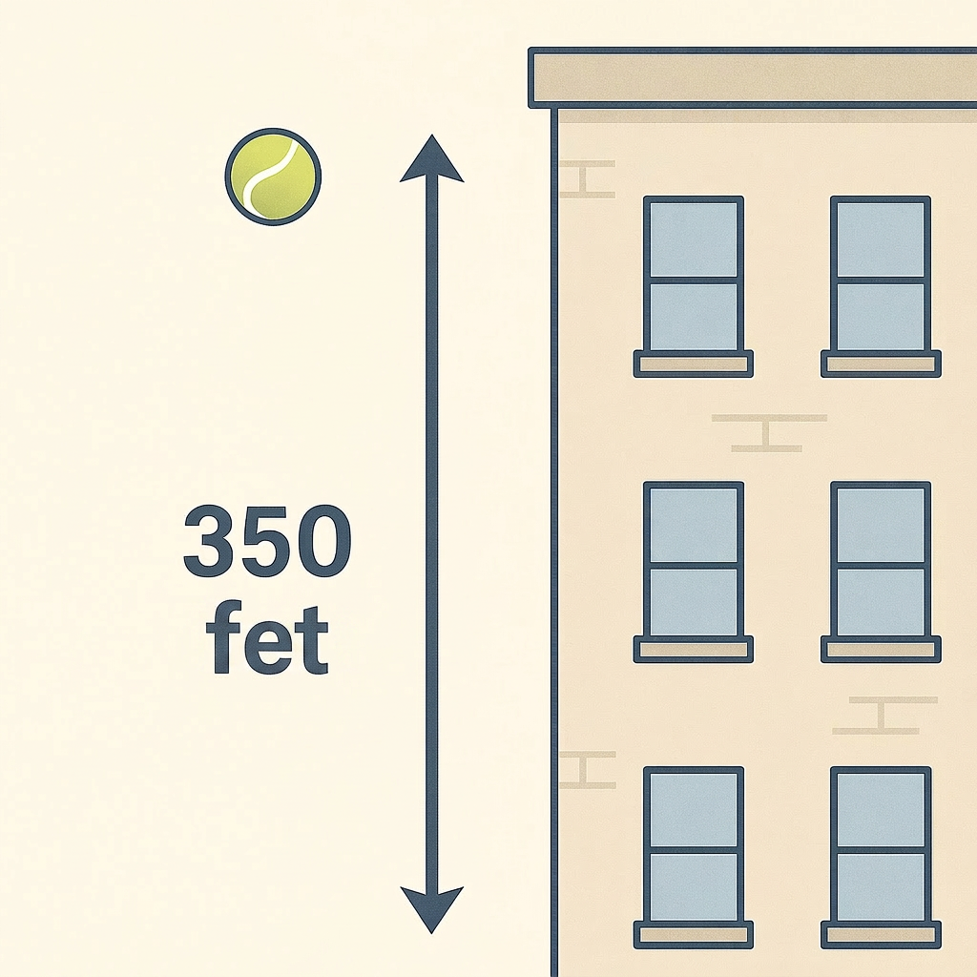
Self Check
A small ball is dropped from a 350-foot-tall building. Which equation could represent the ball’s height, h(t), in feet, relative to the ground, as a function of time, t, in seconds?
h(t) = 350 - 16t
h(t) = 350 - 16t²
h(t) = 350 + 16t²
h(t) = ³⁵⁰⁄₁₆ₜ^{₂}
Let’s review!
Notes:
Answer Feedback - Individualized by Response
Incorrect. The t is squared in the formula.
That’s correct! The ball will fall from 350 feet, so subtract 16 times the time squared to find the height at a given time.
Incorrect. Be sure to subtract, not add.
Incorrect. Subtract the 16t² to find the height.

Slide 19
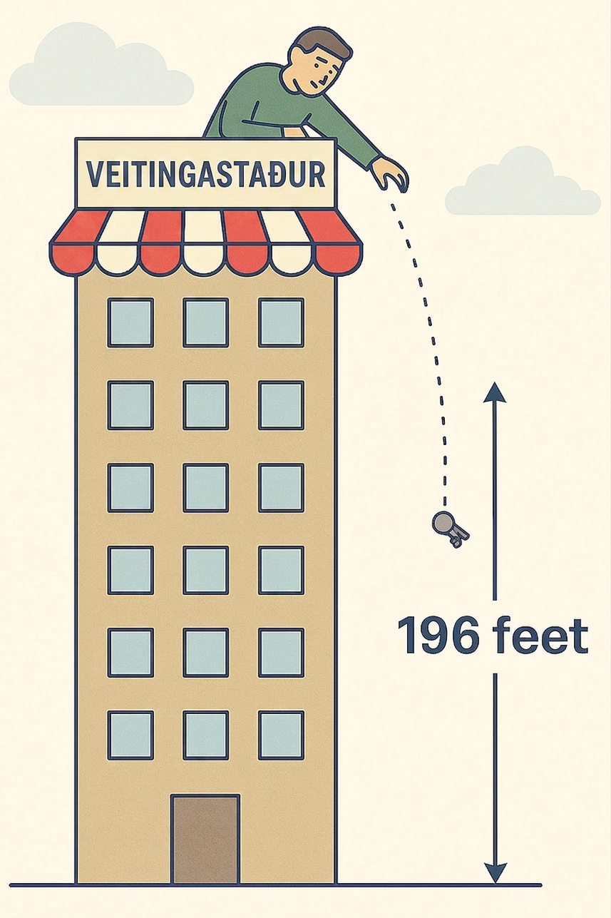
Self Check - Review
The general formula for a free falling object is: h(t) = −16t² + v₀t + h₀.
−16 is a constant from Newton’s Laws and Earth’s gravity, measured in feet per second².
v₀ is the object’s initial vertical speed: 0 if dropped, positive if thrown upward, and negative if thrown downward.
h₀ is the initial height of the object.
A man drops his keys from a restaurant at the top of a 196-foot-tall building.
  Write an equation for the height at a given time, t.
  If the keys are free falling, will they reach the ground within 3 seconds?
Notes:
Height as a Quadratic Function
Answers
a. h(t) = 196 − 16t²
b. At t = 3 seconds, the keys will still have 52 feet to travel to hit the ground.
h(3) = 196 − 16(3)² = 196 − 144 = 52

Slide 20

Lesson Journey
Warm Up
Learning Activity
Practice
Learning Activity
Cool Down
Lesson Synthesis

Slide 21
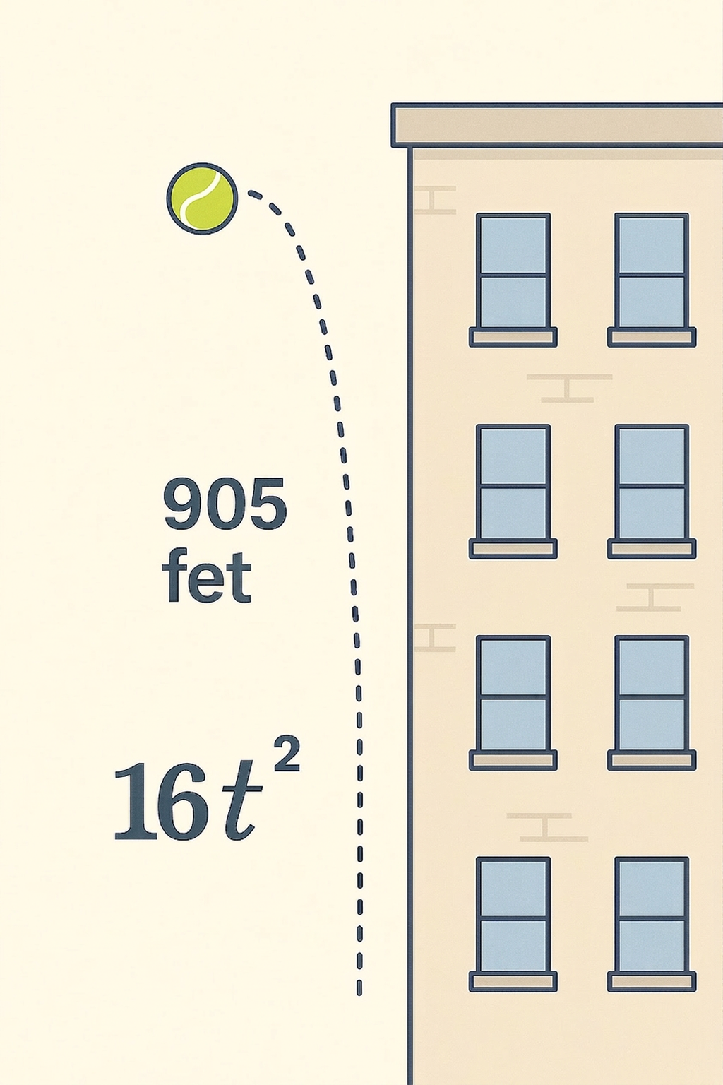
Cool Down
The expression 16t² represents the distance in feet an object falls after t seconds. Assume an object is dropped from a height of 906 feet.
What is the height of the object in feet 2 seconds after it is dropped?
Write an expression representing the height of the object in feet t seconds after it is dropped.
Notes:
Cool Down (5 minutes)
Answers
The object is at 842 feet 2 seconds after it’s dropped. 906 − 16(2)² = 906 − 16(4) = 906 − 64 = 842
906 - 16t²
Response to Student Thinking - More Chances
Students will have more opportunities to understand the mathematical ideas in this cool down, so there is no need to slow down or add additional work to the next lessons. Instead, use the results of this cool down to provide guidance for what to look for and emphasize over the next several lessons to support students in advancing their current understanding.

Slide 22

Lesson Journey
Warm Up
Learning Activity
Practice
Learning Activity
Cool Down
Lesson Synthesis

Slide 23

Practice
Put your hard work to action, practice what you’ve learned!
Notes:
Digital Practice: Access the practice pages at https://openstax.org/k12/algebra

Slide 24

Lesson Journey
Warm Up
Learning Activity
Practice
Learning Activity
Cool Down
Lesson Synthesis

Slide 25
Lesson Synthesis
Answer the questions to review key ideas from this lesson and the connections to earlier lessons.
You used two different functions to describe the movement of a falling object. One function measured the distance the object traveled from its starting point, and the other measured its distance from the ground. How are the representations of these functions alike and different?
How are these functions like or unlike those representing visual patterns in earlier lessons?
How are the graphs representing falling objects like or unlike those representing visual patterns?
Notes:
Possible Answers
The equations both have 16t², but one is positive and the other negative. Their graphs are both curves, but one graph curves upward and the other downward. The values in one table show increasing values, and the others show decreasing values, but they change by the same amounts from row to row.
They can all be represented by quadratic expressions. The relationships between the step number and the number of squares or dots were easier to see. The relationships between time and distance are not as obvious.
The graphs representing the patterns curved upward. They showed plotted points at whole-number inputs because non-whole-number steps would not make sense. In this lesson, we saw graphs that curved upward and downward. The graphs can be continuous because we can measure the distances even when the number of seconds is fractional.

Slide 26
Self Assessment
How much do you agree with the following statements?
I can… | I can | Almost | Not yet
Explain the meaning of the terms in a quadratic expression that represents the height of a falling object.
Use tables, graphs, and equations to represent the height of a falling object.

