Slide 1
Algebra 1
Unit 9 More Quadratic Equations
Lesson 9.7 Applying the Quadratic Formula
Notes:
How to Get Started
Review Slide 2: How to use these slides
Check out the Check out the digital quick start guide!
Review Slide 3: Reference Key of Icons

Slide 2

How to use these slides
On the activity slides check the speaker notes for teacher support and instructional information.
Each lesson includes 1 warm up, 2-3 learning activities, a cool down, practice and a lesson synthesis.
  Learning activities are followed by a self check question, and review section.
Some slides have been hidden from student view, more information can be found on the next slide (Reference Key).
You can edit and use these slides for personal and classroom use, but cannot sell them and must keep the attribution logos.
For more information, Check out the digital quick start guide!
OpenStax CC BY NC SA

Slide 3





Reference Key
Check the top right corner for an icon referencing these unique sections.
Icon | Title | View | Location and Description
n/a | Support for Students with Disability | Hidden | Learning Strategies slide, provides additional support to students for understanding the activity.
n/a | Support for English Language Learners | Hidden | Learning Strategies slide, provides additional support to students for understanding the activity.
n/a | Extending Your Thinking | Hidden | Extending Your Thinking slide, provides an extra challenge for students.
n/a | Self Check | Not Hidden | Self Check slide, checkpoint to assess student understanding after the learning activity.
n/a | Review | Hidden | Self Check - Review slide, designed to help review topics from the self check question.
On the next slides, check the speaker notes for teacher instructions and support.
Notes:
Check the Speaker Notes: On the next slides you can find discussion questions, lesson information, answers to the activities, and ways to adjust the activity for your students!

Slide 4

Learning Goals
By the end of this lesson you will be able to -
Identify common errors when using the quadratic formula.
Describe some ways to tell if a number is a solution to a quadratic equation.
Notes:
Lesson Narrative
In earlier lessons, students learned that the quadratic formula solves any quadratic equation, but is not always the most efficient method. In this lesson, students deepen their understanding by analyzing each step of the process, identifying common errors, and verifying solutions. By checking their own work and the work of others, students practice precision and critique mathematical reasoning. Technology is not required, but may be made available as an optional support.
Required Preparation
Be prepared to display a graph for all to see in the activity synthesis of "Different Methods of Checking Solutions of Quadratic Equations" There is an image to display if graphing technology is not available.
Required Materials
Scientific calculators
Texas Essential Knowledge and Skills
A1(B) use a problem-solving model that incorporates analyzing given information, formulating a plan or strategy, determining a solution, justifying the solution, and evaluating the problem-solving process and the reasonableness of the solution
A1(D) communicate mathematical ideas, reasoning, and their implications using multiple representations, including symbols, diagrams, graphs, and language as appropriate
A1(F) analyze mathematical relationships to connect and communicate mathematical ideas
A1(G) display, explain, and justify mathematical ideas and arguments using precise mathematical language in written or oral communication
A8(A) solve quadratic equations having real solutions by factoring, taking square roots, completing the square, and applying the quadratic formula.

Slide 5

Vocabulary
Previous
Maximum
  The function value that is greater than or equal to all the other values. The highest point on the graph.
Quadratic Equation
  Polynomial equations of degree two.
Quadratic Formula
Zero (of a Function)
  When the input value of a function yields an output of zero (where 𝑓(x) = 0). On the graph, this is where the function intersects the x-axis.
Discriminant
  A portion of the quadratic formula b² + 4ac that determines if the solution is real or imaginary.
Notes:
Lesson Vocabulary
To support student understanding of key vocabulary:
Introduce and review the vocabulary words students will see in this lesson.
Encourage students to notice how these words are used and to include them in their math discussions and explanations—both written and oral.
Use a word wall to reinforce vocabulary. Sample word wall cards are available here.
For newcomers or students with beginning English proficiency, use these Quizlet sets to support vocabulary learning:
Unit 9 Spanish Vocabulary – use first to build understanding
Unit 9 Vocabulary (English) – use after anchoring in Spanish
Support for English Language Learners
ELPS 2(F) listen to and derive meaning from a variety of media such as audiotape, video, DVD, and CD-ROM to build and reinforce concept and language attainment
ELPS 2(I) demonstrate listening comprehension of increasingly complex spoken English by following directions, retelling or summarizing spoken messages, responding to questions and requests, collaborating with peers, and taking notes commensurate with content and grade-level needs
ELPS 3(E) share information in cooperative learning interactions
ELPS 3(G) express opinions, ideas, and feelings ranging from communicating single words and short phrases to participating in extended discussions on a variety of social and grade-appropriate academic topics

Slide 6

Lesson Journey
First Stop: Warm Up

Slide 7

Warm Up | Part 1
Evaluate the Expressions ❓
Evaluate each expression for a = 9, b = − 5, and c = − 2.
−b
b²
b² − 4ac
Select two answers for – b ± √a
  – 14
  8
  2
  4
Notes:
Warm Up (5 minutes)
In this warm up, students evaluate variable expressions that resemble those in the quadratic formula. The aim is to preview the calculations that are the source of some common errors in solving equations using the quadratic formula, which students will analyze in the next activity.
Launch
Encourage and support opportunities for peer interactions.
Invite students to talk about their ideas with a partner before writing them down.
Note the limitations of the equation editor in Google slides does not permit the vinculum to be drawn over the top of the “a” in the radical.
Activity Answers
5
25
(−5)² = 25
97
(−5)² − 4(9)(−2) = 25 − (36)(−2) = 25 −(−72) = 25 + 72 = 97
2, 8
−(−5) + √9 = 5 + 3 = 8 and −(−5) − √9 = 5 − 3 = 2
Activity Synthesis
Invite students to share their responses and discuss any disagreement. For each expression, ask if they can think of an error someone might make when evaluating such an expression. Some possible errors:
−b: Forgetting that −b is really −1(b) and the product of two negative numbers is positive.
b²: When b is -5, evaluating −(5)², instead of (−5)².
b² − 4ac: Forgetting that subtracting by 4ac is equivalent to adding −4ac, or neglecting to see that if c is negative, −4ac is positive, not negative.
−b±√a−: Neglecting the negative in front of , or neglecting to see that the expression takes two different values. Tell students that in the next activity, they will spot some errors in solving quadratic equations.

Slide 8
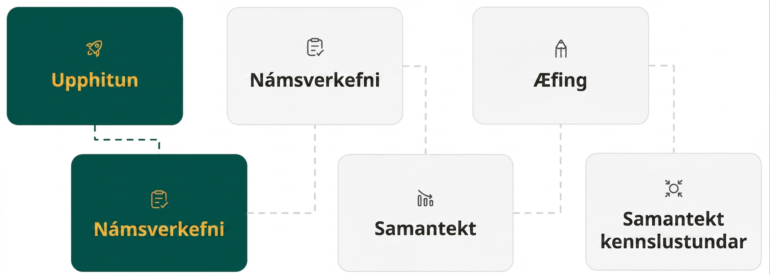
Lesson Journey
Second Stop: Learning Activity A

Slide 9

Learning Activity A | Learning Strategies
Common Calculation Errors 🧮
Teacher Instruction: Use these strategies to adjust the activity to support English language learners and students with disabilities.
You can copy and paste the callouts directly on top of the activity or give the instructions aloud.
Listen to how a classmate explains the mistake.
Say it again in your own words using math language.
Check that you understood their explanation correctly.
Discussion Supports
Use colors to mark important parts.
Highlight where the mistake happens.
Highlight the matching correct part.
Do the same on your paper.
Representation
Notes:
Support for English Language Learners: MLR 8 Discussion Supports: Speaking
Use this routine to support whole-class discussion. After each student shares what they identified and explained as the error in the worked solutions, ask students to restate what they heard using precise mathematical language. Provide students with time to restate what they hear to a partner before selecting one or two students to share with the class. Ask the original speaker if their peer was accurately able to restate their thinking. Call students’ attention to any words or phrases that helped to clarify the original statement. This provides more students with an opportunity to produce language as they interpret the reasoning of others.
Design Principle(s): Support sense-making
Support for Students with Disabilities: Representation: Internalize Comprehension
Use color coding and annotations to highlight connections between representations in a problem. For example, as students share their thinking, display their work and the worked solutions (with errors) side by side for all to see. When the students identify the error, use a highlighter to indicate the spot where the error was initially made, and highlight the corresponding spot in the correct example. Encourage students to do the same on their own materials. Before having students classify errors, invite students to suggest a list of possible types of errors and display the list. As students connect the types of errors to the example, annotate the worked examples and label them as such.
Supports accessibility for: Visual-spatial processing

Slide 10
Learning Activity A | Part 1
Common Calculation Errors 🧮
On the next slides are four equations, followed by attempts to solve them using the quadratic formula. Each attempt contains at least one error.
Solve the equations by using the quadratic formula. Then, find and describe the error(s) in the worked solutions of the same equations as the ones you solved.
Notes:
Support for All Learners
This activity offers additional support for students:
For English language learners and students with disabilities, be sure to review the Learning Strategies slide!
Activity (15 minutes)
Solving with the quadratic formula involves multiple steps that can lead to errors. This activity helps students identify common mistakes and practice careful calculation and clear reasoning. By analyzing worked solutions, students attend to precision and explain their thinking.
Identify students who can clearly explain the errors and invite them to share during discussion.
Launch
Arrange students in groups of two.
Give students a few minutes of quiet work time to solve one to two equations using the quadratic formula, and then a moment to discuss their response with their partner. Encourage students to access the STAAR Algebra 1 Reference Sheet if they need the quadratic formula.
Then, ask them to study the worked solutions (in the activity statement) for the same equations that they had solved and identify the errors.
If time permits, ask groups to identify the errors in the remaining equations. If they get stuck, suggest that they try solving the equations first and then look for the errors.
Provide access to calculators for numerical computations.
Activity questions, answers on the next slide.

Slide 11
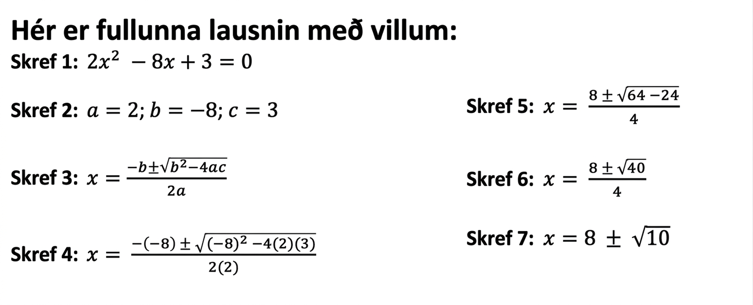
Learning Activity A | Part 2
Common Calculation Errors 🧮
2x² + 3 = 8x
Notes:
Activity Answers
ANIMATION HAS BEEN ADDED to permit students to solve the quadratic first and then look for the error (as directed in slide 10).
The correct solutions are x = 2 ± (√40)/4 or x = 2 ± ½(√10) or equivalent.
The computation from Step 6 to Step 7 is not evaluated correctly, because the square root of the discriminant is incorrectly simplified. (√40)/4 is not √10, it is ((√4)𑇐(√10))/4 = (2√10)/4 = √10/2. Thus, the solution is wrong.
2x²− 8x + 3 = 0
a = 2 , b = −8, c = 3
x = −b ± (√(b²−4ac))/2a
x = (−(−8) ± √((−8)² − (4)(2)(3)))/2(2)
x = (8 ± (√64−24))/4
x = (8 ± (√40))/4
x = (2 ± (√40))/4
x = (2 ± (√4𑇐√10))/4
x = (2 ± (2𑇐√10))/4
x = 2 ± (½)(√10)
The next activity question and answer are on the next slide.

Slide 12
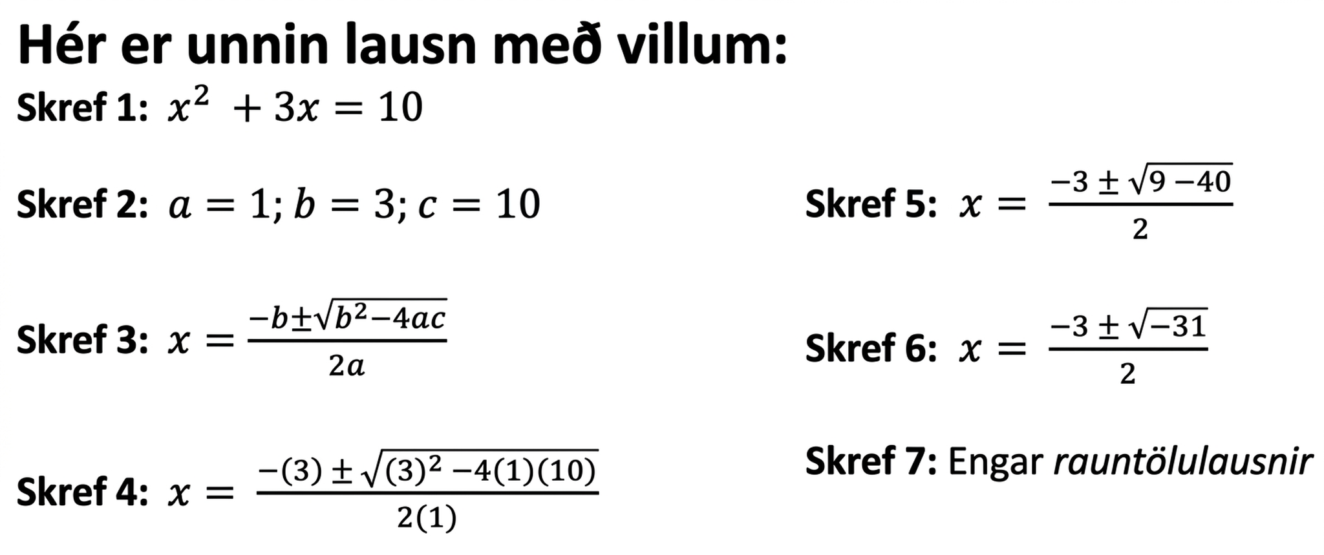
Learning Activity A | Part 3
Common Calculation Errors 🧮
x² + 3x = 10
Notes:
Activity Answers
ANIMATION HAS BEEN ADDED to permit students to solve the quadratic first and then look for the error (as directed in slide 10).
The correct solutions are x = 2 and x = −5.
The equation was not rewritten in standard form, = 0, before Step 1, where the a, b, and c were identified. The c should be – 10, not 10.
x²− 8x + 3 = 0
a = 1 , b = 3, c = – 10
x = −(b ± (√(b²− 4ac)))/2a
x = (−3 ± √((3)² − (4)(1)(−10)))/2(1)
x = (−3 ± (√9 + 40))/2
x = (−3 ± 7)/2
x = (−3 + 7)/2 = 4/2 = ½
x = (−3 − 7)/2 = −10/2 = −5
Note that the term “real” has been added to step 7 to foreshadow imaginary solutions that students will learn about in algebra 2 and improve mathematical accuracy. This term is not used nor introduced in the online textbook and you may or may not wish to discuss it with students.
The next activity question and answer are on the next slide.

Slide 13
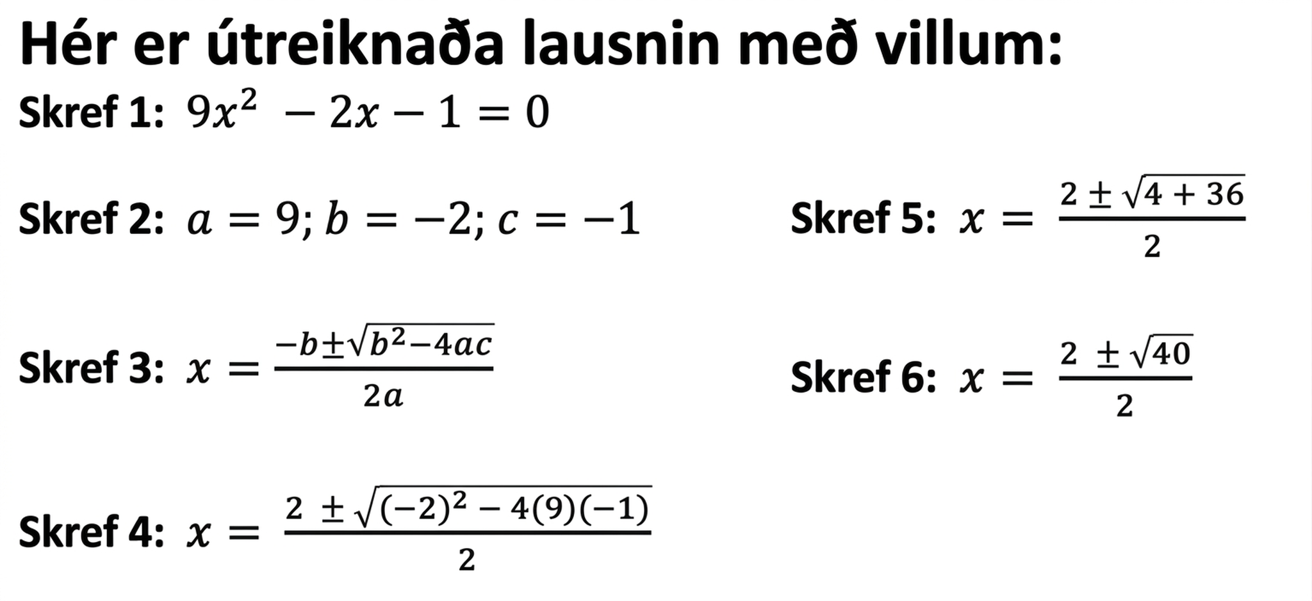
Learning Activity A | Part 4
Common Calculation Errors 🧮
9x² – 2x – 1 = 0
Notes:
Activity Answers
ANIMATION HAS BEEN ADDED to permit students to solve the quadratic first and then look for the error (as directed in slide 10).
The correct solutions are x = 1 ± (√10)/9 or equivalent.
In step 4, the value of a is not multiplied by 2 in the denominator of the formula.
9x² − 2x – 1 = 0
a = 9 , b = −2, c = – 1
x = −b ± (√(b²−4ac))/2a
x = (−(−2) ± √((−2)² − (4)(9)(− 1)))/2(9)
x = (2 ± (√4+36))/18
x = (2 ± (√40)/18
x = (2 ± (√4𑇐√10))/18
x = (2 ± (2𑇐√10))/18
x = (2 ± (2𑇐√10))/2(9)
x = (2 ± √10)/9
The next activity question, answer, and activity synthesis are on the next slide.

Slide 14
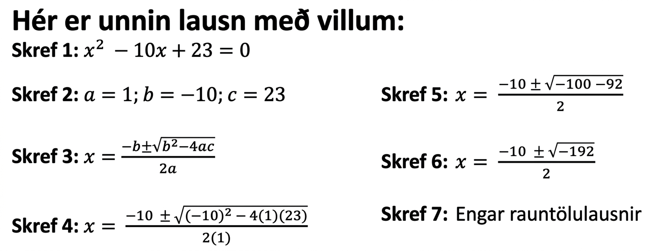
Learning Activity A | Part 5
Common Calculation Errors 🧮
x² – 10x + 23 = 0
Notes:
Activity Answers
ANIMATION HAS BEEN ADDED to permit students to solve the quadratic first and then look for the error (as directed in slide 10).
The correct solutions are x = 5 ± (√2) or equivalent.
In Step 4, when b is – 10, the value of −b should be 10.
In Step 5, the value of b² should be positive even when b is negative.
x²− 10x + 23 = 0
a = 1 , b = −10, c = 23
x = −b ± (√(b²− 4ac))/2a
x = (−(10) ± √((−10)² − (4)(1)(23)))/2(1)
x = (10 ± (√100−92))/2
x = (10 ± (√8))/2
x = (10 ± (√4𑇐√2))/2
x = (10 ± (2𑇐√2)/2
x = 5 ± 1 √2
x = 5 ± √2
Note that the term “real” has been added to step 7 to foreshadow imaginary solutions that students will learn about in algebra 2 and improve mathematical accuracy. This term is not used nor introduced in the online textbook and you may or may not wish to discuss it with students.
Activity Synthesis
Display the worked solutions in the activity statement for all to see. Select previously identified students to identify and explain the error(s) in each worked solution.
After each student presents, ask the class to classify the error(s) by type and to explain their classification. For instance, are the errors careless mistakes or computational mistakes? Do they show gaps in understanding, incomplete communication, or a lack of precision?
If not mentioned by students, point out that these errors are easy to make but not always easy to notice. Sometimes, unless the solutions really make no sense, we won't know if the solutions are actually correct or completely off unless we check them. Tell students that they will consider ways to check their solutions in the next activity.

Slide 15
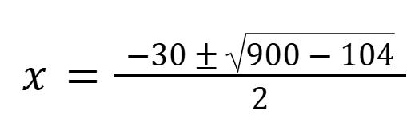
Learning Activity A
Self Check
When solving x² − 30x + 26 = 0 using the quadratic formula, Sloane's work showed the formula as depicted
in the image. Which of the following describes
the error in her work?
The denominator should be 4, not 2.
The discriminant (b² - 4ac) should be 900 + 104,
not 900 − 104.
The first term in the numerator should be 30, not – 30.
The discriminant (b² - 4ac) should be – 900 + 104,
not 900 − 104.
Let’s review!
Notes:
Answer Feedback - Individualized by Response
Incorrect. The formula states the denominator is 2a = 2(1) = 2. So the denominator is correct.
Incorrect. The formula states b² − 4ac = (−30)² − 4(1)26 = 900−104, so the discriminant is correct.
That’s correct! The formula states the first term in the numerator is −b, so −b = −(−30) = 30.
Incorrect. The formula states b² − 4ac = (−30)² − 4(1)26 = 900 − 104, so the discriminant is correct.

Slide 16

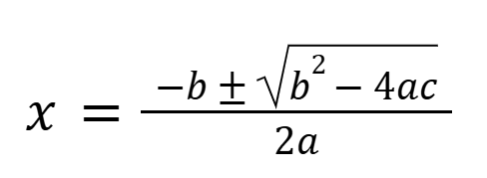
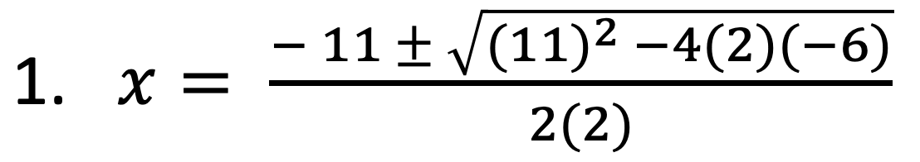
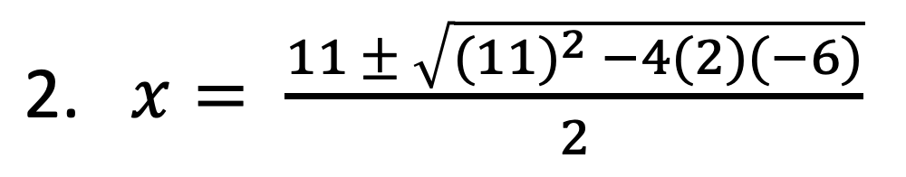
Learning Activity A | Part 1
Self Check - Review
The quadratic formula has many parts in it. A small error in any one part can lead to incorrect solutions.
Suppose we are solving 2x² − 6 = 11x. To use the quadratic formula, let's rewrite it in the form of ax²+ bx + c = 0, which gives: 2x² − 11x − 6 = 0.
For questions 1 – 5, explain the error in each:
Notes:
Answers
Using the wrong values for a, b, and c in the formula.
b is -11, so −b is -(-11), which is 11, not -11.
Forgetting to multiply 2 by a for the denominator in the formula.
The denominator is 2a, which is 2(2) or 4.
More review on the next slide.

Slide 17
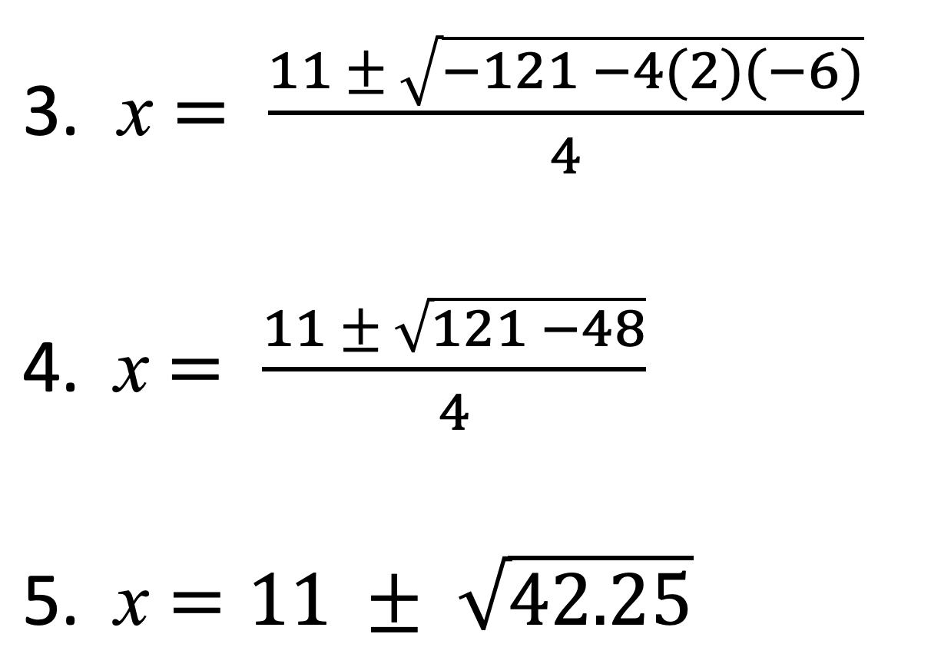
Learning Activity A | Part 2
Self Check - Review
Find and check the solution for 2x² − 6 = 11x.
Notes:
Answers
Forgetting that squaring a negative number produces a positive number.
(−11)² is 121, not -121.
Forgetting that a negative number times a positive number is a negative number.
4(2)(−6) = −48 and 121 − (−48) is 121 + 48.
Making calculation errors or not following the properties of algebra.
This is incorrect! Both parts of the numerator, the 11 and the √169 get divided by 4. Also, √169/4 is not √42.25
Evaluate (11±13)/4 correctly:
x = (11+13)/4 or x = (11−13)/4
x = 24/4 or x = −(2/4)
x = 6 or x = − ½ .
To make sure our solutions are indeed correct, we can substitute the solutions back into the original equations and see whether each solution keeps the equation true.
Checking 6 as a solution:
2x² − 6 = 11x
2(6)² − 6 = 11(6)
2(36) − 6 = 66
72 − 6 = 66
66 = 66✓
Checking −12 as a solution:
2x² − 6 = 11x
2(−½ )² − 6 = 11(−½ )
2(¼) − 6 = −(11/2)
½ − 6 = −5½
−5½ =−5½ ✓
We can also graph the equation y = 2x² − 11x − 6 and find its x-intercepts to see whether our solutions to
2x² − 11x − 6 = 0 are accurate (or close to accurate).
Link to Desmos graph: https://www.desmos.com/calculator/yddcyercpi

Slide 18

Lesson Journey
Third Stop: Learning Activity B

Slide 19
Learning Activity A | Learning Strategies
Ways to Check Solutions ☑️
Teacher Instruction: Use these strategies to adjust the activity to support English language learners.
You can copy and paste the callout directly on top of the activity or give the instructions aloud.
Make a poster showing your two ways to solve the problem.
Walk around and look at two other posters. Think:
→ What is the same?
→ What is different?
Talk with a partner about what you noticed.
Compare and Connect
Notes:
Support for English Language Learners: MLR 7 Compare and Connect: Representing, Conversing
Use this routine to prepare students for the whole-class discussion. At the appropriate time, invite students to create a visual display showing their two strategies and calculations for the first question involving the height of the pumpkin after launch. Allow students time to quietly circulate and analyze the strategies in at least two other displays in the room. Give students quiet think time to consider what is the same and what is different. Next, ask students to find a partner to discuss what they noticed. Listen for and amplify observations that highlight advantages and disadvantages to each method. This will help students make connections between different methods for solving quadratic equations.
Design Principle(s): Optimize output; Cultivate conversation
Learn more about this routine
View the instructional video and follow along with the materials to assist you with learning this routine.
Provide support for students
Distribute graphic organizers to the students to assist them with participating in this routine.

Slide 20

Learning Activity B | Part 1
Ways to Check Solutions ☑️
The equation h(t) = 2 + 30t − 5t² represents the height,
as a function of time, of a pumpkin that was catapulted
up in the air. Height is measured in meters and time
is measured in seconds.
  The pumpkin reached a maximum height
  of 47 meters. How many seconds after launch did that happen?
  Show your reasoning.
  Suppose someone was unconvinced by your solution. Find another way (besides the steps you already took) to show your solution is correct.
Notes:
Support for All Learners
This activity offers additional support and an extension for students:
For English language learners be sure to review the Learning Strategies slide!
For students looking for an extra challenge, be sure to review the Extending Your Thinking slide!
Activity (15 minutes)
Earlier, students identified common mistakes when using the quadratic formula. In this activity, students check solutions to a quadratic equation and recognize that there are multiple valid ways to verify solutions.
Students may verify solutions to 2 + 30t − 5t² = 47 by:
Using a different algebraic method (factoring, completing the square, or the quadratic formula) and comparing results
Substituting the solutions back into the equation to confirm it is true
Graphing y = 2 + 30t − 5t² and 𝑦 = 47 and checking the intersection points.
Graphing y = −45 + 30t − 5t² and checking the x-intercepts
Select students who use different methods to share. Algebraic methods are exact but error-prone, while graphing is faster but may give approximate solutions. Providing calculators and graphing tools supports strategic tool choice.
Launch
Keep students in groups of two. Ask students to think quietly about each question before conferring with their partner. Encourage partners to consider different ways of checking their solutions.
If time is limited, consider asking half of the class to answer the first question and the other half to answer the second question.
Provide access to calculators for numerical computations and to graphing technology, in case requested for solution checking.
Answer
3, The pumpkin reached a maximum height of 47 meters 3 seconds after launch.
h(t) = −5t² + 30t + 2
−5t² + 30t + 2 = 47 −5t² + 30t − 45 = 0a = −5, b = 30 , c = −45
t =(−b ± √(b²−4ac))/2a
t = −(30) ± √((30)²−(4)(−5)(−45))/(2(−5))
t = −30 ± √(900−900) − 10
t = −30 − 10
t = 3
Compare your answer:
Substitute 3 for t in the original expression; evaluating it gives 2 + 30(3) − 5(3)² or 2 + 90 −45, which is 47.
Graphing y = 2 + 30t − 5t² and y = 47 shows an intersection is located at (3, 47).
Graphing y = −45 + 30t − 5t² shows a zero at (3, 0).
More activity questions, answers, and activity synthesis on the next slide.

Slide 21
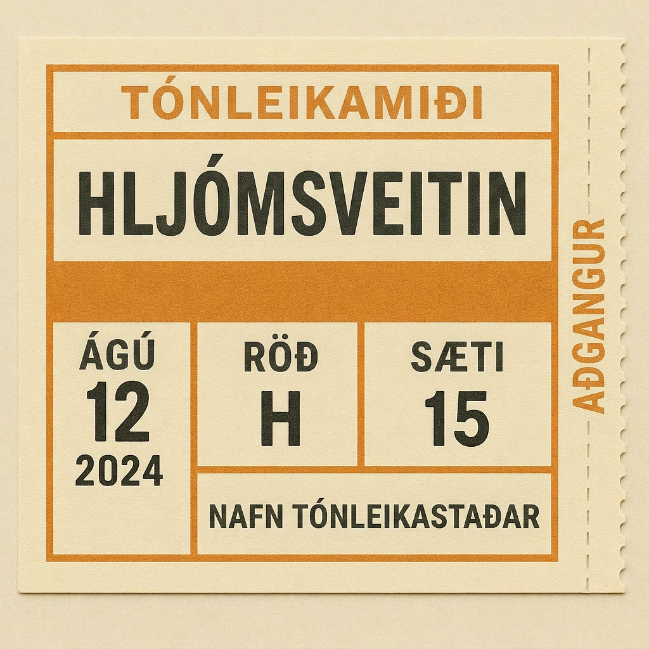
Learning Activity B | Part 2
Ways to Check Solutions ☑️
The equation r(p) = 80p − p² models the revenue a band expects to collect as a function of the price of one concert ticket. Ticket prices and revenues are in dollars.
A band member says that a ticket price of either $15.50 or $74.50 would generate approximately $1000 in revenue.
Do you agree? Show your reasoning.
Are you ready for more?
Notes:
Answer
Compare your answer:
Partially agree. A ticket price of $15.50 will generate about $1000 in revenue, but a ticket price of $74.50 will generate much less (about $410).
Using the quadratic formula to solve 1000 = 80p − p² gives p ≈ 15.50 and p ≈ 64.50 as the solutions.
Substituting 15.50 into the expression 80p − p² gives 999.75, which is close to 1000. (80 (15.50) − (15.50)² = 999.75). Substituting 74.50 into the expression 80p − p² gives 409.75.
Graphing the equation y = r(p) and y = 1000 shows two intersections at approximately (15.50, 1000) and (64.50, 1000).
Activity Synthesis
Select previously identified students to present the different ways in which they checked their solutions. Sequence their presentations based on the precision of the verification (from more precise to less precise), as shown in the Activity Narrative. Highlight as many different strategies as time permits.
If no one mentions solving with a different strategy or graphing as ways to verify solutions, bring these up. Display a graph such as this one to show that the graph can immediately show that 74.50 is not a solution to the equation 80p − p² = 1000, but 64.50 is very, very close.
Link to Desmos graph: https://www.desmos.com/calculator/sxmpaks0a2
Many students may have chosen to substitute the solutions back into the equation as a way to check them. Acknowledge that this is a very useful strategy for checking, but it also has its limits. Sometimes the solutions are not rational numbers-for example, x = 2 ± ½√10. Substituting such an expression back into the equation and evaluating it would mean complicated computations, which may themselves be subject to errors.
We could approximate the values of expressions like x = 2± ½ √10 and write them as decimals before checking. This is a workable strategy if a calculator is handy.

Slide 22
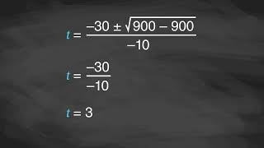
Learning Activity B | Video
Explaining Solutions to Quadratic Situations
Notes:
This video discusses question 1 of activity 9.7.3

Slide 23

Learning Activity B
Extending Your Thinking
Function g is defined by the equation g(t) = 2 + 30t − 5t² − 47. Its graph opens downward.
  Find the zeros of function g without graphing.
  Show your reasoning.
Explain or show how the zeros you found can tell us the vertex of the graph of g.
Recall that g(t) = 2 + 30t − 5t² − 47 and h(t) = 2 + 30t − 5t². Examine these functions g and h. (which defined the height of the pumpkin). Explain how the maximum of function h, once we know it, can tell us the maximum of g.
Notes:
Go back to Lesson Activity
Answer
Function g has one zero: 3.
2 + 30t − 5t² − 47 is equivalent to −5t² + 30t − 45. Solving −5t² + 30t − 45 = 0 using the quadratic formula gives t = 3. −5t² + 30t − 45 can be rewritten as
−5(t² − 6^{t} + 9) and then as −5(t − 3)(t − 3). Applying the zero product property to solve −5(t − 3)(t − 3)=0 gives t = 3.
Function g only has one zero, which means its graph has only one horizontal intercept, occurring when t = 3. Because the point (3, 0) is the only intercept, it must also be the vertex of the graph, otherwise there would have been either two horizontal intercepts, or none.
The value of the expression for g is 47 less than that of h, so if we know the maximum of h, we know that the maximum of g is 47 less than that. We saw that the maximum of h is 47, so the maximum of g is 47 less than 47, which is 0.

Slide 24

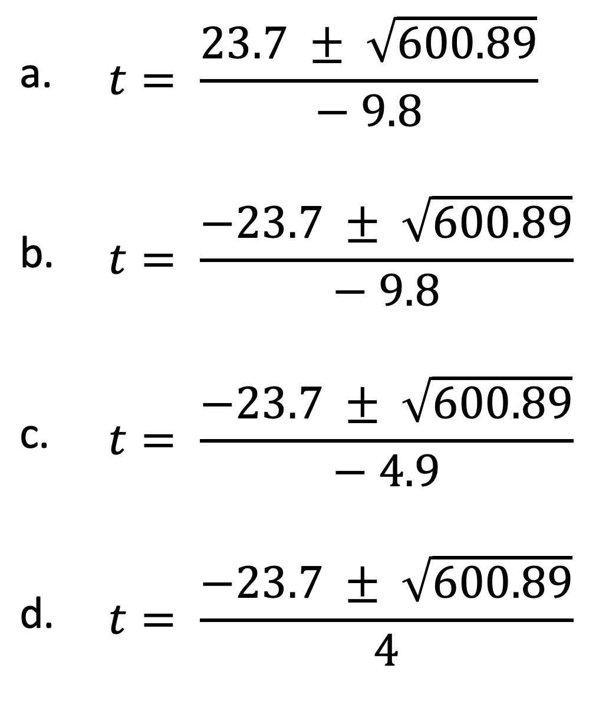
Learning Activity B
Self Check
The equation g(t) = 2 + 23.7t − 4.9t² models the height, in meters, of a pumpkin t seconds after it has been launched from a catapult. Which of the following substitutions into the quadratic formula is correct to find the value of t where the pumpkin hit the ground?
Let’s review!
Notes:
Answer Feedback - Individualized by Response
Incorrect. Let's try again a different way: In the numerator, take the negative of the b value.
That's correct! In the quadratic formula a = −4.9, b = 23.7, c=2.
Incorrect. This is the other horizontal intercept, besides 0.
Incorrect. This is not the maximum value. First, find the horizontal intercepts, then find the halfway point and location of the vertex.

Slide 25
Learning Activity B
Self Check - Review
Here is an example of someone solving a quadratic equation that has no solutions:
Study the example. At what
point did you realize the
equation had no solutions?
Step 1: (x + 3)² + 9 = 0
Step 2: (x + 3)² = −9
Step 3: x + 3 = ± √(−9)
Explain how you know the equation 49 + x² = 0 has no solutions.
Notes:
Answer
For two numbers to add up to 0, they have to be opposites. Since the number 9 is positive, the other number must be negative, which a square cannot be.
A square is always positive, so a square plus a positive number must also be positive and can never equal zero.

Slide 26
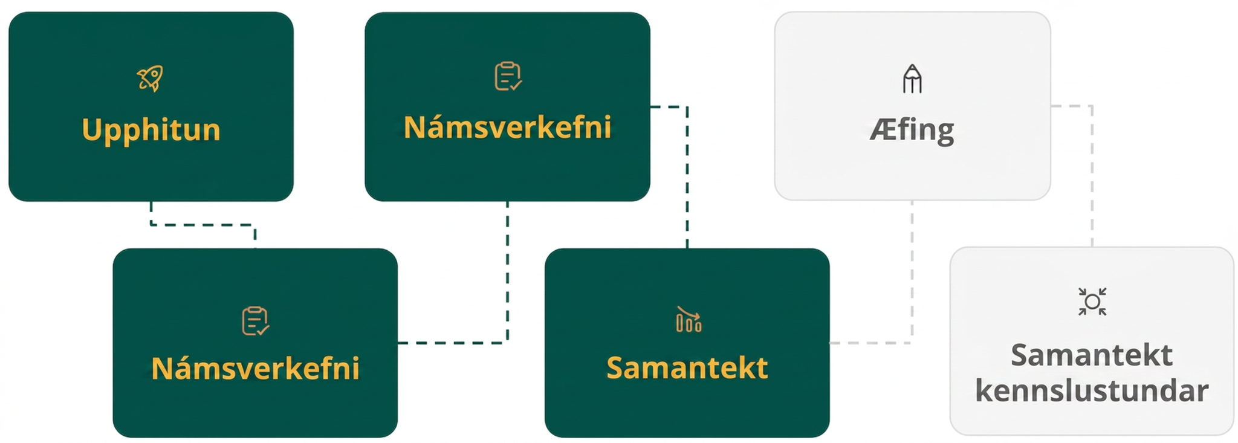
Lesson Journey
Fourth Step: Cool Down

Slide 27
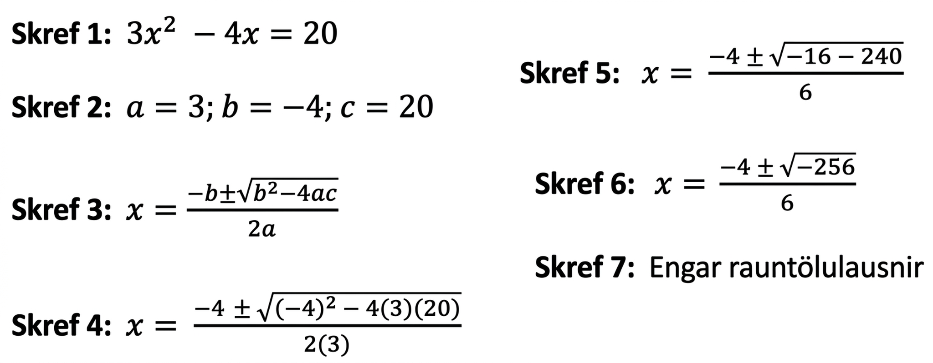
Cool Down
Here is someone's solution to the equation 3x² − 4x = 20.
Identify as many errors as you can and briefly explain each error.
Notes:
Cool Down (5 minutes)
Launch
Ask students to put away their devices for the cool down.
Answers
b is –4, so in Step 4, the value −b should be –(–4), which is 4.
In Step 1, the equation should be rewritten as ax² + bx + c = 0, so the constant term c is – 20, not 20. So, in Step 4, the last part of the numerator should be √((−4)² − 4(3)(−20)).
In Step 4, (−4)² should be 16. Squaring a negative number gives a positive number.
If the earlier issues were fixed, then the values under the square root symbol would be 16 + 240 or 256.
Response to Student Thinking - Points to Emphasize
Use student work from this cool down and the last cool down to highlight common errors that students are making or not identifying as errors.

Slide 28
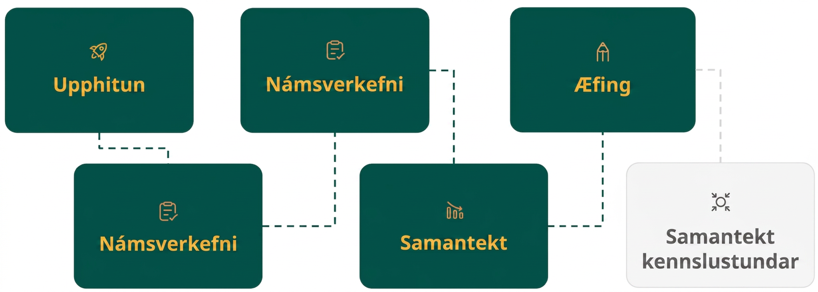
Lesson Journey
Fifth Stop: Practice

Slide 29

Practice
Put your hard work to action, practice what you’ve learned!
Notes:
Digital Practice: Access the practice pages at https://openstax.org/details/books/algebra-1

Slide 30
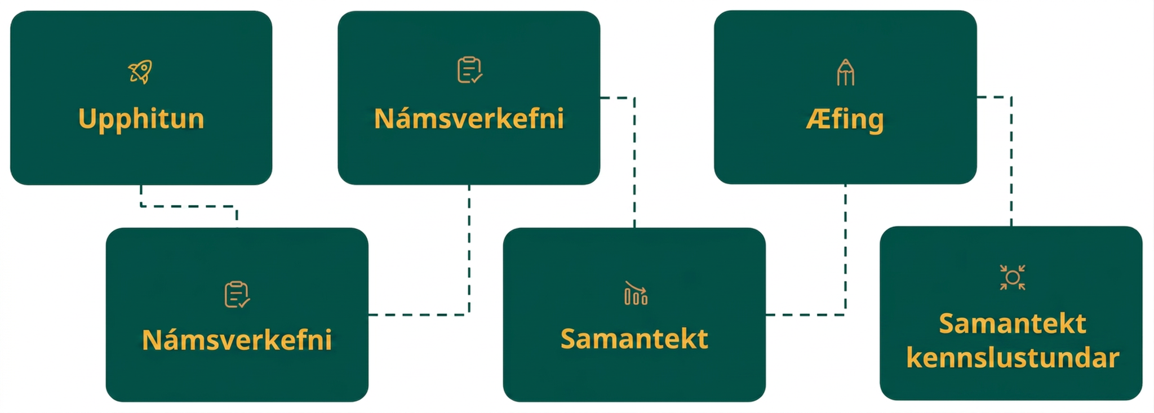
Lesson Journey
Sixth Stop: Lesson Synthesis

Slide 31

Lesson Synthesis
What are some familiar mistakes that are
made when using the quadratic formula,
not only those seen in the activities, but also
mistakes you made yourself or you saw someone else make?
What might be some good ways to check if x = ⅓ and x = ⁵/₂ are solutions to 6x² − 17x + 5 = 0?
Can completing the square be used to check the solution?
Suppose we want to verify if x = ± √3 are correct solutions to
x² + 2x − 2 = 0. Is substituting the expressions in the equation an effective way to check?
What might be some good ways to check?
Notes:
Answers
Answers may vary.
Some possibilities:
Substitute each solution into the equation and see if the equation is true. For example, see if
6(⅓)² − 17(⅓) + 5 equals 0.
Rewrite 6x² − 17x + 5 = 0 in factored form: (3x − 1)(2x − 5) = 0 and apply the zero product property to solve.
Graph y = 6x² − 17x + 5 and find the x-intercepts when the graph has a y-coordinate of 0.
Yes, but it is not simple because the leading coefficient is not a perfect square and the linear coefficient is an odd number.
In this case, substituting ±√3 for x makes the checking cumbersome. The expression to be evaluated would look like (1 + √3)² + 2(1 + √3) − 2, which is not easy to evaluate.
We could:
Solve by completing the square. The leading coefficient of x² + 2x − 2 is 1 and the linear term coefficient is an even number, which makes it fairly simple to complete the square.
Approximate the value of the solutions with a calculator, then graph y = x² + 2x − 2 and see if the solutions match the x-intercepts.)

Slide 32
Self Assessment
How much do you agree with the following statements?
Learning Goals | I can | Almost | Not yet
Identify common errors when using the quadratic formula. | ⃞ | ⃞ | ⃞
Describe some ways to tell if a number is a solution to a quadratic equation. | ⃞ | ⃞ | ⃞

