Slide 1
Algebra 1
Unit 9 More Quadratic Equations
Lesson 9.4 Completing the Square, Part 3
Notes:
NOTE: Activity 9.4.4 is an extension of the TEKS so it is not included in this lesson’s slide deck.

Slide 2

How to use these slides
On the activity slides check the speaker notes for teacher support and instructional information.
Each lesson includes 1 warm up, 2-3 learning activities, a cool down, practice and a lesson synthesis.
  Learning activities are followed by a self check question, and review section.
Some slides have been hidden from student view, more information can be found on the next slide (Reference Key).
You can edit and use these slides for personal and classroom use, but cannot sell them and must keep the attribution logos.
For more information, Check out the digital quick start guide!
OpenStax CC BY NC SA

Slide 3





Reference Key
Check the top right corner for an icon referencing these unique sections.
Icon | Title | View | Location and Description
n/a | Support for Students with Disability | Hidden | Learning Strategies slide, provides additional support to students for understanding the activity.
n/a | Support for English Language Learners | Hidden | Learning Strategies slide, provides additional support to students for understanding the activity.
n/a | Extending Your Thinking | Hidden | Extending Your Thinking slide, provides an extra challenge for students.
n/a | Self Check | Not Hidden | Self Check slide, checkpoint to assess student understanding after the learning activity.
n/a | Review | Hidden | Self Check - Review slide, designed to help review topics from the self check question.
On the next slides, check the speaker notes for teacher instructions and support.
Notes:
Check the Speaker Notes: On the next slides you can find discussion questions, lesson information, answers to the activities, and ways to adjust the activity for your students!

Slide 4

Learning Goals
By the end of this lesson you will be able to -
Complete the square for quadratic expressions of the form ax² + bx + c when a is not 1 and explain the process.
Solve quadratic equations in which the squared term coefficient is not 1 by completing the square.
Notes:
Lesson Narrative
Prior to this lesson, students have solved quadratic equations by completing the square, but all the equations were monic quadratic equations, in which the squared term has a coefficient of 1. In this lesson, students complete the square to solve non-monic quadratic equations, in which the squared term has a coefficient other than 1.
Students begin by noticing that the structure for expanding expressions such as (𝑥 + 𝑚)² can also be used to expand expressions such as (𝑘𝑥 + 𝑚)². The expanded expression is always 𝑘²𝑥² + 2𝑘𝑚𝑥 + 𝑚². If the perfect square in standard form is 𝑎𝑥² + 𝑏𝑥 + 𝑐, then 𝑎 is 𝑘², 𝑏 is 2𝑘𝑚, and 𝑐 is 𝑚². Recognizing this structure allows students to complete the square for expressions 𝑎𝑥²+𝑏𝑥+𝑐 when 𝑎 is not 1, and then to solve equations with such expressions.
Completing the square when 𝑎 is not 1 can be rather laborious, even when 𝑎 is a perfect square and 𝑏 is an even number. It is even more time consuming and complicated when 𝑎 is not a perfect square and 𝑏 is not an even number. Students are not expected to master the skill of solving non-monic quadratic equations by completing the square. In fact, they should see that this method has its limits and seek a more efficient strategy.
This lesson aims only to show that non-monic quadratic equations can be solved by completing the square and exposing students to how it can be done. This exposure provides some background knowledge that will be helpful when students derive the quadratic formula later.
Required Preparation
None
Required Materials
None
Texas Essential Knowledge and Skills
A1(F) analyze mathematical relationships to connect and communicate mathematical ideas.
A8(A) solve quadratic equations having real solutions by factoring, taking square roots, completing the square, and applying the quadratic formula.

Slide 5
Vocabulary
Previous
Completing the Square
  A method used with quadratic expressions to transform it into a perfect square trinomial.
Perfect Square Trinomial
  A perfect square trinomial fits the pattern a² + 2ab + b² = (a + b)² or
  a² – 2ab + b² =(a – b)².
Factor
  If a 𑁦 b = m, then a and b are called factors, since their product is m.
Distributive Property
  A property in which each term inside a set of parentheses can be multiplied by a factor outside the parentheses, such as a(b + c) = ab + ac.
Notes:
Lesson Vocabulary
To support student understanding of key vocabulary:
Introduce and review the vocabulary words students will see in this lesson.
Encourage students to notice how these words are used and to include them in their math discussions and explanations—both written and oral.
Use a word wall to reinforce vocabulary. Sample word wall cards are available here.
For newcomers or students with beginning English proficiency, use these Quizlet sets to support vocabulary learning:
Unit 9 Spanish Vocabulary – use first to build understanding
Unit 9 Vocabulary (English) – use after anchoring in Spanish
Support for English Language Learners
ELPS 2(F) listen to and derive meaning from a variety of media such as audiotape, video, DVD, and CD-ROM to build and reinforce concept and language attainment.
ELPS 3(E) share information in cooperative learning interactions.
ELPS 3(G) express opinions, ideas, and feelings ranging from communicating single words and short phrases to participating in extended discussions on a variety of social and grade-appropriate academic topics.
ELPS 3(H) narrate, describe, and explain with increasing specificity and detail as more English is acquired.

Slide 6

Lesson Journey
First Stop: Warm Up

Slide 7

Warm Up
Square with Care ⚠
Elena says, "(x + 3)² can be expanded into x² + 6x + 9. Likewise, (2x + 3)² can be expanded into 4x² + 6x + 9."
Find an error in Elena's statement and correct the error. Show your reasoning.
Notes:
Warm Up (5 minutes)
In this warm up, students consider perfect squares in standard form in which the leading coefficient is not 1. They use what they know about expanding (𝑥 + 𝑚)² to analyze the expansion of an expression of the form (𝑘𝑥 + 𝑚)² and to identify an error. In explaining and correcting the error, students practice constructing logical arguments.
Launch
Display the entire task for all to see.
Give students two minutes of quiet time to think individually.
Select students to share their responses and how they reasoned about the error in Elena's statement.
Answers
(2𝑥 + 3)² is not equivalent to 4𝑥² + 6𝑥 + 9. Applying the distributive property to (2𝑥 + 3)(2𝑥 + 3) gives 4𝑥² + 6𝑥 + 6𝑥 + 9, which is 4𝑥² + 12𝑥 + 9.
Anticipated Misconceptions
Students may not apply the distributive property correctly.
Make sure that students rewrite (𝑥 + 3)² as (𝑥 + 3)(𝑥 + 3) and then perform the distributive property, rather than simply squaring each term in the binomial.
When students apply the distributive property to (2𝑥 + 3)(2𝑥 + 3), you may need to remind them to use FOIL, and particularly that the products of the “outer” and “inner” terms are both 6𝑥, which add to 12𝑥.
Students will have opportunities to transform more of such expressions later and, with practice, will better see the effects of squaring a linear expression like 2𝑥+3, in which the coefficient of the variable is not 1.
Activity Synthesis
Select one to two students to share their responses. Make sure students see that expanding the expression (𝑘𝑥 + 𝑚)² involves the same structure as expanding (𝑥 + 𝑚)². Highlight the structure using a diagram and the distributive property.
When we expand (𝑥 + 3)², the squared term is 𝑥², the linear term is 2 times (3)(𝑥), which is 6𝑥, and the constant term is 3².
When we expand (2𝑥+3)², the squared term is (2𝑥)², the linear term is 2 times (2𝑥)(3), which is 12𝑥, and the constant term is 3².

Slide 8
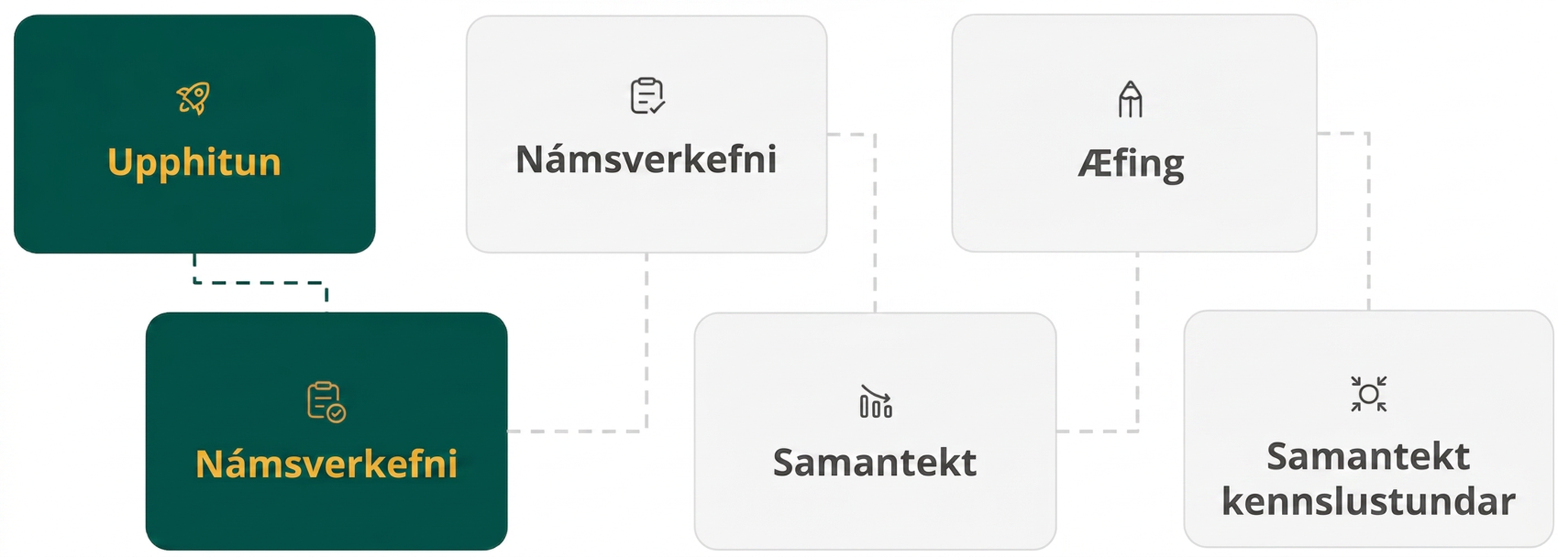
Lesson Journey
Second Stop: Learning Activity A

Slide 9

Learning Activity A | Learning Strategies
Write it the same, but … different! ✍
Teacher Instruction: Use these strategies to adjust the activity to support English language learners and students with disabilities.
You can copy and paste the callouts directly on top of the activity or give the instructions aloud.
Walk around the room and find two other strategies for rewriting expressions d & e in standard form.
Think about what’s the same and different about the way they are written or represented.
Talk with your partner about what you noticed.
Compare and Connect
Partner share:
“I noticed that … “
“It looks like …”
Whole class discussion:
“___ will always ___ because …”
“Is it always true that …?”
Action and Expression
Notes:
Support for English Language Learners: MLR 7 Compare and Connect: Representing, Conversing
As students share their strategies for the first question, call students' attention to the different approaches to rewriting the expressions in standard form. Take a close look at the last two parts of the first problem (d & e) and how the value of 𝑘 is represented in the expression 9x² + 2 (3)(n)x + n² . Wherever possible, amplify student words and actions that describe the connections between a specific feature of one mathematical representation and a specific feature of another representation.
Design Principle(s): Maximize meta-awareness; Cultivate conversation
Learn more about this routine
View the instructional video and follow along with the materials to assist you with learning this routine.
Provide support for students
Distribute graphic organizers to the students to assist them with participating in this routine.
Support for Students with Disabilities: Action and Expression: Develop Expression and Communication
To help get students started, display sentence frames that elicit observations about the connection between squared and standard form for each expression. For example, “I notice that . . . .” and “It looks like . . . .” After students have discussed these initial observations, display frames that encourage students, in their partner groups, to create generalizations from their observations that they can share with the whole class. For example, “_____ will always _____ because . . . .” and “Is it always true that . . . ?”
Supports accessibility for: Language, Organization

Slide 10
Learning Activity A | Part 1
Write it the same, but … different! ✍
Write each expression in standard form.
(4x + 1)²
(5x − 2)²
(½ x + 7)²
(3x + n)²
(kx + m)²
Notes:
Support for All Learners
This activity offers additional support for students:
For English language learners and students with disabilities, be sure to review the Learning Strategies slide!
Activity (15 minutes)
In this activity, students use the structure they saw earlier to rewrite squared expressions of the form (𝑘𝑥 + 𝑚)², where 𝑘 is not 1, into standard form. Through repeated reasoning, students see how the coefficient 𝑘 is related to the values of 𝑎 and 𝑏 when the expression is expanded into 𝑎𝑥² + 𝑏𝑥 + 𝑐, and how the 𝑚 is related to 𝑐.
As students work, monitor for the following strategies for rewriting the expressions in the first question (from factored form to standard form):
Drawing rectangular diagrams.
Applying the distributive property, writing out all the expanded terms, and combining like terms.
Generalizing that when expanding an expression such as (4𝑥 + 1)²:
The coefficient 4 in 4𝑥 + 1 gets squared, so 𝑎 in 𝑎𝑥² + 𝑏𝑥 + 𝑐 is 4².
The coefficient 4 in 4𝑥 + 1 gets multiplied by the constant term 1 twice, so 𝑏 is 2(4)(1).
The constant term 1 in 4𝑥 + 1 is squared, so 𝑐 is 1².
Identify students using each strategy and invite them to share during the class discussion.
Launch
Explain to students that they will now practice squaring expressions such as 4𝑥 + 1 and 12𝑥 + 7, where the coefficient of the linear term is not 1, and writing them in standard form.
Consider arranging students in groups of two and asking them to think individually about each question before conferring with their partner.
Activity Answers
a. 16𝑥² + 8𝑥 + 1
b. 25𝑥² − 20𝑥 + 4
c. ¼ 𝑥² + 7𝑥 + 49
d. 9𝑥² + 2(3)(𝑛)𝑥 + 𝑛² or 9𝑥² + 6𝑛𝑥 + 𝑛²
e. 𝑘²𝑥² + 2𝑘𝑚𝑥 + 𝑚²
Additional activity questions, answers, and synthesis on the next slide.

Slide 11
Learning Activity A | Part 2
Write it the same, but … different! ✍
Decide if each expression is a perfect square. If so, write an equivalent expression of the form (kx + m)². If not, suggest one change to turn it into a perfect square.
  4x² + 12x + 9
  4x² + 8x + 25
Notes:
Activity Answers
a. Yes, a perfect square. (2𝑥 + 3)²
b. No, not a perfect square. Suggested changes include:
Changing the coefficient of the linear term to 20 gives 4𝑥² + 20𝑥 + 25, which is equivalent to (2𝑥 + 5)².
Changing the coefficient of the linear term to –20 gives 4𝑥² − 20𝑥 + 25, which is equivalent to (2𝑥 − 5)².
Changing the constant term to 4 gives 4𝑥² + 8𝑥 + 4, which is equivalent to (2𝑥 + 2)².
Activity Synthesis
Select previously identified students to share their responses and strategies for the first question, starting with students who used diagrams and ending with students who generalized the pattern in the rewriting process. As students explain, display or record their reasoning for all to see.
If not mentioned in students' explanations, highlight the generalization noted in the activity narrative.
Then, discuss how students used their insights from the first question to help them identify perfect squares, or to turn expressions into perfect squares, in the second question. Make sure students see the structure behind the values of 𝑎, 𝑏, and 𝑐 when the expression 𝑎𝑥² + 𝑏𝑥 + 𝑐 is a perfect square. This structure will help them complete the square in the next activity.

Slide 12
Learning Activity A
Self Check
Find the equivalent factored expression for 4x² + 12x + 9.
4(x² + 3x + 9)
(2x − 3)²
(2x + 3)²
(2x + 3)(2x − 3)
Let’s review!
Notes:
Answer Feedback - Individualized by Response
Incorrect. While 4 is the greatest common factor (GCF) of the first two terms, it is not a factor of 9.
Incorrect. This is equivalent to 4𝑥² − 12𝑥 + 9.
That’s correct! Check yourself: When multiplied using distribution, (2𝑥 + 3)(2𝑥 + 3) equals the given expression.
Incorrect. This is equivalent to 4𝑥² − 9.

Slide 13

Learning Activity A
Self Check - Review
Factor 9𝑥² + 12𝑥 + 4.
FACTORING PERFECT SQUARE TRINOMIALS
Step 1 - Write first term as 𝑎² and last constant as 𝑏². Check if middle term is 2𝑎𝑏.
Step 2 - Factor the binomial into:
𝑎² + 2𝑎𝑏 + 𝑏² = (𝑎 + 𝑏)²
or
𝑎² – 2𝑎𝑏 + 𝑏² = (𝑎 – 𝑏)².
Step 3 - Use the Distributive Property to check.
Notes:
Remind Students
Determine which perfect square trinomial pattern to use based on the sign (positive or negative) of the linear term:
Positive: Use 𝑎² + 2𝑎𝑏 + 𝑏² = (𝑎 + 𝑏)²
Negative: Use 𝑎² – 2𝑎𝑏 + 𝑏² = (𝑎 – 𝑏)²
Always check that the middle term has the form 2ab, even if the first term can be written as a² and the constant as b².
Perfect square trinomials and a difference of squares are factored differently!
For additional practice problems, access the online text.

Slide 14
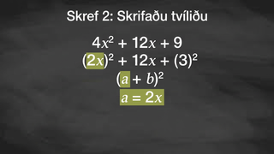
Learning Activity A | Video
Rewrite Squared Expressions
Notes:
This video discusses the Self Check question for activity 9.4.2

Slide 15

Lesson Journey
Third Stop: Learning Activity B

Slide 16
Learning Activity B | Learning Strategies
You Complete Me ◳
Teacher Instruction: Use these strategies to adjust the activity to support students with disabilities.
  You can copy and paste the callout directly on top of the activity or give the instructions aloud.
Capture what you were thinking when you created equivalent expressions for ax² + bx + c and (kx + m)². What connections did you find between the two expressions?
Make your thinking visible by using diagrams, images, arrows, words, descriptions, color coding or other annotations.
Representation
Notes:
Support for Students with Disabilities: Representation: Internalize Comprehension
Use color and annotations to illustrate student thinking. As students share their reasoning about the connections between (k𝑥 + 𝑚)² and 𝑎𝑥² + 𝑏𝑥 + 𝑐, scribe their thinking on a visible display. Invite students to suggest language or diagrams to include that will support their understanding. Keep the display visible as students continue to work. Access the Algebra 1 Activity 9.4.3 Thinking Sheet, if needed.
Supports accessibility for: Visual-spatial processing; Conceptual processing

Slide 17
Learning Activity B | Part 1
You Complete Me ◳
For each expression, find the value of 𝑐 to make a perfect square in standard form.
  100x² + 80x + c
  36x² − 60x + c
  25x² + 40x + c
  0.25x² − 14x + c
For each expression, a – d, refer to your responses in question 1 to help write an equivalent expression in the form of squared factors.
Notes:
Support for All Learners
This activity offers additional support for students:
For students with disabilities, be sure to review the Learning Strategies slide!
Activity (15 minutes)
Earlier, students noticed that when an expression 𝑘𝑥 + 𝑚 is squared and written in standard form 𝑎𝑥² + 𝑏𝑥 + 𝑐, the value of 𝑏 is 2𝑘𝑚 and the value of 𝑐 is 𝑚². In this activity, they use these observations to complete expressions to make them perfect squares and then write them as squared factors. Then, they apply this skill to solve quadratic equations
Launch
To reiterate the connections between (𝑘𝑥 + 𝑚)² and its equivalent expression of the form 𝑎𝑥² + 𝑏𝑥 + 𝑐, display these two expressions for all to see and ask students:
"If the two expressions are perfect squares and are equivalent, how is 𝑎 related to 𝑘?" (𝑎 is 𝑘².)
"How is 𝑐 related to 𝑚?" (𝑐 is 𝑚².)
"How is 𝑏 related to 𝑘 and 𝑚?" (𝑏 is 2𝑘𝑚.)
Tell students they will use these insights to complete some squares.
Consider keeping students in groups of two.
Answers
a. 16
b. 25
c. 16
d. 196
a. (10𝑥 + 4)²
b. (6𝑥 − 5)²
c. (5𝑥 + 4)²
d. (0.5𝑥 − 14)²
Additional activity questions, answers, anticipated misconceptions, and synthesis on the next slide.

Slide 18
Learning Activity B | Part 2
You Complete Me ◳
Write your own pair of equivalent expressions.
  Create an expression that is a perfect square trinomial in standard form (ax² + bx + c).
  Now write the same equivalent expression in the form of squared factors (kx + m)².
Solve each equation by completing the square.
  25x² + 40x = –12
  36x² – 60x + 10 = – 6
Notes:
Answers
a. Answers will vary. One expression in standard form is: 49x² + 14x + 1
b. Answers will vary. Using the expression above, for example, the squared factor of 49x² + 14x + 1 would be (7x + 1)².
a. x = – ⅖ and x = – ⁶/₅ (Refer to the online text for a detailed solution to this question.)
b. x = 4/3 and x = ⅓ (Refer to the online text for a detailed solution to this question.)
Anticipated Misconceptions
If students struggle to follow the generalized relationships between (kx + m)² and its equivalent expression of the form ax² + bx + c (as discussed in the launch), consider revisiting a concrete example from an earlier activity—for example, (5x − 2)². Ask students to relate each term in the squared factor to the terms of its expression in standard form, 25x² − 20x + 4.
If further scaffolding is helpful, consider using an example with an additional variable (for instance, (3x + n)² and its counterpart in standard form, 9x² + 2(3)(n)x + n²) before generalizing the equivalence of the two forms in entirely abstract terms.
Activity Synthesis
Ask students to write the standard-form expression they invented on a piece of scrap paper, except without the constant term (question 3 above). Invite them to switch papers with a partner and complete the square and write each other's expressions in factored form. If they get stuck, encourage them to talk with their partner to work together and fix any mistakes.
If time permits, invite students to share their responses and strategies. Discuss questions such as:
"How did you know what value to use for 𝑐 in, say, 100x² + 80x + c?"
"How did you know whether c would be positive or negative?"
"In the equation 36x² − 60x + 10 = − 6, the expression on the left already has 10 as a constant term but it is not a perfect square. How do we make it a perfect square?"

Slide 19

Learning Activity B
Self Check
Solve by completing the square: 25x² + 30x = 7.
x = 9
x = ⅕, 𝑥 = – ⁷/₅
x = ¹³/₅, 𝑥 = – ¹⁹/₅
x = – ⅗
Let’s review!
Notes:
Answer Feedback - Individualized by Response
Incorrect. This is the number that is added to each side, but not the solution.
That's correct! Check yourself: 9 should be added to each side, then the new equation becomes (5𝑥 + 3)² = 16. When solved, these are the two solutions.
Incorrect. Make sure to take the square root of both sides of the equation.
Incorrect. The solution is not where the factor equals 0.

Slide 20
Learning Activity B
Self Check - Review
COMPLETING THE SQUARE TO SOLVE
ax² + bx + c = 0
Step 1 - Isolate the variable terms on one side and place the constant term on the other.
Step 2 - Use a = k² and b = 2(k 𑁦 m) to find k
and m. Add m² to both sides of the equation.
Step 3 - Factor the perfect square trinomial as a binomial square, (kx + m)².
Step 4 - Use the square root property.
Step 5 - Solve the resulting equations.
Step 6 - Check the solutions.
Solve 16x² + 40x = 11.
Notes:
Remind Students
Isolate the variable terms on one side and place the constant term on the other side first.
Solve completely both equations that result from using the square root property.
Solutions may be decimals or fractions (in Lesson 9.5, students will work with solutions that are irrational numbers).
For answers and additional practice problems, access the online textbook.

Slide 21
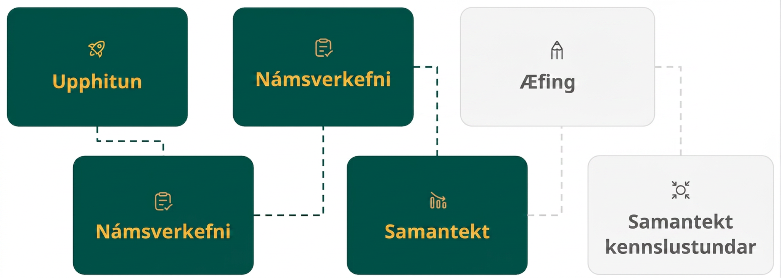
Lesson Journey
Fourth Step: Cool Down
Notes:
NOTE: Activity 9.4.4 is an extension of the TEKS so it is not included in this lesson’s slide deck.

Slide 22
Cool Down
Answer the following questions for expression 4x² – 28x + c.
  Find the value of c to make the expression a perfect square.
  Write an equivalent expression in the form of squared factors.
Solve the equation 4x² – 28x = – 33 by completing the square. Show your reasoning.
Notes:
Cool Down (5 minutes)
Answers
a. 49
b. (2x − 7)²
x = ¹¹/₂ and x = ³/₂ (Refer to the online text for additional work leading to these solutions.)
Response to Student Thinking - Points to Emphasize
If students struggle with completing the square, use the Lesson 9.4.3 activity to highlight key ideas on the completing the square process based on student work in the cool down.

Slide 23
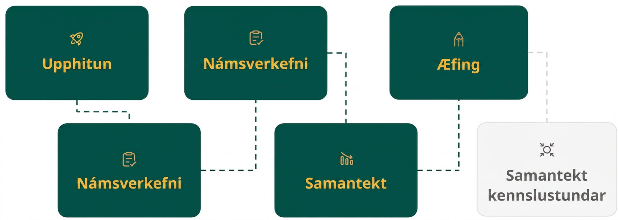
Lesson Journey
Fifth Stop: Practice

Slide 24

Practice
Put your hard work to action, practice what you’ve learned!
Notes:
Digital Practice: Access the practice pages at https://openstax.org/details/books/algebra-1

Slide 25
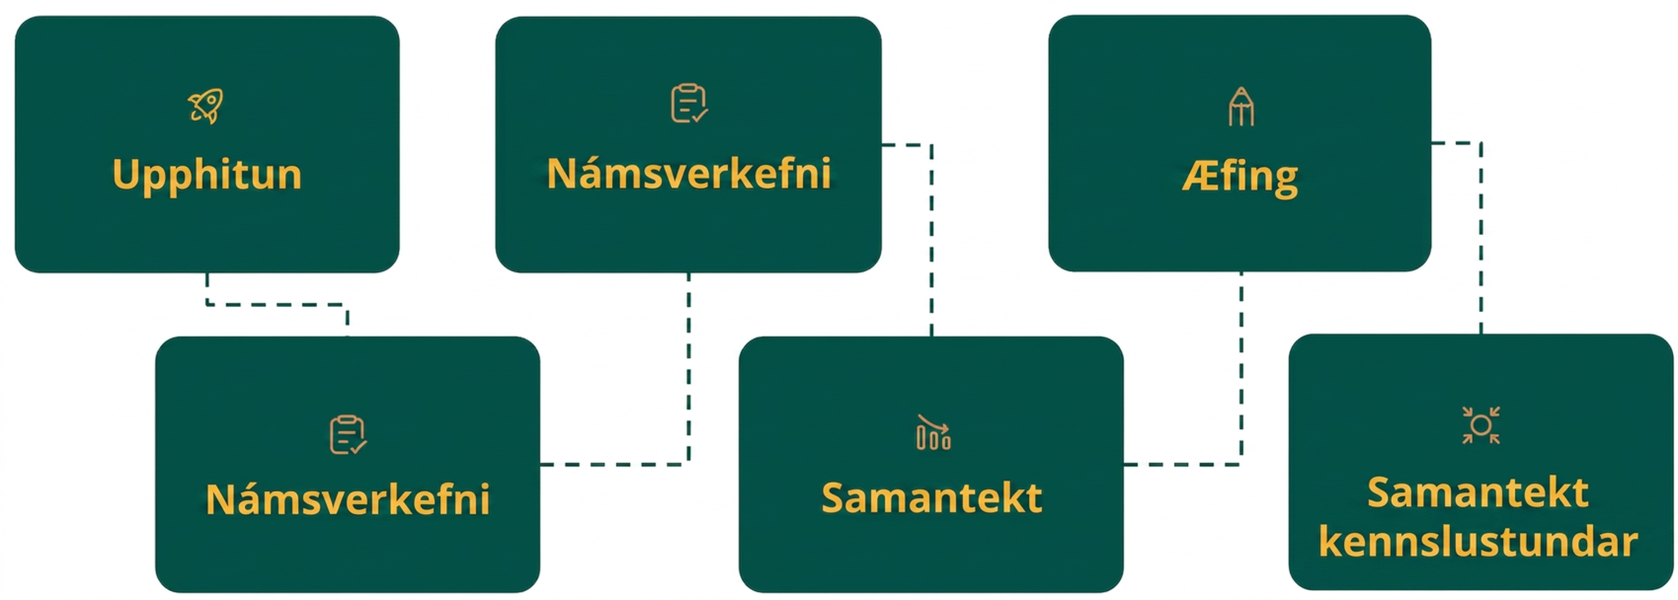
Lesson Journey
Sixth Stop: Lesson Synthesis

Slide 26
Lesson Synthesis
Which of the following equations would be easier to solve if we use completing the square?
x² + 8x = − 12
16x² + 8x = − 12
4x² + 32x = − 7
5x² + 32x = − 7
9x² + 3x − 6 = 0
Notes:
Discuss –
What number would you add to 4x² + 32x (the third equation on the list) to make it a perfect square? How do you know? (64. The coefficient 32 is equal to 2(2)m, so m is 8. The number to be added is 82, which is 64.)
What about 9x² + 6x? How do you know? (1. The coefficient 6 is equal to 2(3)m, so m is 1. The number to be added is 12, which is 1.)
Do certain features or numbers in an equation make it easier or harder to solve it by completing the square? If so, which features or what kinds of numbers? (It's easier when the coefficient of the squared term is 1 or another perfect square. It's harder when some of the coefficients are fractions or the quadratic term's coefficient is not a perfect square.)

Slide 27
Self Assessment
How much do you agree with the following statements?
Learning Goals | I can | Almost | Not yet
Complete the square for quadratic expressions of the form ax² + bx + c when a is not 1 and explain the process. | ⃞ | ⃞ | ⃞
Solve quadratic equations in which the squared term coefficient is not 1 by completing the square. | ⃞ | ⃞ | ⃞

