Slide 1
Algebra 1
Unit 5 Introduction to Exponential Functions
Lesson 5.4 Representing Exponential Growth

Slide 2

How to use these slides
On the activity slides check the speaker notes for teacher support and instructional information.
Each lesson includes 1 warm up, 2-3 learning activities, a cool down, practice and a lesson synthesis.
  Learning activities are followed by a self check question, and review section.
Some slides have been hidden from student view, more information can be found on the next slide (Reference Key).
You can edit and use these slides for personal and classroom use, but cannot sell them and must keep the attribution logos.
For more information, Check out the digital quick start guide!
OpenStax CC BY NC SA

Slide 3





Reference Key
Check the top right corner for an icon referencing these unique sections.
Icon | Title | View | Location and Description
n/a | Support for Students with Disability | Hidden | Learning Strategies slide, provides additional support to students for understanding the activity.
n/a | Support for English Language Learners | Hidden | Learning Strategies slide, provides additional support to students for understanding the activity.
n/a | Extending Your Thinking | Hidden | Extending Your Thinking slide, provides an extra challenge for students.
n/a | Self Check | Not Hidden | Self Check slide, checkpoint to assess student understanding after the learning activity.
n/a | Review | Hidden | Self Check - Review slide, designed to help review topics from the self check question.
On the next slides, check the speaker notes for teacher instructions and support.
Notes:
Check the Speaker Notes: On the next slides you can find discussion questions, lesson information, answers to the activities, and ways to adjust the activity for your students!

Slide 4

Learning Goals
By the end of this lesson you will be able to -
Explain the connections between an equation and a graph that represents exponential growth.
Write and interpret an equation that represents exponential growth.
Notes:
Lesson Narrative
In this lesson, students study a situation characterized by exponential change and learn the term growth factor or constant ratio. They represent this relationship using a table, an expression, and a graph. They also explain the meaning of the numbers 𝑎 and 𝑏 in an exponential expression 𝑎⋅𝑏^{𝑥}, identifying their meaning in terms of a context (𝑎 is the initial amount, and 𝑏 is the multiplier or growth factor) and also in terms of a graph (where 𝑎 is the vertical intercept and 𝑏 determines how quickly the graph increases). Students interpret the different representations of growth in terms of a bacteria population.
In this and following lessons, students will often work with properties of exponents, a topic developed in grade 8. There is also an activity to emphasize the convention that 𝑎⁰=1 for a non-zero number 𝑎.
Technology isn’t required for this lesson, but there are opportunities for students to choose to use appropriate technology to solve problems. We recommend making technology available.
Required Preparation
Acquire devices that can run Desmos (recommended) or other graphing technology as an optional tool for students.
Required Materials
None
Texas Essential Knowledge and Skills
A1(A) apply mathematics to problems arising in everyday life, society, and the workplace
A1(D) communicate mathematical ideas, reasoning, and their implications using multiple representations, including symbols, diagrams, graphs, and language as appropriate
A1(F) analyze mathematical relationships to connect and communicate mathematical ideas
A9(A) determine the domain and range of exponential functions of the form 𝑓(𝑥)=𝑎𝑏^{𝑥} and represent the domain and range using inequalities
A9(B) interpret the meaning of the values of 𝑎 and 𝑏 in exponential functions of the form 𝑓(𝑥)=𝑎𝑏^{𝑥} in real-world problems
A9(C) write exponential functions in the form 𝑓(𝑥)=𝑎𝑏^{𝑥} (where 𝑏 is a rational number) to describe problems arising from mathematical and real-world situations, including growth and decay
A9(D) graph exponential functions that model growth and decay and identify key features, including 𝑦-intercept and asymptote, in mathematical and real-world problems

Slide 5
Vocabulary
Previous
None
New
Growth ratio or Growth factor
  In an exponential function, the output is multiplied by the same factor every time the input increases by one. This value is the multiplier.
Notes:
Lesson Vocabulary
To support student understanding of key vocabulary:
Introduce and review the vocabulary words students will see in this lesson.
Encourage students to notice how these words are used and to include them in their math discussions and explanations—both written and oral.
Use a word wall to reinforce vocabulary. Sample word wall cards are available here.
For newcomers or students with beginning English proficiency, use these Quizlet sets to support vocabulary learning:
Unit 5 Spanish Vocabulary – use first to build understanding
Unit 5 Vocabulary (English) – use after anchoring in Spanish
Support for English Language Learners
ELPS 1(E) internalize new basic and academic language by using and reusing it in meaningful ways in speaking and writing activities that build concept and language attainment
ELPS 2(F) listen to and derive meaning from a variety of media such as audio tape, video, DVD, and CD ROM to build and reinforce concept and language attainment
ELPS 3(B) expand and internalize initial English vocabulary by learning and using high-frequency English words necessary for identifying and describing people, places, and objects, by retelling simple stories and basic information represented or supported by pictures, and by learning and using routine language needed for classroom communication
ELPS 3(G) express opinions, ideas, and feelings ranging from communicating single words and short phrases to participating in extended discussions on a variety of social and grade- appropriate academic topics

Slide 6
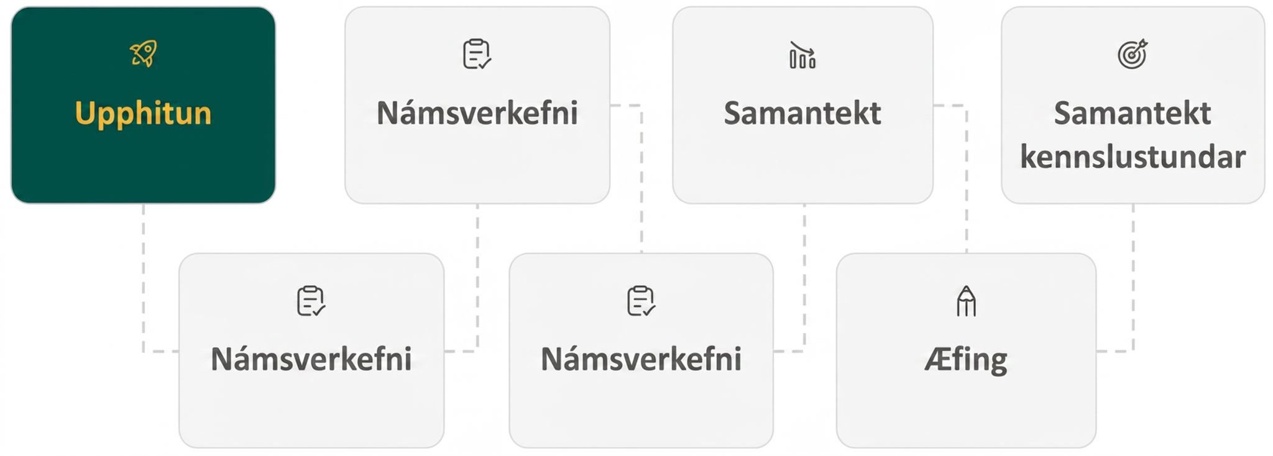
Lesson Journey
First Stop: Warm Up

Slide 7

Warm Up
Exponent Rule Practice
Find the value of 𝑥 that makes the equation true.
2³⋅2⁴ = 2^{𝑥}
2⁵⋅2 = 2^{𝑥}
2¹⁰ ÷ 2⁷ = 2^{𝑥}
2⁹ ÷ 2 = 2^{𝑥}
Notes:
Warm Up (5 minutes)
In grade 8, students studied how to multiply and divide numbers in exponential notation when the bases are the same. This warm up reviews these properties, which students will use systematically as they work with exponential expressions in this unit.
Launch
Display one problem at a time.
Give students quiet time to think individually for each problem and ask them to give a signal when they have an answer and a strategy.
Keep all problems displayed throughout the talk.
Follow with a whole-class discussion.
Answers
7
6
3
8
Anticipated Misconceptions
Before starting the math talk, it may be helpful to take time to ensure that students understand the question. Ask students for examples and non-examples of a power of 2. Some examples are 25 and 2100. Non-examples include 1002 and 5⋅2. It may be useful to further remind students that, for example, 25 equals 2⋅2⋅2⋅2⋅2.
Activity Synthesis
As students share their thinking as part of the math talk, be sure to demonstrate how to break each part of the expression into factors, i.e., 2⁵⋅2=(2⋅2⋅2⋅2⋅2)⋅2=2⁶. Remind students that they can generalize the observations from examples such as this one. The exponents can be added when multiplying exponential expressions with the same base and subtracted when dividing those with the same base.

Slide 8
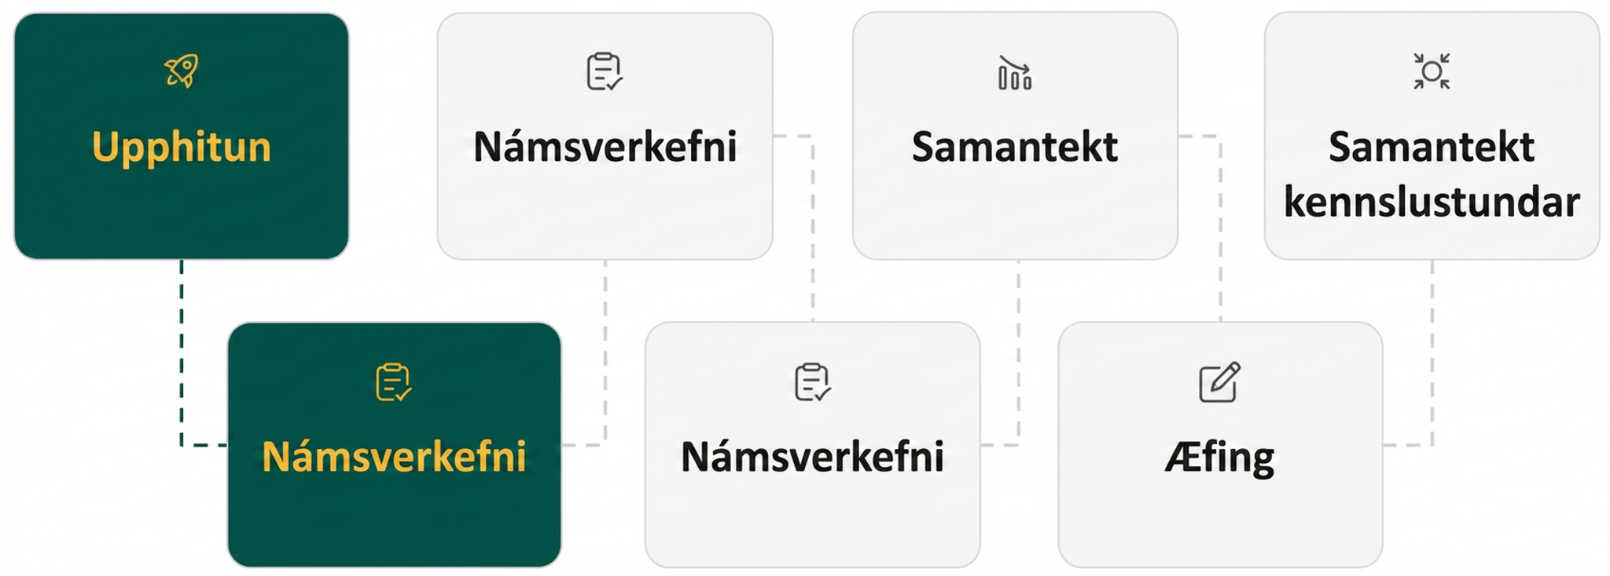
Lesson Journey
Second Stop: Learning Activity A

Slide 9

Learning Activity A | Learning Strategies
The Power of Zero
Critique and identify the error in the problem solution:
“5 to the power of 0 is 0 because I multiplied to get it.”
Correct the reasoning with a partner.
Clarify your explanation by making it more concise and precise.
Critique, Correct, Clarify
Teacher Instruction: Use these strategies to adjust the activity to support English language learners and students with disabilities.
You can copy and paste the callouts directly on top of the activity or give the instructions aloud.
What is the difference between:
8 + 8 + 8 + 8
8 ⨉ 8 ⨉ 8 ⨉ 8
Do they both represent equal groups where an operation is repeated?
Representation
Notes:
Support for English Language Learners: MLR 3 Critique, Correct, Clarify: Reading, Writing, Speaking
Before students share their explanations for the last question, present an incorrect answer and explanation. For example, “5 to the power of 0 is 0, because I multiplied to get it.” Ask students to identify the error, critique the reasoning, and write a correct explanation. As students discuss with a partner, listen for students who identify and clarify the ambiguous language in the statement. Invite students to share their critiques and corrected explanations with the class. Listen for and amplify the language students use to describe what happens when a number is raised to the power of 0 and highlight those who use patterns in the table. This helps students evaluate, and improve on, the written mathematical arguments of others as they clarify their understanding of the power of 0.
Design Principle(s): Optimize output (for explanation); Maximize meta-awareness
Learn more about this routine
View the instructional video and follow along with the materials to assist you with learning this routine.
Provide support for students
Distribute graphic organizers to the students to assist them with participating in this routine.
Support for Students with Disabilities: Representation: Internalize Comprehension
Activate or supply background knowledge about exponents. Discuss the difference between repeated addition and repeated multiplication, while annotating visible examples of expressions to show the differences. Allow students to use calculators to ensure inclusive participation in the activity.
Supports accessibility for: Memory; Conceptual processing; Language
Regarding the support content for Students with Disabilities:
8 + 8 + 8 + 8 is the repeated addition of groups of 8. A shorthand for writing this is to say we have 4 equal groups of 8, so we can say we have 4 ⨉ 8.
8 ⨉ 8 ⨉ 8 ⨉ 8 is the repeated multiplication of groups of 8. A shorthand for writing this is to say we are multiplying 8 by itself 4 times, so we can say we have 8⁴.
Expanding problems to help students review the exponent rules helps to bridge into abstract understanding. Time permitting, have students work with a partner to create flow charts that illustrate at least two different ways to simplify problems such as: (3 ⨉ 7)⁴; (5⁴)³; or 4² 𑁦 4³. As an alternative, if you have not used the Quiz-Quiz-Trade activity described in the Lesson Synthesis for either Lessons 5.1 or 5.2, consider using it now to activate background knowledge.
NOTE: Remember, students learned these exponent rules in middle school. So, if you would like a video to use for reviewing exponent rules, you may want to use this video (beginning at 18 seconds): 2-Minute Crash Course: Exponent Laws with Ms. Lewis from Smart Culture Education. As an alternative, access the Math is Fun website regarding Exponent Laws as a way to review and activate prior knowledge.

Slide 10
Learning Activity A | Part 1
The Power of Zero
Complete the table by entering the values for a, b, and c below the table. Take advantage of any patterns you notice.
Here are some equations. Find the solution to each equation using what you know about exponent rules. Be prepared to explain your reasoning.
  9^{𝑥}⋅9⁷ = 9⁷
  9¹² ÷ 9^{𝑥} = 9¹²
Answer the following questions.
  What is the value of 5⁰?
  What about 2⁰?
x | 4 | 3 | 2 | 1 | 0
3^{x} | 81 | 27 | a. ___ | b. ___ | c. ___
Are you ready for more?
Notes:
Support for All Learners
This activity offers additional support and an extension for students:
For students with disabilities, be sure to review the Learning Strategies slide!
For students looking for an extra challenge, be sure to review the Extending Your Thinking slide!
Activity (10 minutes)
This task reviews an important property of exponents that students have studied in grade 8 and again in lesson 5.1, namely that if 𝑏 is a non-zero number, then 𝑏⁰ = 1. This is a convention, one that allows the rule 𝑏^{𝑥}⋅𝑏^{𝑦} = 𝑏^{(𝑥+𝑦)} to remain true when 𝑥 or 𝑦 is allowed to be 0. An additional convention, which is not addressed in this task, states that 𝑏^{−𝑛} = 1/𝑏^{𝑛} for a whole number 𝑛. With these conventions, the equation 𝑏^{𝑥}⋅𝑏^{𝑦} = 𝑏^{𝑥+𝑦} is true for all integers 𝑥 and 𝑦.
Activity Answer
a. 9
b. 3
c . 1
a. 9⁰⋅9⁷ = 9⁷
b. 9¹² ÷ 9⁰ = 9¹²
5⁰ = 1. For positive whole numbers, 5^{𝑎}⋅5^{𝑏} = 5^{𝑎+𝑏}. For this law to still hold with 0 as an exponent, 5⁰ needs to be equal to 1 because 5⁰⁺⁴ = 5⁴ and 1⋅5⁴ = 5⁴.
2⁰ = 1. For positive whole numbers, 2^{𝑎}⋅2^{𝑏} = 2^{𝑎+𝑏}. For this law to still hold with 0 as an exponent, 2⁰ needs to be equal to 1 because 2⁰⁺⁴ = 2⁴ and 1⋅2⁴ = 2⁴.
Anticipated Misconceptions
Students may think that 𝑎⁰ = 0. First, remind them that exponents are not the same as multiplication (for example, 4³ = 4⋅4⋅4, and 4⋅4⋅4 is very different from 4⋅3). Next, ask them to use the patterns that they notice in the equations and tables to determine the correct value.
Activity Synthesis
Make sure students understand that 5⁰ = 1 is an agreed-upon definition. The reason for defining 5⁰ this way is so that the property (5^{𝑎}⋅5^{𝑏} = 5^{𝑎+𝑏}) continues to hold when we allow 0 as an exponent.

Slide 11

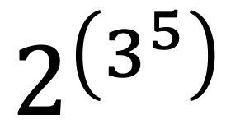
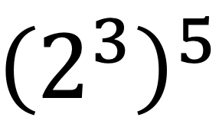
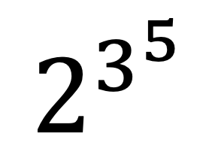
Learning Activity A
Extending Your Thinking
We know: (2 + 3) + 5 = 2 + (3 + 5) and 2 𑁦 (3 𑁦 5) = (2 𑁦 3) 𑁦 5.
Because: Grouping with parentheses does NOT affect the value of the expression.
Is this true for exponents? That is, are the following numbers equal? If not, which number is bigger?
Which of the two numbers, given above, would you
choose as the meaning of the expression, given at
right, written without parentheses?
Notes:
Go back to Lesson Activity
Answer
The two numbers are not even close! Since 3⁵ = 243, the number 2^(3⁵) is 2²⁴³. On the other hand, (2^3)⁵ = 2³⋅2³⋅2³⋅2³⋅2³=2¹⁵. The number 2²⁴³ is much larger than 2¹⁵.
Typically, we define repeated exponents by working down the tower, e.g., 2^3^5=2^(3⁵). One reason for this is that evaluating up the tower, as in (2^3)⁵, can already be simplified by using algebra rules (in this case, to get 2¹⁵).

Slide 12
Learning Activity A
Self Check
Santos and Sara are checking their work on the following problem:
4(2 𑁦 3 𑁦 5)⁰. Santos says the answer is 1. Sara says the answer is 4. Who is correct, and why?
Santos is correct because anything raised to the zero power is 1.
Neither Santos nor Sara did the problem correctly.
Both Santos and Sara are correct since there are two methods to solve the problem.
Sara is correct because you first would simplify the parentheses, and since it’s raised to the zero power, it would be 1. Then you would multiply that by 4, for a final answer of 4.
Let’s review!
Notes:
Answer Feedback - Individualized by Response
Incorrect. Santos is correct that anything to the zero power is 1, but he forgot about the 4 multiplied outside the parentheses.
Incorrect. Santos forgot to multiply by 4, but Sara did the problem correctly.
Incorrect. Remember to use order of operations. There may be more than one method, but all methods should result in the same answer.
That’s correct! Check yourself: Remember when multiple operations are involved to use the order of operations. This problem would result in 4⋅1 or 4.

Slide 13

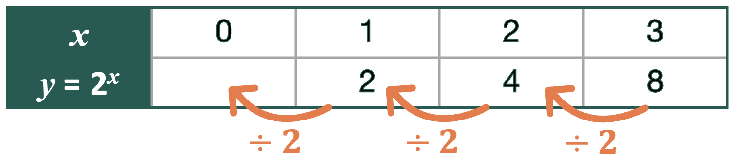
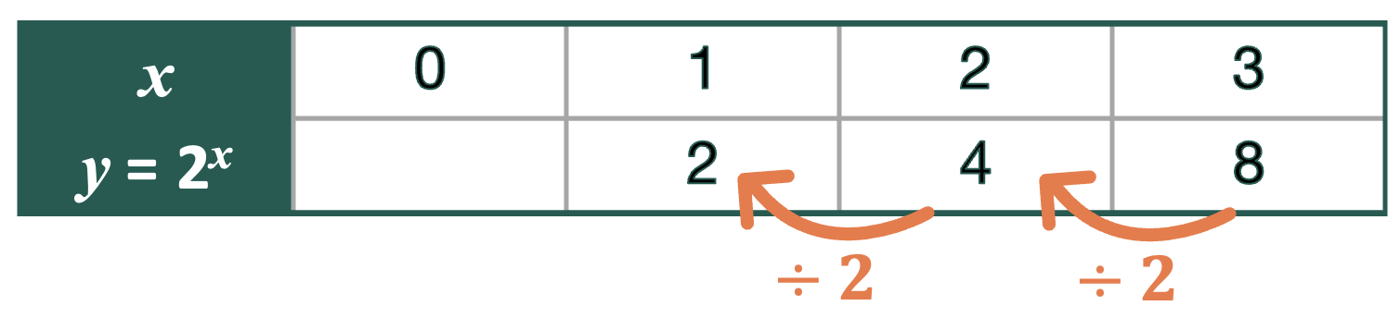
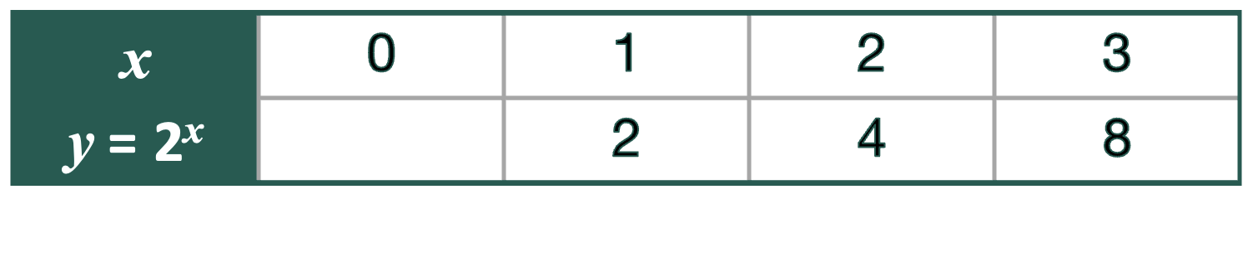
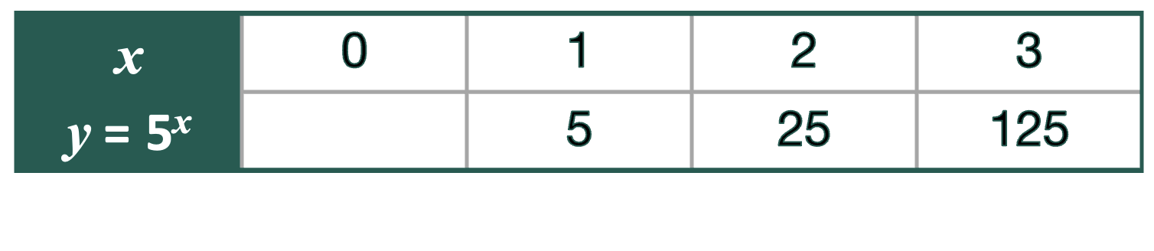
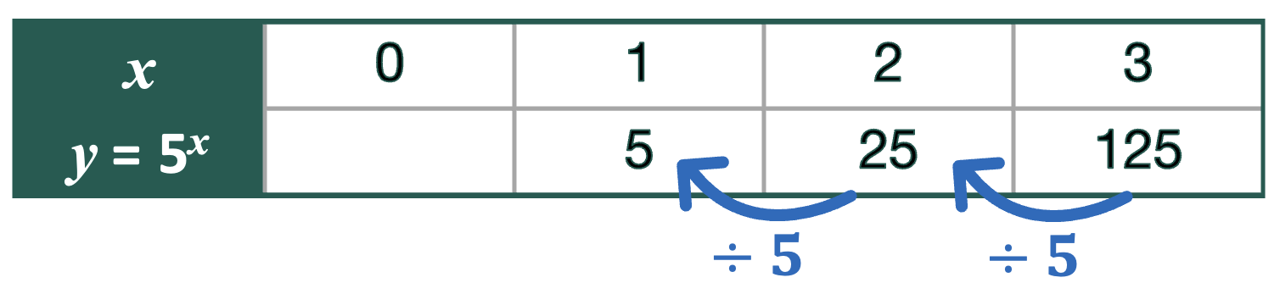
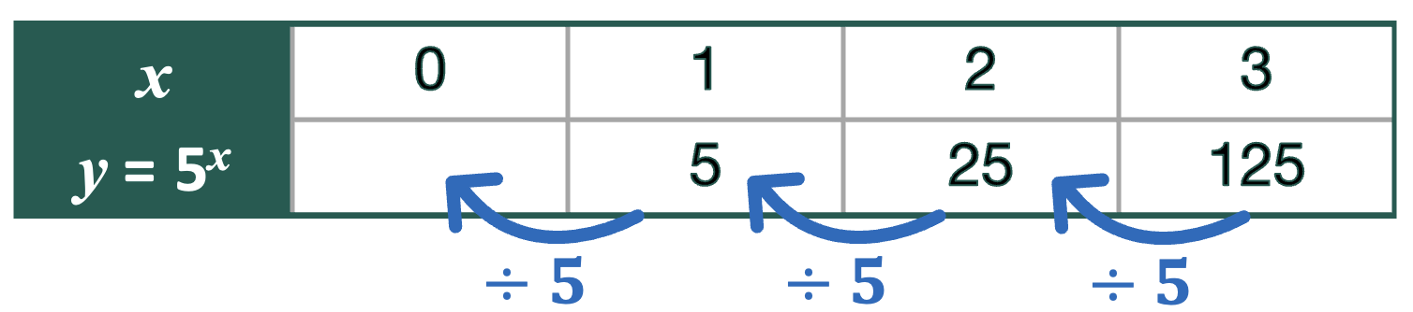
Learning Activity A
Self Check - Review
Why is 2⁰ = 1 and 5⁰ = 1, but 2³ is not the same as 5³?
Determine the values of 2³ and 5³ and place them in a table representing the functions y = 2^{x} and y = 5^{x}, respectively. Also complete values for x = 1 and x = 2.
As we build the table, we multiply by 2 or 5. What if we work BACKWARDS?
That means we DIVIDE by 2 or 5.
So … continuing to DIVIDE by 2 or 5 …
2 ÷ 2 = 1 and 5 ÷ 5 = 1!
SO … 2⁰ = 1 and 5⁰ = 1.
Notes:
Remind students
Exponents in general represent repeated multiplication, much like multiplication represents repeated addition.
Any value - no matter how big or small will equal zero if it is raised to the zero power.
For additional practice problems, access the online textbook.

Slide 14
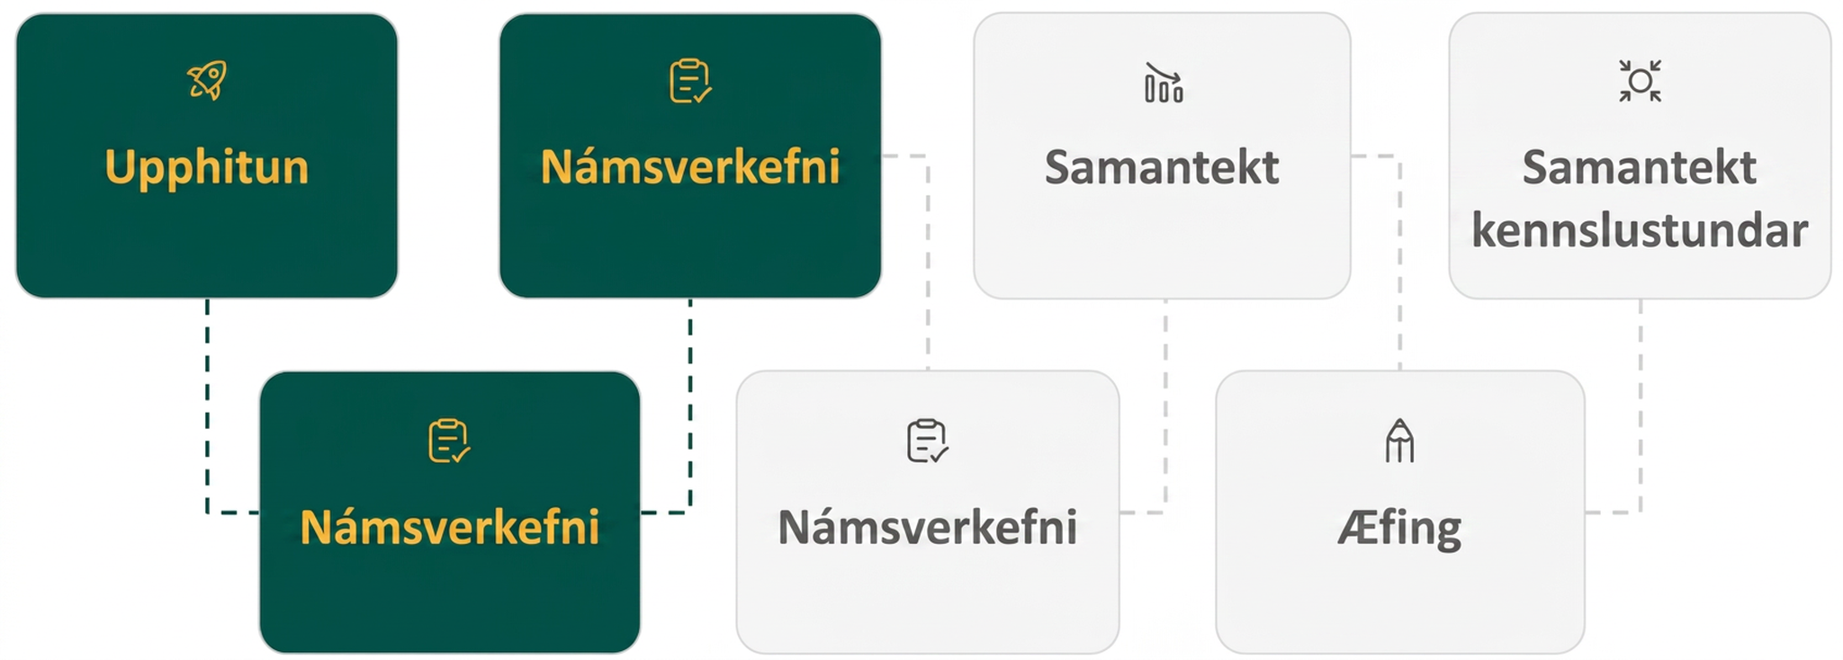
Lesson Journey
Third Stop: Learning Activity B

Slide 15
Learning Activity B | Learning Strategies
That’s a lot of Bacteria!
Prepare to share your thinking with the class.
Listen and watch for words and phrases that connect ideas for you.
Identify how the patterns in the table can be expressed differently.
Collect and Display
Teacher Instruction: Use these strategies to adjust the activity to support English language learners and students with disabilities.
  You can copy and paste the callouts directly on top of the activity or give the instructions aloud.
When the experiment starts, time is at
0 hours. How many bacteria are there?
After 1 hour, each bacteria splits into two. How many bacteria are there after 1 hour?
After 2 hours, each bacteria splits again - how many are there after 2 hours?
After 3 hours, each bacteria splits again - how many are there after 3 hours?
Action and Expression
Notes:
Support for English Language Learners: MLR 2 Collect and Display: Conversing
Before the whole-class discussion, invite students to discuss their thinking for the provided questions with a partner. Listen for and collect vocabulary and phrases students use to describe patterns in the table for the growth of bacteria. Display words and phrases such as “multiplier,” “exponentially,” and “doubling” for all to see. Remind students to suggest additions and to borrow language from the display as needed. This will help students read and use mathematical language during their partner and whole-group discussions.
Design Principle(s): Maximize meta-awareness
Provide support for students
Distribute graphic organizers to the students to assist them with participating in this routine.
Support for Students with Disabilities: Action and Expression: Internalize Executive Functions
Chunk this task into more manageable parts to support students who benefit from support with organization and problem solving. For example, students complete hours 0–3 and discuss the pattern they notice. Use annotations to show how the number of bacteria is changing from one hour to the next. Then invite students to use what they notice to complete the table.
Supports accessibility for: Organization; Attention

Slide 16
Learning Activity B | Part 1
That’s a lot of Bacteria!
In an exponential function, the output is multiplied by the same factor every time the input increases by one. The multiplier is called the growth factor.
In a biology lab, 500 bacteria reproduce by splitting. Every hour, on the hour, each bacterium splits into two bacteria. Fill in the table by writing an expression to show the number of bacteria after each hour.
Hour | Number of bacteria
0 | 500
1 | a?
2 | b?
3 | c?
6 | d?
t | e?
Notes:
Support for All Learners
This activity offers additional support for students:
For English language learners and students with disabilities, be sure to review the Learning Strategies slide!
Activity (15 minutes)
This activity prompts students to build expressions of the form 𝑎⋅𝑏^{𝑥} to encapsulate a type of pattern they have encountered several times so far and to consider what 𝑎 and 𝑏 mean in the context of bacteria growth. They do so by writing numerical expressions that make explicit the key feature of exponential change—the repeated multiplication by the same factor—and then making a generalization of their repeated reasoning (TEKS A.1(F)) using exponential notation. Since students are finally representing this pattern using an exponent, a quantity following this type of pattern is described as changing exponentially. The term growth factor or constant ratio is given to the multiplier or 𝑏 in an expression of the form 𝑎⋅𝑏^{𝑥}.
Launch
Clarify that it is not necessary to compute the number of bacteria at the end of each hour; an expression would suffice.
If needed, provide an example (e.g., write the expression for the first day as 500⋅2 rather than as 1,000).
Activity questions, answers, anticipated misconceptions, and synthesis on the next slide.

Slide 17
Learning Activity B | Part 2
That’s a lot of Bacteria!
Which equation relates 𝑛, the number of bacteria, to 𝑡, the number of hours?
  𝑛 = 500 + 2^{𝑡}
  𝑛 = 500 + 2^{𝑡}
  𝑛 = 500⋅2^{𝑡}
  𝑛 = 500⋅2⋅𝑡
Use your equation to find 𝑛 when 𝑡 is 0. What does this value of 𝑛 mean in this situation?
In a different biology lab, a population of single-cell parasites also reproduces hourly. An equation that gives the number of parasites, 𝑝, after 𝑡 hours is 𝑝 = 100⋅3^{𝑡}. Explain what the numbers 100 and 3 mean in this situation.
Notes:
Answers
a. 500⋅2
b. 500⋅2⋅2
c . 500⋅2⋅2⋅2 (or 500⋅2³)
d. 500⋅2⋅2⋅2⋅2⋅2⋅2 (or 500⋅2⁶)
e. 𝑛 = 500⋅2^{𝑡}
𝑛 = 500⋅2^{𝑡}
When 𝑡 is 0, 𝑛 = 500⋅2⁰. Because 2⁰ = 1, 𝑛 = 500⋅1 or 𝑛 = 500. 500 is the number of bacteria at the starting time or at hour 0.
100 is the number of parasites at hour 0 because 100⋅3⁰ = 100. The number 3 means that every hour, the number of parasites triples.
Anticipated Misconceptions
For the first question, some students may write either 2⋅500 or 500 + 500 for the number of bacteria after one hour. Both are mathematically correct, but 2⋅500 is more helpful for identifying a pattern, which will help generate an expression for the number of bacteria after 𝑡 hours. If they struggle to complete the table, refocus their attention on the second row of the table and ask them if there is a different expression they could use for the number of bacteria after one hour.
Students may misread the directions and write the actual values in the table rather than expressions. Ask them to record the expression they used to determine the value in the table rather than the value itself.
Students may write something like 500⋅2⋅2⋅2 ... with a note about there being 𝑡 2s. Encourage them to think how they might be able to write this expression more concisely.
Activity Synthesis
Invite students to share the expressions in their table and their generalized expression for the number of bacteria after 𝑡 hours. Make connections between, for example, 500⋅2⋅2⋅2⋅2⋅2, the more concise expression 500⋅2⁵, and the more general expression representing any number of hours 500⋅2^{𝑡}. Highlight that 500 is not only the initial number of bacteria, but also the result of evaluating 500⋅2⁰.
Tell students that in patterns like these, where a quantity is repeatedly multiplied by the same factor, the quantity is often described as changing exponentially. We can see why: An exponent is used to express the relationship. The term for the multiplier, which is 2 in the doubling relationship and 3 in the tripling relationship, is the constant ratio or growth factor.
Questions for discussion:
“Is the growth of the bacteria characterized by common differences or common factors? How do you know?” (Common factors, since each time the hour increases by 1, the number of bacteria is multiplied by the same factor.)
“In each row in the table, what does the value of 500 mean? Why doesn’t it change?” (It is the initial bacteria population when they are first measured.)
“What does 2⁰ mean in this situation?” (2⁰ tells us no doubling has happened, so the original population of 500 is all we have.)
“What do the 100 and 3 mean in the expression 100⋅3^{𝑡}?” (100 is the initial population of the parasites when they are first measured, and the number 3 is the growth factor, the number by which the population is multiplied each hour.)
“If the starting parasite population is 80 but the population quadruples every hour, how will the expression change?” (It will be 80⋅4^{𝑡}.)

Slide 18
Learning Activity B
Self Check
The population of a city is 100,000. It doubles each decade. Write an equation that relates the population, 𝑝, to time in decades, 𝑡.
p = 100,000 𑁦 2t
p = 100,000 𑁦 2^{t}
p = 100,000 𑁦 t²
p = 2^{t}
Let’s review!
Notes:
Answer Feedback - Individualized by Response
Incorrect. Doubles means there is a common ratio of 2, and 𝑡 is the exponent.
That's correct! Check yourself: Since you don’t know how many decades have passed, you need to use the variable 𝑡 as the exponent, and doubles means you need to multiply by 2.
Incorrect. Remember, doubles means that the common ratio is 2.
Incorrect. The formula for exponential functions is 𝑦=𝑎⋅𝑏^{𝑥}, where 𝑎 is the initial value. For this scenario, the initial value is 100,000.

Slide 19
Learning Activity B
Self Check - Review
What is the constant ratio (also called the growth factor) of the exponential function shown in the table?
Rewrite each term to show the initial value and repeated use of the constant ratio.
EXPONENTIAL GROWTH
f(x) = a 𑁦 b^{x}
Where –
a is the initial or starting value of the function
b is the growth factor or growth multiplier per unit x
x | 0 | 1 | 2 | 3 | 4
f(x) | 4 | 12 | 36 | 108 | 324
Rewritten form | ? | ? | ? | ? | ?
Notes:
Remind students
Because the output of exponential functions increases very rapidly, the term “exponential growth” is often used in everyday language to describe anything that grows or increases rapidly. However, exponential growth can be defined more precisely in a mathematical sense.
A function that models exponential growth grows by a rate proportional to the amount present.
For any real number 𝑥, 𝑎 and 𝑏 are positive real numbers such that 𝑏 ≠ 1.
Answers
The constant ratio, 𝑏, would be 3, since every value in the table is 3 times the previous term.
The initial or starting value of the function is 4 because that is when the value of 𝑥 is 0.
At x = 0, f(x) = 4
At x = 1, f(x) = 4 𑁦 3¹
At x = 2, f(x) = 4 𑁦 3²
At x = 3, f(x) = 4 𑁦 3³
At x = 4, f(x) = 4 𑁦 3⁴

Slide 20
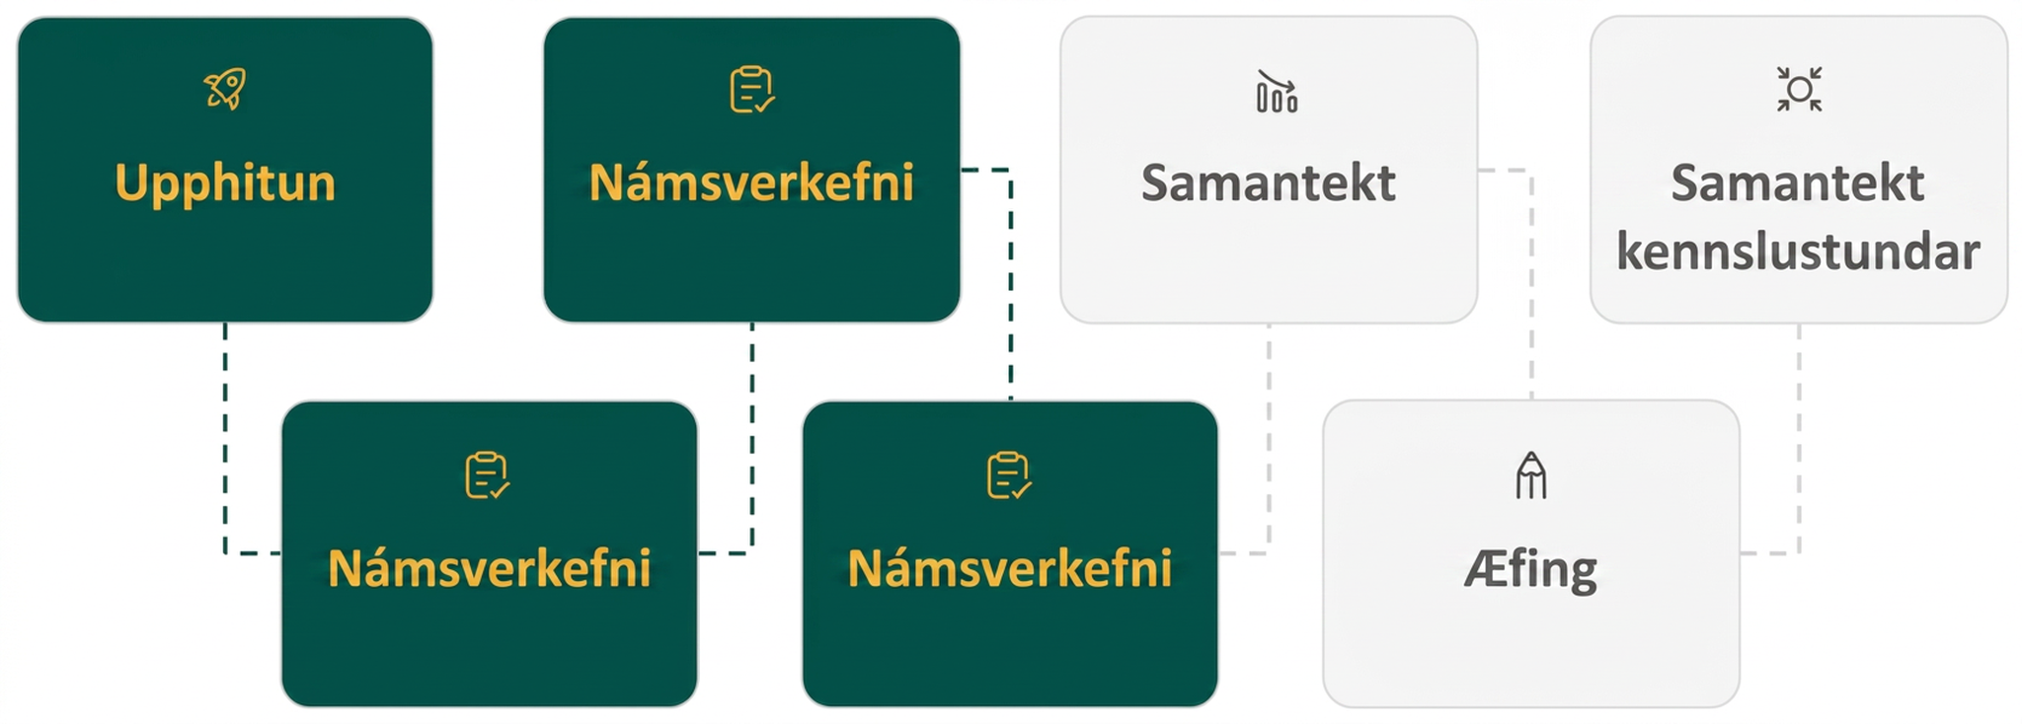
Lesson Journey
Fourth Stop: Learning Activity C

Slide 21
Learning Activity C | Learning Strategies
Let’s Graph It!📈
Teacher Instruction: Use this strategy to adjust the activity to support English language learners.
You can copy and paste the callout directly on top of the activity or give the instructions aloud.
Partner A share your observations about graph 1. Partner B share your observations about graph 2.
Use sentence stems to share your ideas:
  “I can connect the equation to the graph by …”
  “I notice that …”
Press your partner to provide specifics:
  “What is the name of that point?”
  “How would you describe this curve?”
Discussion Supports
Notes:
Support for English Language Learners: MLR 8 Discussion Supports: Speaking, Representing
Use this routine to help students describe the meaning of variables in exponential expressions. Arrange students in groups of 2. Invite Partner A to share their observations for the first graph and Partner B to share their observations for the second graph. Provide sentence frames such as: “I can connect the equation to the graph by . . .” and “I notice that . . . .” Invite the listener to press for additional details referring to features of the graphs, such as the vertical intercept, specific points, and the steepness of the curve. This will help students justify how features of the graph can be used to identify matching equations.
Design Principle(s): Support sense-making; Cultivate conversation

Slide 22
Learning Activity C | Part 1
Let’s Graph It!📈
In an exponential function, the output is multiplied by the same factor every time the input increases by one. The multiplier is called the growth factor.
Graph the equation, 𝑛 = 500⋅2^{𝑡}, to answer these questions. (Refer to 5.4.3).
What is the domain?
What is the range?
Write a reasonable domain and range based on the scenario using inequalities.
Graph (𝑡, 𝑛) when 𝑡 is 0, 1, 2, 3, and 4.
On the graph of 𝑛, where can you see each number that appears in the equation?
Notes:
Support for All Learners
This activity offers additional support for students:
For English language learners, be sure to review the Learning Strategies slide!
Activity (15 minutes)
Having just seen an example of the meaning of 𝑎 and 𝑏 in an exponential expression 𝑎⋅𝑏^{𝑥}, students now focus on interpreting these numbers using graphs. They graph the equations from the previous task, noticing that 𝑎 is the vertical intercept of the graph and the number 𝑏 determines how quickly the graph grows (since in these cases 𝑏 > 1). A larger value of 𝑏 corresponds to a more rapid rate of growth for the bacteria population. The axes for the graphs have been labeled here, but in future activities, students will have to think strategically about how to label the axes to most effectively plot the points.
Making graphing technology available gives students an opportunity to choose appropriate tools strategically
Launch
Display the equations from the previous activity for all to see (if they are not already visible).
Activity image answer, and synthesis on the next slide.

Slide 23
Learning Activity C | Part 2
Let’s Graph It!📈
Use the equation, p = 100⋅3^{𝑡}, to answer these questions. (Refer to 5.4.3).
Graph (𝑡, p) when 𝑡 is 0, 1, 2, 3, and 4.
On the graph of p, where can you see each number that appears in the equation?
Notes:
Activity Answer
The graph of the function shows that all real values of 𝑡 define the domain. In interval notation this is written as (−∞, +∞) or as inequality, −∞ < 𝑡 < +∞.
The graph of the function shows that all real values of 𝑛 greater than 0 define the range. In interval notation this is written as (0, +∞) or as inequality, 0 < 𝑛< +∞.
Domain: 0 ≤ 𝑡< +∞; because we begin measuring time at 0 hours. Range: 500 ≤ 𝑛< +∞; because we begin with 500 bacteria in the lab experiment.
Access the online Teacher Guide to see the graph for this question or use this Desmos graph.
500 is the vertical intercept (or the value of 𝑛 when 𝑡 is 0). The 2 is the doubling of the 𝑛 value every time 𝑡 increases by 1.
Access the online Teacher Guide to see the graph for this question or use this Desmos graph.
100 is the vertical intercept (or the value of 𝑝 when 𝑡 is 0). The 3 is the tripling of the 𝑝 value every time 𝑡 increases by 1
Anticipated Misconceptions
Students may have trouble graphing the points, particularly finding the appropriate vertical (𝑛 or 𝑝) values. Ask them to find the coordinates of the grid points on the vertical axis and use that to estimate the vertical position of their points.
When calculating values by hand, many students may mistakenly write an expression like 100⋅3² as 300². Remind them that the expression 100⋅3² means 100⋅3⋅3.
Activity Synthesis
Make sure students recognize two key takeaways from this activity:
The vertical intercept of the graph is the initial bacteria population size. It is the size of the population when first measured, or when 𝑡, the number of hours since measurement, is 0.
The growth factor of the populations is represented by how quickly the graph increases.

Slide 24
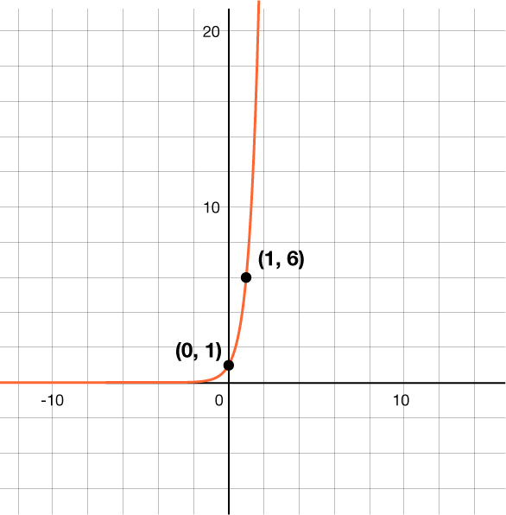
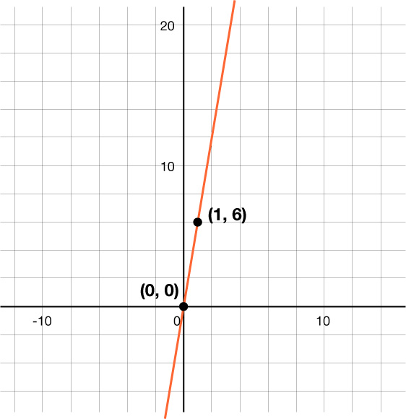
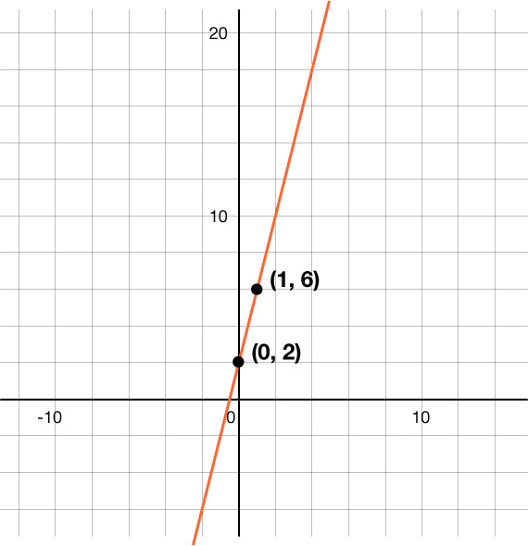
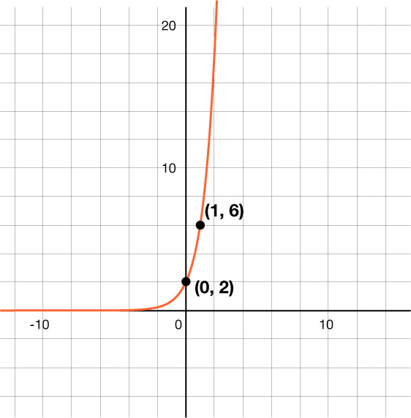
Learning Activity C
Self Check
Graph a.
Graph b.
Which is the graph of y = 2 𑁦 3^{x}?
Graph c.
Graph d.
Let’s review!
Notes:
Answer Feedback - Individualized by Response
Incorrect. (1, 6) is a point on this graph. However, the graph you are looking for has a 𝑦-intercept of 2, not 1. This is the graph of 𝑦 = 6^{𝑥}. When graphing, remember that the 𝑎-value from 𝑦 = 𝑎 𑁦 𝑏^{𝑥} is also the 𝑦-intercept.
Incorrect. The point (1, 6) is on the graph. However, this graph is linear, not exponential. This is the graph of 𝑦 = 6𝑥.
Incorrect. The points (1, 6) and (0, 2) are on the graph. However, this is the graph of a linear function, 𝑦 = 4𝑥 + 2, not an exponential function. When graphing an exponential function, remember it has a constant ratio.
That’s correct! Since the 𝑎-value of the equation is 2, that is also the 𝑦-intercept. When 𝑥 = 1, you have 𝑦 = 2 𑁦 3¹ or 𝑦 = 2 𑁦 3, which is 𝑦 = 6.

Slide 25
Learning Activity C
Self Check - Review
Properties of the graph of f(x) = a^{x} when a > 1
Domain | (– ∞, ∞)
Range | (0, ∞)
x-intercept | none
y-intercept | (0, 1)
asymptote | y = 0
contains | (1, a) and (–1, ¹/a)
Graph y = 4^{x} then identify the following key characteristics:
x-intercept
y-intercept
Asymptote
Domain
Range
Notes:
Remind Students
When graphing any function, it often helps to start with a table. The table should always contain a minimum of 3 to 5 entries. The more information you have, the easier it is to sketch the graph.
The information given in the properties table is generic and applies to the graph of most exponential growth functions - and specifically the parent exponential function.
An asymptote is a line or curve that a function approaches but does not intersect or touch.
As the input values of a function approach a certain value or tend towards infinity or negative infinity, the function values get arbitrarily close to the asymptote without actually crossing it.
Asymptotes can provide valuable information about the behavior of a function and can help in understanding its limits and range.
For the Texas STAAR End of Course exam, students are expected to identify the y-intercept, asymptote, domain, and range. SO - remind students of the link between the asymptote and the range.
Answers - Desmos graph of y = 4^{x}
x-intercept - none
y-intercept - (0, 1)
Asymptote - the x-axis or y = 0
Domain - (– ∞, ∞)
Range - (0, ∞)

Slide 26

Learning Activity C | Video
Graphing Exponential Functions
Notes:
This video discusses questions 1 – 4 of activity 5.4.4 - but it is still based on the bacteria scenario first introduced in activity 5.4.3.

Slide 27
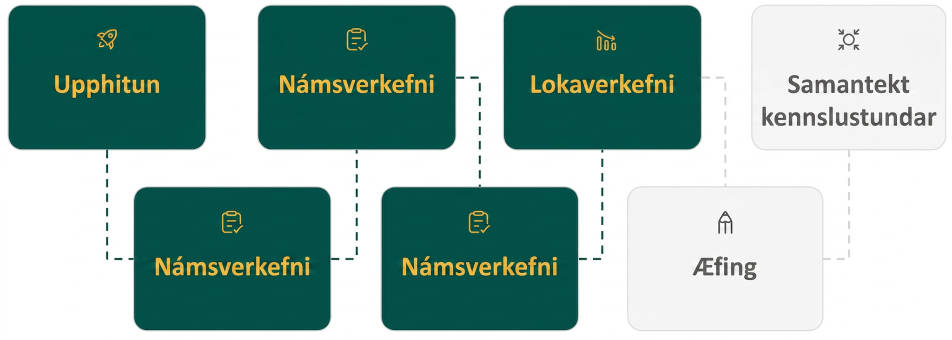
Lesson Journey
Fifth Step: Cool Down

Slide 28
Cool Down
A group of biologists is surveying the mice population in a forest. The equation 𝑛 = 75⋅3^{𝑡} gives the total number of mice, 𝑛, 𝑡 years since the survey began. Explain what the numbers 75 and 3 mean in this situation.
Notes:
Cool Down (15 minutes)
Answer
75 is the initial number of mice in the forest when the survey started, or the number of mice when 𝑡 is 0. The 3 is the growth factor or constant ratio, meaning that each year, the population of mice in the forest is 3 times the previous year’s population.
Response to Student Thinking - More Chances
Students will have more opportunities to understand the mathematical ideas in this cool-down, so there is no need to slow down or add additional work to the next lessons. Instead, use the results of this cool-down to provide guidance for what to look for and emphasize over the next several lessons to support students in advancing their current understanding.

Slide 29
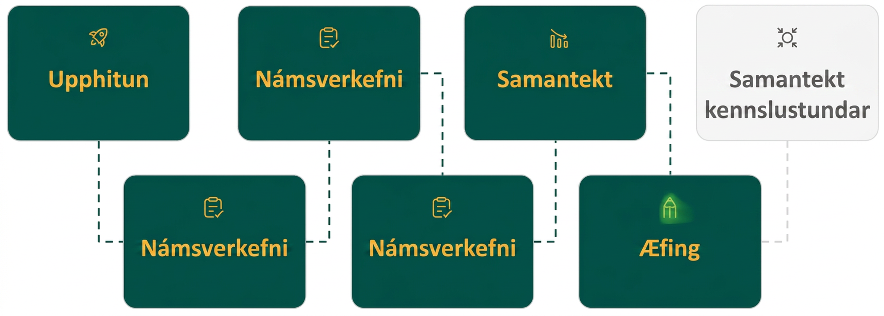
Lesson Journey
Sixth Stop: Practice

Slide 30

Practice
Put your hard work to action, practice what you’ve learned!
Notes:
Digital Practice: Access the practice pages at https://openstax.org/details/books/algebra-1

Slide 31
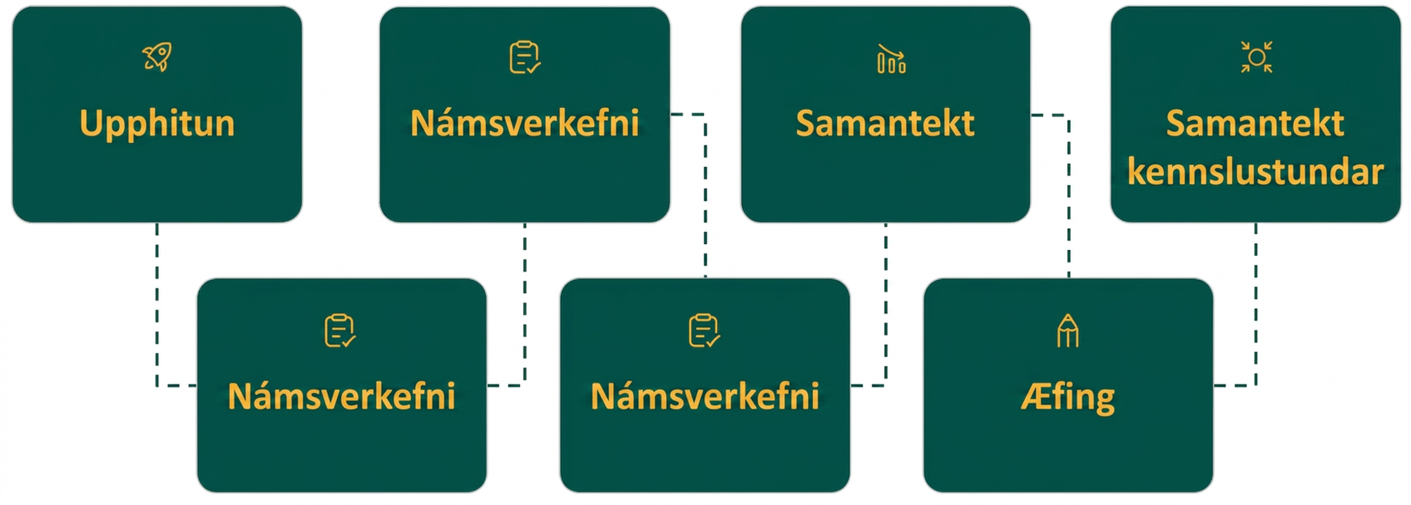
Lesson Journey
Seventh Stop: Lesson Synthesis

Slide 32
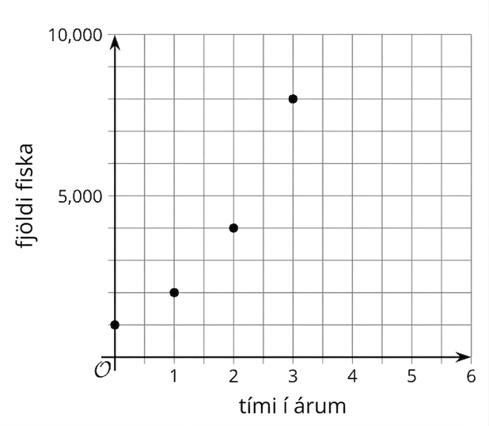
Lesson Synthesis
1000⋅2^{𝑡} represents a fish population after 𝑡 years. Here is the graph of the yearly fish population.
What was the fish population when the scientists first measured it?
How can you tell from the graph?
How is the fish population changing from year to year?
How does the expression 1000⋅2^{𝑡} represent the fish population after 𝑡 years?
Notes:
Lesson Synthesis
In this lesson, we learned the terms growth factor and constant ratio and used equations and graphs to represent situations with quantities that change exponentially. Ask students to identify the connections between the quantities in a situation and the graph and expressions that represent it. Use an example from a classroom activity or a new example the one provided on this slide.

Slide 33
Self Assessment
How much do you agree with the following statements?
Learning Goals | I can | Almost | Not yet
Explain the connections between an equation and a graph that represents exponential growth. | ⃞ | ⃞ | ⃞
Write and interpret an equation that represents exponential growth. | ⃞ | ⃞ | ⃞

