Slide 1
Algebra 1
Unit 9 More Quadratic Equations
Lesson 9.8 Deriving the Quadratic Formula
Notes:
How to Get Started
Review Slide 2: How to use these slides
Check out the Check out the digital quick start guide!
Review Slide 3: Reference Key of Icons

Slide 2

How to use these slides
On the activity slides check the speaker notes for teacher support and instructional information.
Each lesson includes 1 warm up, 2-3 learning activities, a cool down, practice and a lesson synthesis.
  Learning activities are followed by a self check question, and review section.
Some slides have been hidden from student view, more information can be found on the next slide (Reference Key).
You can edit and use these slides for personal and classroom use, but cannot sell them and must keep the attribution logos.
For more information, Check out the digital quick start guide!
OpenStax CC BY NC SA

Slide 3





Reference Key
Check the top right corner for an icon referencing these unique sections.
Icon | Title | View | Location and Description
n/a | Support for Students with Disability | Hidden | Learning Strategies slide, provides additional support to students for understanding the activity.
n/a | Support for English Language Learners | Hidden | Learning Strategies slide, provides additional support to students for understanding the activity.
n/a | Extending Your Thinking | Hidden | Extending Your Thinking slide, provides an extra challenge for students.
n/a | Self Check | Not Hidden | Self Check slide, checkpoint to assess student understanding after the learning activity.
n/a | Review | Hidden | Self Check - Review slide, designed to help review topics from the self check question.
On the next slides, check the speaker notes for teacher instructions and support.
Notes:
Check the Speaker Notes: On the next slides you can find discussion questions, lesson information, answers to the activities, and ways to adjust the activity for your students!

Slide 4

Learning Goals
By the end of this lesson you will be able to -
Explain the steps and complete some missing steps for deriving the quadratic formula.
Explain how the quadratic formula is related to the process of completing the square for a quadratic equation
ax² + bx + c = 0.
Notes:
Lesson Narrative
By now, students know how to use the quadratic formula to solve quadratic equations, have seen when it is useful compared to other methods, and have noticed common errors in its use. In this lesson, they investigate why the formula works by deriving it from completing the square. Because completing the square always works for equations of the form ax² + bx + c = 0, its steps can be generalized into a single formula.
To prepare for completing the square with a, b, and c as letters, students first expand perfect squares from factored to standard form without evaluating, for example rewriting (3x − 4)² as (3x)² + 2(3x) (−4) + (−4)² and
(kx + m)² as (kx)² + 2(kx)m + m². This highlights structural connections and supports reasoning in reverse when completing the square for ax² + bx + c.
One strategy for deriving the formula is to temporarily replace kx in (kx)² +2(kx)m with a single letter, say Q, so that the expression becomes a monic quadratic Q2 + 2Qm. In this lesson, students analyze and complete partially worked-out derivations of the quadratic formula, explaining each step and thereby practicing constructing logical arguments.
Required Preparation
None
Required Materials
None
Texas Essential Knowledge and Skills
A1(B) use a problem-solving model that incorporates analyzing given information, formulating a plan or strategy, determining a solution, justifying the solution, and evaluating the problem-solving process and the reasonableness of the solution
A1(C) select tools, including real objects, manipulatives, paper and pencil, and technology as appropriate, and techniques, including mental math, estimation, and number sense as appropriate, to solve problems
A1(F) analyze mathematical relationships to connect and communicate mathematical ideas
A1(G) display, explain, and justify mathematical ideas and arguments using precise mathematical language in written or oral communication
A8(A) solve quadratic equations having real solutions by factoring, taking square roots, completing the square, and applying the quadratic formula.

Slide 5

Vocabulary
Previous
Completing the Square
  A method used with quadratic expressions to transform it into a perfect square trinomial
Perfect Square
  The product of a whole number or expression that has been multiplied by itself.
Quadratic Formula
New
None
Notes:
Lesson Vocabulary
To support student understanding of key vocabulary:
Introduce and review the vocabulary words students will see in this lesson.
Encourage students to notice how these words are used and to include them in their math discussions and explanations—both written and oral.
Use a word wall to reinforce vocabulary. Sample word wall cards are available here.
For newcomers or students with beginning English proficiency, use these Quizlet sets to support vocabulary learning:
Unit 9 Spanish Vocabulary – use first to build understanding
Unit 9 Vocabulary (English) – use after anchoring in Spanish
Support for English Language Learners
ELPS 2(F) listen to and derive meaning from a variety of media such as audiotape, video, DVD, and CD-ROM to build and reinforce concept and language attainment
ELPS 3(D) speak using grade-level content area vocabulary in context to internalize new English words and build academic language proficiency
ELPS 3(E) share information in cooperative learning interactions
ELPS 5(B) write using newly acquired basic vocabulary and content-based grade-level vocabulary

Slide 6
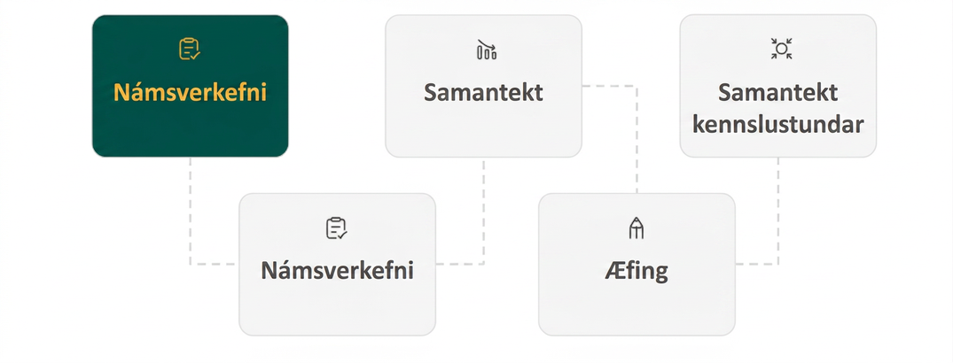
Lesson Journey
First Stop: Learning Activity A

Slide 7

Learning Activity A | Part 1
Making Sense of the Quadratic Formula Part 1💡
Original Equation: x² + 5x + 3 = 0
One way to solve the quadratic equation is by completing the square. A partially solved equation is shown here. Study Steps 1 – 4.
Step 1: Multiply each side by 4. This helps us avoid some tricky fractions.
4x² + 20x + 12 = 0
(In general, multiply each side of the equation by 4 times the coefficient of the x² term. In this case, that is just 4 times 1, which is 4.)
Step 2: Subtract 12 from each side.
4x² + 20x = -12
Step 3: Rewrite 4x² as (2x)² and 20x as 10(2x).
(2x)² + 10(2x) = -12
Step 4: Use P as a placeholder for 2x.
(P)² + 10(P) = -12
Notes:
Activity (10 minutes)
This is the first of two activities that help students derive the quadratic formula. In this activity, students complete the square for a quadratic equation without evaluating certain numerical expressions. This allows them to see the structure of the quadratic formula in numeric form (for example, seeing -5 ± √(5² - 12) instead of -b ± √(b²- 4ac)).
Because the linear coefficient is odd, students learn strategies to rewrite the equation so the linear term becomes even and the leading coefficient becomes 1—conditions that make completing the square easier. These strategies include multiplying the equation by a helpful factor and temporarily substituting simpler variables for more complicated expressions.
These techniques build on ideas from earlier extension activities: multiplying to make 𝑎 a perfect square and using a simple variable to represent a more complex expression.
Launch
Explain
The quadratic equation x² + 5x + 3 = 0 is in the form of ax² + bx + c = 0.
Ask
What are the values of a, d, and c?
Encourage them to talk to a partner about whether it would be relatively simple to complete the square from this equation. (It's doable, but probably pretty messy, as b is an odd number.)
Tell
Tell the students that one way to make it easier to complete the square is to multiply the equation by a number such that the b is an even number and the a is a perfect square.
Try
Let's try multiplying x² + 5x + 3 = 0 by 2. We get 2 x 2 + 10x + 6 = 0. (The right side remains 0 because 0 times any number is 0.) We have 10, an even number for b, but the a is not a perfect square.
Let's try multiplying it by 4. We get 4x² + 20x + 12 = 0. Now the a is a perfect square and the b is still an even number. To complete the square, it helps to isolate the existing constant and rewrite it as 4x² + 10x = −12.
It's still not immediately obvious what constant term to add to make a perfect square. It would be easier if the A or the coefficient of the squared term is 1. One way to deal with this is to think of 4x² as (something)². What would the "something" be? (2x)
If we use a placeholder P to stand for 2x, we can write:
4x² + 20x = -12
(2x)² + 10(2x) = -12
(P)² + 10(P) = -12
Ask students to try completing the square for this simpler-looking equation.
Activity questions, answers, and activity synthesis on the next slide.

Slide 8
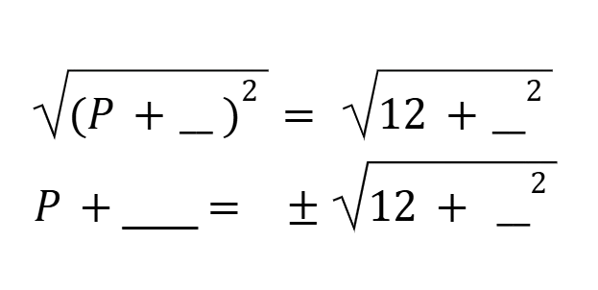
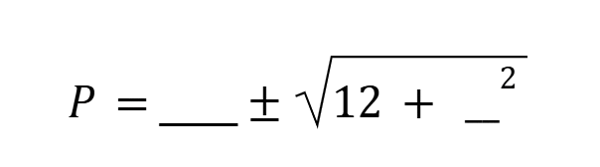
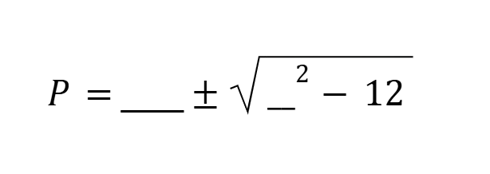
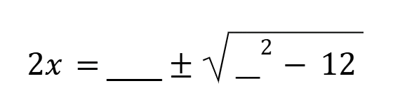
Learning Activity A | Part 2
Making Sense of the Quadratic Formula Part 1💡
Original Equation: x² + 5x + 3 = 0
Step 5: P² + 10P + ___² -12 + ___²
Step 6: (P² + ___ )² = -12 + ___²
Step 7:
Step 8:
Step 9:
Step 10:
Step 11: x = _________________________
For steps 5 - 11 let P serve as a placeholder for 2x, continue to solve for x but without evaluating any part of the expression. For each step, explain the mathematical operation(s) being performed.
Explain how the solution is related to the quadratic formula.
Notes:
Activity Answers
Step 5: Add to complete the square.
P² + 10P + 5² = -12 + 5²
Step 6: Write the left side as a squared factor.
(P+ 5)² = -12 + 5²
Step 7: Find the square root of both sides of the equation.
√((P + 5)²) = ± √(-12 + 5²)
P + 5 = ± √(-12 + 5²)
Step 8: Subtract 5 from both sides to isolate.
P = -5 ± √(-12 + 5²)
Step 9: Rearrange the expression under the square root sign.
P = -5 ± √(5² - 12)
Step 10: Re-substitute 2x for P.
2x = -5 ± √(5² - 12)
Step 11: Divide each side by 2 to isolate x.
x = (-5 ± √(5² - 12))/2
The numbers in the solution are the values of a, d, and in the original equation, x² + 5x + 3 = 0, which is in the form of ax² + bx + c = 0. The -5 is −b. The 5² is b². The 12, which is 4(3)(1), is the value of 4ac. The a in the original equation is 1, and 2(1) is 2, which is the number in the denominator in the solution.
Activity Synthesis
Highlight the connections between the numbers in the solution x = (−5 ± √( 5²−12))/2 and the parameters in the original equation.
The -5 in the expression is −b.
The 5² is b².
The 12 is 4(1)(3) or 4ac.
The 2 in the denominator is 2(1) or 2a.

Slide 9

Learning Activity A
Self Check
After completing the square, Odem used the following steps when deriving the quadratic formula.
x² + 8x + 16 = −11 + 16
x² + 8x + 16 = 5
What should he do next?
Subtract 16 from both sides.
Take the square root of both sides.
Factor the perfect square trinomial.
Complete the square again.
Let’s review!
Notes:
Answer Feedback - Individualized by Response
Incorrect. The 16 was just added in to create the perfect square.
Incorrect. The trinomial must be factored before taking the square root.
That’s correct! After completing the square and adding the new value to both sides, factor the trinomial.
Incorrect. The square only needs to be completed once to create a perfect square trinomial.

Slide 10

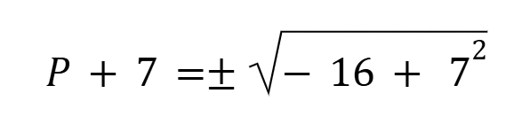
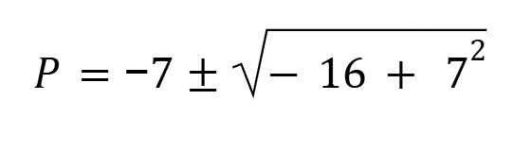
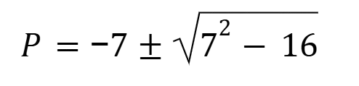
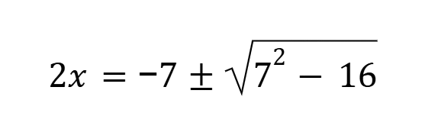
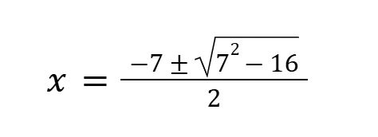
Learning Activity A
Self Check - Review
Here is another example that goes through the process of deriving the quadratic formula:
Original Equation: x² + 7x + 4 = 0
Step 1: Multiply each side by 4. This helps us avoid some tricky fractions. (In general, multiply each side of the equation by 4 times the coefficient of the x² term. In this case, that is just 4 times 1, which is 4.)
Step 2: Subtract 16 from each side.
Step 3: Rewrite.
Step 4: Use P as a placeholder for 2x.
Step 5: Add to complete the square.
Step 6: Write the left side as a squared factor.
Step 7: Find the square root of the expression on the right.
Step 8: Subtract 7 from both sides to isolate.
Step 9: Rearrange the expression under the square root sign.
Step 10: Re-substitute 2x for P.
Step 11: Divide each side by 2 to isolate x.
Step 1: 4x² + 28x +16 = 0
Step 2: 4x² + 28x = -16
Step 3: 4x² as 2x² and 28x as 14(2x)
(2x)² + 14(2x) = -16
Step 4: P² + 14P = -16
Step 5: P² + 14P + 7² = -16 + 7²
Step 6: (P + 7)² = - 16 + 7²
Step 7:
Step 8:
Step 9:
Step 10:
Step 11:
Notes:
Discuss with students
Notice the original equation, y = x² + 7x + 4, has a = 1, b = 7, c = 4, and the last step is of the form x = (−b ± √(b² − 4ac))/2a, which is the quadratic formula.

Slide 11
Learning Activity A
Self Check - Review
Step 1: 4x² + 28x +16 = 0
Step 2: 4x² + 28x = -16
Step 3: 4x² as 2x² and 28x as 14(2x)
(2x)² + 14(2x) = -16
Step 4: P² + 14P = -16
Step 5: P² + 14P + 7² = -16 + 7²
Step 6: (P + 7)² = - 16 + 7²
Step 7:
Step 8:
Step 9:
Step 10:
Step 11:
Here is another example that goes through the process of deriving the quadratic formula. Can you describe in words what happens in each step?
Original Equation: x² + 7x + 4 = 0
Notes:
Answers
Step 1: Multiply each side by 4. This helps us avoid some tricky fractions. (In general, multiply each side of the equation by 4 times the coefficient of the x² term. In this case, that is just 4 times 1, which is 4.)
Step 2: Subtract 16 from each side.
Step 3: Rewrite.
Step 4: Use P as a placeholder for 2x.
Step 5: Add to complete the square.
Step 6: Write the left side as a squared factor.
Step 7: Find the square root of the expression on the right.
Step 8: Subtract 7 from both sides to isolate.
Step 9: Rearrange the expression under the square root sign.
Step 10: Re-substitute 2x for P.
Step 11: Divide each side by 2 to isolate x.
Discuss with students
Notice the original equation, y = x² + 7x + 4, has a = 1, b = 7, c = 4, and the last step is of the form x = (−b ± √(b² − 4ac))/2a, which is the quadratic formula.

Slide 12
Learning Activity A
Self Check - Review
Step 1: Multiply each side of the equation by 4 times the coefficient of the x² term.
Step 2: Add/subtract the constant from each side.
Step 3: Rewrite the first term and second term so they share a common factor. The common factor will most likely be the root of the first term.
Step 4: Use P as a placeholder for the common factor.
Step 5: Add the value needed to complete the square to both sides of the equation.
Step 6: Write one side as a squared binomial and simplify the other side.
Step 7: Take the square root of both sides of the equation.
Step 8: From the binomial, add/subtract the constant from both sides to isolate the variable term.
Step 9: Rearrange the expression under the square root sign so the squared term in first.
Step 10: Re-substitute the common factor for P.
Step 11: Divide each side of the equation by the coefficient of the common factor.
Use the provided steps to solve the quadratic equation.
Example: x² + 7x + 4 = 0
Notes:
Remind students
The reason for step 1 is that it helps to avoid fractions.
In step 3, the goal is to write the first term as a perfect square and express the linear term as a set of factors that includes the root of the first term as one of its factors.
In step 5, to determine the value needed to complete the square, multiply the coefficient of the linear term by one-half and then square the result. This value is what is added to both sides.
To write the squared binomial in step 6, remind students to use the “half value” from completing the square (not the squared value).
Notice the original equation, y = x² + 7x + 4, has a = 1, b = 7, c = 4, and the last step is of the form x = (−b ± √(b² − 4ac))/2a, which is the quadratic formula.
Answers
Step 1: 4x² + 28x +16 = 0
Step 2: 4x² + 28x = –16
Step 3: 4x² as 2x² and 28x as 14(2x)
(2x)² + 14(2x) = –16
Step 4: P² + 14P = –16
Step 5: P² + 14P + 7² = –16 + 7²
Step 6: (P + 7)² = – 16 + 7²
Step 7: P + 7 = ± √(– 16 + 7²)
Step 8: P = – 7 ± √(– 16 + 7²)
Step 9: P = – 7 ± √(7² – 16)
Step 10: 2x = – 7 ± √(7² – 16)
Step 11: x = ½ [– 7 ± √(7² – 16)] or x = [– 7 ± √(7² – 16)] ÷ 2
Access the online textbook for the full version of the answer.

Slide 13
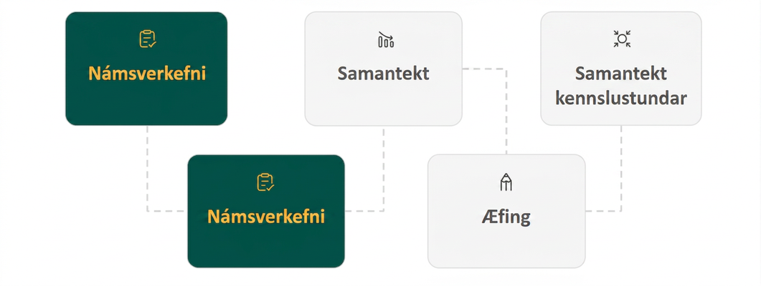
Lesson Journey
Second Stop: Learning Activity B

Slide 14
Learning Activity B | Learning Strategies
Making Sense of the Quadratic Formula Part 2💡
Teacher Instruction: Use these strategies to adjust the activity to support students with disabilities.
You can copy and paste the callouts directly on top of the activity or give the instructions aloud.
Use color to identify and keep track of terms from one step to the next.
Representation
Notes:
Support for Students with Disabilities: Representation: Internalize Comprehension
Use color and annotations to support information processing. Invite students to use color to identify and keep track of terms from one step to the next.
Supports accessibility for: Visual-spatial processing; Organization

Slide 15
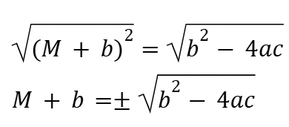
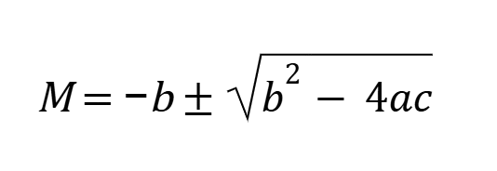
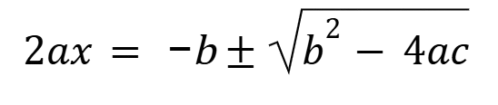
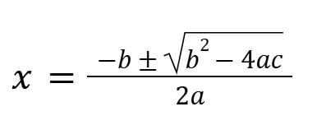
Learning Activity B
Making Sense of the Quadratic Formula Part 2💡
Original Equation: ax² + bx + c = 0
Step 1: 4a²x² + 4abx + 4ac = 0
Step 2: 4a²x² + 4abx = -4ac
Step 3: (2ax)² + 2b(2ax) = -4ac
Step 4: M² + 2bM = -4ac
Step 5: M² + 2bM + b² = -4ac + b²
Step 6: (M + b)² = b² - 4ac
Step 7:
Step 8:
Step 9:
Step 10:
Here is one way to make sense of how the quadratic formula came about. Study the derivation until you can explain what happened in each step.
Write down your explanation for each step.
Are you ready for more?
Notes:
Support for All Learners
This activity offers additional support and an extension for students:
For students with disabilities be sure to review the Learning Strategies slide!
For students looking for an extra challenge, be sure to review the Extending Your Thinking slide!
Activity (15 minutes)
In the previous activity, students completed the square to solve a quadratic without evaluating numbers. Their steps produced a solution that looked almost like the quadratic formula, giving them a concrete sense of how the formula is derived.
In this activity, students examine the steps for solving ax² + bx + c = 0 by completing the square and see how each move leads to the quadratic formula—multiplying to make a perfect-square coefficient, rewriting the linear term, and adding a value to complete the square.
Launch
Tell students that they will now study a worked-out solution to ax² + bx + c = 0.
There are no numbers in this equation, but the process of solving should be familiar.
Ask students to analyze the solution and record an explanation for each step. (They should explain why each step is taken, not only what happens in each step.)
Answers
Step 1: Multiply by 4a so the coefficient of a² is a perfect square.
Step 2: Isolate the constant term to the right.
Step 3: Write the squared term as (something)². Write the linear term as 2b⋅ (something).
Step 4: Use M as the placeholder for 2ax.
Step 5: Add b² to complete the square.
Step 6: Write the left side as a squared factor and commute the terms on the right.
Step 7: Find the square roots of both sides of the equation.
Step 8: Subtract b to isolate M.
Step 9: Replace M with 2ax.
Step 10: Divide both sides by 2a to isolate x.
Anticipated Misconceptions
Some students may think that we multiply just by 4 and wonder where the a comes from. Point out that we need the first term to be a perfect square. In the previous activity, the a value was 1 (which was already a perfect square). We can't be certain that a is a perfect square, so we multiply by 4 and a to make the first term 4a²x², which is (2ax)², a perfect square.
Some may wonder where the M comes from. Consider displaying a completed solution from the previous activity that parallels this work. Remind students of the placeholder P used there. Invite them to compare other steps in the previous activity to those in this activity to help them explain the derivation.
Activity Synthesis
Invite students to share their explanations for each step. Highlight a few key maneuvers:
Multiplying the equation by 4a makes the coefficient of x² a perfect square and the coefficient of the linear term an even number, both of which make completing the square much easier.
Some students may wonder why 4a is chosen to complete the square when solving ax² + bx + c = 0. Why not a, 9a, or 16a? Any of these would work. The equation could also have been divided by a to make the first term x², which is a perfect square. (If time permits, consider asking students to try completing the square using one of these alternatives.) While these alternatives result in a perfect square for the first term, they may not give an even number for the coefficient of the second term or they may produce an equation with larger numbers, making it a bit trickier to manipulate.
We can tell what constant term is needed to complete the square by dividing the coefficient of the linear term by the positive square root of the coefficient of x², taking half of it, and squaring that number. In this case:
The coefficient of x is 4ab.
The coefficient of x² is 4a², so the square root is 2a.
Dividing 4ab by 2a gives 2b. Half of 2b is b.
The constant term that completes the square is b².
Emphasize that the quadratic formula essentially captures the steps for completing the square in one expression. Every time we solve a quadratic equation by completing the square, we are essentially using the quadratic formula, but in a less condensed way.

Slide 16
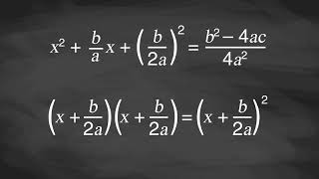
Learning Activity B | Video
Deriving the Quadratic Formula
Notes:
This video discusses all the steps of activity 9.8.2

Slide 17

Learning Activity B | Part 1
Extending Your Thinking
Another way to get the quadratic formula by completing the square.
Divide each side of the equation ax² + bx + c = 0 by a to get x² + ᵇ⁄ₐx + ᶜ⁄ₐ = 0.
Complete the square for x² + ᵇ⁄ₐx + ᶜ⁄ₐ = 0.
Briefly explain what happens in each step by answering the questions.
Step 1: What constant should be subtracted from both sides?
Step 2: What constant do we need to add to both sides to complete the square?
Notes:
Answer
-ᶜ⁄ₐ
(ᵇ⁄₂ₐ)²
More questions and answers on the next slide

Slide 18
Learning Activity B | Part 2
Extending Your Thinking
Continue explaining what happens in each step.
Step 3: Now we can complete the square. What is the binomial that is squared on the left side?
Step 4: Next, we add the fractions on the right side of the equation. What will the common denominator be?
Step 5: Once the fractions on the right side of the equation are added together, what will the numerator of that new fraction be?
Step 6: What is the next step necessary to isolate x on the left side?
Notes:
Answer
x + ᵇ⁄₂ₐ
4a²
b²- 4ac
x + ᵇ⁄₂ₐ = ± √((b²- 4ac)/(4a²))
More questions and answers on the next slide

Slide 19
Learning Activity A | Part 3
Extending Your Thinking
Explain what happens in the last 4 steps.
Step 7: How can the square root be simplified?
Step 8: What is the denominator of the fraction on the right side after simplification?
Step 9: What is the next step I need to take to isolate x on the left side of the equation?
Step 10: What do you notice about the denominator of both fractions on the right side?
Notes:
Go back to Lesson Activity
Answer
x + ᵇ⁄₂ₐ = ± √(b²- 4ac)/√(4a²)
x + ᵇ⁄₂ₐ = ± √(b²- 4ac)/(2a)
x = -ᵇ⁄₂ₐ ± √(b²- 4ac)/(2a)
x = (–b ± √(b²- 4ac))/(2a)
Go back to Lesson Activity

Slide 20

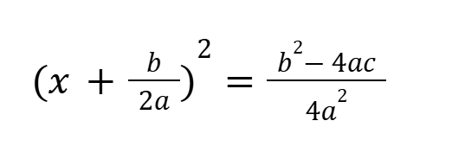
Learning Activity B
Self Check
Looking at the steps of deriving the quadratic formula, which step should follow the one below?
Complete the square.
Take the square root of both sides.
Multiply both sides by 4a².
Complete the square.
Let’s review!
Notes:
Answer Feedback - Individualized by Response
Incorrect. This was already done for the perfect square trinomial to be factored.
That's correct! To get rid of the power of 2, take the square root of both sides and remember the plus and minus sign on the right side.
Incorrect. In a previous step, both sides were already divided by 4a².
Incorrect. This cannot be done until after the square root is taken.

Slide 21
Learning Activity B
Self Check - Review
Step 1: Move the constant term to the right side of the equal sign.
Step 2: As we want the leading coefficient to equal 1, divide through by a.
Step 3: Find ½ of the middle term, and add
(½ ⋅ b/a)² = b²/4a² to both sides of the equal sign.
Step 4: Write the left side as a perfect square. Find the common denominator of the right side and write it as a single fraction.
Step 5: use the square root property.
Step 6: add −b/2a to both sides of the equation and combine the terms on the right side
We can derive the quadratic formula by completing the square.
We will assume that the leading coefficient is positive; if it is negative, we can multiply the equation by −1 and obtain a positive a.
Given ax² + bx + c = 0, a≠0, we will complete the square following the steps.
Notes:
Answer
Step 1: ax² + bx = -c
Step 2: x² + (b/a)x = -(c/a)
Step 3: x² + (b/a)x + (b²/4a²) = (b²/4a²) - (c/a)
Step 4: (x + b/2a)² = (b²- 4ac)/(4a²)
Step 5: x +(b/2a) = (√(b²- 4ac))/(2a)
Step 6: x = (-b ± √(b²- 4ac))/(2a)

Slide 22
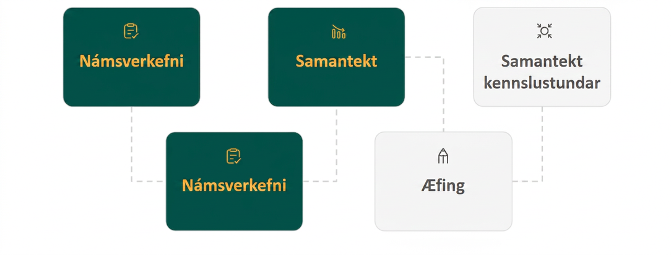
Lesson Journey
Third Stop: Cool Down

Slide 23
Learning Strategies
Cool Down
Give and receive feedback using sentences that begin:
“How do you know…?”
“Why do you think…?”
“What happened between ___ and ___?”
“Is it always true that…?”
Stronger and Clearer Each Time
Teacher Instruction: Use these strategies to adjust the activity to support English language learners and students with disabilities.
You can copy and paste the callouts directly on top of the activity or give the instructions aloud.
Number each step so you don’t lose your place.
Do the first few steps, then stop and check your work.
Use the ideas on the board to help you keep going.
Action and Expression
Notes:
Support for English Language Learners: MLR 1 Stronger and Clearer Each Time: Writing, Listening, Conversing
Use this routine to help students improve their written explanations for each step in the derivation of the quadratic formula. Give students time to meet with two to three partners to share and get feedback on their responses. Display feedback prompts that will help students strengthen their ideas and clarify their language. For example, “How do you know . . . ?”, “Why do you think . . . ?”, “What happened between _____ and _____?”, and “Is it always true that . . . ?” Invite students to go back and revise or refine their written explanation based on the feedback from peers. This will help students understand how completing the square leads to the quadratic formula through communicating their reasoning with a partner.
Design Principle(s): Support sense-making; Cultivate conversation
Provide support for students
Distribute graphic organizers to the students to assist them with participating in this routine.
Support for Students with Disabilities: Action and Expression: Internalize Executive Functions
Chunk this task into manageable parts for students who benefit from support with organizational skills in problem solving. Invite students to number each line to facilitate identification of each step. Check in with students after the first two to three minutes of work time. Invite one to two students to share what they noticed for the first few steps. Record their thinking on a display for all to see, and keep the work visible as students continue.
Supports accessibility for: Organization; Attention

Slide 24
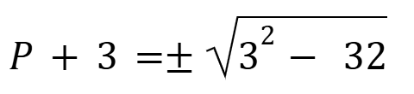
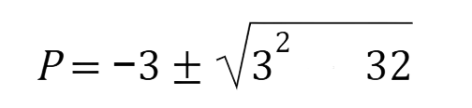
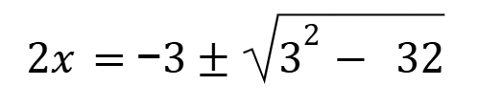
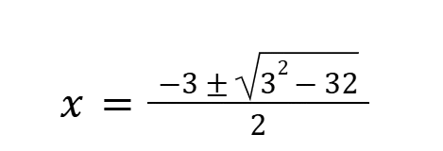
Cool Down
Step 1: x² + 3x = - 8
Step 2: 4x² + 4(3x) = 4(- 8)
Step 3: (2x)² + 6(2x) = - 32
Step 4: P² + 6P = -32
Step 5: P² + 6P +3² = -32 + 3²
Step 6: (P +3)² = 3² - 32
Step 7:
Step 8:
Step 9:
Step 10:
Original Equation: x² + 3x + 8 = 0
Here is one solution for solving
x² + 3x + 8 = 0 by completing the square, where each step is shown, but numerical expressions are not evaluated.
In Step 2, the equation is multiplied by 4. Why might that be?
In Step 5, 3² is added to each side. Why might that be?
What happened between Step 5 and Step 6?
Notes:
Support for All Learners
This activity offers additional support and an extension for students:
For English language learners and students with disabilities, be sure to review the Learning Strategies slide!
Cool Down (5 minutes)
Answers
To make the coefficient of x² a perfect square and the coefficient of x an even number
3² completes the square for the expression on the left side. To keep the two sides equal, it needs to be added to the other side as well.
The perfect square is rewritten in factored form, and −32 + 3² is rewritten as 3² − 32.
Response to Student Thinking - Points to Emphasize
If students struggle with completing the square, have them revisit the Additional Resources in 9.1 – 9.3. If students struggle with recognizing the quadratic formula, have them revisit the Additional Resources in 9.6 and 9.7

Slide 25
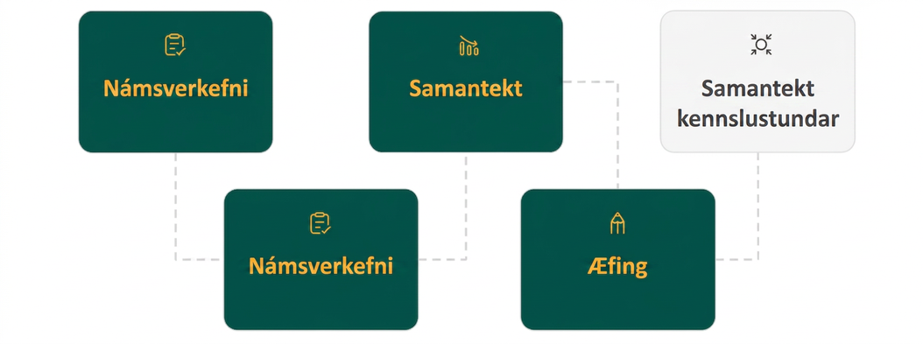
Lesson Journey
Fourth Stop: Practice

Slide 26

Practice
Put your hard work to action, practice what you’ve learned!
Notes:
Digital Practice: Access the practice pages at https://openstax.org/details/books/algebra-1

Slide 27
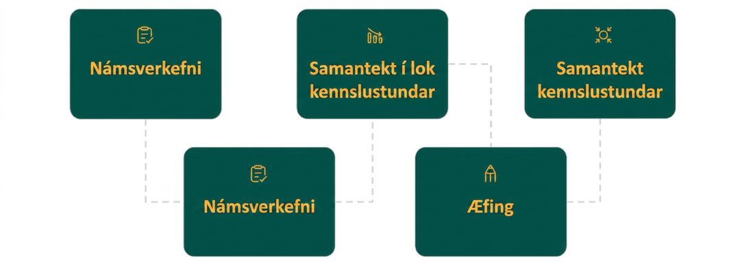
Lesson Journey
Fifth Stop: Lesson Synthesis

Slide 28
Lesson Synthesis
Think about what you observed about the quadratic formula and discuss your answers with the class:
How has your understanding of the quadratic formula changed from the work in this lesson?
A classmate who is absent today is not sure where the quadratic formula came from. What would you say to help them understand, in a nutshell, what the formula is all about?
If the formula is connected to the steps of completing the square, why not just complete the square when we need to solve equations? Why do you think it is helpful to have a formula, even if it involves quite a few operations?
Notes:
Note to Teacher
Students are not expected to internalize how to derive the quadratic formula by the end of the lesson. They should, however, understand that each part of the complicated expression can be traced back to a step in completing the square. In other words, they should recognize that the formula is not an isolated, opaque method that mysteriously produces solutions to quadratic equations.
Discuss with Students
Discuss each of the 3 questions and record student answers for adjustments for future lessons.

Slide 29
Self Assessment
How much do you agree with the following statements?
Learning Goals | I can | Almost | Not yet
Explain the steps and complete some missing steps for deriving the quadratic formula. | ⃞ | ⃞ | ⃞
Explain how the quadratic formula is related to the process of completing the square for a quadratic equation ax² + bx + c = 0. | ⃞ | ⃞ | ⃞

