Slide 1


Algebra 1
Unit 7 Introduction to Quadratic Functions
Lesson 7.7 Domain, Range, Vertex, and Zeros of Quadratic Functions
Notes:
How to Get Started
Review Slide 2: How to use these slides
Check out the digital quick start guide!
Review Slide 3: Reference Key of Icons

Slide 2
How to use these slides
On the activity slides check the speaker notes for teacher support and instructional information.
Each lesson includes 1 warm up, 2-3 learning activities, a cool down, practice and a lesson synthesis.
  Learning activities are followed by a self check question, and review section.
Some slides have been hidden from student view, more information can be found on the next slide (Reference Key).
You can edit and use these slides for personal and classroom use, but cannot sell them and must keep the attribution logos.
For more information, Check out the digital quick start guide!

Slide 3






Reference Key
Check the top right corner for an icon referencing these unique sections.
 | Support for Students with Disability | Hidden | Learning Strategies slide, provides additional support to students for understanding the activity. Learning Strategies slide, provides additional support to students for understanding the activity.
 | Support for English Language Learners | Hidden
 | Extending Your Thinking | Hidden | Extending Your Thinking slide, provides an extra challenge for students.
 | Self Check | Not Hidden | Self Check slide, checkpoint to assess student understanding after the learning activity.
 | Review | Hidden | Self Check- Review slide, designed to help review topics from the self check question.
On the next slides, check the speaker notes for teacher instructions and support.
Notes:
Check the Speaker Notes: On the next slides you can find discussion questions, lesson information, answers to the activities, and ways to adjust the activity for your students!

Slide 4

Learning Goals
By the end of this lesson you will be able to -
Choose a domain that makes sense in a revenue situation.
Model revenue with quadratic functions and graphs.
Relate the vertex of a graph and the zeros of a function to a revenue situation.
Notes:
Lesson Narrative
In this lesson, students apply quadratic functions to an economic context by modeling the relationship between price and revenue. They use tables, equations, and graphs to interpret zeros, domain, and vertex in context, connecting these features to real-world meaning. Technology is optional but available for problem solving.
Required Preparation
None
Required Materials
None
Texas Essential Knowledge and Skills
A1(A) apply mathematics to problems arising in everyday life, society, and the workplace
A1(C) select tools, including real objects, manipulatives, paper and pencil, and technology as appropriate, and techniques, including mental math, estimation, and number sense as appropriate, to solve problems
A1(F) analyze mathematical relationships to connect and communicate mathematical ideas
A6(A) determine the domain and range of quadratic functions and represent the domain and range using inequalities
A7(A) graph quadratic functions on the coordinate plane and use the graph to identify key attributes, if possible, including x-intercept, y-intercept, zeros, maximum value, minimum values, vertex, and the equation of the axis of symmetry

Slide 5
Vocabulary
Zero (of a function)
  An input where f(x)=0; on the graph, it’s the point where the curve crosses the x-axis.
x-intercept
  The point of the graph of a function where the 𝑦-value is 0. This is where the graph of the function crosses the x-axis. (x, 0)
Domain
  The set of all possible input values for a function. Set of the first numbers in the ordered pairs in a relationship.
Range
  The set of all possible output values for a function. Set of the second numbers in the ordered pairs of a relationship.
New
Revenue
  The selling price of each unit times x, the number of units sold; 𝑅(𝑥) = price · 𝑥.
Previous
Equation
  A mathematical statement that demonstrates that two numbers, expressions, or other objects are equal.
Functions
  A relation that takes inputs from one set and assigns them to outputs from another set, assigning exactly one output to each input.
Quadratic Function
  A function where the output is given by a quadratic expression in the input. 𝑓(𝑥) = 𝑎𝑥² + 𝑏𝑥 + 𝑐.
Vertex (of a graph)
  On a parabola, it is the point where the graph changes from increasing to decreasing or vice versa. It is the highest or lowest point on the graph.
Notes:
Lesson Vocabulary
To support student understanding of key vocabulary:
Introduce and review the vocabulary words students will see in this lesson.
Encourage students to notice how these words are used and to include them in their math discussions and explanations—both written and oral.
Use a word wall to reinforce vocabulary. Sample word wall cards are available here.
For newcomers or students with beginning English proficiency, use these Quizlet sets to support vocabulary learning:
Unit 7 Spanish Vocabulary – use first to build understanding
Unit 7 Vocabulary (English) – use after anchoring in Spanish
Support for English Language Learners
ELPS 1(C) use strategic learning techniques such as concept mapping, drawing, memorizing, comparing, contrasting, and reviewing to acquire basic and grade-level vocabulary
ELPS 1(F) use accessible language and learn new and essential language in the process
ELPS 2(F) listen to and derive meaning from a variety of media such as audiotape, video, DVD, and CD-ROM to build and reinforce concept and language attainment
ELPS 3(B) expand and internalize initial English vocabulary by learning and using high-frequency English words necessary for identifying and describing people, places, and objects, by retelling simple stories and basic information represented or supported by pictures, and by learning and using routine language needed for classroom communication
ELPS 3(E) share information in cooperative learning interactions
ELPS 3(H) narrate, describe, and explain with increasing specificity and detail as more English is acquired
ELPS 5(B) write using newly acquired basic vocabulary and content-based grade-level vocabulary

Slide 6





Lesson Journey
Warm Up
Learning Activity
Practice
Learning Activity
Cool Down
Lesson Synthesis

Slide 7
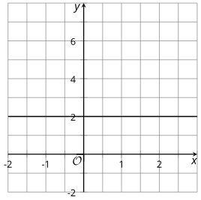
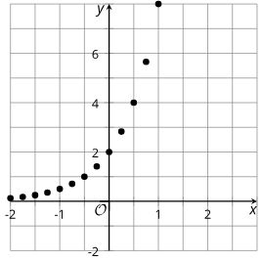
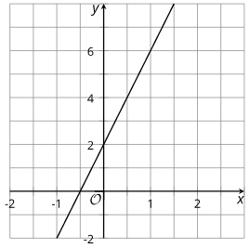
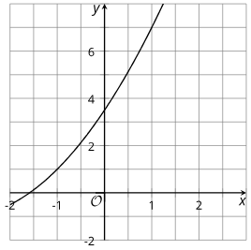
Warm Up - Which One of These is Not Like the Others? 🤔
Which one doesn’t belong?
Graph A
Graph C
Graph B
Graph D
Notes:
Warm Up (5 minutes)
This warm-up invites students to compare the graphs of four functions, using precise language to describe features of linear, exponential, and quadratic graphs while revealing their understanding of key terms.
Launch
Arrange students in groups of two to four.
Display the graphs for all to see.
Give students 1 minute of quiet time to think individually and then time to share their thinking with their small group.
In their small groups, ask each student to share their reasoning why a particular item does not belong, and together find at least one reason each item doesn’t belong.
Activity Answers
Graph A is the only graph where the y-values don’t change.
Graph B is the only graph where the y-value increases by a constant rate.
Graph C is the only graph that is not continuous.
Graph D is the only graph that does not intersect the y-axis at 2.
Activity Synthesis
Ask each group to share one reason why a particular item does not belong. Record and display the responses for all to see. After each response, ask the class if they agree or disagree. Since there is no single correct answer to the question of which one does not belong, attend to students’ explanations and ensure the reasons given are correct.
During the discussion, ask students to explain the meaning of any terminology they use, such as "discrete," "increasing," "x-intercept," and "y-intercept." Also, press students on unsubstantiated claims.

Slide 8

Lesson Journey
Warm Up
Learning Activity
Practice
Learning Activity
Cool Down
Lesson Synthesis

Slide 9
Learning Strategies - The Cost of Downloading a Movie 🍿
Listen carefully as your classmate shares their thinking.
Use one of these sentence frames to respond:
“I agree because …”
“I disagree because …”
Be ready to explain your reasoning clearly.
Discussion Supports
Teacher Instruction: Use these strategies to adjust the activity to support English language learners.
  You can copy and paste the callouts directly on top of the activity or give the instructions aloud.
Notes:
Support for English Language Learners: MLR 8 Discussion Supports: Speaking, Representing
Use this routine to support whole-class discussion of the prompts listed in the synthesis. After a student shares their thinking with the class, provide the class with the following sentence frames to help them respond: "I agree because….” or "I disagree because….” If necessary, revoice student ideas to demonstrate mathematical language use by restating a statement as a question in order to clarify, apply appropriate language, and involve more students.
Design Principle(s): Maximize meta-awareness; Support sense-making

Slide 10
Learning Activity - The Cost of Downloading a Movie 🍿
Fill in the table using the following information.
Price (Dollars per Download) | Number of Downloads (Thousands) | Revenue (Thousands of Dollars)
3 | 15 | 45
5 | a. ___ | g. ___
10 | b. ___ | h. ___
12 | c. ___ | i. ___
15 | d. ___ | j. ___
18 | e. ___ | k. ___
x | f. ___ | l. ___
A company that sells movies online is deciding how much to charge customers to download a new movie. Based on data from previous sales, the company predicts that if they charge x dollars for each download, then the number of downloads, in thousands, is 18−x.
Are you ready for more?
Is the relationship between price and revenue linear, quadratic, or exponential? Explain your reasoning.
Use A graphing tool. Plot the points that represent the revenue, 𝑟, as a function of the price of one download in dollars, 𝑥.
Notes:
Support for All Learners
This activity offers additional support and an extension for students:
For English language learners, be sure to review the Learning Strategies slide!
For students looking for an extra challenge, be sure to review the Extending Your Thinking slide!
Activity (15 minutes)
In this activity, students explore a quadratic function in a business context by examining the relationship between movie download price and number of downloads. Using tables, graphs, and models, they identify how price affects revenue and make a business recommendation.
Students model data, look for patterns, and use appropriate tools such as spreadsheets or graphing technology. They reason that the relationship is quadratic because it can be defined by x(18 − x), or 18x − x², which includes a squared term similar to earlier quadratic patterns.
Launch
Ask students to read the opening paragraph of the activity statement. Then, ask students to make some predictions:
“Suppose the price per download increases. What do you think would happen to the number of downloads as the price goes up?” (Students are likely to predict that as the price increases, the number of downloads decreases, as fewer people are willing to pay the higher price.)
“What happens to the number of downloads as the price decreases?” (As the price decreases, the number of downloads increases. Lower prices tend to encourage more people to purchase a product.)
“Would a business make more money when it sells a product at a higher price or when it sells at a lower price?” (Allow students to make some hypotheses, but it’s not necessary to confirm one way or another.)
Explain that price and the number of sales affect the revenue of a business, and that the term revenue means the money collected when someone sells something. For example, if the price of a movie download is $3 and there are 10 downloads, the revenue is $30.
Consider arranging students in groups of two so that they can discuss their thinking (especially the question about whether price and revenue have a quadratic relationship).
Some students may choose to use a spreadsheet tool to complete the table, and subsequently to use graphing technology to plot the data. Make these tools accessible, in case requested.
Answers
13
8
6
3
0
18 - x
65
80
72
45
0
x(18 - x)
You answer may vary, here is a sample. It is quadratic. The output x(18 - x) can be written as 18 - x², which is a quadratic expression.
Link to Desmos Graph: https://www.desmos.com/calculator/uwuhnehns7
Activity Synthesis
Display the completed table and invite selected students to explain how they determined the relationship was quadratic. Clarify that a few plotted points aren’t enough to confirm a U-shaped, or quadratic, relationship.
Discuss:
Can the company make no money? (Yes. At $0, downloads are free, and at $18, no one buys.)
How can we find the price for the most revenue? (Calculate revenue for prices between $0 and $18 or estimate the vertex from the graph.)
Could the company lose money? (Possibly. If it pays for movie rights without revenue, or sets a negative price.)

Slide 11


Extending Your Thinking
The function that uses the price (in dollars per download) x to determine the number of downloads (in thousands) 18 − x is an example of a demand function, and its graph is known.
Economists are interested in factors that can affect the demand function and therefore the price suppliers wish to set.
What are some things that could increase the number of downloads predicted for the same given prices?
If the demand shifted so that we predicted 20 − x thousand downloads at a price of x dollars per download, what do you think would happen to the price that gives the maximum revenue? Check what actually happens.
Notes:
Answer
Your answer may vary, here is a sample.
The quality of the movies could improve. The number of people who like watching movies could increase. The price of watching a movie in a theater could go up.
Your answer may vary, here is a sample.
The price that gives the maximum revenue would increase from $9 to $10.
Go back to activity information.

Slide 12
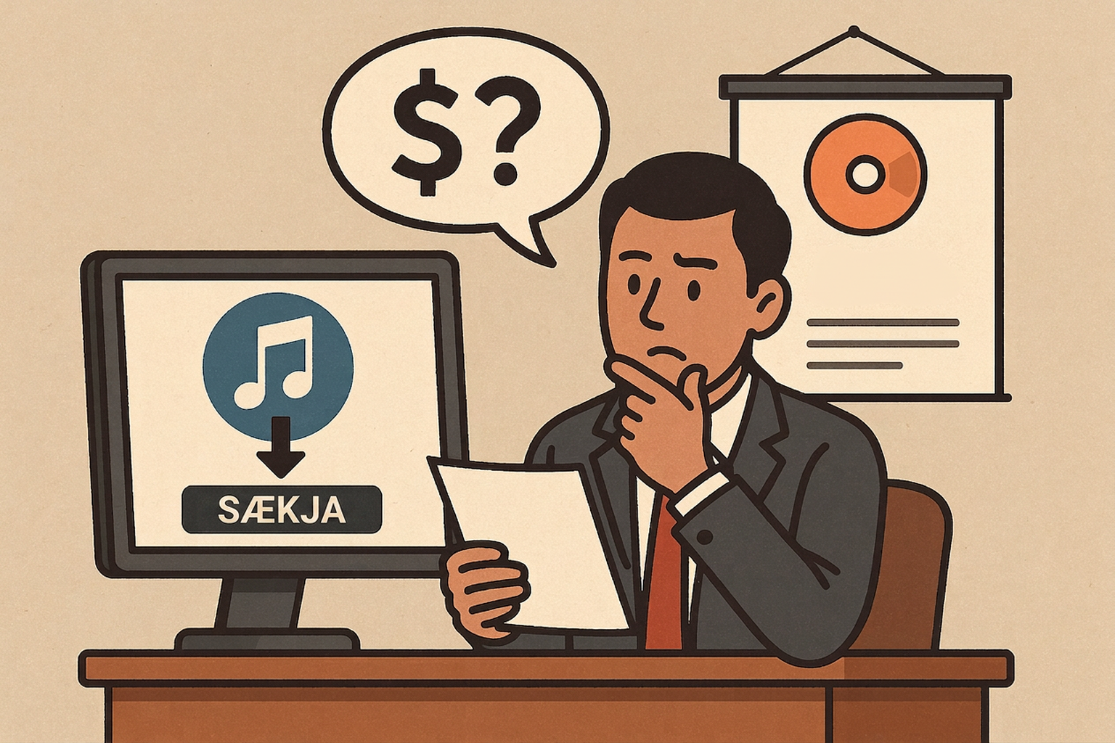
Self Check
A company that sells music downloads is deciding how much to charge customers to download an album. Based on previous sales, the company predicts that if they charge x dollars for each download, then the number of downloads, in thousands, is 13 − x.
Which of the following represents the revenue for downloads?
13 - x
(13 - x) ÷ (x)
13 - x²
13x - x²
Let’s review!
Notes:
Answer Feedback - Individualized by Response
Incorrect. This is the number of downloads. Make sure to multiply the number of downloads by x, the cost per download.
Incorrect. The number of downloads should be multiplied by x, the cost per download.
Incorrect. Be sure to distribute the x to both terms.
That’s correct! Multiply x(13 − x).

Slide 13
Self Check - Review
Quadratic functions often come up when studying revenue. Revenue means the money collected when someone sells something.
A company is deciding how much to charge for raffle tickets. Each ticket has a price of d dollars and we can find the revenue r by multiplying the price by the number of tickets expected to be sold.
The number sold is 600 − 75d.
Given the information above, what does the function r(d) = d(600 − 75d) mean?
Notes:
Revenue Represented with Quadratics
This function represents the revenue collected.
Additional questions and discussion on the next slide

Slide 14
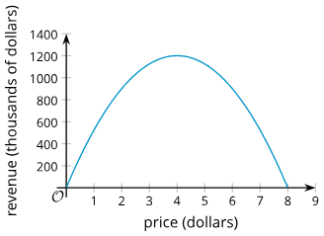
Self Check - Review
The raffle company created a graph to help them understand the relationship between price and revenue. Use the graph to help you answer the following:
What does the vertex represent?
What are the domain and range, and why do they make sense?
How would changing the price from $4 affect revenue?
Notes:
Revenue Represented with Quadratics
Answers
The maximum revenue the company can earn. In this situation, it shows the best ticket price ($4) that produces the highest revenue ($1,200).
Domain: 0 ≤ 𝑑 ≤8. The ticket price can't be negative, and if the price is above $8, the model shows negative tickets sold, which isn’t possible.
Range: 0 ≤ 𝑟 ≤ 1200. Revenue can’t be negative, and the maximum possible revenue is $1,200. h(t) = 6 + 130t − 16t²
If the price is lower or higher than $4, the revenue will decrease.
$4 is the optimal price, moving away from it means fewer tickets sold or not enough money per ticket.
Discuss with the students:
It makes sense that the revenue goes down after a certain point, since if the price is too high nobody will buy a ticket. From the graph, we can tell that the greatest revenue, $1,200, comes from selling the tickets for $4 each. So we know, the range of this parabola reaches a maximum value of $1,200.
We can also see that the domain of the function r is between 0 and 8. This makes sense because the cost of the tickets can’t be negative, and if the price were more than $8, the model would not work, as the revenue collected cannot be negative. (A negative revenue would mean the number of tickets sold is negative, which is not possible.)

Slide 15
Lesson Journey
Warm Up
Learning Activity
Practice
Learning Activity
Cool Down
Lesson Synthesis

Slide 16
Learning Strategies - Identify Vertex and Zero Functions 📈
Choose one of the functions to work with.
Create a visual display that shows your reasoning clearly.
Add notes or details to your graph or function to help others understand your thinking.
Pair up with a partner and take 2–3 minutes of quiet time to read and interpret each other’s work.
Be ready to share your observations during the whole-class discussion.
Compare and Connect
Teacher Instruction: Use these strategies to adjust the activity to support English language learners.
  You can copy and paste the callouts directly on top of the activity or give the instructions aloud.
Notes:
Support for English Language Learners: MLR 7 Compare and Connect: Representing, Conversing
Use this routine to prepare students for the whole-class discussion. Ask students to select one of the functions and to prepare a visual display of their work. Students should consider how to display their reasoning so that another student can interpret what they see. Suggest that students should add notes and details to the graphs or functions to help communicate their thinking. Arrange students in groups of two, and provide two or three minutes of quiet think time for students to read and interpret each other's work before a whole-class discussion.
Design Principle(s): Cultivate conversation; Maximize meta-awareness
Learn more about this routine
View the instructional video and follow along with the materials to assist you with learning this routine.
Provide support for students
Distribute graphic organizers to the students to assist them with participating in this routine.

Slide 17

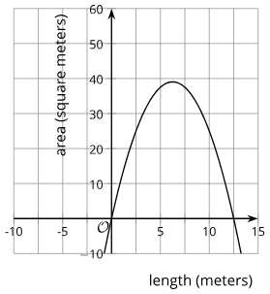
Learning Activity - Identify Vertex and Zero Functions 📈
Use this information to answer 1 - 4.
The area of a rectangle with a perimeter of 25 meters and a side length
What is an inequality that represents the domain?
What is an inequality that represents the range?
What is the vertex of the graph?
What are the zeros of the graph?
Notes:
Support for All Learners
This activity offers additional support and an extension for students:
For English language learners, be sure to review the Learning Strategies slide!
Activity (15 minutes)
This activity serves two main goals. It prompts students to look closely at appropriate domains for quadratic functions given the situations they represent. It also gives them an opportunity to identify or estimate the vertex of the graph and the zeros of the functions, and then to interpret them in context.
Launch
In the previous activity, we saw a function representing the revenue, in thousands of dollars, from selling new movies at x dollars. If we graph the equation r = x(18 − x) using graphing technology, it would produce a graph like this:
Link to Desmos graph: https://www.desmos.com/calculator/rrssg0v34a
Then, discuss questions such as:
“What domain is appropriate for the price of a new movie?” (The price can’t be negative and it can’t be more than $18, or else the revenue will be negative, which is not possible, assuming they are selling a non-negative number of downloads for a non-negative price. So an appropriate domain would be 18 ≤ x ≤ 18. The part of the graph to the left of the vertical axis has no meaning because we can’t have a negative price. The part representing a price above $18 would mean the company is losing money, so it has meaning, but it is unlikely to be considered if the company is trying to maximize revenue.)
“What are the zeros of the function? What do they tell us in this situation?” (0 and 18. They tell us the prices at which the company would earn no revenue.)
“What is the vertex of the graph representing the function? What does it tell us in this situation?” (It appears to be at (9, 81). It tells us the price that would produce the greatest revenue.)
Tell students they will now think about the domain, vertex, and zeros of a few quadratic functions we have seen so far.
Arrange students in groups of two to four.
Consider asking each group to work on only 1 – 2 functions and then to share their findings with the class, or choosing only a couple of functions for the class to investigate.
If the activity is divided among groups and if time permits, consider asking each group to prepare a presentation or to display their work for a gallery walk.
Answers
0 < x < 12.5. All positive rational numbers make sense as an input. The part of the graph that is below the horizontal line is not meaningful here (negative lengths or lengths greater than 12.5 produce a negative area, which doesn’t make sense). Having a length or area equal to 0 doesn’t make sense either.
0 < y < 39.06. All positive rational numbers make sense as an output up to the maximum of the graph at 39.06. The part of the graph that is below the horizontal line is not meaningful here since there can not be a negative area (which doesn’t make sense). Having a length or area equal to 0 doesn’t make sense either.
The vertex is the point on the graph when the input is at 6.25. It’s around (6.25, 39.063). It’s when the rectangle has the greatest area.
The zeros are 0 and 12.5. They tell us that when the side length of the rectangle is 0 or 12.5 meters, the rectangle has no area (no rectangle exists).
More activity questions and answers on the next slide.

Slide 18
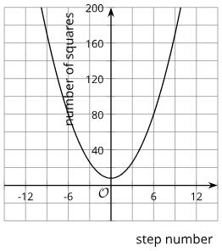
Learning Activity - Identify Vertex and Zero Functions 📈
Use this information to answer 5 - 8.
The number of squares as a function of step number n: f(n) = n² + 4
What is an inequality that represents the domain?
What is an inequality that represents the range?
What is the vertex of the graph?
What are the zeros of the graph?
Notes:
Answers
n ≥ 0 where n is a whole number. Step numbers that are negative or decimal don’t make sense here. The graph should show points at non-negative integer values (instead of a continuous curve). Everything to the left of the vertical axis does not have meaning here.
f ≥ 4. The number of squares starts with 4 and increases.
The vertex is (0, 4). It tells us the number of squares at Step 0.
There are no zeros for this function. There is not a time when there are no squares in the pattern.
More activity questions, answers, anticipated misconceptions, and activity synthesis on the next slide.

Slide 19
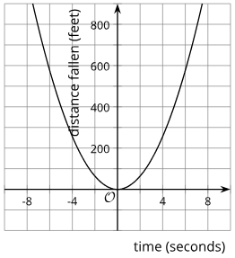
Learning Activity - Identify Vertex and Zero Functions 📈
Use this information to answer 9 - 12.
The distance in feet that an object has fallen t seconds after being dropped: g(t) = 16t²
What is an inequality that represents the domain?
What is an inequality that represents the range?
What is the vertex of the graph?
What are the zeros of the graph?
Notes:
Answers
t ≥ 0 or only positive numbers and 0. Negative values of time don’t make sense here, so the part of the graph to the left side of the vertical axis has no meaning.
g ≥ 0. The distance fallen increases as time increases and would start at g=0.
The vertex is (0,0). It tells us the distance fallen at 0 seconds, which is 0 feet.
The vertex also tells us the zero of the function. It’s the only time when the distance fallen is 0 feet.
Anticipated Misconceptions
Some students may confuse zeros and horizontal intercepts (x-intercepts). Watch for students who write the zeros as ordered pairs such as (25, 0) rather than 25. Emphasize that while these two terms are related, there is a difference. A zero is an input value that makes the function’s output 0, and the horizontal intercept is the point where the graph of the function meets the horizontal axis. A zero of a function is the x-coordinate of an x-intercept of its graph.
Activity Synthesis
Invite groups to share their responses. Show graphs adjusted for appropriate domains if not already displayed. Explain that a quadratic graph may or may not show its vertex, depending on the context.
For example, in the graphs of f(n) = n² + 4 and h(t) = 576 − 16t² the y-intercept is the vertex, but since negative domains don’t apply, the “turn” in the graph isn’t visible.
Link to Desmos graph for Step Number/Number of Squares: https://www.desmos.com/calculator/ztwlw4d4gq
Link to Desmos graph for Time/Height: https://www.desmos.com/calculator/10dtppxe8j
The function f represents the number of squares at step n of a geometric pattern. Because partial step numbers are not possible, it makes sense for the graph to show discrete points at whole-number input values, rather than a continuous curve that includes all rational numbers for the input.
The function h models the height of an object t seconds after being dropped. Because a negative number of seconds is not meaningful here, assuming the object stops once it hits the ground (at 6 seconds), an appropriate domain for the function would be 0 ≤ t ≤ 6.

Slide 20
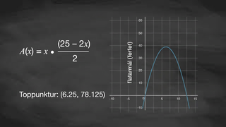
Video: Identifying Domain, Vertex, and Zero of Quadratic Functions

Slide 21
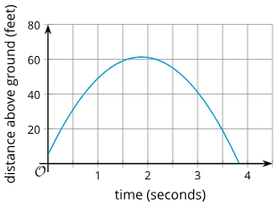
Self Check
Find the approximate domain of the graph:
0 ≤ x ≤ 1.8
0 ≤ x ≤ 60
0 ≤ x ≤ 3.8
x ≤ 0
Let’s review!
Notes:
Answer Feedback - Individualized by Response
Incorrect. 1.8 is approximately where the maximum occurs, not the full domain.
Incorrect. This describes the range.
That’s correct! The time in seconds can be between 0 and almost 4 seconds.
Incorrect. Not all values above 0 are in the domain.

Slide 22
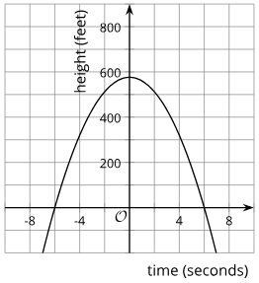
Self Check - Review
The height in feet of an object t seconds after being dropped is graphed below: h(t) = 576 - 16t².
Find the domain of the function.
Find the range of the function.
Find the vertex and describe its meaning.
Find the zeros and describe their meaning.
Notes:
The Meaning of Quadratic Characteristics
Answers
The t values, 0 ≤ t ≤6 or only numbers from 0 up through 6. Negative values of time don’t make sense here, so the part of the graph to the left side of the vertical axis has no meaning. The object hits the ground 6 seconds after being dropped, so values greater than 6 are not meaningful.
The height of the function is from the initial height down to the ground. In this case, since the object is being dropped from a height of 576 feet and falls to the ground, the range of the function is [0, 576]. This means that the object's height will be between 0 feet (when it hits the ground) and 576 feet (when it is initially dropped).
The peak of the parabola, or the maximum, at the point (0,576). It tells us the time when the height is the greatest.
6 . It tells us that the height of the object is 0 feet at 6 seconds after being dropped, or the time when the object hits the ground.

Slide 23

Lesson Journey
Warm Up
Learning Activity
Practice
Learning Activity
Cool Down
Lesson Synthesis

Slide 24
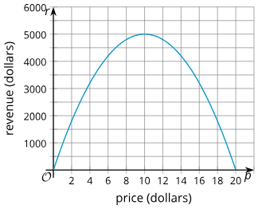
Cool Down
This graph represents the revenue in dollars that a company expects if they sell their product for p dollars.
Based on this model, which price would generate more revenue for the company, $5 or $17?
At what price (in dollars) should the company sell their product if they wish to make as much revenue as possible?
How much revenue (in dollars) would they make?
What is an appropriate domain for the function? Explain how you know.
Notes:
Cool Down (5 minutes)
Answers
$5, as it would generate about $3,700 in revenue. Charging $17 would bring in about $2,500.
10
5,000
Your answer may vary, but here is a sample.
0 ≤ p ≤ 20, because the price has to be non-negative, and the company would earn negative revenue if the price were more than $20.

Slide 25

Lesson Journey
Warm Up
Learning Activity
Practice
Learning Activity
Cool Down
Lesson Synthesis

Slide 26

Practice
Put your hard work to action, practice what you’ve learned!
Notes:
Digital Practice: Access the practice pages at https://openstax.org/k12/algebra

Slide 27

Lesson Journey
Warm Up
Learning Activity
Practice
Learning Activity
Cool Down
Lesson Synthesis

Slide 28

Lesson Synthesis
You’ve explored how the zeros, vertices, and domains of functions connect to real-world situations. Use what you’ve learned to explain these ideas in your own words.
Complete the sentences to show what you know about functions and their graphs. Give an example for each to support your explanation.
The zeros of a function tell us ___. For example: ___.
The vertex of a graph that represents a function tells us ___. For example: ___.
To determine an appropriate domain for a function, we need to consider ___.
For example: ___.
Notes:
Possible Answers
a. The distance an object travels t seconds after being dropped.
b. The height of an object that is dropped from a height of 400 feet.
c. The height of an object that is shot up from 50 feet above the ground at a vertical speed of 100 feet per second, t seconds after being launched.
a. The zero is the time when the object has traveled a distance of 0 feet. This happens at t = 0, before the object is dropped.
b. The zero is the time when the height of the object is 0 feet, which is when it hits the ground.
c. The zero is the time when the height of the object is 0 feet, which is also when it hits the ground.
Explain to students that the models seen here are simplified models, and they ignore other factors, such as air resistance. The models that scientists use to study physical phenomena are likely to be more complex than what students have seen here.
If time permits, consider addressing a common misconception: that a graph of a quadratic function that represents distance-time relationship shows the physical trajectory of the object. Ask students to draw a sketch of what a bystander would see if they are facing the cannon as the ball is being launched. If needed, revisit the GeoGebra applet “Distance as a Quadratic Function of Elapsed Time” (from the previous lesson) to further emphasize this difference.
Clarify that the graph represents the height of the object as a function of time, not the path that the object travels. In the examples given here, the object just goes straight up and straight down.

Slide 29
Self Assessment
How much do you agree with the following statements?
I can… | I can | Almost | Not yet
Choose a domain that makes sense in a revenue situation.
Model revenue with quadratic functions and graphs.
Relate the vertex of a graph and the zeros of a function to a revenue situation.

