Slide 1
Algebra 1
Unit 8 Quadratic Equations
Lesson 8.11 Writing Quadratic Equations Given Real Solutions

Slide 2

How to use these slides
On the activity slides check the speaker notes for teacher support and instructional information.
Each lesson includes 1 warm up, 2-3 learning activities, a cool down, practice and a lesson synthesis.
  Learning activities are followed by a self check question, and review section.
Some slides have been hidden from student view, more information can be found on the next slide (Reference Key).
You can edit and use these slides for personal and classroom use, but cannot sell them and must keep the attribution logos.
For more information, Check out the digital quick start guide!
OpenStax CC BY NC SA

Slide 3





Reference Key
Check the top right corner for an icon referencing these unique sections.
Icon | Title | View | Location and Description
n/a | Support for Students with Disability | Hidden | Learning Strategies slide, provides additional support to students for understanding the activity.
n/a | Support for English Language Learners | Hidden | Learning Strategies slide, provides additional support to students for understanding the activity.
n/a | Extending Your Thinking | Hidden | Extending Your Thinking slide, provides an extra challenge for students.
n/a | Self Check | Not Hidden | Self Check slide, checkpoint to assess student understanding after the learning activity.
n/a | Review | Hidden | Self Check - Review slide, designed to help review topics from the self check question.
On the next slides, check the speaker notes for teacher instructions and support.
Notes:
Check the Speaker Notes: On the next slides you can find discussion questions, lesson information, answers to the activities, and ways to adjust the activity for your students!

Slide 4

Learning Goals
By the end of this lesson you will be able to -
Find the standard form of a quadratic function given its zeros.
Find the standard form of a quadratic function given its graph.
Use the intercept form of a quadratic function to define a specific function given its zeros and a point.
Notes:
Lesson Narrative
In earlier lessons, students factored the standard form of a quadratic function to find its solutions, or zeros. Students will now be provided the zeros of a quadratic function and convert them into the factored form and standard form of that function.
Students will also distinguish between finding a quadratic function that has certain zeros and finding the specific quadratic function that has certain zeros and passes through a particular point. They will learn to differentiate between these related quadratic functions.
Required Preparation
Acquire devices that can run Desmos (recommended) or other graphing technology. It is ideal if each student has their own device.
Required Materials
Paper and pencil
Graphing technology
Texas Essential Knowledge and Skills
A1(F) analyze mathematical relationships to connect and communicate mathematical ideas.
A6(C) write quadratic functions when given real solutions and graphs of their related equations.

Slide 5
Vocabulary
Previous
Factored form
  A quadratic expression that is written as the product of a constant times two linear factors. 𝑓(𝑥) = 𝑎(𝑥 – r₁)(𝑥 – r₂).
Standard form
  When a quadratic expression is written as 𝑓(𝑥) = 𝑎𝑥² + 𝑏𝑥 + 𝑐.
Zero of the function
  When the input value of a function yields an output of zero (where 𝑓(𝑥) = 0). On the graph, this is where the function intersects the 𝑥-axis.
Notes:
Lesson Vocabulary
To support student understanding of key vocabulary:
Introduce and review the vocabulary words students will see in this lesson.
Encourage students to notice how these words are used and to include them in their math discussions and explanations—both written and oral.
Use a word wall to reinforce vocabulary. Sample word wall cards are available here.
For newcomers or students with beginning English proficiency, use these Quizlet sets to support vocabulary learning:
Unit 8 Spanish Vocabulary – use first to build understanding
Unit 8 Vocabulary (English) – use after anchoring in Spanish
Support for English Language Learners
ELPS 2(F) listen to and derive meaning from a variety of media such as audiotape, video, DVD, and CD-ROM to build and reinforce concept and language attainment
ELPS 3(E) share information in cooperative learning interactions
ELPS 3(F) ask and give information ranging from using a very limited bank of high-frequency, high-need, concrete vocabulary, including key words and expressions needed for basic communication in academic and social contexts, to using abstract and content-based vocabulary during extended speaking assignments.

Slide 6
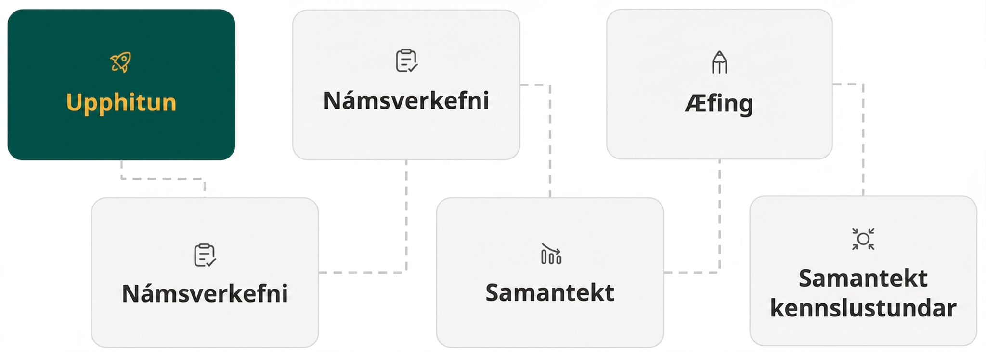
Lesson Journey
First Stop: Warm Up

Slide 7

Warm Up | Part 1
Saved By Zero 💪
Write the quadratic function f(x) = x² – 9x + 20 in factored form.
What are the solutions of the quadratic equation
(x – 4)(x – 5) = 0?
Notes:
Warm Up (5 minutes)
This warm up refreshes students’ ability to convert a quadratic function from standard form to factored form. It also provides practice deriving the solutions, or zeros, of a function from its factored form.
Students will use graphing technology to analyze the graph of a quadratic function by finding the 𝑥-intercepts and zeros.
Continue scrolling down for directions on how to launch the activity and answers.
Launch
Arrange students in groups of two.
Ask students to work through the questions individually, but ask their partner if they have a question.
Answers
𝑓(𝑥) = (𝑥 − 4)(𝑥 − 5)
𝑥 = 4 and 𝑥 = 5
NOTE: An animation has been added. Question 2 will not show until a click has triggered its display. This will keep from students being able to use it to help them answer question 1.
Additional questions, answers and activity synthesis are on the next slide.

Slide 8
Warm Up | Part 2
Saved By Zero 💪
Graph the quadratic function f(x) = x² – 9x + 20.
Marcus states that the zeros of the function of
f(x) = x² – 9x + 20 are 4 and 5. Do you agree? Be prepared to show your reasoning.
Notes:
Answers
(4,0) , (5,0) or 4 and 5 [Access this Desmos graph, if needed]
Yes, 4 and 5 are the input values that result in an output of 0. When the function 𝑓(𝑥) = 𝑥² − 9𝑥 + 20 is graphed, it crosses the 𝑥-axis at 𝑥 = 4 and 𝑥 = 5.
Activity Synthesis
Ensure students understand moving from standard form to factored form to deriving solutions or zeros using a quadratic function. After students work through the questions, ask the class as a whole if there are any outstanding questions.
These are important skills that this lesson builds on as students learn more about writing a quadratic function when given its zeros.

Slide 9
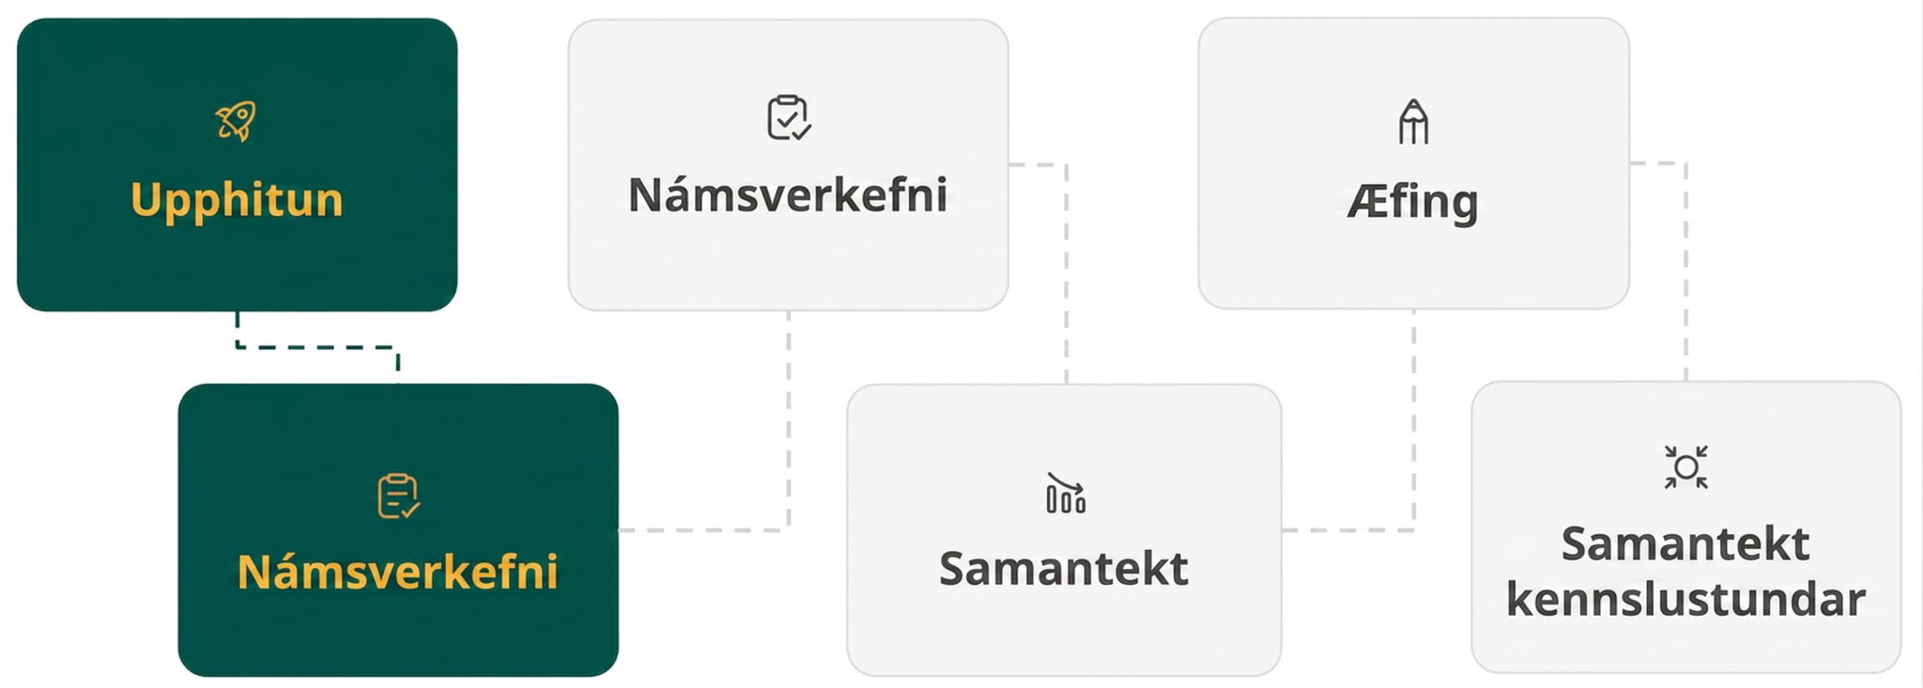
Lesson Journey
Second Stop: Learning Activity A

Slide 10
Learning Activity A | Part 1
Making Something From Nothing 💥
Questions 1 – 3 refer to a quadratic equation that has the zeros –3 and 4.
Write the factored form of this equation set equal to zero.
Now, write the standard form of the same quadratic equation.
Write the quadratic equation as the function 𝑓(𝑥).
Notes:
Activity (20 minutes)
In previous lessons, students learned to derive the zeros of a quadratic function from its standard form or factored form. In this activity, students will convert from a function's zeros to its factored form and standard form. Students will also practice this process after analyzing the graph of a quadratic function.
Launch
Arrange students in groups of two.
Answer questions 1 – 3 to familiarize students with the process of converting from zeros to the standard form of a function.
Pause and allow students to ask any questions.
Then allow each pair to complete questions 4 – 11 on their own.
Emphasize that questions 9 – 11 are the same as the preceding questions, except that students must analyze the graph to find the zeros.
Answers
(𝑥 + 3)(𝑥 − 4) = 0
𝑥² − 𝑥 − 12 = 0
𝑓(𝑥) = 𝑥² − 𝑥 − 12
Additional activity questions, answers, anticipated misconceptions, and synthesis questions on the next slide.

Slide 11
Learning Activity A | Part 2
Making Something From Nothing 💥
For questions 4 – 8, identify a quadratic function in standard form, 𝑓(𝑥), with the given zeros.
8 and 4
– 6 and 3
√3 and – √3
5
– 4
On this graph
On this graph
On this graph
Notes:
Activity Answers
𝑓(𝑥) = 𝑥² − 12𝑥 + 32. The factored form derived from the zeros is 𝑓(𝑥) = (𝑥 − 8)(𝑥 − 4).
𝑓(𝑥) = 𝑥² + 3𝑥 − 18. The factored form derived from the zeros is 𝑓(𝑥) = (𝑥 + 6)(𝑥 − 3).
𝑓(𝑥) = 𝑥² − 3. The factored form derived from the zeros is 𝑓(𝑥) = (𝑥 + √3)(𝑥 − √3).
𝑓(𝑥) = 𝑥² − 10𝑥 + 25. The factored form derived from the zeros is 𝑓(𝑥) = (𝑥 − 5)(𝑥 − 5).
𝑓(𝑥) = 𝑥² + 8𝑥 + 16. The factored form derived from the zeros is 𝑓(𝑥) = (𝑥 + 4)(𝑥 + 4).
𝑓(𝑥) = 𝑥² − 2𝑥 − 24. The zeros are –4 and 6. The factored form derived from the zeros is 𝑓(𝑥) = (𝑥 + 4)(𝑥 − 6).
𝑓(𝑥) = 𝑥² − 6𝑥 + 9. The zero is 3. The factored form derived from the zero is 𝑓(𝑥) = (𝑥 − 3)(𝑥 − 3).
𝑓(𝑥) = 𝑥² − 3𝑥 − 10. The zeros are –2 and 5. The factored form derived from the zeros is 𝑓(𝑥) = (𝑥 + 2)(𝑥 − 5).
Anticipated Misconceptions
Students may not remember how to approach questions 7 and 8, since they only have one solution, or zero. Remind students these are double roots, where the same solution is represented twice. If another hint is needed, tell students that in the factored form for each question, the binomial will repeat itself.
Activity Synthesis
To review key ideas from the activity, discuss the following questions:
Can you convert directly from the zeros of a function to standard form? (No, the zeros of a function can be converted into factored form, which can then be converted into standard form.)
How can you convert the graph of a quadratic function into its standard form? (Analyze the graph to find the zeros, or solutions, of the function. Use the zeros to write the function in factored form. Use FOIL to write the factored form in standard form.)

Slide 12

Learning Activity A
Self Check
Identify a quadratic function, g(x), in standard form, that has the zeros 5 and –7.
g(x) = x² + 2x – 35
g(x) = x² – 2x + 35
g(x) = x² + 12x + 35
g(x) = x² – 12x + 35
Let’s review!
Notes:
Answer Feedback - Individualized by Response
That’s correct! Substitute the zeros in for 𝑥 and check to see the function equals 0. (5)² + 2(5) − 35 = 0, and (−7)² + 2(−7) − 35 = 0.
Incorrect. The factored form of the quadratic function is 𝑔(𝑥) = (𝑥 − 5)(𝑥 + 7). Use the distributive property, or FOIL, to find the answer.
Incorrect. The factored form of the quadratic function is 𝑔(𝑥) = (𝑥 − 5)(𝑥 + 7), not 𝑔(𝑥) = (𝑥 + 5)(𝑥 + 7).
Incorrect. The factored form of the quadratic function is 𝑔(𝑥) = (𝑥 − 5)(𝑥 + 7). Use the distributive property, or FOIL, to find the answer.

Slide 13

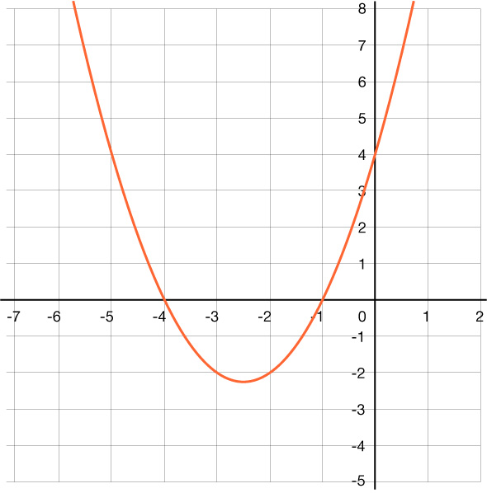
Learning Activity A
Self Check - Review
Example 1 - Write a function, 𝑧(𝑥), that corresponds to the graph shown.
Example 2 - Write a function, 𝑑(𝑥), that has one zero at 8.
Notes:
Remind Students
The zeros on a graph are identified by the locations where the parabola intersects the x-axis.
The resulting factor equations are: 𝑥 – p = 0 and 𝑥 – q = 0, where p and q are the roots or zeros of the function. These can be used to write a quadratic function in factored form: f(𝑥) = (𝑥 – p)(𝑥 – q)
By using the distributive property, or FOIL, we can find the standard form of the function.
Answers
Example 1 - (aligns with example 3 in the online textbook) 𝑧(𝑥) = 𝑥² + 5𝑥 + 4
Example 2 - 𝑑(𝑥) = 𝑥² − 16𝑥 + 64

Slide 14

Lesson Journey
Third Stop: Learning Activity B

Slide 15
Learning Activity B | Learning Strategies
Finding THE One 💓
Compare the functions using the equations, tables, and graphs:
  m(x) = x² – 3x – 40
  n(x) = 2x² – 6x – 80
Use the sentence stems:
  “One thing that is the same is …”
  “One thing that is different is …”
Explain why the quadratics are related.
  “Calling the equations related reminds me of …”
Discussion Supports
Teacher Instruction: Use these strategies to adjust the activity to support English language learners and students with disabilities.
  You can copy and paste the callouts directly on top of the activity or give the instructions aloud.
Create a T-chart or fold a sheet of paper in half vertically.
On the left side of the paper, list all the things that are the same about the functions using their equations, tables, or graphs.
On the right side, list all the things that are different.
Representation
Notes:
Support for English Language Learners: MLR 8 Discussion Supports: Representing, Conversing
Ask students to closely examine and then compare the two functions, 𝑚(𝑥) = 𝑥² − 3𝑥 − 40 and 𝑚(𝑥) = 2𝑥² − 6𝑥 − 80. Encourage students to look at the algebraic, tabular, and graphic representations of both functions. Display sentence frames “One thing that is the same is…” and “One thing that is different is…” Give students time to make sure that everyone in the class can explain or justify that each function has the same zeros. Next, ask students to explain why these quadratic equations are related. Provide the sentence frame, “Calling the equations related reminds me of … “ to support students as they explain their thinking. Some students may benefit from the opportunity to rehearse what they will say with their partner before they share with the whole class.
Design Principle(s): Support sense-making
Support for Students with Disabilities: Representation: Internalize Comprehension
To support working memory, provide students with sticky notes or encourage them to use a T-chart to compare and contrast the equations. Help students understand that related equations have the same zeros and axis of symmetry, but the tables of values, vertices, etc. will differ. Then, have them include how these graphical differences impact the values in each form of the quadratic equations.
Supports accessibility for: Memory, Organization

Slide 16
Learning Activity B | Part 1
Finding THE One 💓
When finding an exact function that has particular zeros and passes through a certain point, we use the intercept form of a quadratic function:
𝑓⁡(𝑥) = 𝑎⁢(𝑥 − 𝑝)⁢(𝑥 − 𝑞)
Step 1 - Find a function, in intercept form, that has the given zeros.
Step 2 - Find the value of 𝑎 by substituting the values of a third given point into the intercept form of the function.
Step 3 - Substitute the value of 𝑎 into the intercept form of the function and multiply to find the standard form.
Find a function, 𝑚⁡(𝑥), in intercept form, that has the zeros –5 and 8.
Use the intercept form of the function above to find the value of 𝑎 that passes through (5, −60).
Substitute the value of 𝑎 into the intercept form of the function and multiply to find the standard form.
Graph comparisons
Notes:
Support for All Learners
This activity offers additional support for students:
For English language learners and students with disabilities, be sure to review the Learning Strategies slide!
Activity (20 minutes)
This activity introduces students to finding a specific quadratic equation that has certain zeros and passes through a particular point. In previous lessons, students found a quadratic function that has certain zeros in its simplest standard form. In this activity, students will find a more specific quadratic function using the given point.
Continue scrolling down for directions on how to launch the activity and answers to the questions.
Launch
In this activity, questions 1 – 3 provide a step-through introduction to finding the specific equation of a quadratic equation that has certain zeros and passes through a given point.
Give students time to complete the first three questions and then pause for a class discussion.
While discussing the first three questions, emphasize that the function 𝑚(𝑥) = 𝑥² − 3𝑥 − 40 is a function that has the zeros –5 and 8. As we found in question 3, 𝑚(𝑥) = 2𝑥² − 6𝑥 − 80 is another function that has the zeros –5 and 8. Only the function 𝑚(𝑥) = 2𝑥² − 6𝑥 − 80 passes through the point (5, −60) and is the specific function we want.
Show the graphs of these two functions using Desmos to help visualize the difference between these two quadratic equations. Emphasize that these quadratic equations are related since they both have the same zeros and axis of symmetry (𝑥 = 1.5). Only one of them, however, passes through the point (5, −60).
Allow students to complete questions 4 – 6 in pairs.
Answers
The intercept form is 𝑚(𝑥) = 𝑎(𝑥 − (−5))(𝑥 − 8) = 𝑎(𝑥 + 5)(𝑥 − 8).
𝑚(𝑥) = 𝑎(𝑥 + 5)(𝑥 − 8)
−60 = 𝑎((5) + 5)((5) − 8)
−60 = 𝑎(10)(−3)
−60 = −30𝑎
2 = 𝑎
𝑚(𝑥) = 𝑎(𝑥 + 5)(𝑥 − 8)
𝑚(𝑥) = 2(𝑥 + 5)(𝑥 − 8)
𝑚(𝑥) = 2(𝑥² + 5𝑥 − 8𝑥 − 40)
𝑚(𝑥) = 2(𝑥² − 3𝑥 − 40)
𝑚(𝑥) = 2𝑥² − 6𝑥 − 80
Additional activity questions, answers, and synthesis on the next slide.

Slide 17
Learning Activity B | Part 2
Finding THE One 💓
Write the quadratic function, 𝑛⁡(𝑥), in standard form, that has the zeros 9 and –2 and passes through the point
(0, −36).
Write the quadratic function, 𝑝⁡(𝑥), in standard form, that has the zeros –6 and –4 and passes through the point
(−5, 3).
Write the quadratic function, 𝑐⁡(𝑥), in standard form, that has the zeros 1 and 7 and passes through the point
(9, 16).
Notes:
Answers
𝑛(𝑥) = 2𝑥² − 14𝑥 − 36
𝑝(𝑥) = − 3𝑥² − 30𝑥 − 72
𝑐(𝑥) = 𝑥² − 8𝑥 + 7
Activity Synthesis
To summarize key ideas from the activity, discuss the following questions:
In this activity, what does it mean for two quadratic equations to be related? (Two quadratic functions are related if they have the same zeros and the same axis of symmetry.)
How can you use the intercept form of a quadratic equation such as 𝑓(𝑥) = 𝑎(𝑥 − 5)(𝑥 − 4) and a point that it passes through to find the value of 𝑎? (Substitute the point into the function and solve for the value of 𝑎. Substitute the value of 𝑎 back into the equation and multiply to find the standard form of the quadratic equation.)

Slide 18

Learning Activity B
Self Check
Write the quadratic function, 𝑧(𝑥), in standard form, that has the zeros –1 and 8 and passes through the point (0,16).
𝑧(𝑥) = − 2𝑥² + 14𝑥 + 16
𝑧(𝑥) = 3𝑥² − 21𝑥 − 24
𝑧(𝑥) = 2𝑥² − 14𝑥 − 16
𝑧(𝑥) = 𝑥² + 7𝑥 + 8
Let’s review!
Notes:
Answer Feedback - Individualized by Response
That's correct! Substitute the points (−1,0), (8,0), and (0,16) into the function and check that each is true. Since each one is true, the answer is correct.
Incorrect. This is an incorrect value 𝑎, in which 𝑎 = 3. The correct value of 𝑎 is –2.
Incorrect. This is an incorrect value 𝑎, in which 𝑎 = 2. The correct value of 𝑎 is –2.
Incorrect. This is the standard form of the function without finding the value of 𝑎. Use the intercept form and the point (0,16) to find the value of 𝑎.

Slide 19
Learning Activity B
Self Check - Review
Write the quadratic function, 𝑓(𝑥), that has the zeros –5 and 4 and passes through the point (−4, −16).
Notes:
Remind Students
When finding an exact function that has particular zeros and passes through a certain point, we use the intercept form of a quadratic function: 𝑓(𝑥) = 𝑎(𝑥 − 𝑝)(𝑥 − 𝑞). The variables 𝑝 and 𝑞 represent the zeros or roots of the function. The variable 𝑎 accounts for any constant that might have been factored out when solving.
Related equations have the same zeros and the same axis of symmetry.
It is very important to note that this is why, in the previous lesson, we were looking for “a function that has zeros at –5 and 4” and not “the function that has zeros at –5 and 4.” This difference in wording is very important since there are infinitely many functions that are related by their solutions.
We can only determine an exact specific function if we have the additional information of a point through which the function passes.
Answer
𝑓(𝑥) = 2𝑥² + 2𝑥 − 40
Consider using a Desmos graph to check the answer.
For additional practice problems, access the online textbook.

Slide 20
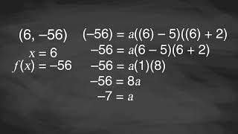
Learning Activity B | Video
Finding a Quadratic Function from Its Zeros and a Point
Notes:
This video does not discuss a specific question in lesson 8.11.

Slide 21
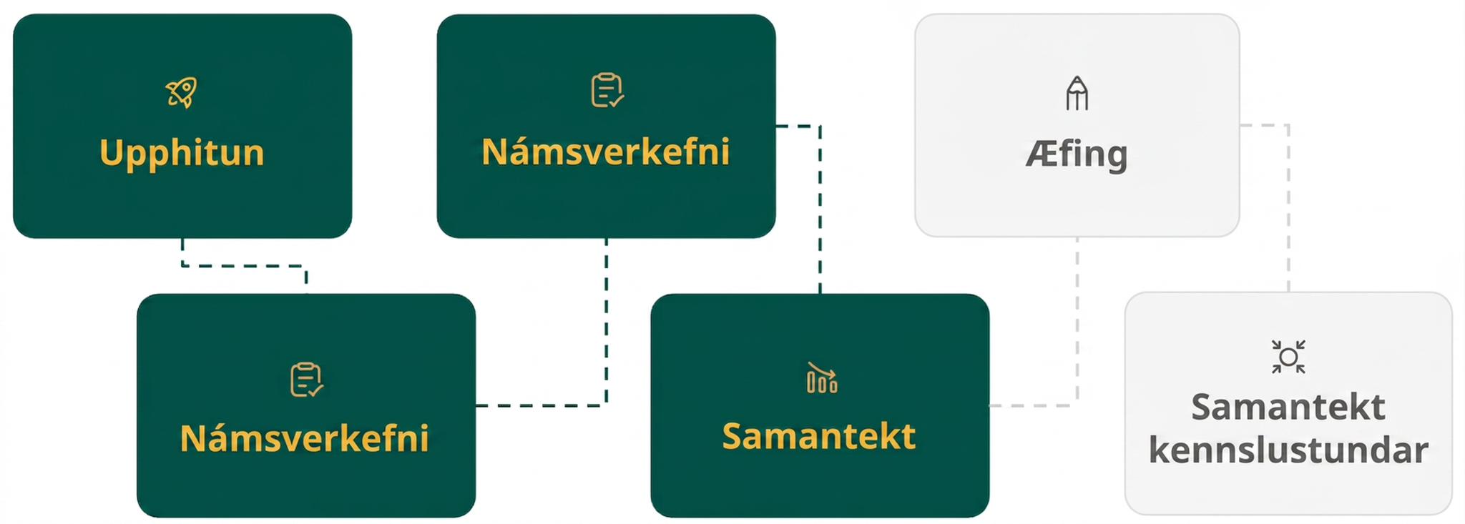
Lesson Journey
Fourth Step: Cool Down

Slide 22
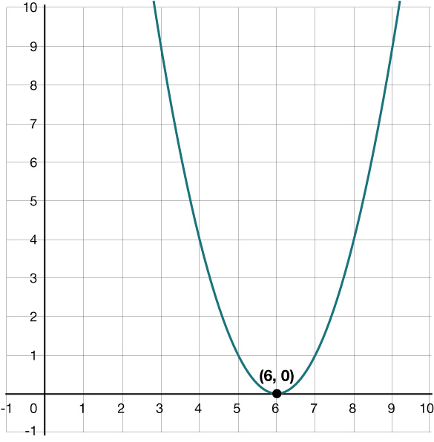
Cool Down
Identify a quadratic function in standard form, 𝑏(𝑥), with the zeros –6 and 8.
Use the graph to identify a quadratic function in standard form, 𝑚(𝑥), with the given zero.
Write the specific quadratic function, 𝑑(𝑥), in standard form, that has the zeros 2 and 5 and passes through the point
(1, 16).
Notes:
Cool Down (5 minutes)
Remind students that in this lesson they have learned how to write a quadratic function from different starting contexts and when provided different information.
Answers
𝑏(𝑥) = 𝑥² − 2𝑥 − 48
𝑚(𝑥) = 𝑥² − 12𝑥 + 36
Intercept form: 𝑑(𝑥) = 𝑎(𝑥 − 2)(𝑥 − 5). Using the point (1, 16), we find 4 = 𝑎. So, the specific quadratic function written in standard form is 𝑑(𝑥) = 4𝑥² − 28𝑥 + 40. Access the online textbook for all of the steps in the answer process.
Response to Student Thinking - More Chances
Students will have more opportunities to understand the mathematical ideas in this cool down, so there is no need to slow down or add additional work to the next lessons. Instead, use the results of this cool down to provide guidance for what to look for and emphasize in the next several lessons to support students in advancing their current understanding.

Slide 23
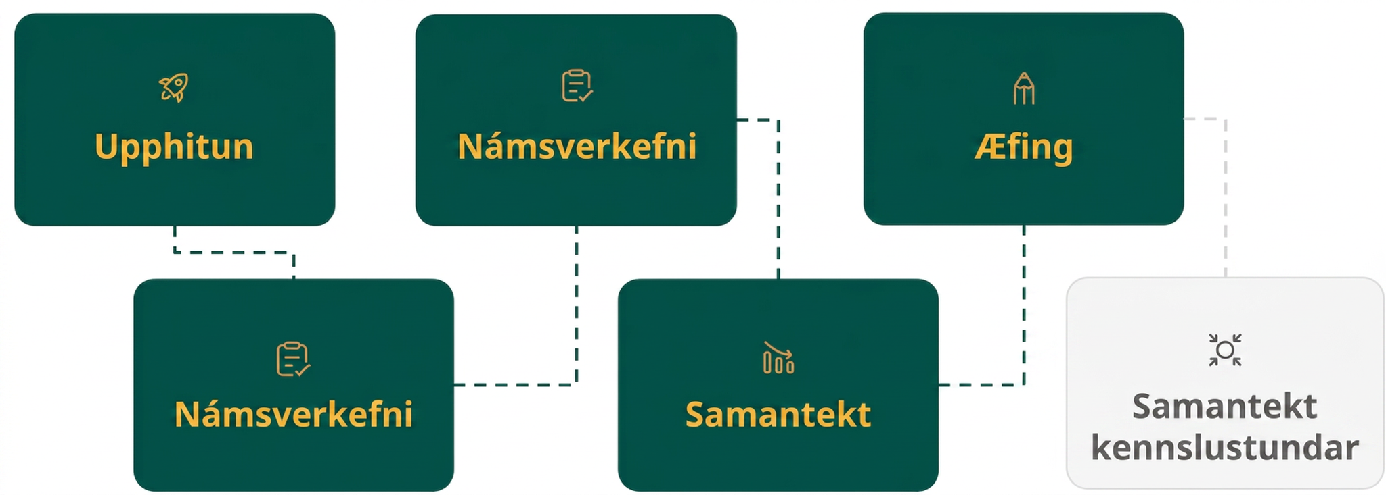
Lesson Journey
Fifth Stop: Practice

Slide 24

Practice
Put your hard work to action, practice what you’ve learned!
Notes:
Digital Practice: Access the practice pages at https://openstax.org/details/books/algebra-1

Slide 25
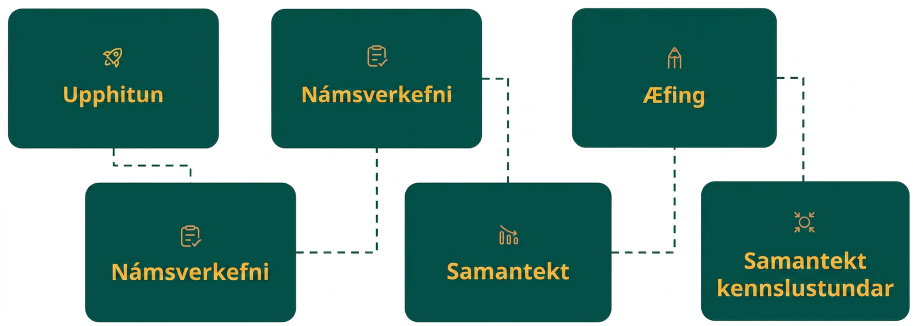
Lesson Journey
Sixth Stop: Lesson Synthesis

Slide 26
Lesson Synthesis
How would you find the standard form of a quadratic function by analyzing its graph?
Can two different functions have the same zeros?
Describe in your own words how to find a specific quadratic function from its zeros and a point that it contains.
Notes:
Answers
Analyze its graph to determine the zeros of the function. Use the zeros of the function to write the function in factored form. Convert the factored form of the function into standard form.
Yes. Related quadratic functions have the same zeros and the same axis of symmetry when graphed.
Use the zeros to find a function’s intercept form using 𝑎 as the multiplier. Substitute the point into the function and solve for the value of 𝑎. Substitute that value back into the intercept form of the equation and distribute the value.

Slide 27
Self Assessment
How much do you agree with the following statements?
Learning Goals | I can | Almost | Not yet
Find the standard form of a quadratic function given its zeros. | ⃞ | ⃞ | ⃞
Find the standard form of a quadratic function given its graph. | ⃞ | ⃞ | ⃞
Use the intercept form of a quadratic function to define a specific function given its zeros and a point. | ⃞ | ⃞ | ⃞

