Slide 1
Algebra 1
Unit 8 Quadratic Equations
Lesson 8.10 Rewriting Quadratic Expressions in Factored Form

Slide 2

How to use these slides
On the activity slides check the speaker notes for teacher support and instructional information.
Each lesson includes 1 warm up, 2-3 learning activities, a cool down, practice and a lesson synthesis.
  Learning activities are followed by a self check question, and review section.
Some slides have been hidden from student view, more information can be found on the next slide (Reference Key).
You can edit and use these slides for personal and classroom use, but cannot sell them and must keep the attribution logos.
For more information, Check out the digital quick start guide!
OpenStax CC BY NC SA

Slide 3





Reference Key
Check the top right corner for an icon referencing these unique sections.
Icon | Title | View | Location and Description
n/a | Support for Students with Disability | Hidden | Learning Strategies slide, provides additional support to students for understanding the activity.
n/a | Support for English Language Learners | Hidden | Learning Strategies slide, provides additional support to students for understanding the activity.
n/a | Extending Your Thinking | Hidden | Extending Your Thinking slide, provides an extra challenge for students.
n/a | Self Check | Not Hidden | Self Check slide, checkpoint to assess student understanding after the learning activity.
n/a | Review | Hidden | Self Check - Review slide, designed to help review topics from the self check question.
On the next slides, check the speaker notes for teacher instructions and support.
Notes:
Check the Speaker Notes: On the next slides you can find discussion questions, lesson information, answers to the activities, and ways to adjust the activity for your students!

Slide 4

Learning Goals
By the end of this lesson you will be able to -
Use the factored form of a quadratic expression or a graph of a quadratic function to answer questions about a situation.
Write equivalent expressions in factored form when given quadratic expressions of the form 𝑎𝑥² + 𝑏𝑥 + 𝑐 and 𝑎 is not 1.
Notes:
Lesson Narrative
Up to this point, most quadratic expressions students have transformed from standard form to factored form had a leading coefficient of 1; that is, they were in the form of 𝑥² + 𝑏𝑥 + 𝑐 because the squared term had a coefficient of 1. In this lesson, students consider how to rewrite expressions in standard form where the leading coefficient is not 1 and the expression is not a difference of two squares. They notice that the same structure they used previously can be used to rewrite expressions such as 3𝑥² + 8𝑥 + 4, but the process is now a little more involved because the coefficient of 𝑥² has to be taken into account when finding the right pair of factors.
This lesson aims to have students rewrite more complicated expressions in factored form, and motivate the need for other, more efficient strategies to solve equations in a series of upcoming lessons.
Required Preparation
Acquire devices that can run Desmos (recommended) or other graphing technology. It is ideal if each student has their own device.
Required Materials
Paper and pencil
Graphing technology
Texas Essential Knowledge and Skills
A1(A) apply mathematics to problems arising in everyday life, society, and the workplace
A8(A) solve quadratic equations having real solutions by factoring, taking square roots, completing the square, and applying the quadratic formula.

Slide 5
Vocabulary
Previous
Quadratic function
  A function where the output is given by a quadratic expression in the input 𝑓(𝑥) = 𝑎𝑥² + 𝑏𝑥 + 𝑐.
Factored Form
  A quadratic expression that is written as the product of a constant times two linear factors. 𝑓(𝑥) = 𝑎(𝑥 − 𝑟₁)(𝑥 − 𝑟₂).
Standard Form
  When a quadratic expression is written as 𝑓(𝑥) = 𝑎𝑥² + 𝑏𝑥 + 𝑐.
Linear term
  In 𝑎𝑥² + 𝑏𝑥 + 𝑐, it is the term 𝑏𝑥.
Coefficient
  In an algebraic expression, it is the constant the variable is multiplied by.
Zero Product Property
  If (𝑎)(𝑏) = 0, then either 𝑎 = 0 or
  𝑏 = 0.
Zero of the function
  Where 𝑓(𝑥) = 0. On the graph, this is where the function intersects the 𝑥-axis.
Notes:
Lesson Vocabulary To support student understanding of key vocabulary:
Introduce and review the vocabulary words students will see in this lesson.
Encourage students to notice how these words are used and to include them in their math discussions and explanations—both written and oral.
Use a word wall to reinforce vocabulary. Sample word wall cards are available here.
For newcomers or students with beginning English proficiency, use these Quizlet sets to support vocabulary learning:
Unit 8 Spanish Vocabulary – use first to build understanding
Unit 8 Vocabulary (English) – use after anchoring in Spanish
Support for English Language Learners
ELPS 2(F) listen to and derive meaning from a variety of media such as audiotape, video, DVD, and CD-ROM to build and reinforce concept and language attainment.
ELPS 3(E) share information in cooperative learning interactions.
ELPS 3(H) narrate, describe, and explain with increasing specificity and detail as more English is acquired.
ELPS 4(F) use visual and contextual support and support from peers and teachers to read grade-appropriate content area text, enhance and confirm understanding, and develop vocabulary, grasp of language structures, and background knowledge needed to comprehend increasingly challenging language.

Slide 6
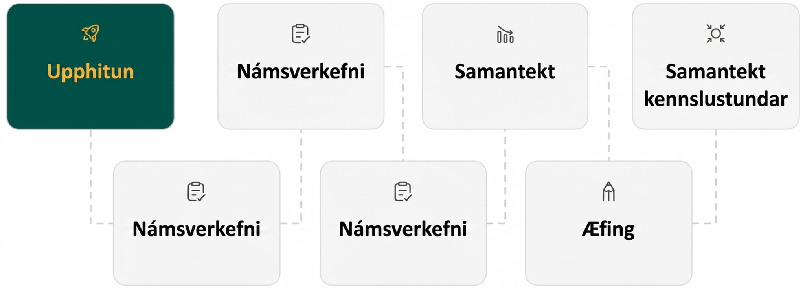
Lesson Journey
First Stop: Warm Up

Slide 7

Warm Up
Which One Doesn’t Belong? 🚫
(𝑥 + 4)(𝑥 − 3) | 𝑥² − 25
3𝑥² − 8𝑥 + 5 | 𝑥² + 2𝑥 + 3
Notes:
Warm Up (5 minutes)
This warm up prompts students to carefully analyze and compare quadratic expressions. The activity also enables the teacher to hear the terminology students know and how they talk about characteristics of the different forms of expressions. As students discuss in groups, listen for rationales that are based on the structure of the expressions. Select those students or groups to share their thinking during class discussion.
Launch
Arrange students in groups of two to four. Display the expressions for all to see. Give students quiet time to think individually and then time to share their thinking with their small group. In their small groups, ask each student to share their reasoning about why a particular item does not belong, and together find at least one reason each item doesn't belong.
Activity Answers
(x + 4)(x – 3): The only expression that is not in standard form. Or, when written in standard form, it is the only one that has an even number for the constant term.
3x² – 8x + 5: The only expression in standard form that has a leading coefficient other than 1.
x² – 25: The only expression in standard form that doesn't have three terms. It is the only one without a linear term.
x² + 2x + 3: The only expression in standard form that can't be written in factored form. It is prime.
Activity Synthesis
Ask each group to share one reason why a particular expression doesn't belong. Record and display the responses for all to see. After each response, ask the class if they agree or disagree. Since there is no single correct answer to the question of which one does not belong, attend to students' explanations and ensure the reasons given are correct.
During the discussion, ask students to explain the meaning of any terminology they use, such as standard form, factored form, linear term, or coefficient.
Also, press students on unsubstantiated claims. For example, if they claim that 3x² – 8x + 5 is the only one that cannot be written in factored form, ask them to show how they know.

Slide 8
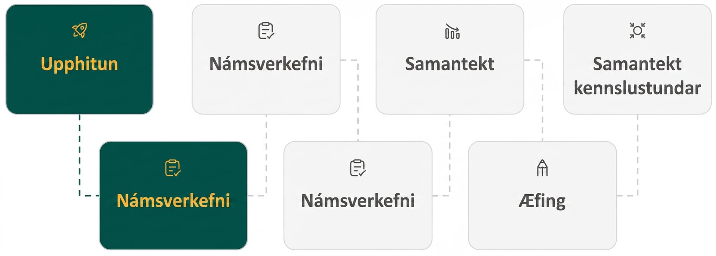
Lesson Journey
Second Stop: Learning Activity A

Slide 9

Learning Activity A | Learning Strategies
Shifting Forms ⟺
Have each group member rehearse an explanation for every problem.
Determine a presentation order.
Discussion Supports
Teacher Instruction: Use these strategies to adjust the activity to support English language learners and students with disabilities.
You can copy and paste the callouts directly on top of the activity or give the instructions aloud.
How might a diagram help rewrite these equations in factored form?
How might a calculator help test different factor pairs?
Representation
Notes:
Support for English Language Learners: MLR 8 Discussion Supports: Speaking, Representing
Give students time to make sure that everyone in the group can explain or justify each step or part of the problem. Invite groups to rehearse what they will say when they share with the whole class. Rehearsing provides students with additional opportunities to speak and clarify their thinking, and will improve the quality of explanations shared during the whole-class discussion. Then make sure to vary who is selected to represent the work of the group so that students get accustomed to preparing each other to fill that role.
Design Principle(s): Support sense-making; Cultivate conversation
Support for Students with Disabilities: Representation: Internalize Comprehension
Activate or supply background knowledge. Demonstrate how students can continue to use diagrams to rewrite expressions in which the coefficient of the squared term is not 1. Invite students to begin by generating a list of factors and to test them using the diagram. Encourage students to persist with this method, reiterating the fact that they are not necessarily expected to immediately recognize which factors will work without testing them. Allow students to use calculators to ensure inclusive participation.
Supports accessibility for: Visual-spatial processing; Organization

Slide 10
Learning Activity A | Part 1
Shifting Forms ⟺
Complete the tables by converting the given expression into standard form. If you get stuck, try drawing a diagram.
Factored Form | Standard Form
(3𝑥 + 1)(𝑥 + 4) | ?
(3𝑥 + 2)(𝑥 + 2) | ?
(3𝑥 + 4)(𝑥 + 1) | ?
? | 5𝑥² + 21𝑥 + 4
? | 3𝑥² + 7𝑥 + 4
Notes:
Support for All Learners
This activity offers additional support and an extension for students:
For English language learners and students with disabilities, be sure to review the Learning Strategies slide!
For students looking for an extra challenge, be sure to review the Extending Your Thinking slide!
Activity (15 minutes)
In this activity, students work with expressions of the form (𝑝𝑥 + 𝑚)(𝑞𝑥 + 𝑛). They expand expressions such as (2𝑥 + 1)(𝑥 + 10) into standard form and look for structure that would allow them to go in reverse, that is, to transform expressions of the form 𝑎𝑥² + 𝑏𝑥 + 𝑐.
With some guessing and checking, students should be able to find the factored form of the expressions in the fourth and fifth questions, but they should also notice that this process is not straightforward.
Launch
Arrange students in groups of two to three and ask them to split up the work for completing the first three questions, with each group member rewriting one expression into standard form.
Invite students to share the expanded expressions in standard form.
Record the expressions in the right column, and ask students to make observations about them.
If not mentioned by students:
Point out that each pair of factors start with 3𝑥 and 𝑥, which multiply to make 3𝑥².
Each pair of factors also has constant terms that multiply to make 4.
The resulting expressions in standard form are all different, however, because using different pairs of factors of 4 and arranging them in different orders produce different expanded expressions.
Ask students to keep these observations in mind as they complete questions 4 and 5.
The student extension and the self check quiz contain examples in standard form where the trinomials have negative 𝑐-values. Ask students how having a negative 𝑐-value would affect the way they approach factoring. (The constants in the binomials must have opposite signs.)
Activity answer and synthesis on the next slide.

Slide 11
Learning Activity A | Part 2
Shifting Forms ⟺
Factored Form | Standard Form
(3𝑥 + 1)(𝑥 + 4) | 3𝑥² + 13𝑥 + 4
(3𝑥 + 2)(𝑥 + 2) | 3𝑥² + 8𝑥 + 4
(3𝑥 + 4)(𝑥 + 1) | 3𝑥² + 7𝑥 + 4
(5𝑥 + 1)(𝑥 + 4) | 5𝑥² + 21𝑥 + 4
(3𝑥 + 4)(𝑥 + 1) | 3𝑥² + 7𝑥 + 4
Are you ready for more?
Notes:
Anticipated Misconceptions
Some students may not think to check their answers to the second question and stop as soon as they think of a pair of factors that give the correct squared term and constant term. Encourage them to check their answers with a partner by giving time to do so. Consider providing a non-permanent writing surface or extra paper so students could try out their guesses and check their work without worrying about having to erase if they make a mistake the first time or two.
Activity Synthesis
Help students to reason about the factors more generally. Discuss questions such as:
To rewrite expressions such as 𝑥² + 𝑏𝑥 + 𝑐, we looked for two numbers that multiply to make 𝑐 and add up to 𝑏. The expressions here are of the form 𝑎𝑥² + 𝑏𝑥 + 𝑐. Are we still looking for two numbers that multiply to make 𝑐? Why or why not? (Yes. The constant terms in the factored expression must multiply to make 𝑐.)
Do we need to look for factors of 𝑎? Why or why not? (Yes. Those factors will be the coefficient of 𝑥 in the factored expressions. They must multiply to make 𝑎.)
Are we still looking for two factors of 𝑐 that add up to 𝑏? Why or why not? (No. The value of 𝑏 is no longer just the sum of the two factors of 𝑐 because the two factors of 𝑎 are now involved.)
How does this affect the rewriting process? (It makes it more complicated, because now there are four numbers to contend with, and there are many more possibilities to consider.)

Slide 12

Learning Activity A
Extending Your Thinking
Find the factored form of the quadratic expression shown.
Factored Form | Standard Form
? | 6𝑥² + 11𝑥 − 10
Notes:
Go back to Lesson Activity
This quadratic expression is different from those in the activity, since its leading coefficient has more than one set of possible factors.
The expression is also different since the constant term is negative, –10. This means when you consider the factors of the constant term, one must be positive and one must be negative.
Answer (3𝑥 − 2)(2𝑥 + 5)

Slide 13
Learning Activity A
Self Check
Find the factored form of the quadratic expression
3𝑥² + 5𝑥 − 2.
(3𝑥 − 2)(𝑥 − 1)
(3𝑥 + 2)(𝑥 + 1)
(3𝑥 − 2)(𝑥 + 1)
(3𝑥 − 1)(𝑥 + 2)
Let’s review!
Notes:
Answer Feedback - Individualized by Response
Incorrect. This results in a middle term of −5𝑥 and a constant term of 2.
Incorrect. This results in a constant term of 2.
Incorrect. This results in a middle term of 3𝑥 − 2𝑥, or 𝑥.
That's correct! Multiply the factored form to check to see if it is equivalent to the original expression. (3𝑥 − 1)(𝑥 + 2) = 3𝑥² + 6𝑥 − 𝑥 − 2 = 3𝑥² + 5𝑥 − 2.

Slide 14

Learning Activity A
Self Check - Review
Write 2𝑥² + 13𝑥 + 15 in factored form.
HINTS:
The leading coefficient is 2, so the structure must be: (2𝑥 + ___)(𝑥 + ___)
The constant term is +15, so the product of the constant terms must be 15. The possibilities include:
  +1 and +15 OR –1 and –15
  +3 and +5 OR –3 and –5
The middle term, 13𝑥, is positive, so we only need to consider the positive factors
Notes:
The “HINTS” box has been animated to “play on click” in case it provides too much information before students have had a chance to brainstorm ways to address the problem.
Answer
Let's try 1 and 15: (2𝑥 + 15)(𝑥 + 1) = 2𝑥² + 2𝑥 + 15𝑥 + 15 = 2𝑥² + 17𝑥 + 15 🚫
Try reordering: (2𝑥 + 1)(𝑥 + 15) = 2𝑥² + 30𝑥 + 𝑥 + 15 = 2𝑥² + 31𝑥 + 15 🚫
Let's try 3 and 5: (2𝑥 + 5)(𝑥 + 3) = 2𝑥² + 6𝑥 + 5𝑥 + 15 = 2𝑥² + 11𝑥 + 15 🚫
Try reordering: (2𝑥 + 3)(𝑥 + 5) = 2𝑥² + 3𝑥 + 10𝑥 + 15 = 2𝑥² + 13𝑥 + 15 ✅

Slide 15
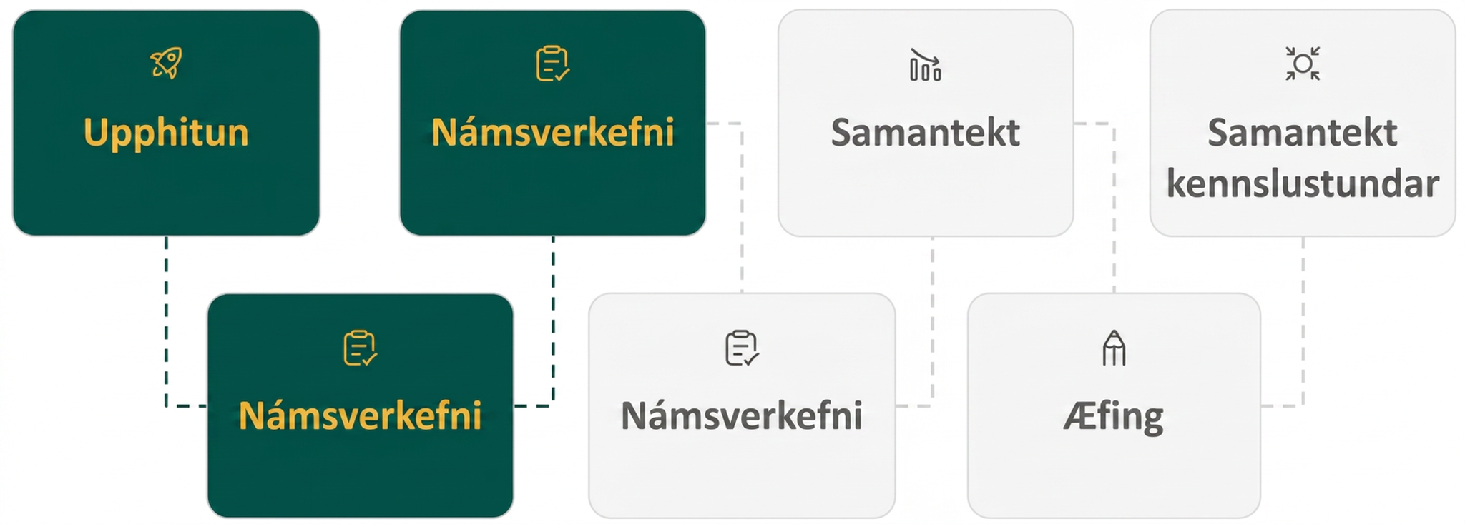
Lesson Journey
Third Stop: Learning Activity B

Slide 16
Learning Activity B | Learning Strategies
Designing Fountains 💦
Teacher Instruction: Use these strategies to adjust the activity to support English language learners and students with disabilities.
  You can copy and paste the callouts directly on top of the activity or give the instructions aloud.
First read: listen and describe the situation without numbers.
Second read: list what can be counted or measured.
Third read: listen for the question and brainstorm ways to solve.
Three Reads
Describe where you have seen a water fountain before.
Describe what the water looks like as it leaves the water fountain.
What words or phrases in the problem are new to you?
Representation
Notes:
Support for English Language Learners: MLR 6 Three Reads: Reading
Use this routine to support reading comprehension, without solving, for students. Use the first read to orient students to the situation. Ask students to describe what the situation is about without using numbers. (An engineer is designing a water fountain.) Use the second read to identify quantities and relationships. Ask students what can be counted or measured without focusing on the values. Listen for, and amplify, the important quantities that vary in relation to each other in this situation: height of a drop of water, in meters, and time, in seconds. After the third read, ask students to brainstorm possible strategies to answer the questions. This helps students connect the language in the word problem and the reasoning needed to solve the problem.
Design Principle(s): Support sense-making
Learn more about this routine
View the instructional video and follow along with the materials to assist you with learning this routine.
Provide support for students
Distribute graphic organizers to the students to assist them with participating in this routine.
Support for Students with Disabilities: Representation: Internalize Comprehension
Provide appropriate reading accommodations and supports to ensure student access to written directions, word problems, and other text-based content. Clarify any unfamiliar terms or phrases.
Supports accessibility for: Language, Conceptual processing

Slide 17
Learning Activity B | Part 1
Designing Fountains 💦
Write an equation that we could solve to answer the question.
Try to solve the equation by writing the expression in factored form and using the zero product property. If it cannot be factored, explain how you came to this conclusion.
A fountain launches water
from a nozzle 3 meters above the ground at a vertical velocity of 9 meters per second. Function ℎ models the height in meters, ℎ, of a drop of water 𝑡 seconds after it is shot out from the nozzle.
ℎ(𝑡) = −5𝑡² + 9𝑡 + 3
How many seconds until the drop of water hits the ground?
Notes:
Support for All Learners -
This activity offers additional support for students:
For English language learners and students with disabilities, be sure to review the Learning Strategies slide!
Activity (15 minutes)
In this activity, they encounter a real-world example in which they struggle to find a combination of rational factors of 𝑎 and 𝑐 that would produce the value of 𝑏. By graphing the function, students discover that the horizontal intercepts are decimals. The graph allows them to estimate the solution, but that is as far as they could go.
Launch
Keep students in groups of two. Let students become briefly frustrated by their unsuccessful attempts to find factors of the expression in standard form, but move them on to the last question after a few minutes. Provide access to devices that can run Desmos or other graphing technology.
Answers:
−5𝑡² + 9𝑡 + 3 = 0
There is no combination of integer factors of the first coefficient, -5, and the third coefficient, 3, that would result in a middle term of 9. Because it is prime, the expression cannot be written in factored form.
Additional questions and activity synthesis on the next slide.

Slide 18
Learning Activity B | Part 2
Designing Fountains 💦
Solve the equation by graphing the function.
Use the Desmos graphing tool or technology outside the course.
Explain how you found the solution.
A fountain launches water
from a nozzle 3 meters above the ground at a vertical velocity of 9 meters per second. Function ℎ models the height in meters, ℎ, of a drop of water 𝑡 seconds after it is shot out from the nozzle.
ℎ(𝑡) = −5𝑡² + 9𝑡 + 3
How many seconds until the drop of water hits the ground?
Notes:
Answer:
About 2. A graph of the equation shows two horizontal intercepts, one with a positive 𝑥-coordinate and one negative 𝑥-coordinate. The negative one does not apply here because time in seconds cannot be a negative value. The other horizontal intercept is around (2.087,0). This means it takes about 2 seconds for the drop to hit the ground.
Activity Synthesis
Ask students to share some challenges they came across when trying to rewrite the expressions in factored form. Solicit some ideas about why this equation presented those challenges. Then, discuss how they found or estimated the solution by graphing.
The approximate solution to the equation, given by the zero of the function and the 𝑥-intercept of the graph, is 2.087 seconds. Some graphing tools would give an approximation with a longer decimal expansion, giving a clue that it might be trickier to rewrite the equation in factored form.
Highlight that some equations are difficult or impossible to rewrite in factored form. In fact, when quadratic models appear in real life, this is usually the case. Graphing is a way to solve these equations, but there are other techniques, which students will learn over the next several lessons.

Slide 19
Learning Activity B
Self Check
A tennis ball is hit by a racket. The function ℎ(𝑡) = −3𝑡² + 7𝑡 + 3 models the height in meters, ℎ, of the tennis ball 𝑡 seconds after the impact with the racket.
Use graphing technology to determine the amount of time that has passed from the tennis ball being hit to when it reaches the ground.
1.167 seconds
2.703 seconds
0.37 seconds
3.124 seconds
Let’s review!
Notes:
Answer Feedback - Individualized by Response
Incorrect. This answer is the time it takes for the tennis ball to reach its maximum height.
That's correct! Check yourself: Substitute 2.703 for 𝑡 and check that the function is approximately 0. −3(2.703)² + 7(2.703) + 3 ≈ 0.
Incorrect. The value – 0.37 is a zero for the function, but a negative time value is not relevant in this example.
Incorrect. Check to see if you entered the function correctly into the graph.

Slide 20
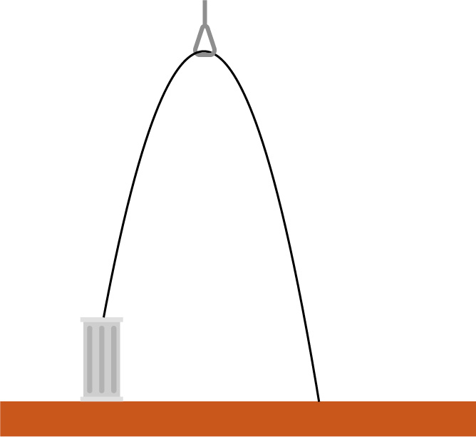
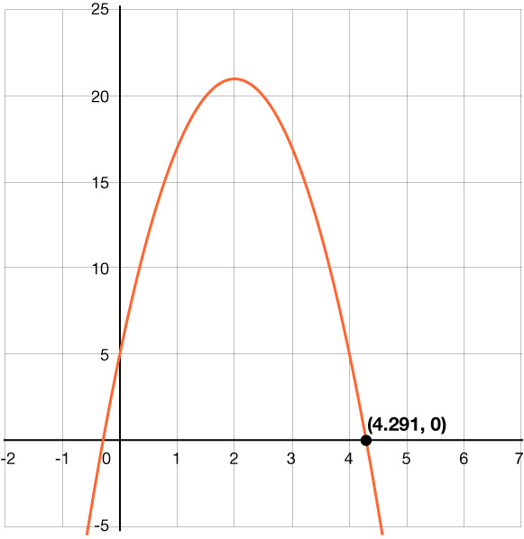
Learning Activity B
Self Check - Review
A thick steel support cable at a construction site forms an arch-like shape. It starts attached to the top of a column, goes up through a loop at a high point, and then back down to the ground.
How far away from the column does the cable attach to the ground?
Graph the equation
Find the zero or x-intercept
h(x) = –4x² + 16x + 5
x is horizontal distance from column
Notes:
Answer:
We can see the function has a zero at 𝑥 = 4.291. The 𝑥-intercept is (4.291,0). This means the cable attaches to the ground 4.291 meters away from the column.
What else about the steel cable system do we know from this graph?
We can also tell that the cable attaches to the column 5 meters off the ground at the 𝑦-intercept and the loop is approximately 21 meters high at the vertex of the parabola.

Slide 21
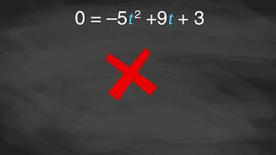
Learning Activity B | Video
Using Technology to Find the Rational Factors
Notes:
This video discusses questions 2 – 3 of activity 8.10.3.

Slide 22
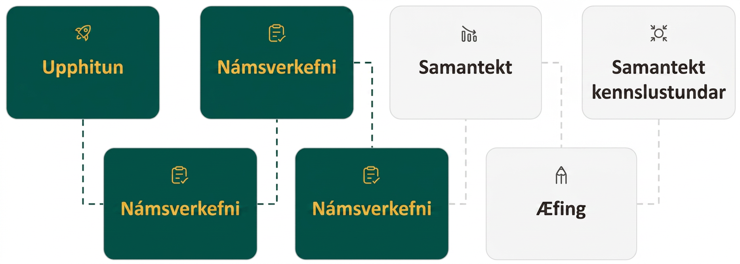
Lesson Journey
Fourth Stop: Learning Activity C
Notes:
This activity [8.10.4] is an extension of the expectations in the TEKS so it is not included in the slides. Access the online textbook if you are interested in completing this activity with students.
This activity allows students to investigate another way (beside guessing and checking) for finding the factors of quadratic expressions in standard form where the leading coefficient is not 1. The method involves temporarily substituting the squared term with another variable so that the leading coefficient is 1 (which makes it easier to spot the factors of the expression), and then substituting the original variable back once the expression is in factored form.
Students may find the reasoning and substitution processes challenging. Transitioning from, for example, 9𝑥² + 21𝑥 + 10 to (3𝑥)² + 7(3𝑥) + 10, and then to 𝑁² + 7𝑁 + 10 requires abstract reasoning. Later in the unit, students will encounter the use of a placeholder, such as done here, as a way to derive the quadratic formula. If desired, this activity can be done at that point to warm students up to the idea of using a placeholder.

Slide 23
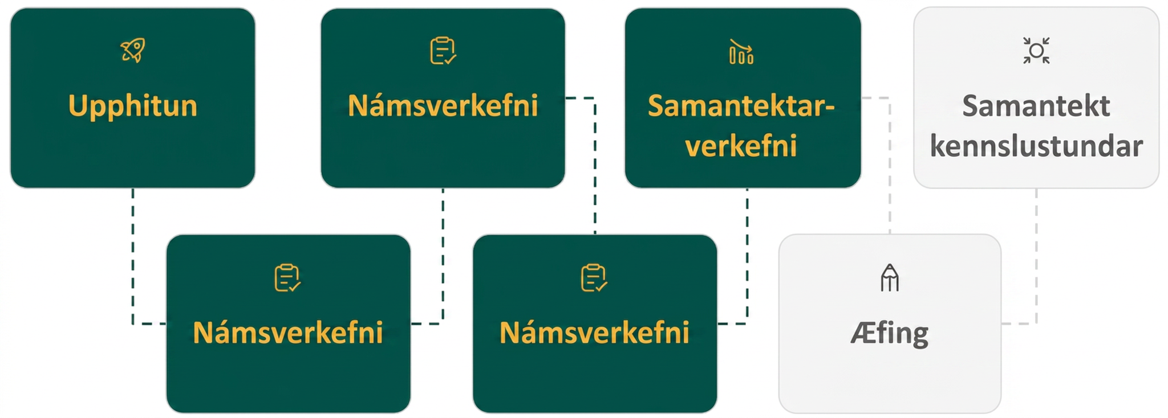
Lesson Journey
Fifth Step: Cool Down

Slide 24
Cool Down
Solve the equation 2𝑥² − 7𝑥 + 5 = 0 by any method. Be prepared to explain your reasoning.
Notes:
Cool Down (5 minutes)
Provide access to graphing technology if requested.
Answers
𝑥 = ⁵/₂ (or 2.5) and 𝑥 = 1. Rewriting the expression in factored form gives (2𝑥 − 5)(𝑥 − 1) = 0. Using the zero product property: 2𝑥 − 5 = 0 or 𝑥 − 1 = 0, so 𝑥 = ⁵/₂ and 𝑥 = 1.
Response to Student Thinking - Points to Emphasize
If students struggle with factoring and don't solve the equation using another method (such as graphing), this is an excellent opportunity to highlight that factoring is not always the most efficient path to a solution (and is not always a possible path to a solution). Highlight different approaches to solving this problem in a subsequent lesson. If your state standards emphasize solving quadratic equations with leading coefficients greater than 1, revisit this problem in a subsequent lesson and assign additional practice problems for review of this topic.

Slide 25
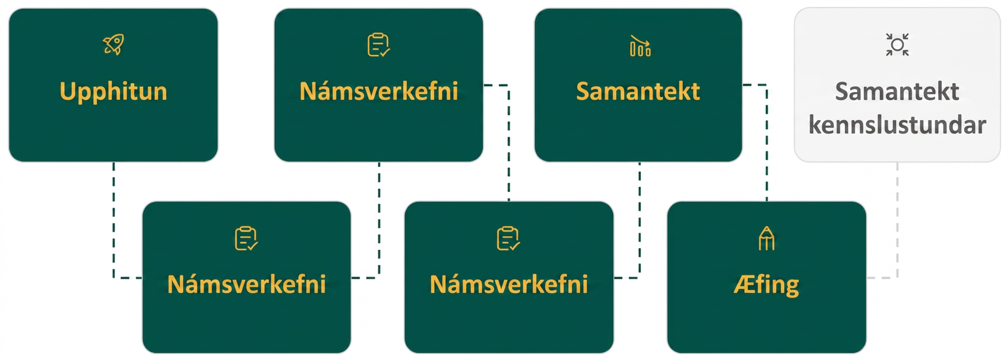
Lesson Journey
Sixth Stop: Practice

Slide 26

Practice
Put your hard work to action, practice what you’ve learned!
Notes:
Digital Practice: Access the practice pages at https://openstax.org/details/books/algebra-1

Slide 27
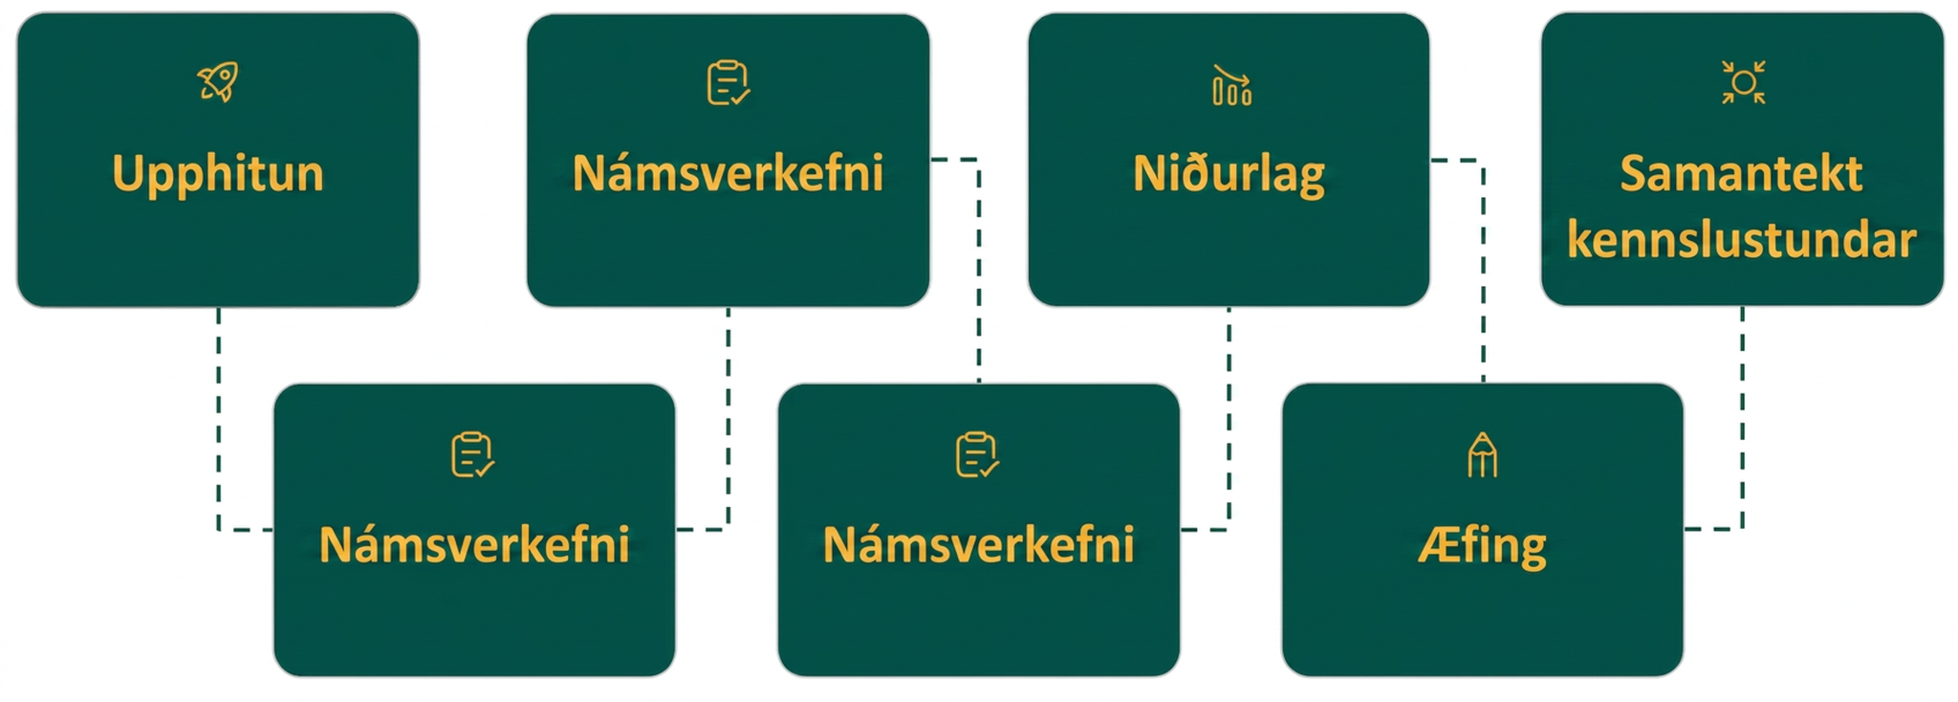
Lesson Journey
Seventh Stop: Lesson Synthesis

Slide 28
Lesson Synthesis
Use the factored form of the equation to solve:
2x² + 29x + 30 = 0
Is this easy or hard? Why?
Notes:
Emphasize the point that rewriting quadratic expressions in factored form is not always an efficient or effective way to find solutions to quadratic equations. Use a generalization or more specific examples.
Highlight that for some quadratic expressions, the right pairs of factors might be easily spotted, but for others, the process of guessing and checking can get pretty cumbersome, especially if 𝑎 and 𝑐 (from 𝑎𝑥² + 𝑏𝑥 + 𝑐) have many pairs of factors.
There is also no guarantee that we will find a combination that works because some expressions do not have rational solutions (so we cannot find factors with rational numbers). This means that if we rely on putting an expression in factored form to solve an equation, we may get stuck. If we rely on graphing, the solutions may not be exact. We need another way!
Tell students that in upcoming lessons we will look at other techniques that allow us to solve without rewriting expressions in factored form.

Slide 29
Self Assessment
How much do you agree with the following statements?
Learning Goals | I can | Almost | Not yet
Use the factored form of a quadratic expression or a graph of a quadratic function to answer questions about a situation. | ⃞ | ⃞ | ⃞
Write equivalent expressions in factored form when given quadratic expressions of the form 𝑎𝑥² + 𝑏𝑥 + 𝑐, and 𝑎 is not 1. | ⃞ | ⃞ | ⃞

