Slide 1


Algebra 1
Unit 4 Functions
Lesson 4.2 Function Notation

Slide 2
How to use these slides
On the activity slides check the speaker notes for teacher support and instructional information.
Each lesson includes 1 warm up, 2-3 learning activities, a cool down, practice and a lesson synthesis.
  Learning activities are followed by a self check question, and review section.
Some slides have been hidden from student view, more information can be found on the next slide (Reference Key).
You can edit and use these slides for personal and classroom use, but cannot sell them and must keep the attribution logos.
For more information, Check out the digital quick start guide!

Slide 3






Reference Key
Check the top right corner for an icon referencing these unique sections.
 | Support for Students with Disability | Hidden | Learning Strategies slide, provides additional support to students for understanding the activity. Learning Strategies slide, provides additional support to students for understanding the activity.
 | Support for English Language Learners | Hidden
 | Extending Your Thinking | Hidden | Extending Your Thinking slide, provides an extra challenge for students.
 | Self Check | Not Hidden | Self Check slide, checkpoint to assess student understanding after the learning activity.
 | Review | Hidden | Self Check- Review slide, designed to help review topics from the self check question.
On the next slides, check the speaker notes for teacher instructions and support.
Notes:
Check the Speaker Notes: On the next slides you can find discussion questions, lesson information, answers to the activities, and ways to adjust the activity for your students!

Slide 4

Learning Goals
By the end of this lesson you will be able to -
Use function notation to express functions that have specific inputs and outputs.
Explain what function notation is and why it exists.
Explain a statement written in function notation in terms of a situation.
Notes:
Lesson Narrative
This lesson introduces function notation as a concise, precise way to describe functions and their input-output pairs. Students explore situations where using function notation helps avoid wordiness and confusion.
They learn how to name functions and express inputs and outputs using notation. Students interpret function notation in context, represent simple function statements, and practice reasoning and communicating with precision.
Required Preparation
None
Required Materials
None
Texas Essential Knowledge and Skills
A1(A) apply mathematics to problems arising in everyday life, society, and the workplace
A1(E) create and use representations to organize, record, and communicate mathematical ideas
A12(A) decide whether relations represented verbally, tabularly, graphically, and symbolically define a function;
A12(B) evaluate functions, expressed in function notation, given one or more elements in their domains

Slide 5
Vocabulary
Previous
None
New
Relation
  A relation is any set of ordered pairs, (𝑥,𝑦).
Function
  A relation that takes inputs from one set and assigns them to outputs from another set, assigning exactly one output to each input.
Notes:
Lesson Vocabulary
To support student understanding of key vocabulary:
Introduce and review the vocabulary words students will see in this lesson.
Encourage students to notice how these words are used and to include them in their math discussions and explanations—both written and oral.
Use a word wall to reinforce vocabulary. Sample word wall cards are available here.
For newcomers or students with beginning English proficiency, use these Quizlet sets to support vocabulary learning:
Unit 4 Spanish Vocabulary, part 1 – use first to build understanding
Unit 4 Vocabulary (English), part 1 – use after anchoring in Spanish
Unit 4 Spanish Vocabulary, part 2 – use first to build understanding
Unit 4 Vocabulary (English), part 2 – use after anchoring in Spanish
Support for English Language Learners
ELPS 2(F) listen to and derive meaning from a variety of media such as audiotape, video, DVD, and CD-ROM to build and reinforce concept and language attainment
ELPS 3(G) express opinions, ideas, and feelings ranging from communicating single words and short phrases to participating in extended discussions on a variety of social and grade-appropriate academic topics
ELPS 4(F) use visual and contextual support and support from peers and teachers to read grade-appropriate content area text, enhance and confirm understanding, and develop vocabulary, grasp of language structures, and background knowledge needed to comprehend increasingly challenging language

Slide 6





Lesson Journey
Warm Up
Learning Activity
Practice
Learning Activity
Cool Down
Lesson Synthesis

Slide 7
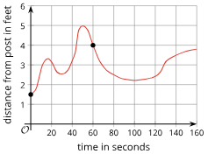
Warm Up - Interpreting Graphs: Day 1 📈
This graph shows how a dog’s distance from a post, in feet, changed over time, in seconds, after the owner left on Day 1.
Use the Day 1 graph to answer the questions.
How far away was the dog from the post…
  …60 seconds after the owner left?
  …when the owner left?
  …160 seconds after the owner left?
How many seconds passed before the dog reached the farthest point it could reach from the post?
Day 1
Notes:
Warm Up (10 minutes)
The goal of this warm up is to motivate the need for a notation that can be used to communicate about functions.
Students analyze three graphs, interpret points, and answer related questions, highlighting the need for clear, precise function descriptions to avoid ambiguity.
Ask students whether the statement,
“The dog was 2 feet from the post after 80 seconds,” is true for all three days or just one.
Then, ask whether the question,
“What was the farthest distance the dog reached from the post?” applies to all three days or just one.
While both the statement and question can be asked for any day, the answers vary depending on the dog’s movement.
The dog was 2 feet away at 80 seconds only on Day 3.
On all three days, the dog reached a farthest distance of 5 feet, but at different times
around 50 seconds on Day 1
35 seconds on Day 2
3 seconds on Day 3.
Launch
Arrange students in groups of 2 to discuss and answer questions.
Activity Answers
4 feet
1.5 feet
3.7 feet
about 50 seconds
Activity questions and answers for Day 2 on the next slide.

Slide 8
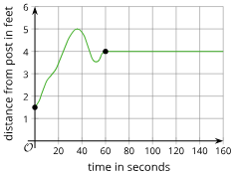
Warm Up - Interpreting Graphs: Day 2 📈
This graph shows how a dog’s distance from a post, in feet, changed over time, in seconds, after the owner left on Day 2.
Use the Day 2 graph to answer the questions.
Consider the statement, “The dog was 2 feet away from the post after 80 seconds.” Do you agree with the statement?
How far away was the dog from the post when the owner left?
The owner returned 160 seconds after he left. How far away was the dog from the post at that time?
How many seconds passed before the dog reached the farthest point it could reach from the post?
Day 2
Notes:
Activity Answers
No, this statement is incorrect. After 80 seconds, the dog is 4 feet away from the post.
1.5 feet
4 feet
about 34 seconds
Activity questions and answers for Day 3 on the next slide, and activity synthesis.

Slide 9
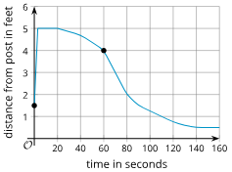
Warm Up - Interpreting Graphs: Day 3 📈
This graph shows how a dog’s distance from a post, in feet, changed over time, in seconds, after the owner left on Day 3.
Use the Day 3 graph to answer the questions.
How far away was the dog from the post…
  …60 seconds after the owner left?
  …when the owner left?
  …160 seconds after the owner left?
How many seconds passed before the dog reached the farthest point it could reach from the post?
Consider the statement, “The dog was 2 feet away from the post after 80 seconds.” Do you agree with the statement?
Day 3
Notes:
Activity Answers
4 feet
1.5 feet
0.5 foot
about 3 seconds
The statement is true.
Activity Synthesis
Invite students to share their response to the first set of questions.
To demonstrate how tedious to refer to a specific part of a function fully and precisely, ask the full question for each day (e.g., “How far was the dog from the post 60 seconds after the owner left on Day 1? Day 2?”). If students respond with just a number like “1.5 feet,” prompt them to explain what it refers to.
Remind students of where the dog was after 80 seconds and when it was farthest from the post, noting that answers vary by day. If the day (or function) isn’t specified, the question becomes unclear.
Explain how important that being precise when talking about functions is and often takes many words. Let students know they’ll learn a clearer, more concise way to do this.

Slide 10

Lesson Journey
Warm Up
Learning Activity
Practice
Learning Activity
Cool Down
Lesson Synthesis

Slide 11
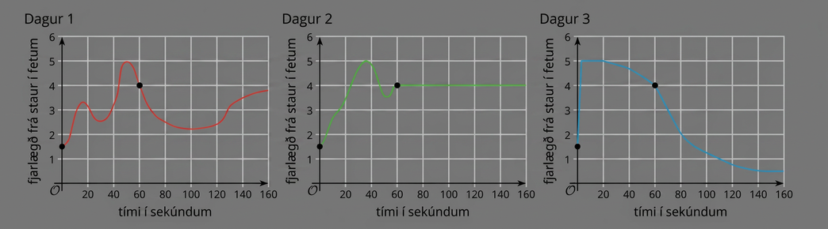
Learning Activity - Using Function Notation🔣
Let’s name the functions that relate the dog’s distance from the post and the time since its owner left: function f for Day 1, function g for Day 2, function h for Day 3. The input of each function is time in seconds, t.
Use the graphs to complete the table on the next slide.
Notes:
Activity (15 minutes)
In this activity, students learn that function notation can be used as a handy shorthand for communicating about functions and specific parts or features of a function. They interpret statements that are written in this notation and use the notation to refer to points on a graph or to represent simple verbal statements about a function.
Launch
Explain to students that one way to talk about functions precisely and without wordy descriptions is by naming the functions and using function notation.
Suppose we give a name to each function that relates the dog’s distance from the post and the time since the dog owner left:
function f for Day 1
function g for Day 2
function h for Day 3
The input of each function is time in seconds, t.
To represent “the distance of the dog from the post 60 seconds after the owner left,”
we can simply write: f(60).
To express the same quantity for the second and third day, we can write g(60) and h(60).
Ask students to refer to the three graphs from the warm up to answer the questions.
Activity image answer, and synthesis on the next slide.

Slide 12
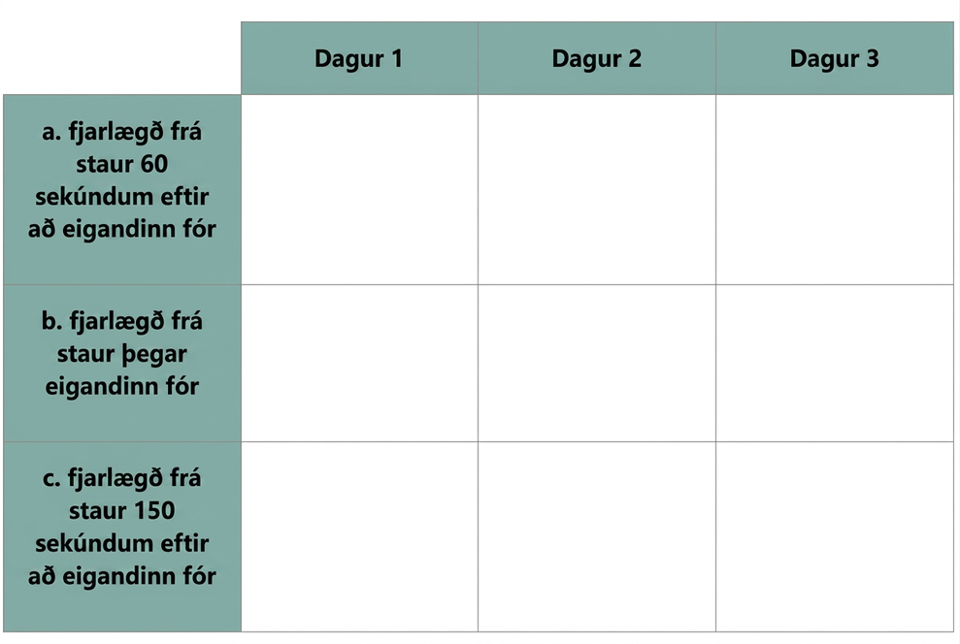
Learning Activity - Using Function Notation🔣
Use function notation to complete the table.
What do the expressions represent?
  f(15)
  g(48)
  h(t)
The equation g(120) = 4 can be interpreted to mean: “On Day 2, 120 seconds after the dog owner left, the dog was 4 feet from the post.” What do the equations represent?
  h(40) = 4.6
  f(t) = 5
  g(t)=d
1a.
2a.
3a.
1b.
2b.
3b.
1c.
2c.
3c.
Notes:
Activity Answer
Compare your work: Your answer may vary, but here is a sample for each day.
Use function notation to represent the dog's distance from the post 60 seconds after the owner left.
f(60)
g(60)
h(60)
Use function notation to represent the dog's distance from the post when the owner left.
f(0)
g(0)
h(0)
Use function notation to represent the dog's distance from the post 150 seconds after the owner left.
f(150)
g(150)
h(150)
Describe what each expression represents in this context:
f(15) is the distance from the post 15 seconds after the owner left on Day 1.
g(48) is the distance from the post 48 seconds after the owner left on Day 2.
h(t) is the distance from the post t seconds after the owner left on Day 3.
The equation g(120) = 4 can be interpreted to mean: “On Day 2, 120 seconds after the dog owner left, the dog was 4 feet from the post.” What does each equation mean in this situation?
On the third day, 40 seconds after the owner left, the dog was 4.6 feet away from the post.
On the first day, t seconds after the owner left, the dog was 5 feet away from the post.
On the second day, t seconds after the owner left, the dog was d feet away from the post.

Slide 13
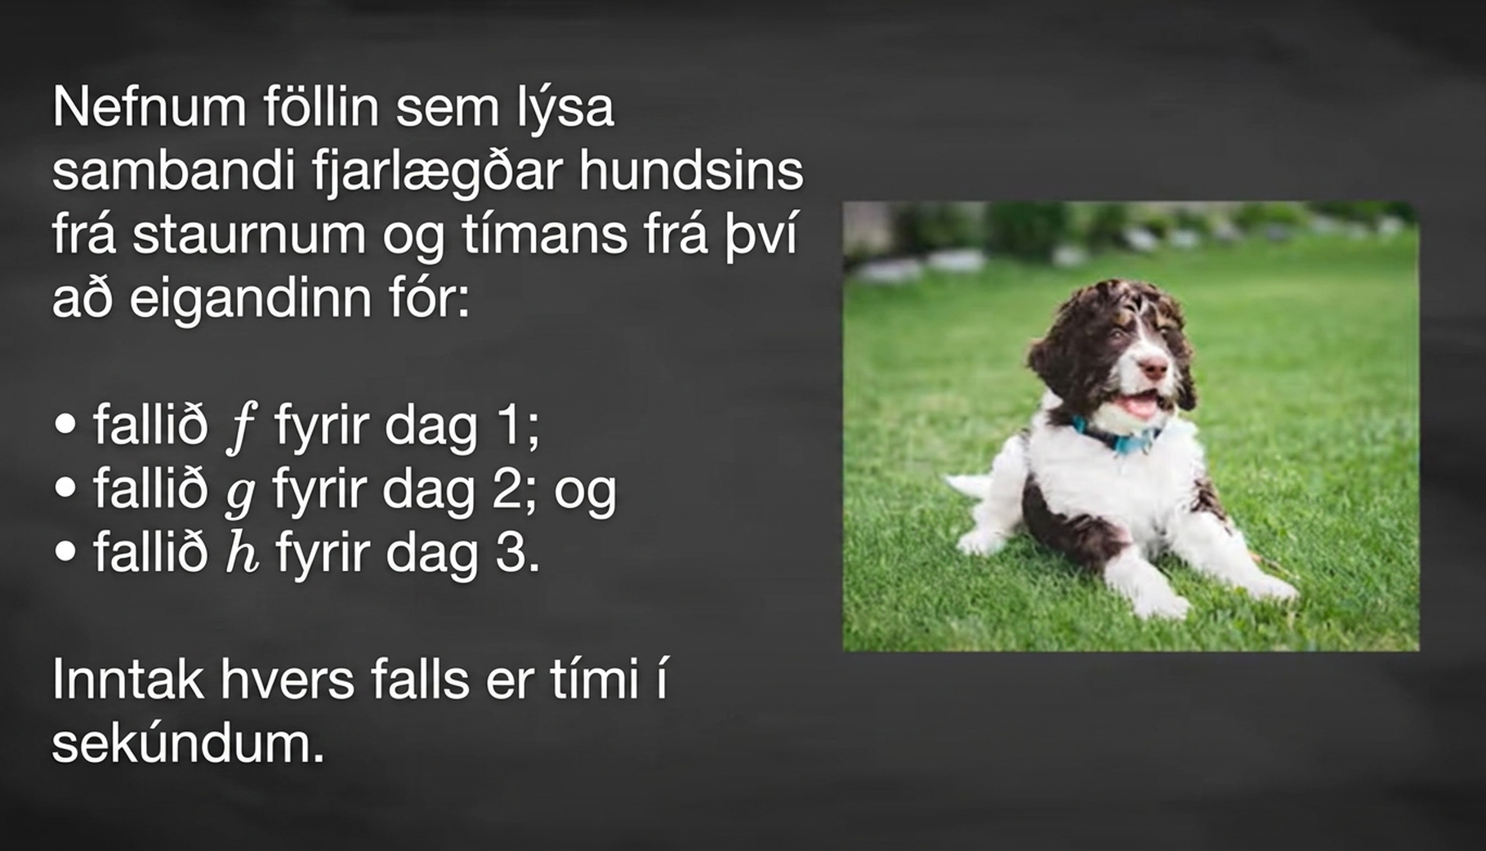
Video: Interpreting Function Notation

Slide 14

Self Check
A function f(y) = N gives the number of police officers, N, in a town in year y. What does f(2005) = 300 represent?
After 2005 years, there were 300 police officers..
At year 300, there were 2005 police officers..
In the year 2005, there were 300 police officers.
In the year 2005, there were 300 more police officers than in 2004.
Let’s review!
Notes:
Answer Feedback - Individualized by Response
After 2005 years, there were 300 police officers.
Incorrect. 2005 is the year, not the number of years. The answer is: In the year 2005, there were 300 police officers.
At year 300, there were 2005 police officers.
Incorrect. 300 is the output, not the input. The answer is: In the year 2005, there were 300 police officers.
In the year 2005, there were 300 police officers.
That’s correct!: The input into the function, f, is 2005, and the output is 300.
In the year 2005, there were 300 more police officers than in 2004.
Incorrect. The output is the number of police officers in the year 2005, not the increase in the number of officers. The answer is: In the year 2005, there were 300 police officers.

Slide 15
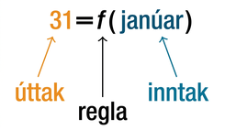
Self Check - Review
Using Function Notation for Days in a Month
Use function notation to represent a function whose input is the name of a month and output is the number of days in that month (don’t include leap years).
For example, f(March) = 31, because March has 31 days. The notation d=f(m) reminds us that the number of days, d (the output), is dependent on the name of the month, m (the input).
The function 31 equals f of January is where 31 is the output, f is the rule, and January is the input.
Notes:
Understanding Function Notation
Using Function Notation
Once we determine that a relationship is a function, we need to display and define the functional relationships so that we can understand and use them, and sometimes also so that we can program them into computers. There are various ways of representing functions. A standard function notation is one representation that facilitates working with functions.
To represent “height is a function of age,” we start by identifying the descriptive variables: h for height and a for age.The letters f, g, and h are often used to represent functions, just as we use x, y, and z to represent numbers and A, B, and C to represent sets.
h is f of a: We name the function f; height is a function of age.
h = f(a): We use parentheses to indicate the function input.
f(a): We name the function f; the expression is read as “f of a.”
Remember, we can use any letter to name the function; the notation h(a) shows us that h depends on a. The value a must be put into the function h to get a result. The parentheses indicate that age is input into the function; they do not indicate multiplication.
We can also give an algebraic expression as the input to a function. For example, f(a+b) means “first add a and b, and the result is the input for the function f.” The operations must be performed in this order to obtain the correct result.
Function Notation
The notation y = f(x) defines a function named f. This is read as “y is a function of x.” The letter x represents the input value, or independent variable. The letter I, or f(x), represents the output value, or dependent variable.
Analysis
Note that the inputs to a function do not have to be numbers; function inputs can be names of people, labels of geometric objects, or any other element that determines some kind of output. However, most of the functions we will work with in this course will have numbers as inputs and outputs.

Slide 16
Lesson Journey
Warm Up
Learning Activity
Practice
Learning Activity
Cool Down
Lesson Synthesis

Slide 17
Learning Activity - Input and Output 🎓
Rule G takes a person's name as its input and gives their high school graduation date as the output.
Rule P takes a high school graduation date and gives a person with that graduation date as the output.
Input | Output
Taylor Swift | 2008
Zendaya | 2015
Storm Reid | 2020
Johnny Orlando | 2021
Input | Output
2020 | Lil Tecca
2021 | Olivia Rodrigo
2022 | Forrest Wheeler
2023 | Miles Brown
Complete the tables with three more examples of input-output pairs.
Notes:
Support for All Learners
This activity offers additional support and an extension for students:
For English language learners and students with disabilities, be sure to review the Learning Strategies slide!
Activity (10 minutes)
This activity reinforces students’ understanding about what makes a relationship between two variables a function, namely, that it gives a unique output for each input. It also prompts students to use function notation to express a functional relationship that does not involve numerical values for its input and output.
Answers
Your answer may vary, but here are some samples.
Input: Skai Jackson; Output: 2020
Input: Keke Palmer; Output: 2010
Input: Jeremy Pena; Output: 2015
Input: Mike Trout; Output: 2009
Input: Bryce Young; Output: 2020
Input: Patrick Mahomes; Output: 2014
Your answer may vary, but here are some samples.
Input: 2012; Output: Ariana Grande
Input: 2012; Output: Drake
Input: 2020; Output: Will Anderson, Jr.
Input: 2019; Output: Kenyon Green
Input: 2015; Output: Marisa Viggiano
Input: 2018; Output: Naomi Girma
Input: 2011; Output: Lynn Williams
Input: 2018; Output: Sophia Smith
More activity questions, answers, anticipated misconceptions, and synthesis on the next slide.

Slide 18

Learning Activity - Input and Output 🎓
Use the rules from the Input/Output tables to answer the questions.
If you input your name into G, how many outputs are possible?
If you input your graduation date into P, how many outputs are possible?
Only one of the relationships, G or P, is a function. Which one is it?
How do you know the relationship you chose is a function?
For the relationship that is a function, write two input-output pairs from the table using function notation.
Are you ready for more?
Notes:
Answers
Your answers may vary, but here are some samples.
Your answer may vary, but here is a sample. One possible output. I can only graduate from high school once.
Many possible outputs. There are other people who will share the same graduation date as mine - especially my classmates who graduate with me.
Rule G is a function and Rule P is not.
G only assigns one output to the input value.
G(TaylorSwift) = 2008; G(StormReid) = 2020
G(Zendaya) = 2015; G(JonnyOrlando) = 2021
Anticipated Misconceptions
If a student wonders what happens to a person born on February 29, tell them that the output of the function is the original birth date, not the annual birthday.
Activity Synthesis
Discuss with students:
“Why is G a function, but P isn’t?” (Each input for G has a unique output, while inputs for P may have several outputs. For example, 2020 is the high school graduation date for Storm Reid, Finn Wolfhard, Skai Jackson, Lil Tecca, and Bryce Young. 2012 is the high school graduation date of both Drake and Ariana Grande.)
“Would it be acceptable to express relationship P using function notation, for instance: P(2021) = Olivia Rodrigo? Why or why not?” (No, because this notation is reserved for functions.)
Some students might wonder if G is still a function if multiple people have the same name. For instance, there might be a few people named Sophia Smith, and if we enter “Sophia Smith” as the input for G, we would likely get different birthdays for the output.
Acknowledge that this is true, and that G would only be a function if it assumes that no two people have the same full name, or if another identifier could be used to distinguish people with the same first name and last name (for instance, if a middle name or initial is also used, or if a number is added to each Sophia Smith to distinguish them from one another).

Slide 19
Learning Strategies - Input and Output 🎓
Teacher Instruction: Use these strategies to adjust the activity to support English language learners and students with disabilities.
You can copy and paste the callouts directly on top of the activity or give the instructions aloud.
Amplify the words “unique,” “input,” and “output.”
Write the students’ words on a visual display and update it throughout the remainder of the lesson.
Remind students to borrow language from the display as needed.
Conversing
Notes:
Support for English Language Learners: MLR 2 Collect and Display: Conversing
Listen for and collect vocabulary, gestures, and diagrams students use to describe what makes a relationship between two variables a function. Capture student language that reflects a variety of ways to describe the characteristics of and differences between a relationship that is a function and a relationship that is not a function. Amplify the words “unique,” “input,” and “output.” Write the students’ words on a visual display and update it throughout the remainder of the lesson. Remind students to borrow language from the display as needed. This will help students read and use mathematical language during their partner and whole-group discussions.
Design Principle(s): Maximize meta-awareness; Support sense-making
Provide support for students
Distribute graphic organizers to the students to assist them with participating in this routine.

Slide 20
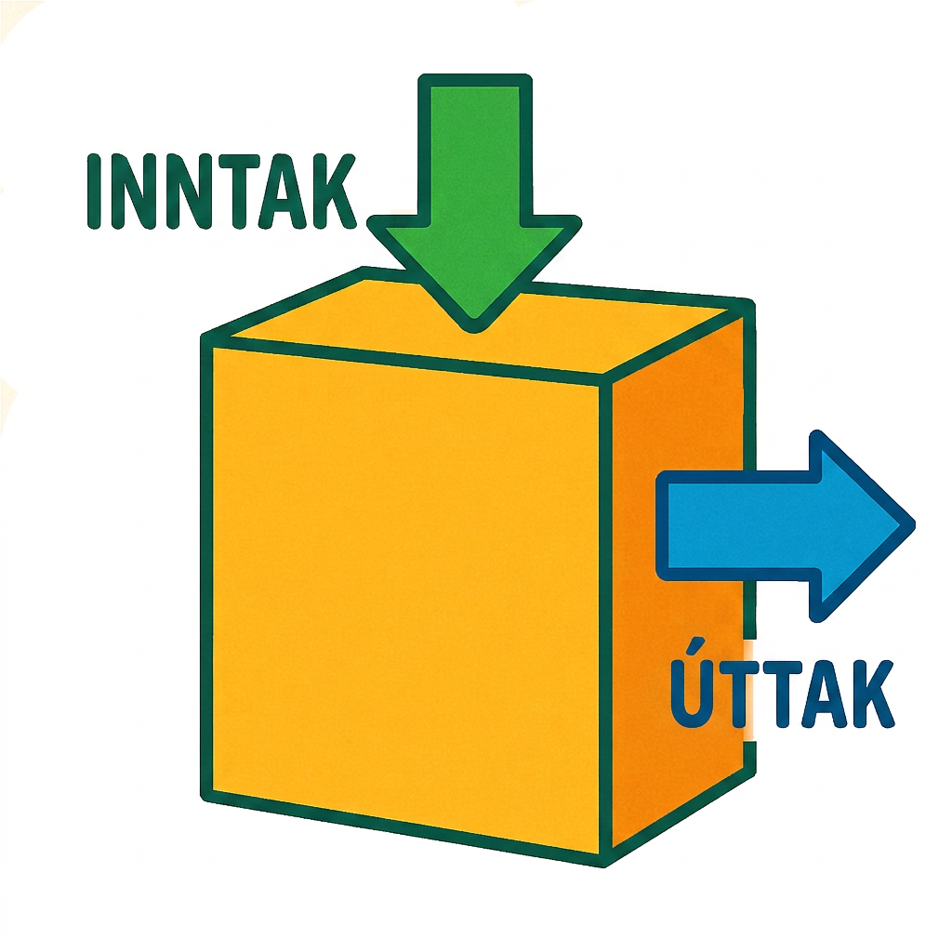
Extending Your Thinking
Write a rule that describes these input-output pairs:
F(ONE) = 3
F(TWO) = 3
F(THREE) = 5
F(FOUR) = 4
What rule could define
function F?
Here are some input-output pairs with the same inputs but different outputs:
v(ONE) = 2
v(TWO) = 1
v(THREE) = 2
v(FOUR) = 2
What rule could define function v?
Notes:
Answer
For example: Function F takes a word for its input and gives the number of letters in that word for its output.
For example: Function v takes a word for its input and gives the number of vowels in that word as its output.

Slide 21

Self Check
The price for pizzas, in dollars, is a function of the number of pizzas bought, n.
Identify the input, output, and meaning of the statement: p(11) = 55
Input: 55, Output: 11, 11 pizzas cost $55
Input: 11, Output: 55, 11 pizzas cost $55
Input: 55, Output: 11, 55 pizzas cost $11
Input: 11, Output: 55, 55 pizzas cost $11
Let’s review!
Notes:
Answer Feedback - Individualized by Response
Incorrect. The meaning is correct, but the input and output are not correct. The input is the number of pizzas. The answer is: Input: 11, Output: 55, 11 pizzas cost $55.
That’s correct! The price depends on the number of pizzas bought.
Incorrect. The input and output are switched, and the meaning statement is also switched. The input is the number of pizzas. The answer is: Input: 11, Output: 55, 11 pizzas cost $55.
Incorrect. The input and output are correct, but the meaning statement is not correct. The answer is: Input: 11, Output: 55, 11 pizzas cost $55.

Slide 22

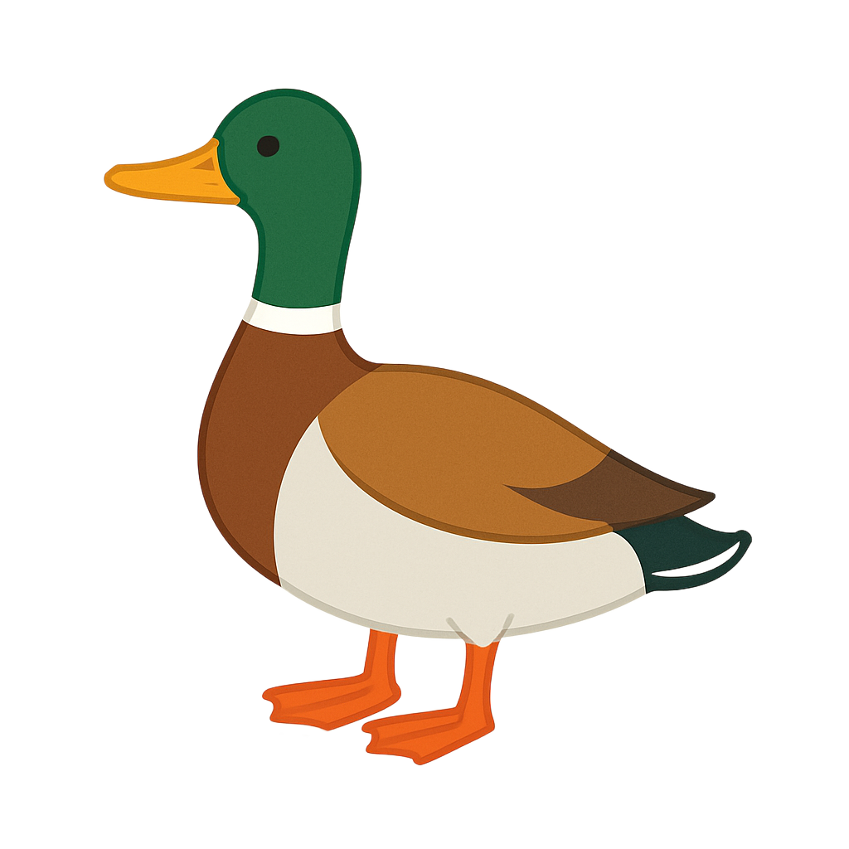
Self Check - Review
Example 1
The number of cubic yards of
dirt, D, needed to cover a
garden with an area of a square
feet is given by D = g(a).
A garden with area 5000 ft² requires 50 yd³ of dirt. Express this information in terms of the function g.
Explain the meaning of the statement g(100) = 1.
Example 2
Let f(t) be the number of ducks in a lake t years after 1990. Explain the meaning of each statement:
f(5) = 30
f(10)=40
Notes:
Meanings in Functions
Discuss the Answers with the Students:
Example 1:
g(5000) = 50
The number of cubic yards of dirt required for a garden of 100 square feet is 1.
Example 2:
In 1995 (5 years after 1990), there were 30 ducks in the lake.
In 2000 (10 years after 1990), there were 40 ducks in the lake.

Slide 23

Lesson Journey
Warm Up
Learning Activity
Practice
Learning Activity
Cool Down
Lesson Synthesis

Slide 24

Cool Down
Function Q gives a puppy’s weight, in pounds, as a function of its age, in months.
What does each expression or equation represent in this situation?
  Q(18)
  Q(30) = 27.5
Use function notation to represent each statement.
  When the puppy turned 12 months old, it weighed 19.6 pounds.
  When the puppy was m months old, it weighed w pounds.
Notes:
Cool Down (5 minutes)
Answers
What does each expression or equation represent in this situation?
The weight of the puppy when it was 18 months old.
When the puppy was 30 months old, it weighed 27.5 pounds.
Use function notation to represent each statement.
Q(12) =19.6
Q(m) = w
Response to Student Thinking - More Chances
Students will have more opportunities to understand the mathematical ideas in this cool-down, so there is no need to slow down or add additional work to the next lessons. Instead, use the results of this cool-down to provide guidance for what to look for and emphasize over the next several lessons to support students in advancing their current understanding.

Slide 25

Lesson Journey
Warm Up
Learning Activity
Practice
Learning Activity
Cool Down
Lesson Synthesis

Slide 26

Practice
Put your hard work to action, practice what you’ve learned!
Notes:
Digital Practice: Access the practice pages at https://openstax.org/details/books/algebra-1

Slide 27

Lesson Journey
Warm Up
Learning Activity
Practice
Learning Activity
Cool Down
Lesson Synthesis

Slide 28
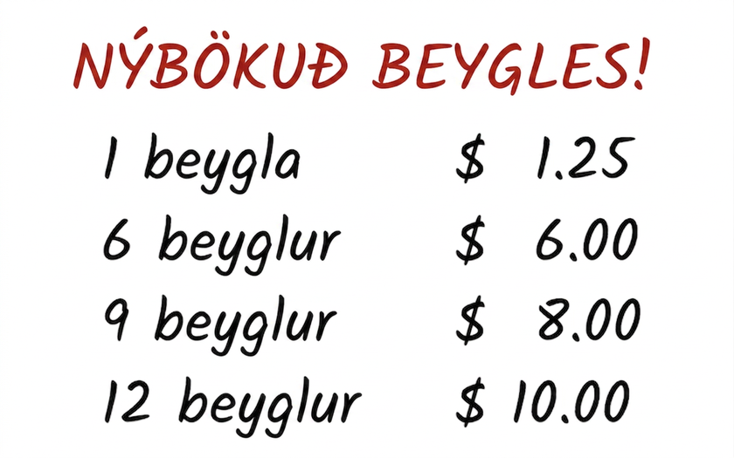
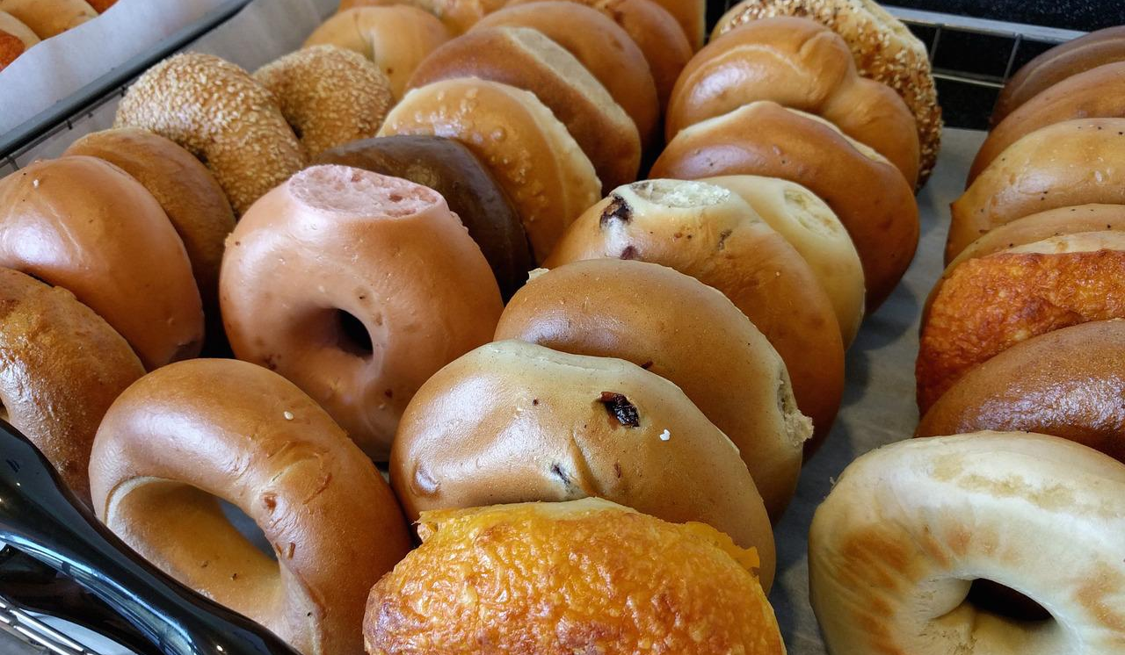
Lesson Synthesis
The best price for bagels, in dollars, is a function of the number of bagels bought, n.
b(2)
b(6)
b(11) = 10.50
b(13)=11.25
For each statement:
Read the statement aloud.
What is the input, output, and function?
What is the meaning of the of entire statement?
Notes:
Prompt: Refer back to the bagel shop activity from the opening lesson. Invite students to consider some statements about the function they saw in that situation
Arrange students in groups of 2. Ask partners to take turns reading and interpreting the statements in function notation. Each person should:
Read the statement aloud to their partner.
Identify the input, the output, and the function in the statement.
Explain the meaning of the entire statement using a complete sentence.
If students say that the first two statements have no outputs, clarify that both represent outputs, even though the value of each is not stated.

Slide 29
Self Assessment
How much do you agree with the following statements?
I can… | I can | Almost | Not yet
Use function notation to express functions that have specific inputs and outputs.
Explain what function notation is and why it exists.
Explain a statement written in function notation in terms of a situation.

