Slide 1
Algebra 1
Unit 6 Working with Polynomials
Lesson 6.3 Dividing Polynomials
Notes:
NOTE: Activities 6.3.3, 6.3.4, and 6.3.5 are extensions of the TEKS expectations for the division of polynomials. While activities 6.3.3 and 6.3.4 are not included in this set of lesson slides, the full Teacher Guide for each may be accessed in the online textbook.

Slide 2

How to use these slides
On the activity slides check the speaker notes for teacher support and instructional information.
Each lesson includes 1 warm up, 2-3 learning activities, a cool down, practice and a lesson synthesis.
  Learning activities are followed by a self check question, and review section.
Some slides have been hidden from student view, more information can be found on the next slide (Reference Key).
You can edit and use these slides for personal and classroom use, but cannot sell them and must keep the attribution logos.
For more information, Check out the digital quick start guide!
OpenStax CC BY NC SA

Slide 3





Reference Key
Check the top right corner for an icon referencing these unique sections.
Icon | Title | View | Location and Description
n/a | Support for Students with Disability | Hidden | Learning Strategies slide, provides additional support to students for understanding the activity.
n/a | Support for English Language Learners | Hidden | Learning Strategies slide, provides additional support to students for understanding the activity.
n/a | Extending Your Thinking | Hidden | Extending Your Thinking slide, provides an extra challenge for students.
n/a | Self Check | Not Hidden | Self Check slide, checkpoint to assess student understanding after the learning activity.
n/a | Review | Hidden | Self Check - Review slide, designed to help review topics from the self check question.
On the next slides, check the speaker notes for teacher instructions and support.
Notes:
Check the Speaker Notes: On the next slides you can find discussion questions, lesson information, answers to the activities, and ways to adjust the activity for your students!

Slide 4

Learning Goals
By the end of this lesson you will be able to -
Divide monomials.
Divide a polynomial by a monomial.
Divide polynomials using long division.
Divide polynomial functions.
Notes:
Lesson Narrative
This lesson invites students to explore polynomial division. Using the Quotient Property for exponents, students will first learn to divide monomials by monomials, as well as larger polynomials by monomials. They will use long division to divide different polynomials by binomials.
NOTE: Activities 6.3.3, 6.3.4, and 6.3.5 are extensions of the TEKS expectations for the division of polynomials. While activities 6.3.3 and 6.3.4 are not included in this set of lesson slides, the full Teacher Guide for each may be accessed in the online textbook.
As a result, the following learning goals were not included on this slide:
Divide polynomials using synthetic division.
Use the Remainder and Factor Theorems.
Required Preparation
None
Required Materials
None
Texas Essential Knowledge and Skills
A1(F) analyze mathematical relationships to connect and communicate mathematical ideas.
A10(C) determine the quotient of a polynomial of degree one and polynomial of degree two when divided by a polynomial of degree one and polynomial of degree two when the degree of the divisor does not exceed the degree of the dividend.

Slide 5
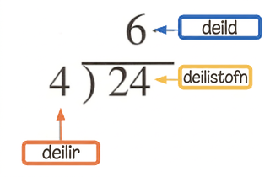
Vocabulary
Previous
Binomial
  An algebraic expression with two terms.
Trinomial
  An algebraic expression with three terms.
Factoring
  Determining the numbers or expressions that multiply to a specific product.
Dividend (in polynomials)
  The original polynomial that
  is being divided by another polynomial.
Divisor (in polynomials)
  The polynomial being divided into the original polynomial.
Quotient (in polynomials)
  The result of polynomial division.
Notes:
Lesson Vocabulary
To support student understanding of key vocabulary:
Introduce and review the vocabulary words students will see in this lesson.
Encourage students to notice how these words are used and to include them in their math discussions and explanations—both written and oral.
Use a word wall to reinforce vocabulary. Sample word wall cards are available here.
For newcomers or students with beginning English proficiency, use these Quizlet sets to support vocabulary learning:
Unit 6 Spanish Vocabulary – use first to build understanding
Unit 6 Vocabulary (English) – use after anchoring in Spanish
Support for English Language Learners
ELPS 2(F) listen to and derive meaning from a variety of media such as audiotape, video, DVD, and CD-ROM to build and reinforce concept and language attainment.
ELPS 3(D) speak using grade-level content area vocabulary in context to internalize new English words and build academic language proficiency.
ELPS 3(E) share information in cooperative learning interactions.

Slide 6
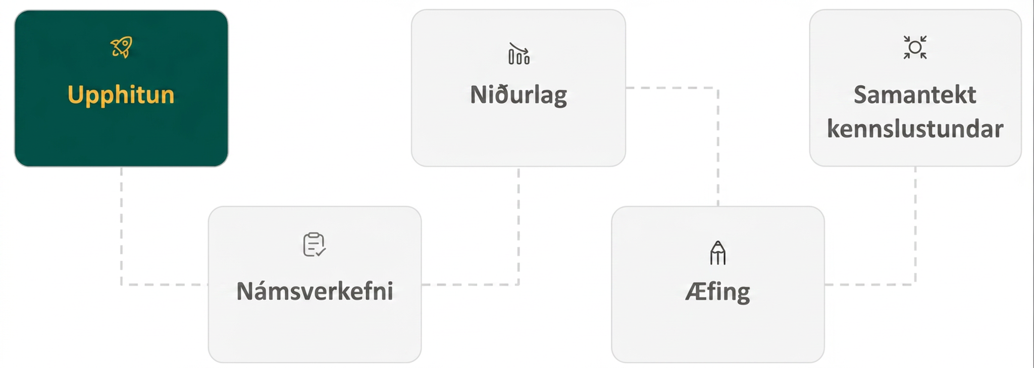
Lesson Journey
First Stop: Warm Up
Notes:
Reminder: Activities 6.3.3, 6.3.4, and 6.3.5 are extensions of the TEKS expectations for the division of polynomials. While the activities are not included in this set of lesson slides, the full Teacher Guide for each may be accessed in the online textbook.

Slide 7

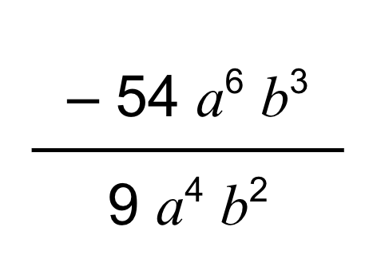
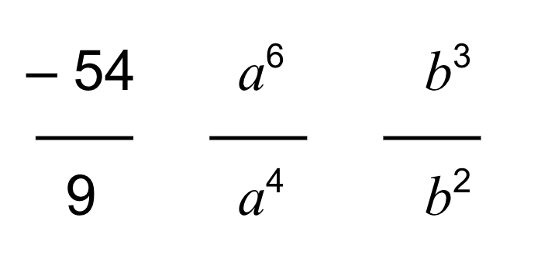
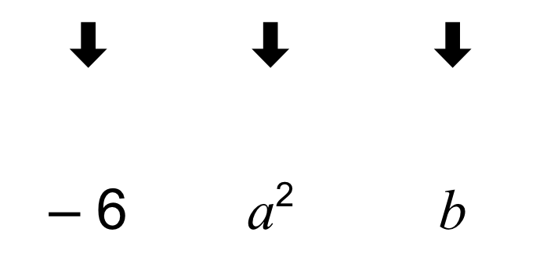
Warm Up | Part 1
Divide and Conquer! ⚔
Look at the division expression
(– 54a⁶b³ ÷ 9a⁴b²).
Rewrite the division expression as a fraction.
Rewrite the fraction as a product of several fractions where the factors in the numerator and denominator “match.”
Simplify the fraction multiplication and use the Quotient Property to divide.
Notes:
Warm Up (5 minutes)
This warm up introduces division by monomials. The first example shows a monomial divided by a monomial. The following exercises provide practice dividing binomials by monomials. Students will learn to simplify the division expressions by dividing the coefficients and using the Quotient Property for exponents on the variables.
Continue scrolling down for directions on how to launch this activity and answers to the questions.
Launch
Before the exercises, review the following vocabulary with students to avoid confusion. Link to vocabulary slide.
divisor: A divisor is a value by which another value is to be divided.
dividend: A dividend is a value to be divided by another value.
quotient: A quotient is the result of a division problem.
remainder: A remainder is the amount left over when performing division. It is expressed as a fraction with the remainder value in the numerator and the divisor in the denominator.
Review the first example of monomial division as a class, −54𝑎⁶𝑏³ ÷ 9𝑎⁴𝑏².
Ask students for answers before looking at the answer. Discuss each step of the division while monitoring for any student questions.
Allow students to work on exercises 1 – 3 individually.
Answers - Answers have been animated [fractions may be easier to visualize in the online textbook]
Fraction form: −54𝑎⁶𝑏³ / 9𝑎⁴𝑏²
−⁵⁴/₉ ⋅ 𝑎⁶ / 𝑎⁴ ⋅ 𝑏³ / 𝑏²
−⁵⁴/₉ ⋅ 𝑎⁶ / 𝑎⁴ ⋅ 𝑏³ / 𝑏² = −6 ⋅ 𝑎² ⋅ 𝑏
So −54𝑎⁶𝑏³ ÷ 9𝑎⁴𝑏² = −6𝑎²𝑏.
Additional activity questions and the synthesis are provided on the next slide.

Slide 8
Warm Up | Part 2
Divide and Conquer! ⚔
Divide each term of the polynomial by the monomial to find the quotient.
(18x³y – 36xy²) ÷ (– 3xy)
(48a²b² + 30ab) ÷ (6ab)
(– 72g⁴h⁶ – 45g⁷h³) ÷ (9g³h³)
Notes:
Activity Answers continued
Step 1 - Rewrite as a fraction: (18𝑥³𝑦 − 36𝑥𝑦²) / (−3𝑥𝑦)
Step 2 - Divide each term by the divisor: [ (18𝑥³𝑦) / (−3𝑥𝑦) ] − [ (36𝑥𝑦²) / (−3𝑥𝑦) ]
Step 3 - Simplify: − 6𝑥² + 12𝑦
8𝑎𝑏 + 5
− 8𝑔ℎ³ − 5𝑔⁴
Activity Synthesis
Invite students to share their interpretations of how to divide monomials. Emphasize the following points while considering this example: 21𝑥⁵𝑦² ÷ −3𝑥²𝑦.
Consider the coefficients and variables separately. To help ensure the division is done correctly, the expression can be written in an expanded form grouping common bases, ²¹/₇ ⋅ 𝑥⁵/𝑥³ ⋅ 𝑦²/𝑦.
Divide the coefficients. ²¹/₇ = 3
For the variables, divide using the Quotient Property for exponents.
𝑥⁵/𝑥³ = 𝑥²
𝑦²/𝑦 =𝑦
Multiply the coefficients and variables as found in the previous steps.
3 ⋅ 𝑥² ⋅ 𝑦 = 3𝑥²𝑦

Slide 9
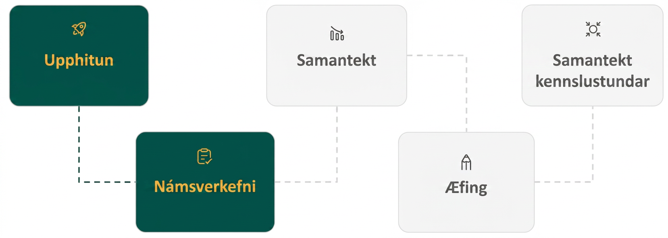
Lesson Journey
Second Stop: Learning Activity A

Slide 10

Learning Activity A | Learning Strategies
Divide and Conquer, Again 🛡
Teacher Instruction: Use these strategies to adjust the activity to support English language learners and students with disabilities.
You can copy and paste the callouts directly on top of the activity or give the instructions aloud.
Prepare to share your process for dividing with the class.
Listen and watch for words and phrases that connect ideas for you.
Identify how other students expressed the method differently from you.
Collect and Display
What tools might you use to help keep the terms lined up and organized?
Graph paper?
Notebook paper turned sideways?
Action and Expression
Notes:
Support for English Language Learners: MLR 2 Collect and Display: Conversing
As students describe the traditional division problem 960 ÷ 20 as a class, listen for and collect the language students use to describe the long division process. Write the students' words and phrases on a visual display and update it throughout the remainder of the lesson. Remind students to borrow language from the display as needed. This will help students read and use mathematical language during their partner and whole-group discussions.
Design Principle(s): Maximize meta-awareness
Provide support for student
Distribute graphic organizers to the students to assist them with participating in this routine.
Support for Students with Disabilities: Action and Expression: Organizational Problem-Solving Skills
Provide students with graph paper or use lined paper turned sideways to help keep factors lined up within the worked solution.
Supports accessibility for: Organizing; Visual-spatial processing

Slide 11
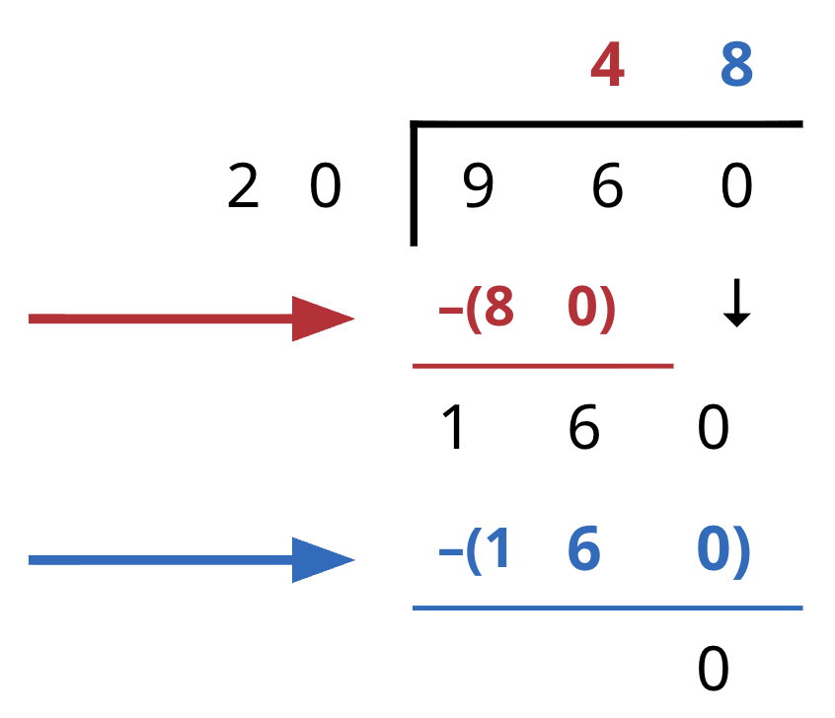
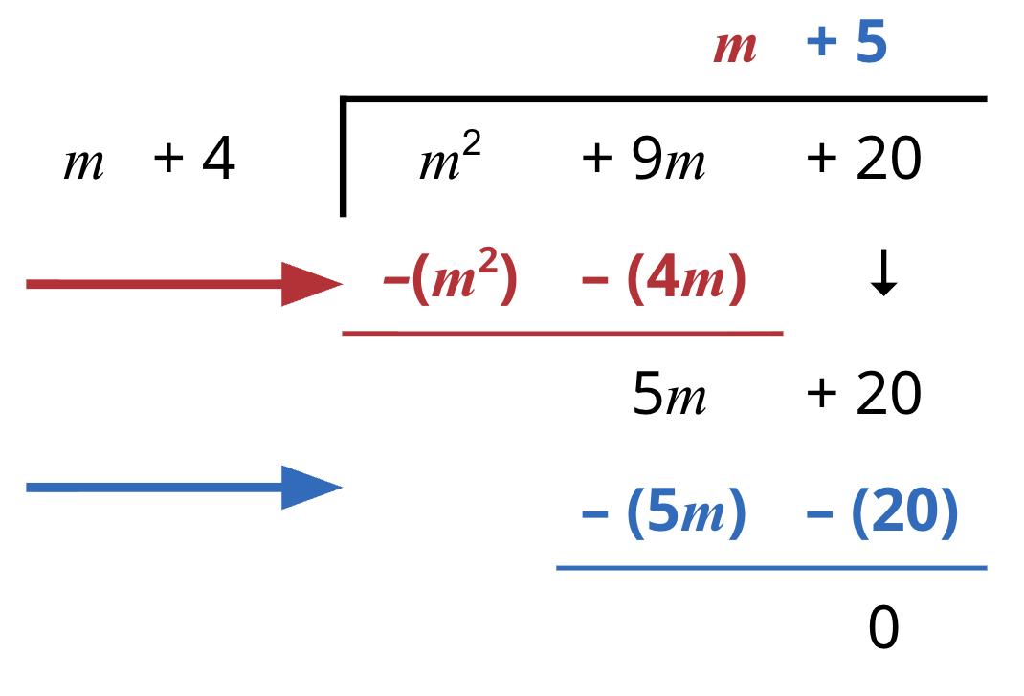
Learning Activity A | Part 1
Divide and Conquer, Again 🛡
Describe each step in the process for (960) ÷ (20).
Describe each step in the process for (m² + 9m + 20) ÷ (m + 4). video
Notes:
Support for All Learners
This activity offers additional support and an extension for students:
For English language learners and students with disabilities, be sure to review the Learning Strategies slide!
For students looking for an extra challenge, be sure to review the Extending Your Thinking slide!
Activity (20 minutes)
This activity introduces students to using the process of long division to divide polynomials. Students will learn to use placeholders, such as 0𝑥², to stand in for a missing term of each degree in a polynomial dividend.
Launch
Display the traditional division problem 960 ÷ 20 to students. As a class, work through each individual step. If more guidance is needed describing each step, see the Additional Resources section in the online textbook for the detailed description of a similar problem. Explain that we will use this process to divide polynomials.
(The second problem is animated to appear after the first question is completed with another click.) Work together to solve the division expression, (𝑚² + 9𝑚 + 20) ÷ (𝑚 + 4), provided in the activity. Ask students to describe each step in the process as they have just done it in the long division problem above. Emphasize that the divisor, 20, was one quantity in the process above, so (𝑚 + 4) will be one quantity in the process here. Help guide each step if any direction is needed. A video is also available for this problem.
Allow time for students to complete the remaining exercises individually.
Activity questions, answers, anticipated misconceptions and synthesis continue on the next slide.

Slide 12
Learning Activity A | Part 2
Divide and Conquer, Again 🛡
Find each quotient using long division.
(p² + 2p – 8) ÷ (p² – 7p + 10)
(5x + 5) ÷ (x + 5)
(x⁴ – 11x² – 7x – 6) ÷ (x + 3) HINT: Placeholders may be needed.
(125x³ – 8) ÷ (5x – 2) HINT: Placeholders may be needed.
Are you ready for more?
Notes:
Answers
1 + [(9p – 18)/ (𝑝² − 7𝑝 + 10)]
5 – [20/(𝑥 + 5)]
𝑥³ − 3𝑥² − 2𝑥 − 1 − [3/(𝑥 + 3)]
25𝑥² + 10𝑥 + 4
Anticipated Misconceptions
As students complete the polynomial long division process, students may try to break apart a binomial divisor into individual monomials. Emphasize that the divisor will always be a single quantity in this process.
Activity Synthesis
Invite students to share questions from the activity. Address any misconceptions about the process. Use the following key concepts to help reinforce the process:
Long division can be performed on polynomials using a very similar process to how it is done using number quantities.
When performing long division on polynomials, as in other long division, making sure all values are properly aligned is helpful to streamline the process and avoid errors.
When the dividend is missing terms of each degree from the highest degree down to a degree of zero, add in placeholders with a coefficient of 0.
When you find a remainder, it should be written as a fraction with the remainder in the numerator and the divisor in the denominator.
You can check your solution by multiplying it by the divisor. The product should be equal to the dividend in the original problem.

Slide 13

Learning Activity A
Extending Your Thinking
Find the quotient using long division:
125y⁵ – 80y⁴ – 31y³ + 37y² + 10y – 24) ÷ (5y – 4)
Notes:
Go back to Lesson Activity
Answer
25𝑦⁴ + 4𝑦³ − 3𝑦² + 5𝑦 + 6
Access the online textbook to see the work for this question.

Slide 14
Learning Activity A
Self Check
Find the quotient (3x³ – 19x² – 9x – 35) ÷ (x – 7).
3x² + 40x + 5
3x² + 2x + 5
3x² + 2x – 23
x² + 2x + 5
Let’s review!
Notes:
Answer Feedback - Individualized by Response
Incorrect. Check the second term in your long division. Did you make a mistake with a sign?
That’s correct! Multiply (𝑥 − 7)(3𝑥² + 2𝑥 + 5). The product is 3𝑥³ − 19𝑥² − 9𝑥 − 35.
Incorrect. Check the third term in your long division. Did you make a mistake with a sign?
Incorrect. Check the first term in your long division.

Slide 15

Learning Activity A
Self Check - Review
Find the quotient: (x² + 9x + 20) ÷ (x + 5).
Step 1 - Determine how many times “x” - from the divisor - can divide into “x²” - from the dividend. Multiply by that value, then subtract it from the dividend.
Step 2 - Bring down the next term. Now. determine how many times the divisor (“x”) can divide into this new dividend (“4x”). Multiply by the value, then subtract.
If needed, repeat the process.
Notes:
Discuss
Sometimes the division of numbers leaves a remainder. The same is true when we divide polynomials. Consider using an example that leaves a remainder (example 2 in the online textbook may be used for this illustration).
Draw attention to the dividend in the example above. The terms were written in descending order of degrees, and there were no missing degrees. Consider using an example that is missing a “degreed” term (again, example 2 in the online textbook may be used for this illustration. It is missing an 𝑥³ term. Be sure students understand how to add in 0𝑥³ as a placeholder.).

Slide 16
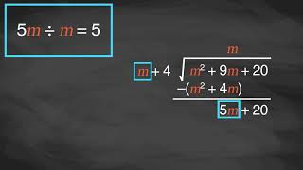
Learning Activity B | Video
Dividing Polynomials Using Long Division
Notes:
This video discusses question 1 of activity 6.3.2.

Slide 17
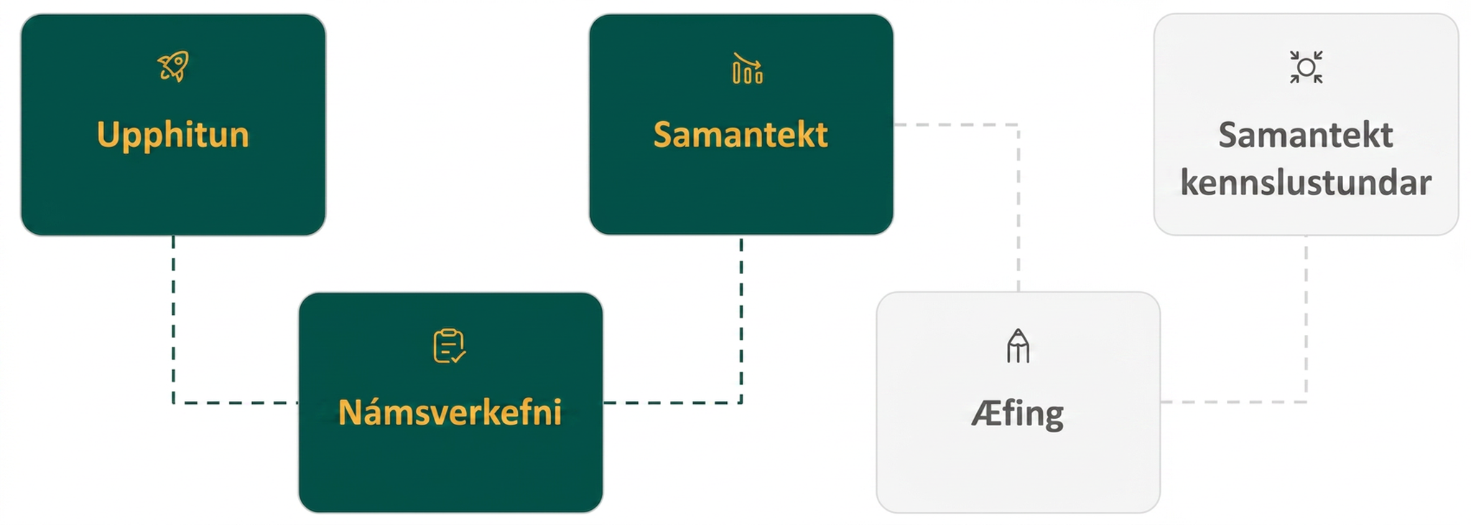
Lesson Journey
Third Step: Cool Down
Notes:
Reminder: Activities 6.3.3, 6.3.4, and 6.3.5 are extensions of the TEKS expectations for the division of polynomials. While the activities are not included in this set of lesson slides, the full Teacher Guide for each may be accessed in the online textbook.
The following Cool Down has been adjusted to align with activity 6.3.2.

Slide 18
Cool Down
Divide (3x² + 23x + 14) ÷ (x + 7).
Use long division to determine if (x + 2) is a factor of
f(x) = 2x² – 3x + 2.
Notes:
Cool Down (5 minutes)
This Cool Down has been adjusted to align with activity 6.3.2.
Answers
Quotient = 3x + 2
No, it is not a factor of the polynomial because there is a remainder of 16. This mean x + 2 does not divide evenly into the polynomial. The quotient is 2x – 7 + [16/(x + 2)]
Response to Student Thinking - Press Pause
This is the only lesson in which students will encounter long division problems with polynomials. If students continue to struggle with the topic, plan to spend extra time on it before the assessment by reviewing activities and practice problems. Since activities 6.3.3 are 6.3.4 extension activities, time should be available to allow for this pause before proceeding to the next lesson.

Slide 19
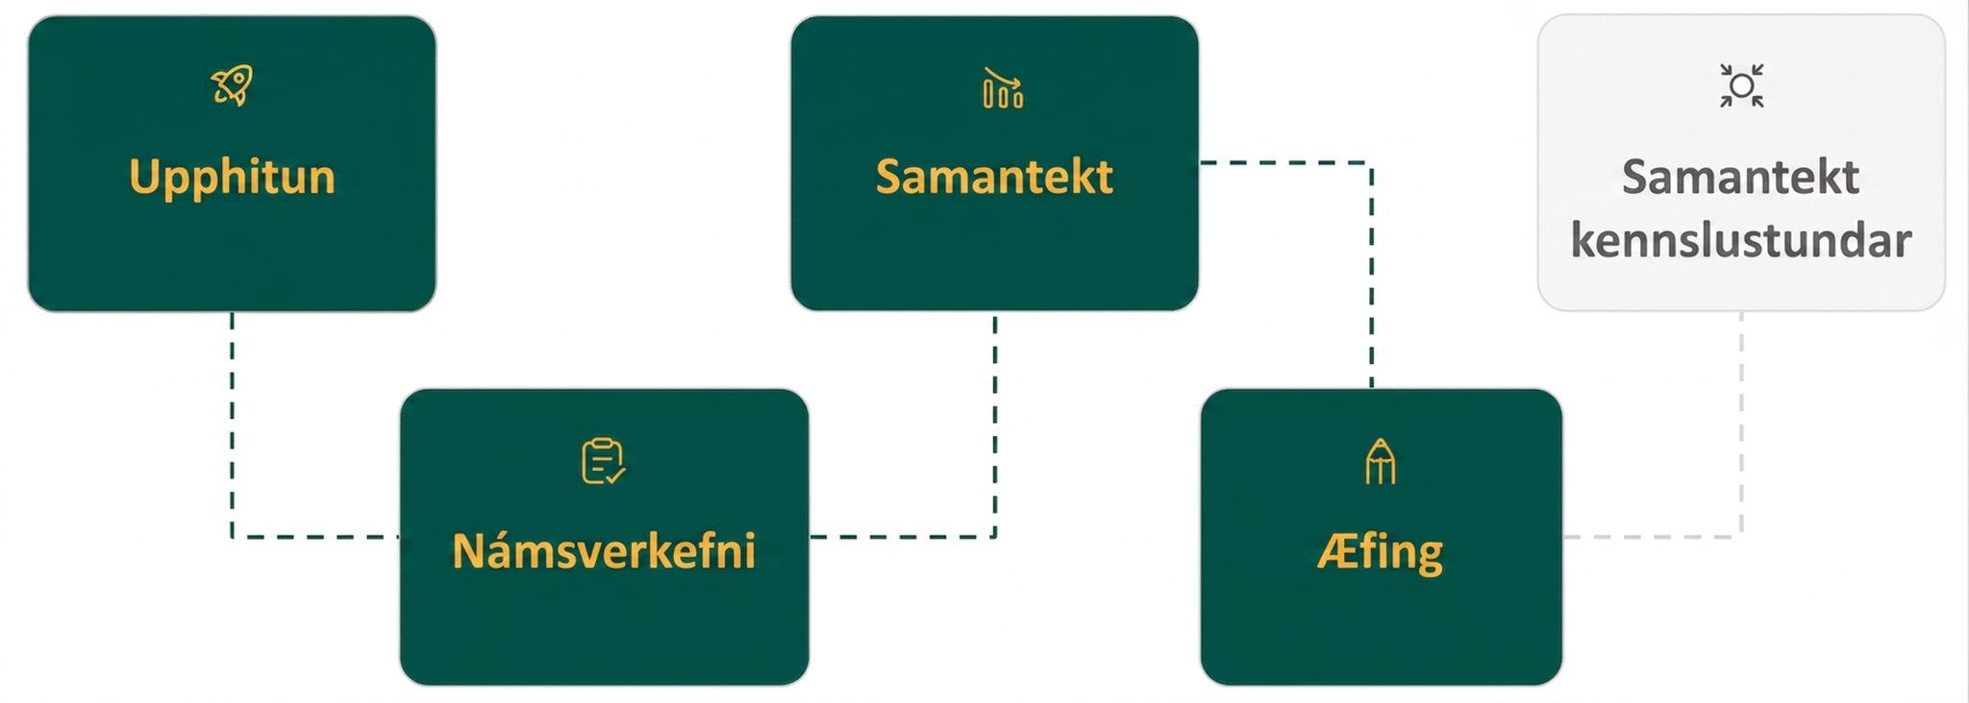
Lesson Journey
Fourth Stop: Practice

Slide 20

Practice
Put your hard work to action, practice what you’ve learned!
Notes:
Digital Practice: Access the practice pages at https://openstax.org/details/books/algebra-1

Slide 21
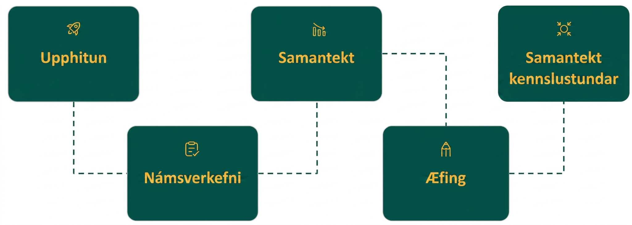
Lesson Journey
Fifth Stop: Lesson Synthesis

Slide 22
Lesson Synthesis
With a partner, complete the following stems:
Divide monomials by monomials by …
Divide a polynomial by a monomial by …
The solution to a division problem can always be checked by …
To divide a polynomial by another polynomial …
Use your academic vocabulary to be succinct.
Remember: The goal is precise & concise responses.
Notes:
To help students summarize the skills they learned dividing polynomials, emphasize the following points:
Divide monomials by monomials by dividing the coefficients and then dividing the variables using the Quotient Property for exponents.
Divide a polynomial by a monomial by distributing the division of the monomial to each term in the polynomial dividend.
The solution to your division problem can alway be checked by multiplying the solution by the divisor to see if the product matches the original dividend.
To divide a polynomial by another polynomial, use long division as you have previously learned using numbers.
An efficient method to divide a polynomial by a binomial is synthetic division.
The divisor must be in the form 𝑥 − 𝑐, where 𝑐 is a constant.
Use a placeholder with a 0 coefficient, such as 0𝑥², for any term that is missing in the dividend from the term with the highest degree down to a degree of 0.
The bottom-right number in the third row of the synthetic division is the remainder.
Polynomial functions can be divided using the same methods as with other polynomials.
Use the Remainder Theorem to easily find the value of a remainder in any polynomial division problem.
Use the Factor Theorem to determine if a divisor is a factor of a larger polynomial.

Slide 23
Self Assessment
How much do you agree with the following statements?
Learning Goals | I can | Almost | Not yet
Divide monomials. | ⃞ | ⃞ | ⃞
Divide a polynomial by a monomial. | ⃞ | ⃞ | ⃞
Divide polynomials using long division. | ⃞ | ⃞ | ⃞
Divide polynomial functions. | ⃞ | ⃞ | ⃞
Notes:
The following I can statements were left out of the list since they align with extension activities in 6.3.3, 6.3.4, and 6.3.5:
Divide polynomials using synthetic division.
Use the Remainder and Factor Theorems.

