Slide 1
Algebra 1
Unit 6 Working with Polynomials
Lesson 6.6 Factor Special Products

Slide 2

How to use these slides
On the activity slides check the speaker notes for teacher support and instructional information.
Each lesson includes 1 warm up, 2-3 learning activities, a cool down, practice and a lesson synthesis.
  Learning activities are followed by a self check question, and review section.
Some slides have been hidden from student view, more information can be found on the next slide (Reference Key).
You can edit and use these slides for personal and classroom use, but cannot sell them and must keep the attribution logos.
For more information, Check out the digital quick start guide!
OpenStax CC BY NC SA

Slide 3





Reference Key
Check the top right corner for an icon referencing these unique sections.
Icon | Title | View | Location and Description
n/a | Support for Students with Disability | Hidden | Learning Strategies slide, provides additional support to students for understanding the activity.
n/a | Support for English Language Learners | Hidden | Learning Strategies slide, provides additional support to students for understanding the activity.
n/a | Extending Your Thinking | Hidden | Extending Your Thinking slide, provides an extra challenge for students.
n/a | Self Check | Not Hidden | Self Check slide, checkpoint to assess student understanding after the learning activity.
n/a | Review | Hidden | Self Check - Review slide, designed to help review topics from the self check question.
On the next slides, check the speaker notes for teacher instructions and support.
Notes:
Check the Speaker Notes: On the next slides you can find discussion questions, lesson information, answers to the activities, and ways to adjust the activity for your students!

Slide 4

Learning Goals
By the end of this lesson you will be able to -
Factor perfect square trinomials.
Factor difference of squares.
Notes:
Lesson Narrative
This lesson focuses on factoring two different special products.
Perfect square trinomials follow the pattern 𝑎² ± 2𝑎𝑏 + 𝑏² and factor to (𝑎 + 𝑏)² or (𝑎 − 𝑏)², depending on the sign of the middle term in the trinomial.
The difference of squares is represented by the binomial 𝑎² − 𝑏² and factors to the conjugate pair (𝑎 − 𝑏)(𝑎 + 𝑏).
Recognizing the patterns of these special products will allow for the easy factoring of these particular cases.
Required Preparation
None
Required Materials
None
Texas Essential Knowledge and Skills
A1(F) analyze mathematical relationships to connect and communicate mathematical ideas.
A10(E) factor, if possible, trinomials with real factors in the form 𝑎𝑥² + 𝑏𝑥 + 𝑐, including perfect square trinomials of degree two.
A10(F) decide if a binomial can be written as the difference of two squares and, if possible, use the structure of a difference of two squares to rewrite the binomial.

Slide 5
Vocabulary
Previous
Binomial
  An algebraic expression with two terms.
Trinomial
  An algebraic expression with three terms.
Factoring
  Determining the numbers or expressions that multiply to a specific product.
New
Conjugate pair
  Two binomials of the
  form (a – b) and (a + b)
Difference of squares
  The product of a conjugate pair of binomials that has the form a² – b².
Notes:
Lesson Vocabulary
To support student understanding of key vocabulary:
Introduce and review the vocabulary words students will see in this lesson.
Encourage students to notice how these words are used and to include them in their math discussions and explanations—both written and oral.
Use a word wall to reinforce vocabulary. Sample word wall cards are available here.
For newcomers or students with beginning English proficiency, use these Quizlet sets to support vocabulary learning:
Unit 6 Spanish Vocabulary – use first to build understanding
Unit 6 Vocabulary (English) – use after anchoring in Spanish
Support for English Language Learners
ELPS 1(E) internalize new basic and academic language by using and reusing it in meaningful ways in speaking and writing activities that build concept and language attainment.
ELPS 2(F) listen to and derive meaning from a variety of media such as audiotape, video, DVD, and CD-ROM to build and reinforce concept and language attainment.
ELPS 3(E) share information in cooperative learning interactions.
ELPS 3(G) express opinions, ideas, and feelings ranging from communicating single words and short phrases to participating in extended discussions on a variety of social and grade-appropriate academic topics.
ELPS 3(H) narrate, describe, and explain with increasing specificity and detail as more English is acquired.
ELPS 3(I) adapt spoken language appropriately for formal and informal purposes.

Slide 6

Lesson Journey
First Stop: Warm Up

Slide 7

Warm Up
2ab or not 2ab … That is the question!
Identify which of the polynomials
is a perfect square trinomial.
25v² + 20v + 4
49s² + 154s + 121
25r² + 65rs + 36s²
64z² – 16z + 1 (VIDEO)
49x² + 28xy + 9y²
RECOGNIZING PERFECT SQUARE TRINOMIALS
Are the first and last terms squares?
Does the middle term fit the pattern of 2ab?
Notes:
Warm Up (5 minutes)
This warm up activity familiarizes students with recognizing the patterns of a perfect square trinomial. Students will learn to look at the first and last terms to determine if they are squares. They will also look for a middle term that fits the pattern ±2𝑎𝑏.
Launch
As a class, read the hints for recognizing perfect square trinomials.
Allow 3 – 4 minutes for students to answer the questions individually.
Pause the class to answer any questions about the trinomials in the activity.
Answer
Yes
Yes
No; 65 is not equal to 2ab ≠ (2)(5)(6)
Yes
No; 28 is not equal to 2ab ≠ (2)(7)(3)
NOTE: Question 4 has a video explanation that includes color annotations along with the use of algebra tiles to explain how to identify perfect square trinomials.
Activity Synthesis
Ask a student to identify a requirement of a perfect square trinomial:
The first and last terms must be squares.
The middle term must fit the pattern of ±2𝑎𝑏.
Tell students that in the next activity, they will learn to better recognize and factor these perfect square trinomials.

Slide 8
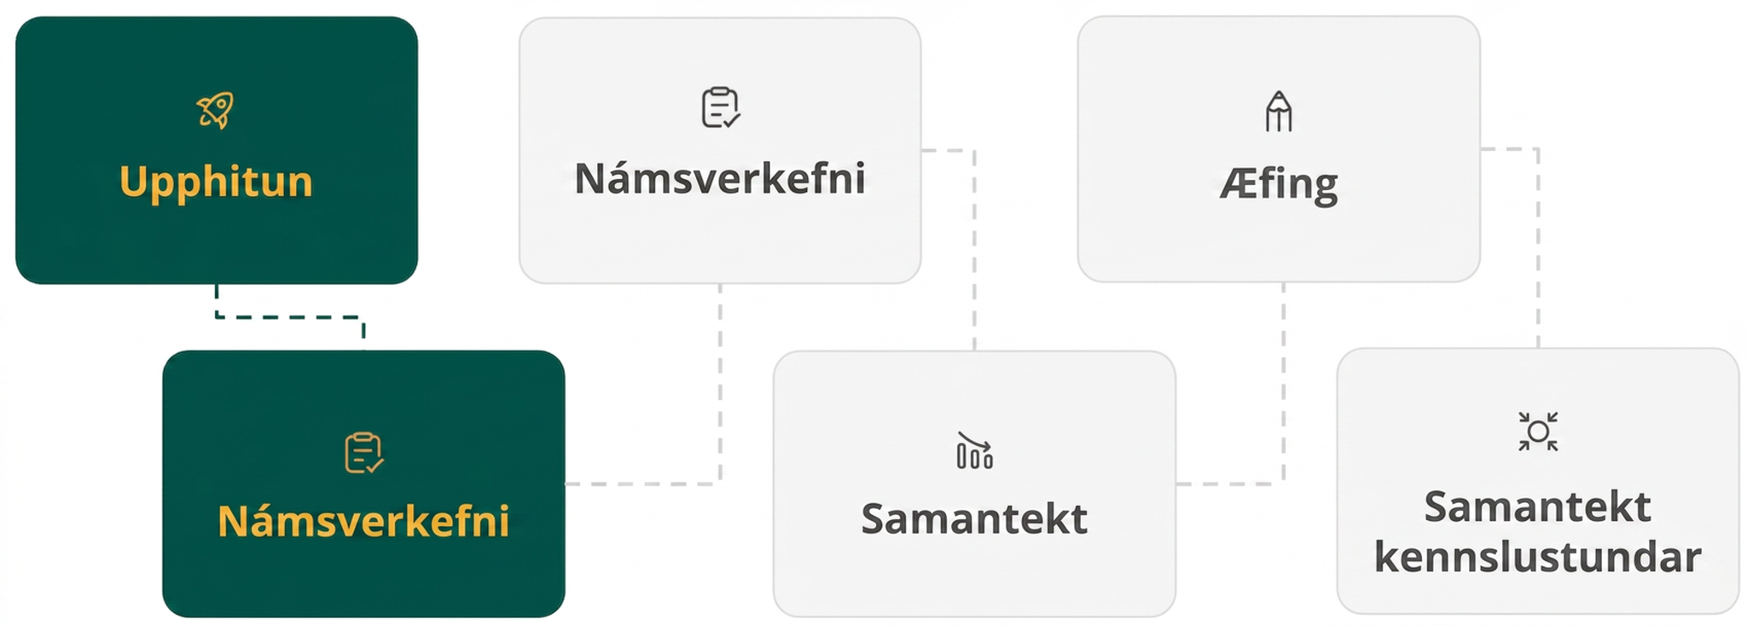
Lesson Journey
Second Stop: Learning Activity A

Slide 9

Learning Activity A | Learning Strategies
Looking for Perfection! 😇
Teacher Instruction: Use these strategies to adjust the activity to support students with disabilities.
You can copy and paste the callout directly on top of the activity or give the instructions aloud.
Access your STAAR Reference Sheet with the formulas!
Perfect square trinomials
a² + 2ab + b² = (a + b)²
a² – 2ab + b² = (a – b)²
Difference of squares
a² – b² = (a – b)(a + b)
Engagement
Notes:
Support for Students with Disabilities: Engagement: Provide Structures
Provide students with math formula support for finding the perfect square while solving practice problems and quizzes by utilizing the STAAR Algebra I Reference Materials that is linked from the Getting Started - Students Start Here - Additional Resources page. It includes these formulas:
Factoring
Perfect square trinomials 𝑎² + 2𝑎𝑏 + 𝑏² = (𝑎 + 𝑏)²
𝑎² − 2𝑎𝑏 + 𝑏² = (𝑎 − 𝑏)²
Difference of squares 𝑎² − 𝑏² = (𝑎 − 𝑏)(𝑎 + 𝑏)
Supports accessibility for Conceptual Processing, Memory

Slide 10
Learning Activity A | Part 1
Looking for Perfection 😇
How do we know if a trinomial is a perfect square trinomial?
64y² – 80y + 25
What is a?
What is b?
What is 2ab?
PERFECT SQUARE TRINOMIALS
If a and b are real numbers,
a² + 2ab + b² = (a + b)²
a² – 2ab + b² = (a – b)²
Notes:
Support for All Learners
This activity offers additional support and an extension for students:
For students with disabilities, be sure to review the Learning Strategies slide!
For students looking for an extra challenge, be sure to review the Extending Your Thinking slide!
Activity (20 minutes)
This activity teaches students to recognize perfect square trinomials by identifying the patterns in their form. With practice, these trinomials can easily be factored into binomials.
Launch
Review the patterns shown for perfect square trinomials.
Emphasize that the middle term, 2𝑎𝑏, determines the sign of the factored binomials.
Factor the first question together as a class. Ask students how they might recognize that the polynomial, 64𝑦² − 80𝑦 + 25, is a perfect square trinomial.
64𝑦² is a perfect square. [so, 𝑎 = 8𝑦]
25 is a perfect square. [so, 𝑏 = 5]
If 𝑎 = 8𝑦 and 𝑏 = 5, then 2𝑎𝑏 = 80𝑦.
Since the middle term is negative, the binomials will also have a negative sign.
Allow students to solve the remaining questions individually.
Before closing the activity, ask students if there is any confusion around recognizing and factoring perfect square trinomials.
Activity questions, answers, anticipated misconceptions, and synthesis questions are included on the next slide.

Slide 11
Learning Activity A | Part 2
Looking for Perfection 😇
Factor each perfect square trinomial. If necessary, factor out the GCF first.
64y² – 80y + 25
16y² + 24y + 9
25n² – 120n + 144
100y² – 20y + 1
10jk² + 80jk + 160j
75u⁴ – 30u³v + 3u²v²
Are you ready for more?
Notes:
Answers
(8y – 5)²
(4y + 3)²
(5n – 12)²
(10y –1)²
10j(k + 4)²
3u²(5u – v)²
Anticipated Misconceptions
If students do not recognize a polynomial from the activity as a perfect square trinomial, remind them that they must first factor out the GCF from the polynomial.
Activity Synthesis
Invite a student to explain in their own words how to identify a perfect square trinomial.
The first and last terms are perfect squares.
The middle term fits the pattern ±2𝑎𝑏
.
Invite a student to explain in their own words how to factor a perfect square trinomial.
The trinomial is factored according to one of the following patterns:
𝑎² + 2𝑎𝑏 + 𝑏² = (𝑎 + 𝑏)²
𝑎² − 2𝑎𝑏 + 𝑏² = (𝑎 − 𝑏)²

Slide 12

Learning Activity A
Extending Your Thinking
Factor this perfect square trinomial.
90p⁴r² + 300p³qr² + 250p²q²r²
Notes:
Go back to Lesson Activity
Answer
10𝑝²𝑟²(3𝑝 + 5𝑞)²

Slide 13
Learning Activity A
Self Check
Factor 64m² + 112mn + 49n².
m(8 + 7n)²
(8n + 7m)²
(8m – 7n)²
(8m + 7n)²
Let’s review!
Notes:
Answer Feedback - Individualized by Response
Incorrect. There is no GCF to factor first.
Incorrect. The coefficients are incorrectly reversed.
Incorrect. The sign is incorrect. It should be addition.
That’s correct! To check yourself, find the square to see that it matches the original polynomial.

Slide 14

Learning Activity A
Self Check - Review
Factor 9𝑥² + 12𝑥 + 4.
PERFECT SQUARE TRINOMIALS
If a and b are real numbers,
a² + 2ab + b² = (a + b)²
a² – 2ab + b² = (a – b)²
Notes:
Additional examples are available in the online textbook.

Slide 15

Lesson Journey
Third Stop: Learning Activity B

Slide 16
Learning Activity B | Learning Strategies
What’s the Difference? 🤷
Teacher Instruction: Use these strategies to adjust the activity to support English language learners.
  You can copy and paste the callout directly on top of the activity or give the instructions aloud.
Critique and identify the error in the solution.
Correct the reasoning with a partner.
Clarify your explanation by making it more concise and precise.
Critique, Correct, Clarify
Notes:
Support for English Language Learners: MLR 3 Critique, Correct, Clarify: Conversing
After discussing question 7 as a class, present an incorrect answer and explanation. For example, "49𝑥² + 16𝑦² = (7𝑥 + 4𝑦)(7𝑥 + 4𝑦) because when you find the square in a polynomial expression you take the square of each term." Ask students to identify the error, critique the reasoning, and write a correct explanation. Invite students to share their critiques and corrected explanations with the class. Listen for and amplify the language students use to explain how to find the difference of squares. This helps students evaluate, and improve upon, the written mathematical arguments of others.
Design Principle(s): Optimize output (for explanation); Maximize meta-awareness
Learn more about this routine
View the instructional video and follow along with the materials to assist you with learning this routine.
Provide support for students
Distribute graphic organizers to the students to assist them with participating in this routine.

Slide 17
Learning Activity B | Part 1
What’s the Difference? 🤷
How would you describe a conjugate pair?
(a – b)(a + b)
What is the product when a conjugate pair of binomials is multiplied?
Notes:
Support for All Learners
This activity offers additional support for students:
For English language learners, be sure to review the Learning Strategies slide!
Activity (20 minutes)
This activity introduces students to factoring a special product where a perfect square is subtracted from another perfect square, 𝑎² − 𝑏². The pattern that represents the factoring of this binomial is 𝑎² − 𝑏² = (𝑎 − 𝑏)(𝑎 + 𝑏), where (𝑎 − 𝑏) and (𝑎 + 𝑏) are a conjugate pair.
Launch
Review the concept of conjugate pairs.
Introduce the difference of squares pattern as it is used to factor this special case of a binomial.
Place students into pairs to work on the questions 1 – 7 in the activity (on the next slide). Allow students to work together to factor the difference of squares.
Bring up question 7 to discuss as a class.
Emphasize that the sum of two perfect squares does not match the pattern given for the difference of squares and therefore cannot be factored.
Activity questions, answers, and the activity synthesis are included on the next slide.

Slide 18
Learning Activity B | Part 2
What’s the Difference? 🤷
As you factor each binomial, take turns with your partner, alternating the completion of each step one at a time.
81y² – 1
196m² – 25n²
6p²q² – 54p²
7a⁴c² – 7b⁴c²
a² + 6a + 9 – 9b²
x² + 6x + 9 – 4y²
Can a binomial with an addition operation be factored using a difference of squares? Explain.
DIFFERENCE OF SQUARES
If a and b are real numbers,
a² – b² = (a + b)(a – b)
Notes:
Launch, continued from previous slide
Bring up question 7 to discuss as a class.
Emphasize that the sum of two perfect squares does not match the pattern given for the difference of squares and therefore cannot be factored.
Continue scrolling down for answers and the activity synthesis.
Activity Answers
(9y – 1)(9y + 1)
(14m – 5n)(14m + 5n)
6p²(q – 3)(q + 3)
7c²(a – b)(a + b)(a² + b²)
(𝑎 + 3 − 3𝑏)(𝑎 + 3 + 3𝑏)
(𝑥 + 3 − 2𝑦)(𝑥 + 3 + 2𝑦)
No, the binomial that can be factored using a difference of squares will always have the form (𝑎² − 𝑏²).
Activity Synthesis
Review the following key points from the lesson:
The difference of squares pattern is 𝑎² − 𝑏² = (𝑎 − 𝑏)(𝑎 + 𝑏), where the difference of squares is factored into a conjugate pair.
After factoring a difference of squares into binomials, multiply the binomials together to check your answer.
The addition of two perfect squares in a binomial of the form 𝑎² + 𝑏² is prime.

Slide 19
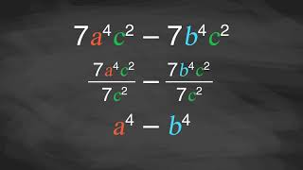
Learning Activity B | Video
Factoring the Difference of Squares
Notes:
This video discusses question 4 of activity 6.6.3.

Slide 20

Learning Activity B
Self Check
Factor using the difference of squares: 121p² – 9q².
(11p – 3q)(11p + 3q)
(11q – 3p)(11q + 3p)
(11p – 3q)²
(11p + 3q)²
Let’s review!
Notes:
Answer Feedback - Individualized by Response
That’s correct! Multiply the conjugate pair to see if it matches the original binomial.
Incorrect. The variables are transposed. This is not equivalent to the original binomial.
Incorrect. Factoring using the difference of squares will result in a conjugate pair with opposite signs.
Incorrect. Factoring using the difference of squares will result in a conjugate pair with opposite signs.

Slide 21
Learning Activity B
Self Check - Review
FACTORING DIFFERENCE OF SQUARES
Step 1 - Does the binomial fit the pattern?
Is this a difference?
Are the first and last terms perfect squares?
a² – b²?
Step 2 - Write the first and last terms as squares.
Step 3 - Write the product of conjugates.
Step 4 - Check by multiplying the factors.
Factor 144x² – 49y².
Notes:
Additional examples are available in the online textbook.

Slide 22
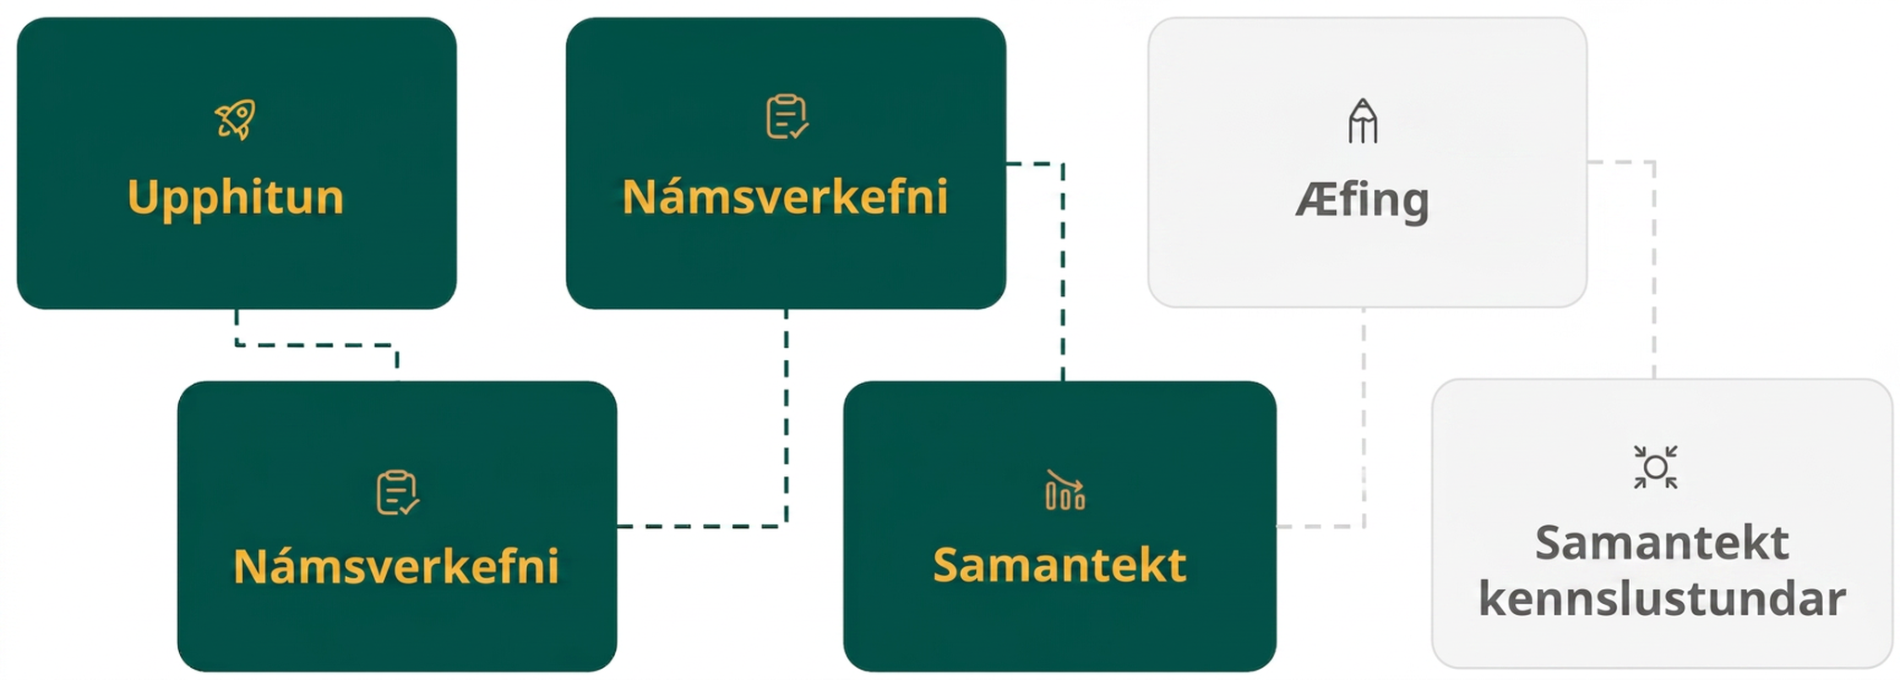
Lesson Journey
Fourth Step: Cool Down

Slide 23
Cool Down | Part 1
Is it this? Or is it that? ↩↪
Draw a table similar to the one below.
As your teacher displays a polynomial –
Determine whether you would factor the polynomial using the difference of squares or the perfect square trinomial method.
Record your answer in the table.
If it requires both methods, place it in both columns.
Difference of Squares Method | Perfect Square Trinomial Method
__________ | __________
Notes:
Cool Down (5 minutes)
Have students create the table provided. The polynomials to be displayed are provided on the next slide. They are animated to appear one at a time.

Slide 24
Cool Down | Part 2
Is it this? Or is it that? ↩↪
Polynomials
As each polynomial is displayed–
Determine whether you would factor the polynomial using the difference of squares or the perfect square trinomial method.
Record your answer in the table.
If it requires both methods, place it in both columns.
27q² – 3
x² – 10x + 25 – y²
16x² – 72x + 81
36y² + 12y + 1
4p² – 100
x² + 12x + 36 – y²
Notes:
NOTE: The polynomials are animated and will display one at a time with each click.
Answers
Difference of Squares Method:
27𝑞² − 3
4𝑝² − 100
𝑥² − 10𝑥 + 25 − 𝑦²
𝑥² + 12𝑥 + 36 − 𝑦²
Perfect Square Trinomial Method:
16𝑥² − 72𝑥 + 81
36𝑦² + 12𝑦 + 1
𝑥² − 10𝑥 + 25 − 𝑦²
𝑥² + 12𝑥 + 36 − 𝑦²
Response to Student Thinking - Press Pause
Students will encounter special trinomials in later lessons, but they will not have another chance to focus on identifying them and specifically applying the prescribed factoring method. If needed, return to the activities in 6.6.1 and 6.6.3 to review how to identify perfect square trinomials and the difference of squares.

Slide 25
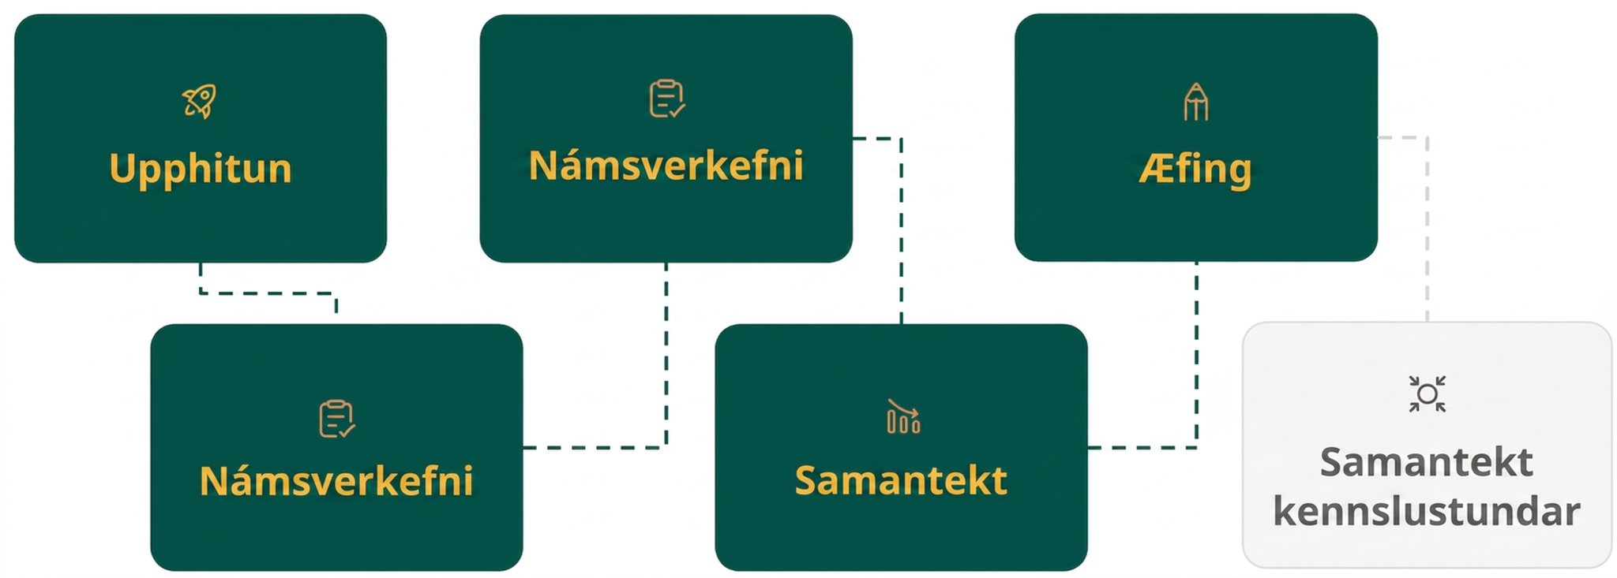
Lesson Journey
Fifth Stop: Practice

Slide 26

Practice
Put your hard work to action, practice what you’ve learned!
Notes:
Digital Practice: Access the practice pages at https://openstax.org/details/books/algebra-1

Slide 27
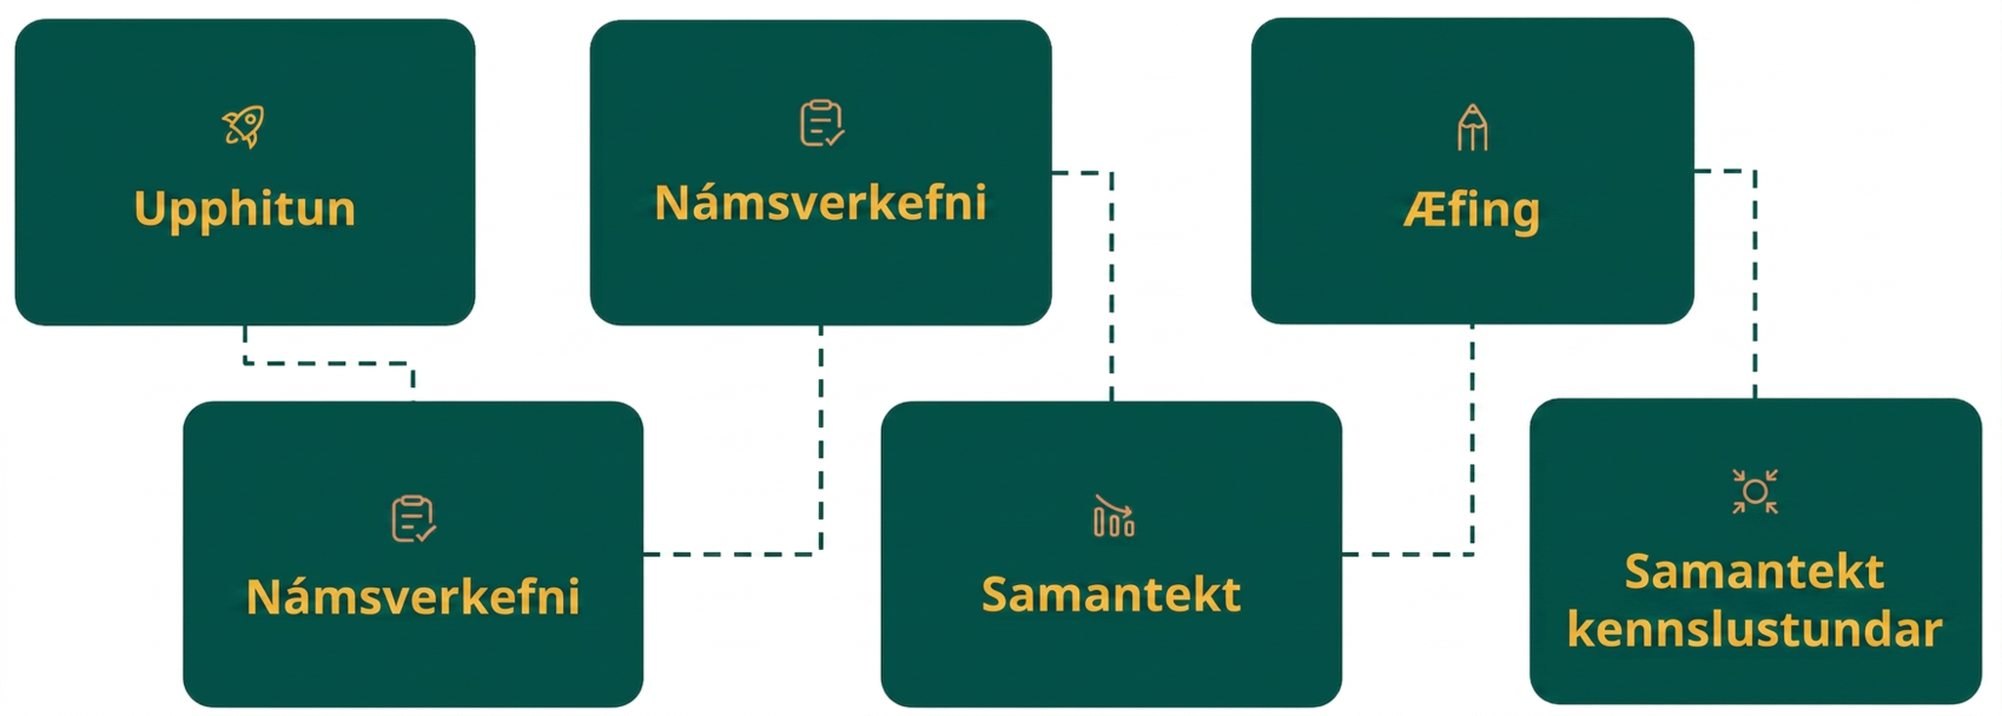
Lesson Journey
Sixth Stop: Lesson Synthesis

Slide 28
Lesson Synthesis
What is unique about the first and last terms in a perfect square trinomial?
What is the pattern of the middle term in a perfect square trinomial?
To what binomial does the trinomial a² – 2ab + b² factor?
What do you call the binomials (a – b) and (a + b)?
What is the pattern used to factor a difference of squares?
Can you factor a² + b²?
Notes:
To help students’ understanding of key points from the lesson, pose the following questions:
What is unique about the first and last terms in a perfect square trinomial? (They are perfect squares.)
What is the pattern of the middle term in a perfect square trinomial? (±2𝑎𝑏)
To what binomial does the trinomial 𝑎² − 2𝑎𝑏 + 𝑏² factor? [(𝑎 − 𝑏)²]
What do you call the binomials (𝑎 − 𝑏) and (𝑎 + 𝑏)? (conjugate pair)
What is the pattern used to factor a difference of squares? [𝑎² − 𝑏² = (𝑎 − 𝑏)(𝑎 + 𝑏)]
Can you factor 𝑎² + 𝑏²? (No, it is prime.)

Slide 29
Self Assessment
How much do you agree with the following statements?
Learning Goals | I can | Almost | Not yet
Factor perfect square trinomials. | ⃞ | ⃞ | ⃞
Factor differences of squares. | ⃞ | ⃞ | ⃞

