Slide 1


Algebra 1
Unit 7 Introduction to Quadratic Functions
Lesson 7.4 Comparing Quadratic and Exponential Functions
Notes:
How to Get Started
Review Slide 2: How to use these slides
Check out the digital quick start guide!
Review Slide 3: Reference Key of Icons

Slide 2
How to use these slides
On the activity slides check the speaker notes for teacher support and instructional information.
Each lesson includes 1 warm up, 2-3 learning activities, a cool down, practice and a lesson synthesis.
  Learning activities are followed by a self check question, and review section.
Some slides have been hidden from student view, more information can be found on the next slide (Reference Key).
You can edit and use these slides for personal and classroom use, but cannot sell them and must keep the attribution logos.
For more information, Check out the digital quick start guide!

Slide 3






Reference Key
Check the top right corner for an icon referencing these unique sections.
 | Support for Students with Disability | Hidden | Learning Strategies slide, provides additional support to students for understanding the activity. Learning Strategies slide, provides additional support to students for understanding the activity.
 | Support for English Language Learners | Hidden
 | Extending Your Thinking | Hidden | Extending Your Thinking slide, provides an extra challenge for students.
 | Self Check | Not Hidden | Self Check slide, checkpoint to assess student understanding after the learning activity.
 | Review | Hidden | Self Check- Review slide, designed to help review topics from the self check question.
On the next slides, check the speaker notes for teacher instructions and support.
Notes:
Check the Speaker Notes: On the next slides you can find discussion questions, lesson information, answers to the activities, and ways to adjust the activity for your students!

Slide 4

Learning Goals
By the end of this lesson you will be able to -
Explain using graphs, tables, or calculations how exponential functions eventually grow faster than quadratic functions.
Notes:
Lesson Narrative
Students extend earlier work comparing linear and exponential growth to explore how quadratic and exponential functions compare. They discover that exponential functions eventually surpass quadratic ones and use graphs, tables, and quotients to reason why. Students notice that quadratic outputs don’t grow by a constant factor, while exponential outputs do, deepening their understanding of growth patterns and graph shapes.
Required Preparation
Acquire devices that can run Desmos (recommended) or other graphing technology. It is ideal if each student has their own device.
Required Materials
Graphing technology
Texas Essential Knowledge and Skills
A1(F) analyze mathematical relationships to connect and communicate mathematical ideas
A1(G) display, explain, and justify mathematical ideas and arguments using precise mathematical language in written or oral communication
A12(B) evaluate functions, expressed in function notation, given one or more elements in their domains

Slide 5
Vocabulary
Previous
Equation
  A mathematical statement that demonstrates that two
  numbers, expressions, or other objects are equal.
Exponential Function
  A function that has a constant growth factor. Another way to say this is that it grows by equal factors over equal intervals.
Expression
  The sum of products of numbers and variables. The variables can be raised to different powers.
Growth Factor
  In an exponential function, the output is multiplied by the same factor every time the input increases by one. This value is the multiplier.
Function
  A relation that takes inputs from one set and assigns them to outputs from another set, assigning exactly one output to each input.
Quadratic Functions
  A function where the output is given by a quadratic expression in the input. 𝑓(𝑥) = 𝑎𝑥² + 𝑏𝑥 + 𝑐.
New
None
Notes:
Lesson Vocabulary
To support student understanding of key vocabulary:
Introduce and review the vocabulary words students will see in this lesson.
Encourage students to notice how these words are used and to include them in their math discussions and explanations—both written and oral.
Use a word wall to reinforce vocabulary. Sample word wall cards are available here.
For newcomers or students with beginning English proficiency, use these Quizlet sets to support vocabulary learning:
Unit 7 Spanish Vocabulary – use first to build understanding
Unit 7 Vocabulary (English) – use after anchoring in Spanish
Support for English Language Learners
ELPS 1(C) use strategic learning techniques such as concept mapping, drawing, memorizing, comparing, contrasting, and reviewing to acquire basic and grade-level vocabulary
ELPS 2(F) listen to and derive meaning from a variety of media such as audiotape, video, DVD, and CD-ROM to build and reinforce concept and language attainment
ELPS 3(B) expand and internalize initial English vocabulary by learning and using high-frequency English words necessary for identifying and describing people, places, and objects, by retelling simple stories and basic information represented or supported by pictures, and by learning and using routine language needed for classroom communication
ELPS 3(D) speak using grade-level content area vocabulary in context to internalize new English words and build academic language proficiency
ELPS 3(E) share information in cooperative learning interactions
ELPS 3(F) ask and give information ranging from using a very limited bank of high-frequency, high-need, concrete vocabulary, including key words and expressions needed for basic communication in academic and social contexts, to using abstract and content-based vocabulary during extended speaking assignments
ELPS 3(H) narrate, describe, and explain with increasing specificity and detail as more English is acquired

Slide 6





Lesson Journey
Warm Up
Learning Activity
Practice
Learning Activity
Cool Down
Lesson Synthesis

Slide 7
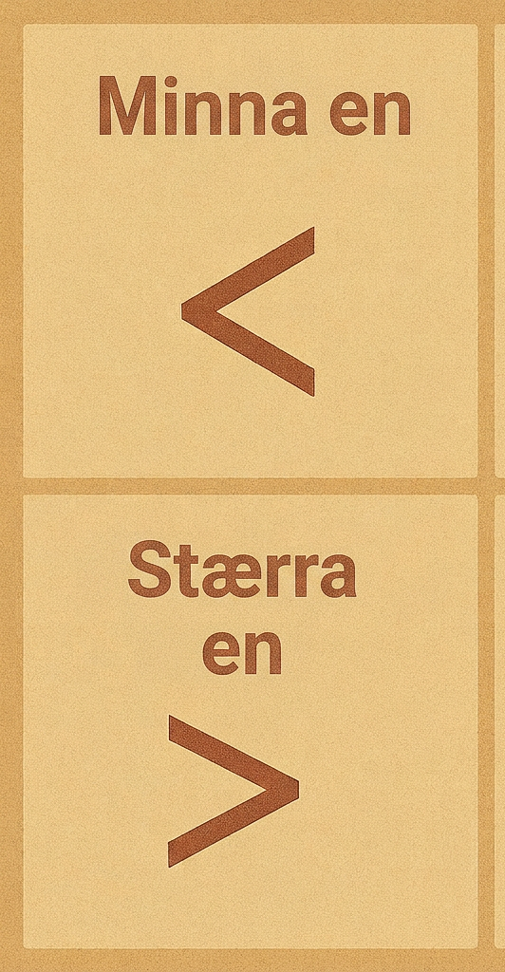
Warm Up - Compare Exponential Expressions🤔
List these quantities in order, from least to greatest, without evaluating each expression. Be prepared to explain your reasoning.
2¹⁰
10²
2⁹
9²
Notes:
Warm Up (5 minutes)
In this warm-up, students compare exponential expressions using their structure, preparing for exponential growth later in the lesson. They notice that 9² < 10² and 2⁹ < 2¹⁰, but deciding between 10² and 2⁹ requires reasoning with exponents. For example, since 2⁴ = 16, then 2⁸ = 16² = 256; because 2⁹ > 256, 2⁹ > 10².
As students share, highlight strategies that use exponent properties and structural reasoning.
Launch
Arrange students in groups of two.
Give students a moment of quiet time to think individually and then time to share their thinking with a partner.
Students should not use a calculator to evaluate the expressions to encourage them to rely on the structure of the expressions.
Activity Answers
The correct order is 9², 10², 2⁹, 2¹⁰. This would be 18, 100, 512, 1024.
Activity Synthesis
Select students to share their responses and reasoning. Highlight explanations that show that the expressions can be compared by analyzing their structure (as in the example in the Activity Narrative), and that it is not necessary to know their exact values to put the expressions in order.

Slide 8

Lesson Journey
Warm Up
Learning Activity
Practice
Learning Activity
Cool Down
Lesson Synthesis

Slide 9
Learning Strategies - Analyze and Describe the Growth 🗣️
Share your equation and table with the class.
Observe how each equation shows the dimensions in the pattern.
Compare how features in equations, tables, and graphs connect to one another.
Use clear math language to explain what you notice.
Compare and Connect
Teacher Instruction: Use these strategies to adjust the activity to support English language learners and students with disabilities.
  You can copy and paste the callouts directly on top of the activity or give the instructions aloud.
Use color-coding and notes to show connections between representations.
Use one color to highlight how the growth factor appears on the quadratic graph.
Use a different color to show how the growth factor appears on the exponential graph.
Representation
Notes:
Support for English Language Learners: MLR 7 Compare and Connect: Representing, Conversing
As students share their equations and tables with the class, call students' attention to the ways the dimensions are represented within the context of each equation. Take a close look at the equation to distinguish how each pattern is represented. Wherever possible, amplify student words and actions that describe the connections between a specific feature of one mathematical representation and a specific feature of another representation.
Design Principle(s): Maximize meta-awareness; Support sense-making
Learn more about this routine
View the instructional video and follow along with the materials to assist you with learning this routine.
Provide support for students
Distribute graphic organizers to the students to assist them with participating in this routine.
Support for Students with Disabilities: Representation: Internalize Comprehension
Demonstrate and encourage students to use color-coding and annotations to highlight connections between representations. Use one color to highlight connections between the growth factor and the graph of the quadratic function, and another color for the exponential function.
Supports accessibility for: Visual-spatial processing

Slide 10
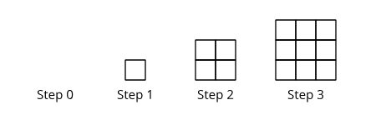
Learning Activity - Analyze and Describe the Growth 🗣️
In this activity, you will compare two different patterns. In each pattern, the number of small squares is a function of the step number, n.
Step Number (n) | Number of Small Squares f(n)
0
1
2
3
4
5
6
7
8
Pattern A
In Pattern A, the length and width of the rectangle grow by 1 small square from each step to the next.
  Write an equation to represent the number of small squares at Step n.
  Is the function linear, quadratic, or exponential?
  Complete the table
Notes:
Support for All Learners
This activity offers additional support for students:
For English language learners and students with disabilities, be sure to review the Learning Strategies slide!
Activity (15 minutes)
This activity has students compare exponential and quadratic growth by writing equations and making tables. They first estimate the number of squares at Steps 5 and 10, then compare estimates with calculated values to make sense of the patterns. From their tables, students see that exponential growth eventually surpasses quadratic growth. Using spreadsheets or graphing tools gives them practice choosing appropriate technology.
Launch
Display the image of the patterns for all to see and ask students to read the description of how the patterns grow. Ask students to predict which pattern will have more small squares in Step 5.
Then, ask students to predict which pattern will have more small squares in Step 10. Poll the class to collect their predictions. Display the number of students who think Pattern A will have more small squares and the number who think Pattern B will have more small squares.
Arrange students in groups of two. If time is limited, ask partners to each complete the questions for one pattern and then work together to compare the patterns and make observations.
Some students may choose to use a spreadsheet tool to study the pattern, and subsequently to use graphing technology to plot the data. Others may wish to use a calculator to compute growth factors. Provide access to devices that can run a spreadsheet tool, graphing technology, or a scientific calculator.
Answers
a. f(n) = n²
b. quadratic
c. 0, 1, 4, 9, 16, 25, 36, 49, 64
More question, answers Anticipated Misconceptions, and Activity Synthesis on next slide

Slide 11
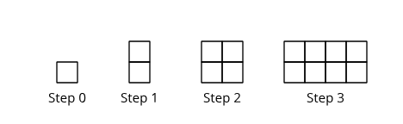
Learning Activity - Analyze and Describe the Growth 🗣️
Pattern B
Step Number (n) | Number of Small Squares g(n)
0
1
2
3
4
5
6
7
8
In Pattern B, the number of small squares doubles from each step to the next.
  Write an equation to represent the number of small squares at Step n.
  Is the function linear, quadratic, or exponential?
  Complete the table.
How would the two patterns compare if they continue to grow? Make one to two observations.
Notes:
Answers
a. g(n) = 2^{n}
b. exponential
c. 1, 2, 4, 8, 16, 32, 64, 128, 256
The number of small squares in Pattern B grows much more quickly than the number of squares in Pattern A once n is greater than 5. The patterns have the same number of squares when n = 2 and when n = 4.
Anticipated Misconceptions
Some students may write the equation for Pattern B as g(n) = 2n. Point out that Pattern B is doubling the number of small squares. Step 3 would have 4 small squares. Prompt students to test their equation when n = 3 to see if it gives the correct output. g(3) = 2(3) = 6, not 4, so a linear function does not work. Since Pattern B is doubling, the function is exponential, not linear. A linear pattern such as 2n would add 2 small squares at each step rather than double the number of small squares.
Activity Synthesis
Select students to share their equations and to display their tables for all to see. Invite others to share their observations about the values in the tables.
To help students understand why the value of the exponential function outgrows that of the quadratic function, consider showing tables that contrast the output values of f and g and amending each with a third column that shows their growth factors as n goes up by 1.
Highlight the fact that a fundamental feature of an exponential function is that it changes by equal factors over equal intervals. In this exponential function, the output increases by a factor of 2 at each step.
In the quadratic function, we can see that the output changes by a factor of 4, then 2¼ , then 1⁷⁄₉, and so on. Even though it started out growing faster than the exponential function, the growth factor of the quadratic function decreases at each step and falls below 2 after a couple of steps. In the meantime, the growth factor of the exponential function stays at 2.
Also consider showing the graphs representing the two functions to help students visualize the data in the tables. This graph plots the outputs of f and g at whole-number inputs.
Discuss how the graphs representing both quadratic and exponential functions curve upward. The two are very close together for small values of x. As x continues to grow, however, the values of g become much greater than those of f and continue to increase more quickly.

Slide 12
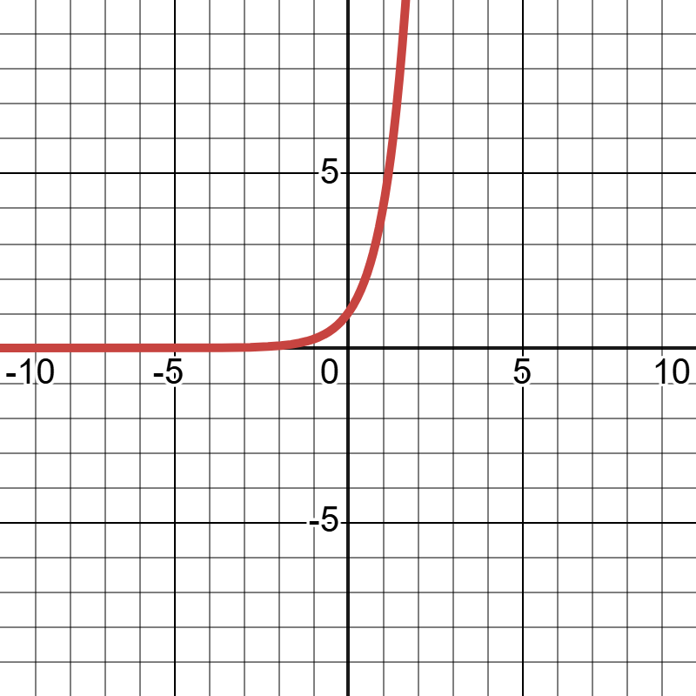
Self Check
Which of the following functions has a constant growth factor?
f(x) = 4x
f(x) = 4x²
f(x) = 4^{x}
f(x) = x + 4
Let’s review!
Notes:
Answer Feedback - Individualized by Response
Incorrect. The slope of this linear function is 4, creating a common difference of 4.
Incorrect. Quadratic functions do not have a constant growth factor like exponential functions.
That’s correct! This exponential function has a growth factor of 4.
Incorrect. This linear function has a y-intercept of 4 but a slope or common difference of 1.

Slide 13
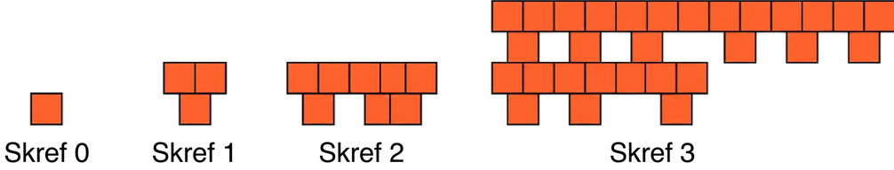
Self Check - Review
Is the pattern below represented by a function that is linear, exponential, or quadratic?
Draw a table. What is the growth factor for each step?
Write the function to represent the pattern.
Determine what type of function this is.
Notes:
Determining Growth Factors
Answers
Step 0, Number of Squares: 1, Growth Factor: 3
Step 1, Number of Squares: 3, Growth Factor: 3
Step 2, Number of Squares: 9, Growth Factor: 3
Step 3, Number of Squares: 27, Growth Factor: 3
f(x) = 3^{x}
The function is exponential.

Slide 14
Lesson Journey
Warm Up
Learning Activity
Practice
Learning Activity
Cool Down
Lesson Synthesis

Slide 15

Learning Strategies - Which function Will Have a Greater Value?
Share your ideas of how the exponential function eventually outgrows the quadratic function.
Listen for words others use to describe this growth.
Watch as key phrases are added to the class display.
Use the display to help you explain your thinking during discussions.
Collect and Display
Teacher Instruction: Use these strategies to adjust the activity to support English language learners.
You can copy and paste the callouts directly on top of the activity or give the instructions aloud.
Notes:
Support for English Language Learners: MLR 2 Collect and Display: Conversing
As students share their analysis with the class, listen for and collect the language students use to identify and describe how the output of the exponential function eventually outgrows that of the quadratic function. Write the students' words and phrases on a visual display and update it throughout the remainder of the lesson. Remind students to borrow language from the display as needed. This will help students read and use mathematical language during their partner and whole-group discussions.
Design Principle(s): Maximize meta-awareness
Provide support for students
Distribute graphic organizers to the students to assist them with participating in this routine.

Slide 16
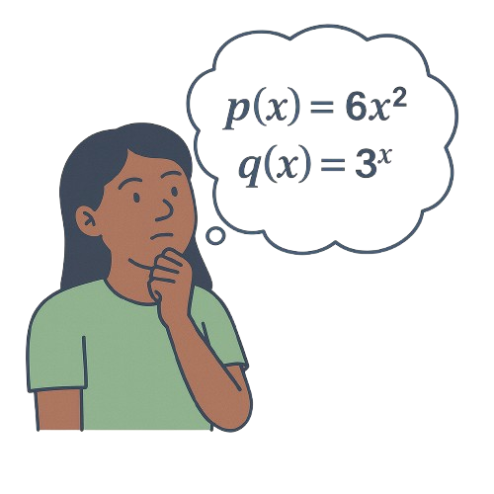
Learning Activity - Which Function Will Have a Greater Value?
Here are two functions:
Investigate the output of p and q for different values of x. For large enough values of x, one function will have a greater value than the other.
Which function will have a greater value as x increases?
Support your answer with tables, graphs, or other representations.
Are you ready for more?
Notes:
Support for All Learners
This activity offers additional support and an extension for students:
For English language learners, be sure to review the Learning Strategies slide!
For students looking for an extra challenge, be sure to review the Extending Your Thinking slide!
Activity (15 minutes)
Students continue to compare quadratic and exponential functions in this activity. This time, they decide how to compare the functions.
Monitor for different strategies students may use to compare the functions. Identify students who:
Create one or more tables of values and compare the values of p(x) and q(x) at increasingly large values of x.
Graph the functions defined by p(x) = 6x² and q(x) = 3^{x} and compare the graphs.
Create one or more tables of values, calculate the growth factors at equal intervals of input, and then compare the growth factors.
If students choose graphing or spreadsheet tools strategically to perform comparisons, they are demonstrating an understanding of the benefits of different strategies.
Launch
Display the two equations and ask students to identify which is exponential and which is quadratic.
Invite students to explain how they know and discuss their reasoning.
Confirm that students recognize p is quadratic and q is exponential before starting the activity.
Provide access to graphing technology and spreadsheets.
Encourage students to adjust the graphing window for clarity—avoid windows that are too narrow (e.g., 0 < x < 5) or too tall
(e.g., 0 < y < 3,000).
Remind students that adjusting the window helps make the graphs more informative and easier to compare.
Answers
q is larger when x = 0 and again when x = 5. Once x is larger than 5, q is growing much more quickly, as shown in the table.
If you open this link to the Demos graph, you will see the plotted values from the table. https://www.desmos.com/calculator/nznecbyggw
Link to Desmos graph: https://www.desmos.com/calculator/14nw0uwe0j
Activity Synthesis
Display the graphs for all to see.
Emphasize that exponential functions eventually outgrow quadratic ones because their outputs increase by a constant factor each time, while quadratic outputs increase by smaller amounts as inputs grow.
Presenting growth factor reasoning last helps solidify this understanding.

Slide 17
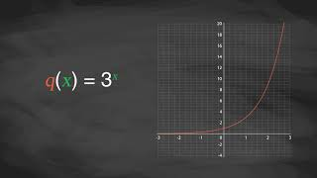
Video: Comparing Exponential and Quadratic Functions

Slide 18

Extending Your Thinking
Janna says that some exponential functions grow more slowly than the quadratic function as x increases. Do you agree with Janna? Be prepared to show your reasoning.
Could you have an exponential function g(x) = b^{x} so that g(x) < f(x) for all values of x?
Notes:
Answer
Yes. This is true for the functions g(x) = (1½)x and f(x) = x² as x increases for x-values less than 10.
No, g(0) > f(0) for all values of b (except 0), because b⁰ = 1 and 0² = 0. (If b = 0, there are problems if x ≤ 0, so this is not usually considered an exponential function.)
Go back to activity information.

Slide 19
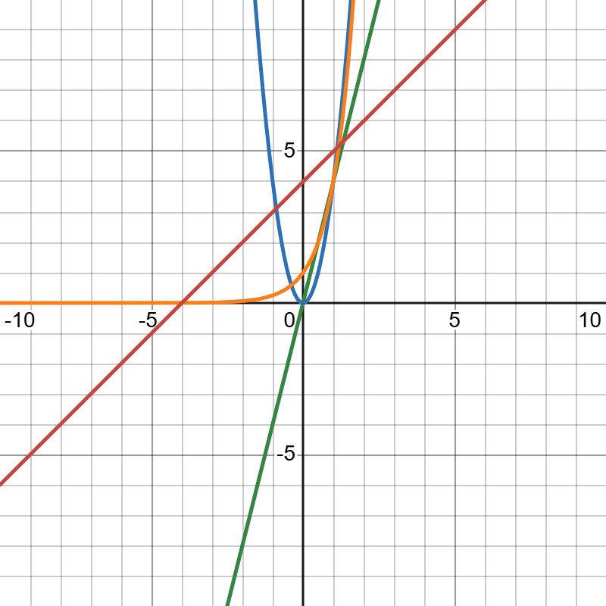
Self Check
Which of the following has the
greatest value as x increases?
y = 4 ⋅ x²
y = 4^{x}
y = 4x
y = (¼)^{x}
Let’s review!
Notes:
Answer Feedback - Individualized by Response
Incorrect. This quadratic function will increase as x increases but will not have the greatest value when compared to an exponential growth function.
That’s correct! This is an exponential function with a growth factor of 4, which will have the greatest value as x increase.
Incorrect. This function is linear and has a constant difference of 4, but that will not increase as much as an exponential function.
Incorrect. The number of rows is n + 1, and the number of columns is n. Be sure to distribute the n to both terms when multiplying.

Slide 20
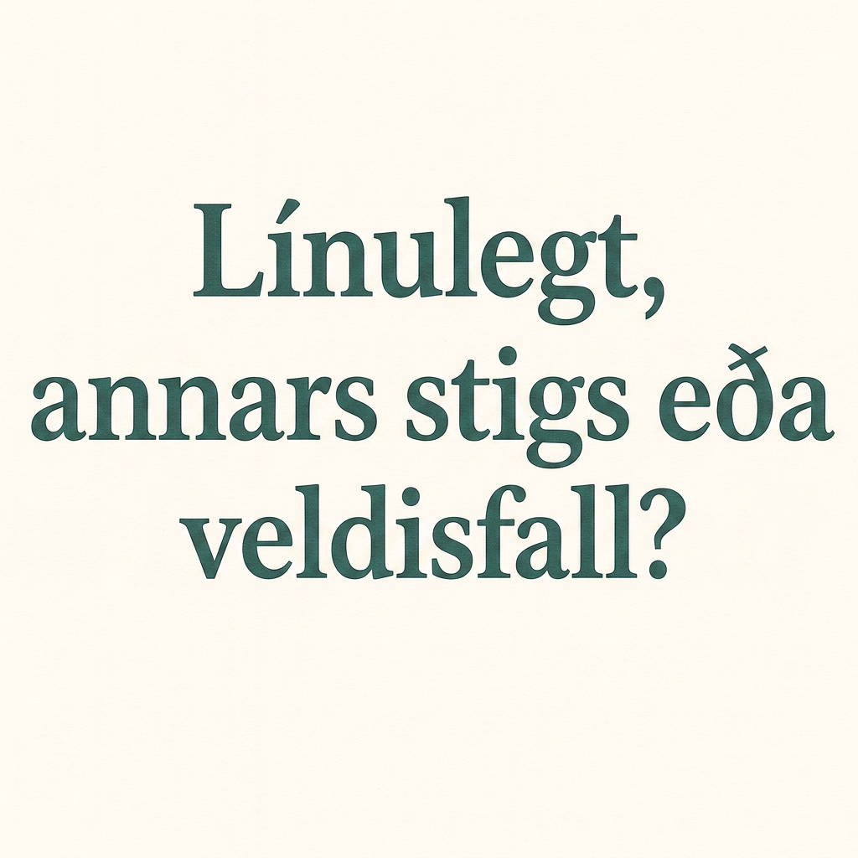
Self Check - Review
For each of the two functions, do the following:
Complete the table of values.
Sketch a graph.
Decide whether each function is linear, quadratic, or exponential, and be prepared to explain how you know.
f(x) = 3 ⋅ 2^{x}
g(x) = 3 ⋅ x²
Notes:
More Complex Quadratic Patterns
Answers
a. If you open this link to the Demos graph, you will see the points from the table. https://www.desmos.com/calculator/h9n1unt7ps
b. Link to Desmos graph: https://www.desmos.com/calculator/h9n1unt7ps
c. This function is exponential. It has a growth factor of 2.
a. If you open this link to the Demos graph, you will see the points from the table. https://www.desmos.com/calculator/3o0kjk3u9x
b. Link to Desmos graph: https://www.desmos.com/calculator/3o0kjk3u9x
c. This function is not linear because it does not have a constant rate of change, and it is not exponential because it does not have a constant growth factor. The function is quadratic because it can be represented by g(x) = 3 ⋅ x², which has x to the second power, and that is the greatest power.
Note: Between f(x) and g(x), f(x) will have the greater value as x increases.

Slide 21

Lesson Journey
Warm Up
Learning Activity
Practice
Learning Activity
Cool Down
Lesson Synthesis

Slide 22
Cool Down
Tyler completes the table comparing values of the expressions 5x² and 2^{x}.
x | 5x² | 2^{x}
1 | 5 | 2
2 | 20 | 4
3 | 45 | 8
4 | 80 | 16
Tyler concludes that 5x² will always result in greater values than 2^{x} for the same value of x.
Do you agree? Explain or show your reasoning.
Notes:
Cool Down (5 minutes)
Answers
Tyler is not correct. For lesser values of x, 5x² results in greater values than 2^{x}, but 2^{x} eventually results in greater values because it always doubles when x increases by 1. When x = 9, 5(9)² = 405 and 2⁹ = 512, so 2⁹ is greater.
Response to Student Thinking - More Chances
Students will have more opportunities to understand the mathematical ideas in this cool down, so there is no need to slow down or add additional work to the next lessons. Instead, use the results of this cool down to provide guidance for what to look for and emphasize over the next several lessons to support students in advancing their current understanding.

Slide 23

Lesson Journey
Warm Up
Learning Activity
Practice
Learning Activity
Cool Down
Lesson Synthesis

Slide 24

Practice
Put your hard work to action, practice what you’ve learned!
Notes:
Digital Practice: Access the practice pages at https://openstax.org/k12/algebra

Slide 25

Lesson Journey
Warm Up
Learning Activity
Practice
Learning Activity
Cool Down
Lesson Synthesis

Slide 26
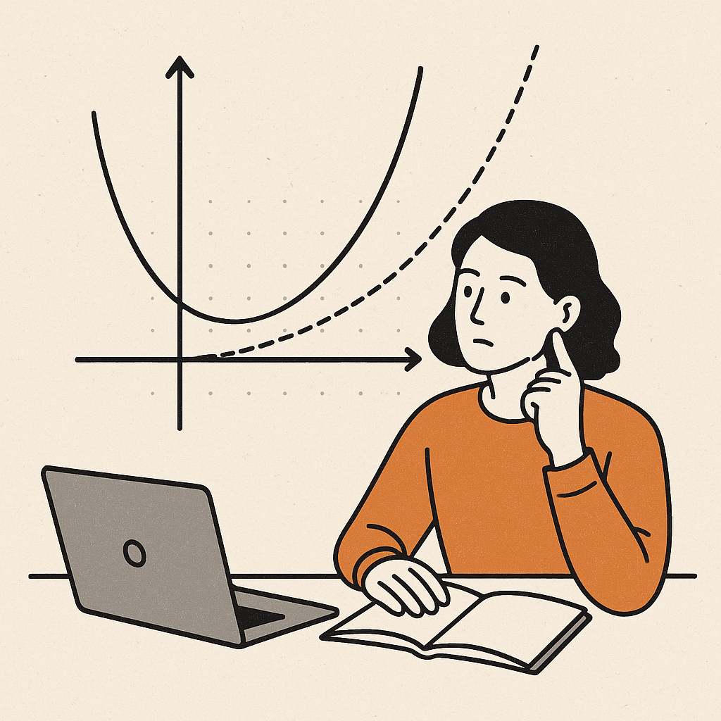
Lesson Synthesis
Answer the questions to reflect on how they analyzed the behaviors of quadratic and exponential functions.
What are some ways for comparing a quadratic growth function and an exponential growth function?
  What clues would you look for?
When we compared n² and 2^{n}, we saw the value of 2^{n} become greater than n² at n = 5. When we compared 6x² and 3^{x}, we saw 3^{x} overtaking 6x² by the time x reaches 5. If we compare, say, 1,000x² and 2^{x}, will the exponential still overtake the quadratic?
  If so, at what x-value do you think it would happen? If not, why not?
Notes:
Possible Answers
By comparing their values in a table, by graphing the equations representing them, or by comparing the growth factors as the input increases.
Yes.
It would probably happen when x is between 15 and 20.

Slide 27
Self Assessment
How much do you agree with the following statements?
I can… | I can | Almost | Not yet
Explain using graphs, tables, or calculations how exponential functions eventually grow faster than quadratic functions.

