Slide 1


Algebra 1
Unit 4 Functions
Lesson 4.9: Interpreting and Creating Graphs

Slide 2
How to use these slides
On the activity slides check the speaker notes for teacher support and instructional information.
Each lesson includes 1 warm up, 2-3 learning activities, a cool down, practice and a lesson synthesis.
  Learning activities are followed by a self check question, and review section.
Some slides have been hidden from student view, more information can be found on the next slide (Reference Key).
You can edit and use these slides for personal and classroom use, but cannot sell them and must keep the attribution logos.
For more information, Check out the digital quick start guide!

Slide 3






Reference Key
Check the top right corner for an icon referencing these unique sections.
 | Support for Students with Disability | Hidden | Learning Strategies slide, provides additional support to students for understanding the activity. Learning Strategies slide, provides additional support to students for understanding the activity.
 | Support for English Language Learners | Hidden
 | Extending Your Thinking | Hidden | Extending Your Thinking slide, provides an extra challenge for students.
 | Self Check | Not Hidden | Self Check slide, checkpoint to assess student understanding after the learning activity.
 | Review | Hidden | Self Check- Review slide, designed to help review topics from the self check question.
On the next slides, check the speaker notes for teacher instructions and support.
Notes:
Check the Speaker Notes: On the next slides you can find discussion questions, lesson information, answers to the activities, and ways to adjust the activity for your students!

Slide 4

Learning Goals
By the end of this lesson you will be able to -
Explain the average rate of change of a function in terms of a situation.
Describe important features of a graph and explain what they mean in a situation.
Sketch a graph that shows important features of the situation.
Notes:
Lesson Narrative
Students have practiced interpreting and creating function graphs using input-output pairs and situation descriptions, and have learned key vocabulary and how to use average rate of change.
In this lesson, they apply those skills to interpret or create graphs for more complex, real-life situations, including flag-raising and other contextual activities.
Information is provided through descriptions, videos, and images, with more ambiguity than before. Students must make assumptions, solve problems, and engage in mathematical modeling to create graphs that fit the given scenarios.
Required Preparation
For activity 4.9.2, have a coordinate grid or graphing technology ready for students to complete the “Are You Ready for More?” section.
Required Materials
Coordinate Grids or Graphing Technology
Texas Essential Knowledge and Skills
A1(A) apply mathematics to problems arising in everyday life, society, and the workplace.
A1(D) communicate mathematical ideas, reasoning, and their implications using multiple representations, including symbols, diagrams, graphs, and language as appropriate.
A1(E) create and use representations to organize, record, and communicate mathematical ideas.
A3(C) graph linear functions on the coordinate plane and identify key features, including x-intercept, y-intercept, zeros, and slope, in mathematical and real-world problems.
A7(A): graph quadratic functions on the coordinate plane and use the graph to identify key attributes, if possible, including x-intercept, y-intercept, zeros, >maximum, and minimum values.

Slide 5
Vocabulary
Previous
Horizontal intercept
  The point where the graph crosses the x-axis, with a y-value of 0: (x, 0).
Vertical intercept
  The point where the graph crosses the y-axis, with an x-value of 0: (0, y).
Constant
  In (5x + 2), the number 2 is constant—it stays the same as x changes
New
None
Notes:
Lesson Vocabulary
To support student understanding of key vocabulary:
Introduce and review the vocabulary words students will see in this lesson.
Encourage students to notice how these words are used and to include them in their math discussions and explanations—both written and oral.
Use a word wall to reinforce vocabulary. Sample word wall cards are available here.
For newcomers or students with beginning English proficiency, use these Quizlet sets to support vocabulary learning:
Unit 4 Spanish Vocabulary, part 1 – use first to build understanding
Unit 4 Vocabulary (English), part 1 – use after anchoring in Spanish
Unit 4 Spanish Vocabulary, part 2 – use first to build understanding
Unit 4 Vocabulary (English), part 2 – use after anchoring in Spanish
Support for English Language Learners
ELPS 2(F) listen to and derive meaning from a variety of media such as audiotape, video, DVD, and CD-ROM to build and reinforce concept and language attainment
ELPS 3(E) share information in cooperative learning interactions
ELPS 4(F) use visual and contextual support and support from peers and teachers to read grade-appropriate content area text, enhance and confirm understanding, and develop vocabulary, grasp of language structures, and background knowledge needed to comprehend increasingly challenging language
ELPS 5(B) write using newly acquired basic vocabulary and content-based grade-level vocabulary

Slide 6





Lesson Journey
Warm Up
Learning Activity
Practice
Learning Activity
Cool Down
Lesson Synthesis

Slide 7
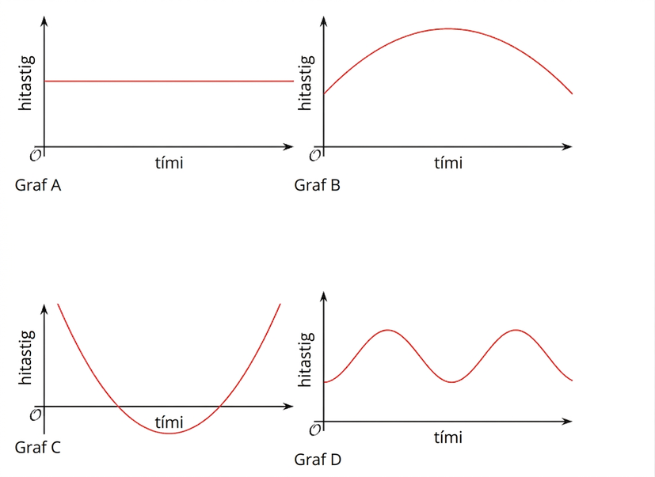
Warm Up - Properties of Graphs📉
One of the graphs on the right does not belong in the same group as the other 3. Which graph do you think does not belong?
Explain why you think that graph does not belong.
Notes:
Warm Up (5 minutes)
This warm-up has students compare four graphs of functions relating time and temperature. Without axis scales, they must rely on graph structure and use precise language to describe similarities and differences using recently learned vocabulary.
Launch
Put students in groups of 2–4. Show the graphs and give 1 minute for individual thinking, then time to share in groups. Each student explains why one item doesn’t belong, and the group finds at least one reason for each item
Activity Answers
Compare your answer: The answer varies.
Compare your answer: Your answer may vary, but here are some samples.
A doesn't belong because: It is the only graph that has no maximum or minimum. It is the only situation in which the temperature does not change.
B doesn't belong because: It is the only graph that has one maximum. It is the only graph that shows the temperature rising and then falling (but not rising again).
C doesn't belong because: It is the only graph that has horizontal intercepts. It is the only graph that has one minimum. It is the only graph that shows negative output values or negative temperatures. It is the only graph that shows temperature falling and then rising (but not falling again).
D doesn't belong because: It is the only graph that has several maxima and minima. It is the only graph where the temperature rises and falls several times. This graph shows a repeating pattern.
Activity Synthesis
Have each group share one reason an item doesn’t belong, and record responses for all to see. Encourage the use of mathematical vocabulary and have students explain any terms they use (e.g., “intercepts,” “minimum,” “linear”). After each response, ask the class if they agree or disagree. Since there’s no single correct answer, focus on the reasoning, verify accuracy, and challenge unsupported claims—for example, questioning how they know intercepts differ without axis scales.

Slide 8

Lesson Journey
Warm Up
Learning Activity
Practice
Learning Activity
Cool Down
Lesson Synthesis

Slide 9

Learning Strategies - Movements of a Flag🏴
Teacher Instruction: Use these strategies to adjust the activity to support English language learners and students with disabilities.
  You can copy and paste the callouts directly on top of the activity or give the instructions aloud.
Write down possible mathematical questions about this situation.
Discuss your questions with 2 others.
Co-Craft Questions
I notice that . . .
I wonder . . .
That could/couldn’t be true because . . . .
Engagement
Notes:
Support for English Language Learners: MLR 5 Co-Craft Questions: Speaking, Reading
Use this routine to help students compare and interpret two functions. Display the student task statement and graph, leaving out the questions. Ask students to write down possible mathematical questions that could be asked about the situation. Invite students to compare their questions before revealing the activity's questions. Listen for and amplify any questions involving the overall shape of the graphs, trends over specific time intervals, and the intersection point of the two graphs. The process of creating mathematical questions, without the pressure of producing answers or solutions, prompts students to make sense of the given information and to activate the language of mathematical questions. This work helps to prepare students to process the actual questions.
Design Principle(s): Optimize output (for explanation); Maximize meta-awareness
Learn more about this routine
View the instructional video and follow along with the materials to assist you with learning this routine.
Provide support for students
Distribute graphic organizers to the students to assist them with participating in this routine.
Support for Students with Disabilities: Engagement: Develop Effort and Persistence
Encourage and support opportunities for peer interactions. Invite students to talk about their ideas with a partner before writing them down. Display sentence frames to support students when they explain their strategy. For example, I notice that . . . I wonder . . . and that could/couldn’t be true because . . . .
Supports accessibility for: Language; Social-emotional skills

Slide 10
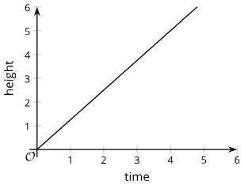
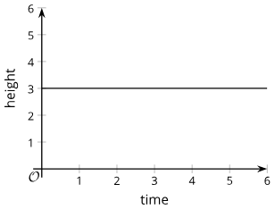

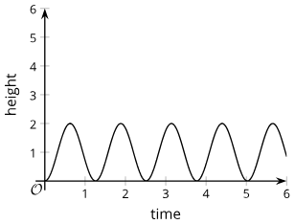

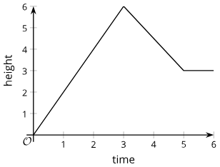
Learning Activity - Movements of a Flag🏴
A flag ceremony is held at a Fourth of July event. The height of the flag is a function of time.
Here are some graphs that could each be a possible representation of the function.
a.
b.
c.
d.
e.
f.
Notes:
Support for All Learners
This activity offers additional support and an extension for students:
For English language learners and students with disabilities, be sure to review the Learning Strategies slide!
For students looking for an extra challenge, be sure to review the Extending Your Thinking slide!
Activity (20 minutes)
Previously, students interpreted graphs of functions with known units, helping them connect graphs to real-world situations. In this activity, they analyze graphs without labeled units, using the context of raising a flag to judge whether the graphs are realistic. They also encounter a vertical line and explore why it doesn't represent a function. Through this, students reason abstractly, justify their thinking, and critique others' reasoning.
Launch
Show images and explain a flag-raising ceremony, noting that it’s a common daily or weekly tradition in some countries.
Have students work in pairs. Ask them to read the task and examine the graphs, then think about:
What reasonable units could be used for the axes?
How can we tell each graph represents a function?
Allow quiet thinking time, then partner discussion, followed by a brief class discussion. Guide them toward units like seconds for time and meters or yards for height, if not mentioned.
Next, have partners take turns interpreting the first graph and pause for discussion before moving to the second. If using the extension, review or model how to use graphing technology as needed.
Activity image answer, and synthesis on the next slide.

Slide 11
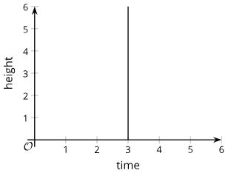
Learning Activity - Movements of a Flag🏴
After you examine graphs a - f, discuss with a partner how each graph could be used to describe the movement of the flag as it is raised on the flagpole. Be prepared to explain your reasoning.
Either select one of the graphs on the previous slide or use the one assigned to you by your teacher. Explain what the graph tells us about the flag and its height over time.
Which graph seems the most realistic and likely to happen at a flag ceremony?
Which graphs seem most unrealistic or least likely to happen at a flag ceremony?
Which graphs might be possible, but seem unlikely?
g.
Use graph g to answer questions 5 and 6.
Can this graph represent the time and height of the flag?
Is this a graph of a function?
Are you ready for more?
Notes:
Activity Answers
Your answer may vary, but here are some samples.
Graph A: The flag starts out on the ground but is immediately raised at a constant rate.
Graph B: The flag starts out at 3 meters above ground and then stays at that height the entire time.
Graph C: The flag starts out on the ground but gets pulled up quickly. The movement slows down and there is a brief pause, and then it is raised up again at a quicker and quicker rate.
Graph D: The flag starts out on the ground, is raised up a couple of meters, and then is lowered back to the ground. This happens repeatedly.
Graph E: The flag starts out at 0.5 meter above the ground and is raised up bit by bit, with a brief pause before it is raised farther.
Graph F: The flag starts out on the ground and is raised up at a constant speed for 3 seconds. It stops abruptly and comes back down at a constant speed. Then, 2 seconds later, it stops at 3 meters above the ground.
Graph E seems the most realistic. It starts at a height where someone would link the flag to the rope and then it rises in spurts like the movement that might happen as someone pulls on the string.
Graphs B and D are the least realistic. On graph B, the flag seems to be attached to the flagpole at one height and then it is never moved up the flagpole. On graph D, the person who raises the flag seems to put it on the ground and then raise it, lower it, raise it, lower it, etc.
Graphs A, C, and F are possible, but it is unlikely that the flag starts out being on the ground.
If we assume that time is measured in seconds and the height is measured in meters, this graph would not represent the height of a flag raised at a flag ceremony. The graph shows the flag being at all heights between 0 and 6 meters at the same time (3 seconds), which is impossible.
This graph does not represent a function. A function has only one output for every input. If we assume that time is measured in seconds and the height is measured in meters, this graph shows many possible outputs when the input is 3 seconds.
Activity Synthesis
Invite students to explain each graph in the context of flag raising and argue whether it is realistic. Encourage partners to illustrate their explanation—one describing the graph, the other acting out the flag raiser’s actions.
Discuss which graph is most realistic and how changing units (e.g., time in days or height in kilometers) could make a graph more or less realistic.
Then, ask why the vertical line doesn’t represent a function. If not mentioned, explain that a vertical line means one input has multiple outputs, which violates the definition of a function.

Slide 12

Video: Interpreting Graphs Without Units

Slide 13
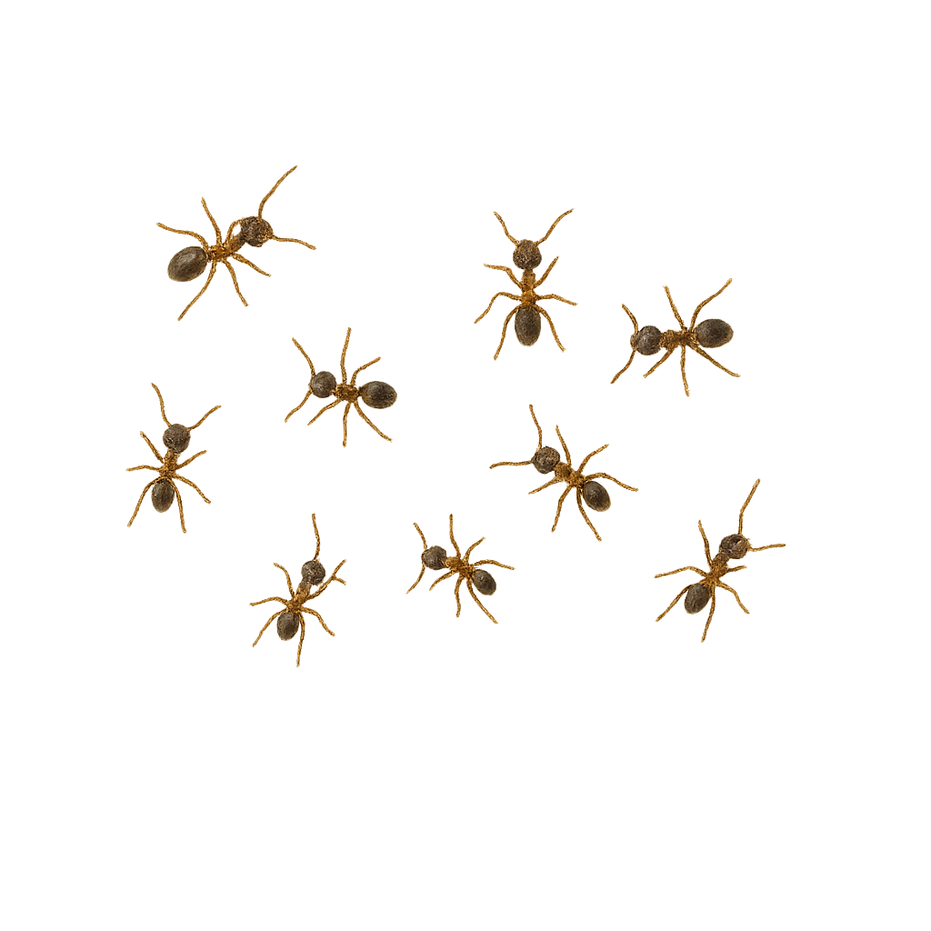
Extending Your Thinking
Suppose an ant is moving at a rate of 1 millimeter per second and keeps going at that rate for a long time. Explain why the equation y = (365⋅24⋅3600)x gives the distance the ant has traveled, in millimeters, as a function of time, x, in years.
Graph the equation using graphing technology.
Does the graph look like that of a function? Why do you think it looks this way?
Using graphing technology, adjust the graphing window until the graph no longer looks this way. If you manage to do so, describe the graphing window that you use.
Do you think the last graph in the flag activity, Graph F, could represent a function relating time and height of a flag? Explain your reasoning.
Notes:
Answer
For example: The number of seconds in a year is 365⋅24⋅60⋅60. If the ant travels 1 millimeter a second, in one year, it would travel 365⋅24⋅3600 millimeters. In x years, it would travel (365⋅24⋅3600)x millimeters.
Access the online Teacher Guide to see the graph for this question.
The graph is a vertical line and doesn’t look like a graph of a function. The slope is really large, so the line is so steep that it looks vertical.
The graph is a slanted line when the x-axis is scaled from –0.0001 to 0.0001 years and the y-axis is scaled to ten thousands in both directions.
It could, depending on the unit of time being used and the scale of the horizontal and vertical axes. If the time is measured in months, for instance, each point on the graph could represent a time value that is just a tiny bit more than 3 months—say, 3 months and 1 second, 3 months and 2 seconds, and so on. A horizontal change of 1 second would not be visible when the horizontal units are measured in months, so all input-output pairs marking the height of the flag at each second would appear to be stacked exactly on top of one another.

Slide 14
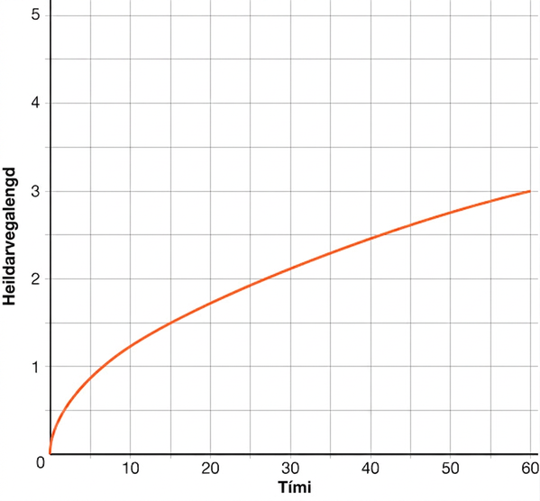
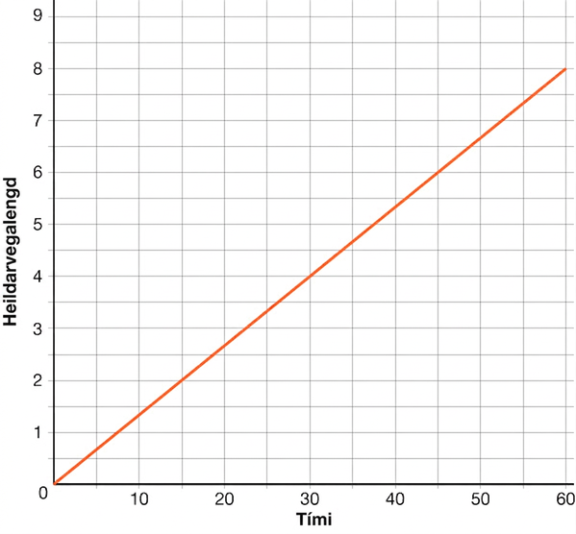
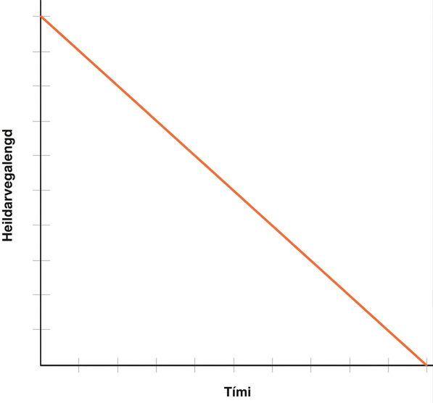
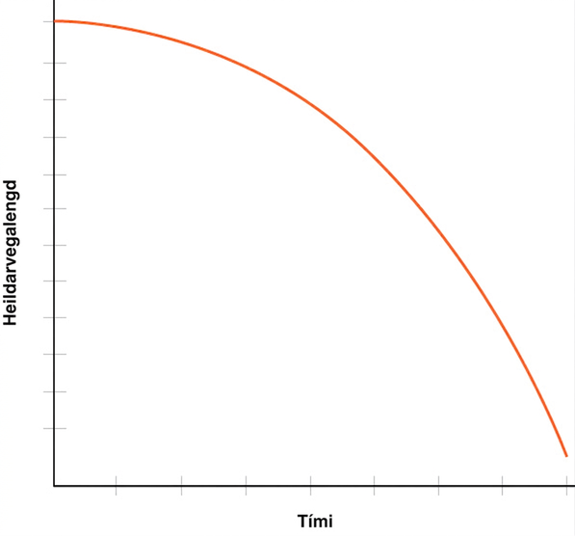
Self Check
Shannon is running on a flat, rocky trail that eventually rises up a steep mountain. Which graph represents the total distance she covers with respect to time?
a.
b.
c.
d.
Let’s review!
Notes:
Answer Feedback - Individualized by Response
That’s correct! She is able to start out faster since the trail is flat, but as the trail rises up the steep mountain, her rate tapers off.
Incorrect. This graph reflects a constant rate. The trail Shannon is running becomes steeper, which will slow down her pace. The answer is graph a.
Incorrect. You are looking for the graph of her distance traveled, so it should start at (0,0). he answer is graph a.
Incorrect. You are looking for the graph of her distance traveled, so it should start at (0,0). he answer is graph a.

Slide 15
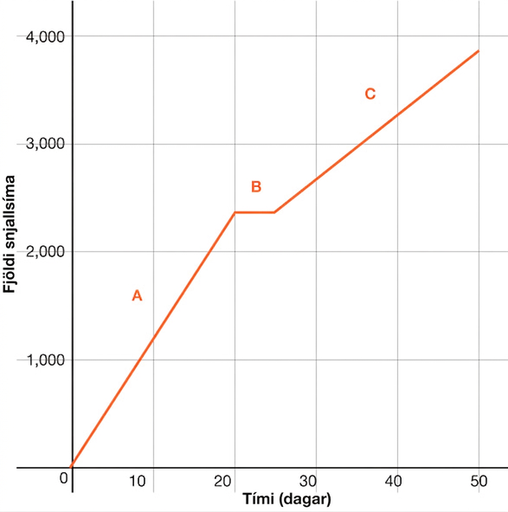
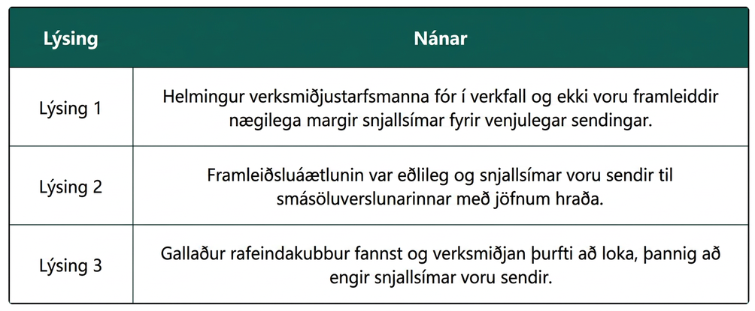
Self Check - Review
The graph represents the total number of smartphones that are shipped to a retail store over the course of days. Match each part of the graph (A, B, and C) to its verbal description. Be prepared to explain the reasoning behind your choice.
Notes:
Answers:
Description 1 best matches part C of the graph. If half of the workers went on strike, then the number of smartphones produced would be less than normal. The rate of change for C is less than the rate of change for A.
Description 3 best matches part B of the graph. If no smartphones are shipped to the sore, the total number remains constant during that time.
Part A of the graph best matches description 2. If the production schedule is normal, the rate of change of interval A is greater than the rate of change of interval C.

Slide 16
Lesson Journey
Warm Up
Learning Activity
Practice
Learning Activity
Cool Down
Lesson Synthesis

Slide 17

Learning Activity - Raising the Flag 🏳️
Your teacher will show a video of a flag being raised.
Function H gives the height of the flag over time. Height is measured in feet. Time is measured in seconds since the flag is fully secured to the string, which is when the video clip begins.
On the coordinate plane, sketch a graph that could represent function H. Be sure to include a label and a scale for each axis.
Notes:
Support for All Learners
This activity offers additional support and an extension for students:
For English language learners and students with disabilities, be sure to review the Learning Strategies slide!
Activity (10 minutes)
Students watch a video of a flag being raised and sketch a graph of the flag’s height over time. Using their graphs, they estimate the rate of change. While precision isn't required, graphs should reflect key features such as starting height, flagpole height, pauses, and movement rate. Students must make modeling decisions about scaling, continuity, and estimates. Provide graph paper and, if possible, access to the video for repeated viewing. Highlight students who make thoughtful, varied choices and have them share their reasoning.
If time is limited, focus work time and discussion on the graphing portion (the first question).
Note: For the additional resources, teachers may need to review inequality statements for students to graph.
Launch
Tell students that they will watch a video of a flag being raised, and their job is to sketch a graph that represents the height of the flag, in feet, as a function of time, in seconds. Explain to students that their graphs do not need to be precise and some estimations are required, but the graphs should reasonably capture the movement of the flag.
Before playing the video, ask students to think about what information or quantities to look for while watching the video. If possible, record and display their ideas for all to see.
Here are videos that show the same clip of a flag being raised, played back at full speed and half speed. Show one or more of the videos for all to see. Students may wish to see the slower version a few times to help them sketch a graph.
Video Raising a Flag (Full Speed)
Video Raising a Flag (Half Speed)
Digital graphing strategy - To graph the flag raising scenario digitally, have students access the GeoGebra link https://www.geogebra.org/calculator/fqcpwtq6 to open a blank graph for the scenario. Provide students with the following prompting questions:
How high was the flag at the beginning of the video? What was the time measurement at the beginning of the video? (Answers will vary. Approximately 10 feet off the ground at time = 0 seconds. This can be used to plot the point (0, 10))
What are specific segments of time that you could use to define the movement of the flag? (Answers will vary. The different time segments might be from 0-2 second, 2-5 seconds, 5 - 8 seconds, 8 - 11 seconds, etc.)
To graph points such as (0, 10) and (2, 10), students can enter the points in the Input menu on the left side of the screen or they can plot the points on the graph by using the Point tool. (Students click on the point tool to activate it, then click on the locations for the points on the graph.)
Point Tool
Click here for the slide with Point Tool.
After students have added as many points as they would like to use to guide their graph, have them use the Freehand Shape tool (accessed through the Move tool menu) to draw the graph that is described in the scenario.
Freehand Shape Tool
Click here for the slide with Freehand Shape tool.
Answer
Click here to see the graph of the answer.
Anticipated Misconceptions
Some students may have trouble starting their graphs because they don’t know what upper limits to use for the axes. Ask them to watch the video clip again and try to gather some information that may help them decide on the upper limits. Assure them that some estimation and decision making are necessary.
Activity Synthesis
Select previously identified students to share their graph and explain their drawing decisions. If time permits, display the graphs for all to see and briefly discuss:
how the graphs are alike and how they are different.
key features such as intercepts, maximum, minimum, and intervals when the function increases, remains constant, or decreases.
If time permits, invite a couple of students to share how they used their graph to estimate the flag’s average rate of change. Emphasize that the average rate of change (which would vary for different graphs) represents how fast, on average, the flag was moving from the time it started being raised until the time it reached the top of the pole.

Slide 18
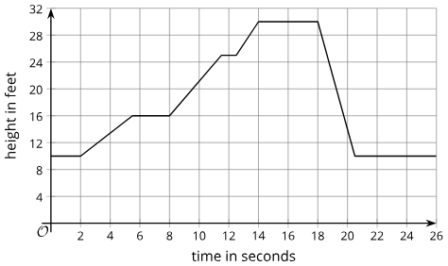
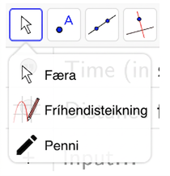

Learning Activity - Raising the Flag 🏳️
Point Tool
Freehand Shape Tool
Graph of the Answer
Notes:
Activity Images

Slide 19
Learning Strategies - Raising the Flag 🏳️
“Where does the maximum height occur?”
“What scale is used on the axes?”
“Where are the constant time intervals?”
Compare and Connect
Teacher Instruction: Use these strategies to adjust the activity to support English language learners and students with disabilities.
You can copy and paste the callouts directly on top of the activity or give the instructions aloud.
Notes:
Support for English Language Learners: MLR 7 Compare and Connect: Representing, Conversing
Use this routine to prepare students for the whole-class discussion. Invite students to quietly circulate and analyze at least 2 other graphs in the room. Give students quiet time to think individually to consider which features of the graphs are alike and which are different. Display these prompts as students move around the room: “Where does the maximum height occur?”; “What scale is used on the axes?”; and “Where are the constant time intervals?” Next, ask students to find a partner to discuss what they noticed. This will help students compare and contrast key features on graphs of the same function.
Design Principle(s): Cultivate conversation
Learn more about this routine
View the instructional video and follow along with the materials to assist you with learning this routine.
Provide support for students
Distribute graphic organizers to the students to assist them with participating in this routine.
Support for Students with Disabilities: Representation: Internalize Comprehension
Use color coding and annotations to highlight connections between representations in a problem. For example, invite students to highlight the W, 0, and 72 in W(0) = 72 in different colors and highlight the corresponding parts of the first sentence of the task statement in the same color to show what each part represents. Remind students to refer to their copy of the annotated function notation.
Supports accessibility for: Visual-spatial processing

Slide 20

Self Check
Marcus is going to the library with his friend Monica.
Monica lives between the library and Marcus’s house.
Marcus lives 0.5 mile from Monica, and she lives 0.25 mile from the library.
Marcus walks to Monica’s house in 5 minutes, and he stays there for 15 minutes before they walk together to the library in 3 minutes.
If you were sketching a graph of Marcus’s distance from home in miles with respect to time, in minutes, how would you represent the 15 minutes he was at Monica’s house graphically?
A vertical line connecting (5,0.5) and (5,20).
A line with a constant rate connecting (0,0) and (5,0.5).
A line with a constant rate connecting (0,0) and (20,0.5).
A horizontal line connecting (5,0.5) and (20,0.5).
Let’s review!
Notes:
Answer Feedback - Individualized by Response
Incorrect.A vertical line would indicate that Marcus was in 2 different places at the exact same time. The answer is a horizontal line connecting (5,0.5) and (20,0.5).
Incorrect. This is the line that represents the distance from when Marcus leaves his house until he gets to Monica’s house. The answer is a horizontal line connecting (5,0.5) and (20,0.5).
Incorrect. This would represent Marcus taking 20 minutes to walk to Monica’s house. The answer is a horizontal line connecting (5,0.5) and (20,0.5).
That’s correct! When Marcus arrives at Monica’s house, 5 minutes have passed and he is 0.5 mile from home. This is represented by (5,0.5). While he is at Monica’s, time passes, but the distance does not change. This can be represented by (20,0.5). Since the distance is the same, the line is horizontal.

Slide 21
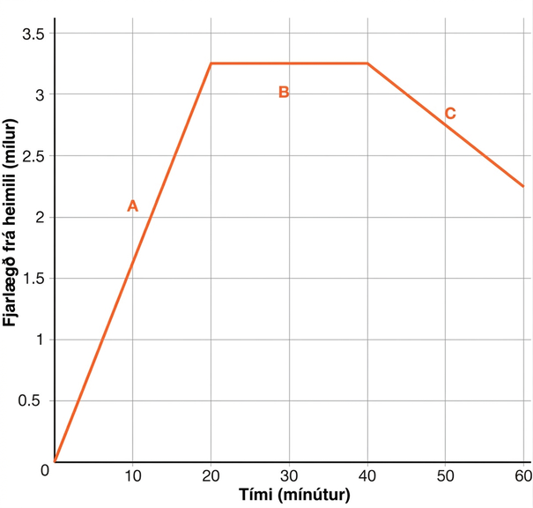
Self Check - Review
Here is a sample graph representing a function that describes Sam’s distance from home over an hour.
Sam rides his bike to his friend’s house at a constant rate for 20 minutes.
Sam plays for 20 minutes at his friend’s house.
Sam and his friend bike together to an ice cream shop that is between their houses for 20 minutes.
Notice that the x-axis is labeled “time in minutes” and the y-axis is labeled “distance from home (miles).”
Sam’s distance from home increased as he rode to his friend’s house, stayed constant while he played, then decreased as he headed to the ice cream shop, which is between their houses.
Notes:
Another example
Tyler filled up his bathtub, took a bath, and then drained the tub. The function gives the depth of the water B, in inches, t minutes after Tyler began to fill the bathtub.
These statements describe how the water level in the tub was changing over time. Use the statements to sketch an approximate graph of the function.
B(0) = 0
B(1) < B(7)
B(9) = 11
B(10) = B(20)
B(20) > B(40)
This sample graph meets all of the statements above.
Click here to see the sample graph.

Slide 22
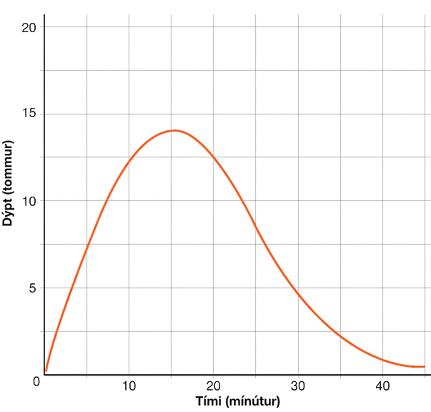
Learning Activity - Raising the Flag 🏳️
Sample Graph
Notes:
Activity Images

Slide 23

Lesson Journey
Warm Up
Learning Activity
Practice
Learning Activity
Cool Down
Lesson Synthesis

Slide 24
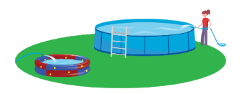
Cool Down
To prepare for a backyard party, a parent uses two identical hoses to fill a small pool that is 15 inches deep and a large pool that is 27 inches deep.
The height of the water in each pool is a function of time since the water is turned on.
Sketch graphs for each of the situations on the next slide.
The graph of each situation should have two lines: S(t) for the small pool’s water height after t minutes and L(t) for the large pool’s water height after t minutes
Notes:
Cool Down (5 minutes)
Answers, anticipated misconceptions, and activity synthesis on next slide

Slide 25
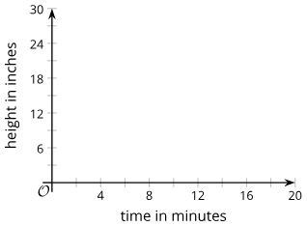
Cool Down
In both S(t) and L(t), the height of the water is measured in inches.
Situation 1: Each hose fills one pool at a constant rate. When the small pool is full, the water for that hose is shut off. The other hose keeps filling the larger pool until it is full.
Situation 2: Each hose fills one pool at a constant rate. When the small pool is full, both hoses are shut off.
Situation 3: Each hose fills one pool at a constant rate. When the small pool is full, both hoses are used to fill the large pool until it is full.
Sample graph of height in inches vs. time in minutes.
Notes:
Answers
Click Here for images of the graphs for each situation.
Anticipated Misconceptions
Some students might mistakenly think that when the pools are “full,” the water in each pool has reached the same height. Remind students that the two pools have different heights, so it takes different heights of water to make them full.
Activity Synthesis
Invite or select students to share their graphs and the assumptions and decisions they made as they were graphing. Display graphs that correctly represent the same situation but look different because of variation in assumptions.
Discuss questions such as:
“How would the vertical values of the two graphs compare when the pools are full?” (The vertical value of the large pool would be up to 12 inches greater than that of the small pool because the large pool is 12 inches taller than the small pool.)
“When each pool is being filled by one hose and at the same rate, should the two graphs have the same slope? Why or why not? If not, which graph has a greater slope?” (No. The water in the smaller pool rises more quickly because the area of the pool is smaller, so the slope for that graph should be greater.)
“How would the graph of the large pool change when one hose was moved from the small pool to the large pool? Would its slope increase, decrease, or stay the same?” (The slope of the graph for the large pool would double, because water is now rising at twice its previous rate. The graph for the small pool would stay constant, as the water is no longer increasing in height.)

Slide 26
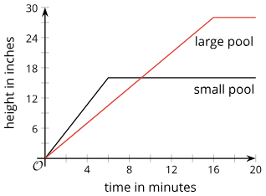
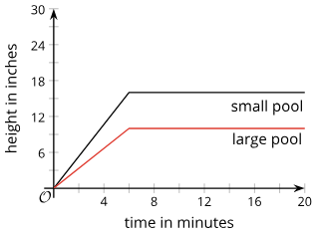
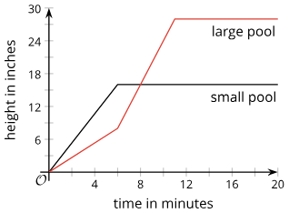
Cool Down
Situation 1: Situation 2: Situation 3:

Slide 27

Lesson Journey
Warm Up
Learning Activity
Practice
Learning Activity
Cool Down
Lesson Synthesis

Slide 28
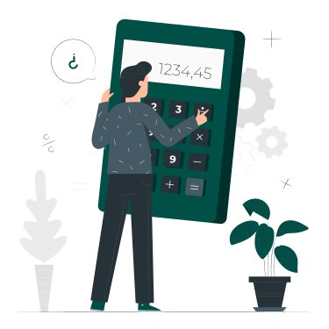
Practice
Put your hard work to action, practice what you’ve learned!
Notes:
Digital Practice: Access the practice pages at https://openstax.org/details/books/algebra-1

Slide 29

Lesson Journey
Warm Up
Learning Activity
Practice
Learning Activity
Cool Down
Lesson Synthesis

Slide 30

Lesson Synthesis
You will observe the teacher walking from one end of the classroom to the other, and imagine how you would graph their distance from the starting point as a function of time.
Take note of any characteristics of the
movement that would affect the output of this function and show up as distinct features on a graph.
Notes:
Prompt:
To highlight how graphs reflect changing quantities, tell students to observe you walking across the room and imagine graphing your distance from the start over time.
Ask students to notice any characteristics of the movement that would affect the output of this function and show up as distinct features on a graph.
Walk from one side of the classroom to the other, incorporating moves such as:
walking at a constant rate all the way
slowing down and speeding up
walking one way and then turning around and walking back
taking a few steps, stopping and standing still, and then continuing walking
walking backward a few steps, and then walking forward again
Gather as many observations as possible about the walk. For each, ask how it would appear on a graph—e.g., speeding up means a steeper line, slowing down a shallower one, and stopping creates a horizontal segment, with longer pauses shown as longer segments.
If time permits, repeat the walking demonstration and ask students to graph the function.
Closing the Lesson
After the Lesson Synthesis, have students review the Lesson Summary to revisit learning targets, key takeaways, and reflect on their confidence with the material.
For more on the benefits of using this type of metacognitive reflection, see the Research in Practice section of the course.

Slide 31
Self Assessment
How much do you agree with the following statements?
I can… | I can | Almost | Not yet
Explain the average rate of change of a function in terms of a situation.
Describe important features of a graph and explain what they mean in a situation.
Sketch a graph that shows important features of the situation, given a description or a visual representation of a situation.

