Slide 1
Algebra 1
Unit 7 Introduction to Quadratic Functions
Lesson 7.16 Graphing from the Vertex Form
Notes:
How to Get Started
Review Slide 2: How to use these slides
Check out the Check out the digital quick start guide!
Review Slide 3: Reference Key of Icons

Slide 2

How to use these slides
On the activity slides check the speaker notes for teacher support and instructional information.
Each lesson includes 1 warm up, 2-3 learning activities, a cool down, practice and a lesson synthesis.
  Learning activities are followed by a self check question, and review section.
Some slides have been hidden from student view, more information can be found on the next slide (Reference Key).
You can edit and use these slides for personal and classroom use, but cannot sell them and must keep the attribution logos.
For more information, Check out the digital quick start guide!
OpenStax CC BY NC SA

Slide 3





Reference Key
Check the top right corner for an icon referencing these unique sections.
Icon | Title | View | Location and Description
n/a | Support for Students with Disability | Hidden | Learning Strategies slide, provides additional support to students for understanding the activity.
n/a | Support for English Language Learners | Hidden | Learning Strategies slide, provides additional support to students for understanding the activity.
n/a | Extending Your Thinking | Hidden | Extending Your Thinking slide, provides an extra challenge for students.
n/a | Self Check | Not Hidden | Self Check slide, checkpoint to assess student understanding after the learning activity.
n/a | Review | Hidden | Self Check - Review slide, designed to help review topics from the self check question.
On the next slides, check the speaker notes for teacher instructions and support.
Notes:
Check the Speaker Notes: On the next slides you can find discussion questions, lesson information, answers to the activities, and ways to adjust the activity for your students!

Slide 4

Learning Goals
By the end of this lesson you will be able to -
Graph a quadratic function given in vertex form, showing the maximum or minimum and the y-intercept.
Find the maximum or the minimum of a quadratic function given in vertex form without first graphing it.
Notes:
Lesson Narrative
Students review how vertex form reveals the vertex and the direction a parabola opens. They consider how the structure of the expression explains whether the vertex is a minimum or maximum and use symmetry to sketch additional points on the graph.
Students reason about a(x − h)² to anticipate the graph’s behavior. Since (x − h)² is always positive except at x = h, a positive a makes the vertex a minimum, and a negative a makes it a maximum.
Students don’t need to master this reasoning formally but use these ideas to sketch quadratic graphs and match functions to their corresponding graphs.
Required Preparation
Print and cut up cards from the blackline master. Prepare one copy for every two students.
Required Materials
Pre-printed cards, cut from copies of the blackline master.
Texas Essential Knowledge and Skills
A1(C) select tools, including real objects, manipulatives, paper and pencil, and technology as appropriate, and techniques, including mental math, estimation, and number sense as appropriate, to solve problems
A1(E) create and use representations to organize, record, and communicate mathematical ideas
A1(F) analyze mathematical relationships to connect and communicate mathematical ideas
A7(A) graph quadratic functions on the coordinate plane and use the graph to identify key attributes, if possible, including x-intercept, y-intercept, zeros, maximum value, minimum values, vertex, and the equation of the axis of symmetry

Slide 5
Vocabulary
Previous
Vertex
  On a parabola, it is the point where the graph changes from increasing to decreasing or vice versa. It is the highest or lowest point on the graph.
Quadratic Function
  A function where the output is given by a quadratic expression in the input f(x) = ax² + bx +c.
New
Axis of Symmetry
  A line that divides a figure, shape, or object into equivalent halves. In a quadratic function of the form y = 𝑎(x − h)² + k where (h, k) is the vertex of the parabola, it is x = h.
Notes:
Lesson Vocabulary
To support student understanding of key vocabulary:
Introduce and review the vocabulary words students will see in this lesson.
Encourage students to notice how these words are used and to include them in their math discussions and explanations—both written and oral.
Use a word wall to reinforce vocabulary. Sample word wall cards are available here.
For newcomers or students with beginning English proficiency, use these Quizlet sets to support vocabulary learning:
Unit 7 Spanish Vocabulary – use first to build understanding
Unit 7 Vocabulary (English) – use after anchoring in Spanish
Support for English Language Learners
ELPS 1(F) use accessible language and learn new and essential language in the process
ELPS 2(F) listen to and derive meaning from a variety of media such as audiotape, video, DVD, and CD-ROM to build and reinforce concept and language attainment
ELPS 3(D) speak using grade-level content area vocabulary in context to internalize new English words and build academic language proficiency
ELPS 3(E) share information in cooperative learning interactions
ELPS 3(G) express opinions, ideas, and feelings ranging from communicating single words and short phrases to participating in extended discussions on a variety of social and grade-appropriate academic topics
ELPS 5(B) write using newly acquired basic vocabulary and content-based grade-level vocabulary

Slide 6

Lesson Journey
First Stop: Warm Up

Slide 7

Warm Up | Part 1
Express Yourself 😐😶😑
Expressions in different forms can be used to define the same function. Here are three ways to define a function f.
Standard form | Factored form | Vertex form
f(x) = x² - 4x + 3 | f(x) = (x - 3)(x - 1) | f(x) = (x - 2)² - 1
f(x) = ax² + bx + c | f(x) = a(x - r₁)(x - r₂) | f(x) = a(x - h)² + k
Which form would you use to find following features of 𝑓? Explain.
  The x-intercepts
  The vertex
  The y-intercept
Notes:
Warm Up (5 minutes)
This warm up highlights the three forms of quadratic expressions students have seen so far. It reinforces how each form gives different insights into the graph of a quadratic function.
Launch
Arrange students in groups of two.
Give students a minute of quiet time to think individually, and then ask them to share their thinking with a partner.
Activity Answers
Factored form
Vertex form
Standard form
Activity Synthesis
Invite students to share their responses and explanations. Encourage students to name specific features of the graph of f. If time permits, consider asking students to use all of the info they can gather to sketch a graph.
If not already mentioned by students, point out that while the standard form allows us to find the y-intercept more readily, the y-intercept can always be found by evaluating the function at x = 0.

Slide 8
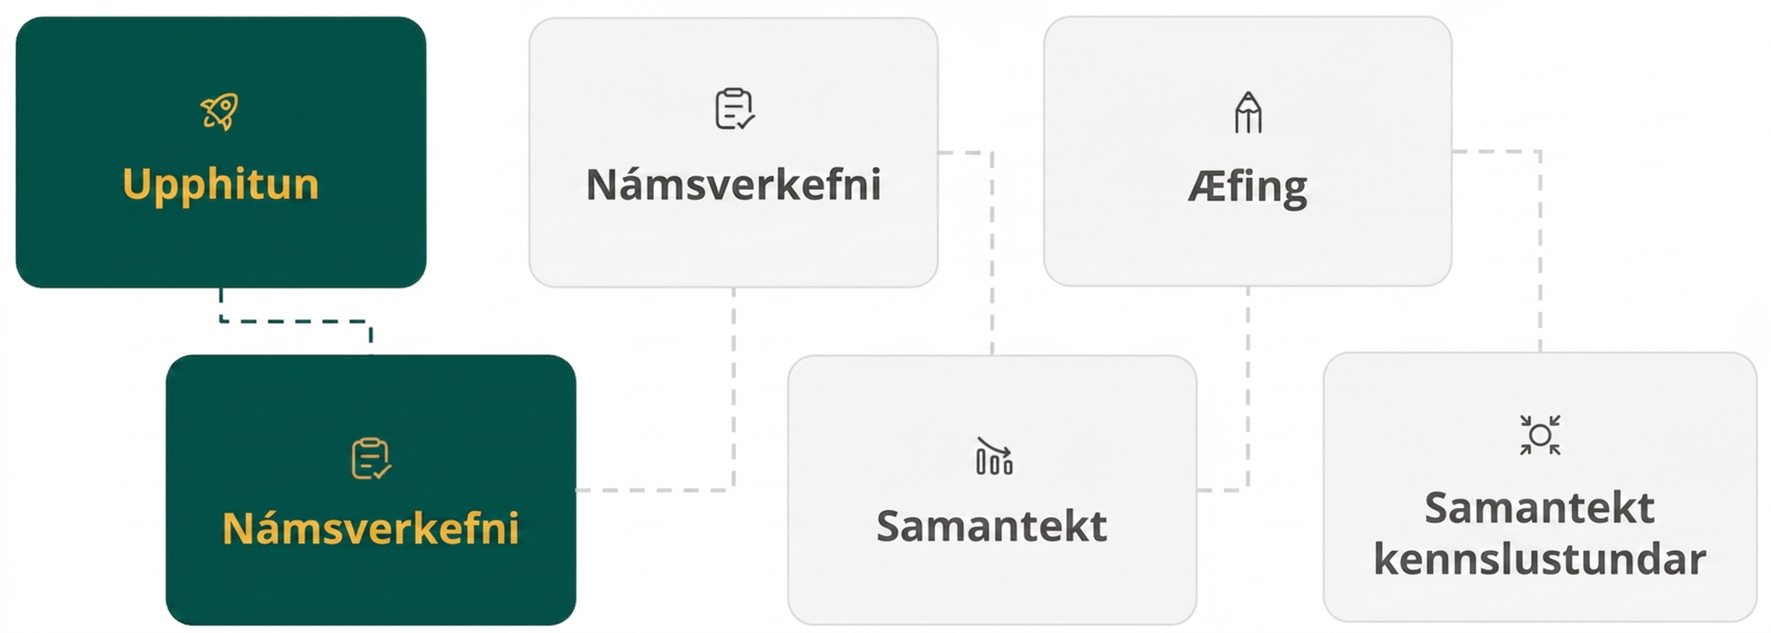
Lesson Journey
Second Stop: Learning Activity A

Slide 9

Learning Activity A | Learning Strategies
The Vertex Tells All💡
Share your explanation with partners.
Check that you agree on the table values.
Give feedback on how Priya knew the vertex was a min or max.
Revise your draft for 2–3 minutes.
Stronger and Clearer Each Time
Teacher Instruction: Use these strategies to adjust the activity to support English language learners and students with disabilities.
You can copy and paste the callouts directly on top of the activity or give the instructions aloud.
If a is positive, the graph opens up; if a is negative, it opens down.
Looking at two y-values can help you tell up or down.
Use symmetry to find a point that matches on the other side.
Find the vertex, decide up or down, then find two more points.
Representation
Notes:
Support for English Language Learners: MLR 1 Stronger and Clearer Each Time: Writing, Conversing
Use this routine to help students improve their writing by providing them with multiple opportunities to clarify their explanations through conversation. Invite students to meet with one to two partners to share and get feedback on their explanation of how Priya might have reasoned about whether the vertex is the minimum or maximum. Students should first check to see if they agree with each other about the values that go in the table. Give two to three minutes to revise their initial draft based on feedback from their peers.
Design Principle(s): Support sense-making; Optimize output (for explanation)
Provide support for students
Distribute graphic organizers to the students to assist them with participating in this routine.
Support for Students with Disabilities: Representation: Internalize Comprehension
Activate or supply background knowledge by creating a display that highlights the following information: a graph of the form y = a(x − h)² + k opens up when a is positive and opens down when a is negative; examining y-values of two points can help to determine if the graph opens up or down; if coordinates of one point are found on the graph, the symmetry of the graph may be used to find another point. Engage students in finding the vertex, deciding whether the graph opens up or down, and finding two more points. The display can be completed during the synthesis.
Supports accessibility for: Memory; Conceptual processing

Slide 10
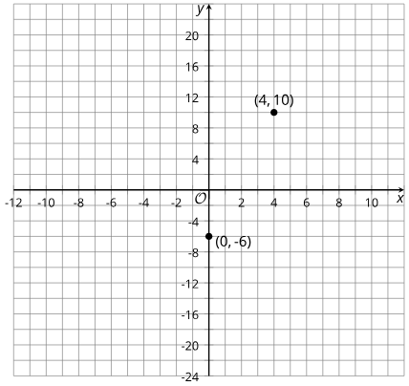
Learning Activity A | Part 1
The Vertex Tells All💡
Be prepared to explain your reasoning.
The graph of p(x) = −(x − 4)² + 10 passes through (0, −6) and (4, 10).
  Find the coordinates of another point on the graph of p.
  Plot p(x) and the points (0, −6), (4, 10), and (8, −6) to label the graph.
Notes:
Support for All Learners
This activity offers additional support and an extension for students:
For English language learners and students with disabilities, be sure to review the Learning Strategies slide!
For students looking for an extra challenge, be sure to review the Extending Your Thinking slide!
Activity (20 minutes)
Students graph quadratic functions in vertex form and strengthen their understanding of how the expression relates to the graph.Students revisit that y = a(x − h)² + k opens up when a > 0 and down when a < 0. They sketch graphs using the vertex, direction of opening, and two additional points. They also determine whether the vertex is a maximum or minimum by comparing values on either side.
Students have several chances to use structure in the function.
With the vertex and one point, students compare y-values to determine if the graph opens up or down. They can use symmetry to find a second point. When explaining Priya’s reasoning, they note that −(x − 4)² is zero at the vertex and negative elsewhere, so p(4)is the maximum value.
Launch
Display the two equations defining p and q for all to see.
Give students a moment to think about how the equations are alike and how they are different. Invite students to share their comments.
If not mentioned by students, ask: "Where are the vertices of the graphs located?" (All of the equations have an (x − 4)² in them and a 10 constant term. This means that the vertex for each graph is at the same location, at (4,10).)
Remind students that, earlier in the unit, we learned that the vertex of a graph represents the maximum or the minimum value of a function. Ask students:
"How can we tell if the vertex of the graph of p represents the maximum or the minimum?" (If the graph opens upward, the vertex is the minimum. If it opens downward, it is the maximum.)
"How can we tell if the graph of p opens upward or downward?" (In an earlier lesson, we saw that when a quadratic function is expressed in the form of y = a(x − h)² + k and the coefficient a is negative, the graph opens downward. This means the vertex represents the maximum of the function. Or we could plot some coordinate pairs to help us visualize the graph.)
If no students mentioned finding additional points on each graph to determine whether the graph opens up or down, ask them about it.
Because this activity is designed to be completed without technology, ask students to put away any devices.
Activity Answers
(8, −6). If we find p(8) and substitute 8 for x in the expression, we have: p(8) = −(8 −4)² + 10, which is equal to −16 + 10 or -6.
Link to Desmos graph: https://www.desmos.com/calculator/ze8h2ubhsf
The graph of a quadratic function is symmetrical across the vertical line containing the vertex. If a point on the graph that is 4 units to the left of the line containing the vertex has a y-value of -6, there is a point to the right of the line containing the vertex that also has a y-value of -6.
More activity questions, answers, anticipated misconceptions and synthesis on the next slide.

Slide 11
Learning Activity A | Part 2
The Vertex Tells All💡
A line containing the vertex is called the parabola’s axis of symmetry.
Equation | x-coordinate of the vertex | y-coordinate of the vertex
q(x) = ½(x − 4)² +10 | a. ___ | b. ___
On the same coordinate plane containing the points and equation from question 1, plot the coordinates of the vertex of the function q.
Find two other points that are on the graph of q. Try to identify points that are symmetrical over the axis of symmetry.
Sketch and label the graph of q. Explain or show your reasoning.
Notes:
Activity Answers
4
10
Link to Desmos graph: https://www.desmos.com/calculator/xsc0xdq3lm
One possible answer could be:
(2, 12) and (6, 12). Substituting 2 for x, we have: q(2) = ½(2 − 4)² + 10, which is 12, so (2, 12) is one point on the graph. Substituting 6 for x, we have: q(6) = 121(6 − 4)² + 10, which equals 12, so (6,12) is another point.
Another possible answer could be (0, 18) and (8, 18). Substituting 0 for x, we get q(0) = 18, so (0, 18) is one point on the graph. This point is 4 units to the left and 8 units up from the vertex. Because the graph has a vertical line of symmetry, or axis of symmetry, through the vertex, it also goes through a point that is 4 units to the right and 8 units up, which is (8, 18)
Link to Desmos graph: https://www.desmos.com/calculator/raselrxquk
More activity questions, answers, anticipated misconceptions and synthesis on the next slide.

Slide 12
Learning Activity A | Part 3
The Vertex Tells All💡
Pilar says, "Once I know the vertex is (4,10), I can find out, without graphing, whether the vertex is the maximum or the minimum of function p. I would just compare the coordinates of the vertex with the coordinates of a point on either side of it."
Complete the table by evaluating p(x) for questions a and b.
x | 3 | 4 | 5
p(x) = -(x - 4)² + 10 | a. __ | 10 | b. __
Are you ready for more?
Explain how Pilar might have reasoned whether the vertex is the minimum or maximum.
Notes:
Activity Answers
p(3) = −(3 − 4)²+10 = −(−1)² + 10 = −1 + 10 = 9.
p(5) = −(5 − 4)²+10 = −(1)² + 10 = −1 + 10 = 9.
The values of p(3) and p(5) are both less than 10. The vertex of a quadratic graph represents the minimum or the maximum of the function. Because the two points on either side of the vertex of p have a lesser y-value, the vertex must be the maximum.
Anticipated Misconceptions
Students may be unsure about what input value to choose to find additional points on each graph. Without telling students a specific value to use, encourage them to choose an x-value that is simple to evaluate and would help them sketch the graph.
Activity Synthesis
Invite students to share their graphs and explain how they found one additional point for p and two for q. Highlight strategies that use symmetry to identify a second point once one non-vertex point is known.
Next, have students explain their analysis of Pilar’s reasoning. Emphasize that the vertex of p cannot be a minimum because other values of p are less than 10. Since (0, −6) has a smaller output than the vertex (4, 10), the vertex must be a maximum and the graph opens downward.
See Table: Function p: on the next slide.
See Table: Function q on the next slide.
If time allows, discuss how the structure of the squared term shows whether the vertex is a maximum or minimum. Using function q, ask students to reason that (x − 4)² is 0 at x = 4 and positive elsewhere, so the minimum occurs at x = 4. Multiplying by ½ ​ or adding 10 shifts or scales the outputs but does not change where the minimum occurs.

Slide 13
Learning Activity A | Part 4
The Vertex Tells All💡
Return to Previous Slide
Tables for Activity Synthesis
Function p
x | 0 | 1 | 2 | 3 | 4 | 5 | 6
-(x - 4)² + 10 | -6 | 1 | 6 | 9 | 10 | 9 | 6
Function q
x | 0 | 1 | 2 | 3 | 4 | 5 | 6
½ (x - 4)² + 10 | 18 | 14½ | 12 | 10½ | 10 | 10½ | 12
Notes:
Activity Synthesis
Return to previous slide.

Slide 14

Learning Activity A
Extending Your Thinking
Choose the equation for a quadratic function whose graph has the vertex at (2, 3) and contains the point (0,−5).
y = −2(x − 2)² + 3
y = −3(x − 2)² + 2
y = −5(x − 2)²
y = 2(x − 2)² + 3
Use the graphing tool or technology outside the course. Sketch a graph of your function.
Notes:
Go back to Lesson Activity
Answers
y = −2(x − 2)² + 3
Link to Desmos graph: https://www.desmos.com/calculator/gvdkfjaoef

Slide 15
Learning Activity A
Self Check
The equation of a quadratic function is y = (x − 1)² + 5
and the point (3, 9) also lies on the parabola. What is another point that lies on the parabola?
(−5, 9)
(3, 1)
(−1, 9)
(−1, 5)
Let’s review!
Notes:
Answer Feedback - Individualized by Response
Incorrect. The vertex is at (1, 5). Use this to find a point symmetric to (3, 9) on the parabola. The x-coordinate will be 2 units to the left of 1.
Incorrect. The vertex is at (1, 5). Use this to find a point symmetric to (3, 9) on the parabola. The x-coordinate will be 2 units to the left of 1.
That’s correct! Because parabolas are symmetric and (3, 9) is two units to the right of x = 1, there must be another point on the parabola two units to the left of x = 1 with the same y-coordinate as (3, 9). That point is (−1, 9).
Incorrect. The x -coordinate is correct. To find the y-value, substitute -1 into the equation. The point will be symmetric to (3, 9) on the parabola.

Slide 16

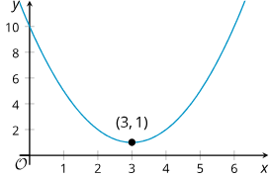
Learning Activity A | Part 1
Self Check - Review
The vertex form tells us:
The graph of function p(x) = (x − 3)² + 1 has a vertex at (3, 1).
If (x − 3)² has a positive coefficient, the graph opens upward.
You can use the vertex (3, 1) to determine that minimum function value is 1.
But why does the function p take on its minimum value when x is 3? Let’s review the following slides to find out.
Notes:
Remind Students
Review the key points about vertex form with students.
More review on the next slide.

Slide 17
Learning Activity A | Part 2
Self Check - Review
When x = 3, the squared term (x − 3)² = 0. (3 − 3)² = 0² = 0.
When x ≠ 3, the squared term (x − 3)² is a positive number greater than 0. (Squaring any number results in a positive number.)
This means that the output when x ≠ 3 will always be greater than the output when x = 3, so the function p has a minimum value at x = 3.
x | 0 | 1 | 2 | 3 | 4 | 5 | 6
(x - 3)² + 1 | 10 | 5 | 2 | 1 | 2 | 5 | 10
Notice that the output is the least when x = 3 and it increases both as x increases and as it decreases.
Notes:
Review with Students
Review each step with students.
More review on the next slide.

Slide 18
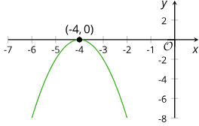
Learning Activity A | Part 3
Self Check - Review
The squared term sometimes has a negative coefficient, h(x) = −2(x + 4)².
When x = −4 the squared term (x + 4)² = 0.
(−4 + 4)² = 0² = 0.
When x ≠ −4 the squared term (x + 4)² > 0. But when (x + 4)² is multiplied by a negative number (-2), then −2(x + 4)², is negative.
This means that the output when x ≠ − 4 will always be less than the output when x = −4, so the function x has its maximum value when x = −4.
Notes:
Review with Students
Review each step with students.
More review on the next slide.

Slide 19
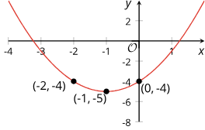
Learning Activity A | Part 4
Self Check - Review
We can find the y-intercept of the graph representing any function. The y-coordinate of the y-intercept is the value of the function when x = 0.
Examine g(x) = (x + 1)² − 5.
The y-intercept is (0,−4).
g(0) = (0 + 1)² − 5 = −4.
Its vertex is at (−1, −5).
Another point on the graph with the same y-coordinate is located the same horizontal distance from the vertex but on the other side.
Notes:
Review with Students
Review each step with students.

Slide 20

Lesson Journey
Third Stop: Learning Activity B

Slide 21
Learning Activity A | Learning Strategies
Graph–Equation Match-Up Challenge 👥
Teacher Instruction: Use these strategies to adjust the activity to support English language learners and students with disabilities.
You can copy and paste the callouts directly on top of the activity or give the instructions aloud.
Work with a partner.
Partner A starts: “Equation ___ matches Graph ___ because…”
Partner B: Ask for details (vertex, steepness, intercepts, opening).
Switch roles after each match.
Discussion Supports
Start with a smaller set of cards.
Make your matches.
Add the remaining cards once you’re ready.
Representation
Notes:
Support for English Language Learners: MLR 8 Discussion Supports: Conversing
Use this routine to help students describe the reasons for their matches. Arrange students in groups of two. Invite Partner A to begin with this sentence frame: “Equation _____ matches with the graph _____ because . . . .” Invite the listener, Partner B, to press for additional details referring to specific features of the graphs and equations, such as vertex, steepness, intercepts, and direction of the opening. Students should switch roles after each match.
Design Principle(s): Support sense-making; Cultivate conversation
Support for Students with Disabilities: Representation: Internalize Comprehension
Chunk this task into more manageable parts to differentiate the degree of difficulty or complexity by beginning with fewer cards. For example, give students a subset of the cards to start with and introduce the remaining cards once students have completed their initial set of matches.
Supports accessibility for: Conceptual processing; Organization

Slide 22

Learning Activity B | Part 1
Graph–Equation Match-Up Challenge 👥
  With your partner, match each equation card your teacher gave you to the graph of the same quadratic.
  Take turns explaining why your matches make sense.
  Listen to your partner’s reasoning and discuss disagreements.
  After all matches are made, record each equation, its letter, a quick sketch, and a brief explanation of how you knew they matched.
Link to cards
Notes:
Support for All Learners
This activity offers additional support for students:
For English language learners and students with disabilities, be sure to review the Learning Strategies slide!
Activity (10 minutes)
In this activity, students match quadratic equations to their graphs by using structural features of each representation, so technology is not needed. Encourage students to use precise mathematical language as they explain and justify their matches and respond to others’ reasoning. Listen for effective strategies and highlight those that reliably connect equation structure to graph features.
Here are the equations and graphs for reference:
f(x) = (x − 1)² + 4
g(x) = −(x − 4)² + 1
h(x) = (x + 1)² − 4
p(x) = −(x + 1)² − 4
q(x) = 2(x − 4)² + 1
r(x) = (x + 4)² − 1
Link to Desmos graph A: https://www.desmos.com/calculator/blpfhipish
Link to Desmos graph B: https://www.desmos.com/calculator/i9awx7nv7l
Link to Desmos graph C: https://www.desmos.com/calculator/uil0uohxh1
Link to Desmos graph D: https://www.desmos.com/calculator/fkzj7m3fsl
Link to Desmos graph E: https://www.desmos.com/calculator/jodplj4mh2
Link to Desmos graph F: https://www.desmos.com/calculator/fdnvntcnn4
Launch
Arrange students in groups of two.
Give each group a set of cut-up cards (Link here). Ask students to take turns matching a card containing an equation with a graph that represents it.
The first partner identifies a match and explains why they think it is a match, while the other listens and works to understand.
Then, they switch roles. If they disagree, they should discuss their thinking and work to reach an agreement.
Ask students to record each match (write the equation and sketch the graph) and their reasoning.
If time is limited, students may just record the label of the graph instead of sketching.
Because this activity is designed to be completed without technology, ask students to put away any devices.
Activity questions and answers on the next slide.

Slide 23
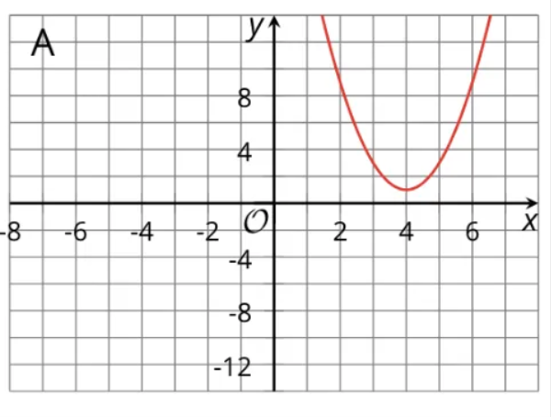
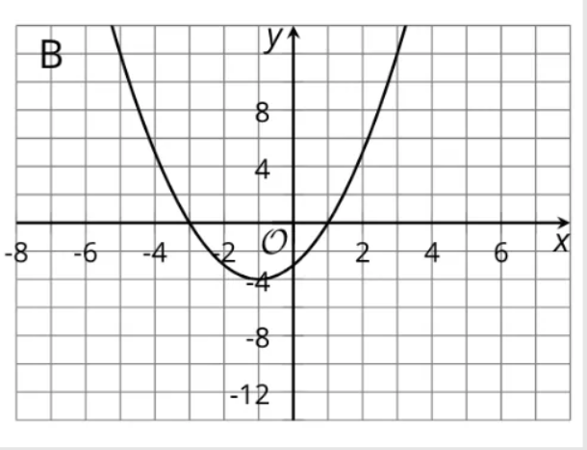
Learning Activity B | Part 2
Graph–Equation Match-Up Challenge 👥
Using the list from the matching activity with your partner, look at each graph and choose the function from the list that correctly matches it.
Graph A
List of Equations
f(x) = (x − 1)² + 4
g(x) = −(x − 4)² + 1
h(x) = (x + 1)² − 4
p(x) = −(x + 1)² − 4
q(x) = 2(x − 4)² + 1
r(x) = (x + 4)² − 1
Graph B
Notes:
Answers
q(x) = 2(x − 4)² + 1
h(x) = (x + 1)² − 4
More activity questions and answers on the next slide.

Slide 24
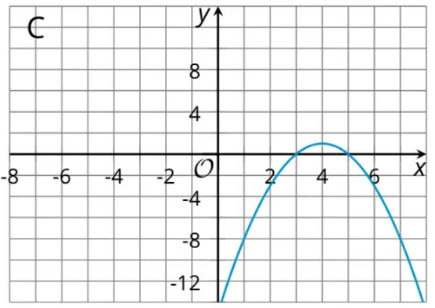
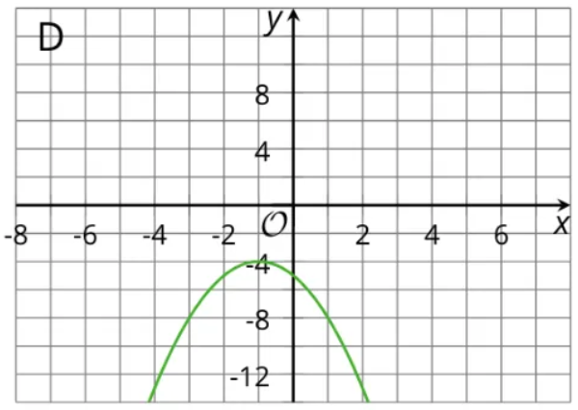
Learning Activity B | Part 3
Graph–Equation Match-Up Challenge 👥
Using the list from the matching activity with your partner, look at each graph and choose the function from the list that correctly matches it.
Graph C
List of Equations
f(x) = (x − 1)² + 4
g(x) = −(x − 4)² + 1
h(x) = (x + 1)² − 4
p(x) = −(x + 1)² − 4
q(x) = 2(x − 4)² + 1
r(x) = (x + 4)² − 1
Graph D
Notes:
Answers
g(x) = −(x − 4)² + 1
p(x) = −(x + 1)² − 4
More activity questions, answers, anticipated misconceptions, and activity synthesis on the next slide.

Slide 25
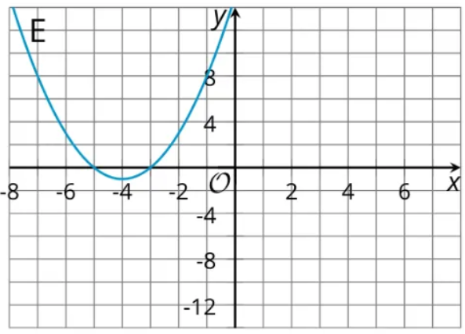
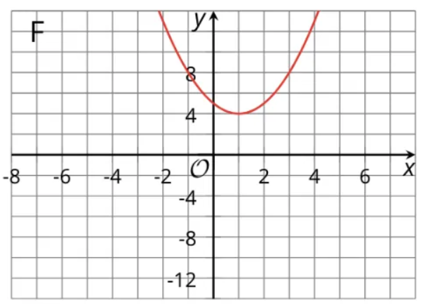
Learning Activity B | Part 4
Graph–Equation Match-Up Challenge 👥
Using the list from the matching activity with your partner, look at each graph and choose the function from the list that correctly matches it.
Graph E
List of Equations
f(x) = (x − 1)² + 4
g(x) = −(x − 4)² + 1
h(x) = (x + 1)² − 4
p(x) = −(x + 1)² − 4
q(x) = 2(x − 4)² + 1
r(x) = (x + 4)² − 1
Graph F
Notes:
Answers
r(x) = (x + 4)² − 1
f(x) = (x − 1)² + 4
Anticipated Misconceptions
Some students may be challenged to identify the coordinates of the vertex on the graphs because the x- and y-axes use a different scale. Encourage students to write down coordinates of the vertex and the intercepts to help them match the graphs to the equations. Some students may have trouble identifying that one graph is steeper than the others. Provide them with graph paper and a piece of patty-paper or a transparency and have them trace one graph onto it. They can overlay the traced graph on top of the other graphs to figure out which one is steeper. Students used similar tools to explore transformations in middle school.
Activity Synthesis
Invite students to share aspects of the equations and graphs they found helpful for the matching. If not mentioned in students' explanations, highlight the following features:
The number being added or subtracted from x in the squared term, or the h in (x − h)²:
If h is being subtracted from x, h is a positive number and the x-coordinate of the vertex is positive.
If h is being added to x in the expression, then h is a negative number and the x-coordinate of the vertex is negative.
The constant term in the quadratic expression in vertex form, or the k in a(x − h)² + k:
If k is positive, the y-coordinate of the vertex is also positive.
If k is negative, the y-coordinate of the vertex is also negative.
The coefficient of the squared term, or the a in a(x −h)² + k:
We saw earlier that when the squared term has a negative coefficient, it makes all positive values negative. This means that:
If a is negative, the vertex represents the maximum (the graph of the quadratic function opens downward).
If a is positive, the vertex represents the minimum (the graph of the quadratic function opens upward).
The magnitude of a:
The larger a is, the narrower the opening of the graph is (or the "steeper" the graph is).
The range of the function:
If the vertex is a maximum, then the range is less than or equal to the y-value of the vertex. So, y ≤ k
If the vertex is a minimum, then the range is greater than or equal to the y-value of the vertex. So, y ≥ k.
Students may also reason the other way around: by looking at the graphs first and then relate the features of the graphs to the equations.

Slide 26
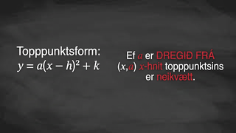
Learning Activity B | Video
Learning About Quadratic Equations and Graphs
Notes:
This video discusses all questions of activity 7.16.3

Slide 27

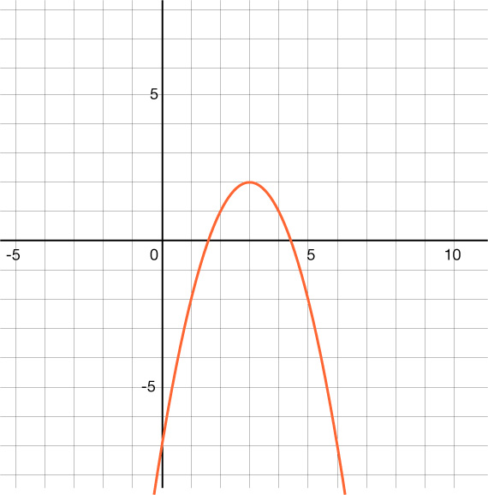
Learning Activity B
Self Check
Which of the following equations matches the graph?
y = (x − 3)² + 2
y = −(x − 3)² + 2
y = (x + 3)² + 2
y = (x + 3)² + 2
Let’s review!
Notes:
Answer Feedback - Individualized by Response
Incorrect. The parabola opens down.
That's correct! The parabola opens down, so the value of a should be negative. The vertex is at (3, 2) so this is the correct vertex form for the graph.
Incorrect. This quadratic has a vertex at (−3, 2) but the graph has a vertex at (3, 2).
Incorrect. This quadratic has a vertex at (−3 ,2) but the graph has a vertex at (3, 2) and opens down.

Slide 28
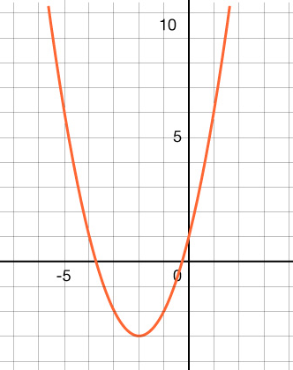
Learning Activity B
Self Check - Review
Step 1 - Find the vertex.
Step 2 - Does the parabola open up or down?
Step 3 - Use the vertex form of the equation and write the parts you know: the coordinates of the vertex.
Step 4 - Find another point on the graph of the parabola and plug in those values for x and x in the equation you wrote.
Step 5 - Solve for a.
Step 6 - Plug the value for a back into the equation.
Choose the equation that matches the graph.
y = (x − 2)² − 3
y = (x + 2)² − 3
y = −(x + 2)² − 3
y = −(x − 2)² − 3
Notes:
Review with Students
Steps for matching graphs of quadratic functions and their equations
Answer
b, y = (x + 2)² − 3.

Slide 29
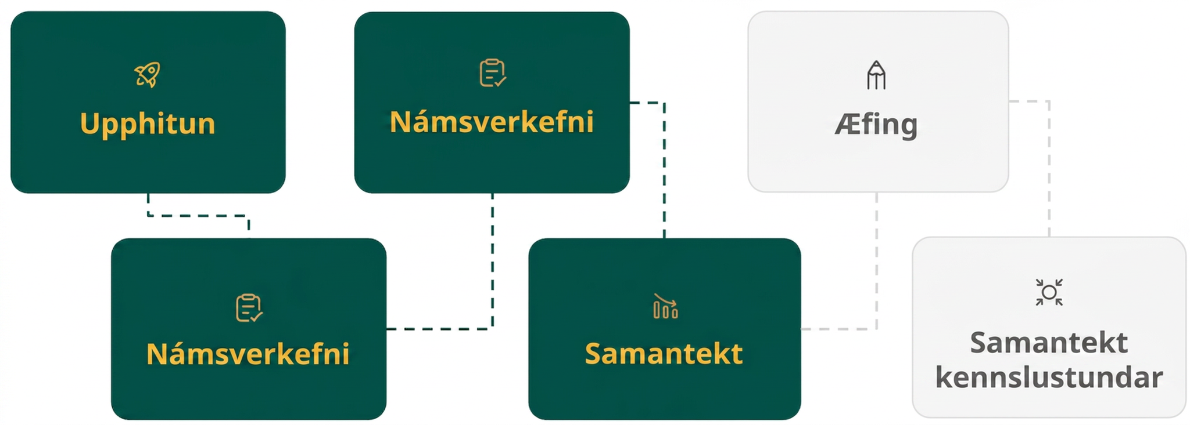
Lesson Journey
Fourth Step: Cool Down

Slide 30
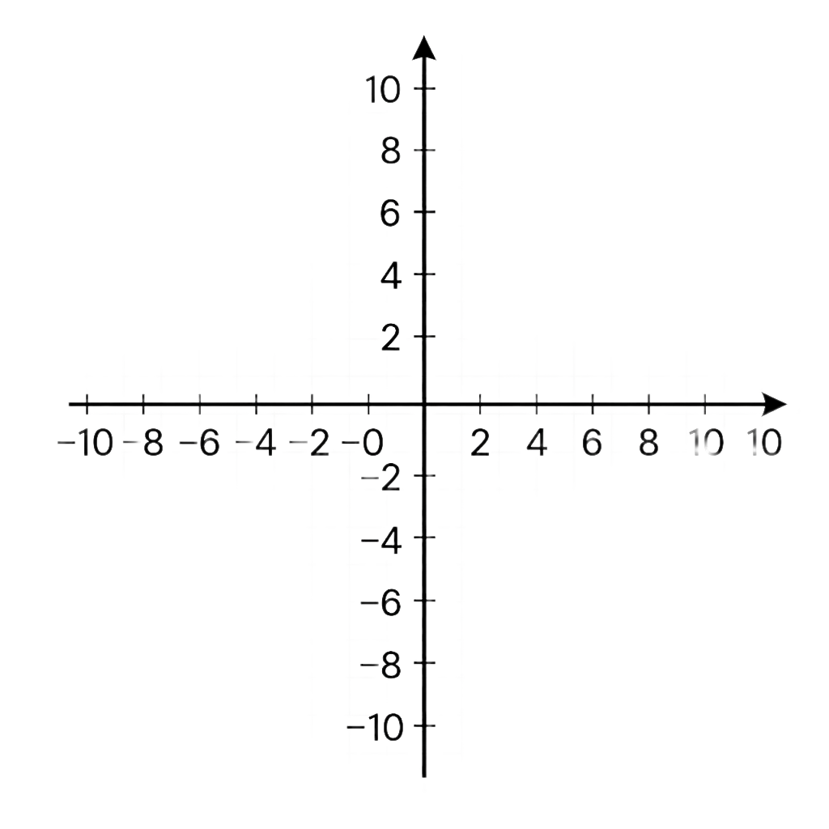
Cool Down
Answer the questions about the equation y = (x − 3)² + 2.
What is the x-coordinate of the vertex of the graph of f?
What is the y-coordinate of the vertex of the graph of f?
Find the coordinates of two other points on the graph. The points should be symmetric across the vertex. Show your reasoning.
Create a graph that
represents the equation.
Notes:
Cool Down (5 minutes)
Launch
Encourage and support opportunities for peer interactions.
Invite students to talk about their ideas with a partner before writing them down.
Answers
3
2
(0, 11) and (6, 11). When x is 0, the value of y is (−3)² + 2 or 11. The other point is 3 units to the right of the vertex with the same y-coordinate.
Link to Desmos graph: https://www.desmos.com/calculator/lo3g0xndgg
Response to Student Thinking - Points to Emphasize
Use student work from this cool down (or think-aloud, if student work does not show these strategies) to demonstrate finding the y-intercept or other key points on the graph that would make graphing easier.

Slide 31
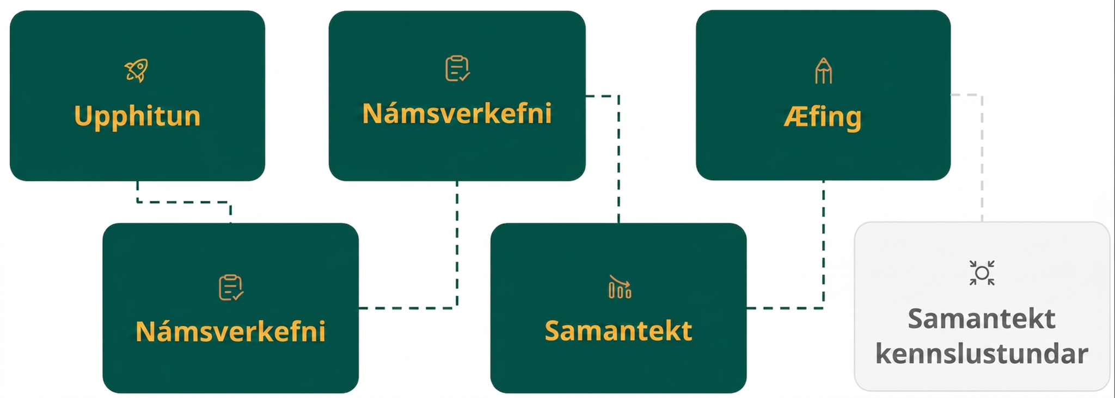
Lesson Journey
Fifth Stop: Practice

Slide 32

Practice
Put your hard work to action, practice what you’ve learned!
Notes:
Digital Practice: Access the practice pages at https://openstax.org/details/books/algebra-1

Slide 33
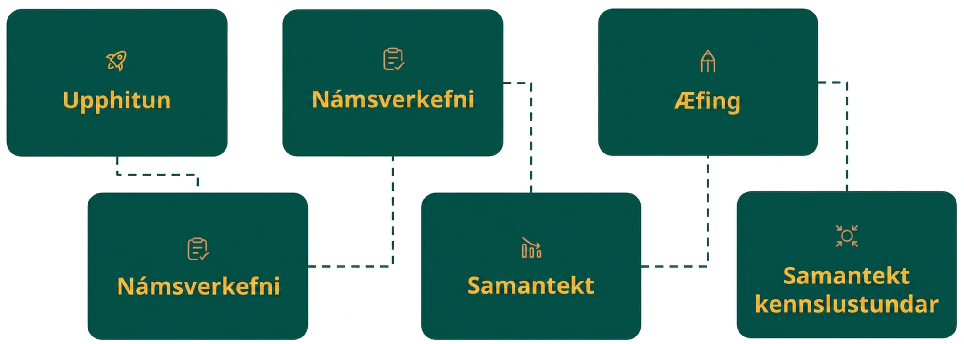
Lesson Journey
Sixth Stop: Lesson Synthesis

Slide 34

Lesson Synthesis
Answer these questions to enhance your understanding of the vertex form and the graph of an equation.
What is the vertex of the graph of y = −2(x − 7)² + 5?
What clues show whether the vertex is a maximum or minimum?
How can we verify that 5 is the y-coordinate of the vertex?
Does knowing the location of the vertex and whether the graph opens up or down enough for sketching the graph to represent −2(x − 7)² + 5? If not, what else is needed?
Notes:
Answers
(7 ,5)
Some explanations:
The squared term (x − 7)² has a negative coefficient. We saw earlier that when that coefficient is negative the graph opens down, so the vertex is the maximum point.
When x = 7, the y-value is 5. When x is greater than 7, y is less than 5. When x is less than 7, y is also less than 5. This means that the points on either side of the vertex have smaller y-values, so the vertex is the maximum.
When x is 7, (x − 7)² is 0. Multiplying it by -2 gives 0. When x is other than 7, (x − 7)² is a positive number. Multiplying it by -2 gives a negative number, so it is less than 0.)
Evaluating the function at x = 7 gives −2(7 − 7)² + 5 = 0 + 5 = 5.
We still don't know how "wide" or "narrow" the opening of the graph will be, so it helps to know another point on the graph. To find another point, we can choose an x-value and find the corresponding y-value. We can use that point to quickly find one more point with the same y-coordinate because the graph is symmetric across the vertex.

Slide 35
Self Assessment
How much do you agree with the following statements?
Learning Goals | I can | Almost | Not yet
Graph a quadratic function given in vertex form, showing the maximum or minimum and the y-intercept | ⃞ | ⃞ | ⃞
Find the maximum or the minimum of a quadratic function given in vertex form without first graphing it. | ⃞ | ⃞ | ⃞

