Slide 1


Algebra 1
Unit 4 Functions
Lesson 4.17: Representing Sequences

Slide 2
How to use these slides
On the activity slides check the speaker notes for teacher support and instructional information.
Each lesson includes 1 warm up, 2-3 learning activities, a cool down, practice and a lesson synthesis.
  Learning activities are followed by a self check question, and review section.
Some slides have been hidden from student view, more information can be found on the next slide (Reference Key).
You can edit and use these slides for personal and classroom use, but cannot sell them and must keep the attribution logos.
For more information, Check out the digital quick start guide!

Slide 3






Reference Key
Check the top right corner for an icon referencing these unique sections.
 | Support for Students with Disability | Hidden | Learning Strategies slide, provides additional support to students for understanding the activity. Learning Strategies slide, provides additional support to students for understanding the activity.
 | Support for English Language Learners | Hidden
 | Extending Your Thinking | Hidden | Extending Your Thinking slide, provides an extra challenge for students.
 | Self Check | Not Hidden | Self Check slide, checkpoint to assess student understanding after the learning activity.
 | Review | Hidden | Self Check- Review slide, designed to help review topics from the self check question.
On the next slides, check the speaker notes for teacher instructions and support.
Notes:
Check the Speaker Notes: On the next slides you can find discussion questions, lesson information, answers to the activities, and ways to adjust the activity for your students!

Slide 4

Learning Goals
By the end of this lesson you will be able to -
Define arithmetic and geometric sequences recursively using function notation.
Represent a sequence in different ways.
Ask questions to get the information needed to represent a sequence in different ways.
Notes:
Lesson Narrative
In this lesson, students learn that sequences are functions and use function notation to define them, moving from informal descriptions to formal recursive definitions like f(n) = f(n − 1) − 3f(n) = f(n - 1) - 3f(n) = f(n − 1) −3. The term “recursive” isn’t required but the concept is central.
Function definitions for sequences are paired with domain inequalities to show where the sequence starts. However, students can describe domain restrictions in words if that's more appropriate for your classroom.
Emphasize writing equations and prepare students to explain the domain of sequences orally when asked.
Students practice writing and interpreting recursive definitions through a matching activity that encourages discussion, reasoning, and multiple representations. Sharing strategies and learning from peers is a key classroom expectation.
Required Preparation
Cut card sort for activity (enough for each pair).
Required Materials
Graph paper
Pre-printed slips, cut from copies of the blackline master, card sort
Texas Essential Knowledge and Skills
A1(F) analyze mathematical relationships to connect and communicate mathematical ideas
A12(C) identify terms of arithmetic and geometric sequences when the sequences are given in function form using recursive processes

Slide 5
Vocabulary
Previous
Geometric Sequence
  A sequence in which each term after the first nonzero term is found by multiplying the preceding term by a constant called the "common ratio 𝑟," where 𝑟 ≠ 0 or 1. A sequence where the ratio between consecutive terms is always the same.
New
Recursive Definition
  A function that provides a repeated or recurring process for
  finding terms in a sequence. Formula used to determine the next term of a sequence that uses one or more of the previous terms.
Notes:
Lesson Vocabulary
To support student understanding of key vocabulary:
Introduce and review the vocabulary words students will see in this lesson.
Encourage students to notice how these words are used and to include them in their math discussions and explanations—both written and oral.
Use a word wall to reinforce vocabulary. Sample word wall cards are available here.
For newcomers or students with beginning English proficiency, use these Quizlet sets to support vocabulary learning:
Unit 4 Spanish Vocabulary, part 1 – use first to build understanding
Unit 4 Vocabulary (English), part 1 – use after anchoring in Spanish
Unit 4 Spanish Vocabulary, part 2 – use first to build understanding
Unit 4 Vocabulary (English), part 2 – use after anchoring in Spanish
Support for English Language Learners
ELPS 2(F) listen to and derive meaning from a variety of media such as audiotape, video, DVD, and CD-ROM to build and reinforce concept and language attainment
ELPS 3(D) speak using grade-level content area vocabulary in context to internalize new English words and build academic language proficiency
ELPS 3(E) share information in cooperative learning interactions
ELPS 4(F) use visual and contextual support and support from peers and teachers to read grade-appropriate content area text, enhance and confirm understanding, and develop vocabulary, grasp of language structures, and background knowledge needed to comprehend increasingly challenging language

Slide 6





Lesson Journey
Warm Up
Learning Activity
Practice
Learning Activity
Cool Down
Lesson Synthesis

Slide 7

Warm Up - Uncover the Sequence Rule 1️⃣2️⃣3️⃣🔵🔵🔵
Use the first 5 terms of each sequence to state if the sequence is arithmetic, geometric, or neither.
30, 40, 50, 60, 70, . . .
80, 40, 20, 10, 5, 2.5, . . .
1, 2, 4, 8, 16, 32, . . .
1, ½ , ¼, ⅛ , ¹⁄₁₆, . . .
20, 13, 6, –1, –8, . . .
1, 3, 7, 15, 31, . . .
Notes:
Warm Up (5 minutes)
The purpose of this activity is for students to practice defining sequences as arithmetic, geometric, or neither. Several of the sequences selected are ones students have seen previously. The sequence 1, 3, 7, 15, 31, . . . is from the Tower of Hanoi puzzle and is the only sequence in the activity that is neither arithmetic nor geometric.
Launch
Arrange students in groups of 2. After quiet work time, ask students to compare their responses to their partner’s for sequences A and B and decide if they are both correct, even if they are different. Follow with a whole-class discussion.
Activity Answers
Arithmetic
Geometric
Geometric
Geometric
Arithmetic
Neither
Activity Synthesis
The purpose of this discussion is for students to identify features of arithmetic and geometric sequences. Display all six sequences and label each with its type as students share their classifications. Have groups present their reasoning for each sequence, then summarize by highlighting key patterns: arithmetic sequences involve adding or subtracting, geometric sequences involve multiplying, and one sequence includes both. Conclude by connecting these to function types—arithmetic as linear and geometric as exponential.

Slide 8

Lesson Journey
Warm Up
Learning Activity
Practice
Learning Activity
Cool Down
Lesson Synthesis

Slide 9
Learning Strategies - Comparing Statements in Function Notation
“Sequence _____ and definition _____ match because . . .”
“I noticed _____, so I matched . . .”
Discussion Supports
Teacher Instruction: Use these strategies to adjust the activity to support English language learners and students with disabilities.
You can copy and paste the callouts directly on top of the activity or give the instructions aloud.
Find matches for at least 4 of the sequences
Engagement
Notes:
Support for English Language Learners: MLR 8 Discussion Supports: Conversing
Use this routine to support small-group discussion as students should take turns finding a match. Display the following sentence frames for all to see: “Sequence _____ and definition _____ match because . . .” and “I noticed _____, so I matched . . .” Encourage students to challenge each other when they disagree, and to press for precise mathematical language. This will help students clarify their reasoning about each match.
Design Principle(s): Support sense-making; Maximize meta-awareness
NO links to supporting materials for teachers or students.
Support for Students with Disabilities: Engagement: Provide Access by Recruiting Interest
Leverage choice around perceived challenge. Invite groups of students to find matches for at least 4 of the sequences. Chunking this task into more manageable parts may also support students who benefit from additional processing time.
Supports accessibility for: Organization; Attention; Social-emotional skills

Slide 10
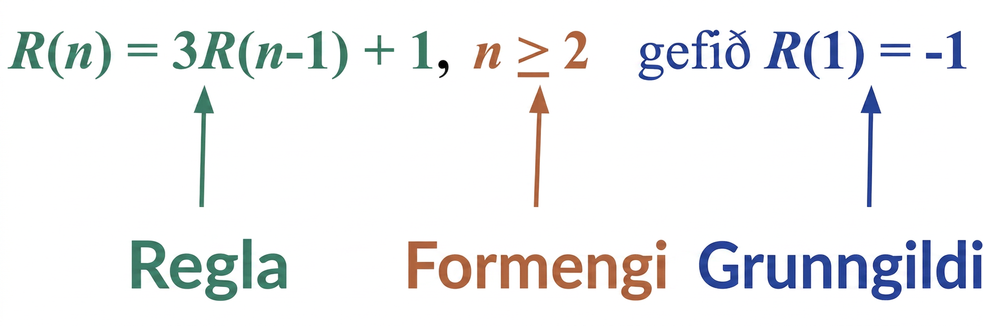
Learning Activity - Recursive Reasoning🤔
The recursive definition is a function that provides a repeated, or recurring, process to find terms in a sequence.
Start with the recursive definition:
Gives instructions to generate the sequence.
Gives a rule or formula for the nth term.
The basis for the sequence or the smallest term value.
The domain of the sequence, including where it starts and which values are used in the function.
Notes:
Support for All Learners
This activity offers additional support and an extension for students:
For English language learners and students with disabilities, be sure to review the Learning Strategies slide!
For students looking for an extra challenge, be sure to review the Extending Your Thinking slide!
Activity (15 minutes)
In this partner activity, students take turns matching a sequence to a definition. As students trade roles explaining their thinking and listening, they have opportunities to explain their reasoning and critique the reasoning of others.
Making a spreadsheet available gives students an opportunity to choose appropriate tools strategically.
Launch
Introduce the recursive definition for a sequence. Then, have students interact with the different parts of the definition by completing questions 1 – 3 of the activity. A table has been provided for students as a type of graphic organizer for the various parts of the definition.
Next, students will complete the matching activity. One partner finds the matching recursive definition and explains their reasoning while the other listens and agrees or discusses. Partners switch roles for each sequence. Demonstrate if needed.
Desmos Activity: OpenStax Alg1 - 4.17.2 Matching Sequences to Recursive Definitions
Decide if students should complete the activity on their own notebook paper or use the Desmos activity.
Desmos activities are different from the graphing calculator application because they lead students through one or more interactive tasks. As students progress through the activity, teachers may use the Teacher Dashboard to monitor student responses and use them for whole group discussion. Activities may also be set to identify student responses that are correct or incorrect.
Access the Desmos guide PDF to learn more about accessing and customizing activities.
Activity and answers on the next slide.

Slide 11
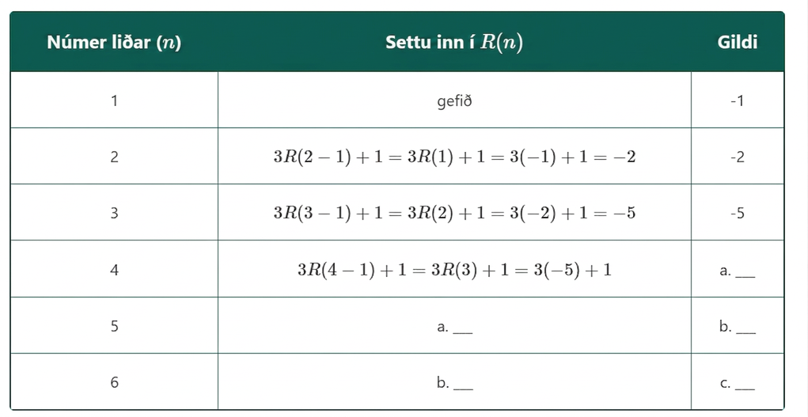
Learning Activity - Recursive Reasoning🤔
See the table for how to substitute to find more terms in the sequence using the recursive definition. Substitute the term number, n, in for n in the recursive definition. Complete the table with a partner.
Using the recursive definition: Substitute the listed values for R(n).
  n = 5
  n = 6
Determine the value for each term:
  n = 4
  n = 5
  n = 6
Write the full sequence out to 6 terms.
Notes:
Activity Answers
3R(5−1)+1
3R(6−1)+1
–14
–41
–122
–1, –2, –5, –14, –41, –122
More activity questions, answers, anticipated misconceptions, and synthesis on the next slide.

Slide 12

Learning Activity - Recursive Reasoning🤔
Determine if the following sequences are arithmetic or geometric.
  3, 6, 12, 24
  18, 36, 72, 144
  3, 8, 13, 18
  18, 13, 8, 3
  18, 9, 4.5, 2.25
  18, 20, 22, 24
  3, 15, 75, 375
Notes:
Activity Answers
Determine if the following sequences are arithmetic or geometric:
Geometric
Geometric
Arithmetic
Arithmetic
Geometric
Arithmetic
Geometric
Anticipated Misconceptions
Some students may not be sure how to begin matching terms in a sequence to a definition. Encourage them to start by picking a definition and calculating the first few terms of the sequence it represents.
Activity Synthesis
Once groups finish matching, ask: “How did you decide which definitions match sequences 3, 6, 12, 24 and 18, 36, 72, 144 when both involve doubling?” (Both are geometric with a factor of 2, but their first terms differ, matching them to M and L.)
Then, have selected students share their recursive definition for 18, 20, 22, 24 and explain their strategy.
If time permits, assign each student a function to graph from the task. Afterward, display and compare their sketches.

Slide 13
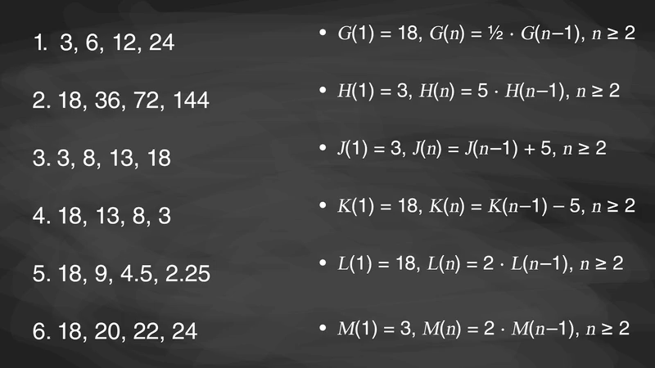
Video: Learning About Recursive Definitions and Sequences

Slide 14
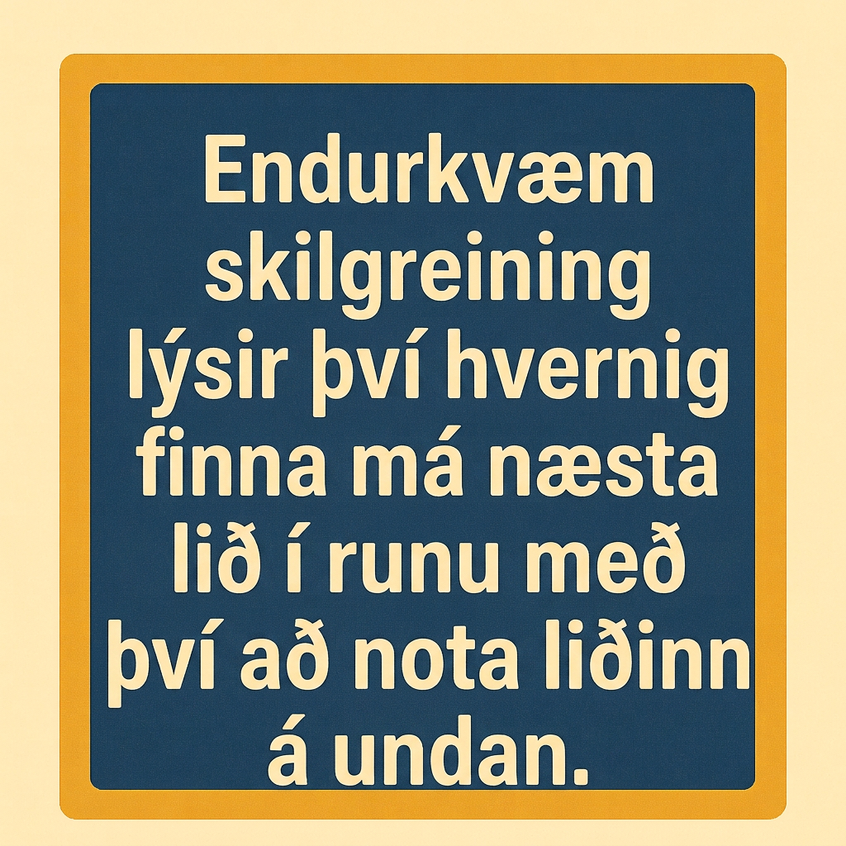
Self Check
Which of the following sequences matches the recursive definition for G(n) where G(n) = G(n − 1) + 4 for n ≥ 2 when G(1) = 3?
4, 8, 12, 16, 20
1, 3, 7, 11, 15
3, 7, 11, 15
3, 12, 48, 144
Let’s review!
Notes:
Answer Feedback - Individualized by Response
Incorrect. The recursive definition adds 4 to the previous number, starting with 3, not 4. The answer is 3, 7, 11, 15.
Incorrect. G(1) = 3 means the first term is 3, so 1 should not be the start of the sequence. The answer is 3, 7, 11, 15.
That’s correct! The first term is 3, and the recursive definition shows the sequence is arithmetic, so 4 is added to each previous term.
Incorrect. This sequence is geometric, and the given recursive definition creates an arithmetic sequence. The answer is 3, 7, 11, 15.

Slide 15
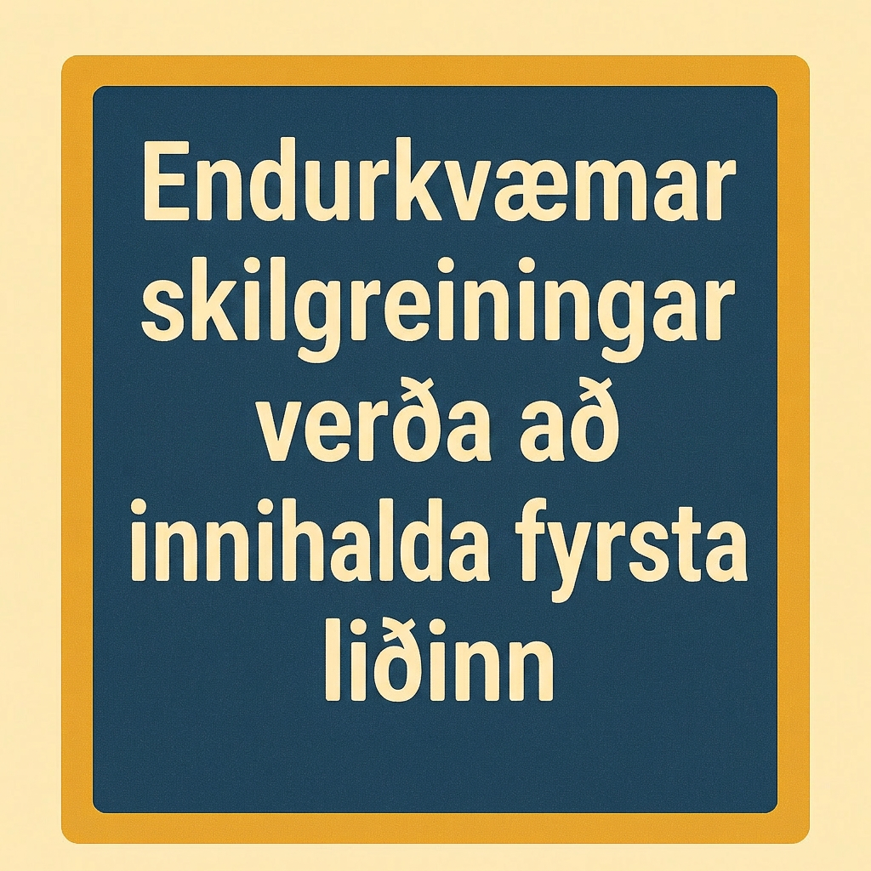
Self Check - Review
A recursive definition describes how to find the next term of a sequence using the previous term.
Example of Arithmetic Sequence
For the sequence 6, 10, 14, 18, 22, …, each term increases by 4. Using function notation, define the sequence as f, where f(n) = f(n−1) + 4. This shows it's arithmetic with a common difference of 4.
Recursive definitions must include the first term. For example, f(1) = 6 or f(0) = 6, depending on where the sequence starts.
A full definition includes the starting value and the rule: f(1) = 6, and f(n) = f(n−1) + 4 for n ≥ 2n. This ensures all terms are defined from the starting value.
Write the recursive definition for each type of sequence:
A. 30,40,50,60,70,… B. 80,40,20,10,5,2.5,… C. 1,3,7,15,31,…
Notes:
Answers:
Sequence A: 30,40,50,60,70,…
Step 1 - Determine the type of sequence
This sequence is arithmetic.
Step 2 - Determine the common difference or common ratio
The terms increase by adding a value of 10, so the common difference is 10.
Step 3 - Determine the formula or rule
Since one term’s value comes from adding 10 to the term value before it, that means n = (n − 1) + 10.
Now write this rule using function notation.
A(n) = A(n − 1) + 10
Step 4 - Determine the initial condition or basis
A(1) = 30
Step 5 - Determine the domain of the formula
We use the first term to find the second term, so that is where we start at n = 2. So, our domain is n ≥ 2
. The recursive definition for 30, 40, 50, 60, 70, … is A(1) = 30, A(n) = A(n − 1) + 10, n ≥ 2.
Sequence B: 80,40,20,10,5,2.5,…
Step 1 - Determine the type of sequence
This sequence is geometric.
Step 2 - Determine the common difference or common ratio
The terms are divided by 2 each time, so the common ratio is ½ (since it is divided by 2).
Step 3 - Determine the formula or rule
Since one term’s value comes from multiplying ½ to the term value before it, that means n = (n − 1)× ½ . Now write this rule using function notation.
B(n) = B(n − 1) × ½
Step 4 - Determine the initial condition or basis
B(1) = 80
Step 5 - Determine the domain of the formula
We use the first term to find the second term, so that is where we start at n = 2. So, our domain is n ≥ 2.
The recursive definition for 80, 40, 20, 10, 5, 2.5, … is B(1) = 80, B(n) = B(n − 1) × ½, n ≥ 2.
Sequence C: 1,3,7,15,31,…
Step 1 - Determine the type of sequence
This sequence is neither arithmetic nor geometric.

Slide 16
Lesson Journey
Warm Up
Learning Activity
Practice
Learning Activity
Cool Down
Lesson Synthesis

Slide 17
Learning Strategies - Problem and Data Cards 🃏
“Can you tell me . . . _____________)?”
”Why do you need to know . . . ____?”
Information Gap
Teacher Instruction: Use these strategies to adjust the activity to support English language learners and students with disabilities.
You can copy and paste the callouts directly on top of the activity or give the instructions aloud.
Can you rephrase the directions in their own words?
Engagement
Notes:
Support for English Language Learners: MLR 4 Information Gap: Conversing
Display questions or question starters for students who need a starting point, such as: “Can you tell me . . . (specific piece of information),” and ”Why do you need to know . . . (that piece of information)?”
Design Principle(s): Cultivate Conversation
Provide support for students
Distribute graphic organizers to the students to assist them with participating in this routine.
Support for Students with Disabilities: Engagement: Develop Effort and Persistence
Display or provide students with a physical copy of the written directions. Check for understanding by inviting students to rephrase directions in their own words. Keep the display of directions visible throughout the activity.
Supports accessibility for: Memory; Organization

Slide 18
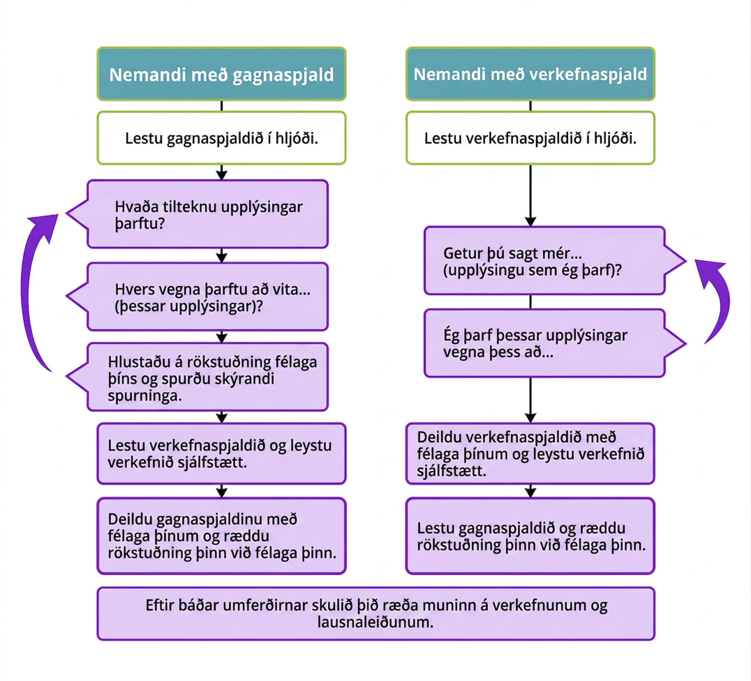
Learning Activity - Problem and Data Cards 🃏
Your teacher will give you either a problem card or a data card.
Do not show or read your card to your partner.
Follow the chart for directions how to complete your part of the activity
Are you ready for more?
Notes:
Support for All Learners
This activity offers additional support and an extension for students:
For English language learners and students with disabilities, be sure to review the Learning Strategies slide!
Activity (30 minutes)
This is the first Info Gap activity in the course. See the launch for extended instructions for facilitating this activity successfully.
This Info Gap activity gives students an opportunity to determine and request the information needed to represent sequences in different ways.
The Info Gap structure requires students to make sense of problems by determining what information is necessary, and then to ask for information they need to solve it. This may take several rounds of discussion if their first requests do not yield the information they need (TEKS A.1(A)). It also allows them to refine the language they use and ask increasingly more precise questions until they get the information they need.
Three pairs of cards are provided for this Info Gap, with the expectation that one pair will be used for a class demonstration of how the Info Gap routine works.
Click here for the text of the cards for reference and planning:
Launch
Tell students they will represent sequences in different ways.
This is the first time students do the Information Gap cards instructional routine, so it is important to demonstrate the routine in a whole-class discussion before they do the routine with each other. For this Info Gap, three sets of cards are provided so that you can demonstrate with one set, leaving two remaining sets so that each student has a chance to work with both the problem card and the data card.
Explain the Info Gap routine: Students work with a partner. One partner gets a problem card with a math question that doesn’t have enough given information, and the other partner gets a data card with information relevant to the problem card. Students ask each other questions like “What information do you need?” and are expected to explain what they will do with the information. Once the partner with the problem card has enough information to solve the problem, both partners can look at the problem card and solve the problem independently. Click here to view a graphic that illustrates a framework for the routine:
Display Problem Card 1 for all to see. Tell students that, as a class, they are playing the role of the person with the problem card while you play the role of the person with the data card. Explain to students that it is the job of the person with the problem card (in this case, the whole class) to think about what information they need to answer the question.
Explain that you will be playing the role of the person with the data card. Ask students, “What specific information do you need to represent the first five terms of the sequence?” Select students to ask their questions. Respond to each question with, “Why do you need that information?” Once students provide a mathematically valid reason, provide only data that appear on the data card. Once the class has created the representations asked for on the problem card, also display the data card so that students can see what it looks like. Reiterate that the person with the data card should only provide information that appears on their card, and only after the person with the problem card explains why they need the information.
Arrange students in groups of 2. In each group, distribute a problem card to one student and a data card to the other student. After you review their work on the first problem, give them the cards for a second problem and instruct them to switch roles. Provide access to graph paper.
Answers
Click here for Problem Card answers
Activity Synthesis
After students have completed their work, share the correct answers and ask students to discuss the process of representing the sequences in different ways. Display the cards for all to see throughout the discussion. Some students may be surprised to see the different structures of the cards even though they were about the same topic. Allow time for students to share what questions they found helpful for solving their problem card and how they came up with them.
Highlight connections between the representations. For example, a recursive definition might include f(1) = 16, which corresponds to an entry in a table and the point (1,16) on a graph.

Slide 19
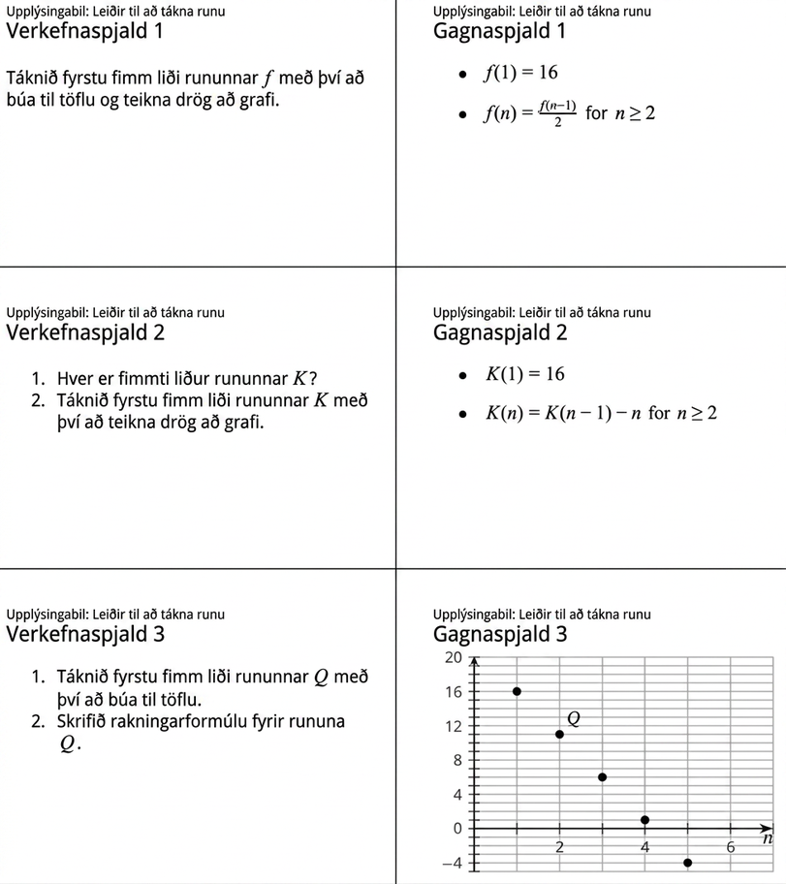
Learning Activity - Problem and Data Cards 🃏
Notes:
Here is the text of the cards for reference and planning

Slide 20
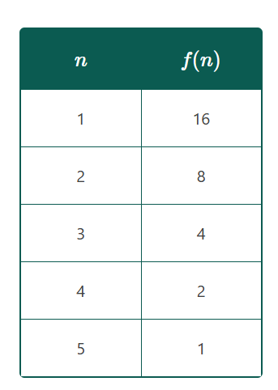
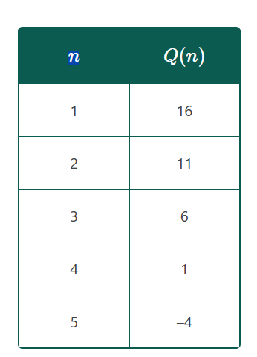
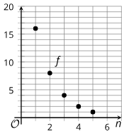
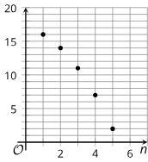
Learning Activity - Problem and Data Cards 🃏
Answers
Problem Card 1
Problem Card 2
Problem Card 3
2
Q(1) = 16, Q(n) = Q(n−1) − 5 for n ≥ 2

Slide 21
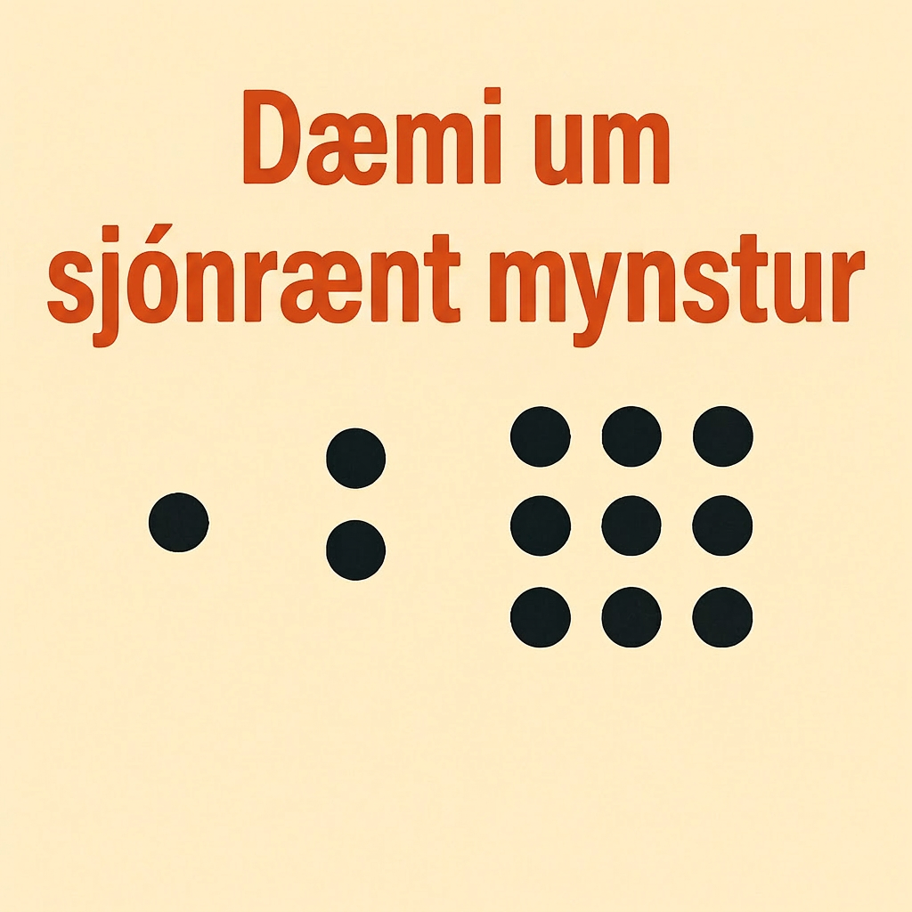
Extending Your Thinking
Make a visual pattern (for example, using dots or boxes), starting with Step 0, so the pattern for Step n contains n² + 3n + 3 dots.
Notes:
Answer
For example: an n + 1 by n + 2 rectangle with one additional dot
⚫⚫⚫⚫
⚫⚫⚫⚫
⚫⚫⚫⚫⚫
n = 2
⚫⚫⚫⚫⚫
⚫⚫⚫⚫⚫
⚫⚫⚫⚫⚫
⚫⚫⚫⚫⚫⚫
n = 3

Slide 22
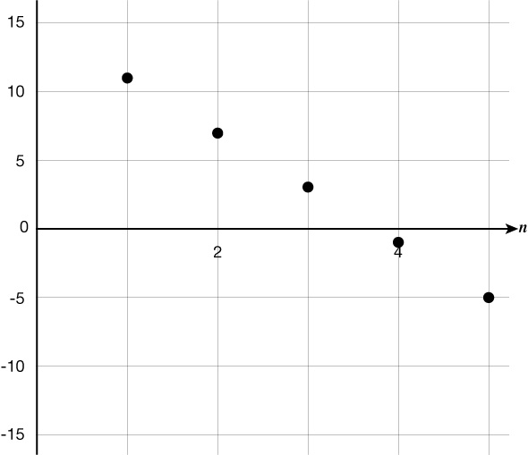
Self Check
Which of the following recursive definitions is represented by the graph below?
a(1) = 11 and a(n) = 4a(n − 1) for n ≥ 2
a(1) = 11 and a(n) = a(n − 1) − 4 for n ≥ 2
a(11) = 1 and a(n) = a(n − 1) − 4 for n ≥ 2
a(1) = 11 and a(n) = a(n) − 4 for n ≥ 2
Let’s review!
Notes:
Answer Feedback - Individualized by Response
Incorrect. This recursive definition would give a geometric sequence. The answer is a(1) = 11 and a(n) = a(n − 1) −4 for n ≥ 2.
That’s correct! The recursive definition would give an arithmetic sequence, like the one that is graphed. The terms are 11, 7, 3, –1, –5.
Incorrect. The first point is (1,11), not (11,1). The answer is a(1) = 11 and a(n) = a(n − 1) −4 for n ≥ 2.
Incorrect. This recursive definition does not account for the previous term. The answer is a(1) = 11 and a(n) = a(n − 1) −4 for n ≥ 2.

Slide 23
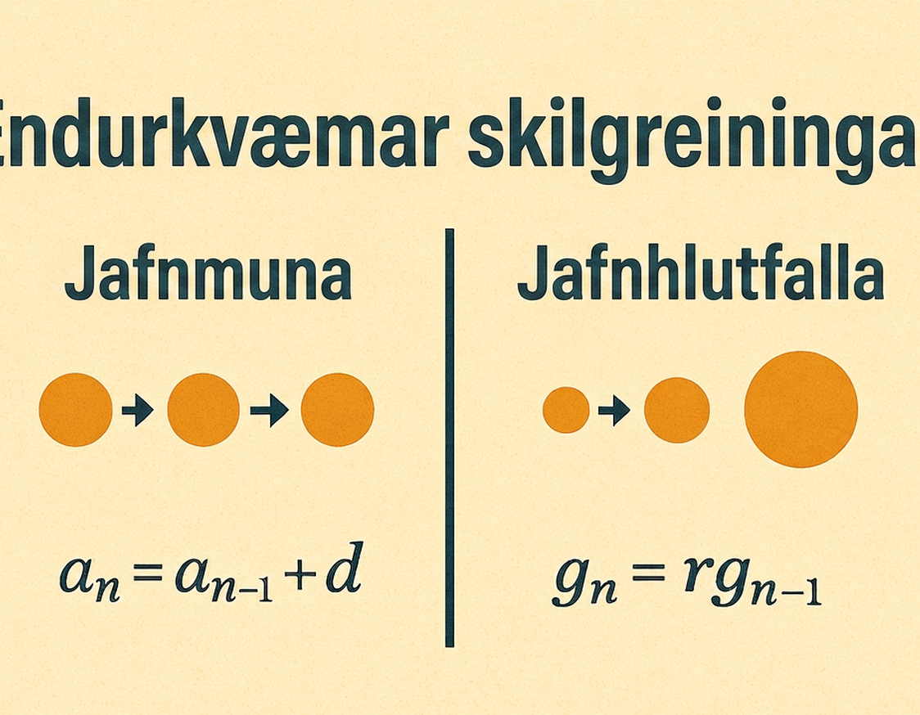
Self Check - Review
Representing Sequences
Let’s explore recursive definitions for arithmetic
and geometric sequences and how to represent them.
An arithmetic sequence, a, begins 11, 7, . . .
  Write a recursive definition for this sequence using function notation.
  Sketch a graph of the first 5 terms of this sequence.
  Explain how to use the recursive definition to find a(100). (Don’t actually determine the value.)
A geometric sequence, g, starts 80, 40, . . .
  Write a recursive definition for this sequence using function notation.
  Use your definition to make a table of values for g(n) for the first 6 terms.
  Explain how to use the recursive definition to find g(100). (Don’t actually determine the value.)
Notes:
Discuss the Answers with the Students:
An arithmetic sequence, a, begins 11, 7, . . .
a(1) = 11, a(n) = a(n − 1) −4, n ≥ 2
Click here for the slide with Image 1b.
A geometric sequence, g, starts 80, 40, . . ..
g(1) = 80, g(n) = ½⋅g(n−1), n ≥ 2
n 1 2 3 4 5 6
g(n) 80 40 20 10 5 2.5
Starting with 80, keep dividing by 2 until you do that 99 times.

Slide 24
Self Check - Review
Image 1b
Notes:
Activity Images

Slide 25

Lesson Journey
Warm Up
Learning Activity
Practice
Learning Activity
Cool Down
Lesson Synthesis

Slide 26
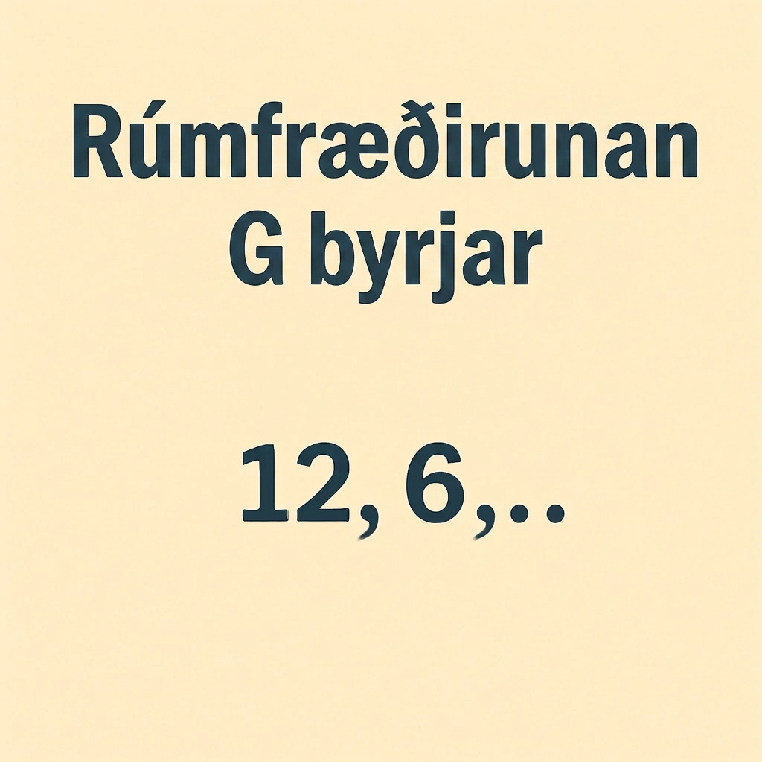
Cool Down
The geometric sequence G starts 12, 6, . . .
Write a recursive definition for sequence G
Sketch a graph representing the first 5 terms of sequence G
Notes:
Cool Down (5 minutes)
Answers
g(1) = 12, g(n) = 0.5 ⋅ g(n−1) for n ≥ 2 or equivalent.
See graph.: Click here for the slide with Image 1.
Response to Student Thinking - Points to Emphasize
If students still struggle, plan to spend more time on the launch to 7.2.

Slide 27
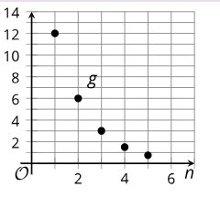
Cool Down
Image 1
Notes:
Cool Down Images

Slide 28

Lesson Journey
Warm Up
Learning Activity
Practice
Learning Activity
Cool Down
Lesson Synthesis

Slide 29

Practice
Put your hard work to action, practice what you’ve learned!
Notes:
Digital Practice: Access the practice pages at https://openstax.org/k12/algebra

Slide 30

Lesson Journey
Warm Up
Learning Activity
Practice
Learning Activity
Cool Down
Lesson Synthesis

Slide 31
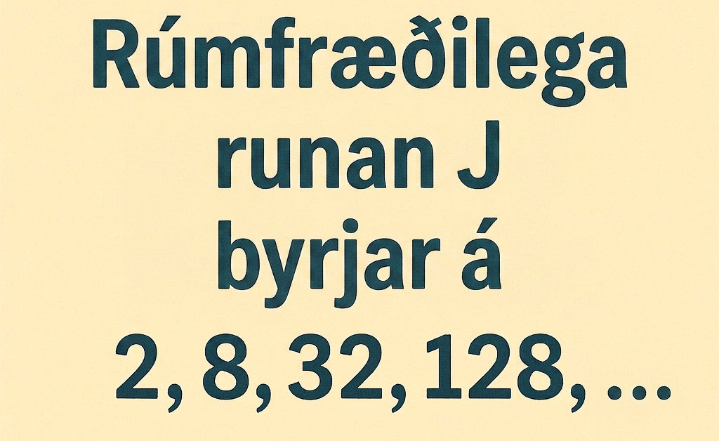
Lesson Synthesis
The geometric sequence J begins with 2, 8, 32, 128, ...
Represent it in as many ways as you can think of.
Notes:
Prompt: Display this sequence J for all to see: 2, 8, 32, 128, . . . and give students a few minutes to represent it in as many ways as they can think of. Then, ask them to check in with their partner and see if their partner came up with any different ways. Time permitting, ask one student to demonstrate or explain each type of representation:
Using function notation: J(1) = 2, J(2) = 8, J(3) = 32, J(4) = 128 where the input is the term number and the output is the value of the term
Using a table of inputs and outputs
Writing a recursive definition like J(1) = 2, J(n) = 4J(n − 1), n ≥ 2
Sketching a graph that includes the points (1,2), (2,8), (3,32), (4,128)
Closing the Lesson
After completing the Lesson Synthesis, wrap up the class by directing students to the Lesson Summary in their student textbook. In this section, students review the day’s learning targets, read summaries about the key takeaways from each activity, and then respond to a reflection question regarding their confidence with the material.
For more on the benefits of using this type of metacognitive reflection, see the Research in Practice section of the course.

Slide 32
Self Assessment
How much do you agree with the following statements?
I can… | I can | Almost | Not yet
Define arithmetic and geometric sequences recursively using function notation.
Represent a sequence in different ways.
Ask questions to get the information needed to represent a sequence in different ways.

