Slide 1


Algebra 1
Unit 2 Linear Inequalities and Systems
Lesson 2.14 Solutions to Systems of Linear Inequalities in Two Variables

Slide 2
How to use these slides
On the activity slides check the speaker notes for teacher support and instructional information.
Each lesson includes 1 warm up, 2-3 learning activities, a cool down, practice and a lesson synthesis.
  Learning activities are followed by a self check question, and review section.
Some slides have been hidden from student view, more information can be found on the next slide (Reference Key).
You can edit and use these slides for personal and classroom use, but cannot sell them and must keep the attribution logos.
For more information, Check out the digital quick start guide!

Slide 3






Reference Key
Check the top right corner for an icon referencing these unique sections.
 | Support for Students with Disability | Hidden | Learning Strategies slide, provides additional support to students for understanding the activity. Learning Strategies slide, provides additional support to students for understanding the activity.
 | Support for English Language Learners | Hidden
 | Extending Your Thinking | Hidden | Extending Your Thinking slide, provides an extra challenge for students.
 | Self Check | Not Hidden | Self Check slide, checkpoint to assess student understanding after the learning activity.
 | Review | Hidden | Self Check- Review slide, designed to help review topics from the self check question.
On the next slides, check the speaker notes for teacher instructions and support.
Notes:
Check the Speaker Notes: On the next slides you can find discussion questions, lesson information, answers to the activities, and ways to adjust the activity for your students!

Slide 4

Learning Goals
By the end of this lesson you will be able to -
Write a system of inequalities to describe a situation, find the solution by graphing, and interpret the solution points.
Explain “the solutions to a system of inequalities” and describe the graphs that represent the solutions.
Find values that satisfy each constraint individually and together, when given descriptions and graphs that represent two different constraints.
Notes:
Lesson Narrative
In this lesson, students extend their work with linear equations and inequalities to systems of inequalities, recognizing that solutions are the values satisfying both constraints and represented graphically by the overlapping region. They apply this understanding to mathematical and real-world problems, practicing perseverance in solving under multiple constraints.
Required Preparation
If using graphing technology:
Acquire devices that can run Desmos (recommended) or other graphing technology. It is ideal if each student has their own device.
Teacher only device: Be prepared to display an embedded applet for all to see.
Required Materials
If available, graphing technology
Optional: notecards
Graph paper
Texas Essential Knowledge and Skills
A1(A) apply mathematics to problems arising in everyday life, society, and the workplace
A1(C) select tools, including real objects, manipulatives, paper and pencil, and technology as appropriate, and techniques, including mental math, estimation, and number sense as appropriate, to solve problems
A1(D) communicate mathematical ideas, reasoning, and their implications using multiple representations, including symbols, diagrams, graphs, and language as appropriate
A1(G) display, explain, and justify mathematical ideas and arguments using precise mathematical language in written or oral communication
A2(H) write linear inequalities in two variables given a table of values, a graph, and a verbal description
A3(H) graph the solution set of systems of two linear inequalities in two variables on the coordinate plane

Slide 5
Vocabulary
Previous
Boundary line
  A line that separates the coordinate plane into regions.
System of inequalities
  Two or more inequalities that represent the constraints in the same situation.
New
Solution to a system of inequalities
  All pairs of values that make the inequalities in a system true. It is represented by the points in the region where the graphs of the two inequalities overlap.
Notes:
Lesson Vocabulary
To support student understanding of key vocabulary:
Familiarize students with the vocabulary words they will see throughout the lesson. Encourage students to look for these words and notice their use and meanings.
Encourage students to use key vocabulary words in “math talk” and their written and oral explanations.
Utilize a word wall. Sample cards are located here: Sample word wall cards are available here.
For newcomers or students with beginning English proficiency, use these Quizlet sets to support vocabulary learning:
Unit 2 Spanish Vocabulary – use first to build understanding
Unit 2 Vocabulary (English) – use after anchoring in Spanish
Support for English Language Learners
ELPS 1(F) use accessible language and learn new and essential language in the process
ELPS 2(F) listen to and derive meaning from a variety of media such as audiotape, video, DVD, and CD-ROM to build and reinforce concept and language attainment
ELPS 3(D) speak using grade-level content area vocabulary in context to internalize new English words and build academic language proficiency
ELPS 3(E) share information in cooperative learning interactions
ELPS 3(H) narrate, describe, and explain with increasing specificity and detail as more English is acquired

Slide 6





Lesson Journey
Warm Up
Learning Activity
Cool Down
Lesson Synthesis
Learning Activity
Learning Activity
Practice

Slide 7


Warm Up - Number Riddle 🔢
Here is a riddle: “I am thinking of two numbers that add up to 5.678. The difference between them is 9.876. What are the two numbers?”
Find pairs of numbers that fit each condition.
Name any pair of numbers whose sum is 5.678.
Name any pair of numbers whose difference is 9.876.
The riddle can be represented with two equations. Write the equations.
Solve the riddle. Be prepared to show your reasoning.
Notes:
Warm Up (5 minutes)
This warm up reminds students that a solution to a linear equation in two variables is any pair of numbers that makes the equation true, and that a solution to a system of two equations in two variables is a pair of numbers that makes both equations true. Encourage students to attempt to solve the problem algebraically.
Launch
Arrange students in groups of 2.
Students can share their answers to the riddle with their partner: “Did they come up with the same answer?”
Use the questions in the activity synthesis to further facilitate discussion.
Continue scrolling down for the activity answers, misconceptions, and synthesis questions.
Activity Answers
2 and 3.678
10 and 0.124
Let x and y represent the numbers: x + y = 5.678 and x − y = 9.876.
The two numbers are 7.777 and − 2.099.
Adding the two equations eliminates the 𝑦-variable and gives 2𝑥 = 15.554 or 𝑥 = 7.777.
Substituting this 𝑥-value into either equation gives 𝑦 = − 2.099.
Graphing the two equations gives two lines that intersect at (7.777, − 2.099). Desmos Graph
Anticipated Misconceptions
Students who graph the system of equations using technology may estimate from the graph and offer (8, −2) as a solution. Ask them to check whether 8 + (− 2) really does equal 5.678.
Activity Synthesis
Ask students using different methods to briefly describe their solving process. Record and display their reasoning (including a graph) for all to see. If not mentioned in students’ explanations, highlight that the riddle can be solved by writing and solving a system of equations. Each equation represents a constraint.
Ask students:
What constraints do the two equations represent?
The first equation represents a constraint about the sum of the two numbers. The second represents a constraint about the difference of the two numbers.
What does a solution to the system represent?
The solution is a pair of numbers that simultaneously meets both constraints or makes both equations true.
How many pairs of numbers meet both constraints at the same time?
Only one pair. The graphs of the equations intersect at one point.

Slide 8

Lesson Journey
Warm Up
Learning Activity
Cool Down
Lesson Synthesis
Learning Activity
Learning Activity
Practice

Slide 9

Learning Strategies - Quilt Making 🛏️
Teacher Instruction: Use these strategies to adjust the activity to support english language learners and students with disabilities.
You can copy and paste the callout directly on top of the activity or give the instructions aloud.
Talk with a partner before sharing your ideas.
“I notice that . . .”
“_____ represents _____ because . . .”
Engagement
Notes:
Support for Students with Disabilities: Engagement: Develop Effort and Persistence
Encourage and support opportunities for peer interactions. During the time spent on the two questions in the launch, invite students to brainstorm with a partner before sharing with the whole class. Display sentence frames that elicit descriptive observations: “I notice that . . .” as well as frames that support interpretation and representation: “_____ represents _____ because . . .”
Supports accessibility for: Language; Social-emotional skills

Slide 10

Learning Activity - Quilt Making 🛏️
To make a quilt, a quilter is buying fabric in two colors, light and dark. He needs at least 9.5 yards of fabric in total.
The light color costs $9 a yard.
The dark color costs $13 a yard.
The quilter can spend up to $110 on fabric.
Notes:
Support for All Learners
This activity offers additional support and an extension for students:
For english language learners and students with disabilities, be sure to review the Learning Strategies slide!
Activity (15 minutes)
In this activity, students see how two inequalities on separate graphs make it hard to find values that satisfy both, motivating the need to place both on the same graph.
Students may try substituting values, estimating visually, or graphing both inequalities on one plane to find overlapping solutions. Select students using these strategies to share in discussion.
Launch
Give students a moment to read the task statement and look at the two graphs. Ask students:
“What are the two constraints in this situation?” (A length constraint and a cost constraint)
“Which graph represents which constraint? How do you know?” (The first graph represents the length constraint. Possible explanations:
The graph intersects the vertical and horizontal axes at approximately 9.5, which means that if the quilter bought 0 yards of one color, he will need at least 9.5 yards of the other color.
The length constraint says “at least 9.5 yards,” so the lengths must include values greater than 9.5, which is shown by the shaded region of the first graph.
The second graph represents the cost constraint. If the quilter bought 0 yards of the light color, he could buy up to 110/13, or about 8.5, yards of the dark color fabric. This corresponds to the vertical intercept of the second graph.
The cost constraint says “up to $110,” so the lengths must be below certain limits. The solution region of the second graph shows values below a boundary.)
Arrange students in groups of 2 and provide access to graphing technology, in case it is requested.
Ask students to pause briefly after they have written both inequalities.
Verify that the inequalities students have written accurately represent the constraints before they proceed to the rest of the activity.
Activity image answer, and synthesis on the next slide.

Slide 11
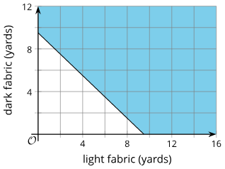
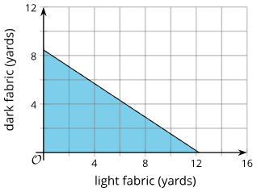
Learning Activity - Quilt Making 🛏️
Write an inequality to represent the length constraint. Let x represent
the yards of light fabric and y represent the yards of dark fabric.
Select three pairs that satisfy the length constraint.
a. (5, 5) c. (7.5, 3.5)
b. (2.5, 4.5) d. (12, 10)
Write an inequality to represent the cost constraint.
Select three pairs that satisfy the cost constraint.
a. (1, 1) c. (8, 3)
b. (4, 5) d. (10, 1)
Explain why (2, 2) satisfies the cost constraint but not the length constraint.
Find at least one pair of numbers that satisfies both constraints.
What does the pair of numbers represent in this situation?
Write the two inequalities together as a system of inequalities.
Graph A
Graph B
The graphs represent the two constraints: Graph A = Length Graph B = Cost
Notes:
Activity Answer
Your answer may vary, but here is a sample.
x + y ≥ 9.5
a. (5, 5)
c. (7.5, 3.5)
d. (12, 10)
Your answer may vary, but here is a sample.
9x + 13y ≤ 110
a. (1,1)
b. (4,5)
d. (10,1)
Your answer may vary, but here is a sample.
2 yards of each color costs $44, which is less than $110, so it satisfies this constraint. However, this is only 4 yards altogether, which is not at least 9.5 yards.
Your answer may vary, but here is a sample.
(10, 1), (8, 2), and (6.5, 3.5) (any point that is in the intersection of the two inequalities).
Your answer may vary, but here is a sample. (
10, 1) means 10 yards of light fabric and 1 yard of dark fabric. This is 11 yards of fabric altogether, which is more than 9.5. It costs $103 because 9(10) + 1(13) = 103. This is less than the $110 maximum.
Your answer may vary, but here is a sample.
9x + 13y ≤ 110x + y ≥ 9.5
Activity Synthesis
Focus on the last two questions, having selected students explain how they found values meeting both constraints, presented from less to more systematic methods.
Have students who graphed both inequalities share their graphs with the class.
If no one did, display the Desmos graph, showing one inequality, then the other, and finally both together by toggling the colored circles.
Desmos Graph
(The Desmos graphs show both variables being restricted to positive values, but students are not expected to do this when graphing. Consider discussing with students why it makes sense in this situation to disregard negative values.)
Discuss that a solution is a pair of values meeting both inequalities—for example, fabric amounts that satisfy length and cost. Explain that two inequalities form a system, and its solutions are all points in the overlapping region of their graphs, since those values make both inequalities true.

Slide 12

Self Check
A singer sold two types of tickets to a performance, seated tickets and standing-room tickets.
Seated tickets cost $25.
Standing-room tickets cost $15.
More than 60 tickets were sold.
More than $1,200 was made from selling tickets.
Which of the following ticket combinations is possible given the situation described here?
14 seated tickets and 55 standing-room tickets
40 seated tickets and 19 standing-room tickets
10 seated tickets and 60 standing-room tickets
20 seated tickets and 50 standing-room tickets
Let’s review!
Notes:
Answer Feedback - Individualized by Response
Incorrect. This ticket combination makes $350 for seats and $825 for the standing room, totaling only $1,175, which is less than $1,200.
Incorrect. This ticket combination is less than 60 tickets.
Incorrect. This ticket combination makes $250 for seats and $900 for the standing room, totaling only $1,150, which is less than $1,200.
That’s correct! This combination represents 70 tickets sold and makes $500 for seats and $750 for the standing room, totaling $1,250, which is more than $1,200.

Slide 13

Self Check - Review
System of Linear Inequalities
Two or more linear inequalities grouped together form a system of linear inequalities.
A system of linear inequalities looks like a system of
linear equations, but it has inequalities instead of equations.
To solve a system of linear inequalities, we will find values of the variables that are solutions to both inequalities. We solve the system by using the graphs of each inequality and show the solution as a graph. We will find the region on the plane that contains all ordered pairs (x , y) that make both inequalities true.
Notes:
Self Check Review Questions and answers on the Next Slide

Slide 14
Self Check - Review
Solutions of A System of Linear Inequalities
Solutions of a system of linear inequalities are the values of the variables that make all the inequalities true.
To determine if an ordered pair is a solution to a system of two inequalities, we substitute the values of the variables into each inequality. If the ordered pair makes both inequalities true, it is a solution to the system.
Determine whether the ordered pair is a solution to this system:
Is the ordered pair (−2,4) a solution?
Is the ordered pair (3,1) a solution?
Notes:
Answers
Determine whether the ordered pair is a solution to this system:
We substitute both x = -2 and y = 4 into both inequalities
(-2) + 4(4) ≳ 10 3(-2) - 2(4) < 12
(-2) + 16 ≳ 10 -6 - 8 < 12
18 ≳ 10 (TRUE) -14 < 12 (TRUE)
The ordered pair (−2 , 4) made both inequalities true. Therefore (−2 , 4) is a solution to this system.
We substitute both x = 3 and y = 1 into both inequalities
(3) + 4(1) ≳ 10 3(3) - 2(1) < 12
(3) + 4 ≳ 10 9 - 2 < 12
7 ≳ 10 (FALSE) 7 < 12 (TRUE)
The ordered pair (3,1) made one inequality true, but it makes the other one false. Therefore (3,1)
is not a solution to this system.
Remind Students
This activity challenges you to complete a very difficult task!
The more you know about the situation, the closer you are to being able to solve this problem mathematically instead of guessing and checking to see if you are correct.

Slide 15
Lesson Journey
Warm Up
Learning Activity
Cool Down
Lesson Synthesis
Learning Activity
Learning Activity
Practice

Slide 16
Learning Strategies - Money Situations 💵
Teacher Instruction: Use these strategies to adjust the activity to support english language learners and students with disabilities.
  You can copy and paste the callouts directly on top of the activity or give the instructions aloud.
Take 2-3 minutes to plan what you want to say to the group about your graph.
What details are important to share?
Practice using clear, mathematical language when presenting.
Supports
We will check in with each other after 3 minutes of work time.
How are you organizing your information?
How many equations do we need. How would you graph them?
Action and Expression
Notes:
Support for English Language Learners: MLR 8 Discussion Supports: Speaking
Use this routine to support small-group discussion. At the appropriate time, give students 2-3 minutes to plan what they will say when they present their responses and graph to their group. Encourage students to consider what details are important to share and to think about how they will explain their reasoning using mathematical language.
Design Principle(s): Support sense-making; Maximize meta-awareness
Support for Students with Disabilities: Action and Expression: Internalize Executive Functions
To support development of organizational skills, check in with students within the first 2-3 minutes of work time. Look for students who are organizing their information, understanding the need for two equations, and strategizing as to how to overlay them onto a single graph.
Supports accessibility for: Memory; Organization

Slide 17

Learning Activity - Money Situations 💵
In this activity you will be writing systems of inequalities and finding the solutions by graphing. Your teacher will give you instructions on which situations you will be working on.
Bank Accounts
A customer opens a checking account and a savings account at a bank. They will deposit a maximum of $600 will be deposited into the two accounts, some in the checking account and some in the savings account. (They might not deposit all of it and keep some of the money as cash.)
The bank requires a minimum balance of $50 in the savings account. It does not matter how much money is kept in the checking account.
Concert Tickets
Two kinds of tickets to an outdoor concert were sold: lawn tickets and seat tickets. Fewer than 400 tickets in total were sold.
Lawn tickets cost $30 each, and seat tickets cost $50 each. The organizers want to make at least $14,000 from ticket sales.
Notes:
Support for All Learners
This activity offers additional support and an extension for students:
For english language learners and students with disabilities, be sure to review the Learning Strategies slide!
Activity (20 minutes)
In this activity, students write systems of inequalities that represent situations and find the solutions by graphing. Students have encountered the same situations and constraints in a previous lesson, so the main work here is on thinking about each pair of constraints as a system, finding the solution region of each inequality, and identifying a point in the region where the graphs overlap as a solution to the system.
Launch
Arrange students in groups of 2 – 4. Explain to students that they will now revisit some situations they have seen and graphed in an earlier lesson. Assign one situation to each group member (or allow them to choose one situation) and ask them to answer the questions. Provide access to graphing technology.
Give students 5 – 6 minutes of quiet work time, and then give them time to discuss their responses and graph with their group.
Activity questions answers on the next slide.

Slide 18


Learning Activity - Money Situations 💵
Working with either the Bank Account or Concert Situation:
  Write a system of inequalities to represent the constraints.
  Specify what each variable represents.
  Use technology or paper to graph the systems of inequalities you identified in the previous questions. Be sure to alter the scale along each axis to fit the data in the scenario.
  Review the graphs you created for each system of inequalities in the previous questions. Use these graphs to help find the solutions to each scenario.
Notes:
Answers
Working with either the Bank Account or Concert Situation:
Write a system of inequalities to represent the constraints.
Bank Account:
x + y ≤ 600
y ≥ 50
Concert:
L + S <400
30L + 50S ≥ 14,000
Specify what each variable represents.
Bank Account:
x represents the amount deposited in the checking account and y represents the amount deposited in the savings account.
Concert:
L represents the number of lawn tickets and S represents the number of seat tickets.
Use technology or paper to graph the systems of inequalities you identified in the previous questions. Be sure to alter the scale along each axis to fit the data in the scenario.
Bank Account:
Link to Graph
Concert:
Link to Graph
Review the graphs you created for each system of inequalities in the previous questions. Use these graphs to help find the solutions to each scenario.
Bank Account:
Your answer may vary, but here is a sample. (150,300) or $150 in the checking account and $300 in the savings account. This combinations meets both requirements. The account owner deposits more than $50 in the savings account and no more that $600 all together.
Concert:
Your answer may vary, but here is a sample. (100,250) or 100 lawn tickets and 250 seat tickets. This combination of lawn tickets and seat tickets meets both constraints. The sum of tickets is 350, so it is fewer than 400. The dollar amount earned would be 100(30)+250(50), which is 3,000 + 12,500, or 15,500. This is more than $14,000.
Anticipated Misconceptions
Students may need reminding what “a solution to the system” would be in these specific contexts. (First find a point where the total money in the two accounts totals less than or equal to $600. Now make sure the money in the savings account is also at least $50.)
Activity Synthesis
Much of the discussion would have happened in small groups. During the whole-class discussion, emphasize the meaning of a point in the region where two graphs of linear inequalities overlap. Make sure students understand that all the points in that region represent values that simultaneously meet both constraints in the situation.
If time permits, ask students: “Why does it make sense to think of the two inequalities in each situation as a system and find the solutions to the system, instead of only to individual inequalities?” (If both constraints in the situation must be met, then we need to find values that satisfy both inequalities.)

Slide 19
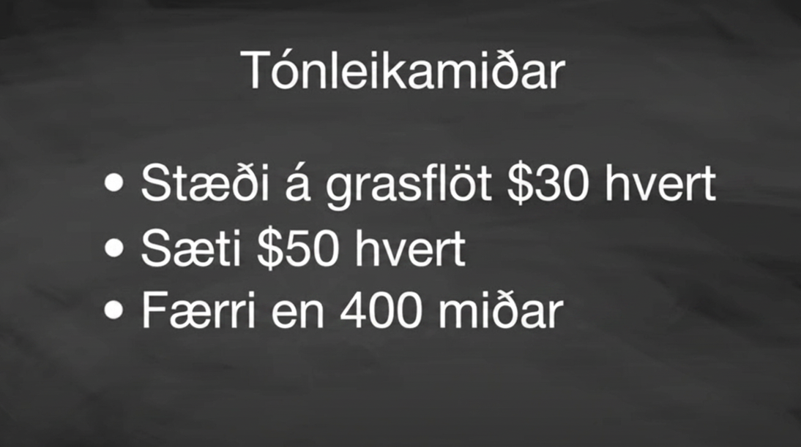
Video: Concert Tickets

Slide 20
Self Check
A music store is shipping guitars and snare drums.
Each guitar weighs 6 pounds.
Each snare drum weighs 14 pounds.
The maximum weight of guitars and snare drums cannot be more than 120 pounds.
The store needs to ship more than 10 total instruments.
Which of the following systems of inequalities describes the situation if x is the number of guitars and y is the number of snare drums?
6x + 14y ≥ 120 x + y > 10
14x + 6y ≤ 120 x + y > 10
14x + 6y ≥ 120 x + y < 10
6x + 14y ≤ 120 x + y > 10
Let’s review!
Notes:
Answer Feedback - Individualized by Response
Incorrect. The weight of the instruments must be less than 120.
Incorrect. The number of guitars is represented by x, and the number of snare drums is represented by y.
Incorrect. The weight of the instruments must be less than 120. The number of instruments shipped must be more than 10.
That's correct! The weight of the guitars at 6 pounds each and the weight of snare drums at 14 pounds each must be less than or equal to 120 pounds. The number of instruments shipped must be more than 10. This is the correct system of inequalities.

Slide 21

Self Check - Review
Christy sells her photographs at a booth at a street fair. At the start of the day, she wants to have at least 25 photos to display at her booth. Each small photo she displays costs her $4, and each large photo costs her $10. She doesn’t want to spend more than $200 on photos to display.
Write a system of inequalities to model this situation.
Graph the system.
Could she display 10 small and 20 large photos?
Could she display 20 large and 10 small photos?
Notes:
Answers
Write a system of inequalities to model this situation.
Step 1 - Identify the Variables.
Let x = the number of small photos.
Let y = the number of large photos.
Step 2 - To find the system of equations, translate the information.
She wants to have at least 25 photos.
The number of small plus the number of large should be at least 25.
x + y ≥ 25
$4 for each small and $10 for each large must be no more than $200.
4x + 10y ≤ 200
Step 3 - Identify constraints based on the context.
The number of small photos must be greater than or equal to 0.
x ≥ 0
The number of large photos must be greater than or equal to 0.
y ≥ 0
Step 4 - Write the system of inequalities.
We have our system of equations.
⎧ x + y > 25
⎪ 4x + 10y < 200
⎨ x > 0
⎪ y ≥ 20
⎩
Graph the system.
Since x ≥ 0 and y ≥ 0 (both are greater than or equal to zero), all solutions will be in the first quadrant. As a result, our graph shows only quadrant one.
To graph x + y ≥ 25, graph x + y = 25 as a solid line. Choose (0,0) as a test point. Since it does not make the inequality true, shade (red) the side that does not include the point (0,0).
To graph 4x + 10y ≤200, graph 4x + 10 y = 200 as a solid line. Choose (0,0) as a test point. Since it does make the inequality true, shade (blue) the side that includes the point (0,0).
Link to Graph
Could she display 10 small and 20 large photos?
The solution of the system is the region of the graph that is shaded the darkest. The boundary line sections that border the darkly shaded section are included in the solution, as are the points on the x-axis from (25,0) to (50,0).
To determine if 10 small and 20 large photos would work, we look at the graph to see if the point (10,20) is in the solution region. We could also test the point to see if it is a solution of both equations.
It is not, so Christy would not display 10 small and 20 large photos.
Could she display 20 large and 10 small photos?
To determine if 20 small and 10 large photos would work, we look at the graph to see if the point (20,10) is in the solution region. We could also test the point to see if it is a solution of both equations.
It is, so Christy could choose to display 20 small and 10 large photos.
Notice that we could also test the possible solutions by substituting the values into each inequality.

Slide 22
Lesson Journey
Warm Up
Learning Activity
Cool Down
Lesson Synthesis
Learning Activity
Learning Activity
Practice

Slide 23

Learning Activity - Scavenger Hunt 🕵️
Members of a high school math club have a scavenger hunt. Three items are hidden in the park, which is a rectangle that measures 50 meters by 20 meters.
The clues are written as systems of inequalities. One system has no solutions.
The locations of the items can be narrowed down by solving the systems. A coordinate plane can be used to describe the solutions.
Notes:
Activity (15 minutes)
This activity reinforces the idea that the solutions to a system of inequalities can be effectively represented by a region on the graphs of the inequalities in the system. The activity is designed to be completed without the use of graphing technology.
Launch
Ask students to put away any devices. Provide students with graph paper to complete the scavenger hunt activity.
Activity questions, answers, anticipated misconceptions, and synthesis on the next slide.

Slide 24
Learning Activity - Scavenger Hunt 🕵️
Can you find the hidden items? Sketch a graph to show where each item could be hidden. For each clue, graph each inequality separately on the same coordinate grid.
Clue 1: y > 14; x < 10 Clue 2: x + y < 20; x > 6
Clue 3: y < -2x +20; y < -2x + 10 Clue 4: y ≥ x + 10; x > y
Reflect: When you graphed each pair of inequalities, you created a
system of inequalities. Where did the possible solutions lie on the graph?
Are you ready for more?
Notes:
Answers
Clue 1: Link to Graph
Clue 2: Link to Graph
Clue 3: Link to Graph
Clue 4: Link to Graph
Reflect: Where the shaded regions overlap.
Anticipated Misconceptions
Some students may have trouble interpreting the graph of the fourth system, wondering if a point in either of the shaded regions on the graph could be where an item is hidden. Ask them to pick a point on the graph and consider whether it satisfies the first inequality, and then whether it satisfies the second inequality. Remind them that a solution to a system needs to satisfy both.
Activity Synthesis
Invite students to share their graphs and strategies for finding the solution regions. In particular, discuss how they found out which system had no solutions.
Remind students that a system of linear equations has no solutions if the graphs of the equations are two parallel lines that never intersect. Explain that a system of linear inequalities has no solutions if their regions are bound by two parallel lines and the solution region of each one is on the “outside” of the parallel lines, as is the case with the last given system.

Slide 25
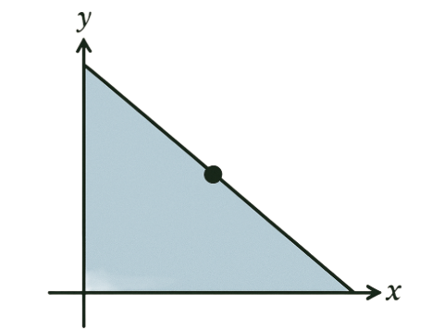
Extending Your Thinking
Two non-negative numbers x and y satisfy x + y ≤ 1. Find a second inequality, also using x and y values greater than or equal to zero, to make a system of inequalities with exactly one solution.
Two non-negative numbers x and y
satisfy x + y ≤ 1. Find as many ways to
identify the answers to this question
as you can.
Notes:
Answer
Your answer may vary, but here is a sample. y ≥ 1.
Your answer may vary, but here is a sample. x ≥ 1 and any inequality of the form y ≥ ax, where a is negative.

Slide 26
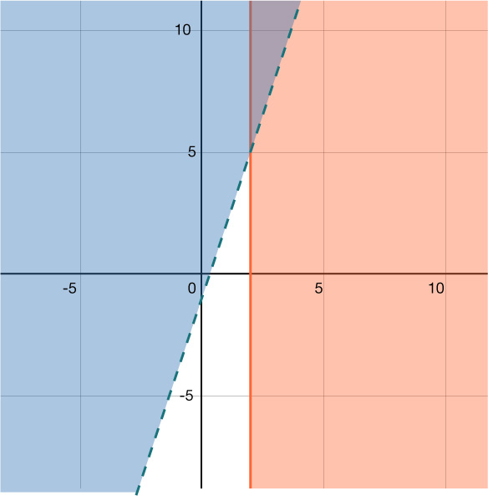
Self Check
Which two inequalities are graphed in the system of inequalities?
a.
c.
b.
d.
x < 2 y > 3x – 1
x > 2 y > 3x – 1
x > 2 y < 3x – 1
x > 2 y > 3x – 1
Let’s review!
Notes:
Answer Feedback - Individualized by Response
Incorrect. Notice that the graph is shaded to the right of x = 2 which represents greater than or equal to 2 and that is not the inequality listed in the system.
That's correct! The graph is shaded to the right of x = 2 with a solid line border, and the graph is shaded above the line y = 3x − 1 with a dashed line border.
Incorrect. Notice that the graph is shaded above the line y = 3x − 1. The inequality in the system represents values where y is less than or equal to 3x – 1.
Incorrect. A line is solid when the inequality has “equal to” included and dashed when it does not have an equal sign with it.

Slide 27
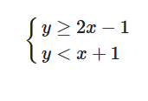
Self Check - Review
The solution to a linear inequality is the region on one side of its boundary line containing all true points. For a system of two inequalities, the solution is the overlapping region where both are true, found by graphing each inequality and identifying their intersection.
The solution is always represented graphically.
Solve the system by graphing:
Step 1 - Graph the first inequality.
Step 2 - On the same grid, graph the second inequality.
Step 3 - The solution is the region where the shading overlaps.
Step 4 - Check by choosing a test point.
Notes:
Answer
Step 1 - Graph the first inequality.
Graph the boundary line.
Shade in the side of the boundary line where the inequality is true.
We will graph y ≥ 2x − 1
We graph the line y = 2x − 1.
It is a solid line because the inequality sign is ≥.
We choose (0 , 0) as a test point. It is a solution to y ≥ 2x − 1, so we shade in above the boundary line.
Link to Graph
Step 2 - On the same grid, graph the second inequality.
Graph the boundary line.
Shade the side of that boundary line where the inequality is true.
We will graph y < x + 1 on the same grid.
We graph the line y = x + 1.
It is a dotted line because the inequality sign is <.
Again, we use (0 , 0) as a test point. It is a solution so we shade in that side of the line y = x + 1.
Link to Graph
Step 3 - The solution is the region where the shading overlaps.
The point where the boundary lines intersect is not a solution because it is not a solution to y<x+1.
The solution is all points in the area shaded twice, which appears as the darkest shaded region.
Step 4 - Check by choosing a test point.
We’ll use (−1 , −1) as a test point.
Is (−1 , 1) a solution to y ≥ 2x − 1?
−1 ≥ ? 2(−1) − 1
−1 ≥ −3 ✓
Is (−1 , −1) a solution to y < x + 1?
−1≥ ?−1 + 1
−1 < 0 ✓
The region containing (−1 , −1) is the solution to this system.

Slide 28

Lesson Journey
Warm Up
Learning Activity
Cool Down
Lesson Synthesis
Learning Activity
Learning Activity
Practice

Slide 29
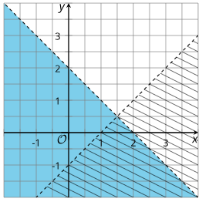
Cool Down
Here is another riddle:
The sum of two numbers is less than 2.
If we subtract the second number from the first, the difference is greater than 1.
What are the two numbers?
The riddle can be represented by a system of
inequalities. Write an inequality for each statement.
The graphs (at right) represent the inequalities in the system. Which graph represents which inequality?
Name a possible solution to the riddle. Explain or
show how you know.
Notes:
Cool Down (5 minutes)
Answers
x + y < 2; x – y > 1
The region with solid blue shading represents the first clue. The region with line shading represents the second clue.
Answers will vary, here are some samples.
(1.5, 0). The sum is 1.5, which is less than 2. The difference is 1.5, which is greater than 1. The point (1.5, 0) is located in the region where the two shaded regions overlap, which means it is a solution to both inequalities in the system.
(2, −1). The sum is 1, which is less than 2. The difference is 3, which is greater than 1. The point (2, −1) is located in the region where the two shaded regions overlap, which means it is a solution to both inequalities in the system.
Response to Student Thinking - More Chances
Students will have more opportunities to understand the mathematical ideas in this cool-down, so there is no need to slow down or add additional work to the next lessons. Instead, use the results of this cool-down to provide guidance for what to look for and emphasize over the next several lessons to support students in advancing their current understanding.

Slide 30

Lesson Journey
Warm Up
Learning Activity
Cool Down
Lesson Synthesis
Learning Activity
Learning Activity
Practice

Slide 31

Practice
Put your hard work to action, practice what you’ve learned!
Notes:
Digital Practice: Access the practice pages at https://openstax.org/details/books/algebra-1

Slide 32

Lesson Journey
Warm Up
Learning Activity
Cool Down
Lesson Synthesis
Learning Activity
Learning Activity
Practice

Slide 33
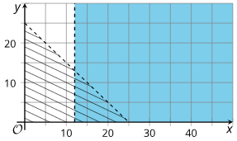
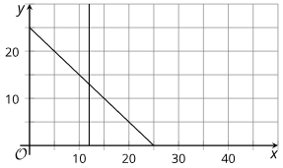
Lesson Synthesis
How are the two sets of graphs alike?
How are they different?
How can we tell the number of solutions from each set of graphs?
Notes:
Help students make connections between systems of equations and systems of inequalities, by displaying and discussing the two graphs for all to see.
Answers:
They have the same two lines. They can tell us about the solutions to individual equations or inequalities, as well as the solutions to systems.
The first set of graphs shows two regions that overlap, bounded by dotted lines. The second set shows two intersecting lines, and the lines are solid. One set represents the solutions to a system of linear inequalities.
The graphs representing a system of equations shows one point of intersection, so there is only one solution. The graphs representing a system of inequalities show one region of overlap, but there are many points in that region. This means that there are many solutions.

Slide 34
Self Assessment
How much do you agree with the following statements?
I can… | I can | Almost | Not yet
Write a system of inequalities to describe a situation, find the solution by graphing, and interpret points in the solution.
Explain what is meant by “the solutions to a system of inequalities” and describe the graphs that represent the solutions.
Find values that satisfy each constraint individually, and values that satisfy both constraints at once, when given descriptions and graphs that represent two different constraints.

