Slide 1
Algebra 1
Unit 5 Introduction to Exponential Functions
Lesson 5.7 Analyzing Graphs

Slide 2

How to use these slides
On the activity slides check the speaker notes for teacher support and instructional information.
Each lesson includes 1 warm up, 2-3 learning activities, a cool down, practice and a lesson synthesis.
  Learning activities are followed by a self check question, and review section.
Some slides have been hidden from student view, more information can be found on the next slide (Reference Key).
You can edit and use these slides for personal and classroom use, but cannot sell them and must keep the attribution logos.
For more information, Check out the digital quick start guide!
OpenStax CC BY NC SA

Slide 3





Reference Key
Check the top right corner for an icon referencing these unique sections.
Icon | Title | View | Location and Description
n/a | Support for Students with Disability | Hidden | Learning Strategies slide, provides additional support to students for understanding the activity.
n/a | Support for English Language Learners | Hidden | Learning Strategies slide, provides additional support to students for understanding the activity.
n/a | Extending Your Thinking | Hidden | Extending Your Thinking slide, provides an extra challenge for students.
n/a | Self Check | Not Hidden | Self Check slide, checkpoint to assess student understanding after the learning activity.
n/a | Review | Hidden | Self Check - Review slide, designed to help review topics from the self check question.
On the next slides, check the speaker notes for teacher instructions and support.
Notes:
Check the Speaker Notes: On the next slides you can find discussion questions, lesson information, answers to the activities, and ways to adjust the activity for your students!

Slide 4

Learning Goals
By the end of this lesson you will be able to -
Use graphs to compare and contrast situations that involve exponential decay.
Use information from a graph to write an equation that represents exponential decay.
Notes:
Lesson Narrative
In this lesson, students continue to examine situations characterized by exponential decay. The emphasis here is on analyzing graphs representing such situations.
Required Preparation
Make copies of the blackline master for the Matching Descriptions to Graphs activity, 1 copy for every 2 students.
Cut up the slips and separate into sets ahead of time.
Required Materials
Pre-printed slips, cut from copies of the blackline master card sort: Matching Descriptions to Graphs
Texas Essential Knowledge and Skills
A1(D) communicate mathematical ideas, reasoning, and their implications using multiple representations, including symbols, diagrams, graphs, and language as appropriate.
A1(F) analyze mathematical relationships to connect and communicate mathematical ideas.
A9(C) write exponential functions in the form 𝑓(𝑥) = 𝑎𝑏^{𝑥} (where 𝑏 is a rational number) to describe problems arising from mathematical and real-world situations, including growth and decay.
A9(D) graph exponential functions that model growth and decay and identify key features, including 𝑦-intercept and asymptote, in mathematical and real-world problems.

Slide 5
Vocabulary
Previous
Equation
  A math statement stating two numbers, expressions, or other objects are equal.
Expression
  The sum of products of numbers and variables. The variables can be raised to different powers.
Variable
  A quantity that can take on different values.
New
Growth factor
  In an exponential function, the output is multiplied by the same factor every time the input increases by one. This value is the multiplier.
Notes:
Lesson Vocabulary
To support student understanding of key vocabulary:
Introduce and review the vocabulary words students will see in this lesson.
Encourage students to notice how these words are used and to include them in their math discussions and explanations—both written and oral.
Use a word wall to reinforce vocabulary. Sample word wall cards are available here.
For newcomers or students with beginning English proficiency, use these Quizlet sets to support vocabulary learning:
Unit 5 Spanish Vocabulary – use first to build understanding
Unit 5 Vocabulary (English) – use after anchoring in Spanish
Support for English Language Learners
ELPS 2(F) listen to and derive meaning from a variety of media such as audiotape, video, DVD, and CD-ROM to build and reinforce concept and language attainment.
ELPS 3(D) speak using grade-level content area vocabulary in context to internalize new English words and build academic language proficiency.
ELPS 3(F) ask and give information ranging from using a very limited bank of high-frequency, high-need, concrete vocabulary, including key words and expressions needed for basic communication in academic and social contexts, to using abstract and content-based vocabulary during extended speaking assignments.

Slide 6

Lesson Journey
First Stop: Warm Up

Slide 7

Warm Up
a, b, … What Else Do You See?
Fraction | Decimal
½ | 0.5
¼ | 0.25
⅛ | 0.125
⅟₁₆ | a
⅟₃₂ | b
Find as many patterns as you can in the given table. Use one or more patterns to help you complete the table. Be prepared to share your reasoning.
What is the value for a?
What is the value for b?
Describe the pattern you used to find a and b.
Notes:
Warm Up (5 minutes)
This warm up encourages students to look for patterns in real numbers, namely the decimal expansions of powers of ½. Students are likely to recognize the 5, 25, 125 in the decimal expansion as powers of 5 and use that insight to describe the pattern, to extend it, and to notice other related patterns. In this warm up, they are not expected to reason about why the non-zero digits of the decimal expansions of powers of ½ are related to powers of 5.
Continue scrolling down for how to launch the activity, answers, and synthesis questions.
Launch
Arrange students in groups of 2.
Encourage them to think quietly for a minute before sharing their responses with their partner.
Answers
a = 0.0625
b = 0.03125
Answers may vary, but here are some samples:
Each number is half of the previous number. We can find the next number by multiplying the current number by ½ or by 0.5, or by dividing by 2.
The non-zero digits of the decimals are powers of 5 (5¹, 5², 5³, etc.), and each time there is an additional decimal place.
0.5 can be written as ⁵/₁₀, 0.25 as ²⁵/₁₀₀, and 0.125 as ¹²⁵/_{1,000}. The numerators are powers of 5, and the denominators are powers of 10, so the next two numbers are 5⁴/10⁴ , which is ⁶⁵/_{10,000} or 0.0625, and 5⁵/10⁵, which is ^{3,125}/_{100,000} or 0.03125.
The denominators in the fractions are powers of 2.
Activity Synthesis
Select a few students (or groups) to share their responses. If not already mentioned by students, discuss:
Are the successive numbers exhibiting linear or exponential change? How do you know?
Are the successive numbers getting larger or smaller? How do you know?
If time permits, consider asking: Why do powers of 5 show up in the decimals?

Slide 8
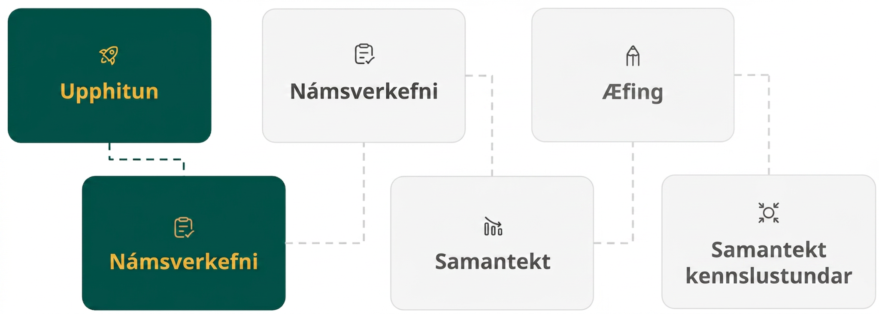
Lesson Journey
Second Stop: Learning Activity A

Slide 9

Learning Activity A | Learning Strategies
Choices! Choices! 📱
Prepare to share your thinking with the class.
Listen and watch for words and phrases that connect ideas for you.
Identify how the same ideas can be expressed differently.
Collect and Display
Teacher Instruction: Use these strategies to adjust the activity to support English language learners and students with disabilities.
You can copy and paste the callouts directly on top of the activity or give the instructions aloud.
Examine the Anchor Chart for the graph of the Exponential Function.
What is the initial value?
What is the growth factor? How do we find it?
Where are these values in the equation?
Representation
Notes:
Support for English Language Learners: MLR 2 Collect and Display: Conversing
Before the whole-class discussion, give students time to discuss their reasoning for determining which phone falls in value more quickly. Listen for and collect vocabulary and phrases students use to describe depreciation. Write the students’ words on a visual display and update it throughout the remainder of the lesson. Be sure to emphasize the term “growth factor” along with associated words used to calculate it, such as “consecutive values” and “dividing.” Remind students to borrow language from the display as needed. This will help students read and use mathematical language during their partner and whole-group discussions.
Design Principle(s): Support sense-making
Provide support for students
Distribute graphic organizers to the students to assist them with participating in this routine.
Support for Students with Disabilities: Representation: Develop Language and Symbols
Display or build an anchor chart with an exponential function and the meaning of each variable. To increase access to the chart, each variable can be color coded. Students can be encouraged to use the chart by highlighting key values and parts of their own equations and graphs with the same colors displayed on the chart.
Supports accessibility for: Conceptual processing; Memory

Slide 10
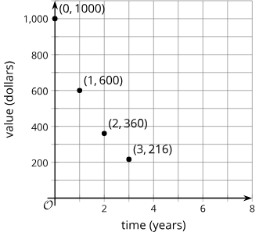
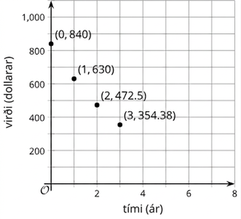
Learning Activity A | Part 1
Choices! Choices! 📱
Phone A
The value of some cell phones changes exponentially after initial release.
Which phone is more expensive to buy when it is first released?
Which graph depicts the value of the cell phone falling in value more quickly? Explain how you know.
How does the value of each phone change with every passing year?
Phone B
Notes:
Support for All Learners
This activity offers additional support and an extension for students:
For English language learners and students with disabilities, be sure to review the Learning Strategies slide!
For students looking for an extra challenge, be sure to review the Extending Your Thinking slide!
Activity (15 minutes)
Students analyze graphs representing the depreciation of the values of two cell phones and write equations to represent the relationship between time and value for each cell phone. To represent the relationships with equations, students need to know the initial value of each phone (which can be read from the graph) and the growth factor (which must be calculated).
Continue scrolling down for key points students need to learn, directions for how to launch the activity, and answers to these questions.
Students may conclude that Phone A is decreasing in value more quickly than Phone B by comparing the graphs visually. They may also reason in one of the following ways:
For Phone A, the annual differences in value are 400, 240, and 144 for the first few years. For Phone B, the annual differences are 210, 157.5, and 118.12. The differences for Phone A are greater than the differences for Phone B.
Phone A loses ⅖ of its value each year, while Phone B loses ¼ of its value. Therefore, the value of Phone A is decreasing more quickly.
For quantities that change exponentially, the second way of reasoning is more appropriate (the former is suitable for quantities changing linearly). If the starting price of Phone B had been substantially higher than the starting price of Phone A, then Phone B would, at least at the beginning, have higher annual differences even if it is losing a smaller fraction of its value each year.
Launch
To give students an overview of the context, consider sharing a news clip or advertisement on the latest release of a popular cell phone or asking students to share what they know about the latest models of some phones.
Solicit ideas from students about how they think the value of a phone changes after it is released. Students are likely to be familiar with the idea that phones decrease in value over time (especially as newer ones come along).
Give an example of how a popular phone might have cost, for instance, $600 when it was first available to the public, but the same type of phone (in new condition) might cost several hundred dollars less a couple of years later.
Remind students of the meaning of the words depreciate or depreciation, which should be familiar from a previous lesson about the value of a car.
Answers
Phone A costs $1,000 and Phone B costs $840, so Phone A is more expensive.
Phone A is depreciating more quickly than phone B. This was determined by comparing the value of the phones each year. For instance, after one year, phone A was only worth $600 compared to phone B’s value of $630. And, again, after three years, phone A was valued at $216 compared to phone B’s value of $354.38.
Phone A loses $400 in the first year, which is ⅖ (or 0.4 or 40%) of the original value. It loses $240 in the second year, which is ⅖ (or 0.4 or 40%) of $600. Phone B loses $210 in the first year, which is ¼ (or 0.25 or 25%) of the original value, and $157.50 in the second year, which is ¼ of $630.
NOTE: Questions 3 & 4 from the online textbook were combined into one question on the slide.
Additional activity questions, answers, misconceptions and synthesis on the next slide.

Slide 11
Learning Activity A | Part 2
Choices! Choices! 📱
Phone A
If the phones continue to depreciate by the same factor each year, what will the value of each phone be 4 years after its initial release?
For each cell phone, write an equation that relates the value of the phone in dollars to the years since release, 𝑡. Use 𝑣 for the value of Phone A and 𝑤 for the value of Phone B.
Phone B
Are you ready for more?
Notes:
Activity Answer
(aligns with question 5 in the online textbook)
⅗ 𑇐 $216 = $129.60
¾ 𑇐 $354.38 ≈ $265.79
(aligns with question 6 in the online textbook)
v = 1,000 𑇐 (⅗)^{t}
w = 840 𑇐 (¾)^{t}
Anticipated Misconceptions
Students may not see, especially for the second graph, that the relationship is exponential. Ask them by what factor the value of each phone decreases in the first year. What about in the second year? Ask them what these numbers tell them about the growth factor.
Activity Synthesis
Invite students to share their responses. Focus the conversation on how they determined which phone loses value more quickly and how they wrote the equations.
Make sure students recognize that to tell which phone depreciates more quickly, we need to identify a growth factor and cannot simply find the differences between consecutive values. Instead of subtracting, we should be dividing the value of one year by that of the previous year. Once the initial amount and the growth factor are identified, we can write an equation to predict the value of the phone at a later time (assuming the mathematical model still applies, e.g., the technology is not considered obsolete or the phone doesn’t somehow become more valuable because of other extraneous reasons).

Slide 12

Learning Activity A
Extending Your Thinking
When given data, it is not always clear how to best model it. In this case, we were told the value of the cell phones was changing exponentially. Suppose, however, we were instead just given the initial values of the cell phones when released and the values after each of the first three years.
Use technology to compute the best fit line for each cell phone. Round any numbers to the nearest dollar.
Explain why, in this situation, an exponential model might be more appropriate than the linear model you just created.
Notes:
Go back to Lesson Activity
Answers
a. v = 933 – 259t
b. w = 816 – 161t
For example: A linear model would quickly lead to negative phone values. For example, Phone A would cost about –$103 four years after its initial release. It makes more sense that the phone would lose a fraction of its value each year.

Slide 13
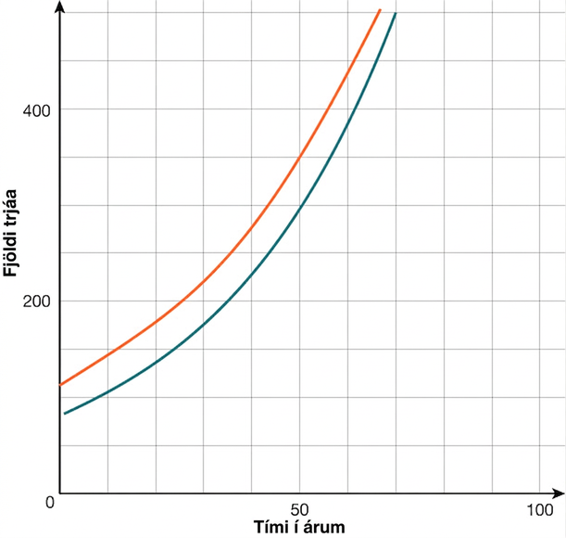
Learning Activity A
Self Check
For each year t, the population of trees in
Forest A is represented by the function
A(t) = 115(1.025)^{t}, (red curve). In a neighboring
forest, Forest B, the population of the same
type of tree is represented by the function
B(t) = 82(1.029)^{t}, (blue curve). Looking at the
graph provided, which forest had a greater
number of trees initially?
Both forests started with the same number of trees.
Forest A, because it starts higher on the y-axis.
Forest A, because it has a greater growth rate.
Forest B, because it has a greater growth rate.
Let’s review!
Notes:
Answer Feedback - Individualized by Response
Incorrect. The initial value of an exponential function is the same as its 𝑦-intercept on the graph, so a higher 𝑦-intercept is a greater initial value.
That’s correct! The initial value of an exponential function is the same as its 𝑦-intercept on the graph, so a higher 𝑦-intercept is a greater initial value.
Incorrect. The initial value of an exponential function is the same as its 𝑦-intercept on the graph, not the growth rate.
Incorrect. Forest B does have a greater growth rate, but the growth rate does not determine the initial value. The initial value of an exponential function is the same as its 𝑦-intercept on the graph.

Slide 14

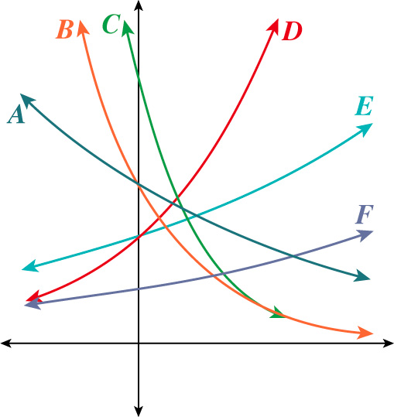
Learning Activity A
Self Check - Review
Which graph has the largest value for 𝑏?
Which graph has the smallest growth factor or value for 𝑏 which is closest to 1?
Which graph has the largest value for 𝑎?
Which graph has the smallest value for 𝑎?
Notes:
Remind Students
When using the form 𝑦 = 𝑎𝑏^{𝑥}, it is important to remember that 𝑎 is the initial value, or the 𝑦-intercept, and 𝑏 is the growth factor. The growth factor reflects an exponential growth function when the value is greater than one. The growth factor reflects an exponential decay function when the value is between zero and one.
Answers
For question 1, you are looking for the largest growth factor, which would mean an exponential growth function that is increasing the most rapidly. First, identify the graphs that reflect exponential growth, which would be D, E, and F, and then decide which is the steepest. Graph D increases much faster than both graphs E and F.
For question 2, you are looking for the smallest growth factor, or the exponential decay function that is decaying slower than the other graphs. The decay graphs are A, B, and C, and graph A is decaying much more slowly than the other graphs.
For question 3, you are looking for the largest initial value or 𝑦-intercept. This could be with a growth or decay function; it just needs to cross the 𝑦-axis higher than the other graphs. Graph C has the highest 𝑎 value.
For question 4, you are looking for the smallest initial value or 𝑦-intercept. This could be a growth or decay function; it just needs to cross the 𝑦-axis lower than the other graphs. Graph F has the lowest 𝑎 value.

Slide 15

Lesson Journey
Third Stop: Learning Activity B

Slide 16
Learning Activity B | Learning Strategies
Make A Match! 💑
Teacher Instruction: Use these strategies to adjust the activity to support English language learners and students with disabilities.
  You can copy and paste the callouts directly on top of the activity or give the instructions aloud.
“____ and ____ represent the same situation because …”
“I noticed ____, so I matched …”
Discussion Supports
Create a T-chart.
On one side, record findings about exponential functions that grow.
On the other side, record findings about exponential functions that decay.
Action and Expression
Notes:
Support for English Language Learners: MLR 8 Discussion Supports: Conversing
Arrange students in groups of 2. Students should take turns finding a match and explaining their reasoning to their partner. Display the following sentence frames for all to see: “ _____ and _____ represent the same situation because . . .” and “I noticed _____ , so I matched . . . .” Encourage students to challenge each other when they disagree. This will help students clarify their reasoning about using the growth factor to match an exponential situation represented by a description or graph.
Design Principle(s): Support sense-making; Maximize meta-awareness
Support for Students with Disabilities: Action and Expression: Internalize Executive Functions
Provide students with a two-column graphic organizer to record deeper understandings about the features of exponential graphs and the related findings revealed in the card sort discussion.
Supports accessibility for: Language; Organization

Slide 17
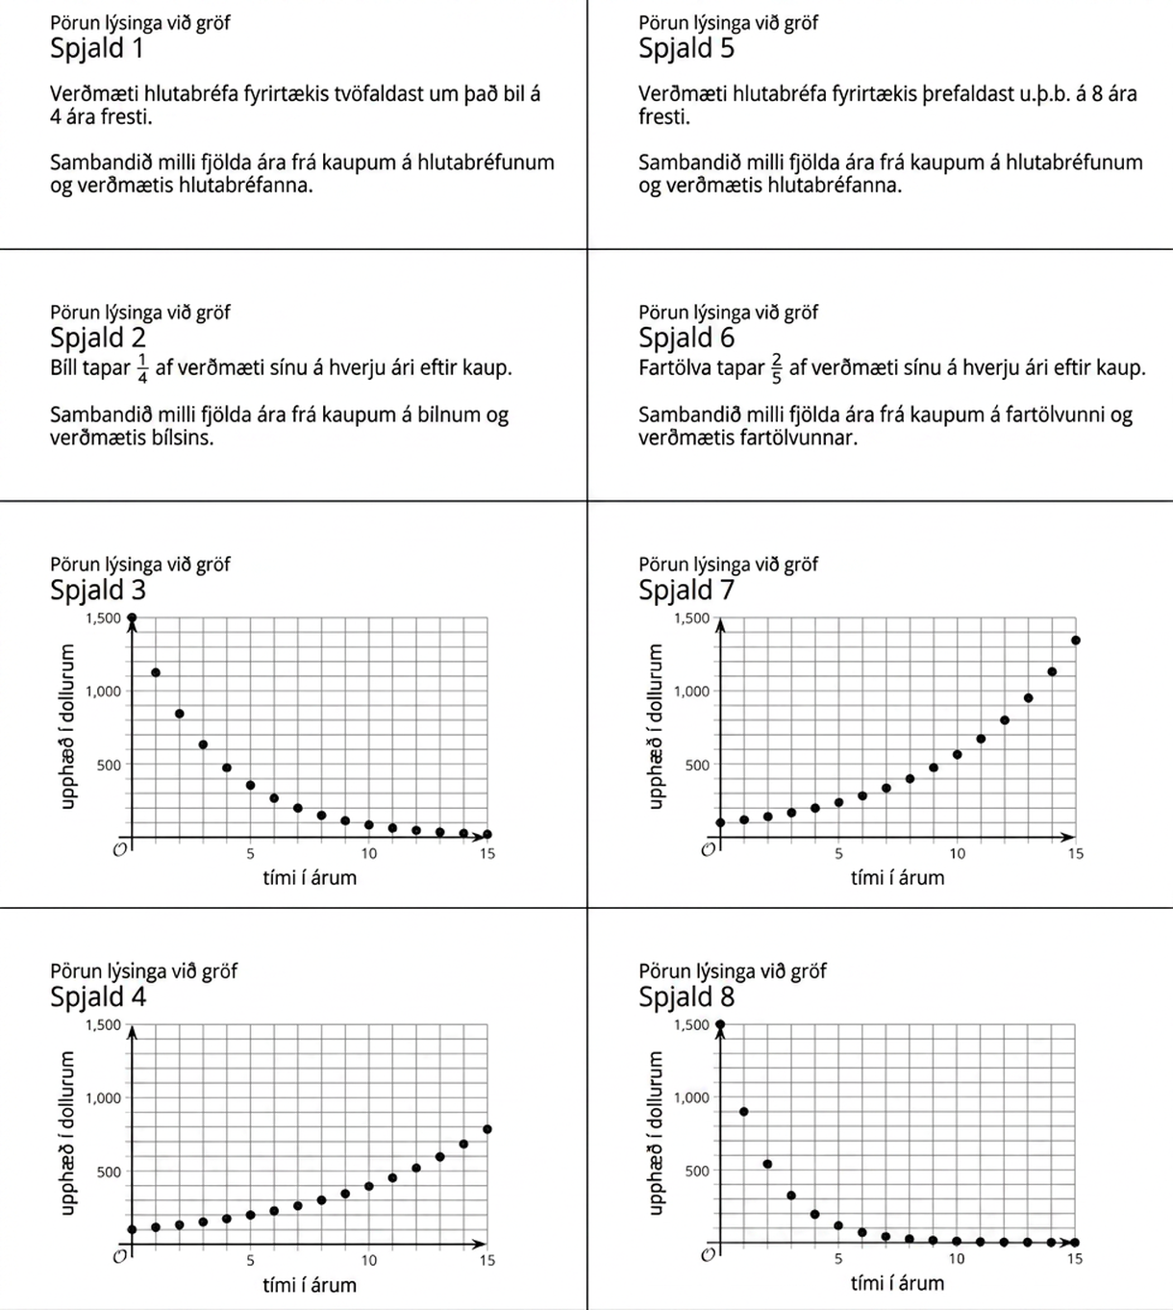
Learning Activity B | Part 1
Make A Match! 💑
Part 1 -
Match each graph representation to the description of the situation characterized by exponential change.
Notes:
Support for All Learners
This activity offers additional support for students:
For English language learners and students with disabilities, be sure to review the Learning Strategies slide!
Activity (15 minutes)
In this activity, students match four descriptions of situations characterized by exponential change with four graphs. To make a correct match, students will need to attend to whether the growth factor is greater than 1 or less than 1 and determine the growth factor from the graph with enough precision to distinguish between two possibilities.
Launch
Arrange students in groups of 2.
Give each group a set of slips or cards from the Blackline Master.
Ask students to take turns.
The first partner identifies a match and explains why they think it is a match, while the other listens and works to understand. Then they switch roles. Before students begin working, demonstrate this routine if necessary.
As students work together, look for those using one of the following approaches. Ask them to share their thinking later:
Separate the cards and descriptions into situations that grow or decay, and then analyze the graphs more closely to compare their growth factors.
Use the information in the descriptions to draw conclusions about the coordinates of points on the graphs.
Answers
Card 1 matches Card 7
Card 2 matches Card 3
Card 5 matches Card 4
Card 6 matches Card 8
Additional activity questions, answers, anticipated misconceptions, and synthesis on the next slide.

Slide 18
Learning Activity B | Part 2
Make A Match! 💑
Part 2 -
Determine the equation for a function that could represent a graph for each scenario.
Hints:
What is the initial value?
What is the growth factor?
Notes:
Answers
Card 1 & Card 7 = v = s 𑇐 2^(t/4)
v = value of the stock after t years
s = initial price of the stock
t = time in years
^{t}/₄ = the number of doubling even for every four years
Card 2 & Card 3 = v = p(1 – ¼)^{t} or v = p(¾)^{t}
v = value of the car after t years
p = initial price of the car
t = time in years
¼ = fraction by which the car loses its value every year
Card 5 & Card 4 = v = p 𑇐 3^(t/8)
v = current value of the stock after t years
p = initial value of the stock
t = number of years since the initial value
In this equation, we raise 3 to the power of ^{t}/₈ to calculate the value after t years. This represents the stock tripling in value approximately every eight years.
Card 6 & Card 8 = v = p(1 – ⅖)^{t} or v = p(⅗)^{t}
v = current value of the laptop after t years
p = initial purchase value of the laptop
t = number of years since the purchase
In this equation, the laptop loses ⅖ (or retains ⅗ of its remaining value) every year. We raise (⅗) to the power of t to calculate the value after t years.
Anticipated Misconceptions
If students struggle to identify the correct graphs, ask them to look carefully at the scales. What do they notice? Once they see that the scales are the same, ask them how the graphs compare. Which one grows or decays faster? Then ask them which of the description cards represent growth and which represent decay. Which situation grows (or decays) faster?
Students may also struggle to determine the equation for cards 5-7 and cards 1-4 because the growth is not annual. As a result, t must be divided by when the stock actually achieves the multiplying factor. If needed, a Google Sheet is provided that includes approximated data lists for all scatter plots.
Have students use their equations to check the accuracy of their matches with each graph.
If students have not adjusted the exponents on cards 5-7 or 1-4, projection tables have also been listed for cards 1 and 5.
Note that year 8 is identified as an “easy” comparison year. Ask students why year 8 would be a good year to use for comparison.
How can this be used to help them identify which graph to use or verify their graph?
Use a Think Aloud to help students understand that equations such as y = 100(3)^{t} and y = 100(2)^{t} represent stock that triple or double every year. The stock that is being described do the same thing, but over a longer period of time. The process in the scenarios is taking a lot longer so we need to slow down what is happening in the annual equations or look at “subsets” of the annual equations. That is why we divide the the exponents. What used to take a year now takes 4 years or 8 years. So, after one year, the stock has only achieved what typically happens in ¼ the time or ⅛ the time – so ^{t}/₄ or ^{t}/₈.
Activity Synthesis
Invite groups who did not previously share their plans to share the expressions they wrote. Select students to share their strategies, starting with the cards that suggest a growth factor that is greater than 1 (Card 1 and Card 5) and moving to cards that suggest a growth factor that is positive and less than 1 (Card 2 and Card 6).
If not mentioned by students, discuss questions such as:
Can we use the vertical intercepts to make a match? (No, that information is not given in the descriptions of the situations. In the descriptions of situations with exponential decay, although a car is likely to cost more than a laptop, a used car might cost less than a new high-end laptop, so we can’t be sure.)
What can we tell about the growth factor in each situation? (The growth happens more quickly for the situation in Card 1 than in Card 5 because that stock quadruples every 8 years. For cards 2 and 6, the phone loses ⅖ of its value every year, while the car only loses ¼ of its value each year.)

Slide 19
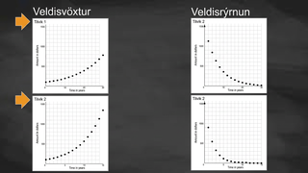
Learning Activity B | Video
Analyzing Graphs of Exponential Scenarios
Notes:
This video discusses various problems from the card sort in activity 5.7.3.

Slide 20

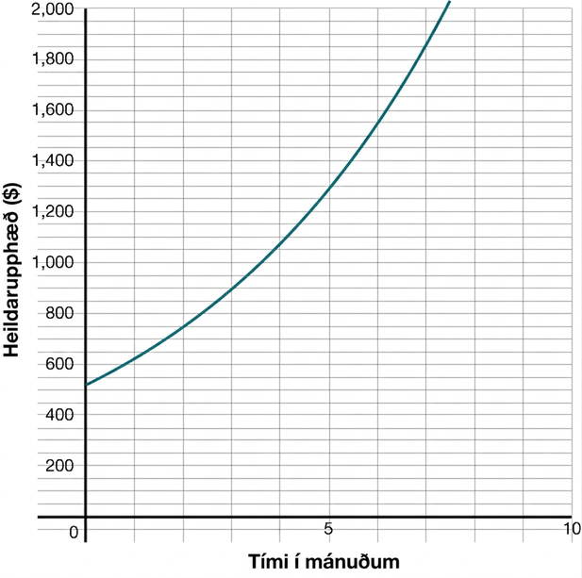
Learning Activity B
Self Check
Which scenario could be represented by the given graph?
A recent graduate’s credit card balance
started around $500 and increases at a
rate of approximately 20% each month.
The population of sea birds started at 518
and is decreasing exponentially each month.
The population of sea birds started at 518
and is increasing exponentially each month.
A recent graduate’s credit card balance started
around $500 and decreases at a rate of
approximately 20% each month.
Let’s review!
Notes:
Answer Feedback - Individualized by Response
That's correct! The labels show you are comparing money over time, and the initial value is around $500.
Incorrect. The graph shows exponential growth, but the situation is exponential decay. Also, the graph’s labels are time and months.
Incorrect. The graph’s labels are time in months and total amount in dollars.
Incorrect. The graph shows exponential growth, but the situation is exponential decay.

Slide 21
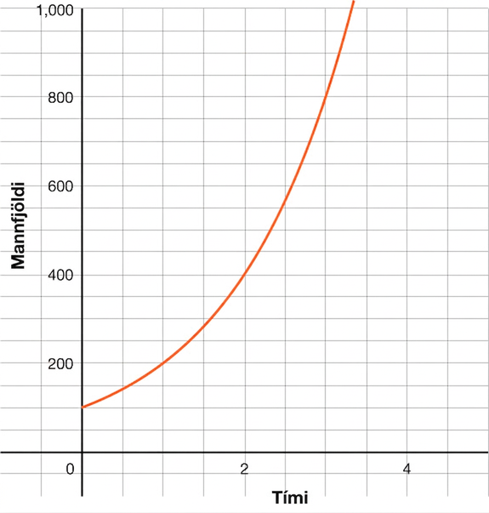
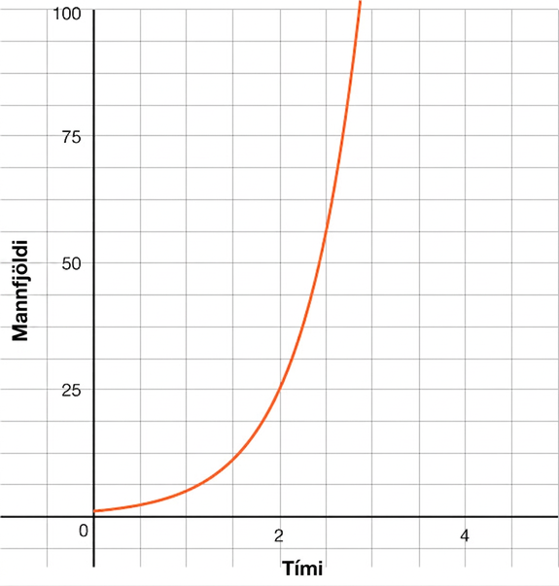
Learning Activity B
Self Check - Review
Graph 1
Situation 1: A dangerous bacterial compound forms in a closed environment but is immediately detected. This bacteria is known to double in concentration in a closed environment every hour and can be modeled by the function 𝑃(𝑡) = 100 𑇐 2^{𝑡}, where 𝑡 is measured in hours.
Situation 2: Loggerhead turtles reproduce every 2 to 4 years, laying approximately 120 eggs in a clutch. As is often the case in biological studies, we will count only the female turtles. If we start with a population of one female turtle in a protected area and assume that all turtles survive, we can roughly approximate the population of female turtles by 𝑃(𝑡) = 5^{𝑡}.
Graph 2
Notes:
Remind Students
Since each graph represents exponential growth, and they both have the same labels, you have to look more closely at each.
The biggest difference is the 𝑦-intercept or initial value.
Graph 1 has an initial value of 100, and Graph 2 has a very small initial value.
When you reread the situations, you can see that Situation 1 starts with 100 bacteria, and Situation 2 starts with 1 female turtle.
This helps you see that Situation 1 belongs to Graph 1 and Situation 2 belongs to Graph 2.

Slide 22
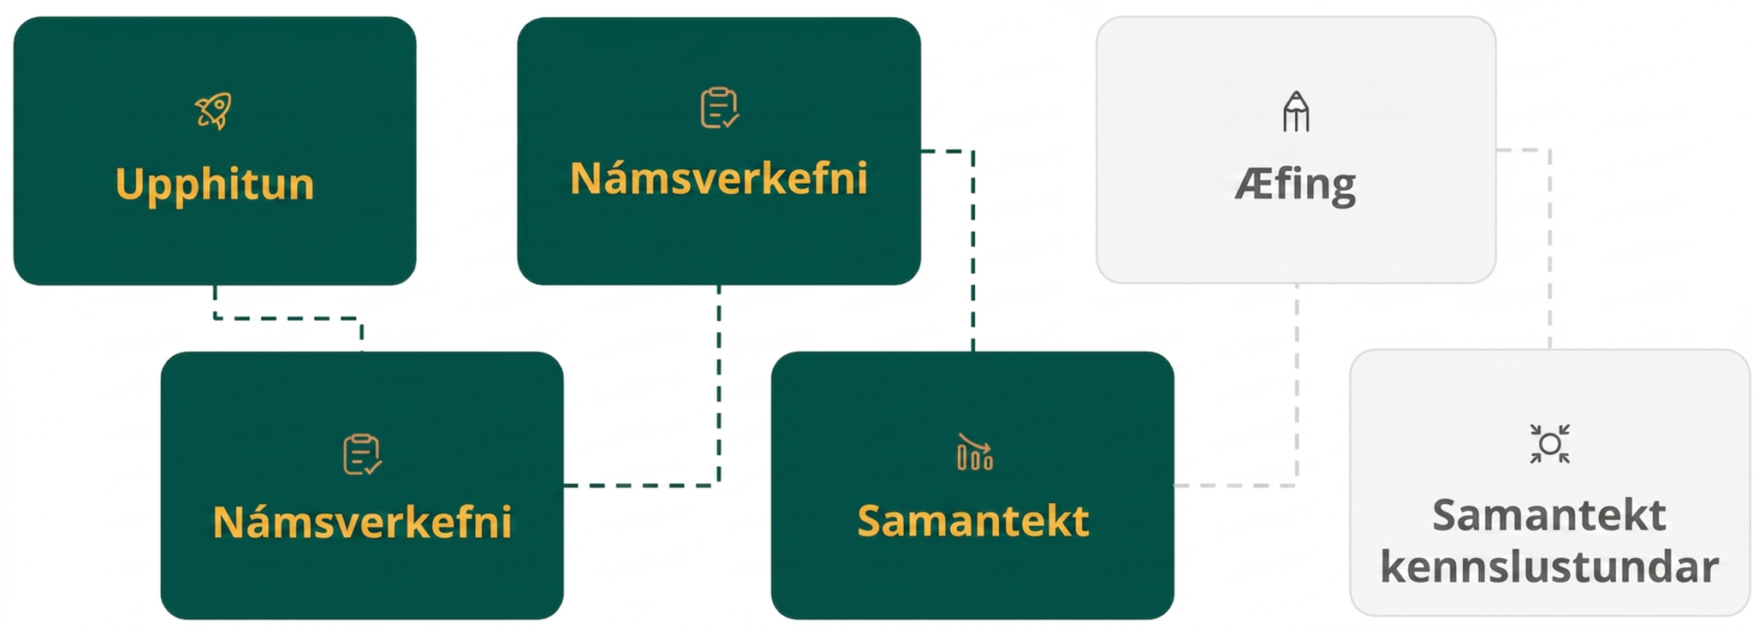
Lesson Journey
Fourth Step: Cool Down

Slide 23
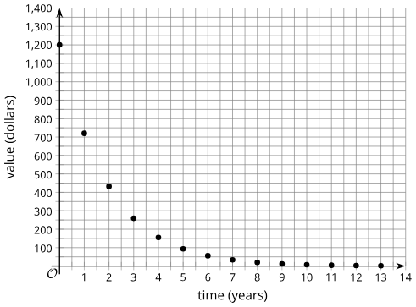
Cool Down
Which description is represented
by the graph?
  A phone loses ⅘ of its value every
  year after purchase; the relationship
  between the number of years since
  purchasing the phone and the value of the phone.
  The number of stores a company has tripled approximately every 5 years; the relationship between the number of years and the number of stores.
  A camera loses ⅖ of its value every year after purchase; the relationship between the number of years since purchasing the camera and the value of the camera.
Explain your answer choice.
Notes:
Cool Down (5 minutes)
Answers
A camera loses ⅖ of its value every year after purchase; the relationship between the number of years since purchasing the camera and the value of the camera.
Compare your answer:
The graph cannot represent Description A because the phone is retaining only ⅕ of its value, which is less than half, and the vertical coordinate of the second point on the graph is more than half of the vertical intercept.
If the camera loses ⅖ of its value each year, then its value is ⅗ that of the previous year. The vertical intercept seems to be 1,200, and ⅗ of 1,200 is about 700, which is roughly the vertical coordinate of the second point.
Response to Student Thinking - Points to Emphasize
If a significant number of students choose option a, consider doing a think aloud in class to determine the rate of decay. Assign a practice problem from this lesson for students to consolidate their thinking. If students struggle to explain their reasoning, select a few examples of student work and discuss as a class what makes the reasoning clear or how the reasoning might be strengthened.

Slide 24
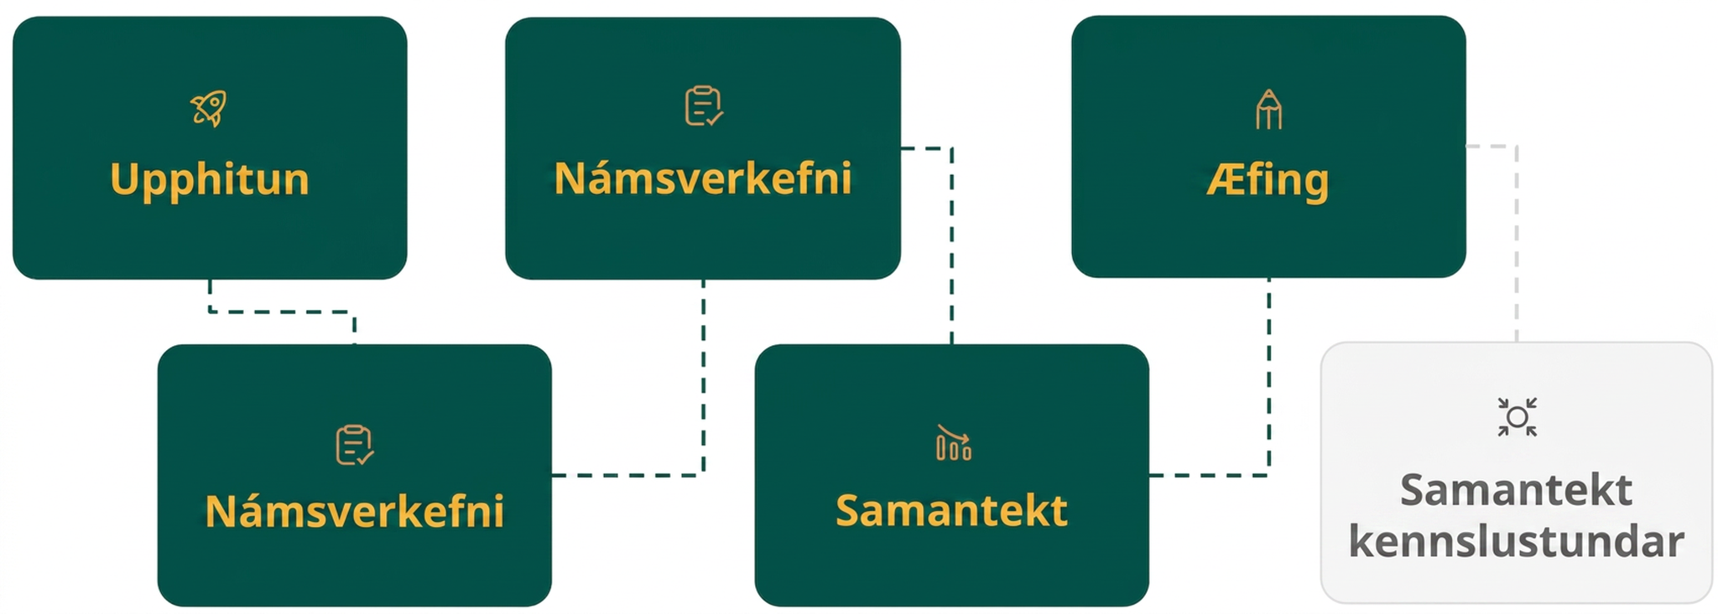
Lesson Journey
Fifth Stop: Practice

Slide 25

Practice
Put your hard work to action, practice what you’ve learned!
Notes:
Digital Practice: Access the practice pages at https://openstax.org/details/books/algebra-1

Slide 26
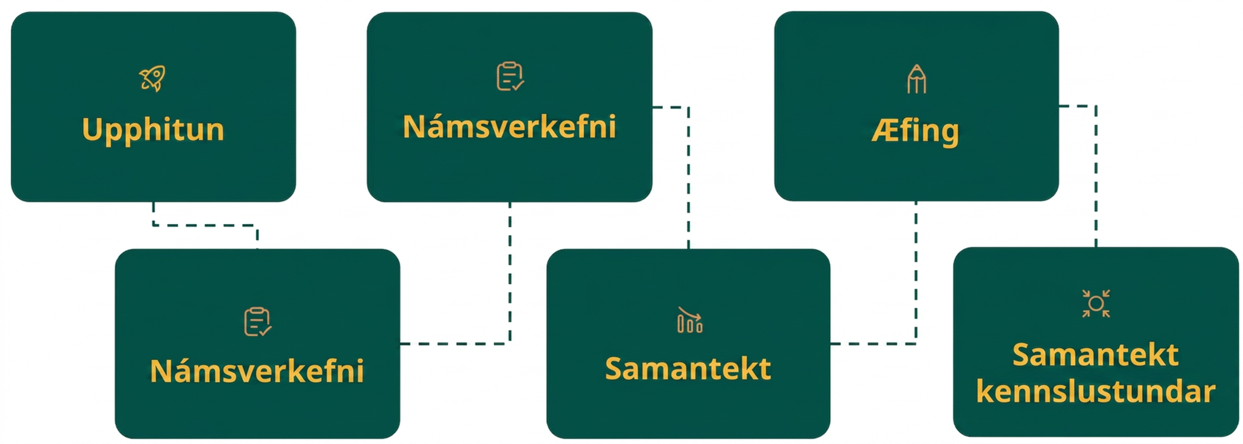
Lesson Journey
Sixth Stop: Lesson Synthesis

Slide 27
Lesson Synthesis
How can you use the graph to determine the initial amount?
How can you tell whether the growth factor is >1 or <1?
How can you use the graph to determine the growth factor?
How can you construct an equation to represent the relationship?
Notes:
Display the graph from an earlier activity in the lesson. Review how we can gather key information about situations from graphs representing them using the provided questions.

Slide 28
Self Assessment
How much do you agree with the following statements?
Learning Goals | I can | Almost | Not yet
Use graphs to compare and contrast situations that involve exponential decay. | ⃞ | ⃞ | ⃞
Use information from a graph to write an equation that represents exponential decay. | ⃞ | ⃞ | ⃞

