Slide 1


Algebra 1
Unit 8 Quadratic Equations
Lesson 8.1 Finding Unknown Inputs

Slide 2
How to use these slides
On the activity slides check the speaker notes for teacher support and instructional information.
Each lesson includes 1 warm up, 2-3 learning activities, a cool down, practice and a lesson synthesis.
  Learning activities are followed by a self check question, and review section.
Some slides have been hidden from student view, more information can be found on the next slide (Reference Key).
You can edit and use these slides for personal and classroom use, but cannot sell them and must keep the attribution logos.
For more information, Check out the digital quick start guide!

Slide 3






Reference Key
Check the top right corner for an icon referencing these unique sections.
 | Support for Students with Disability | Hidden | Learning Strategies slide, provides additional support to students for understanding the activity. Learning Strategies slide, provides additional support to students for understanding the activity.
 | Support for English Language Learners | Hidden
 | Extending Your Thinking | Hidden | Extending Your Thinking slide, provides an extra challenge for students.
 | Self Check | Not Hidden | Self Check slide, checkpoint to assess student understanding after the learning activity.
 | Review | Hidden | Self Check- Review slide, designed to help review topics from the self check question.
On the next slides, check the speaker notes for teacher instructions and support.
Notes:
Check the Speaker Notes: On the next slides you can find discussion questions, lesson information, answers to the activities, and ways to adjust the activity for your students!

Slide 4

Learning Goals
By the end of this lesson you will be able to -
Explain the meaning of a solution to an equation in terms of a situation.
Write a quadratic equation that represents a situation.
Notes:
Lesson Narrative
In the previous unit, students explored quadratic functions by building expressions, writing equivalents, and using graphs to solve problems. They focused on both finding outputs and reasoning backward to find inputs—mainly by analyzing graphs. This lesson builds on that foundation. Students now face a problem that can’t be solved easily with estimation or guess-and-check. They’ll write a quadratic equation and interpret its solution in context, highlighting why solving quadratic equations is important. The next lesson will extend this by introducing variations and new applications.
Required Preparation
Print the cut-out pictures — each picture should measure 7 inches by 4 inches.
Cut colored paper into pieces measuring 4 inches by 2.5 inches. These will represent framing material.
Each students will need 1 picture and 1 piece of colored paper. However, we recommend cutting extra framing material in case of mistakes.
Required Materials
Paper and pencil
Classroom set of scissors (1 per student if possible)
Classroom set of rulers (1 per student if possible)
Cut-out pictures (1 per student)
Colored paper/Framing material (1-3 per student)
Texas Essential Knowledge and Skills
A1(A) apply mathematics to problems arising in everyday life, society, and the workplace
Math process coverage: Lesson provides content that supports this TEKS.
A1(F) analyze mathematical relationships to connect and communicate mathematical ideas
Math process coverage: Lesson provides content that supports this TEKS.
A8(A) solve quadratic equations having real solutions by factoring, taking square roots, completing the square, and applying the quadratic formula.
Foundational: Lesson provides foundational content necessary for students to be able to perform this TEKS in later lessons.

Slide 5
Vocabulary
Previous
Quadratic function
  A function where the output is given by a quadratic expression in the input 𝑓(𝑥) = 𝑎𝑥² + 𝑏𝑥 + 𝑐.
Function
  A relation that takes inputs from one set and assigns them to outputs from another set, assigning exactly one output to each input.
New
Quadratic equation
  Polynomial equations of degree two
Notes:
Lesson Vocabulary
To support student understanding of key vocabulary:
Introduce and review the vocabulary words students will see in this lesson.
Encourage students to notice how these words are used and to include them in their math discussions and explanations—both written and oral.
Use a word wall to reinforce vocabulary. Sample word wall cards are available here.
For newcomers or students with beginning English proficiency, use these Quizlet sets to support vocabulary learning:
Unit 8 Spanish Vocabulary – use first to build understanding
Unit 8 Vocabulary (English) – use after anchoring in Spanish
Support for English Language Learners
ELPS 2(F) listen to and derive meaning from a variety of media such as audiotape, video, DVD, and CD-ROM to build and reinforce concept and language attainment
ELPS 2(I) demonstrate listening comprehension of increasingly complex spoken English by following directions, retelling or summarizing spoken messages, responding to questions and requests, collaborating with peers, and taking notes commensurate with content and grade-level needs
ELPS 3(E) share information in cooperative learning interactions
ELPS 4(G) demonstrate comprehension of increasingly complex English by participating in shared reading, retelling or summarizing material, responding to questions, and taking notes commensurate with content area and grade level needs

Slide 6





Lesson Journey
Warm Up
Learning Activity
Practice
Learning Activity
Cool Down
Lesson Synthesis

Slide 7

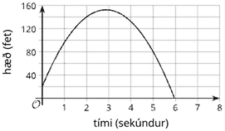
Warm Up - Potato Launch 🥔
A mechanical device is used to launch a potato vertically into the air. The potato is launched from a platform 20 feet above the ground, with an initial vertical velocity of 92 feet per second.
The function h (t) = -16t² + 92t + 20 models the height of the potato over the ground, in feet, t seconds after the launch.
Graph representing the function:
𝘩(𝑡) = -16𝑡² + 92𝑡 + 20
Notes:
Warm Up (5 minutes)
This task reinforces how graphs can help interpret real-world situations. Each question can be answered—or estimated—by analyzing the graph. Watch for students who also use the equation to verify answers, such as evaluating ℎ(1) or ℎ(8). Invite them to share these strategies during the synthesis discussion.
Launch
Students are likely familiar with projectile motion from earlier work. If needed, briefly explain the context: some devices use compressed air to launch potatoes or similar objects. Read the problem together, then have students complete the tasks independently.
Activity questions, answers, and synthesis on the next slide.

Slide 8
Warm Up - Potato Launch 🥔
For each question, explain your reasoning.
What is the height of the potato 1 second after launch?
Will the potato still be in the air 8 seconds after launch?
Will the potato reach 120 feet? If so, when?
When will the potato hit the ground, or have a height of zero feet?
Graph representing the function:
𝘩(𝑡) = -16𝑡² + 92𝑡 + 20
Notes:
Activity Answers
The height of the potato 1 second after launch will be 96 feet.
Substituting 1 second into the function 𝘩(𝑡) yields:
𝘩(1) = -16 (1)2 + 92 (1) + 2
= -16 + 92 +20
= 96
No, from the graph, we can see the potato will land before 8 seconds after the launch.
Yes, from the graph, we can see the potato’s height will be 120 feet at two times: approximately 1.5 seconds and 4.3 seconds after launch.
We can see from the graph the potato will hit the ground, or have a height of zero feet, after approximately 6 seconds.
Activity Synthesis
Guide discussion toward how students used the graph to answer the questions. Encourage precise math vocabulary. Invite students who used the equation—not just the graph—to share their reasoning. Emphasize that while graphs provide helpful information, they often give estimates rather than exact answers.
“Is there a way to get more exact answers?”
Some questions, like where the potato is at 1 or 8 seconds, can be answered by evaluating the function. Others—like when it reaches 120 feet—are harder to calculate and require estimation from the graph.
“How can we verify when the potato is 120 feet up, or when it hits the ground exactly?”
By solving ℎ(𝑡) = 120 or ℎ(𝑡) = 0, we find the exact values for those moments. Explain that in this unit, students will learn to solve such equations to find precise answers instead of relying on estimation or guesswork.

Slide 9

Lesson Journey
Warm Up
Learning Activity
Practice
Learning Activity
Cool Down
Lesson Synthesis

Slide 10

Learning Strategies - Framing a Picture📏✂️
Teacher Instruction: Use these strategies to adjust the activity to support english language learners and students with disabilities.
You can copy and paste the callouts directly on top of the activity or give the instructions aloud.
Walk around and find two other frames in the room
Think about what’s the same and different about the frames
Talk with your partner about what you noticed
Compare and Connect
How would you explain the directions in your own words?
Representation
Notes:
Support for English Language Learners: MLR 7 Compare and Connect: Representing, Conversing
Use this routine to prepare students for the whole-class discussion. Invite students to quietly circulate and examine at least two other “frames” in the room. Give students quiet think time to consider what is the same and what is different about the constructed frames. Next, ask students to find a partner to discuss what they noticed. Listen for and amplify observations that include connections across approaches, challenges faced identifying dimensions of framing material, and the need for more sophisticated strategies for solving this problem using quadratic equations.
Design Principle(s): Cultivate conversation
Learn more about this routine
View the instructional video and follow along with the materials to assist you with learning this routine.
Provide support for students
Distribute graphic organizers to the students to assist them with participating in this routine.
Support for Students with Disabilities: Representation: Access for Perception
Display and read the directions aloud. Students who both listen to and read the information will benefit from additional processing time. Check for understanding by inviting students to rephrase directions in their own words.
Supports accessibility for: Language; Memory

Slide 11
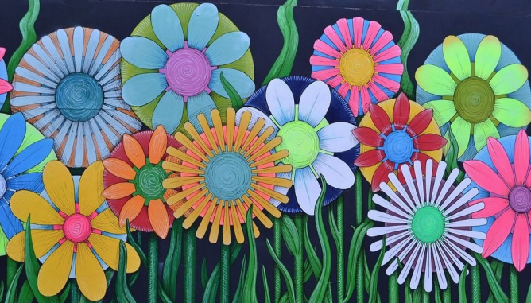
Learning Activity - Framing a Picture📏✂️
Materials:
Picture, 7 x 4 inches
Colored paper/framing material, 4 x 2.5 inches
Ruler
Scissors
Instructions:
Cut the framing material to create a rectangular frame for the picture. The frame should have the same width all the way around and have no overlaps. All of the framing material should be used with no leftover pieces. The frame should not cover any part of the picture.
Describe the process you used to create the frame.
Notes:
Support for All Learners
This activity offers additional support and an extension for students:
For English language learners and students with disabilities, be sure to review the Learning Strategies slide!
For students looking for an extra challenge, be sure to review the Extending Your Thinking slide!
Activity (20 minutes)
This task introduces the need to write and solve a quadratic equation. Students try to create a frame with uniform width using a piece of “framing material” that is smaller and differently proportioned than the picture. Since it can’t just be centered, and trial and error won’t work well, students should begin to feel the need for a more precise method. Some may attempt to write an equation, but they don’t yet have the tools to solve it—especially because the solution is irrational and unlikely to be guessed.
Launch
Ask if students have ever had a picture custom-framed. If not, explain that it’s expensive due to the precision and labor involved. Use this to emphasize the value of using all material correctly.
Distribute to each student:
Scissors
A ruler
The “picture” measuring 7 inches by 4 inches
The “framing material” (colored paper measuring 4 inches by 2.5 inches)
Explain to students:
They must use the entire piece.
It cannot overlap or cover the picture.
The frame must have a uniform width.
Let them know extra pieces are available if needed, but they must remove all of the original material before starting again.
Activity image answer, and synthesis on the next slide.

Slide 12
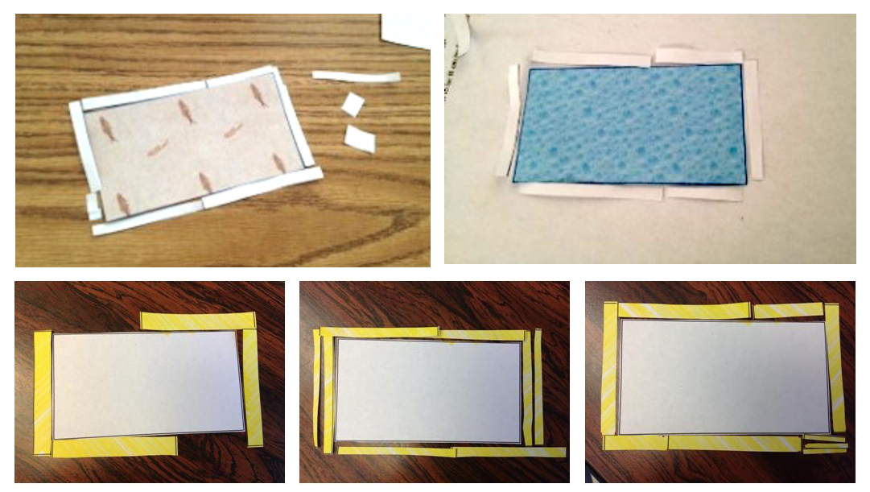
Learning Activity - Framing a Picture📏✂️
Are you ready for more?
Notes:
Activity Answer
Here are some examples of the process shown in images. Only some of the attempts are correct while others are not. Now that you have completed the activity, can you think of any mathematical method to solve the problem?
Activity Synthesis
Ask a few students to share their frames. Use guiding questions like:
“How did you decide how thick the frame should be?”
“How did you know what would be too large or too small?”
“Were all the strips the same size?”
“Is it possible to determine the width with no leftover material?”
Students might describe trying different widths and noticing whether the material ran out or left extra. Highlight their thinking about perimeter, area, and spreading material evenly.
Emphasize that trial and error isn’t efficient—and that today’s challenge shows why we need better strategies. Explain that using what they know, they’ll learn to write a quadratic equation to model the situation and solve for the exact frame width—without guessing. (The solution is about 0.342 inches.)

Slide 13
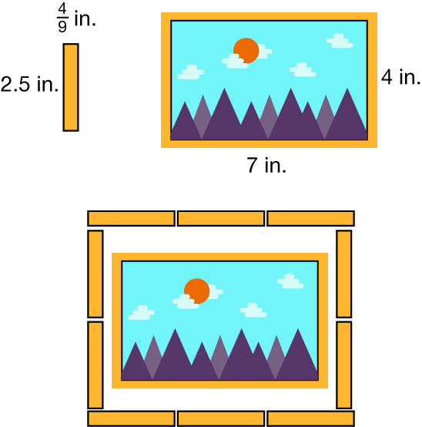
Extending Your Thinking
Juan says, “The perimeter of the picture is 22 inches. If I cut the framing material into 9 pieces, each one being 2.5 inches by 4/9 inch, I’ll have more than enough material to surround the picture because those pieces would yield 9⋅2.5, or 22.5 inches for the frame.”
Do you agree with Juan? Be prepared to show your reasoning.
Notes:
Answer
No, Juan is not correct because 9 pieces would not be enough to go around the frame. While the total length of those pieces is enough to surround the picture, he will need at least two pieces for each short side to cover 4 inches and at least 3 pieces for each long side to cover 7 inches. This adds up to 10 pieces, as shown below.

Slide 14
Self Check
Suppose you want to frame a picture that measures 8 inches by 3 inches. The frame is created from 12 square inches of framing material. The frame must be uniform in width, and all of the framing material must be used. Which statement is true?
The frame will measure exactly 8 inches by 3 inches.
The total area of the framed picture will be 24 square inches.
The perimeter of the framed picture will be 22 inches.
The total area of the framed picture will be 36 square inches.
Let’s review!
Notes:
Answer Feedback - Individualized by Response
Incorrect. The frame cannot have the same dimensions as the picture. Its dimensions will be longer to include the width of the frame. The true statement is that the total area of the framed picture will be 36 square inches: 24 square inches for the picture and 12 square inches for the frame. 24+12=36 square inches.
Incorrect. The area of the picture by itself is 8⋅3, or 24 square inches. The area of the framing material is 12 square inches. To find the total area, these values must be added together. The answer is the total area of the framed picture will be 24+12, or 36 square inches.
Incorrect. The perimeter of the picture by itself is 8+8+3+3, or 22 inches. The framed picture will have a larger perimeter than 22 inches. The true statement is that the total area of the framed picture will be 36 square inches: 24 square inches for the picture and 12 square inches for the frame. 24+12=36 square inches.
That’s correct! The area of the picture is 8⋅3, or 24 square inches. The area of the frame material is 12 square inches. So, the total area of the framed picture will be 24+12, or 36 square inches.

Slide 15
Self Check - Review
Suppose you want to frame a different picture that measures 10 inches by 6 inches. The frame is created from 36 square inches of framing material. The frame must be uniform in width, and all of the framing material must be used.
What is the perimeter of the picture?
  The perimeter of the picture is 10 + 10 + 6 + 6 = 32 inches
What is the area of the picture?
  The area of the picture is 10 · 6 = 60 square inches
What will be the total area of the framed picture?
  The total area of the framed picture will be 60 + 36 = 96 square inches
Notes:
Remind Students
This activity challenges you to complete a very difficult task!
The more you know about the situation, the closer you are to being able to solve this problem mathematically instead of guessing and checking to see if you are correct.
We will use this information in later activities to set up a quadratic equation that can be used to solve the problem.

Slide 16
Lesson Journey
Warm Up
Learning Activity
Practice
Learning Activity
Cool Down
Lesson Synthesis

Slide 17
Learning Strategies - Framing a Picture 🖼
Teacher Instruction: Use these strategies to adjust the activity to support english language learners and students with disabilities.
  You can copy and paste the callouts directly on top of the activity or give the instructions aloud.
First read: listen and describe the situation without numbers.
Second read: list what can be counted or measured.
Third read: listen for the question and brainstorm ways to solve.
Three Reads
Draw and label what you know about the picture and frame on graph paper.
Think about what diagrams would help you understand the problem better (ex. Strips of framing material)
Action and Expression
Notes:
Support for English Language Learners: MLR 6 Three Reads: Reading, Listening, Conversing
Use this routine to support reading comprehension, without solving, for students. Use the first read to orient students to the situation. Ask students to describe what the situation is about without using numbers (creating a frame for a rectangular picture). If students understand the situation based on their work in the prior activity, skip to the next read. After the second read, students list any quantities that can be counted or measured, without focusing on specific values (dimensions of the picture and framing materials). During the third read, the question or prompt is revealed. Invite students to brainstorm possible strategies, referencing the relevant quantities named after the second read. This helps students connect the language in the word problem and the reasoning needed to solve the problem while keeping the cognitive demand of the task.
Design Principle(s): Support sense-making
Learn more about this routine
View the instructional video and follow along with the materials to assist you with learning this routine.
Provide support for students
Distribute graphic organizers to the students to assist them with participating in this routine.
Support for Students with Disabilities: Action and Expression: Internalize Executive Functions
Represent the same information through different modalities by using diagrams. Provide students with graph paper and suggest that they draw and label their diagrams with everything they know so far. Invite students to suggest types of diagrams that might be helpful to draw, such as the strips of framing material, and the picture both with and without the frame.
Supports accessibility for: Conceptual processing; Visual-spatial processing

Slide 18
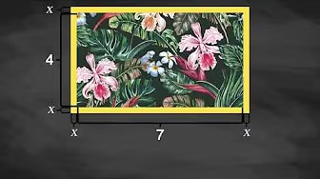
Video: Formulating a Quadratic Equation to Represent the Model

Slide 19

Learning Activity - Framing a Picture 🖼
Here is a diagram that shows the picture with a frame that is the same width all the way around.
The picture is 7 inches by 4 inches.
The frame is created from 10 square inches of framing material (in the form of a rectangle measuring 4 inches by 2.5 inches).
Notes:
Support for All Learners
This activity offers additional support and an extension for students:
For English language learners and students with disabilities, be sure to review the Learning Strategies slide!
Activity (10 minutes)
In this activity, students begin modeling the framing task by writing an equation—though they’re not expected to solve it yet. The open-ended prompt allows for multiple valid approaches. Some may model the total dimensions as (7 + 2𝑥)(4 + 2𝑥) = 38, using the picture and frame’s full dimensions. Others may build the equation by adding the picture’s area (28 in²) and the frame’s decomposed parts: 4𝑥² (corners), 2(7𝑥) (top/bottom), and 2(4𝑥) (sides), leading to 4𝑥² + 22𝑥 + 28 = 38.
As students work, observe different strategies and plan to have contrasting approaches shared during discussion.
Launch
Let students know they’ll now write an equation to represent the framing scenario. Have them think individually first, then discuss in pairs. If stuck, encourage them to label the diagram and ask scaffolding questions like:
What’s the area of a 7×4 picture? (28)
What’s the total area with the frame? (38)
How does adding a frame affect the length and width? (Increases by 2𝑥)
How can we show a uniform frame width? (Use 𝑥 on all sides)
Activity questions, answers, anticipated misconceptions, and synthesis on the next slide.

Slide 20
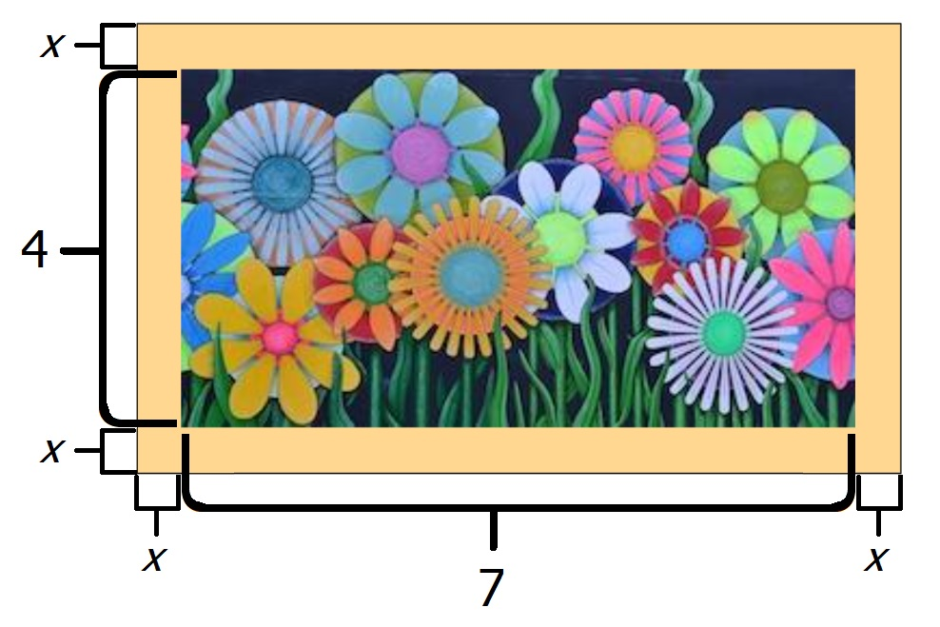
Learning Activity - Framing a Picture 🖼
Write an expression to represent the length of the framed picture on its shorter side. (Use 𝑥 to represent the width of the frame.)
Write an expression to represent the length of the framed picture on its longer side. (Use 𝑥 to represent the width of the frame.)
Write an equation to represent the relationship between the measurements of the framed picture and its total area.
What does a solution to this equation represent?
The picture is 7 inches by 4 inches.
The frame is created from 10 square inches of framing material.
Notes:
Answers
2𝑥+4
2𝑥+7
(2𝑥+7)(2𝑥+4)=38 or 4𝑥²+22𝑥+28=38 (or equivalent)
A solution would represent the width of the frame when all of the framing material is used.
Anticipated Misconceptions
Some students may struggle to express the overall length and width using variables. To support them, draw a segment made of three parts—1.5, 10, and 1.5 inches—and ask for the total length. Then replace 1.5 with 𝑥 to arrive at 10 + 2𝑥. If students confuse 𝑥 + 𝑥 with 𝑥², use a square with side length 𝑥 to show how area (𝑥²) differs from perimeter (adding sides). Continue using visual breakdowns to help students build expressions by combining parts.
Activity Synthesis
Ask students to share the equations they wrote and how they approached the problem. If key strategies from the activity narrative don’t surface, introduce them. Discuss whether equations like (7 + 2𝑥)(4 + 2𝑥) = 38 and 4𝑥² + 22𝑥 + 28 = 38 are equivalent, and how students could check this. Clarify that solving these equations will reveal the frame’s width when all 10 in² of framing material is used.
Invite ideas for how they might solve the equations:
Graphing and finding when 𝑦 = 38
Testing values for 𝑥 until the expression equals 38
Using a spreadsheet to evaluate the expression at different 𝑥 values
Explain that both equations are quadratic. Define a quadratic equation as one that fits the form 𝑎𝑥² + 𝑏𝑥 + 𝑐 = 0 (where 𝑎 ≠ 0). Let students know they’ll explore algebraic strategies to solve these in the next lesson.

Slide 21
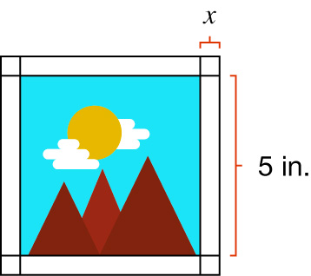
Self Check
Suppose a different picture is 5 inches by 5 inches. The frame is created from 11 square inches of framing material. The frame will be uniform in width, and all of the framing material is used. Which equation would you need to solve in order to determine the value of 𝑥, the width of the frame?
4𝑥² + 20𝑥 + 25 = 36
𝑥² + 10x + 25 = 36
𝑥² + 25 = 11
4𝑥² + 20𝑥 = 36
Let’s review!
Notes:
Answer Feedback - Individualized by Response
That's correct! The length of one side of the frame is 2𝑥+5. The area of the framed picture is (2𝑥+5)(2𝑥+5). Set this equal to the total area, 25+11, or 36 square inches. So, the equation to represent the total area is (2𝑥+5)(2𝑥+5)=36, or 4𝑥2+20𝑥+25=36.
Incorrect.The length of one side of the frame is 2𝑥+5. So the area of the framed picture is (2𝑥+5)(2𝑥+5). Remember to add the product of the inner terms and outer terms when multiplying the binomials. Set this equal to the total area, 25+11, or 36 square inches. The answer, or the equation to represent the total area, is (2𝑥+5)(2𝑥+5)=36, or 4𝑥2+20𝑥+25=36.
Incorrect. This represents only part of the frame. The length of one side of the frame is 2𝑥+5. So the area of the framed picture is (2𝑥+5)(2𝑥+5). Set this equal to the total area, 25+11, or 36 square inches. The answer, or the equation to represent the total area, is (2𝑥+5)(2𝑥+5)=36, or 4𝑥2+20𝑥+25=36.
Incorrect. The length of one side of the frame is 2𝑥+5. So the area of the framed picture is (2𝑥+5)(2𝑥+5). Set this equal to the total area, 25+11, or 36 square inches. Remember to add the product of the last terms of each binomial when multiplying the two binomials. The answer, or the equation to represent the total area, is (2𝑥+5)(2𝑥+5)=36, or 4𝑥2+20𝑥+25=36.

Slide 22
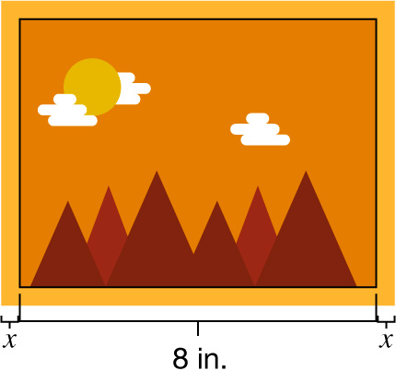
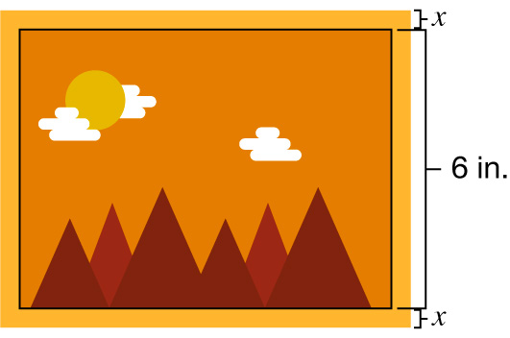
Self Check - Review
Imagine a picture 8 inches by 6 inches. The frame is created from 32 square inches of framing material. The frame will be uniform in width, and all of the framing material is used.
How do we write an equation representing the total area of the framed picture?
The picture area is 8 x 6 = 48 square inches. The frame adds 32 square inches, so the total area is 48 + 32 = 80 square inches.
The frame width is represented by 𝑥.
  Longer side: 𝑥 + 8 + 𝑥 = 2𝑥 + 8
  Shorter side: 𝑥 + 6 + 𝑥 = 2𝑥 + 6
Find the quadratic equation
  (2𝑥 + 8) (2𝑥 + 6) = 80
  4𝑥² + 12𝑥 + 16𝑥 + 48 = 80
  4𝑥² + 28𝑥 + 48 = 80
Notes:
Remind Students: This is a quadratic equation - one that can be written in the form of 𝑎𝑥²+𝑏𝑥+𝑐=0 where 𝑎 is not 0.

Slide 23

Lesson Journey
Warm Up
Learning Activity
Practice
Learning Activity
Cool Down
Lesson Synthesis

Slide 24
Cool Down
A framed picture has a total area 𝑦, in square inches. The thickness of the frame is represented by 𝑥, in inches. The equation 𝑦 = (2𝑥+8) (2𝑥+10) relates these two variables.
What is the width, or shorter side, of the picture without the frame?
What is the length, or longer side, of the picture without the frame?
What would a solution to the equation 100 = (2𝑥+8) (2𝑥+10) mean in this situation?
Notes:
Cool Down (5 minutes)
Answers
8 inches
10 inches
The solution would represent the thickness of a frame that results in a total area of 100 square inches.
Response to Student Thinking - More Chances
Students will revisit these concepts in upcoming lessons, so there's no need to slow down or add extra work now. Instead, use the results of this cool down to guide your focus in future lessons—pay attention to common gaps and emphasize those areas to help students deepen their understanding over time.

Slide 25

Lesson Journey
Warm Up
Learning Activity
Practice
Learning Activity
Cool Down
Lesson Synthesis

Slide 26

Practice
Put your hard work to action, practice what you’ve learned!
Notes:
Digital Practice: Access the practice pages at https://openstax.org/k12/algebra

Slide 27

Lesson Journey
Warm Up
Learning Activity
Practice
Learning Activity
Cool Down
Lesson Synthesis

Slide 28
Lesson Synthesis
In the launched potato situation
What outputs were known?
What inputs did we want to know?
In the framing problem
What was the output that we cared about?
What information was the input?
Why might it be helpful to write an equation to represent a problem such as the one about framing?
If 𝑥 represents the width of the frame, in inches, what would a solution to the equation (2𝑥+7) (2𝑥+4) = 50 mean?
Equations such as (2𝑥+7) (2𝑥+4) = 50 and 4𝑥²+ 22𝑥 + 28 = 38 are called quadratic equations.
Why do you think equations like these are described as quadratic?
Notes:
Prompt: In this lesson, we saw a few examples where we knew the output of a function and were interested in finding the input that produced it.
Answers:
The potato’s heights or distances from the ground.
The times at which the potato was at certain heights.
The total area of the framed picture, which was 38 square inches.
The width of the frame that would produce that total area.
An equation helps us see the relationship between the quantities in the problem, including those whose values are unknown. We can solve for those values.
The width of the frame would produce a total area of 50 square inches.
Each equation has a quadratic expression in it. Each one relates quantities in a quadratic function.
Remind students: Quadratic equations will be defined more formally in the next lesson. It is fine and expected that students have an informal or partial understanding of what they are at this point.

Slide 29
Self Assessment
How much do you agree with the following statements?
I can… | I can | Almost | Not yet
Explain the meaning of a solution to an equation in terms of a situation.
Write a quadratic equation that represents a situation.

