Slide 1
Algebra 1
Unit 8 Quadratic Equations
Lesson 8.2 When and Why Do We Write Quadratic Equations?

Slide 2

How to use these slides
On the activity slides check the speaker notes for teacher support and instructional information.
Each lesson includes 1 warm up, 2-3 learning activities, a cool down, practice and a lesson synthesis.
  Learning activities are followed by a self check question, and review section.
Some slides have been hidden from student view, more information can be found on the next slide (Reference Key).
You can edit and use these slides for personal and classroom use, but cannot sell them and must keep the attribution logos.
For more information, Check out the digital quick start guide!
OpenStax CC BY NC SA

Slide 3





Reference Key
Check the top right corner for an icon referencing these unique sections.
Icon | Title | View | Location and Description
n/a | Support for Students with Disability | Hidden | Learning Strategies slide, provides additional support to students for understanding the activity.
n/a | Support for English Language Learners | Hidden | Learning Strategies slide, provides additional support to students for understanding the activity.
n/a | Extending Your Thinking | Hidden | Extending Your Thinking slide, provides an extra challenge for students.
n/a | Self Check | Not Hidden | Self Check slide, checkpoint to assess student understanding after the learning activity.
n/a | Review | Hidden | Self Check - Review slide, designed to help review topics from the self check question.
On the next slides, check the speaker notes for teacher instructions and support.
Notes:
Check the Speaker Notes: On the next slides you can find discussion questions, lesson information, answers to the activities, and ways to adjust the activity for your students!

Slide 4

Learning Goals
By the end of this lesson you will be able to -
Recognize the factored form of a quadratic expression and know when it can be useful for solving problems.
Use a graph to find the solutions to a quadratic equation but also know its limitations.
Notes:
Lesson Narrative
In this lesson, students revisit some situations that can be modeled with quadratic functions. They analyze and interpret given equations, write equations to represent relationships and constraints, and work to solve these equations.
In doing so, students see that sometimes solutions to quadratic equations cannot be easily or precisely found by graphing or reasoning. Here, they notice that when a quadratic equation is written as factored form = 0, solving the equation is also relatively simple.
Required Preparation
None
Required Materials
Paper and pencil
Texas Essential Knowledge and Skills
A1(A) apply mathematics to problems arising in everyday life, society, and the workplace.
A1(C) select tools, including real objects, manipulatives, paper and pencil, and technology as appropriate, and techniques, including mental math, estimation, and number sense as appropriate, to solve problems.
A8(A) solve quadratic equations having real solutions by factoring, taking square roots, completing the square, and applying the quadratic formula.

Slide 5
Vocabulary
Previous
Quadratic equation
  Polynomial equation of degree two.
Quadratic function
  A function where the output is given by a quadratic expression in the input
  𝑓(𝑥) = 𝑎𝑥² + 𝑏𝑥 + 𝑐.
Factored form (of a quadratic expression)
  A quadratic expression that is written as the product of a constant times two linear factors. 𝑓(𝑥) = 𝑎(𝑥 – r₁)(𝑥 – r₂).
Zero of the function
  When the input value of a function yields an output of zero (where 𝑓(𝑥) = 0). On the graph, this is where the function intersects the 𝑥-axis.
Notes:
Lesson Vocabulary
To support student understanding of key vocabulary:
Introduce and review the vocabulary words students will see in this lesson.
Encourage students to notice how these words are used and to include them in their math discussions and explanations—both written and oral.
Use a word wall to reinforce vocabulary. Sample word wall cards are available here.
For newcomers or students with beginning English proficiency, use these Quizlet sets to support vocabulary learning:
Unit 8 Spanish Vocabulary – use first to build understanding
Unit 8 Vocabulary (English) – use after anchoring in Spanish
Support for English Language Learners
ELPS 1(E) internalize new basic and academic language by using and reusing it in meaningful ways in speaking and writing activities that build concept and language attainment.
ELPS 2(F) listen to and derive meaning from a variety of media such as audiotape, video, DVD, and CD-ROM to build and reinforce concept and language attainment.
ELPS 3(D) speak using grade-level content area vocabulary in context to internalize new English words and build academic language proficiency.
ELPS 3(E) share information in cooperative learning interactions.
ELPS 5(H) using negatives and contractions correctly.

Slide 6

Lesson Journey
First Stop: Warm Up

Slide 7


Warm Up
The Play's the Thing!
Tickets to a play cost $12, and for each
purchase there is a $2.50 fee. The
expression 12𝑡 + 2.50 represents the
cost to purchase tickets for the play,
where 𝑡 is the number of tickets. Be prepared to explain your response to each question.
A family paid $62.50 for tickets. How many tickets were bought?
A teacher paid $278.50 for tickets for her students. How many tickets were bought?
Notes:
Warm Up (5 minutes)
This warm up activates what students know about interpreting equations in context and about solving for a variable. The given equation is linear and is relatively straightforward. The work prepares students to reason about quadratic equations in the lesson.
Continue scrolling down for directions on how to launch the activity, answers, and synthesis questions.
To find the unknown input in each question, students might:
Try different values of 𝑡 until they find one that yields the specified value of 𝑐.
Reason backward (subtract 2.5 from 62.50 and then divide the result by 12) without writing out the steps.
Solve 62.5 = 12𝑡 + 2.5 and 278.5 = 12𝑡 + 2.5 by performing the same operation to each side to isolate 𝑡.
Launch
Read the problem aloud to the class. Allow the students to answer the exercises individually.
Answers
Five tickets were bought. Subtracting 2.50 from 62.50 gives 60. If 12𝑡 is 60, then 𝑡 is 5.
Twenty-three tickets were bought. Subtracting 2.50 from 278.50 gives 276. If 12𝑡 is 276, then 𝑡 is 23.
Activity Synthesis
Ask students to share their responses and reasoning. Highlight the different strategies used to answer the questions.
If no students thought of the situation in terms of a function and wrote an equation, point out that we can think about cost as being a function of the number of tickets. In answering the questions, we were looking for the inputs that produce different outputs. This can be done by solving equations. In the case of linear equations, we can “do the same thing to each side” to isolate the variable.

Slide 8
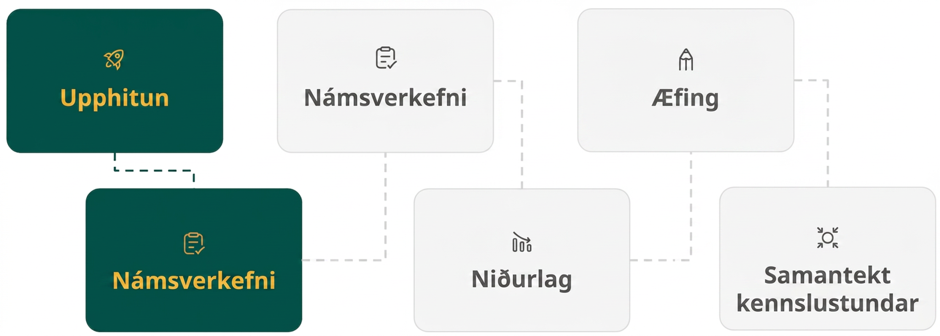
Lesson Journey
Second Stop: Learning Activity A

Slide 9

Learning Activity A | Learning Strategies
Potato Toss, Revisited 🥔
With your partner, describe the steps to find the solutions.
Be sure to include reasons for your steps.
  “We should do ___ next because …”
  “I noticed ___, so I think …”
If you don’t agree with your partner, ask questions or challenge their process.
  “Explain why you did that again.”
  “This method works/doesn’t work
  because …”
  “Another strategy would be ___
  because …”
Discussion Supports/Representation
Teacher Instruction: Use these strategies to adjust the activity to support English language learners and students with disabilities.
You can copy and paste the callouts directly on top of the activity or give the instructions aloud.
Notes:
Support for English Language Learners: MLR 8 Discussion Supports: Conversing
In groups of two, students should take turns describing what steps they think should be taken next to find the solutions and explaining the reasoning behind those steps. Display the following sentence frames for all to see: “We should do ____ next because …”, and “I noticed ___ , so I think …” Encourage students to challenge each other when they disagree. This will help students clarify their reasoning when persevering in problem-solving quadratic equations. When students are discussing what is the same and different about their steps and solving strategies, assist students in using negatives and contractions correctly, such as do/don't, can/can't, is/isn't.
Design Principle(s): Support sense-making; Maximize meta-awareness
Support for Students with Disabilities: Representation: Internalize Comprehension
Use color and annotations to illustrate student thinking. As students share their reasoning about methods to find a solution, scribe their thinking on a visible display. Display sentence frames for students to use during the discussion, such as: “This method works/doesn’t work because . . . .” and “Another strategy would be _____ because . . . .”
Supports accessibility for: Visual-spatial processing; Conceptual processing
NOTE: Support for both accommodations have been included on the same callout.

Slide 10
Learning Activity A
Potato Toss, Revisited 🥔
Here is a function modeling the height of a potato, in feet, 𝑡 seconds after being fired from a device:
𝑓(𝑡) = −16𝑡² + 80𝑡 + 64
What equation would we solve to find the time at which the potato hits the ground?
Use any method except graphing to find a solution to the equation from the previous question.
Notes:
Support for All Learners
This activity offers additional support for students:
For English language learners and students with disabilities, be sure to review the Learning Strategies slide!
Continue scrolling down for how to launch the activity, answers, and synthesis questions.
Activity (15 minutes)
This task prompts students to try different ways to solve a quadratic equation. They are familiar with solving equations by performing the same operation to each side of an equation, but here they see that this is not really a workable strategy. Students are also discouraged from using a graph to solve the equation. Because they do not yet know an efficient way to use algebra to solve −16𝑡² + 80𝑡 + 64 = 0, they need to try different strategies and persevere in problem solving.
As students work, notice those who use strategies listed in the Activity Synthesis. Ask them to share their approach during discussion.
Launch
Arrange students in groups of two.
Give them a few minutes of quiet time to think individually and then time to collaborate on solving the equations.
No graphing technology should be used in this activity.
Answers
− 16𝑡² + 80𝑡 + 64 = 0. Since the potato hits the ground at a height of 0 feet, set the equation equal to 0.
An approximate solution is about 5.7 seconds by using trial and error.
Activity Synthesis
Poll the class on their solutions to the equation and record and display the solutions for all to see. Then, ask some students to share their strategies and any associated challenges. If not mentioned by students, discuss the limitations of these approaches:
Isolating the variable: If we try to solve by performing the same operation to each side of the equation, we quickly get stuck.
Original equation
− 16𝑡² + 80𝑡 + 64 = 0
Subtract 64 from each side.
− 16𝑡² + 80𝑡 = −64
Divide each side by – 16.
𝑡² − 5𝑡 = 4
But then what? If we add 5𝑡 to each side, we now have a variable on both sides and cannot combine any like terms. We could multiply or divide each side by any constant we wish, but we are no closer to isolating 𝑡.
Guessing and checking: We can evaluate the quadratic expression at different values of 𝑡 until the expression has a value that is 0 or close to 0. For example, when 𝑡 is 4, the expression has a value of 128. At 𝑡 = 5, it has a value of 64, and at 𝑡 = 6, it has a value of – 32. That means 𝑡 is between 5 - 6, so we need to try different decimal values in that range. This process is laborious, and it may not get us to a precise solution. This can be true of guessing and checking for many different quadratic equations.
Graphing: Students may suggest that a graph would allow them to solve the problem much more quickly. Use graphing technology to demonstrate that if we graph the equation 𝑦 = 𝑓(𝑡), an approximate solution given is 5.702, as shown in the image. If we evaluate 𝑓(5.702), however, we get roughly –0.044864, rather than exactly 0. A graph is useful for approximating values, but it isn’t always possible to use it to find exact values. Access the online Teacher Guide for the graph (be sure you are logged into your educator account) or use this Desmos graph.
Tell students that in this unit they will learn some efficient strategies for solving equations like these.

Slide 11
Learning Activity A
Self Check
After a flashlight is turned on, it gets brighter as it warms up, and then it grows dimmer as the battery dies. The equation modeling the brightness it emits, in lumens, ℎ hours after being turned on is shown here: f(ℎ) = −8ℎ² + 30ℎ + 50
Which equation would you solve to determine when the flashlight dies and stops emitting lumens?
−8ℎ² + 30ℎ – 50 = 0
8ℎ² + 30ℎ + 50 = 0
−8ℎ² + 30ℎ = 50
−8ℎ² + 30ℎ + 50 = 0
Let’s review!
Notes:
Answer Feedback - Individualized by Response
Incorrect. This equation does not represent when the flashlight dies. The sign on 50 should not have been reversed.
Incorrect. This equation does not represent when the flashlight dies. The sign on 8ℎ² should not have been reversed.
Incorrect. This equation does not represent when the flashlight dies.
That’s correct! By setting the equation equal to 0, we are representing the time when the flashlight is no longer emitting any light (0 lumens).

Slide 12

Learning Activity A
Self Check - Review
SOLVING QUADRATICS BY GUESSING
Step 1 - Write the equation to be solved.
Step 2 - Arrange the equation to support guess & check by making is simpler (add/subtract; divide/multiply).
Step 3 - Guess & check.
A tennis ball is thrown out of the window of a building. The equation modeling the height of the tennis ball, in feet, 𝑡 seconds after being thrown is shown here: 𝑓(𝑡) = − 24𝑡² + 33𝑡 + 30.
Let’s find the equation we would solve to find the time at which the ball hits the ground, then solve it.
Notes:
Remind Students
The guess and check method works, but it can be more difficult when the solution is a decimal.
Graphing can also work, but it is time consuming and results in an approximate solution.
Answers
When the ball hits the ground, its height will be 0. So, we set the equation to 0. The equation − 24𝑡² + 33𝑡 + 30 = 0 represents the ball when it hits the ground. The solution to this equation represents the time it takes from when the ball is thrown for it to hit the ground.
Step 1 - Write the equation to be solved. − 24𝑡² +33𝑡 + 30 = 0
Step 2 - Subtract 30 from each side of the equation. − 24𝑡² + 33𝑡 = −30
Divide each side of the equation by 3. − 8𝑡² + 11𝑡 = − 10
Step 3 - Let’s try to solve the remaining equation using guess and check.
When 𝑡 = 3, the expression − 8𝑡² + 11𝑡 has a value of − 8(3)² + 11(3), or −39. This value is not equal to the −10 we needed to find.
When 𝑡 = 2, the expression − 8𝑡² + 11𝑡 has a value of − 8(2)² + 11(2), or −10. This value is equal to the −10 we needed to find.
The equation is true when 𝑡 = 2, so the ball took 2 seconds to hit the ground.

Slide 13
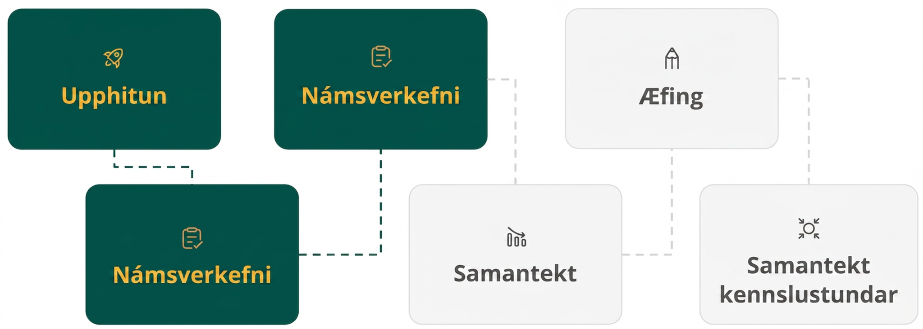
Lesson Journey
Third Stop: Learning Activity B

Slide 14
Learning Activity B | Learning Strategies
Winner! Winner! Chicken Dinner! 🍗
Teacher Instruction: Use these strategies to adjust the activity to support English language learners and students with disabilities.
  You can copy and paste the callouts directly on top of the activity or give the instructions aloud.
Prepare to share your thinking with the class.
Listen and watch for words and phrases that connect ideas for you.
Identify how key characteristics on the graph can be expressed in different forms of the equations.
Collect and Display
Select at least 2 different pen/highlighter colors.
Highlight or mark one factor in one color.
Illustrate the impact this factor has on the entire expression.
Repeat the process with the other color and other factor.
Representation
Notes:
Support for English Language Learners: MLR 2 Collect and Display: Conversing
As students discuss the differences between the forms of each equation with their partner, listen for and collect the language students use: vertex, x-intercept, zeros, etc. Write the students’ words and phrases on a visual display and refer to it during the discussion later in the launch. As the activity continues, update the visual display and continue to do so throughout the remainder of the lesson. Remind students to borrow language from the display as needed. This will help students read and use mathematical language during their partner and whole-class discussions.
Design Principle(s): Maximize meta-awareness; Support sense-making
Provide support for students
Distribute graphic organizers to the students to assist them with participating in this routine.
Support for Students with Disabilities: Representation: Internalize Comprehension
Use color and annotations to illustrate student thinking. As students share their reasoning about finding the solutions for which the ticket sales would equal zero, scribe their thinking on a visible display. Consider highlighting each factor separately and annotating to show that when one factor equals zero, the entire expression equals zero regardless of the value of the other factor.
Supports accessibility for: Visual-spatial processing; Conceptual processing

Slide 15
Learning Activity B
Winner! Winner! Chicken Dinner! 🍗
The expressions 𝑝(200 − 5𝑝) and −5𝑝² + 200𝑝 define the same function. The function models the revenue a school would earn from selling raffle tickets at 𝑝 dollars each.
At what price or prices would the school collect
$0 revenue from raffle sales? Explain or show
your reasoning.
The school staff noticed that there are two ticket prices that would result in a revenue of $500. What equation could you use to determine what those two prices are?
Are you ready for more?
Notes:
Support for All Learners
This activity offers additional support and an extension for students:
For English language learners and students with disabilities, be sure to review the Learning Strategies slide!
For students looking for an extra challenge, be sure to review the Extending Your Thinking slide!
Activity (15 minutes)
This activity aims to show that it is relatively easy to solve a quadratic equation when one side of the equation is zero and the other side is a quadratic expression in factored form, and that it may be a little tricky to solve the equation otherwise.
The activity prompts students to recall what they learned in an earlier unit: The zeros of a function correspond to the horizontal intercepts of the graph representing that function, and the zeros are the solutions to an equation of the form quadratic expression = 0.
Continue scrolling down for directions on how to launch the activity, answers, anticipated misconceptions, and synthesis questions.
Launch
Keep students in groups of two.
Read the opening paragraph in the task statement.
Give students a moment to think about how much the school would collect if it sells the tickets at $5 each (it would collect $875).
Briefly survey how they found out the answer. (Students are likely to have used the factored form because it lends itself to simpler calculations.)
Ask students to recall the form in which each quadratic expression is written. Then, give them a minute to talk to a partner and recall at least two things about each form and what the form might tell us about the graph of the function that the expression defines.
Record their responses for all to see.
If no students mentioned the connection between either of the forms to the horizontal intercepts of the graph or the zeros of the function, ask them about it.
Tell students that they do not need to find the ticket prices in the second question, but only to think about how to go about doing so.
Answers
$0 and $40. For example, if the equation 𝑝(200 − 5𝑝) = 0 is true, then either 𝑝 is equal to 0, or 200 − 5𝑝 is equal to 0. If 200 − 5𝑝 = 0, then 𝑝 is 40, because 200 − 5(40) is 0.
We could write 𝑝(200 − 5𝑝) = 500 and −5𝑝² + 200𝑝 = 500. Approximate solutions can be found using trial and error or graphing. However, we don’t yet know an exact way to solve either equation.
Anticipated Misconceptions
If students struggle to connect the expressions that define the function to the questions, ask them what the input and output of the function represent. If students struggle with the first question, ask them what values of 𝑝 would yield a value of 0 for the expression.
Activity Synthesis
Invite students to share their responses and strategies. Make sure students see that the first question can be represented by solving the equation 𝑝(200 − 5𝑝) = 0, and that the second question can be represented by solving either 𝑝(200 − 5𝑝) = 500 or − 5𝑝² + 200𝑝 = 500.
Although students are not yet formally introduced to the zero product property, they do have experience with finding the zeros of a quadratic function when given an expression in factored form. This prior knowledge enables them to reason about the solutions to the equation 𝑝(200 − 5𝑝) = 0. For instance, noticing the factor 𝑝, students are likely to say that one zero of the function is 0.
Ask students:
How can you show, without graphing, that 𝑝 = 0 will produce no revenue, or that it is a solution to the equation 𝑝(200 − 5𝑝) = 0? (When 𝑝 = 0, the factor 𝑝 is 0, and therefore the entire expression equals 0.)
How can you show that 𝑝 = 40 will also produce no revenue, or that it is also a solution to the same equation? (When 𝑝 = 40, the factor (200 − 5𝑝) is 0, and likewise, the entire expression is 0.)
Can we use the same reasoning to find the solutions to 𝑝(200 − 5𝑝) = 500 or − 5𝑝² + 200𝑝 = 500? Why or why not? (No, not easily. Neither shows the zeros of a function. There are many pairs of factors that have 500 as a product.)
Make sure students see that it is fairly straightforward to find the solutions to equations such as 𝑝(200−5𝑝)=0, but the same cannot be said about equations such as 𝑝(200 − 5𝑝) = 500 or − 5𝑝² + 200𝑝 = 500.
Highlight that all the equations in this activity are quadratic equations. Reinforce that a quadratic equation is one that can be written in the form of 𝑎𝑥² + 𝑏𝑥 + 𝑐 = 0, where 𝑎 is not 0.
If time permits, ask students to show how all of the equations seen here can be written in this form.

Slide 16

Learning Activity B
Extending Your Thinking
Can you find the following prices without graphing?
If the school charges $10, it will collect $1500 in revenue. Find another price that would generate $1500 in revenue.
If the school charges $28, it will collect $1680 in revenue. Find another price that would generate $1680 in revenue.
Find the price that would produce the maximum possible revenue. Be prepared to show your reasoning.
Notes:
Go back to Lesson Activity
Answers
$30. Moving the same distance away from each horizontal intercept, at $0 and $40, results in equal revenue. This means $10 and $30 earn an equal amount of revenue.
$12. Moving the same distance away from each horizontal intercept, at $0 and $40, results in equal revenue. This means $12 and $28 earn an equal amount of revenue.
$20. Moving the same distance away from each horizontal intercept results in equal revenue. The farther away we move from one horizontal intercept in the direction of the other intercept, the greater the revenue. An optimal ticket price of $20, producing $2000 in revenue, is found in the middle point between the two intercepts, at 𝑝 = 20.

Slide 17

Learning Activity B
Self Check
The expressions 𝑠(60 − 12𝑠) and −12𝑠² + 60𝑠 define the same function. A soap bubble machine can launch many soap bubbles into the air before they begin to pop. The function given models the number of soap bubbles floating in the air in 𝑠 seconds.
According to the function, how many seconds have passed before all of the bubbles have been made and also popped?
0 seconds
5 seconds
6 seconds
7 seconds
Let’s review!
Notes:
Answer Feedback - Individualized by Response
Incorrect. At 0 seconds, there are no bubbles. However, the bubbles have not been made and popped yet.
That's correct! The time passed when all of the bubbles are popped is represented by the equation 𝑠(60 − 12𝑠) = 0. Substitute 5 in for 𝑠 to check your answer. Since (5)(60 − 12(5)) = 0, the answer is correct.
Incorrect. Solve the equation 𝑠(60 − 12𝑠) = 0 to find the solution. Do this by setting the factor 60 − 12𝑠 equal to 0 and solving to find the nonzero solution.
Incorrect. Solve the equation 𝑠(60 − 12𝑠) = 0 to find the solution. Do this by setting the factor 60 − 12𝑠 equal to 0 and solving to find the nonzero solution.

Slide 18
Learning Activity B
Self Check - Review
The expressions ℎ(40 − 10ℎ) and −10ℎ² + 40ℎ define the same function. The function models the height of a weather balloon in miles ℎ hours after it is released.
What equation can be used to determine the times the weather balloon is on the ground?
How can we solve the equation ℎ(40 − 10ℎ) = 0?
A scientist wants to determine the two different times when the weather balloon is 30 miles above Earth. Write an equation to represent these times.
If the weather balloon is 30 miles above Earth after 1 hour, find another time that the weather balloon is 30 miles above Earth.
Notes:
Answers
When the weather balloon is on the ground, the expression will equal 0. So, the equation ℎ(40 − 10ℎ) = 0 represents the weather balloon when it is on the ground.
We know that any value multiplied by 0 equals 0. So, if ℎ or (40−10ℎ) equals 0, then the left side of the equation will also equal 0. The weather balloon is on the ground at 0 hours. Now, let’s find the solution to 40 − 10ℎ = 0.
40 − 10ℎ = 0
40 = 10ℎ
4 = ℎ
The weather balloon is also on the ground after 4 hours.
The times when the weather balloon is 30 miles above Earth are represented by the equation ℎ(40 − 10ℎ) = 30 or the equation − 10ℎ² + 40ℎ = 30.
We know the total trip takes the weather balloon 4 hours. Since the graph representing the flight of the weather balloon is symmetric, if it takes 1 hour to reach 30 miles up, then 1 hour from touching the ground, it will be at 30 miles up again. So, the weather balloon will be 30 miles above Earth after 3 hours.

Slide 19
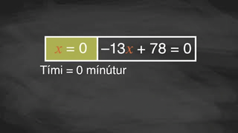
Learning Activity B | Video
Solving a Quadratic Equation Set Equal to Zero
Notes:
This video does not discuss a specific question in lesson 8.2.

Slide 20
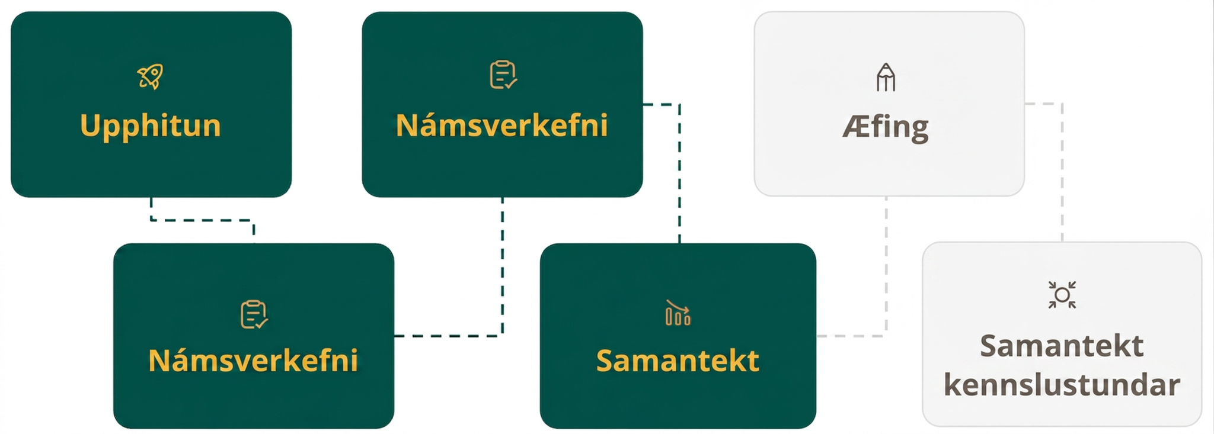
Lesson Journey
Fourth Step: Cool Down

Slide 21
Cool Down
A movie theater models the revenue from ticket sales in one day as a function of the ticket price, 𝑝. Here are two expressions defining the same revenue function.
𝑝(120 − 4𝑝)
120𝑝 − 4𝑝²
According to this model, how high would the ticket price have to be for the theater to make $0 in revenue?
What equation can you write to find out what ticket price(s) would allow the theater to make $600 in revenue?
Notes:
Cool Down (5 minutes)
No graphing technology should be used in this cool down.
Answers
$30. If 𝑝(120 − 4𝑝) = 0, then either 𝑝 = 0 or 120 − 4𝑝 = 0. If the latter is a true equation, 𝑝 must be 30.
𝑝(120 − 4𝑝) = 600 or 120𝑝 − 4𝑝² = 600
Response to Student Thinking - More Chances
Students will have more opportunities to understand the mathematical ideas in this cool down, so there is no need to slow down or add additional work to the next lessons. Instead, use the results of this cool down to provide guidance for what to look for and emphasize over the next several lessons to support students in advancing their current understanding.

Slide 22
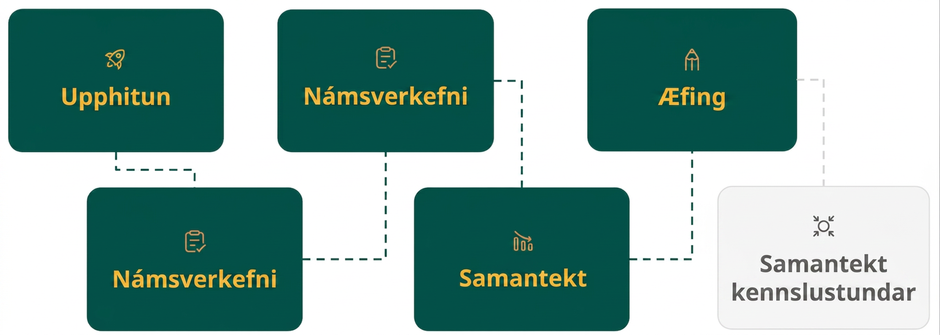
Lesson Journey
Fifth Stop: Practice

Slide 23

Practice
Put your hard work to action, practice what you’ve learned!
Notes:
Digital Practice: Access the practice pages at https://openstax.org/details/books/algebra-1

Slide 24
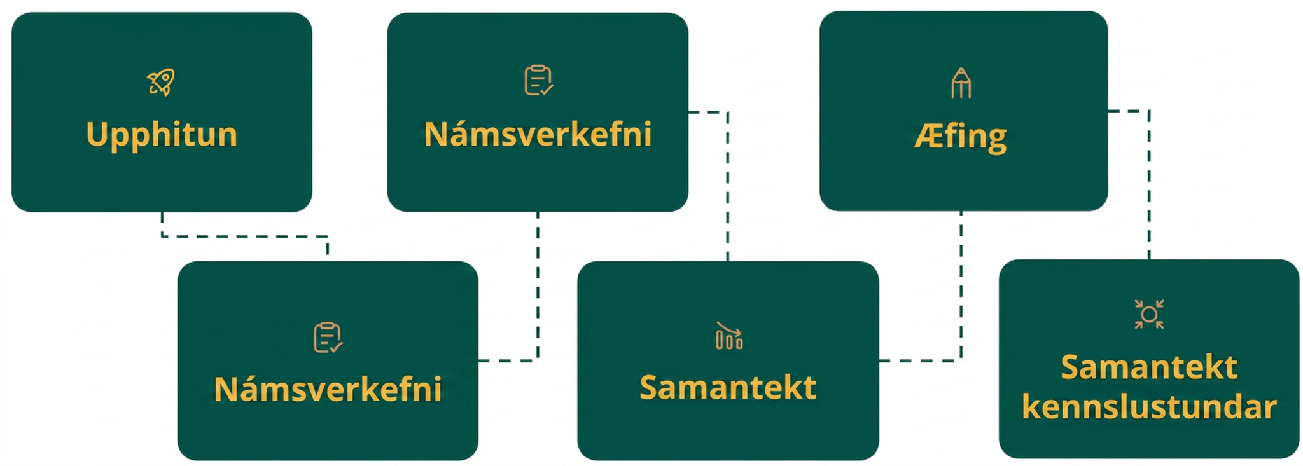
Lesson Journey
Sixth Stop: Lesson Synthesis

Slide 25
Lesson Synthesis
What are some limitations of solving the equation −2𝑥² − 2𝑥 + 40 = 10 by guessing and checking? What about by graphing?
Which equation do you think is easier to solve:
−2𝑥² − 2𝑥 + 40 = 0 or (8 − 2𝑥)(𝑥 + 5) = 0? Why?
Which appears easier to solve: (8 − 2𝑥)(𝑥 + 5) = 10 or −2𝑥² − 2𝑥 + 40 = 10? Why?
Notes:
Answers - Answers will vary, but here are some samples:
If the solution is not an integer, then it will be difficult to find the solution. Graphing will also not produce an exact solution, only an estimate.
The equation in factored form is easier to solve since the equation is set equal to 0. The zeros, or solutions, are easier to identify.
They are both difficult to solve. The factors in the factored form are not equal to zero on their own. The equation −2𝑥² − 2𝑥 + 40 = 10 is one step closer to solving mathematically, if we can figure out a way to factor it.

Slide 26
Self Assessment
How much do you agree with the following statements?
Learning Goals | I can | Almost | Not yet
Recognize the factored form of a quadratic expression and know when it can be useful for solving problems. | ⃞ | ⃞ | ⃞
Use a graph to find the solutions to a quadratic equation but also know its limitations. | ⃞ | ⃞ | ⃞

