Slide 1


Algebra 1
Unit 3 Two Variable Statistics
Lesson 3.4 The Correlation Coefficient
Notes:
Note: Lesson 3.3 on residuals is beyond the expectation of the TEKS and denoted as an optional lesson. Therefore, students may or may not understand the term, “residual,” based on coverage of that lesson. A lack of coverage for lesson 3.3 will not negatively impact student success for this or subsequent lessons.

Slide 2
How to use these slides
On the activity slides check the speaker notes for teacher support and instructional information.
Each lesson includes 1 warm up, 2-3 learning activities, a cool down, practice and a lesson synthesis.
  Learning activities are followed by a self check question, and review section.
Some slides have been hidden from student view, more information can be found on the next slide (Reference Key).
You can edit and use these slides for personal and classroom use, but cannot sell them and must keep the attribution logos.
For more information, Check out the digital quick start guide!

Slide 3






Reference Key
Check the top right corner for an icon referencing these unique sections.
 | Support for Students with Disability | Hidden | Learning Strategies slide, provides additional support to students for understanding the activity.
 | Support for English Language Learners | Hidden | Learning Strategies slide, provides additional support to students for understanding the activity.
 | Extending Your Thinking | Hidden | Extending Your Thinking slide, provides an extra challenge for students.
 | Self Check | Not Hidden | Self Check slide, checkpoint to assess student understanding after the learning activity.
 | Review | Hidden | Self Check- Review slide, designed to help review topics from the self check question.
On the next slides, check the speaker notes for teacher instructions and support.
Notes:
Check the Speaker Notes: On the next slides you can find discussion questions, lesson information, answers to the activities, and ways to adjust the activity for your students!

Slide 4

Learning Goals
By the end of this lesson you will be able to -
Describe the “goodness of fit” of a linear model using the correlation coefficient.
Match the correlation coefficient with a scatter plot and linear model.
Notes:
Lesson Narrative
The mathematical purpose of this lesson is for students to find and interpret the correlation coefficient and to use it to understand the strength of a linear relationship. The work of this lesson connects to previous work because students plotted and analyzed residuals to informally assess the fit of linear models.
When students sort scatter plots, they are given the opportunity to analyze representations, statements, and structures closely and make connections.
Required Preparation
Print and cut up slips from the blackline master for the card sort activity. One copy is needed for every group of 2 students.
Required Materials
Pre-printed slips, cut from copies of the blackline master for 3.4.2 Card Sort
Texas Essential Knowledge and Skills
A1(D) communicate mathematical ideas, reasoning, and their implications using multiple representations, including symbols, diagrams, graphs, and language as appropriate.
A1(E) create and use representations to organize, record, and communicate mathematical ideas
A1(F) analyze mathematical relationships to connect and communicate mathematical ideas.
4(A) calculate, using technology, the correlation coefficient between two quantitative variables and interpret this quantity as a measure of the strength of the linear association.

Slide 5
Vocabulary
Previous
none
New
Correlation coefficient
  Describes the strength and direction of a linear association between two numerical variables.
Notes:
Lesson Vocabulary
To support student understanding of key vocabulary:
Introduce and review the vocabulary words students will see in this lesson.
Encourage students to notice how these words are used and to include them in their math discussions and explanations—both written and oral.
Use a word wall to reinforce vocabulary. Sample word wall cards are available here.
For newcomers or students with beginning English proficiency, use these Quizlet sets to support vocabulary learning:
Unit 3 Spanish Vocabulary – use first to build understanding
Unit 3 Vocabulary (English) – use after anchoring in Spanish
Note: Lesson 3.3 on residuals is beyond the expectation of the TEKS and denoted as an optional lesson. Therefore, students may or may not understand the term, “residual,” based on coverage of that lesson. A lack of coverage for lesson 3.3 will not negatively impact student success for this or subsequent lessons.
Support for English Language Learners
ELPS 1(E) internalize new basic and academic language by using and reusing it in meaningful ways in speaking and writing activities that build concept and language attainment.
ELPS 2(F) listen to and derive meaning from a variety of media such as audiotape, video, DVD, and CD-ROM to build and reinforce concept and language attainment.
ELPS 3(B) expand and internalize initial English vocabulary by learning and using high-frequency English words necessary for identifying and describing people, places, and objects, by retelling simple stories and basic information represented or supported by pictures, and by learning and using routine language needed for classroom communication.
ELPS 3(E) share information in cooperative learning interactions.
ELPS 3(F) ask and give information ranging from using a very limited bank of high-frequency, high-need, concrete vocabulary, including key words and expressions needed for basic communication in academic and social contexts, to using abstract and content-based vocabulary during extended speaking assignments.

Slide 6





Lesson Journey
Warm Up
Learning Activity
Cool Down
Lesson Synthesis
Learning Activity
Learning Activity
Practice

Slide 7

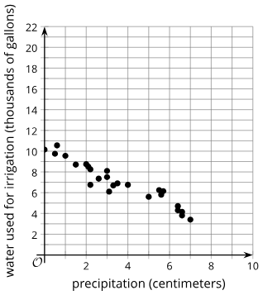
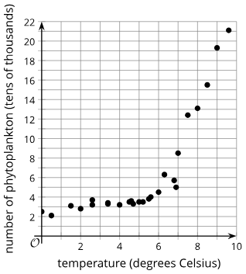
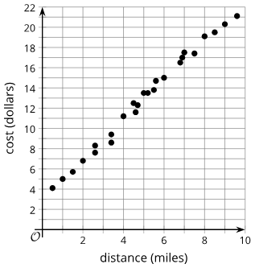
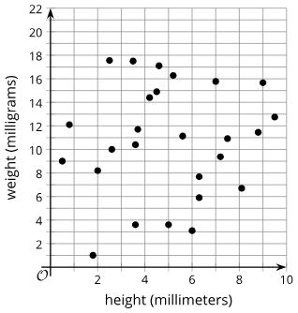
Warm Up - Which One Doesn’t Belong?🚫
Graph A | Graph B | Graph C | Graph D
Notes:
Warm Up (5 minutes)
This warm up prompts students to compare four scatter plots displaying data with linear and nonlinear trends. It gives students a reason to use language precisely and gives you the opportunity to hear how they use terminology and talk about characteristics of the items in comparison to one another.
To allow all students to access the activity, each item has one obvious reason it does not belong. Encourage students to move past the obvious reasons and find reasons based on mathematical properties.
Launch
Arrange students in groups of 2 – 4.
Display the scatter plots for all to see.
Ask students to indicate when they have noticed one that does not belong and can explain why. Give students 1 minute of quiet time to think individually and then time to share their thinking with their small group.
In their small groups, tell each student to share their reasoning as to why a particular item does not belong, and together find at least one reason each item doesn’t belong.
Continue to scroll down through the notes for activity answers and synthesis questions.
Activity Answers: Answers may vary, but here are some samples.
A doesn’t belong because it is the only scatter plot with data that fit a line well and are increasing.
B doesn’t belong because it is the only scatter plot with data that would not fit a line well and do not show a pattern.
C doesn’t belong because it is the only scatter plot with data that would fit a line well and are decreasing.
D doesn’t belong because it is the only scatter plot with data that would not fit a line well and do show a curved pattern.
Activity Synthesis
Ask each group to share one reason why a particular item does not belong.
Record and display the responses for all to see. After each response, ask the class if they agree or disagree.
Since there is no single correct answer to the question asking which one does not belong, attend to students’ explanations and ensure the reasons given are correct.
During the discussion, ask students to explain the meaning of any terminology they use, such as linear, nonlinear, and random. Also, press students on unsubstantiated claims.

Slide 8

Lesson Journey
Warm Up
Learning Activity
Cool Down
Lesson Synthesis
Learning Activity
Learning Activity
Practice

Slide 9

Learning Strategies - Card Sort for “r”
“ ___ and ___ are alike because …”
“I disagree because …”
“These are similar because …”
Discussion Supports
Teacher Instruction: Use these strategies to adjust the activity to support English language learners and students with disabilities.
You can copy and paste the callouts directly on top of the activity or give the instructions aloud.
Use the following terms:
Linear model Non-linear
Increasing Decreasing
Pattern Random
Fit Correlation coefficient
Action and Expression
Notes:
Support for English Language Learners: MLR 8 Discussion Supports: Conversing
As students work in pairs, ask them to take turns finding a match or category and explaining their reasoning to their partner. Display the following sentence frames for all to see: “_____ and _____ are alike because . . . ,” “I disagree because . . . ,” and “These are similar because . . . .” Encourage students to challenge each other when they disagree. This will help students clarify their understanding of linear models.
Design Principle(s): Support sense-making; Maximize meta-awareness
Support for Students with Disabilities: Action and Expression: Develop Expression and Communication
Maintain a display of important terms and vocabulary. Review the following terms from previous lessons that students may have used or wanted words for during this activity: fit, linear model, non-linear, increasing, decreasing, pattern, random. Correlation coefficient can be added to this display as a new term..
Supports accessibility for: Memory, Language

Slide 10
Learning Activity - Card Sort for “r”
Part 1 -
Examine the graphs that will be displayed on the next slide or on the cards provided by your teacher.
Sort the cards into 2 categories. Be prepared to explain the meaning of your categories.
Then, sort the cards into 2 categories in a different way. Be prepared to explain the meaning of your new categories.
Notes:
Support for All Learners
This activity offers additional support for students:
For English language learners and students with disabilities, be sure to review the Learning Strategies slide!
Activity (20 minutes)
In this activity, students are given cards displaying scatter plots of data that can be fit by linear models with varying accuracy. Cards show data that are random, poorly fit by a linear model, well fit by a linear model, and better fit by another type of function, such as quadratic or exponential. Students should begin to recognize these differences and the connection to the correlation coefficient.
Monitor for different ways groups choose to categorize the scatter plots, but especially for categories that distinguish between plots that would be modeled well with a linear function and those that would not.
Launch
Arrange students in groups of 2.
Distribute one copy of the blackline master (that contains just the scatter plots) to each group.
Part 1 -
Tell students to sort some cards into categories of their choosing. When they sort the scatter plots, they should work with their partner to come up with categories.
Have students repeat the sorting process for a second set of categories.
Part 2 - Display or provide another set of the same scatter plots, but this set includes a representation of the best fit line, the regression equation, and the value of the correlation coefficient. They should be prepared to discuss things they notice and wonder about these added representations.
Activity images, answers, and synthesis questions continue on the next two slides.

Slide 11
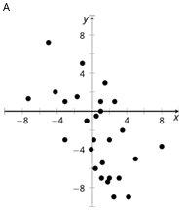
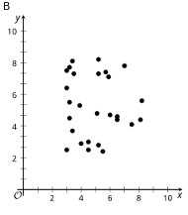
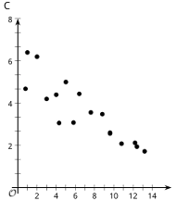
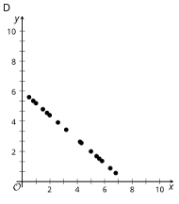
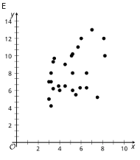
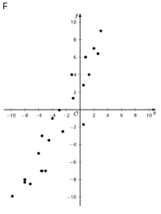
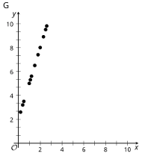
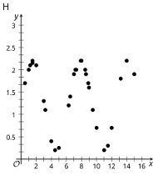
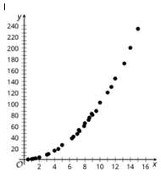
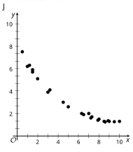
Learning Activity - Card Sort for “r” - P1
Notes:
Part 1 Activity Answers - Answers may vary, but here are some samples.
Scatter plots that look linear: C, D, F, G. Scatter plots that are not very linear: A, B, E, H, I, J
Generally increasing: E, F, G, I. Generally decreasing: A, C, D, J. Not really increasing or decreasing: B, H
Part 1 Activity Synthesis
Select groups of students to share their categories and how they sorted their equations. You can choose as many different types of categories as time allows, but ensure that one set of categories distinguishes between plots that would be modeled well with a linear function and those that would not.
Attend to the language that students use to describe their categories and equations, giving them opportunities to describe their equations more precisely. Highlight the use of terms like linear model, fit, and non-linear.
Activity images, answers, and synthesis questions for part 2 continue on the next slide.

Slide 12
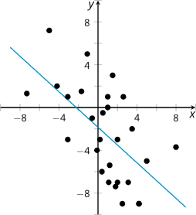
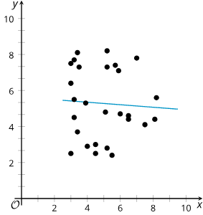
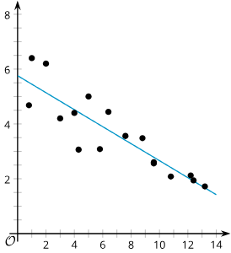
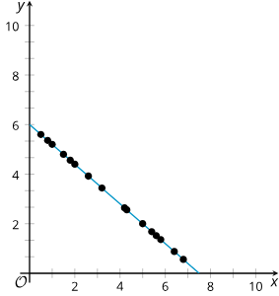
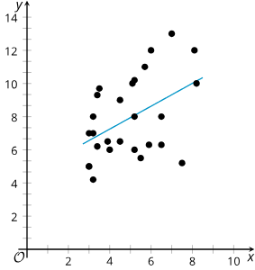
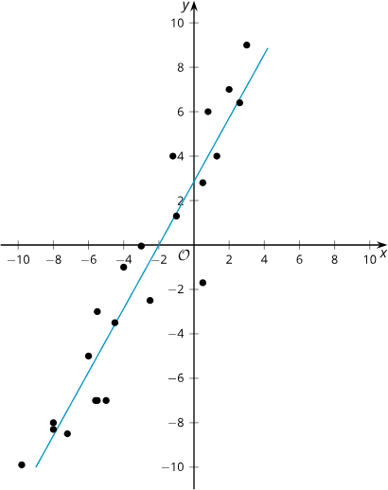
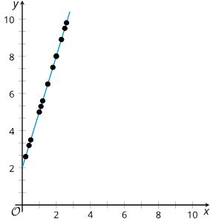
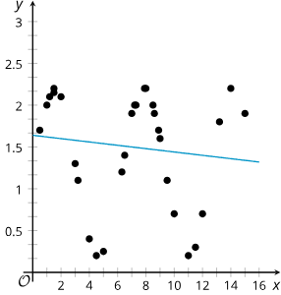
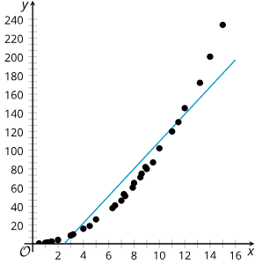
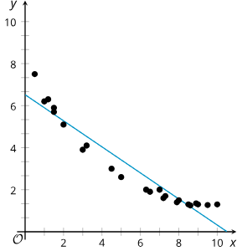
Learning Activity - Card Sort for “r” - P2
y = – 0.83x – 1.85;
r = – 0.61
y = – 0.07x + 5.63;
r = – 0.06
y = – 0.31x + 5.76;
r = – 0.88
y = – 0.8x + 6;
r = – 1
y = 0.69x + 4.49;
r = 0.46
y = 1.43x + 2.86;
r = 0.94
y = 3x + 2;
r = 1
y = – 0.02x + 1.64;
r = – 0.13
y = 14.55x – 36.18;
r = 0.95
y = – 0.62x + 6.52;
r = – 0.96
Notes:
Part 2 Launch
Now, display the same scatterplots with the lines of best fit and 𝑟 values included. Give students 1 minute of quiet time to think, and then 1 minute to discuss the things they notice with their partner, followed by a whole-class discussion.
Part 2 Answers
Among the things students should notice are:
The sign of 𝑟 is the same as the sign of the slope of the line of best fit.
The values for 𝑟 seem to go from –1 to 1.
The closer 𝑟 is to 1 or –1, the stronger the linear relationship between the variables.
The closer 𝑟 is to 0, the weaker the linear relationship between the variables.
Part 2 Activity Synthesis
Encourage partners or groups to share their observations from the scatter plots, line of best fit, and 𝑟-values. Use questioning about the signs of the slopes and the 𝑟-values and the 𝑟-value numbers and the closeness of points to the line of best fit to elicit the sample responses.
Emphasize with students that the sign of the correlation coefficient matches the sign of the slope of the line of best fit, but the value for 𝑟 is not otherwise related to the slope. If 𝑟 = 0.8, the line of best fit will have a positive slope, but whether the slope is 0.2 or 2,000 is not clear without examining the data.
Write the four properties (listed in the answers above) on the board/screen or on an anchor chart.

Slide 13
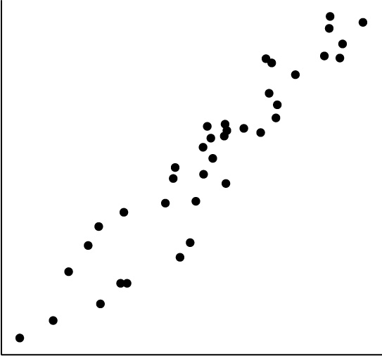
Self Check
Which correlation coefficient best matches the scatter plot?
r = 0.95
r = – 0.89
r = 0.26
r = – 0.39
Let’s review!
Notes:
Answer Feedback - Individualized by Response
That’s correct! The slope is positive, and there is a strong correlation because the points are close to each other. The correlation coefficient should be close to positive 1.
Incorrect. The slope of the line of best fit would be positive, so the 𝑟-value should be positive.
Incorrect. This indicates a weak positive correlation. The scatter plot has points that are very close to each other, so the 𝑟-value should be closer to 1.
Incorrect. This indicates a weak negative correlation. The scatter plot has points that are very close to each other, so the 𝑟-value should be closer to 1. The slope of the line of best fit would be positive, so the 𝑟-value should be positive.

Slide 14
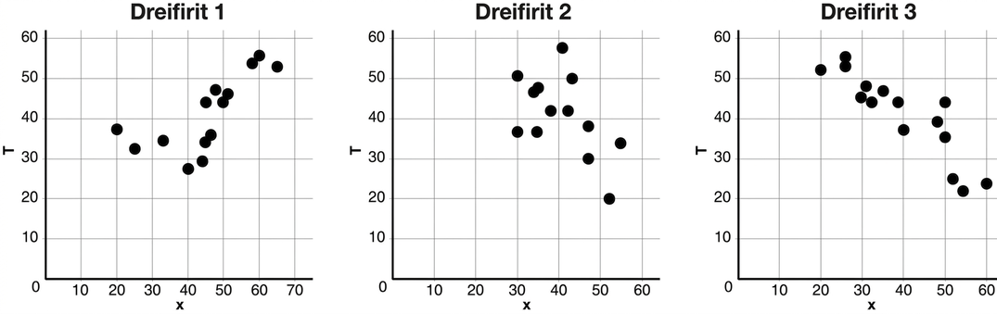
Self Check - Review
When is the value of r positive?
When is the value of r negative?
Is the linear relationship stronger when r is closer to 0 or to 1 (or −1)?
TRY IT - Which of the three scatter plots below shows the strongest linear relationship? Which shows the weakest? Explain.
The correlation coefficient is a number between −1 and +1 (including −1 and +1) that measures the strength and direction of a linear relationship and is denoted by the letter 𝑟.
Notes:
Remind Students
The correlation coefficient is positive when as the 𝑥-values increase, the 𝑦-values also tend to increase.
The correlation coefficient is negative when as the 𝑥-values increase, the 𝑦-values tend to decrease.
As the points form a stronger negative or positive linear relationship, the correlation coefficient gets farther from 0. Students note that when all of the points are on a line with a positive slope, the correlation coefficient is +1. The correlation coefficient is −1 if all of the points are on a line with a negative slope.
For visual examples of different scatter plots and the values of their correlation coefficients, access the Additional Resources for this lesson activity in the online textbook.
TRY IT Answer
The strongest linear relationship would be Scatter Plot 3. The points are closest to having a linear model. The weakest linear relationship would be Scatter Plot 2 because the points are spread apart the most and are less likely to have a strong linear relationship.

Slide 15
Lesson Journey
Warm Up
Learning Activity
Cool Down
Lesson Synthesis
Learning Activity
Learning Activity
Practice

Slide 16
Learning Activity - Calculating “r”
Step 1 - Use Desmos to create a table for entering the data. Click on the “+” symbol and select the table from the drop-down menu.
Step 2 - Enter the data into the corresponding x₁ and y₁ columns in the table you created in Step 1. Press Enter or use arrow keys to enter a new data value in the table.
Step 3 - Click in the entry box #2 below the table from Step 1 and enter the command corr(𝑥₁,𝑦₁). (You can just type x1 and y1. The subscripts will appear automatically.)
Step 4 - Round the correlation coefficient to the nearest thousandth.
Step 5 - Determine the strength of the linear relationship.
x | y
2 | 12
9 | 11
15 | 6
21 | 3
22 | – 1
Notes:
Activity (20 minutes)
In this activity, students learn how to use Desmos to calculate the correlation coefficient for a set of data.
Prompt students to access the directions for calculating regressions in the Using Desmos section of the Getting Started section of the book. Or, provide access to the PDF that contains instructions on how to use technology to find the correlation coefficient of the best fit line.
Continue scrolling down for the activity questions, answers, and synthesis.
Launch
If possible, allow students to work individually so that each understands the steps necessary to find the correlation coefficient of a data set using Desmos. Otherwise, arrange students in pairs or groups, so they have access to Desmos.
After students open a window to Desmos, instruct them to click into each cell in the table and insert each corresponding value in the data set. Once a student has clicked into the first cell in the table, they may also use the arrow keys to navigate from one cell to the next.
Show students that the graphing window, or field of view, may be changed by clicking onto the graph and dragging it in different directions. Also, they may choose to change the window using the wrench tool button.
Ask students to find the correlation coefficient and use it to describe the strength of the linear relationship for the given data.
Answers
The correlation coefficient is – 0.948. This correlation coefficient shows a strong negative linear relationship. This means that as the 𝑥-values increase, the 𝑦-values decrease.
Activity synthesis
If students are having difficulty finding the correlation coefficient using technology, tell them to use the 𝑐𝑜𝑟𝑟(𝑥1,𝑦1) command in Desmos. It may also be helpful to check the accuracy of the data entered into the 𝑥₁ and 𝑦₁ columns.

Slide 17
Self Check
Use Desmos to find the correlation coefficient for the data given in the table.
r = – 0.987
r = 1.64
r = 0.987
r = 0.975
x | y
8 | 23
15 | 41
26 | 53
31 | 72
56 | 103
Let’s review!
Notes:
Answer Feedback - Individualized by Response
Incorrect. Be careful with signs. The table shows that as the x-values increase, so do the y-values. This means the slope is positive so the r-value will also be positive.
Incorrect. This is the slope if this was put into linear regression. The r-value is not equal to the slope. Instead, use technology to find the correlation coefficient.
That’s correct! Enter the 𝑥-values in list one and 𝑦-values in list two and use technology to find the correlation coefficient.
Incorrect. This is the value of 𝑟². Take the square root to find 𝑟.

Slide 18
Self Check - Review
Find r for the given data.
Step 1 - Use Desmos to create a table for entering the data. Click on the “+” symbol and select the table from the drop-down menu.
Step 2 - Enter the data into the corresponding x₁ and y₁ columns in the table you created in Step 1. Press Enter or use arrow keys to enter a new data value in the table.
Step 3 - Click in the entry box #2 below the table from Step 1 and enter the command corr(𝑥₁,𝑦₁). (You can just type x1 and y1. The subscripts will appear automatically.)
Step 4 - Round the correlation coefficient to the nearest thousandth.
Step 5 - Determine the strength of the linear relationship.
x | y
– 6 | – 1
– 4 | 1
0 | – 2
1 | – 3
3 | 0
Notes:
Answer
The correlation coefficient is – 0.299. This correlation coefficient shows a weak negative linear relationship.
NOTE: The provided steps do not yield the regression for the line of best fit - they only provide the value of the correlation coefficient. You may choose to have students also calculate the equation of the best fit line.
For another set of data that students can practice with, use the Try It question in the Additional Resources for this lesson activity in the online textbook.

Slide 19
Lesson Journey
Warm Up
Learning Activity
Cool Down
Lesson Synthesis
Learning Activity
Learning Activity
Practice

Slide 20
Learning Strategies - Matching “r” values
Teacher Instruction: Use these strategies to adjust the activity to support English language learners and students with disabilities.
You can copy and paste the callouts directly on top of the activity or give the instructions aloud.
“I agree/disagree because …”
“An example of this is …”
“I like how the word __ was used because it makes me think …”
“More specifically, I think …”
Discussion Supports
Examine the anchor chart.
How would you draw and explain the different descriptors of the relationships in your own words?
Representation
Notes:
Support for English Language Learners: MLR 8 Discussion Supports: Speaking
Use this routine to support whole-class discussion. Each time a student shares their ideas about the meaning of the correlation coefficient, press for details by requesting students to challenge an idea, elaborate on an idea, or give an example. Revoice student responses to demonstrate mathematical language use by applying appropriate language. Call students’ attention to any words or phrases that helped clarify the original statement. If needed, practice phrases or words through choral response. This provides more students with an opportunity to produce language as they share their ideas about the relationship between data represented in scatter plots and correlation coefficients.
Design Principle(s): Support sense-making
Support for Students with Disabilities: Representation: Develop Language and Symbols
Display or provide charts with symbols and meanings. Create a chart of the 𝑟-value ranging from –1 to 1. Label with the corresponding features of the various domains of the 𝑟-value. Select students to label the chart with the corresponding descriptors for each domain. Small sketches or print outs of example scatter plots can be added to the appropriate areas of the chart.
NOTE: The next slide has been linked and can be printed for this use.
Supports accessibility for: Conceptual processing; Memory

Slide 21
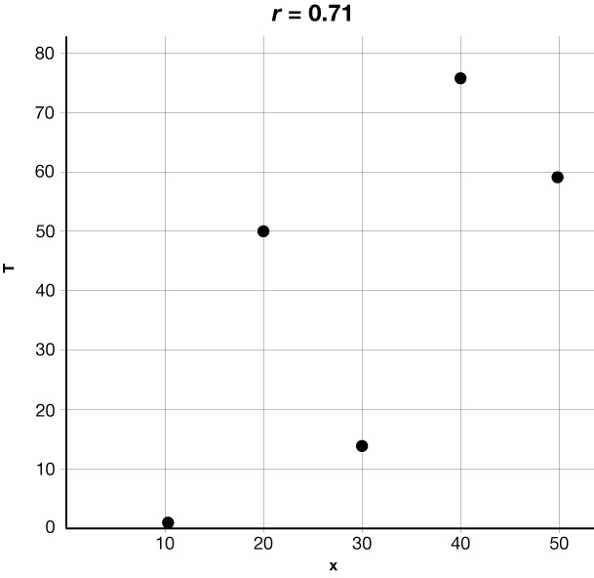
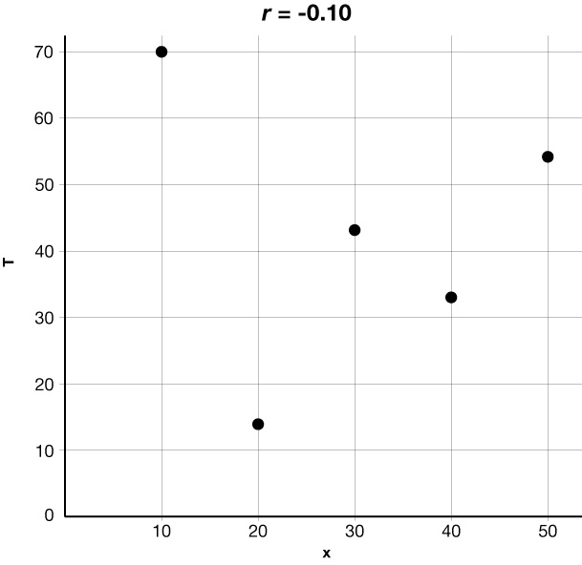
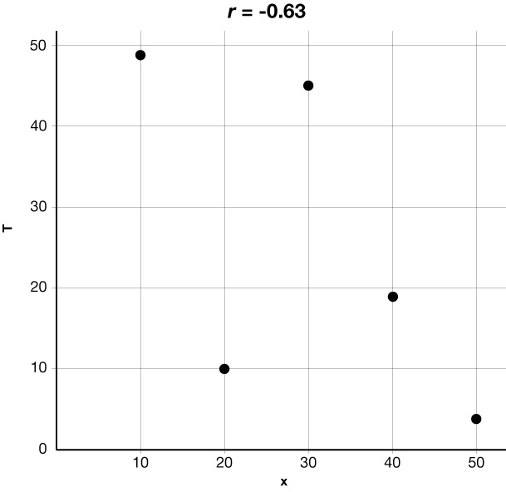
If the correlation coefficient is … | You can say there is a …
r = 1.0 | perfect, positive linear relationship
0.7 < r < 1.0 | strong positive linear relationship
0.3 ≤ r < 0.7 | moderate positive linear relationship
0 < r < 0.3 | weak positive linear relationship
r = 0 | no linear relationship
– 0.3 < r < 0 | weak negative linear relationship
– 0.7 < r < – 0.3 | moderate negative linear relationship
– 1.0 < r < – 0.7 | strong negative linear relationship
r = – 1.0 | perfect, negative linear relationship
Notes:
Possible sample Anchor Chart for use with students with disabilities.

Slide 22
Learning Activity - Matching “r” values
The 𝑟-value is called the correlation coefficient. A correlation coefficient is one way to measure the strength of a linear relationship.
The sign of 𝑟 is the same as the sign of the slope of the best fit line.
The values for 𝑟 go from –1 to 1 and include –1 and 1.
The closer 𝑟 is to 1 or –1, the stronger the linear relationship between the variables.
The closer 𝑟 is to 0, the weaker the linear relationship between the variables.
With the graphs on the next slide, take turns with your partner to match a scatter plot with a correlation coefficient.
For each match you find, explain to your partner how you know it’s a match.
For each match your partner finds, listen carefully to their explanation.
If you disagree, discuss your thinking and work to reach an agreement.
Notes:
Support for All Learners
This activity offers additional support and an extension for students:
For English language learners and students with disabilities, be sure to review the Learning Strategies slide!
For students looking for an extra challenge, be sure to review the Extending Your Thinking slide!
Activity (10 minutes)
In this activity, students gain a better understanding of correlation coefficients by taking turns with a partner to match scatter plots and correlation coefficients. Students trade roles, explaining their thinking and listening, providing opportunities to explain their reasoning and critique the reasoning of others.
Launch
Review the definition and properties of the correlation coefficient (information in the gray box) with students prior to beginning the activity.
Arrange students in groups of 2.
For each scatter plot, one partner finds the associated correlation coefficient and explains why they think it goes with that scatter plot.
The other partner’s job is to listen and make sure they agree.
If they don’t agree, the partners discuss until they come to an agreement.
For the next scatter plot, the students swap roles. If necessary, demonstrate this protocol before students start working.
Activity images, answers, anticipated misconceptions and synthesis continue on the next slide.

Slide 23
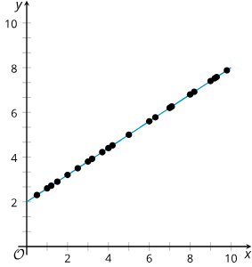
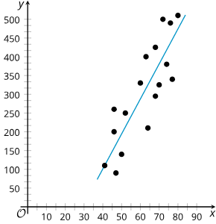
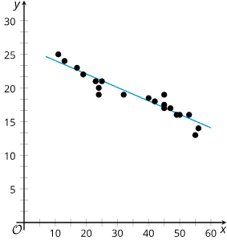
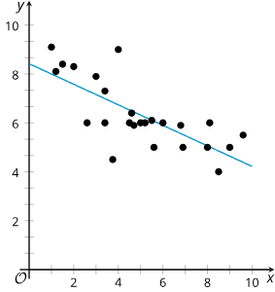
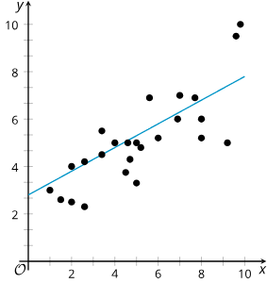
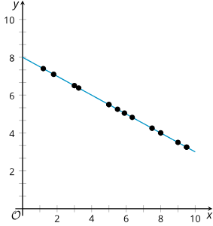
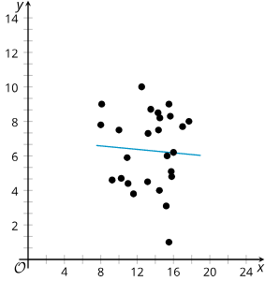
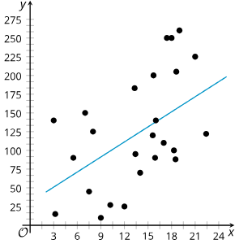
Learning Activity - Matching “r” values
Are you ready for more?
Graph A
Graph B
Graph C
Graph D
Graph E
Graph F
Graph G
Graph H
Which graphs match the r-values below?
r = – 1 r = 0.48
r = – 0.95 r = 0.65
r = – 0.74 r = 0.9
r = – 0.06 r = 1
Notes:
Activity Answer
Graph A r = 1
Graph B r = 0.9
Graph C r = – 0.95
Graph D r = – 0.74
Graph E r = 0.65
Graph F r = – 1
Graph G r = – 0.06
Graph H r = 0.48
Continue scrolling down for anticipated misconceptions and activity synthesis.
Anticipated Misconceptions
Students may struggle with starting to match the scatter plots with a correlation coefficient. Guide students by asking them about the sign of the correlation coefficients. Ask them to sort the cards into groups that make sense and use that to connect to the correlation coefficient values. Ask them: “How does the sign of the correlation coefficient relate to the linear model?”
Activity Synthesis
The purpose of this discussion is for students to understand that the correlation coefficient is a formal way to quantify the strength of a linear relationship between variables, and that the sign of the correlation coefficient tells you whether the variables show a positive or negative association. Here are some questions for discussion.
What does the sign of the correlation coefficient tell you about the data?
If it is negative, then 𝑦 tends to decrease as 𝑥 increases. If it is positive, then 𝑦 tends to increase as 𝑥 increases.
What does it mean to have a correlation coefficient of 1 or –1?
It means that the data are perfectly linear and are fit exactly by a linear function.

Slide 24
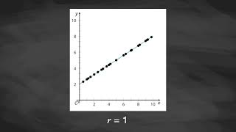
Video: Measuring Strength of Fit with Correlation Coefficients

Slide 25
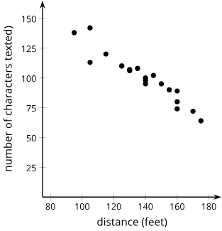
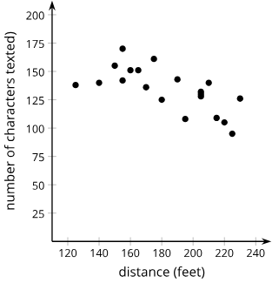
Extending Your Thinking
Jada wants to know if the speed that people walk is correlated with their texting speed. To investigate this, she measured the distance, in feet, that 5 of her friends walked in 30 seconds and the number of characters they texted during that time. Each of the 5 friends took 4 walks for a total of 20 walks. Here are the results of the first 20 walks.
Over the next few days, the same 5 friends practiced walking and texting to see if they could walk faster and text more characters. They did not record any more data while practicing. After practicing, each of the 5 friends took another 4 walks. Here are the results of the final 20 walks.
Notes:
Data for these two experiments can be accessed in the Extending Your Thinking section of this lesson in the online textbook. As an alternative –
The results of Jada’s first experiment are contained in the first tab of this Google Sheets file that can be displayed or copied to be shared with students. Recall that students can copy and paste data from a spreadsheet into Desmos. A Desmos graph of this data can also be shared with students.
The results of Jada’s second experiment are contained in the second tab of the same Google Sheets file. A Desmos graph of this data can also be shared with students.
The data for both graphs has been loaded onto this Desmos graph.
Questions and Answers
What do you notice about the 2 scatter plots?
Answer: Your answer may vary, but here is a sample. I noticed that in the second scatter plot, the students traveled longer distances. In addition, the students seemed to type more characters for any given distance in the second scatter plot than in the first scatter plot.
Jada noticed that her friends walked farther and texted faster during the last 20 walks than they did during the first 20 walks. Since both were faster, she predicts that the correlation coefficient of the line of best fit for the last 20 walks will be closer to −1 than the correlation coefficient of the line of best fit for the first 20 walks. Do you agree with Jada? Be prepared to show your reasoning.
Answer: Your answer may vary, but here is a sample. I do not agree with Jada. The correlation coefficient deals with the strength and direction of a linear relationship. The comparison between walking distance and the number of characters texted relates to the slope of the line, because it compares rates of number of characters texted over the distanced walked.
Use technology to find an equation of the line of best fit for each data set.
Answer: Your answer may vary, but here is a sample. The line of best fit for scatter plot 1 is 𝑦 = −0.8547𝑥 + 218.6053. The line of best fit for scatter plot 2 is 𝑦 = −0.4658𝑥 + 222.1704.
The correlation coefficient for the first line of best fit is −0.95, and the second line of best fit is −0.68. Was your answer to question 2 correct? Why do you think the correlation coefficients for the two data sets are so different? Be prepared to show your reasoning.
Answer: Your answer may vary, but here is a sample. I think the correlation coefficients are different because the data in the second scatter plot are more scattered than the data in the first scatter plot. On average, the data in the first scatter plot are much closer to the line of best fit than the data in the second scatter plot.

Slide 26
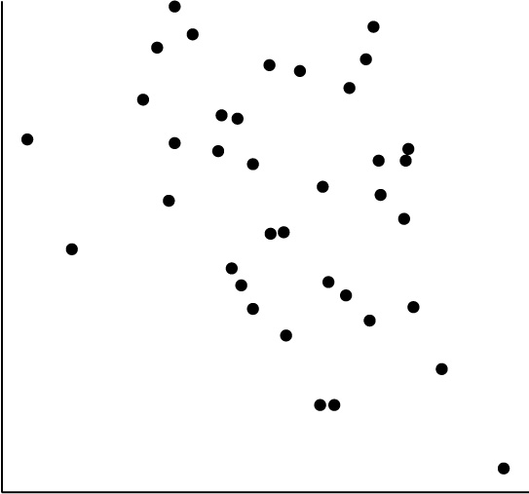
Self Check
Which correlation coefficient best matches the scatter plot?
r = 0.95
r = – 0.89
r = 0.26
r = – 0.39
Let’s review!
Notes:
Answer Feedback - Individualized by Response
Incorrect. This 𝑟-value shows a strong positive correlation, and the scatter plot pictured is very spread out and has a negative slope. The correlation should be weak and negative.
Incorrect. This 𝑟-value shows a strong positive correlation, and the scatter plot pictured is very spread out, signifying a weak correlation.
Incorrect. This 𝑟-value shows a weak correlation but with a positive slope.
That’s correct! This correlation coefficient shows a weak correlation with a negative slope, which matches the scatter plot shown.

Slide 27
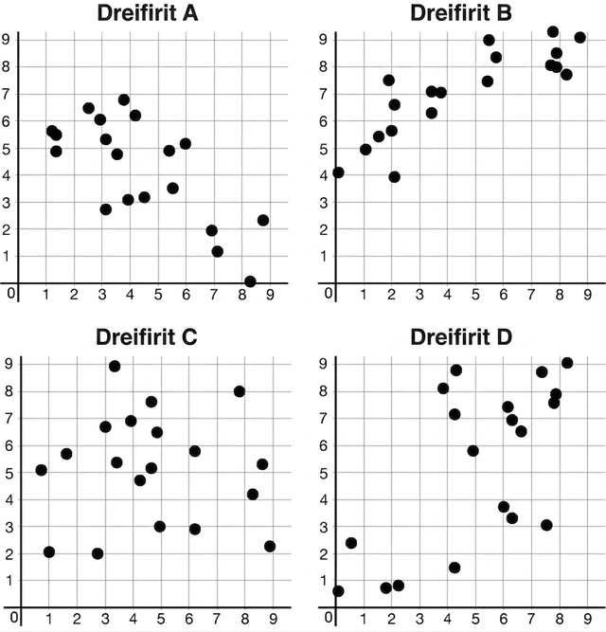
Self Check - Review
Match each scatter plot with one of the following correlation coefficients.
r = – 0.02
r = 0.84
r = – 0.72
r = 0.65
Notes:
Answers
Scatter plot A r = – 0.72
Scatter plot B 𝑟 = 0.84
Scatter plot C r = – 0.02
Scatter plot D r = 0.65

Slide 28

Lesson Journey
Warm Up
Learning Activity
Cool Down
Lesson Synthesis
Learning Activity
Learning Activity
Practice

Slide 29
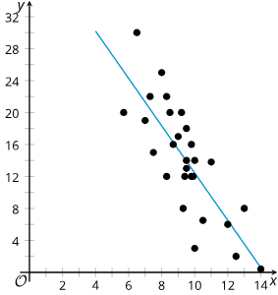
Cool Down
What information does a correlation coefficient tell you about the data in a scatter plot?
Which value best estimates the value for the correlation coefficient of the scatter plot:
–1, –0.8, –0.2, 0.2, 0.8, or 1?
Be prepared to show your reasoning.
Notes:
Cool Down (5 minutes)
Answers:
Your answer may vary, but here is a sample: The sign of the correlation coefficient matches the sign of the slope for the best fit line. The closer the correlation coefficient value is to 0, the weaker the linear relationship. The closer the correlation coefficient is to 1 or –1, the stronger the linear relationship.
Your answer may vary, but here is a sample: – 0.8, since the points form a fairly strong linear pattern that is decreasing to the right.
Response to Student Thinking - More Chances
Students will have more opportunities to understand the mathematical ideas in this cool-down, so there is no need to slow down or add additional work to the next lessons. Instead, use the results of this cool-down to provide guidance for what to look for and emphasize over the next several lessons to support students in advancing their current understanding.

Slide 30

Lesson Journey
Warm Up
Learning Activity
Cool Down
Lesson Synthesis
Learning Activity
Learning Activity
Practice

Slide 31

Practice
Put your hard work to action, practice what you’ve learned!
Notes:
Digital Practice: Access the practice pages at https://openstax.org/details/books/algebra-1

Slide 32

Lesson Journey
Warm Up
Learning Activity
Cool Down
Lesson Synthesis
Learning Activity
Learning Activity
Practice

Slide 33

Lesson Synthesis
What might a scatter plot look like when its line of best fit has a correlation coefficient of 0.9? Sketch it.
What does a scatter plot look like when its line of best fit has a correlation coefficient of –0.5? Sketch it.
Sketch it!
One line of best fit has a correlation coefficient of 0.88, and the other line of best fit has a correlation coefficient of –0.88. Han claims that the one with a positive correlation coefficient fits its data better. Is Han correct? Be prepared to show your reasoning.
Why is it important to know the correlation coefficient for a linear model?
Notes:
Lesson Summary:
Some key takeaways from this lesson are that while residuals can help pick the best line to fit the data among all lines, we still need a way to determine the strength of a linear relationship. The correlation coefficient is a convenient number that can be used to describe the strength and direction of a linear relationship.
Usually represented by the letter 𝑟, the correlation coefficient can take values from –1 to 1.
The sign of the correlation coefficient is the same as the sign of the slope for the best fit line.
The closer the correlation coefficient is to 0, the weaker the linear relationship. When the correlation coefficient is closer to 1 or –1, the linear model fits the data better.
Scatter plots of data that are close to the best fit line are better modeled by the line than scatter plots of data that are farther from the line.
Pose the provided questions to students for discussion.
Answers:
It looks like points that follow a linear model very closely. The linear model has a positive slope.
It looks like a loosely scattered cloud of data that trend downward from left to right.
Han is probably not correct. The sign of the correlation coefficient tells you about the relationship between the variables, not the fit of the data. The positive correlation coefficient just means that as 𝑥 increases, 𝑦 also tends to increase. The residuals should also be examined in both cases to determine which data are fit by a linear model better.
The correlation coefficient is a way to quantify the fit of a given linear model, and it allows you to compare the fits of different linear models for the same data.
Hand Drawn Wood Pencil image from Pixy.org by CC0 public domain

Slide 34
Self Assessment
How much do you agree with the following statements?
I can… | I can | Almost | Not yet
Describe the “goodness of fit” of a linear model using the correlation coefficient.
Match the correlation coefficient with a scatter plot and linear model.

