Slide 1
Algebra 1
Unit 6 Working with Polynomials
Lesson 6.2 Multiplying Polynomials

Slide 2

How to use these slides
On the activity slides check the speaker notes for teacher support and instructional information.
Each lesson includes 1 warm up, 2-3 learning activities, a cool down, practice and a lesson synthesis.
  Learning activities are followed by a self check question, and review section.
Some slides have been hidden from student view, more information can be found on the next slide (Reference Key).
You can edit and use these slides for personal and classroom use, but cannot sell them and must keep the attribution logos.
For more information, Check out the digital quick start guide!
OpenStax CC BY NC SA

Slide 3





Reference Key
Check the top right corner for an icon referencing these unique sections.
Icon | Title | View | Location and Description
n/a | Support for Students with Disability | Hidden | Learning Strategies slide, provides additional support to students for understanding the activity.
n/a | Support for English Language Learners | Hidden | Learning Strategies slide, provides additional support to students for understanding the activity.
n/a | Extending Your Thinking | Hidden | Extending Your Thinking slide, provides an extra challenge for students.
n/a | Self Check | Not Hidden | Self Check slide, checkpoint to assess student understanding after the learning activity.
n/a | Review | Hidden | Self Check - Review slide, designed to help review topics from the self check question.
On the next slides, check the speaker notes for teacher instructions and support.
Notes:
Check the Speaker Notes: On the next slides you can find discussion questions, lesson information, answers to the activities, and ways to adjust the activity for your students!

Slide 4

Learning Goals
By the end of this lesson you will
be able to –
Multiply monomials.
Multiply a polynomial by a monomial.
Multiply binomials.
Multiply a polynomial by a polynomial.
Multiply special products.
Multiply polynomial functions.
Notes:
Lesson Narrative
This lesson continues to explore operations with polynomials as students master polynomial multiplication. Students start by multiplying with monomials. This involves a review of the properties of exponents and the Distributive Property. Multiple methods are then introduced to practice multiplying two binomials.
Required Preparation
None
Required Materials
None
Texas Essential Knowledge and Skills
A1(G) display, explain, and justify mathematical ideas and arguments using precise mathematical language in written or oral communication.
A10(B) multiply polynomials of degree one and degree two.
A12(B) evaluate functions, expressed in function notation, given one or more elements in their domains.

Slide 5
Vocabulary
Previous
Binomial
  An algebraic expression with
  two terms.
Trinomial
  An algebraic expression with
  three terms.
Polynomial
  An algebraic expression containing one or more monomials combined with addition or subtraction.
New
Conjugate pair
  Two binomials of the form
  (a – b) and (a + b).
Difference of squares
  The product of a conjugate pair of binomials that has the form a² – b².
Notes:
Lesson Vocabulary
To support student understanding of key vocabulary:
Introduce and review the vocabulary words students will see in this lesson.
Encourage students to notice how these words are used and to include them in their math discussions and explanations—both written and oral.
Use a word wall to reinforce vocabulary. Sample word wall cards are available here.
For newcomers or students with beginning English proficiency, use these Quizlet sets to support vocabulary learning:
Unit 6 Spanish Vocabulary – use first to build understanding
Unit 6 Vocabulary (English) – use after anchoring in Spanish
Support for English Language Learners
ELPS 2(F) listen to and derive meaning from a variety of media such as audiotape, video, DVD, and CD-ROM to build and reinforce concept and language attainment.
ELPS 3(H) narrate, describe, and explain with increasing specificity and detail as more English is acquired.
ELPS 5(B) write using newly acquired basic vocabulary and content-based grade-level vocabulary.

Slide 6
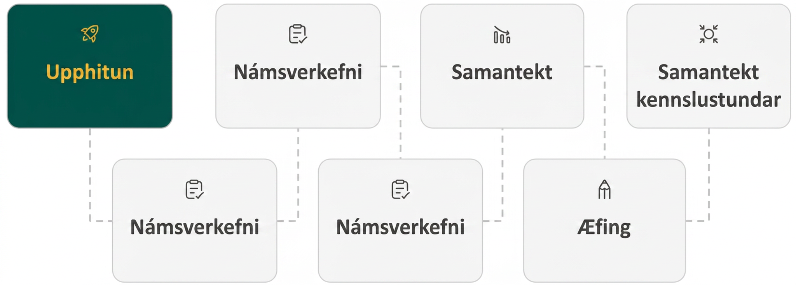
Lesson Journey
First Stop: Warm Up

Slide 7

Warm Up
Multiplying! 🐇
Use the properties of exponents to multiply monomials.
(3x²)(− 4x³)
(⅚ x³y)(12xy²)
Find the product of each expression.
7𝑥(3𝑥 + 6)
7𝑏²(9𝑏 − 4)
2𝑘(5𝑘² + 3𝑘 − 1)
4𝑟²𝑠(2𝑟² + 8𝑟𝑠 − 12𝑠²)
Notes:
Warm Up (5 minutes)
This warm up reviews how to use the Commutative Property and properties of exponents to multiply monomials. Review how the properties of exponents determine how we multiply terms together.
Before assigning the individual exercises, ask students how the Distributive Property [of multiplication over addition] will determine how to multiply the monomial by the expression in parentheses.
Launch
Solve the first two examples as a class to demonstrate multiplying monomials. Review the solutions provided.
Then allow students to solve the following problems individually.
Continue scrolling down for the activity answers and synthesis questions.
Answers
Step 1 - Use the Commutative Property to rearrange the terms: 3⋅(−4)⋅𝑥²⋅𝑥³
Step 2 - Multiply: −12𝑥⁵
Step 1 - Use the Commutative Property to rearrange the terms: ⁵/₆⋅12⋅𝑥³⋅𝑥⋅𝑦⋅𝑦²
Step 2 - Multiply: 10𝑥⁴𝑦³
21𝑥² + 42𝑥
63𝑏³ − 28𝑏²
10𝑘³ + 6𝑘² − 2𝑘
8𝑟⁴𝑠 + 32𝑟³𝑠² − 48𝑟²𝑠³
Activity Synthesis
Review these key concepts from the activity with students:
Remind students that when multiplying monomials together, the individual factors can be written out in a larger multiplication expression. The Commutative Property allows the terms to be rearranged so that appropriate terms can be combined.
The properties of exponents say that when multiplying exponential values with the same base, the base remains the same and the exponents are added together.
To distribute a value through an expression in parentheses, the value is multiplied by each term in the parentheses.

Slide 8
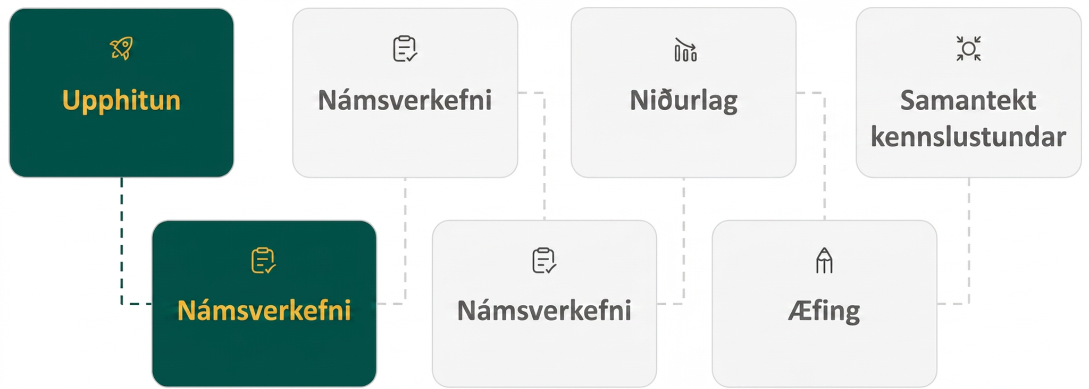
Lesson Journey
Second Stop: Learning Activity A

Slide 9

Learning Activity A | Learning Strategies
Multiple Methods ☜☞
Teacher Instruction: Use these strategies to adjust the activity to support English language learners.
You can copy and paste the callout directly on top of the activity or give the instructions aloud.
Critique and identify the error in the answer.
Correct the reasoning with a partner.
Clarify your explanation by making it more concise and precise.
Critique, Correct, Clarify
Notes:
Support for English Language Learners: MLR 3 Critique, Correct, Clarify: Conversing
After discussing the three methods to multiply (𝑥 − 7)(2𝑥 + 4) as a class, present an incorrect answer and explanation. For example, " (𝑥 + 8)(2𝑥 + 3) = 𝑥² + 24 because when you multiply two binomials, you multiply the first terms and the last terms.” Ask students to identify the error, critique the reasoning, and write a correct explanation. Invite students to share their critiques and corrected explanations with the class. Listen for and amplify the language students use to explain how to find the difference of squares. This helps students evaluate, and improve upon, the written mathematical arguments of others.
Design Principle(s): Optimize output (for explanation); Maximize meta-awareness
Learn more about this routine
View the instructional video and follow along with the materials to assist you with learning this routine.
Provide support for students
Distribute graphic organizers to the students to assist them with participating in this routine.

Slide 10

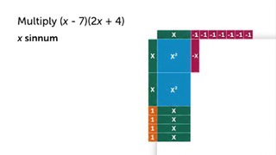
Learning Activity A | Part 1
Multiple Methods ☜☞
Method 1 (𝑥 − 7)(2𝑥 + 4) 𝑥(2𝑥 + 4) − 7(2𝑥 + 4) 2𝑥² + 4𝑥 − 14𝑥 − 28 2𝑥² − 10𝑥 − 28 | Method 2 𝑥 − 7 × 2𝑥 + 4 _____ + 4𝑥 − 28 2𝑥² − 14𝑥 ________ 2𝑥² − 10𝑥 − 28 | Method 3 2𝑥² + 4𝑥 − 14𝑥 − 28 2𝑥² − 10𝑥 − 28 | Method 4
First, Second, Next, So, the solution is 2𝑥² − 10𝑥 − 28. | First, Second, Next, So, the solution is 2𝑥² − 10𝑥 − 28. | First, Second, Next, Combine like terms, and the solution is 2𝑥² − 10𝑥 − 28. | First, Second, Next, So, the solution is 2𝑥² − 10𝑥 − 28.
Notes:
Support for All Learners
This activity offers additional support and an extension for students:
For English language learners, be sure to review the Learning Strategies slide!
For students looking for an extra challenge, be sure to review the Extending Your Thinking slide!
Activity (20 minutes)
This activity introduces three different ways to multiply binomials together. Students should familiarize themselves with each method. Then they can decide which method works best for them and use the others to check their multiplication.
Launch
As a class, examine the methods used in the table to multiple (𝑥 – 7)(2𝑥 + 4). Have students describe how the two binomials are being multiplied.
Go step by step through each method while asking for questions after each method. Notice that method 4 uses algebra tiles that are available at https://polypad.amplify.com/p.
Then allow students to work through the exercises individually.
If you would like to use digital algebra tiles to model the process of multiplying binomials, extensive instructions are provided in the online Teacher Guide for this lesson activity. Remember you must be logged into your verified teacher account before you are able to access this resource (teacher and student accounts are free).
Answers
Method 1
First, the second binomial (2𝑥 + 4) is distributed to both of the terms in the first binomial.
Second, individual terms are distributed.
Next, the like terms 4𝑥 and –14𝑥 are combined.
So, the solution is 2𝑥² − 10𝑥 − 28.
Method 2
First, the binomials are written vertically.
Second, the last term of the bottom binomial is multiplied, or distributed, to each of the terms in the top binomial.
Third, the first term of the bottom binomial is multiplied, or distributed, to each of the terms in the top binomial, being sure to line up the like terms vertically.
Next, add the like terms. They should be “stacked” on top of each other.
So, the solution is 2𝑥² − 10𝑥 − 28.
Method 3
First, distribute the first term of the front binomial to the first term of the back binomial (F).
Second, distribute the first term of the front binomial to the second term of the back binomial (O).
Third, distribute the second term of the front binomial to the first term of the back binomial (I).
Next, distribute the second term of the front binomial to the second term of the back binomial (L).
Combine like terms, and the solution is 2𝑥² − 10𝑥 − 28.
Method 4
First, gather the tiles needed for each binomial (3 x-tiles, 4 positive unit tiles, and 7 negative unit tiles) and place one binomial across the top edge of the paper (x – 7) and the second binomial along the left edge of our paper (2x + 4).
Second, multiply each dimension along the top by the tiles along the vertical edge. [We multiply the x (from the top binomial) times the x 2-times (because the vertical binomial has two x terms) and then the x (from the top binomial) times the four positive unit tiles; the – 1 (unit tiles) times each of the vertical x’s - which gives us 14 negative x-tiles. Finally, we multiply the severn – 1’s times the four +1’s which gives us negative 28 unit tiles.]
Third, we write down all the tiles that are contained in the rectangle and remove the zero pairs to simplify. [In this case, there are +4x that are opposites of –4x leaving –10x.]
Next, we write down the simplified version of our expression; which is 2𝑥² − 10𝑥 − 28.
Activity questions, answers, anticipated misconceptions and synthesis continue on the next slide.

Slide 11
Learning Activity A | Part 2
Multiple Methods ☜☞
Multiply each set of binomials.
(a + 6)(a – 4)
(5b + 9)(4b + 3)
(5x² – 1)(2x – 8)
(7mn + 1)(11mn – 3)
Are you ready for more?
Notes:
Answers
𝑎² + 2𝑎 − 24
20𝑏² + 51𝑏 + 27
10𝑥³ − 40𝑥² − 2𝑥 + 8
77𝑚²𝑛² − 10𝑚𝑛 − 3
Anticipated Misconceptions
When students use the Distributive Property, emphasize that the sign combining the new products is determined by the sign in the binomial that is broken up. The example from the table is shown below, with the corresponding signs in red:
(𝑥 − 7)(2𝑥 + 4) = 𝑥(2𝑥 + 4) − 7(2𝑥 + 4)
Activity Synthesis
Ask students to explain which method they prefer. As students discuss each method, emphasize the following points:
To use the Distributive Property, the first binomial is broken up so that each term is multiplied by the second binomial.
When using Vertical Alignment, it is important to align like terms as you write the individual products. This will help you combine them into the correct final product.
When using the FOIL method, you can view the process as 4 individual steps that are then combined to find the product.
When using algebra tiles, being able physically see the creation of the rectangle helps to ensure you don’t forget to multiply anything. And, it is sometimes easier to find zero pairs when simplifying.

Slide 12

Learning Activity A
Extending Your Thinking
Multiply the binomials. Add like terms to simplify the expression.
(5𝑥²𝑦 − 𝑥𝑦)(3𝑥 + 𝑦) + (6𝑥 + 4𝑦)(−3𝑥²𝑦 + 2𝑥𝑦)
Notes:
Go back to Lesson Activity
Answer
(5𝑥²𝑦 − 𝑥𝑦)(3𝑥 + 𝑦) + (6𝑥 + 4𝑦)(−3𝑥²𝑦 + 2𝑥𝑦)
=15𝑥³𝑦 + 5𝑥²𝑦² − 3𝑥²𝑦 − 𝑥𝑦² − 18𝑥³𝑦 + 12𝑥²𝑦 − 12𝑥²𝑦² + 8𝑥𝑦²
= −3𝑥³𝑦 + 9𝑥²𝑦 − 7𝑥²𝑦² + 7𝑥𝑦²

Slide 13
Learning Activity A
Self Check
Multiply the binomials (5𝑦 + 2)(6𝑦 − 3).
30𝑦² − 3𝑦 − 6
27𝑦 − 6
30𝑦² − 27𝑦 − 6
30𝑦² + 3𝑦 + 6
Let’s review!
Notes:
Answer Feedback - Individualized by Response
That’s correct! Confirm your solution by multiplying the binomials a different way. You should find the same solution.
Incorrect. Did you multiply the first two terms together to get 30𝑦²?
Incorrect. Did you use the correct signs when multiplying in each step?
Incorrect. Did you use the correct signs when combining like terms?

Slide 14

Learning Activity A
Self Check - Review
MULTIPLYING BINOMIALS BY DISTRIBUTING TERMS (aka “FOIL”)
Step 1 - Multiply the first terms. (F)
Step 2 - Multiply the outside terms. (O)
Step 3 - Multiply the inside terms. (I)
Step 4 - Multiply the last terms. (L)
Step 5 - Combine like terms.
Multiply: (4𝑥 + 3)(2𝑥 − 5)
Notes:
Remind students:
If you multiply binomials often enough, you may notice a pattern when the terms are distributed. Notice that the first term in the result is the product of the first terms in each binomial. The second and third terms are the product of multiplying the two outer terms and then the two inner terms. And the last term results from multiplying the two last terms.
We abbreviate “First, Outer, Inner, Last” as FOIL. The letters stand for “First, Outer, Inner, Last.” We use this as another way to multiply binomials. The word FOIL is easy to remember and ensures we find all four products. When you multiply by the FOIL method, drawing the arrows will help your brain focus on the pattern and make it easier to apply.
The FOIL method is usually the quickest method for multiplying two binomials, but it only works for binomials. You can use the Distributive Property to find the product of any two polynomials.
Additional methods and examples can be accessed in the online textbook.

Slide 15
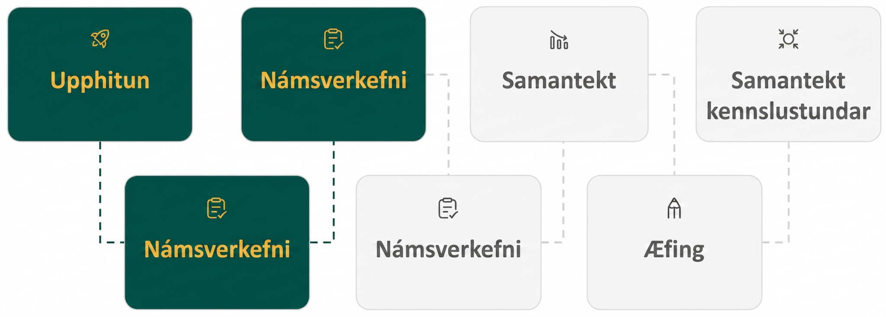
Lesson Journey
Third Stop: Learning Activity B

Slide 16
Learning Activity B | Learning Strategies
Match Them Up ☞ ☜
Teacher Instruction: Use these strategies to adjust the activity to support students with disabilities.
  You can copy and paste the callout directly on top of the activity or give the instructions aloud.
Gather the algebra tiles you need for the polynomial.
Arrange the tiles into a rectangular shape.
HINT: Put the squared terms at the top left of the rectangle.
Action and Expression
Notes:
Support for Students with Disabilities: Action and Expression: Flexibility and Choice
Provide students with algebra tiles to help multiplying polynomials. Algebra tiles help represent algebraic equations and provide students with a visualization of the process of multiplying polynomials and trinomials.
Watch the video from 6.2.2 above Question 1 for an example of how to use algebra tiles multiplying polynomials.
Supports accessibility for: Conceptual processing; Visual-spatial processing

Slide 17
Learning Activity B | Part 1
Match Them Up ☞ ☜
Match each polynomial expression to its simplified solution (on the right).
(𝑐 + 1)(𝑐² + 3𝑐 + 6)
(𝑐 − 6)(𝑐² + 𝑐 + 1)
(𝑐 + 5)(𝑐² + 2𝑐 − 4)
(𝑐² − 3)(𝑐² − 4𝑐 − 1)
(𝑐² + 10)(𝑐² − 5𝑐 + 2)
𝑐³ − 7𝑐² + 11𝑐 + 3
𝑐³ − 5𝑐² − 5𝑐 − 6
𝑐³ + 7𝑐² + 6𝑐 − 20
𝑐³ + 4𝑐² + 9𝑐 + 6
𝑐³ + 5𝑐² − 48𝑐 + 20
Notes:
Support for All Learners
This activity offers additional support for students:
For students with disabilities, be sure to review the Learning Strategies slide!
Activity (20 minutes)
This activity reinforces the use of Vertical Alignment and distribution to multiply a binomial by a larger polynomial. Emphasize that the FOIL method will only work when you are multiplying two binomials, not with a trinomial or a larger polynomial.
Launch
Allow students to work individually on the exercises provided. Allow extra time to answer questions as needed.
Answers
𝑐³ + 4𝑐² + 9𝑐 + 6
𝑐³ − 5𝑐² − 5𝑐 − 6
𝑐³ + 7𝑐² + 6𝑐 − 20
𝑐⁴ − 4𝑐³ − 4𝑐² + 12𝑐 + 3
𝑐⁴ − 5𝑐³ + 8𝑐² − 50𝑐 + 20
Additional activity questions, answers, and synthesis questions continue on the next slide.

Slide 18
Learning Activity B | Part 2
Match Them Up ☞ ☜
Now, fill in the missing blanks to complete the polynomial multiplication.
(2𝑥 − 4)(𝑥² + ⬚𝑥 − 5) = 2𝑥(𝑥² + 6𝑥 − 5) − 4(𝑥² + 6𝑥 − ⬚)
= 2𝑥³ + ⬚𝑥² − 10𝑥 − 4𝑥² − 24𝑥 + ⬚
= ⬚𝑥³ + 8𝑥² − ⬚𝑥 + 20
Notes:
Answers - continued
6. (2𝑥 − 4)(𝑥2 + ⬚𝑥 − 5) = 2𝑥(𝑥² + 6𝑥 − 5) − 4(𝑥² + 6𝑥 − 5)
= 2𝑥³ + 12𝑥² − 10𝑥 − 4𝑥² − 24𝑥 + 20
= 2𝑥³ + 8𝑥² − 34𝑥 + 20
Anticipated Misconceptions
If students are struggling with filling in the blanks to complete the polynomial multiplication, encourage them to use what they know about the Distributive Property to complete the first line. The following lines can be found by continuing to solve by distribution.
Activity Synthesis
Ask students to consider the advantages and disadvantages of each method used in the activity. Consider the following:
Using Vertical Alignment allows you to align like terms so that they can be easily combined into the final product, but using algebra tiles helps you to easily find zero pairs. Which do you find easier?
How does the time spent using Vertical Alignment compare to the time spent using the Distributive Property?
How does the time spent using the algebra tiles compare to the time spent doing the Vertical Alignment or using the “FOIL” acronym?
Which method do you find easier to use to double-compare your work?

Slide 19

Learning Activity B
Self Check
Multiply (𝑑 + 4)(2𝑑² − 3𝑑 + 5).
2𝑑³ − 11𝑑² − 17𝑑 + 20
2𝑑³ + 5𝑑² − 7𝑑 + 20
2𝑑³ − 3𝑑² + 5𝑑
8𝑑² − 12𝑑 + 20
Let’s review!
Notes:
Answer Feedback - Individualized by Response
Incorrect. Check the signs of the terms you found when multiplying and combining terms.
That’s correct! Use the Distributive Property or Vertical Alignment to compare your work.
Incorrect. This is only (𝑑)(2𝑑² − 3𝑑 + 5). Multiply 2𝑑² − 3𝑑 + 5 by 4 and combine like terms of both parts.
Incorrect. This is only (4)(2𝑑² − 3𝑑 + 5). Multiply 2𝑑² − 3𝑑 + 5 by 𝑑 and combine like terms of both parts.

Slide 20
Learning Activity B
Self Check - Review
Multiply: (𝑏 + 3)(2𝑏² − 5𝑏 + 8)
MULTIPLYING POLYNOMIALS BY DISTRIBUTION
Step 1 - Distribute one polynomial to each term of the other.
Step 2 - Multiply.
Step 3 - Combine like terms.
Notes:
Discuss
Remember, FOIL will not work in this case, but we can use other representations of the Distributive Property such as Vertical Alignment or distributing individual terms or polynomials.
Additional methods can be accessed in the online textbook.

Slide 21
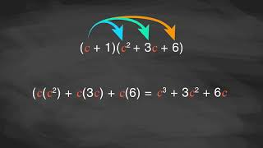
Learning Activity B | Video
Multiplying Polynomials Using Different Methods
Notes:
This video discusses question 1 of activity 6.2.3

Slide 22
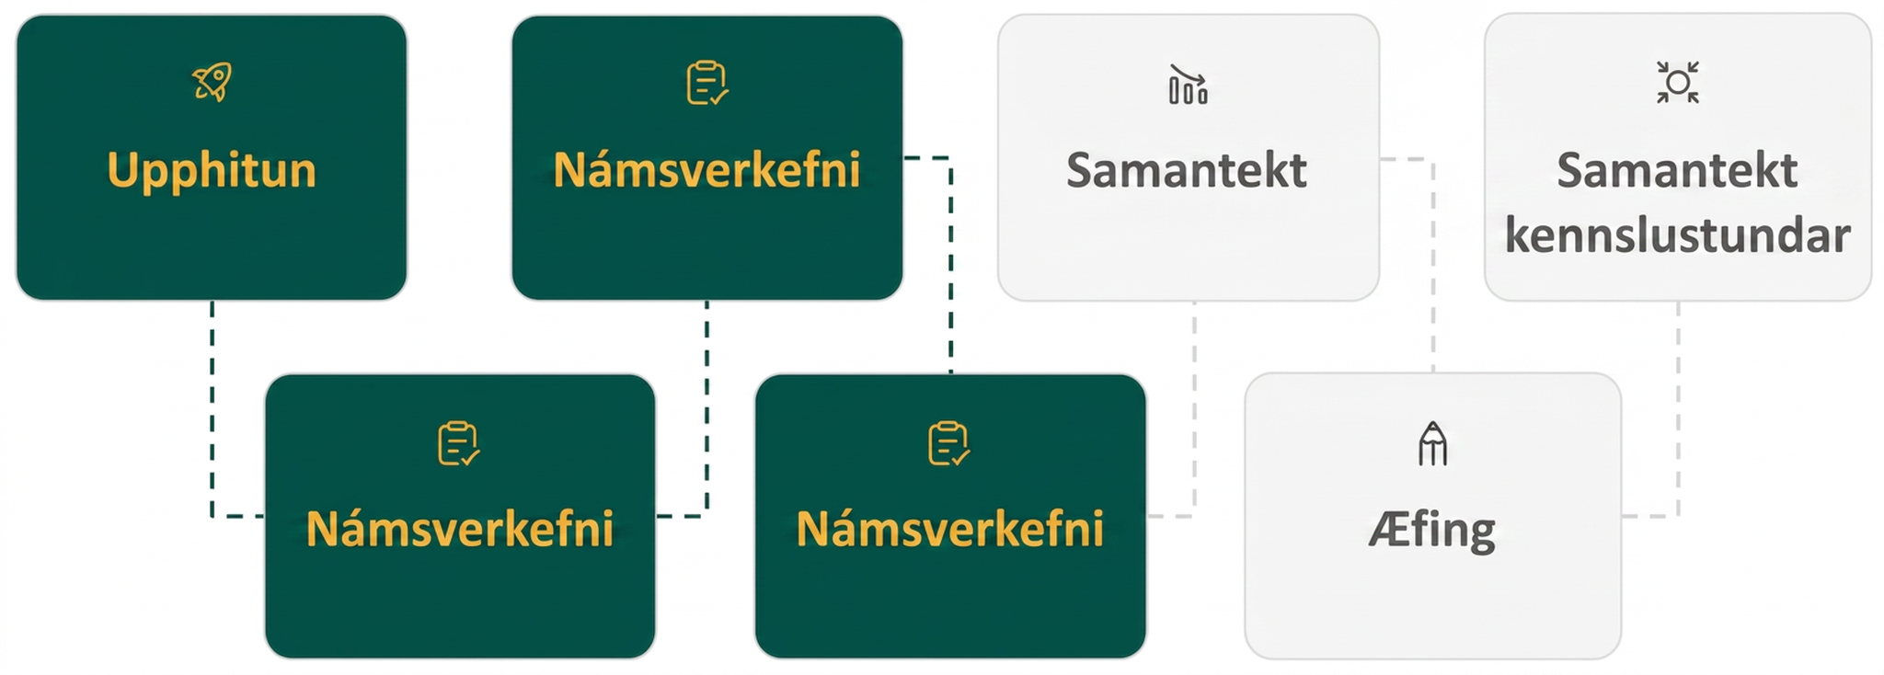
Lesson Journey
Fourth Stop: Learning Activity C

Slide 23
Learning Activity C | Part 1
Isn’t That Special? ✨
What is a binomial square?
Provide an example.
What is a conjugate pair?
Provide an example.
A binomial square is (a + b)² is the result of multiplying a binomial (two-terms) by itself.
For example, (𝑥 + 3)² represents
(𝑥 + 3)(𝑥 + 3).
A conjugate pair are two binomials of the form (a – b) and (a + b).
For example, (𝑥 − 5)(𝑥 + 5).
Notes:
Activity (20 minutes)
This activity prompts students to learn an efficient method to multiply special polynomials. Students will learn to recognize multiplication expressions involving binomial squares and conjugate pairs. They will learn the patterns used to make the multiplication process more efficient than other methods used so far in this lesson.
Launch
Before starting the exercises, ask students to name any polynomial expression that can be identified as a binomial square.
Example of a binomial square: (𝑥 + 3)² (The answer will appear as an animation on the click.)
Ask them to name a conjugate pair. (The question will appear as an animation on the click.)
Example of a conjugate pair: (𝑥 − 5)(𝑥 + 5) (The answer will appear as an animation on the click.)
Ask students how to discern between the two different expressions.
Then, allow students to work through the exercises provided individually.
Activity questions, answers, anticipated misconceptions and synthesis continue on the next slide.

Slide 24
Learning Activity C | Part 2
Isn’t That Special? ✨
Multiply each expression. Identify each as a binomial square or a conjugate pair (difference of squares).
(3𝑥 − 7)²
(6𝑧 + 4)(6𝑧 − 4)
(4𝑎 + 2𝑏)(4𝑎 + 2𝑏)
(3𝑤 − 9𝑝)(3𝑤 + 9𝑝)
(2𝑦 − 8𝑛)(2𝑦 + 8𝑛)
(5𝑘 + 2)(5𝑘 + 2)
Notes:
Answers
9𝑥² − 42𝑥 + 49; binomial square
36𝑧² − 16; conjugate pair
16𝑎² + 16𝑎𝑏 + 4𝑏²; binomial square
9𝑤² − 81𝑝²; conjugate pair
4𝑦² − 64𝑛²; conjugate pair
25𝑘² + 20𝑘 + 4; binomial square
Activity Synthesis
Invite a student to name the equation used to identify the multiplication of a binomial square involving addition.
(𝑎 + 𝑏)² = 𝑎² + 2𝑎𝑏 + 𝑏²
Ask another student how the equation involving subtraction is different.
(𝑎 − 𝑏)² = 𝑎² − 2𝑎𝑏 + 𝑏²
Finally, ask a student to name the equation representing the multiplication of conjugate pairs.
(𝑎 + 𝑏)(𝑎 − 𝑏) = 𝑎² − 𝑏²
Ask students how mastering these equations makes multiplying these types of polynomials easier. Tell students that in future lessons, we will work on reversing this process using factoring.

Slide 25
Learning Activity C
Self Check
Multiply (3𝑓 − 6𝑔)².
9𝑓² − 18𝑓𝑔 + 36𝑔²
9𝑓² − 36𝑓𝑔 + 36𝑔²
9𝑓² − 36𝑓𝑔 − 36𝑔²
9𝑓² + 36𝑔²
Let’s review!
Notes:
Answer Feedback - Individualized by Response
Incorrect. You must multiply the middle term by 2. The correct form for the product of a binomial square is (𝑎 − 𝑏)² = 𝑎² − 2𝑎𝑏 + 𝑏².
That’s correct! he correct form for the product of a binomial square is (𝑎 − 𝑏)² = 𝑎² − 2𝑎𝑏 + 𝑏².
Incorrect. Check the sign on the last term. The correct form for the product of a binomial square is (𝑎 − 𝑏)² = 𝑎² − 2𝑎𝑏 + 𝑏².
Incorrect. The middle term is missing. The correct form for the product of a binomial square is (𝑎 − 𝑏)² = 𝑎² − 2𝑎𝑏 + 𝑏².

Slide 26
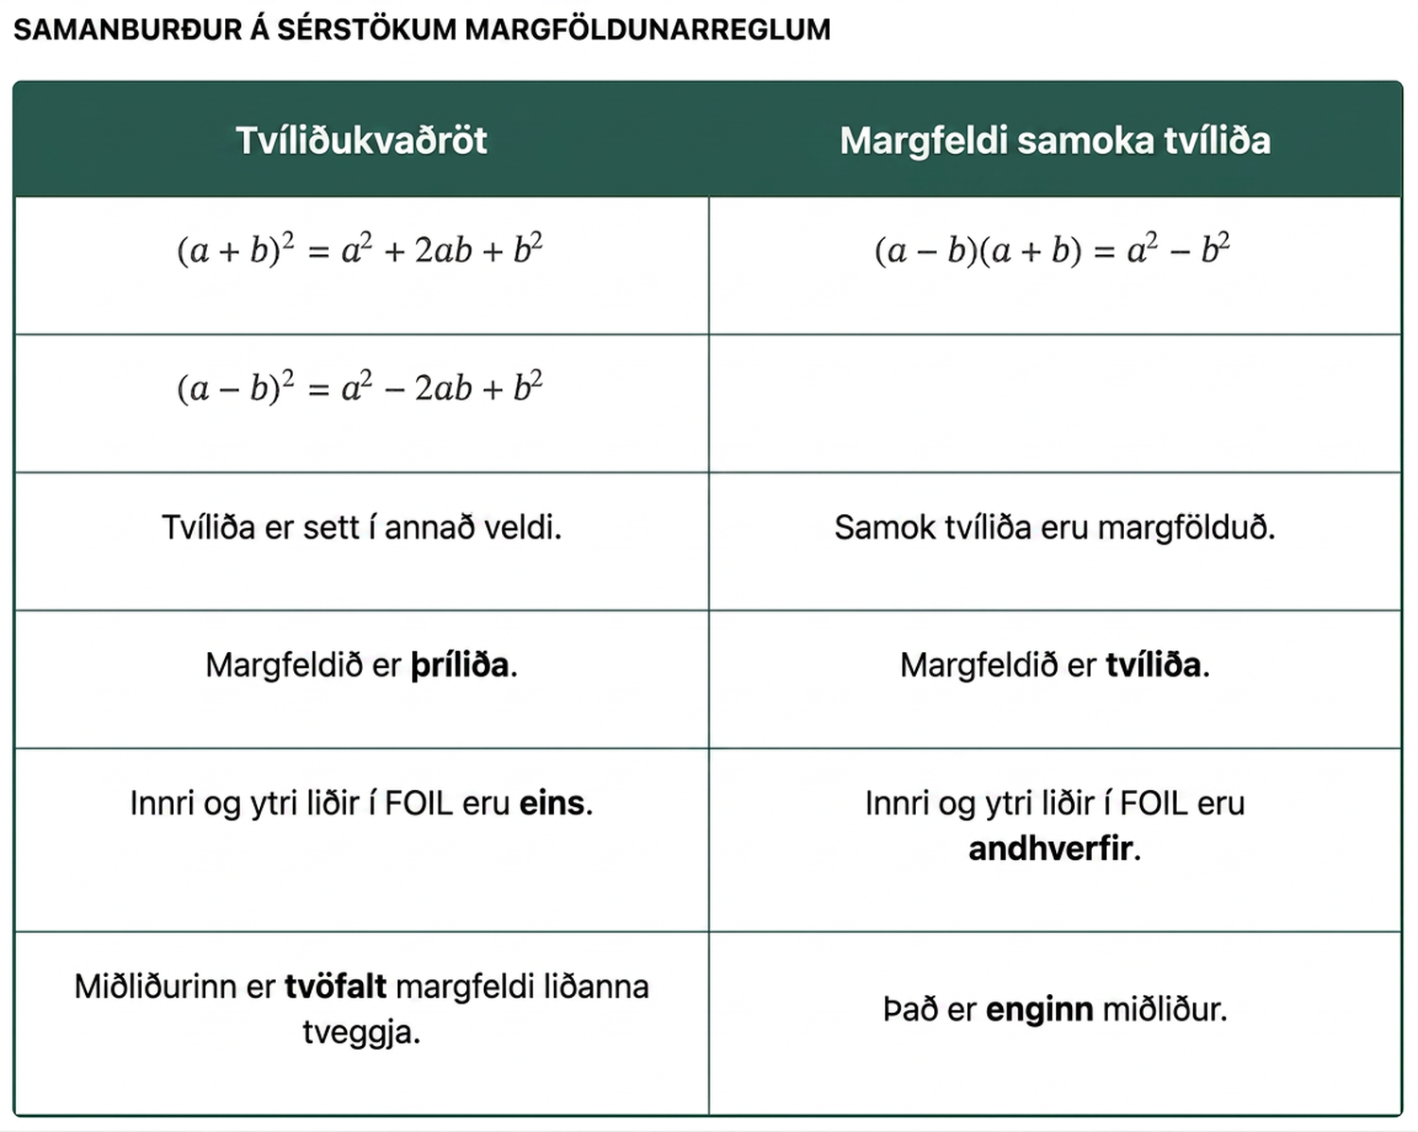
Learning Activity C
Self Check - Review
Multiply: (2𝑥 − 3𝑦)²
Notes:
Access the online textbook for additional explanations and examples.

Slide 27
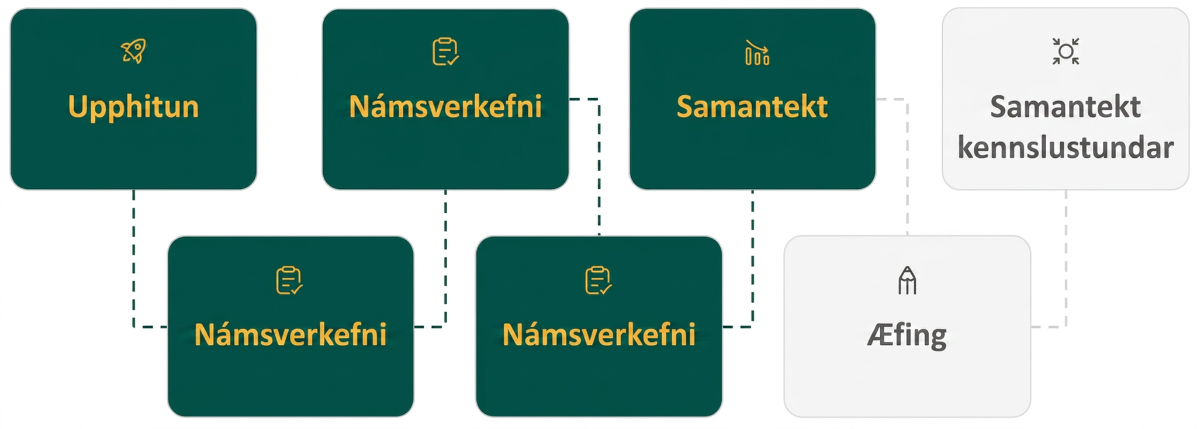
Lesson Journey
Fifth Step: Cool Down

Slide 28
Cool Down
Use the polynomial functions (given at right) to complete the multiplication.
f(x) ● g(x)
f(x) ● f(x)
h(x) ● j(x)
h(x) ● h(x)
f(x) = 3x + 2b g(x) = 3x – 2b h(x) = 7x + 2 j(x) = 9x² – 12x + 4
Notes:
Cool Down (5 minutes)
Answers
9𝑥² − 4𝑏²
9𝑥² + 12𝑥𝑏 + 4𝑏²
63𝑥³ − 66𝑥² + 4𝑥 + 8
49𝑥² + 28𝑥 + 4
Response to Student Thinking - More Chances
Students will have more opportunities to practice the ideas in this cool down, so there is no need to slow down or add additional work to the next lessons. Instead, use the results of this cool down to provide guidance for what to look for and emphasize in upcoming lessons throughout Units 7 and 8.

Slide 29
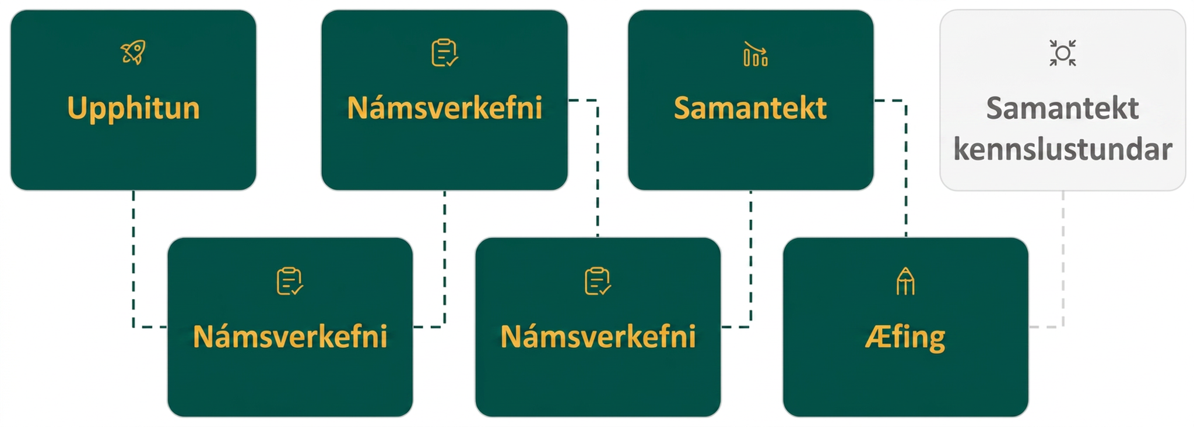
Lesson Journey
Sixth Stop: Practice

Slide 30

Practice
Put your hard work to action, practice what you’ve learned!
Notes:
Digital Practice: Access the practice pages at https://openstax.org/details/books/algebra-1

Slide 31
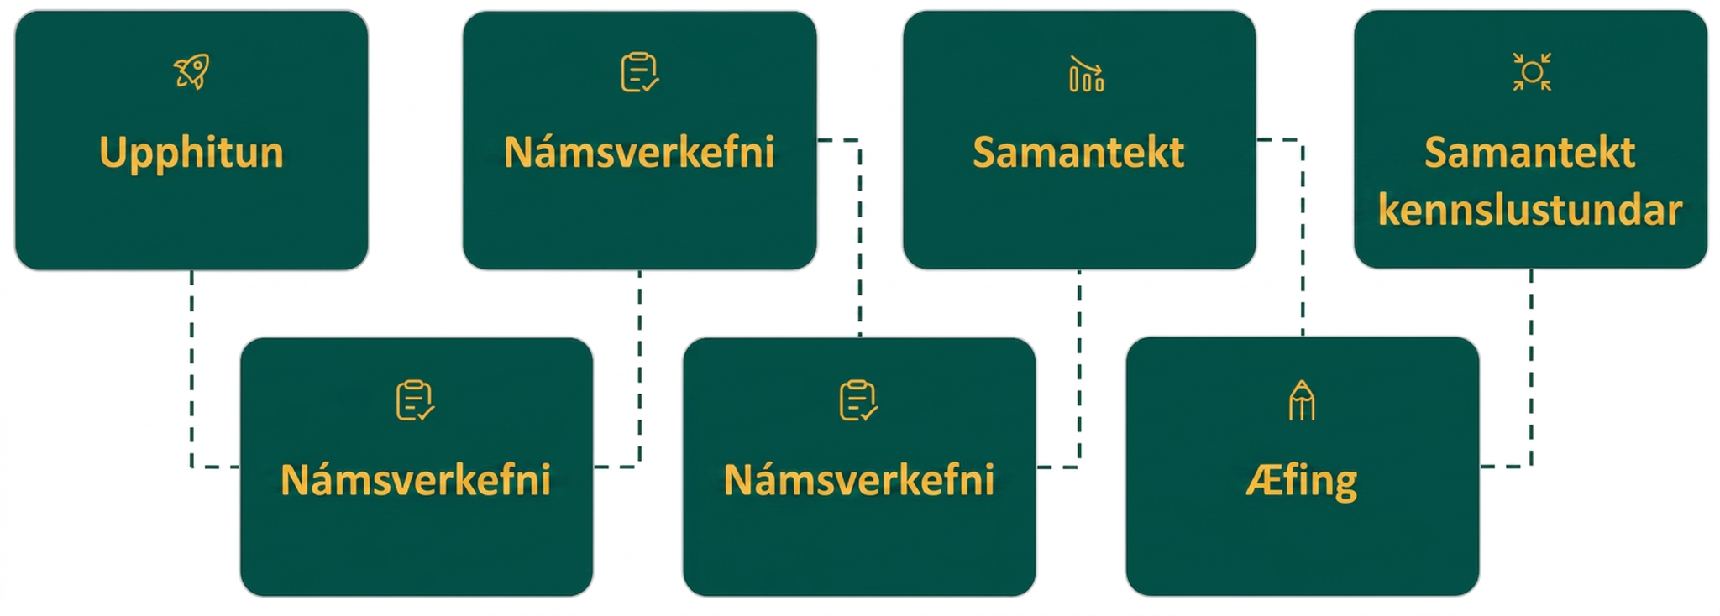
Lesson Journey
Seventh Stop: Lesson Synthesis

Slide 32
Lesson Synthesis
Why are the properties of exponents important when multiplying polynomials?
How is the Distributive Property used to multiply polynomials?
How is Vertical Alignment used to multiply polynomials?
How is the FOIL method used to multiply polynomials?
How is recognizing binomial squares and conjugate pairs helpful in polynomial multiplication?
Notes:
To summarize the key concepts from the lesson, pose the sample questions again to see if students have learned all of the possible situations.
Answers
Why are the properties of exponents important when multiplying polynomials? (When multiplying polynomials, terms of different degrees are often multiplied together. The properties of exponents determine how this process goes.)
How is the Distributive Property used to multiply polynomials? (Each term in one polynomial is distributed through a second polynomial using multiplication. Like terms are combined to simplify the product.)
How is Vertical Alignment used to multiply polynomials? (Polynomials are written vertically in a traditional multiplication format. The individual products from the multiplication of each term are added together to find the final product.)
How is the FOIL method used to multiply polynomials? (The FOIL method is specifically used to multiply two binomials. A four-step process is used, first-outside-inside-last, to ensure that each term is multiplied together. Like terms are combined to simplify the product.)
How is recognizing binomial squares and conjugate pairs helpful in polynomial multiplication? (These two situations represent special cases of binomial multiplication in which the products fit very particular patterns. This helps us take a small shortcut in finding and organizing the final product of these binomials.)

Slide 33
Self Assessment
How much do you agree with the following statements?
Learning Goals | I can | Almost | Not yet
Multiply monomials. | ⃞ | ⃞ | ⃞
Multiply a polynomial by a monomial. | ⃞ | ⃞ | ⃞
Multiply binomials. | ⃞ | ⃞ | ⃞
Multiply a polynomial by a polynomial. | ⃞ | ⃞ | ⃞
Multiply special products. | ⃞ | ⃞ | ⃞
Multiply polynomial functions. | ⃞ | ⃞ | ⃞

