Slide 1


Algebra 1
Unit 4 Functions
Lesson 4.11: Graphing a Function Using Transformations

Slide 2
How to use these slides
On the activity slides check the speaker notes for teacher support and instructional information.
Each lesson includes 1 warm up, 2-3 learning activities, a cool down, practice and a lesson synthesis.
  Learning activities are followed by a self check question, and review section.
Some slides have been hidden from student view, more information can be found on the next slide (Reference Key).
You can edit and use these slides for personal and classroom use, but cannot sell them and must keep the attribution logos.
For more information, Check out the digital quick start guide!

Slide 3






Reference Key
Check the top right corner for an icon referencing these unique sections.
 | Support for Students with Disability | Hidden | Learning Strategies slide, provides additional support to students for understanding the activity. Learning Strategies slide, provides additional support to students for understanding the activity.
 | Support for English Language Learners | Hidden
 | Extending Your Thinking | Hidden | Extending Your Thinking slide, provides an extra challenge for students.
 | Self Check | Not Hidden | Self Check slide, checkpoint to assess student understanding after the learning activity.
 | Review | Hidden | Self Check- Review slide, designed to help review topics from the self check question.
On the next slides, check the speaker notes for teacher instructions and support.
Notes:
Check the Speaker Notes: On the next slides you can find discussion questions, lesson information, answers to the activities, and ways to adjust the activity for your students!

Slide 4

Learning Goals
By the end of this lesson you will be able to -
Use transformations to graph linear functions.
Recognize the shifts made to a parent linear function to form another linear function.
Notes:
Lesson Narrative
In this lesson, students work to graph functions in slope-intercept form using transformations. They will identify vertical shifts, vertical stretches and compressions, and vertical rotations (reflection over the x-axis). They will also identify horizontal shifts, horizontal stretches and compressions, and horizontal rotations (reflection over the y-axis).
Through exploration with graphing, students will recognize patterns for the transformations and understand how the constants applied to f(x) determine the transformations needed to graph the function. Specifically, students learn about:
Vertical Shifts: f(x) + d
Horizontal Shifts: f(x − c)
Vertical Stretches and Compressions (Dilations): af(x)
Horizontal Stretches and Compressions (Dilations): f(bx)
Students will also be able to describe how one function transforms from the parent function, f(x) = x and how one function transforms to another.
Required Preparation
None
Required Materials
coordinate grids
rulers
colored pencils
geoboards (optional)
rubber bands of different colors (optional)
marshmallows (optional)
Required Preparation
Texas Essential Knowledge and Skills
A1(E) create and use representations to organize, record, and communicate mathematical ideas
A1(F) analyze mathematical relationships to connect and communicate mathematical ideas
A2(C) write linear equations in two variables given a table of values, a graph, and a verbal description
A3(E) determine the effects on the graph of the parent function f(x) = x when f(x) is replaced by af(x), f(x) + d, f(x − c), f(bx) for specific values of a,b,c, and d

Slide 5
Vocabulary
Previous
Linear Function
  A function that has a constant rate of change.
New
Parent Function
  The simplest function that still satisfies the definition of the particular type of function.
Transformation
  The movement of a parent function vertically, horizontally, through shifts, reflections, stretches, and compressions.
Types of Transformations
Vertical Shift
  Moves a parent function up or down.
Vertical Stretch
  Occurs when a parent function is multiplied by a constant greater than 1, making the graph appear "skinnier."
Vertical Compression
  Occurs when a parent function is multiplied by a constant less than one.
Vertical Reflection
  Occurs when a parent function is multiplied by -1, flipping the graph over the x-axis.
Notes:
Lesson Vocabulary
To support student understanding of key vocabulary:
Introduce and review the vocabulary words students will see in this lesson.
Encourage students to notice how these words are used and to include them in their math discussions and explanations—both written and oral.
Use a word wall to reinforce vocabulary. Sample word wall cards are available here.
For newcomers or students with beginning English proficiency, use these Quizlet sets to support vocabulary learning:
Unit 4 Spanish Vocabulary, part 1 – use first to build understanding
Unit 4 Vocabulary (English), part 1 – use after anchoring in Spanish
Unit 4 Spanish Vocabulary, part 2 – use first to build understanding
Unit 4 Vocabulary (English), part 2 – use after anchoring in Spanish
Support for English Language Learners
ELPS 2(F) listen to and derive meaning from a variety of media such as audiotape, video, DVD, and CD-ROM to build and reinforce concept and language attainment
ELPS 3(F) ask and give information ranging from using a very limited bank of high-frequency, high-need, concrete vocabulary, including key words and expressions needed for basic communication in academic and social contexts, to using abstract and content-based vocabulary during extended speaking assignments
ELPS 4(D) use prereading supports such as graphic organizers, illustrations, and pretaught topic-related vocabulary and other prereading activities to enhance comprehension of written text

Slide 6





Lesson Journey
Warm Up
Learning Activity
Learning Activity
Practice
Learning Activity
Learning Activity
Cool Down
Lesson Synthesis

Slide 7
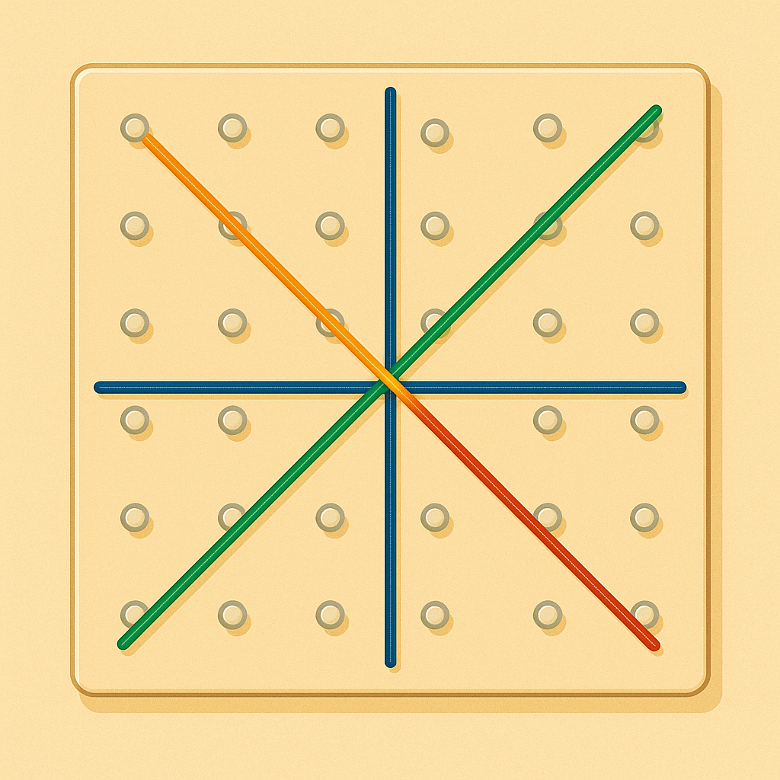
Warm Up - Graphing Linear Functions📉
Graph the following lines given in slope-intercept form:
y = 3x + 4
y = 3x − 2
What is the relationship between the two lines you graphed in question 1?
When you examine the equations of the lines…
…what do you notice is the same about the equations?
…what do you notice is different about the equations?
When you examine the graph of the lines, how many vertical spaces are between the two lines?
Notes:
Warm Up (5 minutes)
This warm-up reviews graphing linear functions, parallel and perpendicular lines, and introduces shifting one line to another. Students will later graph using only transformations, preparing for future work with other functions. Geoboards and colored rubber bands can support students who need a more hands-on approach.
Launch
Arrange students in groups of 2. Allow students to compare their graphs with their partners and discuss the relationships of the lines.
Activity Answers
Graph the following lines given in slope-intercept form: What is the height of the potato 1 second after launch?
y = 3x + 4
Y = 3x − 2
Click here to link to the slide with the completed graph.
What is the relationship between the two lines you graphed in question 1?
They are parallel lines.
When you examine the equations of the lines, what do you notice is the same about the equations?
The slopes of the lines are equal.
The numbers in front of the variables are the same.
When you examine the equations of the lines, what do you notice is different about the equations?
The constant term is different in each equation.
The number that is added to the equation is different.
The y-intercepts for each equation is different.
When you examine the graph of the lines, how many vertical spaces are between the two lines?
There are 6 vertical spaces between the two lines.
More activity questions, answers, and synthesis on the next slide.

Slide 8
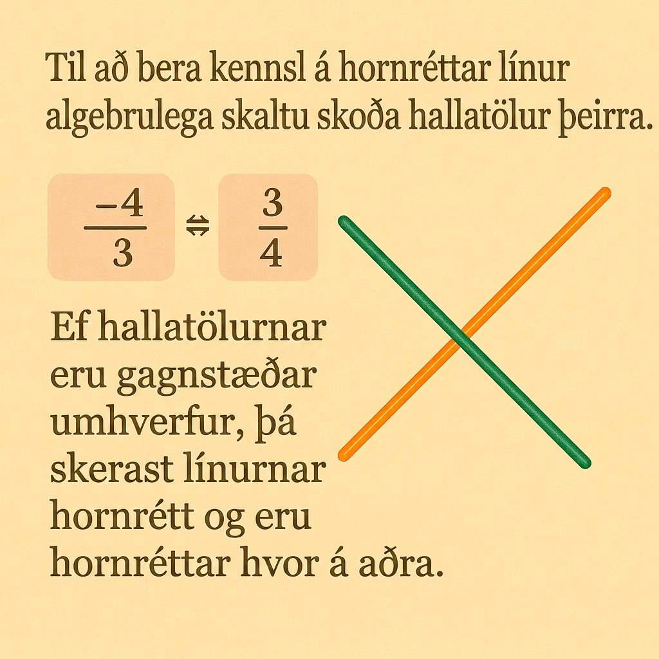
Warm Up - Graphing Linear Functions📉
On your coordinate grid, use the slope and y-intercept of each equation to graph each equation. Use a different color for each equation:
y = 3x − 2
y = −13x − 3
When you examine the graph of the lines in question 6, explain if the lines appear to be perpendicular.
Notes:
Activity Answers
On your coordinate grid, use the slope and y-intercept of each equation to graph each equation. Use a different color for each equation:
y = 3x − 2
Y = −13x − 3
Click here to link to the slide with the completed graph.
When you examine the graph of the lines in question 6, explain if the lines appear to be perpendicular.
No, the lines don't look like they intersect at right angles - so they don't look like they are perpendicular. (Check the settings of your graph, this is incorrect.)
Yes, the lines look like they intersect at right angles - so they appear perpendicular. (This is the correct answer.)
Remember to identify perpendicular lines algebraically, examine their slopes. If the slope values are opposite reciprocals, then the lines intersect at right angles and are perpendicular.
Activity Synthesis
Invite students to share their interpretations of the given equations and the new equations they wrote. Then, discuss with students:
“Do you notice any other relationships between pairs of lines?”
“How many vertical spaces are between lines a and b?”

Slide 9
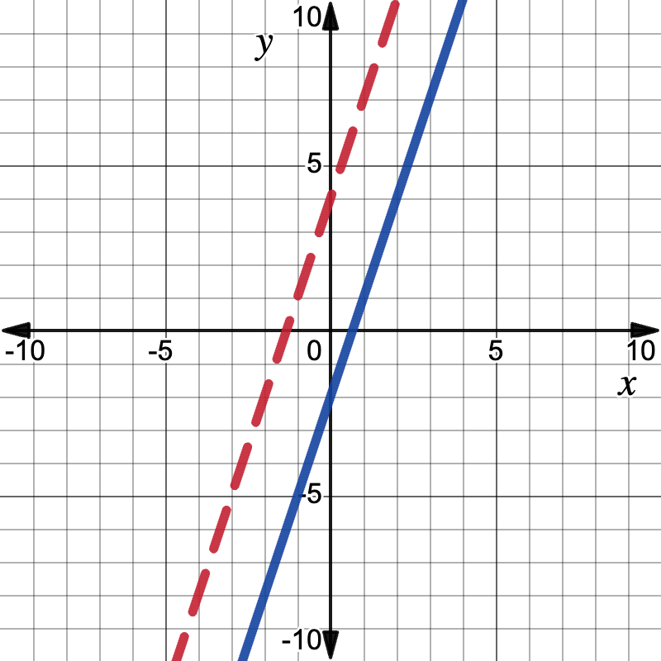
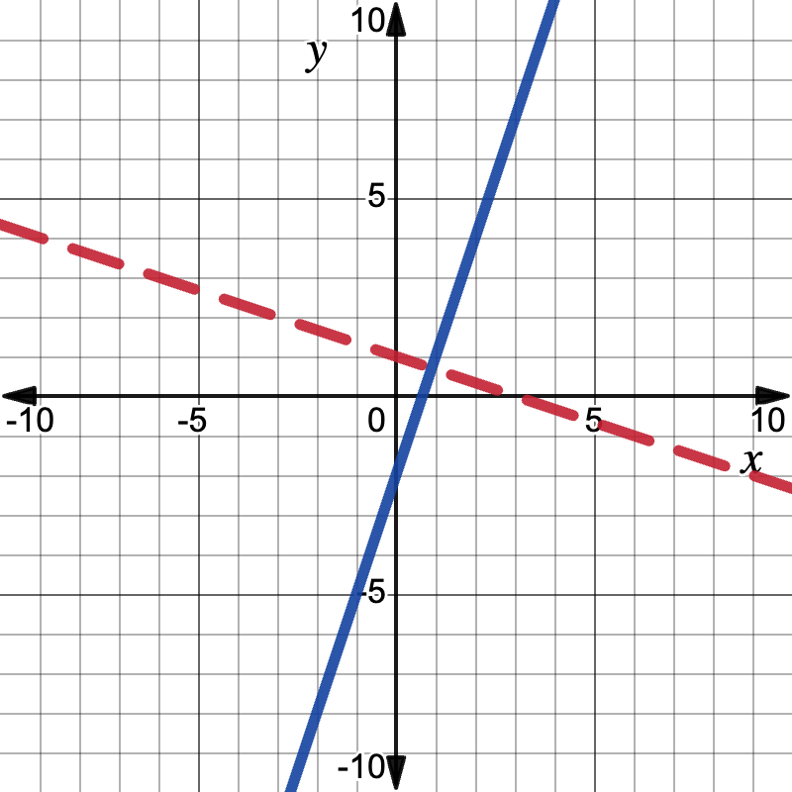
Warm Up - Graphing Linear Functions📉
Notes:
Activity Answer
Completed graph

Slide 10

Lesson Journey
Warm Up
Learning Activity
Learning Activity
Practice
Learning Activity
Lesson Synthesis
Learning Activity
Learning Activity
Cool Down

Slide 11
Learning Activity - The Role of the Y-Intercept🧩
Graph the following linear functions on the same graph.
What are the slopes of each line?
How can the parent function, f(x) = x be shifted to overlap f(x) = x + 2?
How can the parent function, f(x) = x, be shifted to overlap f(x)= x − 4?
f(x) = x + 4 | f(x) = x − 4 | f(x) = x | f(x) = x + 2 | f(x) = x − 2
The parent function of a linear function is f(x) = x.
The y-intercept is (0,0).
The slope is 1.
Notes:
Activity (20 minutes)
This activity prompts students to look at how the y-intercept in slope-intercept form affects the graph of a linear function. Circulate to ensure students are graphing their lines properly. If necessary, partner students during the graphing process.
In pairs, students should discuss the vertical shifts to the parent function, f(x) = x, to graph the new functions.
Launch
Ask students if they have ever played a board game. Connect rolling dice and moving that number of spots to the number of spots a line can shift up the graph.
For students who can benefit from a more accessible model, use geoboards and rubber bands. Use one color rubber band for the x- and y-axes. Use a different color for each line graphed. Work with students to count spots on the geoboard and discuss the graphs and their relationships.
Activity Answer
Click here to link to the slide with the completed graph.
The slope of all the lines equals 1.
Shift up 2.
Shift down 4.
Activity synthesis on the next slide.

Slide 12
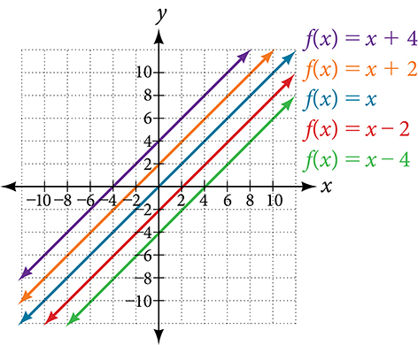
Learning Activity - The Role of the Y-Intercept🧩
Notes:
Activity Answer
Completed graph

Slide 13
Learning Activity - The Role of the Y-Intercept🧩
In f(x) = mx + b, the b acts as the vertical shift. This is a type of transformation to the graph of f(x) = x.
Vertical Shift of a Function
A vertical shift “transforms” the parent function into another function by moving the graph up or down d units.
Vertical Shift → f(x) + d
If the d value is positive, the graph of the function shifts up. If the d value is negative, the graph of the function shifts down.
Notes:
Activity Synthesis
Invite students to create other questions for students to answer about how much one linear function must shift to get to another.

Slide 14
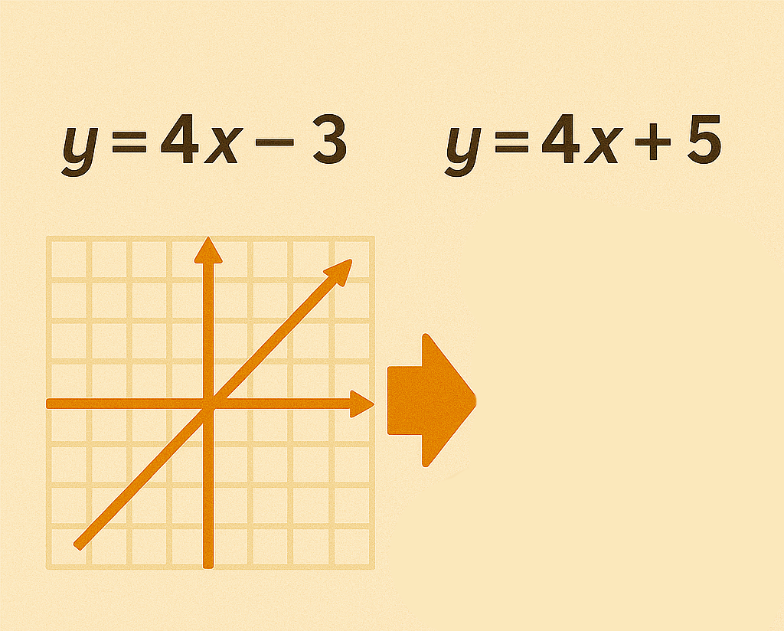
Self Check
What transformation takes place from the graph of y = 4x − 3 to y = 4x + 5?
Down 8
Right 8
Up 8
Left 8
Let’s review!
Notes:
Answer Feedback - Individualized by Response
Incorrect. For the second function to move down, there would be a negative change. The answer is up 8.
Incorrect. In y = mx + b, the b describes the vertical shift. The answer is up 8.
That’s correct! In the two equations, the b, or y-intercept of y = mx + b, changes. This determines the vertical change. From –3 to 5 is a vertical shift up 8.
Incorrect. The y-intercept changing signifies a vertical change. The answer is up 8.

Slide 15
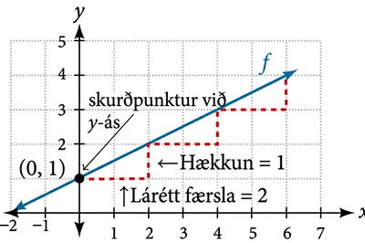
Self Check - Review
Vertical Shift of a Function
A vertical shift “transforms” the parent function into another function by moving the graph up (positive) or down (negative) d units.
Vertical Shift → f(x) + d
Vertical Shifts and y-Intercepts
In the equation f(x) = mx + b: b is the y-intercept of the graph and indicates the point (0, b) at which the graph crosses the y-axis.
m is the slope of the line and indicates the vertical displacement (rise) and horizontal displacement (run) between each successive pair of points.
The y-intercept tells where the parent function, f(x) = x, has shifted up or down.
Notes:
Prompts
Tell how f(x ) = x + 7 has shifted from the parent function f(x) = x.
Answer: Since b = 7, the y-intercept is +7, so the graph shifts up 7 from the parent function.
Tell how f(x ) = x - 9 has shifted from the parent function f(x) = x.
Answer: Since b = −9, the y-intercept is –9, so the graph shifts down 9 from the parent function.
Tell how f(x) = 2x + 1 has shifted from f(x) = 2x + 5.
Answer: Since b = 1, the y-intercept is 1. This point is 4 vertical units below the y-intercepts of the original line that had a y-intercept of 5. So, the graph shifts down 4 units from f(x) = 2x + 5 to arrive at f(x) = 2x + 1.

Slide 16
Lesson Journey
Warm Up
Learning Activity
Learning Activity
Learning Activity
Practice
Learning Activity
Lesson Synthesis
Learning Activity
Learning Activity
Cool Down

Slide 17
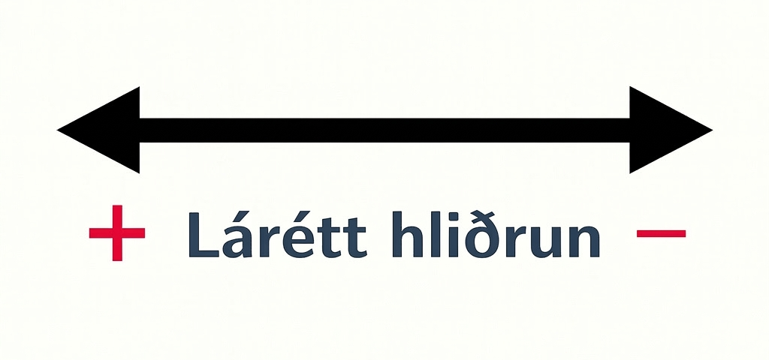
Learning Activity - The Role of the X-Intercept🧩
Graph the following linear functions on the same graph.
f(x)=2(x + 4) | f(x) = 2(x −2) | f(x)=2x
f(x) = 2(x + 2) | f(x) = 2(x − 4)
What is the direction and horizontal distance between the x-intercepts of f(x) = 2x and f(x) = 2(x −2)?
How can the function, f(x) = 2x be shifted to overlap f(x) = 2(x − 4)?
What is the direction and horizontal distance between the x-intercepts of f(x) = 2x and f(x) = 2(x + 2)?
How can the function, f(x) = 2x, be shifted to overlap f(x) = 2(x + 4)?
Notes:
Activity (20 minutes)
This activity prompts students to look at how the x-intercept is affected by horizontal translations of the graph of a linear function. During the lesson, the examples relate the shift to point-slope form. Circulate to ensure students are graphing their lines properly. If necessary, partner students during the graphing process.
Launch
Remind students how rolling dice in board games was linked to vertical shifts on a graph; now, they’ll see that graphs can shift left and right too.
To support all learners, use geoboards with colored rubber bands—one color for axes and others for lines—to help students visualize and discuss line movements.
Activity Answer
Click here to link to the slide with the completed graph.
The x-intercepts for f(x) = 2(x − 2) is 2 spaces to the right of f(x) = 2(x).
Shift right 4 spaces.
The x-intercepts for f(x) = 2(x + 2) has been shifted 2 spaces to the left of f(x) = 2(x).
Shift left 4 spaces.
Activity synthesis on the next slide.

Slide 18
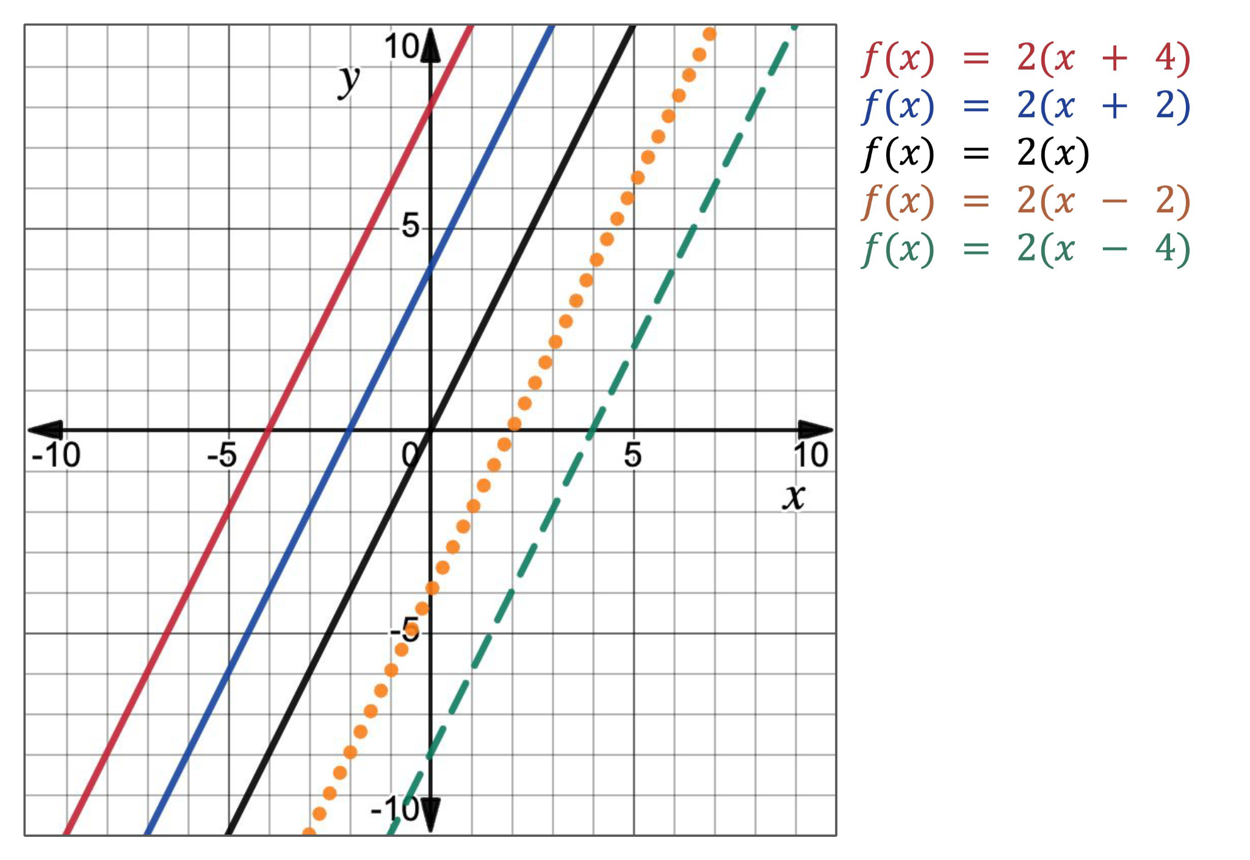
Learning Activity - The Role of the X-Intercept🧩
Notes:
Activity Answer
Completed graph

Slide 19
Learning Activity - The Role of the X-Intercept🧩
In linear functions, when a value is added to or subtracted from the input value, or the x-values, the graph acts as if a horizontal shift is applied. This is another type of transformation to the graph.
Horizontal Shift of a Function
A horizontal shift “transforms” the parent function into another function by moving the graph to the left or right c units.
Horizontal Shift → f (x − c)
If the c value is positive, the graph of the function shifts right. If the c value is negative, the graph of the function shifts left. But, be careful! The sign of the c value is preceded by subtraction in the equation. When the equation is simplified, the sign of the c value is changed.
Notes:
Activity Synthesis
Invite students to create other questions for students to answer about how much one linear function must shift to get to another.
Press students to describe how to determine if a shifted line is a horizontal or vertical shift. For linear functions, this is difficult to determine. Urge students to identify the x− or y-intercepts and then define the transformation based on what happens to that point. This method is similar to the process students used when transforming geometric figures in middle school.

Slide 20
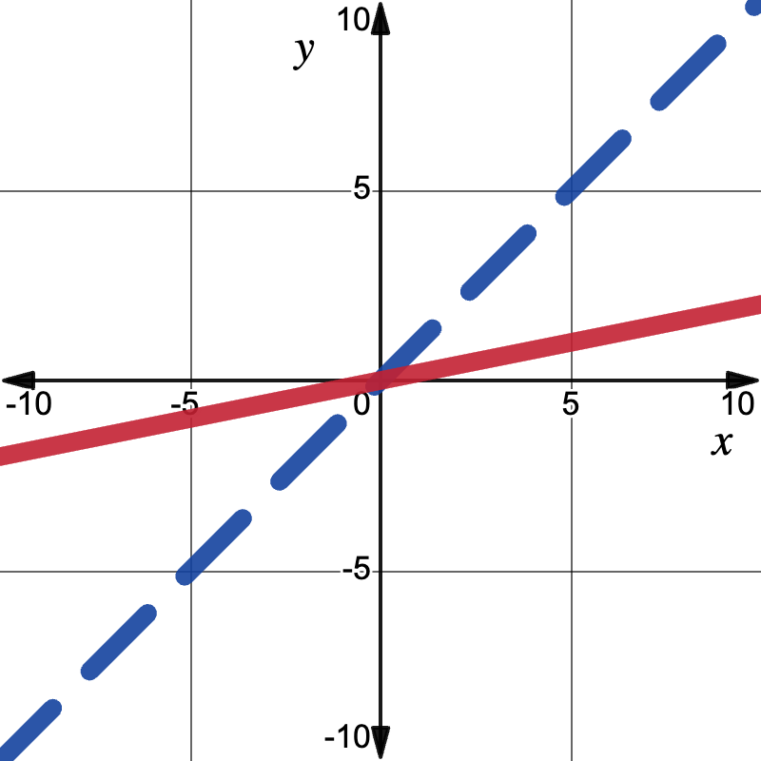
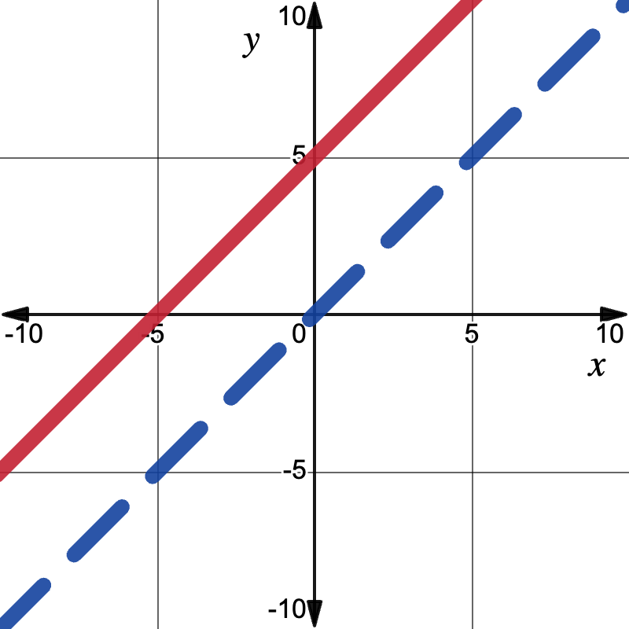
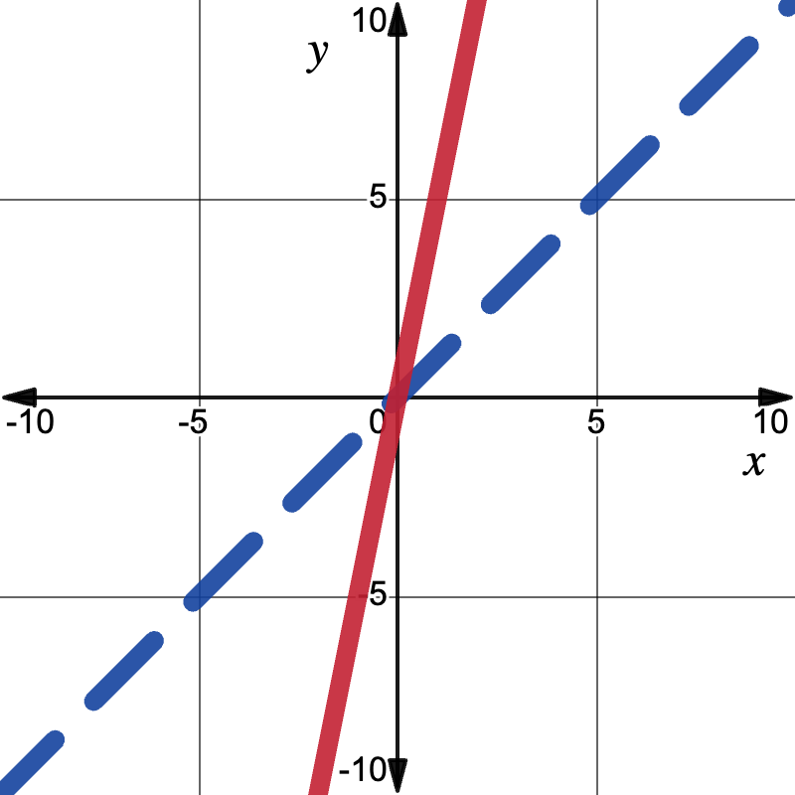
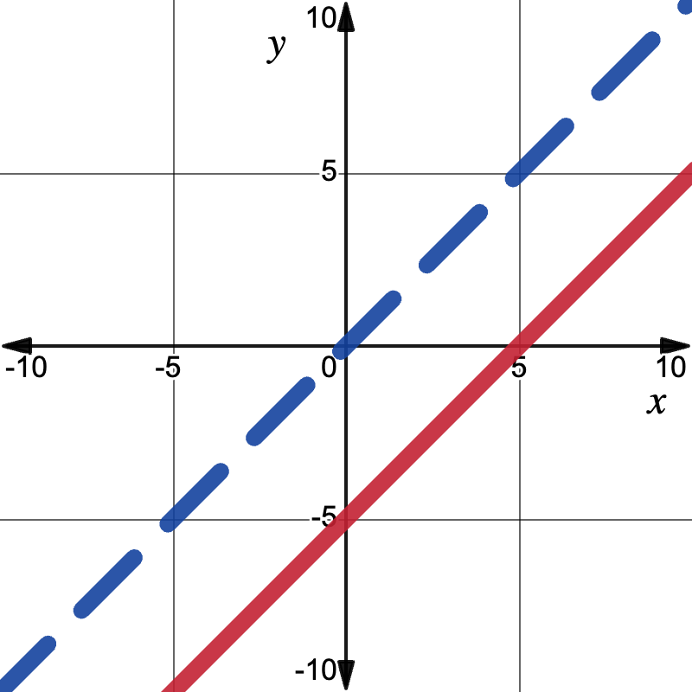
Self Check
Which graph represents f (x − 5) when f (x) = x, the linear parent function? The parent function is represented by the dashed, blue line.
a.
b.
c.
d.
Let’s review!
Notes:
Answer Feedback - Individualized by Response
Graph a
Incorrect. This graph shows the line has been transformed by a vertical compression. The graph of f(x − 5) should display a line that has been horizontally shifted to the right 5 spaces from the parent function, f(x). The answer is Graph d.
Graph b
Incorrect. his graph shows the line has been transformed by a vertical shift that moves the line up 5 units. The graph of f(x − 5) should display a line that has been horizontally shifted to the right 5 spaces from the parent function, f(x). The answer is Graph d.
Graph c
Incorrect. This graph shows the line has been transformed by a horizontal compression. The graph of f(x − 5) should display a line that has been horizontally shifted to the right 5 spaces from the parent function, f(x). The answer is Graph d.
Graph d
That’s correct! The graph of f(x − 5) should display a line that has been horizontally shifted to the right 5 spaces from the parent function, f(x).

Slide 21
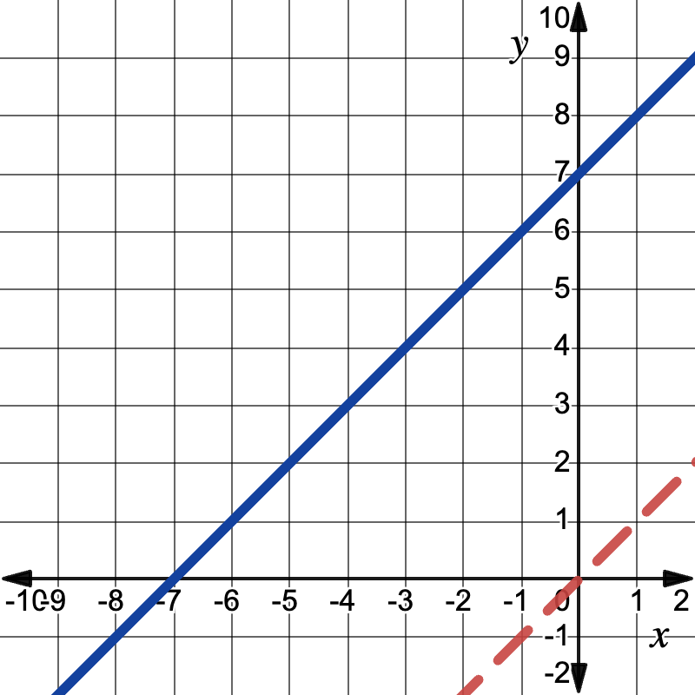
Self Check - Review
Horizontal Shift of a Function
A horizontal shift “transforms” the parent function into another function by moving the graph to the left or right c
units.
Horizontal Shift → f (x − c)
Horizontal Shifts and x-intercepts
The dashed red line shows the parent function f (x) = x. The solid blue line is its graph shifted 7 units left, moving the x-intercept to (–7, 0). Using the slope of 1 and this point, we can write the new equation.
Remember:
If the c value is positive, the graph shifts right. If it is negative, the left.
The sign of the c value is preceded by subtraction in point-slope form.
Next Review Page
Notes:
Additional Review on the next slide

Slide 22
Self Check - Review
Horizontal Shifts and x-intercepts
Substituting these values (-7,0) and m = 1 into point-slope form, we get:
(y − y₁) = m(x − x₁)
(y − 0) = 1(x − (−7))
y = 1(x + 7)
The equation of a line that has been shifted 7 units to the left from the parent function, f(x) = x, is y = x + 7.
But, doesn’t it look like the function f(x) = x + 7 was shifted up 7 units, too? This is because
f(x) = x + 7 is equivalent to f(x) = 1(x + 7). And this is what makes horizontal shifts difficult to see.
Notes:
Examples
Example 1
How has the function f(x) = 3(x − 4) been transformed from f(x) = 3x?
Solution: To answer this question, first consider how the x-values, including the x-intercept, are being changed. The function says to subtract 4 from each x-value. This means the function is being shifted 4 units.Next, we need to determine which direction the x-values are being shifted. Let’s look at the graphs.
Click here to link to the slide with the completed graph.
The solid blue line represents the graph of f(x) = 3(x − 4). The dashed orange line represents the graph of f(x) = x.
On the graph, we can look at specific points on the parent function like the x-intercept (0, 0) and (1, 3). The transformed line is to the right of our parent function. To determine how far to the right the line has been shifted, we count the number of horizontal units between the lines.
We see that (0, 0) corresponds to the point (4, 0) on the transformed line.
The point (1, 3) corresponds to the point (5, 3) on the transformed line.
Each point on the parent function has been shifted 4 units to the right.
Therefore, we conclude the line representing f(x) = 3(x − 4) appears to have been shifted 4 units to the right from the function f(x) = 3x.
Example 2
Describe how the function f(x) = ½(x + 4) is horizontally transformed to g(x) = ½(x − 2).
Solution: Let’s rewrite the equations in point-slope form,(y − y₁) = m(x − x₁):
f(x) = ½ (x + 4)
(y - 0) = ½ (x + 4)
(y - 0) = ½ (x - (-4))
So, the x-intercept is (−4,0).
g(x) = ½ (x -2)
(y - 0) = ½ (x - 2)
So, the x-intercept is (2,0).
The x-intercept of f(x) starts at (−4,0) and moves to (2,0), so this represents a shift of 6 units to the right.
We can also check this using graphs.
Click here to link to the slide with the completed graph.
Examining the x-intercept for f(x) = ½(x + 4), on the orange dashed line, we see that (−4,0) gets shifted 6 units to the right and lands at (2,0) on g(x) = ½(x−2), represented by the blue solid line.
So, we can identify horizontal shifts using either graphs or algebraic equations.

Slide 23
Lesson Journey
Warm Up
Learning Activity
Learning Activity
Learning Activity
Practice
Learning Activity
Lesson Synthesis
Learning Activity
Learning Activity
Learning Activity
Cool Down

Slide 24
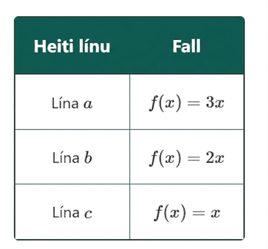
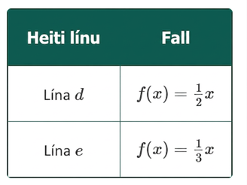
Learning Activity - Vertical Dilations 📉
On the same coordinate grid, graph the linear functions a, b, and c.
What do you notice about the slopes of lines c, b, and a as the number of the coefficient gets larger?
Now, graph lines d and e on the same graph as a, b, and c.
How does line d, representing f(x) = ½x, compare to line b, representing f(x) = 2x?
Examine lines d and e. What can you say about the lines when 0 < m < 1?
Notes:
Activity (20 minutes)
This activity prompts students to look at how the slope in slope-intercept form affects the graph of a linear function. Circulate to ensure students are graphing their lines properly. If necessary, partner students during the graphing process.
In pairs, students should discuss the vertical shifts to the parent function, f(x) = x, to graph the new functions.
Launch
Allow students to work in pairs to check each other’s graphs and discuss the relationships to answer the questions. During class discussion, solicit a pair for each question to describe the effects the different slopes have on the graphs.
For students who can benefit from a more accessible model, use geoboards and rubber bands. Use one color rubber band for the x- and y-axes. Use a different color for each line graphed. Work with students to count spots on the geoboard and discuss the graphs and their relationships.
Answers
Click here to link to the slide with the completed graph.
As the coefficient increases, the line gets steeper.
Click here to link to the slide with the completed graph.
As the coefficient gets smaller, the line is less steep.
As the coefficient gets smaller, the line is less steep.
More activity questions and answers on the next slide.

Slide 25
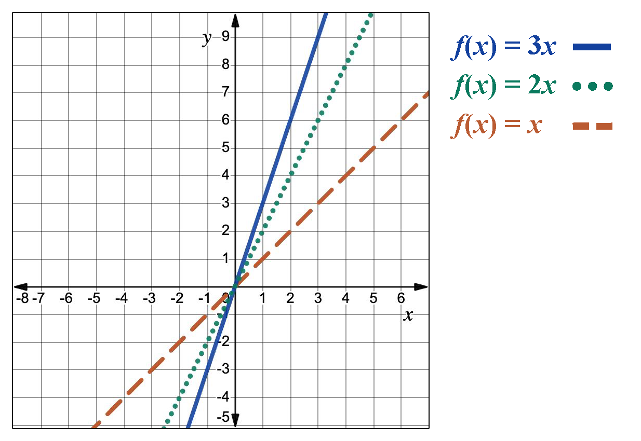
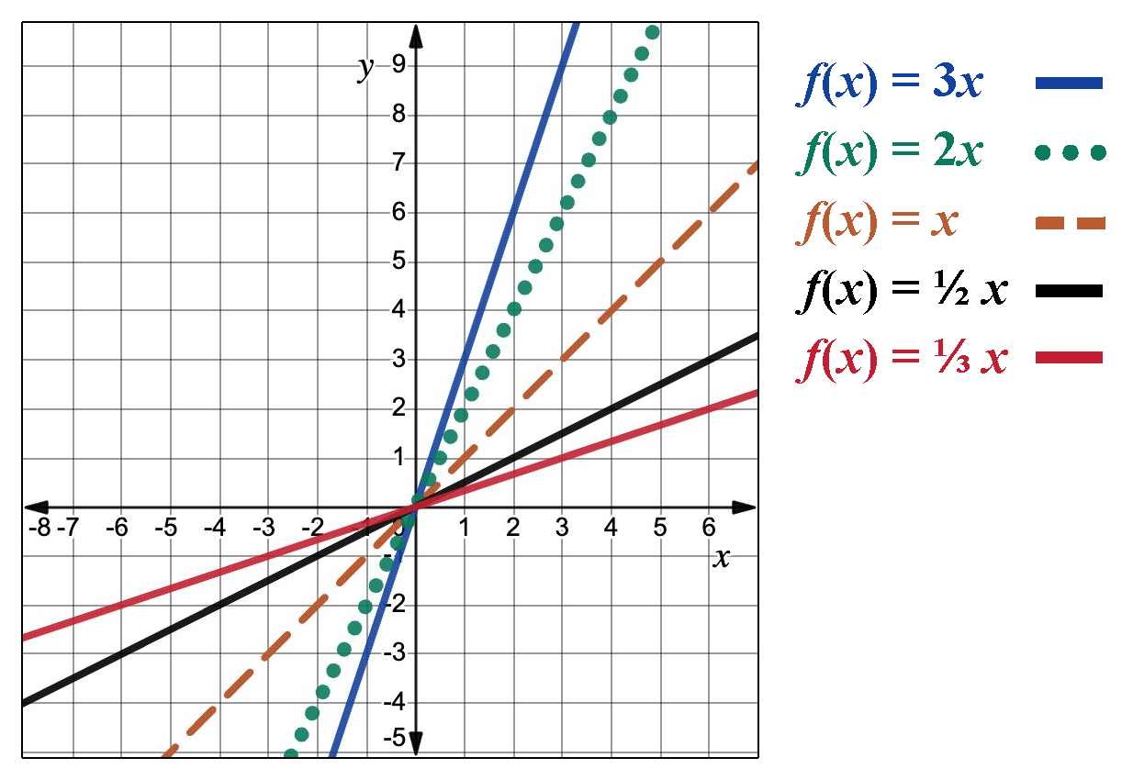
Learning Activity - Vertical Dilations 📉
Notes:
Activity Answer
Completed graph

Slide 26
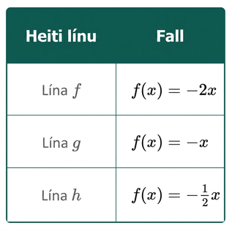
Learning Activity - Vertical Dilations 📉
Now graph lines f, g, and h on the same coordinate grid.
Compare the equations of lines f − h to the graphs of lines b − d. What changed with the equations of these functions?
Compare the graphs of lines f − h to the graphs of lines b − d. How did the change in their equations affect their graphs?
Notes:
Answers
Click here to link to the slide with the completed graph.
As the coefficient increases, the line gets steeper.
Click here to link to the slide with the completed graph.
Explanation of a vertical dilation and activity synthesis on the last slide.

Slide 27
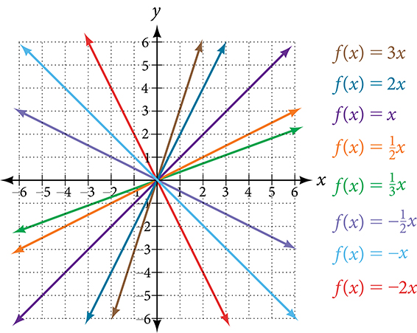
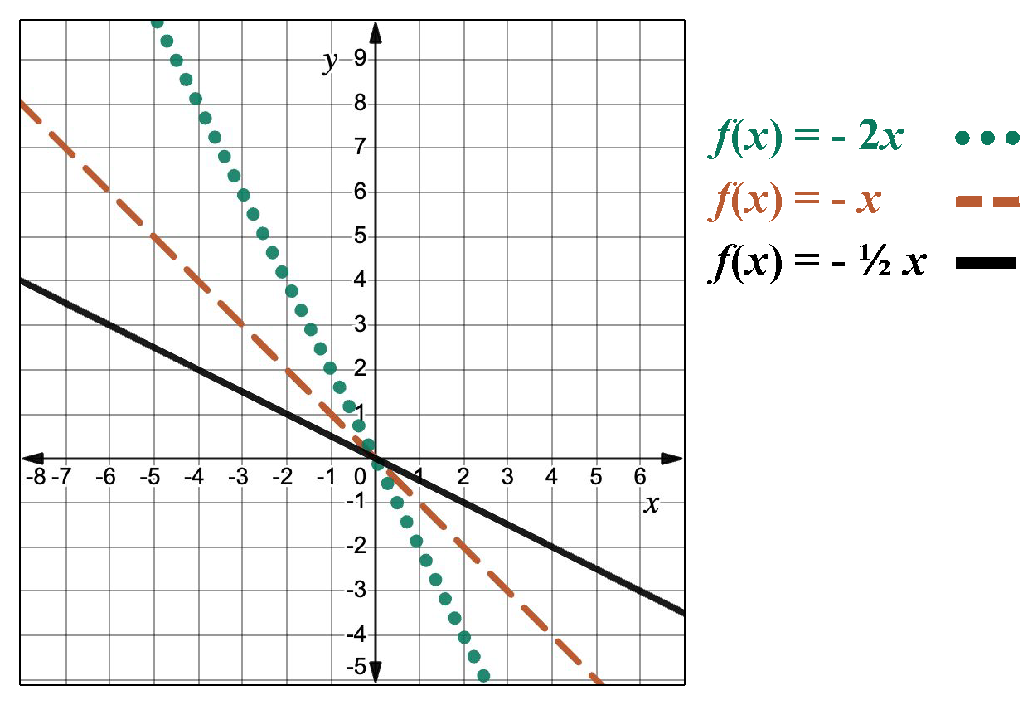
Learning Activity - Vertical Dilations 📉
Notes:
Activity Answer
Completed graph

Slide 28
Learning Activity - Vertical Dilations 📉
In f(x) = mx + b, the m acts as the vertical dilation (stretch or compression factor). This is a type of transformation to the graph of f(x) = x.
Vertical Dilation
A vertical stretch or compression “transforms” the parent function into another function by vertically dilating the graph by “a” units.
Vertical Dilation → af(x)
If the a value is negative, the graph is reflected over the x-axis. If the a value is greater than 1, the graph is stretched by a scale factor of a. If the a value is between 0 and 1, the graph is compressed by a scale factor of a.
Notes:
Activity Synthesis
Explain to students that graphing linear functions using transformations will assist them as you move to graphing different function families in the future.

Slide 29
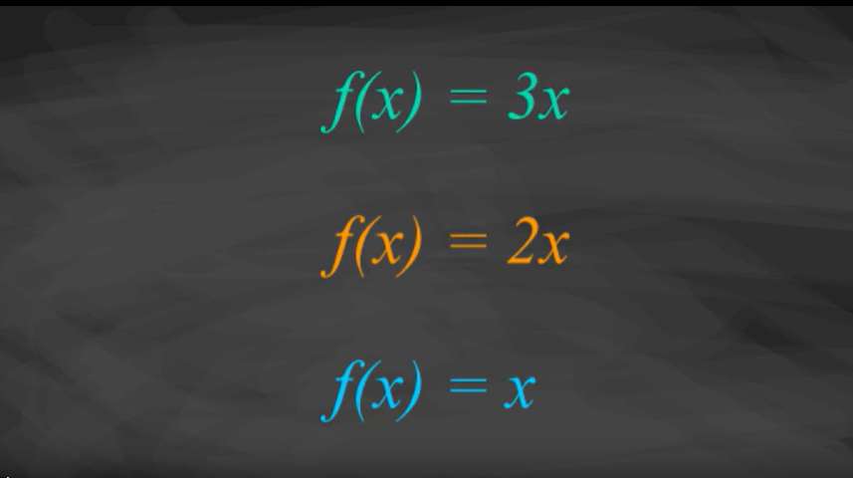
Video: Identifying Vertical Stretches and Compressions

Slide 30
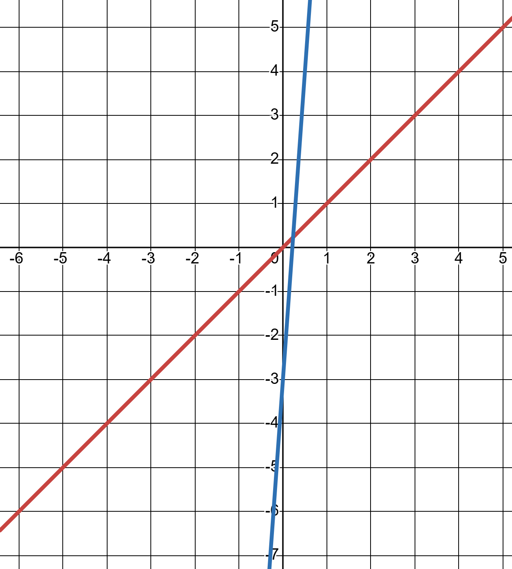
Self Check
How does the graph of f(x) = 14x − 3 change from the parent function, f(x) = x?
Vertical stretch of ¼, down 3
Vertical compression of ¼, down 3
Vertical compression of ¼, up 3
Vertical stretch of ¼, left 3
Let’s review!
Notes:
Answer Feedback - Individualized by Response
Vertical stretch of ¼, down 3
Incorrect. A slope less than 1 signifies a vertical compression. The answer is vertical compression of ¼, down 3.
Vertical compression of ¼, down 3
That’s Correct! The slope is ¼, which is less than 1, so there is a vertical compression. The y-intercept is –3, so there is a vertical shift down 3.
Vertical compression of ¼, up 3
Incorrect. The y-intercept is negative. The answer is vertical compression of ¼, down 3.
Vertical stretch of ¼, left 3
Incorrect. A slope less than 1 signifies a vertical compression, and the y-intercept gives the vertical shift. The answer is vertical compression of ¼, down 3.

Slide 31
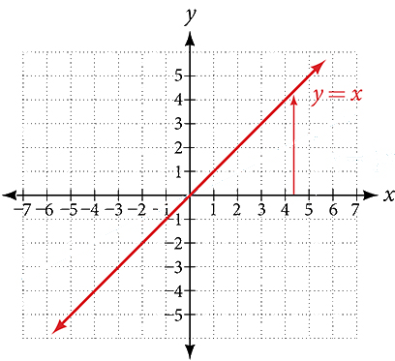
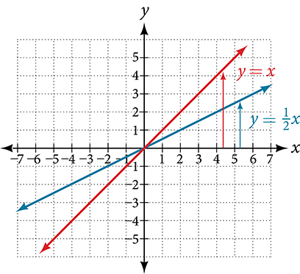
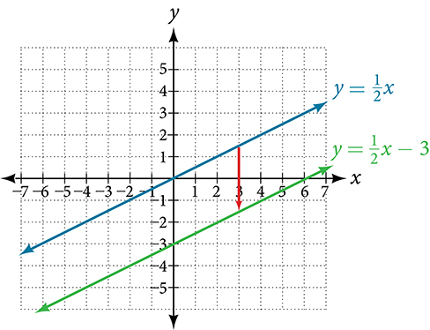
Self Check - Review
Vertical Transformations of Linear Functions
Given the equation of a linear function, use transformations to graph the linear function in the form f(x) = mx + b.
Graph f(x) = ½ x − 3 using transformations.
Step 2 - Vertically stretch or compress the graph by a factor m. The equation for the function shows that
m = ½, so the identity function is vertically compressed by ½.
Step 3 - Shift the graph up or down b units.
The equation for the function also shows that b = −3, so the parent function is vertically shifted down 3 units. Now, show the vertical shift:
Step 1 - Graph the parent function, f(x) = x.
The graph shows two functions: y= ˣ⁄₂, passing through (0, 0) and
(2, 1), and y= ˣ⁄₂ - 3, passing through (0, −3) and (2, −2).
An arrow pointing downward from the first function to the second function reveals the vertical shift.
This graph shows two functions on an (x,y) coordinate plane. One shows an increasing function of y = x divided by 2 that runs through the points (0,0) and (2,1).
The second shows an increasing function of y = x and runs through the points (0,0)
and (1,1).
Notes:
Remind Students: How to determine if a relationship is a function.
Identify the input values.
Identify the output values.
If each input value leads to only one output value, classify the relationship as a function. If any input value leads to two or more outputs, do not classify the relationship as a function.
Discuss the Answers with the Students:
Let’s begin by considering the input values as the items on the menu. The output values are then the prices. Each item on the menu has only one price, so the price is a function of the item.
Two items on the menu have the same price. If we consider the prices to be the input values and the items to be the output, then the same input value could have more than one output associated with it.
The mapping helps to show that two items on the menu have the same price, therefore, an item is a not a function of price.

Slide 32
Lesson Journey
Warm Up
Learning Activity
Learning Activity
Learning Activity
Learning Activity
Practice
Learning Activity
Lesson Synthesis
Learning Activity
Learning Activity
Learning Activity
Cool Down

Slide 33
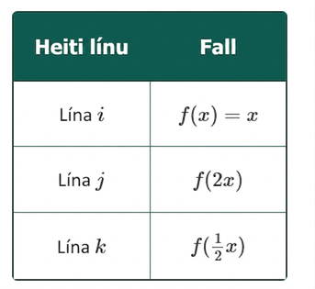
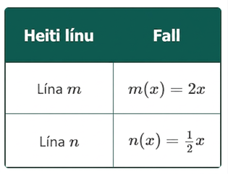
Learning Activity - Horizontal Dilations 📈
On the same coordinate grid, graph the linear functions i, j, and k.
What is the difference between what you entered for the functions of lines j and k in comparison to the function for line i?
Now, graph lines m and n on the same graph as i − k.
How does line j, representing f(2x), compare to line m, representing m(x) = 2x?
How does line k, representing f(½x), compare to line n, representing n(x) = ½x?
Notes:
Activity (20 minutes)
This activity prompts students to look at how horizontal dilations (stretches or compressions) affect the graph of a linear function. Circulate to ensure students are graphing their lines properly. If necessary, partner students during the graphing process.
In pairs, students should discuss the horizontal changes to the parent function, f(x) = x, to graph the new functions.
Launch
Ask students if they’ve ever squished or stretched a jumbo marshmallow—or something similar like play-doh or silly putty. You may provide a manipulative for them to try.
Discuss what happens when the marshmallow is squished from the sides (it expands vertically) and when it’s pulled from the sides (it stretches horizontally and flattens vertically).
Refer back to this experience during the activity to help students visualize how horizontal dilations affect function graphs.
Have students work in pairs to check graphs and discuss transformations. During discussion, invite pairs to explain how each transformation changes the graph.
For students needing support, use geoboards with rubber bands—one color for axes and others for the graphed lines. Count and discuss line positions together.
Answers
Click here to link to the slide with the completed graph.
Line i is the parent linear function. Lines j and k are the result of function f where the input is different from the original x-values.
Click here to link to the slide with the completed graph.
As the coefficient gets smaller, the line is less steep.
As the coefficient gets smaller, the line is less steep.
More activity questions and answers on the next slide.

Slide 34
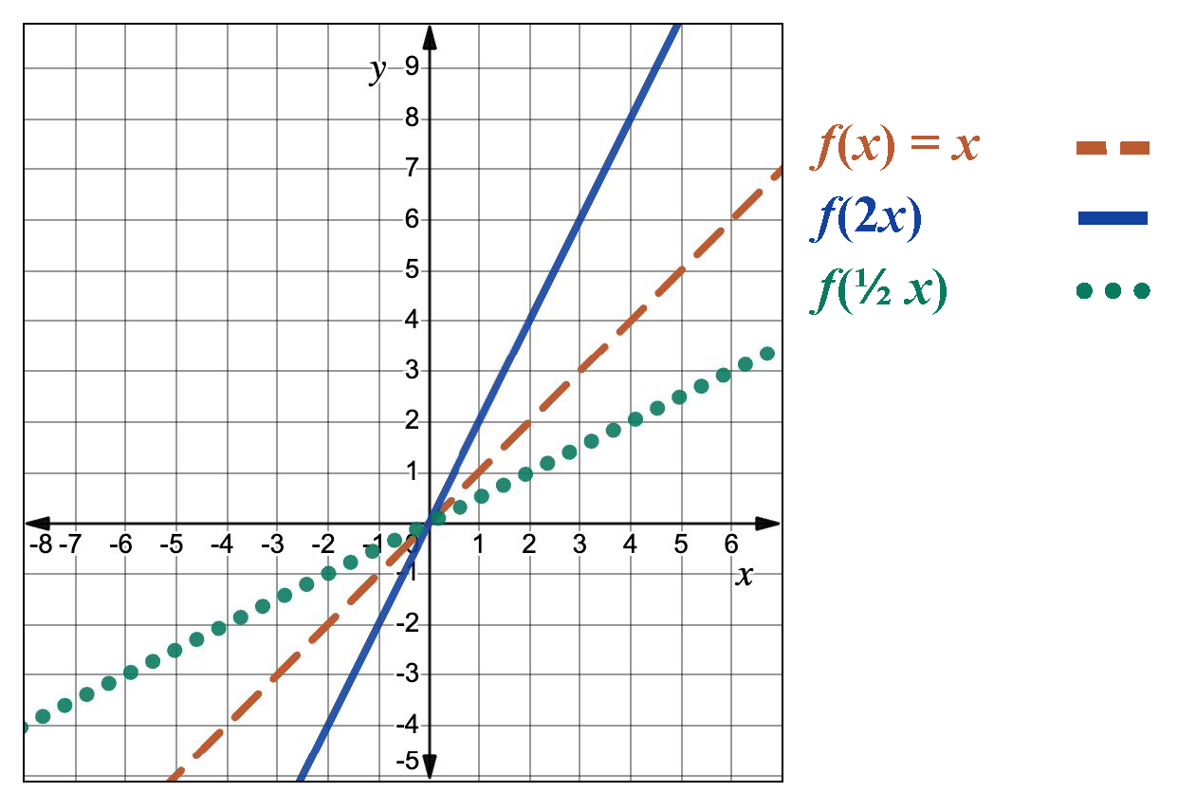
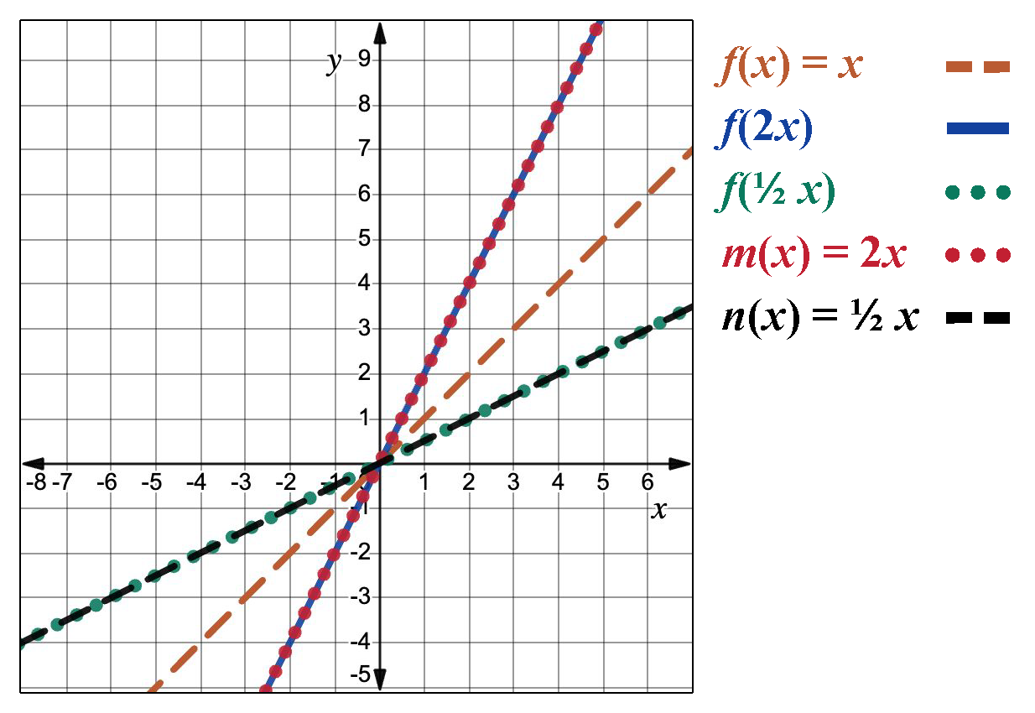
Learning Activity - Horizontal Dilations 📈
Notes:
Activity Answer
Completed graph

Slide 35
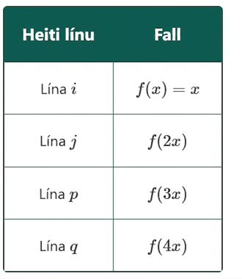
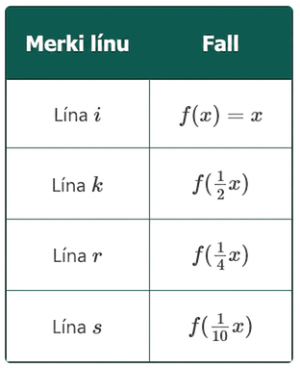
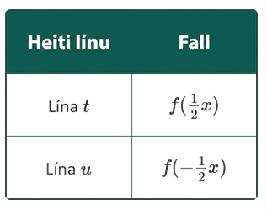
Learning Activity - Horizontal Dilations 📈
Now graph the lines p and q on the same coordinate grid.
As the coefficient on the input increases, what is happening to the graph?
Graph the lines r and s on the same coordinate grid.
As the coefficient on the input approaches 0, what is happening to the graph?
Graph the lines t and u on the same coordinate grid.
Notes:
Answers
Click here to link to the slide with the completed graph.
The line gets closer and closer to the y-axis because the function is being horizontally compressed.
Click here to link to the slide with the completed graph.
The line gets farther from the y-axis because the function is being horizontally stretched.
Click here to link to the slide with the completed graph.
Explanation of a horizontal dilation and activity synthesis on the last slide.

Slide 36
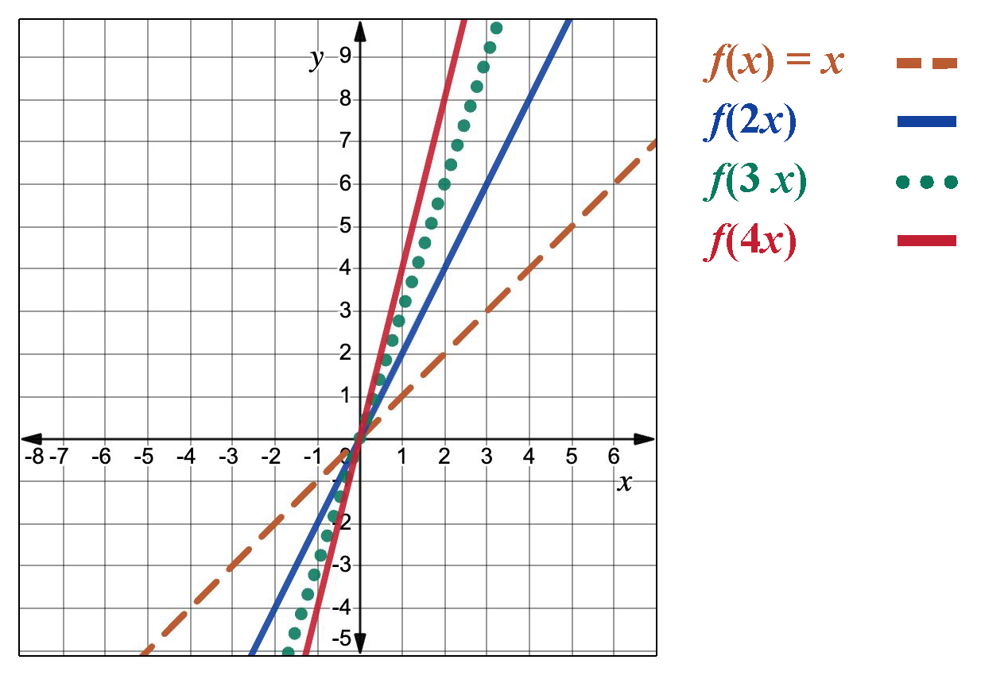
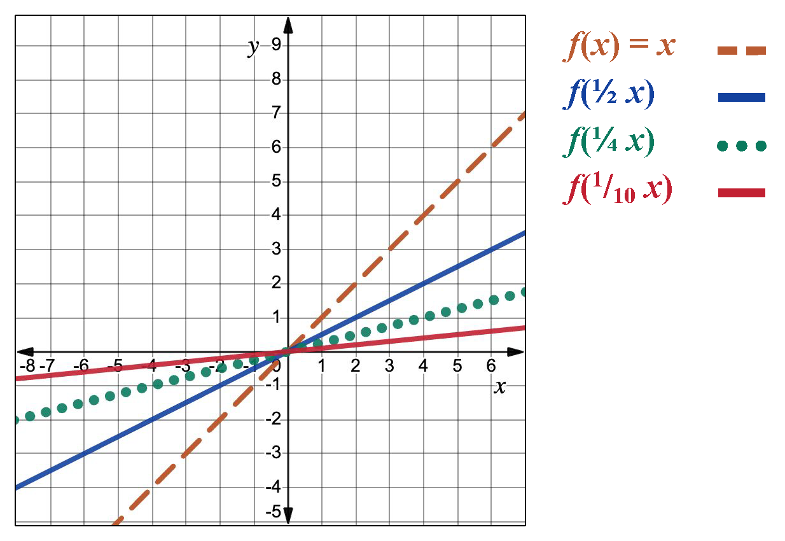
Learning Activity - Horizontal Dilations 📈
Notes:
Activity Answer
Completed graph

Slide 37
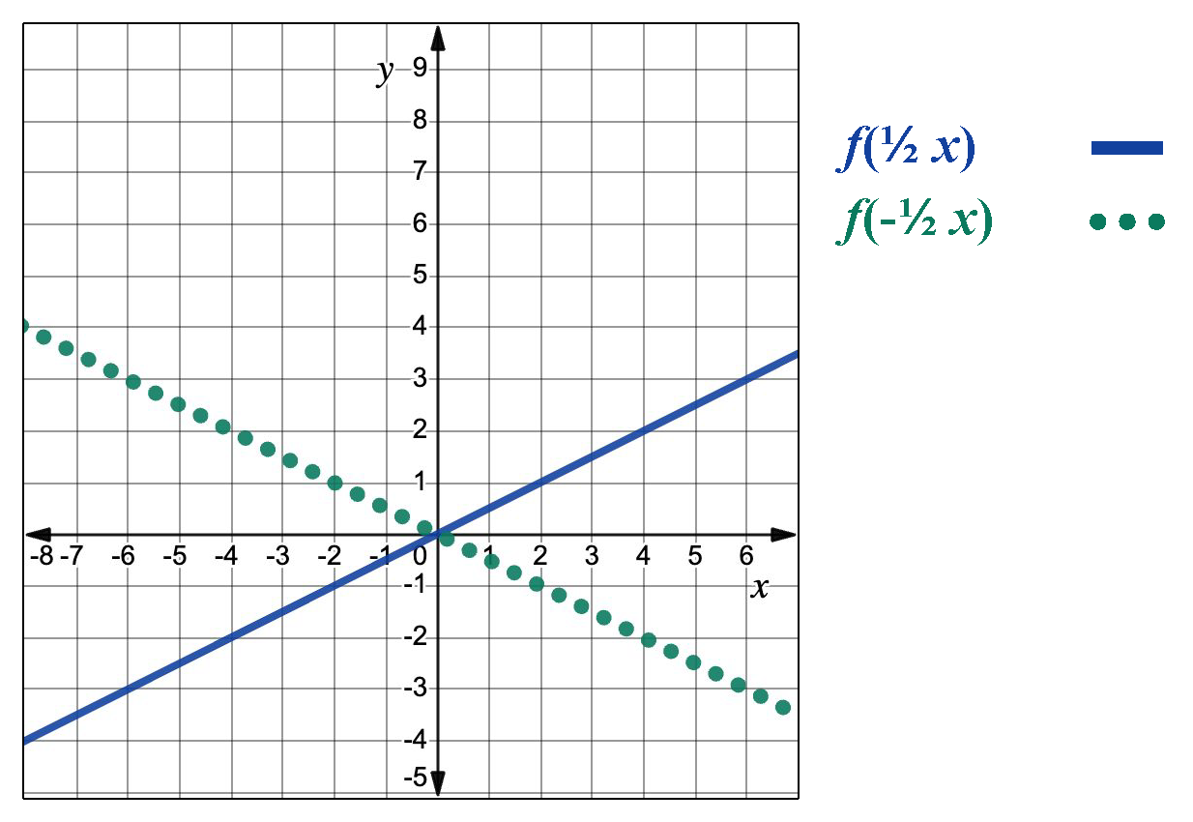
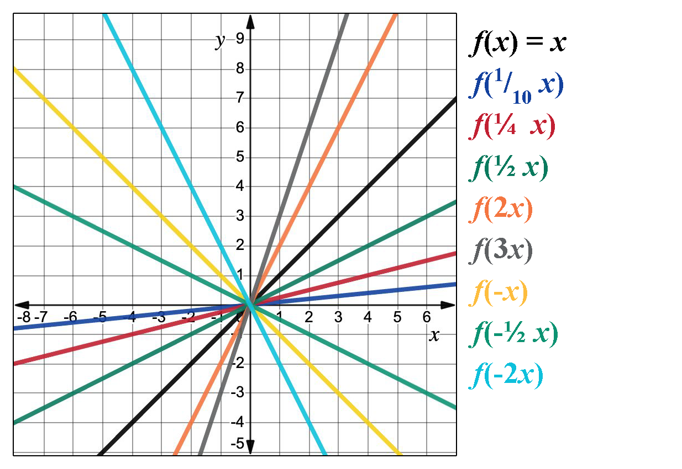
Learning Activity - Horizontal Dilations 📈
Notes:
Activity Answer
Completed graph

Slide 38
Learning Activity - Horizontal Dilations 📈
Horizontal Dilations of a Function
A horizontal stretch or compression “transforms” the parent function into another function by horizontally dilating the graph by “b” units.
Horizontal Dilation → f(bx)
If the b value is negative, the graph is reflected over the y-axis. If the b value is greater than 1, the graph is horizontally compressed. If the b value is between 0 and 1, the graph is horizontally stretched.
Notes:
Activity Synthesis
Now that students know the four types of function transformations, ask: Can we sketch a graph by reversing the order of transformations?
Students work in pairs to develop arguments and visual displays using tables, arrows, or annotations. Differentiate by assigning groups to use two, three, or all four transformations.
As you circulate, choose groups to present in an order that highlights a key idea: transformation order matters and follows the order of operations. For example, vertical dilations must occur before vertical shifts, and horizontal shifts before vertical ones—so the order cannot be reversed.
After presentations, have each student write their final answer.
Emphasize that mastering transformations will support future graphing of other function families.

Slide 39
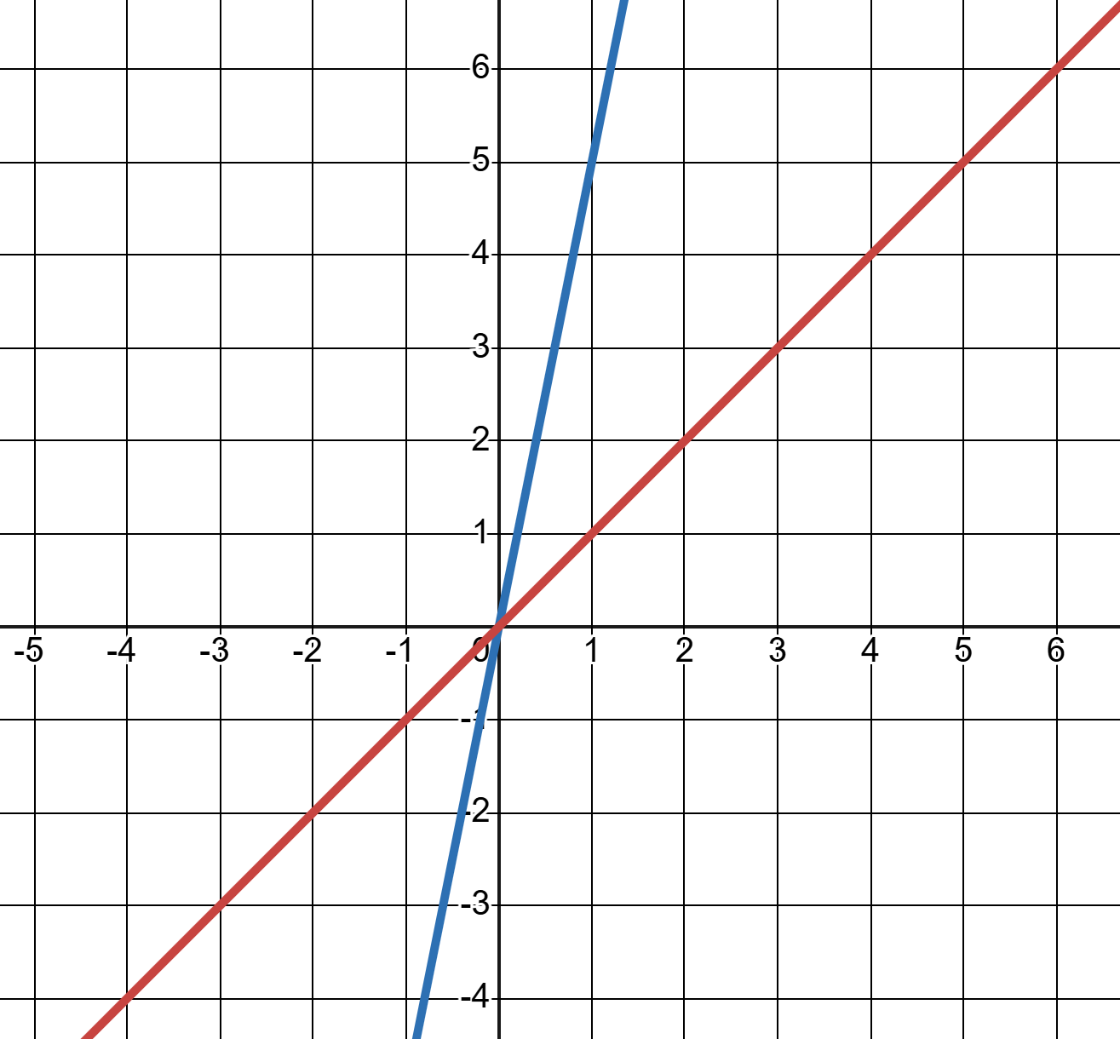
Self Check
Which function represents g(x), a function transformed from f(x) by a horizontal compression?
g(x) = 5f(x)
g(x) = f(5x)
g(x) = f(x) + 5
g(x) = f(x + 5)
Let’s review!
Notes:
Answer Feedback - Individualized by Response
g(x) = 5f(x)
Incorrect. The function 5f(x) represents a line that has been transformed by a vertical stretch. The function 5f(x) represents a function that has been transformed from the parent function, f(x), through a horizontal compression.
g(x) = f(5x)
That’s Correct! . The function 5f(x) represents a function that has been transformed from the parent function, f(x), through a horizontal compression.
g(x) = f(x) + 5
Incorrect. The function f(x) + 5 represents a line that has been transformed by a vertical shift up 5 units. The function 5f(x) represents a function that has been transformed from the parent function, f(x), through a horizontal compression.
g(x) = f(x + 5).
Incorrect. The function f(x + 5) represents a line that has been transformed by a horizontal shift to the left 5 units. The function 5f(x) represents a function that has been transformed from the parent function, f(x), through a horizontal compression.

Slide 40
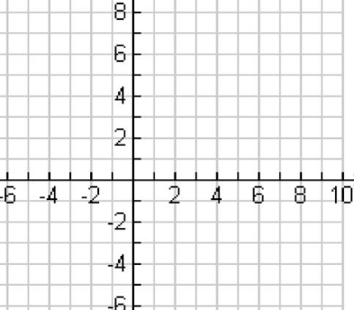
Self Check - Review
Horizontal transformations are the result of altering the input values before applying the function rule. To determine the equation of a transformed function:
Given𝑓(𝑥)=½𝑥−3, determine the equation of the transformed function, 𝑓(𝑥 + 2).
Step 1 - Graph the given function.
Step 2 - Graph the designated transformation.
Horizontal shift right: f(x - c) where c > 0
Horizontal shift left: f(x - c) where c < 0
Horizontal stretch: f(bx) where b < 1
Horizontal compression: f(bx) where b > 1
Step 3 - Determine the equation of the transformed function.
Notes:
Answer
Graph f(x + 2) when f(x) = ½ x − 3. Then, determine the equation of the transformed function.
Solution:
Step 1 - Graph the given function, f(x) = ½ x − 3.
The y-intercept is (0, -3) and the slope is ½.
For horizontal shifts, it is helpful to identify the x-intercept. On our graph, the x-intercept or zero is located at (6,0).
Click here to link to the slide with the completed graph.
Step 2 - Apply the designated transformation. Remember that the rule for a horizontal shift is
f(x − c). If we rewrite f(x + 2) in an equivalent form, we can make it is easier to see x − c.
f(x + 2) = f(x −(−2)). That means c = −2.
So, f(x + 2) represents a horizontal shift of two units to the left. On our graph, we move the x-intercept two units left from (6, 0) to (4, 0).
Click here to link to the slide with the completed graph.
ALT TEXT: A graph with a solid blue line and a dashed red line are parallel on a grid. The blue line passes through points (4, 0), and (6,0), which are marked with open circles. Axes range from -2 to 8 on x and -5 to 6 on y.
The orange dashed line is the graph of the original function and the blue solid line is the transformed function.
Step 3 - Determine the equation of the transformed function.
The y-intercept of the transformed line is (0, -2) and the slope of the line is ²⁄₄ or ½ .
That means the equation f(x + 2) = ½x−2.
Want to check your work? We can check our equation algebraically by substituting x+2 into f(x).
f(x) = ½x − 3
f(x + 2) = ½(x + 2) −3 = ½x +1−3 = ½x − 2 ✔
Extra example
Graph f(4x) when f(x) = ½x − 3. Then, determine the equation of the transformed function.
Solution:
Step 1 - Graph the given function, f(x) = ½ x −3.
The y-intercept is (0, -3) and the slope is ½.
For horizontal shifts, it is helpful to identify the x-intercept. On our graph, the x-intercept or zero is located at (6,0).
Click here to link to the slide with the completed graph.
Step 2 - Apply the designated transformation. Remember that the rule for a horizontal shift is f(bx). And, when the value of b is greater than 1, the function experiences a horizontal compression.
As a result of the horizontal compression, the linear function should look steeper because it is being compressed by a scale factor of 4.
On our graph, this means the x-intercept is compressed from (6, 0) to (1.5, 0).
Click here to link to the slide with the completed graph.
The orange dashed line is the graph of the original function and the blue solid line is the transformed function.
Step 3 - Determine the equation of the transformed function.
The y-intercept of the transformed line is (0, -3) and the slope of the line is 3/1.5 or 2.
That means the equation f(4x) = 2x − 3.
Want to check your work? We can check our equation algebraically by substituting 4x into f(x).
f(x) = ½x − 3
f(4x) = ½(4x) − 3 = 2x − 3 ✔

Slide 41

Lesson Journey
Warm Up
Learning Activity
Learning Activity
Learning Activity
Learning Activity
Practice
Learning Activity
Lesson Synthesis
Learning Activity
Learning Activity
Cool Down
Learning Activity
Cool Down

Slide 42
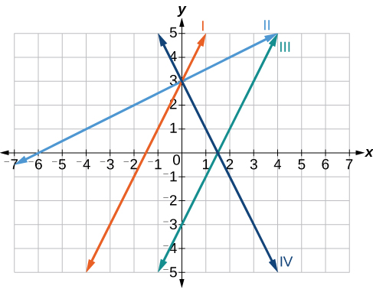
Cool Down
For questions 1 - 4, match each equation of the linear functions with one of the lines in the given graph.
f(x) = 2x + 3
g(x) = 2x − 3
h(x) = −2x + 3
j(x) = 12x + 3
Notes:
Cool Down (10 minutes)
Launch
The Cool Down activity can be completed using the questions below. As an alternative, a Desmos activity has also been provided using the same questions.
Desmos Activity: OpenStax Alg1 - 4.11.6 Graphing Transformations Cool Down
Desmos activities are different from the graphing calculator application because they lead students through one or more interactive tasks. As students progress through the activity, teachers may use the Teacher Dashboard to monitor student responses and use them for whole group discussion. Activities may also be set to identify student responses that are correct or incorrect.
Access the Desmos guide PDF to learn more about accessing and customizing activities.
Answers
I
III
IV
II
Response to Student Thinking - More Chances
Students will have more opportunities to understand the mathematical ideas in this cool down, so there is no need to slow down or add additional work to the next lessons. Instead, use the results of this cool down to provide guidance for what to look for and emphasize over the next several lessons to support students in advancing their current understanding.

Slide 43

Lesson Journey
Warm Up
Learning Activity
Learning Activity
Learning Activity
Learning Activity
Practice
Practice
Learning Activity
Lesson Synthesis
Learning Activity
Learning Activity
Cool Down
Learning Activity
Cool Down

Slide 44

Practice
Put your hard work to action, practice what you’ve learned!
Notes:
Digital Practice: Access the practice pages at https://openstax.org/details/books/algebra-1

Slide 45

Lesson Journey
Warm Up
Learning Activity
Learning Activity
Learning Activity
Learning Activity
Practice
Practice
Learning Activity
Lesson Synthesis
Learning Activity
Learning Activity
Cool Down
Learning Activity
Cool Down
Lesson Synthesis

Slide 46
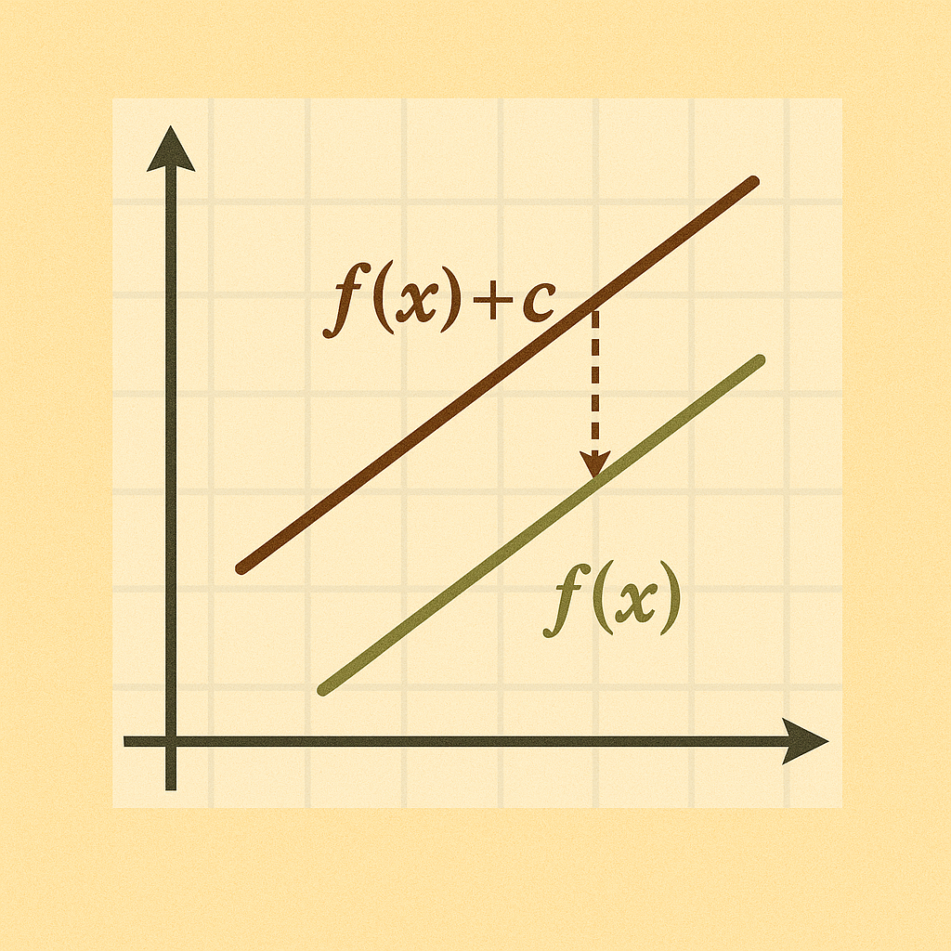
Lesson Synthesis
Describe how a linear function, such as f(x) = 4x − 1, can be graphed using the y-intercept and then the slope and also how it can be graphed using transformations.
Do the same for y = −14x + 3.
Describe how f(x + 2) impacts the graph of f(x) = 4x − 1.
Describe how f(-¼ x) impacts the graph of f(x) = 4x - 1.
Describe the transformations that are visible in point-slope form when compared to the parent linear function. (horizontal shift, vertical shift, vertical dilation)
Notes:
Key Takeaways
Parts of linear functions can be used to determine how graphs of linear functions can be transformed.
Remind students that identifying horizontal transformations (shifts or dilations) may be difficult for students to identify for linear functions. The effects of horizontal transformations often appear to yield similar effects as vertical transformations.
To help students see these points, discuss questions listed on the slide.
Tell students that expressions, equations, and inequalities are mathematical models. A model is a mathematical representation of a real-life situation. When people create models, they rely on the information they have, but they also make assumptions and decisions that affect the models. If the information or assumptions change, the model would also change.
Closing the Lesson
After completing the Lesson Synthesis, wrap up the class by directing students to the Lesson Summary in their student textbook. In this section, students review the day’s learning targets, read summaries about the key takeaways from each activity, and then respond to a reflection question regarding their confidence with the material.
For more on the benefits of using this type of metacognitive reflection, see the Research in Practice section of the course.

Slide 47
Self Assessment
How much do you agree with the following statements?
I can… | I can | Almost | Not yet
Use slope-intercept form and transformations to graph linear functions.
Recognize the shifts made to a parent linear function to form another linear function.

