Slide 1


Algebra 1
Unit 2 Linear Inequalities and Systems
Lesson 2.1 Writing and Graphing Systems of Equations

Slide 2
How to use these slides
On the activity slides check the speaker notes for teacher support and instructional information.
Each lesson includes 1 warm up, 2-3 learning activities, a cool down, practice and a lesson synthesis.
  Learning activities are followed by a self check question, and review section.
Some slides have been hidden from student view, more information can be found on the next slide (Reference Key).
You can edit and use these slides for personal and classroom use, but cannot sell them and must keep the attribution logos.
For more information, Check out the digital quick start guide!

Slide 3






Reference Key
Check the top right corner for an icon referencing these unique sections.
 | Support for Students with Disability | Hidden | Learning Strategies slide, provides additional support to students for understanding the activity. Learning Strategies slide, provides additional support to students for understanding the activity.
 | Support for English Language Learners | Hidden
 | Extending Your Thinking | Hidden | Extending Your Thinking slide, provides an extra challenge for students.
 | Self Check | Not Hidden | Self Check slide, checkpoint to assess student understanding after the learning activity.
 | Review | Hidden | Self Check- Review slide, designed to help review topics from the self check question.
On the next slides, check the speaker notes for teacher instructions and support.
Notes:
Check the Speaker Notes: On the next slides you can find discussion questions, lesson information, answers to the activities, and ways to adjust the activity for your students!

Slide 4

Learning Goals
By the end of this lesson you will be able to -
Explain “the solution to a system of linear equations” and how the solution is represented graphically.
Refer to two equations as a system of equations.
Use tables and graphs to solve systems of equations.
Notes:
Lesson Narrative
In this lesson, students revisit the idea that the solution, if there is one, can be represented graphically as the intersection of the graphs of the equations. Students write a system of equations to represent the quantities and constraints in each of several situations, find a solution that meets multiple constraints by graphing, and then interpret the solution in context.
Required Preparation
Acquire devices that can run Desmos (recommended) or other graphing technology. It is ideal if each student has their own device.
Required Materials
Graphing technology
Texas Essential Knowledge and Skills
A1(B) use a problem-solving model that incorporates analyzing given information, formulating a plan or strategy, determining a solution, justifying the solution, and evaluating the problem-solving process and the reasonableness of the solution
A2(I) write systems of two linear equations given a table of values, a graph, and a verbal description
A5(C) solve systems of two linear equations with two variables for mathematical and real-world problems

Slide 5
Vocabulary
Previous
Linear Equation
  An equation that describes a relationship between two quantities that have a constant rate of change, or slope.
Constraint
  A limitation on the possible values of variables in a model, often expressed by an equation or inequality.
New
Solutions to a System of Equations
  A coordinate pair that makes all equations in the system true.On the graph, it is the point where the equations intersect.
System of Equations
  Two or more equations that represent the constraints in the same situation.
Notes:
Lesson Vocabulary
To support student understanding of key vocabulary:
Introduce and review the vocabulary words students will see in this lesson.
Encourage students to notice how these words are used and to include them in their math discussions and explanations—both written and oral.
Use a word wall to reinforce vocabulary. Sample word wall cards are available here.
For newcomers or students with beginning English proficiency, use these Quizlet sets to support vocabulary learning:
Unit 2 Spanish Vocabulary – use first to build understanding
Unit 2 Vocabulary (English) – use after anchoring in Spanish
Support for English Language Learners
ELPS 1(F) use accessible language and learn new and essential language in the process
ELPS 2(F) listen to and derive meaning from a variety of media such as audiotape, video, DVD, and CD-ROM to build and reinforce concept and language attainment
ELPS 2(I) demonstrate listening comprehension of increasingly complex spoken English by following directions, retelling or summarizing spoken messages, responding to questions and requests, collaborating with peers, and taking notes commensurate with content and grade-level needs
ELPS 3(E) share information in cooperative learning interactions
ELPS 3(F) ask and give information ranging from using a very limited bank of high-frequency, high-need, concrete vocabulary, including key words and expressions needed for basic communication in academic and social contexts, to using abstract and content-based vocabulary during extended speaking assignments
ELPS 3(I) adapt spoken language appropriately for formal and informal purposes
ELPS 4(F) use visual and contextual support and support from peers and teachers to read grade-appropriate content area text, enhance and confirm understanding, and develop vocabulary, grasp of language structures, and background knowledge needed to comprehend increasingly challenging language

Slide 6





Lesson Journey
Warm Up
Learning Activity
Practice
Learning Activity
Cool Down
Lesson Synthesis

Slide 7

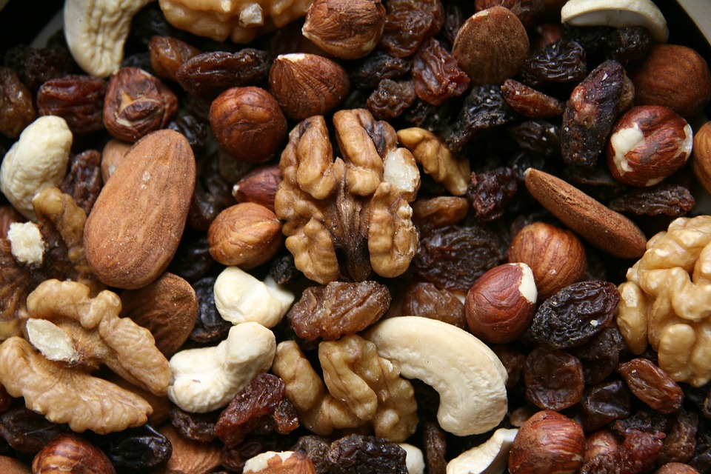
Warm Up - Trail Mix 👍
Diego bought some raisins and walnuts to make trail mix.
Raisins cost $4 a pound, and walnuts cost $8 a pound. Diego spent $15 on both ingredients.
4 pounds of raisins and 2 pounds of walnuts
1 pound of raisins and 1.5 pounds of walnuts
2.25 pounds of raisins and 0.75 pound of walnuts
3.5 pounds of raisins and 1 pound of walnuts
Notes:
Warm Up (5 minutes)
Use the Math Talk protocol in this warm up to refresh students’ knowledge about constraints and the values that meet them. Students are prompted to determine if four given combinations of raisins and walnuts meet a certain cost constraint. The reasoning elicited here prepares them to write and solve systems of linear equations in two variables later.
When explaining their reasoning, encourage students to be precise in their word choice and use of language.
Continue scrolling to see launch instructions, activity answers, and synthesis questions.
Launch
Display one problem at a time.
Give students quiet time to think individually for each problem and ask them to give a signal (such as a thumbs up) when they have an answer and a strategy.
Keep all problems displayed throughout the talk.
Follow with a whole-class discussion.
Support for English Language Learners: MLR 8 Discussion Supports: Speaking [be sure to review the Learning Strategies slide]
Display sentence frames to support students when they explain their strategy. For example, “First, I _____ because . . .” or “I noticed _____ so I . . .” Some students may benefit from the opportunity to rehearse what they will say with a partner before they share with the whole class.
Design principle(s): Optimize output (for explanation)
Activity Answers
No
No
Yes
No
Activity Synthesis
Ask students to share their strategies for each problem. Record and display their responses for all to see. To involve more students in the conversation, ask:
“Who can restate ⎯⎯’s reasoning in a different way?”
“Did anyone have the same strategy but would explain it differently?”
“Did anyone solve the problem in a different way?”
“Does anyone want to add on to ⎯⎯’s strategy?”
“Do you agree or disagree? Why?”
Conclude by reminding students that the given situation involves a cost constraint. Emphasize that only the third option, 2.25 pounds of raisins and 0.75 pound of walnuts, satisfies the constraint.
One way to check if certain values meet the constraint is by writing an equation and checking if it is true. For example, the equation 4(2.25) + 8(0.75) = 15 is true. If we replace the weights of raisins and walnuts with other pairs of values, the equation would be false.

Slide 8

Lesson Journey
Warm Up
Learning Activity
Practice
Learning Activity
Cool Down
Lesson Synthesis

Slide 9

Learning Strategies - Trail Mix 🥜
“First, I _____ because . . .”
“I noticed _____ so I . . .”
Discussion Supports
Teacher Instruction: Use these strategies to adjust the activity to support English language learners and students with disabilities.
You can copy and paste the callout directly on top of the activity or give the instructions aloud.
Read directions or problems aloud to your partner.
Highlight key words. For example,
  Use blue for information about cost
  Use green for information about weight
Representation
Notes:
Support for English Language Learners: MLR 8 Discussion Supports: Speaking (for use in Warm Up)
Display sentence frames to support students when they explain their strategy. For example, “First, I _____ because . . .” or “I noticed _____ so I . . .” Some students may benefit from the opportunity to rehearse what they will say with a partner before they share with the whole class.
Design principle(s): Optimize output (for explanation)
Support for Students with Disabilities: Representation: Access for Perception
Provide appropriate reading accommodations and supports to ensure student access to written directions, word problems, and other text-based content.
Supports accessibility for: Language; Conceptual processing

Slide 10
Learning Activity - Trail Mix 🥜
Diego bought some raisins and walnuts to make trail mix. Raisins cost $4 a pound, and walnuts cost $8 a pound. Diego spent $15 on both ingredients.
Write an equation to represent this constraint. Let x be the pounds of raisins and y be the pounds of walnuts.
Use graphing technology to graph the equation.
Complete the table with the amount of one ingredient Diego could have bought given the other. Be prepared to show your reasoning.
Raisins (lbs) | Walnuts (lbs)
0
0.25
 | 1.375
 | 1.25
1.75
3
Notes:
Support for All Learners
This activity offers additional support for students:
For English language learners and students with disabilities, be sure to review the Learning Strategies slide!
Activity (20 minutes)
Students write and graph equations to represent two constraints in the same situation and use tables and graphs to see possible values that satisfy the constraints. The work prompts them to think about a pair of values that simultaneously meets multiple constraints in the situation, which in turn helps them make sense of the phrase “a solution to both equations.”
Monitor for these likely strategies for completing the tables, from less precise to more precise:
Guessing and checking
Using the graph (by identifying the point with a given x- or y-value and estimating the unknown value, or using technology to get an estimate)
Substituting the given value of one variable into the equation and solving for the other variable
Identify students who use each strategy and ask them to share later.
Launch
Arrange students in groups of 2 and provide access to graphing technology.
Explain to students that they will now examine the same situation involving two quantities (raisins and walnuts), but there are now two constraints (cost and weight).
Give students 3 – 4 minutes of quiet time to complete the first set of questions about the cost constraint, and then pause for a whole-class discussion [Questions 1 – 3].
Select previously identified students to share their strategies, in the order listed in the Activity Narrative. If one of the strategies is not mentioned, bring it up.
Ask a student who used the graph to complete the table to explain how exactly they used the graph. For example: “How did you use the graph of 4x + 8y = 15 to find y when x
is 2?” Make sure students recognize that this typically involves hovering over different points on the graph or tracing the graph to get the coordinates.
Activity Answer
4x + 8y = 15
Access the online Teacher Guide to see the graph for this question or use this Desmos graph.
Access the online Teacher Guide to see the table for this question, access the first tab of this Google sheet, or use this set list: {(0, 1.875), (0.25, 1.75), (1, 1.375), (1.25, 1.25), (1.75, 1), (3, 0.375)}
Continued activity directions, questions, answers, anticipated misconceptions and synthesis on the next slide.

Slide 11
Learning Activity - Trail Mix 🥜
Diego bought a total of 2 pounds of raisins and walnuts combined.
Write an equation to represent this constraint. Let x be the pounds of raisins and y be the pounds of walnuts.
Use graphing technology to graph the equation.
Complete the table with the amount of one ingredient Diego could have bought given the other. Be prepared to show your reasoning.
Diego spent $15 and bought exactly 2 pounds of raisins and walnuts.
How many pounds of raisins did he buy?
How many pounds of walnuts did he buy?
Explain or show how you know how many pounds he purchased of each type.
Raisins (lbs) | Walnuts (lbs)
0
0.25
 | 1.375
 | 1.25
1.75
3
Notes:
Launch continued
Ask students to proceed with the remainder of the activity. If time permits, pause again after the second set of questions [Questions 4 – 6 about the weight constraint] to discuss how the strategies for completing the second table are like or unlike those for completing the first table.
Alternatively, give students a minute to confer with their partner before moving on to the last set of questions.
Continue scrolling down for answers, anticipated misconceptions, and synthesis questions.
Activity Answer
x + y = 2
Access the online Teacher Guide to see the graph for this question or use this Desmos graph.
Access the online Teacher Guide to see the table for this question, access the second tab of this Google sheet, or use this set list: {(0, 2), (0.25, 1.75), (0.625, 1.375), (0.75, 1.25), (1.75, 0.25), (3, -1)} note that the last point is not possible
0.25
1.75
Your answer may vary, but here are some samples.
It’s the only pair of values that appears in both tables.
If the two equations are graphed on the same coordinate plane, it’s where the two graphs intersect, so the pair of values meets both requirements. (Desmos graph)
Anticipated Misconceptions
Some students might think that the values in the second table need to reflect a total cost of $15. Clarify that the table represents only the constraint that Diego bought a total of 2 pounds of raisins and walnuts.
The idea of finding an (𝑥, 𝑦) pair that satisfies multiple constraints should be familiar from middle school. If students struggle to answer the last question, ask them to study the values in the table. Ask questions such as:
If Diego bought 0.25 pound of raisins, would he meet both the cost and weight requirements?
Which combinations of raisins and walnuts would allow him to meet both requirements? How many combinations are there?
Activity Synthesis
Invite students to share their response and reasoning for the last question. Display the graphs representing the system (either created by a student or as shown in the Desmos). Discuss with students:
Can you find other combinations of raisins and walnuts, besides 0.25 pound and 1.75 pounds, that meet both cost and weight constraints?
No
How many possible combinations of raisins and walnuts meet both constraints? How do we know?
One combination, because the graphs intersect only at one point.
Highlight that the solution to the system is a pair of values (in this case, pounds of raisins and walnuts) that meet both constraints. This means the pair of values is a solution to both equations. Graphing is an effective way to see the solution to both equations, if one exists.

Slide 12
Self Check
A school group bought 12 tickets to visit a history museum.
Adult tickets are $5 each.
Student tickets are $8 each.
If the school paid a total of $90, how many adult tickets, x, and student tickets, y, did the school buy?
5 student tickets and 10 adult tickets
9 student tickets and 3 adult tickets
10 student tickets and 2 adult tickets
11 student tickets and 1 adult tickets
Let’s review!
Notes:
Answer Feedback - Individualized by Response
Incorrect. Does the number of tickets bought equal 12? 5 + 10 = 15, not 12.
Incorrect. Does the total spent equal $90? 9(8) + 3(5) = 87, not 90.
That’s correct! 10 student tickets and 2 adult tickets totals 12 tickets and costs $90.
Incorrect. Does the total spent equal $90? 11(8) + 1(5) = 93, not 90.

Slide 13
Self Check - Review
DETERMINING IF ORDERED PAIRS
SOLVE A SYSTEM
Step 1 - Substitute both variables into the first equation and simplify. Verify the equation is true.
Step 2 - Substitute both variables into the second equation and simplify. Verify the equation is true.
Step 3 - If the ordered pair makes BOTH equations true, then it is a solution to the system.
Determine if (– 2, –1) is a solution
to the system.
x – y = – 1 2x – y = – 5
Notes:
Remind Students
A linear equation in two variables, such as 2𝑥 + 𝑦 = 7, has an infinite number of solutions.
Its graph is a line. Every point on the line is a solution to the equation, and every solution to the equation is a point on the line.
To solve a system of two linear equations, we want to find the values of the variables that are solutions to both equations.
In other words, we are looking for the ordered pairs (𝑥, 𝑦) that make both equations true. These are called the solutions to a system of equations.
Answer
(– 2, – 1,) makes the first equation true, but it does not make the second equation true. Therefore, it is not a solution to the system of equations.
Additional Examples and Methods
Example 2: Determine whether the ordered pair (−4, −3) is a solution to the system
x – y = – 1
2x – y = – 5
Answer for Example 2: (−4, −3) is true for both equations. It is a solution.
Alternative Methods
Solving Systems of Linear Equations by Graphing
The graph of a linear equation is a line. Each point on the line is a solution to the equation. For a system of two equations, we will graph two lines. Then we can see all the points that are solutions to each equation. And by finding what the lines have in common, we’ll find the solution to the system.
Using a Graph to Solve a System
Step 1 - Graph the first equation.
Step 2 - Graph the second equation on the same rectangular coordinate system.
Step 3 - Determine whether the lines intersect.
Step 4 - Estimate the solution to the system. If the lines intersect, identify the point of intersection. This is the solution to the system.
Step 5 - Check the solution in both equations.
Example 3
Solve the system by graphing
2x + y = 7
x – 2y = 6
Answer for Example 3: The lines intersect at (4, – 1).

Slide 14
Lesson Journey
Warm Up
Learning Activity
Practice
Learning Activity
Cool Down
Lesson Synthesis

Slide 15
Learning Strategies - Dining Halls, Magic, & Bands
Walk around and find two other displays in the room.
Think about what’s the same and different about the displays.
Talk with your partner about what you noticed.
Compare and Contrast
Teacher Instruction: Use these strategies to adjust the activity to support English language learners and students with disabilities.
  You can copy and paste the callouts directly on top of the activity or give the instructions aloud.
How would you explain your thinking?
Examine the annotations of how other students approached the situations.
What are the different ways the variables are presented in each strategy?
Representation
Notes:
Support for English Language Learners: MLR 7 Compare and Connect: Representing, Conversing
Prior to the whole-class discussion, invite students to select one of the situations and to create a visual display of their work. Students should consider what to include on the display so that other students will be able to interpret how they found a pair of values that met both constraints. Students may wish to add notes or details to their displays to help communicate their reasoning. Begin the whole-class discussion by selecting and arranging 2 – 4 displays for all to see. Give students 1 – 2 minutes of quiet time to think individually to interpret the displays before inviting the authors to share their strategies as described in the lesson synthesis.
Design Principle(s): Cultivate conversation; Maximize meta-awareness
Learn more about this routine
View the instructional video and follow along with the materials to assist you with learning this routine.
Provide support for students
Distribute graphic organizers to the students to assist them with participating in this routine.
Support for Students with Disabilities: Representation: Internalize Comprehension
Use color and annotations to illustrate student thinking. As students describe their strategies, use color and annotations to scribe their thinking on a display of each problem so that it is visible for all students. Call students’ attention to the different ways each variable is presented or visible within each strategy.
Supports accessibility for: Conceptual processing; Visual-spatial processing

Slide 16

Learning Activity - Dining Halls, Magic, & Bands
A dining hall had a total of 25 tables: some long rectangular tables and some round ones. Long tables can seat 8 people. Round tables can seat 6 people. On a busy evening, all 190 seats at the tables are occupied.
How many long tables x are there?
How many round tables, y, are there?
Explain or show how you know how many different size tables there are.
Notes:
Support for All Learners
This activity offers additional support and an extension for students:
For English language learners and students with disabilities, be sure to review the Learning Strategies slide!
For students looking for an extra challenge, be sure to review the Extending Your Thinking slide!
Activity (10 minutes)
As students work, notice the strategies they use. Many students may choose to graph the systems because that strategy was used in the first activity, but some students may choose to solve the systems by guessing and checking, by creating tables, or by reasoning algebraically. (Expect students to have varying degrees of facility with it at this point.) Making graphing technology available gives students an opportunity to choose appropriate tools strategically.
Continue scrolling down for launch directions and activity answers.
Launch
Keep students in groups of 2 and provide them with continued access to graphing technology.
Tell students that they will now look at several situations that also involve two quantities and two constraints. Their job is to represent each pair of constraints by writing a system of equations and then to find a solution to the system.
Give students 3 – 4 minutes of quiet time to think about the first question and then a minute to share their thinking with their partner before proceeding with the rest of the activity.
Leave a couple of minutes for whole-class discussion. If time is limited, ask each student to solve two of the questions.
Answers
20 long tables
5 round tables
Your answer may vary, but here is a sample.
𝑥 + 𝑦 = 25
8𝑥 + 6𝑦 = 190
𝑥 + 𝑦 = 25 can be rewritten as 𝑦 = 25 − 𝑥.
Substituting 25 − 𝑥 for 𝑦 in 8𝑥 + 6𝑦 = 190 gives 𝑥 = 20.
If 𝑥 is 20, then 𝑦 is 5.
Additional activity questions, answers, anticipated misconceptions, and synthesis on the next slide.

Slide 17


Learning Activity - Dining Halls, Magic, & Bands
A family bought a total of 16 adult and child tickets to a magic show. Adult tickets are $10.50 each, and child tickets are $7.50 each. The family paid a total of $141.
How many adult tickets, a,
did they buy?
How many child tickets, c,
did they buy?
Explain or show how you know the prices of the tickets.
At a poster shop, Han paid $16.80 for 2 large posters and 3 small posters of his favorite band. Kiran paid $14.15 for 1 large poster and 4 small posters of his favorite TV shows. Posters of the same size have the same price.
Find the price of a large poster, ℓ.
Find the price of a small poster, s.
Explain or show how
you know the prices
of the posters.
Are you ready for more?
Notes:
Answers
7 adult tickets
9 child tickets
Your answer may vary but here is a sample.
𝑎 + 𝑐 = 16
10.50𝑎 + 7.50𝑐 = 141
When the equations are graphed, the intersection of the two lines is at (7, 9).
4.95
2.30
Your answer may vary but here is a sample.
When the equations 2ℓ + 3𝑠 = 16.80 and ℓ + 4𝑠 = 14.15 are graphed, the intersection of the two lines is at (4.95, 2.30).
Anticipated Misconceptions
If students struggle to sort out the information in a problem, suggest that they start by drawing a picture or diagram to help understand the situation.
Another idea is to start by creating one or more tables to list possible combinations of values and observe the relationship between the values.
For students who need more scaffolding, ask questions such as:
What equation can you write to say that the number of tables, long tables and round ones, is 25?
What do your variables represent?
Then, ask students to use the same variables to write an equation that says that there are 190 seats.
Activity Synthesis
Select students who use different strategies to share their responses and reasoning. Start with strategies that are less systematic (such as guessing and checking) and move toward those that are more systematic (graphing or using algebra). If possible, display their work for all to see. After each student presents, ask if others solved it the same way.
If no students share an algebraic strategy, ask if anyone solved the problems without graphing. If so, invite them to share their rationale. Otherwise, it is not crucial to probe further at this moment.

Slide 18
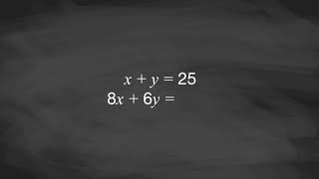
Video: Meeting Constraints

Slide 19
Extending Your Thinking
Make up equations for two lines that intersect at (4,1).
Make up equations for three lines whose intersection points form a triangle with vertices at (−4, 0) , (2, 9), and (6, 5).
Notes:
Answers
Answers may vary, but here are some samples.
x = 4 and y = 1
y = x – 3 and y = – x + 5
y = ³/₂ x + 6, y = – x + 11, y = ½ x + 2
Go back to activity information.

Slide 20
Self Check
An automotive store is shipping car parts to a mechanic.
Each shock weighs 7 pounds.
Each brake pad weighs 4 pounds.
The store shipped 20 parts weighing a total of 104 pounds. How many shocks, x, and brake pads, y, did the mechanic buy?
8 shocks and 12 brake pads
4 shocks and 19 brake pads
14 shocks and 6 brake pads
6 shocks and 14 brake pads
Let’s review!
Notes:
Answer Feedback - Individualized by Response
That's correct! 8 shocks and 12 brake pads equals 20 parts and weighs 104 pounds.
Incorrect. Do the number of parts bought equal 20? 4 shocks and 19 brake pads total 23 parts.
Incorrect. Do the parts weigh 104 pounds in total? 14 shocks weigh a total of 98 pounds and 6 brake pads weigh a total of 24 pounds. This sums to 122 pounds, not 104.
Incorrect. Do the parts weigh 104 pounds in total? 6 shocks weigh a total of 42 pounds and 14 brake pads weigh a total of 56 pounds. This sums to 98 pounds, not 104.

Slide 21
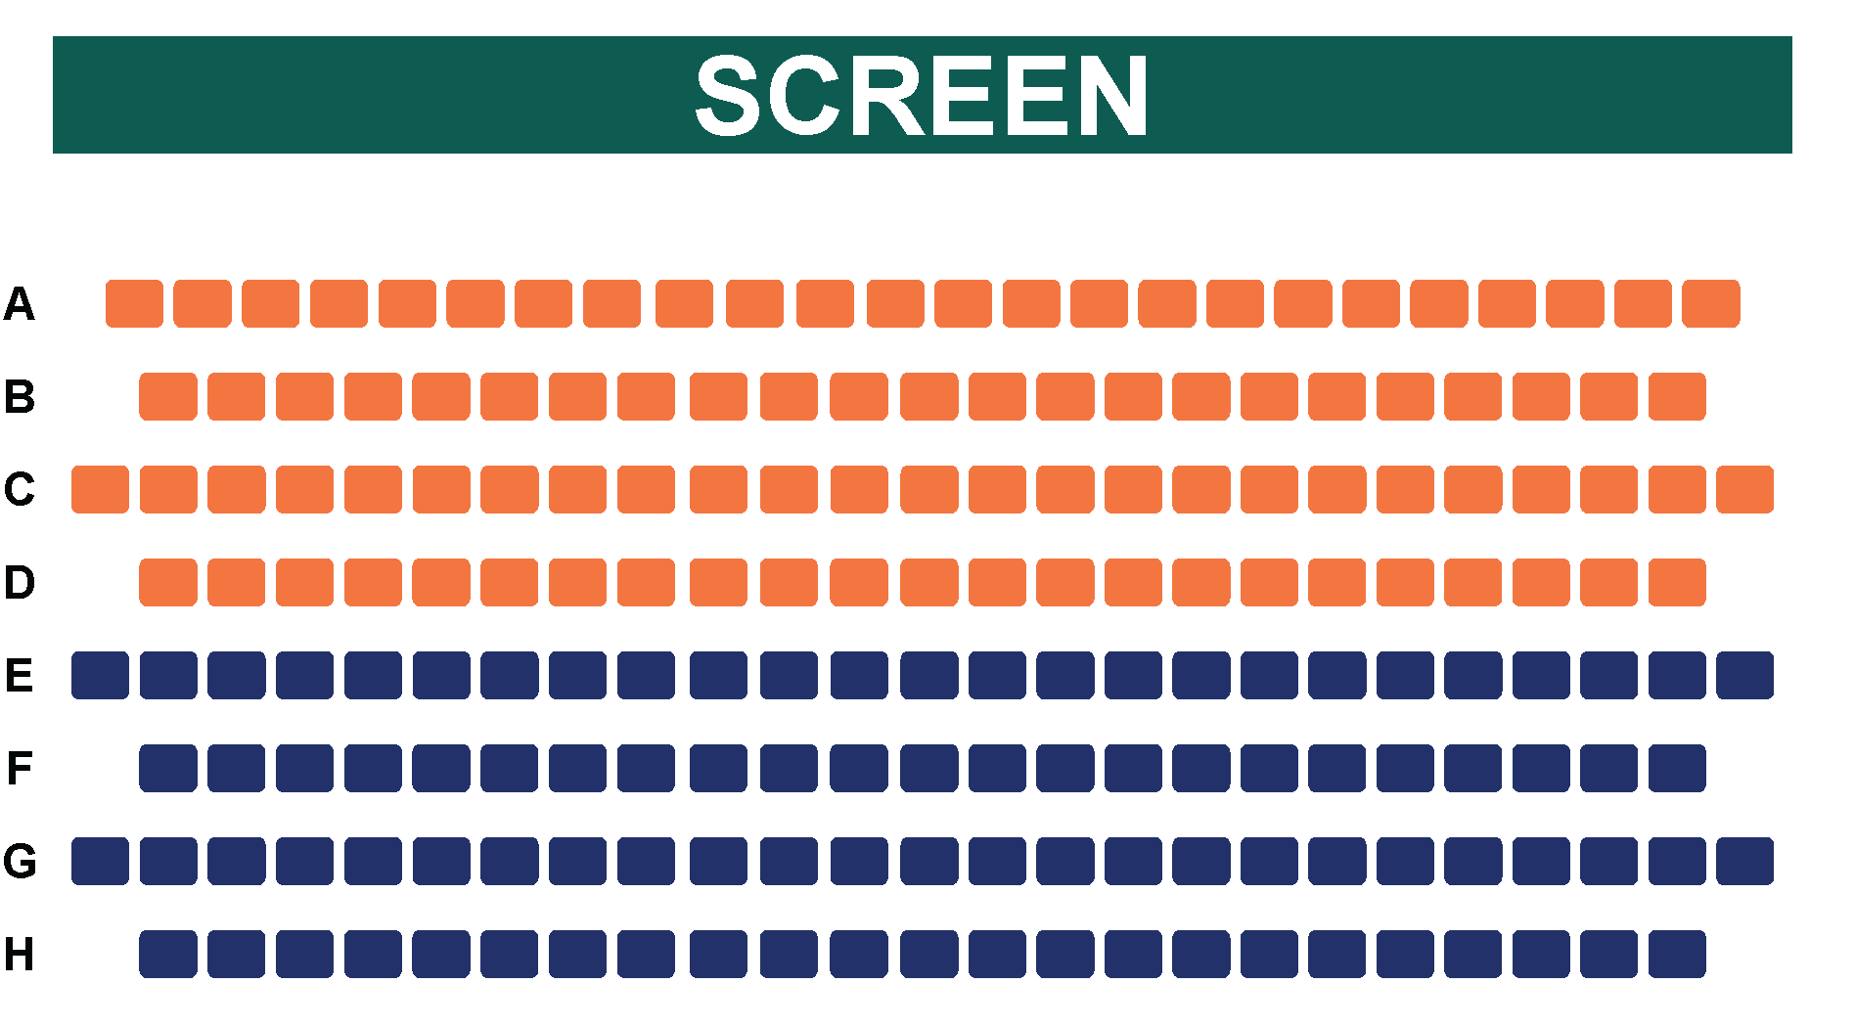
Self Check - Review
A movie theater sells two types of tickets for a movie showing. Stadium recliner seats cost $18 each, and regular seats cost $15 each. The theater has a total of 40 seats. When every seat is sold, the theater earns $648 in ticket sales. How many stadium
recliner seats, x, and regular seats, y, are there?
To solve this problem, we first need to recognize
that there are two constraints in this situation.
Write an equation to represent each constraint, then solve.
Image not to scale
Notes:
Constraint #1: the total number of seats. There are x stadium recliner seats and y regular seats representing a total of 40 seats. This is represented by the equation x + y = 40.
Constraint #2: the total sales from the seats. Stadium recliner seats cost $18 and regular seats cost $15, for a total of $648. This is represented by the equation 18x + 15y = 648.
There are many ways to solve these equations: graphing and algebraic solving, guessing and checking, or using tables.
Answer
16 stadium recliner seats and 24 regular seats represent a total of 40 seats and is $648 in total sales.

Slide 22

Lesson Journey
Warm Up
Learning Activity
Practice
Learning Activity
Cool Down
Lesson Synthesis

Slide 23
Cool Down
At a fabric store, fabrics are sold by the yard. A dressmaker spent $36.35 on 4.25 yards of silk and cotton fabrics for a dress. Silk is $16.90 per yard, and cotton is $4 per yard. Here is a system of equations that represents the constraints in the situation.
What does the solution to the system represent?
Find the solution to the system of equations.
Explain or show how you know. (Desmos graph)
x + y = 4.25 16.90x + 4y = 36.35
Notes:
Cool Down (5 minutes)
Answers
Your answer may vary, but here is a sample. The solution represents the combination of lengths of silk and cotton (in yards) that meet both constraints: they add up to 4.25 yards, and the cost of buying both is $36.35.
1.5 yards of silk and 2.75 yards of cotton.
Your answer may vary, but here is a sample.
The graphs of the equations intersect at (1.5, 2.75).
Solving by using a table gives x = 1.5 and y = 2.75.
Response to Student Thinking - More Chances
The cool-down in lesson 2.4 gives another opportunity for students to discuss the meaning of a solution in context, so there is no need to slow down or add additional work to the next lessons. Instead, use the results of this cool-down to provide guidance for what to look for and emphasize over the next several lessons to support students in advancing their current understanding.

Slide 24

Lesson Journey
Warm Up
Learning Activity
Practice
Learning Activity
Cool Down
Lesson Synthesis

Slide 25

Practice
Put your hard work to action, practice what you’ve learned!
Notes:
Digital Practice: Access the practice pages at https://openstax.org/details/books/algebra-1

Slide 26

Lesson Journey
Warm Up
Learning Activity
Practice
Learning Activity
Cool Down
Lesson Synthesis

Slide 27
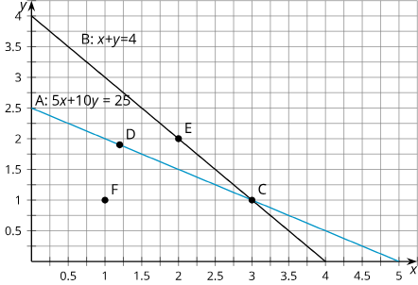
Lesson Synthesis
How would you explain ‘a system of equations’ to a classmate who is absent today?
What would you say if they asked, ‘What does it mean to solve the system of equations?’
Using the graph:
Which point or points are solutions
to the equation x + y = 4?
Which are solutions to 5x + 10y = 25?
Which are solutions to the system?
Notes:
Answers
Two or more equations that represent the constraints in the same situation form a system of equations.
The solution to a system of equations is a pair of values that makes all of the equations in the system true. Graphing the equations is one way to find the solution to a system of equations.
Points E and C
Points D and C
Point C
Additional Question and Answer
What is alike and what is different about solving a single linear equation in two variables, say 𝑥 + 𝑦 = 4, and solving a system of equations, say 𝑥 + 𝑦 = 4 and 5𝑥 + 10𝑦 = 25?
(Consider setting up a two-column organizer and recording students’ responses accordingly. Here is an example.)
Alike:
The solutions are pairs of values.
The solutions are points on the graph of each equation.
We can solve by using the graph.
We can solve by substituting different values for 𝑥 and 𝑦 and seeing which pairs of values make the equation true.
Different:
To solve a linear equation in two variables is to find pairs of values that make one equation true (or meet one constraint). To solve a system is to find pairs of values that simultaneously make both equations in the system true (or meet both constraints in a situation).
There are many solutions to a linear equation in two variables, but there might only be one (or no) solution to a system of linear equations in two variables.
The solution to a linear equation in two variables could be any point on the graph. The solution to a system must be the intersection of the two graphs

Slide 28
Self Assessment
How much do you agree with the following statements?
I can… | I can | Almost | Not yet
Explain “the solution to a system of linear equations” and how the solution is represented graphically.
Refer to two equations as a system of equations.
Use tables and graphs to solve systems of equations.

