Slide 1
Algebra 1
Unit 6 Working with Polynomials
Lesson 6.1 Add and Subtract Polynomials

Slide 2

How to use these slides
On the activity slides check the speaker notes for teacher support and instructional information.
Each lesson includes 1 warm up, 2-3 learning activities, a cool down, practice and a lesson synthesis.
  Learning activities are followed by a self check question, and review section.
Some slides have been hidden from student view, more information can be found on the next slide (Reference Key).
You can edit and use these slides for personal and classroom use, but cannot sell them and must keep the attribution logos.
For more information, Check out the digital quick start guide!
OpenStax CC BY NC SA

Slide 3





Reference Key
Check the top right corner for an icon referencing these unique sections.
Icon | Title | View | Location and Description
n/a | Support for Students with Disability | Hidden | Learning Strategies slide, provides additional support to students for understanding the activity.
n/a | Support for English Language Learners | Hidden | Learning Strategies slide, provides additional support to students for understanding the activity.
n/a | Extending Your Thinking | Hidden | Extending Your Thinking slide, provides an extra challenge for students.
n/a | Self Check | Not Hidden | Self Check slide, checkpoint to assess student understanding after the learning activity.
n/a | Review | Hidden | Self Check - Review slide, designed to help review topics from the self check question.
On the next slides, check the speaker notes for teacher instructions and support.
Notes:
Check the Speaker Notes: On the next slides you can find discussion questions, lesson information, answers to the activities, and ways to adjust the activity for your students!

Slide 4

Learning Goals
By the end of this lesson you will be able to -
Determine the degree of polynomials.
Add and subtract polynomials.
Evaluate a polynomial function for a given value.
Add and subtract polynomial functions.
Notes:
Lesson Narrative
This opening lesson introduces students to different types of polynomials. As students gain familiarity with these polynomial expressions, they will learn to recognize like terms within these expressions and combine them whenever possible. Students will also be able to perform these same operations while representing polynomials using function notation.
Required Preparation
None
Required Materials
None
Texas Essential Knowledge and Skills
A1(G) display, explain, and justify mathematical ideas and arguments using precise mathematical language in written or oral communication.
A10(A) add and subtract polynomials of degree one and degree two.
A12(B) evaluate functions, expressed in function notation, given one or more elements in their domains.

Slide 5
Vocabulary
New
Monomial
  An algebraic expression with one term.
Binomial
  An algebraic expression with two terms.
Trinomial
  An algebraic expression with three terms.
Polynomial
  An algebraic expression that contains one or more monomials combined with addition or subtraction.
Degree of a polynomial
  The highest exponent occurring on "x" when you write the polynomial as a sum of non-zero constants times powers of "x."
Notes:
Lesson Vocabulary
To support student understanding of key vocabulary:
Introduce and review the vocabulary words students will see in this lesson.
Encourage students to notice how these words are used and to include them in their math discussions and explanations—both written and oral.
Use a word wall to reinforce vocabulary. Sample word wall cards are available here.
For newcomers or students with beginning English proficiency, use these Quizlet sets to support vocabulary learning:
Unit 6 Spanish Vocabulary – use first to build understanding
Unit 6 Vocabulary (English) – use after anchoring in Spanish
Support for English Language Learners
ELPS 2(F) listen to and derive meaning from a variety of media such as audiotape, video, DVD, and CD-ROM to build and reinforce concept and language attainment.
ELPS 3(E) share information in cooperative learning interactions.
ELPS 4(F) use visual and contextual support and support from peers and teachers to read grade-appropriate content area text, enhance and confirm understanding, and develop vocabulary, grasp of language structures, and background knowledge needed to comprehend increasingly challenging language.
ELPS 5(B) write using newly acquired basic vocabulary and content-based grade-level vocabulary.

Slide 6
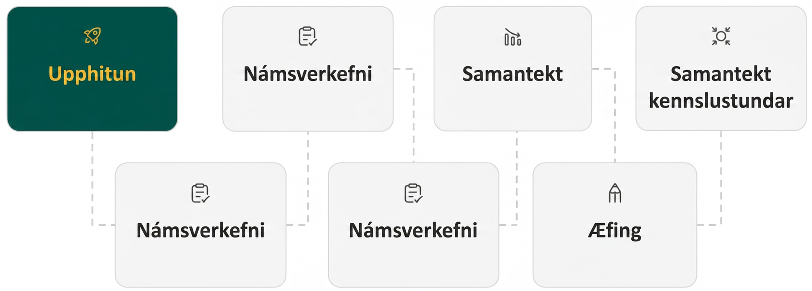
Lesson Journey
First Stop: Warm Up
Notes:
Alt text draft 1:
Image of six rectangles connected by dotted lines conveying the progression of the Lesson. Each rectangle has an icon with text.
The first rectangle is green with a yellow icon and text. The icon is a rocket and text reads Warm Up.
It is connected to the second rectangle, which is light gray with a dark gray icon and text. The icon is a clipboard with a checkmark and the text reads Learning Activity.
It is connected to the third rectangle, which is light gray with a dark gray icon and text. The icon is a clipboard with a checkmark and the text reads Learning Activity.
It is connected to the fourth rectangle, which is light gray with a dark gray icon and text. The icon is a three progressively smaller bar graph rectangles with an arrow on top, following the slope. The text reads Cool Down.
It is connected to the fifth rectangle, which is light gray with a dark gray icon and text. The icon is a pencil tip and the text reads Practice.
It is connected to the sixth rectangle, which is light gray with a dark gray icon and text. The icon is a four arrows pointing at a circle. The text reads Lesson Synthesis.

Slide 7

Warm Up | Part 1
Classifying Polynomials 🧐
A monomial is an algebraic expression with exactly one term: 5x²
A binomial is an algebraic expression with exactly two terms: 5x² + 6y³
A trinomial is an algebraic expression with exactly three terms: 5x² + 6y³ − 7𝑐
Monomials, binomials, and trinomials are all different types of polynomials. A polynomial is a monomial or two or more monomials combined by addition or subtraction.
The degree of a polynomial is the highest degree of all its terms.
Notes:
Warm Up (10 minutes)
This warm up familiarizes students with the different types of polynomials. Students will classify polynomials by number of terms and degree of exponent. Recognizing these differences will help students as they perform operations on polynomials of different types.
Launch
Review the new vocabulary defined at the start of the activity.
After all the terms have been introduced, ask students to name a new polynomial of each type.
Arrange students in groups of two.
Have each pair of students complete the activity questions together.
DESMOS OPTION: Desmos Activity: OpenStax Alg1 - 6.1.1 Types of Polynomials
Decide if students should complete the activity on their own notebook paper or use the Desmos activity. If you use the Desmos activity, direct students to students.desmos.com and provide students with your Desmos class code so they may use it to access the activity. More information for how to assign this activity to students is provided in the online textbook.
Activity questions, answers, and the activity synthesis are located on the next slide.

Slide 8
Warm Up | Part 2
Classifying Polynomials 🧐
x²
c + 4
mn
8d² + 3e – g
b – h
15
n² – 7f + ab
z
Which of the polynomials are –
Monomials?
Binomials?
Trinomials?
Which of the polynomials have –
A degree of 0?
A degree of 1?
A degree of 2?
Notes:
Answers
There are four answers: 𝑥², 15, 𝑧, 𝑚𝑛
There are two answers: 𝑐 + 4 and 𝑏 − ℎ
There are two answers: 8𝑑² + 3𝑒 − 𝑔 and 𝑛² − 7𝑓 + 𝑎𝑏
There is only one answer: 15
There are three answers: 𝑐 + 4, 𝑏 − ℎ, and 𝑧
There are four answers: 𝑥², 8𝑑² + 3𝑒 − 𝑔, 𝑛² − 7𝑓 + 𝑎𝑏, and 𝑚𝑛
Activity Synthesis
After students complete the activity, have them answer the three statements.
Copy and complete the sentence: An example of a monomial is ________.
Write a sentence using the word “trinomial” and an example.
Write a sentence explaining what the prefixes “bi-” and “tri-” mean and how they relate to polynomials.
Next, have students switch sentences with a partner. After reading each other’s sentences, have the students discuss whether or not they agree or disagree with their partner and explain why. Encourage students to change their sentences if necessary. Ask select groups to share their sentences and any changes they made.
Explain that identifying the type of polynomial and its degree will be important for determining how to perform different operations on them.

Slide 9
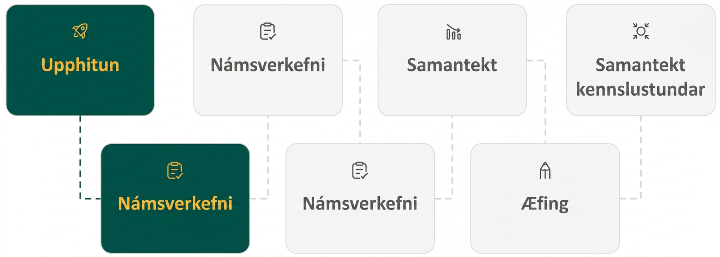
Lesson Journey
Second Stop: Learning Activity A

Slide 10

Learning Activity A | Learning Strategies
Great Together! 🍞&🧈
Teacher Instruction: Use these strategies to adjust the activity to support students with disabilities.
You can copy and paste the callout directly on top of the activity or give the instructions aloud.
Use color coding to show which terms “match” since they have –
SAME VARIABLES
SAME EXPONENTS
Representation
Notes:
Support for Students with Disabilities: Representation: Illustrate Connections
Use different color highlighters to help show the terms that have the same variables with the same exponents. You can also use colored index cards to break down expressions by putting all of the terms with same variable and same exponents on different colors.
Supports accessibility for: Organizing; Visual-spatial processing

Slide 11
Learning Activity A | Part 1
Great Together! 🥛&🍪
Do these terms have the same variables and the same exponents? Explain.
6𝑥⁴𝑦² 8𝑥⁴𝑦²
Add the terms together: 6𝑥⁴𝑦² + 8𝑥⁴𝑦². What is the sum?
Simplify.
12𝑞 + 9𝑞
−14𝑐³ + 5𝑐³
8𝑔²ℎ² + (−6𝑔²ℎ²)
Notes:
Support for All Learners
This activity offers additional support and an extension for students:
For students with disabilities, be sure to review the Learning Strategies slide!
For students looking for an extra challenge, be sure to review the Extending Your Thinking slide!
Activity (20 minutes)
Students will first add and subtract monomials and then move to adding and subtracting larger polynomial expressions by focusing on combining like terms within the polynomials.
Launch
Answer the first two questions in the activity as a class.
As students analyze the terms in question 1, 6𝑥⁴𝑦² and 8𝑥⁴𝑦², stress that only like terms, with the same variables having the same degree, can be added and subtracted.
Allow a moment for students to think about question 2. After soliciting the class for an answer, emphasize that when like terms are added or subtracted, the variables and exponents remain the same while the coefficients are added or subtracted.
Allow students to complete the remaining questions individually.
Answers
Yes. Both terms have the same variables raised to the same degrees: 𝑥 is raised to the fourth power, and 𝑦 is squared.
14𝑥⁴𝑦²
21𝑞
−9𝑐³
2𝑔²ℎ²
Not included on the slide:
8𝑚𝑛³𝑝 − (− 5𝑚𝑛³𝑝)
Answer: 13𝑚𝑛³𝑝
− 16𝑎² + 3𝑏² + 8𝑎²
Answer: − 8𝑎² + 3𝑏²
Additional activity questions, answers, anticipated misconceptions and synthesis continue on the next slide.

Slide 12
Learning Activity A | Part 2
Great Together! 🥓&🍳
Can the following monomials be simplified using like terms? Explain.
17𝑎²𝑏𝑐³ + 6𝑎²𝑏²𝑐³
Simplify the following polynomial expressions.
(5𝑘 + 7𝑚 − 2) + (7𝑘 + 9𝑚 − 4)
(12𝑤 − 11) − (5𝑤 + 6)
(5𝑘² + 7𝑘 − 2) + (7𝑘² + 9𝑘 − 4) video
Are you ready for more?
(9ℎ² − 4ℎ + 17) + (2ℎ² − 9)
(8𝑓² + 6𝑓𝑣 − 3𝑣²) − (6𝑓² − 3𝑣²)
(8𝑧³ − 6𝑧𝑥 + 3𝑥²) + (12𝑧³ − 4𝑧𝑥)
Notes:
Answers
No, the monomial terms do not contain the same variables with the same exponents. The first term has the variable 𝑏 with an exponent of 1. The second term has the variable 𝑏 with an exponent of 2. The monomials are not like terms.
12𝑘 + 16𝑚 − 6
7𝑤 − 5
12𝑘² + 16𝑘 − 6 A video explaining how to do this problem is available.
11ℎ² − 4ℎ + 8
2𝑓² + 6𝑓𝑣
20𝑧³ − 10𝑧𝑥 + 3𝑥²
Anticipated Misconceptions
Students may think that they can combine any terms that share the same variables. Emphasize that each variable in the terms must also share the same degree for the terms to be added or subtracted.
Activity Synthesis
As students add and subtract to simplify the polynomial expressions, emphasize that the degree of the term does not change. When 5𝑥² is added to 6𝑥², the sum still has a degree of two, 11𝑥². The same is true for the difference between two like terms.
Invite students to share any of the problems that gave them difficulty. Work through the addition or subtraction as a class.

Slide 13

Learning Activity A
Extending Your Thinking
Simplify.
(6𝑎³ − 2𝑎²𝑏) − 2(𝑎𝑏² + 3𝑏³) + (2𝑎²𝑏 + 2𝑎𝑏²)
Notes:
Go back to Lesson Activity
Answer
Here is how to solve this problem:
(6𝑎³ − 2𝑎²𝑏) − 2(𝑎𝑏² + 3𝑏³) + (2𝑎²𝑏 + 2𝑎𝑏²)
Step 1 - Distribute the multiplication over addition.
6𝑎³ − 2𝑎²𝑏 − 2𝑎𝑏² − 6𝑏³ + 2𝑎²𝑏 + 2𝑎𝑏²
Step 2 - Use the Commutative Property to rearrange like terms together.
6𝑎³ − 2𝑎²𝑏 + 2𝑎²𝑏 − 2𝑎𝑏² + 2𝑎𝑏² − 6𝑏³
Step 3 - Combine like terms.
6𝑎³ − 6𝑏³

Slide 14
Learning Activity A
Self Check
Find the sum.
(14𝑦² + 6𝑦 − 4) + (3𝑦² + 8𝑦 + 5)
17𝑦² + 14𝑦 + 1
11𝑦² − 2𝑦 − 9
17𝑦² + 14𝑦 − 9
11𝑦² + 14𝑦 + 1
Let’s review!
Notes:
Answer Feedback - Individualized by Response
That’s correct! By combining like terms, you can add the polynomials.
Incorrect. You need to add the polynomials instead of subtracting them.
Incorrect. Check the constants that you added.
Incorrect. Check your addition on the terms to the second degree.

Slide 15

Learning Activity A
Self Check - Review
HOW TO COMBINE
LIKE TERMS
Step 1 - Identify like terms by finding those with the same variable and same exponent.
Step 2 - Use the Commutative Property to rearrange like terms together. Be sure to take the appropriate sign with each term (+/−).
Step 3 - Combine like terms.
Simplify:
(7𝑦² − 2𝑦 + 9) + (4𝑦² − 8𝑦 − 7)
Step 1 -
(7𝑦² − 2𝑦 + 9) + (4𝑦² − 8𝑦 − 7)
Step 2 -
7𝑦² + 4𝑦² − 2𝑦 − 8𝑦 + 9 − 7
Step 3 -
11𝑦² − 10𝑦 + 2
Notes:
Remind Students
Like terms have the same variables with the same exponents.
If the monomials are like terms, we combine them by adding or subtracting the coefficients.
The variables and exponents of the monomials do not change when combined.
Access the online textbook for additional examples.

Slide 16
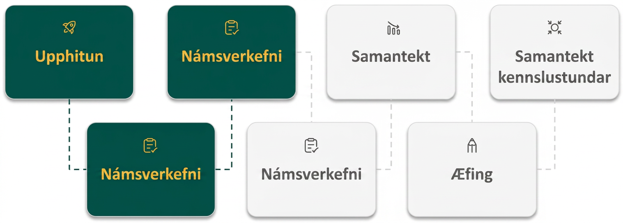
Lesson Journey
Third Stop: Learning Activity B

Slide 17
Learning Activity B | Learning Strategies
Plug It In! Plug It In! 🔌
Teacher Instruction: Use these strategies to adjust the activity to support English language learners.
  You can copy and paste the callout directly on top of the activity or give the instructions aloud.
Share your ideas with your partner.
“We should do ___ next because … “
“I noticed ___, so I think …”
Be ready to challenge or question any step you disagree with or are unsure of.
Discussion Supports
Notes:
Support for English Language Learners: MLR 8 Discussion Supports: Listening, Conversing
As students are working in groups of two to choose a strategy to solve the polynomial problem, provide the following sentence frames for all to see: “We should do ____ next because . . .”, and “I noticed ___ , so I think . . . .” . " Encourage students to challenge each other when they disagree. This will help students clarify their reasoning when solving polynomial equations. When students are discussing what is the same and different about their steps and solving strategies, assist students in using negatives and contractions correctly, such as do/don't, can/can't, is/isn't.
Design Principle(s): Maximize meta-awareness

Slide 18
Learning Activity B | Part 1
Plug It In! Plug It In! 🔌
Evaluate each function for ℎ(−4), ℎ(0), and ℎ(6).
ℎ(𝑥) = 3𝑥² − 7𝑥 − 9
ℎ(𝑥) = − 4𝑥² − 3𝑥 + 2
ℎ(𝑥) = − 2𝑥² − 5𝑥 + 15
Evaluate each function for 𝑑(−2), 𝑑(0), and 𝑑(3).
𝑑(𝑥) = 8𝑥² − 2𝑥 + 6
𝑑(𝑥) = − 5𝑥² − 4𝑥 + 10
𝑑(𝑥) = −3𝑥² + 6𝑥 + 7
Notes:
Support for All Learners
This activity offers additional support for students:
For students with disabilities, be sure to review the Learning Strategies slide!
Activity (20 minutes)
This activity introduces students to polynomial functions. Students will learn that evaluating a polynomial function for a given value is similar to how they have evaluated other functions in previous lessons.
Continue scrolling down for directions on how to launch the activity and answers to the questions.
Launch
Have students work on the first 3 problems individually and pause the class for questions before students move on to subsequent questions.
Then, arrange students in groups of 2. Provide access to calculators.
Instruct one partner in each pair to write their own polynomial function.
Have the other partner generate three values between –10 and 10.
Partners should exchange their values and functions.
Each member should evaluate the polynomial function for each of the values given.
Students should compare solutions and discuss any differences.
Answers
ℎ(−4) = 67
ℎ(0) = − 9
ℎ(6) = 57
ℎ(−4) = − 50
ℎ(0) = 2
ℎ(6) = − 160
ℎ(−4) = 3
ℎ(0) = 15
ℎ(6) = − 87
𝑑(−2) = 42
𝑑(0) = 6
𝑑(3) = 72
𝑑(−2) = – 2
𝑑(0) = 10
𝑑(3) = – 47
𝑑(−2) = – 17
𝑑(0) = 7
𝑑(3) = – 2
Additional activity questions, answers, and synthesis questions continue on the next slide.

Slide 19
Learning Activity B | Part 2
Plug It In! Plug It In! 🔌
Work with a partner.
  One partner should write their own polynomial function similar to the ones in this activity.
  The other partner should select 3 different values between –10 and 10.
  Exchange your function and values with your partner.
  Each member should evaluate the polynomial function for the given values.
  When finished, compare your answers.
  Did you find the same solutions? Share any differences you found.
Notes:
Answers will vary
Activity Synthesis
Since students have worked with functions in previous lessons, much of this activity will be familiar to them. Emphasize that polynomial functions often behave in the same way as other functions students have studied. Tell students that in the next activity, we will work on adding and subtracting polynomial functions in the same way we learned to add and subtract polynomials.

Slide 20

Learning Activity B
Self Check
For the function 𝑔(𝑥) = 5𝑥² − 8𝑥 + 4, find 𝑔(−3).
– 17
13
25
73
Let’s review!
Notes:
Answer Feedback - Individualized by Response
Incorrect. When you squared –3 in the first term, did you get 9?
Incorrect. Did you square –3 in the first term?
Incorrect. When you substituted –3 into the function, you did not multiply the middle term correctly. The value of –8 times –3 results in a +24.
That’s correct! 𝑔(−3) = 5(−3)² − 8(−3) + 4 = 5(9) – 24 + 4 = 73.

Slide 21
Learning Activity B
Self Check - Review
HOW TO EVALUATE FUNCTIONS
Step 1 - Substitute the given value for the variable, x.
Step 2 - Simplify the exponents.
Step 3 - Multiply.
Step 4 - Simplify.
For the function 𝑓(𝑥) = 5𝑥² − 8𝑥 + 4, find 𝑓(−2).
Notes:
Remind students:
A polynomial function is a function whose range values are defined by a polynomial.
To evaluate a polynomial function, we will substitute the given value for the variable and then simplify using the order of operations.
Additional examples can be accessed in the online textbook.

Slide 22
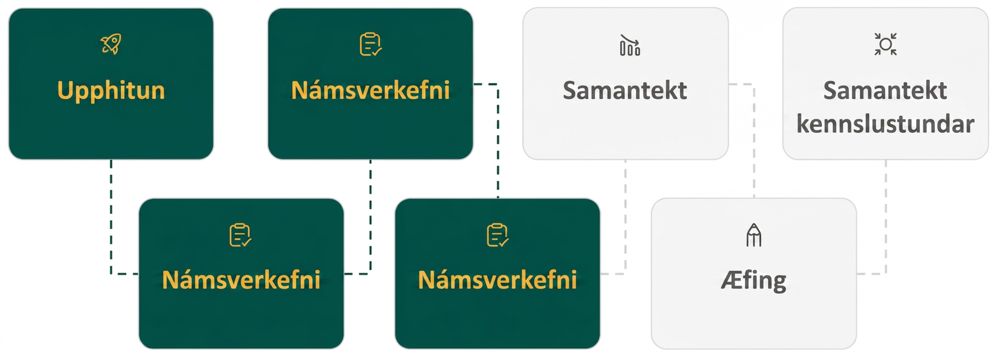
Lesson Journey
Fourth Stop: Learning Activity C

Slide 23
Learning Activity C | Part 1
Function Junction 🚂
Add the polynomial functions. Evaluate the sum for each given value.
𝑧(𝑥) = 8𝑥² + 4𝑥 − 6 𝑤(𝑥) = − 5𝑥² + 2𝑥 + 3
(𝑧 + 𝑤)(𝑥) =
(𝑧 + 𝑤)(6) =
(𝑧 + 𝑤)(− 9) =
(𝑧 + 𝑤)(0) =
Notes:
Activity (15 minutes)
This activity pushes students’ mastery of adding and subtracting polynomials through the introduction of operations on polynomial functions. As students solve the exercises, monitor for those who:
are confused by the function notation when performing polynomial addition and subtraction skills learned in the previous activity in this lesson.
do not distribute the subtraction sign through the entire function when subtracting a polynomial function.
Launch
Have students work on the first 4 problems individually.
Pause the class for questions before students move on to subsequent questions.
Answers
(𝑧 + 𝑤)(𝑥) = 3𝑥² + 6𝑥 − 3
(𝑧 + 𝑤)(6) = 141
(𝑧 + 𝑤)(− 9) = 186
(𝑧 + 𝑤)(0) = – 3
Additional activity questions, answers, and synthesis continue on the next slide.

Slide 24
Learning Activity C | Part 2
Function Junction 🚂
Subtract the polynomial functions. Evaluate the sum for each given value.
𝑚(𝑥) = − 6𝑥² + 2𝑥 − 8 𝑛(𝑥) = − 𝑥² − 7𝑥 − 6
(𝑚 − 𝑛)(𝑥) =
(𝑚 − 𝑛)(− 2) =
(𝑚 − 𝑛)(0) =
(𝑚 − 𝑛)(4) =
What is a good way to check that you found the correct sum or difference when adding or subtracting polynomial functions?
Notes:
Answers
(𝑚 − 𝑛)(𝑥) = − 5𝑥² + 9𝑥 − 2
(𝑚 − 𝑛)(− 2) = – 40
(𝑚 − 𝑛)(0) = – 2
(𝑚 − 𝑛)(4) = – 46
Substitute a value for 𝑥 into the individual polynomial functions. Add or subtract the results. The answer should be equal to the value you find when you substitute it into the sum or difference of the polynomial functions.
Activity Synthesis
As discussed in the final question, emphasize that for any functions 𝑓(𝑥) and 𝑔(𝑥), (𝑓 − 𝑔)(𝑥) = 𝑓(𝑥) − 𝑔(𝑥). This can be a useful tool for evaluating that your solution to (𝑓 − 𝑔)(𝑥) is correct.
Ask students to verify this by finding 𝑧(6) + 𝑤(6) using the functions in the first part of the activity. The solution should match what they found for (𝑧 + 𝑤)(6) in question 2.

Slide 25
Learning Activity C
Self Check
For functions 𝑓(𝑥) = 5𝑥² − 4𝑥 − 1 and 𝑔(𝑥) = 𝑥² + 3𝑥 + 8, find:
(𝑓 + 𝑔)(𝑥) = __
(𝑓 + 𝑔)(5) = __
(𝑓 + 𝑔)(𝑥) = 4𝑥² − 𝑥 + 7 (𝑓 + 𝑔)(5) = 102 | (𝑓 + 𝑔)(𝑥) = 6𝑥² − 𝑥 + 7 (𝑓 + 𝑔)(5) = 152
(𝑓 + 𝑔)(𝑥) = 4𝑥² − 7𝑥 – 9 (𝑓 + 𝑔)(5) = 56 | (𝑓 + 𝑔)(𝑥) = 6𝑥² − 𝑥 + 7 (𝑓 + 𝑔)(5) = 32
Let’s review!
Notes:
Answer Feedback - Individualized by Response
Incorrect. Check your operations when finding (𝑓 + 𝑔)(𝑥).
That’s correct! (𝑓 + 𝑔)(𝑥) = 5𝑥² − 4𝑥 − 1 + 𝑥² + 3𝑥 + 8 = 6𝑥² − 𝑥 + 7. Substitute 5 for 𝑥 to find (𝑓 + 𝑔)(5). (𝑓 + 𝑔)(5) = 6(5)² − (5) + 7 = 150 − 5 + 7 = 152.
Incorrect. Did you find (𝑓 − 𝑔)(𝑥)? You need to find (𝑓 + 𝑔)(𝑥).
Incorrect. You added the functions correctly. But, did you square 5 in the first term when finding (𝑓 + 𝑔)(5)?

Slide 26
Learning Activity C
Self Check - Review
For the two functions:
𝑓(𝑥) = 3𝑥² − 5𝑥 + 7
𝑔(𝑥) = 𝑥² − 4𝑥 − 3
Find (𝑓 − 𝑔)(𝑥) = 𝑓(𝑥) − 𝑔(𝑥).
HOW TO
ADD OR SUBTRACT FUNCTIONS
For functions f(x) and g(x),
(f + g)(x) = f(x) + g(x)
(f – g)(x) = f(x) – g(x)
Notes:
Additional questions to pose to students include -
Find (𝑓 + 𝑔)(𝑥)
Find (𝑓 + 𝑔)(3)
Find (𝑓 − 𝑔)(−2)
Access the online textbook for additional problems.

Slide 27
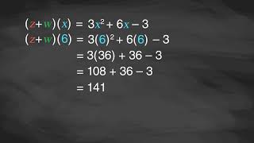
Learning Activity B | Video
Combining and Evaluating Polynomial Functions
Notes:
This video discusses questions 1–4 of activity 6.1.4

Slide 28
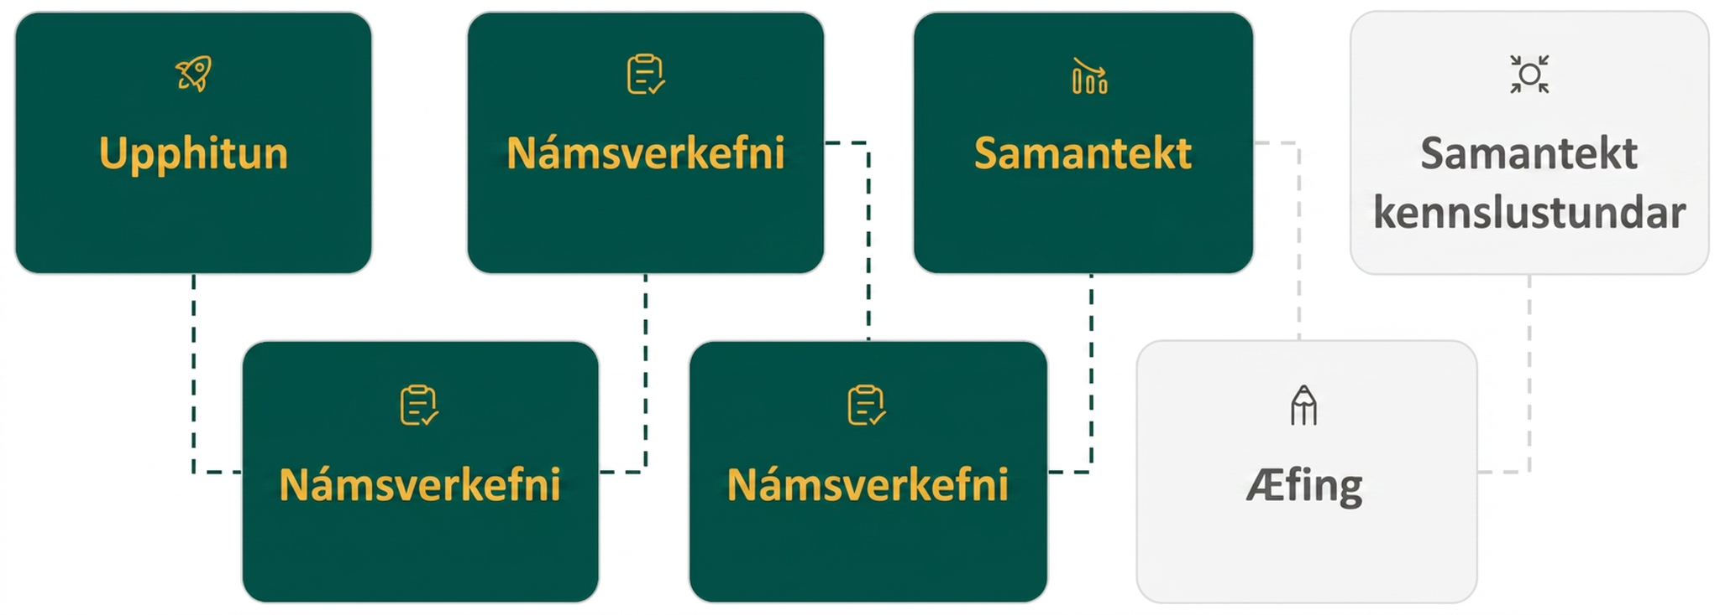
Lesson Journey
Fifth Step: Cool Down

Slide 29
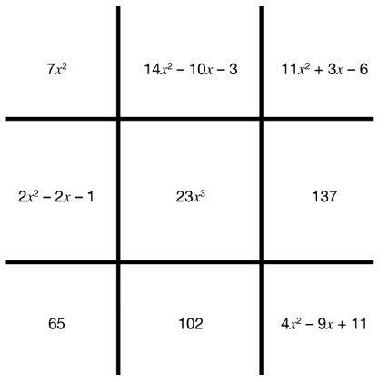
Cool Down -
Who wins - Xs or Os?
Use the following polynomial functions:
f(x) = 8x² – 6x – 2
h(x) = 6x² – 4x – 1
Mark the Tic-Tac-Toe board corresponding
to the following solutions for each mark:
Mark an X:
16x² – 9x²
(9x² – 5x – 3) + (2x² + 8x – 3)
f(5) – h(– 2)
(7x² – 3x + 7) – (3x² + 6x – 4)
f(4)
Mark an O:
11x³ + 12x³
f(x) – h(x)
f(x) + h(x)
h(– 3)
Notes:
Cool Down (5 minutes)
Answers
The Xs win the game.
Game board:
X - O - X
O - O - X
O - X - X
Xs:
16𝑥² − 9𝑥² = 7𝑥²
(9𝑥² − 5𝑥 − 3) + (2𝑥² + 8𝑥 − 3) = 11𝑥² + 3𝑥 − 6
𝑓(5) − ℎ(−2) = 137
𝑓(4) = 102
(7𝑥² − 3𝑥 + 7) − (3𝑥² + 6𝑥 − 4) = 4𝑥² − 9𝑥 + 11
Os:
11𝑥³ + 12𝑥³ = 23𝑥³
𝑓(𝑥) − ℎ(𝑥) = 2𝑥² − 2𝑥 − 1
𝑓(𝑥) + ℎ(𝑥) = 14𝑥² − 10𝑥 − 3
ℎ(−3) = 65
Response to Student Thinking - More Chances
Students will have more opportunities to practice the ideas in this cool down, so there is no need to slow down or add additional work to the next lessons. Instead, use the results of this cool down to provide guidance for what to look for and emphasize in upcoming lessons of this unit.

Slide 30
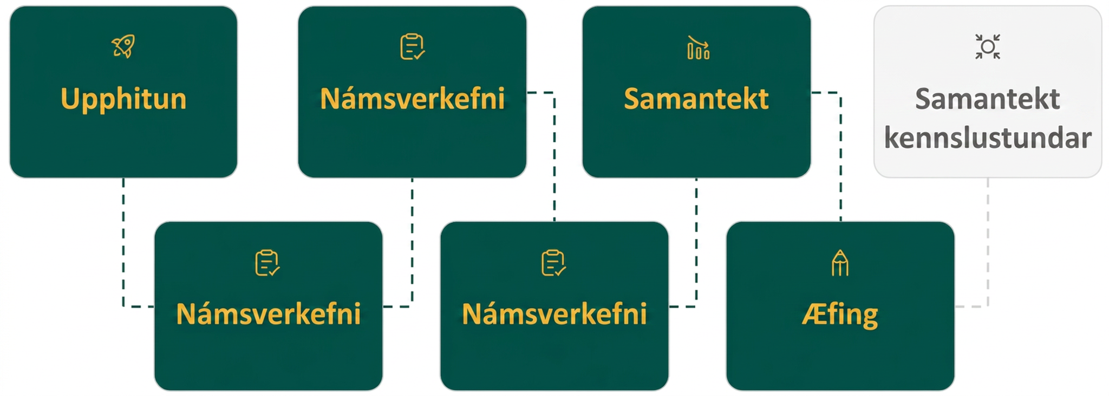
Lesson Journey
Sixth Stop: Practice

Slide 31

Practice
Put your hard work to action, practice what you’ve learned!
Notes:
Digital Practice: Access the practice pages at https://openstax.org/details/books/algebra-1

Slide 32
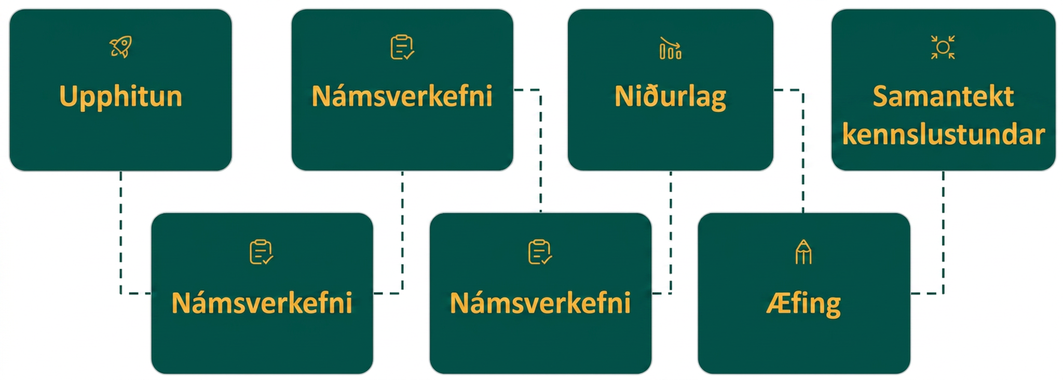
Lesson Journey
Seventh Stop: Lesson Synthesis

Slide 33
Lesson Synthesis
What is the difference between monomials, binomials, and trinomials?
How do you determine the degree of a polynomial?
How do you add or subtract polynomials?
How do you evaluate a polynomial function for a given value?
How do you check a sum or difference when adding or subtracting polynomial functions?
Notes:
To summarize the key concepts from the lesson, pose the sample questions again to see if students have learned all of the possible situations.
Answers
What is the difference between monomials, binomials, and trinomials? (Monomials have a single term, binomials have two terms, and trinomials have three terms.)
How do you determine the degree of a polynomial? (The degree of a polynomial is the highest degree of all its terms.)
How do you add or subtract polynomials? (Polynomials are added or subtracted by combining like terms.)
How do you evaluate a polynomial function for a given value? (Substitute the given value into the function for the variable and simplify.)
How do you check a sum or difference when adding or subtracting polynomial functions? (Substitute a value for 𝑥 into the individual polynomial functions. Add or subtract the results. The answer should be equal to the value you find when you substitute it into the sum or difference of the polynomial functions.)

Slide 34
Self Assessment
How much do you agree with the following statements?
Learning Goals | I can | Almost | Not yet
Determine the degree of polynomials. | ⃞ | ⃞ | ⃞
Add and subtract polynomials. | ⃞ | ⃞ | ⃞
Evaluate a polynomial function for a given value. | ⃞ | ⃞ | ⃞
Add and subtract polynomial functions. | ⃞ | ⃞ | ⃞

