Slide 1


Algebra 1
Unit 1 Linear Equations
Lesson 1.11: Connecting Equations to Graphs, Part 2
Notes:
Teacher Slides assignments

Slide 2
How to use these slides
On the activity slides check the speaker notes for teacher support and instructional information.
Each lesson includes 1 warm up, 2-3 learning activities, a cool down, practice and a lesson synthesis.
  Learning activities are followed by a self check question, and review section.
Some slides have been hidden from student view, more information can be found on the next slide (Reference Key).
You can edit and use these slides for personal and classroom use, but cannot sell them and must keep the attribution logos.
For more information, Check out the digital quick start guide!

Slide 3






Reference Key
Check the top right corner for an icon referencing these unique sections.
 | Support for Students with Disability | Hidden | Learning Strategies slide, provides additional support to students for understanding the activity. Learning Strategies slide, provides additional support to students for understanding the activity.
 | Support for English Language Learners | Hidden
 | Extending Your Thinking | Hidden | Extending Your Thinking slide, provides an extra challenge for students.
 | Self Check | Not Hidden | Self Check slide, checkpoint to assess student understanding after the learning activity.
 | Review | Hidden | Self Check- Review slide, designed to help review topics from the self check question.
On the next slides, check the speaker notes for teacher instructions and support.

Slide 4

Learning Goals
By the end of this lesson you will be able to -
Find the slope and vertical intercept of a line with equation ax + by = c.
Take an equation of the form ax + by = c and rearrange it into the equivalent form y = mx + b.
Use a variety of strategies to find the slope and vertical intercept of the graph of a linear equation given in different forms.
Notes:
Lesson Narrative
In this lesson, students connect equations, situations, and graphs by analyzing whether a graph represents a given equation and context. They apply their understanding of constraints and use points on a graph to support their reasoning. This helps them practice both quantitative and abstract thinking, as well as building logical arguments.
Students also work with linear equations outside of context. They rearrange equations to identify slope and y-intercepts and explain their thinking. While technology isn't required, students may choose to use it to support their work. We recommend having it available.
Required Preparation
None
Required Materials
None
Texas Essential Knowledge and Skills
A1(F) analyze mathematical relationships to connect and communicate mathematical ideas
A3(A) determine the slope of a line given a table of values, a graph, two points on the line, and an equation written in various forms, including y = mx + b, Ax + By = C, and y − y1 = m(x − x1)
A3(C) graph linear functions on the coordinate plane and identify key features, including x-intercept, y-intercept, zeros, and slope, in mathematical and real-world problems

Slide 5
Vocabulary
Previous
Equation
  A mathematical statement showing that two numbers, expressions, or objects are equal.
Expression
  The sum of products of numbers and variables.
Variable
  A quantity that can take on different values. Often represented by a letter such as 𝑥, 𝑦, 𝑎, 𝑏, 𝑚, etc.
New
Standard Form
  𝐴𝑥 + 𝐵𝑦 = 𝐶, where 𝐴, 𝐵, and 𝐶 are real numbers, and 𝐴 and 𝐵 are not both zero.
Notes:
Lesson Vocabulary
To support student understanding of key vocabulary:
Introduce and review the vocabulary words students will see in this lesson.
Encourage students to notice how these words are used and to include them in their math discussions and explanations—both written and oral.
Use a word wall to reinforce vocabulary. Sample word wall cards are available here.
For newcomers or students with beginning English proficiency, use these Quizlet sets to support vocabulary learning:
Unit 1 Spanish Vocabulary – use first to build understanding
Unit 1 Vocabulary (English) – use after anchoring in Spanish
Support for English Language Learners
ELPS 1(C) use strategic learning techniques such as concept mapping, drawing, memorizing, comparing, contrasting, and reviewing to acquire basic and grade-level vocabulary
ELPS 2(F) listen to and derive meaning from a variety of media such as audio tape, video, DVD, and CD ROM to build and reinforce concept and language attainment
ELPS 3(B) expand and internalize initial English vocabulary by learning and using high-frequency English words necessary for identifying and describing people, places, and objects, by retelling simple stories and basic information represented or supported by pictures, and by learning and using routine language needed for classroom communication
ELPS 3(E) share information in cooperative learning interactions
ELPS 3(I) adapt spoken language appropriately for formal and informal purposes

Slide 6






Lesson Journey
Warm Up
Learning Activity
Practice
Learning Activity
Cool Down
Lesson Synthesis

Slide 7





Warm Up - Equivalent Expressions＝
Rewrite each quotient as a sum or a difference.
 | 3.
2. | 4.
Notes:
Warm Up (5 minutes)
In this warm up, students review how to apply the distributive property to rewrite expressions that involve division, preparing them to do so in the next activity in the lesson.
Launch
Arrange students in groups of 2. Give students a moment of quiet time to work on the first two questions and then time to discuss their responses with their partner before moving on the last two questions.
Activity Answers
2x − 5
−1/2 + 25x
1/5x + 2
–1/10x + 5/2
Anticipated Misconceptions
Some students may answer the first question with 2𝑥 − 10 or 4𝑥 − 5, which are incorrect. To help clarify, use a simple example like 4 + 6 ÷ 2. Remind students that 10 ÷ 2 = 5, but dividing just the 4 or just the 6 won’t give the correct result. You can also explain that the fraction bar means division, so an expression like (4𝑥 − 10) ÷ 2 can be simplified using the distributive property. In the second expression, students might be confused by the signs and write −1/2 − 25𝑥, 1/2 + 25𝑥, or something else. Encourage them to plug in a value for 𝑥 and test each option. Emphasize that −1/2 + 25𝑥 is correct, and connect this to the distributive property to explain why.
Later in the lesson, students analyze and rearrange linear equations without context. They'll identify slope and y-intercepts and explain their reasoning. Technology isn’t required for this lesson, but students may choose to use it. It’s helpful to have calculators or devices available for those who want them.
Activity Synthesis
Invite students to share their equivalent expressions and how they reasoned about them. Display their expressions for all to see. Make sure students see that rewriting the expressions as sums or differences involves distributing the division (or applying the distributive property of division). If not mentioned in students’ explanations, point out each division could be thought of in terms of multiplication. For example, (4𝑥 − 10)/2 is equivalent to ½(4𝑥 − 10), because dividing by a number (in this case, ½). Applying the distributive property of multiplication to ½(4𝑥 − 10 enables us to rewrite this product as a difference.

Slide 8

Lesson Journey
Learning Activity
Warm Up
Learning Activity
Warm Up
Practice
Practice
Warm Up
Learning Activity
Practice
Warm Up
Learning Activity
Practice
Cool Down
Learning Activity
Cool Down
Learning Activity
Lesson Synthesis
Learning Activity
Cool Down
Lesson Synthesis
Cool Down
Lesson Synthesis
Learning Activity
Lesson Synthesis

Slide 9
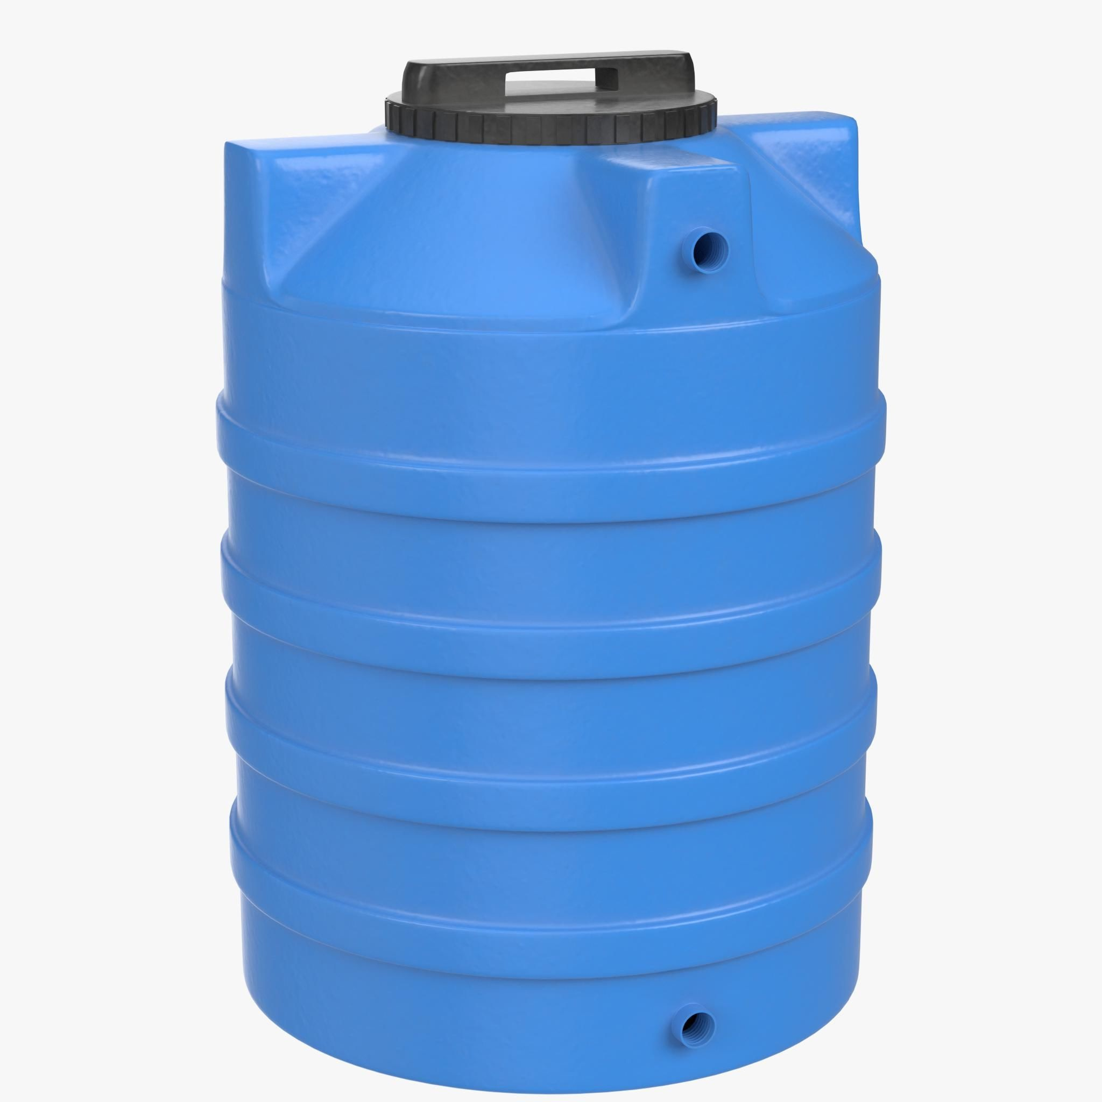
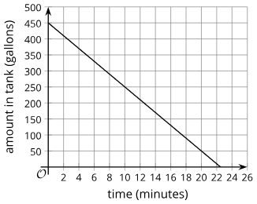
Learning Activity - Water and Figs
The graph represents a = 450 − 20t, which describes the relationship between gallons of water in a tank and time in minutes.
Where on the graph can we see the 450?
Where can we see the −20?
What do the numbers 450 and −20 mean in the situation that is graphed?
Notes:
Support for All Learners -
This activity offers additional support and an extension for students:
For English language learners and students with disabilities, be sure to review the Learning Strategies slide!
For students looking for an extra challenge, be sure to review the Extending Your Thinking slide!
Activity (20 minutes)
This activity builds on students’ earlier work connecting equations, graphs, and real-world situations. First, students practice linking parts of a slope-intercept equation to features of its graph and explaining what they mean in context (TEKS A.1(B)). Then, they analyze a graph to decide whether it matches a given equation in standard form. Some students may justify their thinking by plugging in (x, y) values from the graph to show the equation is true. Others may explain it in terms of the context (like buying almonds and figs). For example, both (8, 3) and (11, 1) are on the graph. That means Clare could buy 8 pounds of almonds and 3 of figs OR 11 of almonds and 1 of figs for $75.
Encourage students to think about less obvious points too—like those with fractional values—and how they could check them. This can lead into a discussion about rearranging the equation into slope-intercept form. Overall, this task supports students in reasoning about equations and graphs and making logical arguments.
Launch
Display the two graphs in the task statement for all to see. Tell students the graphs represent two situations they have seen in earlier activities.
Arrange students in groups of 2. Give students a minute of quiet time to think individually and ask them to be prepared to share at least one thing they notice and one thing they wonder about the graphs. Give them another minute to discuss their observations and questions with their partner before moving on to the task.
Activity answers and synthesis on the next slide.

Slide 10

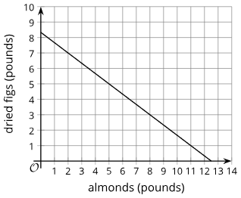
Learning Activity - Water and Figs
The graph shows the equation 6x + 9y = 75, which represents how much Clare spends on almonds and figs. Suppose a classmate says,
“I am not sure the graph represents 6x + 9y = 75 because I don’t see the 6, 9, or 75 on the graph.”
How could you explain that the graph does match the equation?
Notes:
Answers
450 is where the graph intersects the vertical axis.
−20 is the slope.
Your answer may vary, but here is a sample. 450 is the gallons of water in the tank at 0 minutes, before the tank starts to be drained. −20 means the gallons of water (vertical value) drops by 20 for every 1 minute increase in time (horizontal value).
Your answer may vary, but here are some samples:
If we substitute 0 for x in the equation and solve for y, we get 75/9 or 8 ⅓. That combination is the point (0, 8 ⅓) or the y-intercept of the graph. If we substitute 0 for y in the equation and solve for x, we get 12.5 for x. That combination is the point (12.5, 0) or the x-intercept of the graph.
If we substitute the x- and y-values of any point on the graph in the equation, the equation remains true. If we rewrite the equation and solve for y, we have y = (75 − 6x)/9 or y = 8⅓ − ⅔x. The 8⅓ matches where the graph intersects the y-axis and −⅔ matches the slope of the graph. (For every 3 additional pounds of almonds that Clare bought, she could buy 2 fewer pounds of figs.)
From the graph, we can see that the y-intercept is (0, 8⅓) and the slope is −⅔, so the equation of the line is y = 8⅓ − ⅔x. Multiplying each side of the equation by 9 (an acceptable move) gives an equivalent equation, 9y = 75 − 6x, which can be rewritten as 6x + 9y = 75.
Activity Synthesis
Focus the discussion on students’ explanations for the last question. If no one mentions that 6x + 9y = 75 can be rearranged into an equivalent equation, y = 8⅓ − ⅔x, point this out. (Demonstrate the rearrangement process, if needed.)
Ask students if we can now see the 8⅓ and the −⅔ on the graph and if so, where they are visible. To help students connect these values back to the quantities in the situation, ask what each value tells us about almonds and figs. Make sure students see that the 8⅓ tells us that if Clare bought no almonds, she could buy 8⅓ pounds of figs. For every pound of almonds she buys, she can buy less figs (⅔ pound less, to be exact).

Slide 11

Learning Strategies - Water and Figs
Teacher Instruction: Use these strategies to adjust the activity to support english language learners and students with disabilities.
You can copy and paste the callouts directly on top of the activity or give the instructions aloud.
When looking at the graphs, use one of these sentence starters to help explain your ideas clearly:
I noticed that ___________
I think the graph matches the equation because _________
Speaking
Notes:
Support for English Language Learners: MLR 8 Discussion Supports: Speaking
Support students in producing statements when they share their observations. Provide sentence frames for students to use when they are sharing, such as “I noticed that . . .” or “I wondered about _____ because . . .”
Design Principle(s): Support sense-making

Slide 12
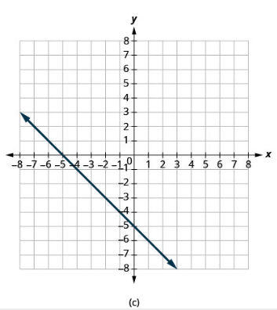
Self Check
For the line graphed, what is the y-intercept?
(−5, 0) | (0, −5)
(0, 5) | (5, 0)
Let’s review!
Notes:
Answers and Feedback
(-5,0)
Incorrect. This is the x-intercept. Look at where the line crosses the vertical axis. The answer is (0, −5).
(0,5)
Incorrect. Look at where the line crosses the vertical axis. It crosses below the x-axis. The sign should be negative. The answer is (0, −5).
(0, -5)
That’s correct! The y-intercept is where the graph crosses the vertical, when x = 0.
(5,0)
Incorrect. Look at where the line crosses the vertical axis. It crosses below the x-axis. Also, a coordinate is written (x, y). The answer is (0, −5).

Slide 13
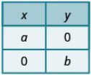
Self Check - Review
The x-intercept is the point (a, 0) where the line crosses the x-axis. The y-intercept is the point (0, b) where the line crosses the y-axis.
Find the x- and y-intercepts from the Equation of a Line
the x-intercept occurs when y is zero.
the y-intercept occurs when x is zero.
Example
Find the intercepts of 2x + y = 8
To find the x-intercept:
Step 1 - Let y = 0.
Step 2 - Solve for x.
Step 3 - Write the intercept as a point.
To find the y-intercept:
Step 1 - Let x = 0.
Step 2 - Solve for y.
Step 3 - Write the intercept as a point.
Notes:
Prompt
The points where a line crosses the x-axis and the y-axis are called the intercepts of the line. The x-intercept is where the line crosses the x-axis. At this point, y = 0. The y-intercept is where the line crosses the y-axis. At this point, x = 0. You can also find the intercepts using an equation instead of a graph. We’ll try an example next, use the steps on the slide to help you find both intercepts.
To find the x-intercept:
Step 1 - Let y = 0.
2x + 0 = 8
Step 2 - Solve for x.
x = 4
Step 3 - Write the intercept as a point.
(4, 0)
To find the y-intercept:
Step 1 - Let x = 0.
2(0) + y = 8
Step 2 - Solve for y.
y = 8
Step 3 - Write the intercept as a point.
(0, 8)

Slide 14
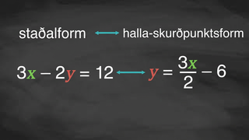
Video: Using Standard Form

Slide 15
Lesson Journey
Warm Up
Learning Activity
Practice
Warm Up
Learning Activity
Practice
Learning Activity
Cool Down
Lesson Synthesis
Learning Activity
Cool Down
Lesson Synthesis

Slide 16
Learning Activity - Standard Form & Intercepts
For numbers 1-5, match the slope and intercept from the list that corresponds to each equation:
m = 3, y-int = (0, 1)
m = 4/3, y-int = (0, 1)
m = 4/3, y-int = (0, −2)
m = −4, y-int = (0,8)
m = 3, y-int = (0,−2)
−4x + 3y = 3
12x − 4y = 8
8x + 2y = 16
−x + 1/3y = 1/3
−4x + 3y = −6
Notes:
Support for All Learners -
This activity offers additional support and an extension for students:
For English language learners and students with disabilities, be sure to review the Learning Strategies slide!
For students looking for an extra challenge, be sure to review the Extending Your Thinking slide!
Activity (15 minutes)
Students have previously worked with equations in concrete and contextual ways. In this activity, they begin reasoning more abstractly, focusing on linear equations in two variables. The task asks students to match equations written in standard form to their corresponding slopes and y-intercepts. Students may use a variety of strategies to make these matches, including:
Substituting the given y-intercepts into each equation to check for a true statement.
Plugging in x = 0 and x = 1 to find the y-intercept and calculate the slope.
Graphing each equation and analyzing the result.
Rearranging the equation into slope-intercept form (y = mx + b) to identify m and b.
Recognizing patterns when solving for y for example, that the slope becomes –A/B and the y-intercept becomes C/B when starting from Ax + By = C. These approaches range from trial-and-error to more structural and symbolic reasoning. Students who notice and apply these patterns are practicing regularity in repeated reasoning. Providing access to graphing technology gives students a chance to choose tools that help them work efficiently.
As students work, observe the strategies they use. Encourage those who are substituting values to also try rearranging equations or looking for structural patterns in the equations.
Launch
Keep students in groups of 2. Consider asking students to take turns finding a match and explaining their strategy to their partner.
Activity answers and synthesis on the next slide.

Slide 17
Learning Activity - Standard Form & Intercepts
Standard form, Ax + By = C, is helpful for finding the x-intercepts and y-intercepts of an equation. For 6 - 9, use the equation 6x − 4y = 24.
What is the value of y at the x-intercept? What is the x-intercept of the equation?
What is the value of x at the y-intercept? What is the y-intercept of the equation?
Graph the two intercepts and the equation of the line.
Using the graph from question 10, what is the slope of the line in simplest form?
Are you ready for more?
Notes:
Answers
m = 4/3, y-int = (0,1)
m = 3, y-int = (0,−2)
m = −4, y-int = (0,8)
m = 3, y-int = (0,1)
m = 4/3, y-int = (0,−2)
0; 4
0; –6
The graph will show the equation, y = 3/2x – 6 and go through the coordinate points (0, –6) and (4, 0)
3/2
Anticipated Misconceptions
Students will likely try rewriting the equations in slope-intercept form. Common mistakes include isolating x instead of y, dividing only one term by the coefficient of y, or changing the sign of just one term when dividing by a negative. (Refer back to the warm-up for these errors.)
Some students may use the shortcut that the slope is –A/B and the y-intercept is C/B from the standard form Ax + By = C. These students might mix up signs or flip the ratio. Have them isolate y in one equation to check their work.
Activity Synthesis
Have a few students share their strategies in the order suggested in the Activity Narrative. After each one, ask if others used a similar method. You might also ask:
Was this strategy quick or time-consuming? Easy to make mistakes?
Could you still find the slope and y-intercept without a list to choose from?
If you graphed the equations using technology, would you still use that method if you had to graph by hand?
Emphasize that using the structure of an equation helps make matching more efficient. Students don’t need to memorize slope and intercept rules for standard form yet, but they should start to see that solving for y is predictable and helps reveal the slope and y-intercept.

Slide 18
Learning Strategies - Standard Form & Intercepts
_____ and _____ match because . . .
I noticed _____ , so I matched . . .
Conversing
Teacher Instruction: Use these strategies to adjust the activity to support english language learners and students with disabilities.
You can copy and paste the callouts directly on top of the activity or give the instructions aloud.
Focus on one equation to start with, and how could you use a graph or table to help you figure out which slope and y-intercept it matches?
Internalize Executive Functions
Notes:
Support for English Language Learners: MLR 8 Discussion Supports: Conversing
Arrange students in groups of 2. Students should take turns finding a match and explaining their reasoning to their partner. Display the following sentence frames for all to see: “_____ and _____ match because . . .” and “I noticed _____ , so I matched . . .” Encourage students to challenge each other when they disagree.
Design Principle(s): Support sense-making; Maximize meta-awareness
Support for Students with Disabilities: Action and Expression: Internalize Executive Functions
Chunk this task into more manageable parts to differentiate the degree of difficulty or complexity. Some students may benefit by starting with a subset of the equations to match. Check in with students within the first 2 – 3 minutes of work time to ensure that they have a strategy to find a match. Invite students who are unsure how to get started to consider using graphing technology for a visual representation.
Supports accessibility for: Organization; Attention

Slide 19
Extending Your Thinking - Noticing Patterns
Select two equations from the student activity, “Standard Form and Intercepts.” Using either graph paper or graphing technology:
Graph the equation.
On the same graph, also draw a line that goes through the origin (0, 0) and the point (𝐴, 𝐵).
For example: Graph the equation − 4𝑥 + 3𝑦 = 3. Also graph the line that goes through (0, 0) and (−4, 3). Repeat this for the other equation using the same method. Look for any patterns in the graphs.
4x − 3y = −3 | 12x − 4y = 8 | 8x + 2y = 16
3x − y = −1 | 4x − 3y = 6
Notes:
Prompt
Now we’re going to explore a connection between equations and the graphs of certain lines. For each equation, you’ll graph the line that represents the equation. Then, on the same graph, draw another line that goes through the origin, (0, 0), and the point (𝐴, 𝐵) from the equation. For example, if the equation is −4𝑥 + 3𝑦 = 3, you’ll graph that equation and also graph the line through (0, 0) and (−4, 3). Use any graphing tool you’re comfortable with, like Desmos. As you go, look for patterns between the original equation and the second line you draw.Once everyone has had a chance to work through a few, we’ll come back together and share what we noticed.
Answer
The two lines are perpendicular.

Slide 20
Self Check
What is the slope of the line 4x + 3y = 12?
3/4 | 4/3
–3/4 | –4/3
Let’s review!
Notes:
Answers and Feedback
3/4
Incorrect. The slope of a line in standard form is −A/B.
-3/4
Incorrect. The slope of a line in standard form is −A/B, not −B/A.
4/3
Incorrect. The slope of a line in standard form is −A/B
-4/3
That’s correct! The slope of a line in standard form is −A/B.

Slide 21
Self Check - Review
Find the slope for 5x − y = 15.
Find the y-intercept for 5x − y = 15.
Explain your reasoning.
Notes:
Answers
5
–15
Strategy 1: Solve for y.
Step 1 - Subtract the x term from both sides: Subtract 5 from both sides. (5x − 5x) − y = 15 − 5x
Step 2 - Simplify. −y = 15 − 5x
Step 3 - Divide both sides by the coefficient of y: Divide both sides by −1. −y/−1 = (15 −5x)/−1
Step 4 - Simplify. y = 5x − 15
The slope is the coefficient of x, so the slope is 5. The y-intercept is the constant, which is −15.
Strategy 2: Use standard form.
Step 1 - Identify A, B, and C.
In 5x − y = 15, A = 5, B = −1, C = 15.
Slope: −A/B = −5/−1 = 5; y-intercept: C/B = 15/−1 = −15

Slide 22

Lesson Journey
Warm Up
Learning Activity
Practice
Warm Up
Learning Activity
Practice
Learning Activity
Cool Down
Lesson Synthesis
Learning Activity
Cool Down
Lesson Synthesis

Slide 23
Cool Down
For numbers 1 – 3, consider the equation 1.5x + 4.5y = 18.
Consider the equation 1.5x + 4.5y = 18. For each question explain your reasoning.
If we graph the equation, what is the slope of the graph?
Where does the graph intersect the y-axis?
Where does it intersect the x-axis?
Notes:
Cool Down (5 minutes)
Answers
The slope is −1/3. Rearranging the equation to isolate y gives y = −13x + 4.
The graph intersects the y-axis at (0, 4). The 4 in y = −13x + 4 tells us where the graph crosses the y-axis.
The graph intersects the x-axis at (12, 0). Substituting 0 for y in the original equation and solving for x gives x = 12.
Response to Student Thinking - More Chances
Students will have more opportunities to understand the mathematical ideas in this cool down in 1.12 and 1.13, so there is no need to slow down or add additional work to the next lessons. Instead, use the results of this cool down to provide guidance for what to look for and emphasize over the next several lessons to support students in advancing their current understanding.

Slide 24

Lesson Journey
Warm Up
Learning Activity
Practice
Warm Up
Learning Activity
Practice
Learning Activity
Cool Down
Lesson Synthesis
Learning Activity
Cool Down
Lesson Synthesis

Slide 25

Practice
Put your hard work to action, practice what you’ve learned!
Notes:
Access the practice pages at https://openstax.org/details/books/algebra-1

Slide 26

Lesson Journey
Warm Up
Learning Activity
Practice
Warm Up
Learning Activity
Practice
Learning Activity
Cool Down
Lesson Synthesis
Learning Activity
Cool Down
Lesson Synthesis

Slide 27
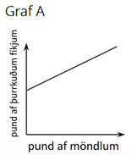
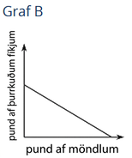
Lesson Synthesis
Suppose Clare went back to the store to get more almonds and dried figs and spent $108 this time. Almonds cost $6 a pound, and dried figs cost $9 a pound. Clare’s purchase can be represented by the equation 6x + 9y = 108.
Here are two graphs that represent the relationship between pounds of almonds, x, and pounds of figs, y.
Notes:
Prompt: Discuss with students:
“Without calculating anything, can you tell which graph could represent the equation 6x + 9y = 108 and which graph could not?” (Yes, graph B could represent the equation. The graph of the equation would have a negative slope because the more almonds Clare bought, the fewer dried figs she could have afforded. Graph A shows that as more almonds are bought, more figs are also bought, which couldn’t be true if Clare spent a fixed amount of money.)
“What does the vertical intercept mean in this situation?” (It shows the pounds of dried figs Clare could buy if she bought no almonds.)
“What is the vertical intercept of the graph? How can we find it?” (The vertical intercept is (0, 12). One way to find it is to substitute 0 for x and solve for y, which gives y = 12. Another way is to rearrange the equation into slope-intercept form.)
“What is the slope of the graph? How can we find it?” (The slope is −2/3. We can rearrange the equation into slope-intercept form, or we can find the coordinates of another point and calculate the slope.)
“What does the slope tell us about the almonds and dried figs?” (It tells us that for every additional pound of almonds that Clare buys, she could buy 2/3 fewer pound of dried figs.)
Closing the Lesson
After completing the Lesson Synthesis, wrap up the class by directing students to the Lesson Summary in their student textbook. In this section, students review the day’s learning targets, read summaries about the key takeaways from each activity, and then respond to a reflection question regarding their confidence with the material. For more on the benefits of using this type of metacognitive reflection, see the Research in Practice section of the course.

Slide 28
Self Assessment
How much do you agree with the following statements?
I can… | I can | Almost | Not yet
Find the slope and vertical intercept of a line with equation ax + by = c.
Take an equation of the form ax + by = c and rearrange it into the equivalent form y = mx + b.
Use a variety of strategies to find the slope and vertical intercept of the graph of a linear equation given in different forms.

