Slide 1


Algebra 1
Unit 5 Introduction to Exponential Functions
Lesson 5.13 Reasoning about Exponential Graphs, Part 2

Slide 2
How to use these slides
On the activity slides check the speaker notes for teacher support and instructional information.
Each lesson includes 1 warm up, 2-3 learning activities, a cool down, practice and a lesson synthesis.
  Learning activities are followed by a self check question, and review section.
Some slides have been hidden from student view, more information can be found on the next slide (Reference Key).
You can edit and use these slides for personal and classroom use, but cannot sell them and must keep the attribution logos.
For more information, Check out the digital quick start guide!

Slide 3






Reference Key
Check the top right corner for an icon referencing these unique sections.
 | Support for Students with Disability | Hidden | Learning Strategies slide, provides additional support to students for understanding the activity. Learning Strategies slide, provides additional support to students for understanding the activity.
 | Support for English Language Learners | Hidden
 | Extending Your Thinking | Hidden | Extending Your Thinking slide, provides an extra challenge for students.
 | Self Check | Not Hidden | Self Check slide, checkpoint to assess student understanding after the learning activity.
 | Review | Hidden | Self Check- Review slide, designed to help review topics from the self check question.
On the next slides, check the speaker notes for teacher instructions and support.
Notes:
Check the Speaker Notes: On the next slides you can find discussion questions, lesson information, answers to the activities, and ways to adjust the activity for your students!

Slide 4

Learning Goals
By the end of this lesson you will be able to -
Explain the meaning of the intersection of the graphs of two functions in terms of the situations they represent.
Write an equation for the function given two points on a graph of an exponential function
Notes:
Lesson Narrative
This lesson deepens work with orm f(x)=ab^{x}, focusing on how parameters a and b connect to the graph. Students interpret a given graph in context and compare abstract graphs with unlabeled axes to decide which fits a situation. This abstraction builds on prior learning and helps students use graphs to connect exponential expressions to real-world contexts, reinforcing why exponential functions matter.
Required Preparation
Devices that can run Desmos (recommended) or other graphing technology should be available as an optional tool for students to select.
Required Materials
None
Texas Essential Knowledge and Skills
A1(A) apply mathematics to problems arising in everyday life, society, and the workplace
A9(B) interpret the meaning of the values of a and b in exponential functions of the form f(x)=ab^{x} in real-world problems
A9(C) write exponential functions in the form f(x)=ab^{x} (where b is a rational number) to describe problems arising from mathematical and real-world situations, including growth and decay
A9(D) graph exponential functions that model growth and decay and identify key features, including y-intercept and asymptote, in mathematical and real-world problems

Slide 5
Vocabulary
Previous
Exponential function
  A function that has a constant growth factor. Another way to say this is that it grows by equal factors over equal intervals.
New
None
Notes:
Lesson Vocabulary
To support student understanding of key vocabulary:
Introduce and review the vocabulary words students will see in this lesson.
Encourage students to notice how these words are used and to include them in their math discussions and explanations—both written and oral.
Use a word wall to reinforce vocabulary. Sample word wall cards are available here.
For newcomers or students with beginning English proficiency, use these Quizlet sets to support vocabulary learning:
Unit 5 Spanish Vocabulary – use first to build understanding
Unit 5 Vocabulary (English) – use after anchoring in Spanish
Support for English Language Learners
ELPS 2(F) listen to and derive meaning from a variety of media such as audiotape, video, DVD, and CD-ROM to build and reinforce concept and language attainment
ELPS 2(I) demonstrate listening comprehension of increasingly complex spoken English by following directions, retelling or summarizing spoken messages, responding to questions and requests, collaborating with peers, and taking notes commensurate with content and grade-level needs
ELPS 4(D) use prereading supports such as graphic organizers, illustrations, and pretaught topic-related vocabulary and other prereading activities to enhance comprehension of written text
ELPS 5(B) write using newly acquired basic vocabulary and content-based grade-level vocabulary

Slide 6





Lesson Journey
Warm Up
Learning Activity
Practice
Learning Activity
Cool Down
Lesson Synthesis

Slide 7
Warm Up - Which One Doesn’t Belong?🤔
Which one doesn’t belong?
f(n) = 8 ⋅ 2^{n}
g(n) = 2 ⋅ 8^{n}
h(n) = 8 + 2n
j(n) = 8 ⋅ (½)^{n}
Notes:
Warm Up (5 minutes)
This warm up encourages students to look closely at functions and articulate the ways in which they are similar or distinct. There are many possible responses to the question. Given their current work on exponential functions, students might be inclined to wonder if the equations define exponential functions, to look for a growth factor, or to think about the initial value of the function.
Launch
Display the four functions and ask: “Which one doesn’t belong?” (remind: more than one answer is possible).
Give quiet think time, move to partner share, then whole-class discussion.
Highlight key ideas: exponential vs. linear, growth/decay, vertical intercept, and precise math language.
Activity Answers
Answers may vary but here is a sample:
f is the only one that doubles when n increases by 1.
g is the only one that does not have 8 for its vertical intercept.
h is the only one that is not an exponential function.
j is the only one that is not increasing.
Activity Synthesis
Invite students to share their responses. Highlight ideas that are important to this unit, for example, how the vertical intercept for each function can be identified, that j is a function involving exponential decay, etc. Encourage precision in students’ mathematical language, for instance, by reinforcing the use of terms such as exponential, growth factor, initial amount, base, exponent, linear, etc.

Slide 8

Lesson Journey
Warm Up
Learning Activity
Practice
Learning Activity
Cool Down
Lesson Synthesis

Slide 9
Learning Strategies - The Decreasing Value of a Computer💻
Look at the task and graph.
Write your own math questions (1–2 min).
Share and notice questions about equations, points, and trends.
Co-Craft Questions
Teacher Instruction: Use these strategies to adjust the activity to support English language learners and students with disabilities.
  You can copy and paste the callouts directly on top of the activity or give the instructions aloud.
Use color or notes to show how parts of a problem connect.
Example: In 100 = 400 · (b)², highlight or label each value and variable.
Match your colors/notes to the graph.
Representation
Notes:
Support for English Language Learners: MLR 5 Co-Craft Questions: Reading, Conversing
To help students make sense of an exponential situation in which the graph is given before the equation, start by displaying only the first task statement and its graph. Give students 1 – 2 minutes to write their own mathematical questions about the situation. Invite students to share their questions with the class, and then reveal the questions. Listen for and amplify any questions seeking to write an equation, interpret the meaning of various points, or predict future trends. This will help students create questions and use language that demonstrates what they know is true about a situation given a graph first.
Design Principle(s): Maximize meta-awareness; Cultivate conversation
Learn more about this routine
View the instructional video and follow along with the materials to assist you with learning this routine.
Provide support for students
Distribute graphic organizers to the students to assist them with participating in this routine.
Support for Students with Disabilities: Representation: Internalize Comprehension
Demonstrate and encourage students to use color coding and annotations to highlight connections between representations in a problem. For example, display the equation 100 = 400 ⋅ (b)² and use color or annotations to illustrate how each value or variable is represented graphically.
Supports accessibility for: Visual-spatial processing; Conceptual processing

Slide 10
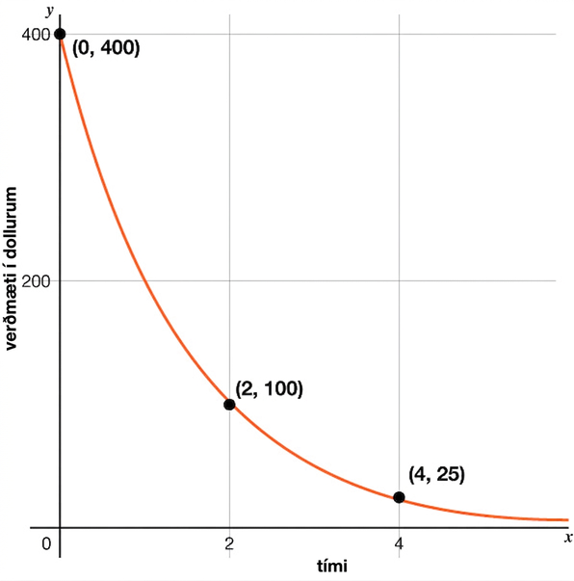
Learning Activity - The Decreasing Value of a Computer💻
The exponential function f gives the value of a computer, in dollars, as a function of time, x, measured in years since the time of purchase.
Based on the graph, what can you say about the following?
The purchase price of the computer.
The value of f when x is 1.
The meaning of f(1).
How the value of the computer is changing each year.
An equation that defines f.
Whether the value of f will reach 0 after 10 years.
Notes:
Support for All Learners
This activity offers additional support and an extension for students:
For English language learners and students with disabilities, be sure to review the Learning Strategies slide!
For students looking for an extra challenge, be sure to review the Extending Your Thinking slide!
Activity (15 minutes)
In a previous lesson, students used equations defining functions to reason about graphs. Here they work in the opposite direction, analyzing graphs and creating corresponding equations. In the first question, the coordinates given are not of two consecutive values of x, so students need to reason about the decay factor indirectly. They may:
Try different factors that, when multiplied by f(0) twice, give f(2).
Use the graph to estimate f(1), and then use that estimate to find a reasonable decay factor.
Find the factor that takes f(0) to f(2) (or f(2) to f(4)), recognize that number as b², and then find b.
The second question has no context and is thus more abstract. This prepares students to interpret graphs in the next activity, where minimal information is given.
Launch
Arrange students in groups of 2 – 4.
Ask students to take a few minutes of quiet time to think individually on each question before discussing their thinking with a partner.
Answers
$400
f(1) = 200
The value of the computer after 1 year.
The computer loses half of its value each year.
f(x) = 400(½)^{x} (or equivalent, i.e. f(x) = 400(0.5)^{x})
No, it will not. After 10 years, the value of the computer will be a little less than $0.40.
More activity questions, answers, misconceptions, and synthesis on the next slide.

Slide 11
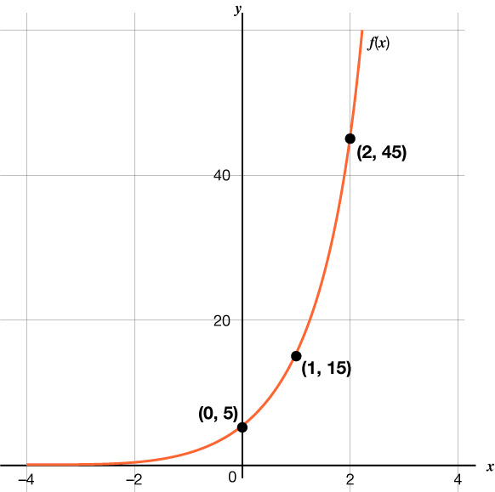
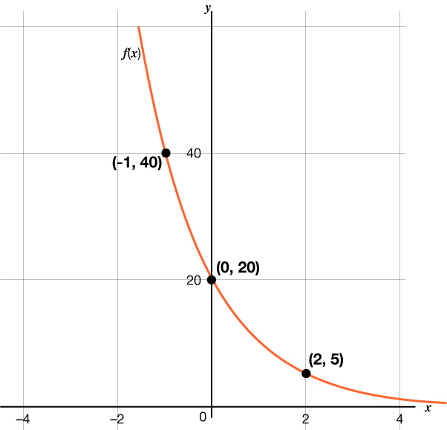
Learning Activity - The Decreasing Value of a Computer💻
Graph A
Graph B
Answer questions 7 and 8 for each exponential function graph.
Write an equation that defines the function.
Find the value of the function when x is 5.
Are you ready for more?
Notes:
Activity Answer
Graph A: f(x) = 5 ⋅ 3^{x}
Graph B: f(x) = 20 ⋅ (½)^{x} (or equivalent, i.e. f(x) = 20 ⋅ (0.5)^{x})
Graph A: f(5) = 1,215
Graph B: f(5) = 0.625
Anticipated Misconceptions
If students have trouble getting started, ask them to consider the graph and say what they know is true about the situation that the graph represents. Most likely, they will answer some parts of the first question by doing this and will be in a better position to figure out any questions they didn’t answer.
Activity Synthesis
Select students to share their responses to the first four questions. Write the exponential model, y = a b^{x}, on the board. Ask students what each variable represents. Help facilitate the following connections with students:
The value of a is the initial value, in this case, the starting price, $400.
Ask students, no matter what the value of b, if x = 0, what is the value of the function? 400.
The value of b is the growth factor. In this problem, the value of the computer decays. In question 4, students should have answered that the computer loses half its value every year, therefore b = ½.
Note that since b = ½ which is less than 1, the model will represent the decay.
Ask students what would happen if b is greater than 1.
If students are willing to share their different equations, this is a great time to address any mistakes and misconceptions of the formula in a constructive manner.
For question 6, begin to introduce the concept of an asymptote since the value will not reach 0. Ask students if at 10 years and beyond, is there any part of the computer that will still be worth something to someone?
For the last graph, discuss questions such as:
“What information is needed to describe an exponential function?” (the factor of growth or decay and the initial value)
“Where on the graph do we see the initial value?” (the y-intercept of the graph)
“What points on the graph can we use to help us find the growth factor?” (the points (−1, 40) and (0, 20), or the points (0, 20) and (2, 5))
“Why might (−1, 40) and (0, 20) be a more strategic choice than (0, 20) and (2, 5) for finding the factor of growth?” (The x-coordinates of first two points differ by 1, so the quotient of the y-coordinates of those points can be used to find the factor of decay. It is a more direct way to find the factor of decay, which is the factor by which the output of f changes when the input x changes by 1. In the second pair, the x-coordinate changes by 2.)

Slide 12
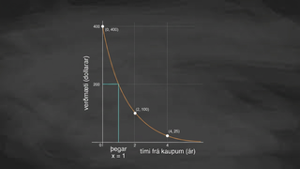
Video: Interpreting an Exponential Function from a Graph

Slide 13

Extending Your Thinking
Consider a function f defined by f(x) = a ⋅ b^{x}.
If the graph of f goes through the points (2,10) and (8,30), would you expect f(5) to be less than, equal to, or greater than 20?
If the graph of f goes through the points (2,30) and (8,10), would you expect f(5) to be less than, equal to, or greater than 20?
Notes:
Answers
The value 20 is what you would get for f(5) if f were a linear function through (2,10) and (8,30) (or (2,30) and (8,10)). Looking at graphs representing our exponential functions, we can see that the line connecting two points on the graph always seems to be above the graph of the exponential function itself. Thus, we would expect f(5) < 20 in both cases.
Go back to activity information.

Slide 14
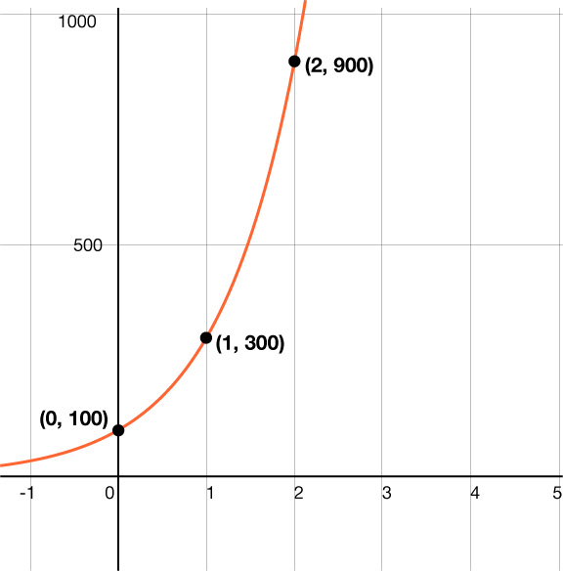
Self Check
Which of the following is the function
for the curve graphed?
f(x) = 100 + 3^{x}
f(x) = 3 ⋅ 100^{x}
f(x) = 100 ⋅ 3^{x}
f(x) = (100³)^{x}
Let’s review!
Notes:
Answer Feedback - Individualized by Response
Incorrect. The starting value must be multiplied by the growth factor. The answer is f(x) = 100 ⋅ 3^{x}.
Incorrect. The a and b need to be switched. The answer is f(x) = 100 ⋅ 3^{x}.
That's correct! The starting value was 100, and the growth factor is 3.
Incorrect. Only the 3 should be raised to the x power.. The answer is f(x) = 100 ⋅ 3^{x}.

Slide 15
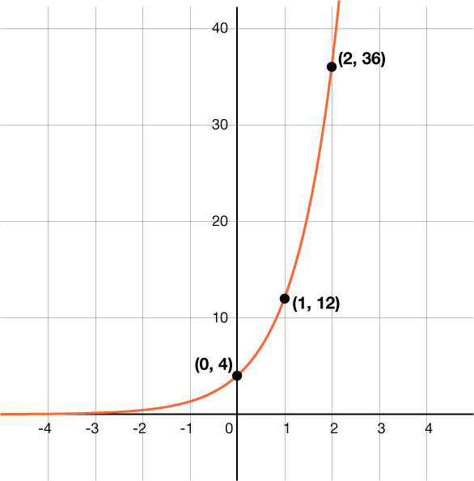
Self Check - Review
Use the graph to answer the questions.
Find the value of a, the starting point.
Find the b, the growth factor.
Write the equation of the function.
Find f(5).
Notes:
Writing Functions from Graphs
Answers
a = 4
b = 3
f(x) = 4 ⋅ 3^{x}
f(5) = 4 ⋅ 3⁵ = 972

Slide 16
Lesson Journey
Warm Up
Learning Activity
Practice
Learning Activity
Cool Down
Lesson Synthesis

Slide 17
Learning Strategies - How Fast Does Mold Grow? 📈
Listen to your classmate’s idea.
Restate it using math words.
Share with a partner, then with the class.
Speaker checks if the restatement is accurate.
Conversing
Teacher Instruction: Use these strategies to adjust the activity to support English language learners.
You can copy and paste the callouts directly on top of the activity or give the instructions aloud.
Notes:
Support for English Language Learners: MLR 8 Discussion Supports: Conversing
Use this routine to support whole-class discussion. For each explanation that is shared, ask students to restate what they heard using precise mathematical language. Consider providing students time to restate what they hear to a partner before selecting one or two students to share with the class. Ask the original speaker if their peer was able to accurately restate their thinking. Call students’ attention to any words or phrases that helped clarify the original statement. This provides more students with an opportunity to produce language as they interpret the reasoning of others.
Design Principle(s): Support sense-making

Slide 18
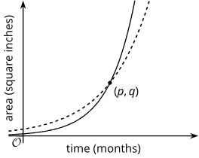
Learning Activity - How Fast Does Mold Grow? 📈
Use the graph of these two functions and their descriptions to explain your answers.
Which graph represents each function?
When the mold was first spotted and measured, was there more of Mold A or Mold B?
What does the point (p,q) tell us in this situation?
Function f: The area of a wall that is covered by Mold A, in square inches, doubling every month.
Function g: The area of a wall that is covered by Mold B, in square inches, tripling every month.
Notes:
Support for All Learners
This activity offers additional support for students:
For English language learners, be sure to review the Learning Strategies slide!
Activity (15 minutes)
This activity presents students with two graphs without numerical values assigned to any points on the graphs. The only labeled point is where the two graphs intersect. Students will need to use their understanding that tripling each day is a greater growth factor than doubling each day. This is their only means to decide which function represents which situation. Students then interpret the graphs in terms of the situations that they represent.
Launch
Display the graph for all to see.
Give students a moment to observe the graph and ask, “What do you notice? What do you wonder?”
Invite students to share their observations and questions.
Answers
For example: Since Mold B is growing more quickly, the graph that shows a greater growth factor (the one starting lower and ending higher) is function f (solid).
There was more of Mold A. The graph for f (dashed) shows a greater vertical intercept.
After p months, there was the same amount of Mold A and Mold B on the wall (q square inches), after which Mold B started to have larger area than Mold A.
Anticipated Misconceptions
Some students may think that the dashed graph represents the mold that is tripling because it has a greater vertical intercept. Ask these students to think carefully about the second question.
Activity Synthesis
Select students to share their responses and explanations. Focus on how they deciphered the meanings of the graphs. Discuss questions such as:
“The solid graph started off lower than the dashed graph. What does that mean in this context?” (The mold population represented by the solid graph is initially smaller or covers a smaller area on the wall than the one represented by the dashed graph.)
“After some point, the solid graph passes the dashed one. What does that mean in this context?” (The mold population that started out covering a greater area on the wall is surpassed by the other population, so it is growing at a slower rate.)
“What does the intersection of the two graphs mean? What do p and q represent?” (The two mold populations are the same at time p, with populations covering an area of q square inches.)

Slide 19
Self Check
In the formula f(x) = a ⋅ b^{x}, what changes on the graph when a changes?
The x-intercept
The y-intercept
The slope
The growth factor
Let’s review!
Notes:
Answer Feedback - Individualized by Response
Incorrect. The a value changes the vertical intercept. The answer is the y-intercept.
That's correct! The a value in the exponential function causes the value when x = 0 to change.
Incorrect. The slope is affected by changes in b. The answer is the y-intercept.
Incorrect. The growth factor is affected by changes in b. The answer is the y-intercept.

Slide 20
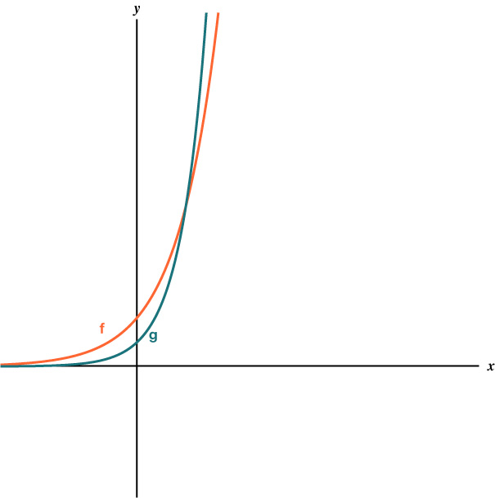
Self Check - Review
The graphs of f and g are showed to the right and are functions of the form y = a ⋅ b^{x}.
Which curve has the larger a value?
Which curve has the larger b value?
Notes:
Reading Exponential Graphs
Answers
f(x) because its y-intercept is higher.
g(x) because it is growing more quickly.

Slide 21

Lesson Journey
Warm Up
Learning Activity
Practice
Learning Activity
Cool Down
Lesson Synthesis

Slide 22
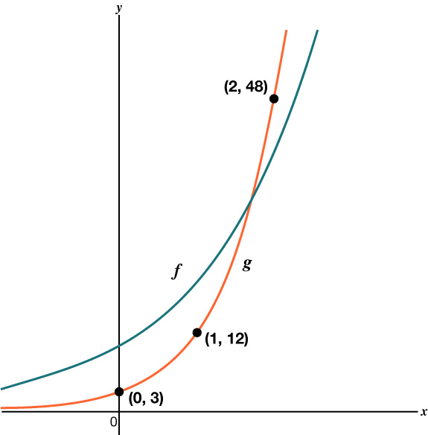
Cool Down
Here are two graphs representing the function f given by f(x) = 10 ⋅ 2^{x} and the function g defined by g(x) = a ⋅ b^{x}.
In function g, is b greater than or less than 2? Explain how you know.
Write an equation that defines g. Explain your answer.
f and g represent the number, in thousands, of social media followers of two organizations as a function of years since 2010. What does the intersection of f and g mean in this context?
Notes:
Cool Down (5 minutes)
Answers
b is greater than 2. Compare your answer:
The graph of g starts off being below the graph of f, but later it surpasses the graph of f. Since g grows more quickly than f, the growth factor b for g must be greater than the growth factor for f, which is 2.
The growth factor from the first point (0,3) to the second point (1,12) is 4 because 12/3 = 4, and 4 is greater than 2.
g(x) = 3 ⋅ 4^{x} because the initial value is 3 and the y-value is multiplied by 4 when the x-value increases by 1, so the growth factor is 4.
It represents the time, in years since 2010, when the two organizations have the same number of followers.
Response to Student Thinking - More Chances
Students will have more opportunities to understand the mathematical ideas in this cool-down, so there is no need to slow down or add additional work to the next lessons. Instead, use the results of this cool-down to provide guidance for what to look for and emphasize over the next several lessons to support students in advancing their current understanding.

Slide 23

Lesson Journey
Warm Up
Learning Activity
Practice
Learning Activity
Cool Down
Lesson Synthesis

Slide 24

Practice
Put your hard work to action, practice what you’ve learned!
Notes:
Digital Practice: Access the practice pages at https://openstax.org/k12/algebra

Slide 25

Lesson Journey
Warm Up
Learning Activity
Practice
Learning Activity
Cool Down
Lesson Synthesis

Slide 26
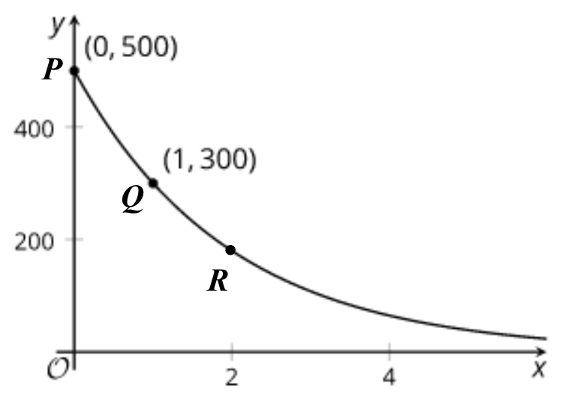
Lesson Synthesis
In the graph of the exponential function y = f(x), the x-coordinate of Q is 1, and the x-coordinate of R is 2.
What do you need to know to describe how the function is decreasing?
If you could find out the coordinates of two of these points, which two would you choose? Why?
How would you find the equation using these two coordinates?
Notes:
In this lesson, students interpreted graphs and reasoned about their equations
Answers
Your answer may vary, but here is an example.
Coordinates of two of the labeled points
P and Q or Q and R because the quotient of their y-coordinates gives the growth factor.
Use the y-coordinate of P and the growth factor.
Consider showing the graph of y = f(x) along with the graph of y = g(x) for another exponential function g.
Link to Desmos graph: https://www.desmos.com/calculator/9ndfyfwdkl
Ask students to compare the two functions:
Which function is decreasing faster? How do you know? (g because it has a larger y-intercept than f but then takes smaller values than f as x grows)
(If the graphs cross) What does the intersection of the two graphs mean? (The outputs of f and g are the same for this value of x.)

Slide 27
Self Assessment
How much do you agree with the following statements?
I can… | I can | Almost | Not yet
Explain the meaning of the intersection of the graphs of two functions in terms of the situations they represent.
Write an equation for the function given two points on a graph of an exponential function.

