Slide 1


Algebra 1
Unit 1 Linear Equations
Lesson 1.2 Writing Equations to Model Relationships, Part 1

Slide 2
How to use these slides
On the activity slides check the speaker notes for teacher support and instructional information.
Each lesson includes 1 warm up, 2-3 learning activities, a cool down, practice and a lesson synthesis.
  Learning activities are followed by a self check question, and review section.
Some slides have been hidden from student view, more information can be found on the next slide (Reference Key).
You can edit and use these slides for personal and classroom use, but cannot sell them and must keep the attribution logos.
For more information, Check out the digital quick start guide!

Slide 3






Reference Key
Check the top right corner for an icon referencing these unique sections.
 | Support for Students with Disability | Hidden | Learning Strategies slide, provides additional support to students for understanding the activity. Learning Strategies slide, provides additional support to students for understanding the activity.
 | Support for English Language Learners | Hidden
 | Extending Your Thinking | Hidden | Extending Your Thinking slide, provides an extra challenge for students.
 | Self Check | Not Hidden | Self Check slide, checkpoint to assess student understanding after the learning activity.
 | Review | Hidden | Self Check- Review slide, designed to help review topics from the self check question.
On the next slides, check the speaker notes for teacher instructions and support.
Notes:
Check the Speaker Notes: On the next slides you can find discussion questions, lesson information, answers to the activities, and ways to adjust the activity for your students!

Slide 4

Learning Goals
By the end of this lesson you will be able to -
Identify quantities that vary and quantities that are fixed in a situation or equation.
Explain that letters can represent both variables and constants.
Write equations with numbers and variables to show relationships and limits.
Notes:
Lesson Narrative
This is the first of two lessons focused on writing equations to model real-world situations. The lesson increases in both relationship complexity and independence from guided prompts. Students start by reviewing how to find a percentage of a number. They then explore situations involving geometry, spending, earning, and tax—using addition, subtraction, and multiplication, including percent increases. They move from modeling with known values to working with unknown or variable quantities. Through repeated reasoning, students practice identifying patterns, interpreting descriptions, and writing equations to represent constraints, strengthening their quantitative and abstract thinking.
Required Preparation
None
Required Materials
None
Texas Essential Knowledge and Skills
A1(A) apply mathematics to problems arising in everyday life, society, and the workplace
A2(C) write linear equations in two variables given a table of values, a graph, and a verbal description

Slide 5
Vocabulary
Previous
Constraint
  A limitation on the possible values of variables in a model, often expressed by an equation or inequality.
Model
  A mathematical representation of a problem from STEM or everyday life, used to solve problems and make decisions.
New
Percent
  This represents a rate per 100 units. The symbol is %.
Notes:
Lesson Vocabulary
To support student understanding of key vocabulary:
Introduce and review the vocabulary words students will see in this lesson.
Encourage students to notice how these words are used and to include them in their math discussions and explanations—both written and oral.
Use a word wall to reinforce vocabulary. Sample word wall cards are available here.
For newcomers or students with beginning English proficiency, use these Quizlet sets to support vocabulary learning:
Unit 1 Spanish Vocabulary – use first to build understanding
Unit 1 Vocabulary (English) – use after anchoring in Spanish
Support for English Language Learners
ELPS 1(E) internalize new basic and academic language by using and reusing it in meaningful ways in speaking and writing activities that build concept and language attainment
ELPS 2(F) listen to and derive meaning from a variety of media such as audio tape, video, DVD, and CD- ROM to build and reinforce concept and language attainment
ELPS 3(B) expand and internalize initial English vocabulary by learning and using high-frequency English words necessary for identifying and describing people, places, and objects, by retelling simple stories and basic information represented or supported by pictures, and by learning and using routine language needed for classroom communication
ELPS 3(D) speak using grade-level content area vocabulary in context to internalize new English words and build academic language proficiency
ELPS 4(E) read linguistically accommodated content area material with a decreasing need for linguistic accommodations as more English is learned

Slide 6





Lesson Journey
Warm Up
Learning Activity
Cool Down
Lesson Synthesis
Learning Activity
Learning Activity
Practice

Slide 7

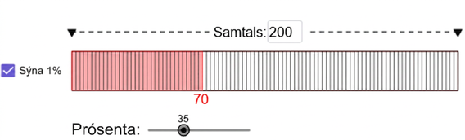
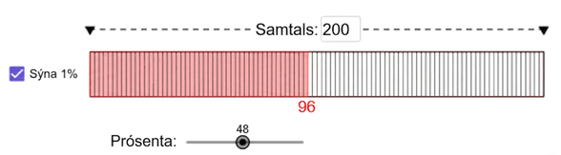
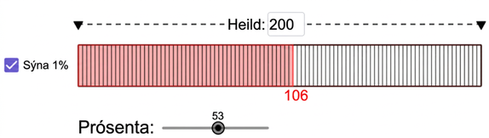
Warm Up - Math Talk 🗣️
You are going to evaluate the percentage of a number mentally. Two visual examples have been provided. Look for a pattern that can be used to describe how to find the percentage of any number.
Notes:
Warm Up (5 minutes)
This Math Talk helps students use their understanding of fractions, decimals, and percent to solve problems mentally. It sets the stage for later work on percent increases and write an equation to generalize the calculation.
Students find different percents of the same number (200), which encourages repeated reasoning and noticing patterns. They may:
Convert percents to fractions (e.g., 25% as ¼) and multiply by 200
Use decimals (e.g., 0.25 × 200)
Recognize that 1% of 200 is 2, so any percent of 200 is just 2 × that percent (e.g., 25% = 25 × 2 = 50, or 2p)
This activity deepens students’ number sense and prepares them for using percent in more complex contexts.
Launch
Display one problem at a time, if possible. Give students quiet time to think individually for each problem and ask them to give a signal when they have an answer and a strategy. Keep all problems displayed throughout the talk. Follow with a whole-class discussion.
Activity questions, answers, and synthesis on the next slide.

Slide 8
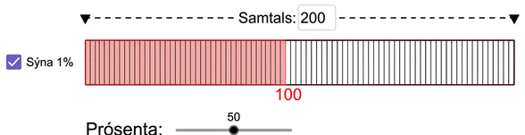
Warm Up - Math Talk 🗣️
For each question, explain your reasoning. Use the model for reference.
What is 25% of 200?
What is 12% of 200?
What is 8% of 200?
What is p% of 200?
Notes:
Activity Answers
50
24
16
Your answers may vary, here are some examples: 2p; p/100 ⋅ 200; change the percentage to a decimal and multiply it by 200; since percent means “per hundred” and there are two hundreds, the percentage is multiplied by two.
Activity Synthesis
Ask students to share their strategies for each problem. Record and display their responses for all to see. To involve more students in the conversation, consider asking:
“Who can restate _____’s reasoning in a different way?”
“Did anyone have the same strategy but would explain it differently?”
“Did anyone solve the problem in a different way?”
“Does anyone want to add on to ______’s strategy?”
“Do you agree or disagree? Why?”
If one of the strategies shown in the Narrative is not mentioned, consider sharing it with students.

Slide 9

Lesson Journey
Warm Up
Learning Activity
Cool Down
Lesson Synthesis
Learning Activity
Learning Activity
Practice

Slide 10
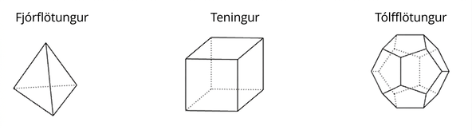
Learning Activity - Platonic Solids 🎲
In what ways are the three figures alike? In what ways are they different?
Notes:
Support for All Learners
This activity offers additional support and an extension for students:
For english language learners and students with disabilities, be sure to review the Learning Strategies slide!
For students looking for an extra challenge, be sure to review the Extending Your Thinking slide!
Activity (10 minutes)
Have students close their books or devices. Display the images of the three Platonic solids. Ask: “In what ways are the three figures alike? In what ways are they different?” Students might note similarities:
They are all 3D shapes.
Each Platonic solid has only one kind of polygon for its faces (triangle for the tetrahedron, square for the cube, and pentagon for the dodecahedron).
The faces of each figure seem to be regular polygons (or polygons whose sides are equal in length).
All have an even number of faces, edges, and vertices.
And differences:
Each has a different type of polygon for its faces (triangle, square, pentagon)
They all have a different number of faces, vertices, and edges.
If students use informal terms like "lines" or "points," review faces, edges, and vertices. Tell students that they will now investigate the relationships between the faces, vertices, and edges in each polyhedron.
Continued activity and synthesis on the next slide.

Slide 11
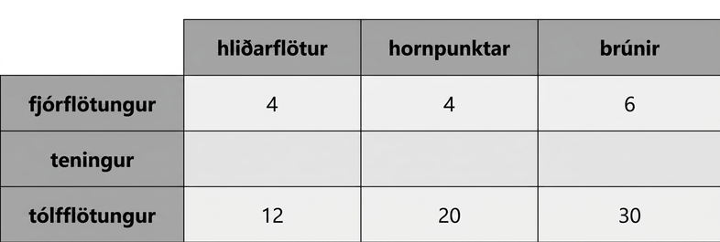
Learning Activity - Platonic Solids 🎲
The table shows the number of faces, vertices, and edges for the tetrahedron and dodecahedron.
Determine the following values regarding the cube.
Number of faces.
Number of edges.
Number of vertices.
Are you ready for more?
Notes:
Anticipated Misconceptions
Watch for confusion between vertices, edges, and faces—make sure students know what to count. If students notice a pattern like “you always get two more,” encourage them to write it as an equation and test it with an example. If it doesn’t work, have them revise it. Ask if different equations represent the same pattern. It’s enough for students to show the equations match the table; they don’t need to explain why they’re equivalent yet—that will come in future lessons.
Activity Synthesis
Have students share what they notice about the quantities and patterns in the table. Some observations may not true for all Platonic solids. For now, it is sufficient that they are supported by the values in the table.
Then, guide students to express the relationship as an equation, like V + F − 2 = E. Write down all correct versions (e.g., V + F − E = 2, V + F − E − 2 = 0), and ask if they all show the same pattern. Students don’t need to explain why they’re equivalent yet—they’ll explore that more in future lessons.
Activity Answer
6 faces
8 edges
12 vertices
ASK: “What do you notice about the relationships between the numbers of faces (F), edges (E), and vertices (V) of the Platonic solids?
(Answers may vary: I noticed all the numbers are even; I noticed the number of faces is less than or equal to the number of vertices, or F ≤ V; I noticed the number of edges is always greater than the number of faces, or E > F)
ASK: What do you wonder about the relationships between the numbers of faces, edges, and vertices of the Platonic solids?
(Answers may vary: I wonder if the number of edges is always less than the sum of the number of faces and the number of vertices, or E < F + V; I wonder if there is an equation that connects all of the variables)
SAY: There is a relationship that can be expressed with an equation using all three values: F, V, E. Write the equation that represents this relationship.
(The number of edges is 2 less than the sum of the other two numbers, or V + F − 2 = E)

Slide 12

Learning Strategies - Platonic Solids 🎲
Teacher Instruction: Use these strategies to adjust the activity to support english language learners and students with disabilities.
You can copy and paste the callouts directly on top of the activity or give the instructions aloud.
Share your ideas using your own words.
You can use the words on the board to help you talk during group or class discussions.
Conversing
Use sticky notes or whiteboards to help you remember your thinking.
Representation
Notes:
Support for English Language Learners: MLR 2 Collect and Display: Conversing
During the launch, listen for and collect language students use to describe how the three Platonic solids are alike and different. Record informal student language alongside the mathematical terms (vertices, edges, faces) on a visual display of the three solids and update it throughout the remainder of the lesson. Remind students to borrow language from the display as needed. This will provide students with a resource from which to draw language during small-group and whole-group discussions.
Design Principle(s): Maximize meta-awareness; Support sense-making
Provide support for students
Distribute graphic organizers to the students to assist them with participating in this routine.
Support for Students with Disabilities: Representation: Internalize Comprehension
To support working memory, provide students with sticky notes or mini whiteboards.
Supports accessibility for: Memory; Organization

Slide 13

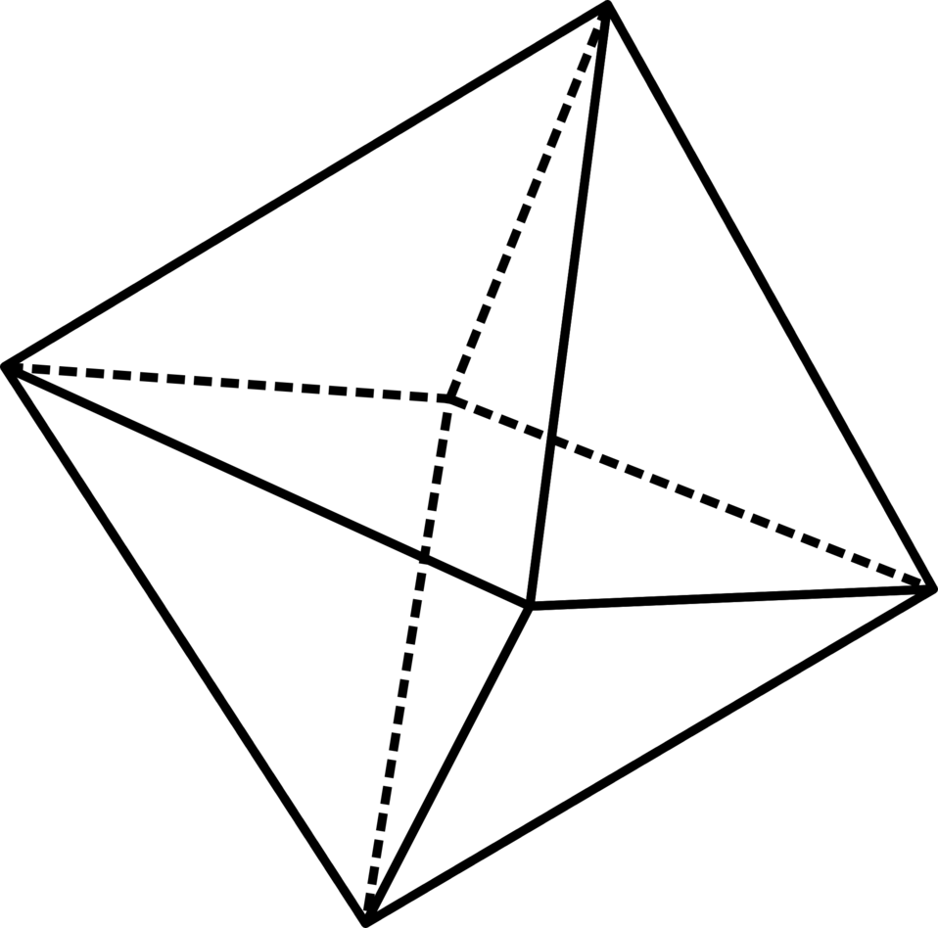
Extending Your Thinking
There are two more Platonic solids: an octahedron, which has 8 faces that are all triangles, and an icosahedron, which has 20 faces that are all triangles.
How many edges would (a) the octahedron and (b) the icosahedron have? (Keep in mind that each edge is used in two faces.)
Use your discoveries from the activity to determine how many vertices (a) the octahedron and (b) the icosahedron have.
For all 5 Platonic solids, determine how many faces meet at each vertex.
Notes:
Answer
The octahedron has 12 edges; the icosahedron has 30 edges.
The octahedron has 6 vertices; the icosahedron has 30 vertices.
The tetrahedron, cube, and dodecahedron have 3 faces meeting at each vertex. The octahedron has 4 faces meeting at each vertex. The icosahedron has 5 faces meeting at each vertex.

Slide 14
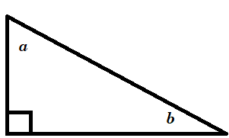
Self Check
The sum of the measures of the angles of a triangle is 180°. The right triangle shown has angle measures a, b, and 90°. Which equation could model this relationship?
ab + 90 = 180
a + b − 90 = 180
a + b + 90 = 180
90ab = 180
Let’s review!
Notes:
Answer Feedback - Individualized by Response
ab + 90 = 180
Incorrect. Let’s try again a different way: Sum means to add. The angles measures must be added. The sum is 180. The answer is a + b + 90 = 180.
a + b − 90 = 180
Incorrect. Let’s try again a different way: Sum means to add. The angles measures must be added. The sum is 180. The answer is a + b + 90 = 180.
a + b + 90 = 180
That’s correct! The measures of the angles must be added. The sum is 180. The answer is a+b+90=180.
90ab = 180
Incorrect. Let’s try again a different way: Sum means to add. The angles measures must be added. The sum is 180. The answer is a + b + 90 = 180.

Slide 15
Self Check - Review
When writing statements using algebraic symbols, the following steps may be helpful.
Step 1 - Read the problem: The sum of three consecutive integers is 372.
Step 2 - Identify the variables and known values.
Let x = the first integer. Each number that follows is 1 more than the number before it: x + 1 and x + 2. The sum of all three numbers is 372.
Step 3 - Write a sentence using the relationship among the values: The sum of x, x + 1 , and x + 2 is 372.
Step 4 - Translate the sentence into an equation: x + (x + 1) + (x + 2) =3 72; 3x + 3 = 372
Notes:
Additional Problems
The following two problems will provide students with a chance to work through the 4 steps independently or in small groups.
The sum of three consecutive integers is 1,623.
The sum of three consecutive odd integers is 93.
Answers
x + (x + 1) + (x + 2) = 1,623; 3x + 3 = 1,623
x + (x+2) + (x+4) = 93; 3x + 6 = 93

Slide 16
Lesson Journey
Warm Up
Learning Activity
Cool Down
Lesson Synthesis
Learning Activity
Learning Activity
Practice

Slide 17
Learning Activity - Writing Equations ✍️
Write an equation to represent each situation.
Blueberries are $4.99 a pound. Diego buys b pounds of blueberries and pays $14.95.
Blueberries are $4.99 a pound. Jada buys p pounds of blueberries and pays c dollars.
Blueberries are d dollars a pound. Lin buys q pounds of blueberries and pays t dollars.
Notes:
Support for All Learners
This activity offers additional support and an extension for students:
For english language learners and students with disabilities, be sure to review the Learning Strategies slide!
Activity (10 minutes)
In this activity, students write equations for two situations, first using numbers and variables, then using only variables. This helps them understand that both known and unknown quantities—whether fixed or changing—can be represented with numbers or letters.
Launch
Let students know that they will now begin exploring a variety of different scenarios beyond Geometry. Each scenario will have the theme of representing quantities and relationships with expressions and equations.
Activity questions, answers, anticipated misconceptions, and synthesis on the next slide.

Slide 18
Learning Activity - Writing Equations ✍️
Noah earned n dollars over the summer. Mai earned $275, which is $45 more than Noah did.
Noah earned v dollars over the summer. Mai earned m dollars, which is 45 dollars more than Noah did.
Noah earned w dollars over the summer. Mai earned x dollars, which is y dollars more than Noah did.
How are the equations you wrote for the blueberry purchases like the equations you wrote for Mai’s and Noah’s summer earnings? How are they different?
Notes:
Answers
4.99 ⋅ b = 14.95
4.99 ⋅ p = c
d ⋅ q = t
n + 45 = 275 or 275 − 45 = n (or equivalent)
v + 45 = m or m − 45 = v (or equivalent)
w + y = x or x − y = w (or equivalent)
Both sets of equations are similar in structure
Each equation involves three quantities
The first equation has two known values, the second has one, and the third has none.
They differ in content and operation
The quantities differ: Set 1 uses unit price, pounds, and total cost; Set 2 uses Noah’s earnings, Mai’s earnings, and their difference
Set 1 involves multiplication; Set 2 involves addition or subtraction.
Anticipated Misconceptions
Students may translate “Mai earned m dollars, which is 45 more dollars than Noah did” as m + 45 = v, not paying attention to where the plus sign should go. As with other problems throughout this unit, encourage students to try using numbers in their equation to see if the equation really says what they want it to say.
Activity Synthesis
Focus the discussion on how the two sets of equations are alike, then explore how the equations within each set differ. If students mention known or unknown quantities, ask them to specify which are which.
Emphasize that we often use letters to represent quantities that are unknown or changing—but sometimes also for known values to highlight relationships rather than specific numbers. Let students know they’ll see more examples of this in upcoming activities.

Slide 19
Learning Strategies - Writing Equations ✍️
Share your answer with one or two classmates. Listen to their ideas, too.
Ask or answer questions like: “Can you describe the quantities?” “What operation did you use?” “Can you give a different example?”
Use your partner’s feedback to fix or add to your writing. Try to make your explanation clearer.
Stronger and Clearer
Teacher Instruction: Use these strategies to adjust the activity to support english language learners and students with disabilities.
  You can copy and paste the callouts directly on top of the activity or give the instructions aloud.
Think of 3 different situations. Write an equation for each one. Take your time.
Engagement
Notes:
Support for English Language Learners: MLR 1 Stronger and Clearer Each Time: Writing, Listening, Conversing
Use this routine to help students improve their written responses to the final question. Give students time to meet with one to two partners to share and get feedback on their responses. Display feedback prompts that will help students strengthen their ideas and clarify their language. For example, “Can you describe the quantities?,” “What operation was used?,” and “Can you try to explain this using a different example?” Invite students to go back and revise their written explanation based on the feedback from peers. This will help students understand situations in which quantities are related through communicating their reasoning with a partner.
Design Principle(s): Optimize output (for explanation); Cultivate conversation
Provide support for students
Distribute graphic organizers to the students to assist them with participating in this routine.
Support for Students with Disabilities: Engagement: Provide Access by Recruiting Interest
Leverage choice around perceived challenge. Invite students to write equations for three to four of the situations they select. Chunking this task into more manageable parts may also benefit students who benefit from additional processing time.
Supports accessibility for: Organization; Attention; Social-emotional skills

Slide 20
Self Check
Max and Jules are renting a car for their 3-day trip. The rental company charges $50 per day and $0.40 per mile driven. Which is a possible equation for their cost of the rental car?
C = 50(3) + 40m
C = 50m + 40(3)
C = 50(3) + 40(3) + 0.40m
C = 50(3) + 0.40m
Let’s review!
Notes:
Answer Feedback - Individualized by Response
C = 50(3) + 40m
Incorrect. The cost per mile should represent 40 cents, which is 0.40. The correct answer is C = 50(3) + 0.40m.
C = 50m + 40(3)
Incorrect. This equation shows they traveled 3 miles. The number of miles is unknown, m, and the cost per mile should be 0.40. The cost per day is $50, and the number of days is known, 3. The correct answer is C = 50m + 40(3).
C = 50(3) + 40(3) + 0.40m
Incorrect. Look for the known and unknown values. The cost per day is known, $50. The number of days of the trip is known, 3. The number of miles driven is unknown, m. The cost per mile is known, $0.40. The correct answer is C = 50m + 40(3).
C = 50m + 40(3)
That’s Correct! They will pay $50 times 3 days plus 0.40 multiplied by the number of miles, C = 50m + 40(3).

Slide 21
Self Check - Review
Translate the following scenario into an equation:
A married couple together earns $110,000 a year. The wife earns $16,000 less than twice what her husband earns. What does the husband earn?
Step 1 - After reading the problem, what are some of the known variables identified in the description?
Step 2 - Identify a variable and describe what it represents for this scenario.
Step 3 - What sentence can be used to describe the relationship among the values?
Step 4 - What equation can be used to represent the scenario?
Notes:
Answers
Together the husband and wife earn $110,000 a year; the wife earns $16,000 less than twice what her husband earns.
2h − 16,000 = the amount the wife earns; let h = the amount the husband earns.
Together the husband and wife earn $110,000.
h + 2h − 16,000 = $110,000
Additional Instruction
Watch the following video to support your instruction on writing an equation to represent a real-world problem.

Slide 22
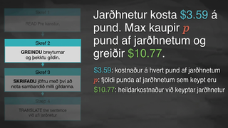
Video: Writing an Equation to Represent a Real-World Problem

Slide 23
Lesson Journey
Warm Up
Learning Activity
Cool Down
Lesson Synthesis
Learning Activity
Learning Activity
Practice

Slide 24
Learning Activity - Total Car Costs 🚙
The tax on the sale of a car in Michigan is 6%. At a dealership in Ann Arbor, a car purchase also involves $120 in miscellaneous charges. *Each equation should describe the relationship between all the quantities when given specific information.
Write an equation representing the total price if the original car price is $9,500.
Write an equation representing the total price if the original car price is $14,699.
Write an equation if the total price is $22,480.
Write an equation representing the total price if the original car price is p.
Notes:
Activity (10 minutes)
This activity gives students another chance to represent relationships with numbers and variables, reason through patterns, and understand how equations help generalize relationships. In each car purchase scenario, students identify four key quantities. At least one is unknown, prompting students to name it (e.g., "total price") or assign a variable (e.g., T or p). Watch for the different ways students represent these unknowns.
Launch
Ask students if they’ve ever paid sales tax and to briefly explain how it works.Let them know car purchases include sales tax (a percentage of the price) and additional dealership fees. Tell students that they will write equations showing the relationship between car price, tax, fees, and total cost—no need to calculate, just model. Arrange students in groups of 2. Give them a few minutes of quiet work time and then a minute to discuss their responses with a partner. Follow with a whole-class discussion.
Activity questions, answers, anticipated misconceptions, and synthesis on the next slide.

Slide 25

Learning Activity - Total Car Costs 🚙
How would each equation you wrote change if the tax on car sales is r% and the miscellaneous charges are m dollars?
Notes:
Answers
T = 9,500 + 0.06(9,500) + 120 or T = 1.06(9,500) + 120
T = 14,699 + 0.06(14,699) + 120 or T = 1.06(14,699) + 120
22,480 = p + 0.06p + 120 or 22,480 = 1.06p + 120
T = p + 0.06p + 120 or T = 1.06p + 120
T = 9,500 + (r/100)(9,500) + m
T = 14,699 + (r/100)(14,699) + m
22,480 = p + (r/100)p + m
T = p + (r/100)p + m
Anticipated Misconceptions
Some students may struggle to write an expression with four quantities. If stuck, suggest they start by calculating the cost of a $9,500 car and show their work. In the first question, remind students not to confuse the total price with the original car price. If they do, prompt them to recheck the information.
In the last question, students may be unsure how to represent r% algebraically. Some may use r, others 0.0r. Refer them back to their earlier work and ask, “What did you multiply the price by? How did you turn 6 into 0.06?”
Activity Synthesis
Select students whose equations are equivalent but written in different forms. Display their equations for the class. Focus students’ attention on the first and last equation in questions 1 – 4 and first and last equation in question 5.
For the first question, the equations might be: T = 9,500 + 0.06(9,500) + 120 and T = p + 0.06p + 120. ASK: “In the first equation, what quantities do we know?” (Specific price, tax rate, fees); “When might it be useful to write an equation like this?” (When all values except one are known); In the other equation, what quantities do we know?” (Only tax rate and fees); “When might it be useful to write an equation like this?” (To create a general formula for any price, assuming the tax rate and miscellaneous charges are fixed).
For the second question, the equations might be: T = 9,500 + (r/100)(9,500) + m and T = p + (r/100)p + m. ASK: “In the first equation, what quantities do we know?” (Original price only); “When might it be useful to write an equation like this?” (When tax/fees are unknown); “In the other equation, what quantities do we know?” (Nothing specific); “Why might it be helpful to write an equation like this?” (To model all relevant quantities flexibly)
Key idea: We choose variables for known or unknown values depending on what we’re solving for or trying to understand.

Slide 26
Self Check
Sweet’s Candy Store charges $5.00 to fill a bag of candy. There is also a sales tax of 7% per purchase. Mrs. Lee buys 4 bags of candy for her children for Christmas. What is an equation that can represent the cost of the candy that Mrs. Lee buys?
C = 0.07(4(5)) + 4(5)
C = 0.07(4(5))
C = 4(5)
C = 0.07 + 4(5)
Let’s review!
Notes:
Answer Feedback - Individualized by Response
C = 0.07(4(5)) + 4(5)
That’s Correct! Mrs. Lee will pay $5 times 4 bags plus 7% of $5 times 4 bags for the purchase of the candy.
C = 0.07(4(5))
Incorrect. Be sure to include the original price of the 4 bags of candy at $5.00 a bag. The correct answer is C = 0.07(4(5)) + 4(5).
C = 4(5)
Incorrect. Be sure to include the tax amount multiplied by the cost of the candy. Then add the tax to the cost of the candy. The correct answer is C = 0.07(4(5)) + 4(5).
C = 0.07 + 4(5)
Incorrect. You must multiply the tax rate by the cost of the 4 bags of candy. The correct answer is C = 0.07(4(5)) + 4(5).

Slide 27
Self Check - Review
The steps for writing percent equations are the same—just convert the percent to a decimal first.
The label on Audrey’s yogurt said that one serving provided 12 grams of protein, which is 24% of the recommended daily amount. What is the total recommended daily amount of protein?
Step 1 – Read the problem.
Step 2 – Identify the variables and known values (sketch a picture if needed).
Step 3 – Write a sentence using the relationship among the values.
Step 4 – Translate the sentence into an equation.
Notes:
Answers
The label on Audrey's yogurt said that one serving provided 12 grams of protein, which is 24% of the recommended daily amount. What is the total recommended daily amount of protein?
1 serving = 12 grams of protein; 1 serving is 24% of recommended daily amount; Let a = total amount of protein (in grams).
12 grams is 24% of the total amount
12 = 0.24a

Slide 28

Lesson Journey
Warm Up
Learning Activity
Cool Down
Lesson Synthesis
Learning Activity
Learning Activity
Practice

Slide 29
Cool Down
A school choir is ordering T-shirts for its 75 members and has budgeted money for the cost. The printing company charges $3 per shirt plus $50 for each color printed.
Write an equation showing the relationship between the number of shirts, number of colors, and total cost. Define any variables you use.
Which quantities can change? Which ones stay the same?
Notes:
Cool Down (5 minutes)
Answers
75(3) + 50x = D (or equivalent). x represents the number of colors on the shirts. D represents the total cost in dollars.
Your answer may vary, but here is a sample: The shirt cost and fee per color are fixed. The number of colors, and the total cost, can vary based on how many colors are printed.
Response to Student Thinking - More Chances
Students will have more opportunities to understand the mathematical ideas in this cool down, so there is no need to slow down or add additional work to the next lessons. Instead, use the results of this cool down to provide guidance for what to look for and emphasize over the next several lessons to support students in advancing their current understanding. Lessons 1.4 and 1.5 provide additional opportunities to analyze the meaning of variables in equations and write equations to represent a situation.

Slide 30

Lesson Journey
Warm Up
Learning Activity
Cool Down
Lesson Synthesis
Learning Activity
Learning Activity
Practice

Slide 31

Practice
Put your hard work to action, practice what you’ve learned!
Notes:
Digital Practice: Access the practice pages at https://openstax.org/details/books/algebra-1

Slide 32

Lesson Journey
Warm Up
Learning Activity
Cool Down
Lesson Synthesis
Learning Activity
Learning Activity
Practice

Slide 33
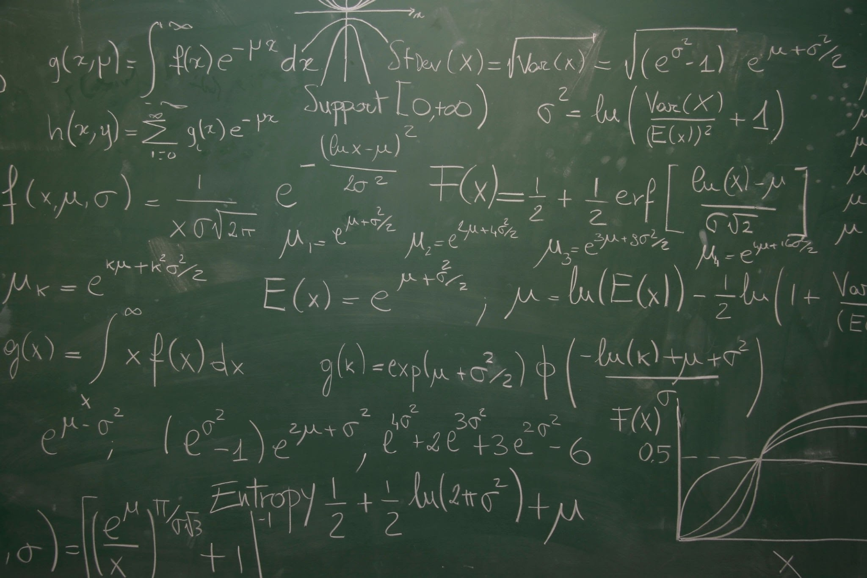
Lesson Synthesis
Think about what you learned today. Choose one or both questions to answer in writing:
When does it make sense to use only numbers in a situation? When is it better to use letters?
In your own words, what do “a quantity that varies” and “a quantity that stays constant” mean? Can you give an example of each?
Notes:
Prompt: In today’s lesson, we learned how to write equations to model real-world situations by using known and unknown values, applying operations like addition, subtraction, and multiplication, and reasoning about percentages and relationships between quantities. Use this knowledge to reflect on the following questions.
Answers:
Answers will vary, but here is an example: (a) It makes sense to use only numbers when all the values in a situation are known and won’t change—like finding the total cost of something when you know the exact price and tax. (b) It’s better to use letters when values can change or when you want to write a rule or formula—like using p to represent the price of any item.
Answers will vary, but here is an example: A quantity that varies is something that can change, like the number of hours you study each week. A quantity that stays constant doesn’t change, like the price of a notebook if it’s always $2. For example, if you earn $10 per hour, the total money you earn (which varies) depends on how many hours you work, while the $10 per hour (the rate) stays constant.

Slide 34
Self Assessment
How much do you agree with the following statements?
I can… | I can | Almost | Not yet
Tell which quantities in a situation can vary and which ones cannot.
Use letters and numbers to write equations representing the relationships in a situation.

