Slide 1


Algebra 1
Unit 5 Introduction to Exponential Functions
Lesson 5.9 Interpreting Exponential Functions

Slide 2
How to use these slides
On the activity slides check the speaker notes for teacher support and instructional information.
Each lesson includes 1 warm up, 2-3 learning activities, a cool down, practice and a lesson synthesis.
  Learning activities are followed by a self check question, and review section.
Some slides have been hidden from student view, more information can be found on the next slide (Reference Key).
You can edit and use these slides for personal and classroom use, but cannot sell them and must keep the attribution logos.
For more information, Check out the digital quick start guide!

Slide 3






Reference Key
Check the top right corner for an icon referencing these unique sections.
 | Support for Students with Disability | Hidden | Learning Strategies slide, provides additional support to students for understanding the activity. Learning Strategies slide, provides additional support to students for understanding the activity.
 | Support for English Language Learners | Hidden
 | Extending Your Thinking | Hidden | Extending Your Thinking slide, provides an extra challenge for students.
 | Self Check | Not Hidden | Self Check slide, checkpoint to assess student understanding after the learning activity.
 | Review | Hidden | Self Check- Review slide, designed to help review topics from the self check question.
On the next slides, check the speaker notes for teacher instructions and support.
Notes:
Check the Speaker Notes: On the next slides you can find discussion questions, lesson information, answers to the activities, and ways to adjust the activity for your students!

Slide 4

Learning Goals
By the end of this lesson you will be able to -
Analyze a situation and determine whether it makes sense to connect the points on the graph that represents the situation.
Describe the relationship in a graph of an exponential function using function notation.
Notes:
Lesson Narrative
In this lesson, students revisit average rate of change and extend it to exponential functions. They calculate and compare average rates of change over different intervals to see that exponential growth and decay are not constant. Contexts such as coffee shop growth and solar cell costs help students reason abstractly and quantitatively.
Required Preparation
The blank paper is for the Paper Folding activity. Consider 1 sheet per student, or, to save paper, 1 sheet for every 2 students.
For the info gap activity, prepare 1 set of cut-up slips for every 2 students.
Acquire devices that can run Desmos (recommended) or other graphing technology. Graphing technology is required for the extension activity "Deciding on Graphing Window". It is ideal if each student has their own device.
Required Materials
Blank paper
Graphing technology
Pre-printed slips, cut from copies of the blackline master
Texas Essential Knowledge and Skills
A1(G) display, explain, and justify mathematical ideas and arguments using precise mathematical language in written or oral communication
A9(A) determine the domain and range of exponential functions of the form f(x)=ab^{x} and represent the domain and range using inequalities
A9(B) interpret the meaning of the values of a and b in exponential functions of the form f(x)=ab^{x} in real-world problems
A9(D) graph exponential functions that model growth and decay and identify key features, including y-intercept and asymptote, in mathematical and real-world problems
A9(E) write, using technology, exponential functions that provide a reasonable fit to data and make predictions for real-world problems

Slide 5
Vocabulary
Previous
Exponential function
  A function that has a constant growth factor. Another way to say this is that it grows by equal factors over equal intervals.t.
Domain
  The set of all possible input values for a function. Set of the first numbers or abscissa of the ordered pairs in a relationship.
Range
  The set of all possible output values for a function. Set of the second numbers in the ordered pairs of a relationship.
New
Asymptote
  A line which a graph of a function approaches closely but never touches.
Horizontal asymptote
  A line where the outputs of the function approach, as the inputs get larger and larger in either the positive or negative direction. This means the graph gets closer and closer to the line as you move to the right or left along the 𝑥-axis.
Notes:
Lesson Vocabulary
To support student understanding of key vocabulary:
Introduce and review the vocabulary words students will see in this lesson.
Encourage students to notice how these words are used and to include them in their math discussions and explanations—both written and oral.
Use a word wall to reinforce vocabulary. Sample word wall cards are available here.
For newcomers or students with beginning English proficiency, use these Quizlet sets to support vocabulary learning:
Unit 5 Spanish Vocabulary – use first to build understanding
Unit 5 Vocabulary (English) – use after anchoring in Spanish
Support for English Language Learners
ELPS 1(F) use accessible language and learn new and essential language in the process
ELPS 2(F) listen to and derive meaning from a variety of media such as audio tape, video, DVD, and CD ROM to build and reinforce concept and language attainment
ELPS 3(D) speak using grade-level content area vocabulary in context to internalize new English words and build academic language proficiency
ELPS 3(E) share information in cooperative learning interactions
ELPS 3(G) express opinions, ideas, and feelings ranging from communicating single words and short phrases to participating in extended discussions on a variety of social and grade- appropriate academic topics
ELPS 5(B) write using newly acquired basic vocabulary and content-based grade-level vocabulary

Slide 6





Lesson Journey
Warm Up
Learning Activity
Practice
Learning Activity
Cool Down
Lesson Synthesis

Slide 7
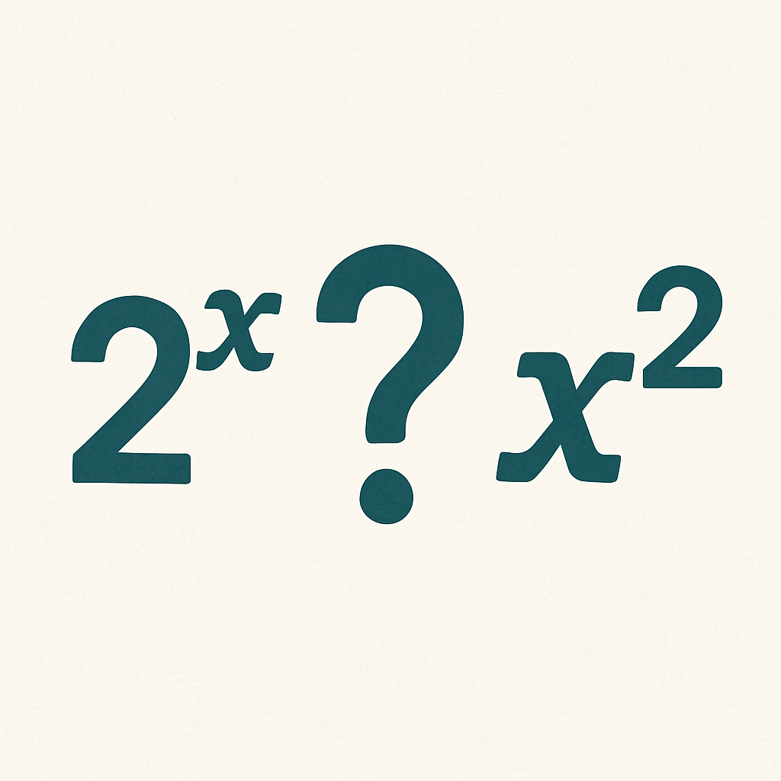
Warm Up - Is 2^{x} Equal to x² ? 🤔
Lin and Diego are discussing two expressions: x² and 2x.
Lin says, “I think the two expressions are equivalent.”
Diego says, “I think the two expressions are only equal for some values of x.”
Do you agree with either of them? Explain or show your reasoning.
Notes:
Warm Up (5 minutes)
This warm up addresses a common confusion among students mistaking the expression 2^{x} for the expression x². One good way to address this confusion is by evaluating the expressions for different values of x, which is the path students are likely to take here. Another way to illustrate the distinction is by graphing, though students are less likely to take this approach.
Launch
Display the task for all to see and ask students to read it quietly to themselves.
Ask what they think Lin means by equivalent. They may remember from earlier grades, or they may guess based on contrasting her statement with Diego’s statement.
Before they start working, be sure that students understand equivalent to mean equal no matter what value is used in place of x.
Activity Answers
I agree with Diego. Sample explanation: If we find the value of x² and 2^{x} for different values of x, say 0, 1, 2, 3, and 4, we can see that they are not always equal. As the table shows, they are only equal sometimes, for example, when x is 2 and 4.
x | x² | 2^x
---- |------ |------
1 | 1 | 2
2 | 4 | 4
3 | 9 | 8
4 | 16 | 16
5 | 25 | 32
10 | 100 | 1024
Anticipated Misconceptions
Some students might confuse finding an average of the values in the table with finding an average rate of change. Help them see that average usually involves one unit, such as average number of cookies. Average rate of change involves comparing how one quantity changes when another quantity changes by 1, such as cost ($) per year.
Activity Synthesis
The goal of this discussion is for students to recall the meaning of average rate of change for a function and how it is calculated. Select students to describe what the value of each expression represents in this context.
For example, p(10) − p(0) is the difference in cost for a solar cell between 1977 and 1987, while p(10) / p(0) could be used to identify the percent change from 1977 to 1987.
An important takeaway for students is that the actual expression for the average rate of change, p(10) - p(0) / 10 - 0 ≈ −7.55 tells us that the price decreased by –$7.55 each year on average since the expression looks at the total difference in price between 1977 and 1987 divided by the total number of years that passed.

Slide 8

Lesson Journey
Warm Up
Learning Activity
Practice
Learning Activity
Cool Down
Lesson Synthesis

Slide 9
Learning Strategies - The Cost of Solar Energy☀️
Teacher Instruction: Use these strategies to adjust the activity to support students with disabilities.
  You can copy and paste the callouts directly on top of the activity or give the instructions aloud.
Use color coding to match parts of the problem.
Highlight f(4) in the question.
Highlight the matching output value on the graph in the same color.
Remember: the x-coordinate is 4, and f(4) is the y-coordinate.
Representation
Notes:
Support for Students with Disabilities: Representation: Internalize Comprehension
Demonstrate and encourage students to use color coding and annotation to highlight connections between representations in a problem, for example, highlighting f(4) as written in the question and then highlighting the corresponding output value on the graph. Some students may benefit from reviewing that the x-coordinate is 4 and f(4) is the y-coordinate.
Supports accessibility for: Visual-spatial processing

Slide 10
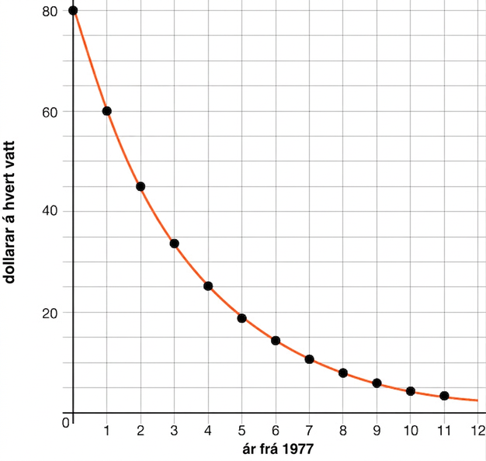
Learning Activity - The Cost of Solar Energy☀️
The cost, in dollars, to produce 1 watt of solar energy is a function of the number of years since 1977, t.
From 1977 to 1987, the cost could be modeled by this graph of the exponential function f.
What is the statement f(9) ≈ 6 saying about this situation?
What is f(4)? What about f(3.5)? What do these values represent in this context?
Notes:
Support for All Learners
This activity offers additional support for students:
For students with disabilities be sure to review the Learning Strategies slide!
Activity (15 minutes)
Previously, students were presented with descriptions of functions and, in one case, an equation that represents a function. In this activity, students are given the graph of a function and asked to analyze the underlying relationship and describe it using function notation.
The data used in this task are approximate, but the costs of solar energy during the time period mentioned in this activity can be appropriately modeled by an exponential decay model.
Launch
Ask what students already know about solar cells. Give a brief intro if needed: solar cells turn sunlight into electricity (measured in watts), and costs have decreased over time.
Read the task’s opening sentence and display the graph.
Explain the vocabulary word : An imaginary line that a function value will not touch or cross is called an asymptote. The value of the range that the function will never touch is called the horizontal asymptote. In the function graphed, the horizontal asymptote is y = 0.
Ask: Is the price per watt a function of time?
Ask: Is time a function of the price per watt?
Activity Answers
9 years after 1977 (or in 1986), the cost in dollars for 1 watt of solar energy was about $6.
f(4) ≈ 25, and f(3.5) ≈ 30. These values represent the cost in dollars of 1 watt of solar energy in 1981 (4 years after 1977) and halfway through 1980 (3.5 years after 1977).
More activity questions, answers, misconceptions, and synthesis on the next slide.

Slide 11
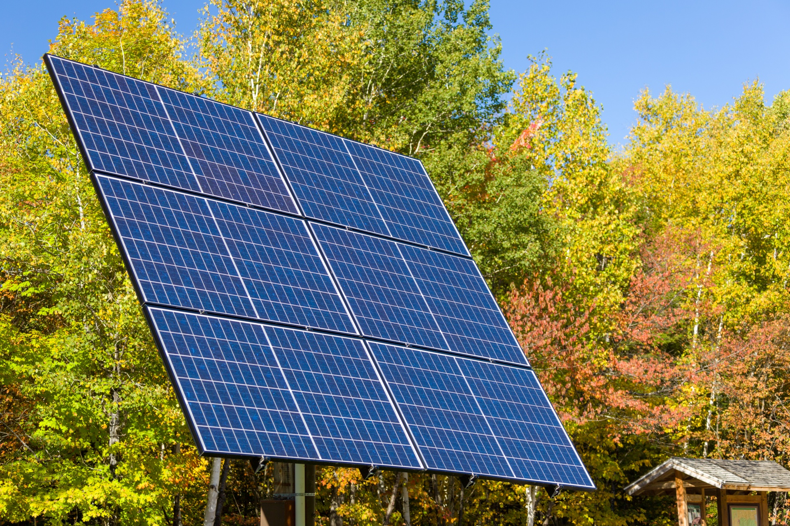
Learning Activity - The Cost of Solar Energy☀️
When f(t) = 45, what is t? What does that value of t represent in this context?
By what factor did the cost of 1 watt of solar energy change each year? (If you get stuck, consider creating a table.)
Notes:
Activity Answer
Compare your work: Your answer may vary, but here is a sample for each day.
2 years after 1977 (in 1979), the cost in dollars of 1 watt of solar energy was $45.
¾ or 0.75
Anticipated Misconceptions
If students struggle with the function notation in the questions, ask them to recall what each part of f(t) means, or remind them that the f is the name of the function, and the t is the input value.
Activity Synthesis
Focus the discussion on how students selected points on the graph to calculate the growth factor. Strategically, it is important to choose values of time t so that the price per watt f(t), in dollars, is unambiguous (for example, t = 0, t = 1, and t = 2). Because we are told that the price decreases exponentially, two values are enough to find the growth factor.
Interpreting statements such as f(4) = 25 in terms of the context is a chance to highlight precision in language, for example, to articulate that the 4 means 4 years after 1977 (1981), and the value f(4) = 45 means that each watt produced via solar energy cost $45 in 1981.

Slide 12
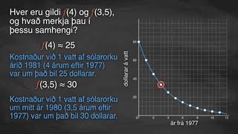
Video: Understanding Characteristics of Graphs

Slide 13
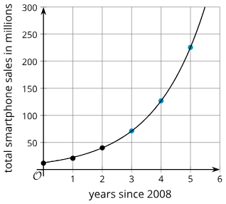
Self Check
The graph shows the total smartphones, s, in millions that were sold in the years, t, since 2008. What does the point (4,125) represent in this context?
In 2004, there were 125 million smartphones sold.
In 2012, there were 125 million more smartphones than in 2008.
In 2012, there were 125 million smartphones sold.
In 2004, there were 125 million more smartphones than in 2000.
Let’s review!
Notes:
Answer Feedback - Individualized by Response
Incorrect. When t = 4, this means 4 years after 2008.
Incorrect. The s value represents the total number sold, not a comparison.
That’s correct!: Since t = 4, the point represents 2012, 4 years after 2008. The s value is 125 and represents the number of millions of smartphones sold.
Incorrect. When t = 4, this means 4 years after 2008.

Slide 14
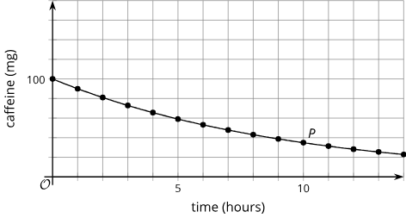
Self Check - Review
The graph describes the amount of caffeine, c, in a person’s body t hours after an initial measurement of 100 mg.
What does the point
c(10) = 35 mean?
What is the value of t when c(t) = 80?
Notes:
Reading Exponential Graphs
Answers
After 10 hours, there is 35 mg of caffeine in a person’s body.
When the caffeine concentration is 80 mg, time is 2 hours, so t = 2.

Slide 15
Lesson Journey
Warm Up
Learning Activity
Practice
Learning Activity
Cool Down
Lesson Synthesis

Slide 16
Learning Strategies - Folding Paper📄
How many folds does it take before the folded sheet of paper is more than 1 mm thick?
Consider this response: “It takes 4.5 folds, because I looked on the graph to check the points.”
Identify the error and critique the reasoning.
Write an improved explanation.
Share and discuss with a partner.
Be ready to share your corrected explanation with the class. Use both the graph and the table to show your thinking.
Clarify, Critique, Correct
Teacher Instruction: Use these strategies to adjust the activity to support English language learners.
You can copy and paste the callouts directly on top of the activity or give the instructions aloud.
Notes:
Support for English Language Learners: MLR 3 Clarify, Critique, Correct: Reading, Writing, Speaking
Present the question: “How many folds does it take before the folded sheet of paper is more than 1 mm thick?” Consider using this ambiguous response: “It takes 4.5 folds, because I looked on the graph to check the points.” Ask students to identify the error, critique the reasoning, and write an improved explanation. As students discuss with a partner, listen for students who identify and clarify the ambiguous language in the statement. Invite students to share their critiques and corrected explanations with the class. Listen for and amplify the language students use to describe the point using both the graph and a created table. This helps students evaluate, and improve on, the written mathematical arguments of others as they clarify their understanding of discrete graphs.
Design Principle(s): Optimize output (for explanation); Maximize meta-awareness
Learn more about this routine
View the instructional video and follow along with the materials to assist you with learning this routine.
Provide support for students
Distribute graphic organizers to the students to assist them with participating in this routine.

Slide 17

Learning Activity - Folding Paper📄
The thickness t in millimeters of a folded sheet of paper after it is folded n times is given by the equation t = (0.05)⋅2^{n}.
  What does the number 0.05 represent in the equation?
  What does the number 2 represent in the equation?
  Use graphing technology to graph the equation t = (0.05)⋅2^{n}.
  How many folds does it take before the folded sheet of paper is more than 1 mm thick? How many folds before it is more than 1 cm thick? Explain how you know.
Notes:
Support for All Learners
This activity offers additional support for students:
For English language learners be sure to review the Learning Strategies slide!
Activity (15 minutes)
In this activity, students graph equations about the thickness and area of a sheet of paper folded repeatedly. Since only whole numbers of folds make sense, they discuss why the graph should be discrete, unlike a continuous graph such as solar energy costs. This creates a chance to talk about interpreting models in context. Students may use tables, graphs, or equations to find how many folds reach a certain thickness, and these different methods can be shared with the class.
Launch
Ask students to research the world record for folding paper (currently 12 folds with a hydraulic press).
Give each student a sheet of paper to fold in half repeatedly (or work in pairs to save paper). Have them share how many folds they managed and estimate the thickness.
Explain that they will investigate the relationship between the number of folds and paper thickness.
Provide graphing technology and remind students to check the scale/window. Offer support as needed for graphing exponentials and adjusting axes.
Answers
a. The sheet of paper is 0.05 mm thick.
b. The number 2 indicates that the thickness doubles with each increment of n, the number of folds.
c. Link to Demos table and graph: https://www.desmos.com/calculator/0o5noqcumb
NOTE: n = x₁ and t = y₁
d. It takes 5 folds before the paper is more than 1 mm thick. After 4 folds, the paper is 0.8 mm thick, and after 5 folds, it is 1.6 mm thick. It takes 8 folds before the paper is more than 1 cm or 10 mm thick (1.28 cm to be precise).
More activity questions, answers, anticipated misconceptions, and synthesis on the next slide.

Slide 18
Learning Activity - Folding Paper📄
The area of a sheet of paper is 93.5 square inches.
  Find the remaining visible area of the sheet of paper after it is folded in half once, twice, and three times.
  Write an equation expressing the visible area a of the sheet of paper in terms of the number of times it has been folded, n.
  Use graphing technology to graph the equation.
In this context, can n take negative values? Be prepared to show your reasoning.
Can a take negative values? Be prepared to show your reasoning.
Identify the domain of the graph using an inequality.
Identify the range of the graph using an inequality.
What equation represents the horizontal asymptote?
Notes:
Answers
a. 46.75, 23.375, 11.6875 square inches
b. a = 93.5 ⋅ (12)^{n}
c. Link to Desmos graph: https://www.desmos.com/calculator/0o5noqcumb
d. 46.75, 23.375, 11.6875 square inches
e. a = 93.5 ⋅ (12)^{n}
f. Need to recreate graph and table
g. Need to recreate graph and table
h. Need to recreate graph and table
t = (0.05) ⋅ 2⁷ = (0.05)(128) = 6.4
t = (0.05) ⋅ 2⁰ = (0.05)(1) = 0.05
In this equation, the value of thickness of the paper t becomes larger as the number of folds n increases (approaches infinity). This means that, as the paper is folded an increasing number of times, the thickness has the potential to be infinite, but in reality, it can never quite reach it.
Anticipated Misconceptions
If students have trouble organizing their data points, suggest that they use a table.
Activity Synthesis
Focus the discussion on:
How students identified the growth factor, given an equation or a description.
How students determined how many folds are needed to reach a certain thickness. Invite previously identified students to share their strategies.
The meaningful values of the variables in the equations:
Highlight that a discrete graph is more appropriate in both situations: only the whole-number values make sense for the number of folds because it is not possible to fold the paper a fractional number of times.
Practically speaking, a large number of folds, such as 36, is not possible.
Demonstrate, using graphing technology, how to graph the equations and invite students to share how they chose an appropriate graphing window. If students just typed an equation, most likely the tool plotted a continuous curve. This is an opportunity to talk about interpreting the continuous graph in this context: really, only whole-number values for n are meaningful. Time permitting, you might demonstrate how to graph only whole number values of n using your graphing technology of choice. Typically, this is done by using the technology to generate a table based on a rule. Here is an example:
Link to the Desmos graph with the table: https://www.desmos.com/calculator/wjkooe0ct7
Time permitting, consider asking students if the equations t = (0.05) ⋅ 2^{n} and a = (93.5) ⋅ (½)^{n} could be plotted on the same set of axes. Even though the variable n (the number of folds) is the same for the two equations, the thickness t and the area a are measured in different units, so they cannot be plotted on the same axes.

Slide 19
Learning Activity - Folding Paper📄
Use the equation to make a prediction of the thickness with 7 folds.
The y-intercept represents the initial thickness of the paper t before folding (when n is zero). Calculate the value of the y-intercept.
The asymptote represents the possible limit of thickness of the paper as it is folded. What does this mean?
Notes:
Answers
t = (0.05) ⋅ 2⁷ = (0.05)(128) = 6.4
t = (0.05) ⋅ 2⁰ = (0.05)(1) = 0.05
In this equation, the value of thickness of the paper t becomes larger as the number of folds n increases (approaches infinity). This means that, as the paper is folded an increasing number of times, the thickness has the potential to be infinite, but in reality, it can never quite reach it.
Anticipated Misconceptions
If students have trouble organizing their data points, suggest that they use a table.
Activity Synthesis
Focus the discussion on:
How students identified the growth factor, given an equation or a description.
How students determined how many folds are needed to reach a certain thickness. Invite previously identified students to share their strategies.
The meaningful values of the variables in the equations:
Highlight that a discrete graph is more appropriate in both situations: only the whole-number values make sense for the number of folds because it is not possible to fold the paper a fractional number of times.
Practically speaking, a large number of folds, such as 36, is not possible.
Demonstrate, using graphing technology, how to graph the equations and invite students to share how they chose an appropriate graphing window. If students just typed an equation, most likely the tool plotted a continuous curve. This is an opportunity to talk about interpreting the continuous graph in this context: really, only whole-number values for n are meaningful. Time permitting, you might demonstrate how to graph only whole number values of n using your graphing technology of choice. Typically, this is done by using the technology to generate a table based on a rule. Here is an example:
Link to the Desmos graph with the table: https://www.desmos.com/calculator/wjkooe0ct7
Time permitting, consider asking students if the equations t = (0.05) ⋅ 2^{n} and a = (93.5) ⋅ (½)^{n} could be plotted on the same set of axes. Even though the variable n (the number of folds) is the same for the two equations, the thickness t and the area a are measured in different units, so they cannot be plotted on the same axes.

Slide 20
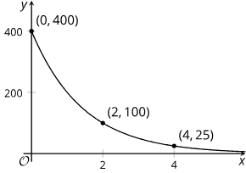
Self Check
The graph represents the function that gives the value of a computer in dollars, y, as a function of time, x, measured in years since the time of purchase.
What is the range for this graph and situation?
0 < y ≤ 400
x ≥ 0
y ≥ 0
y ≤ 400
Let’s review!
Notes:
Answer Feedback - Individualized by Response
That’s correct! The largest y-value is the starting price of the computer, $400, and the lowest value will approach 0 but never actually equal $0.
Incorrect. This is the domain.
Incorrect. The value of the computer will not go above the starting value of $400. The value of the computer will get close to zero, but it will never reach 0.
Incorrect. The range in this situation cannot be negative because the computer value will not ever be negative.

Slide 21
Self Check - Review
The graph describes the amount of caffeine, c, in a person’s body t hours after an initial measurement of 100 mg. The equation of this curve is y = 100(1 − 0.1)^{t}.
What is the smallest value c can reach?
Can t ever take on negative values?
What are the lowest and highest values for t?
Notes:
Domain and Range of Exponential Graphs
Discuss the Answers with the Students:
Since c is the amount of caffeine, it can get close to 0.
No, time will not be negative in this relationship because time is moving forward.
At the beginning, t = 0, and t can go as long as it takes for c to get so close to 0 it is insignificant.
The domain (or values of t) written as an inequality is t ≥ 0.
The range (or values of c) written as an inequality is 0 < c ≤100.

Slide 22

Lesson Journey
Warm Up
Learning Activity
Practice
Learning Activity
Cool Down
Lesson Synthesis

Slide 23
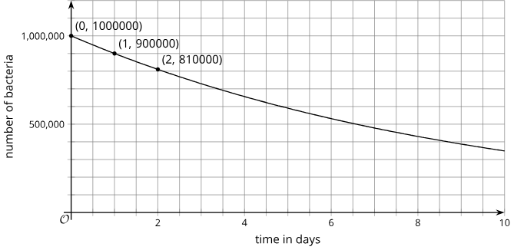
Cool Down
The graph shows the bacteria population on a petri dish as a function f of the days d since an antibiotic is introduced.
What is the approximate value of f(4.5)?
Approximately what is d when f(d)=400,000?
Explain what you would do, using your usual graphing technology, to be able to see f(15) on the graph.
Notes:
Cool Down (5 minutes)
Launch
In case students are unfamiliar with antibiotics, explain that they kill bacteria and keep bacteria from reproducing.
Answers
The exact value is 622,431, but reasonable approximations should be greater than 600,000 and less than 650,000.
The value to one decimal place is 8.7, but reasonable approximations should be greater than 8.5 and less than 9.
Answers vary based on what graphing technology is used.
Response to Student Thinking - Points to Emphasize
Students will have more opportunities to interpret graphs, so use the results from this cool-down to choose points to emphasize in subsequent lessons and highlight and reinforce strategies for identifying points on graphs.

Slide 24

Lesson Journey
Warm Up
Learning Activity
Practice
Learning Activity
Cool Down
Lesson Synthesis

Slide 25

Practice
Put your hard work to action, practice what you’ve learned!
Notes:
Digital Practice: Access the practice pages at https://openstax.org/k12/algebra

Slide 26

Lesson Journey
Warm Up
Learning Activity
Practice
Learning Activity
Cool Down
Lesson Synthesis

Slide 27
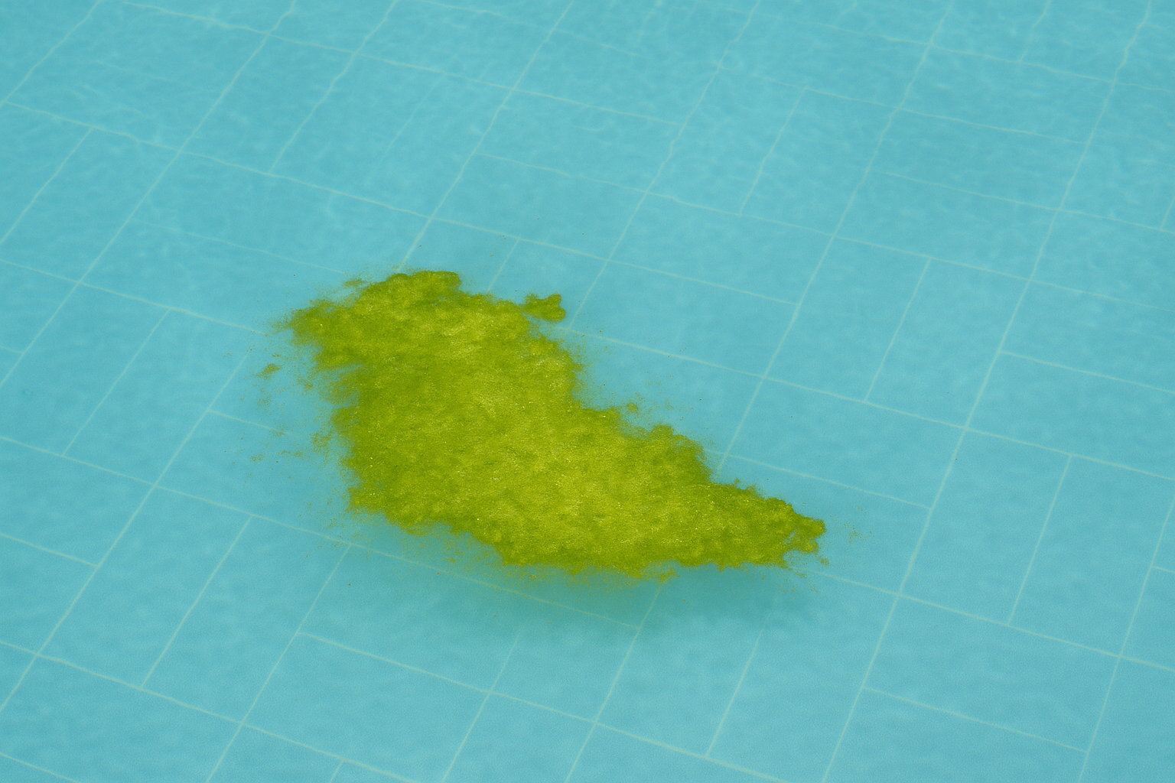
Lesson Synthesis
In a previous lesson, we saw that a function f defined by f(t) = 240(⅓)^{t} represents the area of algae in square yards after t weeks of treatment.
Let’s discuss how the equation can be used to:
produce a graph.
find the area of the algae 6 weeks after treatment.
find out when the area of the algae would drop below 10 square yards.
What does f(1)=80 and f(2)=⁸⁰⁄₃ mean in this context?
Notes:
In this lesson, students used exponential functions to answer questions about different situations.
To reiterate the importance of choosing an appropriate graphing window, ask students to give examples of a graphing window that would be appropriate (or inappropriate) for the function f(1)=80 and f(2)=⁸⁰⁄₃. Time permitting, demonstrate the outcomes of their suggestions using graphing technology.
Closing the Lesson
For more on the benefits of using metacognitive reflection, see the Research in Practice section of the course.

Slide 28
Self Assessment
How much do you agree with the following statements?
I can… | I can | Almost | Not yet
Analyze a situation and determine whether it makes sense to connect the points on the graph that represents the situation.
Describe the relationship in a graph of an exponential function using function notation.

