Slide 1
Algebra 1
Unit 5 Introduction to Exponential Functions
Lesson 5.8 Exponential Situations as Functions

Slide 2

How to use these slides
On the activity slides check the speaker notes for teacher support and instructional information.
Each lesson includes 1 warm up, 2-3 learning activities, a cool down, practice and a lesson synthesis.
  Learning activities are followed by a self check question, and review section.
Some slides have been hidden from student view, more information can be found on the next slide (Reference Key).
You can edit and use these slides for personal and classroom use, but cannot sell them and must keep the attribution logos.
For more information, Check out the digital quick start guide!
OpenStax CC BY NC SA

Slide 3





Reference Key
Check the top right corner for an icon referencing these unique sections.
Icon | Title | View | Location and Description
n/a | Support for Students with Disability | Hidden | Learning Strategies slide, provides additional support to students for understanding the activity.
n/a | Support for English Language Learners | Hidden | Learning Strategies slide, provides additional support to students for understanding the activity.
n/a | Extending Your Thinking | Hidden | Extending Your Thinking slide, provides an extra challenge for students.
n/a | Self Check | Not Hidden | Self Check slide, checkpoint to assess student understanding after the learning activity.
n/a | Review | Hidden | Self Check - Review slide, designed to help review topics from the self check question.
On the next slides, check the speaker notes for teacher instructions and support.
Notes:
Check the Speaker Notes: On the next slides you can find discussion questions, lesson information, answers to the activities, and ways to adjust the activity for your students!

Slide 4

Learning Goals
By the end of this lesson you will be able to -
Use function notation to write equations that represent exponential relationships.
Determine whether the relationships in descriptions, tables, equations, or graphs are functions.
Notes:
Lesson Narrative
Prior to this lesson, students studied situations characterized by exponential change using descriptions, tables, graphs, and equations. In this lesson, they start to view these relationships as exponential functions. The contexts here are chosen and presented so that it is more natural to choose an independent variable that leads to an exponential function.
Required Preparation
Devices that can run Desmos (recommended) or other graphing technology should be available as an option for students to select during the lesson. It is ideal if each student has their own device.
Required Materials
Graphing technology
Texas Essential Knowledge and Skills
A1(E) create and use representations to organize, record, and communicate mathematical ideas.
A9(B) interpret the meaning of the values of 𝑎 and 𝑏 in exponential functions of the form 𝑓(𝑥) = 𝑎𝑏^{𝑥} in real-world problems.
A9(C) write exponential functions in the form 𝑓(𝑥) = 𝑎𝑏^{𝑥} (where 𝑏 is a rational number) to describe problems arising from mathematical and real-world situations, including growth and decay.

Slide 5
Vocabulary
Previous
Function
  A relation that takes inputs from one set and assigns them to outputs from another set, assigning exactly one output to each input.
New
Exponential function
  A function that has a constant growth factor. Another way to say this is that it grows by equal factors over equal intervals.
Notes:
Lesson Vocabulary
To support student understanding of key vocabulary:
Introduce and review the vocabulary words students will see in this lesson.
Encourage students to notice how these words are used and to include them in their math discussions and explanations—both written and oral.
Use a word wall to reinforce vocabulary. Sample word wall cards are available here.
For newcomers or students with beginning English proficiency, use these Quizlet sets to support vocabulary learning:
Unit 5 Spanish Vocabulary – use first to build understanding
Unit 5 Vocabulary (English) – use after anchoring in Spanish
Support for English Language Learners
ELPS 2(F) listen to and derive meaning from a variety of media such as audio tape, video, DVD, and CD ROM to build and reinforce concept and language attainment.
ELPS 3(D) speak using grade-level content area vocabulary in context to internalize new English words and build academic language proficiency.
ELPS 4(F) use visual and contextual support and support from peers and teachers to read grade- appropriate content area text, enhance and confirm understanding, and develop vocabulary, grasp of language structures, and background knowledge needed to comprehend increasingly challenging language.

Slide 6
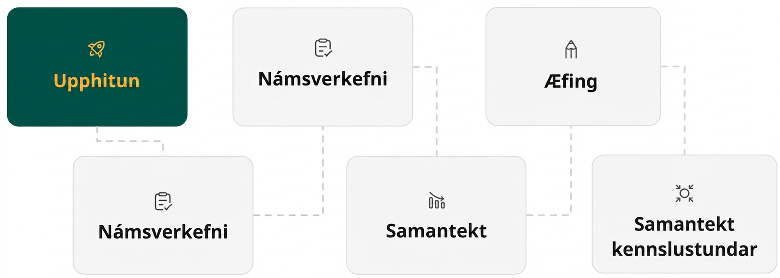
Lesson Journey
First Stop: Warm Up

Slide 7

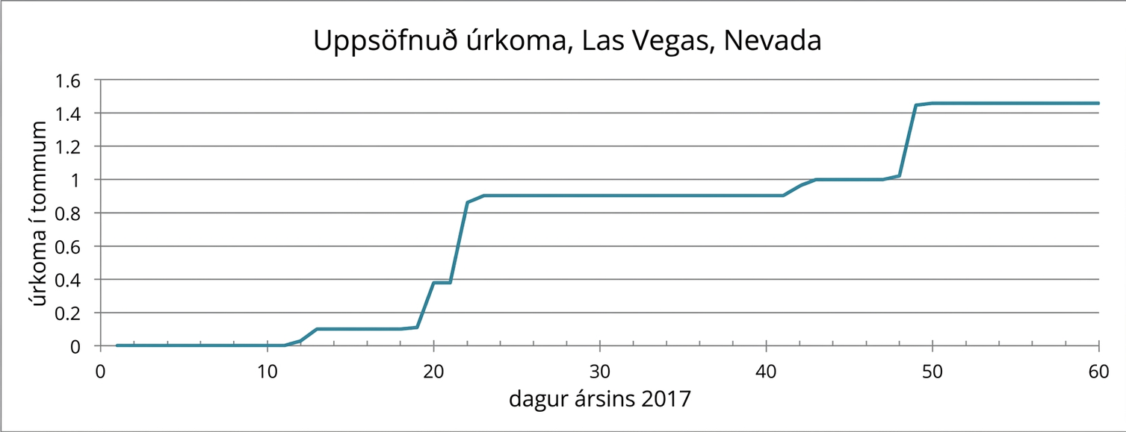
Warm Up | Part 1
Notice & Wonder 👀
Notes:
Warm Up (5 minutes)
The goal of this warm up is to review the meaning of a function presented graphically. While students do not need to use function notation here, interpreting the graph in terms of the context will prepare them for their work with functions in the rest of the unit.
Launch
Tell students to close their books or devices.
Display the graph for all to see.
Ask students to observe the graph and be prepared to share one thing they notice and one thing they wonder.
Select students to briefly share one thing they noticed or wondered to help ensure all students understand the information conveyed in the graph.
Ask students to open their books or devices and answer the questions about the graph.
Follow with a whole-class discussion.
Activity questions, answers, and synthesis on the next slide.

Slide 8
Warm Up | Part 2
Notice & Wonder 👀
Is the accumulated amount of rainfall a function of time?
Is time a function of accumulated rainfall?
Notes:
Answers
Yes. For each number of days 𝑑 between 0 and 60, a certain amount of rain fell up to that time, so there is one particular value for the accumulated rain at any point in time.
No. There was no rainfall in the first 10 days. This means that for the amount of rainfall 0 inches, or for the input value of 0, there are lots of times 𝑑 that could be the output.
Anticipated Misconceptions
If students struggle to see from the graph how the accumulated rainfall is a function of time but time is not a function of accumulated rainfall, consider displaying the data in a table. The online textbook depicts a data table for the first 20 days of 2017 (also provided here in Google Sheets). Help students see that for every value of 𝑡, the time in days, there is one value of 𝑟, the accumulated rainfall in inches, but this is not true the other way around.
Activity Synthesis
Make sure students understand why the accumulated rain is a function of time but not the other way around.
Then, recall the notation for writing, using function notation, accumulated rainfall as a function of time. If 𝑟 represents the amount of rainfall in inches and 𝑡 is time in days, then 𝑟(𝑡) is the amount of rain that has fallen in the first 𝑡 days of 2017. For example, 𝑟(2) = 0 tells us that the accumulated rainfall in the first two days of the year was 0 inches. 𝑟(48) = 1 means that there was 1 inch of accumulated rainfall in the first 48 days of the year. Ask students to write and explain the meaning of a few other statements using function notation.

Slide 9
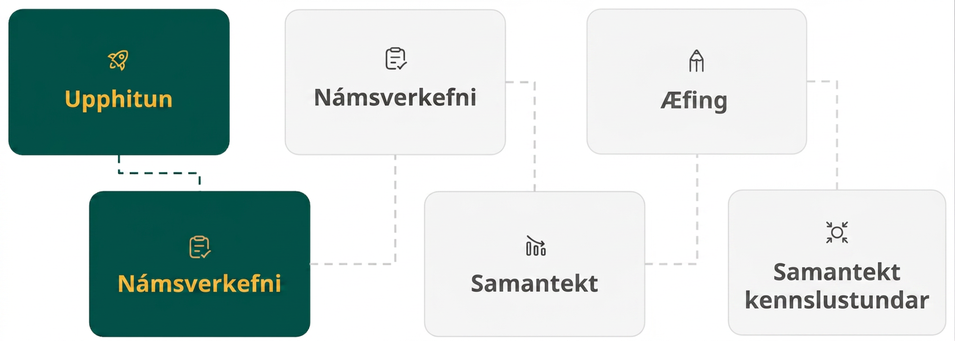
Lesson Journey
Second Stop: Learning Activity A

Slide 10

Learning Activity A | Learning Strategies
A Moldy Oldy 🍞
Prepare to share your thinking with the class.
Listen and watch for words and phrases that connect ideas for you.
Identify how the same situation can be described differently.
Collect and Display
Teacher Instruction: Use these strategies to adjust the activity to support English language learners and students with disabilities.
You can copy and paste the callouts directly on top of the activity or give the instructions aloud.
Sketch a slice of bread on graph paper.
Shade in the area that might be covered in mold after 1 day.
Shade the area covered in mold after 2 days
Repeat this until the bread is completely covered in mold.
Representation
Notes:
Support for English Language Learners: MLR 2 Collect and Display: Conversing
During the discussion, listen for and collect the language students use to describe the situation as a function. Call students’ attention to language such as “independent or dependent variable” or “input or output value.” Write the students‘ words and phrases on a visual display and update it throughout the remainder of the lesson. Remind students to borrow language from the display as needed. This will help students use mathematical language for describing an exponential function and determining which variable is a function of the other.
Design Principle(s): Maximize meta-awareness
Provide support for students
Distribute graphic organizers to the students to assist them with participating in this routine.
Support for Students with Disabilities: Representation: Internalize Comprehension
Represent the same information through different modalities by drawing a diagram. Encourage students who are unsure where to begin to sketch a diagram of a slice of bread on graph paper and to shade the area that is covered in mold after 1 day, then 2 days . . . until they reach the day when the slice of bread is completely covered in mold.
Supports accessibility for: Conceptual processing; Visual-spatial processing

Slide 11
Learning Activity A | Part 1
A Moldy Oldy 🍞
Clare noticed mold on the last slice of bread in a plastic bag. The area covered by the mold was about 1 square millimeter. She left the bread alone to see how the mold would grow. The next day, the area covered by the mold had doubled, and it doubled again the day after that.
If the doubling pattern continues, how many square millimeters will the mold cover 4 days after she noticed the mold? Show your reasoning.
Notes:
Support for All Learners
This activity offers additional support and an extension for students:
For English language learners and students with disabilities, be sure to review the Learning Strategies slide!
For students looking for an extra challenge, be sure to review the Extending Your Thinking slide!
Activity (15 minutes)
In this activity, students represent a situation using a table of values, a graph, and an equation. From the exponential equation, it is a short step to thinking of the relationship between the quantities as a function. Making graphing technology available gives students an opportunity to choose appropriate tools strategically.
Note that it is possible and acceptable to think of time as a function of area, but expressing this using an equation is out of the scope of this course. Students could, however, represent such a function with a graph, table, or description.
Launch
Place students in partners.
If needed, help students visualize what Clare noticed by providing short videos. Possible short videos:
Moulding of Bread by @FuturisticMedics: https://youtube.com/shorts/-osOtxHYKAY?si=_pKf-AecEdFl7-YO
Growth of Mould {Fungus} on Bread by @frnd_23: https://youtube.com/shorts/MrAm-jRCg_g?si=hOANQwwdxfaxP9kL
Answer
16 square millimeters. 2⋅2⋅2⋅2 or 2⁴ is 16.
Additional activity questions and answers, misconceptions and synthesis on the next slide.

Slide 12
Learning Activity A | Part 2
A Moldy Oldy 🍞
When Claire noticed the bread, the area covered by the mold was about 1 square millimeter. Each day after, the area covered by the mold doubled.
Represent the relationship between the area 𝐴, in square millimeters, covered by the mold and the number of days 𝑑 since the mold was spotted using a table of values, equation, and graph showing the values from the day the mold was spotted through 5 days.
Discuss with a partner: Is the relationship between the area covered by mold and the number of days a function? If so, write ____ is a function of ____. If not, explain why it is not.
Are you ready for more?
Notes:
Activity Answers
See this Google sheet for a table of values or access the online textbook.
Equation: A = 1 𑁦 2^{d} or A = 2^{d}
See this Desmos graph or access the online textbook.
Yes.
The area covered by mold is a function of the number of days that have passed. At any given time since mold was spotted, there is a certain area of the bread that is covered in mold.
The number of days that have passed is a function of the area covered by the mold up to a certain point (e.g., when the entire bread is already completely covered, the area of mold would correspond to more than one day). We do not have a way to write this relationship using an equation, but we could use a table or a graph to show the relationship.
Anticipated Misconceptions
Students may have trouble understanding how to account for time in the first question. They may benefit from writing the area after 1 day has passed, after 2 days have passed, etc. A table is a convenient way to gather this information.
Activity Synthesis
Discuss why the area covered by mold is a function of the number of days that have passed. Attend explicitly to language students learned in unit 4 on functions: The area of the mold 𝐴 is a function of the number of days 𝑑 since the mold was spotted, 𝐴 = 𝑓(𝑑). The function 𝑓 expressing the mold relationship can be written as 𝑓(𝑑) = 1 𑁦 2^{𝑑}, where 𝑑 measures days since the mold was spotted and 𝑓(𝑑) gives the area covered by the mold in square millimeters.
Discuss whether a discrete graph or a curve is more appropriate and what domain would be suitable in this context. Ask questions such as:
Can the independent variable be something like 1.5, a number that is not a whole number? Is there an area that is associated with 1.5 days? (Yes, some areas of the bread are covered by mold at any point in time. The mold doesn’t disappear after being spotted and then reappear at exactly 1 full day, 2 full days, etc.)
What would be the meaning of a point on the graph where the value of 𝑑 is, for instance, between 2 and 3?” (It would mean the area covered by mold at some point longer than 2 days but less than 3 days after mold was spotted.)
What domain would be appropriate for this function? Can the mold grow indefinitely? (Since the area of the bread (the range) is limited, the exponential growth cannot continue indefinitely. By the end of one week, more than 1 square cm will be covered and, by the end of the second week, the values of the function will be close to or will exceed the total area of the bread.)
Students using paper and pencil may decide that it makes sense to connect the points on the graph, but they will not yet know how to do so. Consider stating that they are connected (in a very specific way), and their properties will be studied later.
Students using graphing technology along with the paper and pencil version may see the continuous graph. If desired, you may want to demonstrate how using function notation to write the equation like 𝐴(𝑑) = 1 𑁦 2^{𝑑} can be put to use. Try typing 𝐴(2) or 𝐴(−1).

Slide 13

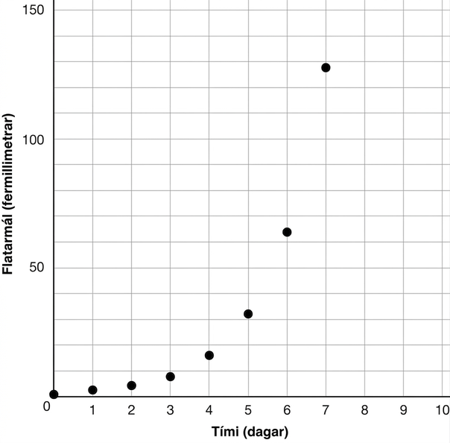
Learning Activity A
Extending Your Thinking
What do you think is an appropriate domain for the mold area function A? Be prepared to show your reasoning.
Notes:
Go back to Lesson Activity
Answer
Your answer may vary, but here is a sample: Some negative values of 𝑡 could be relevant, but we don’t know how the mold was growing before Clare started watching. Positive values of 𝑡 will not be valid indefinitely because the bread will soon be completely covered by mold. If a piece of bread is 10 cm by 10 cm, that’s 10,000 square mm. An appropriate domain would be 0 ≤ 𝑑 ≤ 14.

Slide 14
Learning Activity A
Self Check
Which of the following equations represents the values in the table?
y = 3x
y = 3 𑁦 1^{x}
y = 1 𑁦 3^{x}
y = 3x + 1
x | y
0 | 1
1 | 3
2 | 9
3 | 27
Let’s review!
Notes:
Answer Feedback - Individualized by Response
Incorrect. The values in the table are growing at an exponential rate, not a linear rate.
Incorrect. This equation only works when 𝑥 = 1 and 𝑦 = 3. A different exponential pattern is needed. Remember the base is the growth factor, 3.
That’s correct! When the exponent, 𝑥, is 3, the equation is equivalent to 3³ = 27. All values in the table follow this exponential pattern.
Incorrect. This equation only works when 𝑥 = 1 and 𝑦 = 3. The values in the table are growing at an exponential rate, not a linear rate.

Slide 15

Learning Activity A
Self Check - Review
For the function given below, create a table of values and then a graph.
g(x) = (½)^{x}
Why do you think the function is described as representing exponential decay?
What is the special name given to the x-axis for this function?
What is special about the point (0, 1) for this function?
Notes:
Remind Students
How to make the table of values (but substituting values of x into the function, f(x))
Answers
Access the online textbook for the table of values and graph or use this Google Sheet & Desmos graph.
The function is exponential because the values have a common ratio and it is decaying because the values decrease from left to right.
The special name given to the x-axis for this exponential function is an asymptote. An asymptote is a like a mathematical guide. The function gets closer and closer to the asymptote - or approaches it - but never reaches it.
The point (0, 1) is the y-intercept for the exponential function. It is also the value when the function is equal to 0. In a real world problem, if the y-value represents time, this is when t = 0.

Slide 16

Lesson Journey
Third Stop: Learning Activity B

Slide 17
Learning Activity B | Learning Strategies
I Can Write That Equation With 2 Variables 🎵♪♩
Teacher Instruction: Use these strategies to adjust the activity to support English language learners and students with disabilities.
  You can copy and paste the callouts directly on top of the activity or give the instructions aloud.
“I agree because … “
“I disagree because … “
Discussion Supports
What are all the words and phrases you can think of when we talk about y = a(b)^{x}?
How do the variables a, b, x, and y relate to some of the examples we have studied?
Representation
Notes:
Support for English Language Learners: MLR 8 Discussion Supports: Speaking, Representing
Use this routine to support whole-class discussion. After each student shares, provide the class with the following sentence frames to help them respond: “I agree because . . .” or “I disagree because . . . .” If necessary, revoice student ideas to demonstrate mathematical language use by restating a statement as a question to clarify, apply appropriate language, and involve more students.
Design Principle(s): Supports sense-making
Support for Students with Disabilities: Representation: Develop Language and Symbols
Create a display of important terms and vocabulary. Invite students to brainstorm vocabulary and phrases that they associate with each variable of 𝑦 = 𝑎(𝑏)^{𝑥}. Compile words and phrases that will assist students with setting up equations on a display. This may include labels such as “independent variable,” “dependent variable,” “multiplier,” and “starting point,” and also specific words explored in previous examples to incorporate prior knowledge. If referencing the moldy bread scenario, the labels of “output” and “input” can also be paired with “area” and “time,” respectively.
Supports accessibility for: Conceptual processing; Memory

Slide 18
Learning Activity B | Part 1
I Can Write That Equation With 2 Variables 🎵♪♩
For each scenario:
Write a sentence of the form: “__ is a function of __.”
Indicate which is the independent and which is the dependent variable.
Write an equation that represents the situation using function notation.
In a biology lab, a population of 50 bacteria reproduce by splitting. Every hour, on the hour, each bacterium splits into two bacteria.
Every year after a new car is purchased, it loses ⅓ of its value. Let’s say that the new car costs $18,000.
Notes:
Support for All Learners
This activity offers additional support for students:
For English language learners and students with disabilities, be sure to review the Learning Strategies slide!
Activity (15 minutes)
Students have described and analyzed situations involving exponential change, using graphs, tables, and equations. Now they revisit several of these contexts, viewing them as functions and expressing them using function language and notation.
Look for students who explicitly state the meaning of their variables, including units, and invite them to share during the discussion. For example, in the second situation, if 𝑡 represents the number of years and 𝑣 represents the value of the car, in dollars, after 𝑡 years, then 𝑣 can be viewed as a function 𝑓 of 𝑡 where 𝑓(𝑡) = 18,000(⅔)^{𝑡}. The meaning and units for both 𝑡 and 𝑓(𝑡) (or 𝑣) are vital elements to answering the question fully.
Continue scrolling down for information about how to launch this activity and answers to the activity questions.
Use the function 𝑓(𝑥) = 𝑎𝑏^{𝑥}, to explain dependent and independent variables.
Dependent variable: The dependent variable is the variable that depends on or is influenced by the independent variable. In this case, the dependent variable is 𝑓(𝑥), which represents the output or value of the function. It is determined by the value of 𝑥 and the parameters 𝑎 and 𝑏.
Independent variable: The independent variable is the variable that is not influenced by any other variable in the context of the function. It is typically 𝑥 and represents the input or value for which the function is evaluated. The independent variable can have various values, and it is the variable which can be controlled or manipulated.
In the given function 𝑓(𝑥) = 𝑎𝑏^{𝑥}, the value of 𝑓(𝑥) depends on the value of 𝑥, where 𝑎 and 𝑏 are constant parameters. By plugging in different values for 𝑥, we can determine the values of 𝑓(𝑥) using the given function.
So, In the function 𝑓(𝑥) = 𝑎𝑏^{𝑥}, the dependent variable is 𝑓(𝑥), and the independent variable is 𝑥.
Each situation involves two quantities, and students will need to choose one of these to be the independent variable and one to be the dependent variable. For all of these relationships, it is possible to choose either variable as the independent, but one choice gives a logarithmic function (which is out of the scope of this course), while the other gives an exponential function.
Launch
Tell students that they will now revisit some previously seen situations.
Ask students to read the three situations in the task.
Then solicit a few ideas on why all of them can be seen as functions.
Answers
a. The number of bacteria is a function of time passed in hours.
b. Independent: number of hours. Dependent: number of bacteria.
c. f(t) = 50 𑁦 2^{t}
a. The value of a car is a function of the number of years since purchase.
b. Independent: number of years since purchase of car. Dependent: value of car in dollars.
c. f(t) = 18,000 𑁦 (⅔)^{t}
NOTE: ⅓ is the rate, and growth rate = 1 – rate, so the growth factor is ⅔ because there is ⅔ left.
Additional activity questions, answers, anticipated misconceptions, and synthesis on the next slide.

Slide 19
Learning Activity B | Part 2
I Can Write That Equation With 2 Variables 🎵♪♩
For each scenario:
Write a sentence of the form: “__ is a function of __.”
Indicate which is the independent and which is the dependent variable.
Write an equation that represents the situation using function notation.
In order to control an algae bloom in a lake, scientists introduce some treatment products. The day they begin treatment, the area covered by algae is 240 square yards. Each day since the treatment began, a third of the previous day's area (in square yards) remains covered by algae. Time 𝑡 is measured in days.
Notes:
Answers
a. The area covered by algae is a function of the number of days since the treatment.
b. Independent: number of days since treatment. Dependent: area of algae in square yards.
c. f(t) = 240 𑁦 (⅓)^{t}
NOTE: ⅓ is given as the growth factor because it represents what remains.
Anticipated Misconceptions
Students may confuse the terms “independent” and “dependent.” Help them think about which variable depends on the other in context.
Activity Synthesis
Invite selected students to present their equations, making sure to indicate what each variable represents, as well as the units of the variable.
For the third question, point out that it is a short step from an equation for the area covered by the algae 𝐴 = 240 𑁦 (⅓)^{𝑡} to a similar equation with function notation. The equation gives the area covered by the algae at each time 𝑡, so a function 𝑓 can be defined using the same expression: 𝑓(𝑡) = 240 𑁦 (⅓)^{𝑡} and 𝐴 = 𝑓(𝑡).

Slide 20

Learning Activity B | Video
Writing an Exponential Function from a Situation
Notes:
This video discusses question 2 of activity 5.8.3.

Slide 21

Learning Activity B
Self Check
A new computer is purchased for $2,500. Each year after its purchased, it loses ⅕ of its value. Which equation represents this situation?
f(t) = 2500 + (⅘)^{t}
f(t) = 2500 𑁦 (⅘)t
f(t) = 2500 𑁦 (⅘)^{t}
f(t) = ⅘ 𑁦 (2500)^{t}
Let’s review!
Notes:
Answer Feedback - Individualized by Response
Incorrect. The growth factor should be multiplied by the initial value, not added.
Incorrect. The situation is exponential, not linear.
That's correct! The initial price of the computer was 2,500, and each year the price was multiplied by ⅘.
Incorrect. The base of the exponential function is the growth factor, not the initial value. The 2,500 and ⅘ should be switched in the formula.

Slide 22
Learning Activity B
Self Check - Review
Write an equation for each function described.
Example 1- The starting value of the function is 10. The function doubles every year.
Example 2 - An acre of land is worth $40,000 at the time of purchase. It doubles in value every decade. Use t to represent the time in decades.
EXPONENTIAL GROWTH
f(x) = a 𑁦 b^{x}
Where –
a is the initial or starting value of the function
b is the growth factor or growth multiplier per unit x
Notes:
Remind Students
A function that models exponential growth grows by a rate proportional to the amount present.
That 𝑥 can be any real number and that 𝑎 and 𝑏 can be any positive real numbers 𝑎 such that 𝑏 ≠ 1.
Answers
Example 1 -
a = 10
b = 2
x = t for time in years
f(t) = 10 𑁦 2^{t}
Example 2 -
a = 40,000
b = 2
x = t for time in decades
f(t) = 40,000 𑁦 2^{t}

Slide 23
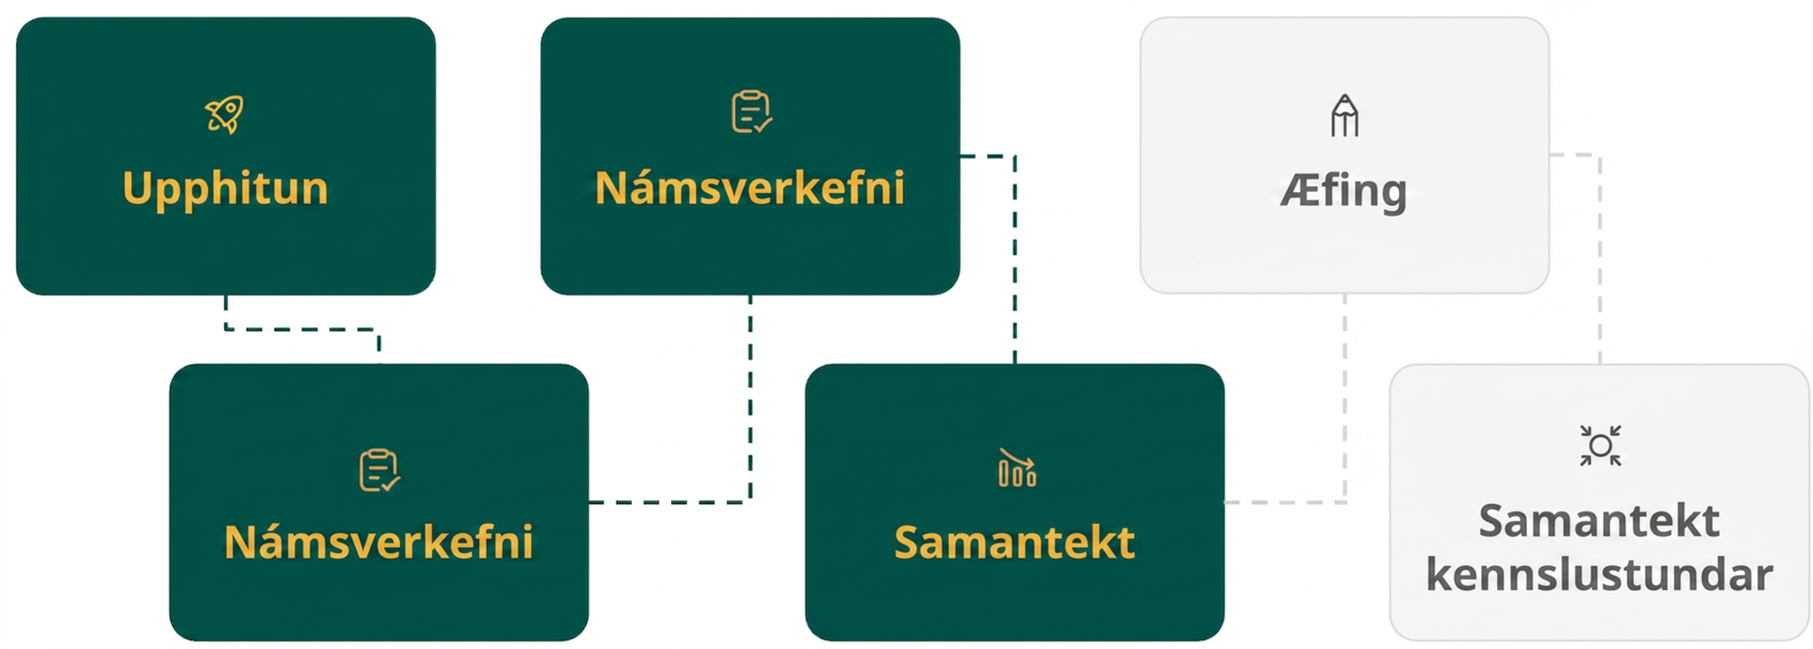
Lesson Journey
Fourth Step: Cool Down

Slide 24
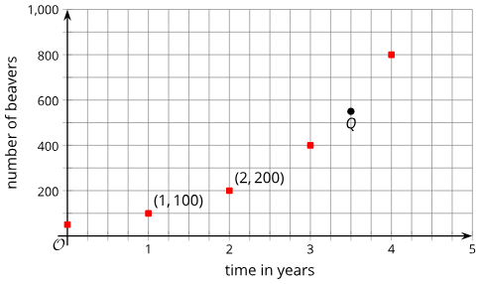
Cool Down
The graph shows the population of beavers in a forest for different numbers of years after 1995. The beaver population is growing exponentially.
Explain why we can think of the beaver population as a function of time in years.
What is the meaning of the point labeled Q in this context?
Write an equation using function notation to represent this situation.
Notes:
Cool Down (5 minutes)
Answers
The number of beavers depends on time in years. In any given year, there is a particular number of beavers in the forest.
The point 𝑄 indicates that 3.5 years after 1995, the beaver population was about 550.
𝑝(𝑡) = 50 𑁦 2^{𝑡} where 𝑡 is years after 1995 and 𝑝(𝑡) is the beaver population at that time.
An additional question 4 can be accessed from the online textbook and used if needed.
Response to Student Thinking - More Chances
If students struggle with function notation, there will be more chances throughout the unit to strengthen their understanding, so there is no need to slow down. However, if students are misinterpreting the scales on the graph, spend a few minutes in the next lesson, perhaps during Activity 2, eliciting strategies for correctly interpreting axes.

Slide 25
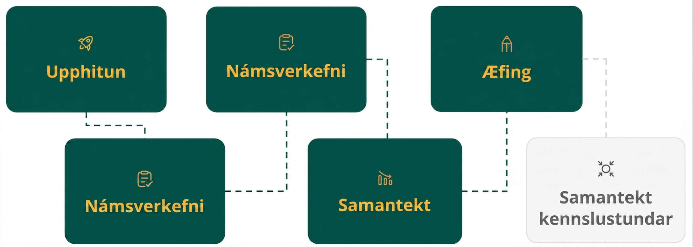
Lesson Journey
Fifth Stop: Practice

Slide 26

Practice
Put your hard work to action, practice what you’ve learned!
Notes:
Digital Practice: Access the practice pages at https://openstax.org/details/books/algebra-1

Slide 27
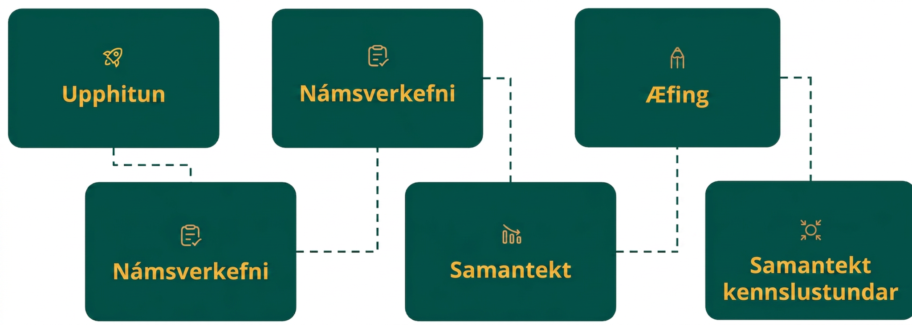
Lesson Journey
Sixth Stop: Lesson Synthesis

Slide 28
Lesson Synthesis
Consider a bacteria population 𝑝, described by the equation
𝑝 = 1,000 𑁦 2^{𝑡}, where 𝑡 is the number of hours after it is first measured.
Complete the sentence for this situation: _____ is a function of _____.
How is 𝑝 related to the function 𝑓 given by 𝑓(𝑡) = 1,000 𑁦 2^{𝑡}?
How are these equations similar to or different from the equations you’ve written previously, without function notation?
How are the exponential functions here similar to or different from linear functions we saw earlier in the course?
Notes:
Many of the situations we have seen that are characterized by exponential growth can also be viewed as functions. Review why we can think of them as functions and how they compare to other functions students have studied.
Answers
The number of bacteria is a function of time, or 𝑝 is a function of 𝑡.
𝑝 = 𝑓(𝑡)
They express the relationships the same way. Both equations can be used to produce a table or graph or to answer questions about the bacteria population. The notation 𝑝 = 𝑓(𝑡) makes explicit that 𝑝 depends on 𝑡.)
Both functions represent relationships where one quantity is determined by another quantity, and there is only one possible output for every input. They are different in that linear functions grow by addition, and exponential functions grow by multiplication.

Slide 29
Self Assessment
How much do you agree with the following statements?
Learning Goals | I can | Almost | Not yet
Use function notation to write equations that represent exponential relationships. | ⃞ | ⃞ | ⃞
Determine whether the relationships in descriptions, tables, equations, or graphs are functions. | ⃞ | ⃞ | ⃞

