Slide 1
Algebra 1
Unit 8 Quadratic Equations
Lesson 8.6 Rewriting Quadratic Equations in Factored Form, Part 1

Slide 2

How to use these slides
On the activity slides check the speaker notes for teacher support and instructional information.
Each lesson includes 1 warm up, 2-3 learning activities, a cool down, practice and a lesson synthesis.
  Learning activities are followed by a self check question, and review section.
Some slides have been hidden from student view, more information can be found on the next slide (Reference Key).
You can edit and use these slides for personal and classroom use, but cannot sell them and must keep the attribution logos.
For more information, Check out the digital quick start guide!
OpenStax CC BY NC SA

Slide 3





Reference Key
Check the top right corner for an icon referencing these unique sections.
Icon | Title | View | Location and Description
n/a | Support for Students with Disability | Hidden | Learning Strategies slide, provides additional support to students for understanding the activity.
n/a | Support for English Language Learners | Hidden | Learning Strategies slide, provides additional support to students for understanding the activity.
n/a | Extending Your Thinking | Hidden | Extending Your Thinking slide, provides an extra challenge for students.
n/a | Self Check | Not Hidden | Self Check slide, checkpoint to assess student understanding after the learning activity.
n/a | Review | Hidden | Self Check - Review slide, designed to help review topics from the self check question.
On the next slides, check the speaker notes for teacher instructions and support.
Notes:
Check the Speaker Notes: On the next slides you can find discussion questions, lesson information, answers to the activities, and ways to adjust the activity for your students!

Slide 4

Learning Goals
By the end of this lesson you will be able to -
Explain how the numbers in a quadratic expression in factored form relate to the numbers in an equivalent expression in standard form.
Rewrite a quadratic expression in standard form when given the quadratic expression in factored form.
Rewrite a quadratic expression in factored form when given the quadratic expression in the form of 𝑥² + 𝑏𝑥 + 𝑐.
Notes:
Lesson Narrative
Previously, students learned that a quadratic expression in factored form can be quite handy in revealing the zeros of a function and the 𝑥-intercepts of its graph. They also observed that the factored form can also help us solve quadratic equations algebraically. In this lesson, students begin to rewrite quadratic expressions from standard to factored form.
In an earlier unit, students learned to expand quadratic expressions in factored form and rewrite them in standard form. They did so by applying the distributive property to multiply out the factors—first by using diagrams for support, and then by relying on structure they observed in the process. The attention to structure continues in this lesson. Students relate the numbers in the factored form to the coefficients of the terms in standard form, looking for structure that can be used to go in reverse—from standard form to factored form.
This lesson only looks at expressions of the form (𝑥+𝑚)(𝑥+𝑛) and (𝑥−𝑚)(𝑥−𝑛) where 𝑚 and 𝑛 are positive. This is so that arithmetic doesn’t get in the way of noticing the relationships between the numbers in factored form and the numbers in standard form. In the next lesson, students will encounter expressions of the form (𝑥+𝑚)(𝑥−𝑛)
and (𝑥−𝑚)(𝑥+𝑛).
Note that this course includes only four lessons on transforming quadratic expressions from standard form to factored form. This is intentional. The goal is to help students see factored form conceptually, understand what it can tell us about the function, and use that knowledge in modeling problems, including problems where the zeros are not rational and algebraic factoring wouldn’t help. Too much attention to the algebraic skill of factoring can obscure these underlying concepts.
Sometimes—including in later courses and beyond—expressions do need to be written in factored form. With the universal availability of computer algebra systems, however, there is less need to spend lots of time learning how to factor by hand.
Required Preparation
None
Required Materials
Paper and pencil
Texas Essential Knowledge and Skills
A1(F) analyze mathematical relationships to connect and communicate mathematical ideas.
A8(A) solve quadratic equations having real solutions by factoring, taking square roots, completing the square, and applying the quadratic formula.

Slide 5
Vocabulary
Previous
Quadratic expression
  A polynomial expression of degree two.
Factored form (of a quadratic expression)
  A quadratic expression in the form a(x – r₁)(x – r₂), where a, r₁, and r₂ are constants and a ≠ 0.
Standard form (of a quadratic expression)
  A quadratic expression in the form ax² + bx + c, where a, b, and c are constants and a ≠ 0.
Notes:
Lesson Vocabulary
To support student understanding of key vocabulary:
Introduce and review the vocabulary words students will see in this lesson.
Encourage students to notice how these words are used and to include them in their math discussions and explanations—both written and oral.
Use a word wall to reinforce vocabulary. Sample word wall cards are available here.
For newcomers or students with beginning English proficiency, use these Quizlet sets to support vocabulary learning:
Unit 8 Spanish Vocabulary – use first to build understanding
Unit 8 Vocabulary (English) – use after anchoring in Spanish
Support for English Language Learners
ELPS 2(F) listen to and derive meaning from a variety of media such as audiotape, video, DVD, and CD-ROM to build and reinforce concept and language attainment
ELPS 3(D) speak using grade-level content area vocabulary in context to internalize new English words and build academic language proficiency
ELPS 3(E) share information in cooperative learning interactions

Slide 6

Lesson Journey
First Stop: Warm Up

Slide 7

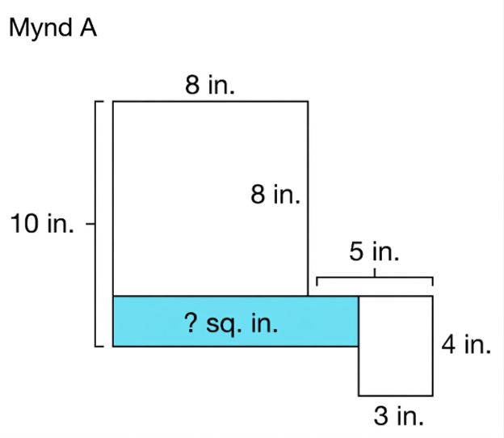
Warm Up | Part 1
Solving Area Puzzles🧩
What is the missing area in Figure A? Be prepared to explain your reasoning.
Notes:
Warm Up (10 minutes)
When they write expressions in factored form later in the lesson, students will need to reason about factors that yield certain products. This warm up prompts students to find unknown factors in the context of area puzzles. Solving the puzzles involves reasoning about the measurements in multiple steps.
Launch
Arrange students in groups of two.
Give students a few minutes of quiet time to think individually and then time to share their thinking with their partner.
Follow with a whole-class discussion.
Activity questions, answers, and synthesis on the next slide.

Slide 8
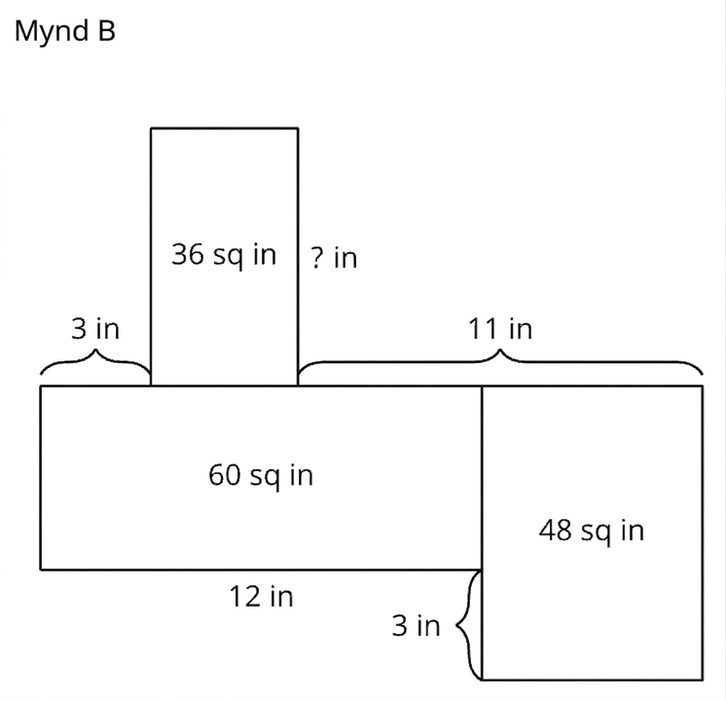
Warm Up | Part 2
Solving Area Puzzles🧩
What is the missing length in Figure B? Be prepared to explain your reasoning.
Notes:
Answers
The area of the blue rectangle is equal to 20 square inches.
To determine the area of the blue rectangle, we need to figure out its width and length.
The top shape is a square measuring 8 in. by 8 in. If the measurement of the longer left side is 10 inches, then the width of the blue rectangle can be found using the equation: 8 + w = 10, so w = 2. The width of the rectangle is 2 inches.
The bottom of the square is 8 inches, and the length of the blue rectangle can be written as an equation. But we have an unknown part that extends beyond the 8 inches of the square. In addition to seeing that the smaller rectangle has a length of 3 inches, we see that along the top of the rectangle, there is a measurement that includes the top length of our rectangle and a part that extends beyond the rectangle. If we call the extension part 𝑥, then we can solve the equation: 5 = 𝑥 + 3, so 𝑥 = 2. Since 𝑥 is the length of the blue rectangle that we were missing, the full length of the blue rectangle is: 8 + 𝑥 = 8 + 2 = 10.
Now, determine the area of the blue rectangle using 𝐴𝑟𝑒𝑎 = l × w. 𝐴𝑟𝑒𝑎 = 10 × 2 = 20. The area of the blue rectangle is equal to 20 square inches.
The missing width of the 36 square inch rectangle is 9 inches.
Start with what you know to figure out the missing side lengths.
Start with the rectangle that measures 60 square inches, because we know the full measure of one of its sides. The bottom length of that rectangle is labeled 12 inches. So, to find the width, we solve an area equation, Area = = l × w. Substituting gives 60 = 12 × w, so w = 5.
For the rectangle to the right side with an area of 48 square inches, we see that there is a small part of the width that is labeled 3 inches. The rest of the width must be equal to 5 inches, the measurement we just found from the 60 square inch rectangle. So, the total width of the 48 square inch rectangle is 5 + 3 = 8 inches. Again, use Area = = l × w, to determine the length, l, of this rectangle. Substituting gives 48 = l × 8, so l = 6. The length of this rectangle is 6 inches.
From the 11 inches, if we subtract the length of the 48 square inch rectangle (which is 6 inches), then the part that extends along a portion of the 60 square inch rectangle equals 5 inches since 11 − 6 = 5. Since the full length of the 60 square inch rectangle measures 12 inches, then 3 + 𝑙 + 5 = 12, where l is the missing portion of the length. Simplifying gives, 8 + 𝑙 = 12, so 𝑙 = 4.
Now we can solve for the width of the 36 square inch rectangle because 𝑙 also measures its length. Again, use Area = = l × w, to determine the width, w, of this rectangle. Substituting gives 36 = 4 × w, so w = 9. The missing width of the 36 square inch rectangle is 9 inches.
Anticipated Misconceptions
None
Activity Synthesis
Display the images for all to see. Invite students to share their responses and how they reasoned about the missing values, using the diagrams to illustrate their thinking.
After the solution to the second puzzle is presented, draw students’ attention to the rectangle with area 36 sq. in. Point out that, without reasoning about other parts of the puzzle, we cannot know which two numbers are multiplied to get 36 sq. in. (The numbers may not be whole numbers.) But by reasoning about other parts, we can conclude what the missing length must be.
Emphasize that in this lesson, they will also need to find two factors that yield a certain product and to reason logically about which numbers the factors can or must be.

Slide 9
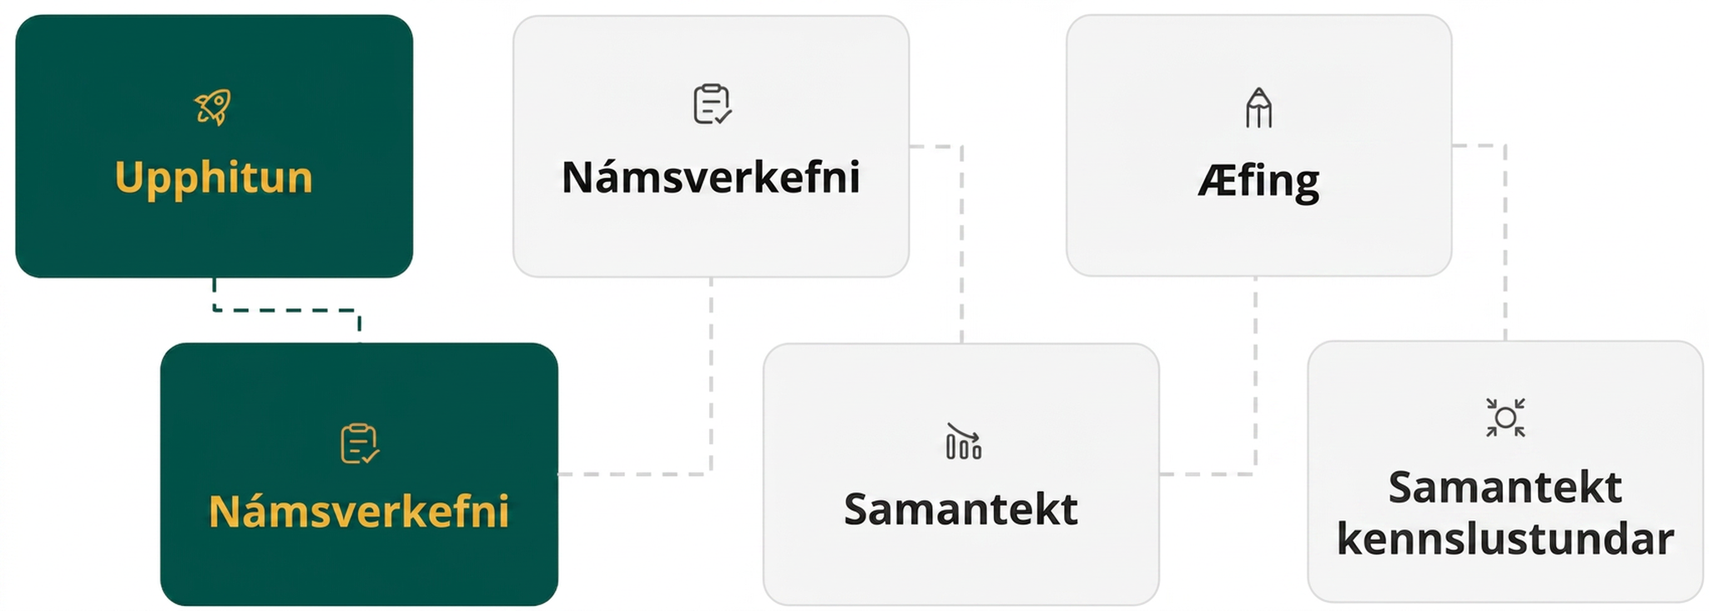
Lesson Journey
Second Stop: Learning Activity A

Slide 10

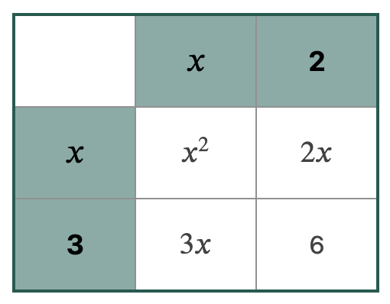
Learning Activity A | Learning Strategies
Use a Diagram!
Teacher Instruction: Use these strategies to adjust the activity to support English language learners and students with disabilities.
You can copy and paste the callouts directly on top of the activity or give the instructions aloud.
Use color coding to show which terms “match” since they have –
SAME VARIABLES
SAME EXPONENTS
Representation
Notes:
Support for Students with Disabilities: Representation: Internalize Comprehension
Use color coding and annotations to highlight connections between representations. Invite students to use color to identify the like terms in their diagrams and expressions. Demonstrate how students can use different colors to keep track of like terms as they use diagrams to show that each pair of expressions is equivalent.
Supports accessibility for: Visual-spatial processing

Slide 11
Learning Activity A | Launch
Use a Diagram!
What expression does each diagram represent?
 | 𝑥 | 2
𝑥 | 𝑥² | 72𝑥
3 | 93𝑥 | 6
 | 𝑥 | -6
𝑥 | 𝑥² | 72𝑥
-2 | 93𝑥 | 6
 | 𝑥 | -6
𝑥
-2
Notes:
Support for All Learners
This activity offers additional support and an extension for students:
For English language learners and students with disabilities, be sure to review the Learning Strategies slide!
For students looking for an extra challenge, be sure to review the Extending Your Thinking slide!
Activity (15 minutes)
This activity prompts students to notice the structure that relates quadratic expressions in factored form and their equivalent counterparts in standard form. Students began this work earlier in the course. They applied the distributive property to expand an expression such as (𝑥 + 5)(𝑥 + 4) into standard form, using rectangular diagrams to help organize and keep track of the partial products. Here, the focus is on using the structure to go in reverse: rewriting into factored form an expression given in standard form.
The expressions students encounter here are two sums or two differences, in the form of (𝑥 + 𝑚)(𝑥 + 𝑛) or (𝑥 − 𝑚)(𝑥 − 𝑛). When working with two differences, it is helpful to think of subtracting 𝑚 and 𝑛 as adding −𝑚 and −𝑛 and labeling the diagrams accordingly. For example, for the last expression, (𝑥 − 1)(𝑥 − 7), one side of the diagram should be labeled with 𝑥 and –1, and the other side should be labeled with 𝑥 and –7.
Launch
Consider using this slide to display the diagrams for the launch.
Focus students’ attention on the diagram on the left. Remind students that they have seen diagrams such as this one in a previous unit on quadratic functions.
Ask students what expression the diagram represents (Answer: both (𝑥 + 2)(𝑥 + 3) and 𝑥² + 5𝑥 + 6).
Next, ask students what expression the diagram on the right represents (Answer: (𝑥 + (−6))(𝑥 + (−2)) or (𝑥 − 6)(𝑥 − 2)).
Ask students what expression or number goes in each blank rectangle. Make sure students see that the rectangles are used to organize the partial products of (𝑥 − 6)(𝑥 − 2), the sum of which is 𝑥² − 8𝑥 + 12. NOTE: This slide has been animated so that the filled-in diagram will appear for example 2 on click.
Optional Material (Introduction to the Student Activity)
Consider using this slide, if you want to incorporate the additional content provided in the online text.
Activity questions begin on the this slide.

Slide 12
Learning Activity A | Introduction
Use a Diagram!
In this activity, two expressions are shown to be equivalent by using a diagram.
Consider (𝑥 + 7)(𝑥 + 9) and 𝑥² + 16𝑥 + 63
Step 1 - Place the factors (𝑥 + 7) and (𝑥 + 9) in the cells along the horizontal and vertical edge of the diagram.
Step 2 - Find the internal cells by multiplying the terms in each factor together.
Step 3 - Combine like terms in the product cells. Notice that 7𝑥 + 9𝑥 results in the linear term of our second expression, 16𝑥 (from 𝑥² + 16𝑥 + 63).
 | 𝑥 | 7
𝑥 | 𝑥² | 7⁢𝑥
9 | 9⁢𝑥 | 63
Notes:
Support for All Learners
This activity offers additional support and an extension for students:
For English language learners and students with disabilities, be sure to review the Learning Strategies slide!
For students looking for an extra challenge, be sure to review the Extending Your Thinking slide!
Activity (15 minutes)
This activity prompts students to notice the structure that relates quadratic expressions in factored form and their equivalent counterparts in standard form. Students began this work earlier in the course. They applied the distributive property to expand an expression such as (𝑥 + 5)(𝑥 + 4) into standard form, using rectangular diagrams to help organize and keep track of the partial products. Here, the focus is on using the structure to go in reverse: rewriting into factored form an expression given in standard form.
The expressions students encounter here are two sums or two differences, in the form of (𝑥 + 𝑚)(𝑥 + 𝑛) or (𝑥 − 𝑚)(𝑥 − 𝑛). When working with two differences, it is helpful to think of subtracting 𝑚 and 𝑛 as adding −𝑚 and −𝑛 and labeling the diagrams accordingly. For example, for the last expression, (𝑥 − 1)(𝑥 − 7), one side of the diagram should be labeled with 𝑥 and –1, and the other side should be labeled with 𝑥 and –7.
Launch
Consider using this slide to display the diagrams for the launch.
Focus students’ attention on the diagram on the left. Remind students that they have seen diagrams such as this one in a previous unit on quadratic functions.
Ask students what expression the diagram represents (Answer: both (𝑥 + 2)(𝑥 + 3) and 𝑥² + 5𝑥 + 6).
Next, ask students what expression the diagram on the right represents (Answer: (𝑥 + (−6))(𝑥 + (−2)) or (𝑥 − 6)(𝑥 − 2)).
Ask students what expression or number goes in each blank rectangle. Make sure students see that the rectangles are used to organize the partial products of (𝑥 − 6)(𝑥 − 2), the sum of which is 𝑥² − 8𝑥 + 12. NOTE: This slide has been animated so that the filled-in diagram will appear for example 2 on click.
Optional Material (Introduction to the Student Activity)
Consider using this slide, if you want to incorporate the additional content provided in the online text.
Activity questions begin on the next slide.

Slide 13
Learning Activity A | Part 1
Use a Diagram!
Use a diagram to show that each pair of expressions is equivalent.
𝑥(𝑥 + 3) and 𝑥² + 3𝑥
𝑥(𝑥 + (−6)) and 𝑥² − 6𝑥
Notes:
Support for All Learners
This activity offers additional support and an extension for students:
For English language learners and students with disabilities, be sure to review the Learning Strategies slide!
For students looking for an extra challenge, be sure to review the Extending Your Thinking slide!
Activity (15 minutes)
This activity prompts students to notice the structure that relates quadratic expressions in factored form and their equivalent counterparts in standard form. Students began this work earlier in the course. They applied the distributive property to expand an expression such as (𝑥 + 5)(𝑥 + 4) into standard form, using rectangular diagrams to help organize and keep track of the partial products. Here, the focus is on using the structure to go in reverse: rewriting into factored form an expression given in standard form.
The expressions students encounter here are two sums or two differences, in the form of (𝑥 + 𝑚)(𝑥 + 𝑛) or (𝑥 − 𝑚)(𝑥 − 𝑛). When working with two differences, it is helpful to think of subtracting 𝑚 and 𝑛 as adding −𝑚 and −𝑛 and labeling the diagrams accordingly. For example, for the last expression, (𝑥 − 1)(𝑥 − 7), one side of the diagram should be labeled with 𝑥 and –1, and the other side should be labeled with 𝑥 and –7.
Launch
Consider using this slide to display the diagrams for the launch.
Focus students’ attention on the diagram on the left. Remind students that they have seen diagrams such as this one in a previous unit on quadratic functions.
Ask students what expression the diagram represents (Answer: both (𝑥 + 2)(𝑥 + 3) and 𝑥² + 5𝑥 + 6).
Next, ask students what expression the diagram on the right represents (Answer: (𝑥 + (−6))(𝑥 + (−2)) or (𝑥 − 6)(𝑥 − 2)).
Ask students what expression or number goes in each blank rectangle. Make sure students see that the rectangles are used to organize the partial products of (𝑥 − 6)(𝑥 − 2), the sum of which is 𝑥² − 8𝑥 + 12. NOTE: This slide has been animated so that the filled-in diagram will appear for example 2 on click.
Optional Material (Introduction to the Student Activity)
Consider using this slide, if you want to incorporate the additional content provided in the online text.
Activity answers on the next slide.

Slide 14
Learning Activity A | Part 1 Answers
Use a Diagram!
Use a diagram to show that each pair of expressions is equivalent.
𝑥(𝑥 + 3) and 𝑥² + 3𝑥
𝑥(𝑥 + (−6)) and 𝑥² − 6𝑥
 | 𝑥 | 0
𝑥 | 𝑥² | 0
3 | 3⁢𝑥 | 0
 | 𝑥 | 0
𝑥 | 𝑥² | 0
-6 | -6⁢𝑥 | 0
Notes:
Activity questions continue on the next slide.

Slide 15
Learning Activity A | Part 2
Use a Diagram!
Use a diagram to show that each pair of expressions is equivalent.
(𝑥 + 2)(𝑥 + 4) and 𝑥² + 6𝑥 + 8
(𝑥 + 4)(𝑥 + 10) and 𝑥² + 14𝑥 + 40
Notes:
Activity answers on the next slide.

Slide 16
Learning Activity A | Part 2 Answers
Use a Diagram!
Use a diagram to show that each pair of expressions is equivalent.
(𝑥 + 2)(𝑥 + 4) and 𝑥² + 6𝑥 + 8
(𝑥 + 4)(𝑥 + 10) and 𝑥² + 14𝑥 + 40
 | 𝑥 | 2
𝑥 | 𝑥² | 72𝑥
4 | 94𝑥 | 8
 | 𝑥 | 4
𝑥 | 𝑥² | 74𝑥
10 | 10⁢𝑥 | 40
Notes:
Activity questions continue on the next slide.

Slide 17
Learning Activity A | Part 3
Use a Diagram!
Use a diagram to show that each pair of expressions is equivalent.
(𝑥 + (−5))(𝑥 + (−1)) and 𝑥² − 6𝑥 + 5
(𝑥 − 1)(𝑥 − 7) and 𝑥² − 8𝑥 + 7
Notes:
Activity answers on the next slide.

Slide 18
Learning Activity A | Part 3 Answers
Use a Diagram!
Use a diagram to show that each pair of expressions is equivalent.
(𝑥 + (−5))(𝑥 + (−1)) and 𝑥² − 6𝑥 + 5
(𝑥 − 1)(𝑥 − 7) and 𝑥² − 8𝑥 + 7
 | 𝑥 | -5
𝑥 | 𝑥² | -5𝑥
-1 | -1𝑥 | 5
 | 𝑥 | -1
𝑥 | 𝑥² | -1⁢𝑥
-7 | -7𝑥 | 7
Notes:
Activity questions, answers, anticipated misconceptions, and synthesis on the next slide.

Slide 19
Learning Activity A | Part 4
Use a Diagram!
Review the pairs of expressions from your diagrams. How is each expression in factored form related to the equivalent expression in standard form?
Are you ready for more?
Notes:
Activity Answer
Because the coefficients of the 𝑥-terms are both 1 in the factored form, when the two numbers that appear in factored form are added, the result is the coefficient of the linear term in standard form. If those same two numbers are multiplied, the result is the constant term in standard form. (Note that this explanation relies on recasting every subtraction expression as adding the opposite.)
Anticipated Misconceptions
None
Activity Synthesis
Invite students to share their diagrams and observations. Make sure students notice that the linear term in the expression in standard form is the sum of the two numbers in the expression in factored form, and the constant term is the product of the two numbers in the expression in factored form. (For this explanation to be succinct, it requires rewriting any subtractions as adding the opposite.)

Slide 20

Learning Activity A
Extending Your Thinking
A mathematician threw a party. She told her guests, "I have a riddle for you. I have three daughters. The product of their ages is 72. The sum of their ages is the same as my house number. How old are my daughters?"
The guests went outside to look at the house number. They thought for a few minutes, and then they said, "This riddle can't be solved!"
The mathematician said, "Oh yes, I forgot to tell you the last clue. My youngest daughter prefers strawberry ice cream."
With this last clue, the guests could solve the riddle. How old are the mathematician's daughters? Be prepared to show your reasoning.
Notes:
Go back to Lesson Activity
Answer
2, 6 and 6
If the product of their ages is 72, there are twelve possibilities.
Access the online textbook for the work that explains how to solve this riddle.

Slide 21
Learning Activity A
Self Check
An expression in standard form is shown. The diagram below is equivalent to which expression in factored form?
𝑥² − 13𝑥 + 42
(𝑥 − 13)(𝑥 + 42)
(𝑥 + 6)(𝑥 + 7)
(𝑥 − 6)(𝑥 + 7)
(𝑥 − 6)(𝑥 – 7)
 | 𝑥 | -6
𝑥 | 𝑥² | -6𝑥
-7 | -7⁢𝑥 | 42
Let’s review!
Notes:
Answer Feedback - Individualized by Response
Incorrect. Use the diagram to help you convert from standard form to factored form. Look in the top-right and bottom-left squares for the numbers to use in the factored form.
Incorrect. This expression results in a linear term of +13𝑥 instead of the −13𝑥 we need.
Incorrect. This expression does not result in a constant term of +42.
That’s correct! Check yourself: Multiply (𝑥 − 6)(𝑥 − 7) using FOIL. The result is 𝑥² − 13𝑥 + 42.

Slide 22

Learning Activity A
Self Check - Review
Show each pair of expressions are equivalent by using a diagram.
(𝑥 + 3)(𝑥 + 5) and 𝑥² + 8𝑥 + 15
(𝑥 – 6)(𝑥 – 9) and 𝑥² − 15𝑥 + 54
Step 1 - Populate the table.
Step 2 - Multiply the columns and rows.
Step 3 - Use the diagram to write the expression in standard form.
Notes:
Remind Students
For expressions involving subtraction, like example 2, it is helpful to rewrite the factored form as the addition of negative numbers when subtracting occurs in the factors.
Notice that…
the linear term (𝑥-term) in the expression in standard form is the sum of the two numbers in the expression in factored form.
the constant term is the product of the two numbers in the expression in factored form.
this pattern only occurs when the coefficients of the 𝑥-terms in the factors are 1 (because they result in a quadratic term that has a coefficient of 1 as well, 𝑥²)
Access the online textbook for the work that explains how to solve these examples.

Slide 23

Lesson Journey
Third Stop: Learning Activity B

Slide 24
Learning Activity B | Learning Strategies
Make Them Equivalent 🔄
Teacher Instruction: Use these strategies to adjust the activity to support English language learners and students with disabilities.
  You can copy and paste the callouts directly on top of the activity or give the instructions aloud.
Practice what to say on your own or with a partner.
“Here is how we changed the expression _____ from standard form to factored form. “
“We factored out the greatest common factor of _____.”
“We found factors of _____ that add to _____.”
Speaking
Notes:
Support for English Language Learners: MLR 8 Discussion Supports: Speaking
Use this routine to support whole-class discussion. At the appropriate time, give students, or pairs of students, two to three minutes to plan what they will say when they present how they transformed their expressions from standard form to factored form, using specific examples in their explanations. Encourage students to consider what details are important to share and to think about how they will explain their reasoning using mathematical language.
Design Principle(s): Support sense-making; Maximize meta-awareness

Slide 25
Learning Activity B | Part 1
Make Them Equivalent 🔄
Complete the table with the missing equivalent expressions.
Factored Form | Standard Form
𝑥(𝑥 + 7)
 | 𝑥² + 9𝑥
 | 𝑥² – 8𝑥
(𝑥 + 6)(𝑥 + 2)
 | 𝑥² + 13𝑥 + 12
(𝑥 – 6)(𝑥 – 2)
Notes:
Support for All Learners
This activity offers additional support for students:
For English language learners, be sure to review the Learning Strategies slide!
Activity (10 minutes)
This activity allows students to practice rewriting quadratic expressions in standard form by using the structure they observed in the earlier activity.
As students work, look for those who approach the work systematically: by looking for two factors of the constant term that add up to the coefficient of the linear term of the expression in standard form, listing the possible pairs of factors, and checking their chosen pair. Invite them to share their strategy during discussion.
Launch
Consider arranging students in groups of two.
Ask students to think quietly about how to make equivalent expressions before conferring with their partner. Remind students to consider drawing a diagram if they get stuck.
Leave a few minutes for a whole-class discussion.
Ask students to complete as many equivalent expressions as time permits while aiming to complete at least the first seven rows in the table.
Ask students to generalize their observations in the last row of the table.
Activity questions, answers, anticipated misconceptions, and synthesis on this slide.

Slide 26
Learning Activity B | Part 1 Answers
Make Them Equivalent 🔄
Complete the table with the missing equivalent expressions. ANSWERS
Factored Form | Standard Form
𝑥(𝑥 + 7) | 𝑥² + 7𝑥
𝑥(𝑥 + 9) | 𝑥² + 9𝑥
𝑥(𝑥 – 8) | 𝑥² – 8𝑥
(𝑥 + 6)(𝑥 + 2) | 𝑥² + 8𝑥 + 12
(𝑥 + 1)(𝑥 + 12) | 𝑥² + 13𝑥 + 12
(𝑥 – 6)(𝑥 – 2) | 𝑥² – 8𝑥 + 12
Notes:
Support for All Learners
This activity offers additional support and an extension for students:
For English language learners and students with disabilities, be sure to review the Learning Strategies slide!
Activity (10 minutes)
This activity allows students to practice rewriting quadratic expressions in standard form by using the structure they observed in the earlier activity.
As students work, look for those who approach the work systematically: by looking for two factors of the constant term that add up to the coefficient of the linear term of the expression in standard form, listing the possible pairs of factors, and checking their chosen pair. Invite them to share their strategy during discussion.
Launch
Consider arranging students in groups of two.
Ask students to think quietly about how to make equivalent expressions before conferring with their partner. Remind students to consider drawing a diagram if they get stuck.
Leave a few minutes for a whole-class discussion.
Ask students to complete as many equivalent expressions as time permits while aiming to complete at least the first seven rows in the table.
Ask students to generalize their observations in the last row of the table.
Activity questions, answers, anticipated misconceptions, and synthesis on the this slide.

Slide 27
Learning Activity B | Part 2
Make Them Equivalent 🔄
Complete the table with the missing equivalent expressions.
Factored Form | Standard Form
 | 𝑥² – 7𝑥 + 12
 | 𝑥² + 6𝑥 + 9
 | 𝑥² + 10𝑥 + 9
 | 𝑥² – 10𝑥 + 9
 | 𝑥² – 6𝑥 + 9
 | 𝑥² + (m + n)𝑥 + 9mn
Notes:
Answers
A completely filled in table, including answers for expressions 1 - 6 is on this slide.
A completely filled in table, including answers for expressions 7 - 12 is on this slide.
Anticipated Misconceptions
Some students may struggle to remember how each term in standard form relates to the numbers in the equivalent expression in factored form. Encourage them to use a diagram (as in the earlier activity) to go from factored form to standard form, and then work backward.
Activity Synthesis
Focus first on the first three rows. Ask one or more students to share their equivalent expressions and any diagrams that they drew. Point out that this is a fairly straightforward application of the distributive property, which students first learned about in grade 6.
Select students to share how they transformed the remaining expressions from standard form to factored form, using specific examples in their explanations. For the example of 𝑥² + 13𝑥 + 12, highlight that:
We are looking for two factors of 12.
We are looking for two numbers with a sum of 13.
One strategy is to list out all the factor pairs of 12.
Another strategy is to list out all pairs of numbers that add up to 13, but usually the list of factors is shorter.

Slide 28
Learning Activity B | Part 2 Answers
Make Them Equivalent 🔄
Complete the table with the missing equivalent expressions. ANSWERS
Factored Form | Standard Form
(𝑥 – 4)(𝑥 – 3) | 𝑥² – 7𝑥 + 12
(𝑥 + 3)(𝑥 + 3) | 𝑥² + 6𝑥 + 9
(𝑥 + 9)(𝑥 + 1) | 𝑥² + 10𝑥 + 9
(𝑥 – 9)(𝑥 – 1) | 𝑥² – 10𝑥 + 9
(𝑥 – 3)(𝑥 – 3) | 𝑥² – 6𝑥 + 9
(𝑥 + m)(𝑥 + n) | 𝑥² + (m + n)𝑥 + 9mn
Notes:
Answers
A completely filled in table, including answers for expressions 1 - 6 is on this slide.
A completely filled in table, including answers for expressions 7 - 12 is on this slide.
Anticipated Misconceptions
Some students may struggle to remember how each term in standard form relates to the numbers in the equivalent expression in factored form. Encourage them to use a diagram (as in the earlier activity) to go from factored form to standard form, and then work backward.
Activity Synthesis
Focus first on the first three rows. Ask one or more students to share their equivalent expressions and any diagrams that they drew. Point out that this is a fairly straightforward application of the distributive property, which students first learned about in grade 6.
Select students to share how they transformed the remaining expressions from standard form to factored form, using specific examples in their explanations. For the example of 𝑥² + 13𝑥 + 12, highlight that:
We are looking for two factors of 12.
We are looking for two numbers with a sum of 13.
One strategy is to list out all the factor pairs of 12.
Another strategy is to list out all pairs of numbers that add up to 13, but usually the list of factors is shorter.

Slide 29
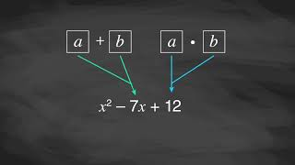
Learning Activity B | Video
Rewriting Quadratic Expressions
Notes:
This video discusses question 1 of activity 8.6.3

Slide 30

Learning Activity B
Self Check
Find the factored form of 𝑥² − 18𝑥 + 80.
(𝑥 − 8)(𝑥 − 10)
(𝑥 − 12)(𝑥 − 6)
(𝑥 − 4)(𝑥 − 20)
(𝑥 + 8)(𝑥 + 10)
Let’s review!
Notes:
Answer Feedback - Individualized by Response
That's correct! Check yourself: Multiply (𝑥 − 8)(𝑥 − 10) to check. Since (𝑥 − 8)(𝑥 − 10) = 𝑥² − 18𝑥 + 80, you are correct.
Incorrect. The product of −12⋅(−6) is 72, not 80.
Incorrect. The sum of −4+(−20) is –24, not –18.
Incorrect. The sum of 8+10 is 18, not –18.

Slide 31
Learning Activity B
Self Check - Review
Find the factored form of each expression.
𝑥² + 9𝑥 + 18
𝑥² − 12𝑥 + 35
If the coefficient of the 𝑥²-term is 1, then find two numbers whose
sum equals the coefficient of the linear term
and
product equals the constant term.
Notes:
Remind Students
The sum-product pattern only occurs when the coefficient of the leading term (quadratic or x² term) is 1.
Access the online textbook for the work that explains how to solve these examples.

Slide 32
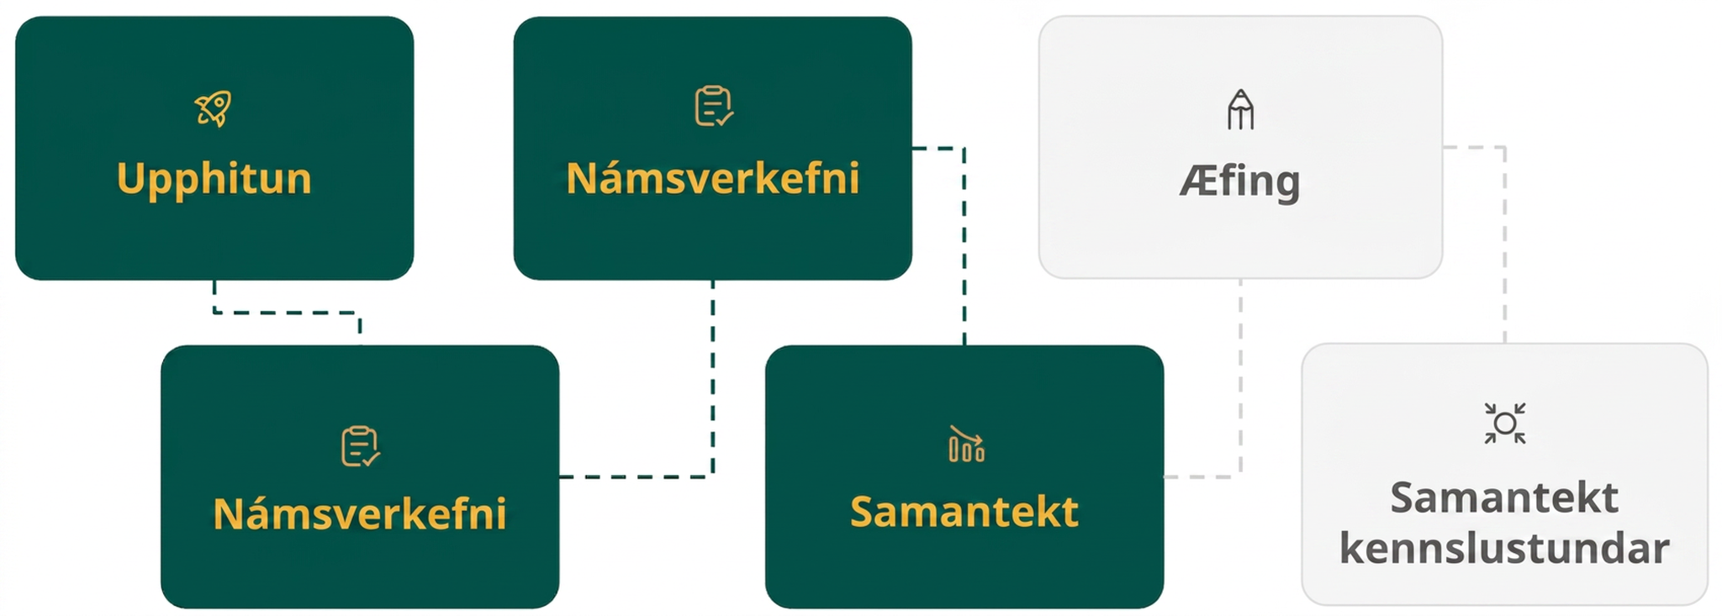
Lesson Journey
Fourth Step: Cool Down

Slide 33
Cool Down
Each problem has a pair of equivalent expressions: one in standard form and the other in factored form.
Find the missing numbers.
𝑥² + __ 𝑥 + __ and (𝑥 + 1)(𝑥 + 17)
𝑥² + 9𝑥 + 14 and (𝑥 + 2)(𝑥 + __ )
𝑥² − 7𝑥 + 10 and (𝑥 − 2)(𝑥 − __ )
𝑥² − 9𝑥 + 20 and (𝑥 − __ )(𝑥 − __ )
Notes:
Cool Down (5 minutes)
Answers
18 and 17, respectively. The completed expression is 𝑥² + 18𝑥 + 17.
7. The completed expression is (𝑥 + 2)(𝑥 + 7).
5. The completed expression is (𝑥 − 2)(𝑥 − 5).
4 and 5. The completed expression is (𝑥 − 4)(𝑥 − 5).
Response to Student Thinking - More Chances
If students make computational errors, address those in the next lesson and emphasize the use of diagrams.

Slide 34
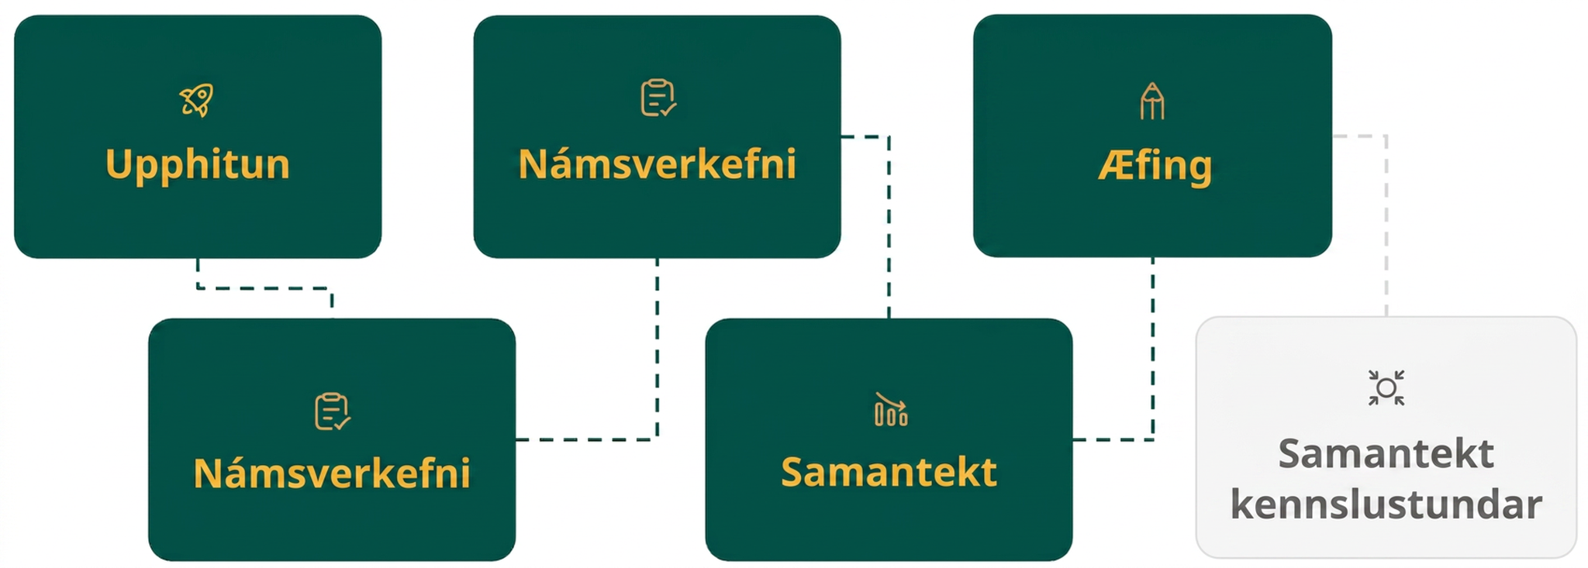
Lesson Journey
Fifth Stop: Practice

Slide 35

Practice
Put your hard work to action, practice what you’ve learned!
Notes:
Digital Practice: Access the practice pages at https://openstax.org/details/books/algebra-1

Slide 36
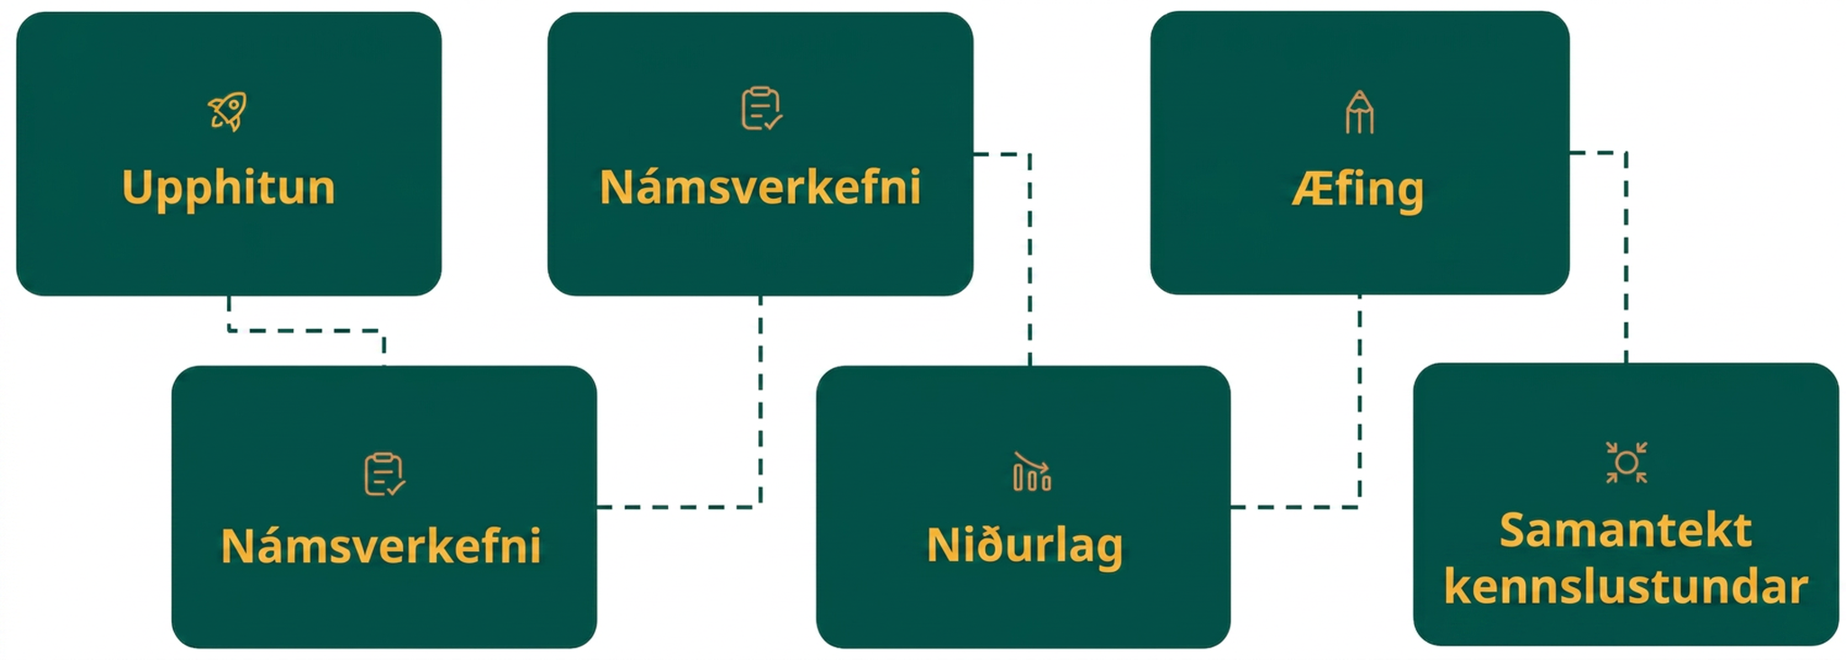
Lesson Journey
Sixth Stop: Lesson Synthesis

Slide 37
Lesson Synthesis
Rewrite each quadratic expression in standard form into factored form. Be prepared to explain your process.
𝑥² + 8𝑥 + 15
𝑥² + 11𝑥 + 28
𝑥² + 𝑏𝑥 + 𝑐
Notes:
Launch
Ask students to explain the process of transforming each expression into factored form by completing (in writing or by talking a partner) sentence starters such as these:
To find the factors, I first try to find . . .
Next, I think about . . .
The equivalent expression in factored form is . . .
To check that the factors are correct, I can . . .
Consider formally summarizing the discussion to make sure students see that for 𝑥² + 𝑏𝑥 + 𝑐, a helpful process goes something like this:
First, we find all pairs of factors of 𝑐.
Next, find a pair of factors of 𝑐 that add up to equal 𝑏. (If the factors are 𝑚 and 𝑛, then we want 𝑚+𝑛=𝑏.)
The factors will be (𝑥 + 𝑚)(𝑥 + 𝑛).
We can check by expanding the factored form (by applying the distributive property) and see if we get the original expression as a result.
A duplicate of this slide with a formal summary textbox is on the next slide (currently hidden).

Slide 38
Lesson Synthesis
Rewrite each quadratic expression in standard form into factored form. Be prepared to explain your process.
𝑥² + 8𝑥 + 15
𝑥² + 11𝑥 + 28
𝑥² + 𝑏𝑥 + 𝑐
Rewrite a quadratic expression like ax² + bx + c in factored form
Find all pairs of factors of 𝑐.
Find a pair of factors of 𝑐 that add up to equal 𝑏. (If the factors are 𝑚 and 𝑛, then we want 𝑚 + 𝑛 = 𝑏.)
The factors are (𝑥 + 𝑚)(𝑥 + 𝑛).
Check by expanding using the Distributive Property.
Notes:
Launch
Ask students to explain the process of transforming each expression into factored form by completing (in writing or by talking a partner) sentence starters such as these:
To find the factors, I first try to find . . .
Next, I think about . . .
The equivalent expression in factored form is . . .
To check that the factors are correct, I can . . .
Consider formally summarizing the discussion to make sure students see that for 𝑥² + 𝑏𝑥 + 𝑐, a helpful process goes something like this:
First, we find all pairs of factors of 𝑐.
Next, find a pair of factors of 𝑐 that add up to equal 𝑏. (If the factors are 𝑚 and 𝑛, then we want 𝑚+𝑛=𝑏.)
The factors will be (𝑥 + 𝑚)(𝑥 + 𝑛).
We can check by expanding the factored form (by applying the distributive property) and see if we get the original expression as a result.

Slide 39
Self Assessment
How much do you agree with the following statements?
Learning Goals | I can | Almost | Not yet
Explain how the numbers in a quadratic expression in factored form relate to the numbers in an equivalent expression in standard form. | ⃞ | ⃞ | ⃞
Rewrite a quadratic expression in standard form when given the quadratic expression in factored form. | ⃞ | ⃞ | ⃞
Rewrite a quadratic expression in factored form when given the quadratic expression in the form of 𝑥² + 𝑏𝑥 + 𝑐. | ⃞ | ⃞ | ⃞

