Slide 1


Algebra 1
Unit 4 Functions
Lesson 4.10: Comparing Graphs

Slide 2
How to use these slides
On the activity slides check the speaker notes for teacher support and instructional information.
Each lesson includes 1 warm up, 2-3 learning activities, a cool down, practice and a lesson synthesis.
  Learning activities are followed by a self check question, and review section.
Some slides have been hidden from student view, more information can be found on the next slide (Reference Key).
You can edit and use these slides for personal and classroom use, but cannot sell them and must keep the attribution logos.
For more information, Check out the digital quick start guide!

Slide 3






Reference Key
Check the top right corner for an icon referencing these unique sections.
 | Support for Students with Disability | Hidden | Learning Strategies slide, provides additional support to students for understanding the activity. Learning Strategies slide, provides additional support to students for understanding the activity.
 | Support for English Language Learners | Hidden
 | Extending Your Thinking | Hidden | Extending Your Thinking slide, provides an extra challenge for students.
 | Self Check | Not Hidden | Self Check slide, checkpoint to assess student understanding after the learning activity.
 | Review | Hidden | Self Check- Review slide, designed to help review topics from the self check question.
On the next slides, check the speaker notes for teacher instructions and support.
Notes:
Check the Speaker Notes: On the next slides you can find discussion questions, lesson information, answers to the activities, and ways to adjust the activity for your students!

Slide 4

Learning Goals
By the end of this lesson you will be able to -
Compare the features of graphs of functions and explain what they mean in the situations represented.
Make sense of an equation of the form f(x) = g(x) in terms of a situation and a graph, and know how to find the solutions.
Explain statements about two or more functions when they are written in function notation.
Notes:
Lesson Narrative
In this lesson, students deepen their understanding of functions by comparing multiple representations of functions that relate the same quantities, focusing on features and average rates of change.
They interpret statements like A(x) = B(x) and B(10) > A(10) using context, such as population changes, phone ownership trends, and TV show popularity.
Students explore graph intersections as solutions to equations like f(x) = g(x), understanding these points as shared outputs for the same input.
Accurate comparisons require precise mathematical language. Students reason abstractly and quantitatively to draw conclusions from different function representations..
Required Preparation
None
Required Materials
None
Texas Essential Knowledge and Skills
A1(C) select tools, including real objects, manipulatives, paper and pencil, and technology as appropriate, and techniques, including mental math, estimation, and number sense as appropriate, to solve problems
A1(D) communicate mathematical ideas, reasoning, and their implications using multiple representations, including symbols, diagrams, graphs, and language as appropriate
A1(F) analyze mathematical relationships to connect and communicate mathematical ideas
A12(B) evaluate functions, expressed in function notation, given one or more elements in their domains

Slide 5
Vocabulary
Previous
Equation
  A mathematical statement that demonstrates that two numbers, expressions, or other objects are equal.
Proportion
  The equation that results when two rational expressions (fractions) are equal.
Probability
  A measure that tells how likely it is for an event to happen. A value of 1 means the event will always happen. A value of 0 means the event will never happen.
New
None
Notes:
Lesson Vocabulary
To support student understanding of key vocabulary:
Introduce and review the vocabulary words students will see in this lesson.
Encourage students to notice how these words are used and to include them in their math discussions and explanations—both written and oral.
Use a word wall to reinforce vocabulary. Sample word wall cards are available here.
For newcomers or students with beginning English proficiency, use these Quizlet sets to support vocabulary learning:
Unit 4 Spanish Vocabulary, part 1 – use first to build understanding
Unit 4 Vocabulary (English), part 1 – use after anchoring in Spanish
Unit 4 Spanish Vocabulary, part 2 – use first to build understanding
Unit 4 Vocabulary (English), part 2 – use after anchoring in Spanish
Support for English Language Learners
ELPS 2(F) listen to and derive meaning from a variety of media such as audiotape, video, DVD, and CD-ROM to build and reinforce concept and language attainment
ELPS 2(I) demonstrate listening comprehension of increasingly complex spoken English by following directions, retelling or summarizing spoken messages, responding to questions and requests, collaborating with peers, and taking notes commensurate with content and grade-level needs
ELPS 3(E) share information in cooperative learning interactions
ELPS 3(I) adapt spoken language appropriately for formal and informal purposes
ELPS 4(I) demonstrate English comprehension and expand reading skills by employing basic reading skills such as demonstrating understanding of supporting ideas and details in text and graphic sources, summarizing text, and distinguishing main ideas from details commensurate with content area needs

Slide 6





Lesson Journey
Warm Up
Learning Activity
Cool Down
Lesson Synthesis
Learning Activity
Learning Activity
Practice

Slide 7
Learning Strategies - Graph It: Landline vs. Cell📈
Teacher Instruction: Use these strategies to adjust the activity to support English language learners and students with disabilities.
  You can copy and paste the callouts directly on top of the activity or give the instructions aloud.
Write down possible mathematical questions that could be asked about the situation.
Compare your questions before the activity’s questions are revealed.
Co-Craft Questions
One thing that is the same is . . .,
One thing that is different is . . .,” and “_____ represents _____.
Engagement
Notes:
Support for English Language Learners: MLR 5 Co-Craft Questions: Speaking, Reading
Use this routine to help students compare and interpret two functions. Display the student task statement and graph, leaving out the questions. Ask students to write down possible mathematical questions that could be asked about the situation. Invite students to compare their questions before revealing the activity’s questions. Listen for and amplify any questions involving the overall shape of the graphs, trends over specific time intervals, and the intersection point of the two graphs. The process of creating mathematical questions, without the pressure of producing answers or solutions, prompts students to make sense of the given information and to activate the language of mathematical questions. This work helps prepare students to process the actual questions.
Design Principle(s): Maximize meta-awareness; Support sense-making
Learn more about this routine
View the instructional video and follow along with the materials to assist you with learning this routine.
Provide support for students
Distribute graphic organizers to the students to assist them with participating in this routine.
Support for Students with Disabilities: Engagement: Develop Effort and Persistence
Encourage and support opportunities for peer interactions. Prior to the whole-class discussion, invite students to share their work with a partner. Display sentence frames to support student conversation, such as: “One thing that is the same is . . .,” “One thing that is different is . . .,” and “_____ represents _____.”
Supports accessibility for: Language; Social-emotional skills

Slide 8
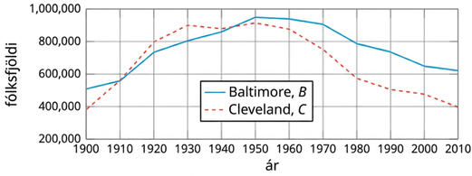
Warm Up - Baltimore and Cleveland 📌
This graph shows the populations of Baltimore and Cleveland in the 20th century. B(t)
is the population of Baltimore in year t. C(t) is the population of Cleveland in year t.
Notes:
Warm Up (5 minutes)
In this warm up, students compare functions by analyzing graphs and statements in function notation. The work here prepares students to make more sophisticated comparisons later in the lesson.
Activity questions, answers, and synthesis on the next slide.

Slide 9

Warm Up - Baltimore and Cleveland 📌
Estimate B(1930) and explain what it means in this situation.
Which statement is true:
B(2000) ≥ C(2000) or B(2000) ≤ C(2000)?
Explain the reasoning for your response to question 2.
Which statement is true:
B(1900) = C(1900) or B(1900) > C(1900)?
Explain the reasoning for your response to question 4.
Were the two cities’ populations ever the same? If so, when?
Notes:
Activity Answers
B(1930) is about 800,000. It’s the population of Baltimore in 1930.
B(2000) ≥ C(2000)
Your answer may vary, but here is a sample. On the graph, the point that represents B(2000) is located at a higher location than the point that represents C(2000) for each function.
B(1900) > C(1900)
Your answer may vary, but here is a sample. The blue function representing Baltimore has a higher y-value in 1900 than the red-dashed function representing Cleveland does.
Yes. The populations were the same in roughly 1910 and 1943..
Activity Synthesis
Invite students to share their response to the first question. After students give a reasonable estimate of the population of Baltimore (about 800,000), display the statement B(1930) = 800,000 for all to see. Make sure students can interpret it to mean: “In 1930, the population of Baltimore was about 800,000 people.”
Next, ask students to explain how they knew which statement in each pair of inequalities is true, and how they knew that there were two points in time when Baltimore and Cleveland had the same population.
Ask students how we could use function notation to express that the populations of Baltimore and Cleveland were equal in 1910. If no students mention
B(1910) = C(1910)
or B(t) = C(t) for t = 1910, bring these up and display these statements for all to see.

Slide 10

Lesson Journey
Warm Up
Learning Activity
Cool Down
Lesson Synthesis
Learning Activity
Learning Activity
Practice

Slide 11
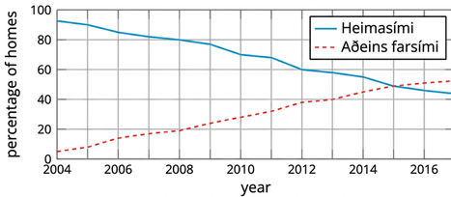
Learning Activity - Graph It: Landline vs. Cell📈
H(t) is the percentage of homes in the United States that have a landline phone in year t.
C(t) is the percentage of homes with only a cell phone. Here are the graphs of H and C.
Estimate H(2006). Explain what this value tells us about the phones.
Estimate C(2006). Explain what this value tells us about the phones.
What is the approximate solution to C(t) = 20? Explain what the solution means in this situation.
Are you ready for more?
Notes:
Support for All Learners
This activity offers additional support and an extension for students:
For English language learners and students with disabilities, be sure to review the Learning Strategies slide!
For students looking for an extra challenge, be sure to review the Extending Your Thinking slide!
Activity (20 minutes)
Students compare two functions using graphs and function notation, interpret them in context, revisit solutions like
C(t) = 20, and use average rate of change to analyze trends.
Additionally, the activity draws students’ attention to the point where the two graphs intersect, its meaning in context, and its corresponding representation in function notation.
Launch
Ask students how many of them have a landline phone at home and how many only have cell phones. If students are unfamiliar with landline phones, explain as needed.
Display the graphs for all to see. Discuss questions such as:
“How would you describe the trends in phone ownership over the years?” (Cell phones are increasing in use, and landlines are decreasing.)
“How would you describe the shape of the graph of each function?” (Both are roughly linear. The value of H
is decreasing over time, so the graph slants downward. The value of C
is increasing over time, so the graph slants upward.)
“In what year did about 60% of homes have a landline?” (2012)
Additional activity problems, answers, misconceptions, and synthesis questions on the next slides.

Slide 12
Learning Activity - Graph It: Landline vs. Cell📈
H(t) is the percentage of homes in the United States that have a landline phone in year t.
C(t) is the percentage of homes with only a cell phone. Here are the graphs of H and C.
Is this equation true: C(2011) = H(2011)? Explain your reasoning.
Is this equation true: C(2015) = H(2015)? Explain how you know.
From 2004 - 2015, did the percentage of homes with landline
decrease at the same rate that cell-phones-only homes increased? Explain.
Are you ready for more?
Notes:
Activity Answers
H(2006) is about 85. This means in 2006, 85% of homes had a landline phone. In 2006, 85% of homes had a landline phone.
C(2006) is about 14. This means in 2006, 14% of homes had only a cell phone and no landline. In 2006, 14% of homes had only a cell phone and no landline.
Approximately 2008. It means that around 2008, 20% of homes used only cell phones. The solution to C(t) = 20 is
t = 2008. This means that around 2008, 20% of homes used only cell phones.
No. C(2011) ≠ H(2011). The percentage of homes with a landline in 2011, H(2011), is about 70. The percentage of homes with only a cell phone in 2011, C(2011), is about 30. These values are not equal. The equation is not true. In 2011, H(2011) is about 70%, indicating that 70% of homes had a landline. C(2011) is about 30%, indicating that 30% of homes had only a cell phone. Since these values are not equal, the equation is false.
Yes. C(2015) = H(2015). In 2015, the percentages of homes with a landline and those with only a cell phone were equal, as shown by the intersection of the graphs. The equation is true. In 2015, the graph showing the percentage of homes with a landline intersects with the graph showing the percentage of homes with only a cell phone, indicating that both percentages were equal.
No, the rate of increase for cell-phones-only homes and the rate of decrease for landline-owning homes were close but not exactly the same. In 2004, about 6% of homes had only cell phones, while in 2015, about 48% did. For landlines, the percentages were 92% in 2004 and 48% in 2015. The reasoning is based on the average rate of change for each type of phone usage. The percentage of homes with only cell phones grew from 6% in 2004 to 48% in 2015, while the percentage of homes with landlines decreased from 92% to 48% during the same period. The rates of increase and decrease are not identical but show a general trend of decreasing landline use and increasing cell phone-only use.
Anticipated Misconceptions
Students encounter percentages as the output of a function for the first time in this activity. Some students might think that the output of the functions here must be number of homes, and that they cannot estimate any output values because only percentages are known. Clarify that percent is the unit used in this case because we are studying how the proportion of the two groups (rather than the actual number of homes in each group) changed over time.
Activity Synthesis
Focus the discussion on the meaning of equations, such as C(t) = 20 and C(2015) = H(2015), and on the meaning of the average rate of change of each function.
Select students to share their responses. Highlight the following points, if not already mentioned in students’ explanations:
C(t)=20 means “in year t, 20% of homes relied only on cell phones” and, based on the graph of C, the value of t that makes that statement true is 2008.
C(2015)=H(2015) means “in year 2015, the percentage of homes with only cell phones and the percentage of homes with landlines are equal.” We know this is true because at t = 2015 the two graphs intersect, which also means they share the same output value.
The average rate of change for C is positive because, in the measured interval, the value of C increased overall. The average rate of change for H is negative because the value of H decreased overall.
An average rate of change of 3.8% per year for C means that the percentage of homes relying only on cell phones grew by about 3.8% each year.
An average rate of change of –4% per year means the percentage of homes that used landlines fell by 4% each year.
If time permits, discuss with students:
“The average rate of change for C is 4% per year, while the average rate of change for H is –3.8% per year, which is very close to –4%. Why might the rate at which one increased be so close to the rate at which the other decreased? Could it be a coincidence?” (One possible explanation is that, as people relied more on cell phones, they relied less on landlines, and they discontinued using landlines around the same time they acquired new cell phones. These people essentially went from one group to the other.)

Slide 13

Extending Your Thinking
Explain why the statement C(t) + H(t) ≤ 100 is true in this situation.
What value does C(t) + H(t) appear to take between 2004 and 2017? How much does this value vary in that interval?
Notes:
Answers
Each household either has a landline or has no landline and relies only on cell phones, so H(t) and C(t) calculate separate groups of people. As long as there are not rounding errors, H(t) and C(t) together can only be 100 percent, and it is less if there are people with no phone service at all.
It appears to take a value a little less than 100, maybe close to 97. For example, the two graphs meet below the midway point (50). At the beginning and the end of the shown interval, they add up to a little less than 100 as well. The sum is not constant (the shapes of the two graphs are different) but does not vary much, so the percentage of people with no phone service is small for the entire period.

Slide 14
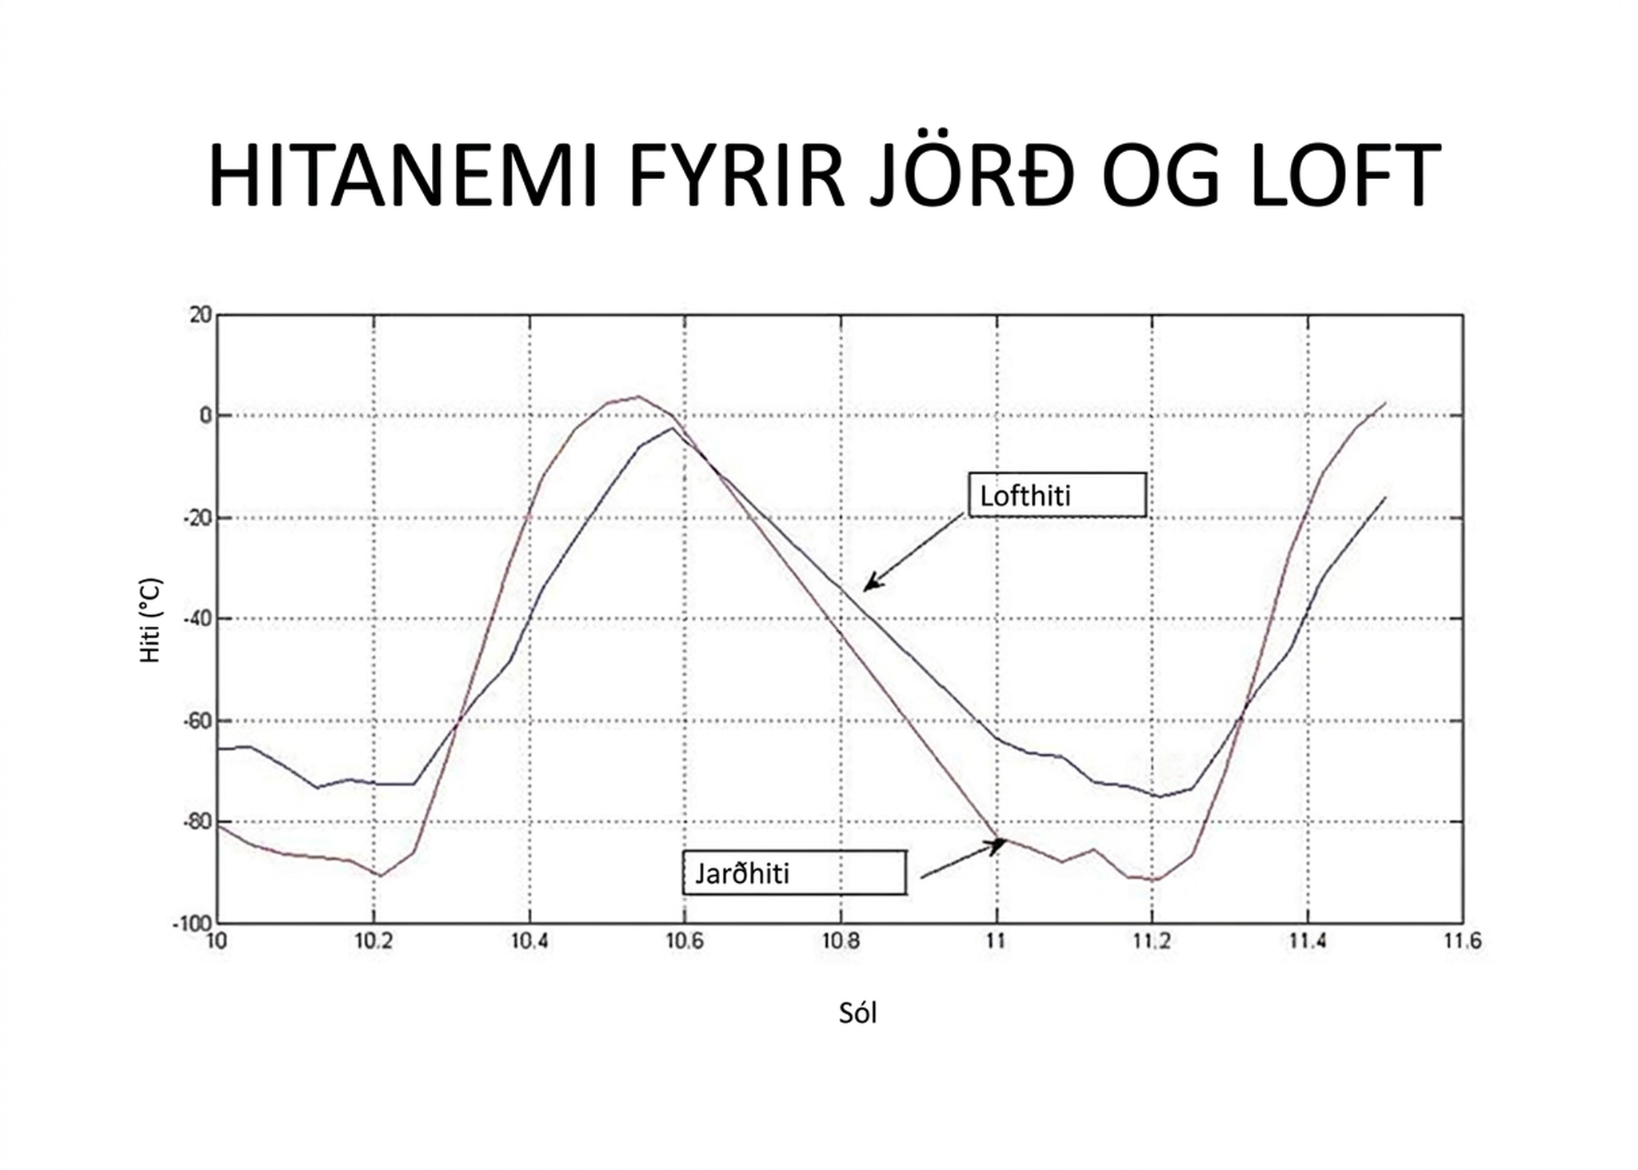
Self Check
A Mars rover recorded temperature data over 1.6 Martian days (Sols). The graph shows air and ground temperatures in Celsius (y-axis) over time in Sols (x-axis). Which statement best compares the ground and air temperatures?
At 11 Sols, the ground temperature is warmer than the air temperature.
The ground temperature is always warmer than the air temperature.
At 11 Sols, the air temperature is warmer than the ground temperature.
The air temperature is always warmer than the ground temperature.
Let’s review!
Notes:
Answer Feedback - Individualized by Response
At 11 Sols, the ground temperature is warmer than the air temperature.
Incorrect. The ground temperature graph is below that of the air temperature at this time. The answer is at 11 Sols, the air temperature is warmer than the ground temperature.
The ground temperature is always warmer than the air temperature.
Incorrect. Throughout the temperature collection, the ground and air temperatures change which is greater than the other. The answer is at 11 Sols, the air temperature is warmer than the ground temperature.
At 11 Sols, the air temperature is warmer than the ground temperature.
That’s correct! : The graph of the air temperature is above the graph of the ground temperature at the place where the x-axis is 11 Sols.
The air temperature is always warmer than the ground temperature.
Incorrect. Throughout the temperature collection, the ground and air temperatures change which is greater than the other. The answer is at 11 Sols, the air temperature is warmer than the ground temperature.

Slide 15
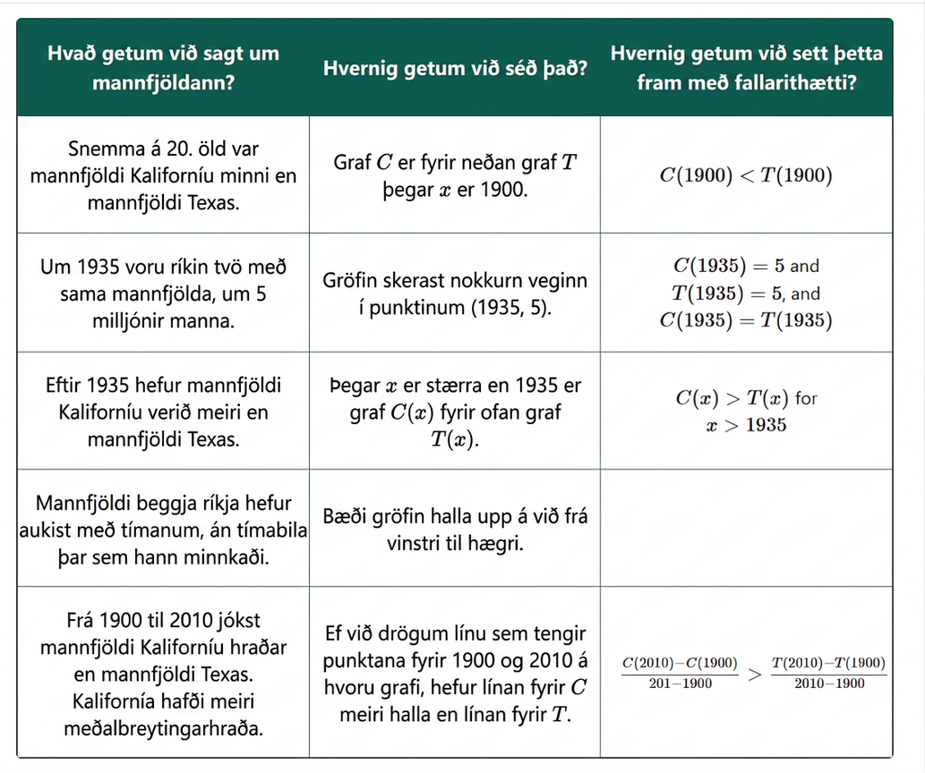
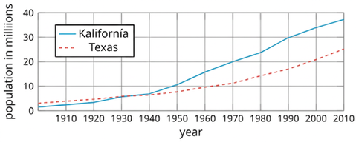
Self Check - Review
Comparing Populations
Examine the graph given above that displays the populations of California and Texas over time.

Slide 16
Lesson Journey
Warm Up
Learning Activity
Cool Down
Lesson Synthesis
Learning Activity
Learning Activity
Practice

Slide 17
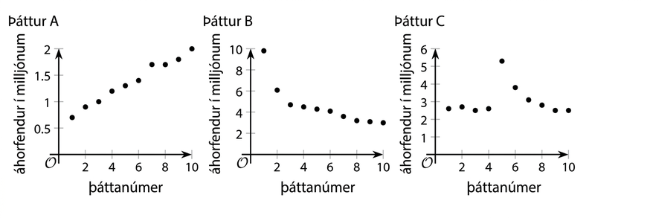
Learning Activity - Watching Television 📺
The number of people who watched a TV episode is a function of that show’s episode number. The three graphs of three functions—A, B, and C—represent three different TV shows.
On the following slide you will match each description with a graph that could represent the situation described. One description has no corresponding graph.
Notes:
Activity (20 minutes)
Previously, students compared continuous functions on the same graph. Now, they analyze discrete graphs shown separately, representing TV show viewership by episode. Students interpret graph features, connect them to function notation and show descriptions, and sketch a graph for a fourth show. This activity deepens their understanding of quantities, relationships, and accurate graphical representation.
Launch
Arrange students in groups of 2. Give students a few minutes of quiet work time, then time to discuss their thinking with their partner. Follow with a whole-class discussion.
Activity questions, answers, and synthesis on the next slide.

Slide 18

Learning Activity - Watching Television 📺
Match each description with a graph from the previous slide. that could represent the situation described. One description has no corresponding graph.
Which show spiked in episode 5 due to a guest star, then dropped back to normal?
Which show is very popular and keeps gaining viewers?
Which show started with few viewers, but is now growing?
Which show started big, dropped, but still has more viewers than another?
Which is greatest at episode 7: A(7), B(7), or C(7)? What does this mean?
Sketch a graph for the show that didn’t match any of the existing ones.
Notes:
Answers
Graph of function C
No match
Graph of function A
Graph of function B
Your answer may vary, but here is a sample. B(7). 3.6 million people watched the 7th episode of Show B.
Our answer may vary, but here is a sample.
Click here to see the sample answer.
Activity Synthesis
Focus the discussion on how students made their matches. Ask students to explain how parts of the descriptions and features of the graphs led them to believe that a pair of representations belong together.
Next, invite students to share their graph of the fourth TV show. Display the graphs for all to see and discuss how the graphs are alike and how they are different. Because each graph is created based on the same description, they should share some common features. If they look drastically different, solicit possible reasons. (Possible explanations include differences in interpretation of the description or in the choice of scale for the vertical axis, errors in reading the description, and plotting errors.)
If time permits, ask students,
"How are the graphs or the functions in this activity different than those in earlier activities?" (They show points rather than lines. The input is episode number, while in other cases, the input was time. Each function is shown on a different coordinate plane.)
"How is the work of comparing functions here like comparing functions in earlier activities?" (They all involve comparing the output values of points on a graph, interpreting the points, making sense of verbal descriptions, and some estimating.)
"How is the work of comparing functions here different than in earlier activities?" (Here we are comparing function values across three separate graphs, which is trickier than when the graphs are all on the same coordinate plane. Figuring out which function has a greater or lesser value was also easier when the functions were represented with lines or curves. It is harder to do with a set of points, especially when they are not in the same image.)

Slide 19
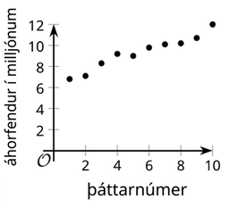
Learning Activity - Watching Television 📺
Sample Graph
Notes:
Activity Images

Slide 20
Learning Strategies - Watching Television 📺
Teacher Instruction: Use these strategies to adjust the activity to support English language learners and students with disabilities.
You can copy and paste the callouts directly on top of the activity or give the instructions aloud.
"_____ matches _____ because . . ."
“I noticed _____, so . . .”
Discussion Supports
Notes:
Support for English Language Learners: MLR 8 Discussion Supports: Speaking, Representing
Use this routine to support whole-class discussion as students explain how they matched the description to the graph. Display the following sentence frames for all to see: "_____ matches _____ because . . ." and "I noticed _____, so . . . ." Encourage students to challenge each other when they disagree. This routine will help students explain how they used parts of the descriptions and features of the graphs to find matches.
Design Principle(s): Support sense-making
NO links to supporting materials for teachers or students.

Slide 21
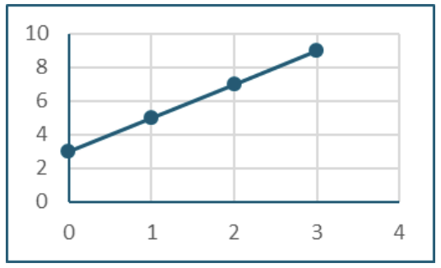
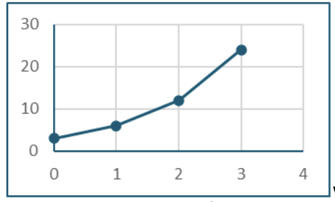
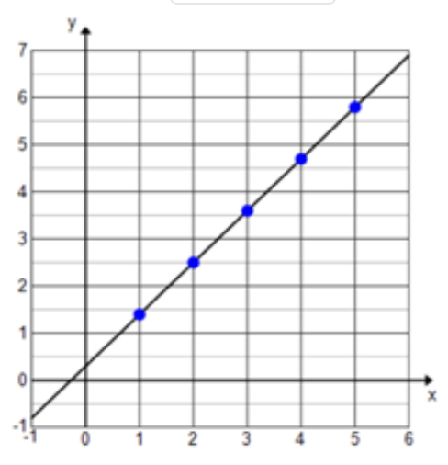
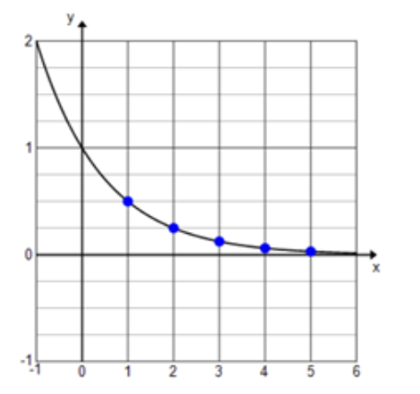
Self Check
For which of the following functions is f(3) the greatest value?
a.
c.
b.
d.
Let’s review!
Notes:
Answer Feedback - Individualized by Response
Graph a: Line graph with points at (0,2), (1,4), (2,6), and (3,8), showing a steady upward trend.
Incorrect. The value of f(3) is approximately 9. The answer is where f(3) is approximately 23.
Graph b: A line graph with points at (0,0), (1,5), (2,10), and (3,25), showing a steady increase with a sharp rise between points 2 and 3.
That’s correct! f(3) equals approximately 23.
Graph c: A graph showing a straight line passing through points (1,1), (2,2), (3,3), (4,4), and (5,5) marked with blue dots. The x and y axes range from -1 to 6 and 0 to 7 respectively.
Incorrect. The value of f(3) is approximately 3.6. The answer is where f(3) is approximately 23.
Graph d: A graph shows a curve decreasing from y=2 on the y-axis towards zero as x increases. Five blue points are marked on the curve at intervals along the x-axis from x = 1 to x = 5.
Incorrect. The value of f(3) is approximately 0.2. The answer is where f(3) is approximately 23.

Slide 22
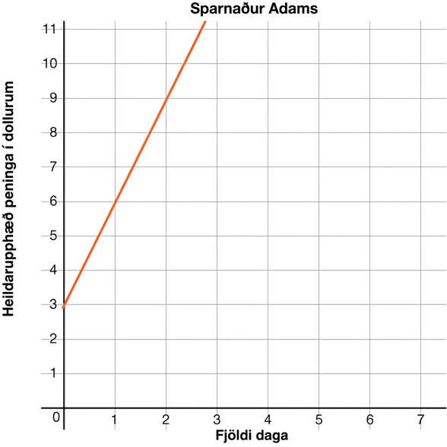
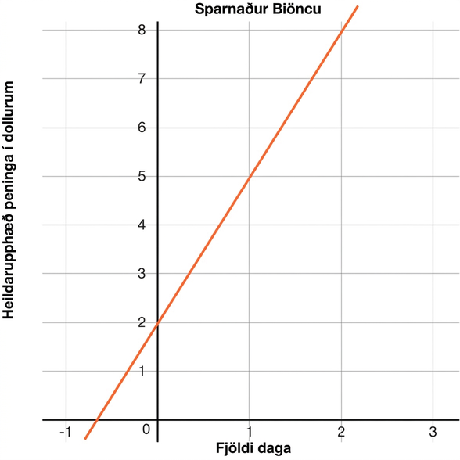
Self Check - Review
Adam and Bianca are competing to save the most money in one month. Use the table and graph to determine who will save more and how much each started with. Adam’s savings is A(t) and Bianca’s is B(t), where t is days. Assume both follow a linear saving pattern.
Which is greater, A(2) or B(2)? Explain what this means.
Notes:
Answer
A(2) = 9 and B(2) = 8, so after 2 days, Adam has saved more money.

Slide 23
Lesson Journey
Warm Up
Learning Activity
Cool Down
Lesson Synthesis
Learning Activity
Learning Activity
Practice

Slide 24
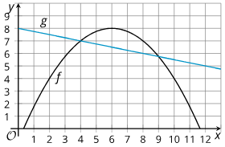
Learning Activity - Comparing Function Values 🔎
Here are graphs that represent two functions, f and g. Decide which function value is greater for each given input. Be prepared to explain your reasoning.
Which is greater, f(2) or g(2)?
Which is greater, f(4) or g(4)?
Which is greater, f(6) or g(6)?
Which is greater, f(8) or g(8)?
Is there a value of x at which the equation f(x) = g(x) is true? Show your reasoning.
Identify at least two values of x at which the inequality f(x) < g(x) is true.
Notes:
Activity (10 minutes)
Students compare graphs and function statements without context, using their understanding of function notation and graph points to interpret intersections.
Previously, students interpreted equations like f(8) = g(8) in context. Now, they reason abstractly about f(x) = g(x) and understand that solutions are x-values where the graphs of f and g intersect.
Answers
g(2) is greater.
They appear to be equal.
f(6) is greater.
f(8) is greater.
Yes. For example: If the graphs intersect when x is 4 and when it is 9, then f(4) = g(4) and f(9) = g(9).
For example: 1, 3, 10, 11, or other x-values that are less than 4 and greater than 9.
Activity Synthesis
Display the graphs of f and g for all to see. Invite students to share their responses to the first set of questions. As they point out the greater function value in each pair, mark the point on the graph and write a corresponding statement in function notation:
f(2) < g(2), f(4) = g(4), f(6) > g(6), and f(8) > g(8). Emphasize that the function value that is greater in each pair has a higher vertical value on the coordinate plane for the same input value.
Next, discuss if there are values of x that make f(x) = g(x) true and how we can tell. Point out that earlier we wrote
f(4) = g(4) because the values of (f) and g are equal when the input is 4. This means that (4,f(4)) and (4,g(4)) are coordinates of the same point.
So, we can interpret an equation such as f(x) = g(x) to mean that the values of f and g are equal when the input is x
, and that x must be the horizontal value of the intersection of both graphs, which is a point that they share.

Slide 25
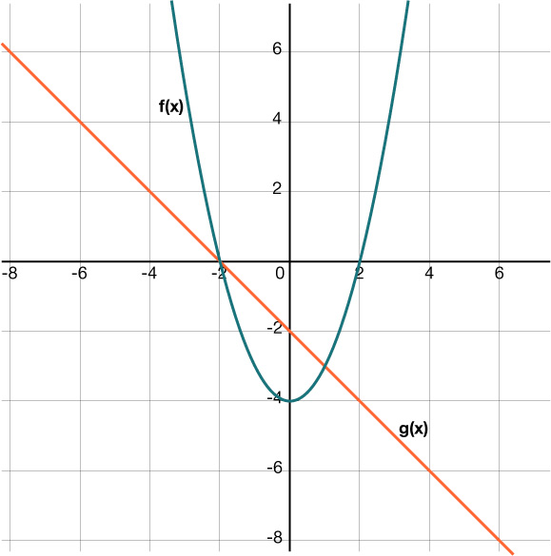
Self Check
Which of the following is true about the graphs of f(x) and g(x)?
f(0) > g(0)
f(1) = g(1)
f(−3) < g(−3)
f(−1) = g(−1)
Let’s review!
Notes:
Answer Feedback - Individualized by Response
Incorrect. The graph of g is higher than the graph of f at x = 0. The answer is f(1) = g(1).
That’s Correct! When x = 1, both f and g equal –3.
Incorrect. At x = −3, f is higher than g. The answer is f(1) = g(1).
Incorrect. At x = −1, g is greater than f. The answer is f(1) = g(1).

Slide 26
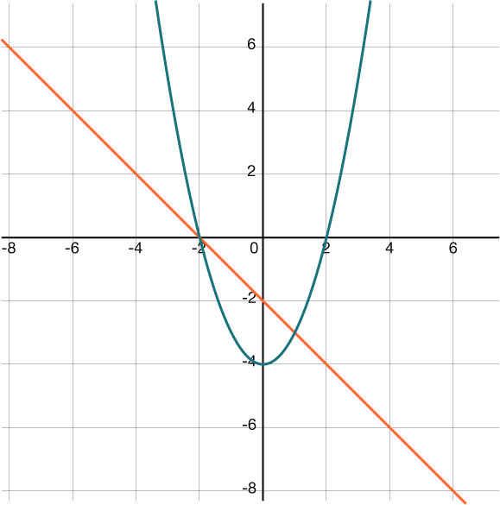
Self Check - Review
Two functions, f(x) and g(x) are shown on the graph.
What is the value of f(−1)?
What is the value of g(−1)?
Which value is greater?
Notes:
Answers
Look at where x = −1 touches the graph of f. The y-value is –3.
f(−1) = −3
Look at where x = −1 touches the graph of g. The y-value is –1.
g(−1) = −1
g(−1) > f(−1)

Slide 27

Lesson Journey
Warm Up
Learning Activity
Cool Down
Lesson Synthesis
Learning Activity
Learning Activity
Practice

Slide 28
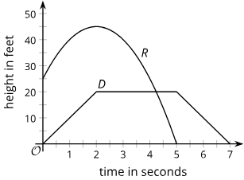
Cool Down
Functions R and D give the height, in feet, of a toy rocket and a drone, t seconds after they are released. Here are the graphs of R (for the rocket) and D (for the drone).
Which of the inequalities is true: R(2) > D(2) or D(2) > R(2)?
What was the height of the drone when the toy rocket hit the ground?
For what value of t is R(t) = D(t) true?
What does this tell you about the drone and the toy rocket?
Notes:
Cool Down (5 minutes)
Answers
R(2) > D(2)
20 feet
About t = 4.5.
At 4.5 seconds, the toy rocket and the drone are at the same height.
Response to Student Thinking - More Chances
Students will have more opportunities to understand the mathematical ideas in this cool down, so there is no need to slow down or add additional work to the next lessons. Instead, use the results of this cool down to provide guidance for what to look for and emphasize over the next several lessons to support students in advancing their current understanding.

Slide 29

Lesson Journey
Warm Up
Learning Activity
Cool Down
Lesson Synthesis
Learning Activity
Learning Activity
Practice

Slide 30

Practice
Put your hard work to action, practice what you’ve learned!
Notes:
Digital Practice: Access the practice pages at https://openstax.org/details/books/algebra-1

Slide 31

Lesson Journey
Warm Up
Learning Activity
Cool Down
Lesson Synthesis
Learning Activity
Learning Activity
Practice

Slide 32
Lesson Synthesis
Let’s refer back to the population graphs for Baltimore and Cleveland from 1900 to 2010 that we saw in the warm up.
On the next slide you will see a series of statements. Your job is to explain how you can tell from the graphs that each statement is true, and translate each verbal description into a statement with the same meaning but written in function notation.
Notes:
Refer back to the population graphs for Baltimore and Cleveland from 1900 to 2010, which students saw in the warm up. Display the graphs for all to see.
Present students with the following statements, one at a time, about the populations of the two cities. Tell students that their job is to explain how they could tell from the graphs that each statement is true, and to translate each verbal description into a statement with the same meaning but written in function notation.
Consider using a three-column graphic organizer to organize students’ responses.

Slide 33
Lesson Synthesis
What can we tell about the populations? | How can we tell? | How can we convey this with function notation?
In 2010, Baltimore had more people than Cleveland.
Baltimore and Cleveland had the same population twice in the past century, in 1910 and around 1944.
After the mid-1940s, Cleveland has had a smaller population than Baltimore.
In the first half of the 20th century, the population of Cleveland grew at a faster rate than that of Baltimore.
Since 1950, the population of Cleveland has dropped at a faster rate than that of Baltimore.
Notes:
Closing the Lesson
After completing the Lesson Synthesis, wrap up the class by directing students to the Lesson Summary in their student textbook. In this section, students review the day’s learning targets, read summaries about the key takeaways from each activity, and then respond to a reflection question regarding their confidence with the material.
For more on the benefits of using this type of metacognitive reflection, see the Research in Practice section of the course.

Slide 34
Self Assessment
How much do you agree with the following statements?
I can… | I can | Almost | Not yet
Compare the features of graphs of functions and explain what they mean in the situations represented.
Make sense of an equation of the form 𝑓(𝑥) = 𝑔(𝑥) in terms of a situation and a graph, and I know how to find the solutions.
Explain statements about two or more functions when they are written in function notation.

