Slide 1
Algebra 1
Unit 8 Quadratic Equations
Lesson 8.3 Solving Quadratic Equations by Reasoning

Slide 2

How to use these slides
On the activity slides check the speaker notes for teacher support and instructional information.
Each lesson includes 1 warm up, 2-3 learning activities, a cool down, practice and a lesson synthesis.
  Learning activities are followed by a self check question, and review section.
Some slides have been hidden from student view, more information can be found on the next slide (Reference Key).
You can edit and use these slides for personal and classroom use, but cannot sell them and must keep the attribution logos.
For more information, Check out the digital quick start guide!

Slide 3





Reference Key
Check the top right corner for an icon referencing these unique sections.
Icon | Title | View | Location and Description
n/a | Support for Students with Disability | Hidden | Learning Strategies slide, provides additional support to students for understanding the activity.
n/a | Support for English Language Learners | Hidden | Learning Strategies slide, provides additional support to students for understanding the activity.
n/a | Extending Your Thinking | Hidden | Extending Your Thinking slide, provides an extra challenge for students.
n/a | Self Check | Not Hidden | Self Check slide, checkpoint to assess student understanding after the learning activity.
n/a | Review | Hidden | Self Check - Review slide, designed to help review topics from the self check question.
On the next slides, check the speaker notes for teacher instructions and support.
Notes:
Check the Speaker Notes: On the next slides you can find discussion questions, lesson information, answers to the activities, and ways to adjust the activity for your students!

Slide 4

Learning Goals
By the end of this lesson you will be able to -
Find solutions to quadratic equations by reasoning about the values that make the equation true.
Explain that quadratic equations may have one or two solutions.
Implement the square root property.
Notes:
Lesson Narrative
In this lesson, students begin to solve quadratic equations by reasoning about what values would make the equations true and by using structure in the equations. The idea that some quadratic equations have two solutions is also made explicit. Students may begin to record their reasoning process as steps for solving, but this is not critical at this point as it will be emphasized in a later lesson.
As students reason about an equation, they may intuitively perform the same operation on each side of the equal sign to get closer to the solution(s). In the warm up activity, refrain from telling students to “take the square root of each side.” Instead, focus on reasoning about values that would make the equation true.
For example, to solve 4𝑥²=100, we could divide each side by 4 and get 𝑥²=25. Encourage students to interpret this equation as: “Some number being squared gives 25” and to reason: “There are two different values that can be squared to get 25: –5 and 5.”
Initially reasoning this way helps curb the following common misconception:
The only solution to an equation such as 𝑥²=25 is √25. Each positive number has two square roots, one positive and the other negative. By convention, the radical symbol √ refers to the positive square root. So the number √25 refers only to the positive square root of 25 and does not capture the negative square root.
In the second activity, the square root property is introduced, establishing that taking the square root of a number yields two possible solutions: a positive square root and a negative square root.
Technology isn’t required for this lesson, but there are opportunities for students to choose to use appropriate technology to solve problems. Consider making technology available.
Required Preparation
None
Required Materials
Paper and pencil
Texas Essential Knowledge and Skills
A1(F) analyze mathematical relationships to connect and communicate mathematical ideas.
A8(A) solve quadratic equations having real solutions by factoring, taking square roots, completing the square, and applying the quadratic formula.

Slide 5
Vocabulary
Previous
Quadratic equation
  Polynomial equation of degree two.
Variable
  A quantity that can take on different values.
Root
  A value that is a solution of an algebraic equation.
New
Square root property
  If x² = k, then x equals ± √k.
Double root
  A value that appears twice in the solution of an algebraic equation.
Notes:
Lesson Vocabulary
To support student understanding of key vocabulary:
Introduce and review the vocabulary words students will see in this lesson.
Encourage students to notice how these words are used and to include them in their math discussions and explanations—both written and oral.
Use a word wall to reinforce vocabulary. Sample word wall cards are available here.
For newcomers or students with beginning English proficiency, use these Quizlet sets to support vocabulary learning:
Unit 8 Spanish Vocabulary – use first to build understanding
Unit 8 Vocabulary (English) – use after anchoring in Spanish
Support for English Language Learners
ELPS 2(F) listen to and derive meaning from a variety of media such as audiotape, video, DVD, and CD-ROM to build and reinforce concept and language attainment
ELPS 3(H) narrate, describe, and explain with increasing specificity and detail as more English is acquired
ELPS 5(Eiii) using negatives and contractions correctly

Slide 6
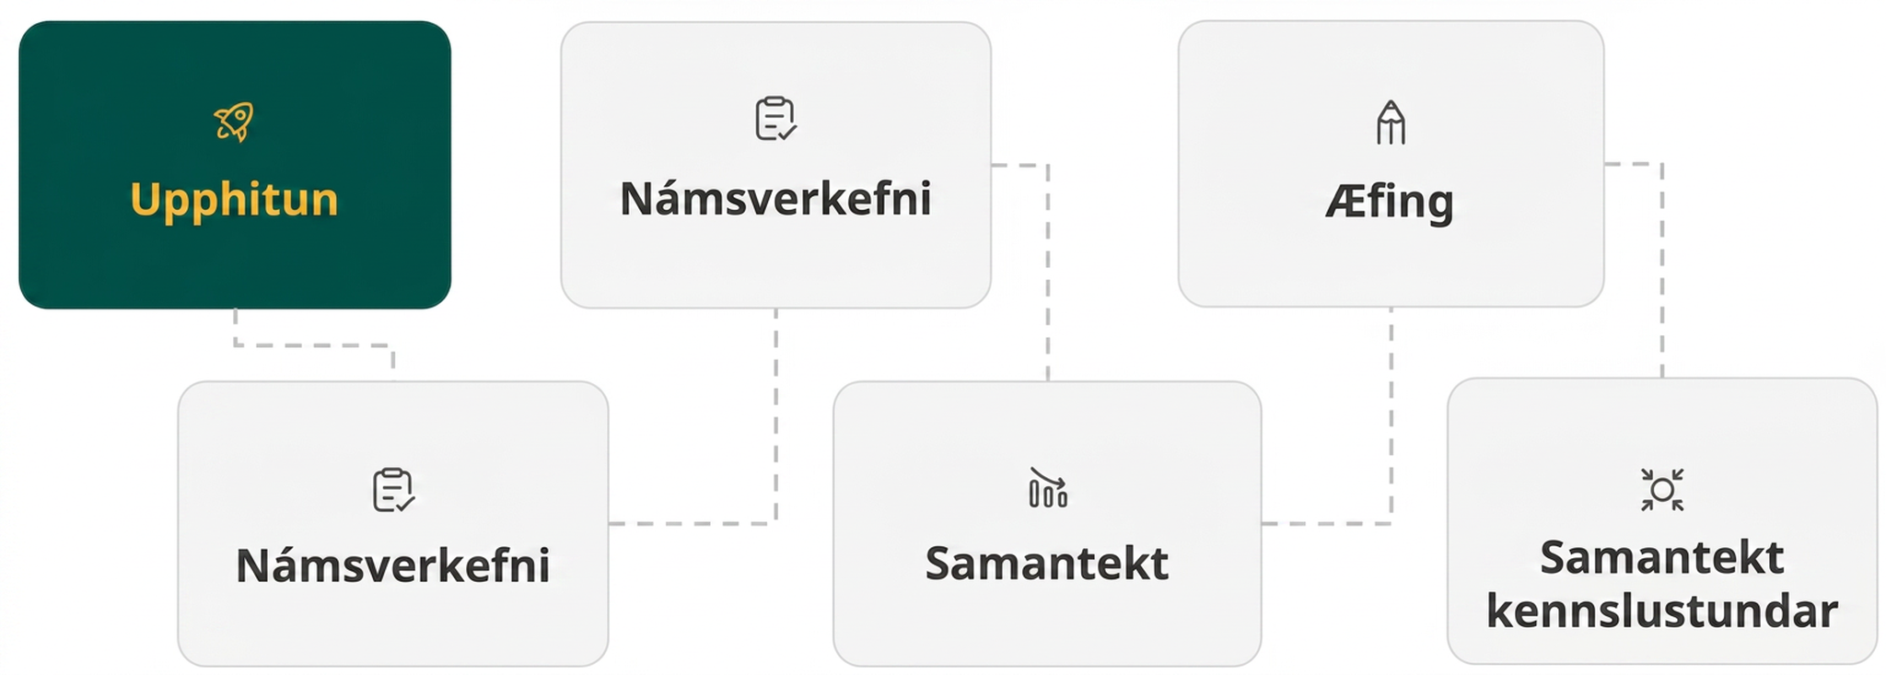
Lesson Journey
First Stop: Warm Up

Slide 7

Warm Up
How Many Solutions?🤔
How many solutions does each equation have? Be prepared to show your reasoning.
x² = 9
x² = 0
x² – 1 = 3
2x² = 50
(x + 1)(x + 1) = 0
x(x – 6) = 0
(x – 1)(x – 1) = 4
How are questions 2 and 5 different from other solutions?
Notes:
Warm Up (10 minutes)
Previously, students saw that a function could have two input values that give the same output value (which could be 0). The input values were primarily interpreted in terms of a situation. In this warm up, students begin to think more abstractly about this process—in terms of finding the solutions to an equation. They recognize that some quadratic equations have one solution and others have two.
All of the equations can be solved by reasoning and do not require formal knowledge of algebraic methods such as rewriting into factored form or completing the square. For example, for 𝑥² − 1 = 3, students can reason that 𝑥² must be 4 because that is the only number that, when 1 is subtracted from it, gives 3.
Finding the solutions of these equations, especially the last few equations, requires perseverance in making sense of problems and of representations.
Launch
Ask students to evaluate 4⋅4 and −4⋅(−4). Make sure they recall that both products are positive 16.
Allow students to complete the first exercise individually. Then ask a student to explain their solution.
Allow time for students to complete the remaining exercises.
Use question 8 to emphasize that questions 2 and 5 are unique since they have only one solution each.
Introduce the vocabulary word double root, or a root that appears twice in the solution of an algebraic equation.
Answers
Two solutions. Both 3² and (-3)² equal 9.
One solution. Only 0² is 0.
Two solutions. Add 1 to both sides of the equation. Then, both 2² and (−2)² equal 4.
Two solutions. Divide both sides of the equation by 2. Then, both 5² and (−5)² equal 25.
One solution. Setting each factor equal to zero results in −1 being the only solution.
Two solutions. Setting each factor equal to zero results in 0 and 6 being solutions.
Two solutions. By trial and error, both 3 and −1 make the equation true.
Questions 2 and 5 only have one solution each, while the others have two solutions.
A double root is a root that appears twice in the solution of an algebraic equation.
Anticipated Misconceptions
None
Activity Synthesis
Ask students to share their responses and reasoning. After each student explains, ask the class if they agree or disagree and discuss any disagreements.
Make sure students see that in cases such as 𝑥(𝑥−6)=0 and (𝑥−1)(𝑥−1)=4, the solutions to each equation may not necessarily be opposites, as was the case in the preceding equations. For example, in question 7, we want to find a number that produces 4 when it is squared. That number can be 2 or −2. If the number is 2, then 𝑥 is 3. If the number is −2, then 𝑥 is −1.
Discuss questions such as:
“The equation (𝑥 + 1)(𝑥 + 1) = 0 has only one solution, while (𝑥 − 1)(𝑥 − 1) = 4 has two. Why is that?” (The former has only one solution because the only number that equals 0 when squared is 0 itself. It is a double root. The latter has two solutions because there are two numbers that, when squared, equal 4.)
“In an equation like 𝑥(𝑥 − 6) = 0, how can we tell that there are two solutions?” (There are two factors here, either of which could make the product 0.)

Slide 8
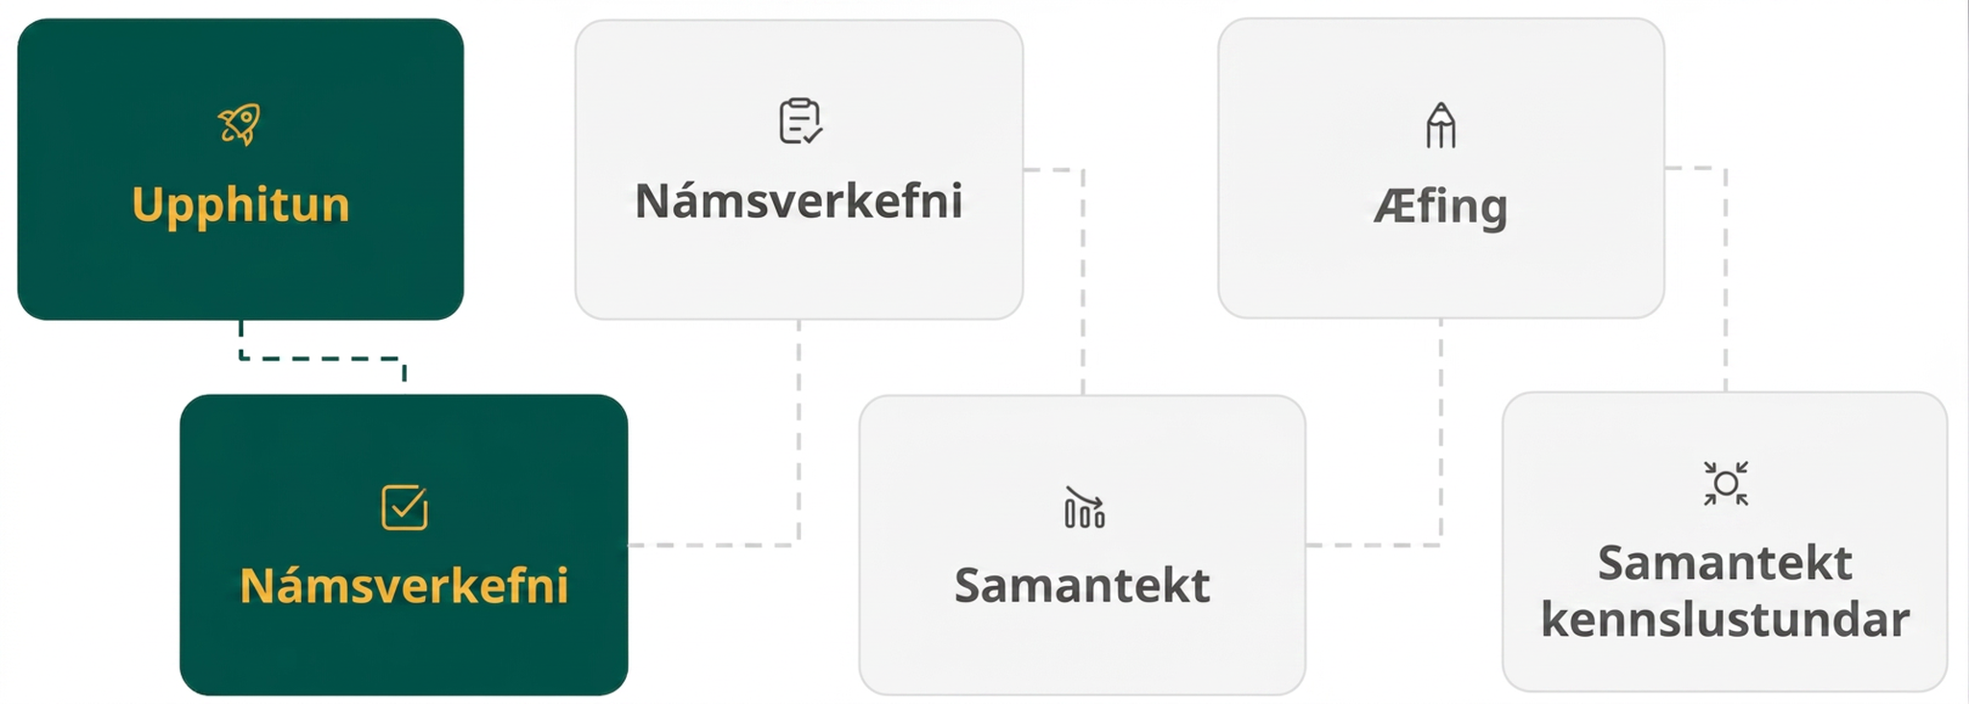
Lesson Journey
Second Stop: Learning Activity A

Slide 9

Learning Activity A | Learning Strategies
Finding pairs of solutions 👀
Teacher Instruction: Use these strategies to adjust the activity to support English language learners and students with disabilities.
You can copy and paste the callouts directly on top of the activity or give the instructions aloud.
Walk around and find two other displays for solving the equations.
Think about what’s the same and different about the methods.
Talk with your partner about what you noticed.
Compare and Connect
Show your work for each problem on a separate slip of paper.
Use space provided on each slip to record your thinking.
Memory & Organization
Notes:
Support for English Language Learners: MLR 7 Compare and Connect: Representing, Conversing
Use this routine to prepare students for the whole-class discussion. At the appropriate time, invite student pairs to create a visual display of their strategies for solving the quadratic equations. Allow students time to quietly circulate and analyze the strategies in at least two other visual displays in the room. Give students quiet think time to consider what is the same and what is different about their solution strategies. Next, ask students to return to their partner and discuss what they noticed. Listen for and amplify observations that highlight advantages and disadvantages to each method. This will help students make connections between different strategies for solving quadratic equations.
Design Principle(s): Optimize output; Cultivate conversation
Learn more about this routine
View the instructional video and follow along with the materials to assist you with learning this routine.
Provide support for students
Distribute graphic organizers to the students to assist them with participating in this routine.
Support for Students with Disabilities: Engagement: Develop Effort and Persistence
Chunk this task into manageable parts for students who benefit from support with organizational skills in problem solving. For example, cut problems into four separate slips and have students obtain the new problem only after finishing the last. Provide students four copies of a graphic organizer with two sections—one for work, and another for notes/explanations. Invite students to record their work for each problem on its own paper. When presenting multiple strategies and approaches, encourage students to use the space for notes/explanations to record explanations and alternate strategies.
Supports accessibility for: Memory; Organization

Slide 10
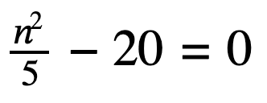
Learning Activity A
Finding pairs of solutions 👀
Find the two solutions for each equation.
n² + 4 = 404
432 = 3n²
2n² – 7 = 65
_
Are you ready for more?
Notes:
Support for All Learners
This activity offers additional support and an extension for students:
For English language learners and students with disabilities, be sure to review the Learning Strategies slide!
For students looking for an extra challenge, be sure to review the Extending Your Thinking slide!
Activity (25 minutes)
In this activity, students encounter quadratic equations that are slightly more complex than those in the warm up. Encourage students to first isolate the squared variable algebraically. Then have them apply the square root property, while reinforcing that this yields two solutions.
Launch
Introduce the square root property as shown at the top of the activity.
Emphasize that when using the property to solve an equation, there is always a positive and a negative square root.
Consider arranging students in groups of two and asking them to work quietly for a few minutes before discussing their thinking with a partner.
Activity Answers
n = 20 and n = -20
n = 12 and n = -12
n = 6 and n = -6 [NOTE: In the online textbook, this is question 4. A sequence change was made to better support accessibility features.]
n = 10 and n = -10 [NOTE: In the online textbook, this is question 3. A sequence change was made to better support accessibility features.]
Anticipated Misconceptions
Students may forget the negative square root. Reinforce that the square root property yields two solutions.
Activity Synthesis
Ask students to explain in their own words why the square root property is true. Use an example such as 𝑥² = 64 to help explain. Ask a student to complete the following sentence: “If 𝑥² = 64, then ______________________.” Sample answers:
If 𝑥² = 64, then 𝑥 = √64 and 𝑥 = −√64.
If 𝑥² = 64, then 𝑥 = ±√64.
If 𝑥² = 64, then 𝑥 = 8 and 𝑥 = −8.
Emphasize that there are two solutions that make the equation true, a positive square root and a negative square root.

Slide 11

Learning Activity A
Extending Your Thinking
How many solutions does the equation
(𝑥 − 3)(𝑥 + 1)(𝑥 + 5) = 0 have? What are the solutions?
How many solutions does the equation
(𝑥 − 2)(𝑥 − 7)(𝑥 − 2) = 0 have? What are the solutions?
Write a new equation that has 10 solutions.
Notes:
Go back to Lesson Activity
Answer
Three solutions: 𝑥 = 3, 𝑥 = −1, and 𝑥 = −5.
Two solutions: 𝑥 = 2 and 𝑥 = 7.
There are many different possible answers. For example: (𝑥 − 1)(𝑥 − 2)(𝑥 − 3)(𝑥 − 4)(𝑥 − 5)(𝑥 − 6)(𝑥 − 7)(𝑥 − 8)(𝑥 − 9)(𝑥 − 10) = 0.
.

Slide 12
Learning Activity A
Self Check
Solve for 𝑝. Find all solutions.
3p² + 8 = 251
p = 9
p = 11 and p = –11
p = 11
p = 9 and p = –9
Let’s review!
Notes:
Answer Feedback - Individualized by Response
Incorrect. There is more than one solution, since both 9² and (–9)² equal 81.
Incorrect. Subtracting 8 from both sides and then dividing both sides by 3 leaves 𝑝²=81.
Incorrect. There is more than one solution, since both 9² and (–9)² equal 81.
That’s correct! Substitute each value in for p in the original equation to check your answers. 3(9)² + 8 = 251, and 3(–9)² + 8 = 251. Since they are true, your answers are correct.
How to Solve: Subtract 8 from both sides. Divide both sides by 3. This leaves 𝑝² = 81. When you take the square root of 81, there is more than one solution. The answer is 𝑝 = 9 and 𝑝 = −9.

Slide 13

Learning Activity A
Self Check - Review
USING THE SQUARE ROOT PROPERTY TO SOLVE QUADRATIC EQUATIONS
Step 1 - Isolate the quadratic term and make its coefficient 1.
Step 2 - Use the square root property.
Step 3 - Pull out any perfect square factors and simplify.
Step 4 - Check the solutions.
Solve x² – 50 = 0
Notes:
Remind Students
Review the square root property: if x² = k, then x = ± √k.
The square root property gives two solutions, the principal square root and its opposite.
Access the online textbook for the work that explains how to solve this specific example and for additional examples.

Slide 14

Lesson Journey
Third Stop: Learning Activity B

Slide 15
Learning Activity B | Learning Strategies
Heavy Duty Solving 💪
Teacher Instruction: Use these strategies to adjust the activity to support English language learners and students with disabilities.
  You can copy and paste the callouts directly on top of the activity or give the instructions aloud.
Walk around and find two other displays for solving the equations.
Think about what’s the same and different about the methods.
Talk with your partner about what you noticed.
Compare and Connect
Highlight the parts of the equations that are similar and the parts that are different.
Highlight the parts of the solution process that are similar and the parts that are different.
Representation
Notes:
Support for English Language Learners: MLR 7 Compare and Connect: Representing, Conversing
Use this routine to prepare students for the whole-class discussion. At the appropriate time, invite student pairs to create a visual display of their process for solving the first equation and the second equation. Displays may include a list of steps, a flow chart, etc. Allow students time to quietly circulate and analyze at least two other visual displays in the room. Give students quiet think time to consider how the processes are similar and how they are different. Next, ask students to return to their partner and discuss what they noticed. Listen for and amplify observations that connect the parentheses with adding another step to the solution/thinking process. This will help students make connections between algebraic representations of quadratic functions.
Design Principle(s): Optimize output; Cultivate conversation
Learn more about this routine
View the instructional video and follow along with the materials to assist you with learning this routine.
Provide support for students
Distribute graphic organizers to the students to assist them with participating in this routine.
Support for Students with Disabilities: Representation: Internalize Comprehension
Use color and annotations to illustrate student thinking. Consider highlighting the parts of the equations that are similar and the parts of the equations that are different for each equation. Then, highlight the parts of the process that are similar and the parts of the process that are different for each equation. Press students to use annotations to connect the highlighted parts for the equations and process.
Supports accessibility for: Visual-spatial processing

Slide 16
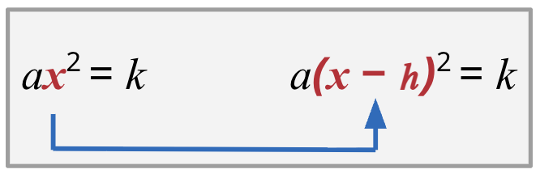
Learning Activity B | Part 1
Heavy Duty Solving 💪
To solve equations like
a(x − ℎ)² = k, follow steps similar to equations we have solved before.
Notice the quadratic term, 𝑥, in the original form ax² = k is replaced with (x − ℎ).
Solve 144 = (n + 1)².
Step 1 - Isolate the binomial.
144 = (n + 1)²
Step 2 - Use the square root property.
√144 = √(n + 1)²
±12 = n + 1
Step 3 - Isolate the variable.
+ 12 – 1 = n and – 12 – 1 = n
Step 4 - Simplify.
The solutions are n = 11 and n = –13.
Notes:
Support for All Learners
This activity offers additional support for students:
For English language learners and students with disabilities, be sure to review the Learning Strategies slide!
Activity (5 minutes)
In this activity, students will use what they have learned about the square root property to reason the solutions to more complex quadratic equations.
The variable being squared is now an expression being squared, but the principles used to solve the equation remain the same. Students will use the square root property to identify two different solutions.
Launch
Read the activity opening together as a class.
Ask students why solving the new equation might be more complex. (The variable being squared is now an expression being squared.)
As a hint for the first exercise, tell students to take the square root of both sides as previously done. This gives ±√144 = (𝑛 + 1).
Students might then reason:
Some number plus 1 equals the positive square root of 144.
Some number plus 1 equals the negative square root of 144.
Activity questions, answers, anticipated misconceptions, and synthesis on the next slide.

Slide 17
Learning Activity B | Part 2
Heavy Duty Solving 💪
Solve the following quadratic equations. Explain or show your reasoning.
(u – 6)² = 64
(n – 5)² – 30 = 70
4(x + 6)² – 5 = 31
Are you ready for more?
Notes:
Answers
n = 11 and n = – 13
Because 12 and −12 are the two numbers we can square to make 144 and 𝑛+1 is the number being squared, we need 𝑛 to be 1 less than 12 or −12. So 𝑛 = 11 and 𝑛 = −13.
u = 14 and u = – 2
Since 8 and −8 are the two numbers we can square to make 64 and 𝑢−6 is the number being squared, we need 𝑢 to be 6 more than 8 or −8. So 𝑢 = 14 and 𝑢 = −2.
𝑛 = 15 and 𝑛 = −5
To isolate the binomial, add 30 to both sides of the equation. Since 10 and –10 are the two numbers we can square to make 100 and 𝑛−5 is the number being squared, we need 𝑛 to be 5 more than 10 or –10. So 𝑛 = 15 and 𝑛 = −5.
x = – 3 and x = −9
To begin isolating the binomial, add 5 to both sides of the equation. Then divide both sides of the equation by 4. Since 3 and –3 are the two numbers we can square to make 9 and 𝑥+6 is the number being squared, we need 𝑥 to be 6 less than 3 or –3. So 𝑥 = −3 and 𝑥 = −9.
Anticipated Misconceptions
Students may forget to isolate the variable after using the square root property (ex. #1 subtracting 1, #2, adding 6, etc.). Reinforce that the variable must be isolated before finding solutions using the two square roots. Additionally, students may be confused that these equations have solutions that are not opposites. Use this as an opportunity to discuss why equations in the first activity yielded two opposite solutions, but in this activity, the solutions are not opposites.
Activity Synthesis
This activity demonstrates a different way to use the square root property to solve a more complex equation. After completing the activity, ask students to rewrite the square root property using the following starting expression: If (𝑥 + 1)² = 𝑘, then ____________. After some discussion, reveal the answer to be: 𝑥 + 1 = √𝑘 and 𝑥 + 1 = −√𝑘, so 𝑥 = −1 ± √𝑘

Slide 18
Learning Activity B
Extending Your Thinking
Solve the following quadratic equation. Be prepared to show your reasoning.
(4𝑥 − 3)² + 1 = 47
Notes:
Go back to Lesson Activity
Answer
𝑥 = ⁹/₄ and 𝑥 = − ³/₄
.

Slide 19
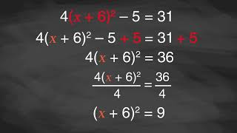
Learning Activity B | Video
Solving More Complex Quadratic Equations
Notes:
This video discusses question 4 of activity 8.3.3.

Slide 20

Learning Activity B
Self Check
Solve the following quadratic equation.
(x + 3)² – 16 = 48
x = 11 and x = – 5
x = – 11 and x = 5
x = – 8 and x = 8
x = 5
Let’s review!
Notes:
Answer Feedback - Individualized by Response
Incorrect. The final step is subtracting 3 from –8 and 8, not adding.
That's correct! Insert each solution into the original equation. ((–11)+3)² – 16 = 48 and (5+3)² – 16 = 48.
Incorrect. You forgot the final step of subtracting 3 from –8 and 8.
Incorrect. When you take the square root of 64, remember that there are two possible answers, –8 and 8.
How to Solve: Add 16 to both sides. Then, take the square root of 64, remembering that there are two possible answers, –8 and 8. Finally, subtract 3 from each answer. The answer is 𝑥 = −11 and 𝑥 = 5.
.

Slide 21
Learning Activity B
Self Check - Review
Solve 4(y – 7)² = 48.
USING THE SQUARE ROOT PROPERTY TO SOLVE QUADRATIC EQUATIONS
Step 1 - Isolate the quadratic term and make its coefficient 1.
Step 2 - Use the square root property on the binomial.
Step 3 - Pull out any perfect square factors and simplify.
Step 4 - Check the solutions.
Notes:
Access the online textbook for the work that explains how to solve this specific problem.

Slide 22
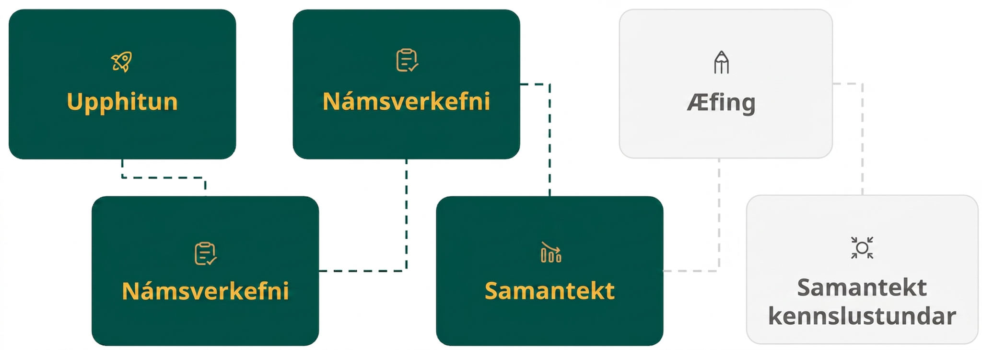
Lesson Journey
Fourth Step: Cool Down

Slide 23
Cool Down
Use what you learned in this lesson to solve each equation.
5m² = 80
(m – 6)² = 100
⅔y² – 8 = – 2
⅙(x + 3)² – 8 = 16
Notes:
Cool Down (5 minutes)
Answers
m = 4, m = – 4
m = 16, m = – 4
y = 3, y = – 3
x = 9, x = –15
Response to Student Thinking - Press Pause
If students struggle to use the square root property correctly, spend some time reviewing student work from cool downs and providing additional practice opportunities through practice problems.
.

Slide 24
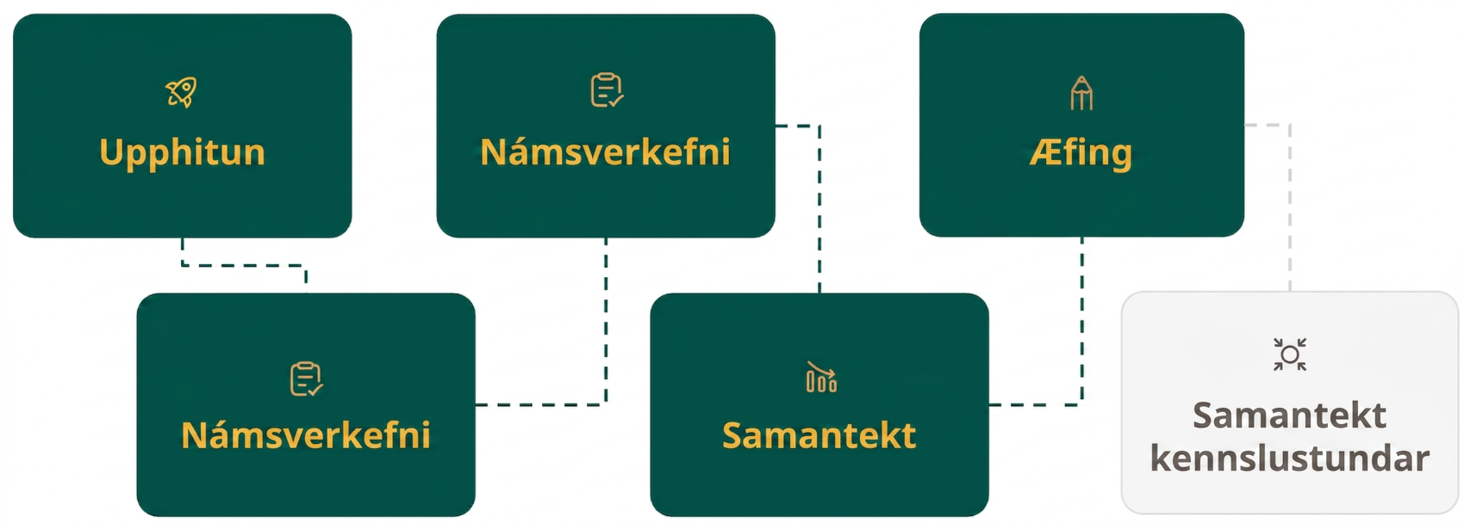
Lesson Journey
Fifth Stop: Practice

Slide 25

Practice
Put your hard work to action, practice what you’ve learned!
Notes:
Digital Practice: Access the practice pages at https://openstax.org/details/books/algebra-1

Slide 26
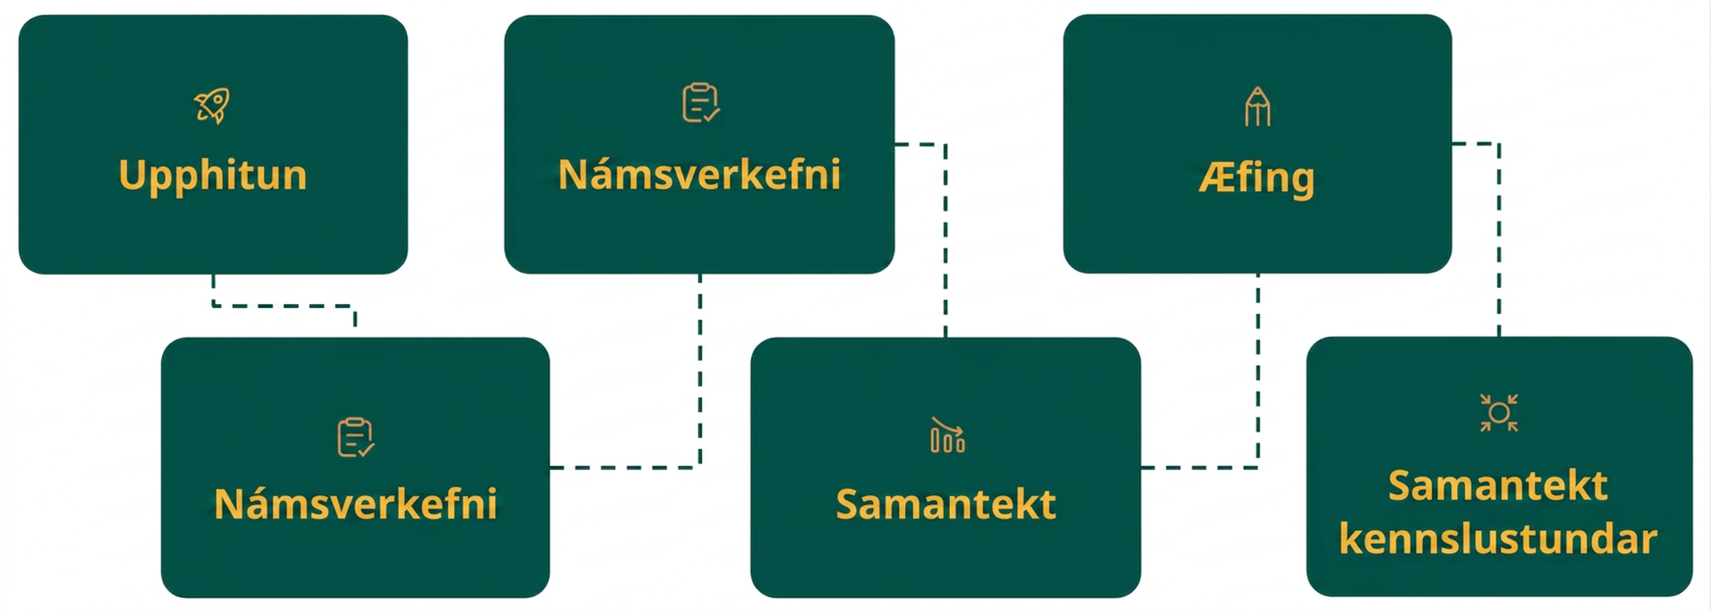
Lesson Journey
Sixth Stop: Lesson Synthesis

Slide 27
Lesson Synthesis | Part 1
Lesson Synthesis
x² = 9
x² = 0
x² – 1 = 3
2x² = 50
(x + 1)(x + 1) = 0
x(x – 6) = 0
(x – 1)(x – 1) = 4
Which equations have one solution?
Which equations have two solutions?
Notes:
Lesson Synthesis
To help students generalize their reasoning and attend more closely to the structure of quadratic equations, display the equations from the warm up activity. Ask students if they can tell (without referring to the solutions they found earlier and without solving again) if an equation would have one or two solutions.
Lesson Synthesis continues on the next slide.

Slide 28
Lesson Synthesis | Part 2
Lesson Synthesis
n² + 4 = 404
432 = 3n²
144 = (n + 1)²
(n – 5)² – 30 = 70
Which equations have two solutions that are opposites?
Which equations have two solutions that are not opposites?
Notes:
Lesson Synthesis - continued
To help students generalize their reasoning and attend more closely to the structure of quadratic equations, display a mix of equations from the second and third activities.
Ask students if they can tell (without referring to the solutions they found earlier) which equations will have two solutions that are opposites (such as 5 and –5) and which will have two solutions that are not opposites (such as 3 and 7). Ask students to explain their thinking.

Slide 29
Self Assessment
How much do you agree with the following statements?
Learning Goals | I can | Almost | Not yet
Find solutions to quadratic equations by reasoning about the values that make the equation true. | ⃞ | ⃞ | ⃞
Explain that quadratic equations may have one or two solutions. | ⃞ | ⃞ | ⃞
Implement the square root property. | ⃞ | ⃞ | ⃞

