Slide 1
Algebra 1
Unit 7 Introduction to Quadratic Functions
Lesson 7.10 Graphs of Functions in Standard and Factored Form
Notes:
How to Get Started
Review Slide 2: How to use these slides
Check out the Check out the digital quick start guide!
Review Slide 3: Reference Key of Icons

Slide 2

How to use these slides
On the activity slides check the speaker notes for teacher support and instructional information.
Each lesson includes 1 warm up, 2-3 learning activities, a cool down, practice and a lesson synthesis.
  Learning activities are followed by a self check question, and review section.
Some slides have been hidden from student view, more information can be found on the next slide (Reference Key).
You can edit and use these slides for personal and classroom use, but cannot sell them and must keep the attribution logos.
For more information, Check out the digital quick start guide!

Slide 3





Reference Key
Check the top right corner for an icon referencing these unique sections.
Icon | Title | View | Location and Description
n/a | Support for Students with Disability | Hidden | Learning Strategies slide, provides additional support to students for understanding the activity.
n/a | Support for English Language Learners | Hidden | Learning Strategies slide, provides additional support to students for understanding the activity.
n/a | Extending Your Thinking | Hidden | Extending Your Thinking slide, provides an extra challenge for students.
n/a | Self Check | Not Hidden | Self Check slide, checkpoint to assess student understanding after the learning activity.
n/a | Review | Hidden | Self Check - Review slide, designed to help review topics from the self check question.
On the next slides, check the speaker notes for teacher instructions and support.
Notes:
Check the Speaker Notes: On the next slides you can find discussion questions, lesson information, answers to the activities, and ways to adjust the activity for your students!

Slide 4

Learning Goals
By the end of this lesson you will be able to -
Explain the meaning of the intercepts on a graph of a quadratic function in terms of the situation it represents.
Explain how the numbers in the factored form of a quadratic expression relate to the intercepts of its graph.
Notes:
Lesson Narrative
This lesson has two goals. First, it connects students’ work with quadratic expressions to quadratic functions, showing that different expressions can represent the same function. Second, it helps students see how numbers in standard and factored forms relate to the x- and y-intercepts of a graph. These observations lay the groundwork for understanding how the parameters of quadratic expressions affect a graph’s shape and position in future lessons.
Required Preparation
None
Required Materials
None
Texas Essential Knowledge and Skills
A1(B) use a problem-solving model that incorporates analyzing given information, formulating a plan or strategy, determining a solution, justifying the solution, and evaluating the problem-solving process and the reasonableness of the solution
A7(B) describe the relationship between the linear factors of quadratic expressions and the zeros of their associated quadratic functions

Slide 5
Vocabulary
Standard form
  linear
    𝐴𝑥 + 𝐵𝑦 = 𝐶, where 𝐴, 𝐵, and 𝐶 are real numbers, and 𝐴 and B are not both zero.
  quadratic
    When a quadratic expression is written as f(x) = ax²+ bx + c.
New
None
Previous
Factored form
  The form of a number or algebraic expression when it has been broken down into a product of its factors.
Quadratic functions
  A function where the output is given by a quadratic expression in the input.
f(x) = ax²+ bx + c.
Notes:
Lesson Vocabulary
To support student understanding of key vocabulary:
Introduce and review the vocabulary words students will see in this lesson.
Encourage students to notice how these words are used and to include them in their math discussions and explanations—both written and oral.
Use a word wall to reinforce vocabulary. Sample word wall cards are available here.
For newcomers or students with beginning English proficiency, use these Quizlet sets to support vocabulary learning:
Unit 7 Spanish Vocabulary – use first to build understanding
Unit 7 Vocabulary (English) – use after anchoring in Spanish
Support for English Language Learners
ELPS 1(C) use strategic learning techniques such as concept mapping, drawing, memorizing, comparing, contrasting, and reviewing to acquire basic and grade-level vocabulary
ELPS 2(F) listen to and derive meaning from a variety of media such as audiotape, video, DVD, and CD-ROM to build and reinforce concept and language attainment
ELPS 3(E) share information in cooperative learning interactions
ELPS 3(H) narrate, describe, and explain with increasing specificity and detail as more English is acquired

Slide 6
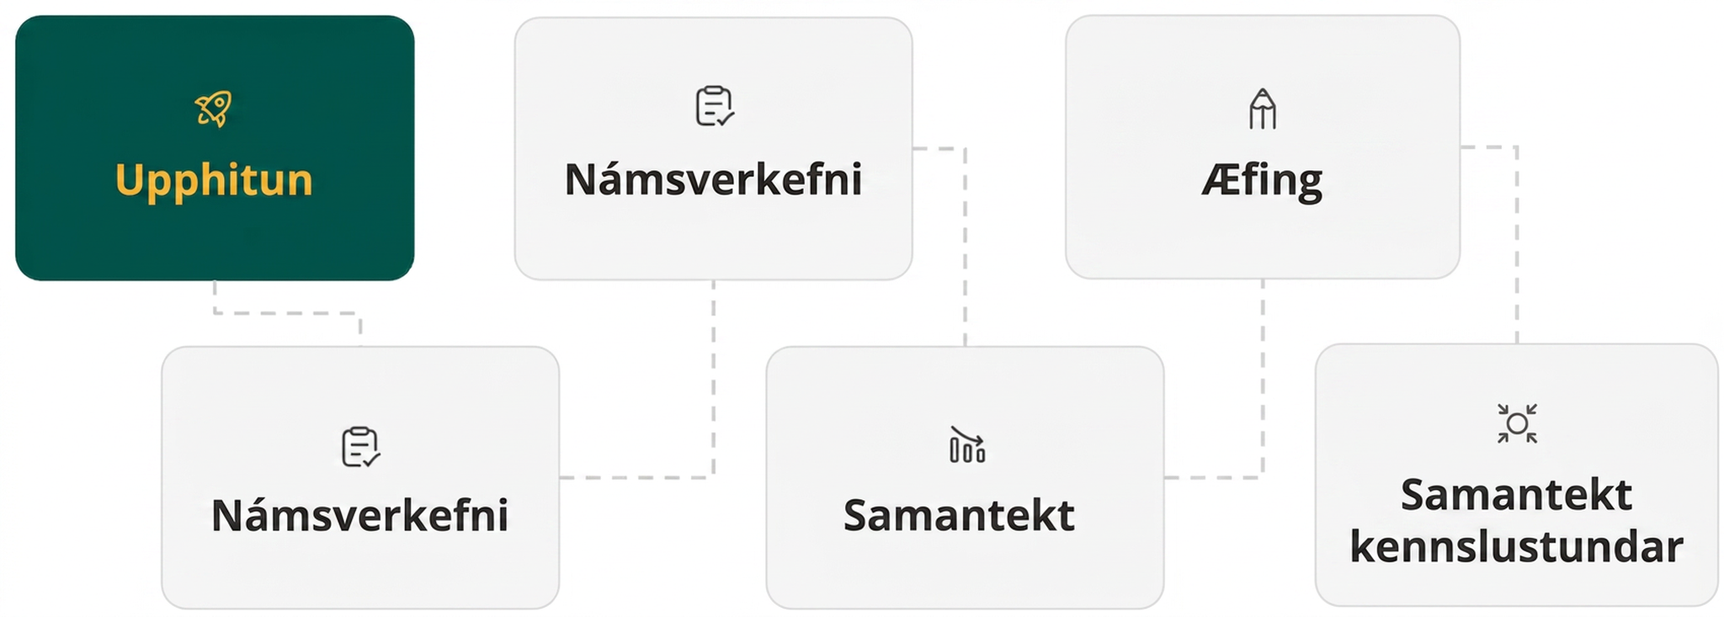
Lesson Journey
First Stop: Warm Up

Slide 7

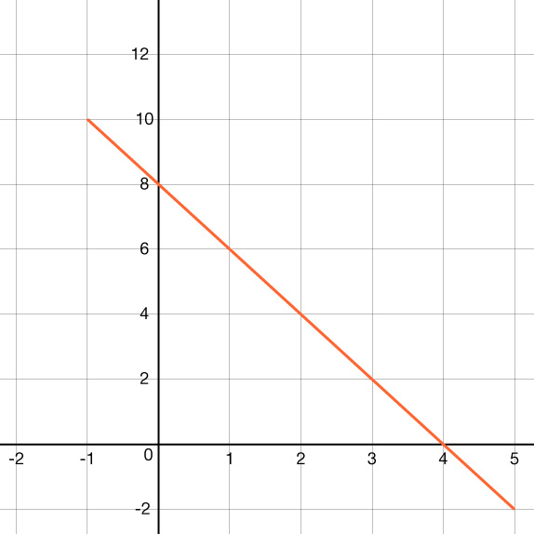
Warm Up
What Can the Equation Tell Us? 🤨
Here is a graph of the equation
y = 8 − 2x.
Where do you see the 8 from the equation in the graph?
here do you see the –2 from the equation in the graph?
What is the value of x for the x-intercept of the graph? How does this relate to the equation?
Notes:
Warm Up (5 minutes)
In this warm up, students revisit the graph of a linear equation and recall that an equation can tell us something about the graph that represents it and vice versa.
Launch
Allow students time to answer on their own, and then “turn and talk” to compare answers.
Answers
The 8 in y = 8 − 2x means the graph intersects the y-axis at 8. The y-intercept is (0, 8).
The –2 is the slope of the line. You can see it, for example, by looking at (0, 8) and (1, 6). When x increases by 1, y decreases by 2.
The x-intercepts is (4, 0) so the x-value is 4. When 4 is substituted for the value of x in the equation, the result is 0. In other words, this is when y = 0. Thus, it is location where the graph of the equation crosses the x-axis and where the value of the equation equals 0.
Activity Synthesis
Make sure students recall that:
The y-intercept tells us where a graph intersects the y-axis, at which point the x value is 0. When a linear equation is written in the form y = mx + b, the b tells us the y-intercept because when x is 0, mx is also 0, so y = b and (0, b) is the y-intercept.
The x-intercept tells us where a graph intersects the x-axis, at which point the y-value is 0. To find where the graph intersects the x-axis, find the solution to 0 = mx + b.
Tell students that, when written in certain forms, quadratic expressions also tell us information about their graphs, and vice versa. We'll explore these connections in this lesson and upcoming ones.

Slide 8
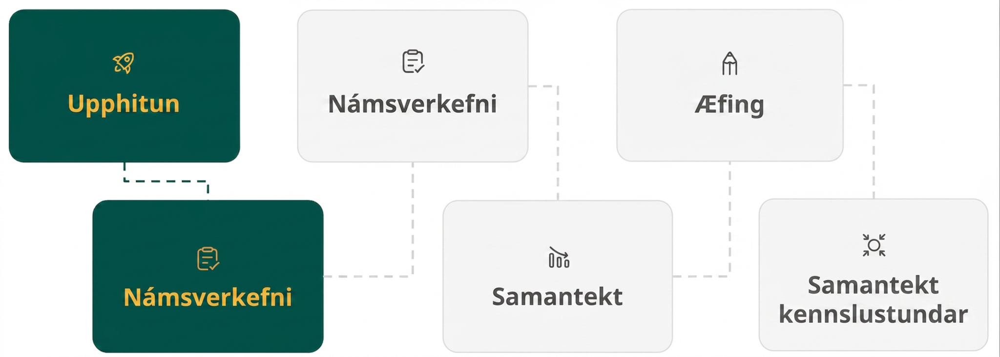
Lesson Journey
Second Stop: Learning Activity A

Slide 9

Learning Activity A | Learning Strategies
Compare Two Equivalent Expressions 🟰
Teacher Instruction: Use these strategies to adjust the activity to support English language learners.
You can copy and paste the callouts directly on top of the activity or give the instructions aloud.
Examine the situation, graph, and both expressions.
Compare standard and factored forms to see how each shows parts of the situation.
Highlight how features connect across forms—like points on the graph and numbers in the equation.
Compare and Connect
Notes:
Support for English Language Learners: MLR 7 Compare and Connect: Representing, Conversing
As students share their observations with the class, create a display to illustrate the connections between the situation, the graph, and both expressions. Take a close look at both standard and factored forms to distinguish how different aspects of the situation are represented in each one. Amplify student language and gestures that describe the connections between a specific feature of one mathematical representation with a specific feature of another representation.
Design Principle(s): Maximize meta-awareness; Support sense-making
Learn more about this routine
View the instructional video and follow along with the materials to assist you with learning this routine.
Provide support for students
Distribute graphic organizers to the students to assist them with participating in this routine.

Slide 10


Learning Activity A | Part 1
Compare Two Equivalent Expressions 🟰
In an earlier lesson, we saw that an equation such as h(t) = 10 + 78t − 16t² can model the height of an object thrown upward from a height of 10 feet with a vertical velocity of 78 feet per second.
Is the expression −16t² + 78t + 10 written in standard form? Be prepared to show your reasoning.
Paola said that the equation g(t) = −2(8t + 1)(t − 5) also defines the same function, written in factored form. Is Paola correct? Be prepared to show your reasoning.
Notes:
Support for All Learners
This activity offers additional support for students:
For English language learners, be sure to review the Learning Strategies slide!
Activity (15 minutes)
In this activity, students connect their recent work with quadratic expressions to the functions that represent earlier situations. They compare two equivalent expressions for the same function, justify their equivalence using expansion, and interpret the graph’s features in context, focusing on the horizontal and vertical intercepts rather than x- and y-intercepts.
Launch
Encourage and support opportunities for peer interactions.
Invite students to talk about their ideas with a partner before writing them down.
Answers
Yes. It is a sum of a squared term, a linear term, and a constant term. Written in the form ax² + bx + c, – 16 is a, 78 is b, and 10 is c.
Yes. Distribute the – 2 to (8t + 1) and you have (−16t − 2). Multiply this binomial by (t − 5). The result of (−16t − 2)(t − 5) is −16t² + 78t + 10.
More activity questions, answers, misconceptions, and synthesis on the next slide.

Slide 11
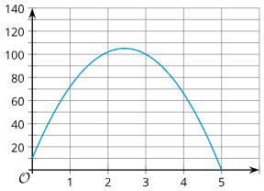
Learning Activity A | Part 2
Compare Two Equivalent Expressions 🟰
Here is a graph representing both g(t) = −2(8t + 1)(t − 5) and h(t) = 10 + 78t − 16t².
What is the y-value of the y-intercept?
What is the x-value of the x-intercept?
What do each of these points mean in this situation?
Notes:
Answers
a. 10
b. 5
c. The y-intercept shows the height, in feet, of the object when it was thrown, and the x-intercept shows the number of seconds that passed after the object was thrown before it hit the ground.
Anticipated Misconceptions
Some students may not recognize that the quadratic terms are the same if they identify the squared term as 16t² rather than −16t². Some may ignore the subtraction sign in 10 + 78t − 16t², or associate it with the 78t rather than the 16t². Show them a simpler problem expression such as (5 − 10) and rewrite it as 5 + −10. Then, ask them to rewrite the expression defining h in a similar way.
Activity Synthesis
Make sure that:
Students see that the expression 10 + 78t − 16t² is in standard form, even though it is written as c + bx + ax². Clarify that – 16 is a (the coefficient of the squared term), 78 is b (the coefficient of the linear term), and 10 is c (the constant term).
Students can explain the equivalence of (−16t − 2)(t − 5) and 10 + 78t − 16t² using a strategy from earlier lessons (for example, drawing a diagram or applying the Distributive Property).
Ask students if they notice any connections between the two equations and the features of the graph. Some may notice the 10 in the standard form of the equation tells us the vertical intercept is (0, 10). Others may predict that the subtraction of 5 has something to do with the horizontal intercepts or may not see any connections. Any observation is fine at this point, as students will look closely at equations and graphs starting in the next activity.

Slide 12
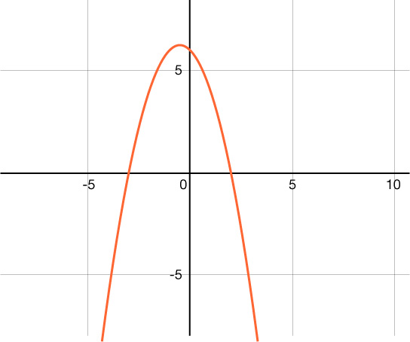
Learning Activity A
Self Check
This is a graph of the quadratic function y = −(x − 2)(x + 3).
What are all the x intercepts?
x = -3
x = 2, x = 6
x = -3, x = 2
x = 6
Let’s review!
Notes:
Answer Feedback - Individualized by Response
Incorrect. This is one x-intercept, but there are two.
Incorrect. This is one x-intercept (x = 2) and 6 is the value of the y-intercept.
That’s correct! The graph crosses the x-axis at these two values.
Incorrect. Six is the value of the y-intercept.

Slide 13

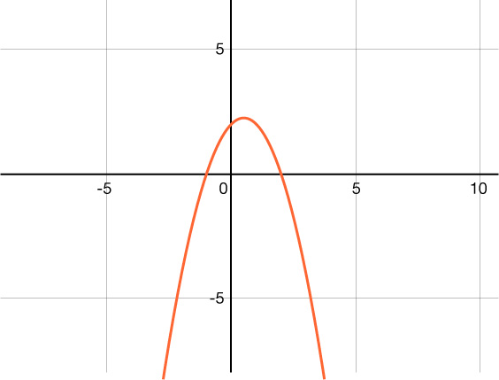
Learning Activity A
Self Check - Review
This is a graph of y = (x + 1)(x − 2).
The x-intercepts are where the graph crosses the x-axis.
What are the x-intercepts of the graph?
The y-intercept is where the graph crosses the y-axis.
What is the y-intercept of the graph?
Notes:
Characteristics of Quadratic Graphs
This happens at (−1, 0) and (2, 0).
This happens at (0, 2).

Slide 14

Lesson Journey
Third Stop: Learning Activity B

Slide 15
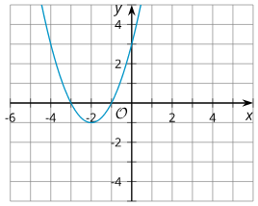
Learning Activity B | Part 1
Uncover The x- and y-intercept Connections 🫣
Each pair of expressions, one in standard form and one in factored form, represents the same quadratic function, shown by the accompanying graph.
For each graph:
Identify the x-intercepts
Identify the y-intercept
Function f
x² + 4x + 3
(x + 3)(x + 1)
Notes:
Support for All Learners
This activity offers an extension for students:
For students looking for an extra challenge, be sure to review the Extending Your Thinking slide!
Activity (15 minutes)
This activity helps students connect the x- and y-intercepts of a graph to the parameters of quadratic expressions in standard and factored form. It reinforces that the zeros of a quadratic function are the x-values where y = 0, corresponding to the graph’s x-intercepts. Students may notice that, in these examples, the y-intercept equals the product of the zeros—though this is not always true. Encourage them to revisit this idea in future lessons.
Launch
Arrange students in groups of two.
Give students a few minutes of quiet time to complete the first two questions.
Then, ask them to discuss their observations with a partner before completing the last question.
Answers
a. Graph of f: x-intercepts: (−3, 0) and (−1, 0).
b. 3, Graph of f: y-intercept: (0, 3).
More activity questions and answers on the next slide.

Slide 16
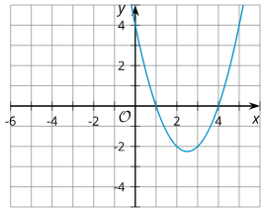
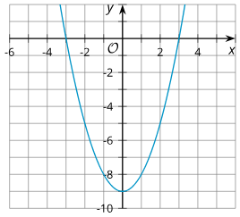
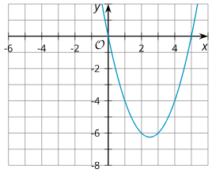
Learning Activity B | Part 2
Uncover The x- and y-intercept Connections 🫣
Function g
x² - 5x + 4
(x - 4)(x - 1)
Function h
x² - 9
(x - 3)(x + 3)
Function j
x² - 5x
x(x - 5)
Notes:
Answers
a. Graph of g: x-intercepts: (1, 0) and (4, 0).
b. 4, Graph of g: y-intercept: (0, 4).
a. Graph of h: x-intercepts: (3, 0) and (−3, 0).
b. -9, Graph of h: y-intercept: (0, -9).
a. Graph of j: x-intercepts: (0, 0) and (0, 5).
b. 0, Graph of j: y-intercept: (0, 0).
More activity questions, answers, and synthesis on the next slide.

Slide 17
Learning Activity B | Part 2
Uncover The x- and y-intercept Connections 🫣
What do you notice about the x-intercepts, the y-intercept, and the numbers in the expressions defining each function? Make a couple of observations.
Here is an expression that models function p, another quadratic function: (x − 9)(x − 1).
  Predict the x-intercepts of the graph that represents this function.
  Identify the y-value of the y-intercept of the graph that represents this function.
Are you ready for more?
Notes:
Answers
NOTE: Additional questions can be accessed in the full Teacher Guide and Student Versions in the online textbook.
• The y-coordinate of the y-intercept is the constant term when the function is expressed in standard form. The y-intercept is (0, −9) for the function h, x² − 9.
The x-intercepts in each graph seem to match the numbers in the factors of the expressions in factored form, but the signs seem to be the opposite. For example, when the expression is (x + 3)(x + 1), the x-intercepts are (−3, 0) and (−1, 0).
When one of the factors is just a variable (rather than a sum or a difference), one of the x-intercepts is (0, 0). For the function j, x(x − 5), one of the intercepts is (0, 0)).
a. The x-intercepts will be (9, 0) and (1, 0).
b. 9
Activity Synthesis
Have students share how numbers in the expressions relate to the graph’s intercepts. Ask them to predict the x- and y-intercepts for p(x) = (x − 9)(x − 1).
Discuss:
Finding x-intercepts: Notice that for (x − a)(x − b), the x-intercepts are (a, 0) and (b,0).
Finding y-intercept: Substitute x=0x = 0x=0 or look at the constant term in standard form.
Graph p(x) with technology and point out the intercepts.
Remind students:
Earlier in the unit we learned that the x-intercepts of a graph tell us the zeros of the function, or the input values that produce an output of 0. Highlight that, because an expression in factored form can tell us about the x-intercept of the graph, this form is also handy for telling us about the zeros of the function that the expression represents.
At this point, students are just noticing that numbers in the expression have something to do with intercepts on the graph. Tell students that, in the next lesson, we will explore why they are related.

Slide 18
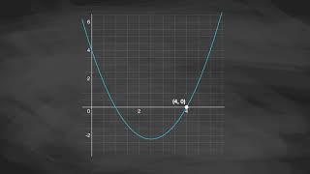
Learning Activity B | Video
Video: Determining the x- and y-intercepts of Quadratic Expressions
Notes:
This video discusses question 2 of activity 7.10.3

Slide 19

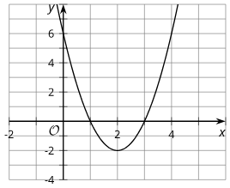
Learning Activity B
Extending Your Thinking
Find the values of a, p, and q that will make
y = a(x − p)(x − q) be the equation represented by the graph.
What is the value of a?
What is the value of p?
What is the value of q?
Notes:
Go back to Lesson Activity
Answer
a = 2
p = 1 or p = 3
q = 1 or q = 3

Slide 20

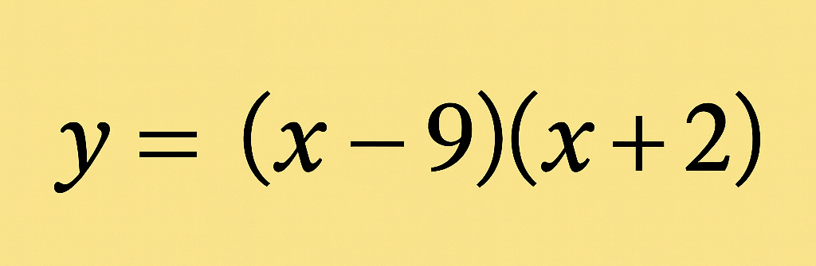
Learning Activity B
Self Check
What are the x-values of the x-intercept(s) of the equation?
x = 2, x = -9
x = -2, x = 9
x = -2, x = -9
x = 2, x = 9
Let’s review!
Notes:
Answer Feedback - Individualized by Response
Incorrect. What value for x makes the factors zero? The x-intercepts are the opposite sign of the numbers in the parenthesis.
That's correct! There is a -9 in (x − 9) so the x-intercept is 9. There is a 2 in (x + 2) so the x-intercept is – 2.
Incorrect. Check your answers by substituting the values into the factors to see if they equal zero. While x = –2 is a x-intercept, x = –9 is not.
Incorrect. 9 is one of the intercepts. However, the x-intercepts are the opposite sign of the numbers in the parenthesis.

Slide 21
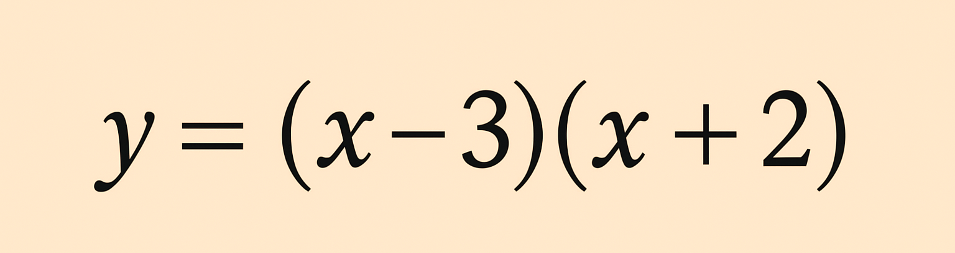
Learning Activity B
Self Check - Review
Find the x-intercepts of the equation.
When a quadratic is in factored form, the x-intercepts of a quadratic equation will be:
the opposite sign of the constant in the factor because if x + a = 0 , then x = –a.
x = 0 is an option.
If a factor is repeated, there is only one x-intercept.
Reminder:
The x-intercepts occur when y = 0.
Notes:
Finding x-intercepts Without Graphs
x − 3 = 0 x + 2 = 0
x = 3 x = -2
Remind Students
Notice that for the factor (x − 3) or (x − 3)(x + (−3)), the constant is – 3, so the x-intercept is x = +3 or the point (3,0).
For the factor (x + 2), the constant is +2, so the x-intercept is x = –2 or the point (−2, 0).

Slide 22
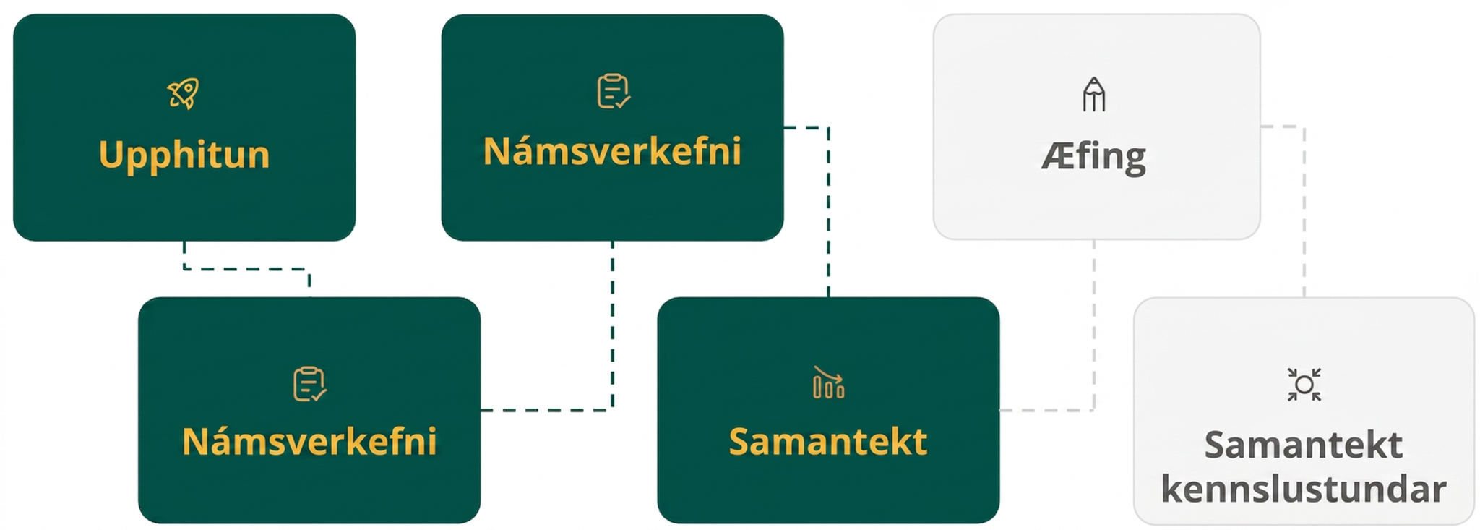
Lesson Journey
Fourth Step: Cool Down

Slide 23
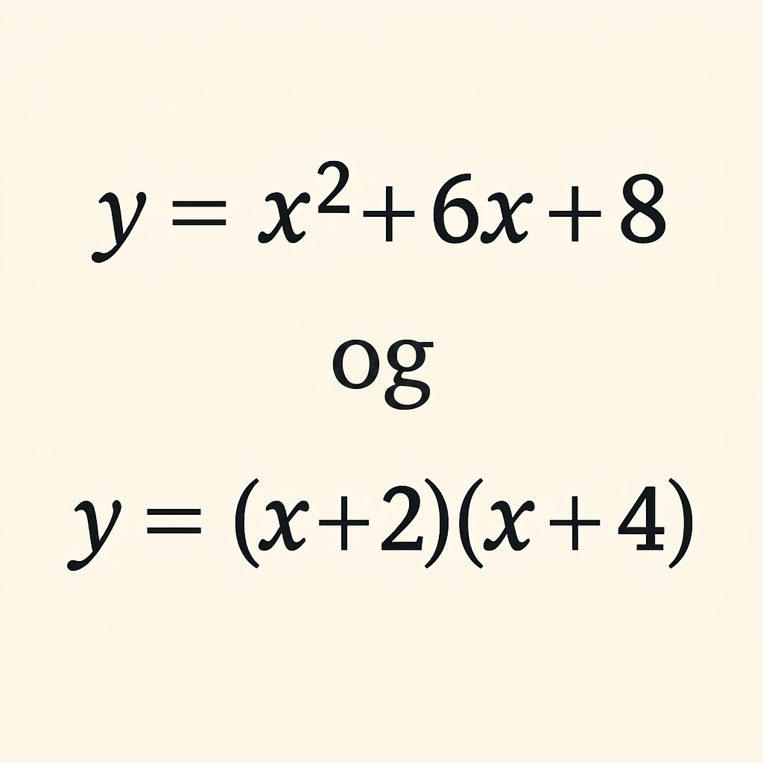
Cool Down
Both of the equations define the same quadratic function.
Without graphing, identify the x-intercepts of the graph. Explain how you know.
Without graphing, identify the y-value of the y-intercept of the graph. Be prepared to show your reasoning.
Notes:
Cool Down (5 minutes)
Answers
(−2, 0), (−4, 0); The constants in the factors of an equation in factored form give a clue about where the x-intercepts are when the equation is graphed. In the equation y = (x + 2)(x + 4), the x-intercepts are (−2, 0) and (−4, 0).
8; The y-intercepts of the graph can be seen when the equation is in standard form. The y-coordinate is the number without the variable. In the equation y = x² + 6x + 8, it is the 8 so the y-intercept is (0,8).
Response to Student Thinking - More Chances
Students will have more opportunities to understand the mathematical ideas in this cool down, so there is no need to slow down or add additional work to the next lessons. Instead, use the results of this cool down to provide guidance for what to look for and emphasize over the next several lessons, in order to support students in advancing their current understanding.

Slide 24
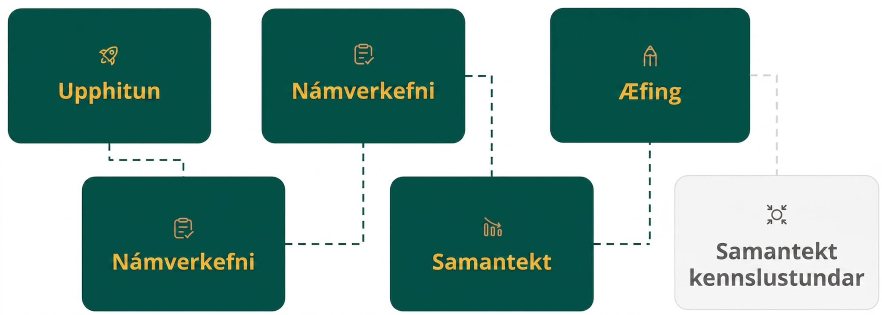
Lesson Journey
Fifth Stop: Practice

Slide 25

Practice
Put your hard work to action, practice what you’ve learned!
Notes:
Digital Practice: Access the practice pages at https://openstax.org/details/books/algebra-1

Slide 26
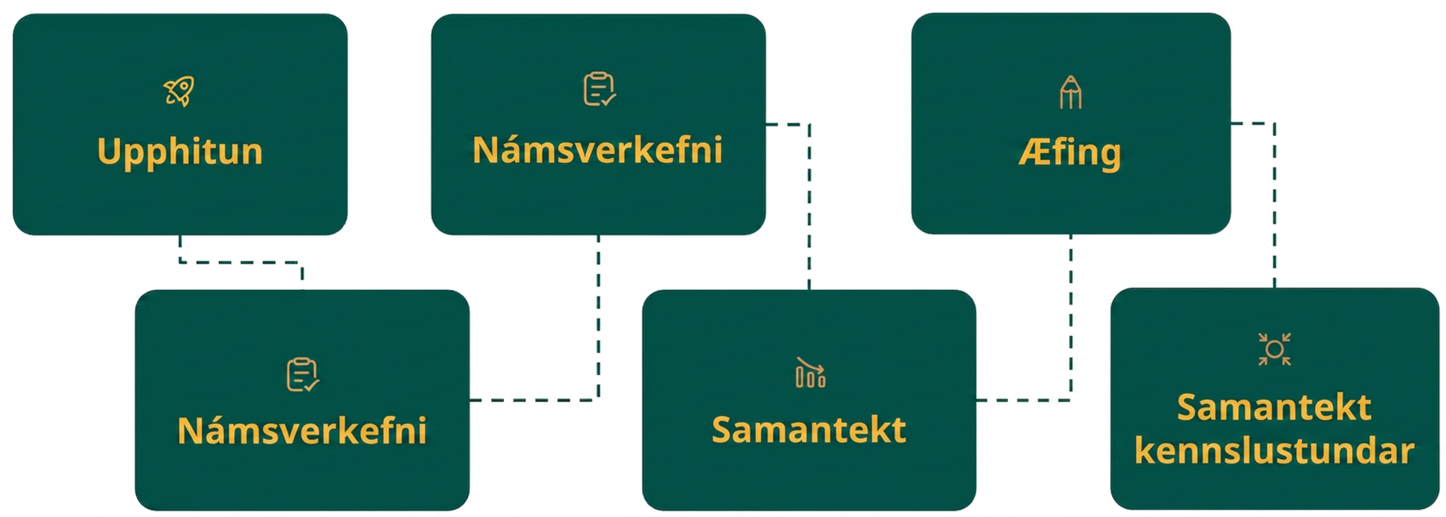
Lesson Journey
Sixth Stop: Lesson Synthesis

Slide 27

Lesson Synthesis
Answer the questions to reinforce your understanding of how quadratic expressions can give us clues about the intercepts of their graphs, and graphs can give us insights about the expressions they represent.
If we graph y = (x − 7)(x − 3) and y = x² − 10x + 21, will we end up with the same graph? How do you know?
Where do you predict the intercepts of the graph will be? How do you make your predictions?
What do the x-intercepts of a graph tell us about the quadratic function it represents?
Notes:
Answers
Yes. The two expressions that define y are equivalent. Expanding (x − 7)(x − 3) gives x² − 7x − 3x + 21 or y = x² − 10x + 21.
The y-intercept will be (0, 21) and the x-intercepts will be (7, 0) and (3, 0). In the examples in the lesson, we saw that the numbers in the factored form give a clue about the x-intercepts, and the constant term in the standard form gives a clue about the y-intercept. Also, evaluating y when x = 0 gives us the y-intercept.
They tell us the zeros of the function.

Slide 28
Self Assessment
How much do you agree with the following statements?
Learning Goals | I can | Almost | Not yet
Explain the meaning of the intercepts on a graph of a quadratic function in terms of the situation it represents. | ⃞ | ⃞ | ⃞
Explain how the numbers in the factored form of a quadratic expression relate to the intercepts of its graph. | ⃞ | ⃞ | ⃞

