Slide 1
Algebra 1
Unit 9 More Quadratic Equations
Lesson 9.11 Using Quadratic Expressions in Vertex Form to Solve Problems
Notes:
How to Get Started
Review Slide 2: How to use these slides
Check out the Check out the digital quick start guide!
Review Slide 3: Reference Key of Icons

Slide 2

How to use these slides
On the activity slides check the speaker notes for teacher support and instructional information.
Each lesson includes 1 warm up, 2-3 learning activities, a cool down, practice and a lesson synthesis.
  Learning activities are followed by a self check question, and review section.
Some slides have been hidden from student view, more information can be found on the next slide (Reference Key).
You can edit and use these slides for personal and classroom use, but cannot sell them and must keep the attribution logos.
For more information, Check out the digital quick start guide!
OpenStax CC BY NC SA

Slide 3





Reference Key
Check the top right corner for an icon referencing these unique sections.
Icon | Title | View | Location and Description
n/a | Support for Students with Disability | Hidden | Learning Strategies slide, provides additional support to students for understanding the activity.
n/a | Support for English Language Learners | Hidden | Learning Strategies slide, provides additional support to students for understanding the activity.
n/a | Extending Your Thinking | Hidden | Extending Your Thinking slide, provides an extra challenge for students.
n/a | Self Check | Not Hidden | Self Check slide, checkpoint to assess student understanding after the learning activity.
n/a | Review | Hidden | Self Check - Review slide, designed to help review topics from the self check question.
On the next slides, check the speaker notes for teacher instructions and support.
Notes:
Check the Speaker Notes: On the next slides you can find discussion questions, lesson information, answers to the activities, and ways to adjust the activity for your students!

Slide 4

Learning Goals
By the end of this lesson you will be able to -
Find the maximum or minimum of a function by writing the quadratic expression that defines it in vertex form.
Explain why the vertex is a maximum or minimum when given a quadratic function in vertex form.
Notes:
Lesson Narrative
In an earlier lesson, students used vertex form to identify the vertex of a quadratic and practiced rewriting expressions into vertex form by completing the square. Now, they use vertex form to determine the maximum or minimum value of a quadratic and solve related problems.
Students have found maximums and minimums before, but only when the expression was already in vertex form. Now that they can rewrite any quadratic into vertex form, they can find maximums and minimums no matter how the expression is written.
This lesson focuses on using the structure of y = a(x − h)² + k to explain why the vertex represents a maximum or minimum:
(x − h)² is always 0 or positive, and equals 0 only when x = h=h.
If a > 0, a(x − h)² is never negative, so k is the minimum value.
If a < 0, a(x − h)² is never positive, so k is the maximum value.
Students use this reasoning to justify why the vertex gives the maximum or minimum value and to communicate their thinking precisely.
Required Preparation
None
Required Materials
None
Texas Essential Knowledge and Skills
A1(A) apply mathematics to problems arising in everyday life, society, and the workplace
A1(D) communicate mathematical ideas, reasoning, and their implications using multiple representations, including symbols, diagrams, graphs, and language as appropriate
A1(F) analyze mathematical relationships to connect and communicate mathematical ideas
A1(G) display, explain, and justify mathematical ideas and arguments using precise mathematical language in written or oral communication
A7(A) graph quadratic functions on the coordinate plane and use the graph to identify key attributes, if possible, including x-intercept, y-intercept, zeros, maximum value, minimum values, vertex, and the equation of the axis of symmetry
A8(A) solve quadratic equations having real solutions by factoring, taking square roots, completing the square, and applying the quadratic formula.

Slide 5
Vocabulary
Previous
Maximum
  The function value that is greater than or equal to all the other values. The highest point on the graph.
Minimum
  The function value that is less than or equal to all the other values. The lowest point on the graph.
Parabola
  All points in a plane that are the same distance from a fixed point and a fixed line. The curved shape of the graph of a quadratic function.
Vertex (of a graph)
  On a parabola, it is the point where the graph changes from increasing to decreasing or vice versa. It is the highest or lowest point on the graph.
Vertex Form (of a quadratic)
  An expression in the form a(x − h)² + k where a, h, and k are constants, and a ≠ 0.
Notes:
Lesson Vocabulary
To support student understanding of key vocabulary:
Introduce and review the vocabulary words students will see in this lesson.
Encourage students to notice how these words are used and to include them in their math discussions and explanations—both written and oral.
Use a word wall to reinforce vocabulary. Sample word wall cards are available here.
For newcomers or students with beginning English proficiency, use these Quizlet sets to support vocabulary learning:
Unit 9 Spanish Vocabulary – use first to build understanding
Unit 9 Vocabulary (English) – use after anchoring in Spanish
Support for English Language Learners
ELPS 1(B) monitor oral and written language production and employ self-corrective techniques or other resources
ELPS 2(A) distinguish sounds and intonation patterns of English with increasing ease
ELPS 2(B) recognize elements of the English sound system in newly acquired vocabulary such as long and short vowels, silent letters, and consonant clusters
ELPS 3(A) practice producing sounds of newly acquired vocabulary such as long and short vowels, silent letters, and consonant clusters to pronounce English words in a manner that is increasingly comprehensible
ELPS 4(A) learn relationships between sounds and letters of the English language and decode (sound out) words using a combination of skills such as recognizing sound-letter relationships and identifying cognates, affixes, roots, and base words
ELPS 5(A) learn relationships between sounds and letters of the English language to represent sounds when writing in English

Slide 6

Lesson Journey
First Stop: Warm Up

Slide 7

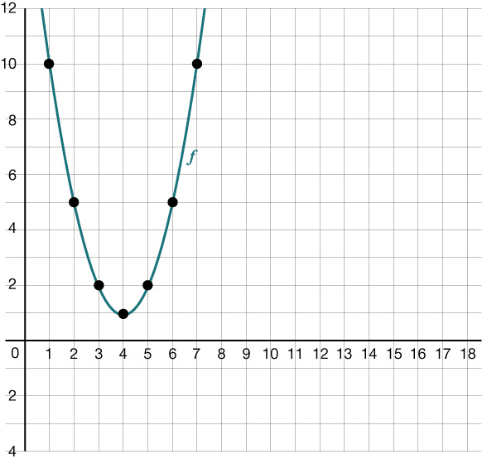
Warm Up | Part 1
Is it Maximum or Minimum? 📉
f(1) can be expressed in words as "the
value of f when x is 1." Find or compute:
  the value of f when x is 1
  f(3)
  f(10)
Yes or no: Can you find an x-value that
makes f(x):
  Less than 1?
  Greater than 10,000?
f(x) = (x − 4)² + 1
Notes:
Warm Up (5 minutes)
In this activity, students recall the meaning of maximum or minimum value of a function, which they learned in a previous unit. They also practice interpreting the language related to maximum and minimum values of functions.
Launch
Ask students to describe some situations in which people use the words "minimum" and "maximum." For example, we might say there is a minimum age for voting or for getting a driver's license, or that roads and highways have maximum speed limits.
Then, ask students what the words "minimum" and "maximum" mean more generally. We might think of a minimum as the least, the least possible, or the least allowable value, and a maximum as the greatest, the greatest possible, or the greatest allowable value.
Activity Answers
10
2
37
No. From the graph, it seems that 1 is the least value of f, and that occurs when x = 4. All other x-values produce outputs that are greater than 1.
Yes. There are lots of x-values that produce an output greater than 10,000. For example, both -100 and 110 would make f(x) greater than 10,000.
More activity questions, answers, anticipated misconceptions, and activity synthesis on the the next slide

Slide 8
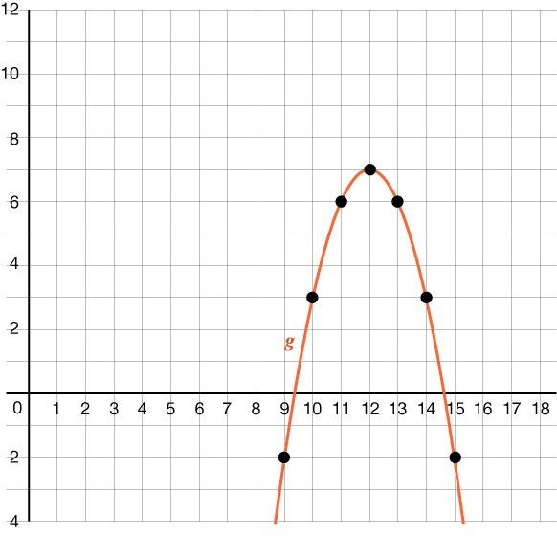
Warm Up | Part 2
Is it Maximum or Minimum? 📉
g(9) can be expressed in words as "the
value of g when x is 9." Find or compute:
  the value of g when x is 9
  g(13)
  g(2)
Yes or no: Can you find an x-value that
would make g(x):
  Greater than 7?
  Less than -10,000?
g(x) = – (x − 12)² + 7
Notes:
Activity Answers
-2
6
-93
No. From the graph, it seems that 7 is the greatest value of g, and that occurs when x = 12. All other x-values produce outputs that are less than 7.
Yes. There are lots of x-values that produce an output less than -10,000. For example, both -200 and 200 would make g(x) greater than -10,000.
Anticipated Misconceptions
Some students may struggle to relate the y-coordinates of the points on a graph with the outputs of a function. Earlier in the course, students learned that the graph of a function f is the graph of the equation y = f(x). Consider having students label the coordinates of points on each graph and then complete the statements, such as, "The point (3, 2) on the graph means 2 = f(3)." Another approach would be to have students organize the points on the graphs into tables with headers x and f(x) and x and g(x).
Activity Synthesis
Discuss with students:
"Why does f not have a maximum value?" (We can always use larger values of x in both the positive and negative directions to get greater and greater values of f.)
"Why does g not have a minimum value?" (We can always find an input that makes the value of g less and less.)
Emphasize that we can find an input that makes the value of f as great as we want and that makes g as small as we want.
Remind students that:
A maximum value of a function is a value of a function that is greater than or equal to all the other values. It corresponds to the highest y-value on the graph of the function.
A minimum value of a function is a value of a function that is less than or equal to all the other values. It corresponds to the lowest point on the graph of the function.
For quadratic functions, there is only one maximum or minimum value.

Slide 9
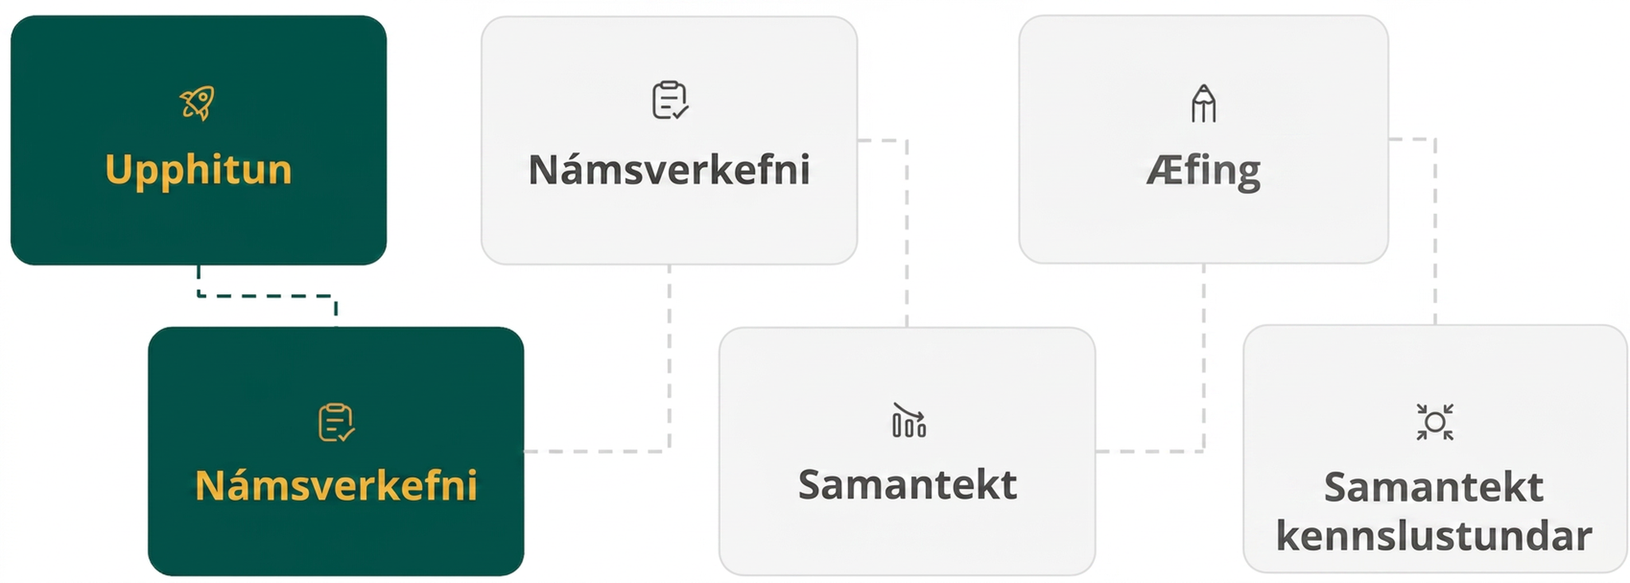
Lesson Journey
Second Stop: Learning Activity A

Slide 10

Learning Activity A | Learning Strategies
Up or Down? What the Vertex Tells Us ☝️👇
Teacher Instruction: Use these strategies to adjust the activity to support English language learners and students with disabilities.
You can copy and paste the callouts directly on top of the activity or give the instructions aloud.
Partner A explains using a sentence starter:
→ “First, I ___ because …”
→ “I noticed ___ so I …”.
Partner B asks for details:
→ “What happens when x = 4?”
→ “What happens when (x – 4) is squared?”
Decide together if the vertex is a maximum or minimum.
Discussion Supports
Use a sticky note or mini whiteboard to track your thinking.
Decide if the vertex is a maximum or minimum.
Make a quick sketch or table to prepare for discussion.
Representation
Notes:
Support for English Language Learners: MLR 8 Discussion Supports: Conversing
Use this routine to help partners explain their reasoning for the first question. Invite Partner A to begin with this sentence frame: “The point (4, 1) is a maximum value because . . .”, “First, I _____ because. . .”, or “I noticed _____ so I . . . .” Invite the listener, Partner B, to press for additional details by asking “What happens when x = 4?”, “What happens when you square (x − 4)?”, or “Can you say that a different way?” This will help students justify if a vertex represents the minimum or maximum value of a function.
Design Principle(s): Support sense-making; Cultivate conversation
Support for Students with Disabilities: Representation: Internalize Comprehension
To support working memory, provide students with sticky notes or mini whiteboards. After students decide whether the vertex is a maximum or minimum, encourage students to prepare for the discussion by drawing a rough sketch of the graphs, or by making tables to reinforce understanding.
Supports accessibility for: Memory; Organization

Slide 11

Learning Activity A | Part 1
Up or Down? What the Vertex Tells Us ☝️👇
The graph that represents p(x) = (x − 8)² + 1 has its vertex at (8, 1). Here is one way to show, without graphing, that (8, 1) corresponds to the minimum value of p.
When x = 8, the value of (x − 8)² is 0 because
(8 − 8)² = 0² = 0.
Squaring any number always results in a positive
number, so when x is any value other than 8,
(x − 8) will be a number other than 0, and when
squared, (x − 8)² will be positive.
Any positive number is greater than 0, so when x ≠ 8, the value of
(x − 8)² will be greater than when x = 8. In other words, p has the least value when x = 8.
Notes:
Support for All Learners
This activity offers additional support and an extension for students:
For English language learners and students with disabilities, be sure to review the Learning Strategies slide!
For students looking for an extra challenge, be sure to review the Extending Your Thinking slide!
Activity (15 minutes)
The goal of this activity is to use the vertex form to find out if a vertex represents the minimum or the maximum value of the function. To do this, students rely on the behavior of a quadratic function, the structure of the expression, and some properties of operations.
Because using structure is central to the work here, graphing technology is not an appropriate tool.
Launch
Arrange students in groups of two and ask students to keep their materials closed.
Display the equation p(x) = (x − 8)² + 1 for all to see. Ask students how they would determine, without graphing, if the vertex of the graph, (8, 1), is a maximum or a minimum.
Give partners a moment to discuss their thinking. Solicit a few ideas from the class. Possible students responses have been ANIMATED TO DISPLAY ON CLICK (bulleted responses).
Before proceeding to the activity, ask students to take a couple of minutes of quiet time to think individually to make sense of the line of reasoning in the first question and then discuss their understanding with their partner.
Activity questions, answers on the next slide.

Slide 12
Learning Activity A | Part 2
Up or Down? What the Vertex Tells Us ☝️👇
Explain why the point (4, 1) corresponds to the maximum value of q, defined by
q(x) = −2(x − 4)² + 1.
KEY CONCEPTS
In quadratic functions, the maximum or minimum value occurs at the vertex of the parabola.
The greatest value of a function is the maximum value.
The lowest value of a function is the minimum value.
Since infinity cannot be reached or touched, it is not considered a maximum or minimum.
Notes:
Activity Answers
Encourage students to use similar reasoning to one of the previous models (on slide 11) to help them think through this problem.
When x = 4, the value of (x − 4)² is 0 because −2(4 − 4)² = −2(0²) = 0.
Squaring any number always results in a positive number, so when x is any value other than 4 (either greater or less), (x − 4) will be a number other than 0. When squared, (x − 4)² will be positive, but then it gets multiplied to a negative number, so the product will be negative.
Any negative number is less than 0, so when x ≠ 4, the value of −2(x − 4)² will be less than when x = 4. In other words, q has the greatest value when x = 4.
More activity questions, answers, and activity synthesis on the next slide.

Slide 13
Learning Activity A | Part 3
Up or Down? What the Vertex Tells Us ☝️👇
Given the quadratic function and the coordinates of the vertex of the graph of each. Determine if the vertex corresponds to the maximum or the minimum value of the function.
Equation | Coordinate of the vertex - max? min?
f(x) = −(x − 4)² + 6 | a. (4, 6)
g(x) = (x + 7)² − 3 | b. (− 7, − 3)
h(x) = 4(x + 5)² + 7 | c. (− 5, 7)
k(x) = x² − 6x − 3 | d. (3, − 12)
m(x) = − x² + 8x | e. (4, 16)
Are you ready for more?
Notes:
Activity Answers
Maximum. The leading coefficient is negative, so the parabola opens down.
Minimum. The leading coefficient is positive, so the parabola opens up.
Minimum. The leading coefficient is positive, so the parabola opens up.
Minimum. The leading coefficient is positive, so the parabola opens up.
Maximum. The leading coefficient is negative, so the parabola opens down.
Activity Synthesis
Focus the discussion on students' responses to the first question. Invite students to share their explanations and highlight reasoning that makes use of structure (as shown in the sample response).
Squaring an expression results in a positive value or a zero value.
Zero is the least possible value of a squared expression.
Multiplying a squared expression (which is either positive or zero) by a negative number gives either a negative or zero value.
The graph of a quadratic function is symmetrical across the vertex. If an input value on one side of the vertex (h, k) produces an output that is less than k, then (h, k) represents the maximum value of the function. Similarly, if an input value on one side of the vertex (h, k) produces an output that is more than k, then (h, k) represents the minimum value of the function.

Slide 14

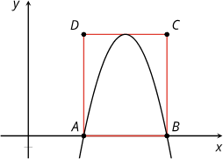
Learning Activity A
Extending Your Thinking
Here is a portion of the graph of
function q, defined by
q(x) = −x² + 14x − 40.
ABCD is a rectangle. Points A
and B coincide with the x-intercepts
of the graph, and segment CD
just touches the vertex of the graph.
Find the area of ABCD. Show your reasoning.
Notes:
Go back to Lesson Activity
Answer
54 square units.
For example:
The expression can be rewritten in factored form as (−x + 10)(x − 4), so the x-intercepts are (4, 0) and (10, 0), which means the length of AB
is 6 units. The x-coordinate of the vertex is halfway between 4 and 10, which is 7. Substituting 7 for x in (−x + 10)(x − 4) gives 3⋅3 or 9, so the height of the rectangle is 9. The area is 6⋅9 or 54 square units.
The equation q(x) = −x² + 14x − 40 can be written in vertex form as q(x)= −1(x − 7)² + 9, so its vertex is at (7, 9) and the height of the rectangle is 9 units. Completing the square for −x² + 14x −40 = 0 gives the solutions x = 4 and x = 10, which correspond to the x-intercepts at points A and B. This means the width of the rectangle is 10 − 4 or 6 units.

Slide 15
Learning Activity A
Self Check
Which of the following is the correct vertex for h(x) = −3(x − 2)² + 5? Describe the vertex as a maximum or minimum.
(−2, −5), maximum
(2, 5), minimum
(2, 5), maximum
(2, −5), minimum
Let’s review!
Notes:
Answer Feedback - Individualized by Response
Incorrect. The x-value is the opposite sign of what is there, and the y-value remains the same sign.
Incorrect. Since the leading coefficient is negative, the parabola opens down and the vertex is a maximum value.
That’s correct! Since the leading coefficient is negative, the parabola opens down and the vertex is a maximum value.
Incorrect. The x-value is the opposite sign of what is there, and the y-value remains the same sign.

Slide 16

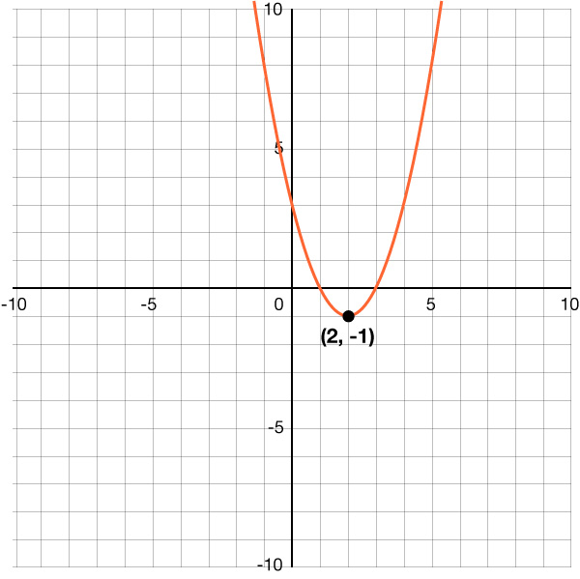
Learning Activity A | Part 1
Self Check - Review
Example 1 –
In the vertex form (of a quadratic expression), f(x) = a(x − h)² + k, the
vertex (of a graph) is located at (h, k).
What is the vertex of this graph?
Is the vertex a maximum or a minimum?
f(x) = (x − 2)² – 1
Notes:
Remind Students
That the maximum is the highest point of the graph and the minimum is the lowest point of the graph.
A quadratic function shape is called a parabola, and a parabola will only have a maximum or a minimum.
Answers
The vertex is at (2, −1).
Since the leading coefficient, a, is positive, the parabola opens up. This means the vertex is a minimum.
More review on the next slide.

Slide 17
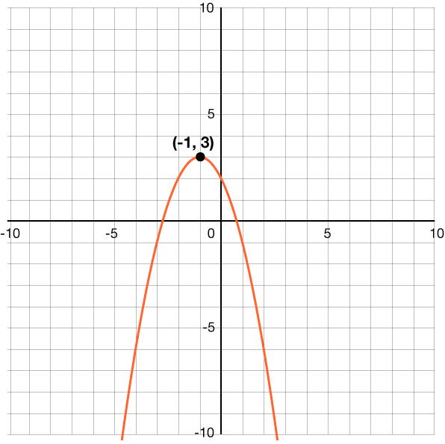
Learning Activity A | Part 2
Self Check - Review
Example 2 –
In the vertex form (of a quadratic expression), f(x) = a(x − h)² + k, the
vertex (of a graph) is located at (h, k).
What is the vertex of this graph?
Is the vertex a maximum or a minimum?
f(x) = – (x + 1)² + 3
Notes:
Answers
The vertex is at (-1, 3).
Since the leading coefficient, a, is negative, the parabola opens down and the vertex is a maximum.

Slide 18
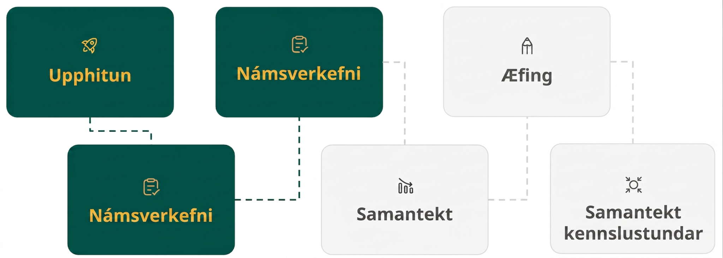
Lesson Journey
Third Stop: Learning Activity B

Slide 19
Learning Activity A | Learning Strategies
Which One Made More Money? 🎫
First read: Describe the situation without numbers: What is the scenario about?
Second read: Name the quantities involved: What can be counted or measured? Is anything related to each other?
Third read: Brainstorm different possible methods to answer the question.
Three Reads
Teacher Instruction: Use these strategies to adjust the activity to support English language learners and students with disabilities.
You can copy and paste the callouts directly on top of the activity or give the instructions aloud.
Can you find the zeros?
Would it help to rewrite an equation in vertex form?
What have you done in past lessons that might help?
Would creating a graph help? Does writing the equation and graph next to each other suggest any relationship?
Action and Expression
Notes:
Support for English Language Learners: MLR 6 Three Reads: Reading, Listening, Conversing
Use this routine to support reading comprehension, without solving, for students. Use the first read to orient students to the situation. Ask students to describe what the situation is about without using numbers (two performances occurred and generated revenue). Use the second read to identify quantities and relationships. Ask students what can be counted or measured without focusing on the values. Listen for, and amplify, the important quantities that vary in relation to each other in this situation: ticket price and revenue. After the third read, ask students to brainstorm possible strategies to answer the question, “Without creating a graph to represent the revenue from Performance A, determine which performance has the greater maximum revenue. Explain or show your reasoning.” This helps students connect the language in the word problem and the reasoning needed to solve the problem while keeping the cognitive demand of the task.
Design Principle: Support sense-making
Learn more about this routine
View the instructional video and follow along with the materials to assist you with learning this routine.
Provide support for students
Distribute graphic organizers to the students to assist them with participating in this routine.
Support for Students with Disabilities: Action and Expression: Internalize Executive Functions
To support development of organizational skills, check in with students within the first two to three minutes of work time. Look for students who are working to identify the zeros or convert the equation for Performance A into vertex form. If students are stuck, remind them of previous experiences converting expressions into vertex form, and encourage them to write the vertex of Performance B next to the graph to compare. If a display was created in the previous lesson, use the display as a reference.
Supports accessibility for: Memory; Organization

Slide 20
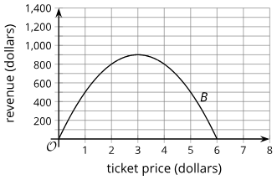
Learning Activity B
Which One Made More Money? 🎫
A function A, defined by p(600 − 75p), describes the revenue collected from the sales of tickets for Performance A, a musical.
The graph (at right) represents a function B that models the revenue collected from the
sales of tickets for Performance B, a Shakespearean comedy.
In both functions, p represents the price of one ticket, and both revenues and prices are measured in dollars.
Without graphing A, decide which performance has the greater maximum revenue at p dollars per ticket. Explain your reasoning.
Notes:
Support for All Learners
This activity offers additional support for students:
For English language learners and students with disabilities, be sure to review the Learning Strategies slide!
Activity (10 minutes)
Students may intuitively think of graphing the function for Performance A, comparing the two graphs, and seeing which one has a greater y-value at its vertex. While this strategy is both effective and efficient, the task asks students to decide which function has a greater maximum without graphing in order to encourage them to reason algebraically.
Monitor for students taking different approaches. Some possible strategies:
Use the factored form of the expression for Performance A to find the x-intercepts. Then, find the midpoint of the two intercepts, identify its x-value, evaluate the expression at that value, and compare the output with the y-value of the vertex of the other graph.
Convert the expression representing Performance A to vertex form, identify the vertex, and compare the y-value to that of the vertex on the graph for Performance B.
Launch
Arrange students in groups of two.
Give students time to read the task statement and think quietly about how they would go about comparing the two functions.
Then, ask them to share their thoughts with their partner before beginning to work on the problem.
Answer
Performance A.
The maximum revenue for Performance B is $900 based on the vertex (of a graph) of its graph. For Performance A, the expression p(600 − 75p) is in factored form, which tells us that the horizontal intercepts are (0, 0) and (8, 0). The horizontal coordinate of the vertex is halfway between 0 and 8, which is 4. Substituting 4 for p in p(600 − 75p) gives 1200, so the vertex is at (4, 1200). 1200 is greater than 900.
The maximum revenue for Performance B is $900 based on the vertex of its graph. The expression p(600 − 75p) can be rewritten in vertex form (of a quadratic expression): −75(p − 4)² + 1200, which tells us that the vertex of a graph of the function is at (4, 1200) and that the maximum revenue is $1200.
Activity Synthesis
Invite previously identified students to share their solutions. Ask students to explain why they decided to take the steps that they did. Highlight any connections made between the structure of an expression defining a function, points on its graph, and the meaning of any values in this situation.

Slide 21
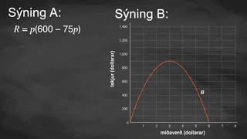
Learning Activity B | Video
Comparing Maximums between Quadratics
Notes:
This video discusses the entire question of activity 9.11.3

Slide 22


Learning Activity B
Self Check
A function, defined by p(600 − 60p), describes the revenue collected from the sales of tickets for a concert where p is the price of one ticket. Find the maximum revenue, in dollars.
5
1500
10
600
Let’s review!
Notes:
Answer Feedback - Individualized by Response
Incorrect. This is the x-coordinate of the vertex. The y-value is needed for the maximum.
That's correct! x = 5 is the value halfway between the horizontal intercepts and is the x-value of the vertex. Substitute into p(600 − 60p) to find the maximum revenue.
Incorrect. This is the other horizontal intercept, besides 0.
Incorrect. This is not the maximum value. First, find the horizontal intercepts, then find the halfway point and location of the vertex.

Slide 23
Learning Activity B
Self Check - Review
FINDING THE MAXIMUM VALUE OF A FUNCTION
Step 1 - Find the horizontal intercepts (or x-intercepts).
Step 2 - Find the “x”-coordinate of the vertex halfway through the horizontal intercepts.
Step 3 - Write in the function in standard form and substitute “x”.
The revenue brought in by a newspaper is modeled by
R = p(−2500p + 159,000).
Find the maximum revenue where R is revenue and p is price per newspaper subscription.
Notes:
Answer
The maximum revenue is at $2,528,100 with a $31.80 subscription.
Note, students may be more comfortable using the terminology of “x-intercepts,” and become confused with terminology such as “horizontal intercepts.” It may be helpful to discuss with them why the terms “horizontal” and “vertical” are used when the axes are no longer labeled with an “x” or a “y.”

Slide 24
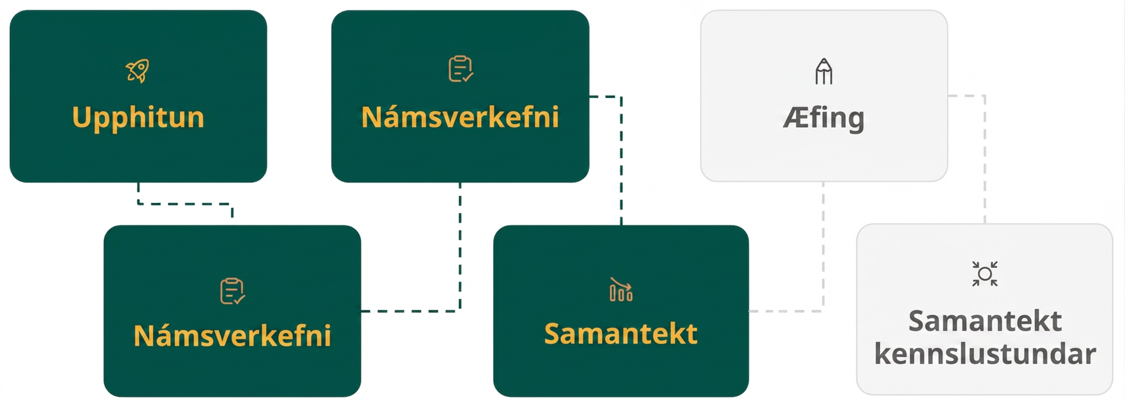
Lesson Journey
Fourth Step: Cool Down

Slide 25

Cool Down
Without graphing, find the vertex of the graph of a quadratic function defined by f(x) = −x² − 14x − 60. Show your reasoning.
Does the y-coordinate of the vertex correspond to a maximum or a minimum value of the function? Explain how you know.
Notes:
Cool Down (5 minutes)
Launch
Ask students to put away their devices for the cool down.
Answers
The vertex is at (−7, −11).
f(x) = −(x² + 14x + 60)
f(x) = −(x² + 14x + 49 + 11)
f(x) = −((x + 7)² + 11)
f(x) = −(x + 7)² − 11
A maximum value. The squared term has a coefficient of -1. The squared term will be 0 when x is -7. For all other values of x, the squared term will be subtracted from -11, resulting in outputs that are less than -11.
Note: If the vertex isn't asked for and the "value of the maximum or minimum" is asked for, the maximum or minimum value occurs at the y-value of the vertex because that is the value of the coordinate that represents the vertical height of the point.
Response to Student Thinking - Press Pause
If students struggle to transform quadratic expressions into vertex form, and it is emphasized in your standards, take a few minutes from the next lesson to highlight examples of misconceptions from student work and use practice problems for additional opportunities to practice.

Slide 26
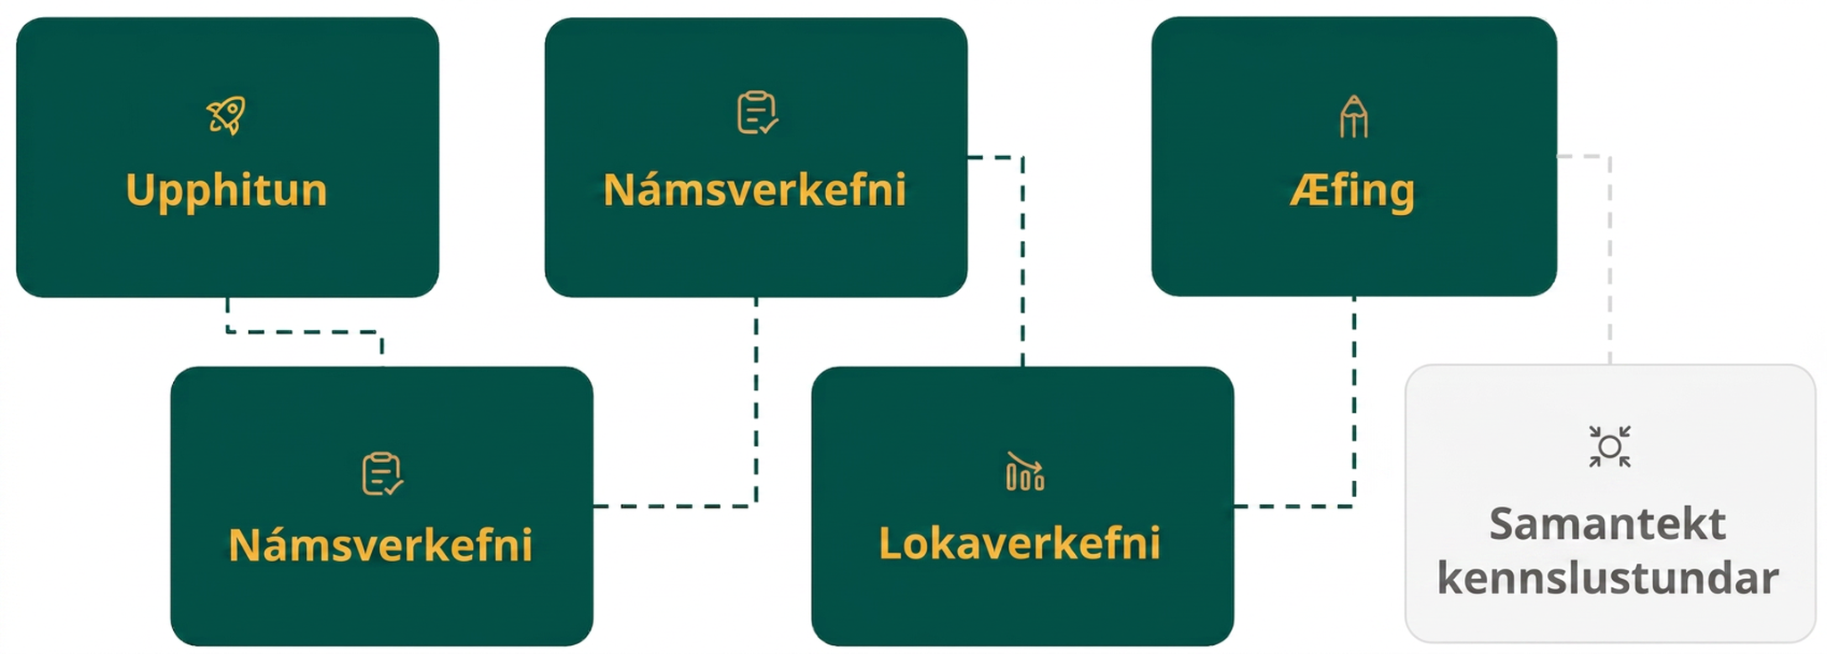
Lesson Journey
Fifth Stop: Practice

Slide 27

Practice
Put your hard work to action, practice what you’ve learned!
Notes:
Digital Practice: Access the practice pages at https://openstax.org/details/books/algebra-1

Slide 28
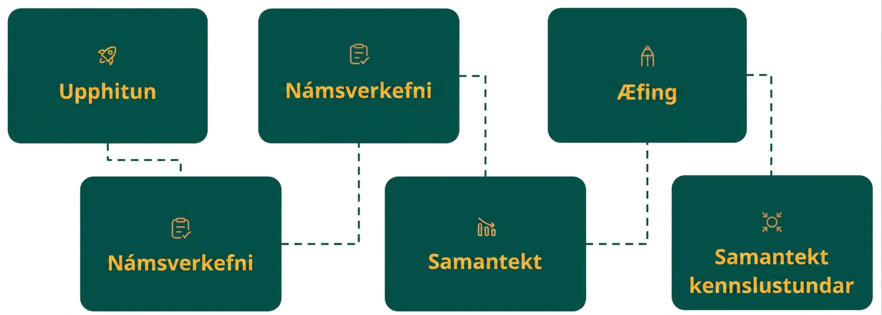
Lesson Journey
Sixth Stop: Lesson Synthesis

Slide 29

Lesson Synthesis
Think about these questions to reinforce your understanding
of maximum or minimum values of a function.
Consider this expression: – x² – 6x – 2.
Develop an approach or procedure to answer each question.
Do not actually determine numeric answers - focus on how to answer each question.
After a few minutes of individual quiet think-time, be prepared to share your answers.
How do you know if the function has a maximum or minimum value?
How do you determine what the maximum or minimum value is?
Notes:
Possible Answers
Since the coefficient of x² is negative, I know the graph of the function opens downward, so the function has a maximum value.
I could use technology to graph the function and see if the graph has a largest y-coordinate, so the function has a maximum value, or a smallest y-coordinate, so the function has a minimum value.
I could use the quadratic equation to find the zeros, and since I know the vertex is exactly in between the zeros, I could determine the value of the midpoint of the two zeros and then substitute that value into the function to determine its output. Then I could compare this output to any other output value and see if it was larger or smaller.
I could rewrite the expression in vertex form to see the coordinates of the vertex. Then, I could think about x-values on either side, and whether their corresponding y-values were greater than or less than the y-coordinate of the vertex.

Slide 30
Self Assessment
How much do you agree with the following statements?
Learning Goals | I can | Almost | Not yet
Find the maximum or minimum of a function by writing the quadratic expression that defines it in vertex form. | ⃞ | ⃞ | ⃞
Explain why the vertex is a maximum or minimum when given a quadratic function in vertex form. | ⃞ | ⃞ | ⃞

