Slide 1


Algebra 1
Unit 4 Functions
Lesson 4.13: Domain and Range, Part 2

Slide 2
How to use these slides
On the activity slides check the speaker notes for teacher support and instructional information.
Each lesson includes 1 warm up, 2-3 learning activities, a cool down, practice and a lesson synthesis.
  Learning activities are followed by a self check question, and review section.
Some slides have been hidden from student view, more information can be found on the next slide (Reference Key).
You can edit and use these slides for personal and classroom use, but cannot sell them and must keep the attribution logos.
For more information, Check out the digital quick start guide!

Slide 3






Reference Key
Check the top right corner for an icon referencing these unique sections.
 | Support for Students with Disability | Hidden | Learning Strategies slide, provides additional support to students for understanding the activity. Learning Strategies slide, provides additional support to students for understanding the activity.
 | Support for English Language Learners | Hidden
 | Extending Your Thinking | Hidden | Extending Your Thinking slide, provides an extra challenge for students.
 | Self Check | Not Hidden | Self Check slide, checkpoint to assess student understanding after the learning activity.
 | Review | Hidden | Self Check- Review slide, designed to help review topics from the self check question.
On the next slides, check the speaker notes for teacher instructions and support.
Notes:
Check the Speaker Notes: On the next slides you can find discussion questions, lesson information, answers to the activities, and ways to adjust the activity for your students!

Slide 4

Learning Goals
By the end of this lesson you will be able to -
Determine a reasonable domain and range for the function when given a description of a function in a situation.
Notes:
Lesson Narrative
Previously, students used descriptions or rules to reason about domain and range. Now, they use graphs to explore which values make sense in different situations.
Students learn to spot graph features—like intercepts, gaps, and endpoints—that reveal restrictions on inputs or outputs, and understand that graphs may only show part of a function.
By comparing graphs with real-world situations, students strengthen their reasoning and precision when identifying domain and range.
This lesson sets the stage for understanding absolute value functions, where output changes depending on input intervals.
Advanced preparation, which includes data collection and organization, is needed for an upcoming lesson on absolute value functions. See Required Preparation for Absolute Value Functions (Part 1)
Required Preparation
Copy graph handout for each student.
Required Materials
4.12 Graph Handout
Texas Essential Knowledge and Skills
A1(A) apply mathematics to problems arising in everyday life, society, and the workplace
A1(E) create and use representations to organize, record, and communicate mathematical ideas
A1(G) display, explain, and justify mathematical ideas and arguments using precise mathematical language in written or oral communication
A2(A) determine the domain and range of a linear function in mathematical problems; determine reasonable domain and range values for real-world situations, both continuous and discrete; and represent domain and range using inequalities

Slide 5
Vocabulary
Previous
Domain
  The set of all possible input values for a function.
Range
  The set of all possible output values for a function.
Function
  A relation that takes inputs from one set and assigns them to outputs from another set, assigning exactly one output to each input.
New
Discrete function
  A function with distinct and separate values that are not connected with each other.
Continuous function
  A function that does not have any breaks or jumps.
Notes:
Lesson Vocabulary
To support student understanding of key vocabulary:
Introduce and review the vocabulary words students will see in this lesson.
Encourage students to notice how these words are used and to include them in their math discussions and explanations—both written and oral.
Use a word wall to reinforce vocabulary. Sample word wall cards are available here.
For newcomers or students with beginning English proficiency, use these Quizlet sets to support vocabulary learning:
Unit 4 Spanish Vocabulary, part 1 – use first to build understanding
Unit 4 Vocabulary (English), part 1 – use after anchoring in Spanish
Unit 4 Spanish Vocabulary, part 2 – use first to build understanding
Unit 4 Vocabulary (English), part 2 – use after anchoring in Spanish
Support for English Language Learners
ELPS 1(F) use accessible language and learn new and essential language in the process
ELPS 2(F) listen to and derive meaning from a variety of media such as audiotape, video, DVD, and CD-ROM to build and reinforce concept and language attainment
ELPS 3(E) share information in cooperative learning interactions
ELPS 3(G) express opinions, ideas, and feelings ranging from communicating single words and short phrases to participating in extended discussions on a variety of social and grade-appropriate academic topics
ELPS 5(B) write using newly acquired basic vocabulary and content-based grade-level vocabulary

Slide 6





Lesson Journey
Warm Up
Learning Activity
Cool Down
Lesson Synthesis
Learning Activity
Learning Activity
Practice

Slide 7
Learning Strategies - A Playground Swing⛲
Teacher Instruction: Use these strategies to adjust the activity to support English language learners and students with disabilities.
  You can copy and paste the callouts directly on top of the activity or give the instructions aloud.
“_____ matches the graph _____ because . . .”
“I noticed _____, so . . . .”
Discussion Supports
Use the same color to:
Highlight the input in each description.
Label the horizontal axis of each graph
Highlight the label.
Representation
Notes:
Support for English Language Learners: MLR 8 Discussion Supports: Speaking, Representing
Use this routine to support whole-class discussion as students explain how they matched the function description to the graph. Display the following sentence frames for all to see: “_____ matches the graph _____ because . . .” and “I noticed _____, so . . . .” Encourage students to challenge each other when they disagree. The sentence frames will help students consider the domain and range of functions as they connect written descriptions with graphical representations.
Design Principle(s): Support sense-making
NO links to supporting materials for teachers or students.
Support for Students with Disabilities: Representation: Internalize Comprehension
Use color coding and annotations to highlight connections between representations in a problem. For example, invite students to highlight the input in each description using one color, label the horizontal axis of each graph, and highlight the label in the same color. Then they can repeat the process for the outputs and the vertical axes
Supports accessibility for: Visual-spatial processing

Slide 8
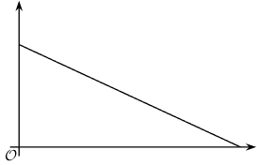
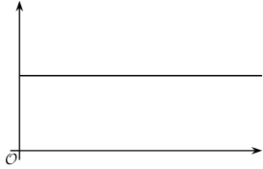
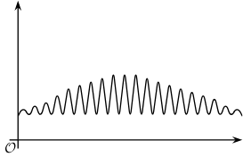
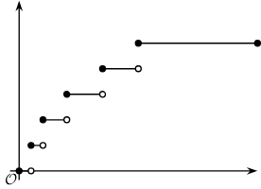
Warm Up - Which One Doesn’t Belong? 🚫
Why doesn’t one of the graphs belong with the others?
A.
C.
B.
D.
Notes:
Warm Up (5 minutes)
This warm-up asks students to compare four unlabeled graphs, focusing on their structure to determine similarities and differences between the functions.
In making comparisons, students have a reason to use language precisely, especially mathematical terms that describe features of graphs or properties of functions.
Depending on their background knowledge, students may need help understanding what is happening in graph B.
Activity Answers
Graph A doesn't belong because:
It is the only graph that has a positive vertical intercept and a positive horizontal intercept.
It is the only one that has a constant, negative rate of change.
Graph B doesn't belong because:
It is the only graph that is not a continuous curve and has multiple pieces.
It is the only one that shows both points and lines.
Graph C doesn't belong because:
It is the only graph that has a constant y-value.
Graph D doesn't belong because:
It is the only graph whose y-value increases and decreases multiple times.
It is the only graph that is not a simple line or curve and that has wave-like features.
Activity Synthesis
Have each group share one reason an item doesn’t belong, using and explaining relevant math terms. Record responses for all to see and invite agreement or disagreement from the class.
Since there's no single correct answer, focus on the accuracy of students' reasoning. Emphasize that key graph features reveal important information about quantities and can help us understand domain and range, which will be explored in the lesson.

Slide 9

Lesson Journey
Warm Up
Learning Activity
Cool Down
Lesson Synthesis
Learning Activity
Learning Activity
Practice

Slide 10
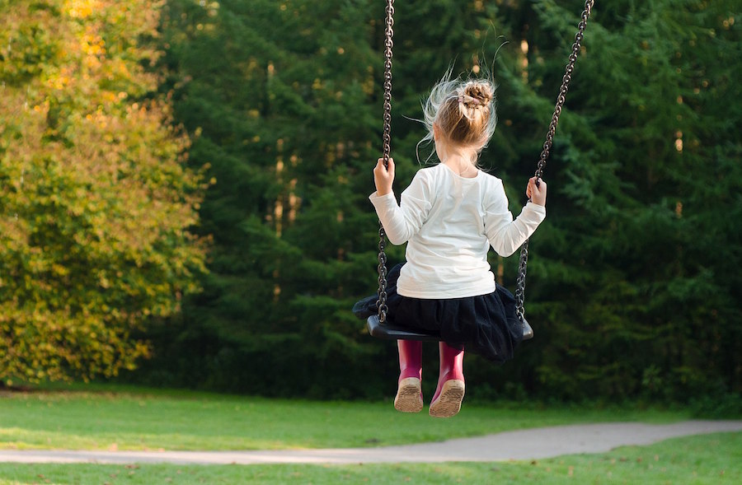
Learning Activity - A Playground Swing⛲
In this activity you will be provided with four graphs that represent a child getting on a swing in a playground, swinging for 30 seconds, and then getting off the swing.
For each graph, choose the description of the
function that best represents the graph.
The independent variable in each function is
time, measured in seconds.
Notes:
Support for All Learners
This activity offers additional support and an extension for students:
For English language learners and students with disabilities, be sure to review the Learning Strategies slide!
Activity (20 minutes)
In this activity, students are given the same four graphs they saw in the warm up and four descriptions of functions and are asked to match them. All of the functions share the same context. Students then use these features to reason about the likely domain and range of each function.
To make the matches, students analyze and interpret features of the graphs, looking for and making use of structure in the situation and in the graph. Here are some possible ways students may reason about each match:
The swing goes up and down while the child is swinging, so D could be a graph for function h.
The time left on the swing decreases as the time on the swing increases, so A is a possible graph for function r.
The distance of the child from the top beam of the swing doesn’t change as long as the child is on the swing, so C is a possible graph for function d.
The total number of times the swing is pushed must be a counting number and cannot be fractional. Graph B has multiple pieces, and each one could represent the total number of pushes for certain intervals of time, so B is a possible graph of function s.
Students reason quantitatively and abstractly as they connect verbal and graphical representations of functions and as they think about the domain and range of each function.
Launch
Decide if students will use notebook paper or the Desmos activity. Unlike the graphing calculator, Desmos guides students through interactive tasks, offers writing prompts with sentence stems, and lets teachers monitor responses via the Teacher Dashboard for discussion.
Desmos Activity: OpenStax Alg1 - 4.13.2 Graphing & Describing the Motion of a Swing
Ask students to imagine a child swinging for 30 seconds. They'll explore four related functions by matching verbal descriptions to graphs and identifying reasonable domain and range values.
Have students work in pairs using your Desmos class code. Give them quiet time to match graphs to scenarios (screen 1 of the activity).
Invite students to share their matches and explain each pairing. Ensure they justify all matches, not just default to leftover options.
Students will then explore each graph more deeply (screens 2–9), labeling axes and identifying domain and range. If needed, prompt them to identify key points like intercepts or maxima/minima, using proper mathematical terms.
Notice that additional information has been given to help students with determining domain and range values. The information includes the following:
The child is given 30 seconds on the swing.
While the child is on the swing, an adult pushes the swing a total of 5 times.
The swing is 1.5 feet (18 inches) above ground.
The chains that hold the seat and suspend it from the top beam are 7 feet long.
The highest point that the child swings up to is 4 feet above the ground.
If time is limited, ask each partner to choose two functions (different from their partner’s) and write the domain and range for only those functions.
Access the Desmos guide PDF to learn more about accessing and customizing activities.
Activity image answer, and synthesis on the next slide.

Slide 11
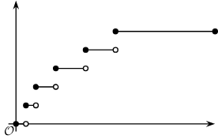
Learning Activity - A Playground Swing⛲
Choose the description of the function that best represents the graph.
Function h: The height of the swing, in feet, as a function of time since the child gets on the swing
Function r: The amount of time left on the swing as a function of time since the child gets on the swing
Function d: The distance, in feet, of the swing from the top beam (from which the swing is suspended) as a function of time since the child gets on the swing
Function s: The total number of times an adult pushes the swing as a function of time since the child gets on the swing
Graph B
Graph C
Graph D
Graph A
Notes:
Activity Answer
Graph A
Function r: The amount of time left on the swing as a function of time since the child gets on the swing.
Graph B
Function s: The total number of times an adult pushes the swing as a function of time since the child gets on the swing.
Graph C
Function d: The distance, in feet, of the swing from the top beam as a function of time since the child gets on the swing.
Graph D
Function h: The height of the swing, in feet, as a function of time since the child gets on the swing
Anticipated Misconceptions
Some students may struggle to match the descriptions and the graphs because they confuse the independent and dependent variables and think that, in each situation, time is represented by the vertical axis. Encourage them to reread the activity statement, clarify the input and output in each situation, label the horizontal graph with the input, and then try interpreting the graphs again.
Activity Synthesis
Select students to share the domain and range for each function and their reasoning. Record and display their responses for all to see.
One key point to highlight is that the range of a function could be a single value (say 7, as shown in graph C), a bunch of isolated values (say, only some whole numbers, as shown in graph B), all values in an interval (say, all values from 1.5 to 4, as shown in graph D, or all values between 0 and 30, as in graph A), or a combination of these.
The domain of a function may also be limited in similar ways. Tell students that, in upcoming lessons, we will look at functions in which the rules relating their input and output are a bit more complex, so their domain and range are also a bit more complex.

Slide 12
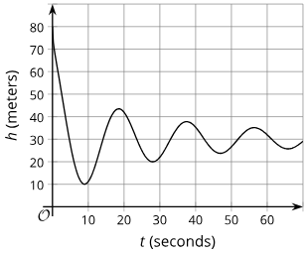
Self Check
Which of the following is true about the range of the graph below?
The range of this function includes all values that are at least 0 and no more than 70.
The range of this function includes all values that are at least 0 and no more than 90.
The range of this function includes all values that are at least 10 and at most 75.
The range of this function only includes 10 and 75.
Let’s review!
Notes:
Answer Feedback - Individualized by Response
Incorrect. This describes the domain values of the graph. The answer is the range of this function includes all values that are at least 10 and at most 75.
Incorrect. This describes the window of the graph, not the range. The answer is the range of this function includes all values that are at least 10 and at most 75.
That’s correct! The minimum y-value of the graph is 10, and the maximum y-value of the graph is 75.
Incorrect. This describes the minimum and maximum values of the range of the graph, but the range includes many more between these values. The answer is the range of this function includes all values that are at least 10 and at most 75.

Slide 13
Self Check - Review
Describing Domain and Range Graphs
In a previous lesson, you explored the height, h, of a bungee jumper at t seconds.
Assuming the jump ended at 35 seconds, what is the domain?
What are the values in the range?
Notes:
Discuss the answers with the students
Assuming the jump ended at 35 seconds, what is the domain?
For domain, consider the x-values, so look from left to right.
The leftmost x-value is 0, and the rightmost x-value is 35.
The domain includes all the values from at least 0 up to and including 35 meters.
What are the values in the range?
For the range, consider the y-values, so look from bottom to top.
The lowest y-value is 10, and the highest y-value is about 75.
So, the range includes all of the values from at least 10 up to about 75.

Slide 14
Lesson Journey
Warm Up
Learning Activity
Cool Down
Lesson Synthesis
Learning Activity
Learning Activity
Practice

Slide 15
Learning Strategies - Bouncing Tennis Ball🎾
Teacher Instruction: Use these strategies to adjust the activity to support English language learners and students with disabilities.
  You can copy and paste the callouts directly on top of the activity or give the instructions aloud.
“Can you explain this using points on the graph?”
“Are there values for the domain and range not shown on the graph? How do you know?”
Discussion Supports
Notes:
Support for English Language Learners: MLR 8 Discussion Supports: Speaking, Listening, Representing
Use this routine to support whole-class discussion of the meaning of domain and range in the context of a tennis ball bouncing. As students share explanations of their reasoning about the domain and the range for the function, encourage students to press for details and precision in language in peers' responses by asking questions such as, “Can you explain this using points on the graph?” or “Are there values for the domain and range not shown on the graph? How do you know?”
Design Principle(s): Support sense-making
NO links to supporting materials for teachers or students.

Slide 16
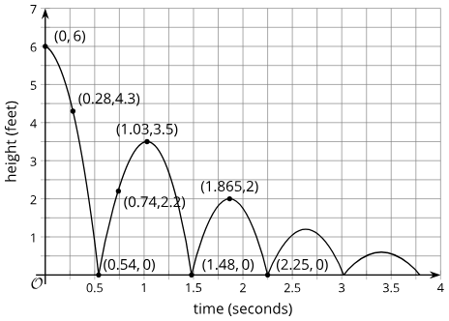
Learning Activity - Bouncing Tennis Ball🎾
A tennis ball was dropped from a certain height. It bounced several times, rolled along for a short period, and then stopped. Function H gives its height over time.
Use the graph to answer the questions. Explain what each value or set of values means in this situation.
Find H(0). What point is this on the graph? What does it represent?
Solve H(x) = 0.
Describe the domain of the function.
Describe the range of the function.
Partial graph of H. Height is measured in feet. Time is measured in seconds.
Are you ready for more?
Notes:
Support for All Learners
This activity offers additional support and an extension for students:
For English language learners and students with disabilities, be sure to review the Learning Strategies slide!
For students looking for an extra challenge, be sure to review the Extending Your Thinking slide!
Activity (10 minutes)
In this activity, students interpret a graph in context and connect its features to the domain and range, using a familiar situation to focus on reasoning.
Unlike the swing activity, this graph includes axis scales and coordinates to help identify the range, but only shows part of the function—students must reason about the domain beyond the fifth bounce.
Answers
H(0) = 6. It tells us the ball was dropped from a height of 6 feet at t = 0.
X = 0.54, x = 1.48, and x = 2.25 are three possible solutions, but there are others. Each one represents the time when the ball hit the ground.
For example: The domain includes all values between 0 and the time when the ball stopped moving, which, based on the graph, is about 3.8.
For example: The range includes all values between 0 and 6 feet, the height from which the ball was dropped.
Activity Synthesis
Focus the discussion on how students reasoned about the domain and the range for the function. Highlight explanations that account for what is realistic in the context.
The domain tells us all the possible amounts of time that passed since the moment the tennis ball was dropped until it stopped rolling.
The range includes all the possible heights of the tennis ball from the time it was dropped until the time it stopped rolling. Ask students if there are points on the graph whose coordinates are particularly useful for identifying the domain and range of the function. (The heights of the bounces? The points where the ball hits the ground? Points between the two? Others?)
Emphasize that, just like in the activity about the swing, some points and features on a graph can give us more information than others about possible input-output values of a function.

Slide 17
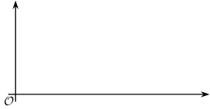
Extending Your Thinking
In function H, the input was time in seconds, and the output was height in feet.
Describe a function whose domain includes only integers. Be sure to specify the units.
Sketch a graph of this function.
Describe a function whose range includes only integers. Be sure to specify the units
Sketch a graph of this function.
Notes:
Answers
The maximum height, in feet, that the ball reaches after n bounces as a function of the number of bounces.
Click here to see Image 2.
The number of times the ball has hit the ground as a function of time, in seconds, since the ball was dropped.
Click here to see Image 4.

Slide 18
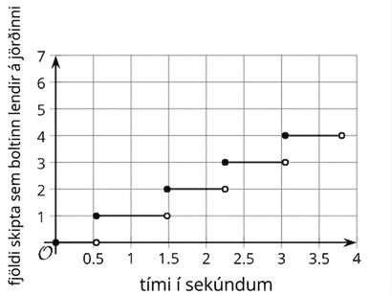
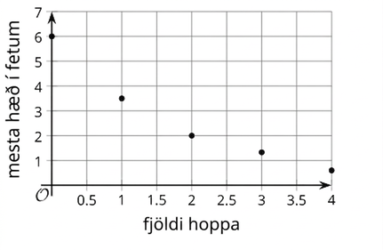
Extending Your Thinking
Image 2
Image 4
Notes:
Activity Images

Slide 19
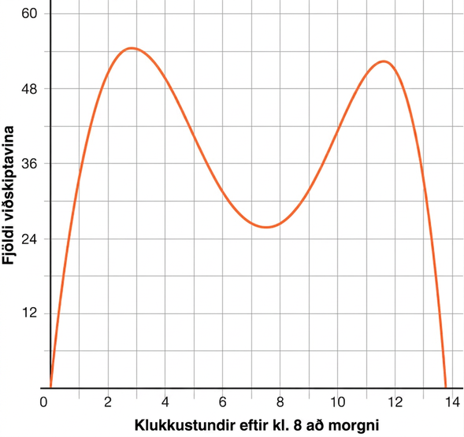
Self Check
The graph below shows the number of customers, C, in a restaurant x hours after 8 a.m.
What does C(14) equal, and what does it mean?
C(14) = 0.5 and means there are 14 customers around 8:30.
C(14) = 0 and is when the restaurant closes and has no more customers around 10 p.m.
C(14) = 0 and means there are 14 customers at 8 a.m.
C(14) = 0 means there have not been any customers over 14 hours.
Let’s review!
Notes:
Answer Feedback - Individualized by Response
Incorrect. The input is 14, so it is the x-value. The answer is C(14) = 0 and is when the restaurant closes and has no more customers around 10 p.m.
That’s correct! Since 14 is the input value, look for where 14 is located on the x-axis. The output there is 0, which means that there are no customers 14 hours after 8 a.m., which is about 10 p.m.
Incorrect. he input and output values and their meanings should be switched. The answer is C(14) = 0 and is when the restaurant closes and has no more customers around 10 p.m.
Incorrect. The output gives the number of customers at that time, not over a period of time. The answer is C(14) = 0 and is when the restaurant closes and has no more customers around 10 p.m.

Slide 20
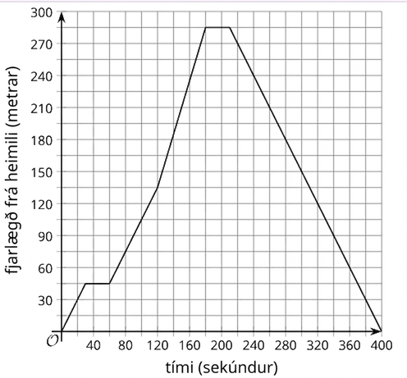
Self Check - Review
Domain and Range from Graphs
The graph shows the distance Carl drives from home, D(t), when t is time in seconds.
What is the domain of the graph?
What is the range of the graph?
What are the values of x where D(x) = 0, and what do they mean?
Notes:
Discuss the answers with the students
What is the domain of the graph?
The domain is x-values that are at least 0 and a maximum of 400.
What is the range of the graph?
The range is the y-values that are at least 0 and a maximum of 285.
What are the values of x where D(x) = 0, and what do they mean?
D(0) = 0 and D(400) = 0, and this is when Carl left home and then arrived home, so the distance was 0.

Slide 21
Lesson Journey
Warm Up
Learning Activity
Cool Down
Lesson Synthesis
Learning Activity
Learning Activity
Practice

Slide 22
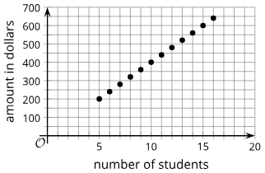
Learning Activity - Camp Attendance in Dollars 🏕️
A discrete function has distinct separate values in the domain and range, rather than an interval of values
The graph is from the previous lesson that
graphs the number of students attending
a camp and the amount, in dollars, the
camp earns. There must be 5 students to
hold the camp.
  What are the x-values of this function that make up the domain?
  Why can’t we say the domain is all values from 5 to 16?
  What are the y-values of this function that make up the range?
Notes:
Activity (10 minutes)
Answers
The graph is from the previous lesson that graphs the number of students attending a camp and the amount, in dollars, thecamp earns. There must be 5 students to hold the camp.
5, 6, 7, 8, 9, 10, 11, 12, 13, 14, 15, 16
The number of students cannot be fractions or decimals, so those values are not in the domain.
200, 250, 300, 350, 400, 450, 500, 550, 600, 650
More activity questions, answers on the next slide.

Slide 23
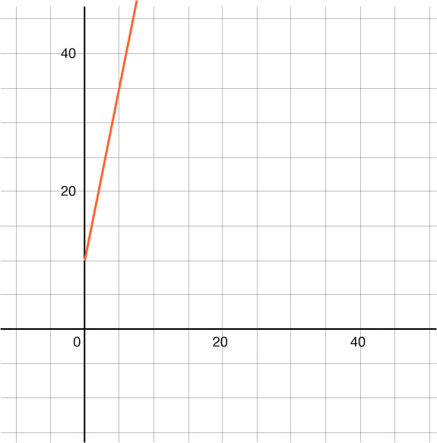
Learning Activity - Camp Attendance in Dollars 🏕️
A continuous function refers to a function that does not have any breaks in its graph. The domain and range of a continuous function are often represented by an interval that can be written as an inequality.
The continuous function, P, is the cost of parking in a garage for t hours. It is represented by the function
P(t) = 5h + 10.
  What does P(0) represent?
  In words, what are the values of the domain?
  Write the domain values as an inequality.
  In words, what are the values of the range?
  Write the range values as an inequality.
Notes:
Answers
A continuous function refers to a function that does not have any breaks in its graph. The domain and range of a continuous function are often represented by an interval that can be written as an inequality.
It represents the starting price of parking for the day.
The domain includes the values where x is at least 0.
x ≥ 0
The range includes the values where y is at least 10.
y ≥ 10

Slide 24
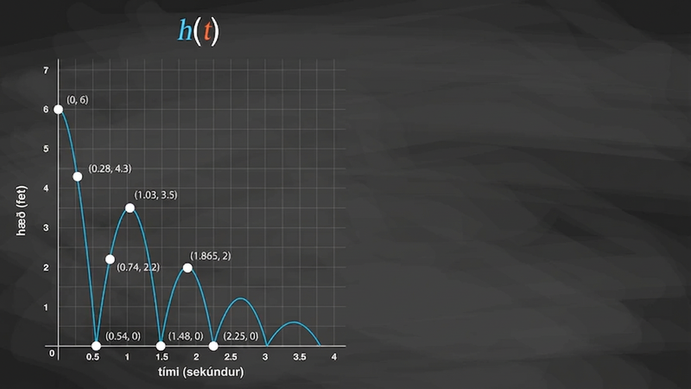
Video: Interpreting Function Notation

Slide 25
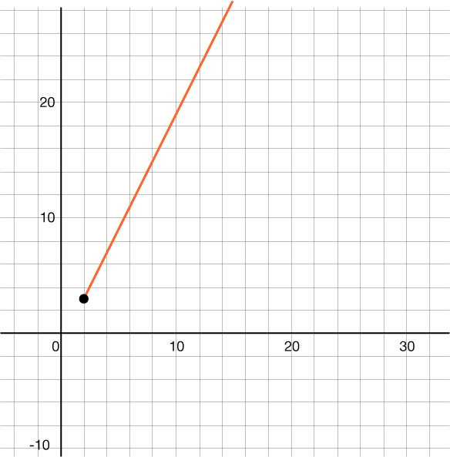
Self Check
Which of the following correctly describes the domain and range of the graph below?
Domain: x ≥ 3, Range: y ≥ 2
Domain: x ≥ 2, Range: y ≥ 3
Domain: x ≤ 2, Range: y ≤ 3
Domain: x > 2, Range: y > 3
Let’s review!
Notes:
Answer Feedback - Individualized by Response
Incorrect. The domain is the x-values. and the lowest x-value is 2. Domain: x ≥ 2 and Range: y ≥ 3.
That’s Correct! The lowest x-value is 2, and the graph continues forever right. The lowest y-value is 3, and then the graph continues forever up.
Incorrect. Watch the inequality symbol you use. The domain includes the x-values greater than or equal to 2, and the range includes the y-values greater than or equal to 3. The answer is Domain: x ≥ 2 and Range: y ≥ 3.
Incorrect. The domain includes 2 and the range includes 3, so both inequalities should have an equal sign included. The answer is Domain: x ≥ 2 and Range: y ≥ 3.

Slide 26
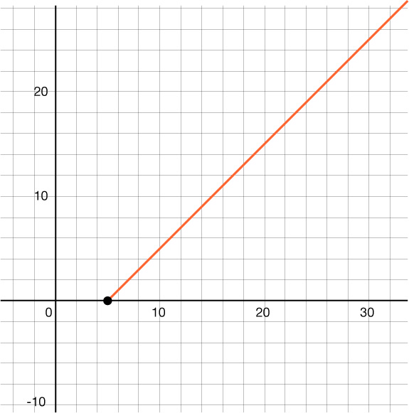
Self Check - Review
Looking at the linear function, use inequalities to represent the domain and range.
Domain:
Since the domain is all x-values, look left to right for the least to greatest values.
The smallest x-value on this linear function is 5, and then the line continues to the right forever.
So, the domain is all values that are at least 5.
As an inequality, write this as x ≥ 5.
Range:
Since the range is all y-values, look from the bottom to the top for the least to greatest values.
The smallest y-value is 0, and then the line continues up forever.
So, the range is all values that are at least 0.
As an inequality, the range is y ≥ 0.
.

Slide 27

Lesson Journey
Warm Up
Learning Activity
Cool Down
Lesson Synthesis
Learning Activity
Learning Activity
Practice

Slide 28
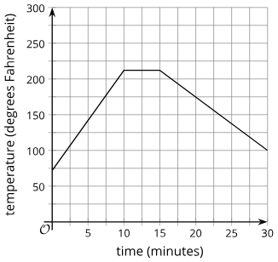
Cool Down
The function W gives the temperature, in degrees Fahrenheit, of a pot of water on a stove t minutes after the stove is turned on. After 30 minutes, the pot is taken off the stove.
Is 250 in the range of function W? Explain how you know.
Describe the range of the function.
Does W(t) = 0 have a solution? Explain how you know.
Notes:
Cool Down (5 minutes)
Answers
No, 250 is not in the range. The highest temperature is 212 degrees Fahrenheit.
The range is all values between 75 and 212, the lowest and the highest temperature, 75 ≤ y ≤ 212.
No, a solution to this equation would be the time when the temperature is 0 degrees Fahrenheit, which is never the case.
Response to Student Thinking -More Chances
If students are still struggling with domain and range, examine errors in the cool-down and make sure to discuss domain and range during each of the activities in Lesson 13.

Slide 29

Lesson Journey
Warm Up
Learning Activity
Cool Down
Lesson Synthesis
Learning Activity
Learning Activity
Practice

Slide 30

Practice
Put your hard work to action, practice what you’ve learned!
Notes:
Digital Practice: Access the practice pages at https://openstax.org/details/books/algebra-1

Slide 31

Lesson Journey
Warm Up
Learning Activity
Cool Down
Lesson Synthesis
Learning Activity
Learning Activity
Practice

Slide 32
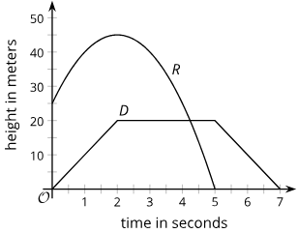
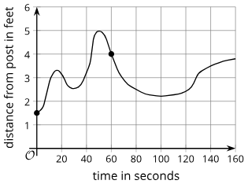
Lesson Synthesis
What can these graphs tell us about the domain and range of functions?
Notes:
Prompt: Ask students to examine the graphs and use them to help summarize what graphs can tell us about the domain and range of functions. Ask students to complete the following prompts as thoroughly as they can.
I can learn about the domain and range of a function from a graph by looking for . . .
A graph may not always show all that is needed to fully describe the domain and range, however. For example, it may not show . . .
Closing the Lesson
After completing the Lesson Synthesis, wrap up the class by directing students to the Lesson Summary in their student textbook. In this section, students review the day’s learning targets, read summaries about the key takeaways from each activity, and then respond to a reflection question regarding their confidence with the material.
For more on the benefits of using this type of metacognitive reflection, see the Research in Practice section of the course.

Slide 33
Self Assessment
How much do you agree with the following statements?
I can… | I can | Almost | Not yet
Determine a reasonable domain and range for the function when given a description of a function in a situation.

