Slide 1
Algebra 1
Unit 9 More Quadratic Equations
Lesson 9.1 What Are Perfect Squares?

Slide 2

How to use these slides
On the activity slides check the speaker notes for teacher support and instructional information.
Each lesson includes 1 warm up, 2-3 learning activities, a cool down, practice and a lesson synthesis.
  Learning activities are followed by a self check question, and review section.
Some slides have been hidden from student view, more information can be found on the next slide (Reference Key).
You can edit and use these slides for personal and classroom use, but cannot sell them and must keep the attribution logos.
For more information, Check out the digital quick start guide!
OpenStax CC BY NC SA

Slide 3





Reference Key
Check the top right corner for an icon referencing these unique sections.
Icon | Title | View | Location and Description
n/a | Support for Students with Disability | Hidden | Learning Strategies slide, provides additional support to students for understanding the activity.
n/a | Support for English Language Learners | Hidden | Learning Strategies slide, provides additional support to students for understanding the activity.
n/a | Extending Your Thinking | Hidden | Extending Your Thinking slide, provides an extra challenge for students.
n/a | Self Check | Not Hidden | Self Check slide, checkpoint to assess student understanding after the learning activity.
n/a | Review | Hidden | Self Check - Review slide, designed to help review topics from the self check question.
On the next slides, check the speaker notes for teacher instructions and support.
Notes:
Check the Speaker Notes: On the next slides you can find discussion questions, lesson information, answers to the activities, and ways to adjust the activity for your students!

Slide 4

Learning Goals
By the end of this lesson you will be able to -
Recognize perfect-square expressions written in different forms.
Recognize quadratic equations that have a perfect-square expression and solve the equations.
Notes:
Lesson Narrative
This lesson has two key aims.
The first aim is to familiarize students with the structure of perfect-square expressions. Repeated reasoning allows them to generalize expressions of the form (x + n)² as equivalent to x² + 2nx + n². (Note, students were first introduced to perfect square trinomials in Unit 6.)
The second aim is to help students see that perfect squares can be handy for solving equations because we can find their square roots.
Achieving these aims prepares students to solve quadratic equations by completing the square in upcoming lessons.
Required Preparation
None
Required Materials
None
Texas Essential Knowledge and Skills
A1(B) use a problem-solving model that incorporates analyzing given information, formulating a plan or strategy, determining a solution, justifying the solution, and evaluating the problem-solving process and the reasonableness of the solution
A1(D) communicate mathematical ideas, reasoning, and their implications using multiple representations, including symbols, diagrams, graphs, and language as appropriate
A11(A) simplify numerical radical expressions involving square roots
A8(A) solve quadratic equations having real solutions by factoring, taking square roots, completing the square, and applying the quadratic formula

Slide 5
Vocabulary
Previous
Perfect Square
  The product of a whole number or expression that has been multiplied by itself.
Perfect Square Trinomial
  A trinomial that fits the pattern a² + 2ab + b² = (a + b)² or a² – 2ab + b² = (a – b)².
Square Root Property
  If x² = k, then x = √k and
  x = – √k.
Notes:
Lesson Vocabulary
To support student understanding of key vocabulary:
Introduce and review the vocabulary words students will see in this lesson.
Encourage students to notice how these words are used and to include them in their math discussions and explanations—both written and oral.
Use a word wall to reinforce vocabulary. Sample word wall cards are available here.
For newcomers or students with beginning English proficiency, use these Quizlet sets to support vocabulary learning:
Unit 9 Spanish Vocabulary – use first to build understanding
Unit 9 Vocabulary (English) – use after anchoring in Spanish
Support for English Language Learners
ELPS 2(C) learn new language structures, expressions, and basic and academic vocabulary heard during classroom instruction and interactions
ELPS 2(F) listen to and derive meaning from a variety of media such as audiotape, video, DVD, and CD-ROM to build and reinforce concept and language attainment
ELPS 2(I) demonstrate listening comprehension of increasingly complex spoken English by following directions, retelling or summarizing spoken messages, responding to questions and requests, collaborating with peers, and taking notes commensurate with content and grade-level needs
ELPS 3(E) share information in cooperative learning interactions
ELPS 3(G) express opinions, ideas, and feelings ranging from communicating single words and short phrases to participating in extended discussions on a variety of social and grade-appropriate academic topics
ELPS 4(A) learn relationships between sounds and letters of the English language and decode (sound out) words using a combination of skills such as recognizing sound-letter relationships and identifying cognates, affixes, roots, and base words
ELPS 4(B) recognize directionality of English reading such as left to right and top to bottom
ELPS 4(C) develop basic sight vocabulary, derive meaning of environmental print, and comprehend English vocabulary and language structures used routinely in written classroom materials
ELPS 4(D) use prereading supports such as graphic organizers, illustrations, and pretaught topic-related vocabulary and other prereading activities to enhance comprehension of written text
ELPS 4(E) read linguistically accommodated content area material with a decreasing need for linguistic accommodations as more English is learned
ELPS 4(F) use visual and contextual support and support from peers and teachers to read grade-appropriate content area text, enhance and confirm understanding, and develop vocabulary, grasp of language structures, and background knowledge needed to comprehend increasingly challenging language
ELPS 4(G) demonstrate comprehension of increasingly complex English by participating in shared reading, retelling, or summarizing material, responding to questions, and taking notes commensurate with content area and grade level needs
ELPS 4(H) read silently with increasing ease and comprehension for longer periods
ELPS 4(I) demonstrate English comprehension and expand reading skills by employing basic reading skills such as demonstrating understanding of supporting ideas and details in text and graphic sources, summarizing text, and distinguishing main ideas from details commensurate with content area needs
ELPS 4(J) demonstrate English comprehension and expand reading skills by employing inferential skills such as predicting, making connections between ideas, drawing inferences and conclusions from text and graphic sources, and finding supporting text evidence commensurate with content area needs
ELPS 4(K) demonstrate English comprehension and expand reading skills by employing analytical skills such as evaluating written information and performing critical analyses commensurate with content area and grade-level needs.

Slide 6

Lesson Journey
First Stop: Warm Up

Slide 7

Warm Up
Balancing Act ⚖️
In each equation, what expression could be substituted for a so the equation is true for all values of x?
x² = a²
(3x)² = a²
a² = (7x)(7x)
25x² = a²
a² = ¼ x²
a² = (x + 1)²
(2x – 9) (2x – 9) = a²
Notes:
Warm Up (5 minutes)
In this warm up, students reason about equations with quadratic expressions on both sides of the equal sign. They look for and use structure to solve the equations. Though each equation appears to be more complicated or to have more pieces than the preceding one, the underlying structure of all the equations is unchanged: (something)² = a². The last equation is written in factored form, but because the factors are identical, students can see that it can also be written as (something)² = a².
Launch
Give students a moment to observe the list of equations and ask them what they notice and wonder about the equations.
Solicit a few observations and questions.
Tell students that their job is to think about what a should be so that each equation is always true, regardless of what x is.
Activity Answers
a = x
a = 3x
a = 7x
a = 5x
a = ½ x
a = x + 1
a = 2x – 9
Activity Synthesis
Invite students to share their responses and how they viewed the equations. If not mentioned by students, point out that the question can be thought of as: "When a is squared, it is equal to something squared," so a must be equal to that something.
Explain to students that expressions that represent something squared are known as perfect squares. This term is related to what students learned in earlier grades about the area of a square. Multiplying the side length of a square by itself gives the area of the square, so we can say, for instance, that 25 is a perfect square because it is the area (in square units) of a square whose side length is 5 units. (2x − 9)(2x − 9) can be thought of as the area of a square with side length 2x − 9. To help students visualize, draw squares and label the side lengths to discuss the area of the square. Algebra tiles can also be used to illustrate the concept of perfect squares.

Slide 8
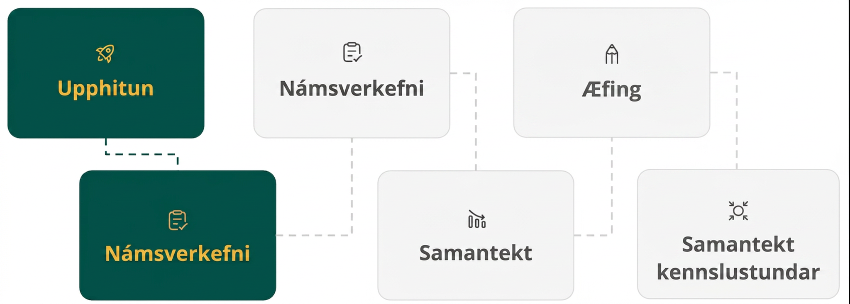
Lesson Journey
Second Stop: Learning Activity A

Slide 9

Learning Activity A | Learning Strategies
Picture Perfect 📷
Critique and identify the error in the statement: “Every polynomial with a square term is a perfect square.”
Correct the reasoning with a partner.
Clarify your explanation by making it more concise and precise.
Clarify, Critique, Correct
Teacher Instruction: Use these strategies to adjust the activity to support English language learners and students with disabilities.
You can copy and paste the callouts directly on top of the activity or give the instructions aloud.
Use a diagram to write each expression in expanded form.
Look for patterns in the diagrams and be prepared to explain them.
Representation
Notes:
Support for English Language Learners: MLR 3 Clarify, Critique, Correct: Reading, Writing, Speaking
Before students share their explanations for the last question, present an incorrect answer and explanation. For example, “Some people may say they're perfect squares because they have a term that is a square.” Ask students to identify the error, critique the reasoning, and write a correct explanation. As students discuss with a partner, listen for students who identify and clarify the ambiguous language in the statement. For example, the author probably meant to say that each expression can be written as a squared linear expression. This will help students understand the language of “perfect squares” when referring to quadratic expressions and the relationship between the coefficients in standard and factored form.
Design Principle(s): Optimize output (for explanation); Maximize meta-awareness
Learn more about this routine
View the instructional video and follow along with the materials to assist you with learning this routine.
Provide support for students
Distribute graphic organizers to the students to assist them with participating in this routine.
Support for Students with Disabilities: Representation: Internalize Comprehension
Activate or supply background knowledge. Represent the same information through different modalities by using a diagram to write each expression in expanded form. As students progress through the questions, invite them to notice how each side of their diagrams will be the same since the expressions are perfect squares. If students struggle on the last question, ask them to observe patterns of the entries in their diagrams (such as the lower left and upper right cells are the same) to help them diagram “in reverse,” starting from the standard form.
Supports accessibility for: Conceptual processing; Visual-spatial processing

Slide 10
Learning Activity A
Recognizing Structure in Perfect Square Expressions
Each expression is written as the product of factors. Write an equivalent expression in standard form.
(3x)²
(7x)(7x)
(x + 4)(x + 4)
(x + 1)²
(x – 7)²
(x + n)²
Why do you think the following expressions can be described as perfect squares?
x² + 6x + 9
x² – 16x + 64
x² – (⅓)x + (¹/₃₆)
Are you ready for more?
Notes:
Support for All Learners
This activity offers additional support and an extension for students:
For English language learners and students with disabilities, be sure to review the Learning Strategies slide!
For students looking for an extra challenge, be sure to review the Extending Your Thinking slide!
Activity (15 minutes)
The goal of this activity is to illustrate that a perfect-square expression can take different forms, some of which may not look like (something)⋅(something) or (something)². The work here prompts students to recognize structure in perfect-square expressions, particularly when written in standard form, preparing them to complete the square in an upcoming lesson.
Launch
Encourage and support opportunities for peer interactions.
Invite students to talk about their ideas with a partner before writing them down.
Continue scrolling down for answers to the activity questions, anticipated misconceptions, and synthesis questions.
Answers
a. 9x²
b. 49x²
c. x² + 8x + 16
d. x² + 2x + 1
e. x² – 14x + 49
f. x² + 2nx + n²
If these expressions are written in factored form, each one is the square of a linear expression:
(x + 3)²; (x – 8)²; and (x + ⅙)².
Anticipated Misconceptions
If students have trouble generalizing (x + n)² as x² + 2nx + n² from working only with expressions, ask them to draw a rectangular diagram showing x
and n along both sides of the rectangle and see if they can show on the diagram where the 2n and n² come from. (If some scaffolding is needed, consider starting with numbers, for example, (10 + 4)², then (x + 4)², and then (x + n)² .) An example box diagram to help students expand the polynomial is located in the OpenStax online teacher version.
Additionally, many students will jump from (x + n)² to x² + n². It can be helpful to show students that this is not equivalent to the answer x² + 2nx + n². Encourage students to always rewrite expressions of the form (x + n)² as (x + n)(x + n).
Activity Synthesis
Invite students to share their responses and reasoning for the last question. Make sure students see the structure that relates the expression in standard form and its equivalent expression in factored form. Highlight that:
In each given example, the constant term is a number squared (n²), and the coefficient of the linear term is twice that number (2n).
This is also true for the expression that contains fractions: ¹/₃₆ is (⅙)² and ⅓ is 2⋅(⅙).
We call these expressions "perfect squares" because they can be written as something squared: (x + 3)², (x − 8)², and (x + 16)².
In general, when (x + n) is squared and expanded, we have: x² + 2nx + n².
Tell students that knowing about quadratic expressions that are perfect squares can help us solve all kinds of equations in upcoming lessons.

Slide 11

Learning Activity A
Extending Your Thinking
Write each expression in factored form.
x⁴ – 30x² + 225
x + 14√(x) + 49
5^{2x} + 6(5^{x}) + 9
Notes:
Go back to Lesson Activity
Answer
1. (x² – 15)²
2. (√(x) + 7)²
3.(5^{x} + 3)²

Slide 12
Learning Activity A
Self Check
Which of the following is equivalent to (x – 4)² ?
a. x² – 16
b. x² + 16
c. x² – 8x + 16
d. x² + 8x + 16
Let’s review!
Notes:
Answer Feedback -
Incorrect. Make sure to remember (x − 4)² = (x − 4)(x − 4).
Incorrect. Make sure to remember (x − 4)² = (x − 4)(x − 4).
That’s correct! Check yourself: (x − 4)² = (x − 4)(x − 4). Then use the distributive property (FOIL).
Incorrect. Make sure to remember (x − 4)² = (x − 4)(x − 4).

Slide 13

Learning Activity A
Self Check - Review
A perfect square trinomial is created by multiplying a binomial by itself.
Step 1 - Multiply the binomial by itself.
Step 2 - Use the distributive property to expand (FOIL).
Step 3 - Combine like terms
Write (x – 2)² as an expanded polynomial in standard form.
Notes:
Remind Students
x times x is x², not 2x
FOIL is “First, Outer, Inner, Last”
Students may need a reminder about what like terms are.
Answer: x² – 4x + 4
To see the full worked problem and additional examples, see the online textbook.

Slide 14

Lesson Journey
Third Stop: Learning Activity B

Slide 15
Learning Activity B | Learning Strategies
Which Method is Best? 🤔
Teacher Instruction: Use these strategies to adjust the activity to support English language learners and students with disabilities.
  You can copy and paste the callouts directly on top of the activity or give the instructions aloud.
“First, I _____ because . . .”
“Why did you …?”
“How do you know …?”
“I know _____ because . . .”
Discussion Supports
Use color coding or highlighting to annotate steps or processes that are similar in the problems.
Representation
Notes:
Support for English Language Learners: MLR 8: Discussion Supports: Conversing
In their groups of two, display the following sentence frames for students to use when describing their steps to solve each quadratic equation and questioning each others’ reasoning: “First, I _____ because . . .”, “I know _____ because . . .”, “Why did you . . .?”, and “How do you know . . . ?” Encourage students to challenge each other when they disagree. This will help students clarify their reasoning when solving quadratic equations using multiple methods.
Design Principle(s): Support sense-making; Maximize meta-awareness
Support for Students with Disabilities: Representation: Internalize Comprehension
Use color coding and annotations to highlight connections between representations in a problem. For example, use the same color to call students' attention to the common elements of each method.
Supports accessibility for: Visual-spatial processing; Conceptual processing

Slide 16
Learning Activity B | Part 1
Which Method is Best? 🤔
Han and Jada solved the same quadratic equation with different methods. Here they are:
Han’s Method
(x – 6)² = 25
(x – 6)(x – 6) = 25
x² – 12x + 11 = 0
(x – 11)(x – 1) = 0
(x – 11) = 0 and (x – 1) = 0
x = 11 or x = 1
Jada’s Method
(x – 6)² = 25
√(x – 6)² = √(25)
x – 6 = ± 5
x – 6 = 5 and x – 6 = –5
x = 11 or x = 1
Notes:
Support for All Learners
This activity offers additional support for students:
For English language learners and students with disabilities, be sure to review the Learning Strategies slide!
Activity (15 minutes)
Earlier in the unit, students solved equations with a squared variable on one side and a square number on the other, for example, x² = 49 or 4x² = 100. This activity allows students to see that more complicated quadratic equations can also be solved relatively easily when both sides of the equal sign are perfect squares. The work here motivates upcoming lessons on completing the square.
Launch
Arrange students in groups of two.
Display the two solutions from the task statement for all to see.
Give students a moment to study and make sense of the two methods.
Then, ask them to talk to their partner about what Han and Jada did at each step in their solution.
Next, ask students which method they prefer and why. They are likely to prefer Jada's method since it takes far fewer steps, but some might prefer Han's method because it is more familiar.
Tell partners that they will take turns solving equations with each method and get a better feel for each method.
Activity questions, answers, anticipated misconceptions, and synthesis on the next slide.

Slide 17
Learning Activity B | Part 2
Which Method is Best? 🤔
Work with a partner to solve these equations.
For each equation, one partner solves with Han's method, and the other partner solves with Jada's method.
Make sure both partners get the same solutions to the same equation.
If not, work together to find your mistakes.
1. (y – 5)² = 49
2. (x + 4)² = 9
3. (z + ⅓)² = 49
4. (v – 0.1)² = 0.36
Notes:
Answers
y = 12 and y = –2
x = –1 and x = –7
z = 6.6666 or 6 ⅔ and z = –7.3333 or – 7 ⅓
v = 0.7 and v = – 0.5
Anticipated Misconceptions
Students may need scaffolding beginning with solving equations such as x² = 9, which becomes √(x²) = √(9) so x = ±3. Show students that both solutions x = 3 and x = −3 work when checked into the original equation. Students have limited experience with the ± that is needed and may need further explanation and practice to show that √(x²) will result in two solutions.
Activity Synthesis
Select students to display their solutions for all to see. Ask students to reflect on the merits of the solution methods. Make sure they recognize that when equations are in perfect squares, they are easier to solve because we can find their square roots.
Point out that all the equations in this activity already have perfect squares on both sides, but most equations that we need to solve do not. Tell students that in upcoming lessons, they will learn how to transform equations so that they have a perfect square and can be more easily solved.

Slide 18
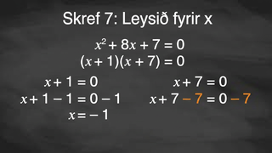
Learning Activity B | Video
Solving Multi Step Quadratic Equations Using Perfect Squares
Notes:
This video discusses question 2 of activity 9.1.3.

Slide 19

Learning Activity B
Self Check
Find all solutions to (x – 3)² = 25.
x = 8
x = –2, x = 8
x = 22, x = 28
x = 28
Let’s review!
Notes:
Answer Feedback - Individualized by Response
Incorrect. While this is one solution, there are two. Make sure to set up two equations after taking the square root of both sides.
That's correct! Take the square root of each side. Then be sure to set up two equations.
Incorrect. Be sure to take the square root of both sides of the equation.
Incorrect. Be sure to take the square root of both sides of the equation AND set up two equations.

Slide 20
Learning Activity B
Self Check - Review
SOLVING QUADRATICS USING
THE DISTRIBUTIVE PROPERTY
Step 1 - Isolate the quadratic term so its coefficient = 1.
Step 2 - Rewrite so the binomial is multiplied by itself.
Step 3 - Use the distributive property or FOIL.
Step 4 - Combine like terms to set the equation = 0.
Step 5 - Factor.
Step 6 - Set each factor equal to 0.
Step 7 - Solve.
Step 8 - Check the solutions.
Solve 4(x – 7)² = 36
Notes:
Remind Students
Utilize inverse operations.
Isolate the variable by dividing both sides by 4.
Recall that a power of 2 means to multiply a binomial by itself.
Remind students that checking their solution(s) is important.
Answer: x = 10, x = 4
To see the full worked problem and additional examples, see the online textbook.

Slide 21
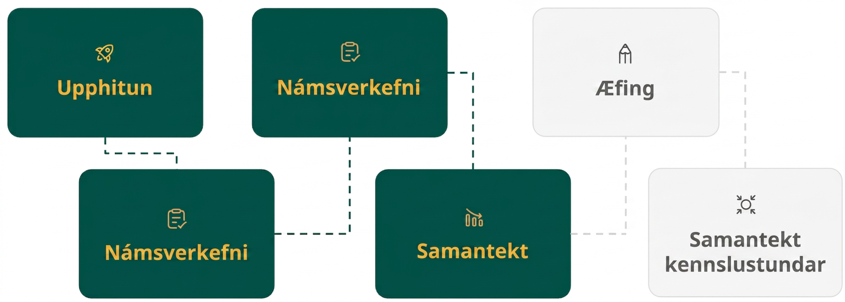
Lesson Journey
Fourth Step: Cool Down

Slide 22

Cool Down
Explain why it makes sense to call the expression x² + 20x +100
a perfect square.
Solve x² + 20x +100 = 81.
Notes:
Cool Down (5 minutes)
Answers
It is equivalent to (x + 10)², so it is a factor squared.
x = –1 and x = –19
Response to Student Thinking - More Chances
If students solve the second equation by factoring and using the square root property, state that some equations cannot be easily factored and that Lessons 9.2-9.4 explore equations that cannot always be easily factored but can be solved by completing the square.

Slide 23
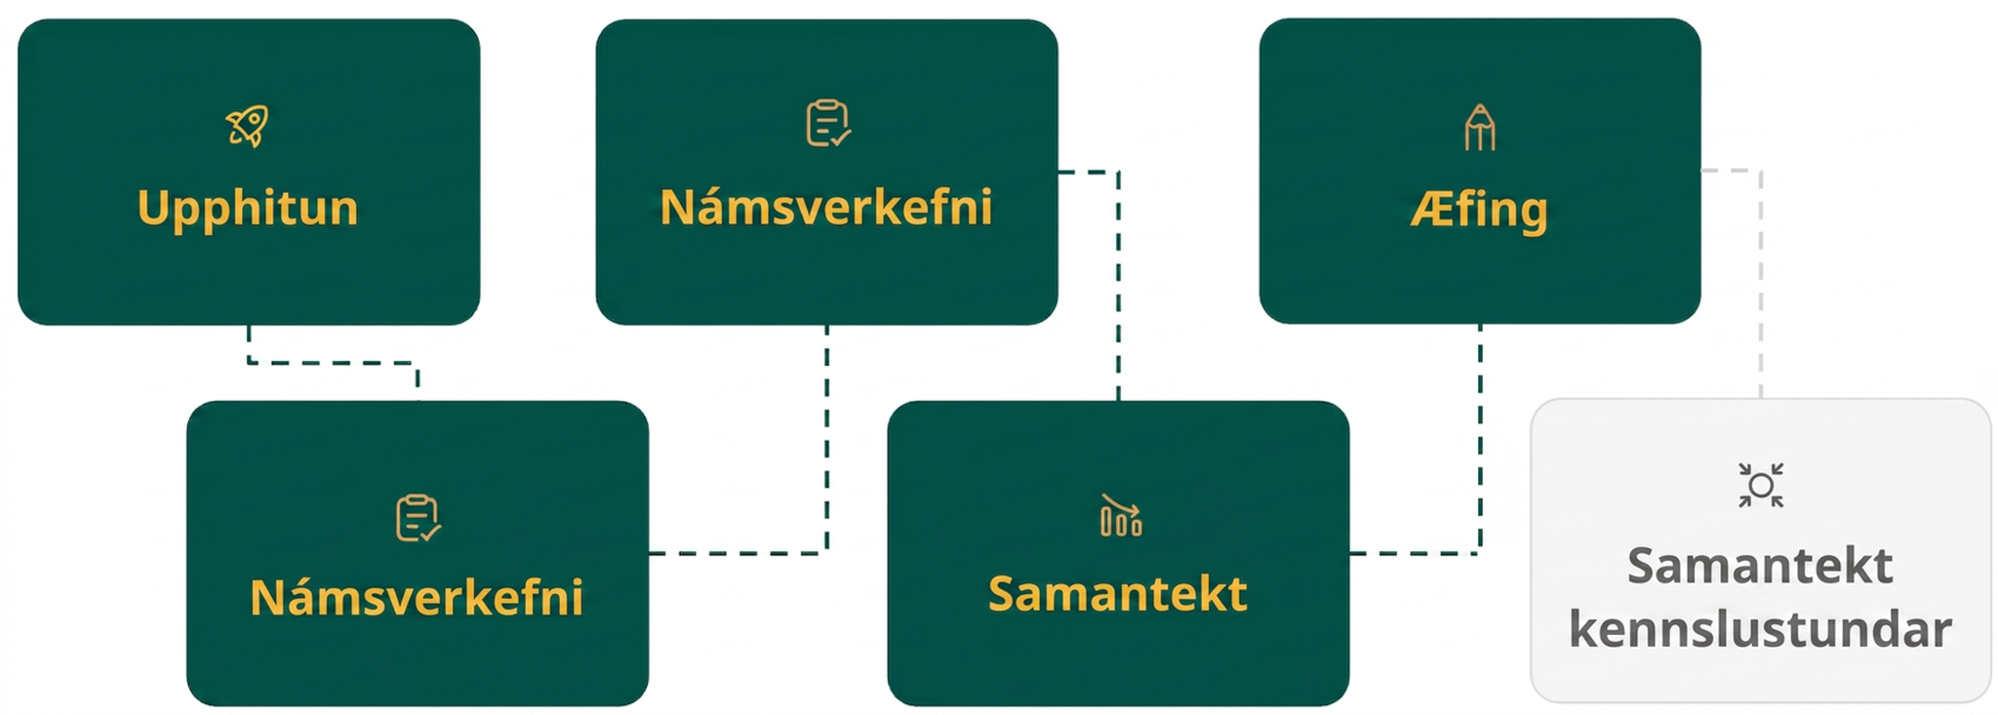
Lesson Journey
Fifth Stop: Practice

Slide 24

Practice
Put your hard work to action, practice what you’ve learned!
Notes:
Digital Practice: Access the practice pages at https://openstax.org/details/books/algebra-1

Slide 25
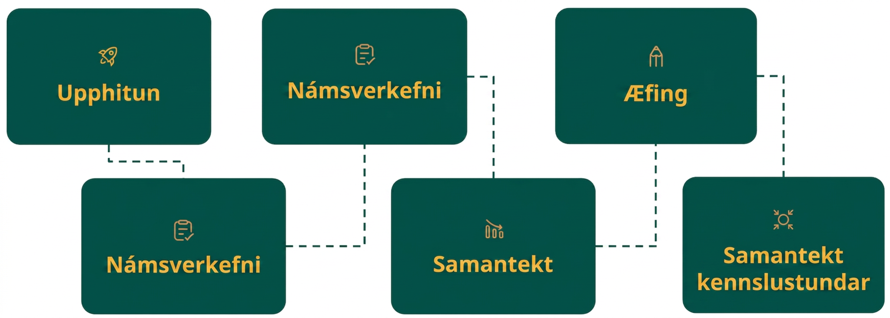
Lesson Journey
Sixth Stop: Lesson Synthesis

Slide 26
Lesson Synthesis
Which of these quadratic expressions are perfect squares and which are not?
How can you tell?
Suppose expressions 3 and 4 are both equal to 9, which is easier to solve? Why?
x² + 6x + 16 = 9
x² – 40x + 400 = 9
x² + 4x + 8
x² + 24x + 144
x² + 6x + 16
x² – 40x + 400
Notes:
Discuss questions such as:
Which of these quadratic expressions are perfect squares? Which are not? (The second and fourth expressions are perfect squares. The other two are not.)
How can you tell? (When in standard form, an expression with perfect squares has a constant term that is a number squared and a linear term that is twice that number. In x² + 24x + 144, we can see 144 is 12 squared, and 24 is twice 12. In x² − 40x + 400, the term 400 is – 20 squared, and – 40 is twice – 20.)
Why isn't the third expression a perfect square? Isn't 16 a perfect square? (16 is 4 squared or – 4 squared, but for the expression to be a perfect square, the coefficient of the linear term should be 8 (twice 4) or – 8 (twice 4).)
Suppose we have two equations: x² − 10x + 16 = 9 and x² − 40x + 400 = 9. Which is easier to solve? Why? (The second one, because the equation has a perfect square on each side. It can be rewritten as (x − 20)² = 9. There are two numbers that can be squared to make 9, which are 3 and – 3, so x − 20 = 3 or x − 20 = − 3.)
Can we simply rewrite the left side of x² − 10x + 16 = 9 in factored form and solve? (Rewriting the left side gives (x − 8)(x − 2) = 9, but now we are stuck. We can't use the zero product property because the expression does not equal 0.)

Slide 27
Self Assessment
How much do you agree with the following statements?
Learning Goals | I can | Almost | Not yet
Recognize perfect-square expressions written in different forms. | ⃞ | ⃞ | ⃞
Recognize quadratic equations that have a perfect-square expression and solve the equations. | ⃞ | ⃞ | ⃞

