Slide 1
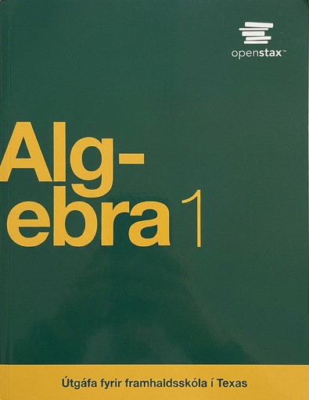

Algebra 1
Unit 1 Linear Equations
Lesson 1.1 Exploring Expressions and Equations

Slide 2
How to use these slides
On the activity slides check the speaker notes for teacher support and instructional information.
Each lesson includes 1 warm up, 2-3 learning activities, a cool down, practice and a lesson synthesis.
  Learning activities are followed by a self check question, and review section.
Some slides have been hidden from student view, more information can be found on the next slide (Reference Key).
You can edit and use these slides for personal and classroom use, but cannot sell them and must keep the attribution logos.
For more information, Check out the digital quick start guide!

Slide 3






Reference Key
Check the top right corner for an icon referencing these unique sections.
 | Support for Students with Disability | Hidden | Learning Strategies slide, provides additional support to students for understanding the activity. Learning Strategies slide, provides additional support to students for understanding the activity.
 | Support for English Language Learners | Hidden
 | Extending Your Thinking | Hidden | Extending Your Thinking slide, provides an extra challenge for students.
 | Self Check | Not Hidden | Self Check slide, checkpoint to assess student understanding after the learning activity.
 | Review | Hidden | Self Check- Review slide, designed to help review topics from the self check question.
On the next slides, check the speaker notes for teacher instructions and support.
Notes:
Check the Speaker Notes: On the next slides you can find discussion questions, lesson information, answers to the activities, and ways to adjust the activity for your students!

Slide 4

Learning Goals
By the end of this lesson you will be able to -
Tell which quantities in a situation can vary and which ones cannot.
Explain the meaning of the term “constraint.”
Use letters and numbers to write expressions representing the quantities in a situation.
Notes:
Lesson Narrative
In this lesson, students will use variables, expressions, and equations to model real-world relationships and learn to represent limits or constraints using expressions and equations. Students will determine whether quantities are fixed or variable, make assumptions and estimates, and use numbers and letters to represent the quantities and relationships.
Required Preparation
None
Required Materials
None
Texas Essential Knowledge and Skills
A1(A) apply mathematics to problems arising in everyday life, society, and the workplace
A2(C) write linear equations in two variables given a table of values, a graph, and a verbal description

Slide 5
Vocabulary
Previous
Equation
  A mathematical statement showing that two numbers, expressions, or objects are equal.
Expression
  The sum of products of numbers and variables.
Variable
  A quantity that can take on different values. Often represented by a letter.
New
Model
  A mathematical or statistical representation of a problem used to solve problems and make decisions.
Constraint
  A limitation on the possible values of variables in a model
Notes:
Lesson Vocabulary
To support student understanding of key vocabulary:
Introduce and review the vocabulary words students will see in this lesson.
Encourage students to notice how these words are used and to include them in their math discussions and explanations—both written and oral.
Use a word wall to reinforce vocabulary. Sample word wall cards are available here.
For newcomers or students with beginning English proficiency, use these Quizlet sets to support vocabulary learning:
Unit 1 Spanish Vocabulary – use first to build understanding
Unit 1 Vocabulary (English) – use after anchoring in Spanish
Support for English Language Learners
ELPS 1(E) internalize new basic and academic language by using and reusing it in meaningful ways in speaking and writing activities that build concept and language attainment
ELPS 2(F) listen to and derive meaning from a variety of media such as audiotape, video, DVD, and CD-ROM to build and reinforce concept and language attainment
ELPS 2(I) demonstrate listening comprehension of increasingly complex spoken English by following directions, retelling or summarizing spoken messages, responding to questions and requests, collaborating with peers, and taking notes commensurate with content and grade-level needs
ELPS 5(B) write using newly acquired basic vocabulary and content-based grade-level vocabulary

Slide 6






Lesson Journey
Warm Up
Learning Activity
Practice
Learning Activity
Cool Down
Lesson Synthesis

Slide 7

Warm Up - Partner Talk 🤝
Here are some letters and what they represent. All costs are in dollars.
m represents the cost of a main dish.
n represents the number of side dishes.
s represents the cost of a side dish.
t represents the total cost of a meal.
For questions 1 - 4, discuss what each equation means with a partner. Then, describe the situation in words.
m = 7.50
m = s + 4.50
ns = 6
m + ns = t
Notes:
Warm Up (5 minutes)
This warm up elicits the idea that an equation can contain only letters, with each letter representing a value. It also reminds students that an equation is a statement that two expressions are equal and that different expressions could be used to represent a quantity. Later in this lesson and throughout the unit, students will create, interpret, and reason about equations with letters representing quantities.
Launch
Arrange students in groups of 2. For the last question, ask each partner to come up with a new equation.
Continue to scroll down through the notes for activity answers, synthesis questions, and warm-up extension.
Activity Answers
m = 7.50
Answer: A main dish costs $7.50.
m = s + 4.50
Answer: Your answer may vary, but here are some examples.
The cost of a main dish is the cost of the side dish plus $4.50.
The cost of a main dish is $4.50 more than the cost of a side dish.
ns = 6
Answer: The number of side dishes times the cost of the side dish is $6.
m + ns = t
Answer: The main dish added to the quantity of the number of side dishes times the cost of the side dish represents the total cost of the meal.
Activity Synthesis
Invite students to share their interpretations of the given equations. Then, discuss with students:
“What is an equation? What does it tell us?” (An equation is a statement that an expression has the same value as another expression.)
“Can equations contain only numbers?” (Yes.) “Only letters?” (Yes.) “A mix of numbers and letters?” (Yes.)
“The last question asked you to write an equation that could be true. Could this equation be true: m + 5 = t? How do you know?” (It could be. If m is 7.50 and t is 12.50, then the equation is true.)
“When might the equation be false?” (If m is 7.50 and t is anything but 12.50, or if the value of t is not 5 more than m, then it is false.)
“One equation tells us that a main dish is $7.50. Another equation tells us that it is equal to the expression s + 4.50. Could both be true? Are they both appropriate for expressing the cost of a main dish?” (Yes. The first one tells us the price in dollars. The second tells us how the price compares to a side dish.)
Warm Up Extension
Write a new equation that could be true in this same situation.
Answer: Answers may vary, but here are some examples.
m = 2
m − s = 4.5
m + 6 = 13.5
Describe what your new equation means in words.
Answer: Answers may vary, but here are some examples.
The main dish costs $2.
The difference in cost between the main dish and a side dish is $4.50.
$13.50 is the cost of the main dish and a $6 tip.

Slide 8

Lesson Journey
Warm Up
Learning Activity
Practice
Warm Up
Learning Activity
Practice
Learning Activity
Cool Down
Lesson Synthesis
Learning Activity
Cool Down
Lesson Synthesis

Slide 9
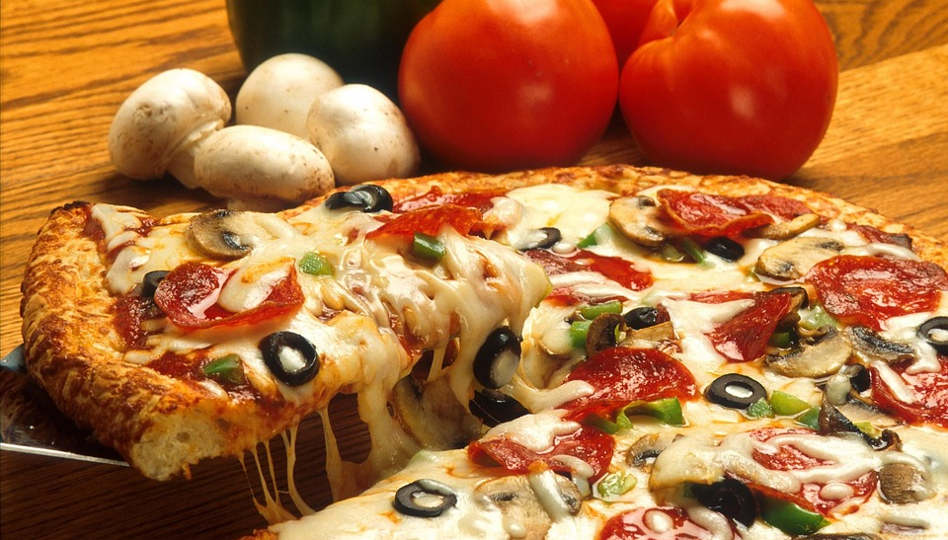
Learning Activity - Pizza Party 🍕
Imagine your class is having a pizza party.
Work with your group to plan what to order and to estimate what the party would cost.
What is your favorite type of pizza to order?
How many toppings are on your favorite type of pizza?
What type of crust does your favorite pizza have?
Notes:
Support for All Learners
This activity offers additional support and an extension for students:
For english language learners and students with disabilities, be sure to review the Learning Strategies slide!
For students looking for an extra challenge, be sure to review the Extending Your Thinking slide!
Activity (20 minutes)
This activity prompts students to create expressions to represent the quantities and relationships in a situation and engages them in mathematical modeling.
Students plan a pizza party and present a cost estimate. Some students may choose to perform research and revise their models as they gather new information. There are many possible solutions to the task.
As students discuss their ideas, monitor for those who:
Find and use actual data or exact values (for example, count the number of students in the class, research the cost of a large pizza at a nearby shop, or quickly survey the class for topping preferences).
Estimate quantities based on prior knowledge (for example, the cost of a large pizza in a recent purchase or the number of slices they and their friends generally consume at lunch time).
Make assumptions about behaviors, preferences, or quantities (for instance, assume that a certain percentage of the class prefers a certain topping).
Launch
Ask students if they have ever been in charge of planning a party. Solicit a few ideas of what party planners need to consider.
Ask students to imagine being in charge of a class pizza party. Explain that their job is to present a plan and a cost estimate for the party.
Arrange students in groups of 4. Provide access to calculators and, if feasible and desired, access to the internet for researching pizza prices. Students can also make estimates based on prior experience, refer to printed ads, or use their personal device to look up pricing information.
Limit the time spent on the first question to seven or eight minutes and pause the class before students move on to subsequent questions. Give groups of students one or two minutes to share their proposals with another group. Then, select a few groups who used contrasting strategies (such as those outlined in the 1.1.0 Lesson Narrative) to briefly share their plans with the class. Record or display their plans for all to see.
Next, ask students to complete the remaining questions. If needed, give an example of an expression that can be written to represent a cost calculation.
Activity answers and synthesis on the next slide.

Slide 10
Learning Activity - Pizza Party 🍕
What is the cost estimate for your group's planned class party?
Write down one expression that show how your group’s cost estimate was calculated.
In your expression, which quantities, if any, might change on the day of the party?
Rewrite your expression, replacing the quantities that might change with letters.
What do the letters represent?
Are you ready for more?
Notes:
Activity Answers
Your answer may vary, but here are some samples: A supreme pizza that has pepperoni, sausage, bell peppers, mushrooms, and olives. A deep-dish cheese pizza. A thin crust pizza with hamburger meat.
Your answer may vary.
Your answer may vary, but here are some samples: Pan crust, Deep-dish, Stuffed crust
Your answer may vary.
10 x (3(1.50) + 21.99) + 2.50
Your answer may vary, but here are some samples: The delivery cost might change. The number of toppings we select may change. The total number of pizzas ordered may change if someone is absent.
(1.50t + 21.99)p + d
Your answer may vary, but here are some samples:
t = number of toppings
p = number of pizzas ordered
d = delivery charge
Activity Synthesis
Invite groups who did not previously share their plans to share the expressions they wrote and explain what the expressions represent. After each group shares, ask if others calculated the costs the same way but wrote different expressions.
As students present their expressions, record the quantities that they mention and display them for all to see. Some examples:
The number of students in the class
The number of pizza slices per person
The cost of delivery
The price per topping
Briefly discuss the quantities that students anticipate would change (and therefore would be replaced with letters).
Explain to students that the expressions they have written are examples of mathematical models. They are mathematical representations of a situation in life that can be used to make sense of problems and solve them. We will look more closely at how expressions could represent the quantities in a situation like party planning, which involves certain conditions or requirements.

Slide 11

Learning Strategies - Pizza Party
Teacher Instruction: Use these strategies to adjust the activity to support english language learners and students with disabilities.
You can copy and paste the callouts directly on top of the activity or give the instructions aloud.
Highlight different ways students represent quantities in expressions.
Compare strategies and expressions that model the same quantity.
Emphasize how students revise models by estimating and making assumptions.
Maximize meta-awareness; Support sense-making
Notes:
Support for English Language Learners: MLR 7 Compare and Connect: Representing, Conversing
As students share their plans with the class, call students’ attention to the different ways the quantities are represented in expressions and to the different expressions that represent the same quantity. Take a close look at the contrasting strategies used within the context of the situation. Wherever possible, amplify student words and actions that students use to revise their models by estimating quantities and making assumptions about the situation.
Design Principle(s): Maximize meta-awareness; Support sense-making
Learn more about this routine
View the instructional video and follow along with the materials to assist you with learning this routine.
Provide support for students
Distribute graphic organizers to the students to assist them with participating in this routine.
Support for Students with Disabilities: Representation: Access for Perception
Display and read the directions aloud. Students who both listen to and read the information will benefit from additional processing time. Check for understanding by inviting students to rephrase directions in their own words.
Supports accessibility for: Language; Memory

Slide 12
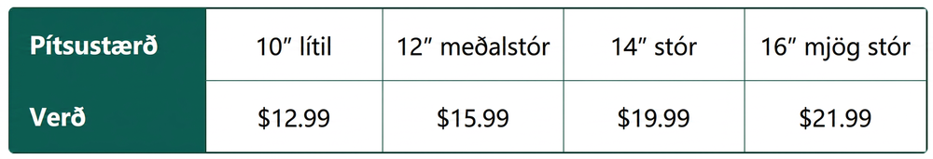
Extending Your Thinking 💪
A local pizzeria sells gourmet pizzas for the prices posted below. Remember the sizes are determined by the diameter of each pizza. Compare the cost per square inch of the sizes.
How did you determine the cost per square inch of each pizza?
Which size pizza is the better deal? Which size pizza is the most expensive per square inch?
What is the difference in price per square inch between the most and least expensive sizes?
Notes:
Answer
First, determine the total area of the pizza using the area formula for a circle, πr². Then, divide the cost of the pizza by the area measurement. The expression could be c/πr², if c = cost.
Xlarge, Small
$0.06

Slide 13
Self Check
A ninth-grade class is ordering pizza for lunch. There are n students in the class. Each slice of pizza costs $3, and the delivery fee is $8. Which expression represents the total cost if each student gets 2 slices of pizza?
3n
(2)3n
(2)3n + 8
3n + 8
Let’s review!
Notes:
Answer Feedback - Individualized by Response
3n
Incorrect. Each student gets 2 slices of pizza. Multiply the cost of one slice (3n) by 2. Also, add the delivery fee of $8. The answer is (2)3n+8.
(2)3n
Incorrect. The cost must include a delivery fee of $8. The answer is (2)3n+8.
(2)3n + 8
That’s correct! The expression that represents the cost of 2 slices of pizza for n students is (2)3n. Adding the delivery fee of $8 results in the expression (2)3n+8.
3n + 8
Incorrect. Each student gets 2 slices of pizza. Multiply the cost of one slice by 2. The answer is(2)3n+8.

Slide 14
Self Check - Review 💫
A ninth-grade class is ordering pizza for lunch. There are n students in the class. Each slice of pizza costs $3, and the delivery fee is $8. Which expression represents the total cost if each student gets 2 slices of pizza?
Each slice of pizza, n, costs $3.
  3n
Each student gets 2 slices of pizza. Multiply the cost of one slice by 2.
  (2)3n
The cost must include a delivery fee of $8.
  The total cost for the class is (2)3n + 8
Notes:
Remind Students
This activity challenges you to complete a very difficult task!
The more you know about the situation, the closer you are to being able to solve this problem mathematically instead of guessing and checking to see if you are correct.

Slide 15
Lesson Journey
Warm Up
Learning Activity
Practice
Learning Activity
Cool Down
Lesson Synthesis

Slide 16
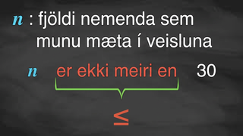
Video: Writing an Inequality for the Constraint

Slide 17

Learning Activity - Constraints ✋
A constraint is something that limits what is possible or reasonable in a situation.
For example, one constraint in a pizza party might be the number of slices of pizza each person could have, s. We can write s < 4 to say that each person gets fewer than 4 slices.
Notes:
Support for All Learners
This activity offers additional support and an extension for students:
For english language learners and students with disabilities, be sure to review the Learning Strategies slide!
Activity (10 minutes)
Writing and solving equations often involves showing and meeting constraints. This activity introduces the term “constraints” and shows how expressions and equations can describe limits on quantities—either by the values they can take or how they relate to other quantities.
Launch
Tell students they'll now explore the limits, or constraints, of the pizza party. A constraint is something that limits what’s possible or reasonable—like how long a class lasts or how many students are in a room. Some are fixed, others can vary within a limit.
Keep students in groups of 4. Give them 2 minutes to work quietly, then a few minutes to share in their group. Follow with a class discussion.
Activity questions, answers, anticipated misconceptions, and synthesis on the next slide.

Slide 18

Learning Activity - Pizza Costs 💲
What equation did your group create to represent the cost of the pizza party?
What does the first letter represent? The second letter?
What values would be reasonable for this each letter (Could a value be greater than 50? Is it possible for the letter to be a non-whole number? A negative number?)
Notes:
Answers
Answers may vary, but here is an example. (1.50t + 21.99)p + d
Answers may vary, but here is an example. t = number of toppings; p = number of pizzas ordered
Answers may vary, but here is an example. The cost of a topping is usually less than $2.00 per topping; The number of pizzas ordered will probably be less than or equal to the number of students in the class
Activity Synthesis
Invite students to share the equations or inequalities that represent the constraints in their party plan. Emphasize the following points: Sometimes, a constraint is an exact value. For example: Ordering pizza online involves a fee of $2.50, or the price of a large cheese pizza is $9.
Other times, a constraint involves a boundary or a limit. For example: An order must be at least $25 to qualify for free delivery, or the party must cost no more than $90.

Slide 19
Learning Strategies - Pizza Party Constraints
Teacher Instruction: Use these strategies to adjust the activity to support english language learners and students with disabilities.
  You can copy and paste the callouts directly on top of the activity or give the instructions aloud.
What do the symbols on this chart mean? Can you explain them in your own words?
Can you think of other variables that could act as constraints in this situation?
Conceptual processing; Memory
Notes:
Support for Students with Disabilities: Representation: Develop Language and Symbols:
Display or provide charts with symbols and meanings. Invite students to name additional examples of variables that might be considered constraints to encourage critical thinking and application to the expressions created in this activity. Examples of additional constraints might include t < 2 to represent how long the party could last, or b < 3 to say that each student will get fewer than 3 beverages.
Supports accessibility for: Conceptual processing; Memory

Slide 20
Self Check
Marcus works s hours per week stocking shelves. He works m hours per week mowing lawns. Marcus works at least 8 hours per week stocking shelves. He works at most a total of 20 hours per week. Which of the following represent constraints for this situation?
s + m ≥ 20; s ≥ 8
s + m ≤ 20; s ≥ 8
s + m ≥ 20; s ≤ 8
s + m ≤ 20; s ≤ 8
Let’s review!
Notes:
Answer Feedback - Individualized by Response
s + m ≥ 20; s ≥ 8
Incorrect. At most 20 hours means 20 hours or less. Use the less than or equal to symbol. The correct answer is s + m ≥ 20; s ≥ 8
s + m ≤ 20; s ≥ 8
That’s Correct! At most 20 hours means 20 hours or less, which uses the less than or equal to symbol. At least 8 hours means 8 hours or more, which uses the greater than or equal to symbol.
s + m ≥ 20; s ≤ 8
Incorrect. At most 20 hours means 20 hours or less. Use the less than or equal to symbol. At least 8 hours means 8 hours or more. Use the greater than or equal to symbol. The answer is s + m ≥ 20; s ≥ 8
s + m ≤ 20; s ≤ 8
Incorrect. At least 8 hours means 8 hours or more Use the greater than or equal to symbol. The correct answer is s + m ≥ 20; s ≥ 8

Slide 21
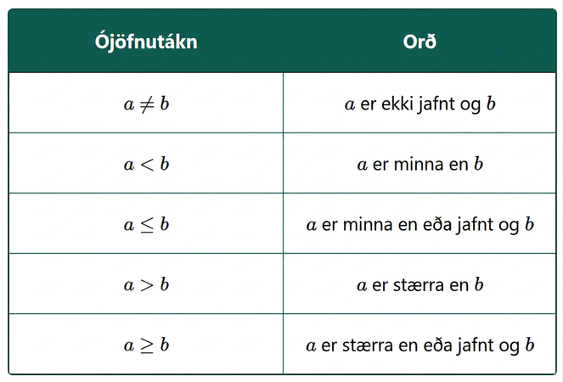
Self Check - Review ✔
Translate the following expressions from algebra to English:
14 ≤ 27
12 > 4 ÷ 2
x − 7 < 1
Notes:
Remind Students
One way to represent a constraint is to use an inequality symbol. For example, you may decide that at most 3 toppings should be on each pizza. This could be represented by t < 3, if t represents the number of toppings.
On the number line, the numbers get larger as they go from left to right. The number line can be used to explain the symbols “<” and “>.”
a < b is read “a is less than b.” a is to the left of b on the number line.
a > b is read “a is greater than b.” a is to the right of b on the number line.
Answers:
14 is less than or equal to 27
12 is greater than 4 divided by 2
x minus 7 is less than 1

Slide 22

Lesson Journey
Warm Up
Learning Activity
Practice
Warm Up
Learning Activity
Practice
Learning Activity
Cool Down
Lesson Synthesis
Learning Activity
Cool Down
Lesson Synthesis

Slide 23
Cool Down 🧊
At the end of the school year, all students in the ninth grade are invited to an ice cream party. Use the skills you learned from planning a pizza party to answer the following:
Identify and describe at least one letter that you will use to represent the cost of something you need to buy for the party.
Write an expression that could represent an estimated cost for the party using that letter. Note, you may use other letters, too, if needed.
Describe your expression in words.
Using the letter you identified in question 1, describe the values that would be reasonable for the quantity that the letter represents.
Notes:
Cool Down (5 minutes)
Answers
Answers may vary, but here are some samples: t = number of different toppings one student selects; s = number of different scoops of ice cream one student requests; n = total number of ninth grade students at party; p = cost of paper products like napkins, bowls, and spoons.
Answers may vary, but here are some samples: (0.75s + 1.5t)n = total cost; 4.00n + 15 = total cost; 1.50n + 0.08(1.50n) = total cost.
Answers may vary, but here are some samples: (a) Each scoop of ice cream costs $0.75 and the cost of each topping is $1.50 which sum to the cost of one bowl of ice cream. Now we multiply the cost of one bowl of ice cream by the number of students in the class. (b) A flat cost of $4 per bowl of ice cream for each student plus a charge of $15 for the bowls, spoons, and napkins. (c) There are n students in the ninth grade. A packaged ice cream cone is about $1.50, and tax is about 8%.
Answers may vary, but here are some samples: (a) You may choose to limit each student to selecting at most five toppings, t, per bowl of ice cream. Or, t ≤ 5. (b) The number of scoops of ice cream, s, provided to each student should not exceed three. Or, s ≤ 3. (c) A whole number between 90 and 100 is a reasonable value for the number of students in ninth grade, or 90 ≤ n ≥ 100.
Response to Student Thinking - More Chances
Students will have more opportunities to understand the mathematical ideas in this cool down, so there is no need to slow down or add work to the next lessons. Instead, use the results of this cool-down to provide guidance for what to look for and emphasize over the next several lessons to support students in advancing their current understanding.

Slide 24

Lesson Journey
Warm Up
Learning Activity
Practice
Learning Activity
Cool Down
Lesson Synthesis

Slide 25

Practice
Put your hard work to action, practice what you’ve learned!
Notes:
Digital Practice: Access the practice pages at https://openstax.org/details/books/algebra-1

Slide 26

Lesson Journey
Warm Up
Learning Activity
Practice
Learning Activity
Cool Down
Lesson Synthesis

Slide 27

Lesson Synthesis
In planning for a pizza party…
How did we gather information to estimate the pizza cost?
What assumptions did we make?
Would asking each student for exact toppings and slice counts be reasonable? How would that method affect the cost estimate?
How would different assumptions change the estimate? What if we assumed that everyone wanted only one slice of pepperoni pizza, would that have changed the cost estimate?
What constraints did we see in planning the party? What constraints might come up when planning a field trip or community service event?
Notes:
Prompt: One big idea from today’s lesson is that real-life situations often have limits, or constraints. We can use expressions, equations, and inequalities to represent those limits and help us make sense of the situation.
Answers:
Counting the number of students, researching actual prices.
Pizza preferences, number of slices per person, possible prices of pizza.
It would be inefficient to take exact orders, cost much more, and likely mean a lot of leftovers.
If the assumption was a slice of pepperoni pizza per person, it would probably cost less, but many students might not be able to enjoy the pizza or might not have enough.
Answers will vary.
Remind students: Expressions, equations, and inequalities are math models that represent real-life situations. Models use known information and some assumptions, so if those change, the model might change too.

Slide 28
Self Assessment
How much do you agree with the following statements?
I can… | I can | Almost | Not yet
Tell which quantities in a situation can vary and which ones cannot.
Explain the meaning of the term “constraint.”
Use letters and numbers to write expressions representing the quantities in a situation.

