Slide 1


Algebra 1
Unit 1 Linear Equations
Lesson 1.8 Choosing the Correct Variable to Solve For, Part 1

Slide 2
How to use these slides
On the activity slides check the speaker notes for teacher support and instructional information.
Each lesson includes 1 warm up, 2-3 learning activities, a cool down, practice and a lesson synthesis.
  Learning activities are followed by a self check question, and review section.
Some slides have been hidden from student view, more information can be found on the next slide (Reference Key).
You can edit and use these slides for personal and classroom use, but cannot sell them and must keep the attribution logos.
For more information, Check out the digital quick start guide!

Slide 3






Reference Key
Check the top right corner for an icon referencing these unique sections.
 | Support for Students with Disability | Hidden | Learning Strategies slide, provides additional support to students for understanding the activity. Learning Strategies slide, provides additional support to students for understanding the activity.
 | Support for English Language Learners | Hidden
 | Extending Your Thinking | Hidden | Extending Your Thinking slide, provides an extra challenge for students.
 | Self Check | Not Hidden | Self Check slide, checkpoint to assess student understanding after the learning activity.
 | Review | Hidden | Self Check- Review slide, designed to help review topics from the self check question.
On the next slides, check the speaker notes for teacher instructions and support.

Slide 4

Learning Goals
By the end of this lesson you will be able to -
Solve for a particular variable, given an equation.
Determine the more useful form of an equation.
Explain the phrase “to solve for a variable.”
Notes:
Lesson Narrative
By now, students are aware that a relationship between two or more quantities can be expressed in multiple ways by writing equivalent equations. In this lesson, they see that depending on the quantity in which we are interested, one form of equation might be more useful than others. Pinning down a quantity of interest may mean manipulating or rearranging a given equation. The rearrangement may involve solving for a variable—isolating it and defining it in terms of the other variables. Students notice that solving for a variable can be an efficient way to solve problems and to avoid cumbersome calculations.
Throughout the lesson, students reason repeatedly and look for regularity as they manipulate equations and solve for a variable (A1.1B and A1.1F).
Required Preparation
None
Required Materials
Four-function calculators
Texas Essential Knowledge and Skills
A1(G) display, explain, and justify mathematical ideas and arguments using precise mathematical language in written or oral communication
A2(C) write linear equations in two variables given a table of values, a graph, and a verbal description
A12(E) solve mathematic and scientific formulas, and other literal equations, for a specified variable

Slide 5
Vocabulary
Previous
Equation
  A mathematical statement showing that two numbers, expressions, or objects are equal.
Expression
  The sum of products of numbers and variables.
Equivalent equations
  Equations that have identical solutions. Example: 2(3𝑥 + 5) = 6𝑥 + 10
New
None
Notes:
Lesson Vocabulary
To support student understanding of key vocabulary:
Introduce and review the vocabulary words students will see in this lesson.
Encourage students to notice how these words are used and to include them in their math discussions and explanations—both written and oral.
Use a word wall to reinforce vocabulary. Sample word wall cards are available here.
For newcomers or students with beginning English proficiency, use these Quizlet sets to support vocabulary learning:
Unit 1 Spanish Vocabulary – use first to build understanding
Unit 1 Vocabulary (English) – use after anchoring in Spanish
Support for English Language Learners
ELPS 1(B) monitor oral and written language production and employ self-corrective techniques or other resources
ELPS 1(F) use accessible language and learn new and essential language in the process
ELPS 2(F) listen to and derive meaning from a variety of media such as audiotape, video, DVD, and CD-ROM to build and reinforce concept and language attainment
ELPS 3(E) share information in cooperative learning interactions
ELPS 4(F) use visual and contextual support and support from peers and teachers to read grade-appropriate content area text, enhance and confirm understanding, and develop vocabulary, grasp of language structures, and background knowledge needed to comprehend increasingly challenging language

Slide 6





Lesson Journey
Warm Up
Learning Activity
Practice
Learning Activity
Cool Down
Lesson Synthesis

Slide 7

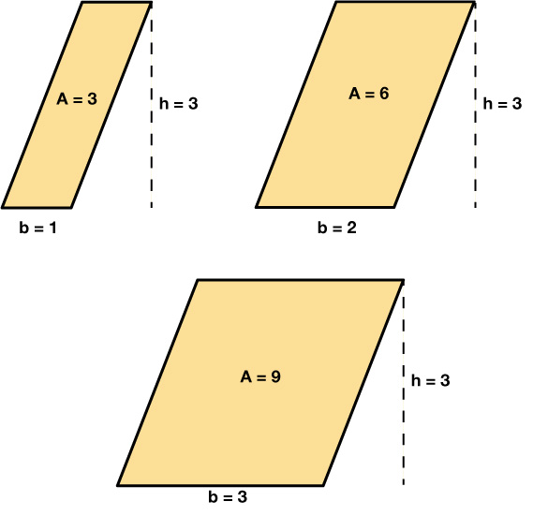
Warm Up - Parallelograms 📏
In the image below, all the parallelograms have the same height. Base length is measured in inches, and area is measured in square inches.
A table can be used to show the relationship between the base length, b , and the area, A, of the parallelograms. Complete the table by entering the missing information.
b (in.) | 1 | 2 | 3 | 4.5 | 11/2 | ___ | ___
A (sq in.) | 3 | 6 | 9 | ___ | ___ | 36 | 46.5
Notes:
Warm Up (5 minutes)
In this warm-up, students explore the relationship between two quantities by interpreting a description and analyzing a table of values. They use this relationship to find unknown values and consider equations that could represent the pattern (TEKS A.1(F)).
This activity reinforces that relationships can be expressed in different ways, and some forms are more useful than others depending on the question. For example, if the area and height of a parallelogram are known, using b = A ÷ 3 is more helpful than A = 3b when solving for the base.
Launch - Desmos Activity: OpenStax Alg1 – 1.8.1 Expressing Relationships Between Two Quantities
As students work through the interactive Desmos activity, use the Teacher Dashboard to monitor their responses. You can highlight correct or incorrect answers and use student work to guide whole-class discussions. If internet access is not available, use the image and table provided on the slide. Provide four-function calculators if students request them.
Note: Desmos activities differ from standard graphing tools—they guide students through tasks that build understanding step-by-step.
Activity Answers
13.5
33/2
12
15.5
Anticipated Misconceptions
Some students may think that the height must be known before they could find the missing area or base. Encourage them to look for a pattern in the table and to reason from there.
Activity Synthesis
Invite students to share their responses and explanations. Then, focus the whole-class discussion on the second question. Discuss with students:
“Are the two equations we chose equivalent? How do you know?” (Yes. There is an acceptable move that takes one to the other. If we divide each side of A = 3b by 3, we have A/3 = b, which can also be written as b = A/3. If we multiply each side of b = A/3 by 3, we have 3b = A or A = 3b.)
“If we know the base, which equation would make it easier to find the area? Why?” (A = 3b. The variable for area is already isolated. All we have to do is multiply the base by 3 to find the area.)
“If we know the area, which equation would make it easier to find the base? Why?” (b = A/3. The variable for the base is already isolated. We can just divide the area by 3 to find the base.)

Slide 8

Lesson Journey
Warm Up
Learning Activity
Practice
Learning Activity
Cool Down
Lesson Synthesis

Slide 9
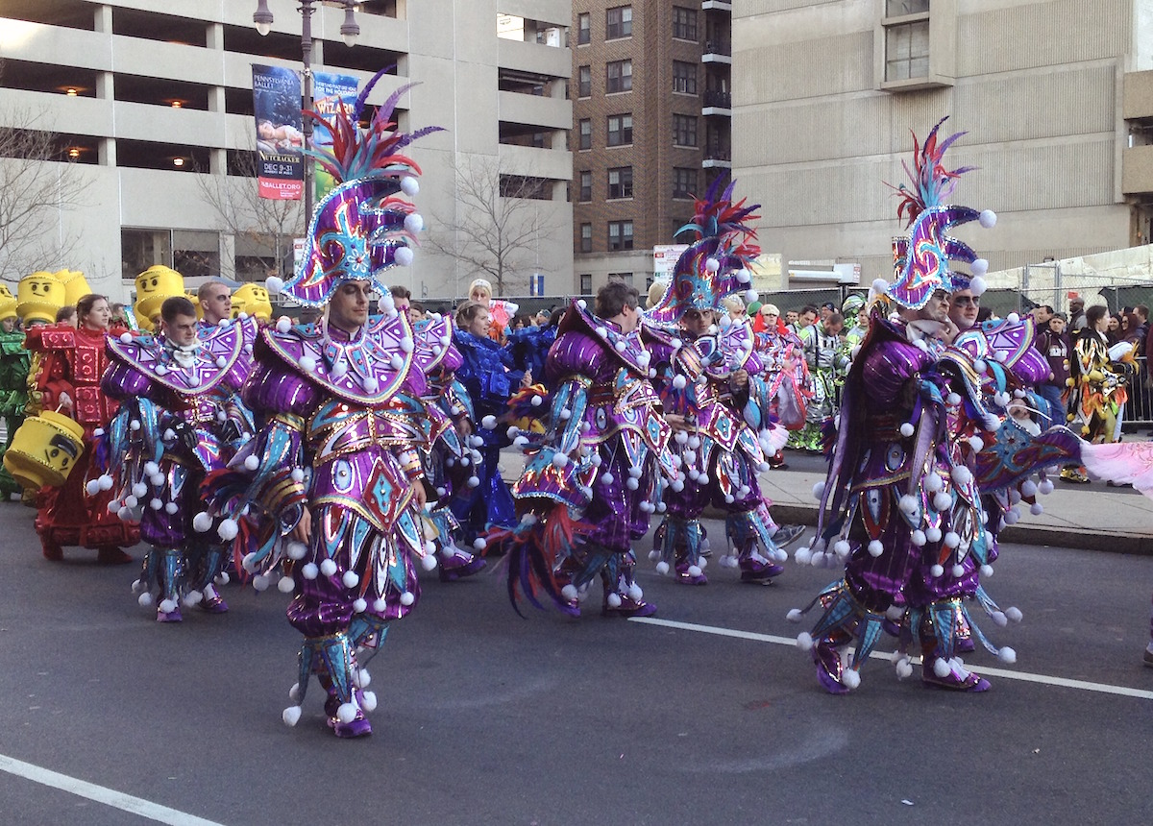
Learning Activity - Parade Volunteers 🎆
After a parade, volunteers are cleaning up a 2-mile stretch of road. They decide to split it evenly so each person is responsible for the same length.
Figure out how long each person’s section would be for the different numbers of volunteers. Be ready to explain how you got your answers.
8 volunteers
10 volunteers
25 volunteers
35 volunteers
Write an equation that would make it easy to find l, the length of a road section in miles for each volunteer, if there are n volunteers.
Notes:
Support for All Learners -
This activity offers additional support and an extension for students:
For English language learners and students with disabilities, be sure to review the Learning Strategies slide!
For students looking for an extra challenge, be sure to review the Extending Your Thinking slide!
Activity (15 minutes)
In a previous lesson, students worked with two quantities that multiplied to a constant, writing equations like xy = C, y = C/x, or x = C/y.
In this activity, students revisit that relationship but focus on which equation form is more useful for solving a particular quantity. Early on, they may use diagrams, proportional reasoning, or multiplication (e.g., “8 times what is 2?”). They might also write and solve equations like n · l = 2. As the activity continues, some strategies become less efficient, while others consistently work well. For example, when solving for the number of volunteers, students will likely notice that dividing 2 by the number of volunteers, or evaluating 2 ÷ n or 2/n, remains efficient.
Encourage a variety of strategies, but highlight students who use division effectively. Have them share during discussion.
Launch
Arrange students in groups of 2 and provide access to calculators. Give students a few minutes of quiet work time and then time to share their responses with their partner. Follow with a whole-class discussion.
Activity answers and synthesis on the next slide.

Slide 10
Learning Activity - Parade Volunteers 🎆
For numbers 6 - 9, find the number of volunteers in the group if each volunteer cleans up a section of the following lengths. Be prepared to show your reasoning.
0.4 mile
2/7 mile
0.125 mile
6/45 mile
Write an equation that would make it easy to find the number of volunteers, n, if each volunteer cleans up a section that is l miles.
Are you ready for more?
Notes:
Answers
¼ or 0.25 mile
⅕ or 0.2 mile
2/25 or 0.08 mile
2/36 or 1/18 mile
l = 2/n
n = 2/0.4 = 5 volunteers
n = 2/(2/7) = (2/1) x (7/2) = 7 volunteers
n = 2/0.125 = 16 volunteers
n = 2/(6/45) = (2/1) x (45/6) = 15 volunteers
n = 2/l
Activity Synthesis
Choose students to share how they solved one or both sets of questions. Start with the least direct strategies and end with those who solved for l = 2/n or n = 2/l. Emphasize that solving for the variable we care about before plugging in values can make the work simpler and more efficient.
Explain that this process is called “solving for a variable.” For example, solving for l tells us the length of road each person covers; solving for n tells us how many people are needed.

Slide 11

Learning Strategies - Parade Volunteers
Teacher Instruction: Use these strategies to adjust the activity to support english language learners and students with disabilities.
You can copy and paste the callouts directly on top of the activity or give the instructions aloud.
What do you notice about tables, situations, and graphs that show the same equation?
Can you point out where you see the variable (like l) in the diagram or in your reasoning?
Internalize Comprehension
Notes:
Support for Students with Disabilities: Representation: Internalize Comprehension
Use color coding and annotations to highlight connections between representations. As students share their reasoning, scribe their thinking on a visible display. Invite students to describe connections they notice between approaches that use diagrams, proportional reasoning, or multiplication and those that use an equation. For example, ask, “Where does l appear in this (diagram)?”
Supports accessibility for: Visual-spatial processing

Slide 12
Extending Your Thinking
Think about the graph of the equation y = 2/x or y = 2 ÷ x.
Create a list (x, y) pairs that will help you graph the equation. Make sure to include some negative numbers for x and some numbers that are not integers.
Use a graphing tool or technology to graph the equation using the listed pairs (x, y) from question 1.
What do you think the graph looks like when x is between 0 and 12? Continue to use the graphing tool or technology to graph the function y = 2x with your points. Try some values of x to test your idea.
What is the largest value y can ever be?
Notes:
Answer:
Your answer may vary, but here is an example: (−2.5, −0.8); (−1, −2); (0.5, 4); (1.25, 1.6)
The graph of y = 2/x shows an inverse relationship. As x increases, y decreases, and vice versa. That means as x gets bigger, y gets smaller (but stays positive if x is positive). As x approaches 0, the value of y becomes very large (positive or negative depending on the side of 0), but y is never defined at x = 0. This creates a vertical asymptote at x = 0. There is also a horizontal asymptote at y = 0, because as x becomes very large (positive or negative), y gets closer and closer to 0.
The graph gets steeper and steeper as x gets closer to 0.
There is no limit to the value of y.

Slide 13
Self Check
Use the formula for the area of a triangle, A = (½)bh, where b is the base of the triangle and h is the height of the triangle. Which equation would best be used to find the base of the triangle?
b = (2/A)h | 2A = bh
h = (2A)/b | (½)b = A/h
Let’s review!
Notes:
Answers and Feedback
b = (2/A)h
That’s correct! To find the base, solve for b. Multiply both sides by 2, and then divide both sides by h. Now, b = (2/A)/h.
h = (2A)/b
Incorrect. Since b stands for the base in the formula, solve the formula for b. The answer is b = (2/A)/h.
2A = bh
Incorrect. Since b stands for the base in the formula, solve the formula for b. The answer is b = (2/A)/h.
(½)b = A/h
Incorrect. Since b stands for the base in the formula, solve the formula for b. The answer is b = (2/A)/h.

Slide 14

Self Check - Review
We often use formulas in math and other fields, so it's important to recognize and rearrange them as needed. Geometric formulas can also be rearranged. For example, the formula for the volume of a cone is V = ¹⁄₃πr²h. Next, we’ll solve this formula for h (height).
Step 1: Remove the fraction on the right.
Multiply both sides by 3.
Step 2: Simplify.
Step 3: Divide both sides by πr2.
Your turn:
Solve 8x + 7y = 15 for x
Notes:
Answer
Step 1: Subtract 7y from each side.
8x + 7y − 7y = 15 − 7y
Step 2: Simplify.
8x = 15 − 7y
Step 3: Divide both sides by 8.
(8x)/8 = (15 − 7y)/8
The equation solved for x is x = (15 − 7y)/8

Slide 15
Lesson Journey
Warm Up
Learning Activity
Practice
Learning Activity
Cool Down
Lesson Synthesis

Slide 16


Learning Activity - Filling a Water Tank
Tank A initially contained 124 liters of water. It is then filled with more water, at a constant rate of 9 liters per minute.
How many liters of water are in Tank A after 4 minutes? 80 seconds? m minutes?
How many minutes, m, have passed when Tank A contains 151 liters of water?
How many minutes, m, have passed when Tank A contains 191.5 liters of water?
How many minutes, m, have passed when Tank A contains 270.25 liters of water?
How many minutes, m, have passed when Tank A contains p liters of water?
Notes:
Support for All Learners -
This activity offers additional support and an extension for students:
For English language learners and students with disabilities, be sure to review the Learning Strategies slide!
Activity (15 minutes)
In this activity, students solve problems involving non-proportional linear relationships. They reason about how one quantity changes with another, write expressions to represent the relationship, and connect this to writing and solving equations.
As students work, watch for how they approach the missing number of minutes in the second question (Tank A) and the last question (Tank B). Some may reason informally; others may write and solve equations. For example, to find how long it takes for Tank B to reach 18 liters, a student might (1) reason: 80 − 18 = 62 liters lost, and at 2.5 liters per minute, 62 ÷ 2.5 = 24.8 minutes or (2) write and solve an equation: 80 − 2.5t = 18 → subtract 80 from both sides and divide both sides by – 2.5:
80 – 80 − 2.5t = 18 – 80
− 2.5t ÷ − 2.5 = − 62 ÷ − 2.5
t = 24.8
Highlight this key idea: To find the time when Tank B reaches volume v, subtract v from 80 and divide by 2.5. This can be written as: t = (80 − v) ÷ 2.5
This also matches what you get when solving the equation: 80 − 2.5t = v → t = (80 − v) ÷ 2.5
Launch
Keep students in groups of 2 and provide continued access to calculators. If time is limited, consider asking one half of the class to answer the first two questions about Tank A and the other half to answer the last two questions about Tank B.
Activity answers and synthesis on the next slide.

Slide 17
Learning Activity - Filling a Water Tank
Tank B, which initially contained 80 liters of water, is being drained at a rate of 2.5 liters per minute.
How many liters of water are in Tank B after 30 seconds? 7 minutes? t minutes?
For how many minutes, t, has the water been draining when Tank B contains 75 liters of water?
For how many minutes, t, has the water been draining when Tank B contains 32.5 liters of water? when Tank B contains 18 liters of water? when Tank B contains v liters of water?
Are you ready for more?
Notes:
Answers
160; 136; 124 + 9m
3
7.5
16.25
(p – 124) ÷ 9
78.75; 62.5; 80−2.5t
2
19; 24.8; (80 – v) ÷ 2.5
Anticipated Misconceptions
Invite students to share their expressions for the last part of each question. Then, focus the discussion on how the different strategies students used to answer the other parts of each question could be summed up by the expression, as shown in the example in the Activity Narrative above.
Activity Synthesis
Ask students to share their expressions for the final part of each question. Then, guide a discussion about how their strategies in earlier parts connect to those expressions, refer to the example in the Activity Narrative as needed. Discuss questions such as:
“How do you know that the expression gives us the liters of water in Tank A after m minutes?” (When finding the liters of water in the tank after 4 minutes and 80 seconds, we multiplied the minutes by 9 and then added it to 124. So for m minutes, we’d multiply m by 9 and add 124.)
“How do you know that the expression gives us the minutes at which the tank reaches p liters?” (When finding the minutes at which the tank reaches 151 liters, 191.5 liters, and 270.25 liters, we subtracted 124 from each number and then divided the difference by 9. So we can do the same for p liters.)
If no one mentioned solving an equation to get the expression, demonstrate it for all to see: Start with 124 + 9m = p. To solve for m, first subtract 124 from both sides of the equation: 124 + 9m – 124 = p – 124. Then divide both sides of the equation by 9: 9m ÷ 9 = (p – 124) ÷ 9. m = (p – 124) ÷ 9

Slide 18
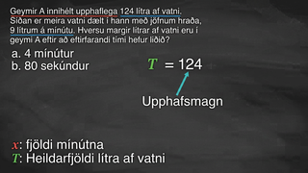
Video: Isolating the Variable

Slide 19
Learning Strategies - Filling a Water Tank
Teacher Instruction: Use these strategies to adjust the activity to support english language learners and students with disabilities.
You can copy and paste the callouts directly on top of the activity or give the instructions aloud.
How can you show your work so others can understand it?
What could you add to your display to help explain your thinking?
What do you notice when you look at someone else’s work?
Cultivate conversation; Maximize meta-awareness
Choose the set of questions that feels like the right challenge for you – would you rather work on Tank A or Tank B? Starting with just one part can help make the task more manageable.
Organization; Attention; Social-emotional skills
Notes:
Support for English Language Learners: MLR 7 Compare and Connect: Representing, Conversing
Prior to the whole-class discussion, invite students to create a visual display of their work about either Tank A or Tank B. Students should consider how to display their work so that other students will be able to interpret the connections between their calculations and the expressions they created. Students may wish to add notes or details to their displays to help communicate their thinking. Begin the whole-class discussion by selecting and arranging 2 – 4 displays for all to see. Give students 1 – 2 minutes of quiet time to think individually to interpret the displays before inviting the authors to share their expressions as described in the lesson synthesis.
Design Principle(s): Cultivate conversation; Maximize meta-awareness
Learn more about this routine
View the instructional video and follow along with the materials to assist you with learning this routine.
Provide support for students
Distribute graphic organizers to the students to assist them with participating in this routine.
Support for Students with Disabilities: Provide Access by Recruiting Interest
Leverage choice around perceived challenge. Invite students to choose between working on the questions about Tank A or the questions about Tank B. Chunking this task into more manageable parts may also support students who benefit from additional processing time.
Supports accessibility for: Organization; Attention; Social-emotional skills

Slide 20
Self Check
All learning activities will have this section under self check. Question prompt A pool is filled with 15,000 gallons of water. It loses 200 gallons per day. How many days, d, have passed when the pool has g gallons of water?
g − 200d | (15,000 – g) ÷ 200
15,000 − 200d | g ÷ 200d
Let’s review!
Notes:
Answers and Feedback
g − 200d
Incorrect. Be sure to include that the pool started with 15,000 gallons. The answer is (15,000 − g) ÷ 200.
15,000 − 200d
Incorrect. This represents the number of gallons in the pool. Write an expression to find the days. The answer is (15,000 − g) ÷ 200.
(15,000 – g) ÷ 200
That’s correct! To find how many days it takes to get to g gallons, solve g = 15,000 − 200d for d. The answer is (15,000 − g) ÷ 200.
g ÷ 200d
Incorrect. Be sure to include that the pool started with 15,000 gallons. The answer is (15,000 − g) ÷ 200.

Slide 21
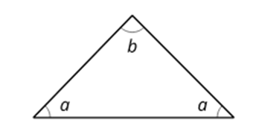
Self Check - Review
A relationship between quantities can be described in more than one way. Let’s look at the angles of an isosceles triangle, for example.
Example
Suppose we want to find a when b is 20°.
a + a + b = 180
2a + 20 = 180
2a = 180 − 20
2a = 160
2a ÷ 2 = 160 ÷ 2
a = 80°
What is the value of b if a is 72.5°?
Notes:
Answers
a + a + b = 180
72.5 + 72.5 + b = 180
145 + b = 180
b = 35°

Slide 22


Lesson Journey
Lesson Journey
Warm Up
Learning Activity
Practice
Warm Up
Learning Activity
Practice
Learning Activity
Cool Down
Lesson Synthesis
Learning Activity
Cool Down
Lesson Synthesis
‹#›

Slide 23
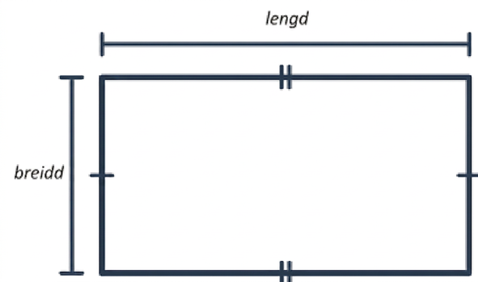
Cool Down
The perimeter of a rectangle is 48 centimeters. The relationship between the length, the width, and the perimeter of the rectangle can be described with the equation: 2 ⋅ length + 2 ⋅ width = 48.
Find the length, in centimeters, if the width is:
10 centimeters
3.6 centimeters
w centimeters
Notes:
Cool Down (5 minutes)
Give students continued access to calculators.
Answers
2L + 2(10) = 48
2L + 20 = 48
2L + 20 − 20 = 48 − 20
2L = 28
12(2L) = 12(28)
L = 14 cm
2L + 2(3.6) = 48
2L + 7.2 = 48
2L + 7.2 − 7.2 = 48 − 7.2
2L = 40.8
12(2L) = 12(40.8)
L = 20.4 cm
2L + 2(w) = 48
2L + 2w = 48
2L + 2w − 2w = 48 − 2w
2L = 48 − 2w
(½)(2L) = (½)(48−2w)
L = (48 − 2w)/2 or L = 24 − w

Slide 24

Lesson Journey
Lesson Journey
Warm Up
Learning Activity
Practice
Warm Up
Learning Activity
Practice
Learning Activity
Cool Down
Lesson Synthesis
Learning Activity
Cool Down
Lesson Synthesis
‹#›

Slide 25

Practice
Put your hard work to action, practice what you’ve learned!
Notes:
Access the practice pages at https://openstax.org/details/books/algebra-1

Slide 26

Lesson Journey
Lesson Journey
Warm Up
Learning Activity
Practice
Warm Up
Learning Activity
Practice
Learning Activity
Cool Down
Lesson Synthesis
Learning Activity
Cool Down
Lesson Synthesis
‹#›

Slide 27
Lesson Synthesis
Suppose a classmate who is absent today wanted to know:
What does it mean to “solve for a variable”?
Why should we solve for a variable?
How do we solve for a variable?
How would you respond to these questions and help your classmate catch up with what was missed? Use 1 or 2 of the equations below to help you explain to your classmate how to solve for a variable.
A = 3b | 124 + 9m = p
n ⋅ ℓ = 2 | 80 − 2.5t = v
Notes:
Prompt: Alright class, we’re going to do a quick partner activity. I want you to get into pairs and you’ll take turns doing a little role play. One of you will pretend to be a classmate who was absent today, and the other will be the explainer. Your job is to help your partner understand what we learned.
I’ll display the different equations on the board. As you talk through the lesson, choose one or two equations to help you explain how to solve for a variable. Be sure to explain your thinking clearly; just like a teacher would.
Once we’ve finished our Lesson Synthesis together, I’d like you to turn to the Lesson Summary in your textbook. This section goes over the big ideas from today and gives you a chance to reflect on how confident you’re feeling with the material. Take a minute to read through it and answer the reflection question thoughtfully.
(Remember, taking time to reflect like this really helps your brain process what you’ve learned—there’s a whole section about this in the Research in Practice if you’re curious!)
Answers
The following is an example of something a student might say, using the equation 124 + 9m = p.
“The 'm' and the 'p' are both variables. That just means they can change, they're not fixed numbers like 124 or 9. The m could represent something like the number of minutes someone works, and the 9 could be how much money they earn per minute. So, 9m means 9 times however many minutes they worked. Then you add 124, which might be like a base payment or something they already had. And p would be the total amount of money. So when we say 'm' is a variable, we mean it's a number we don't know yet, it can change depending on the situation. Same with p. Variables are just letters that stand in for unknown numbers."

Slide 28
Self Assessment
How much do you agree with the following statements?
I can… | I can | Almost | Not yet
Solve for a particular variable, given an equation.
Determine the more useful form of an equation.
Explain the phrase “to solve for a variable.”

