Slide 1
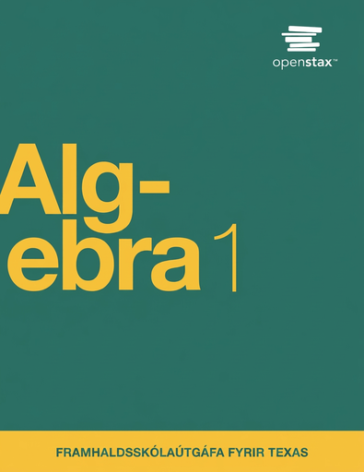

Algebra 1
Unit 7 Introduction to Quadratic Functions
Lesson 7.3 Determining if a Function is Quadratic
Notes:
How to Get Started
Review Slide 2: How to use these slides
Check out the digital quick start guide!
Review Slide 3: Reference Key of Icons

Slide 2
How to use these slides
On the activity slides check the speaker notes for teacher support and instructional information.
Each lesson includes 1 warm up, 2-3 learning activities, a cool down, practice and a lesson synthesis.
  Learning activities are followed by a self check question, and review section.
Some slides have been hidden from student view, more information can be found on the next slide (Reference Key).
You can edit and use these slides for personal and classroom use, but cannot sell them and must keep the attribution logos.
For more information, Check out the digital quick start guide!

Slide 3






Reference Key
Check the top right corner for an icon referencing these unique sections.
 | Support for Students with Disability | Hidden | Learning Strategies slide, provides additional support to students for understanding the activity. Learning Strategies slide, provides additional support to students for understanding the activity.
 | Support for English Language Learners | Hidden
 | Extending Your Thinking | Hidden | Extending Your Thinking slide, provides an extra challenge for students.
 | Self Check | Not Hidden | Self Check slide, checkpoint to assess student understanding after the learning activity.
 | Review | Hidden | Self Check- Review slide, designed to help review topics from the self check question.
On the next slides, check the speaker notes for teacher instructions and support.
Notes:
Check the Speaker Notes: On the next slides you can find discussion questions, lesson information, answers to the activities, and ways to adjust the activity for your students!

Slide 4

Learning Goals
By the end of this lesson you will be able to -
Recognize quadratic functions written in different ways.
Use information from a pattern of shapes to write a quadratic function.
Know that, in a pattern of shapes, the step number is the input and the number of squares is the output.
Notes:
Lesson Narrative
In this lesson, students extend their work with visual patterns to recognize and write quadratic functions. Students recognize that different expressions can be used to describe the same function. Previously, they learned that an expression like n² + 2n is a quadratic expression. Here they see that n(n + 2) defines the same function as n²+2n, so n(n + 2) is also a quadratic expression. The work here is a preview to a more formal exploration of equivalent expressions later.
Required Preparation
None
Required Materials
None
Texas Essential Knowledge and Skills
A1(D) communicate mathematical ideas, reasoning, and their implications using multiple representations, including symbols, diagrams, graphs, and language as appropriate
A1(E) create and use representations to organize, record, and communicate mathematical ideas
A1(F) analyze mathematical relationships to connect and communicate mathematical ideas
A1(G) display, explain, and justify mathematical ideas and arguments using precise mathematical language in written or oral communication
A6(B) write equations of quadratic functions given the vertex and another point on the graph, write the equation in vertex form f(x) = a(x−h)² + k, and rewrite the equation from vertex form to standard form 𝑓(𝑥) = 𝑎𝑥² + 𝑏𝑥 + 𝑐.

Slide 5
Vocabulary
Previous
Function
  A relation that takes inputs from one set and assigns them to outputs from another set, assigning exactly one output to each input.
Expression
  The sum of products of numbers and variables. The variables can be raised to different powers.
Variable
  A quantity that can take on different values. Often represented by a letter such as 𝑥, 𝑦, 𝑎, 𝑏, 𝑚, etc.
Term
  Part of an expression that can be a single number, a variable, or a number and a variable that are multiplied together.
New
Quadratic Functions
  A function where the output is given by a quadratic expression in the input. 𝑓(𝑥) = 𝑎𝑥² + 𝑏𝑥 + 𝑐.
Notes:
Lesson Vocabulary
To support student understanding of key vocabulary:
Introduce and review the vocabulary words students will see in this lesson.
Encourage students to notice how these words are used and to include them in their math discussions and explanations—both written and oral.
Use a word wall to reinforce vocabulary. Sample word wall cards are available here.
For newcomers or students with beginning English proficiency, use these Quizlet sets to support vocabulary learning:
Unit 7 Spanish Vocabulary – use first to build understanding
Unit 7 Vocabulary (English) – use after anchoring in Spanish
Support for English Language Learners
ELPS 2(F) listen to and derive meaning from a variety of media such as audiotape, video, DVD, and CD-ROM to build and reinforce concept and language attainment
ELPS 3(B) expand and internalize initial English vocabulary by learning and using high-frequency English words necessary for identifying and describing people, places, and objects, by retelling simple stories and basic information represented or supported by pictures, and by learning and using routine language needed for classroom communication
ELPS 3(D) speak using grade-level content area vocabulary in context to internalize new English words and build academic language proficiency
ELPS 3(E) share information in cooperative learning interactions
ELPS 3(F) ask and give information ranging from using a very limited bank of high-frequency, high-need, concrete vocabulary, including key words and expressions needed for basic communication in academic and social contexts, to using abstract and content-based vocabulary during extended speaking assignments
ELPS 4(D) use prereading supports such as graphic organizers, illustrations, and pretaught topic-related vocabulary and other prereading activities to enhance comprehension of written text
ELPS 5(B) write using newly acquired basic vocabulary and content-based grade-level vocabulary

Slide 6





Lesson Journey
Warm Up
Learning Activity
Practice
Learning Activity
Cool Down
Lesson Synthesis

Slide 7
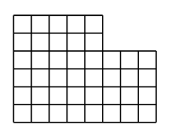
Warm Up - Represent the Squares ⏹️
How does each expression represent the number of small squares in the figure?
Expression A: 6 ⋅ 8 − 2 ⋅ 3
Expression B: 4 ⋅ 8 + 2 ⋅ 5
Expression C: 8 + 8 + 8 + 8 + 5 + 5
Expression D: 5 ⋅ 6 + 3 ⋅ 4
Notes:
Warm Up (5 minutes)
This warm up encourages students to quantify the number of squares in a geometric pattern by looking for and making use of structure. The thinking involved here prepares students to reason about other patterns that illustrate quadratic relationships.
Launch
Arrange students in groups of two.
Give students 2 – 3 minutes of quiet time to think individually.
Ask them to share their thinking with their partner.
Activity Answers
There are 6 rows with 8 small squares, but from this, 2 rows of 3 small squares have been removed.
There are 4 rows of 8 small squares, and to this, 2 rows of 5 small squares are added.
This counts each row, starting from the bottom.
There are 5 columns of 6 small squares and 3 columns of 4 small squares.
Activity Synthesis
Make sure students see how each expression tells us about a way the squares can be counted or how the area of the figure can be determined. If time permits, ask students if they could generate a different expression that also represents the number of squares in the figure.

Slide 8

Lesson Journey
Warm Up
Learning Activity
Practice
Learning Activity
Cool Down
Lesson Synthesis

Slide 9
Learning Strategies -Write Equations from Patterns 🟰
Teacher Instruction: Use these strategies to adjust the activity to support English language learners.
  You can copy and paste the callouts directly on top of the activity or give the instructions aloud.
Explain to your partner how each part of your equation shows the pattern.
Share your words or diagrams with the class.
Use the class display to help discuss and explain ideas.
Add new math words or phrases as you learn.
Collect and Display
Notes:
Support for English Language Learners: MLR 2 Collect and Display: Conversing
Prepare students for the discussion by inviting them to first explain to a partner how each part of their equation relates to the pattern. Record the words, phrases, and diagrams students use to explain the equations they wrote to represent the pattern. Display the collected language for all to see, and invite students to borrow from, or add more language to the display throughout the remainder of the lesson. This will help students read and use mathematical language during partner and whole-class discussions.
Design Principle(s): Optimize output (for explanation); Maximize meta-awareness
Provide support for students
Distribute graphic organizers to the students to assist them with participating in this routine.

Slide 10
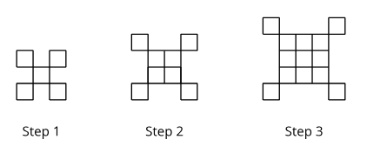
Learning Activity - Write Equations from Patterns 🟰
If the pattern continues, what will we see?
Sketch or describe the figure in each of these steps.
  Step 5
  Step 18
How many small squares are in each of these steps? Explain how you know.
  Step 5
  Step 18
Notes:
Support for All Learners
This activity offers additional support and an extension for students:
For English language learners, be sure to review the Learning Strategies slide!
For students looking for an extra challenge, be sure to review the Extending Your Thinking slide!
Activity (10 minutes)
In earlier activities, students described visual patterns using tables. Here, they write equations directly from patterns and, in reverse, create patterns from equations. This helps them connect visual structure to algebraic form and see the relationship as a function with inputs and outputs—laying groundwork for defining a quadratic function.
Students may view the pattern as:
An n-by-n square plus four corner squares, giving n² + 4, or
An (n + 2)-by-(n + 2) square minus four n-rectangles, giving (n+2)² – 4n.
If equivalent expressions arise, invite students to share their reasoning. This activity builds students’ ability to see and use structure and to reason both visually and algebraically.
Launch
Give students a moment to observe the pattern from the activity
Ask them what they notice and what they wonder.
Then, ask students to sketch the next step in the pattern and share their sketch with a partner.
Answers
a. Step 5 is a collection of 25 small squares, in a 5-by-5 arrangement, surrounded by 4 other small squares at the corners.
b. Step 18 is a collection of 18² small squares, in an 18 by 18 arrangement, surrounded by 4 other small squares at the corners.
a. Step 5: 29, because it is 52 + 4 or (5 ⋅ 5) + 4.
b. Step 18: 328, because it is 182 + 4 or (18 ⋅ 18) + 4.
More question, answers Anticipated Misconceptions, and Activity Synthesis on next slide

Slide 11
Learning Activity - Write Equations from Patterns 🟰
Step (n) | # of columns | # of rows | # of squares (y)
1
2
3
n
Write an equation to represent the relationship between the step number n and the number of squares y.
Be prepared to explain how each part of your equation relates to the pattern. (If you get stuck, try making a table like the one shown.)
Sketch the first three steps of a pattern that can be represented by the equation
y = n² − 1.
Table Example
Are you ready for more?
Notes:
Answers
y = n² + 4 or equivalent. The n² term represents the number of small squares in the central n-by-n
large square. The 4 represents the 4 small squares that are added to the large square at its 4 corners
An n-by-n array of squares with one square missing at the top right. The first step (for n = 1) will have no squares.
Link to the sketch of the three steps in the online textbook. https://k12.openstax.org/contents/raise/resources/8965a03887be419785389417c8ac9bb33490ead8
Anticipated Misconceptions
Some students may wonder how to draw a pattern given the equation y = n² − 1. Show them the warm up problems where they subtracted 1 to remove the small square in Figure B and added 1 when there was an extra small square in Figure C. Prompt them to describe subtracting 1 as removing one small square from each step. Some students may find it easier to start drawing Step 2 or Step 3. They can work backward to draw Step 1, which would have 0 squares since
12 − 1 = 0. Emphasize that making a table can help them figure out exactly how many small squares are needed in each step.
Activity Synthesis
Emphasize how the equation y = n² + 4 matches the pattern: each Step n shows an n × n square plus 4 corner squares.
Then connect this to the idea of functions:
The step number is the input, and the number of squares is the output, so the relationship is a function.
Using notation, we can write f(n) = n² + 4.
Introduce that a quadratic function is one defined by a quadratic expression and can be represented with an equation, table, graph, or description.

Slide 12
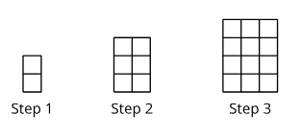
Self Check
Which equation represents the relationship between the step number n and the number of squares y?
y = n + 1
y = n² + 1
y = 2n + 1
y = n(n + 1)
Let’s review!
Notes:
Answer Feedback - Individualized by Response
Incorrect. This only works for the first step.
That’s correct! When n is the number of steps, there are n rows and n columns, or n times n, then one additional block.
Incorrect. This only works for the second step.
Incorrect. The base of the area is always n, but the height is not always n + 1.

Slide 13

Extending Your Thinking
For the original step pattern in the statement, y = n² + 4, write an equation to represent the relationship between the step number, n, and the perimeter, P.
For the step pattern you created in Part 3 of the activity, y = n² - 1, write an equation to represent the relationship between the step number, n, and the perimeter, P.
Are these linear functions?
Notes:
Answer
P = 4n + 16
If the pattern was an n-by-n array of squares with a square missing from the corner, the perimeter could be given by P=0 when n = 1, and by P = 4n when n>1.
Yes, in both cases, these are linear functions
Go back to activity information.

Slide 14
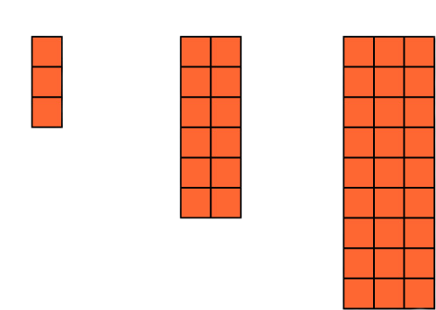
Self Check - Review
Steps 1 – 3 of a pattern of squares.
Step (n) | # of columns | # of rows | # of squares (y)
1 | a.___ | 3 | 3
2 | 2 | 6 | b.___
3 | 3 | c.___ | 27
n | d.___ | e.___ | f.___
Fill in the table (a - f) to try to find the pattern.
Use the table to help you write an equation that represents the relationship between the step number n and the number of squares y.
Notes:
Patterns Represented by Quadratics
Answers
a. 1
b. 12
c. 9
d. n
e. 3n
f. 3n²
First, count how many columns there are in each step (the length):
For each, there are n columns.
Next, count how many rows there are in each step (the height):
For each, there are 3n rows.
The area of this figure is then l × h or n × 3n, which becomes y = 3n².

Slide 15
Lesson Journey
Warm Up
Learning Activity
Practice
Learning Activity
Cool Down
Lesson Synthesis

Slide 16
Learning Strategies - Complex Quadratic Patterns 🧩
Teacher Instruction: Use these strategies to adjust the activity to support students with disabilities.
You can copy and paste the callouts directly on top of the activity or give the instructions aloud.
I think that the next pattern will . . .
I agree/disagree with _____ because . . .
_____ is correct because. . .
Action and Expression
Notes:
Support for Students with Disabilities: Action and Expression: Develop Expression and Communication
To help get students started, display sentence frames such as “I think that the next pattern will . . .”, “I agree/disagree with _____ because . . .”, or “_____ is correct because. . .”
Supports accessibility for: Language; Organization

Slide 17
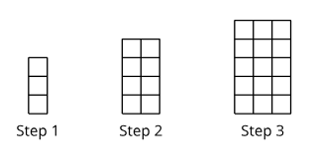
Learning Activity - Complex Quadratic Patterns 🧩
Sketch the next step in the pattern. Explain what you sketched.
Kiran says that the pattern is growing linearly because as the step number goes up by 1, the number of rows and the number of columns also increase by 1. Do you agree? Be prepared to show your reasoning.
Notes:
Support for All Learners
This activity offers additional support and an extension for students:
For students with disabilities, be sure to review the Learning Strategies slide!
Activity (15 minutes)
This activity helps students distinguish and explain what makes a function quadratic. Using a pattern of squares, they evaluate whether two equations represent the same pattern and recognize that expressions like n(n + 2) are also quadratic. Students construct and support logical arguments.
Look for students who explain that the pattern is not linear because the number of squares doesn’t increase by equal amounts.
In the second question, identify students who:
Use the distributive property to show n(n + 2) = n² + 2n.
Visualize equivalence by showing an n-by-n square plus two n-by-2 rectangles.
Invite these students to share their reasoning with the class.
Launch
Arrange students in groups of two.
Give students quiet work time and then time to share their work with a partner.
Answers
Step 4 is a 4-by-6 rectangle.
Kiran is correct that the number of rows and the number of columns each grow by 1, but the total number of squares does not increase by the same amount from step to step. So, the total number of squares does not grow linearly.
Diego’s expression n(n + 2) is correct because there are n columns and n + 2 rows of small squares in Step n. Jada’s expression is also correct because the n(n + 2) array of small squares can be divided into an n-by-n square (having n² small squares) and an n-by-2 rectangle (having 2n small squares).
Link to a sketch of Diego’s and Jada’s expressions in the online textbook. https://k12.openstax.org/contents/raise/resources/9776a847dcb46065c0397d122cda9d25d29ec0b3
Activity Synthesis
Briefly review students’ sketches for Step 4, then invite a few to explain their reasoning for the second question. Emphasize that when both the length and width increase, the total number of squares (area) does not grow by a constant amount—so the pattern is not linear.
If no one explains visually, demonstrate how n² + 2n and n(n + 2) represent the same area by labeling the parts of the rectangle. Highlight that using the Distributive Property also shows their equivalence: n(n + 2) = n² + 2n. Both expressions define the same quadratic function.

Slide 18
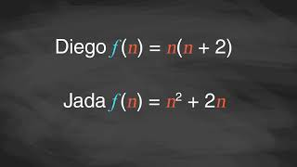
Video: Quadratic Sequences

Slide 19
Self Check
Which equation represents the relationship between the step number n and the number of squares y?
y = n + 1
y = n² + n
y = 2n
y = n² + 1
Let’s review!
Notes:
Answer Feedback - Individualized by Response
Incorrect. This is the number of rows only.
That’s correct! There are n + 1 rows and n columns. The number of blocks in each step would be n(n + 1), which equals n² + n.
Incorrect. This only works for Step 1.
Incorrect. The number of rows is n + 1, and the number of columns is n. Be sure to distribute the n to both terms when multiplying.

Slide 20
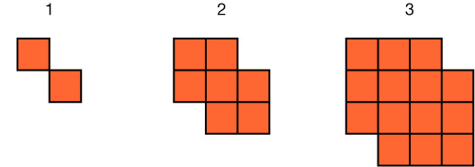
Self Check - Review
Steps 1 – 3 of a pattern of squares.
Step (n) | # of columns | # of rows | # of squares (y)
1 | 2 | a.___ | 2
2 | b.___ | 3 | 7
3 | 4 | 4 | c.___
n | d.___ | e.___ | f.___
Fill in the table (a - f) to try to find the pattern if the missing squares were actually there.
Use the table to help you write an equation that represents the relationship between the step number n and the number of squares y.
Notes:
More Complex Quadratic Patterns
Answers
a. 2
b. 3
c. 14
d. n + 1
e. n + 1
f. (n + 1)² - 2
There would be (n + 1)(n + 1) squares, but there are 2 missing from each step, so the equation would be:
y = (n + 1)² - 2
.

Slide 21

Lesson Journey
Warm Up
Learning Activity
Practice
Learning Activity
Cool Down
Lesson Synthesis

Slide 22
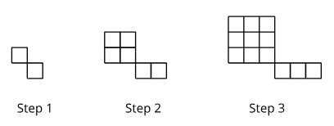
Cool Down
Write an equation to represent the relationship between the step number and the number of squares in the pattern. Briefly describe how each part of the equation relates to the pattern.
Is the relationship between the step number and number of squares a quadratic function? Explain how you know.
Notes:
Cool Down (5 minutes)
Answers
y = n^{.2}+ n or equivalent because there is an n-by-n array of small squares, which gives n², and then there is a row of n squares in the lower right.
The relationship is a quadratic function because the number of squares could be expressed as n^{.2}+ n, which is a quadratic expression.
Response to Student Thinking - Points to Emphasize
Emphasize the idea that in a pattern of shapes, the step number is the input. Use student examples or a think-aloud to show strategies for writing expressions for a visual pattern.

Slide 23

Lesson Journey
Warm Up
Learning Activity
Practice
Learning Activity
Cool Down
Lesson Synthesis

Slide 24

Practice
Put your hard work to action, practice what you’ve learned!
Notes:
Digital Practice: Access the practice pages at https://openstax.org/k12/algebra

Slide 25

Lesson Journey
Warm Up
Learning Activity
Practice
Learning Activity
Cool Down
Lesson Synthesis

Slide 26

Lesson Synthesis
Answer the questions to show your understanding of how to determine if a function is quadratic.
How do you know if the relationship between two quantities represents a quadratic function?
  What clues would you look for?
What does it mean when we say that two expressions define the same function?
Can we say that x(x + 5) and x² + 5x define the same function?
  How can you show if they do or don’t?
Notes:
Possible Answers
There is only one output for every input. In the relationship, one quantity is in some way squared or multiplied by itself to obtain the second quantity.
The relationship can be expressed with a squared term, among other ways. A pattern that changes linearly in two directions, such as a rectangle that grows linearly in length and width.
The two expressions describe the same relationship between two quantities, and there’s a way to show that this is the case.
Yes.
Using the Distributive Property shows that x(x + 5) = x² + 5x. A diagram can also show that the two are equivalent. A rectangle with side lengths x and x + 5 has the area x(x + 5). If we decompose the rectangle into two sub-rectangles that are x by x and x by 5 and calculate their areas and combine them, we get x² + 5x

Slide 27
Self Assessment
How much do you agree with the following statements?
I can… | I can | Almost | Not yet
Recognize quadratic functions written in different ways.
Use information from a pattern of shapes to write a quadratic function.
Understand that, in a pattern of shapes, the step number is the input and the number of squares is the output.

