Slide 1


Algebra 1
Unit 7 Introduction to Quadratic Functions
Lesson 7.1 Patterns of Change
Notes:
How to Get Started
Review Slide 2: How to use these slides
Check out the digital quick start guide!
Review Slide 3: Reference Key of Icons

Slide 2
How to use these slides
On the activity slides check the speaker notes for teacher support and instructional information.
Each lesson includes 1 warm up, 2-3 learning activities, a cool down, practice and a lesson synthesis.
  Learning activities are followed by a self check question, and review section.
Some slides have been hidden from student view, more information can be found on the next slide (Reference Key).
You can edit and use these slides for personal and classroom use, but cannot sell them and must keep the attribution logos.
For more information, Check out the digital quick start guide!

Slide 3






Reference Key
Check the top right corner for an icon referencing these unique sections.
 | Support for Students with Disability | Hidden | Learning Strategies slide, provides additional support to students for understanding the activity. Learning Strategies slide, provides additional support to students for understanding the activity.
 | Support for English Language Learners | Hidden
 | Extending Your Thinking | Hidden | Extending Your Thinking slide, provides an extra challenge for students.
 | Self Check | Not Hidden | Self Check slide, checkpoint to assess student understanding after the learning activity.
 | Review | Hidden | Self Check- Review slide, designed to help review topics from the self check question.
On the next slides, check the speaker notes for teacher instructions and support.
Notes:
Check the Speaker Notes: On the next slides you can find discussion questions, lesson information, answers to the activities, and ways to adjust the activity for your students!

Slide 4

Learning Goals
By the end of this lesson you will be able to -
Create drawings, tables, and graphs that represent the area of a garden.
Recognize a situation represented by a graph that increases and then decreases.
Notes:
Lesson Narrative
In this lesson, students explore a pattern where a quantity increases then decreases. They see it is neither linear nor exponential and begin to describe it qualitatively in a geometric context. Calculations or expressions may be used but are not required, as symbolic work with quadratics comes later. Technology isn’t needed, but making tools available allows strategic use.
Required Preparation
Graph paper is optional for the activity “The Relationship Between Length and Area.”
Required Materials
Graph paper
Calculators
Texas Essential Knowledge and Skills
A1(A) apply mathematics to problems arising in everyday life, society, and the workplace
A1(B) use a problem-solving model that incorporates analyzing given information, formulating a plan or strategy, determining a solution, justifying the solution, and evaluating the problem-solving process and the reasonableness of the solution
A1(C) select tools, including real objects, manipulatives, paper and pencil, and technology as appropriate, and techniques, including mental math, estimation, and number sense as appropriate, to solve problems
A1(E) create and use representations to organize, record, and communicate mathematical ideas
A7(A) graph quadratic functions on the coordinate plane and use the graph to identify key attributes, if possible, including x-intercept, y-intercept, zeros, maximum value, minimum values, vertex, and the equation of the axis of symmetry

Slide 5
Vocabulary
Previous
Input
  The value that is substituted into a function.
Output
  The value that results from substituting the input values into a function.
Area
  A measurement of the total space contained by a shape on a 2-dimensional surface. It is measured by the number of nonoverlapping square units
Perimeter
  The length of the continuous line forming the boundary around a closed geometric figure.
New
None
Notes:
Lesson Vocabulary
To support student understanding of key vocabulary:
Introduce and review the vocabulary words students will see in this lesson.
Encourage students to notice how these words are used and to include them in their math discussions and explanations—both written and oral.
Use a word wall to reinforce vocabulary. Sample word wall cards are available here.
For newcomers or students with beginning English proficiency, use these Quizlet sets to support vocabulary learning:
Unit 7 Spanish Vocabulary – use first to build understanding
Unit 7 Vocabulary (English) – use after anchoring in Spanish
Support for English Language Learners
ELPS 2(F) listen to and derive meaning from a variety of media such as audiotape, video, DVD, and CD-ROM to build and reinforce concept and language attainment
ELPS 2(I) demonstrate listening comprehension of increasingly complex spoken English by following directions, retelling or summarizing spoken messages, responding to questions and requests, collaborating with peers, and taking notes commensurate with content and grade-level needs
ELPS 3(B) expand and internalize initial English vocabulary by learning and using high-frequency English words necessary for identifying and describing people, places, and objects, by retelling simple stories and basic information represented or supported by pictures, and by learning and using routine language needed for classroom communication
ELPS 3(C) speak using a variety of grammatical structures, sentence lengths, sentence types, and connecting words with increasing accuracy and ease as more English is acquired
ELPS 3(G) express opinions, ideas, and feelings ranging from communicating single words and short phrases to participating in extended discussions on a variety of social and grade-appropriate academic topics
ELPS 3(H) narrate, describe, and explain with increasing specificity and detail as more English is acquired
ELPS 4(D) use prereading supports such as graphic organizers, illustrations, and pretaught topic-related vocabulary and other prereading activities to enhance comprehension of written text

Slide 6





Lesson Journey
Warm Up
Learning Activity
Practice
Learning Activity
Cool Down
Lesson Synthesis

Slide 7
Warm Up - Do You See A Pattern? 🤔
Look at the patterns in the three tables. What do you notice? What do you wonder?
x | y
1 | 0
2 | 5
3 | 10
4 | 15
5 | 20
x | y
1 | 3
2 | 6
3 | 12
4 | 24
5 | 48
x | y
1 | 8
2 | 11
3 | 10
4 | 5
5 | 4
Notes:
Warm Up (5 minutes)
This warm-up highlights quadratic change by contrasting it with linear and exponential patterns. Students aren’t expected to find the exact rule but are prompted to notice structure: outputs don’t change by equal amounts or factors, and values increase then decrease.
Activity Answers
Things you may notice:
The x-values are 1, 2, 3, 4, and 5 in all three tables.
In the first two tables, the y-values increase, while in the third table, they increase and then decrease.
The y-values in the first table are all multiples of 5, and they grow linearly. In the second table, the y-values grow by a factor of 2 each time x increases by 1. In the third table, there isn’t an obvious pattern in how the y-values change.
Things you may wonder:
Is there a rule for the relationship in the third table?
Will the y-values in the third table continue to decrease, or will they increase again at some point?
What would the third relationship look like if graphed?
Activity Synthesis
Have students share what they noticed and wondered, recording responses for all to see. Afterward, invite discussion, encouraging respectful disagreement or clarification. If no one raises questions about the third table’s rule or outputs, prompt them to do so, noting that this unit will explore such relationships.

Slide 8

Lesson Journey
Warm Up
Learning Activity
Practice
Learning Activity
Cool Down
Lesson Synthesis

Slide 9
Learning Strategies - A Rectangular Garden🌱
Teacher Instruction: Use these strategies to adjust the activity to support English language learners.
  You can copy and paste the callouts directly on top of the activity or give the instructions aloud.
Listen carefully to each observation.
Say what you heard using math language.
Ask the original speaker: Did I repeat your thinking correctly?
Notice words or phrases that make the idea clearer.
Speaking
Notes:
Support for English Language Learners: MLR 8 Discussion Supports: Speaking
Use this routine to support whole-class discussion. For each observation that is shared, ask students to restate what they heard using precise mathematical language. Ask the original speaker if their peer was accurately able to restate their thinking. Call students' attention to any words or phrases that helped to clarify the original statement. This provides more students with an opportunity to produce language as they interpret the reasoning of others.
Design Principle(s): Support sense-making

Slide 10
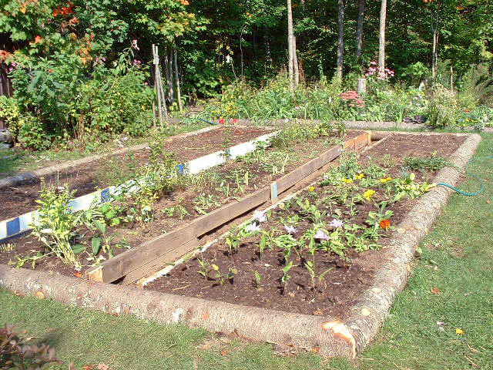
Learning Activity - A Rectangular Garden🌱
Noah has 50 meters of fencing to completely enclose a rectangular garden in the backyard.
Draw some possible diagrams of Noah’s garden. Label the length and width of each rectangle.
Find the length and width of a rectangle that would produce the largest possible area. Explain why you think that pair of length and width gives the largest possible area.
Notes:
Support for All Learners
This activity offers additional support for students:
For English language learners, be sure to review the Learning Strategies slide!
Activity (20 minutes)
In this activity, students explore a quadratic relationship in a geometric context: a rectangle with fixed perimeter. As one side grows, area increases then decreases. Students make informal observations (not equations), and are encouraged to test non-whole number lengths. Highlight varied strategies and use of tools like spreadsheets to support reasoning about dimensions and area.
Launch
Arrange students in groups of 2.
Encourage students to think quietly about the questions before conferring with their partner.
Provide access to graphing technology.
Answers
Your answers will vary. Did you consider organizing your lengths, widths, and areas into a table? For example:
Link to data table: Noah's Garden Data
When the length and width are each 12.5 meters, the area is the largest (156.25 square meters). A table shows that as the rectangular shape gets closer and closer to being a square, the area gets larger.
Anticipated Misconceptions
Some students may exclude a rectangle with side lengths 12.5 and 12.5 from their diagrams of Noah’s garden, possibly because they think a square is not a rectangle, or possibly because they only generate whole numbers. Emphasize that a square is a type of rectangle that happens to have four sides of equal length. Prompt them to think of the definition of a rectangle and explain why a square meets all the criteria for a rectangle.
Activity Synthesis
Display the work of a student who organized lengths, widths, and areas in a table. If no students did so, generate a table as a class. An example is shown here. (Pairs of length and area values will be needed in the next activity.)
Noah's Garden Data
Discuss with students:
“What do you notice about the relationship between the length and the width?” (They add up to 25. Each time the length increases by 1, the width decreases by 1. The relationship is linear.)
“What do you notice about the relationship between the length and the area?” (As the length increases from 1 to 24, the area increases and then decreases. The relationship is not linear.)
Ask students to describe the rectangle they found to have the largest area and how they went about finding it. It is likely that many students will say that it has side lengths of 12 and 13 since these are the whole-number values that produce the greatest area. If no students tried 12.5 and 12.5, ask them to compute this area.
Solicit some ideas from students on how the area is related to the length. Ask questions such as:
“How do we know if 12.5 and 12.5 would indeed produce the greatest area?”
“Do you think going from 5 to 8 meters in length would produce a rectangle with a greater area? What about going from 15 to 18? Why or why not?”
Tell students that we’ll try to get a better idea of what’s happening between the side lengths and the area of the rectangle by plotting some points in the next activity, “Plotting Measurements.”

Slide 11
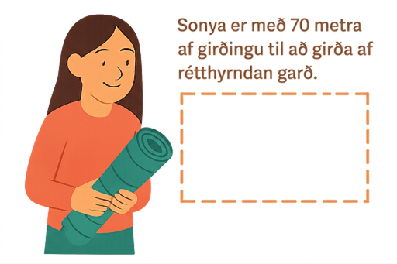
Self Check
What is the largest possible area that can be enclosed, in square meters?
17.5
35
306.25
1225
Let’s review!
Notes:
Answer Feedback - Individualized by Response
Incorrect. This is the measurement of the length and the width for the largest possible area.
Incorrect. This is the sum of the width and length of the rectangle with the largest possible area.
That’s correct! A square has the largest possible area with a length of 17.5 and a width of 17.5. Area of a rectangle is length times width.
Incorrect. This is the result of a length of 35 and width of 35. This would require 140 meters of fencing.

Slide 12
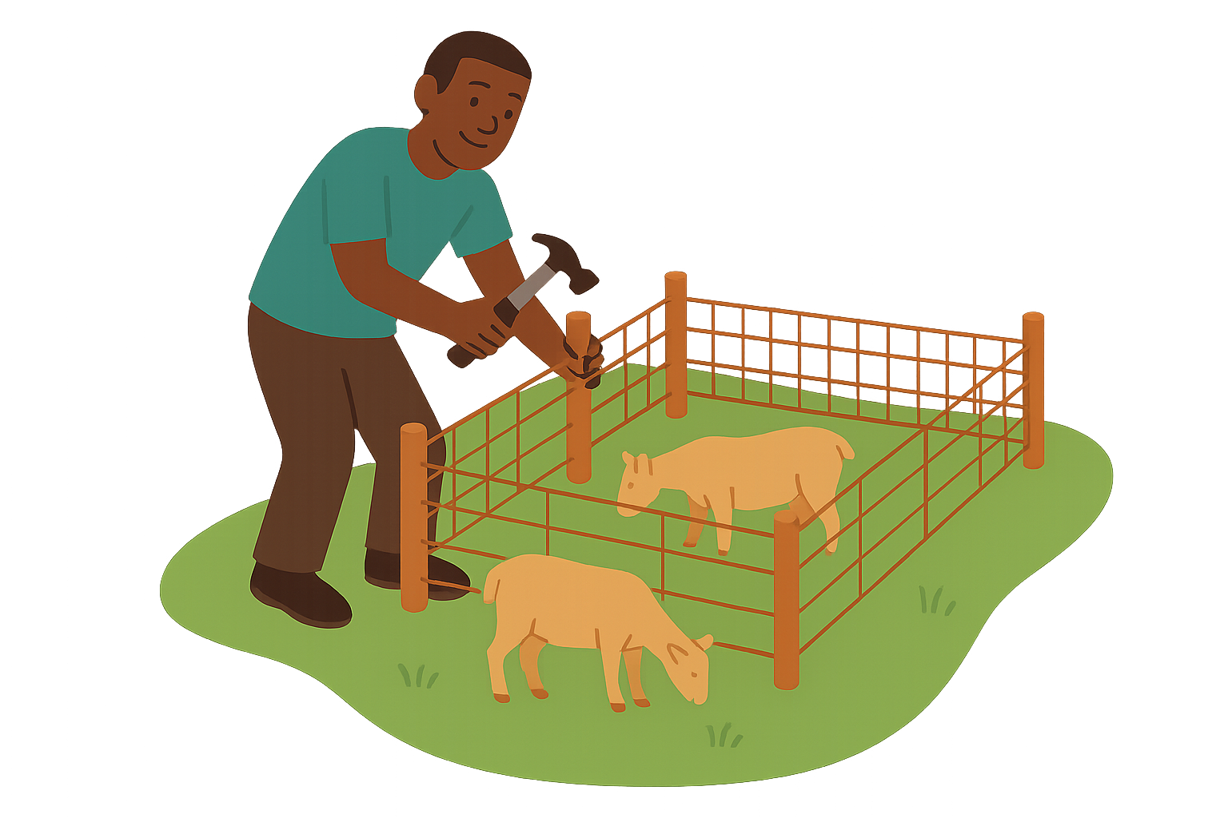
Self Check - Review
Predict where the area will be largest. Then complete the table to check.
Tyrel has 80 feet of fencing and wants to make a rectangular enclosed area for his goats.
Length (feet) | Width (feet) | Area (square feet)
5 | 35 | 175
10 | 30
15 |  | 375
20
25
30 | 10 | 300
35 | 5 | 175
Notes:
Largest Possible Area
Guiding Questions:
“What do you notice about how the area changes as the length increases?”
“Where do you predict the largest area will be? Why?”
Remind them 2l + 2w = 80 and A = lw.
Answers
300
25
20
400
15
375
Notice that the closer the rectangle is to a square, the larger the area.
The largest area occurs when the length and width are both 20 feet for an area of 400 square feet.

Slide 13
Lesson Journey
Warm Up
Learning Activity
Practice
Learning Activity
Cool Down
Lesson Synthesis

Slide 14
Learning Strategies - Plotting Measurements for a Garden🪴
Teacher Instruction: Use these strategies to adjust the activity to support students with disabilities.
You can copy and paste the callouts directly on top of the activity or give the instructions aloud.
You will get a graphic organizer to help you focus.
One column shows the questions we will talk about.
The other column is blank for you to write your answers.
Use it to stay on task during discussion.
Engagement
Notes:
Support for Students with Disabilities: Engagement: Develop Effort and Persistence
Provide a graphic organizer that focuses on increasing the length of on-task orientation in the face of distractions. For example, during the whole-class discussion create a graphic organizer that includes the questions that will be asked in one column and a blank space to record the answers in the other column.
Supports accessibility for: Attention; Social-emotional skills

Slide 15
Learning Activity - Plotting Measurements for a Garden🪴
Length (meters) | Area (square meters)
5 | 100
10 | 150
12 | 156
12.5 | 156.25
18 | 126
20 | 100
24 | 24
Plot some values for the length and area of the garden with perimeter 50 meters on the coordinate plane.
What do you notice about how the plotted points increase and decrease?
The points (3, 66) and (22, 66) each represent the length and area of the garden. Plot these two points on a coordinate plane. What do these points mean in this situation?
Could the point (1, 25) represent the length and area of the garden?
Are you ready for more?
Notes:
Support for All Learners
This activity offers additional support and an extension for students:
For students with disabilities, be sure to review the Learning Strategies slide!
For students looking for an extra challenge, be sure to review the Extending Your Thinking slide!
Activity (15 minutes)
In this activity, students compare a linear and an exponential function (without context). Though the exponential grows more slowly, they must determine which reaches 2,000 first. Students may extend a table, use graphing technology, or solve f(x) = 2,000 and test x = 1,000 in g(x). Providing graphing or spreadsheet tools supports strategic tool use.
Launch
Display a rectangle, label sides, and ask students to find perimeter and area.
Review definitions: perimeter = distance around, area = unit squares covering region.
Provide graph paper and calculators as optional supports.
For the second question, suggest or provide access to a spreadsheet tool to organize lengths, widths, and areas.
Answers
Link to Desmos graph: https://www.desmos.com/calculator/nz9tzjcrx4
Compare your answer: At first, the area grows as the length increases, but then it decreases. Also, the area increases more and more slowly as the length increases.
The point (3, 66) means that if the length of the garden is 3 meters, then the area is 66 square meters. This is right because the width is 22 meters and 3 ⋅ 22 = 66. The point (22, 66) means that the length of the garden is 22 meters, so its width is 3 meters, and the area is again 66 square meters.
Compare your answer: The point (1, 25) cannot represent the length and area of the garden. If the length of the garden is 1 meter, the width would be 24 meters, so the area is 24 square meters, not 25 square meters.
Activity Synthesis
Select a student to present their graph or display a graph with some points already plotted and amend it with additional points students provide. Discuss with students:
“Is the graph linear? Is it exponential?” (It is neither.)
“If we plot a bunch more points—say for every whole-number length between 0 and 25—what do you think the graph would look like?” (Possible predictions: A stretched out upside-down U, or an arch. A line with a positive slope that then turns into one with a negative slope. A curve. Some students might even recall the term parabola.)
“How can we tell whether (1, 25) represents the length and area of the garden?” (By multiplying 1 and 24 (if the length is 1, the width is 24) to see if it gives 25. Because 1 times 24 is 24, (1, 25) does not represent the length and area.)
“Can we tell if a point represents the length and area of the garden simply by plotting it on the graph? For example, does (1.5, 200) represent the length and area? What about (23, 60)?” (It depends. If a point is far away from other points (for example, (1.5, 200)), we can probably tell it does not. If it seems to belong with the general trend of the other points, we may need to check if the input times the width equals the output value.)
Tell students that this unit will focus on functions like the one relating the length and area of the garden. The output of the functions may both increase and decrease, so we know they are neither linear nor exponential, but they also don’t change in a random way.

Slide 16

Extending Your Thinking
What happens to the area when you interchange the length and width? For example, compare the areas of a rectangle of length 11 meters and width 14 meters with a rectangle of length 14 meters and width 11 meters.
What patterns would you notice if you were to plot more length and area pairs on the graph?
Notes:
Answer
The area stays the same if the length and width are interchanged because the area is the product of the length and the width.
Many of the areas would come with two different pairs: for example, 100 comes from the pair (5, 100) and also from the pair (20, 100) because a rectangle with length 5 meters and width 20 meters is the same as a rectangle with length 20 meters and width 5 meters. Using a different length and corresponding width, the 156 comes from the pair (12, 156) and also from the pair (13, 156). The points on the graph would have reflectional symmetry about the line x = 12.5.
Go back to activity information.

Slide 17
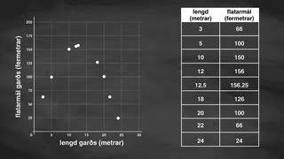
Video: The Meaning of Points on a Graph

Slide 18
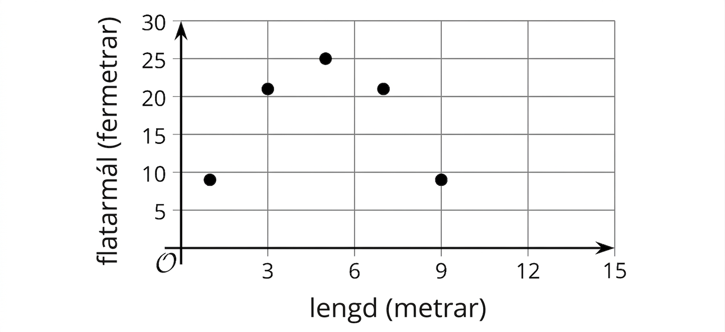
Self Check
The graph shows a rectangle’s side length and its area. What is true about the point (3, 21)?
The width of the rectangle is 3 meters, and the area is 21 square meters.
The length of the rectangle is 3 meters, and the area is 21 square meters.
It is not possible to find the width of the rectangle when the length is 3 meters.
The area of the rectangle is 3 square meters.
Let’s review!
Notes:
Answer Feedback - Individualized by Response
Incorrect. The x-coordinate represents the length, not the width.
That’s correct! The x-axis represents the side length, which would be the x-coordinate of 3 meters.
Incorrect. Working backward, the width would be 7 meters.
Incorrect. The x-coordinate represents the length, not the area.

Slide 19
Self Check - Review
The graph shows the relationship between a rectangle’s side length and area.
What does the point (7, 28) mean in the situation?
Notes:
Determining the Meaning of a Point on a Graph
Answers
The x-axis represents the length of the rectangle in inches. So, when x = 7, the rectangle has a side length of 7 inches.
The y-axis represents the area of the rectangles. So, when y = 28, the rectangle has an area of 28 square inches.
This also means the rectangle has a width of 4 inches since 7 × 4 = 28.

Slide 20

Lesson Journey
Warm Up
Learning Activity
Practice
Learning Activity
Cool Down
Lesson Synthesis

Slide 21
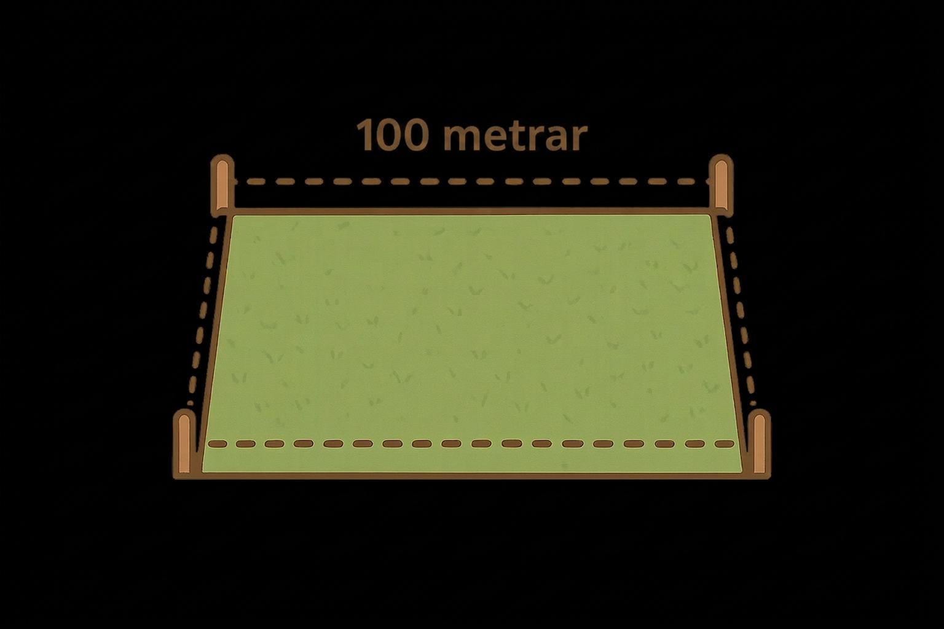
Cool Down
A rectangular yard is enclosed by 100 meters of fencing. The table shows some possible values for the length and width of the yard.
Length (meters) | Width (meters) | Area (square meters)
10 | 40 | 400
20 | 30
25 | 25 | 625
35 | 15 | 525
40
Complete the table with the missing values.
If the values for length and area are plotted, what would the graph look like?
How is the relationship between the length and the area of the rectangle different from other kinds of relationships we’ve seen before?
Notes:
Cool Down (5 minutes)
Answers
a. 625
b. 10
c. 400
The points would form a stretched out upside-down U shape, or an arch..
As one quantity increases, the other quantity first increases and then decreases, instead of always increasing or always decreasing.
Response to Student Thinking - More Chances
Students will have more opportunities to understand the mathematical ideas in this cool down, so there is no need to slow down or add additional work to the next lessons. Instead, use the results of this cool down to provide guidance for what to look for and emphasize over the next several lessons to support students in advancing their current understanding.

Slide 22

Lesson Journey
Warm Up
Learning Activity
Practice
Learning Activity
Cool Down
Lesson Synthesis

Slide 23

Practice
Put your hard work to action, practice what you’ve learned!
Notes:
Digital Practice: Access the practice pages at https://openstax.org/k12/algebra

Slide 24

Lesson Journey
Warm Up
Learning Activity
Practice
Learning Activity
Cool Down
Lesson Synthesis

Slide 25

Lesson Synthesis
Reflect on how the relationship between the side lengths and the area of a rectangle differs from other relationships you’ve seen.
From this lesson, what observations can you make about:
the values in the table relating the length and the area of the rectangle
the graph representing the length–area relationship
the rule that relates the input and output of the function
Notes:
It is not essential that students frame their observations in precise ways at this point. Their capacity to do so will be developed in the coming lessons.

Slide 26
Self Assessment
How much do you agree with the following statements?
I can… | I can | Almost | Not yet
Create drawings, tables, and graphs that represent the area of a garden.
Recognize a situation represented by a graph that increases and then decreases.

